Slide 1
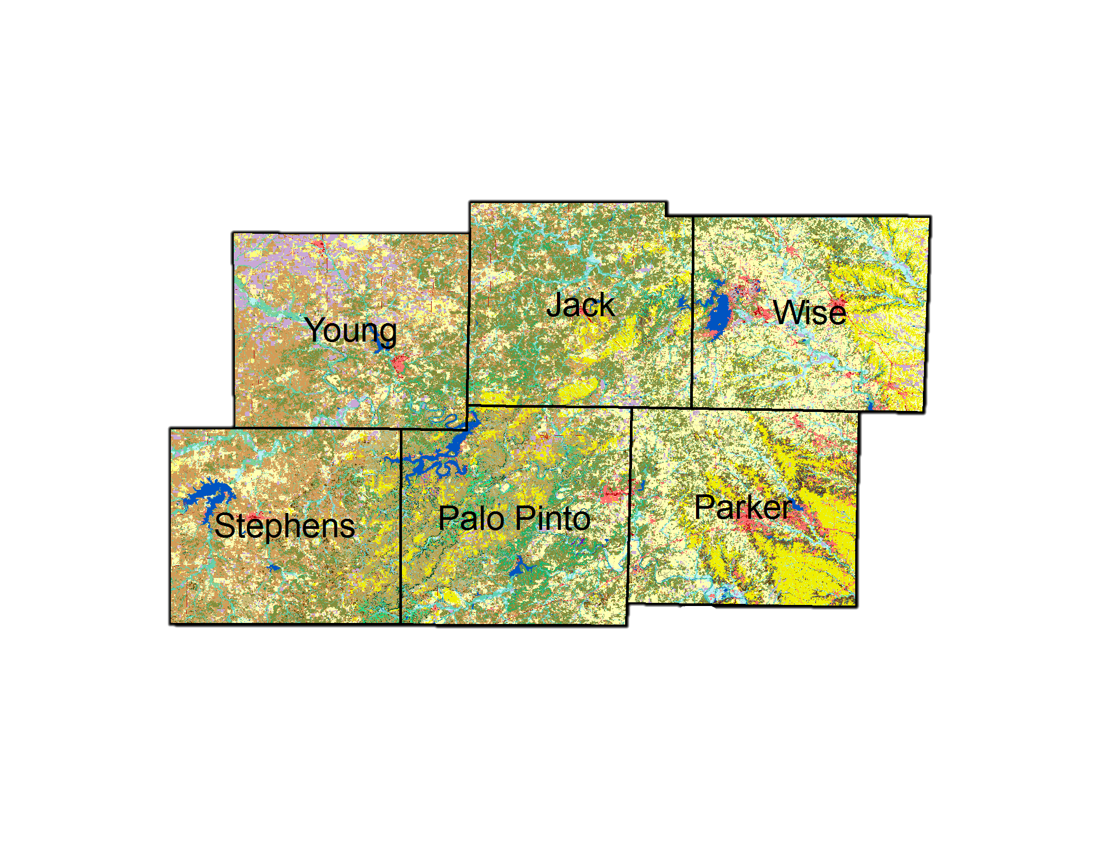
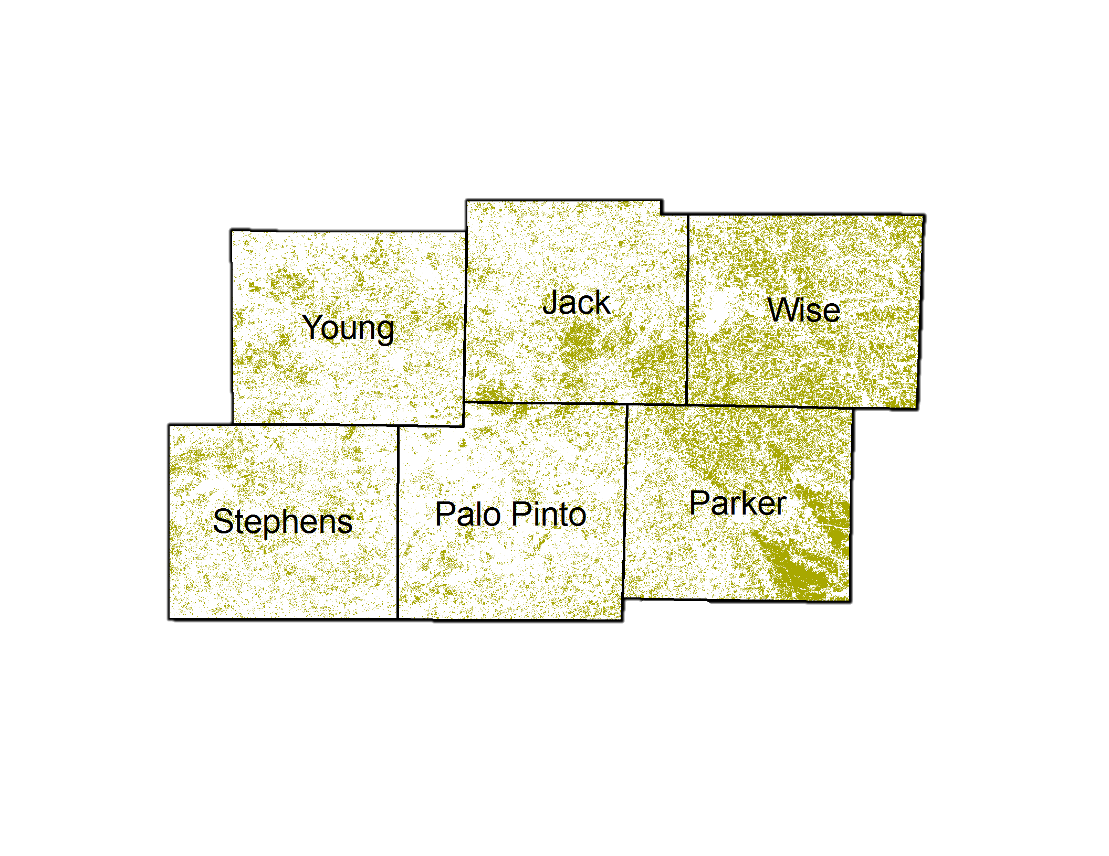
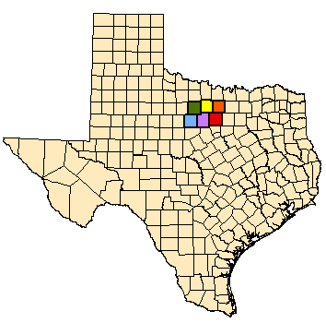
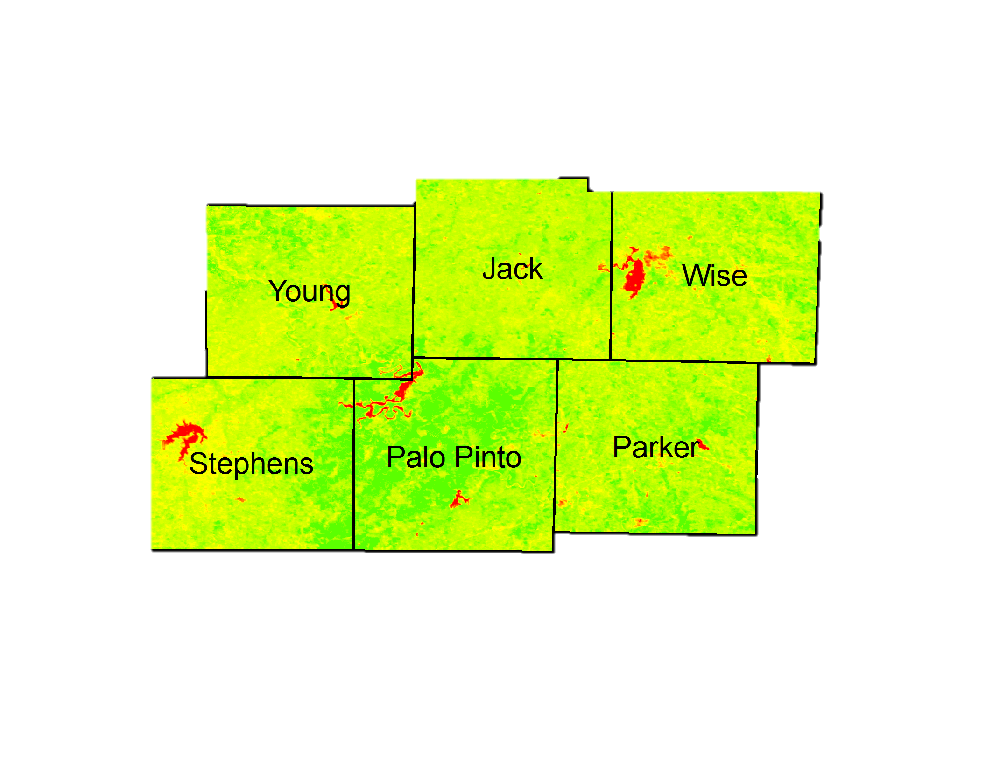
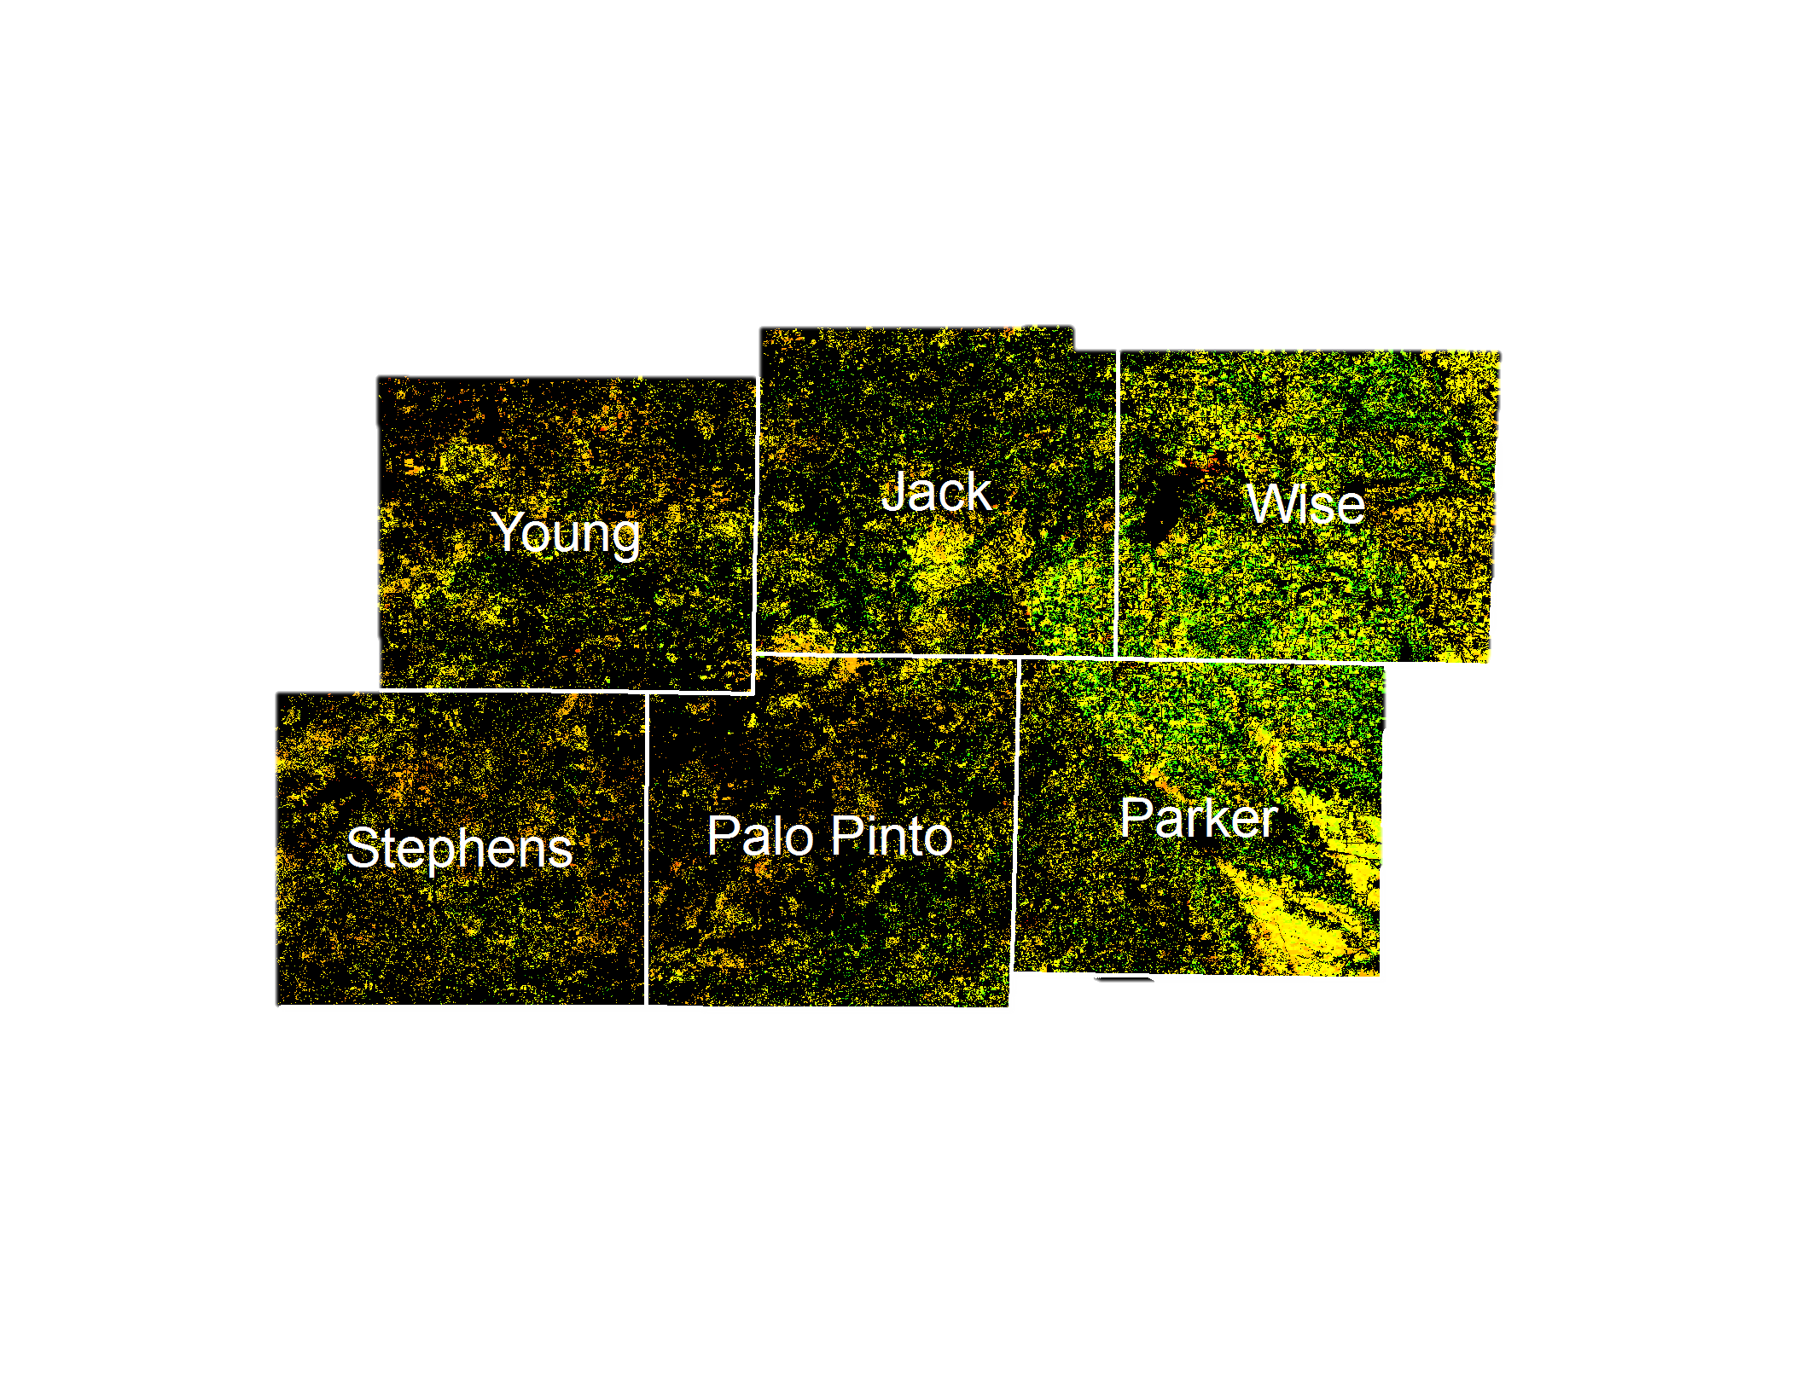
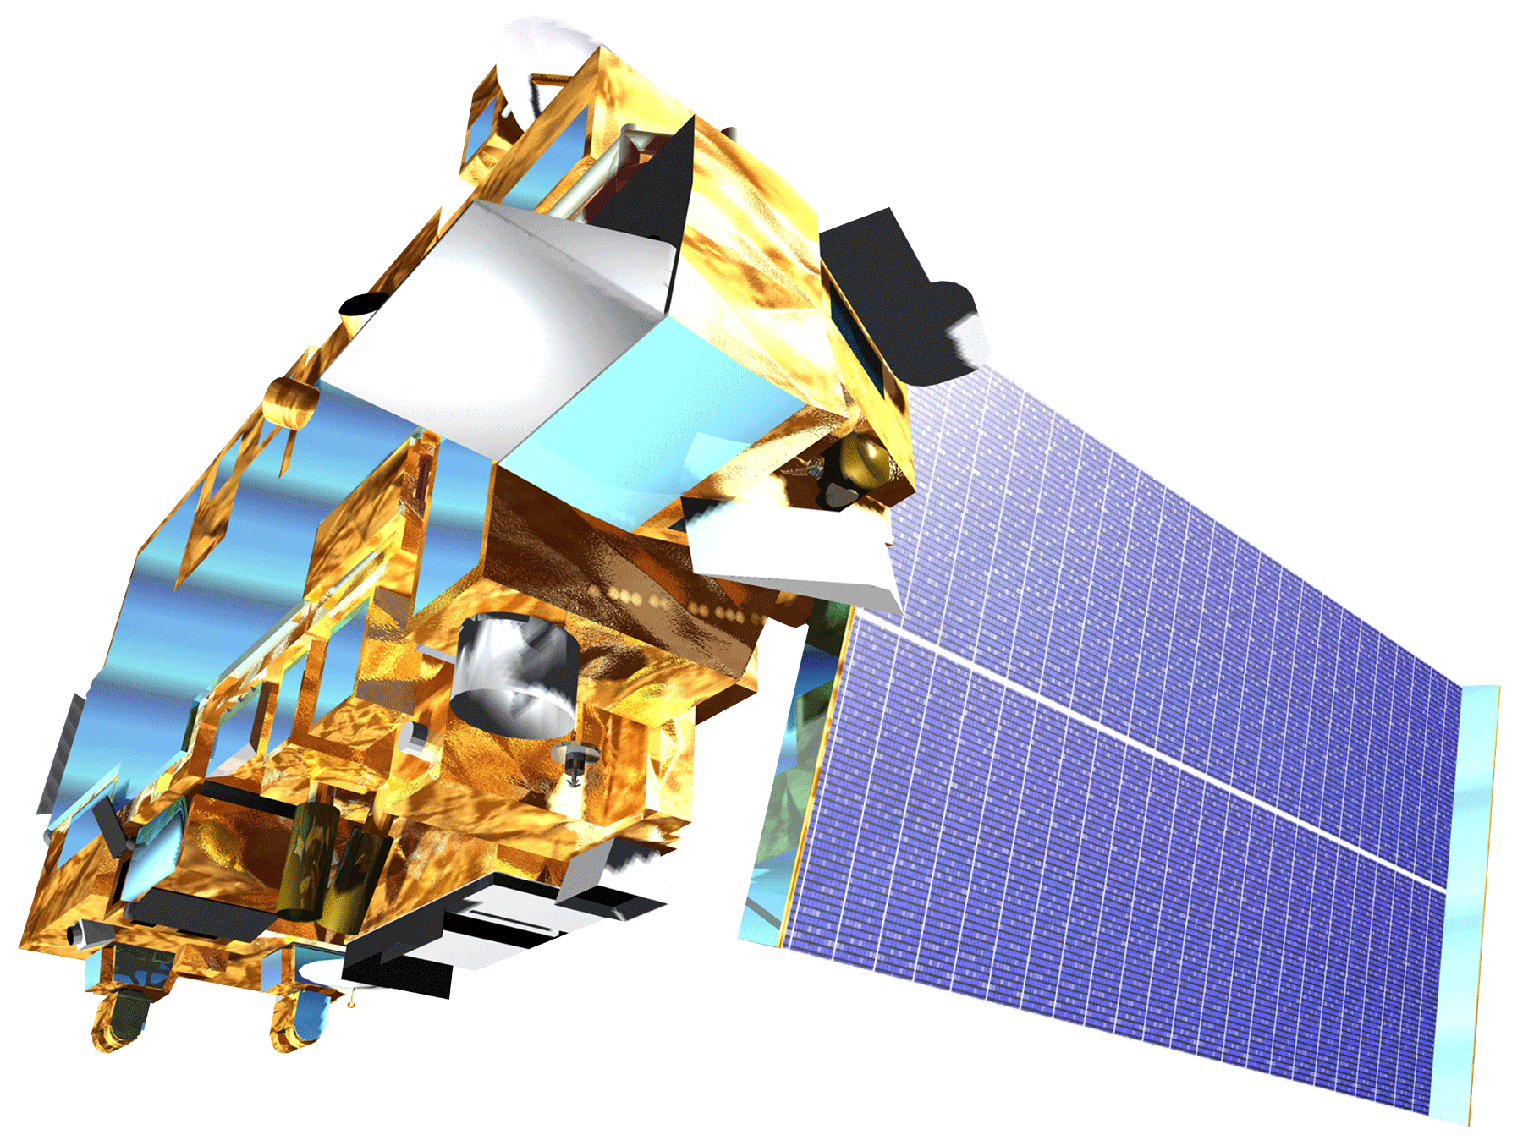
Texas Disasters II
Utilizing NASA Earth Observations to Assist the Texas Forest Service in Mapping and Analyzing Fuel Loads and Phenology in Texas Grasslands
James Michael Brooke (Project Lead), Meredith Williams, Teresa Fenn
NASA DEVELOP National Program at John C. Stennis Space Center
Abstract
Objectives
The risk of severe wildfires in Texas has been increasing due to weather phenomena such as climate change and recent urban expansion into wild land areas. Texas’ wild land areas are susceptible to sequences of wet and dry years that increase the wildfire risk. In order to prevent and contain wildfires, the Texas Forest Service (TFS) is tasked with eliminating and evaluating potential fire risk to manage and distribute resources. The task at hand is made more difficult due to the vast and varied landscape of Texas. The TFS assesses fire risk by understanding vegetative fuel types and fuel loads. To better assist the TFS, NASA Earth observations, including Landsat and MODIS data, were analyzed to produce maps of vegetation type and specific vegetation phenology as it related to potential wildfire fuel loads. Fuel maps from 2010-2011 and 2014-2015 fire seasons created by Texas Disasters I project were used and provided a more synergistic analysis of wildfire risk in Texas. The TFS will utilize the end products to evaluate and better understand wildfire risk across Texas.
Utilize NASA Earth observations to assist the Texas Forest Service in mapping vegetation type and specific vegetation phenology as it relates to potential wildlife fuel loads.
Utilize John C. Stennis Space Center Texas Disasters Summer 2015 and Langley Research Center Texas Water Resources Summer 2015 project results to help understand the wildfire risk in Texas.
Study Area
Methodology
Palo Pinto County
Stevens County
Jack County
Wise County
Young County
Parker County
Surface fuel types were subset to specific grass and shrub types. These data were then masked over USFS ForWarn MODIS phenology data to create fuel-type specific phenology for the most combustible fuel types.
By assessing the fuel-type specific phenology, a more thorough understanding of the season-to-season wildfire potential can be gained.
All Fuel Types
Specific Fuel
Phenology
Earth Observations
Fuel-Specific Phenology
Results
Landsat 8 OLI
MODIS
Terra and Aqua
Use images.
Make sure that it has some sort of flow, that it makes sense. Show your results in a logical order.
No bullets.
Conclusions
Use bullets.
Use complete sentences with periods.
Team Members
Project Partners
Acknowledgements
Texas Forest Service; Tom Spencer and Curt Stripling- Predictive Services
USDA Forest Service; William “Bill” Hargrove- PI for the ForWarn Early Warning System
Joseph Spruce (Senior Scientist and Lead Science Advisor at NASA SSC)
James “Doc” Smoot (Senior Scientist and Assistant Science Advisor at NASA SSC)
Dr. Kenton Ross (NASA DEVELOP National Science Advisor, LaRC)
Benjamin Beasley (former DEVELOPer)
Alex Holland (former DEVELOPer)
Kristen Kelehan (former DEVELOPer)
James Michael Brooke, Meredith Williams, Teresa Fenn
John C. Stennis Space Center

