Slide 1
CLEAR LAKE VOLCANIC FIELD DISASTERS
Creating a Deformation Record Using InSAR to Assess Hazards and Detect Volcanic Unrest in Clear Lake Volcanic Field
Charlie Nuncio
Lexi Crilley
Shilpa Kannan
Ivan Tochimani-Hernandez
California - Ames | Summer 2024
Notes:
Our team participated in the in-person Summer 2024 term of the NASA DEVELOP program at the Ames Research Center under the guidance of team lead, Lauren Webster. In doing so, we focused on applying InSAR methods in tracking volcanic deformation at the Clear Lake Volcanic Field, creating an InSAR time-series and supplementary maps. Let us introduce ourselves:
Charlie introduces themselves
Shilpa introduces themselves
Lexi introduces themselves
Ivan introduces themselves
Image on the left is a DEM and NDVI composite of the Clear Lake Volcanic Fields. This helps us make a distinction on the relationship between elevation and vegetation. In the CLVF area, which could cause noise in the inSAR data we utilize.

Slide 2
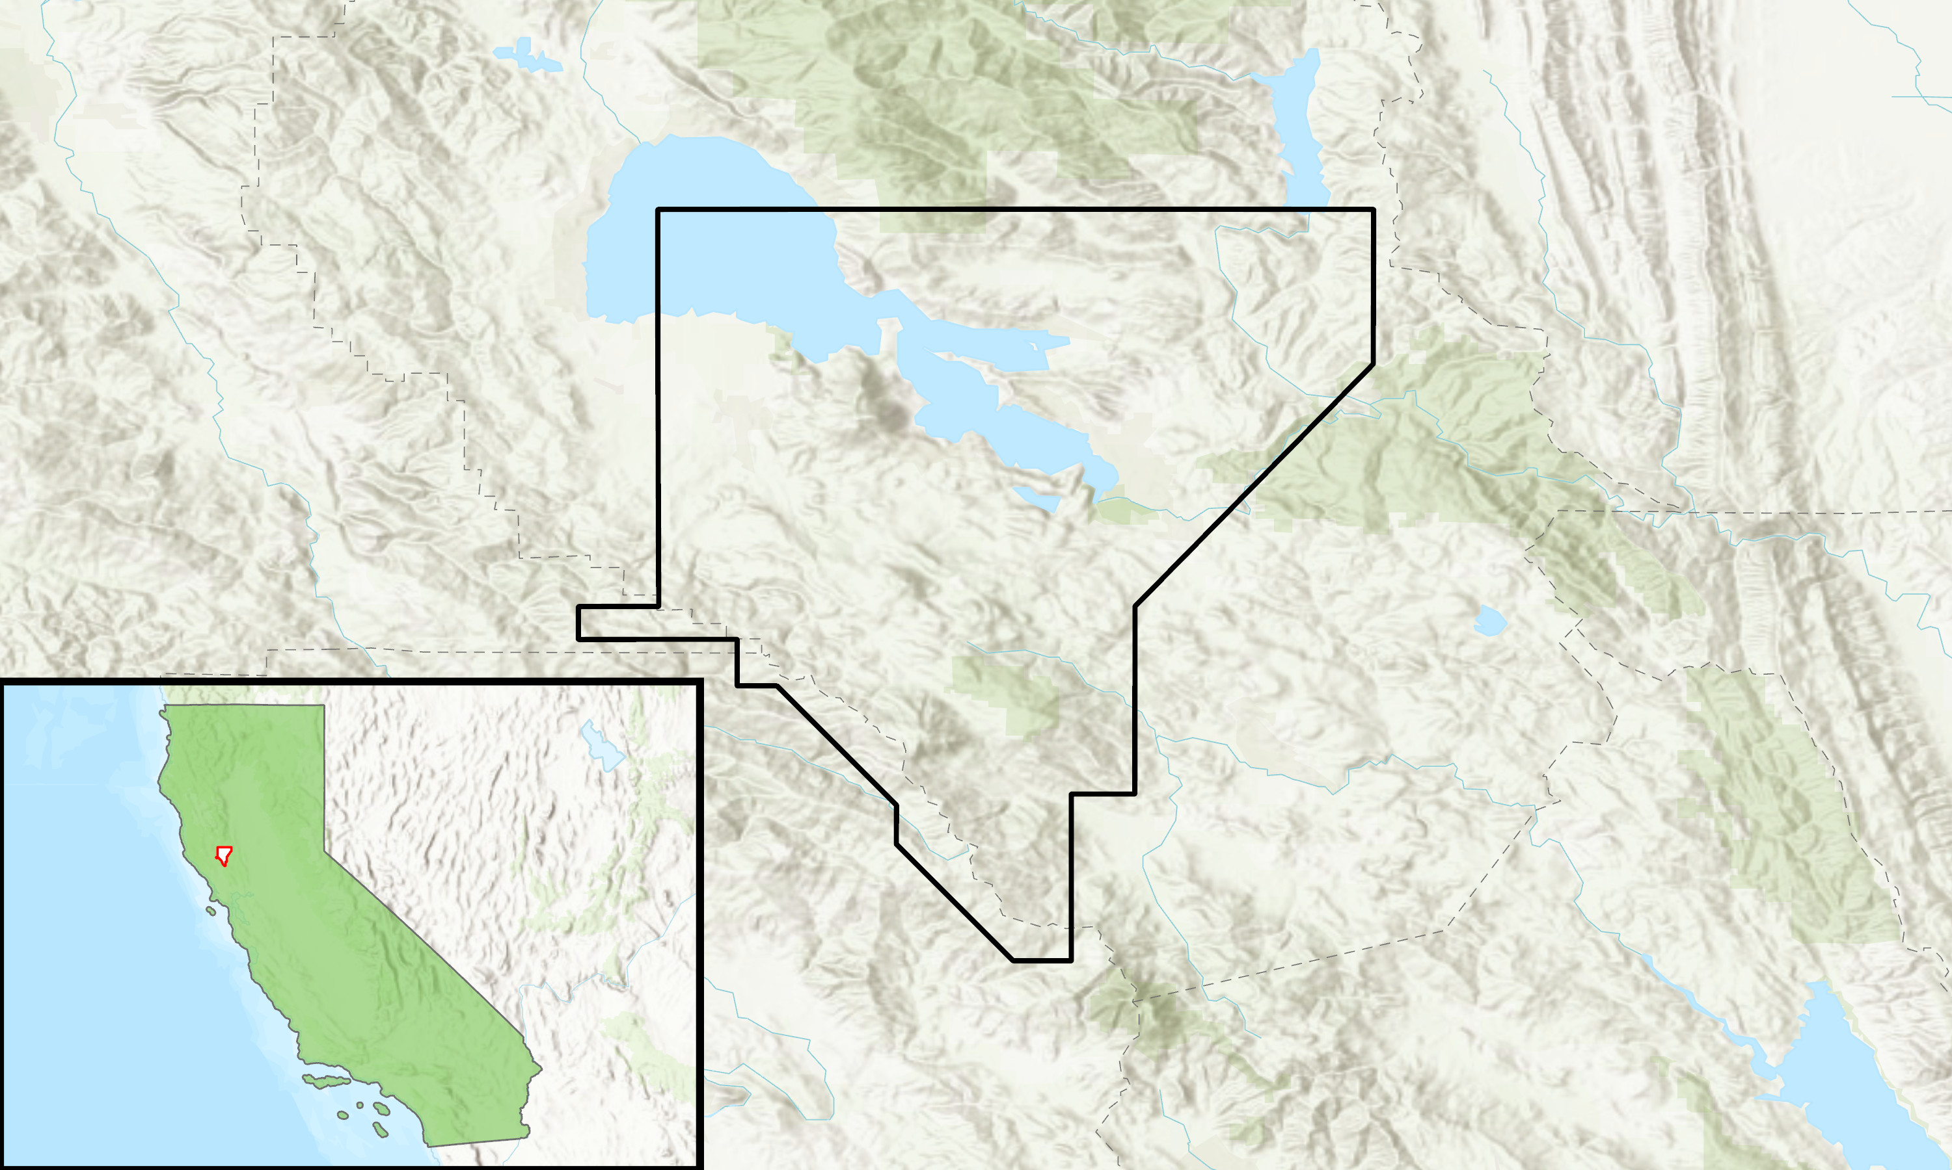
STUDY AREA & PERIOD
Clear Lake ​Volcanic Field, ​California, U.S.A​
January 2016–January 2024​
Clear Lake Volcanic Field Boundary
N
0
5
10
20
California
km
Basemap Credits: Esri, TomTom, Garmin, FAO, NOAA, USGS, EPA, USFWS, NASA, NGA, California State Parks, Garmin, SafeGraph, METI, Bureau of Land Management, NPS
0
100
200
50
km
Notes:
Our area of interest is the Clear Lake Volcanic Field, the youngest and northernmost volcanic site within the California Coastal Range . The Clear Lake Volcanic Field boundary is defined by the USGS to be the southern portion of the actual lake, and portions of Kelseyville and southward agricultural areas. The study period evaluated the region from January 2016 to January 2024. The shapefile was provided by our partners and trimmed down to encompass the area of interest (AOI). ----------Image Information Below----------
[Map of the Clear Lake Volcanic Field"]
Image Credit: Ivan Tochimani-Hernandez
Image Source: ArcGIS Pro Basemap Credits: Esri, TomTom, Garmin, FAO, NOAA, USGS, EPA, USFWS, NASA, NGA, California State Parks, Garmin, SafeGraph, METI, Bureau of Land Management, NPS

Slide 3
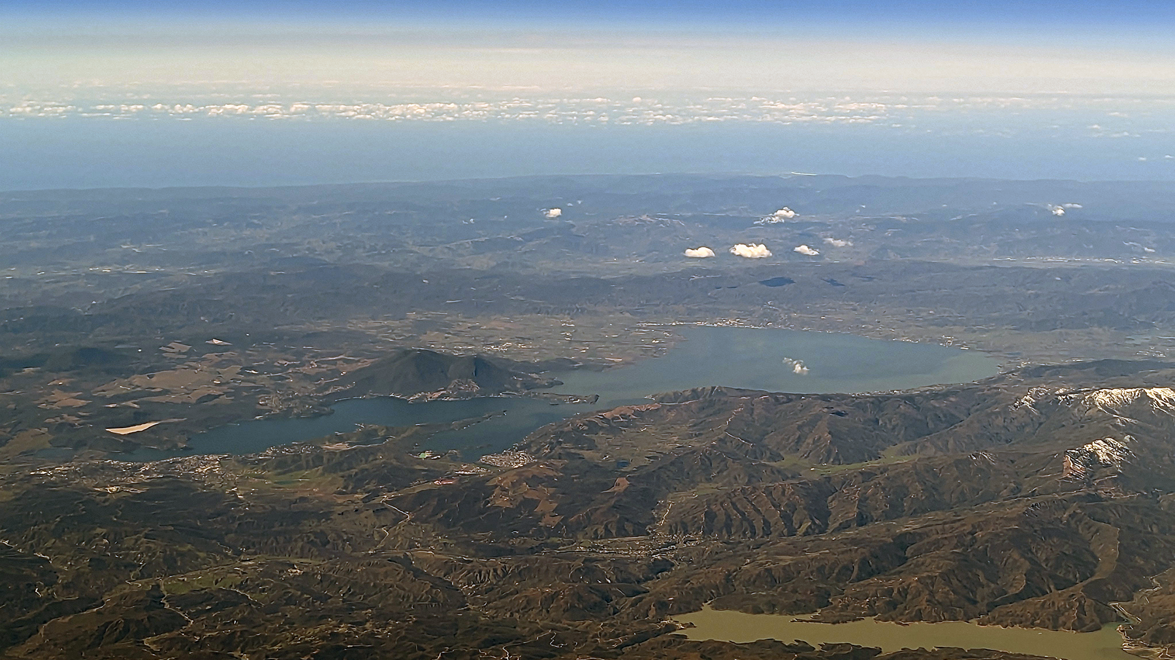
BACKGROUND
Youngest California Coast range volcano
Populated areas near previous eruption sites
Faults running under the lake
Potential for explosive volcanism
Image Credit: Jessica Ball (USGS)
Notes:
The Clear Lake Volcanic Field is located in northern California and is the youngest volcano in the California Coast volcanic range - all of which formed as a result of tectonic movement with the Mendocino Triple Junction.
Faults underlying the actual lake are areas of weakness, where magma often may intrude. If magma interacts with water, it may result in a dangerous, explosive phreatomagmatic eruption. Phreatomagmatic eruptions are characterized by magma interacting with water, causing pockets of water to rapidly expand and trigger explosions.
There are populated areas (such as Kelseyville) and agricultural sites very close to CLVF, so it's important that we monitor the region for both safety and economic reasons.
----------Image Information Below----------
[Photo of the Clear Lake Volcanic Field"]
Image Credit: Dr. Jessica Ball (Partner)
Image Source: Partner Provided

Slide 4
COMMUNITY CONCERNS
"Residents, infrastructure, agricultural, water, and recreational resources would be at significant risk in the event of explosive phreatomagmatic activity. " (Ball, 2022)
1,000+ Acres
of Agriculture
20+ Community
Service Facilities
18,000+ People
Notes:
Thanks! I'm sure you all are wondering what specifically makes Clear Lake Volcanic Field a hazard, and how potential disaster would impact the community surrounding the region.
To illustrate the overall picture of the potential disaster surrounding clear lake, I will quote Dr. Ball in saying that "Residents, infrastructure, agricultural, water, and recreational resources would be at significant risk in the event of explosive phreatomagmatic activity. " (Ball, 2022) . (Concern Notes & Quote Credits: https://www.frontiersin.org/journals/earth-science/articles/10.3389/feart.2022.911129/full )
To delve deeper on this, as Charlie mentioned, the magma and water interaction poses risk for explosivity, resulting in phreatomagmatic activity. In addition, Clear Lake's vents are in close proximity to community areas, and the volcanic field also contains magma reservoirs that underlie the volcanic field and geyser steam field.
To further illustrate areas of potential impact, according to USGS, 18 thousand people are exposed to potential hazard zone in addition to 70K+ visits to Clear Lake State Park a year. Furthermore, 20+ community services (fire stations, schools, hospitals, police) and over a thousand acres of agriculture are in impact range.
(Statistics Credits: https://geonarrative.usgs.gov/calvo_exposure/)
--------Quote Credits--------- Quote credit: Jessica Ball (partner) Quote Source: https://www.frontiersin.org/journals/earth-science/articles/10.3389/feart.2022.911129/full
--------Statistics Credits--------- Quote credit: USGS (partner) Quote Source: https://geonarrative.usgs.gov/calvo_exposure/
Image Credits: Microsoft Icons

Slide 5
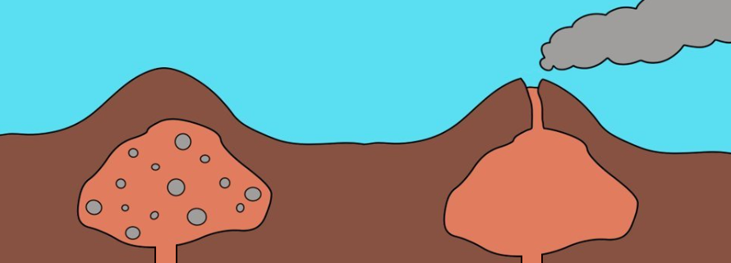
GROUND DEFORMATION
Closed-Vent
Open-Vent
More Inflation
Less Inflation
gas & magma
expanding chamber
magma expanding chamber
Image Credit: Charlie Nuncio
Notes:
This slide depicts two volcanic magma chamber scenarios: closed-vents and open-vents. Magma chambers produce CO2 and SO2 which is released in open-vent scenarios, but gets trapped in closed-vent scenarios. When gases are trapped underground, it causes great ground expansion. This ground expansion is what leads to deformation on the surface, which can be detected by satellite methods such as inSAR. Our AOI is a closed vent system, meaning that if the magma chamber is relatively close to the ground we will note deformation on the surface.
----------Image Information Below----------
[Photo of Closed-Vent and Open-Vent Volcanoes"]
Image Credit: Charlie Nuncio
Image Source: Made specifically for this presentation in Clip Studio Paint.

Slide 6
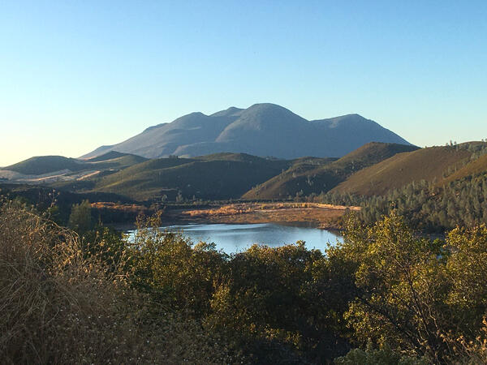
PARTNERS
United States Geological Survey
California Volcano Observatory
Support hazards assessment related to Clear Lake Volcanic Field (CLVF)
Investigate the area's eruptive history
Inform on local disaster mitigation
Image Credit: Julie Donnelly-Nolan
Notes:
For this project, we collaborated with the United States Geological Survey (USGS) California Volcano Observatory - primarily with Dr. Jessica Ball and Dr. Brianna Corsa. The observatory evaluates all volcanic hazards in California, including those at CLVF, where they evaluate the site geologically, geochemically, and geophysically.
Together, the observatory and the team sought to develop a long-term deformation record, as to see if any eruptive precursors could be detected through InSAR and related methods. Deformation maps have been used to observe volcanic activity in Hawaii and Yellowstone, but is a new mothods to understand volcanic activity in the CLVF region.
----------Image Information Below----------
[Photo of the USGS Logo]
Image Credit: USGS Public Domain
Image Source: https://commons.wikimedia.org/wiki/File:USGS_logo_green.svg
[Photo of Clearlake] Image Credit: USGS, Julie Donnelly-Nolan
Image Source: https://www.usgs.gov/media/images/thurston-lake-and-mount-konocti-clear-lake-volcanic-field , USGS public domain

Slide 7
OBJECTIVES
OUR GOAL: Assess feasibility of using Sentinel-1 C-SAR data and Digital Elevation Models (DEMs) to create a historic time series of deformation with interferometric analysis.
Provide the USGS with a deformation baseline at CLVF to assist hazard identification and inform future decision making
Contextualize deformation patterns using supplemental study area data
Use social media to communicate the capabilities of InSAR to monitor volcanoes & potential hazards at CLVF
Notes:
Our primary objective has been to assess the feasibility of using Sentinel-1 C-SAR data and Digital Elevation Models (DEMs) to create a historic time series of deformation with interferometric analysis. These end products will create a baseline for response to volcanic unrest, especially for ground deformation monitoring, and assist future hazard assessment in the region. Additionally, we produced a Social Media series for the USGS and DEVELOP Facebook, Instagram, and X pages to boost communication of these concepts and improve public engagement with the site as well as disseminate information pertaining to the applications of satellite data.

Slide 8
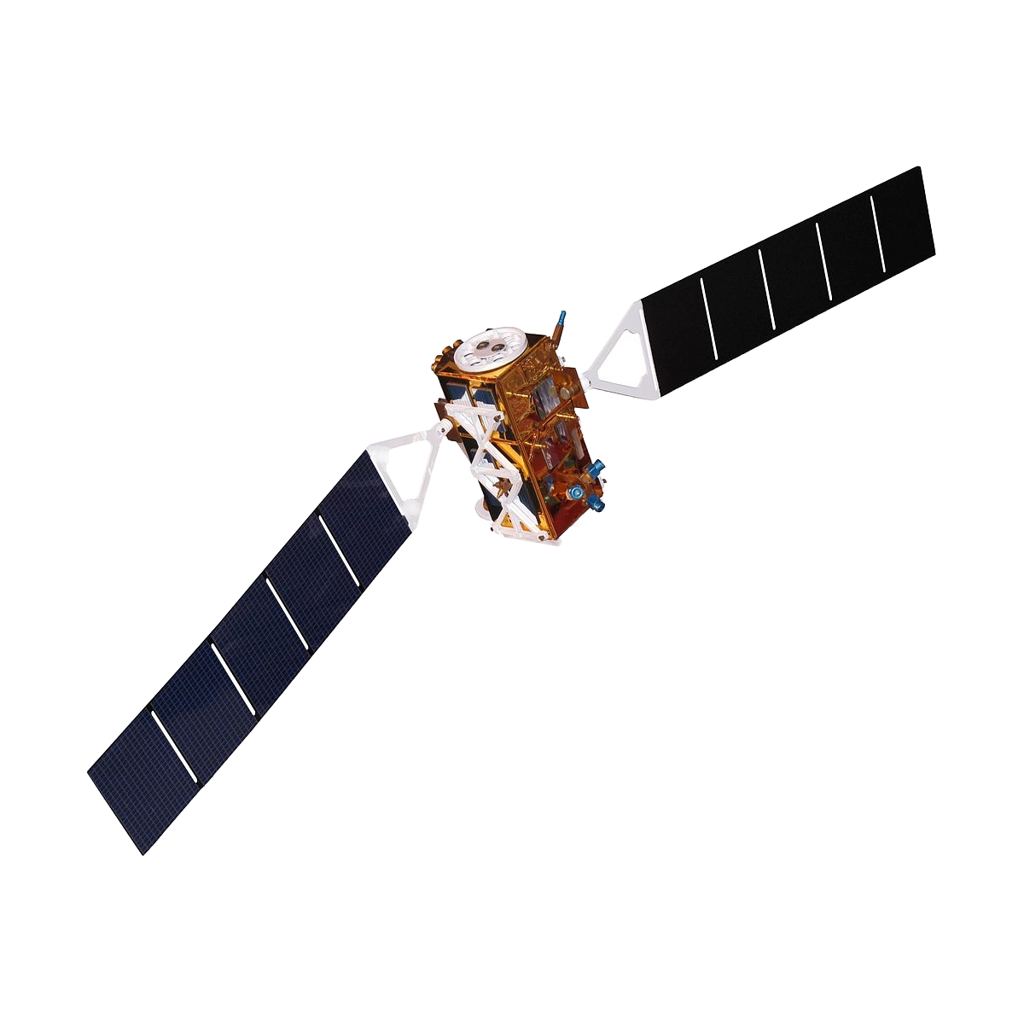
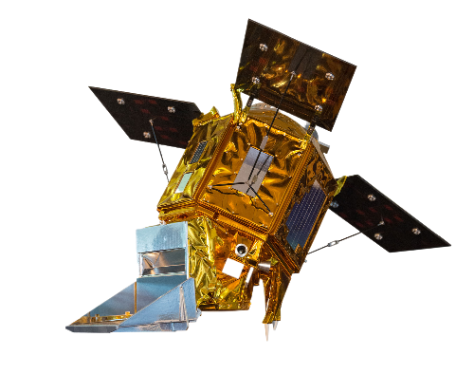
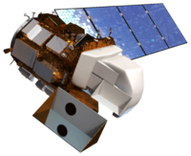
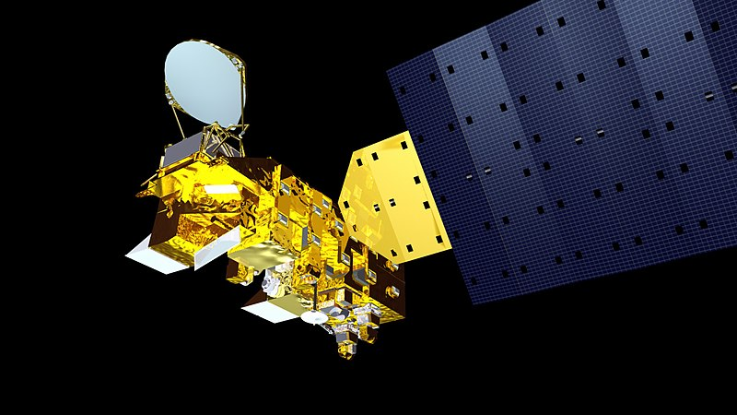
EARTH OBSERVATIONS
Sentinel-1 C-SAR
Sentinel-5P TROPOMI
Aqua MODIS
Landsat 8 OLI
Notes:
We used a variety of Earth observations in achieving these objectives, from NASA and other sources. Our main data source was Sentinel-1 C-SAR from the European Space Agency and accessed through the Alaska satellite facility's vertex platform. We supplemented this with data from Landsat 8 and Aqua Modis to draw relationships between temperature, landcover and deformation.
Satellites: Sentinel-1 C-SAR (Parameters: Elevation, Vertical displacement) was used to create a record of deformation. InSAR techniques will be utilized. Sentinel-5p TROPOMI was used to investigate if there was a pattern between SO2 and deformation trends.
Aqua MODIS was used to evaluate nighttime temperatures. Landsat 8 was used to study landcover.
-------Image credits--------
Image of Sentinel 1 from Wikipedia; https://en.wikipedia.org/wiki/Sentinel-1
Image of Sentinel 5 from Wikimedia: https://commons.wikimedia.org/wiki/File:Sentinel_5P_model.jpg
Image of Landsat 8 from USGS: https://www.usgs.gov/media/images/landsat-8
Image of Aqua Modis: https://commons.wikimedia.org/wiki/File:Artist%27s_rendering_of_NASA%27s_Aqua_Satellite.jpg
Image of DEM from Science Photo Gallery; https://sciencephotogallery.com/featured/shuttle-radar-topography-mission-detlev-van-ravenswaay.html
Background image; Microsoft 365 Stock Images

Slide 9
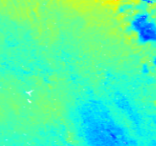
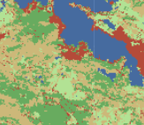
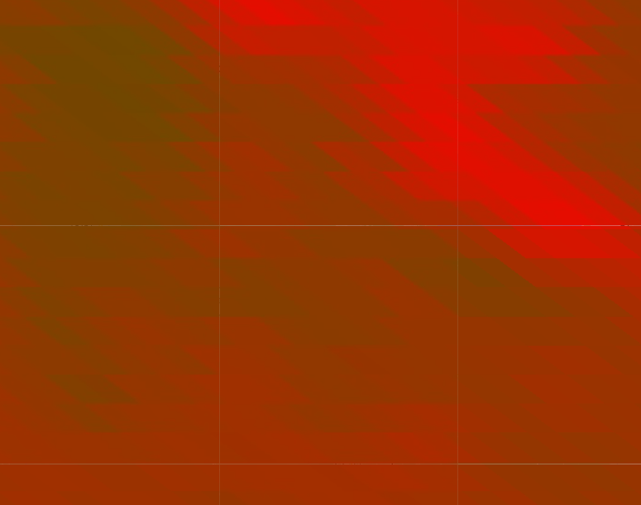
METHODS
Deformation
DEM
SO₂
Land Surface Temperature (LST)
Landcover
Notes:
InSAR deformation mapping through mintPy
Unwrapped interferograms were retrieved from the Alaska Satellite Facility and processed using the Miami InSAR time-series software (MintPy), following stacking workflow procedures as defined by Yunjun et al. (2019) (Figure #). MintPy’s workflow was sequentially executed in two phases starting with correcting unwrapping errors and inverting for a phase time-series. The inverted phase was then corrected for additional noise (tropospheric delay, phase deramping, topographic residuals) using outside inputs such as global atmospheric and DEMs. If noise corrections were found to be unreasonable during this step, they were reprocessed until deemed viable for a displacement time-series. This displacement was then used for velocity estimations; including evaluating average velocity for the volcanic field.
Land cover map methods
The land cover map was produced using an in-house NASA DEVELOP Google Earth Engine script. This script utilized machine learning, trained with the 2021 National Land Cover Database (NLCD) dataset, to classify Landsat 8 true color. Output classifications included dry land, forest, other vegetation, developed land, and water.
DEM time series methods
A DEM time-series and land cover map were produced to aid in DInSAR interpretations at CLVF. The DEM time-series was posed as an “absolute” elevation change reference for the DInSAR’s “relative” change, while the land cover map was used to better understand potential decorrelating effects of local vegetation. 30m resolution data was retrieved from the MERIT global hydrology data set (CITE) for January 1st, 2014 to January 1st, 2024. Elevation data was then extracted, where a mask was applied to interpolate for no-data value points. We then calculated and compared the mean elevations for every month, tracking elevation change in a time-series.
Land surface temperature mapping can help us note where magma chambers are present, with areas that host magma chambers closer to the surface showing higher surface temperatures. We note that the data must be collected during the night time as we do not want daytime atmospheric interreference to affect ground temperature readings.
SO2 mapping can help us note where volcanic gases are being released and at what extent.
----------Image Information Below----------
[Image of deformation, DEM, LST, Landcover, SO2, CO2 maps for the Clear Lake Volcanic Field]
Image Credit: Ivan Tochimani-Hernandez
Image Source: Made in OpenSARLab's Jupyter Notebook and with Google Earth Engine interface

Slide 10
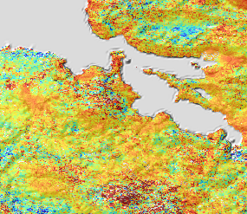
DEFORMATION MAP
Deformation Map
Extract and Clean Sentinel SAR Data
Correct for Noise and Possible Errors
Create a
Displacement
Time-series for Each Season
Invert for a Phase Time-Series
Notes:
First a little overview of how inSAR data works. InSAR data is collected by comparing two different radar images of the same area taken at different times from a similar point in space. The two images as then combined to create a single wavelength- revealing surface topography.
Unwrapped interferograms were retrieved from the Alaska Satellite Facility and processed using the Miami InSAR time-series software (MintPy), following stacking workflow procedures as defined by Yunjun et al. (2019) (Figure #). MintPy’s workflow was sequentially executed in two phases starting with correcting unwrapping errors and inverting for a phase time-series. The inverted phase was then corrected for additional noise (tropospheric delay, phase deramping, topographic residuals) using outside inputs such as global atmospheric and DEMs. If noise corrections were found to be unreasonable during this step, they were reprocessed until deemed viable for a displacement time-series. This displacement was then used for velocity estimations; including evaluating average velocity for the volcanic field.
----------Image Information Below----------
[Image of deformation map for the Clear Lake Volcanic Field]
Image Credit: Ivan Tochimani-Hernandez
Image Source: Made specifically for this presentation in OpenSARLab's Jupyter Notebook

Slide 11
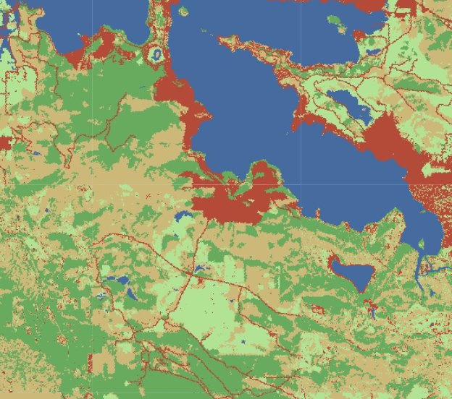
LANDCOVER AND DEM MAPS
Train
Algorithm on NLCD Layer to classify Landsat Imagery
Run Trained Model on Landsat
Imagery
Extract, Clean Landsat &
NLCD Data
Classify Landcover Types on NLCD Layer
Landcover Map
Select Dates for Data Retrieval​
Average ​
Elevations ​
for Each Year​
Create Time-series for Elevation Data
Extract, Clean
MERIT Data
Elevation Map
Notes:
Land cover map methods
The land cover map was produced using an in-house NASA DEVELOP Google Earth Engine script. This script utilized machine learning, trained with the 2021 National Land Cover Database (NLCD) dataset, to classify Landsat 8 true color. Output classifications included dry land, forest, other vegetation, developed land, and water. Understanding landcover can help us better interpret how the earth surface can interact with the incoming radar waves and potentially cause noise. This also helps us understand how human-earth relations can affect ground deformation.
DEM map methods
Extract dem data from MERIT hydrography data set for each year within given study area. Calculate mean elevation in AOI for each year and create the time series for the years. The DEM maps can help us interpret absolute deformation that inSAR might not be able to spot.
----------Image Information Below----------
[Image of landcover and DEM maps for the Clear Lake Volcanic Field]
Image Credit: Ivan Tochimani-Hernandez
Image Source: Made on Google Earth Engine

Slide 12
LST AND SO2
Create LST Map for Every Study Year​
Extract MODIS
LST Band Data
Select Winter Dates
Select Nighttime
LST
Extract SO₂
Data from
Sentinel-5 TROPOMI
Product
​
Define Study Dates for Collection
​​​
Get Monthly Mean Concentrations
​​​​
Create ​
SO₂ Map for Every Year​
​​
​​​
SO₂
Notes:
LST map
Extract night time temperature data from MODIS. Do this only for winter seasons since we are trying to minimize the interference surface temperature faces through sunlight and other daytime interferences. Create a LST for every year between 2016 and 2022. The LST maps can help us interpret the distance of the magma from the surface to help us correlate deformation with volcanic processes
SO2 mapping
SO2 mapping can help us attribute deformation to volcanic activities as well. So2 is one of the primary gases emitted by volcanoes. Noting the concentrations of so2 gases in the region at any given time can help us associate any defomation we see in the inSAR data with the volcanic activity we are observing for.
----------Image Information Below----------
[Image of land surface temperature and so2 maps for the Clear Lake Volcanic Field]
Image Credit: Ivan Tochimani-Hernandez
Image Source: Made on Google Earth Engine

Slide 13
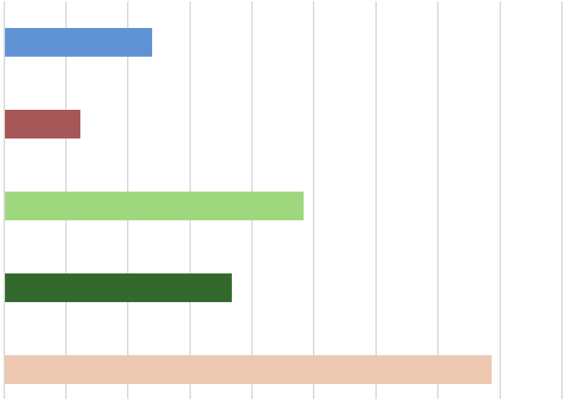
RESULTS: LANDCOVER DATA
Landcover Data (2021)
LANDCOVER PERCENT
Water
Developed
Landcover Type
Other Vegetation
Forest
Dry Land
0
5
10
15
20
25
30
35
40
45
Percent
Notes:
Landcover data chart for 2021 year. Similar trend are seen across all years. Dry land dominates so we know that the InSAR data is not super affected by the effects of vegetation on it. We also note that although almost a quarter of the area is vegetated, it's likely that agriculture pumping up groundwater in the region (despite the vineyards in the region) is not a cause for the deformation we are observing in the AOI.
----------Graph Information Below----------
[Graph landcover data for the Clear Lake Volcanic Field]
Image Credit: Ivan Tochimani-Hernandez
Image Source: Made on Google Earth Engine

Slide 14
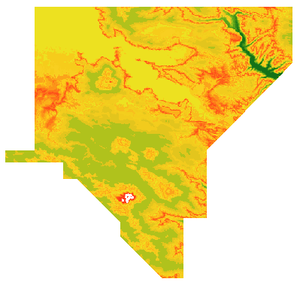
RESULTS: ELEVATION DATA
0
km
20
2021 Elevation (m)
0–300 300–600 600–900 900–1200 1200–1500 1500–1800 1800–2100 2100–2400
N
Notes:
Elevation Data for 2021, MERIT DATA. Elevation data sources not enough to tell us absolute elevation differences due to lack of temporally available data and difference in resolution between elevation datasets and InSAR data used in the deformation time series. Topographic analysis can help us better understand the relationship between collected inSAR data and ground deformation. We note that topography has some effects on radar signal and must be corrected for in the inSAR processing.
----------Graph Information Below----------
[Graph and map DEM data for the Clear Lake Volcanic Field]
Image Credit: Ivan Tochimani-Hernandez
Image Source: Made on Google Earth Engine and ArcGIS

Slide 15
RESULTS: LAND SURFACE TEMPERATURE DATA
Monthly Mean Nighttime Land Surface Temperature (°F)
70
60
50
Temperature (°F)
40
60
30
20
10
0
2016
2017
2018
2019
2020
2021
2022
Year
Notes:
Seasonal variations were observed at CLVF, showing noticeable changes in land surface temperature that peaks in summer months and is lowest in winter months. Magma chambers were too far below the ground to be correlated to the land surface temperature. This means that the deformation we observe at CLVF is likely not due to subsurface volcanic processes, especially since the region is a partial melt system and does not hold large magma reservoirs near surface. It is important to highlight these observations as we must pivot our interpretations to Geo-processes at depths closer to the surface.
----------Graph Information Below----------
[Graph LST data for the Clear Lake Volcanic Field]
Image Credit: Ivan Tochimani-Hernandez
Image Source: Made on Google Earth Engine

Slide 16
RESULTS: SO₂ DATA
Monthly Mean SO₂ Content Time-Series (2019–2023)
2019
2020
2021
2022
2023
0.004
0.003
0.002
SO₂ Content (mol/m²)
0.001
0.000
-0.001
July
March
July
March
July
March
July
March
September
November
September
September
November
November
September
November
Month
Notes:
SO2 content time-series for fall between 2019–2023. SO2 content remains relatively static between 0.000 and –0.001 mol/m2, but has sharp jumps usually around the beginning and end of the fall seasons. The spikes we noted were slightly correlated with earthquake events, meaning that volcanic gases could have been released due to tectonic activity. That said, limited data for both earthquake observations in the region plus a lack of so2 locality means that we have difficulties attributing large seismic events to volcanic gas release from identified faults/hydrothermal vents.
----------Image Information Below----------
["Photo of SO2 Content Time Series (Fall 2019-2023)"]
Image Credit: Ivan Tochimani-Hernandez
Image Source: Made in Google Earth Engine

Slide 17
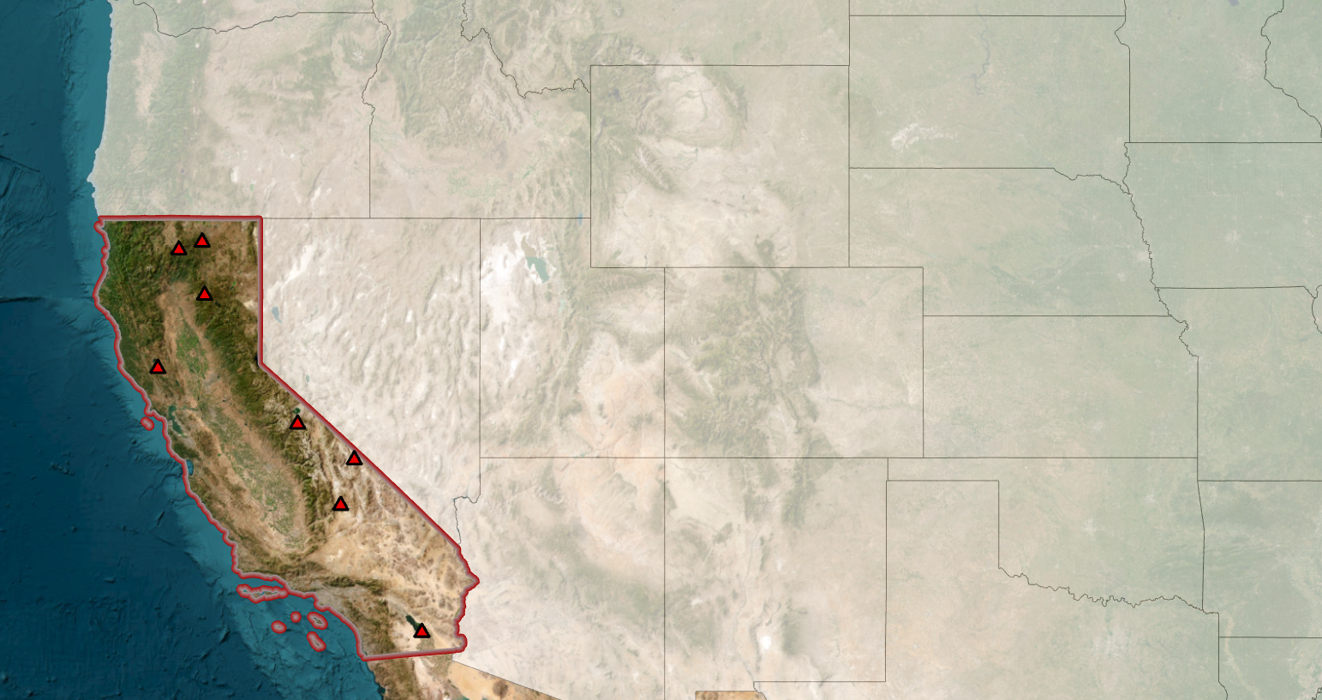
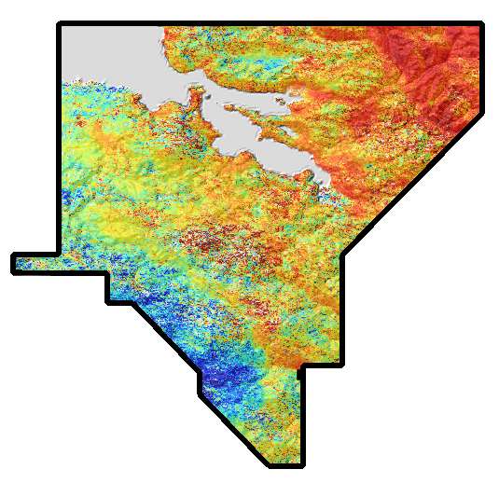
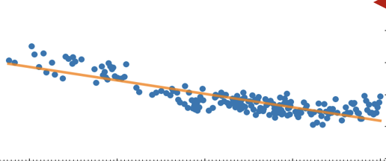
RESULTS: INSAR TIME-SERIES
-10
10
0
20
cm
km
Previous Eruption Site
Clear Lake
Volcanic
Field
Point Displacement Over Time
15
10
Displacement [cm]
5
0
-5
N
-10
-15
0
200
2016
2018
2020
2022
2024
km
Year
Source: Esri, Maxar, Earthstar Geographics, and the GIS User Community
Notes:
We were able to successfully create InSAR time-series for the Clear Lake Volcanic Field. From this time series, we were further able to create point displacement graphs that showed the change in elevation from 2016 to 2024.
Within this, there were four observed trends:
Uplift trend at previous eruption site (circled)
Subsidence trend observed along waterfront
Uplift trend to the northeast
Subsidence trend to the southwest
----------Image Information Below----------
["Basemap of the United States of America, focusing on the state of California"]
Image Credit: Charlie Nuncio
Image Source: ESRI, Maxar, Earthstar Geographics, and the GIS User Community
["Displacement map of the Clear Lake Volcanic Field"]
Image Credit: Charlie Nuncio
Image Source: Made specifically for this presentation in Clip Studio Paint and OpenSARLab
["Point Displacement Over Time Graph"]
Image Credit: Ivan Tochimani-Hernandez
Image Source: Made specifically for this presentation in OpenSARLab

Slide 18
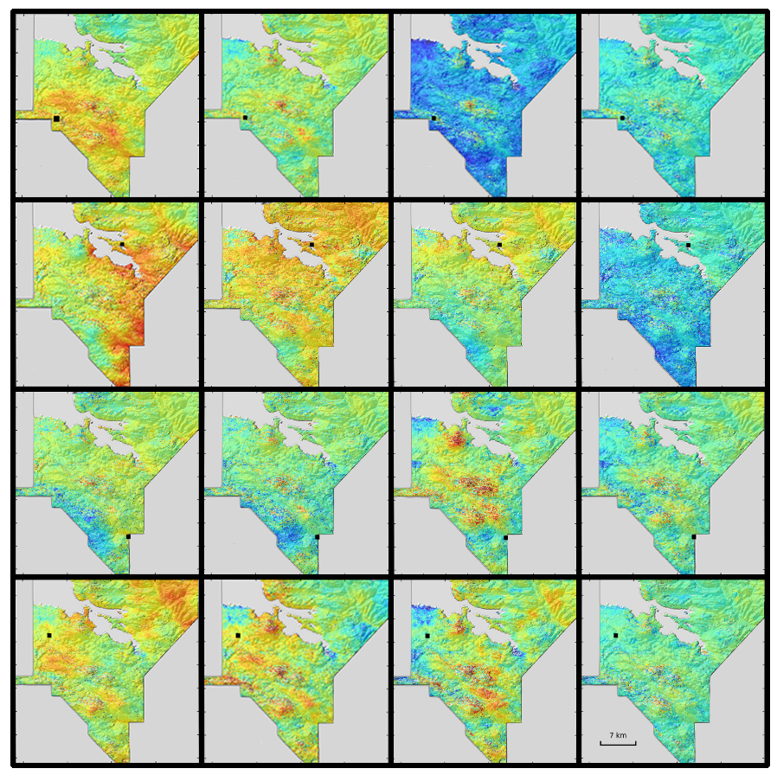
RESULTS: SEASONAL TRENDS
2016–2018
2018–2020
2020–2022
2022–2023
Spring
Summer
10
Displacement (cm )
Fall
-10
Winter
N
7km
Notes:
Seasonal variations were observed at CLVF, showing noticeable coastal deformation in the winter. Larger deformation contrasts were observed in the summer and winter, while lower contrast was observed in the spring and fall.
Deformation trends were also observed based on time-series year interval. Greater uplift was observed in 2016–2018, while slightly larger subsidence was observed in 2020–2022. Across all seasons, large amounts of subsidence was observed in 2022–2023.
Abnormally large subsidence was specifically observed in spring 2020–2022.
----------Image Information Below----------
["Displacement maps of the Clear Lake Volcanic Field by Season and Year Intervals"]
Image Credit: Charlie Nuncio
Image Source: Made specifically for this presentation in Clip Studio Paint and OpenSARLab

Slide 19
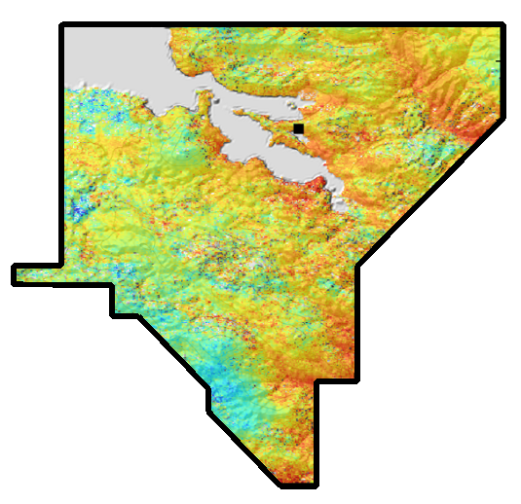
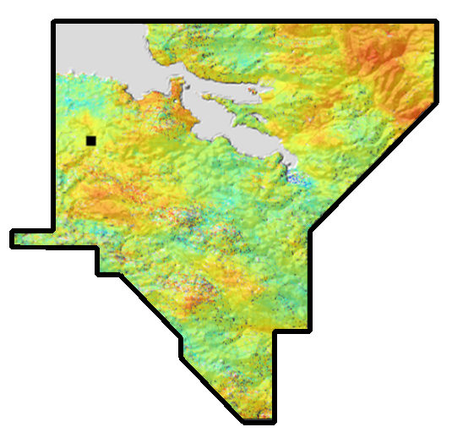
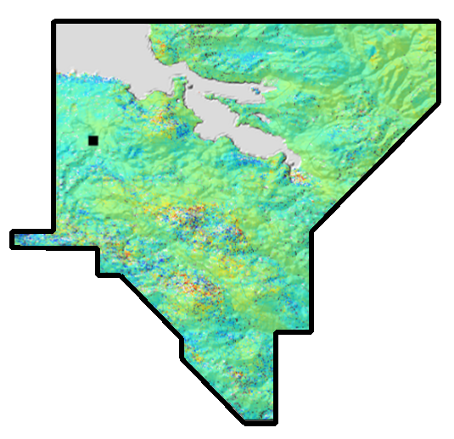
RESULTS: SEISMIC OBSERVATIONS
Summer 2016–2018
Winter 2016–2018
Winter 2022–2023
10
Displacement (cm )
N
-10
5 km
5.5
5.0
EQ Magnitude
4.5
4.0
3.5
2016
2017
2018
2019
2020
2021
2022
2023
2024
Year
Notes:
Three significant earthquakes (>5 magnitude) were observed near the Clear Lake Volcanic Field between 2016 and 2023. The respective displacement maps that those seismic events fall into are shown.
The >5 magnitude earthquake in the summer of 2016 is located slightly southwest of the study area, very close to the geyser field. Slight subsidence is seen in that area.
The >5 magnitude earthquake in the winter of 2016 was far away from the study area. Deformation is observed, however, it seems to follow a time-interval trend, rather than being directly correlated to the seismic event.
The >5 magnitude earthquake in the winter of 2022 was far from the study area. Large subsidence is observed, however, it seems to follow a time-interval trend, rather than being directly correlated to the seismic event.
----------Image Information Below----------
["Displacement maps of the Clear Lake Volcanic Field"]
Image Credit: Charlie Nuncio
Image Source: Made specifically for this presentation in Clip Studio Paint and OpenSARLab
["Earthquakes Over Time Near the Clear Lake Volcanic Field"]
Image Credit: Charlie Nuncio
Image Source: Made specifically for this presentation with Python using USGS earthquake catalog data

Slide 20
LIMITATIONS & ERRORS
Limited Satellite Data
Coarse Elevation Data​
Atmospheric Distortion
Temporal Omissions
Image Credit: USGS
Notes:
Errors include:
The 24 baseline (coherence decreases) period satellite data we're getting from sentinel could be 1. More frequent and 2. At a higher resolution
The DEM maps we have are at 30 m res... needs to be refined through additional airborne data. Missing time component in the DEM data which means absolute deformation could not be measured.
Atmospheric distortion causes gaps in our data and corrections may delete significant amount of data
Periods of time are missing from the InSAR data (sometimes months worth of data) that affect the overall interferogram
----------Image Information Below----------
[Aerial image of the Clear Lake Volcanic Field]
Image Credit: Clear Lake Volcanic Field, USGS
Image Source: https://www.usgs.gov/volcanoes/clear-lake-volcanic-field/science/volcanic-history-mount-konocti

Slide 21
CONCLUSION
Considerable deformation of Clear Lake Volcanic Field detected
Ranges from approximately 5 to 10 centimeters
Notable differences in surface displacement across seasons
Deformation is predominantly associated with seismic activity and geothermal changes in the geyser field
Limited evidence suggesting deformation is due to volcanic activity within study area
Baseline of deformation created will help inform USGS CA Volcano Observatory in detecting future volcanic hazards
Notes:
Considerable deformation of Clear Lake Volcanic Field detected, ranging from approximately 5 to 10 centimeters
Notable differences in surface displacement across seasons
Deformation is predominantly associated with seismic activity and geothermal changes in the geyser field – strong correlation with fault lines
Limited evidence suggesting deformation is due to volcanic activity in this area
Baseline of deformation created will help inform USGS CA Volcano Observatory in detecting future volcanic hazards
No relationship between LST, SO2, and landcover when compared to volcanic deformation.
----------Image Information Below----------
[Image of interferogram screen capture showing northern California]
Image Credit: Lexi Crilley
Image Source: Made with Sentinel-1 C-SAR data retrieved from ASF Vertex

Slide 22
Project Partners and Advisors
Lauren Webster (NASA DEVELOP Node Lead – Ames)
Maya Hall (NASA DEVELOP Impact Analysis Fellow)
Dr. Morgan Gilmour, NASA Ames Research Center
Dr. Mike Poland, USGS Yellowstone Volcano Observatory
Dr. Brianna Corsa, USGS California Volcano Observatory
Dr. Jessica Ball, USGS California Volcano Observatory
Dr. Seth Burgess, USGS California Volcano Observatory
Jonathan Stock, USGS National Innovation Center
Dr. Franz Meyer, University of Alaska Fairbanks & Alaska Satellite Facility
Lisa Tanh, ESRI
This material contains modified Copernicus Sentinel data (2024), processed by ESA.
Notes:
Thank you all so much for listening. Thank you especially to our wonderful partners and advisors who have been so much help this term.

Slide 23
LST and PRECIPITATION MAPS
Extract Landsat and MODIS
LST Band Data
Create LST Map for Every Study Year​
Select Winter Dates
Select Nighttime
LST Map
Create
Precipitation Map for Every Year
​
Extract CHIRPS
Precipitation Data
​
Calculate Annual
Precipitation
Sum
​
Filter Data to Study Area
​
Precipitation Map
Credits: ​​
Ivan Tochimani-Hernandez​
Notes:
LST map
Extract night time temperature data from modis. Do this only for winter seasons since we are trying to minimize the interference surface temperature faces through sunlight and other daytime interferences. Create a LST for every year between 2016 and 2022
----------Image Information Below----------
[Image of land surface temperature and precipitation maps for the Clear Lake Volcanic Field]
Image Credit: Ivan Tochimani-Hernandez
Image Source: Made on Google Earth Engine

Slide 24
RESULTS: NON-CORRELATION
No clear visual or statistical evidence proving the impacts of:
Precipitation​
Agriculture
Groundwater
No major influx of precipitation that could lead to:
Slope instability
Soil swelling
Limited correlation with deformation maps
Consumes water resources & contributes to erosion with minor impact
Significant groundwater extraction between 2020-2023​​​
No clear subsidence aligning with the impacted area ​​
Notes:
Export Note: Slide only for Partner Meeting
No clear visual or statistical evidence proving the impacts of precipitation (No major influx), agriculture (limited correlation with deformation), and groundwater (no clear subsidence aligning with the impacted area).

