Slide 1
New York City Transportation and Infrastructure
Assessing Urban Heat Island Effects at Bus Stops in New York City to Support Cooling Interventions
Thomas Schindelman • Emily Culling • Gianna Méndez Germán • Janna Chapman
Virtual Environmental Justice – VEJ | Spring 2023
Notes:
Hi everyone, we are the New York City Transportation and Infrastructure team from the Virtual Environmental Justice Node. Today we're going to talk you through our project: Assessing Urban Heat Island Effects at Bus Stops in New York to Support Cooling Interventions.
So, to briefly introduce ourselves, I’m ________, and I’m calling in from __________, I’m ________, and calling in from __________, I’m________, and I’m calling in from __________, and I’m ________, and calling in from __________. I’ll pass it off to ________ who will get us started.
~Personal intros and land acknowledgment for where each team member is working from~ (blanks filled in when we decide who’s speaking when)
Short title font size: 32pt Long title font size: 22pt Team names font size: 20pt

Slide 2
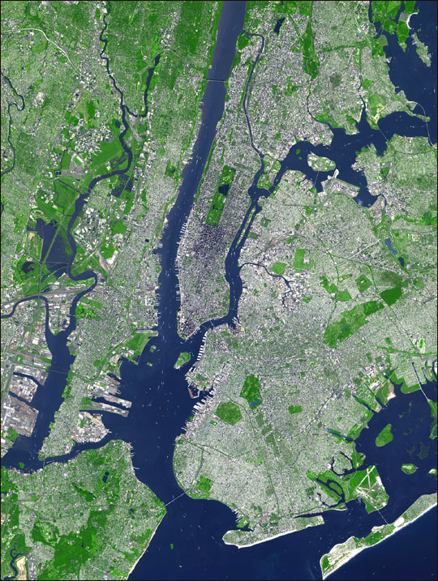
STUDY AREA & PERIOD
New York City
(Lenapehoking)
Area - 300 miles²
Population - 8.5 million
Bus Ridership - 2.2 millions riders a day
Study Period - 2017 - 2022
Image Credit: NASA
Notes:
Our study area is federally recognized as New York City, known as Lenapehoking, the ancestral lands of the Lenape people. NYC is the most populous urban area in the United States, and is composed of five boroughs: the Bronx, Brooklyn, Manhattan, Staten Island, and Queens. The city covers a total area of 300 square miles, and contains about 8.5 million people, with a diverse population that is approximately 32% White, 23% Black, 29% Hispanic and Latino, 14% Asian, and 0.5% Native American – the largest urban Indigenous population in the US. NYC is recognized for its wide variety of transportation options, including an extensive bus system administered by the Metropolitan Transportation Authority. The bus system receives 2.2 million riders per weekday along 300 bus routes and 16,000 stops, whose frequency and location are being updated by the MTA. Our study focuses on 2017 to 2022.
Image source: NASA
Image credit: https://earthobservatory.nasa.gov/images/3678/new-york-city

Slide 3
THE URBAN HEAT ISLAND EFFECT
Day Surface Temp Day Air Temp
Night Surface Temp Night Air Temp
Day (4 PM)
Temperature
Night (2 AM)
Rural
Urban Residential
Downtown
Urban Residential
Rural
Image Credit: Bernardo62
Image Credit: EPA
Notes:
The Urban Heat Island effect is the phenomenon where urban areas experience higher temperatures than surrounding rural and exurban areas due to the higher concentration of solar radiation-absorbing impervious surfaces (roads and buildings), and the lack of green space and canopy cover. Exposure to extreme heat can lead to dangerous or even mortal health effects, especially when accompanied by other air pollutants. People walking to and waiting for buses are more vulnerable to this phenomenon, though cooling interventions, such as shade infrastructure and trees, can significantly reduce the impact of urban heat around bus stops.
Image credit: EPA
Recreation of: https://www.epa.gov/heatislands/learn-about-heat-islands

Slide 4
ENVIRONMENTAL (IN)JUSTICE IN NYC
Colonization of Lenapehoking
Formation of
WE ACT
Key Events:
(There are many other injustices that have happened in the city)
Demolishment of Seneca Village
Notes:
As mentioned, our study area lies on the ancestral lands of the Lenape people who were subject to over four hundred years of genocide and violent displacement by white colonizers. As we discuss urban heat, it is important to keep in mind that the form of urbanization responsible for creating urban heat island effects is itself product of settler colonialism and is only possible due to the displacement and ongoing oppression of the Lenape people.
Since the colonization of Lenapehoking, environmental injustice has, and continues to be, a product of NYC’s policy and planning practices. This can be seen in the demolishing of Seneca Village, which was a predominantly Black and immigrant settlement, and the displacement of its inhabitants to create Central Park. As we’ll see from our results, Central Park now provides cooling benefits to the surrounding neighborhoods during hot summer months – neighborhoods which are now predominately white and wealthy. Further, public policy in the 20th century continued these practices of displacement and segregation pushing Black, Brown and poor communities into spaces of undesirable land use through redlining, highway infrastructure, and so-called urban renewal projects.
In response, NYC also has a rich landscape of environmental justice organizing. Following protesting the detrimental air quality caused by the North River Sewage Treatment Plant, Vernice Miller-Travis, Peggy Shepard, Chuck Sutton formed WE ACT, the first Environmental Justice Organization in NYC. Their research, organizing, and advocacy, as well as landmark lawsuit against the NYC Department of Environmental Protection, set the stage for EJ work in NYC today.

Slide 5
COMMUNITY CONCERNS
Uneven distribution of
shade infrastructure and heat
exposure
Lack of shade infrastructure at bus stops impacting accessibility
Effects of heat and
air pollution on health and safety of bus riders
Image Credit: Bernardo62
Notes:
The aforementioned racist policy and planning has created an inequitable distribution of shade and heat exposure, which disproportionately impacts marginalize communities. Black and low-income New Yorkers in particular experience the greatest impacts to their health, often co-burdened by exposure to heat and air pollution. Further, bus riders in NYC, who are predominately people of color, lower income, and/or elderly, are also exposed to these environmental burdens when walking to and waiting for the bus.
Redesigning bus networks and adding shade infrastructure is an ongoing process, that leaves stops and routes inaccessible or exposed to the elements, especially in historically redlined minority neighborhoods. Further, structural racism and income inequality limit access to the healthcare and cooling resources necessary to endure heat – a growing concern with the increasing number of hot days per year. Additionally, while green infrastructure can mitigate the UHI effect around bus stops, urban greening can cause gentrification in minority and low-income neighborhoods in the absence of policy intervention.
------------------------------Image Information Below ------------------------------
Image Credit: The Noun Project (creative commons)
Image source: https://thenounproject.com/icon/bus-stop-1230795/
Image Credit: The Noun Project (creative commons)
Image source: https://thenounproject.com/icon/shade-3856697/
Image credit: Powerpoint icons

Slide 6
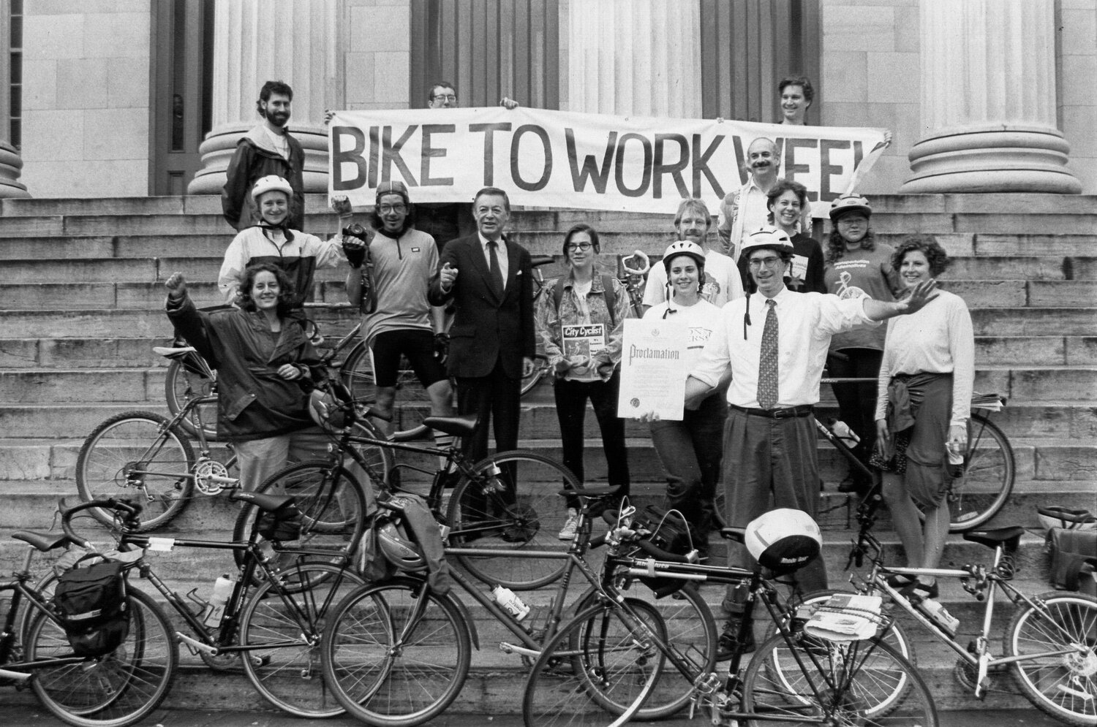
PROJECT PARTNER
Transportation Alternatives (TA)
50 years of advocating to reclaim streets from cars, increase pedestrian safety, and create healthy and joyous public spaces
Recent increase in advocacy around UHI effects on public transportation users
Image Credit: Transportation Alternatives
Image Credit: Bernardo62
Notes:
We partnered with Transportation Alternatives (TA), an non-profit organization with a fifty-year legacy of advocacy and community organizing for the reclamation of public space from cars in NYC. Originally focused on increasing bike accessibility, their mission has expanded to creating safer, more equitable streets, including most recently: urban heat.
------------------------------Image Information Below ------------------------------
•Image Credit: Transportation Alternatives
•Image Source: https://images.squarespace-cdn.com/content/v1/5cab9d9b65a707a9b36f4b6c/1593464414621-PS8JD69DO911K1IG69PE/image-asset.jpeg?format=1500w (Pending Approval, Provided by Partner, used with permission)

Slide 7
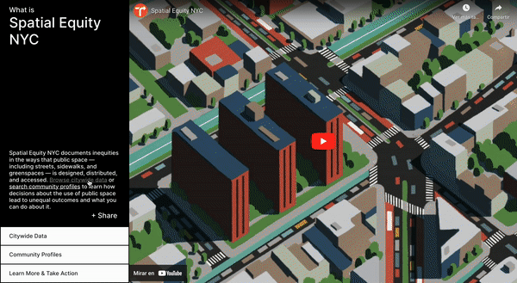
SPATIAL EQUITY NYC
Image Credit: Bernardo62
Video Credit: Spatial Equity NYC
Notes:
With collaborators at the Massachusetts Institute of Technology, TA built Spatial Equity NYC, an interactive dashboard that visualizes public health, mobility, and environmental conditions. By communicating transportation-related data, and its associated disparities, it serves as a tool for grassroots change. The results from our project hope to be included in this dashboard, incorporating urban heat and its intersections with bus ridership.
Video source: Spatial Equity NYC
Video credit: https://www.spatialequity.nyc/ (Provided by Partner, used with permission)

Slide 8
OBJECTIVES
Heat Assessment Map Package
Vulnerability Analysis
Tutorial
Show heat distribution in city council districts and bus stops
Determine who and which bus stops are most affected by extreme heat
Create resource to expand on work to improve transportation accessibility
Notes:
To support TA’s work, our team conducted a UHI analysis to identify areas with the greatest exposure to heat. We then created a heat vulnerability index (HVI) utilizing sociodemographic, economic, and public health metrics of ridership, to identify the top X bus stops and top X routes with the highest vulnerability to extreme heat. From these analyses, we created map layers for TA to include into their dashboard. Our key findings will inform their future advocacy for just distribution of cooling interventions as bus stops are redesigned. Finally, we created a GIS tutorial documenting our methods as a resource for TA to use as they continue in their advocacy around transportation and urban heat.
------------------------------Image Information Below ------------------------------
Image credit: Powerpoint icons

Slide 9
EARTH OBSERVATIONS
Landsat 8 TIRS / Landsat 9 TIRS-2
Daytime Land Surface Temperature (LST) data
ISS ECOSTRESS
Nighttime LST data
Image Credits: NASA
Notes:
We used Landsat 8/9 Thermal Infrared Sensor data collected from Google Earth Engine for use in our analysis of daytime land surface temperatures in the city. ISS ECOSTRESS imagery was downloaded through the AppEEARS platform for nighttime land surface temperature. We gathered daytime and nighttime temperatures for the city and for a forested “rural reference” to compare with each other and obtain the urban heat island factor.
Image Credit (Left): NASA
Image Source: https://landsat.gsfc.nasa.gov/wp-content/uploads/2021/12/ldcm_2012_COL-300x168-1.png (NASA, public domain)
Image Credit (Middle): NASA
Image Source: https://www.nasa.gov/sites/default/files/thumbnails/image/landsat9.png (NASA, public domain)
Image Credit (Right): NASA
Image Source: https://www.jpl.nasa.gov/missions/ecosystem-spaceborne-thermal-radiometer-experiment-on-space-station-ecostress (NASA, public domain)

Slide 10
METHODOLOGY OVERVIEW
Heat Island Assessment
Principal Component Analysis
Modeling Thermal Comfort
Landsat 8/9 TIRS
ISS ECOSTRESS
Demographics
Transit & Enviro Vars
Ridership and Other Transit Data
Cloud Masking
Time Filtering ACS
Principal Component Analysis (PCA)
Transit Proximity Index
SOLWEIG
Day and Night LST
UHI Factor
Transportation Heat Vulnerability Index
Mean Radiant Temperature (TMRT)
Notes:
Our project composes of three main analyses. The first analysis is the Heat Island Assessment. Landsat 8/9 TIRS data for the time period of 2017 to 2022 was processed in Google Earth Engine using code from the Fall VEJ Milwaukee II Team to generate cloud correct median daytime LST. Median nighttime ISS ECOSTRESS data was downloaded from AppEARS and corrected for clouds. We then compared NYC LST with LST from a rural reference, generating an Urban Heat Island Factor at the community district level.
Then, we used American Community Survey demographic data and other environmental and transportation related variables to complete a Principal Component Analysis (PCA) to determine the key variables that are vulnerable to heat in the city. These variables were combined into a Transportation Vulnerability Index at the community district level.
Following this, we visualized the Transportation Vulnerability Index along with the Urban Heat Island Factor in a bivariate choropleth map to show where the high vulnerability and high heat exposure areas in the city are.
Finally, we performed another PCA including bus stop specific transportation data for bus stops to determine the 5 most vulnerable stops in the city. We then performed a shade analysis using the SOLWEIG tool in QGIS to model mean radiant temperature, or thermal comfort at each of the most vulnerable stops.

Slide 11
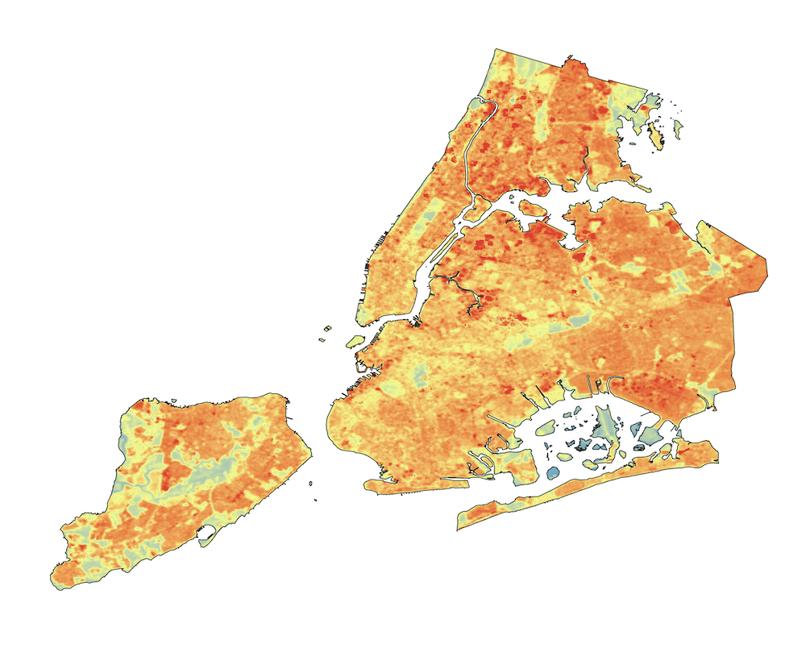
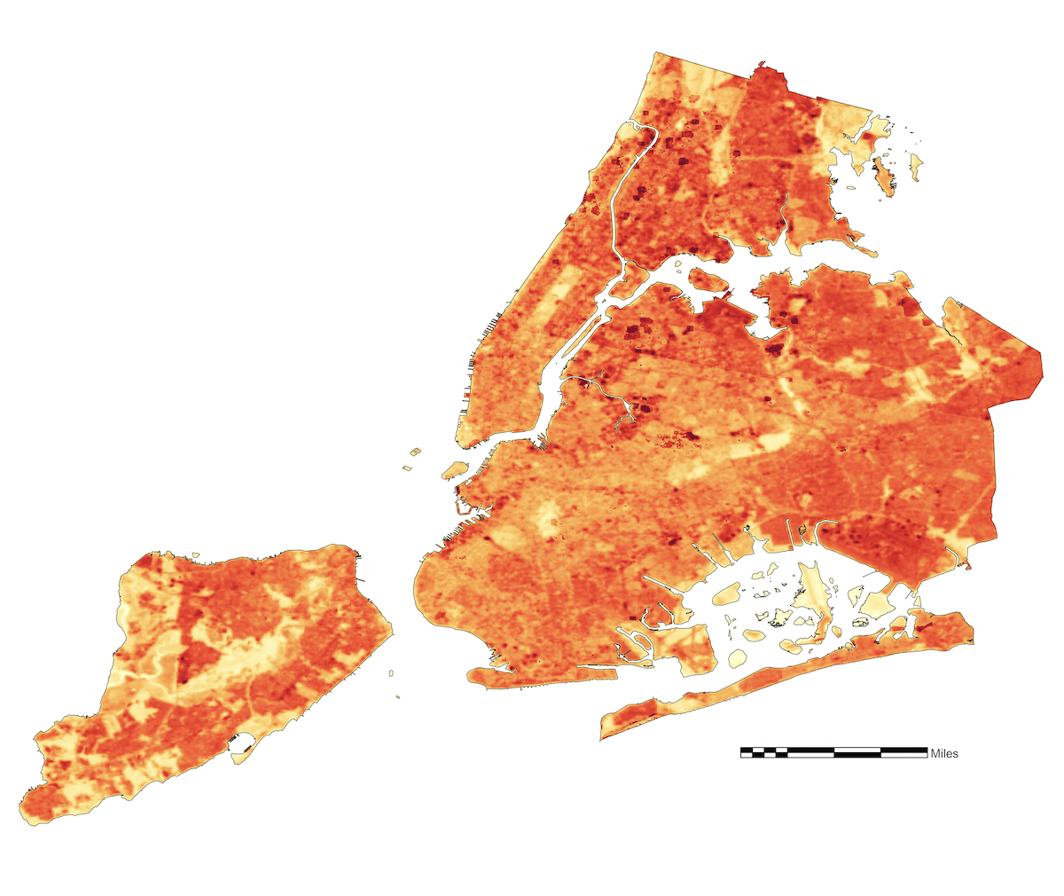
URBAN HEAT ISLAND ASSESSMENT
Median Daytime LST
Urban Heat Island Factor
Preliminary Data only showing Daytime LST
Over study period of 2017 to 2022 from May 1st to Sept 30th
Performed same processing for Rural Reference
Difference between NYC Day LST and Mean Rural Reference LST
Redder pixels indicate urban heat anomaly
3.5
7
3.5
7
7
3.5
Image Credit: Bernardo62s
Notes:
To create our Urban Heat Island factor, we needed to generate an anomaly raster to indicate the urban heat island effect in NYC. We did so by comparing our NYC LST data with LST data from a rural reference, to simulate a factor of difference between actual surface temperature in NYC and what NYC’s surface temperature ‘should’ be like if it was not urbanized. This rural reference consisted of forested, unbuilt environment in/near Wharton State Forest, selected because this area is climatically, geographically and topographically similar to NYC. Then, every pixel in the NYC LST raster images was subtracted by the respective rural reference LST images to create daytime and nighttime temperature anomaly rasters. We then took the mean of these two anomaly rasters at the community district level to create our Urban Heat Island Factor.

Slide 12
PRINCIPAL COMPONENT ANALYSIS
High
Low
High
Medium
High
High
Medium
Low
Medium
Medium
Medium
High
Urban Heat Island Factor
Low
Low
Low
Medium
Low
High
Transportation Vulnerability Index
Transit
Variables
Environmental
Variables
Social
Variables
Income
Variables
Notes:
To construct the other piece of our THVI, we analyzed demographic data using a PCA which is a dimension reduction analysis. For our PCA, we collected transportation variables, environmental variables, social variables and income variables at the census tract level. Then, we ran them through the PCA, to get 3 components combine the variables that explain the most variability in the data. These principal components were summed to get our transportation vulnerability index. From there, we were able to get our first level of analysis – bivariate maps at the community district level showing high-high low-low values for UHI factor vs transportation vulnerability index.

Slide 13
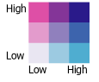
BIVARIATE MAP
UHI Factor
Vulnerability
3.5
7
Notes:
On the left is a map of our whole NYC Transportation Heat Vulnerability Index at the community district level, showing bivariate mapping of vulnerability on the X-axis of the legend, and UHI factor on the Y-axis of the legend. Dark purple districts correspond high vulnerability and light purple districts correspond to low vulnerability and low UHI factor. As we can see, the hottest and most vulnerable districts are in southern Manhattan and the least vulnerable populations and coolest districts are in Staten Island.

Slide 14
MOST VULNERABLE STOPS AND ROUTES
THVI Factor
Proximity of other Transportation
Presence of Bus Shelters
Wait Time and Ridership
3.5
7
Notes:
Following generating the bivariate map for all of NYC, we zoomed in to determine vulnerability at the individual bus stop and route level. To do so, we performed another PCA, including scores for the THVI factor for each stop, the proximity of other public transportation stops within a 5 minute walking distance, bus wait time, bus shelter presence and ridership?. This resulted in transportation vulnerability for each bus stop, which we then were able calculate for each bus route. We used this analysis to determine the 5 most vulnerable stops.

Slide 15
3D SHADE MODELING WITH SOLWEIG
Ground and
Building DMS
Vegetation DSMs
Thermal
Comfort
Ground
Cover
Notes:
Once we had determined the top 5 most vulnerable stops, we 3D modeled mean radiant temperature at each one, to get a better understanding of actual experienced heat. TO do so we used SOLWEIG, a qgis plug in which stands for SOlar and LongWave Environmental Irradiance Geometry model. To calculate SOLWEIG, we input Vegetation Digital Surface Models, Ground Cover, and Ground and Building Digital Surface Models, allowing us to paint a deeper picture of Thermal Comfort for each of these 5 hottest stops, generating a model of thermal comfort as based on mean radiant temperature. Mean radiant temperature more accurately simulates the felt experience for someone standing at a stop, highlighting the importance of shade infrastructure in mitigating heat.

Slide 16
Visualize Urban Heat
Advocation for better, more equitable public transportation and infrastructure.
Determine Relationships Between Heat and Vulnerability Factors For Bus Riders
CONCLUSIONS
Notes:
While many heat vulnerability studies have been performed in NYC, ours adds the axis of public transportation to the conversation. From our preliminary analysis, we were able to visualize the relationship between heat and social vulnerability factors for bus riders. With our final results, Transportation Alternatives will be able to better advocate for public transportation and infrastructure in the face of worsening urban heat. A next step in this research could be to do a deeper dive – generating a more in-depth and comprehensive model of the relationship between transportation and heat.
Image Credit: MTA
Image Link: https://new.mta.info/project/zero-emission-bus-fleet

Slide 17
LIMITATIONS
Vulnerability Indices Inherent Shortcomings
Holes in Census Data
ECOSTRESS Processing
10 Week Project
Notes:
As objective as we try to be as researchers, models always carry a layer of subjectivity, with vulnerability analyses particularly reducing the nuance of real-world phenomena. This is especially present as a limitation in the determination of which factors to consider in the analysis. In addition to this, we had some limitations regarding data as some census tracts did not have data for certain layers when pulled from the census. Data processing for nighttime LST through ISS ECOSTRESS was particularly patchy across our study area and time, which limited our data quality and ability to incorporate a nighttime UHI assessment. Finally, this project took place over only 10 weeks, limiting the breadth and depth of analysis we were able to perform.

Slide 18
Transportation Alternatives
Philip Miatkowski - Director of Research
Em Friedenberg - Senior Research Coordinator
Science Advisors
Dr. Mehdi Heris – Assistant Professor at Hunter College
Dr. Kenton Ross – DEVELOP Program Manager
Lauren Childs-Gleason – DEVELOP Science Manager
DEVELOP
Julianne Liu - VEJ Node Fellow
Great Salt Lake DEVELOP Team
Piper Christian - Team Lead
Andrea Delgado - Participant
Yoana Vargas Magana - Participant
Fiona Summers - Participant
Notes:
We’d like to close out this presentation by thanking those who helped us in this research. First, we’d like to thank our partners at Transportation Alternatives, Em Friedenberg and Philip Miatkowski. We’d like to also thank our science advisors for their invaluable guidance, Dr. Kenton Ross, Lauren Childs-Gleason and Mehdi Heris. Finally, we would like to thank our fellow Julianne Liu for her support and leadership as well as the rest of our node, Piper, Andrea, Yoana, and Fiona for their camaraderie and support throughout this term.

