Slide 1
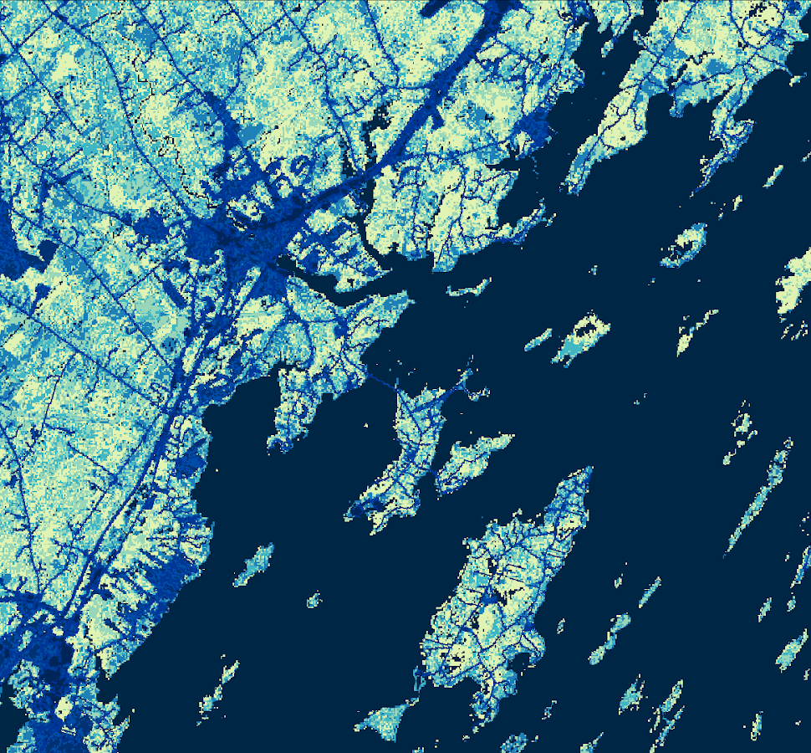
SOUTHERN MAINE HEALTH & AIR QUALITY
Examining Tick-Borne Illness Risk by Evaluating Land Cover and Tick Habitat Suitability in Southern Maine
Celeste Gambino
Britnay Beaudry
Madison Berman
Monica Colmenares
Massachusetts – Boston | Summer 2019
Notes:
Good morning!
My name is __________ and today we’ll be telling you about the work conducted by the Southern Maine Health and Air Quality team during the Summer 2019 DEVELOP term at the Massachusetts – Boston node.

Slide 2
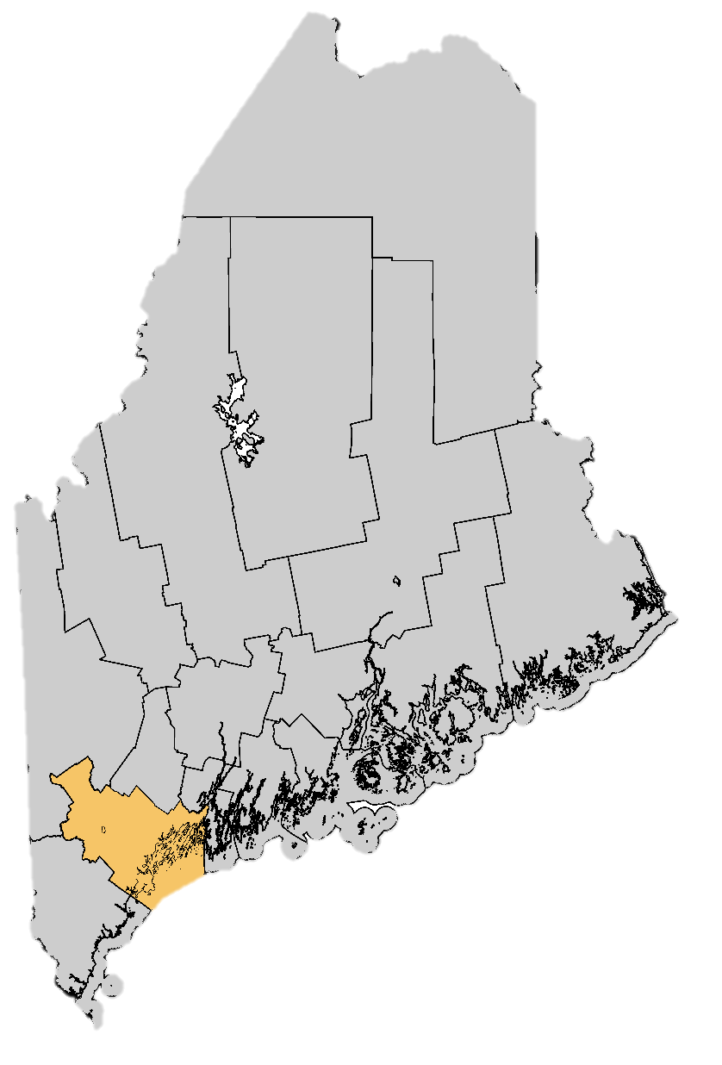
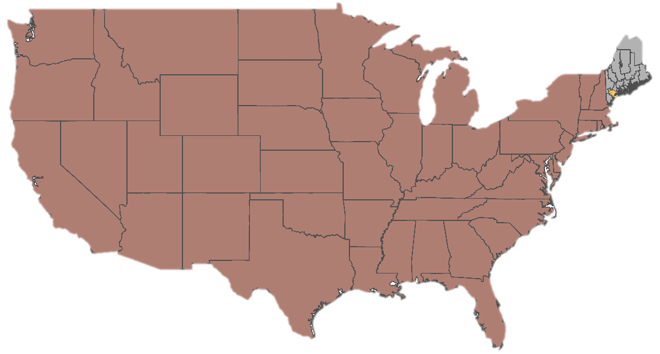
Study Region and Period
Study Region: Cumberland County, Maine
Study Period: January 2008 to June 2019
Most populated county in Maine
COUNTIES
Cumberland
All other counties
Destination of hundreds of thousands of visitors every year
0
40
80
160
240
320
Miles
Source: Mike Lindsey (Flickr)
Source: DEVELOP Southern Maine Health & Air Quality Team
Notes:
The region of interest for this project is Southern Maine, specifically the area of Cumberland County, Maine.
The data acquired for this project was from January 2008 to June 2019. This study period was chosen based on the satellite data availability and to ensure that the most recent data is included in the analyses.
Largest county by population in Maine with over 280,000 people ------------------------------Image Information Below ------------------------------
Images created by DEVELOP Southern Maine Health & Air Quality Team
------------------------------Maine Information Below ------------------------------
Cumberland County Maine Website. Community Video Tours: http://www.elocallink.tv/clients3/me/cumberlandcounty2014/tourplay.php?movie=mecuco14_wel_rev4_iwd&spon=welcome
Cumberland County Maine Website. Community Video Tours: http://www.elocallink.tv/clients3/me/cumberlandcounty2014/tourplay.php?movie=mecuco14_tou_rev4_iwd&spon=tourism

Slide 3
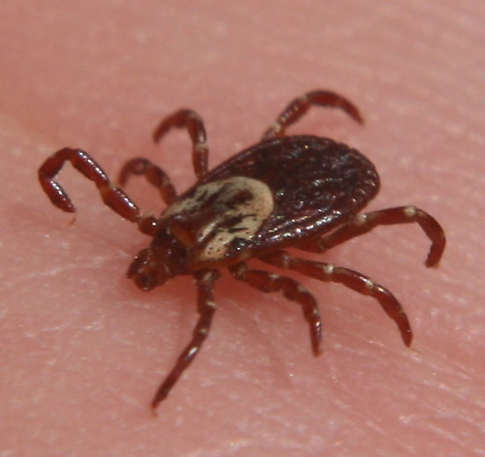
Community Concerns
Tick-Borne illnesses are a public health issue in Southern Maine
There is a tendency to underreport cases of tick-borne illness
The CDC estimates that only 1 in 10 cases of Lyme disease are actually reported
Local communities require increased efforts to identify locations of high tick encounter risk
Source: Creative Commons
Notes:
Tick-borne illnesses, such as Lyme disease, Anaplasmosis, and Babesiosis are an increasing concern to communities in and around Cumberland County, Maine.
In 2017, the Maine Department of Health and Human Services reported 1,769 probable or confirmed cases. However, the CDC estimates as little as 1 in 10 cases of Lyme disease are reported in Maine; It is this tendency to underreport that often makes medical intervention difficult.
To address concerns such as these, the community requires increased public health efforts to prevent and mitigate contact with ticks that may carry disease, and they need help in providing the public with informative disease risk advisories.
------------------------------Image Information Below ------------------------------
URL: https://ccsearch.creativecommons.org/photos/84bce3aa-5679-4f80-9a60-fbc12dc8203e (CC BY-SA 2.0)

Slide 4
Objectives
Create land cover maps of Cumberland County that identify the main land cover types known to increase likelihood of tick encounter
Examine the relationship between environmental factors and the estimation of actual disease incidence
Improve public awareness of high disease risk locations while also informing future research related to tick-borne illness mitigation
Source: Mike Lindsey (Flickr)
Notes:
The objectives of this project were created to address the task of improving public awareness of areas experiencing high tick abundance and disease risk, and to better understand the relationship between certain environmental parameters and tick-borne disease distribution.
These objectives will help both the DEVELOP team and project partners build the capacity for using NASA Earth observation data.
Our team strove to:
Create land cover maps of Cumberland County that displays tick-preferred habitats.
Illustrate how variation in environmental parameters impacts the spatial distribution of tick-borne disease risk
Examine the relationship between those remotely sensed environmental factors and the estimation of actual disease incidence
Improve public awareness of high disease risk locations and inform future research relating to mitigation efforts
------------------------------Image Information Below ------------------------------
https://www.flickr.com/photos/dosmosis/249347923/ (CC BY-NC-ND 2.0)

Slide 5
Partners
Maine Medical Center Research Institute, Lyme & Vector-Borne Disease Laboratory
Maine Vector-Borne Disease Working Group
Bigelow Laboratory for Ocean Sciences
Notes:
Our team partnered with the Maine Medical Center Research Institute, working with Field Biologist Chuck Lubelczyk and Director and Co-Founder Rob Smith.
We also partnered with Dr. Susan Elias, of the Maine Vector-Borne Disease Working Group and with Bigelow Laboratory for Ocean Science’s Senior Research Scientist, Dr. Nick Record.
In collaborating with these groups, our goal was to create maps and tools that will improve public awareness of tick abundance and disease risk, and expand their current tick-borne illness mitigation efforts.
------------------------------Image Information Below ------------------------------
https://www.flickr.com/photos/dosmosis/249347923/ (CC BY-NC-ND 2.0)

Slide 6
Satellite Sensors Used
Aqua MODIS
Landsat 8 OLI
Terra MODIS
Source: NASA Scientific Visualization Studio
Notes:
To create our end products, we used several Satellites/Sensors and Datasets...
Landsat 8 OLI was used to complete land cover classifications of Southern Maine.
We also used the MODIS sensor onboard both the Terra satellite and the Aqua satellite to incorporate Land Surface Temperature (LST) data into the analyses.
We also used other ancillary data over the course of this project.
------------------------------Image Information Below ------------------------------
All Satellite images were taken from the DEVELOPedia page.
Landsat 8 URL: http://www.devpedia.developexchange.com/dp/images/c/c2/03_Landsat8.png
Terra URL: http://www.devpedia.developexchange.com/dp/images/9/91/05_Terra.png
Aqua URL: http://www.devpedia.developexchange.com/dp/images/b/bf/06_Aqua.png
Earth URL: https://svs.gsfc.nasa.gov/cgi-bin/details.cgi?aid=3639 (Federal public domain)
Daymet URL: https://daymet.ornl.gov
Daymet URL: https://ldas.gsfc.nasa.gov
Earth Spinning URL: https://svs.gsfc.nasa.gov/cgi-bin/details.cgi?aid=3639 (Federal public domain)

Slide 7
Land Cover Methodology
This tool uses Landsat 8 OLI imagery in Google Earth Engine (GEE) to create a supervised land cover map of Cumberland County
Inputs
Processing
Validation
Outputs
Choose classes (water, urban, cultivated, forest, barren)
Input training data points for each class
Ground truthing validation of points
Landsat 8 OLI
(July 12th, 19th, 28th, 2018)
Land cover map
1x
Notes:
Our team used Google Earth Engine (GEE) to analyze surface reflectance remote sensing imagery in order to create a supervised land cover map of Cumberland County, Maine.
GEE is a free, cloud-based geospatial research service that houses a variety of datasets and raw or preprocessed imagery collections from NASA and European Space Agency sensors.
To create this supervised map, GEE data for July 10th, 2018 (the clearest image available with less than 10% cloud cover) was acquired from Landsat 8 OLI Level-1.
First, we defined a list of land cover classes
Then, for each class, a set of training data was manually input and processed in GEE.
Based on that training data, GEE produced a land cover map of Cumberland County divided by our pre-chosen classes.
We attempted to create an unsupervised map, where a random set of pixels from the Landsat 8 image was used to create training data to help GEE assign land cover classifications. We decided, however, that a supervised classification was better suited for the study area and our partners.
To visually confirm that our supervised classification was accurate, our team traveled to Cumberland County Maine to perform ground truthing validation of latitude/longitude training points, then reprocessed the map using the corrected points.
This process provided us with a Land Cover map that illustrates the different habitats we can associate with ticks.
------------------------------Image Information Below ------------------------------
Image created by DEVELOP Southern Maine Health & Air Quality Team

Slide 8
Edge Map Methodology
This tool uses the classes from the Land Cover map to create an Edge map of Cumberland County
Inputs
Processing
Outputs
Choose land cover type (forest, urban, cultivated)
Create buffer along edge of each land cover type
Isolate edges where land cover types touch or overlap
Land Cover map layers
Edge map
Notes:
Through our research, we found that the risk of coming contact with ticks increases when two habitats meet. For example, the edge of forests can be more species rich with deer and raccoons, for example, which are known to serve as hosts for Deer ticks.
If we look at the edges between forest and urban areas, these locations might attract heavy human usage, and pose high entomological risk (especially with transportation workers who spend a lot of time at these edge areas).
In order to create the Edge map, we used the forest, urban and agriculture land cover layers from the Supervised Classification land cover map.
We calculated the distance to the edge of the forest area and also the urban area (within a 30 m radius) to create a buffer along those edges. We then isolated only the areas where the edge of the forest buffer overlaps the edge of the urban buffer.
The result of this process is a map that displays those Forest to Urban edge areas in Cumberland County.
------------------------------Image Information Below ------------------------------
Image created by DEVELOP Southern Maine Health & Air Quality Team

Slide 9
Modeling Methodology
Outputs
- Expected number of tick disease incidence
- Parameter estimates
Reported Tick Disease Incidence
Data aggregated to annual resolution
Terra MODIS LST
Hypothesis generation
Fit models in JAGS
Aqua MODIS LST
Center data to mean
gridMET Humidity
Validation
- Out of sample years
Combine co-parameters
Notes:
For risk and environmental parameter relationship analyses, CDC disease incidence, LST, humidity were input to simple Bayesian models.
The data was first aggregated yearly, then centered on the mean for each variable, and similar co-parameters (for example, all LST datasets) were combined.
Hypothesis were generated for each variable, then parameters were input into individual simple Bayesian models in an R package, JAGS.
Model outputs include: the expected number of tick disease incidence, the probability of acquiring Lyme disease per person per town, and estimations of environmental parameter influence on that probability.
Models were validated with a Deviance Information Criterion score, as well as with both out of sample towns and years.
------------------------------Image Information Below ------------------------------
Image created by DEVELOP Southern Maine Health & Air Quality Team

Slide 10
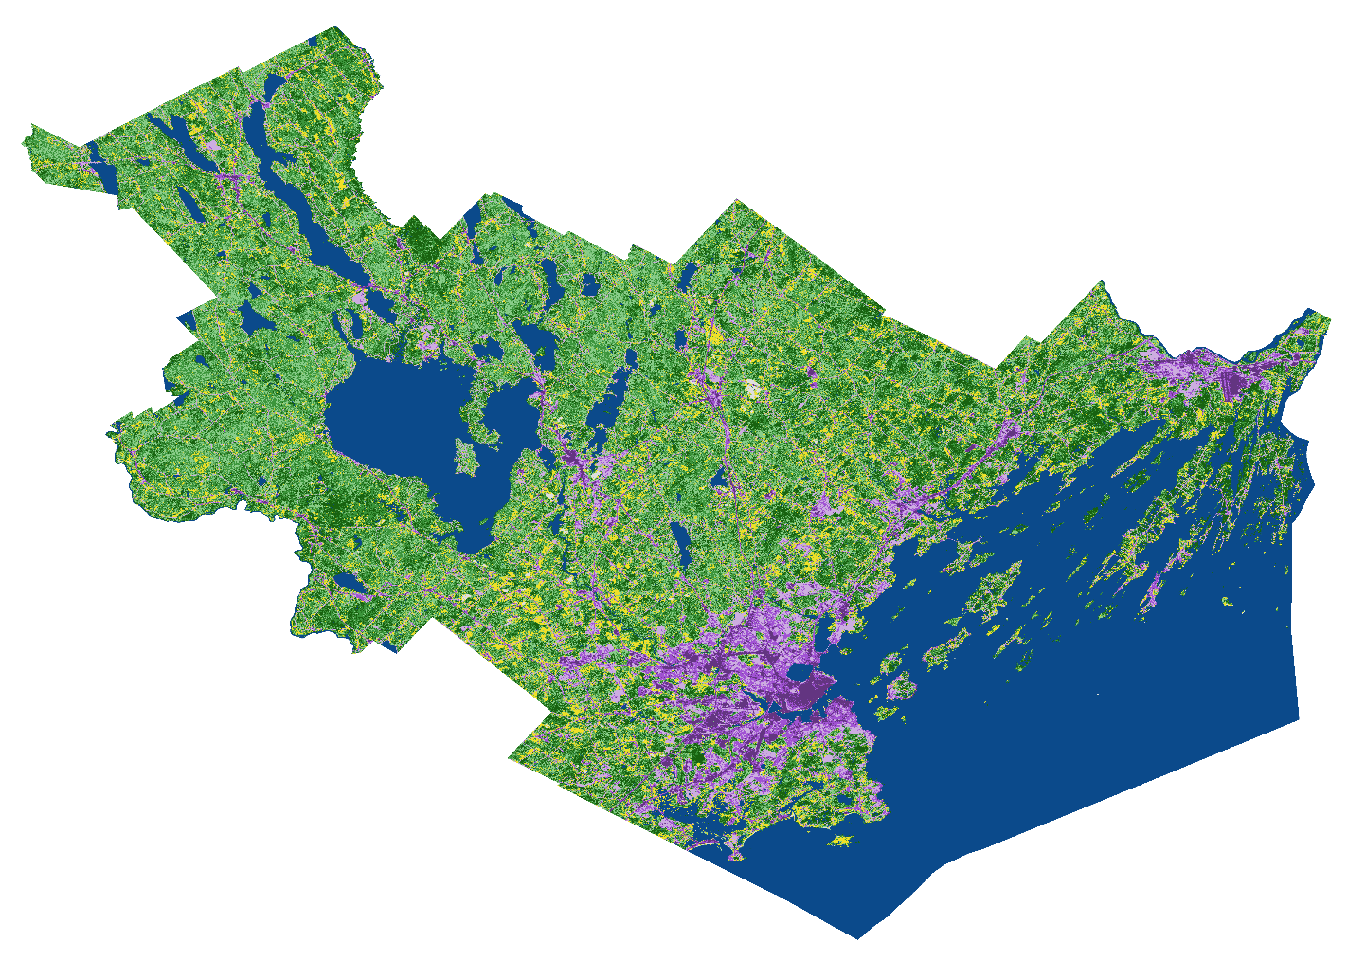
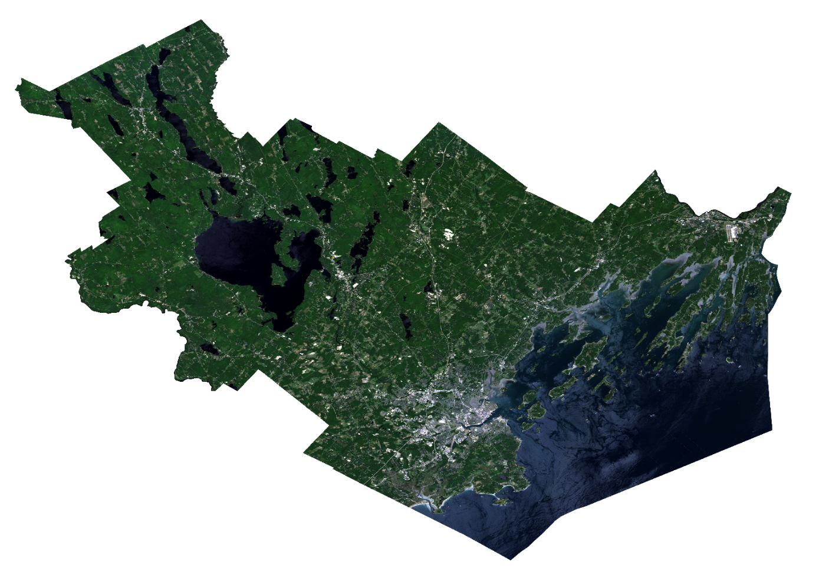
Land Cover Results
Low Density Development
Mid Density Development
Coniferous
0
5
10
20
30
40
High Density Development
Mixed
Miles
Deciduous
Cultivated
Water
Barren
Source: DEVELOP Southern Maine Health & Air Quality Team
Notes:
The image to the left is a true color mosaic of Landsat 8 images of Cumberland County, filtered for minimal cloud cover.
The image to right is of the preliminary supervised land cover classification. Both are made in Google Earth Engine.
Eventually we separated the original Forest classification into Deciduous, Mixed, and Coniferous.
We also separated the Urban classification into Low, Medium, and High Density Development categories.
To improve our accuracy of the data, we performed a ground truthing assessment and added a confusion matrix to the Earth Engine script. ------------------------------Image Information Below ------------------------------
Images created by DEVELOP Southern Maine Health & Air Quality Team

Slide 11
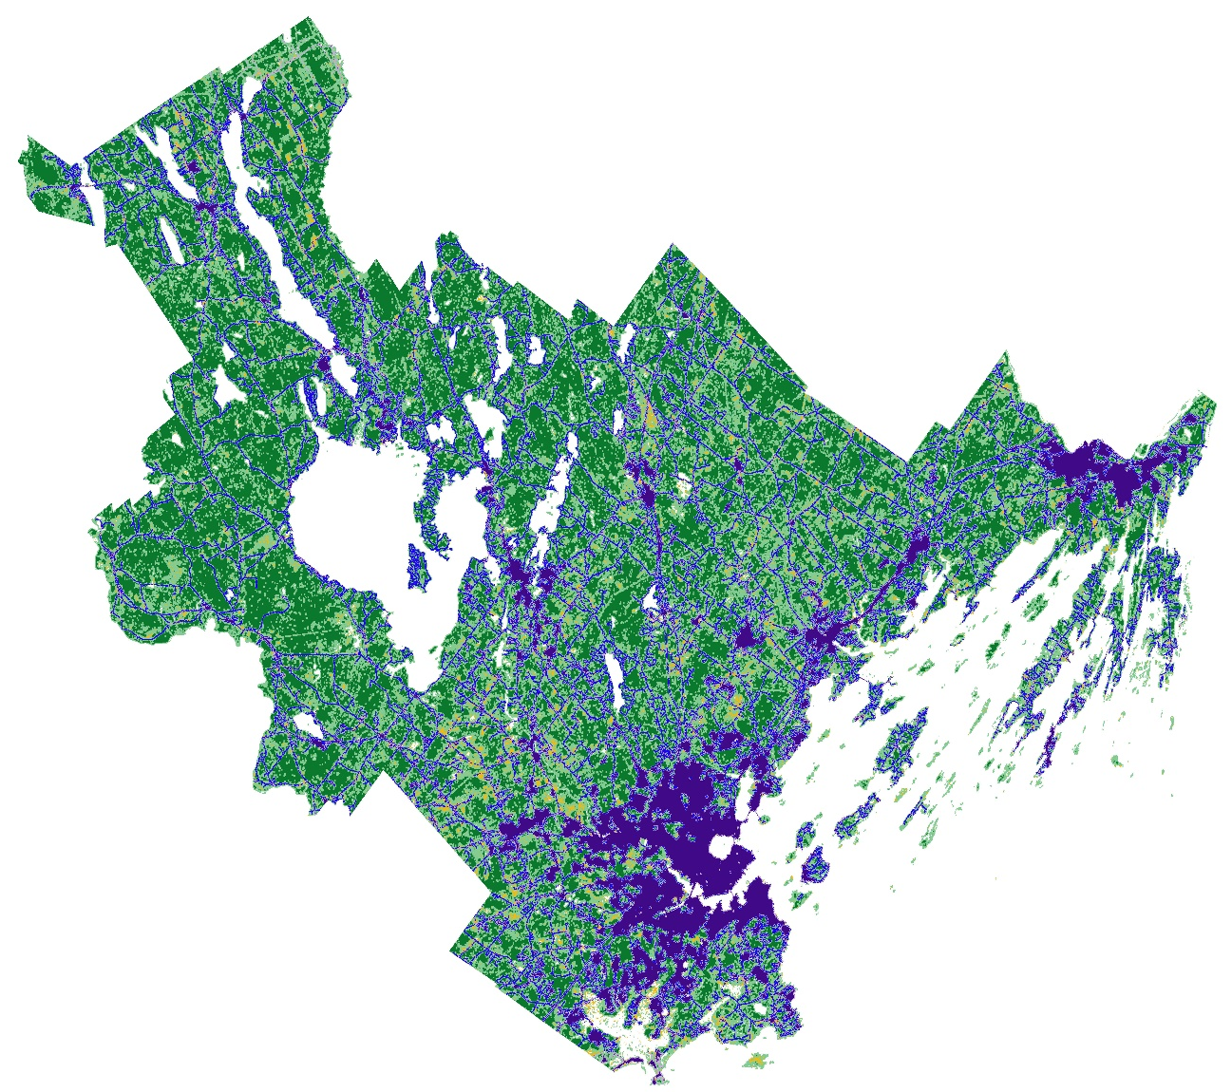
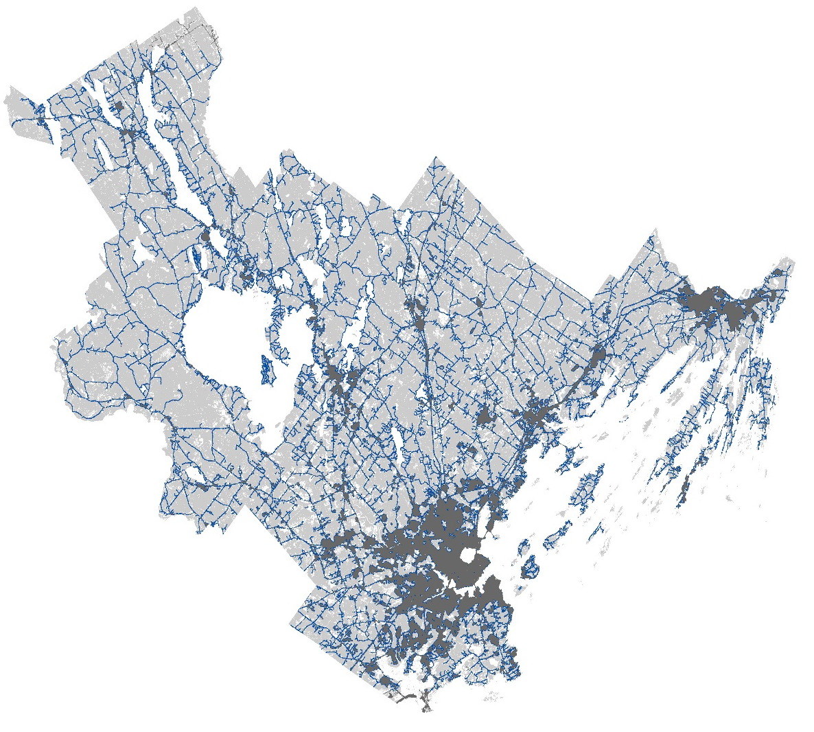
Edge Map Results
Urban Development
Urban Edge
Forest Cover
Forest Cover
Forest Edge
Urban Cover
Cultivated
Forest – Urban Edge
0
5
10
20
30
40
Miles
Forest – Urban Edge
Source: DEVELOP Southern Maine Health & Air Quality Team
Notes:
The image to the left displays the forest cover in dark green, the forest edge in light green, the urban development in dark purple, and the urban edge in light purple. Where the forest edge meets the urban edge is illustrated by the dark blue line.
The image to the right is a greyscale image of Cumberland County; highlighted in blue are those ‘edges’ where people are supposedly more at risk of coming in contact with ticks.
Both images are made with Google Earth Engine
------------------------------Image Information Below ------------------------------
Images created by DEVELOP Southern Maine Health & Air Quality Team

Slide 12
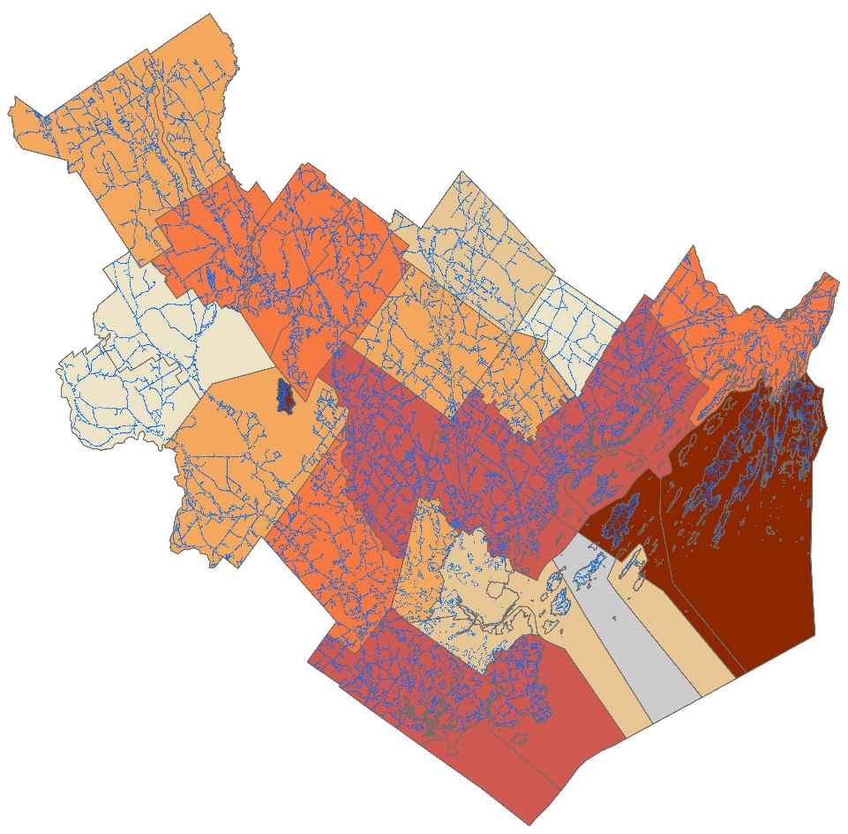
Edge Map Results
PERCENT EDGE
≤ 12.540%
≤ 15.770 %
≤ 19.006 %
≤ 22.503%
≤ 29.251%
≤ 63.210%
Forest – Urban Edge
0
5
10
20
30
40
Miles
Source: DEVELOP Southern Maine Health & Air Quality Team
Notes:
Using the Edge map, we were able to calculate the ‘percent edge’ of each town in Cumberland County. This map shows that range.
The darker the color gets, the more interaction there is between the edges of forest cover and the edges of Urban Cover, and the higher the probability is for coming in contact with ticks.
Cumberland county as a whole contains about 20% of area that is considered to forest-urban edge.
Frye Island, Chebeague Island, and Long Island have the highest percentage of edge features, calculated at 63.21%, 37.89%, and 39.079% respectively.
This is notable as these areas are small islands that aren’t as populated as bigger cities such as Portland.
These small areas that are not dominated by any one land cover type, which means more edge areas that provide opportunities for humans to come in contact with ticks.
Comparatively, towns such as Baldwin, Sebago, and Pownal have much smaller percentages of edge: 11.82%, 11.89%, and 12.54%.
These towns tend to have one dominating land cover class, resulting in less edge habitat, and thus a smaller risk of encountering ticks. ------------------------------Image Information Below ------------------------------
Images created by DEVELOP Southern Maine Health & Air Quality Team

Slide 13
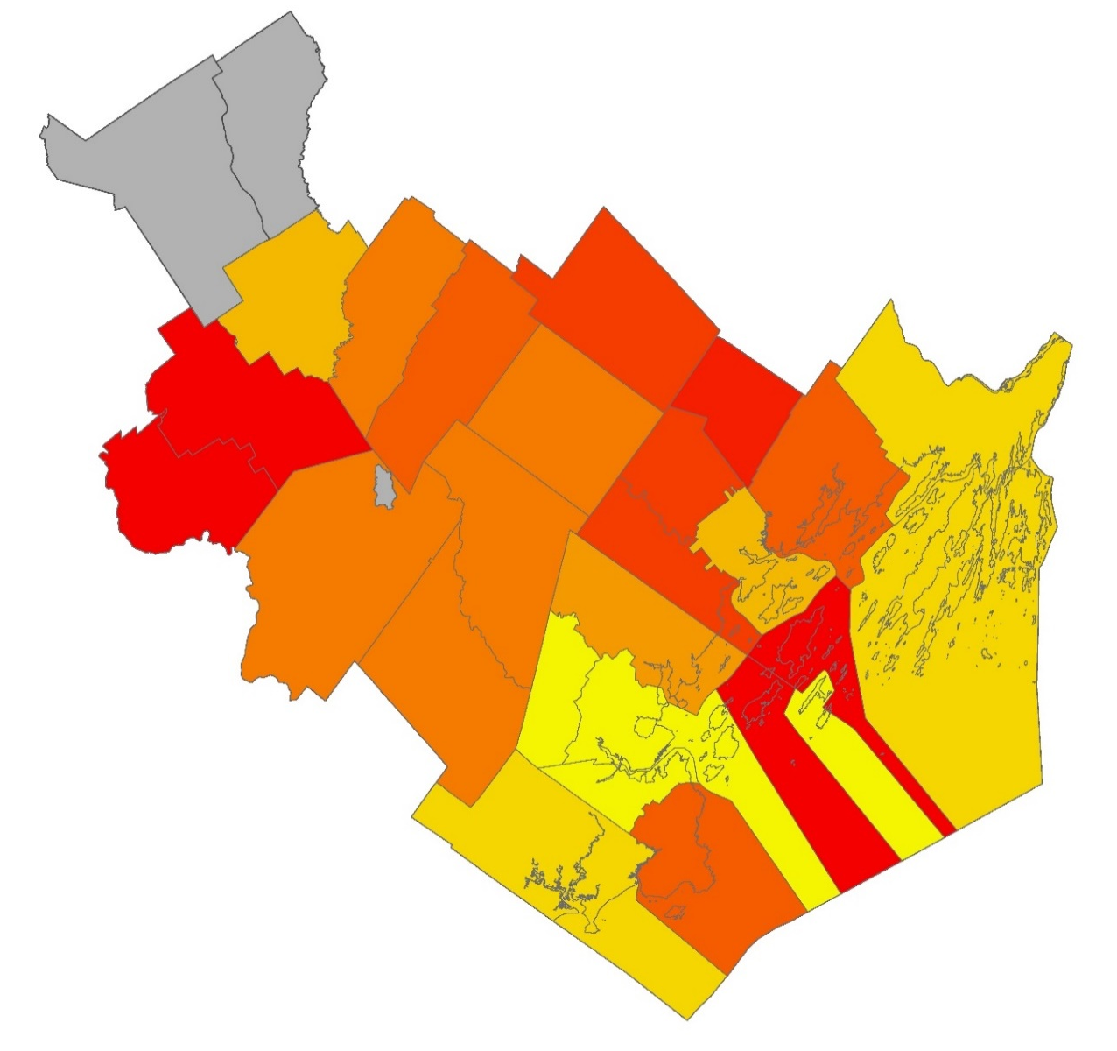
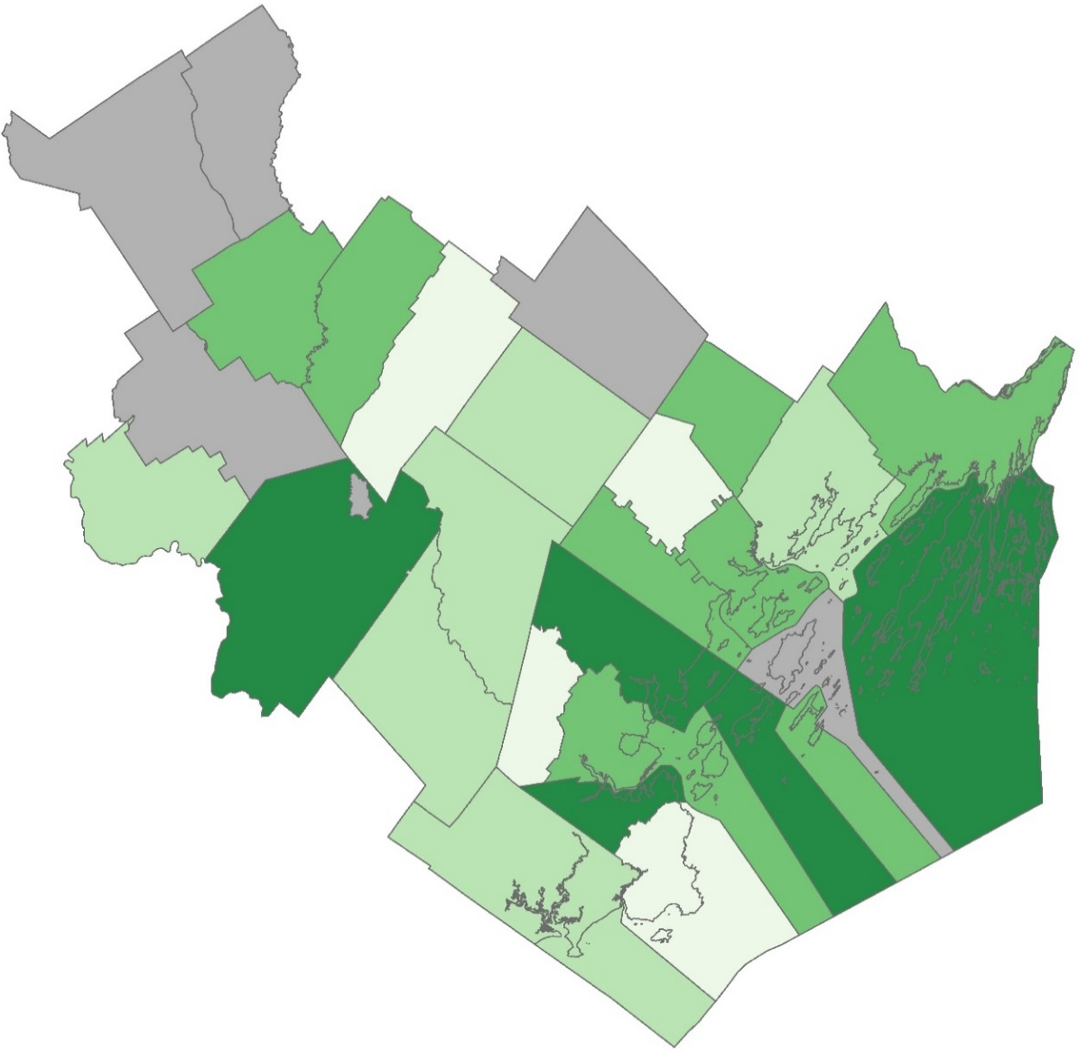
Modeling Results
PROBABILITY OF INFECTION
RELATIVE STRENGTH OF TEMPERATURE EFFECT
Higher Risk
Positive Effect
Lower Risk
Negative Effect
Town Omitted
Town Omitted
0
5
10
20
30
40
Miles
Notes:
The choropleth map on the left displays the probability of acquiring Lyme disease per person at town-level spatial resolution for Cumberland County, as estimated by disease incidence and population.
New Gloucester, North Yarmouth, and Cumberland were found to have the highest modeled tick-borne LD risk per person in Cumberland County, while Portland, South Portland, and Westbrook had the lowest risk.
Baldwin, Sebago, Chebeague Island, Long Island, and Pownal had unrealistically high probabilities, due to a high standard deviation combined with suppressed data.
The map on the right illustrates the relative comparative effect of Land Surface Temperature on LD incidence in Cumberland County towns. While the overall magnitude of temperature’s effect is small, the magnitude of effect varies when comparing Cumberland towns to each other.
Standish, South Portland, and Harpswell were found to have the most positive relative strength of effect. Raymond, Westbrook, and Cape Elizabeth were found to have the most negative influence.
Humidity’s effect was found to be negligible, suggesting that humidity may not strongly drive changes in LD incidence in Cumberland towns.
Omitted towns were not included as the probability of infection and probability of detection were too difficult to separate and the number of model iterations were considered too large in R; so the models did not converge. This could be due to two possible factors:
1) the model was not informative enough,
2) the data used to fit the model did not provide enough constraint. A tighter prior for the probability of infection from an expert in the field would likely help model convergence moving forward. ------------------------------Image Information Below------------------------------
Image created by DEVELOP Southern Maine Health & Air Quality Team

Slide 14
Errors and Uncertainties
While ground truthing was performed for a subset of training points in refining the land cover map, not all points were confirmed.
The relationship between ticks and climate variables might not be representative of tick disease rates, as they do not affect human behavior in the same way as tick behavior.
Despite modeling town-level disease rates, those towns may not be where the disease was contracted.
The models were aggregated to annual resolution using methods as descriptive as possible. However, this may not be as descriptive as is needed.
Notes:
Over the course of this project, there were several areas in which some error or uncertainty could be expected.
First, while the team did perform ground truthing for a subset of training points as a method of validating the land cover map, not all points were confirmed.
Second, there are several sources of error that can be found in the modeling analysis portion of the project:
In this model, tick disease incidence is being used instead of just tick rates; this means that the model is focusing on a combination of the behavior of both ticks and humans, with no way to separate those signals.
The result is that our knowledge of the relationship between ticks and climate variables may not be representative of tick disease rates (as it doesn’t affect human behavior in the same way).
For example: it is possible that while ticks love humidity, humans hate it, so tick disease rates are negatively correlated with humidity
Despite modeling town-level disease rates, there is no guarantee that that town is the location at which the disease was contracted.
The models were aggregated to Annual using methods that are as descriptive as possible, however this may not be as descriptive as is needed for this project

Slide 15
Conclusions
The land cover map demonstrated that vegetation classes were more mixed than expected and impervious surface was a subjective proxy for urbanization.
Frye Island, Chebeague Island, and Long Island had the highest percent edge features, and should be targeted for increased public awareness.
New Gloucester, North Yarmouth, and Cumberland were found to have the highest modeled tick-borne disease incidence risk per person.
Temperature’s strength of effect was stronger in towns such as Standish, Harpswell, and South Portland. Humidity was not predictive of Lyme cases.
Notes:
The land cover map demonstrated that vegetation classes were more mixed than expected and impervious surface was a subjective proxy for urbanization.
Frye Island, Chebeague Island, and Long Island had the highest percent edge features, and should be targeted for increased public awareness.
New Gloucester, North Yarmouth, and Cumberland were found to have the highest modeled tick-borne disease incidence risk per person.
Temperature’s strength of effect was stronger in towns such as Standish, Harpswell, and South Portland. Humidity was not predictive of Lyme cases.

Slide 16
Partners
Chuck Lubelczyk, MMCRI, Lyme & Vector Borne Disease Laboratory
Dr. Rob Smith, MMCRI, Lyme & Vector Borne Disease Laboratory
Dr. Susan Elias, Maine Vector-Borne Disease Working Group and MMCRI, Lyme & Vector Borne Disease Laboratory
Dr. Nick Record, Bigelow Laboratory for Ocean Sciences
Advisors and Mentors
Dr. Cedric Fichot, Boston University
Dr. Valerie Pasquarella, Boston University
Tess McCabe, Boston University
John Foster, Boston University
Zachary Bengtsson, DEVELOP Massachusetts – Boston
Notes:
We’d like to thank our project partners: Nick, Chuck, Rob, and Susan; it’s been a pleasure working with you this term.
A huge thank you to our science advisors and mentors this term, we could not have done this project without you.
And finally, a special thank you to our science advisor, Zach Bengtsson.
Thank you for your time.

