Slide 1
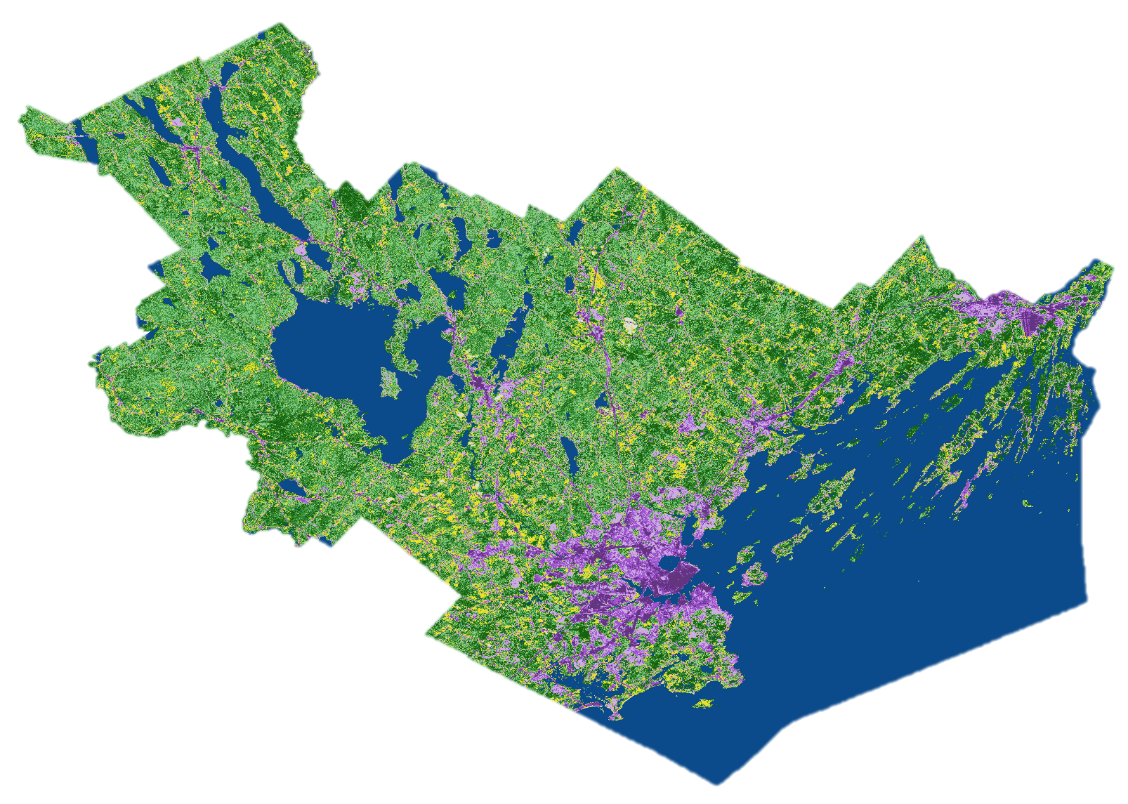

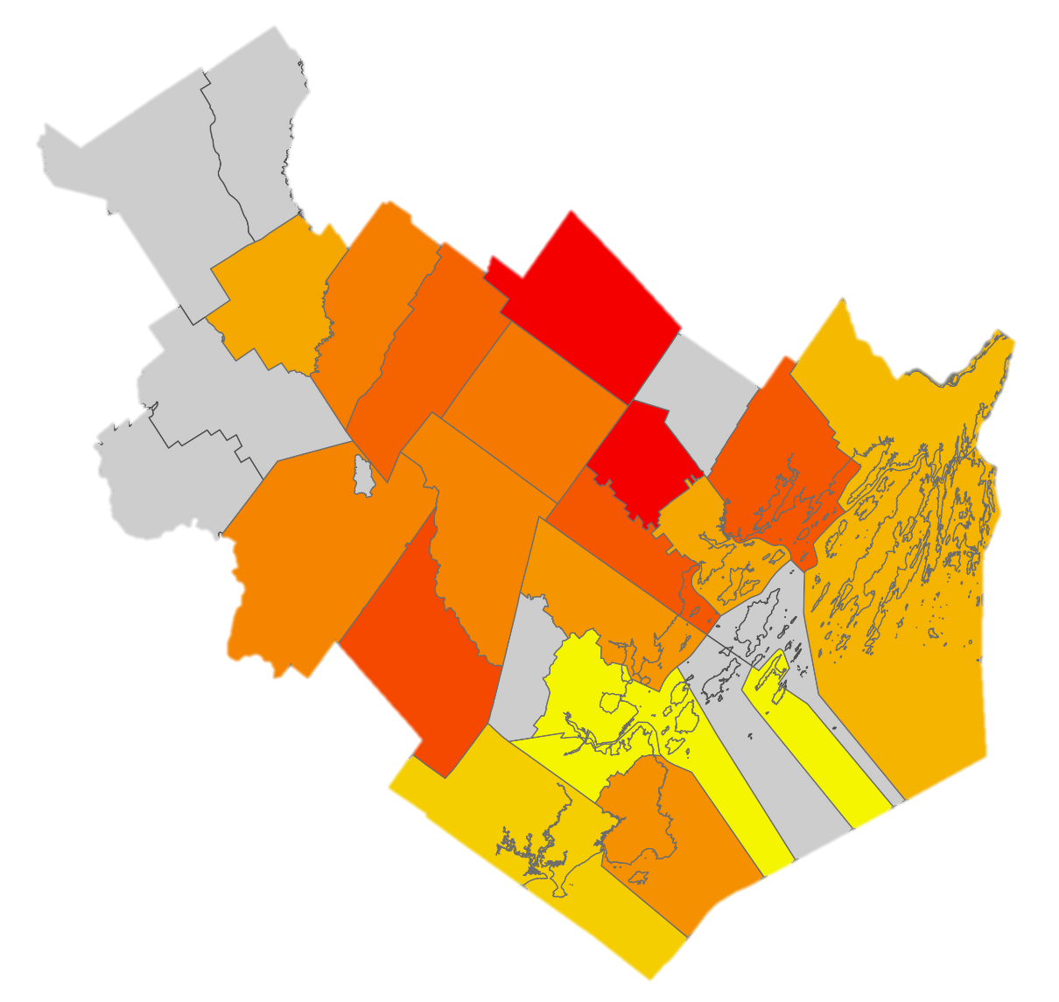
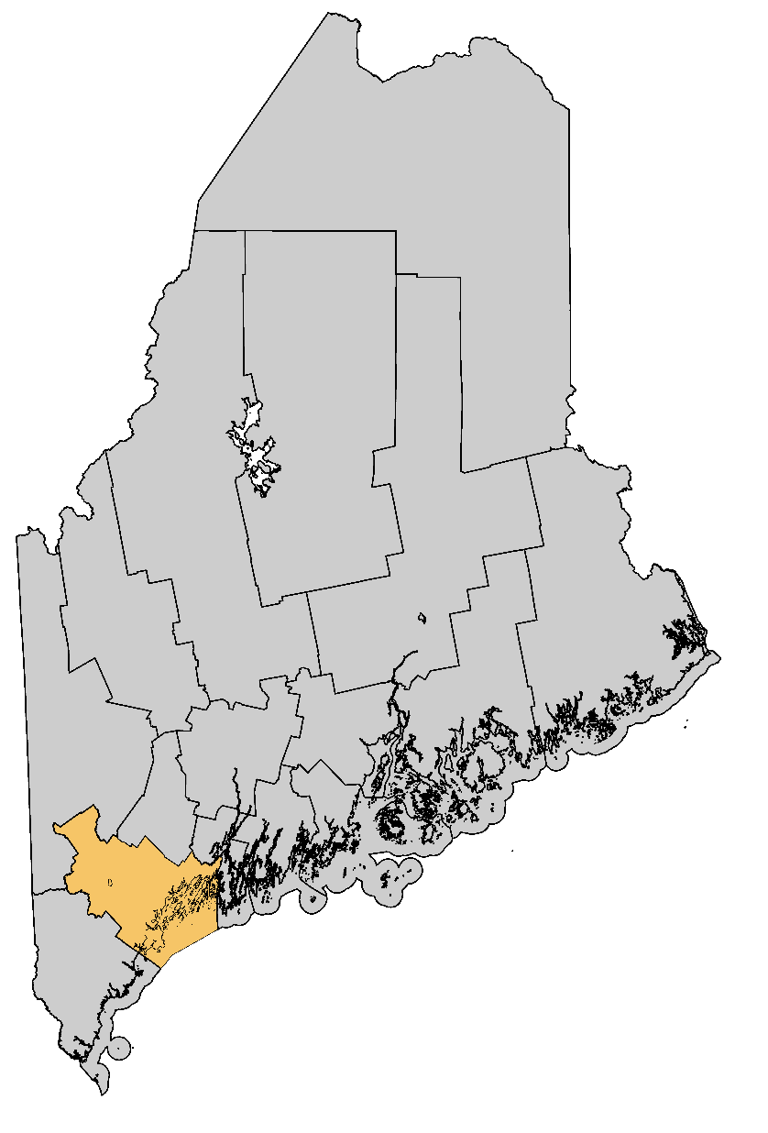

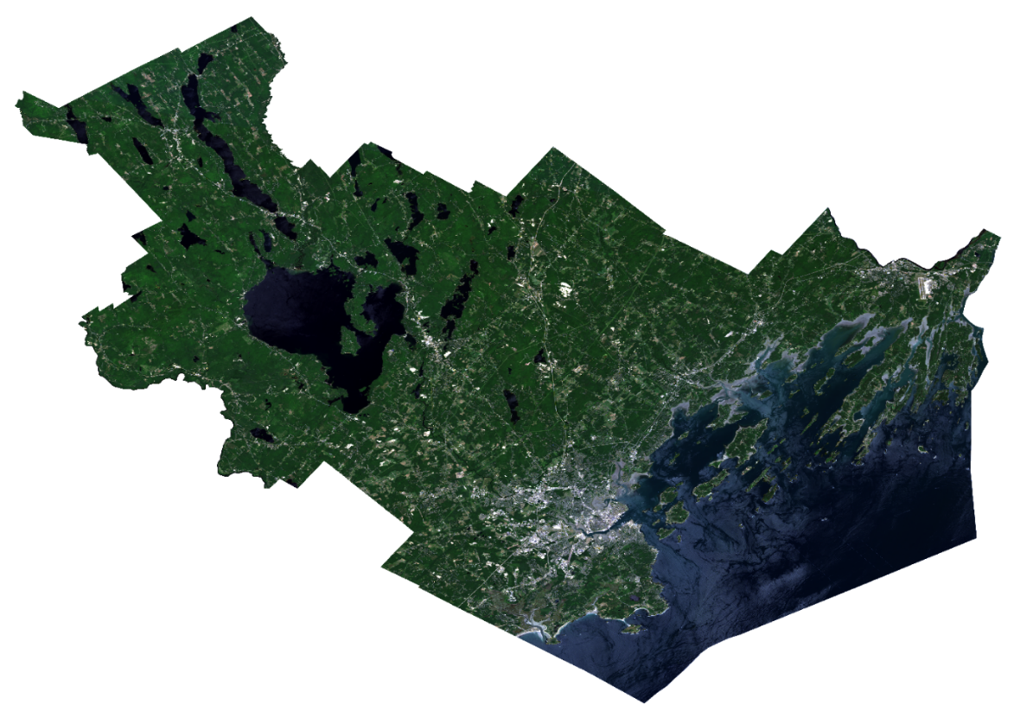
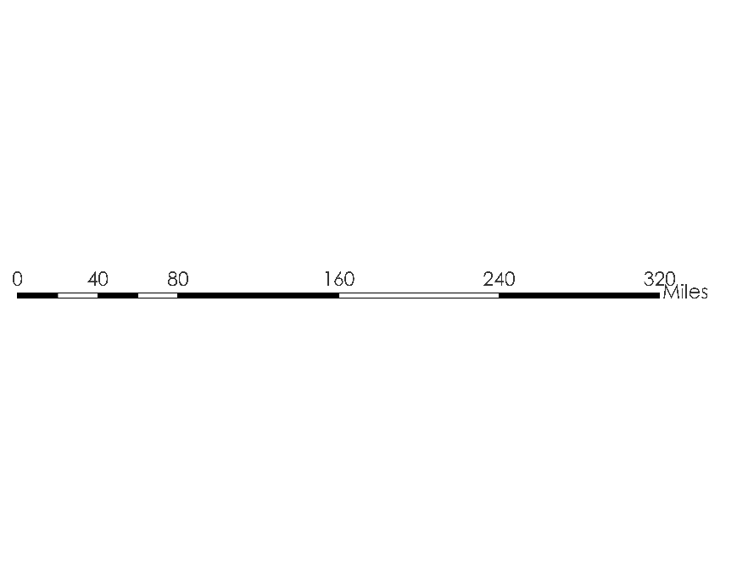








Examining Tick-Borne Illness Risk by Evaluating Land Cover and Tick Habitat Suitability in Southern Maine
Abstract
Methodology
Southern Maine Health & Air Quality
Tick-borne diseases are a public health issue in southern Maine, and recent estimates completed by the State of Maine suggest that as little as 1 in 10 cases of Lyme disease are actually reported. There are three tick-borne diseases known to occur in Maine that can be transmitted by the deer tick (Ixodes scapularis). Due to the higher prevalence and attention from Maine public health institutions, Lyme disease was the predominant focus in this study. The Massachusetts – Boston NASA DEVELOP team partnered with the Maine Medical Center Research Institute, Lyme & Vector-Borne Disease Laboratory; Maine Vector-Borne Disease Working Group; and Bigelow Laboratory for Ocean Sciences to assist with Maine’s tick-borne disease mitigation efforts. The team utilized NASA data from Landsat 8 Operational Land Imager (OLI), Terra and Aqua Moderate Resolution Imaging Spectroradiometer (MODIS), as well as ancillary datasets, from January 2008 to June 2019. Accurate land cover and tick-borne disease risk maps were created for Cumberland County, Maine. The land cover map allows for improved public awareness of areas conducive to tick encounter. The risk maps illustrate how variations in temperature and humidity contribute to the spatial distribution of tick-borne illness risk and determine the estimated number of actual Lyme disease incidents per year in every town. In addition, the team created a time series analysis that informs the end user’s research related to the impact of environmental parameters on tick distribution.
Supervised
Land Cover
Classification
Landsat 8 OLI
July 12th, 19th, and 28th, 2018
Figure 2: SLaCC creates a supervised classification land cover image using a mosaic of July 12, 19, and 28, 2018 Landsat 8 OLI data. *Classes are subdivided into high → low imperviousness, and deciduous → coniferous respectively.
Choose classes
(water, urban*, cultivated, vegetation*, clouds)
Input training data points for each class
Ground truthing validation of points
Land Cover Map of Cumberland County, Maine
Figure 3: Maine CDC and remotely sensed environmental data are incorporated into JAGS in order to assess the spatial distribution of tick-borne disease risk and incidence in the study region at a town resolution.
Tick-Borne Disease Incidence Modeling
Reported Tick Disease Incidence Data from the Maine CDC
Remotely Sensed Land Surface Temperature and Humidity Data from Aqua and Terra MODIS and gridMET
Data aggregation to annual resolution and combine any co-variates
Hypothesis Generation
Fit models in Just Another Gibbs Sampler (JAGS)
Validation:
Deviance information criterion
Out of sample towns and years
Outputs:
Expected number of tick disease incidence
Parameter estimates
Objectives
Results
Higher Risk
Create a land cover map and corresponding Google Earth Engine code that will help target areas for tick monitoring efforts and advise the community on the location of land cover types predisposed to high risk of tick encounter
Examine the relationship between environmental parameters and the estimation of actual disease incidence
Improve public awareness of high disease risk locations while also informing future research related to tick-borne illness mitigation
Lower Risk
Town Omitted
Study Area
Coniferous
Mixed
Deciduous
Figure 5: Displayed is the Lyme disease risk per person at town-level spatial resolution for Cumberland County. Grayed towns indicated that data has been withheld either for validation purposes or highly uncertain initial conditions.
Figure 1: The region of interest is highlighted here, encompassing all of Cumberland County, Maine. All analyses were performed on individual towns within Cumberland County. The study period is from January 2008 – June 2019. Insert displays true color image of study area, exported from Google Earth Engine.
COUNTIES
Low Density Development
Water
Cumberland
Mid Density Development
Cultivated
All other counties
High Density Development
Barren
Figure 4: Shown is a supervised classification land cover map of Cumberland County, Maine. Urban developed regions were sub-classified from low (0 – 22%), mid (22 – 56%), and high (56 – 100%) percentage of impervious surfaces. Visual assessment of 18 team-acquired ground truthing points resulted in an accuracy assessment of over 86%.
Conclusions
Of surveyed towns, New Gloucester, North Yarmouth, and Cumberland were found to have the highest modeled tick-borne disease incidence risk per person.
The land cover map demonstrated that vegetation classes were more mixed than expected and impervious surface was a subjective proxy for urbanization.
Temperature's strength of effect was stronger in towns such as Standish, Harpswell, and South Portland. Humidity was not predictive of Lyme cases.
Earth Observations
0
40
80
160
240
320
Miles
Project Partners
Maine Medical Center Research Institute, Lyme and Vector-Borne Disease Laboratory
Maine Vector-Borne Disease Working Group
Bigelow Laboratory for Ocean Sciences
Acknowledgements
Landsat 8 OLI
Terra MODIS
Aqua MODIS
Chuck Lubelczyk, MMCRI, Lyme & Vector-Borne Disease Laboratory
Dr. Rob Smith, MMCRI, Lyme & Vector-Borne Disease Laboratory
Dr. Susan Elias, Maine Vector-Borne Disease Working Group and MMCRI, Lyme & Vector-Borne Disease Laboratory
Dr. Nick Record, Bigelow Laboratory for Ocean Sciences
Dr. Cedric Fichot, Boston University
Dr. Valerie Pasquarella, Boston University
Tess McCabe, Boston University
John Foster, Boston University
Zachary Bengtsson, DEVELOP Massachusetts – Boston
Team Members
Celeste Gambino
Project Lead
Britnay Beaudry
Madison Berman
Monica Colmenares
Massachusetts – Boston | Summer 2019

