Slide 1
Gulf of Mexico Health & Air Quality
Utilizing NASA Earth observations to manage air quality and pollutants over the Gulf of Mexico
Amanda Clayton (Project Lead)
Lori Mandable

Slide 2
Community Concerns
12 km
9 km
6 km
3 km
Credit: NASA
Offshore oil and natural gas drilling in the GOM produces aerosol, nitrogen dioxide, and sulfur dioxide emissions
Affects onshore AQ, causing health and environmental impacts
Point data from individual platform and non-platform sources do not provide the regional coverage necessary to answer larger scale scientific questions
Notes:
Offshore oil and natural gas drilling in the Gulf of Mexico, on over 3,000 platforms, produces aerosols, nitrogen dioxide, and sulfur dioxide emissions. Emissions from offshore drilling can impact onshore air quality, causing health and environmental impacts. Emissions point data from individual platform and non-platform sources do not provide the regional coverage necessary to answer larger scale scientific questions.
Image Source: http://www.nasa.gov/content/goddard/cats-eyes-clouds-smoke-and-dust-from-the-space-station (Composite image created from photographs by Patrick Byrne, Carolyn Conner, Peggy Davis, Daneil Fogg, John Newman, Cyrus Reed, and Gayle Trautman)

Slide 3
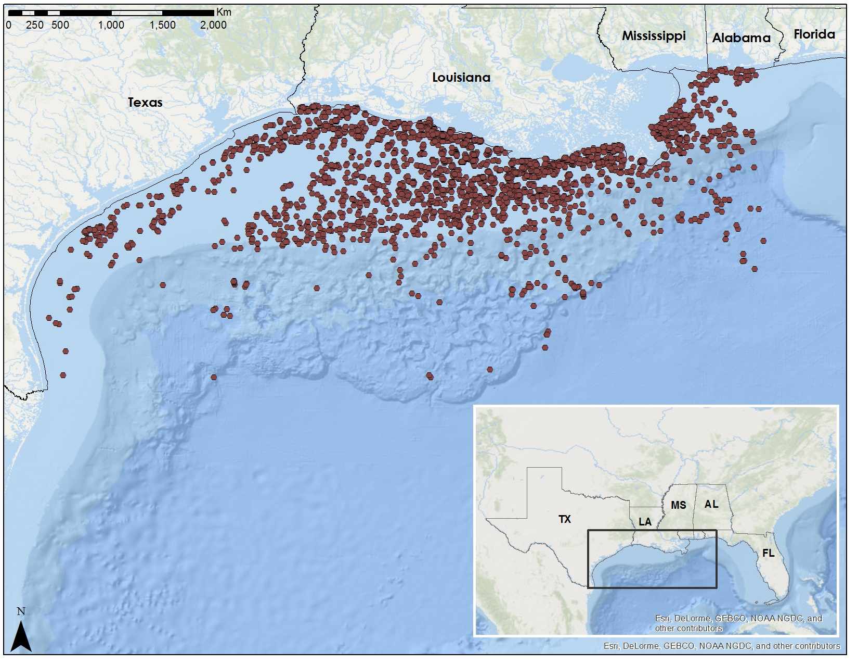
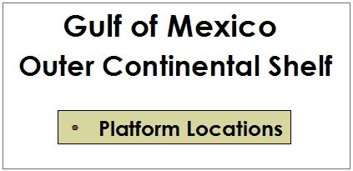
Study Area
Notes:
The points on the map show oil and natural gas production platform locations from 2000 to 2015.

Slide 4
Objectives
Map and Analyze airborne pollutant concentrations of PM_{2.5}, NO₂, and SO₂ using NASA Earth observations
Determine correlations between pollutants and primary emission sources (BOEM and EPA)
Develop methodology for continuing emissions monitoring
Notes:
Working with our partners at the Bureau of Ocean Energy Management, we determined three objectives for our project. First, to use NASA Earth observations to map and analyze airborne pollutant concentrations of aerosol PM2.5, nitrogen dioxide and sulfur dioxide trace gases. Second, to determine correlations between these pollutants and primary emissions sources by incorporating data from BOEM’s Gulfwide emission inventories and from EPA ground monitoring sites. Lastly, to develop a methodology that BOEM can use for continuing emissions monitoring.

Slide 5
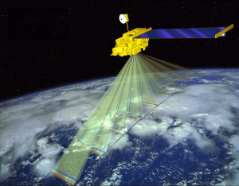
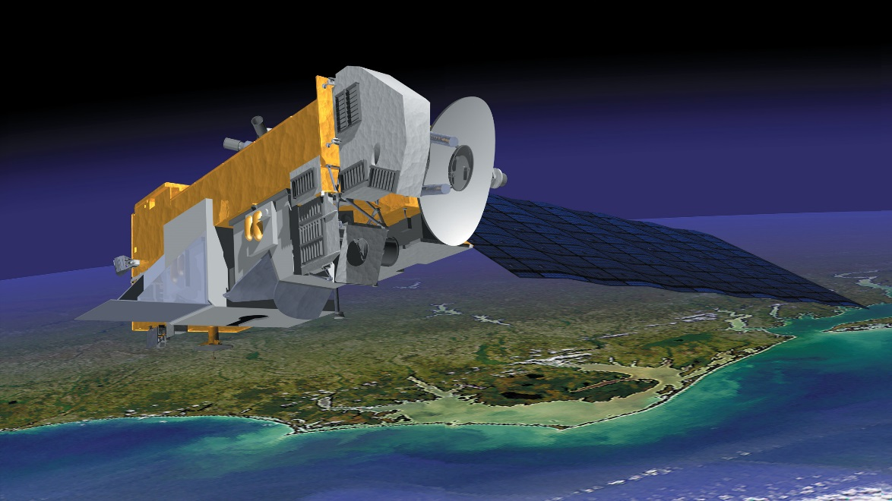
NASA Satellites & Sensors
Credit: NASA
Terra / MODIS
Aura / OMI
Aerosol Optical Depth (AOD)
Proxy for PM 2.5
Nitrogen Dioxide (NO₂)
Sulfur Dioxide (SO₂)
Notes:
Image Source: http://mynasadata.larc.nasa.gov/oyw/terra-celebrates-5000th-day-on-orbit/
Image Source: http://earthobservatory.nasa.gov/Features/Aura/

Slide 6
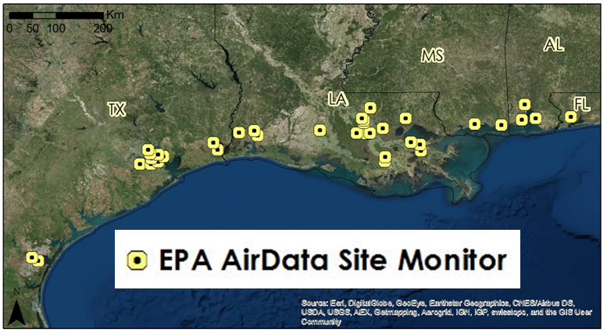
Methodology
Level 3 Data Product
Level 2 Data Product
In Situ Data
Area-Averaged Time Series and Time-Averaged Maps in GIOVANNI
[In Progress]
BOEM Gulfwide Emission Inventory (2000, 2005, 2008, 2011)
Aura/OMI NO₂ (OMNO2D_hr)
Aura/OMI SO₂
Terra/MODIS Aerosol Optical Depth (AOD)
Aura/OMI Total Column NO₂
Aura/OMI Total Column SO₂
Terra/MODIS
[In Progress]
EPA AirData
Onshore air quality monitors
Examine Level 3 satellite data to determine local “hot spots”
Obtain Level 2 data for “hot spot” locations to analyze emission patterns
Compare and correlate Level 2 data analysis with BOEM and EPA point data
Notes:
The first step in the process was to obtain Level 3 satellite data from the Terra/MODIS instrument and the Aura/OMI instrument. Terra/MODIS provided the Aerosol Optical Depth component, which is a proxy for PM2.5 measurement, on a daily basis over a gridded area of 1 degree by 1 degree for the time series of 2005-2015. Aura/OMI provided the nitrogen dioxide and sulfur dioxide measurements on a daily basis over the same 1 degree by 1 degree gridded area for the same 2005-2015 time series. Both time series graphs illustrating the variation in pollutant level as well as map averaged products detailing locations of higher pollution were produced, then fed into ArcGIS, where areas of high pollution flagged as “hot spots.”
For areas identified as emitting high pollution values, Level 2 data was obtained at a spatial resolution of 0.25 degree by 0.25 degree grids, which was then analyzed, compared and correlated with point data provided by BOEM and EPA to determine relationships between emission values and air quality.

Slide 7
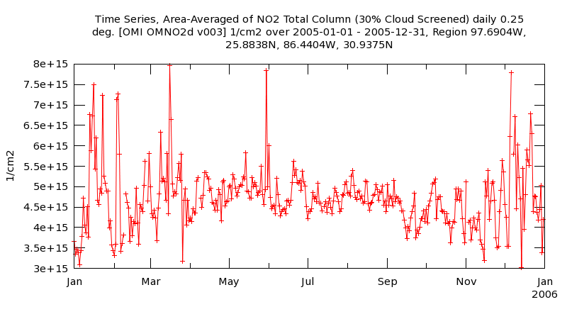
GIOVANNI
GIOVANNI is one of NASA’s interfaces allowing access, analysis and downloading of NASA satellite datasets
Time series and time-averaged map products illustrating levels of Aerosol Optical Depth, nitrogen dioxide and sulfur dioxide were produced from Level 3 data for initial analysis
Notes:
Giovanni is NASA Goddard’s Earth Sciences Data and Information Services Center interface allowing “access to global data sets from NASA Earth remote-sensing missions and other environmental data sets.” Users have the ability to easily access, analyze and download data from a variety of NASA’s Earth observing satellites.
Quote from http://disc.sci.gsfc.nasa.gov/giovanni/additional/users-manual/G3_manual_Chapter_1_introduction.shtml

Slide 8
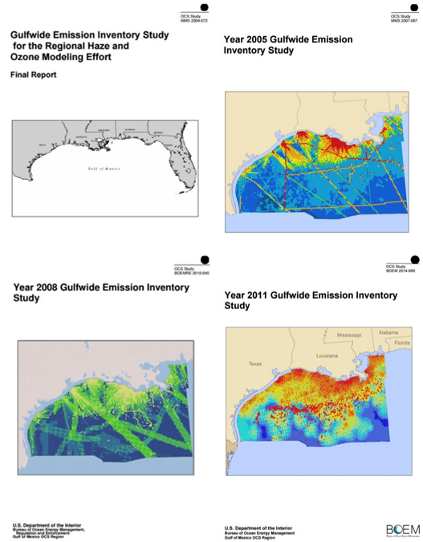
BOEM Emission Inventories
Monthly emission data from Platform and Non-Platform point sources
Emission data parsed to specifically identify PM_{2.5}, NO_{x} and SO₂ sources
Data uploaded into ArcGIS for comparison and correlation with satellite data
Notes:
BOEM requires that oil and gas platform and non-platform sources in the Gulf of Mexico record monthly emissions measurements for a variety of pollutants including PM2.5, nitrogen oxides and sulfur dioxide, where emissions are stored in the form of Microsoft Access database tables. These data were parsed by pollutant type and downloaded into Microsoft Excel for upload into ArcGIS, where it could be correlated with NASA satellite data.

Slide 9
EPA AirData
Methodology
Notes:
The Environmental Protection Agency records air quality data

Slide 10
Results
[In progress]
Time series and area averaged map visualizations

Slide 11
Conclusions
[In progress]

Slide 12
Advisors
Dr. Rob Levy, NASA GSFC
Dr. Pawan Gupta, NASA GSFC
Partners
Dr. Jose Hernandez, Bureau of Ocean Energy Management
Dr. Pawan Gupta, ARSET
Others
Dr. Bryan Duncan, NASA GSFC
Dr. Nickolay Krotkov, NASA GSFC
Dr. Lok Lamsal, NASA GSFC

Slide 13
General Guidelines I
Things that are typically included in a presentation:
The slides provided in the template are just a starting point for teams. Feel free to expand upon these topics, alter the headings, and change the order of the slides to fit your needs.
Study area
Study period
Objectives
Community concerns
NASA satellites/sensors used
Methodology
Results
Conclusions
Errors & uncertainties
Future work
Acknowledgements
Backup slides
Required Statement

Slide 14
General Guidelines II
Header text point size should be between 40 and 60 on most slides.
Body text point size should be at least 20.
Use Century Gothic.
Keep text to a minimum.
Try to use a consistent font size between slides.
Image Credit: Monet
Notes:
Image Source: http://commons.wikimedia.org/wiki/File:Claude_Monet_-_The_Magpie_-_Google_Art_Project.jpg

Slide 15
Maps & Logos
Maps
Import the legend separately.
Make sure all text is legible and editable.
Cite base layer source in speaker notes.
Logos
US Federal logos only.
No state, NGO, local and or international government logos, or software logos.

Slide 16
Photos & Figures I
You may only use images taken by your team, provided by your partners (as long as you have permission from them), from a Federal Agency, from the new DEVELOP stock imagery collection on DEVELOP’s Flickr page, or Creative Commons images.
Obtain a media release form from all people in photos that your team has taken — no children!
All image sources should be cited using a consistent format and should be visible on the slide.

Slide 17
Photos & Figures II
Please do not include the image URL in the source text box but rather place it in the notes section below.
If you use a border for your images include it on all photographs to keep your presentation consistent.
Keep all images and text boxes editable, including individual elements of flowcharts.
Background images are discouraged. If you use one, make sure that your text remains clear and legible.

