Slide 1
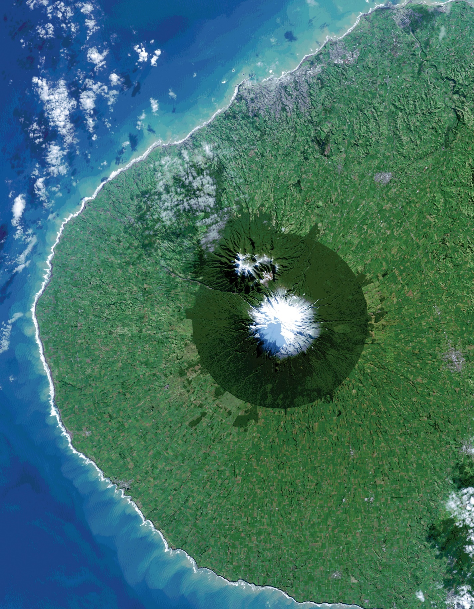
DEVELOP National Orientation (2023)
Module 4. Projects

Slide 2
PROJECTS
Project Characteristics
40-60 projects take place each year – at their core they share these characteristics:
Highlight the applications and capabilities of NASA Earth observations
Address community concerns relating to decision-making for real-world environmental issues
Partner with organizations who can benefit from using NASA Earth observations to enhance decision making by providing decision support tools
Align with at least one of the eight NASA Applied Sciences Program’s National Application Areas
Create a consistent set of deliverables
Research is conducted by teams with diverse backgrounds under the scientific guidance of Science Advisors and mentors from NASA and partner organizations

Slide 3
PROJECTS
By The Way
Ideas can come from anywhere as long as they connect to a decision-making end user! Have an idea? Tell your Fellow!
Project Idea Sources
National
Science
Objectives
Environmental
Decision
Makers
NASA
Program
Managers
End-User Needs
State & Local
Policy
Makers
DEVELOP
Science
Advisors
DEVELOP
Leads/Fellows & Participants
NSF
Decadal
Survey
Local
Communities &
Tribal Entities
New
NASA
Missions
Federal
Agencies &
Organizations

Slide 4
PROJECTS
Project Lifecycle
Identify Needs Surrounding Partners’ Decision-Making Processes
NPO Collects Project Ideas
Proposal Process – Reviewed by NPO and NASA HQ
Project Execution
Hand Off to Partners & Conference Presentations
All DEVELOP projects center around a decision.
DEVELOP identifies the information that would be helpful to the partner when making this decision. This is the partner’s need.
Project end products are designed to fit into the partner’s decision-making process.
The end deliverable package is handed off for partners to explore further and assess integration into their decision-making process.
Sometimes we have to reach back out to teams after the end of the term for clarification on final deliverables. We appreciate your help in answering these questions!

Slide 5
PROJECTS
Project Workload
Although your project will last 10 weeks, you will not have the full 10 weeks to work directly on the project.
Generally speaking, you will likely only work on the actual data processing & analysis for 6 or 7 weeks.
Remember that creating deliverables & conducting literature review are essential parts of the project.
Data Processing, Data Analysis, Deliverables
Week 1 2 3 4 5 6 7 8 9 10
Literature Review, Methodology Creation, Data Acquisition, Deliverables
Project Wrap-Up, Finalize Results, Final Deliverables, Project Handoff

Slide 6
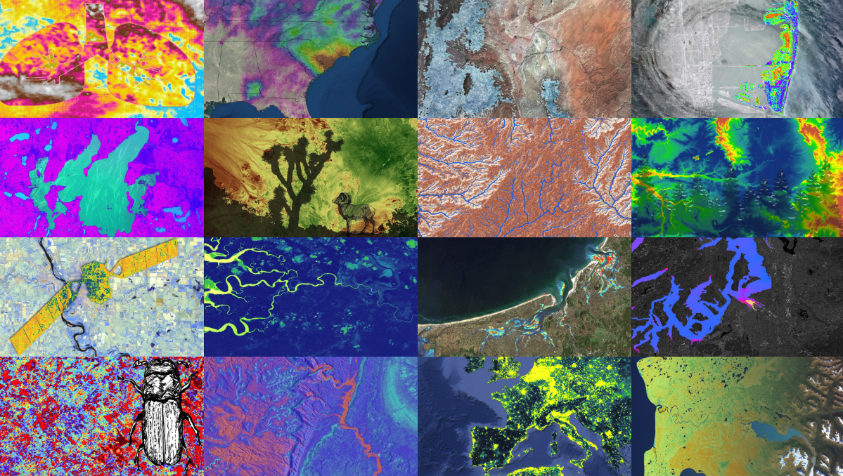
PROJECTS
Deliverables
All Projects Create…
Project Summary
Study Area Shapefile
Presentation
Poster
Tech Paper
DEVELOPedia Page
Website Image
Feedback Form
Some Projects Create…
Tutorial
Video & Transcript
Code
Social Media Campaign
Flyer
Brochure
By The Way
Start deliverables early and work on them incrementally to make life easier later!

Slide 7
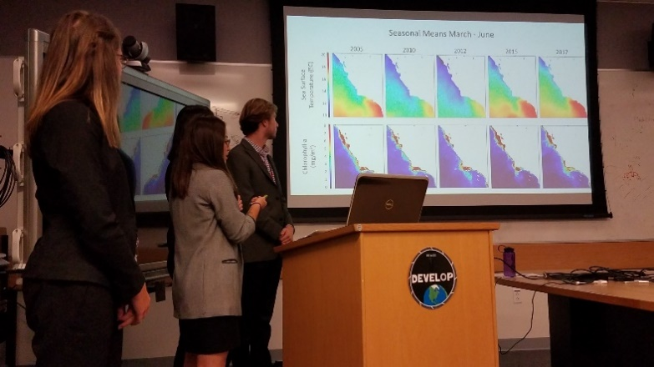
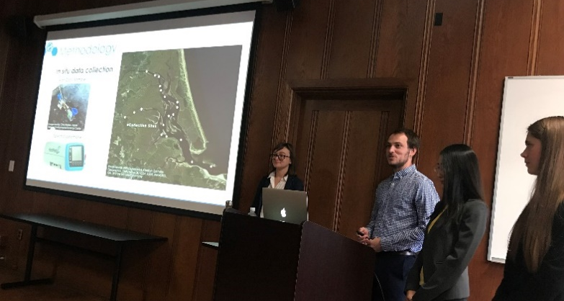
PROJECTS
Project Handoff
Handoffs are an important step in transitioning results and methodologies to end users and working towards the goal of the end users integrating NASA Earth observations into their decision-making processes.
Depending on what you are handing off, be cognizant that you must get materials approved by NASA prior to handoff.
Commonly Used Handoff Styles
Email deliverables (Tech Paper, Tutorials, Presentation, etc.)
Teleconference or videoconference presenting the results and methodologies
In-person presentation of results and methodologies
By The Way
Get creative in how and what you hand off. Interesting idea? Speak to your Fellow about it!

Slide 8
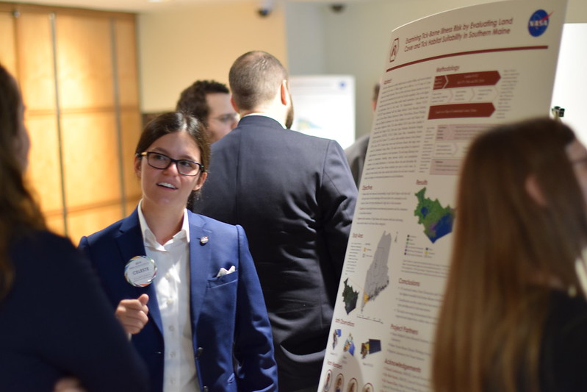


PROJECTS
Project Assessment –
Partner Inputs
A Pre-Project Partner Form was sent out before the term to gather information about partner needs and expectations. A Post-Project Partner Form will follow the completion of the term to collect information regarding the perceptions of success of collaborating with DEVELOP.
  Were the project results and methodologies useful?
  Was the experience a good one?
  Is the partner using the results or methodologies in their decision-making process?
You can use information from the Pre-Project Partner Form to better understand your partners’ needs, level of experience with NASA EOs, and decision-making processes.
Please communicate to your partners that DEVELOP will stay in touch and send a brief survey after the end of the project’s final term.

Slide 9
PROJECTS
Feasibility Considerations
DEVELOP projects are 10-week feasibility studies – in 10 weeks, validation efforts are limited at best.
Be mindful in how you communicate with partners – do not overpromise or oversell your products and results.
NASA does not develop or prescribe policy, thus DEVELOP projects do not either – they simply demonstrate the feasibility of integrating NASA Earth observations into decision-making processes.
Other agencies and organizations may use the data and scientific results in their policy analysis and development.
NASA funds DEVELOP, thus DEVELOP projects are focused on the application of freely-available NASA Earth observations.
The North Carolina node receives NOAA funds, so they have an additional directive to highlight NOAA CDRs.

Slide 10
2022 Fall Portfolio
Eco Conservation
Idaho Eco (ID)
Coronado Eco (GA)
New Hampshire Eco (MA)
Disasters
Georgia Disasters II (GA)
Urban Development
Los Angeles Urban (JPL)
InVEST Urban (PUP)
Wildland Fires
Marin County Wildland Fires (ARC)
Front Range Wildland Fires (CO)
Water Resources
Shoshone River Water II (PUP)
WET Water (JPL)
Health & Air Quality
Great Salt Lake HAQ (VEJ)
Colorado Springs HAQ (LaRC)
Climate
Maldives Climate II (ARC)
Northeast Alaska Climate (NC)
Peru & Bolivia Climate (GSFC)
Southeast US Climate II (MSFC)
Agriculture
Southeast US Ag (MSFC)
Southern Rockies Western Slope Ag (CO)
Transportation & Infrastructure
New York City TI (VEJ)

Slide 11
PROJECTS
Quiz Time
How many projects does DEVELOP conduct a year?
What do all DEVELOP projects center around?
What is the last step in the DEVELOP project lifecycle?
What is DEVELOP’s project assessment called?
Does NASA prescribe policy?
Can teams pursuing similar projects reach out to other nodes?

Slide 12
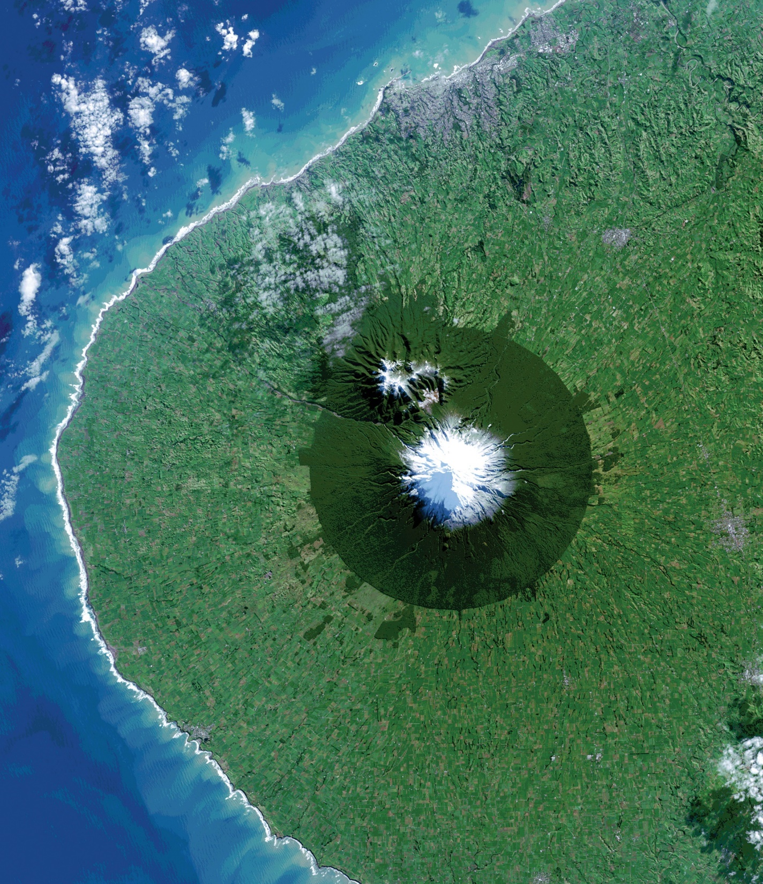
Thank You.
“A place for everything and everything in its place.”
-- Benjamin Franklin --

