Slide 1
CHILE
Disasters
Automating Wildfire Risk and Occurrence Mapping in Google Earth Engine to Improve Wildfire Detection and Response Time Efforts
Maria De Los Santos
Cooper Campbell
Karen Alvarez
Hannah Ferriby
California – JPL
Notes:
Speaker:
This projected was conducted by Maria De Los Santos (Project Lead), Cooper Campbell, Karen Alvarez, Hannah Ferriby remotely at the Jet Propulsion Lab (JPL) node. We automated our partner current wildfire detection system, produced fire risk and fire anomalies maps to help partner identify where wildfire risk has changed. We also created a Wildfire Risk Google Earth Engine App to help partners monitor wildfire risk in near-real time, burned area, and wildfire parameter anomalies to inform how monitoring and recovery resources should be allocated.

Slide 2
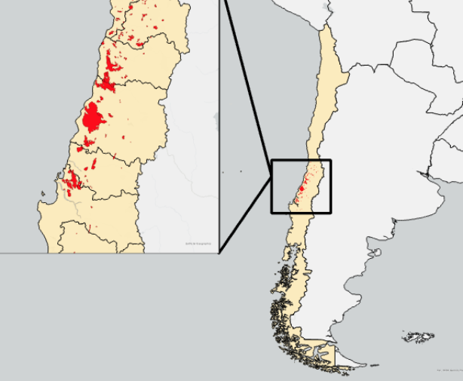
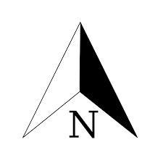
STUDY AREA & PERIOD
Study area included Chile and
surrounding regions of interest
The case study compared model
results with the perimeter of historic fires
Study period of the case study was
the record-breaking 2017 fire season
Bolivia
Brazil
Chile
Paraguay
Argentina
Uruguay
0 60 120 240 Km
National boundary of Chile
Perimeter of 2016-2017 wildfires
in Central Chile
0 300 600 1,200 Km
Notes:
Speaker Notes:
The study area of the Google Earth Engine model included the entirety of Chile and surrounding regions that are significant to Corporación Nacional Forestal (CONAF’s) decision making and have been included in their past analyses of recent years.
The case study to evaluate the accuracy of the model compared the output of the GEE model with CONAF's ancillary data of historic fire perimeters.
The study period of this case study focused upon the 2016-2017 season wildfires, which were abnormally severe and greatly affected the Maule Region of Central Chile. The model itself is capable of producing predictions up to 9 days in advance using near real-time meteorological data.
World Imagery Basemap
Source: Esri, Maxar, GeoEye, Earthstar Geographics, CNES/Airbus DS, USDA, USGS, AeroGRID, IGN, and the GIS User Community

Slide 3
OBJECTIVES
placeholder
placeholder
placeholder
Generate an automated workflow to improve wildfire predictive models and reduce human error and uncertainties
Incorporate NASA Earth observations to compare and evaluate methods for identifying wildfires and burned areas.
Derive a set of fire severity and estimated burned area maps from an automated workflow
Notes:
Speaker
The overarching goal of the project was to support partners’ current disaster monitoring and response through remote sensing analysis and training materials.
Within this framework, the project had three objectives:
First, we generated an automated workflow to improve wildfire predictive models in order to reduce human error and uncertainties.
Second, we incorporated NASA Earth Observations to compare and evaluate methods for identifying wildfires and burned areas. I think the second one its good.
Finally, we derived a set of fire severity and estimated burned area maps from an automated workflow
-------------------------Image Information Below-------------------------
Microsoft Powerpoint Icons

Slide 4
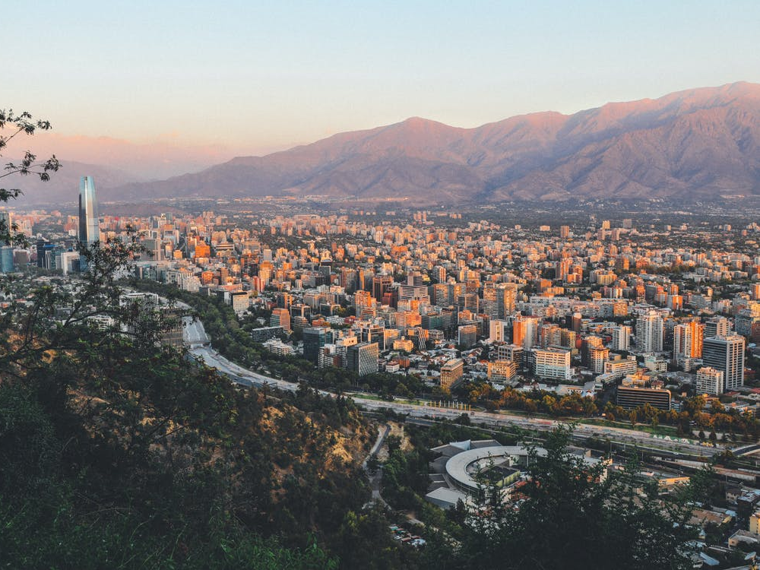
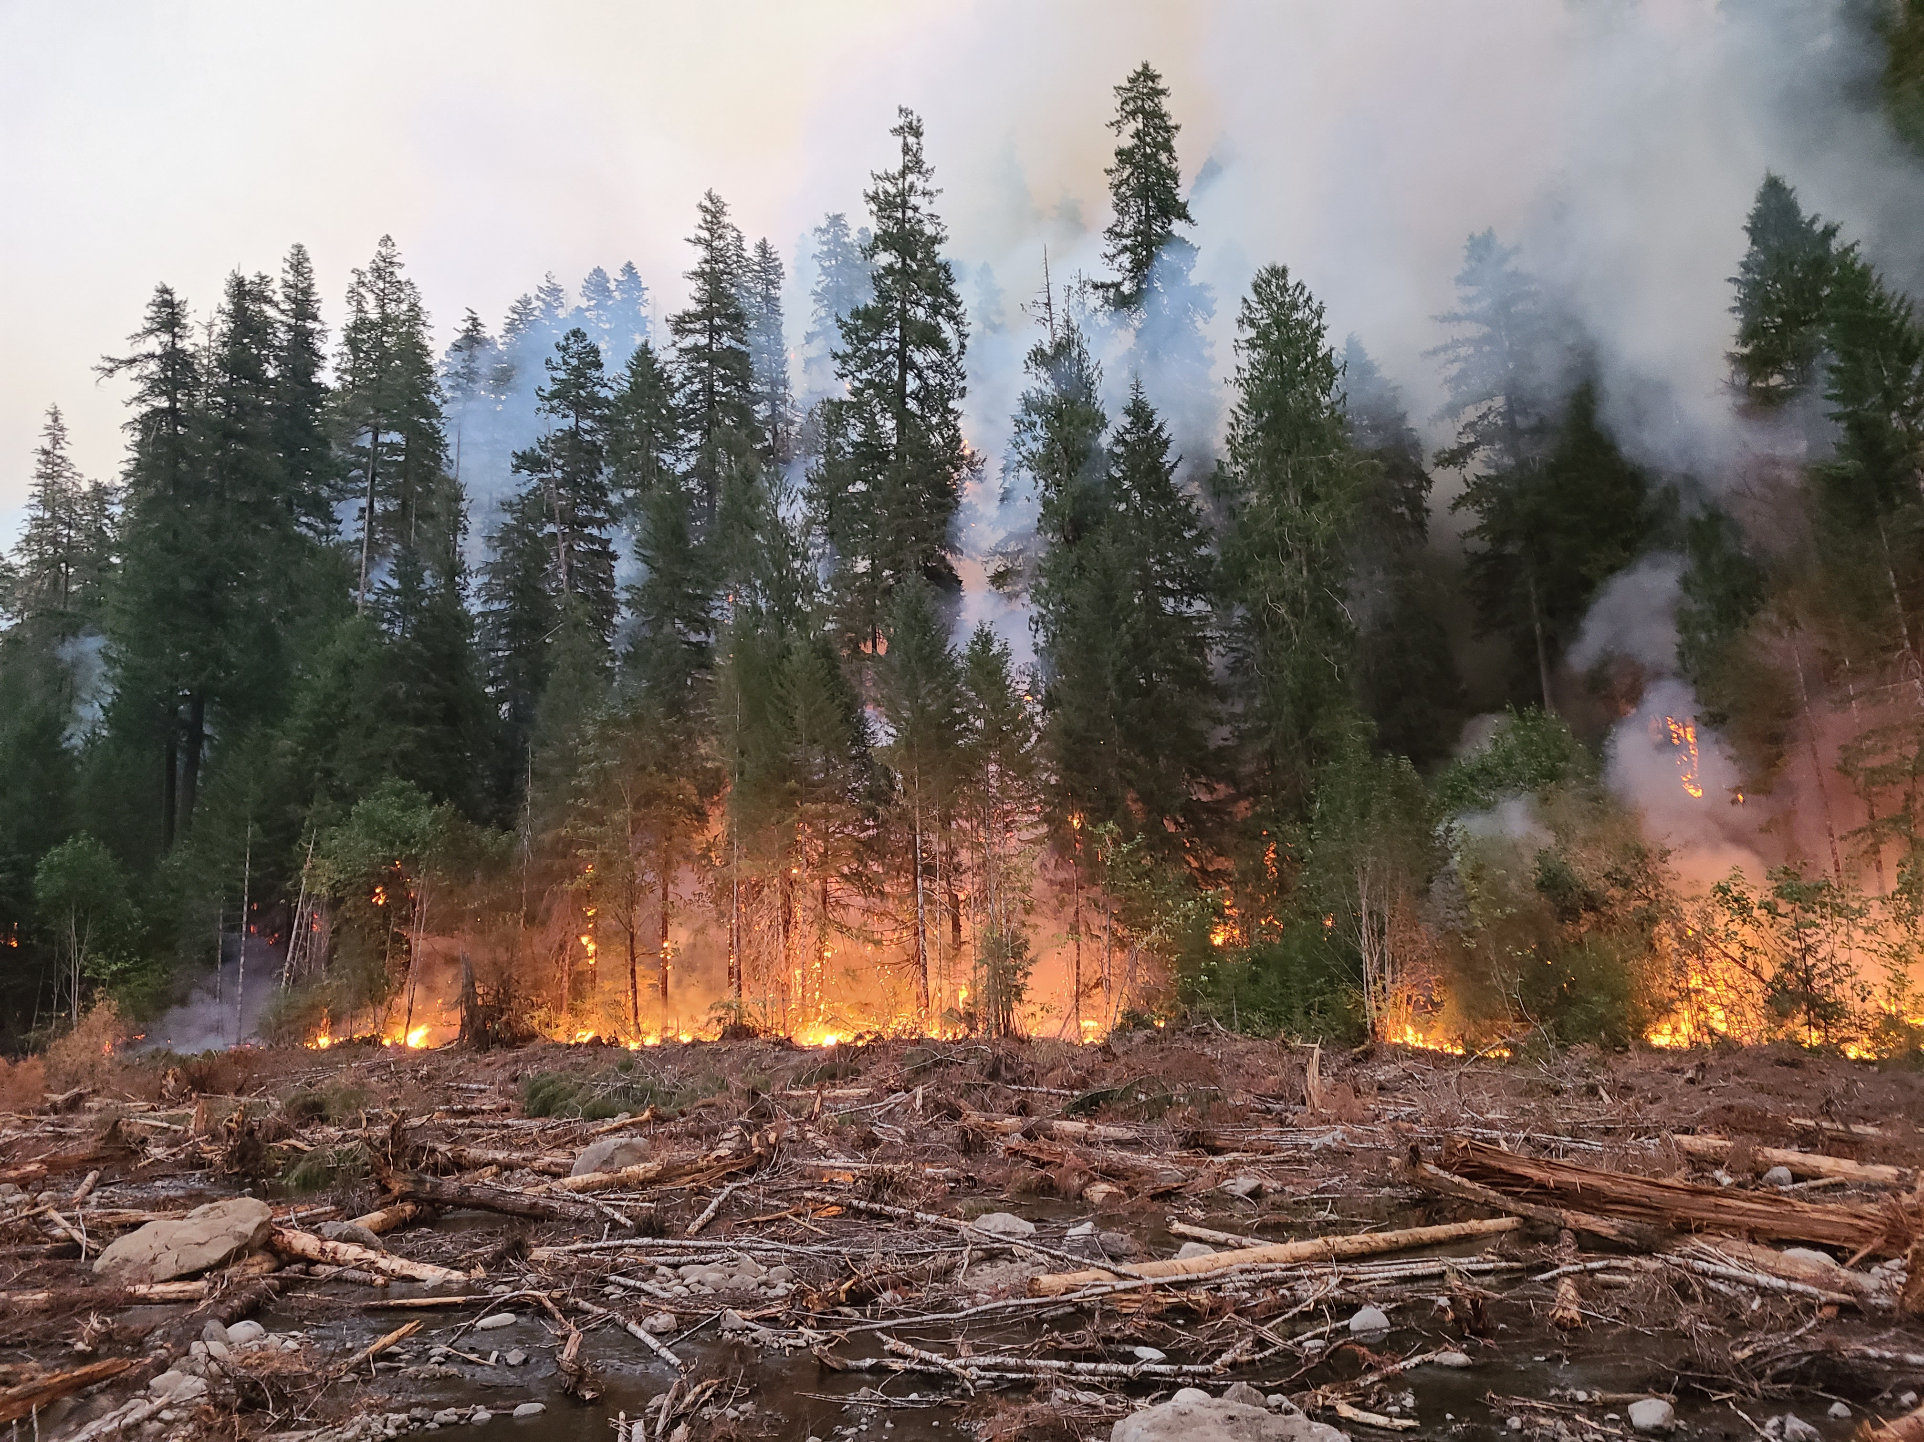
PARTNERS
Image Credit: Alisha Lubben, Pexels
Image Credit: Cooper Campbell
Embassy of Chile
Corporación Nacional Forestal (CONAF)
Notes:
Speaker notes: Our two partners for this project are the Embassy of Chile and Corporación Nacional Forestal (CONAF). The Chilean embassy assisted in facilitating the connections for the project. CONAF is a private, non-profit that aims to sustainably manage and protect Chile’s forest resources, which includes wildfire management. The non-profit focuses on sustainable management of forests and are concerned with the rise of wildfires within the country. CONAF requested our team to improve upon one of their fire risk models in order to further their forest management mission.
-------------------------Image Information-------------------
right photo credit: Cooper Campbell, Chile Disasters team
Left Photo credit: Alisha Lubben
Left photo source: https://www.pexels.com/photo/aerial-photography-of-city-near-mountain-2017747/ - free to use license thru Pexels

Slide 5
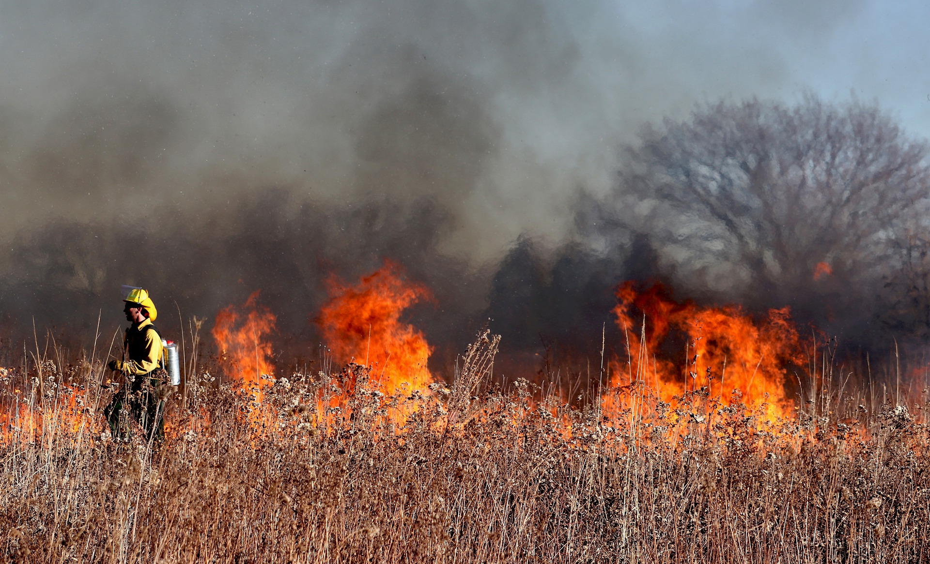
COMMUNITY CONCERNS
Identify
Identify areas prone to wildfires
Monitor
Monitor populated and rural areas
Plan
Plan sustainable fire management strategies
Reduce
Reduce the cost of monitoring fires within Chile
Inform
Inform disaster and safety management
Image Credit: terski, Pixabay
Notes:
Speaker Notes:
In 2017, Chile experienced the worst wildfire season on record. Due to the increased frequency and severity of wildfires, proper management and preparation is required. The partners brought these main community concerns regarding monitoring, management and prevention of wildfires within Chile: Identify, monitor, plan, reduce and inform. In order to protect and conserve Chile's biodiversity, communities and ecosystems, it is important to identify and accurately monitor populated and fire vulnerable areas.
It is vital to understand the relationship between fire occurrence and climatic conditions in the region. Identifying areas prone to wildfires over large regions helped the partners plan sustainable fire management strategies. Ultimately, all of the concerns for identifying, monitoring and planning are related to what is financially possible. Preliminary studies such as these could help reduce the cost and identify target zones for future studies. One final concern was regarding safety responses and disaster management for severe fires.
-------------------------Image Information Below-------------------------
Image Credit: terski, Pixabay
Image Source: Pixabay under "Free to use" license - https://pixabay.com/photos/firefighter-fire-flames-smoke-burn-5799151/

Slide 6
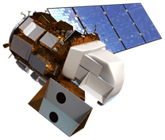
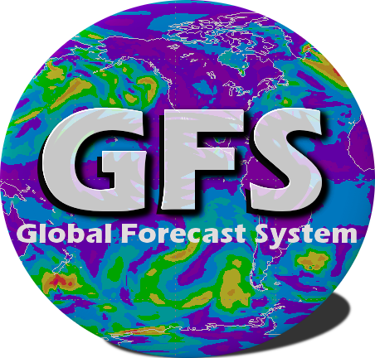
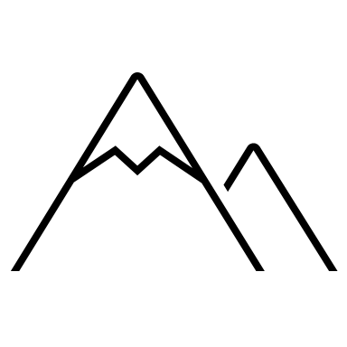
EARTH OBSERVATIONS
Landsat 8 OLI
STRM
Wind
%
Temperature
Relative Humidity
Surface Reflectance
Elevation
Image credit: NASA, NOAA
Notes:
Speaker Notes:
We utilized Landsat 8 Operational Land Imager (OLI) data for surface reflectance Shuttle Radar Topography Mission (SRTM) data for elevation. We also used the Global Forecast System (GFS) for temperature, wind, and relative humidity.
-------------------------Image Information Below-------------------------
Satellite images
Image Credit: NASA
Image source: http://www.devpedia.developexchange.com/dp/index.php?title=List_of_Satellite_Pictures
License: Public Domain (https://www.nasa.gov/multimedia/guidelines/index.html)
Icons
Image credits: PowerPoint Icons
Surface Reflectance Icon Created by Maria De Los Santos, Chile Disasters Team
GFS Logo
Image credit: NOAA
Image source: https://www.emc.ncep.noaa.gov/emc/pages/numerical_forecast_systems/gfs.php

Slide 7
Model Workflow
Notes:
Speaker Notes:
The next section will focus on the methodology for the automation of CONAF’s workflow.

Slide 8
Input Data
Data Processing
Software
Data Processing
Climatic Variable Layers
Model Outputs
Products
NBR
Calculate dNBR
Temperature
GEE App and code tutorial
Temperature, humidity, and wind
Reclassify interpolated images
Relative Humidity
Google Earth
Engine
Red Flag Warning
Calculate % of probability of ignition
Wind
Elevation
Fire severity and estimated burned area maps
Inverse distance weighted
interpolation
Fine Fuel Moisture Content
ArcGIS Pro
CONAF's historical fires
Icon Credit: Microsoft PowerPoint Icons
Notes:
Speaker Notes:
We utilized several optical Earth observations and additional data to examine wildfires for the case study analysis on Chile wildfires. Multiband temperature, relative humidity and wind layers were created using the Global Forecast System. We used the NASA SRTM digital terrain model at 90 m resolution for elevation. Normalize Burned Ratio (NBR) pre and post-fire imagery and CONAF's historical fires data were used to highlight burned areas and estimate burn severity.
-------------Image Credit----------------
Microsoft PowerPoint Icons

Slide 9
Input Data
Data Processing
Software
Data Processing
Climatic Variable Layers
Model Outputs
Products
NBR
Calculate dNBR
Temperature
GEE App and code tutorial
Temperature, humidity, and wind
Reclassify interpolated images
Relative Humidity
Google Earth
Engine
Red Flag Warning
Calculate % of probability of ignition
Wind
Elevation
Fire severity and estimated burned area maps
Inverse distance weighted
interpolation
Fine Fuel Moisture Content
ArcGIS Pro
CONAF's historical fires
Icon Credit: Microsoft PowerPoint Icons
Notes:
Speaker Notes:
The original workflow from CONAF processed the GFS data in ArcGIS Pro. The team recreated the ArcGIS ModelBuilder workflow in Google Earth Engine, with all Earth observations and data layer inputs processed using GEE.
-------------Image Credit----------------
Microsoft PowerPoint Icons

Slide 10
Input Data
Data Processing
Software
Data Processing
Climatic Variable Layers
Model Outputs
Products
NBR
Calculate dNBR
Temperature
GEE App and code tutorial
Temperature, humidity, and wind
Reclassify interpolated images
Relative Humidity
Google Earth
Engine
Red Flag Warning
Calculate % of probability of ignition
Wind
Elevation
Fire severity and estimated burned area maps
Inverse distance weighted
interpolation
Fine Fuel Moisture Content
ArcGIS Pro
CONAF's historical fires
Icon Credit: Microsoft PowerPoint Icons
Notes:
Speaker Notes:
NBR is calculated using pre-fire and post-fire images. The post-fire NBR image is subtracted from the pre-fire NBR image to create the differenced (dNBR) image. dNBR can be used for burn severity assessment. All multiband temperature, humidity and wind imagery was interpolated using the inverse distance weighted, reclassified and utilized to calculate the % of probability of ignition.
-------------Image Credit----------------
Microsoft PowerPoint Icons

Slide 11
Input Data
Data Processing
Software
Data Processing
Meteor-ological Variable Layers
Model Outputs
Products
NBR
Calculate dNBR
Temperature
GEE App and code tutorial
Temperature, Humidity, and Wind
Reclassify interpolated images
Relative humidity
Google Earth
Engine
Red Flag Warning
Calculate % of probability of ignition
Wind
Elevation
Fire severity and estimated burned area maps
Inverse distance weighted
interpolation
Fine fuel moisture content
ArcGIS Pro
CONAF's historical fires
Icon Credit: Microsoft PowerPoint Icons
Notes:
Speaker Notes:
Temperature, relative humidity, wind velocity and fine fuel moisture content layers are produced which can then later on be used to create maps and identify Red Flag Warning (RFW) zones.
-------------Image Credit----------------
Microsoft PowerPoint Icons

Slide 12
Input Data
Data Processing
Software
Data Processing
Climatic Variable Layers
Model Outputs
Products
NBR
Calculate dNBR
Temperature
GEE App and code tutorial
Temperature, Humidity, and Wind
Reclassify interpolated images
Relative Humidity
Google Earth
Engine
Red Flag Warning
Calculate % of probability of ignition
Wind
Elevation
Fire severity and estimated burned area maps
Inverse distance weighted
interpolation
Fine Fuel Moisture Content
ArcGIS Pro
CONAF's historical fires
Icon Credit: Microsoft PowerPoint Icons
Notes:
Speaker Notes:
Areas in Chile with a 70% or greater probability of ignition (POI; considered high wildfire risk areas) are classified and mapped as ‘Red Flag Warning' locations.
-------------Image Credit----------------
Microsoft PowerPoint Icons

Slide 13
Input Data
Data Processing
Software
Data Processing
Climatic Variable Layers
Model Outputs
Products
NBR
Calculate dNBR
Temperature
GEE App and code tutorial
Temperature, Humidity, and Wind
Reclassify interpolated images
Relative Humidity
Google Earth
Engine
Red Flag Warning
Calculate % of probability of ignition
Wind
Elevation
Fire severity and estimated burned area maps
Inverse distance weighted
interpolation
Fine Fuel Moisture Content
ArcGIS Pro
CONAF's historical fires
Notes:
Speaker Notes:
The team produced fire severity and estimated burned area maps for the country of Chile. Lastly, the code tutorial and the Fire Risk Location Automated Model (FLAMe) GEE App makes producing files that are vital for our partners much faster and user friendly. Partners can take an area of interest along with GFS data and output red flag warning much faster than before.
-------------Image Credit----------------
Microsoft PowerPoint Icons

Slide 14
Results
Notes:
Speaker Notes:
The next section will focus on the results of our automated model

Slide 15
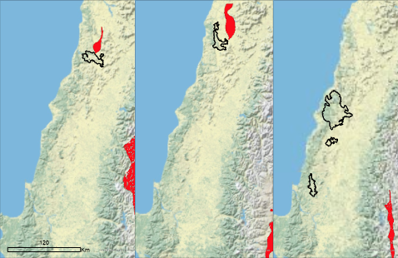
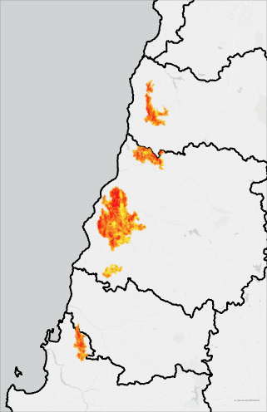
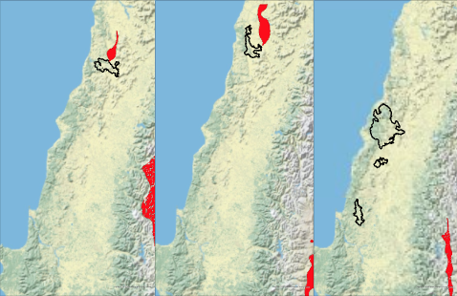
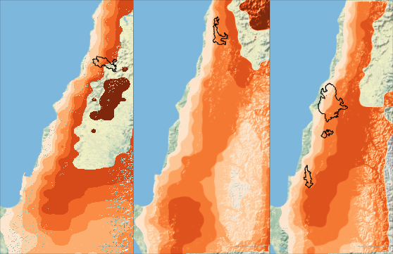
Day 1
1/14/2017
Day 4
1/17/2017
Day 7
1/20/2017
RESULTS
>1.5 Difference
Normalized
- 0.5 Burn Ratio
Historic fires ignited adjacent to Red Flag Warning areas
Fires began in or near areas of high POI levels
Accuracy decreased with successive days of model forecast
O'Higgins
0 120 240 Km
Maule
v 90% Probability of
Ignition (POI)
10%
Red Flag Warning
Zones
Historic Fire
Perimeters
Ñuble
0 120 240 Km
Bíobío
0 25 50 100 Km
Notes:
Speaker Notes:
The case study fires we selected were the 5 largest fires of the record-breaking 2016-2017 fire season. These fires included the Nilahue Barahona, Las Cardillas, Las Maquinas, Santa Cruz, and San Antonio. They were each larger than 15,000 hectares, with the largest, the Las Maquinas, growing to over 192,000 hectares. All five fires began from 1/14/17 - 1/20/17, and occurred in Central Chile, in the O'Higgins, Maule, and Bío Bío regions. To showcase the intensity of the fires, the team showed the differencedNormalized Burn Ratio within the fire perimeters.
The panel on the right shows the unscaled dNBR given a pre-fire (12/20/2016-1/13/2017) period and a post-fire (2/20/2017-3/28/2017) period. The values range from –0.500 to +1.500 with higher positive values showing more severely burned areas. The top three panels on the left show the “Red Flag” warning zones from our model output (in red) in relation to the perimeter of historic wildfires that began on the same day, which are outlined in black. The bottom three panels on the left show the model output of Probability of Ignition (POI), once again in relation to historic fire perimeters beginning on the same respective date outlined in black.
Our model yielded a shapefile of areas forecasted for a 'red flag' warning. To evaluate accuracy, the team performed a case study by comparing red flag warning results with the confirmed perimeter of historic fires that fell within the period that the model created warning maps for. By running the model with input data set to 1/13/17, the team compared Days 1, 4, and 7 of model results with fires that ignited on Jan. 14th, 17th, and 20th, respectively. These maps were analyzed to identify instances of accurately predicted fires using the system. Additionally, we compared historic fire perimeters with the POI outputs from the model.
The team observed that ignitions occurred proximate to calculated Red Flag Warning zones on Days 1 and 4. On all days, fires occurred in and near areas showing higher POI levels. Additionally, proximity of fires to Red Flag Warning zones decreased in later days of model calculations.
Basemap: USA Topographic Map (USGS)

Slide 16
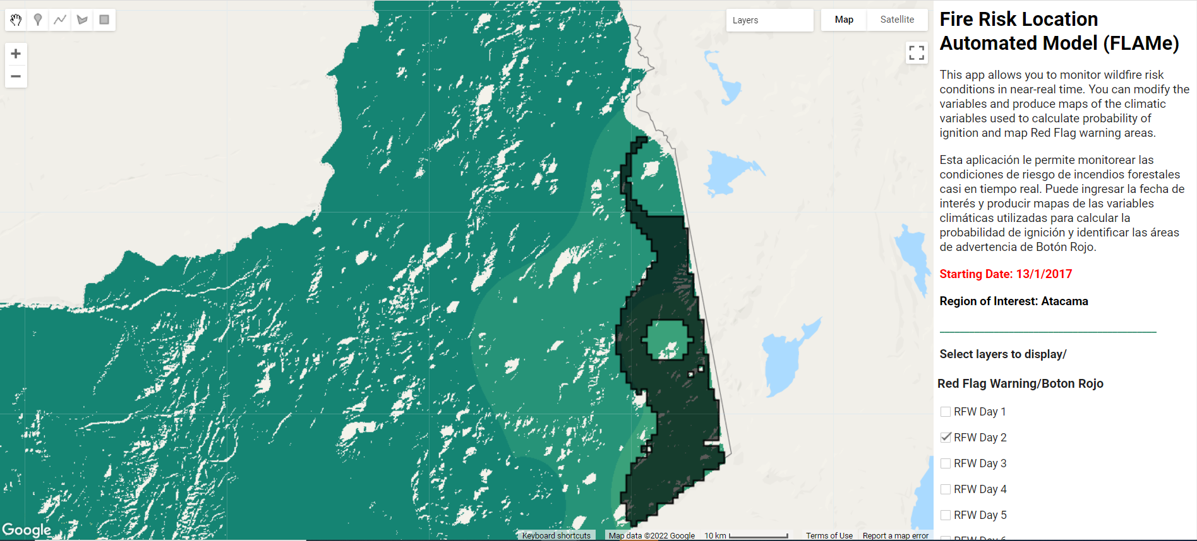
Fire Risk Location Automated Model (FLAMe) GEE App
Notes:
Speaker Notes:
Here is a screenshot of what the final FLAMe application looks like. This application was designed for CONAF to be able to share their wildfire conditions data for a wide audience. Within this application, the user can select RFW, POI, fine fuel moisture code (FFMC), wind velocity, temperature, relative humidity, and NBR layers for the region of interest and specific dates. The region and dates are chosen by the developer, or CONAF, within the code itself. The application is currently showing a RFW zone in northeast Atacama in Black. Beneath that layer is the POI layer in green. The lighter the green color, the higher the POI.

Slide 17
CODE TUTORIAL
Written document containing the workflow for the Fire Location Risk Automated Model (FLAMe)
Goal: Give partners the capacity to replicate these analyses for future fire events
Notes:
Speaker:
A code tutorial was also produced as part of this project. The code tutorial contains a written tutorial that describes the workflow for the FLAMe model. The ultimate goal of the tutorial is to give our partners the capacity to easily replicate these analyses for fire flood events by using open sources such as Google Earth Engine (GEE).
-------------------------Image Information Below-------------------------
Image Credit: Microsoft PowerPoint Icon

Slide 18
ERROR & UNCERTAINTY
Day 1 (January 14, 2017)
Minor fire intersection with RFW
30-80% POI zones
Day 4 (January 17, 2017)
No fires reported within RFW zones
60-70% POI zones
Day 7 (January 20, 2017)
No fires reported within RFW zones
20-70% POI zones
Notes:
Speaker notes:
We compared the FLAMe red flag warning (RFW) predictions to where fires broke out in central Chile in 2017. On the first day of prediction, the RFW did predict where some of the fire was, but it was a very small area. The POI for the fire location ranged from 30 to 80%.
On the 4th day, the RFW area did not contain any fires, but was close in proximity to where the fires occurred. The POI for where the fire was located had a much smaller range between 60-70%.
On the 7th and last day of comparison, we also did not see any fires within our RFW zones and the POI at the fire location ranged from 20-70%.
-------------------------Image Information Below-------------------------
Image Credit: Microsoft PowerPoint Icon

Slide 19
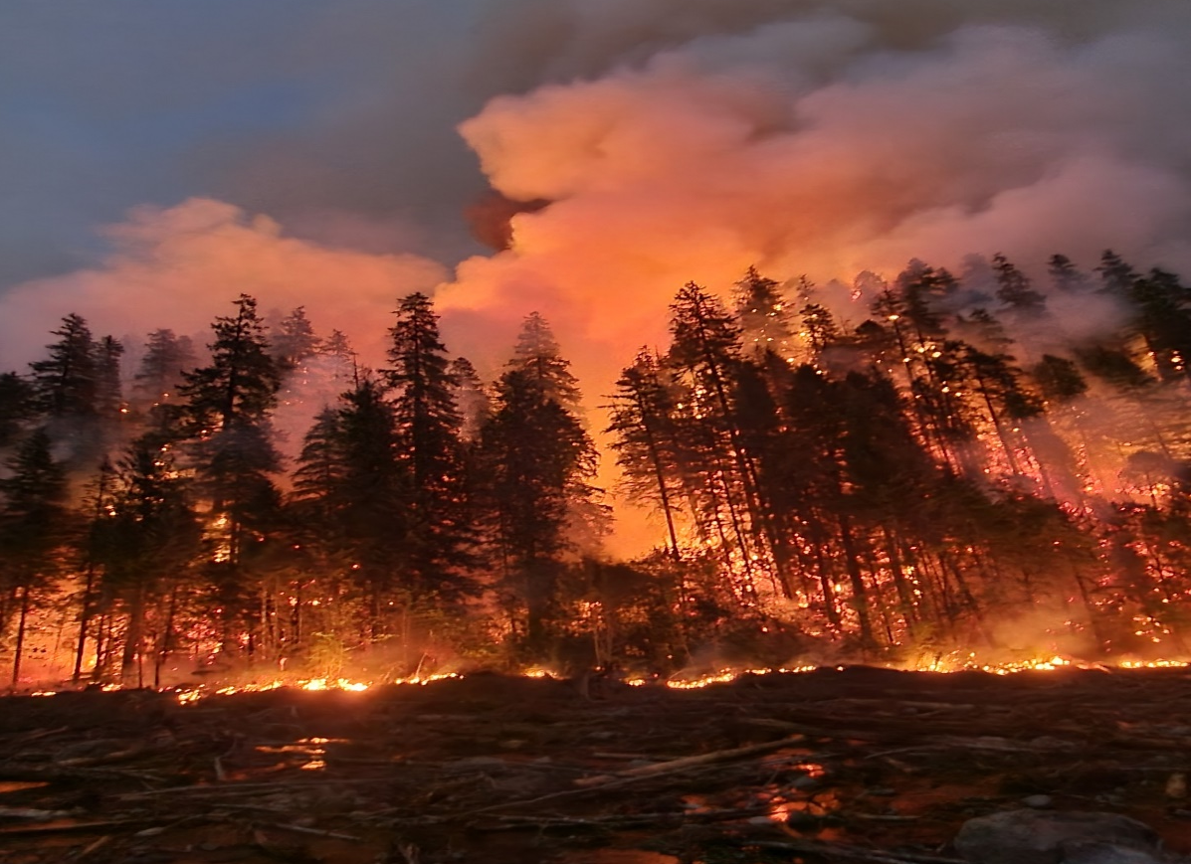
CONCLUSIONS
The team successfully encoded CONAF’s model in GEE, providing the partners with a single script that outputs all their data faster than before.
The FLAMe App will allow the partners to share their data with ease to non-GEE users.
Results from this project can help identify vulnerable locations of potential wildfires-prone areas
The project’s results could increase fire resiliency in other countries outside of Chile who also face wildfire issues
Image credit: Cooper Campbell
Notes:
Speaker:
By using a combination of Earth observation data and in-situ data, the team was able to map wildfire risk and fire perimeters in near-real time to improve wildfire prevention and response time efforts. The team encoded the entirety of the model in GEE, providing the partners with a single script that outputs all their data faster than before. CONAF’s model takes about 3-4 months to prepare all the datasets needed for fire monitoring. The GEE script takes only about 10 minutes to output all the layers.
We observed that these methods improved partners’ ability to monitor wildfire conditions and captured fire risk, occurrence and severity. We gained confidence through our validation, iterative process and related research that our fire risk and severity maps captured wildfires within the time periods and regions, as hypothesized.
Results from this project could help identify vulnerable locations of potential wildfires-prone areas where partner groups can conduct targeted field campaigns to gather additional validation data.
Moreover, the project’s results could increase fire resiliency in other countries outside of Chile who also face wildfire issues. GEE scripts released for our partners along with detailed methods workflow, may be implemented in a variety of studies and further refined to suit different objectives and datasets.
------------------Image Credit--------------------
Cooper Campbell CD team

Slide 20
FUTURE WORK
Incorporate
Incorporate newer datasets and models to improve fire detection analysis and reduce human error and uncertainties
Adapt
Adapt scripts to improve the accuracy of our model's red flag warning predictions
Complete
Complete a multi-year red flag warning time series analysis
Image Credit: Andres Escalona Vergara, Pexels
Notes:
Speaker Notes:
Results from this project and others like it could help improve wildfire models and highlight fire vulnerable areas for future forest and land management, and environmental monitoring.
Future work should include:
Incorporating newer datasets and models; for example, Sentinel-1 C-SAR data. With its' C-band SAR's increased resolution and temporal coverage, it would be useful when characterizing wildfire risk "detection and analysis" as well as mapping fire perimeter in near real-time.
Adapting the scripts to improve the accuracy of our model's red flag warning predictions
Completing a multi-year red flag warning time series analysis
-------------------------------------------Image Information Below-------------------------------
Image Credit: Andres Escalona Vergara, Pexels
Image Source: Pexels under "Free to use" license - https://www.pexels.com/photo/person-in-water-in-the-middle-of-the-forest-8674366/

Slide 21
Dr. Virginia Iglesias, University of Colorado Boulder
Erica Carcelen, NASA DEVELOP
Benjamin Holt, NASA Jet Propulsion Lab - Caltech
Jorge Saldias, Corporación Forestal Nacional
Jordi Bull, Corporación Forestal Nacional
Fernandez Vasquez, Embassy of Chile
Andres Rodriguez, Embassy of Chile
Patricio Sanhuez, Corporación Forestal Nacional
This material contains modified Copernicus Sentinel data (2016-2017), processed by ESA.
Notes:
Speaker Notes:
We would like to thank you all who helped make this project possible. Thank you for a wonderful term and for this amazing opportunity, it has been an absolute pleasure working with you all.
Muchas gracias a todos, ha sido un placer trabajar con ustedes.

