Slide 1
Arizona
Water Resources
Utilizing Aerial Imagery and NASA Earth Observations to Assess Pinyon-Juniper Tree Mortality in Flagstaff, AZ
Margaret Jaenicke
Anne Britton
Abbi Brown
Liam Megraw
Maryland – Goddard
Notes:
Hello everyone! We are the Arizona Water Resources team: Maggie Jaenicke, Anne Britton, Abbi Brown, and Liam Megraw. For our 10-week long project for NASA DEVELOP, we worked to map widespread pinyon-juniper woodland mortality in Flagstaff, AZ that occurred in 2021. Additionally, this project examined how topographic factors and measurements of water availability may have impacted mortality across the landscape. This presentation will introduce you to our partners and the project, share our methods, and discuss the team's results.
------------------------------Image Information Below ------------------------------
Image Credit: DEVELOP team
Image Source: All images generated by our NASA DEVELOP team

Slide 2
PARTNERS
National Park Service, Flagstaff Area National Monuments
Wupatki National Monument
Mark Szydlo, Biologist
Seeking to better understand pinyon-juniper tree mortality in 2021
Limited use of remote sensing to monitor landscape-scale changes
Image Credit: NPS
Notes:
For this project, we partnered with the National Park Service branch for Flagstaff Area National Monuments. They are a key point in where our research begins. In mid-2021, in the midst of a decades-long ecological and hydrological drought, our partner at Wupatki National Monument began to notice something strange: juniper trees, typically a very drought-tolerant species, were experiencing mass mortality at a landscape scale. And this wasn't only happening in protected areas. News outlets were publishing stories on the phenomena warning homeowners to water trees in their backyards.
Our partners were curious as to why this die-off was occurring, but with only limited time, resources, and remote sensing capabilities, it was a difficult question for them to answer alone.
------------------------------Image Information Below ------------------------------
Image Credit: NPS
Image Source: Create Your Own Park Logo or Arrowhead (U.S. National Park Service) (nps.gov) (Public domain)

Slide 3
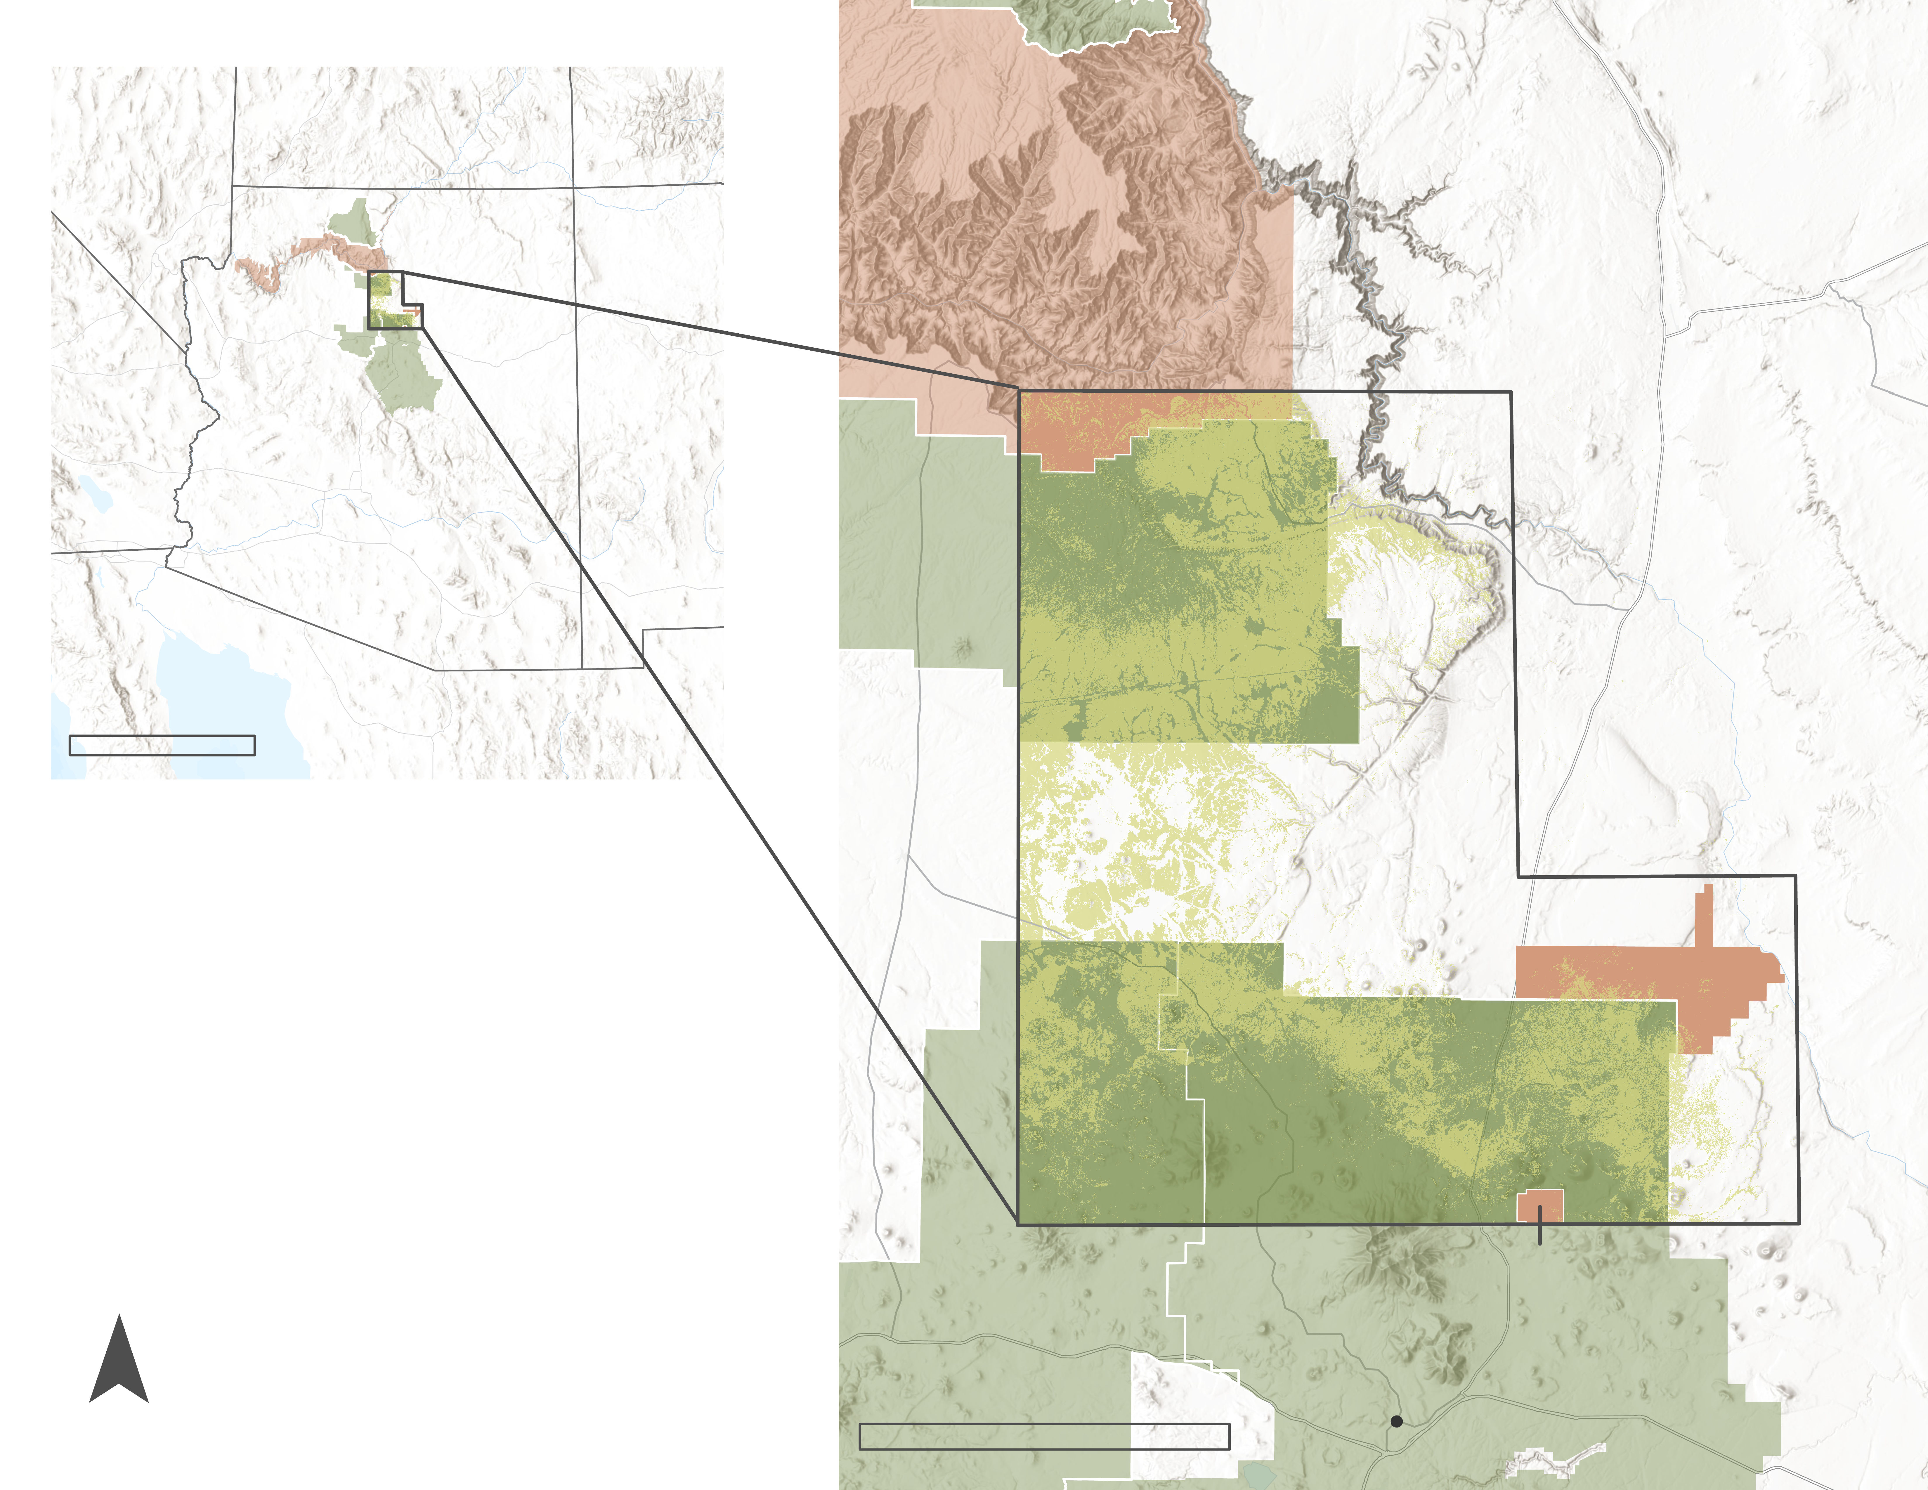
STUDY AREA
4
1.9-million-acre study area near Flagstaff, AZ
Study period: 2015 – 2021
2
A R I Z O N A
0
150
N
Miles
STUDY AREA
JUNIPER EXTENT (LANDFIRE)
3
FOREST SERVICE LAND
1. Coconino National Forest
2. Kaibab National Forest
2
1
NATIONAL PARK SERVICE LAND
3. Wupatki National Monument
4. Grand Canyon National Park
5. Sunset Crater Volcano
National Monument
5
0
300
Flagstaff
Miles
Pinyon-juniper tree experiencing partial mortality.
Image Credit: DEVELOP Team, Basemap: Esri, World Terrain Base
Image Credit: Mark Szydlo
Notes:
In response to our partner's research questions, the team looked at pinyon-juniper woodlands across a nearly 2-million-acre study area in north-central Arizona spanning from Flagstaff to the Southern Rim of the Grand Canyon. Much of the study area is made up of federal land including the National Park Service's Wupatki National Monument, Grand Canyon National Park, and Sunset Crater Volcano National Monument. The United States Forest Service's Coconino and Kaibab National Forests make up a significant portion of the study area as well.
The team's research spanned a study period between 2015 and 2021, pre- and post- mortality event.
------------------------------Image Information Below ------------------------------
Image Credit: DEVELOP team
Image Source: All images generated by our NASA DEVELOP team
Basemap Credit: ESRI, World Terrain Base
Basemap Source: ESRI World Terrain Base
Image Credit: Mark Szydlo
Image Source: Provided by partner with permission to use.

Slide 4
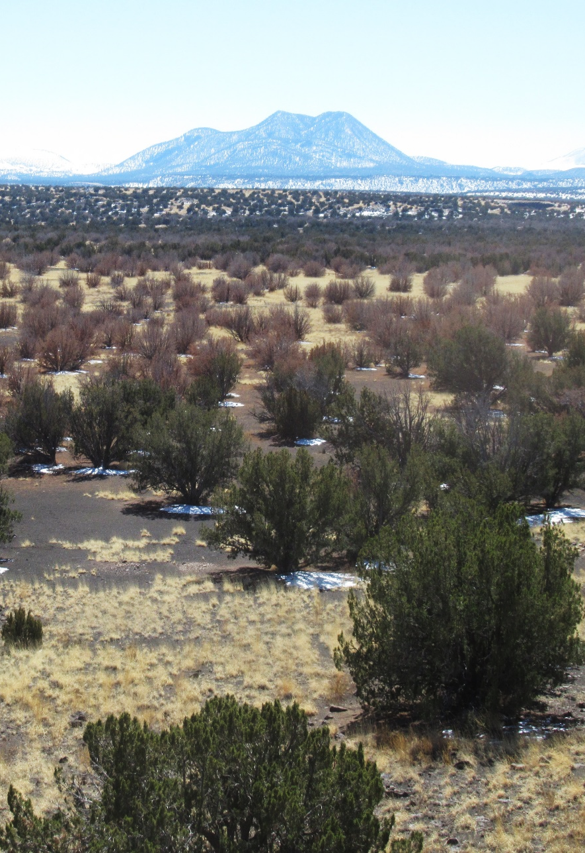
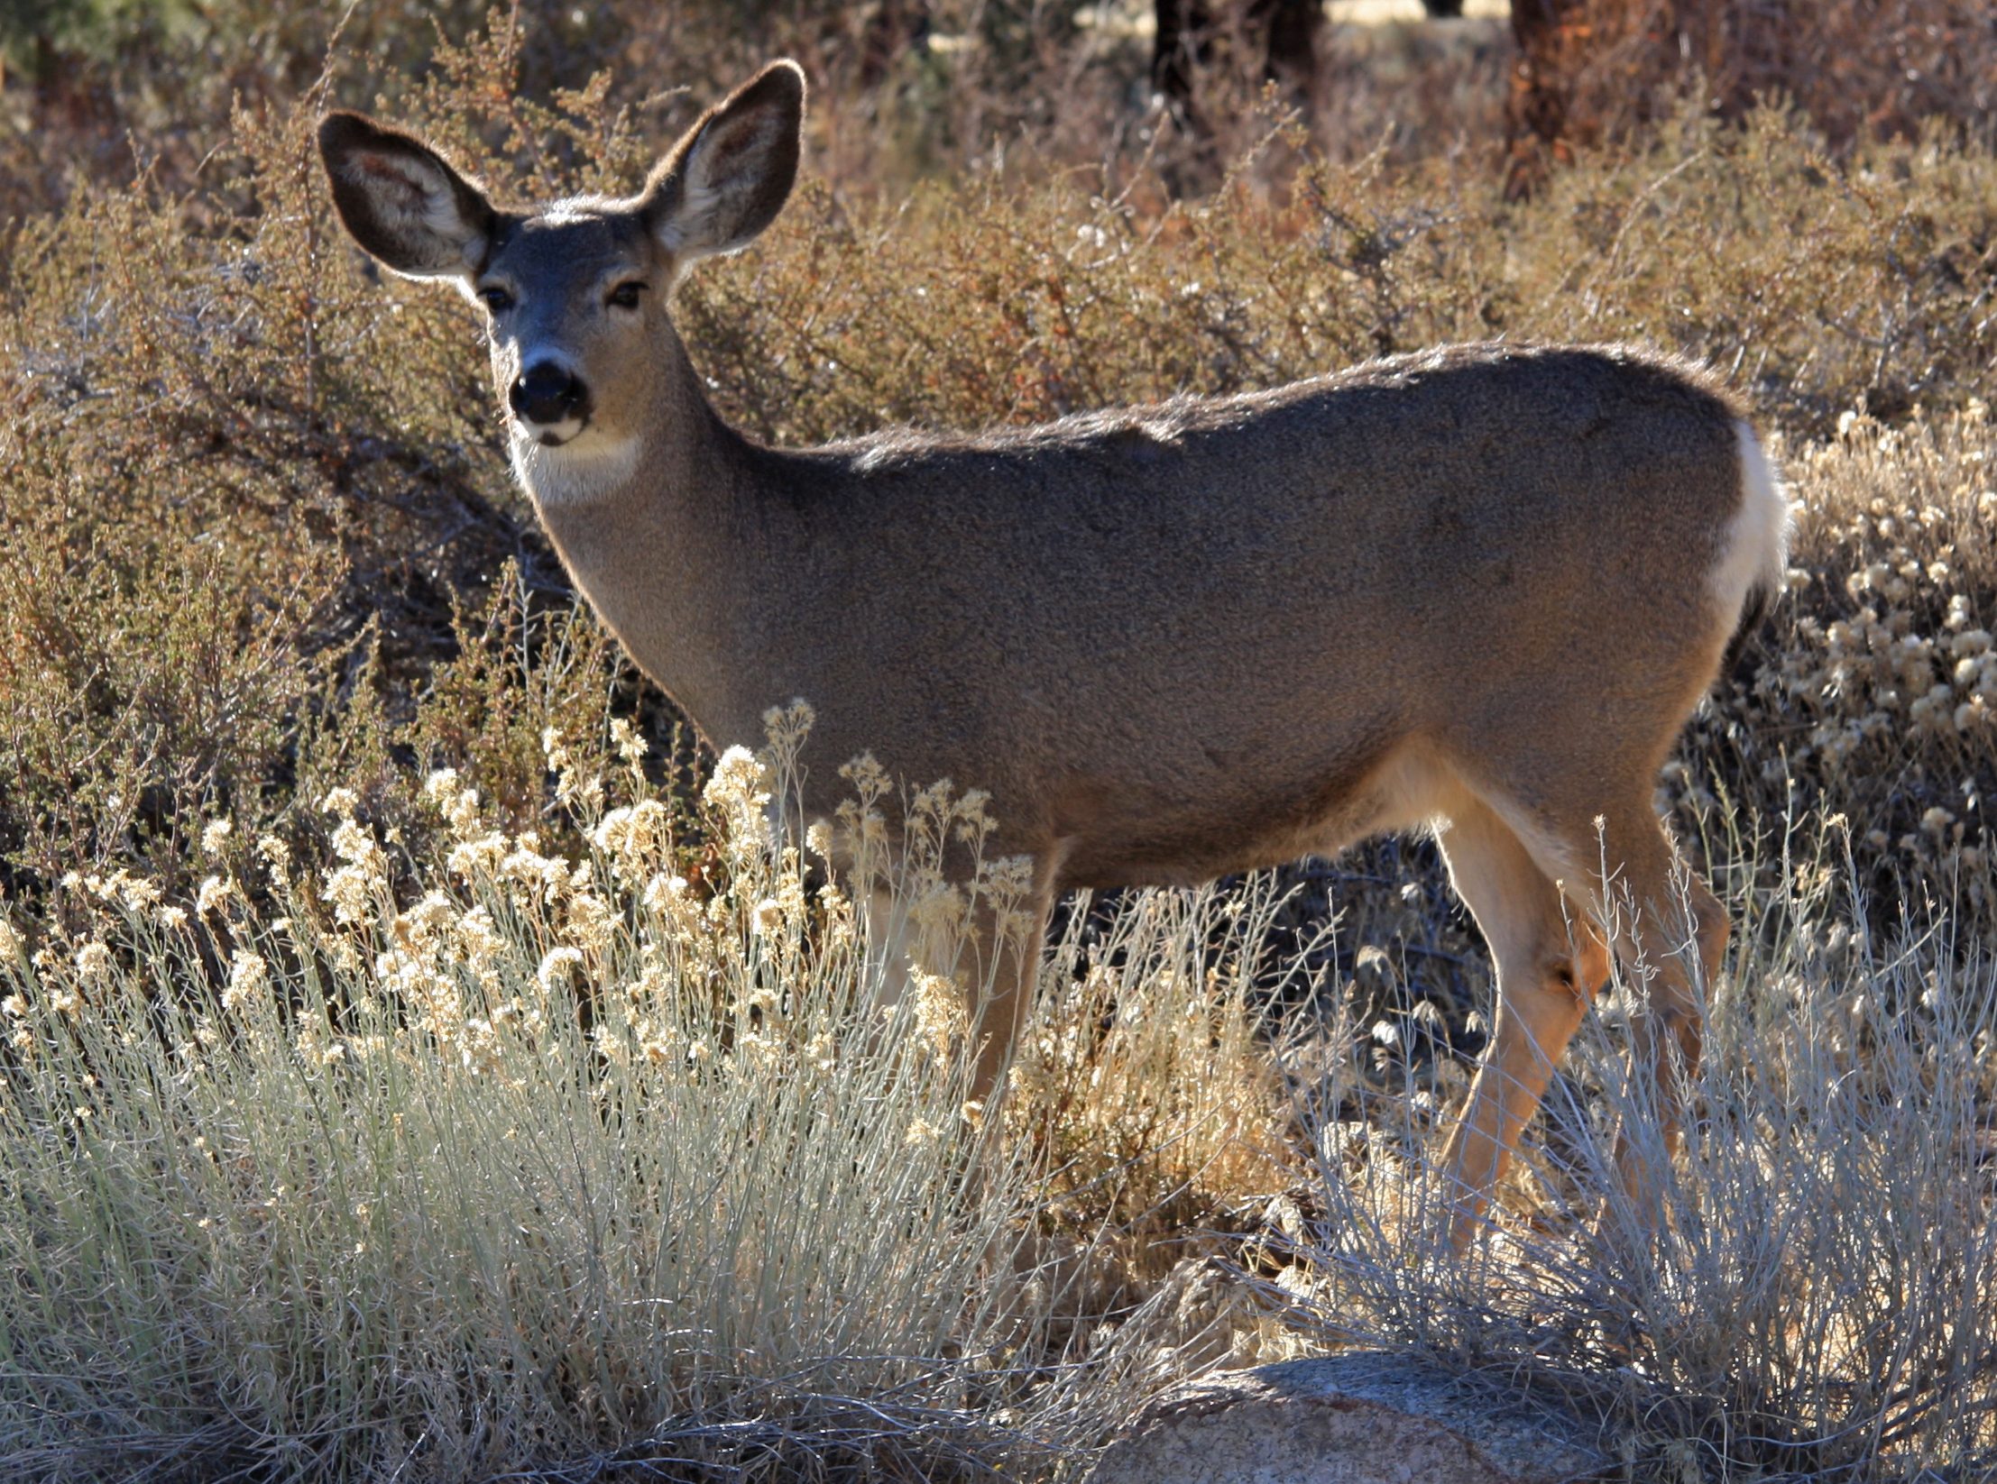
COMMUNITY CONCERNS
Increased wildfire risk to cultural resource sites
Prolonged drought resulting in regional
hydrological and ecological shifts
Drought-related pinyon-juniper mortality across the landscape
Reduction of important habitat for wildlife
Image Credit: Mark Szydlo (left), Mark Szydlo (center), National Park Foundation (top right), Jane Shelby Richardson (bottom right)
Notes:
The drought believed to be causing the mortality has been going on for multiple decades, reducing the water available to trees. This impacts their ability to photosynthesize and makes them susceptible to pests. This is troubling because in total, pinyon-juniper woodlands provide habitat, breeding area, and food sources for nearly 1,000 species, several of which rely exclusively on these woodlands. When stands of trees die, they act as fuel for fires, increasing the risk of damage to Ancestral Puebloan heritage sites.
------------------------------Image Information Below ------------------------------
Image Credit: Mark Szydlo
Image Source: Provided by partner with permission to use.
Image Credit: Mark Szydlo
Image Source: Provided by partner with permission to use.
Image Credit: National Park Foundation
Image Source: Arizona Attractions: Ancient Pueblos in Wupatki | National Park Foundation (nationalparks.org)
Image Credit: Jane Shelby Richardson
Image Source: Mule Deer Doe Backlit | Wikimedia (commons.wikimedia.org)

Slide 5
PROJECT OBJECTIVES
Map and assess extent of pinyon-juniper tree mortality
Evaluate factors including evapotranspiration, climatic, and topographic variables using NASA Earth observation data
Provide partners with a method for continued monitoring and detection of mortality events
Notes:
To help the NPS effectively respond to these concerns in the area, our project set out to answer where and why pinyon-juniper mortality had occurred. Our first objective was to map the extent of pinyon-juniper woodlands and identify where tree mortality was occurring. After knowing where mortality was occurring, we wanted to evaluate factors that might be causing mortality, such as elevation, soil moisture, temperature, and precipitation. Finally, to enable the NPS to effectively use our results and replicate our work, we set out to provide partners with a method for continued monitoring and detection of mortality events.
------------------------------Image Information Below ------------------------------
Image Credit: Icons from PowerPoint

Slide 6
RESEARCH PROCESS
The WHERE
Ancillary Data
Map Pinyon-Juniper Mortality
Map Environmental Factors in ArcGIS
The WHY
NASA Earth
Observations
Plot Time Series of Environmental Factors in Tableau
Statistical Analyses of Mortality and Environmental Factors in R
Notes:
Here is an overview of the process we used to achieve our objectives. National Agricultural Imagery Program (NAIP) data was used to map trees, while NASA Earth observation data was used to relate environmental factors to tree mortality. With these data, we then performed statistical analyses and created timeseries to attempt to discover relationships between environmental factors and mortality.

Slide 7
METHODOLOGY: NAIP IMAGERY
Unsupervised classification with NAIP imagery
Accuracy assessments of land cover classifications
Re-classification with only vegetated classes
Inter-year differencing and mortality accuracy assessment
Percent mortality calculations
2015 Base
Imagery
2015 Classified
Image
Differenced Mortality
2021 Base
Imagery
2021 Classified
Image
Image Credit: DEVELOP Team
Notes:
To map forests, we used imagery from the National Agricultural Imagery Program (NAIP), a high-resolution airborne data product from the USDA. Using a "bookend" approach, we performed an unsupervised classification on two color infrared NAIP images of our study area, one from 2015 and one from 2021, post-mortality event. Through this process, pixels with common characteristics are automatically grouped together to form different “classes” within an image. Because NAIP is high resolution imagery, we were able to identify pinyon-juniper stands at a per-tree level.
To test the performance of the classification, we visually assessed 240 points equally split between classes for both the 2015 and 2021 imagery. Following this, we determined where mortality was occurring by subtracting the 2015 pinyon-juniper classification from the 2021 classification. An accuracy assessment of mortality was then performed on this "difference" map. Our team proceeded to use ArcPro to generate spatially explicit maps of percent mortality. We also used R to calculate the spatially implicit percent of juniper trees that had experienced mortality between 2015 and 2021.
------------------------------Image Information Below ------------------------------
Image Credit: DEVELOP team
Image Source: All images generated by our NASA DEVELOP team

Slide 8
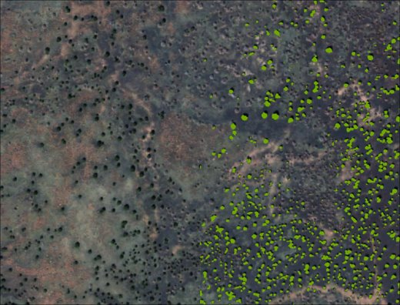
RESULTS: ACCURACY ASSESSMENT
82% accuracy for 2015 landcover classification
73% accuracy for 2021 landcover classification
89% accuracy for differenced mortality in high probability areas*
Image Credit: DEVELOP Team
*Areas excluding burn areas and mixed pinyon-juniper ponderosa forests
Notes:
We were pleased with the accuracy of our classifications, with the 2015 classification resulting in an 82% accuracy and the 2021 classification resulting in a 73% accuracy. Additionally, the mortality accuracy assessment was performed on areas specifically determined to have a high probability of pinyon-juniper land cover, excluding burn areas and mixed pinyon-juniper ponderosa forests. This assessment resulted in an accuracy of 89%.
------------------------------Image Information Below ------------------------------
Image Credit: DEVELOP team
Image Source: All images generated by our NASA DEVELOP team

Slide 9
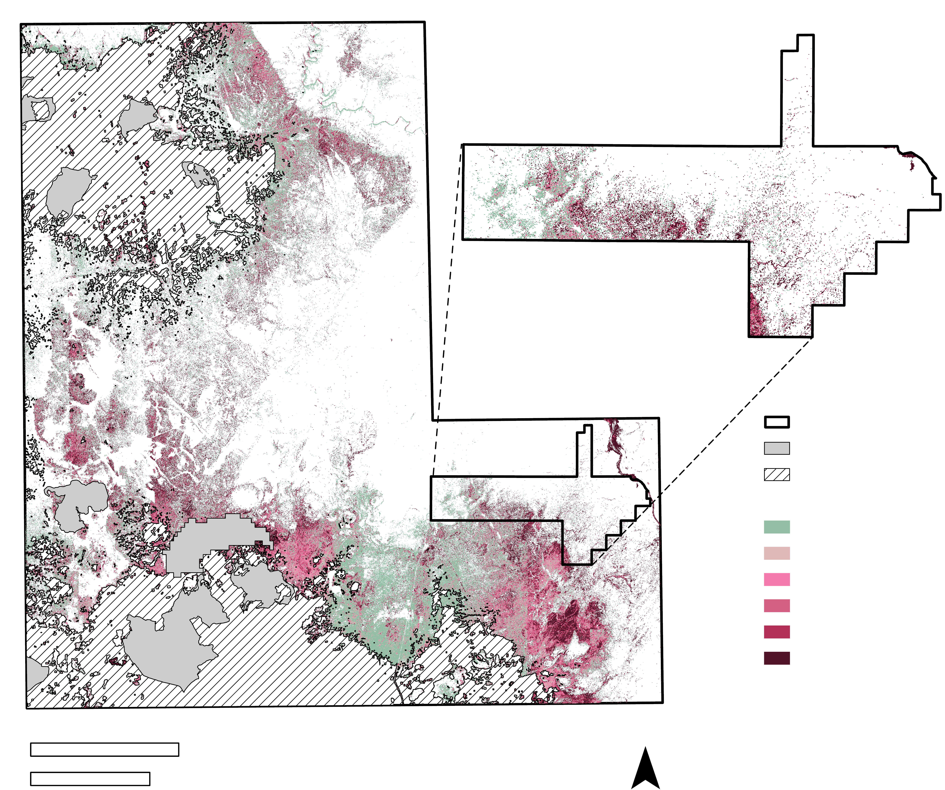
RESULTS: PINYON-JUNIPER MORTALITY
43% mortality in high probability areas*
47% mortality in Wupatki National Monument
Wupatki National
Monument
Study Areas
Wildfire
Low Prob. Areas
Mortality
No Mortality
1 – 20%
20 – 40%
40 – 60%
60 – 80%
80 – 100%
0
25
N
*Areas excluding burn areas and mixed pinyon-juniper ponderosa forests
Kilometers
Miles
0
10
Image Credit: DEVELOP Team
Notes:
The map on the right shows our spatially explicit data mortality data. The percentage of tree mortality is shown in shades of purple, while stands with no mortality are shown in green. White areas are those that did not contain any living or dead stands of pinyon-juniper trees in either 2015 or 2021. Spatially, mortality was widespread across stands in the study area, with some areas having upwards of 80-100% mortality according to our classification.
Additionally, spatially implicit calculations of mortality in R found that 43% of 3m² pixels classified as pinyon-juniper in 2015 showed mortality in 2021 within high probability pinyon-juniper areas. In Wupatki National Monument, 47% of 3m² pixels previously classified as pinyon-juniper in 2015 showed mortality in 2021.
------------------------------Image Information Below ------------------------------
Image Credit: DEVELOP team
Image Source: All images generated by our NASA DEVELOP team

Slide 10
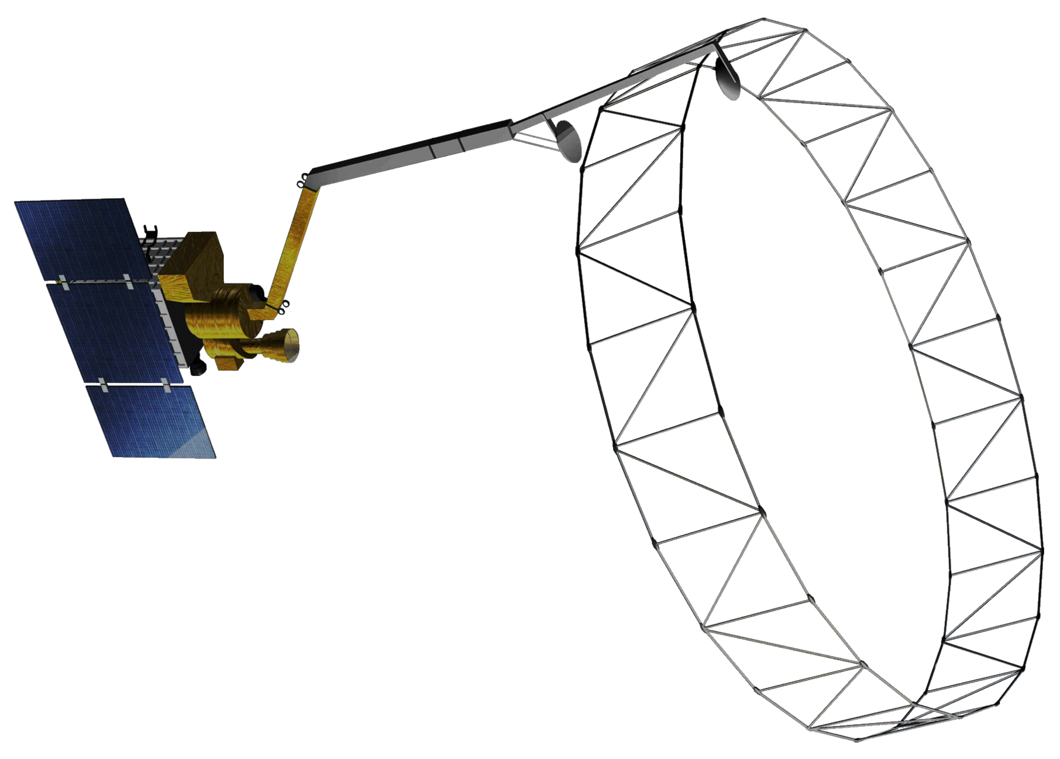
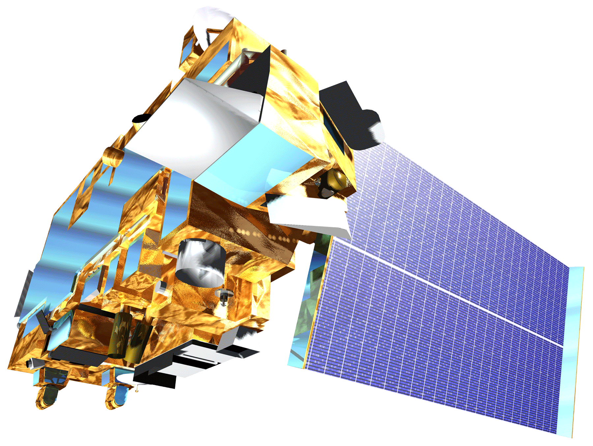
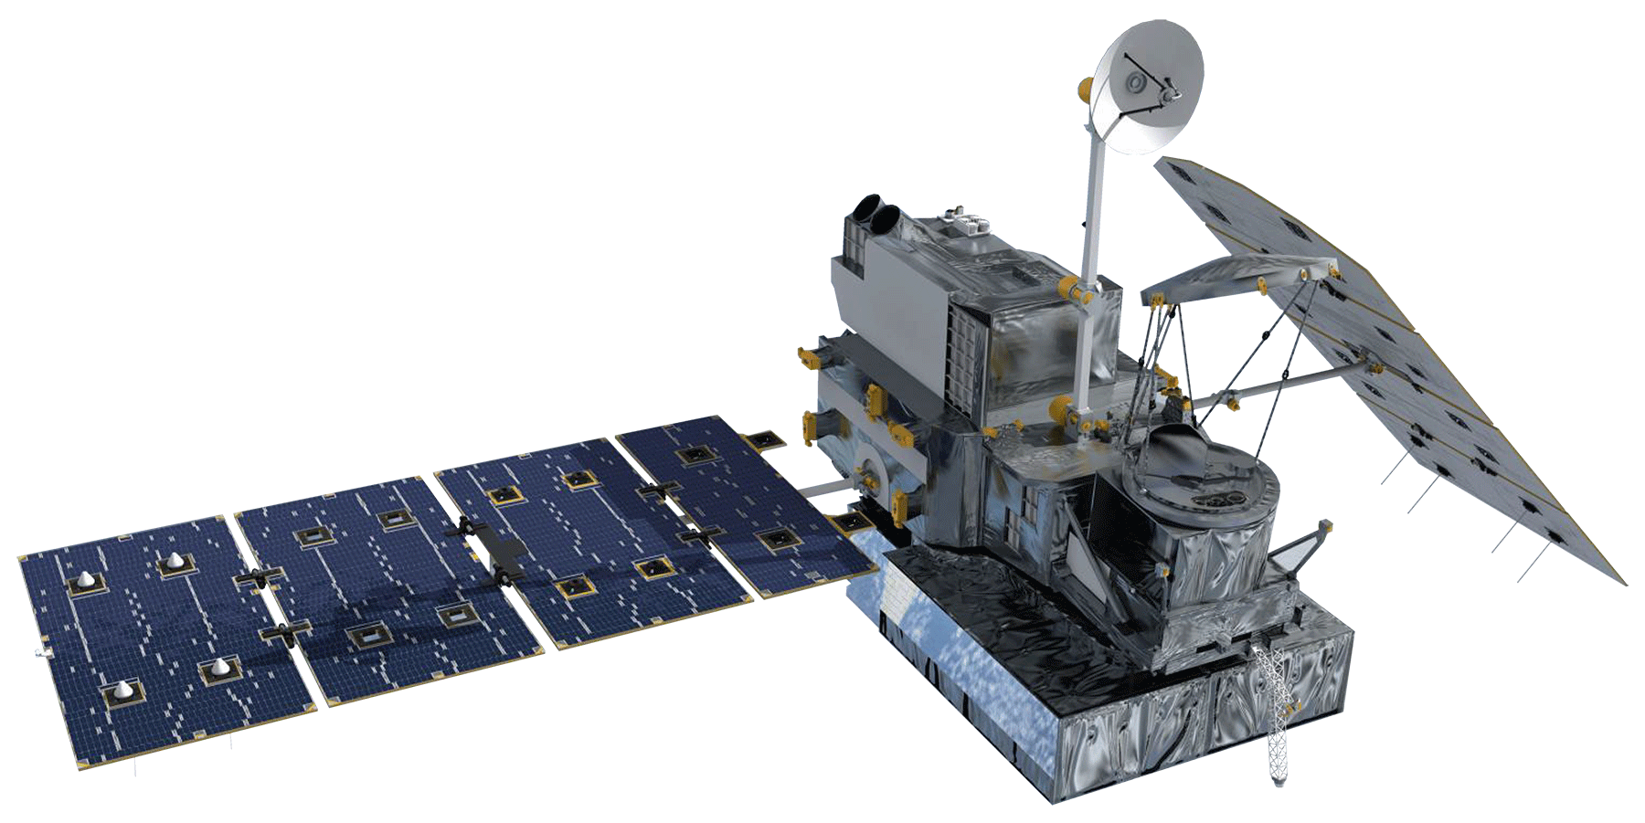
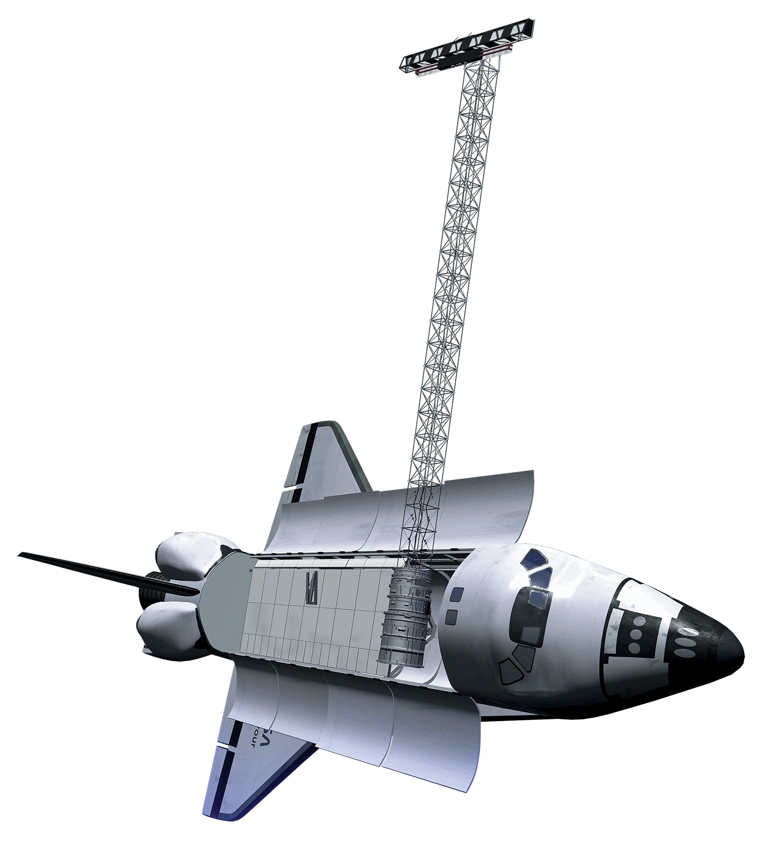
METHODOLOGY: NASA SATELLITES & SENSORS
METHODOLOGY: NASA SATELLITES & SENSORS
SMAP
GPM IMERG
Terra MODIS
SRTM
Landsat 8 OLI & TIRS
Image Credit: NASA
Notes:
After determining where mortality was occurring across the study area in 2021, our team turned to investigating the why of mortality. We utilized a wide variety of NASA satellites and sensors. These 5 satellites and sensors provided our team with data for topographical features such as slope, elevation, and aspect, as well as monthly precipitation, soil moisture, evapotranspiration, and land surface temperature for our study area. These instruments provided the necessary datasets to determine the influence of these environmental variables on pinyon-juniper mortality when combined with the classified NAIP imagery.
------------------------------Image Information Below ------------------------------
Image Credit: DEVELOPedia
Image Source: 03 Landsat8 - List of Satellite Pictures - DEVELOPedia (developexchange.com)
Image Credit: DEVELOPedia
Image Source: 05 Terra - List of Satellite Pictures - DEVELOPedia (developexchange.com)
Image Credit: DEVELOPedia
Image Source: 08 GPM - List of Satellite Pictures - DEVELOPedia (developexchange.com)
Image Credit: DEVELOPedia
Image Source: 12 SRTM - List of Satellite Pictures - DEVELOPedia (developexchange.com)
Image Credit: DEVELOPedia
Image Source: 20 SMAP - List of Satellite Pictures - DEVELOPedia (developexchange.com)
Image Credit: NASA Earth Observatory
Image Source: NASA Goddard Space Flight Center Flickr

Slide 11
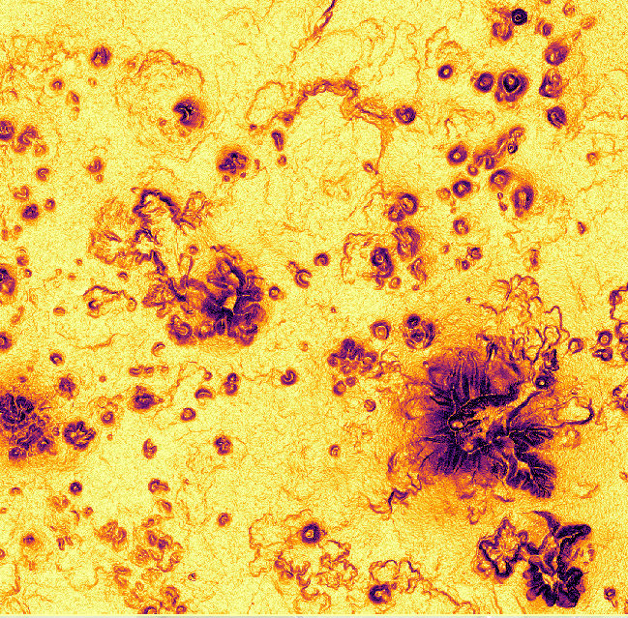
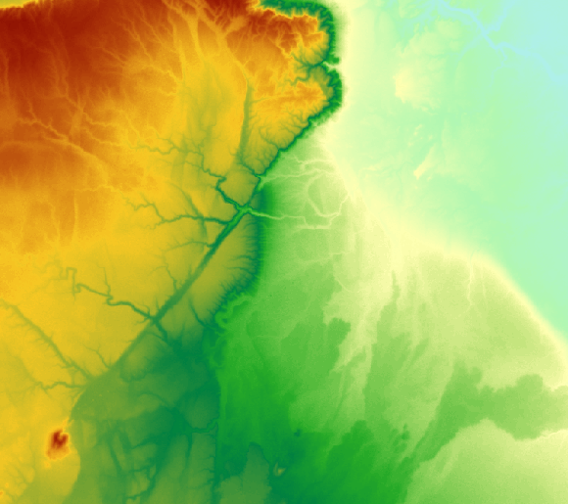
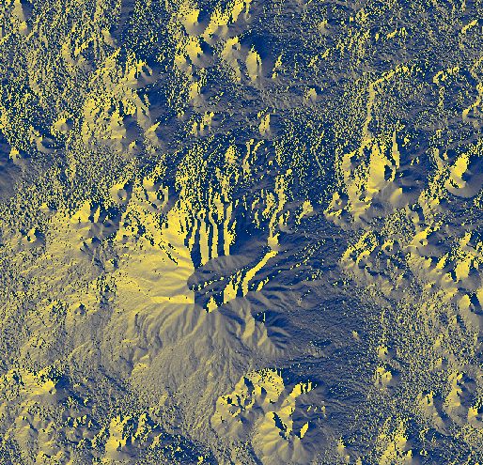
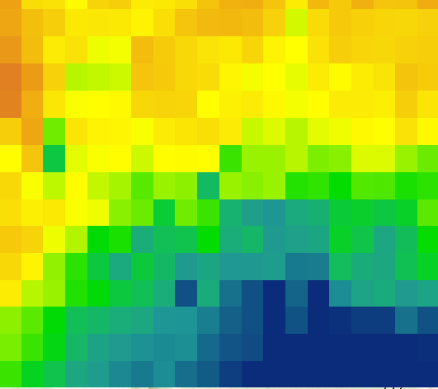
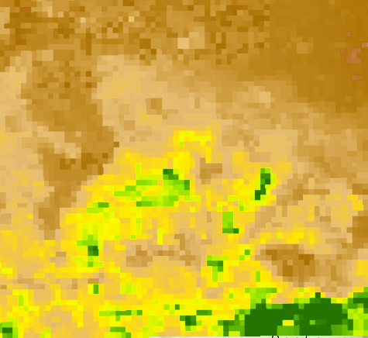
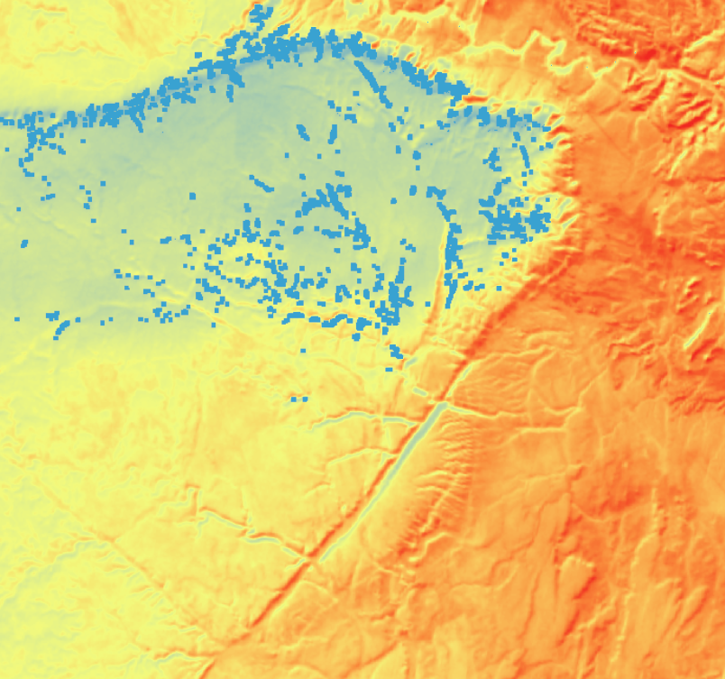
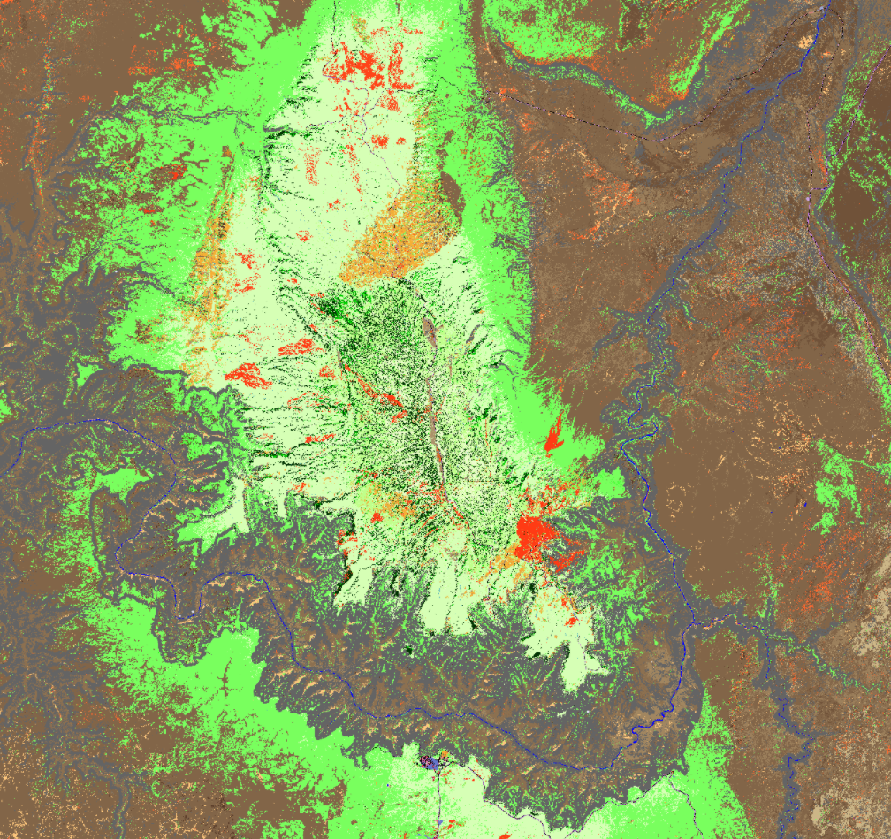
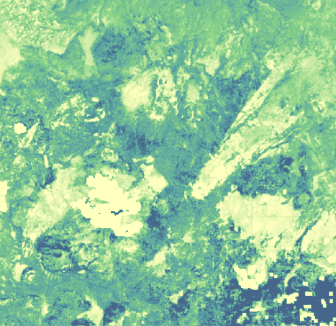
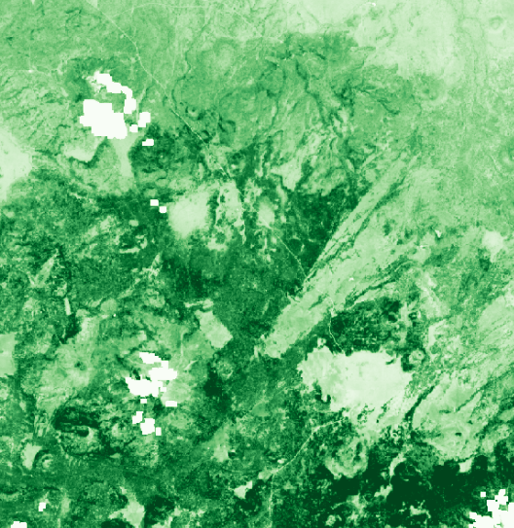
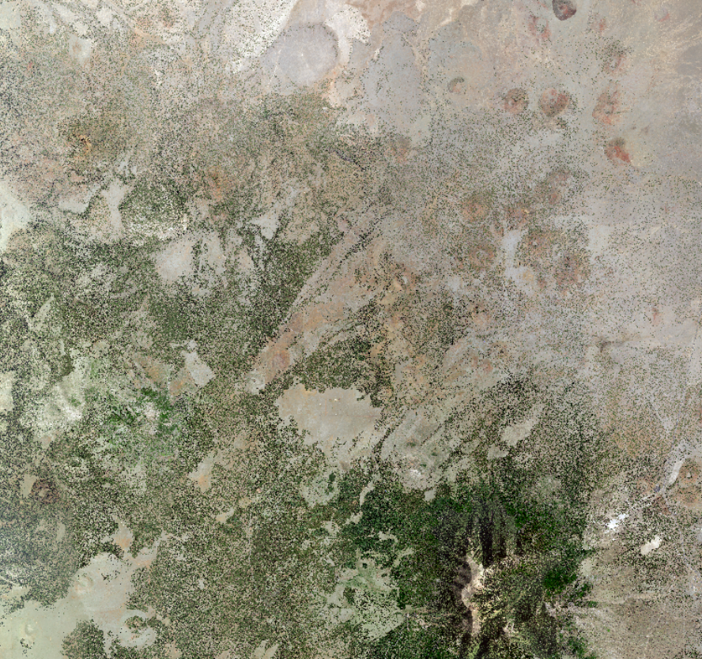
METHODOLOGY: ENVIRONMENTAL VARIABLES
Slope
Elevation
Topography
Aspect
Precipitation
Soil Moisture
Evapotranspiration
Land Surface Temperature
LANDFIRE
Normalized Difference Moisture Index
Normalized Difference Vegetation Index
NAIP Aerial Reflectance Data
Notes:
Our team used these data from NASA Earth observations to find potential relationships between the environment and pinyon-juniper mortality. First, we plotted monthly timeseries of environmental data in Tableau to determine general trends over the seven-year study period.
Next, we looked at the relationship between these variables and mortality. As you can see illustrated with the soil moisture data in the center here, our data had greatly varying spatial resolutions. Before we could compare these variables to our classification, we had to aggregate them to the same scale. Imagery with relatively high resolution, like Landsat and NAIP, had to be aggregated to a larger pixel size, while data with relatively low resolution, like soil moisture and precipitation had to be sampled up to a smaller pixel size. It was a "meet in the middle" approach.
Our mortality data was not normally distributed, so we used a non-parametric approach for analysis. Using topographic and environmental data, a Spearman's Correlation was performed in R to examine relationships with pinyon-juniper mortality. This process was run three separate times on environmental variables aggregated over three separate time periods: a mean between 2020 and 2021, a mean between 2019 and 2021, and a difference between 2015 and 2021.
------------------------------Image Information Below ------------------------------
Image Credit: DEVELOP team
Image Source: All images generated by our NASA DEVELOP team

Slide 12
RESULTS: ENVIRONMENTAL VARIABLES
Precipitation and soil moisture levels showed significant downward trend from 2015 to 2021
Mean Monthly Precipitation in Study Area, 2015 – 2021
0.13
p-value = .026
0.10
0.08
Mean Precipitation (mm)
0.05
0.03
0.000
2015 | 2016 | 2017 | 2018 | 2019 | 2020 | 2021
Mean Monthly Soil Moisture in Study area, 2015 – 2021
Rho in Wupatki NM:
Elevation = -0. 37
Soil moisture = 0. 39*
Land surface temp = 0. 38*
0.13
p-value = .016
0.10
0.08
Mean Soil Moisture (mm)
0.05
0.03
0.000
*2020 – 2021 Mean Data Run
2015 | 2016 | 2017 | 2018 | 2019 | 2020 | 2021
Image Credit: DEVELOP Team
Notes:
Time series plots of precipitation and soil moisture between 2015 and 2021 showed significant downward trends in both metrics. The other variables examined - evapotranspiration, land surface temperature, NDVI, and NDMI - did not show significant trends for this time period, but may show trends if examined over a longer study period.
Additionally, the Spearman's Correlation performed in R did not return any Rho values greater than 0.16 for our high probability areas as a whole. The highest Rho values returned by this analysis across all time periods was 0.16 for both Land Surface Temperature and NDVI.
Within Wupatki National Monument, the Spearman's Correlation returned higher Rho values. The Rho for elevation was -0.37, while, for the 2020–2021 mean run of the analysis, soil moisture was 0.39, and land surface temperature was 0.38. Despite these higher numbers, these are considered only weak relationships. It is possible that with additional years of data or with a multivariate analysis, these values could be higher. Unfortunately, those analyses were not realistic within the scope and time of this project.
------------------------------Image Information Below ------------------------------
Image Credit: DEVELOP team
Image Source: All images generated by our NASA DEVELOP team

Slide 13
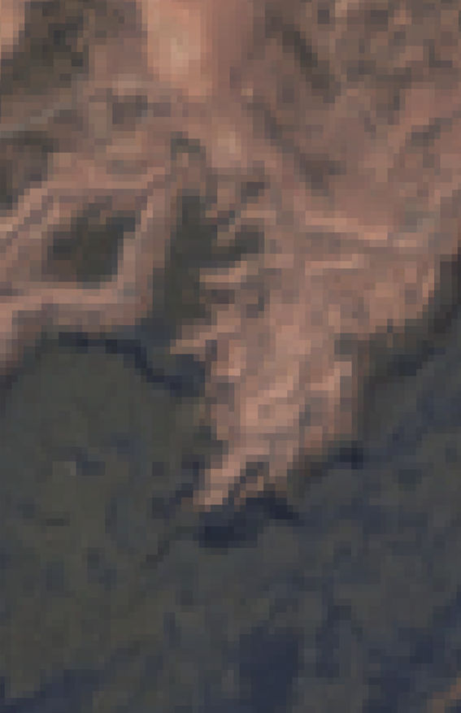
ERRORS & UNCERTAINTIES
Error associated with unsupervised classification of pinyon-juniper stands
Coarse resolution of some data products
Other contributing variables not considered
Resolution: 0.6 meters
Resolution: 30 meters
Image Credit: DEVELOP Team
Notes:
There were a variety of sources of error in our unsupervised classification. One of the bigger challenges was distinguishing pinyon-juniper woodlands from ponderosa pine, as well as areas that are mixed ponderosa and pinyon-juniper. While we had data that showed the extent of ponderosa pine, it came with its own set of uncertainties. Because of this, we ended up only analyzing areas with a high probability of pinyon-juniper-only landcover.
Another challenge we faced was the coarse resolution of some of our data products. When compared with our high-resolution NAIP classification, they offered only very general information about climatic trends – not enough to perform the fine-scale analysis necessary to identify conditions specific to each tree or stand of trees.
Lastly, as a feasibility project, it wasn't within our scope to incorporate the influence of variables such as pests, which are known contributors to tree mortality. A greater breadth and depth of data may have offered us a more complete understanding of influences on mortality.
------------------------------Image Information Below ------------------------------
Image Credit: DEVELOP team
Image Source: All images generated by our NASA DEVELOP team

Slide 14
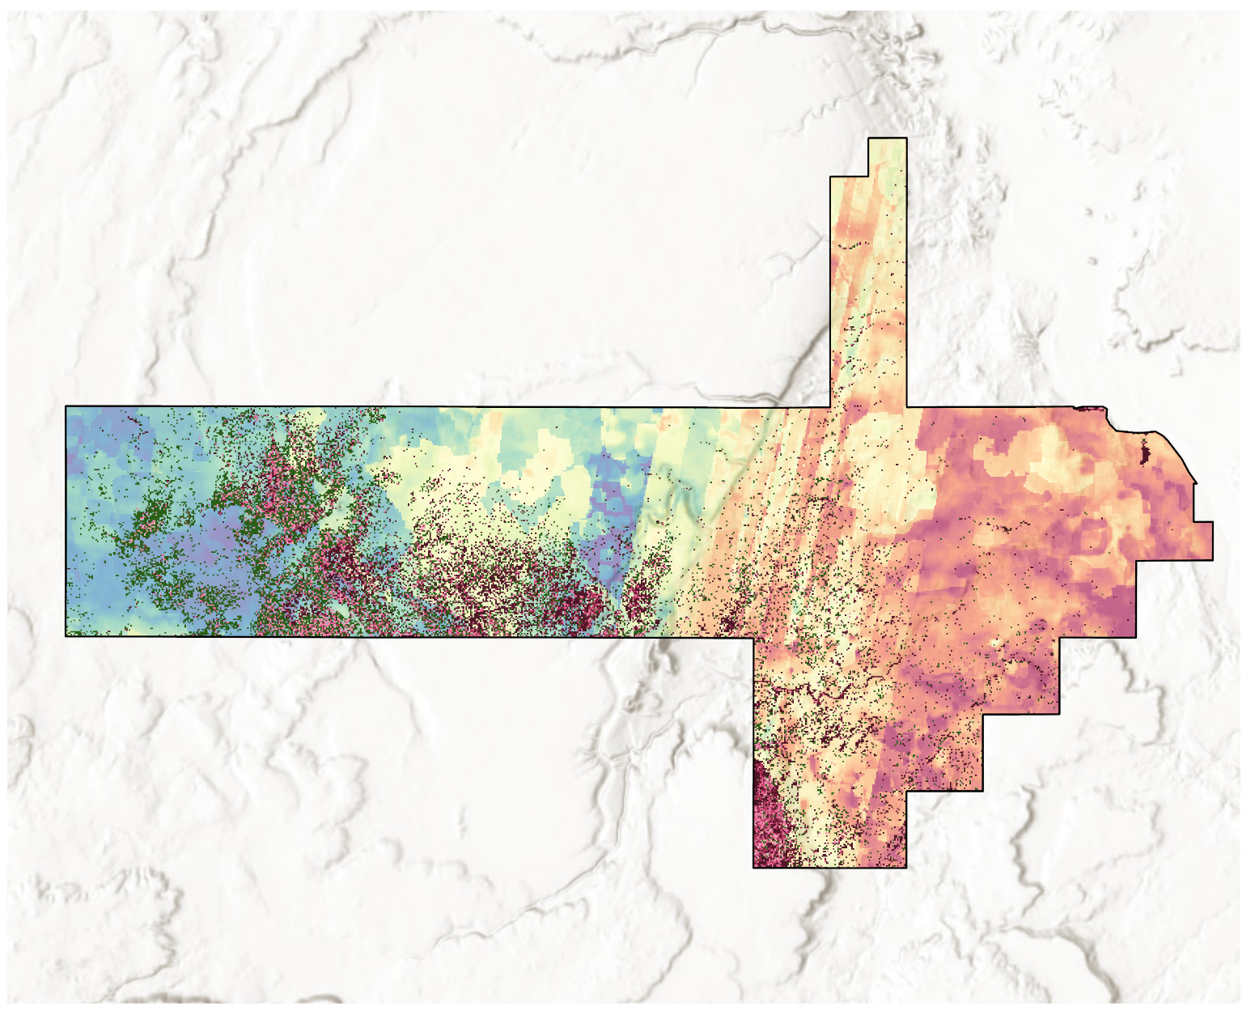
CONCLUSIONS
NAIP imagery can be used to accurately map mortality
High mortality percentages corroborate partner observations on the ground
No high correlations with environmental variables and mortality
Wupatki NM
Temperature
20.24°C
-4.00°C
Mortality
No Mortality
1-20%
20-40%
40-60%
60-80%
80-100%
0
10
N
Kilometers
Miles
0
5
Image Credit: DEVELOP Team
Notes:
From these results, the team demonstrated that NAIP imagery is a viable option for mapping pinyon-juniper mortality over a large spatial scale. While there were significant challenges that came along with refining our process, we ultimately were able to produce mortality data that was 89% accurate in our high probability areas.
Additionally, our calculated mortality percentages corroborate ground level mortality observations from our partner at the National Park Service as well as observations from the US Forest Service. Through this work, it is evident that the area of study has experienced an extensive mortality event even in areas not monitored by these organizations.
Lastly, low Rho values for mortality and environmental variables across the study area exemplify the inherent difficulties of correlating environmental and climatic variables with mortality over time, particularly in an area that has been experiencing drought for decades. It is our hope that with a greater scope of data, stronger relationships would be found.
------------------------------Image Information Below ------------------------------
Image Credit: DEVELOP team
Image Source: All images generated by our NASA DEVELOP team
Basemap Credit: ESRI, World Terrain Base
Basemap Source: ESRI World Terrain Base

Slide 15
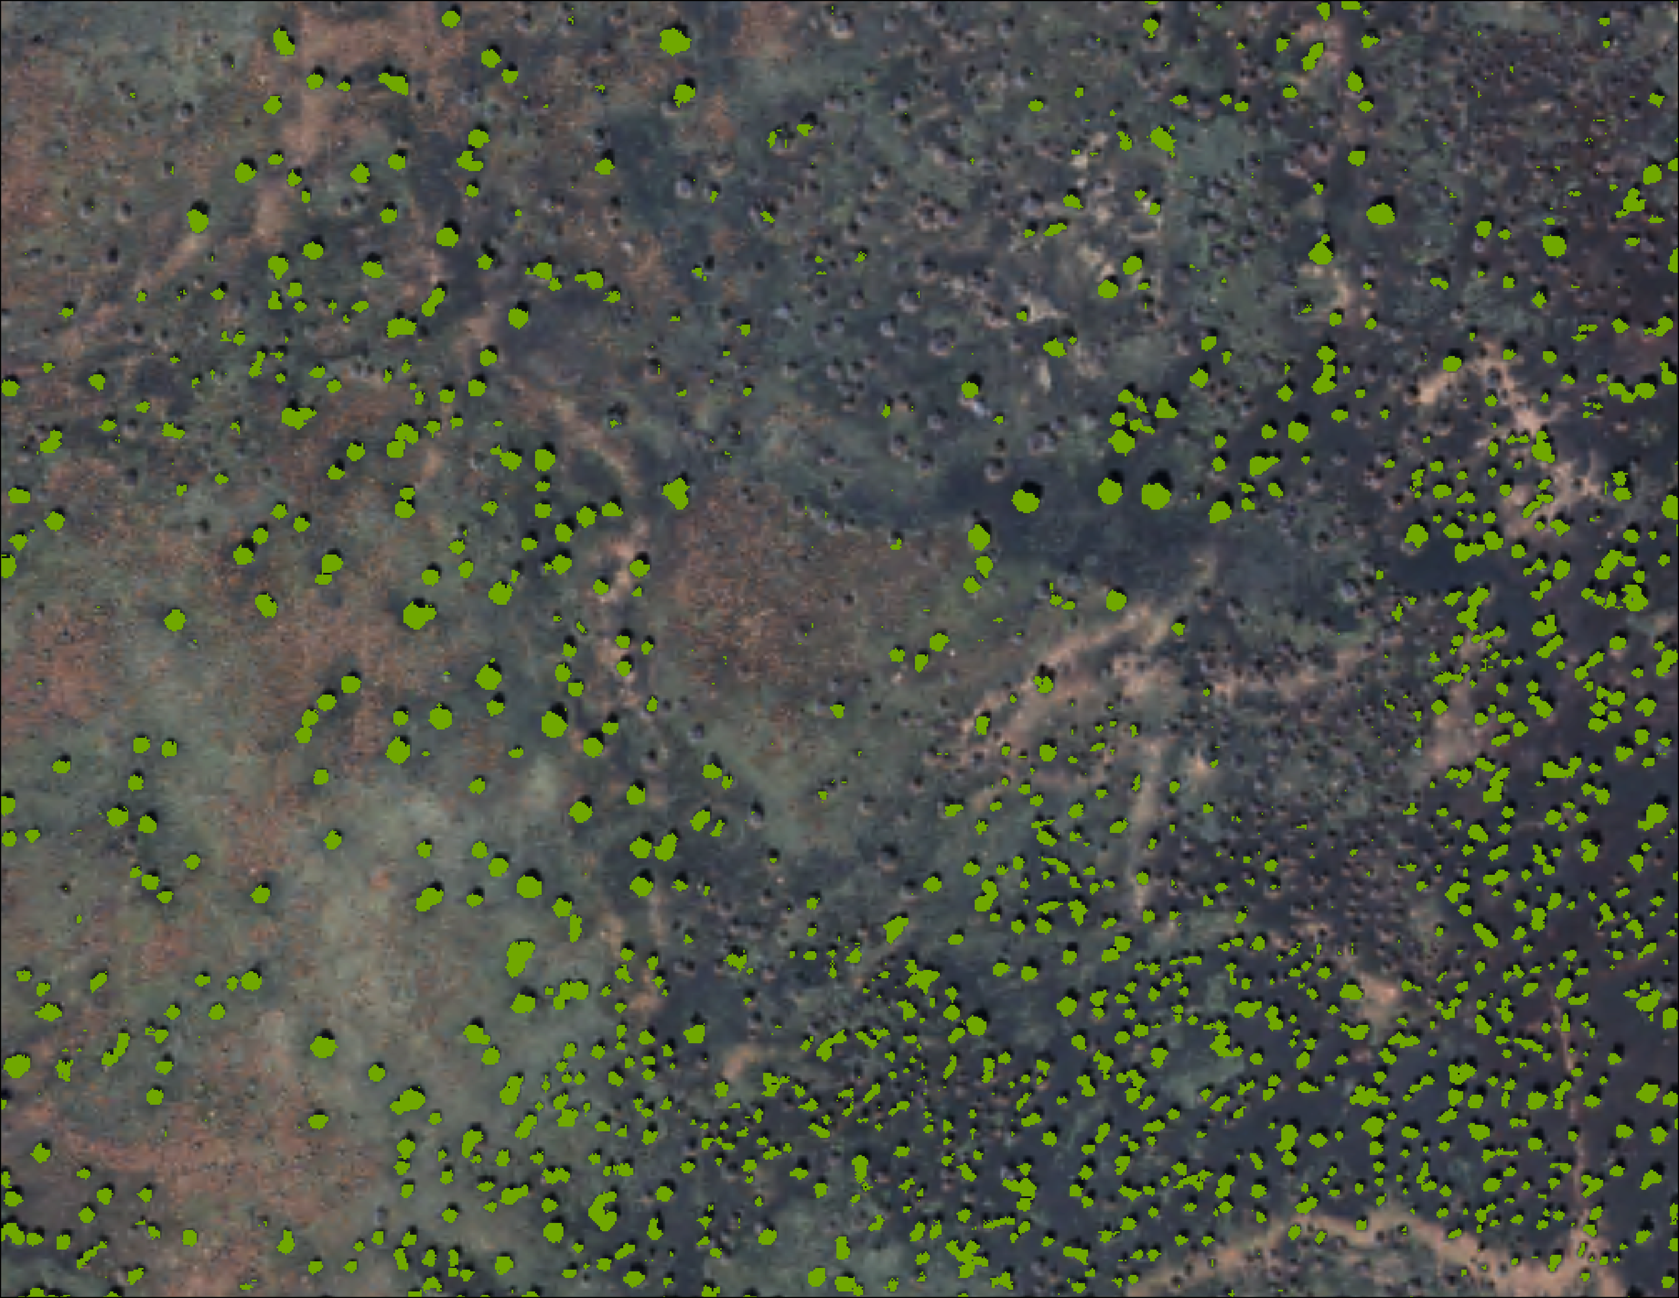
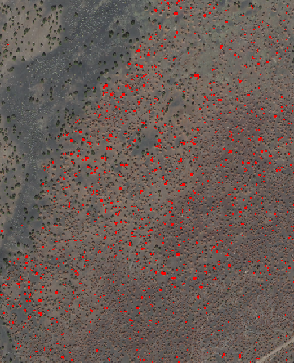
FUTURE WORK
Increase the accuracy of unsupervised classification
Extend the study period to include previous years of drought
Yearly time series for mortality classifications
Image Credit: DEVELOP Team (left), Mark Szydlo (center), DEVELOP Team (right)
Notes:
Moving forward, it would be beneficial to increase the accuracy of unsupervised classification as well as the accuracy of the mortality data. Additionally, future work should consider increasing the duration of the study period to encompass additional years prior to 2015. This may lend to a deeper understanding of trends in environmental variables leading up to the pinyon-juniper mortality event in 2021. It may also prove helpful to evaluate pinyon-juniper mortality on a year-to-year basis between 2015 and 2021 through a time series of mortality classifications, as opposed to this project's "bookend" approach.
------------------------------Image Information Below ------------------------------
Image Credit: DEVELOP team
Image Source: Created by the NASA DEVELOP team
Image Credit: Mark Szydlo
Image Source: Provided by partner with permission to use.
Image Credit: DEVELOP team
Image Source: Created by the NASA DEVELOP team

Slide 16
Partner
Mark Szydlo (National Park Service, Wupatki National Monument)
Joseph Spruce (Science Systems & Applications, Inc.)
Sean McCartney (Science Systems & Applications, Inc., NASA Goddard Space Flight Center)
Dr. Nicole Ramberg-Pihl (Science Systems & Applications, Inc., NASA Goddard Space Flight Center)
Dr. John Bolten (NASA Goddard Space Flight Center)
Dr. Kent Ross (NASA Langley Research Center)
Science Advisors
Fellow
Additional Support
Maps throughout this work were created using ArcGIS® software by Esri. ArcGIS® and ArcMap™ are the intellectual property of Esri and are used herein under license. Copyright © Esri. All rights reserved. For more information about Esri® software, please visit www.esri.com.
Notes:
As with any scientific endeavor, this project and our team greatly benefited from the advice and guidance of our partner, Mark Szydlo with the National Park Service at Wupatki National Monument, our science advisors: Joe Spruce, Sean McCartney, Dr. John Bolten, and Dr. Kent Ross, and our fellow Nicole Ramberg-Pihl with Goddard Space Flight Center. Thank you.

Slide 17
APPENDIX
Accuracy Assessment Data
Assessment | # of Random Points | Method | # of Combined Classes | Accuracy | Kappa | Error | 95% Confidence Interval
2015 Vegetation Classification | 240 | Equalized Stratified Random | 4 - Pinyon-Juniper, Bare Earth, Shrubs, Shadow | 82% | 0.69 | 0.18 | 82% +/- 4.9
2021 Vegetation Classification | 240 | Equalized Stratified Random | 4 - Pinyon-Juniper, Bare Earth, Shrubs, Shadow | 73% | 0.65 | 0.27 | 73% +/- 5.6
Mortality in High Confidence Areas | 240 | Equalized Stratified Random | 2 - Mortality, Not Mortality | 89% | 0.78 | 0.11 | 89% +/- 4.0
Notes:
Looking at our vegetation classifications, we saw an 82% accuracy for 2015 and a 73% accuracy for 2021. In our high confidence areas specifically, we were able to achieve an 89% accuracy for the mortality classifications.

Slide 18
APPENDIX
Environmental Variables
Platform & Sensor | Parameters | Use
Landsat 8 Operational Land Imager (OLI) and Thermal Infrared Sensor (TIRS) | Land Surface Temperature, NDMI, NDVI | Land surface temperature, NDMI, and NDVI were used to evaluate their potential effects on pinyon-juniper mortality.
Soil Moisture Active Passive (SMAP) | Soil Moisture | SMAP was used to assess soil moisture over time in the region.
Global Precipitation Measurement (GPM) Integrated Multi-satellite Retrievals for Global Precipitation Measurement (IMERG) | Precipitation | Precipitation accumulation data, derived from algorithms to predict interpolated values, were used to assess precipitation over time.
Shuttle Radar Topography Mission (SRTM) | Elevation, Slope, and Aspect | Elevation, slope, and aspect were used to map topographic characteristics of the landscape.
Terra Moderate Resolution Imaging Spectroradiometer (MODIS) | Evapotranspiration, Burn Boundary (2021) | Terra MODIS was used to assess evapotranspiration over time and relate it with pinyon-juniper mortality.
Notes:
This table includes all the platforms and sensors that were used to acquire the data for our environmental and topographic variables as well as the uses for each.

Slide 19
APPENDIX
Time Series p-Values, 2015 – 2021
Variable | R² | p-Value
Soil Moisture | 0.071 | 0.016
Evapotranspiration | 0.006 | 0.478
Precipitation | 0.061 | 0.026
Land Surface Temperature | 0.006 | 0.501
NDMI | 0.007 | 0.454
NDVI | 0.002 | 0.687
Notes:
Here we display the R squared and p values for our statistical analysis of our time series plots for each environmental variable. The only two significant environmental variables we have here are soil moisture and precipitation.

Slide 20
APPENDIX
Spearman's Correlation |  | High Prob. Areas |  | Wupatki
Date | Variable | Rho | P-Value | Rho | P-Value
No Date | Aspect​ | -0.01 | 0.4364 | 0.03 | 0.617
No Date | Elevation​ | -0.11 | 2.20E-16 | -0.37 | 3.75E-10
No Date | Slope​ | -0.04 | 0.004554 | -0.10 | 0.1215
No Date | Stand Density​ | 0.02 | 0.1107 | -0.03 | 0.6201
April 2019 - May 2021 Mean | Soil Moisture​ | 0.04 | 1.95E-03 | 0.35 | 4.66E-09
April 2019 - May 2021 Mean | Evapotranspiration​ | -0.04 | 3.06E-03 | -0.30 | 5.40E-06
April 2019 - May 2021 Mean | Precipitation​ | -0.03 | 0.01367 | -0.14 | 0.02766
April 2019 - May 2021 Mean | Land Surface Temperature​ | 0.12 | 2.20E-16 | 0.35 | 4.94E-09
April 2019 - May 2021 Mean | NDMI​ | -0.03 | 0.04881 | 0.19 | 0.001925
April 2019 - May 2021 Mean | NDVI​ | -0.12 | 2.20E-16 | -0.07 | 0.2665
April 2020 - May 2021 Mean | Soil Moisture​ | 0.05 | 4.32E-05 | 0.39 | 1.01E-10
April 2020 - May 2021 Mean | Evapotranspiration​ | -0.06 | 6.14E-05 | -0.21 | 1.13E-03
April 2020 - May 2021 Mean | Precipitation​ | -0.06 | 5.78E-06 | -0.20 | 0.001153
April 2020 - May 2021 Mean | Land Surface Temperature​ | 0.12 | 2.20E-16 | 0.38 | 3.21E-10
April 2020 - May 2021 Mean | NDMI​ | 0.00 | 0.7104 | 0.19 | 0.002817
April 2020 - May 2021 Mean | NDVI​ | -0.16 | 2.20E-16 | -0.14 | 0.02352
April 2015 - May 2021 Difference | Soil Moisture​ | 0.12 | 2.20E-16 | 0.39 | 6.79E-11
April 2015 - May 2021 Difference | Evapotranspiration​ | -0.02 | 9.25E-02 | -0.10 | 2.18E-01
April 2015 - May 2021 Difference | Precipitation​ | -0.01 | 0.3516 | -0.20 | 0.00121
April 2015 - May 2021 Difference | Land Surface Temperature​ | 0.16 | 2.20E-16 | 0.33 | 3.15E-08
April 2015 - May 2021 Difference | NDMI​ | -0.10 | 0.000000 | -0.23 | 0.000128
April 2015 - May 2021 Difference | NDVI​ | -0.05 | 0.000031 | -0.06 | 0.304400
Notes:
We used a non-parametric statistical analysis called a Spearman’s Correlation to compare pinyon-juniper mortality and our environmental and topographic variables. For the years 2019 to 2021, we took the mean of each variable to use for the analysis as we hoped to encompass any lag effects that might be present from the previous year leading up to the extensive mortality event seen in 2021. We also wanted to evaluate just the year leading up to the mortality event as well by taking the mean of each variable between April of 2020 and May of 2021 to evaluate the relationship between mortality and the environmental conditions most closely associated with the mortality event while still taking into account seasonal variability by averaging the entire year. Finally, we also took the difference between the mean values for 2015 and the mean values for 2021 to evaluate the change in each environmental variable during our study period and compare those values to the mortality we observed.

