Slide 1
Montana
Water Resources II
Enhancing a Composite Moisture Index for Drought and Flood Monitoring in the Missouri River Basin
Chloe Schneider, Bevan Pearson, Madelyn Savan, Catherine Buczek
North Carolina – NCEI
Notes:
Intoduce DEVELOP team
Through the NASA DEVELOP program, we partnered with local climate and forecast offices in the Missouri River Basin to conduct a feasibilty study that investigated how NASA earth observations can be leveraged to provide a flood and drought forecasting tool for the region
-------------Website Image Info --------------
Mean snow cover imagery derived from the Normalized Difference Snow Index (NDSI). The NDSI is obtained by NASA’s Terra Moderate Resolution Imaging Spectroradiometer. March 2020 snow cover in the Missouri River Basin is displayed. Lighter shades indicate the presence of snow and darker shades indicate absence of snow. Monthly snow cover is compared to historic conditions to assist in drought and flood predictions in the Missouri River Basin.

Slide 2
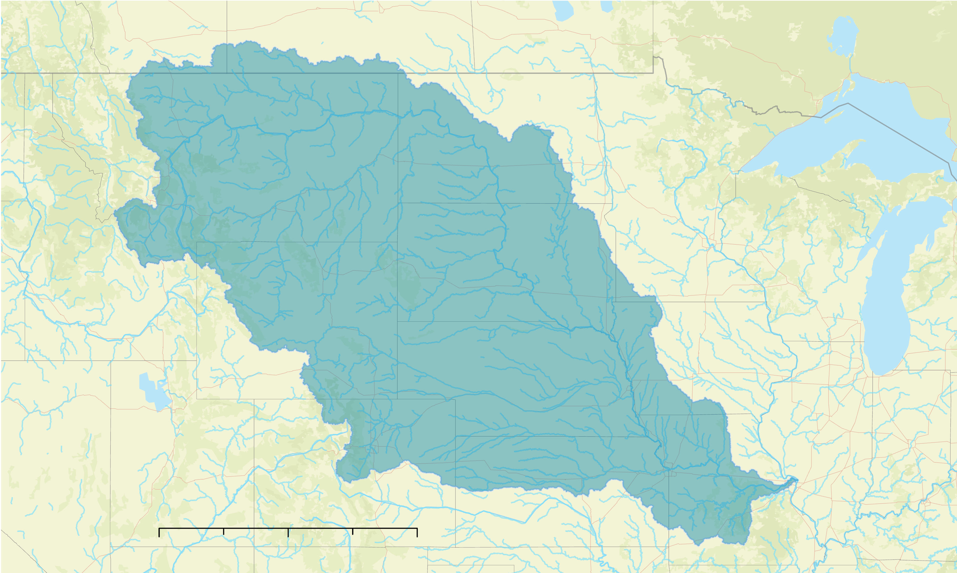
Region of Interest
N
Missouri River Basin
Largest river basin in the United States
Supports some of the most agriculturally productive land in the country
0 1,500 3,000 km
Missouri River Basin
0 500 1,000 km
Notes:
The Missouri River Basin (MRB) is the largest river basin in the United States, encompassing 500,000 square miles of drainage from all of Nebraska and parts of Colorado, Iowa, Kansas, Minnesota, Missouri, Montana, North Dakota, South Dakota and Wyoming. The Missouri River Basin supports much of the United States agricultural industry and produces approximately 46% of the wheat, 22% of the grain corn and supports 34% of the cattle found in the United States.
------------------------------Image Information Below ------------------------------
Map credit: The image was created using ArcGIS Pro, and overlays ESRI basemaps
Basemap Sources: Esri, DeLorme, HERE, TomTom, Intermap, increment P Corp., GEBCO, USGS, FAO, NPS, NRCAN, GeoBase, IGN, Kadaster NL, Ordnance Survey, Esri Japan, METI, Esri China (Hong Kong), swisstopo, MapmyIndia, and the GIS User Community

Slide 3
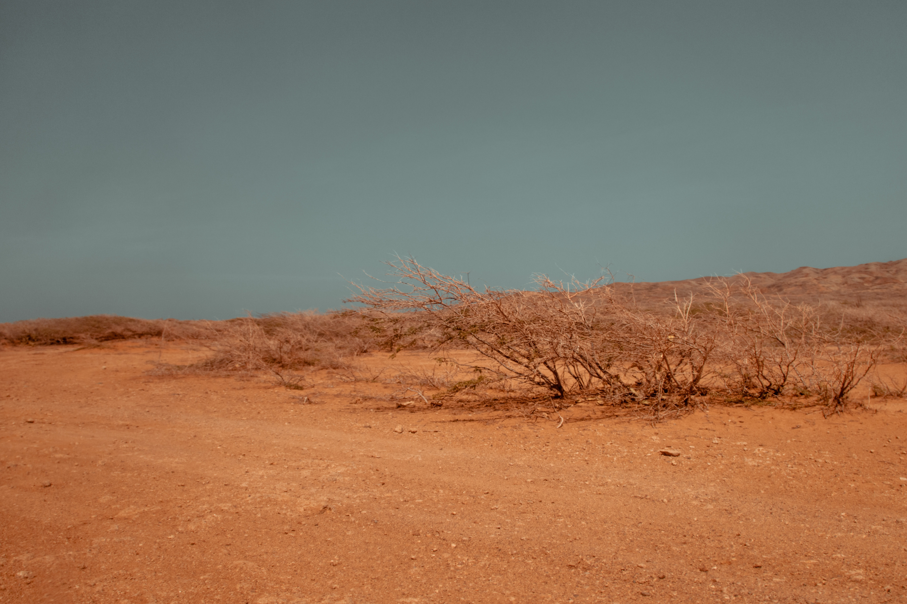
Community Concerns
Drought and flood events impact the resource availability and the economic productivity of the Missouri River Basin
A single moisture indicator that captures fall and winter conditions would aid end users in effective resource management and decision-making.
Image Credit: Luis Quintero
Notes:
Drought and flood events impact the resource availability and the economic productivity of the Missouri River Basin. In 2017, an unexpected flash drought devastated the region, causing agricultural losses exceeding $2.6 billion and record wildfires. Fall and Winter moisture conditions specifically affect the Spring growing season. While state agencies employ various drought indicators in their monitoring efforts, there is currently no single drought index that holistically considers various moisture conditions that can be applied across the entire forecast region. Regional organizations are seeking to improve drought early warning systems and communication with stakeholders in order to better prepare for extreme weather events.
------------------------------Image Information Below ------------------------------
•Image Credit: Luis Quintero
•Image Source: https://www.pexels.com/photo/brown-desert-sand-2106223/
CC Free to use

Slide 4
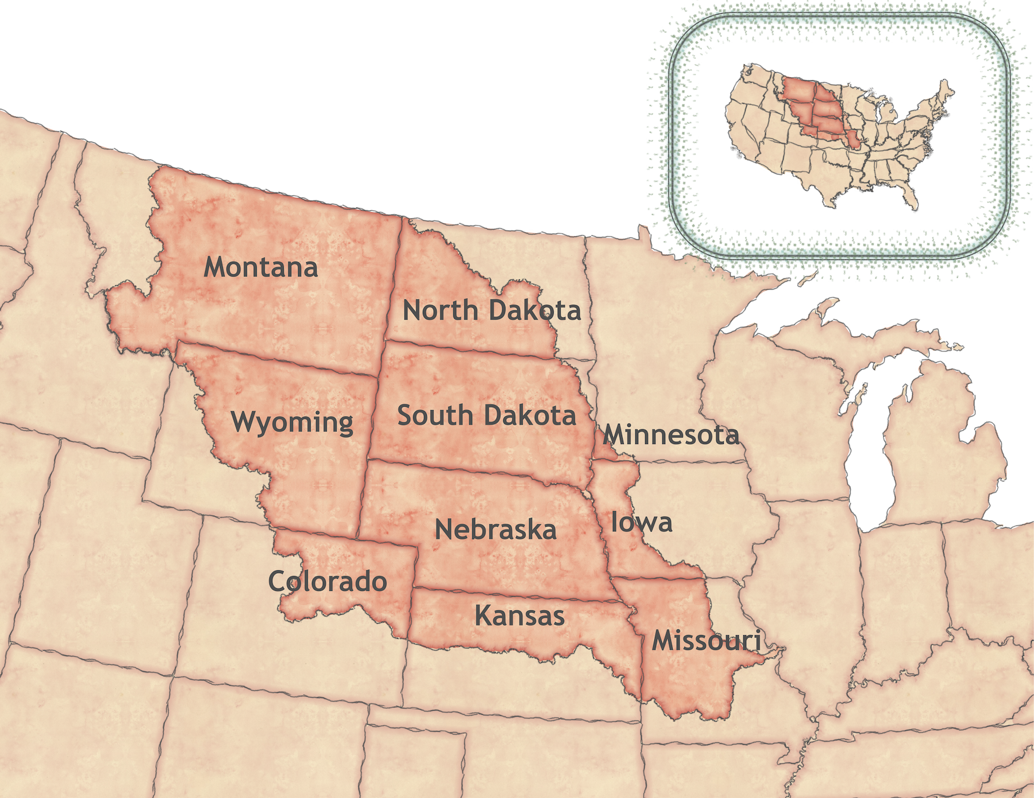
Project Partners
Montana Climate Office
NOAA, National Weather Service, Missouri Basin River Forecast Center
NOAA, Physical Sciences Laboratory
US Army Corps of Engineers, Northwestern Division
NOAA, Regional Climate Services, Central Region
Image Credit: DEVELOP Montana Water Resources I Team
Notes:
The team partnered with the Montana Climate Office, the National Oceanic and Atmospheric Association (NOAA) National Weather Service (NWS) Missouri Basin River Forecast Center, NOAA Regional Climate Services of the Central Region, US Army Corps of Engineers, Northwestern Division and NOAA, Physical Sciences Laboratory to accomplish these goals. These collaborators work firsthand with communities of the Missouri River Basin communities. They provide local stakeholders with precise and timely information of hydro-climatological conditions.
In light of the severe drought events recently experienced in the region, the partners were interested in a product that communicated the antecedent soil moisture conditions influencing drought and runoff. They collaborated with the DEVELOP team and provided expert hydrological advice to produce a scientifically sound product.
------------------------------Image Information Below ------------------------------
•Image Credit: DEVELOP Montana Water Resources I Team
•Image Source: DEVELOPedia Montana Water Resources I Team

Slide 5
Image Credit: Yevgeniya Fedorova
Assessing Moisture Conditions
Fall and winter moisture states are of interest as they are antecedent conditions to spring, determining moisture state at start of growing season
Notes:
Fall and early Winter moisture states can be locked-in during Winter freezes, resulting in similar Spring moisture conditions as thawing occurs.
Snowmelt accounts for a large portion of annual streamflow, so Winter snow heavily influences moisture conditions during Spring snowmelt.
Therefore, Fall and Winter moisture conditions are the antecedent conditions to Spring, determining moisture state at beginning of growing season
For this reason, we are interested in Fall and Winter snow, soil moisture, streamflow, and groundwater measurements that can be used as early indicators of Spring and Summer basin conditions.
------------------------------Image Information Below ------------------------------
•Image Credit: Yevgeniya Fedorova from Pexels
•Image Source: https://www.pexels.com/photo/snow-capped-mountain-ranges-2308815/
CC Free to use

Slide 6
Wetter than normal
Montana Water Resources I
The Montana Water Resources I team developed a Composite Moisture Index (CMI) that incorporated soil moisture, snow cover, snow depth and snow water equivalent measurements into a single metric
Normal
Drier than normal
Notes:
To address the needs of our partners, our project built upon the Montana Water Resources I team, who created the framework for incorporating various NASA Earth observations and ancillary datasets to be incorporated into a single Composite moisture index (CMI) that will be used to communicate moisture conditions of the basin relative to their normal conditions. The first DEVELOP team incorporated soil moisture, snow cover, snow depth and snow water equivalent measurements into the CMI.
------------------------------Image Information Below ------------------------------
•Image Credit: This image was created using ArcGIS Pro (ESRI software)

Slide 7
Objectives
Our team expanded the functionality of the CMI by incorporating additional groundwater and fall streamflow datasets
Access additional datasets
Normalize data and create CMI
Correlate CMI with in situ data
Study Period: 2000 to Present
Notes:
Our team expanded the functionality of the CMI by incorporating additional datasets of groundwater and streamflow to strengthen the CMI. We also expanded the analysis of our CMI product and how it performs in relation to historic in situ data.
Specific Objectives:
Develop a framework for a monthly Composite Moisture Index (CMI) that can holistically and quantitatively assess the general moisture state of the Upper Missouri River Basin
Expand the functionality and scope of the CMI produced in the first term
Include fall streamflow as an input to the CMI
Automate data ingestion and processing for updated CMI outputs
Conduct a sensitivity analysis to determine which threshold values and timescales of CMI indicate spring and summer stream discharge anomalies

Slide 8
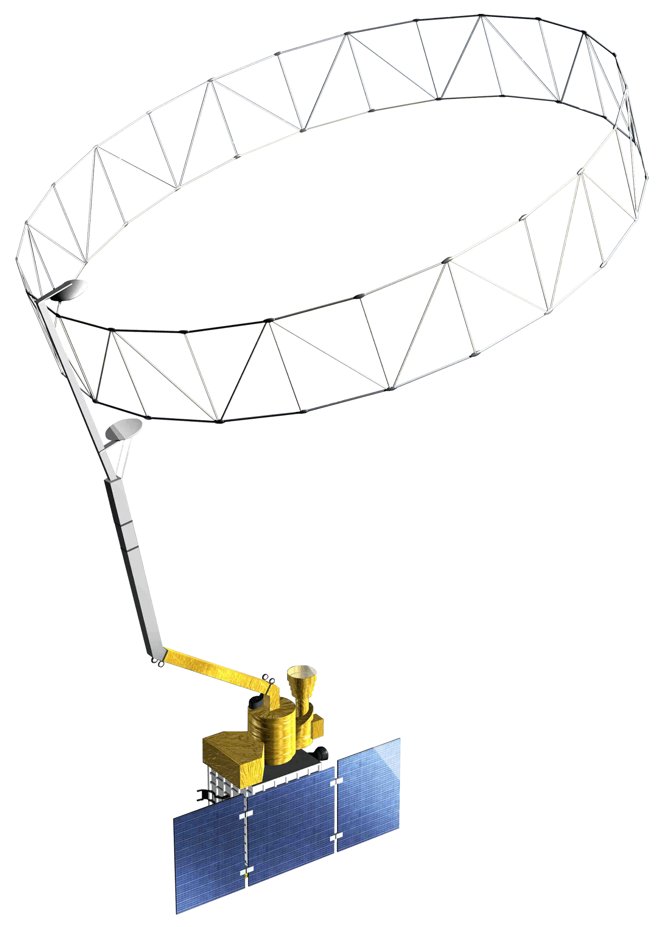
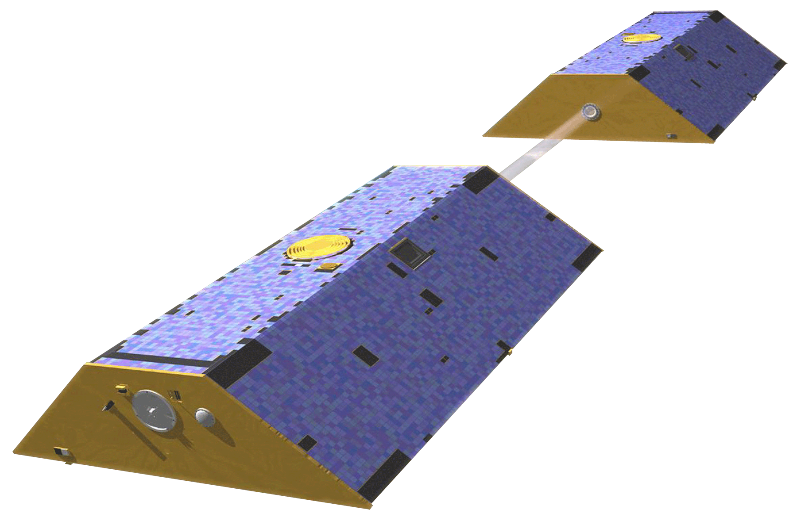
NASA Satellites
SMAP
GRACE/ GRACE-FO
Terra MODIS
Groundwater Storage
Surface Soil Moisture
Snow Cover
Image Credit: NASA
Notes:
We used three NASA Earth Observing satellites to obtain snow cover, groundwater storage and surface soil moisture data:
1. Gravity Recovery and Climate Experiment (GRACE) and GRACE Follow On
2. Terra Moderate Resolution Imaging Spectroradiometer (MODIS)
3. Soil Moisture Active Passive (SMAP)
Our Study period ranged from 2000 to present
------------------------------Image Information Below ------------------------------
All images credit: NASA
All images sources:
SMAP- http://www.devpedia.developexchange.com/dp/images/b/b5/20_SMAP.png
MODIS- https://www.devpedia.developexchange.com/dp/images/9/91/05_Terra.png
GRACE- https://www.devpedia.developexchange.com/dp/images/b/b4/10_Grace.png

Slide 9
GRACE & GRACE-FO
GRACE/ GRACE-FO
Acquisition:
FTP Server
Years of Data:
Acquired: April 4, 2002 - Present
Data Product:
Weekly ground water storage percentile
Groundwater Storage
Image Credit: NASA
Notes:
We acquired weekly groundwater storage estimates generated at 0.125 degree. Data were accessed through an FTP server hosted by the National Drought Mitigation Center at University of Nebraska-Lincoln.
------------------------------Image Information Below ------------------------------
Image credit: NASA
Image Source: https://www.devpedia.developexchange.com/dp/images/b/b4/10_Grace.png

Slide 10
Terra
Acquisition:
Google Earth Engine Python API
Years of Data:
Acquired: February 24, 2000 – Present
Data Product:
Snow Cover Daily L3
Global 500m SIN Grid, Version 6
Terra MODIS
Snow Cover
Image Credit: NASA
Notes:
We acquired gridded daily snow cover data at 500m resolution from the MODIS instrument on the Terra satellite for 2000 to present via the Google Earth Engine Python API
------------------------------Image Information Below ------------------------------
Image credit: NASA
Image source: https://www.devpedia.developexchange.com/dp/images/9/91/05_Terra.png

Slide 11
Soil Moisture Active Passive
SMAP
Acquired:
Google Earth Engine Python API
Years of Data Acquired:
April 01, 2015 – Present
Data Product:
SMAP L3 Radiometer Global Daily 36km EASE-GRID Soil Moisture, Version 4
Surface Soil Moisture
Image Credit: NASA
Notes:
We acquired surface soil moisture anomaly data at 26km resolution from the Soil Moisture Active Passive (SMAP) mission for 2015 to present via the Google Earth Engine Python API
------------------------------Image Information Below ------------------------------
Image credit: NASA
Image source: http://www.devpedia.developexchange.com/dp/images/b/b5/20_SMAP.png

Slide 12
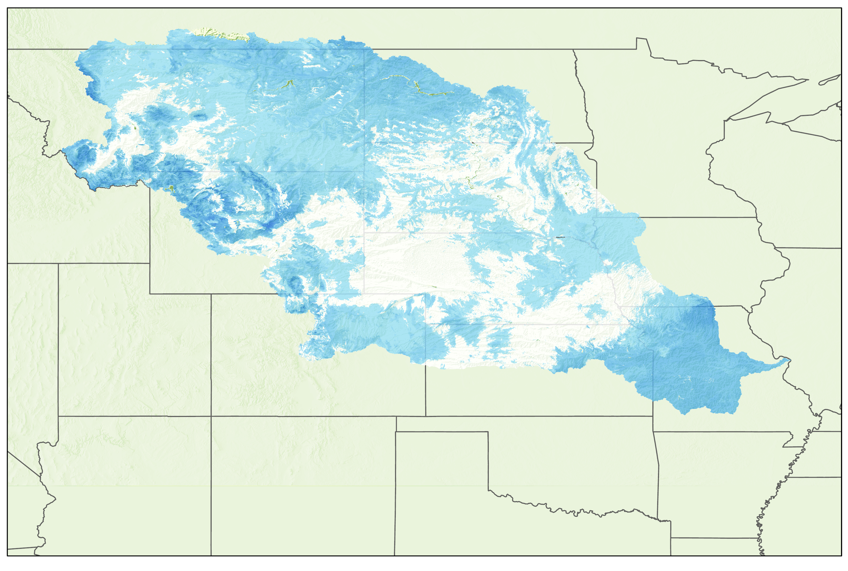
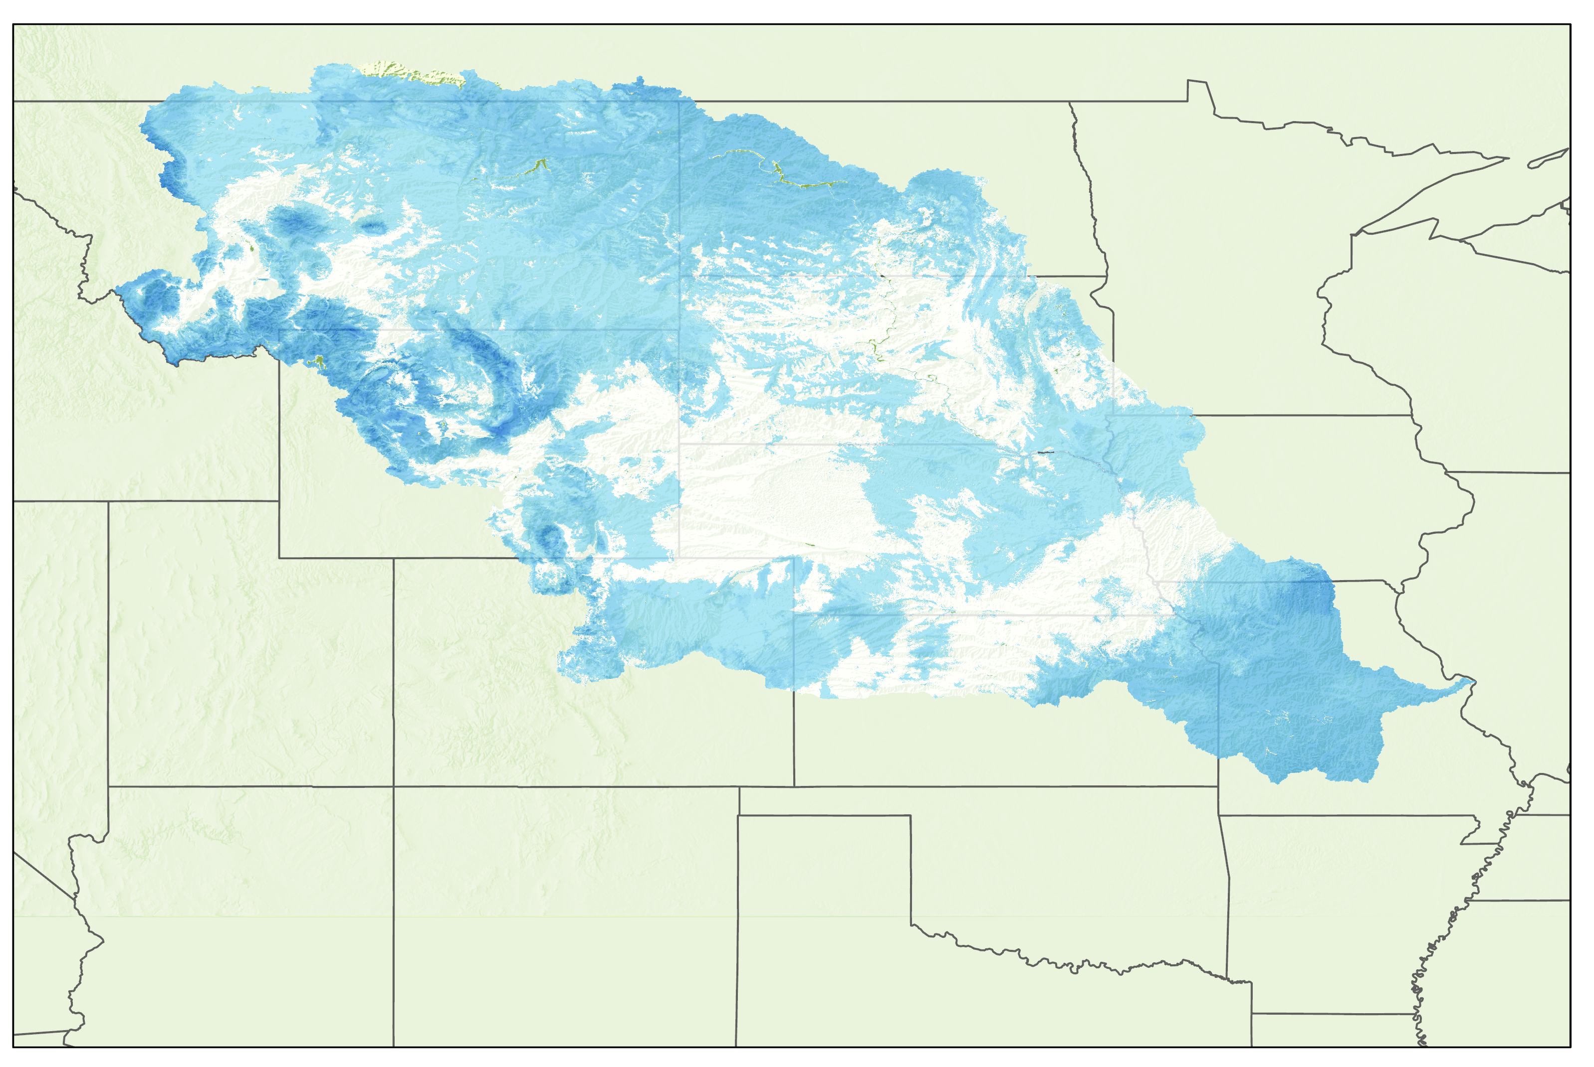
Ancillary Data
SNODAS
Snow Data Assimilation System (SNODAS) Data Products at NSIDC, Version 1
March 2019 Snow Water Equivalence
March 2019 Snow Depth
N
Snow Water Equivalence
Standard Anomalies
N
Snow Depth
Standard Anomalies
0 250 500 km
0 250 500 km
0 250 500 km
2.3
2.3
-1.6
-1.6
Notes:
Ancillary data were used to support Earth observation parameters in the CMI. To obtain stream discharge, snow water equivalent and snow depth data, the team used in situ and modeled data. The SNODAS data products used in this CMI include snow water equivalent and snow depth. These datasets was acquired through the NOAA FTP Server. In this slide we present Snow Water Equivalent and Snow Depth Data for March 2019.
------------------------------Image Information Below ------------------------------
Map credit: The image was created using ArcGIS Pro
Basemap Sources: USA States (Generalized) from ESRI basemaps. https://www.arcgis.com/home/user.html?user=esri_basemaps

Slide 13
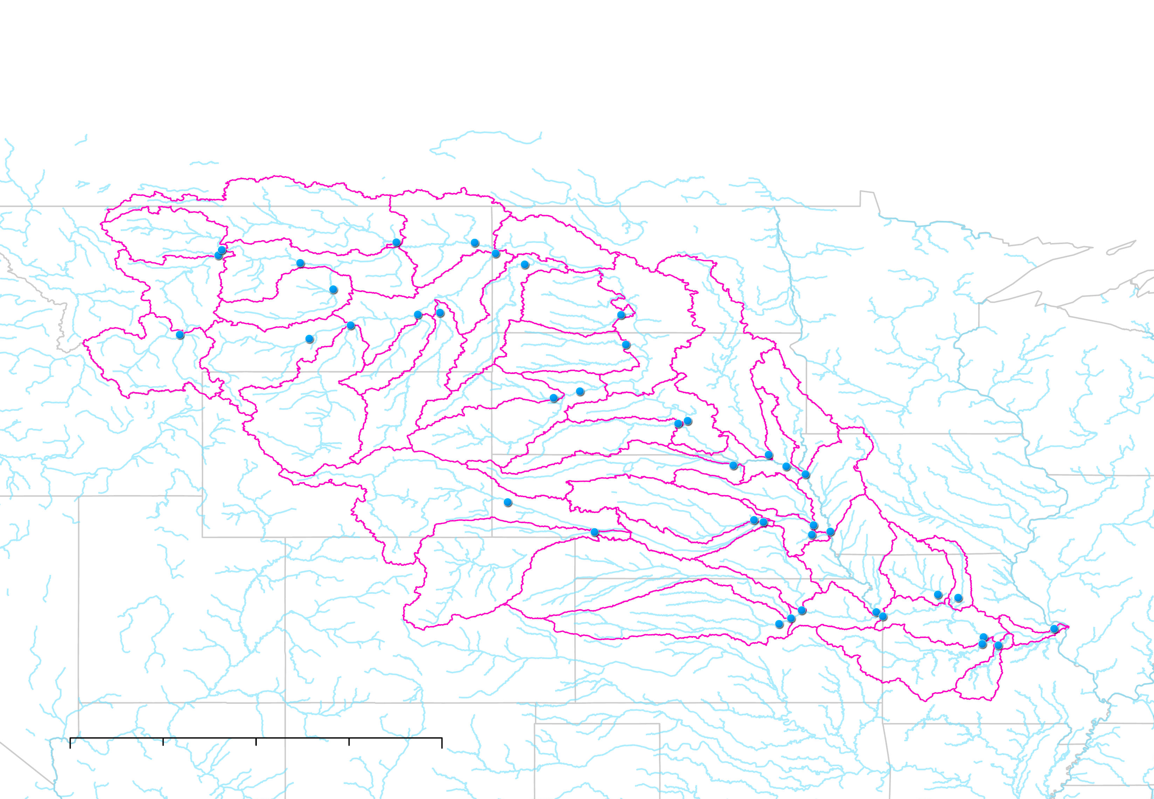
Ancillary Data
USGS Stream Gages
USGS Water Data for the Nation
0 500 1,000 km
Notes:
Ancillary data were used to support earth observation parameters in the CMI. To obtain stream discharge, snow water equivalent and snow depth data, the team used in situ and modeled data. In situ streamflow data from the USGS stream gage network was acquired using the waterData package in RStudio. One gauge per HUC-6 level basin was selected throughout the MRB. HUC refers to the USGS’s classification system for hydrologic areas (Hydrologic Unit Code). Partners from the Missouri River Basin Forecast Center selected the gauge locations-based proximity to the confluence in order to capture as much of the discharge of the basin as possible. This map shows stream gauge locations selected for our analysis
------------------------------Image Information Below ------------------------------
Map credit: The image was created using ArcGIS Pro
Basemap Sources:
U.S. Geological Survey (USGS) National Atlas of the United States https://hifld-geoplatform.opendata.arcgis.com/datasets/streamflow-gaging-stations
U.S. Geological Survey (USGS), U.S. Department of Agriculture - Natural Resource Conservation Service (NRCS), U.S. Environmental Protection Agency (EPA)Other Federal ftp://rockyftp.cr.usgs.gov/ngtoc/hydro/outgoing/WBDArchivedMetadata
U.S. Geological Survey(USGS) Water Data for the Nation https://waterdata.usgs.gov/nwis/sw

Slide 14
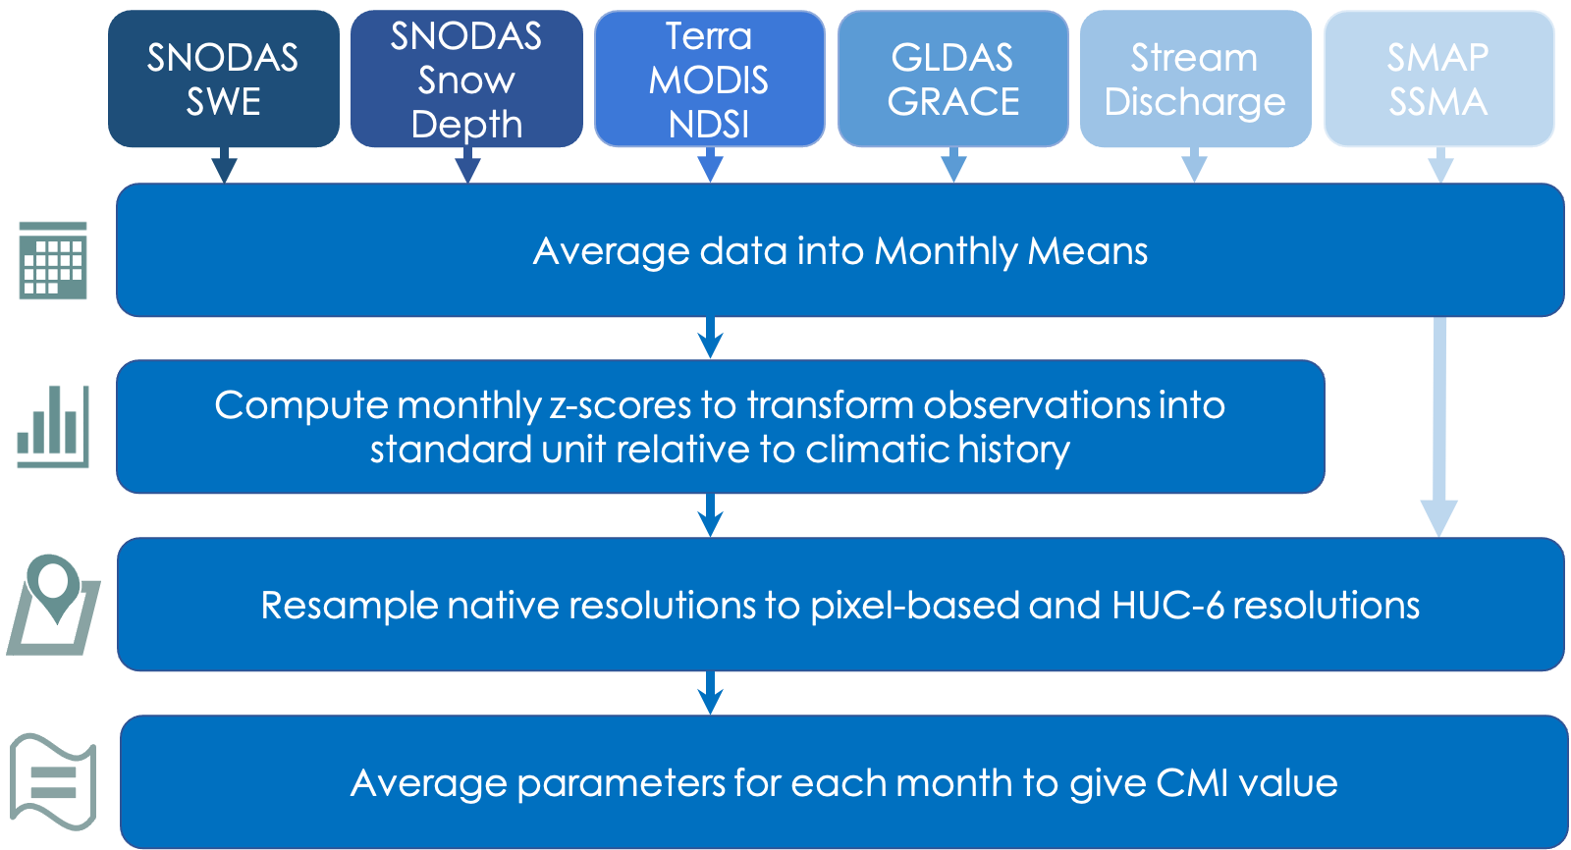
Methodology Workflow
Clipart Credit: Microsoft Office 365​
Notes:
The data processing steps are outlined here from top to bottom.
1. The top row represents each dataset that was acquired
2. Each dataset was converted from raw daily or weekly values into monthly means
3. From mean values, we computed monthly z-score in order to normalize the observation into a standard unit relative to their climatic history. SMAP was excluded from this processing step because it was downloaded as anomalies
4. In order to integrate each parameter into the CMI despite the varying native resolutions, we resampled each dataset to obtain pixel-based and HUC-6 resolutions.
5. Each parameter is then averaged to produce a single CMI value
------------------------------Image Information Below ------------------------------
Clipart source: Microsoft Office 365

Slide 15
CMI Calculation
The Composite Moisture Index is an average of each index's standardized values for a given month.
CMI = mean(Soil moisture, Soil depth, Snow water equivalent, Snow cover, Groundwater, Streamflow)
CMI = mean(soil moisture, soil depth, snow water equivalent, snow cover, groundwater, streamflow)
Notes:
The composite moisture index was the average of each input variable for a given pixel or HUC-6 region for a given month. Note that the pixel CMI does not include streamflow as a variable is the mean of the remaining 5 variables. The CMI is relative to the standard, or normal, conditions of each region. The scale of the CMI is -2 - 2, with 0 corresponding to normal conditions, 2 to wetter than normal, and –2 to drier than normal conditions.

Slide 16
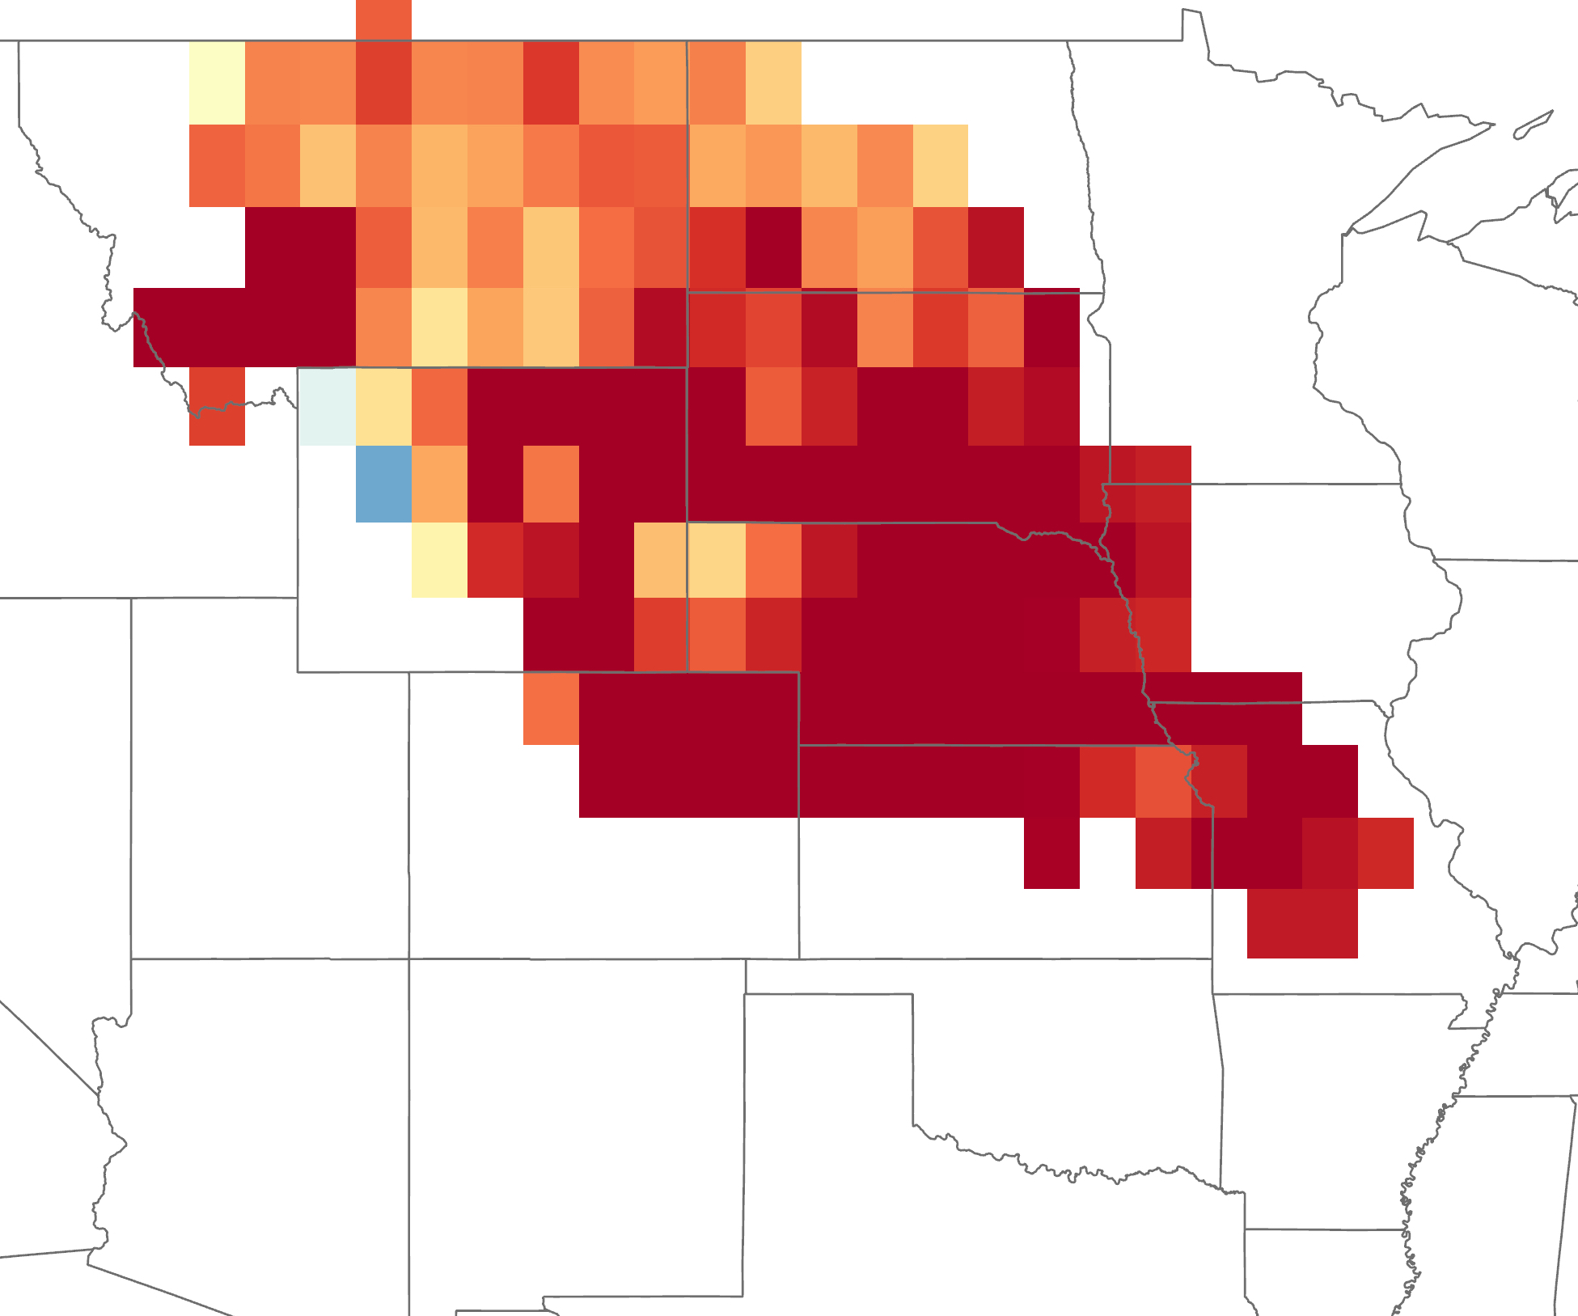
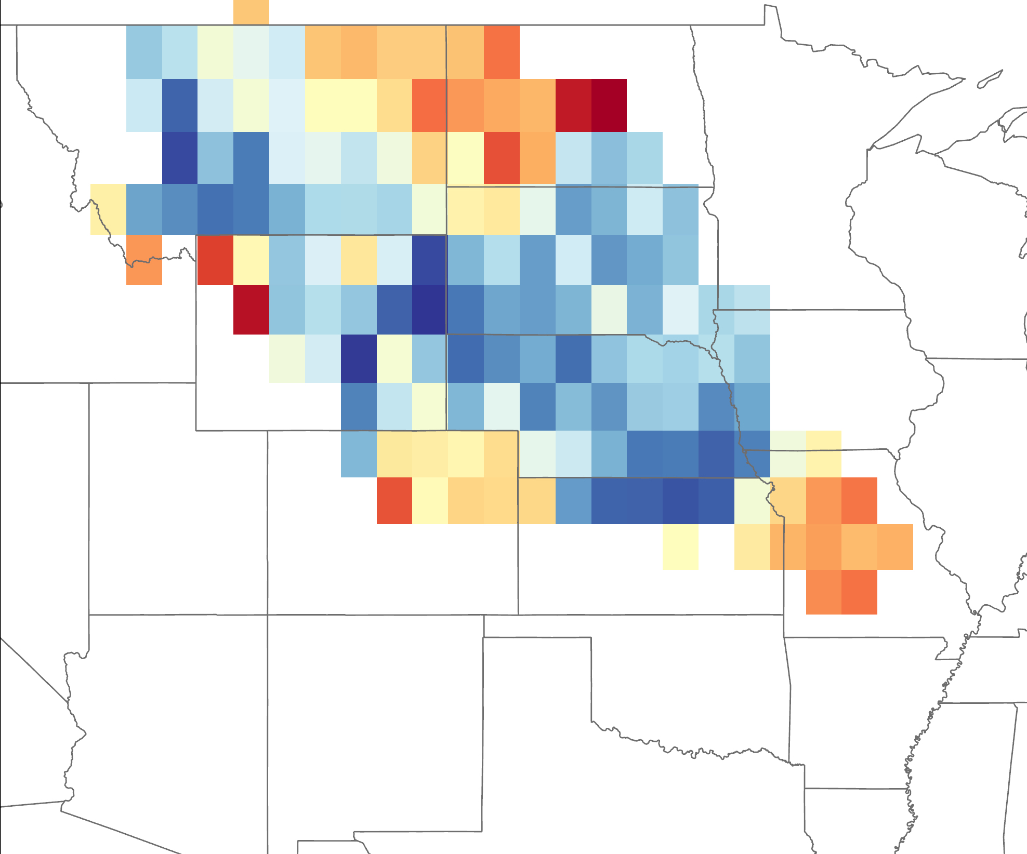
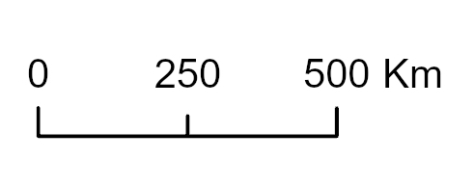
Results
March 2017
March 2019
CMI values
CMI values
2
2
0 250 500 km
N
0 250 500 km
N
-1
-1
Notes:
Here we present two example maps of the output CMI for the pixel based spatial aggregation approach – where all values we resample to the resolution of the coarsest variable at ~25km. Colors in red represent negative CMI values that indicate an aggerate of drier than normal snowpack and soil moisture conditions and blue represents positive CMI values that indicate an aggregate of wetter than normal conditions. The figure on the left represents CMI values in the MRB in March of 2017. 2017 was a major drought year. The figure on the right displays CMI value for march of 2019. 2019 was the second wettest year since 1973.
------------------------------Image Information Below ------------------------------
Map credit: The image was created using ArcGIS Pro
Basemap Sources: USA States (Generalized) from ESRI basemaps. https://www.arcgis.com/home/user.html?user=esri_basemaps

Slide 17
Results
HUC CMI March 2017
HUC CMI March 2019
1.6 - 1.8
1.4 - 1.6
1.2 - 1.4
1.0 - 1.2
0.6 - 0.8
0.8 – 1.0
0.4 - 0.6
0.2 - 0.4
0.0 - 0.2
-0.2 - 0.0
0 500 1,000 Km
0 500 1,000 Km
Notes:
Here we present two example maps of the output CMI for the pixel based spatial aggregation approach – where all values we resample to the resolution of the coarsest variable at ~25km. Colors in red represent negative CMI values that indicate an aggerate of drier than normal snowpack and soil moisture conditions and blue represents positive CMI values that indicate an aggregate of wetter than normal conditions.
------------------------------Image Information Below ------------------------------
Map credit: The image was created using ArcGIS Pro
Basemap Sources: USA States (Generalized) from ESRI basemaps. https://www.arcgis.com/home/user.html?user=esri_basemaps

Slide 18
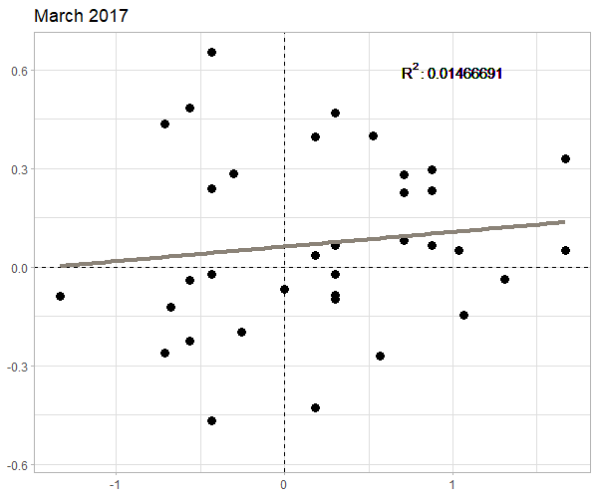
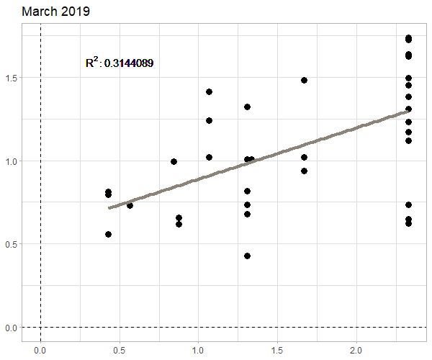
Correlation Analysis
March 2017 Correlation
March 2019 Correlation
0.6
0.3
0.0
-0.3
-0.6
R² : 0.014
R² : 0.314
1.5
1.0
0.5
0.0
March CMI Outputs
-1.0 0.0 1.0
0.0 0.5 1.0 1.5 2.0 2.5
Spring Standardized Discharge
Winter CMI values compared against spring and summer cumulative discharge for March 2017 and 2019
Notes:
We assessed the strength and accuracy of the CMI by conducting a correlation analysis between hydrologic basin level CMI outputs and in situ streamflow data. The two figures shown analyze CMI outputs against standardized spring streamflow for each HUC. For March 2017, our data did not show a strong relationship between CMI values and spring discharge, with a r-squared of .014. For March 2019, our data showed a more promising correlation with an r-squared value of .314. More promising, all HUCS experienced greater than normal spring streamflow in 2019 and the CMI values reflect this, as all CMI values are above 0, meaning wetter than normal conditions.

Slide 19
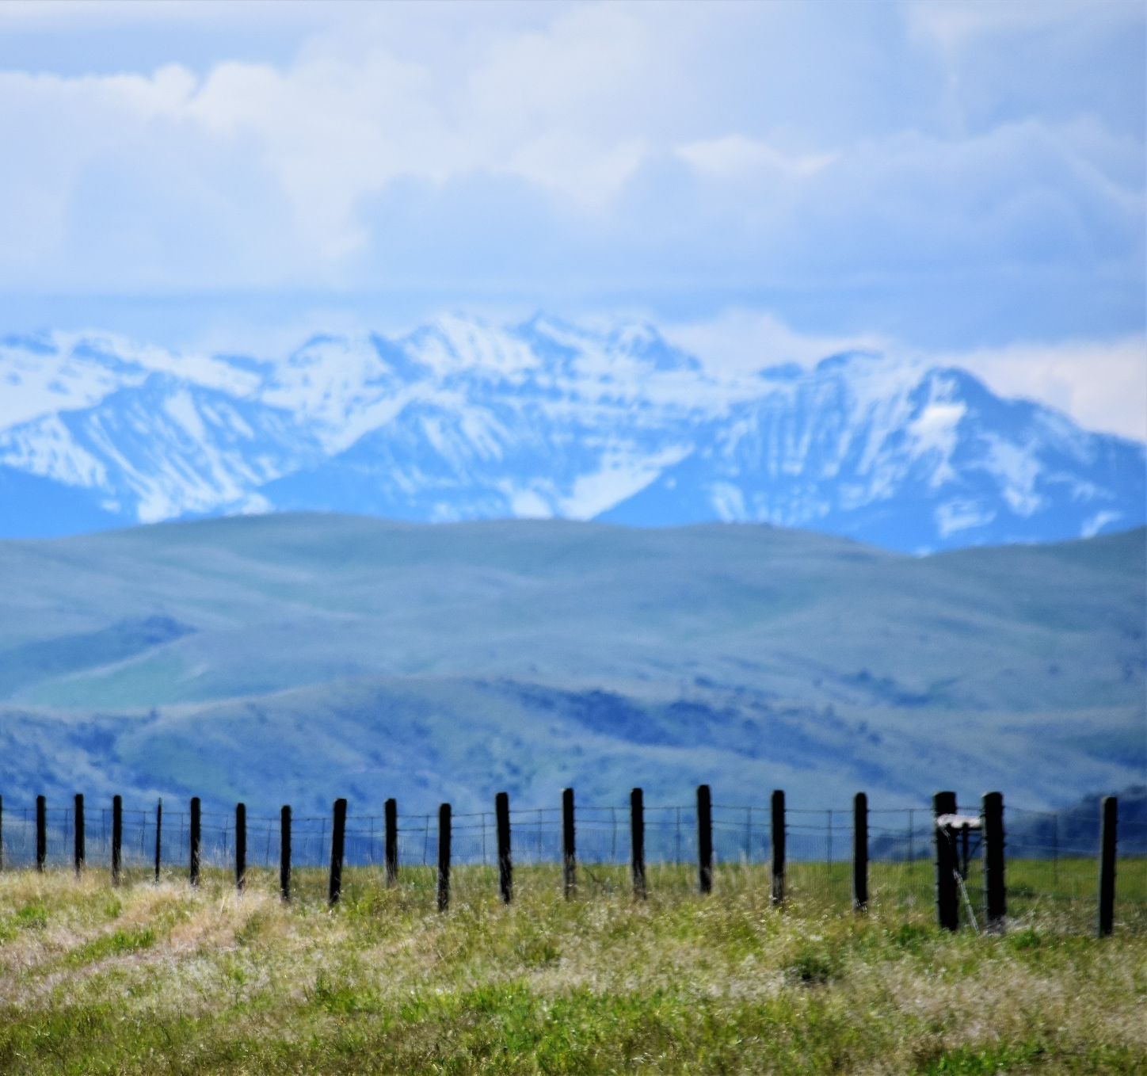
Conclusions
The CMI provides a holistic measure of moisture conditions on regional scales throughout the Missouri River Basin
Improved accuracy in describing moisture storage states with the addition of indicators
Image Credit: ”Kerry”
Notes:
The CMI was found to be successful in reflecting general wet and dry conditions across the basin at both the pixel ~26km resolution and HUC6 resolution for the Missouri River Basin. The CMI provides a holistic understanding of soil moisture conditions in the Missouri River Basin and serves as a useful tool for out partners. The CMI will aid in analyzing and predicting seasonal moisture conditions that will further facilitate efforts drought and flooding events before they occur.
We improved the accuracy of the CMI in capturing moisture storage states by adding groundwater storage and streamflow as indicators in the CMI
Our team also completed a sensitivity analysis and a principal component analysis of our CMI input parameters to understand how each metric contributes to the CMI in relation to spring streamflow conditions. Results of the sensitivity analyses will be reported in future DEVELOP materials.
------------------------------Image Information Below ------------------------------
•Image Credit: “Kerry”
•Image Source: https://www.pexels.com/photo/black-wooden-fences-and-green-grasses-534394/

Slide 20
Spatial resolution discrepancies among datasets
Influence of upper HUC streamflow into lower basin
Assumptions about data distribution
Errors and Uncertainties
Clipart source: Microsoft Office 365​​
Notes:
One major source of uncertainty in our calculations stems from the variance in native resolutions of our datasets. Resampling data onto a common grid results in a loss of some information.
Another limitation is that upstream conditions may block signals of local moisture conditions in lower HUC's. Future work should consider only local hydrology by subtracting the sum of all upstream HUC-6 discharge values from the from the discharge at the local HUC-6 basin
We are making the assumption that we have a perfect normal distribution when converting GRACE percentile data into anomaly value in order to incorporate into the CMI
------------------------------Image Information Below ------------------------------
Clipart source: Microsoft Office 365

Slide 21
Automated Mapping
Sensitivity Analysis
Consider only local hydrology in lower HUC's
Identify snowmelt timeframe
Future Work
Clipart source: Microsoft Office 365​
Notes:
* Future teams could consider improving on customization and automation of the CMI, into an updating map similar to the U.S Drought Monitor.
* An automated CMI could automatically pull data from an FTP Server and calculate CMI values from the updated data sets. This would remove the need to manually update the data each time new values are calculated.
* Future teams may also consider customizing the weighted values to include or exclude relevant databased on seasonal conditions. For example, the CMI includes snow depth data that would likely be less relevant during the summer months. Integrating a method that adjusts to the variation in seasonal conditions would further optimize the CMI ability to meet the needs of UMRB communities.
------------------------------Image Information Below ------------------------------
Clipart source: Microsoft Office 365

Slide 22
This project was made possible through the support and mentorship of the following:
Julie Sorfleet, Dean Burkowitz, Egla Ochoa-Madrid, and Andrew Shannon - DEVELOP Montana Water Resources I
Ronald Leeper, Research Associate at NOAA National Centers for Environmental Information, North Carolina Institute for Climate Studies - Science Advisor
Kelsey Jencso, Montana State Climatologist at the Montana Climate Office
Zachary Hoylman, Assistant Climatologist at the Montana Climate Office
Kevin Low, Hydrologist at NOAA, National Weather Service, Missouri Basin River Forecast Center
Doug Kluck, NOAA Regional Climate Services Director, Central Region
Andrew Hoell, NOAA Meteorologist
Kevin Stamm, Senior Hydraulic Engineer at US Army Corps of Engineers, Northwestern Division
Kevin Grode, Missouri River Basin Water Management Reservoir Regulation Team Lead at US Army Corps of Engineers, Northwestern Division
Britt Parker, NOAA Regional Drought Information Coordinator
Notes:
We would like to thank all who helped make this project possible. Without their help, our project would not have been successful

