Slide 1
Ellicott City
Disasters III
Building a Real-Time Statistical Flood Model for Improving Early Warning Systems in Ellicott City, Maryland
Erika Munshi, Alina Schulz, Eli Orland, Ryan Hammock
Maryland – Goddard
Notes:
Hello everyone! My name is Erika and I had the pleasure of serving as the Team Lead for Goddard’s Ellicott City Disasters III team. We are very excited to share the progress we have made on creating a real-time flood prediction tool for early warning systems in Ellicott City, Maryland.

Slide 2
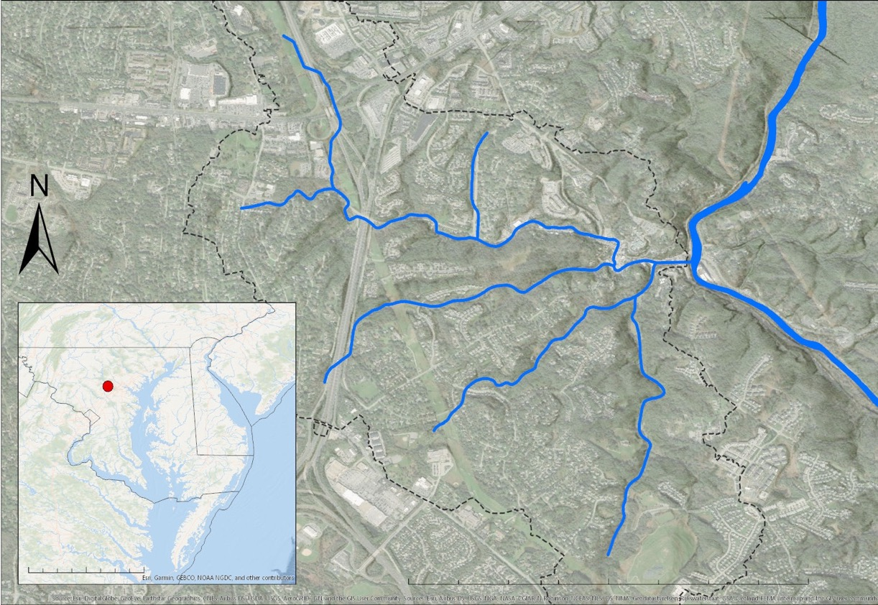
ELLICOTT CITY, MARYLAND
Located on the Patapsco River in Howard County, MD
City population just over 72,000 in 2020
Over 1,000 residents living in the Historic Downtown
Tiber Hudson Watershed Boundary
Historic Downtown
PATAPSCO
PA
NJ
RIVER
Ellicott City
MD
DE
VA
ATLANTIC OCEAN
0
25
50
100 Miles
0
0.5
1
2 Miles
Notes:
Ellicott City is a historic town in Howard County, MD. It is home to over 72,000 residents, many of whom share close ties with the historic downtown district. Located where the Tiber, Hudson, and New Cut rivers join the Patapsco River, the historic district is particularly vulnerable to flood events. The Howard County Office of Emergency Management is interested in employing new technologies in remote sensing to make Ellicott City more resilient to flood events.
Image Credits: Esri, generated by EC Disasters III Team

Slide 3
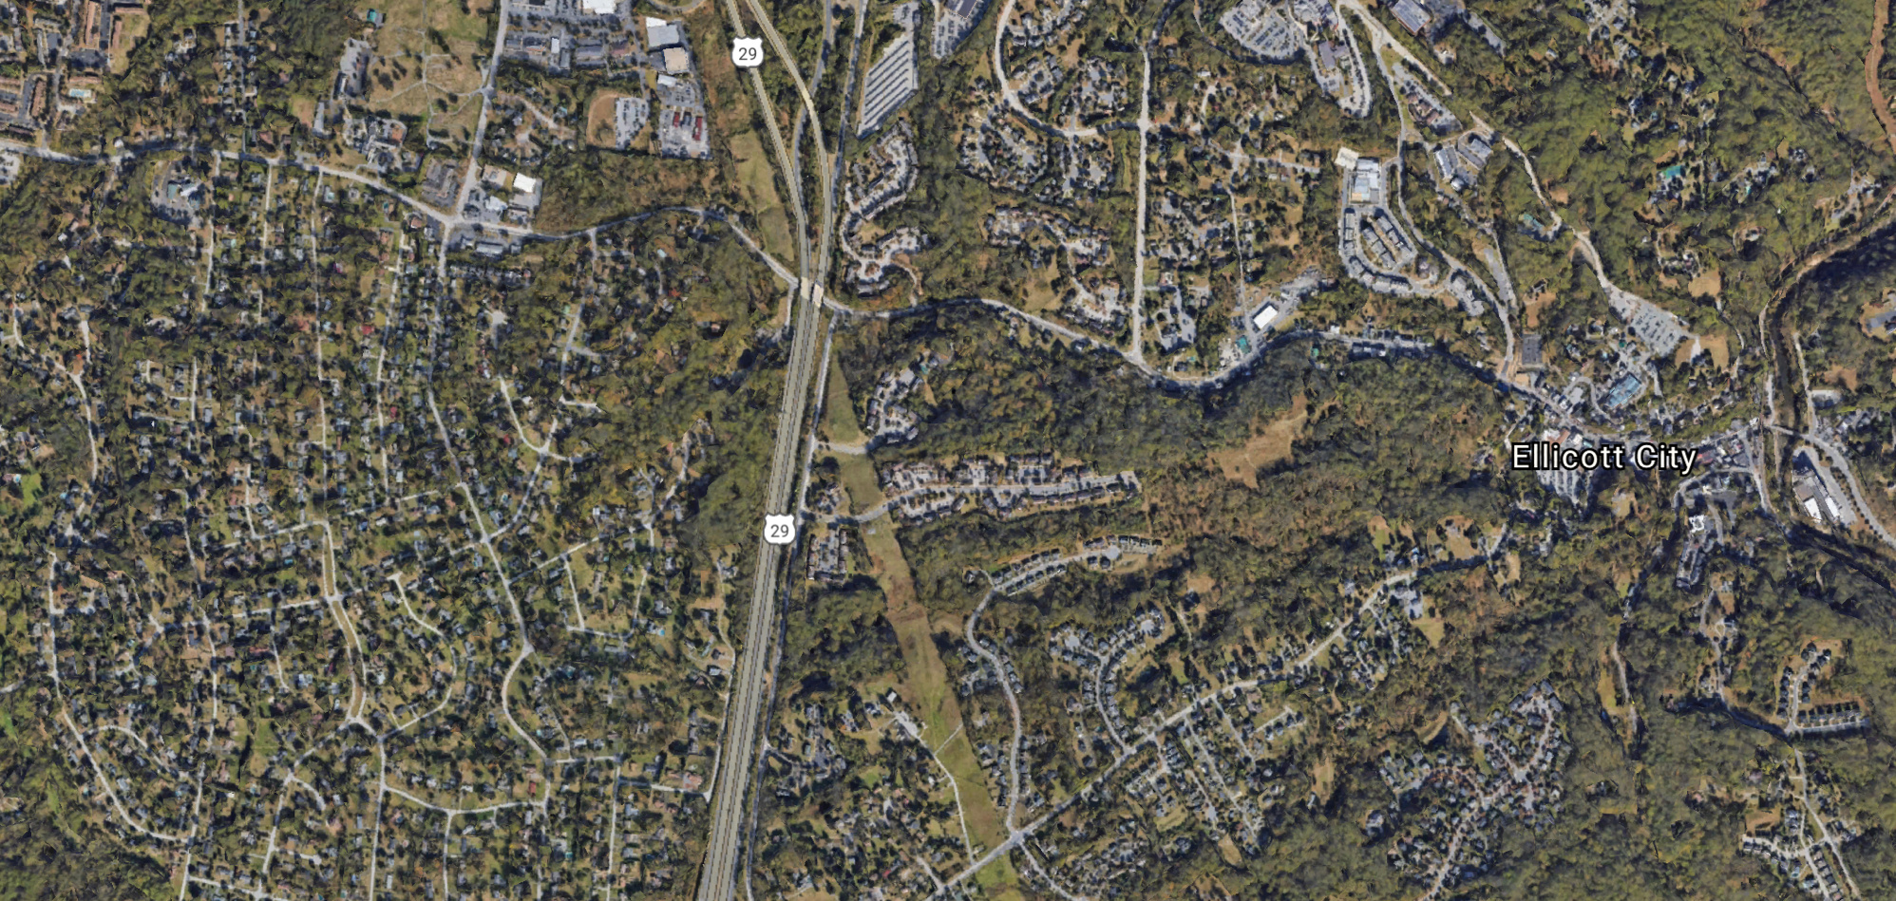
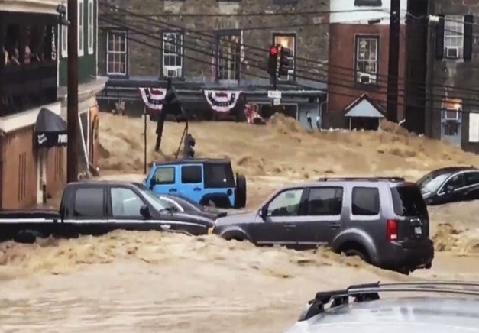
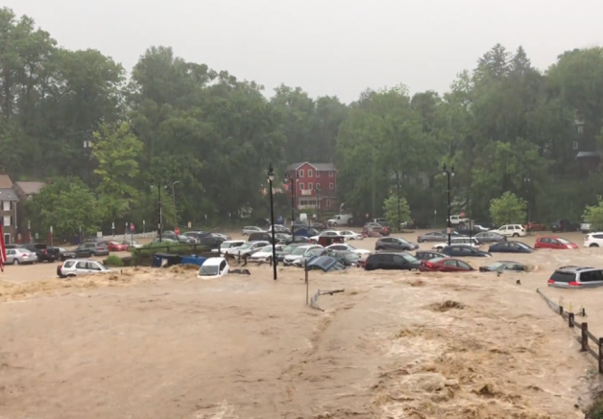

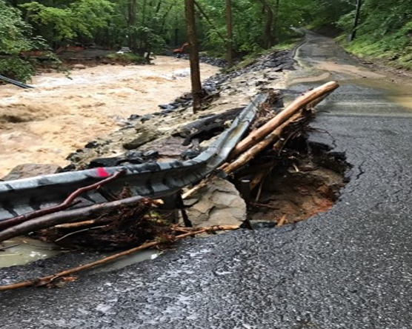
COMMUNITY CONCERNS
Image credits: Libby Solomon, Baltimore Magazine, Ron Peters
Notes:
Over the last 10 years, the city has been devastated by major flooding events.
*CLICK*
*CLICK*
As shown in these photos, the intensity of the floods is enough to move cars, destroy buildings, and wash-out roadways.
*CLICK*
The damages incurred by these flood events have lasting impacts that harm businesses, residents, and public infrastructure. In order to protect the city, the Office of Emergency Management has developed an early warning system to alert residents of flooding events. Our goal is to help improve OEM’s early warning system through implementing a real-time flood forecasting tool.
Image Credits:
Top left: Image produced by Libby Solomon for The Baltimore Sun, available under Creative Commons License
Top right: Image from Baltimore Magazine, available under Creative Commons License
Bottom left: Resident Photo (permission granted by owner and HC OEM)
Bottom right: Ron Peters, EC Resident (permission granted, release form signed)
Background Image: Google Earth

Slide 4
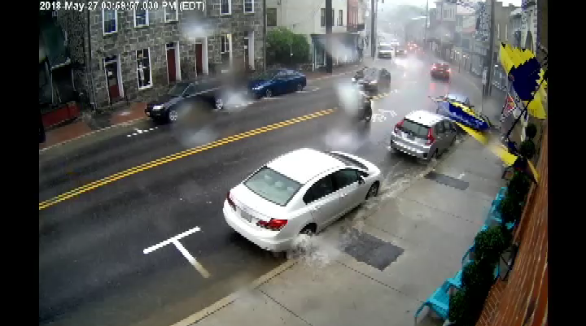
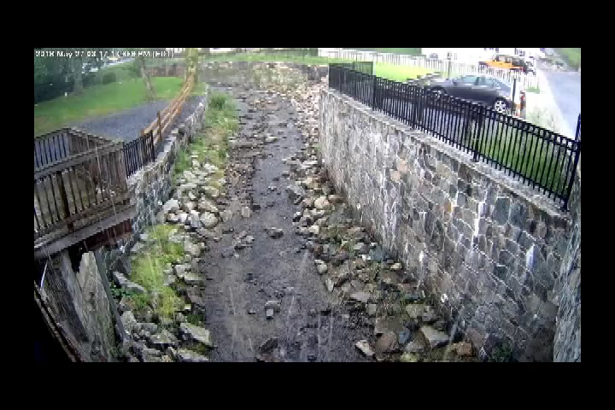
PREVIOUS FLOOD EVENTS
Historic Main St.
Residential Area
May 27th, 2018 Flood Event
2-hour time lapse
Source: Ron Peters
Notes:
These time lapse videos show a thousand-year flood event from May 27th, 2018 that devasted Ellicott City’s historic downtown. These videos capture just two vantage points of the damage incurred by that particularly flooding event. In addition to the destruction of property, businesses, and infrastructure, the increasing frequency and severity of flood events poses a direct threat to the health and safety of residents. The rapid onset of severe flood conditions illustrates the need for proactive emergency management procedures, which is the primary motivation behind this project.
Video Credit: Ron Peters (permission granted)

Slide 5

PARTNERS
NOAA - NWS - Baltimore-Washington Weather Forecast Office
Stormwater Management Division
Office of Emergency Management
Howard County Gov
Howard County Gov
Notes:
To inform our project objectives, the DEVELOP team partnered with the NOAA and National Weather Service Weather Forecast Office as well as Howard County’s Stormwater Management Division and Office of Emergency Management. Building on the foundation set by the previous two DEVELOP terms, we continued to work with our partners to identify appropriate real-time data sources, improve our model, and develop a user-friendly interface.

Slide 6

A THREE-TERM PROJECT
Assessed Machine Learning
Feasibility Using NASA Earth
Observations
Improved Deep Learning
Model Using LSTM
Architecture
Increased Predictive
Capacity and OneRain
Integration
FLASH
FLuME
Sequentially Trained Real-time EstimAted Model
STREAM
Image credit: DEVELOP Team, NextAvenue
Notes:
The model developed during this term builds on two prior DEVELOP teams’ work.
*CLICK*
During the first term, the team developed the Flood Learning Model Environment, or FLuME, which showed that the machine learning approach was effective for modeling floods. FLuME, however lacked the capacity to forecast future flood events.
*CLICK*
To address this, the second DEVELOP team focused on using deep learning techniques to create a new model with the ability to forecast future flood events This model, titled the Flood Learning Environment and Severity Assessment Hub (or FLASH) used a Long Short-term Memory architecture to predict flood events based on precipitation metrics and gauge data. This model was capable of forecasting between 15mins and 3 hours in advance of a flood event, with decreasing confidence for each time step beyond the 15-minute prediction.
*CLICK*
During the current and final term of the project, our team modified the previous FLASH model to incorporate real-time and forecasted data. Our final model, titled STREAM or Sequentially-Trained Real-time EstimAted Model, incorporates forecasted weather products in to a sequence to sequence deep learning architecture. This allowed us to increase the predictive capacity of the model and provide forecasts up to 8 hours in advance. We then integrated our model into an online platform for partner use in decision-making.
Images: licensed under CC0 Public Domain
Brain - Nextavenue: https://www.nextavenue.org/best-way-improve-brain-health/
FLuME, FLASH, and STREAM graphics created by DEVELOP terms I, II, and III

Slide 7
OBJECTIVES
Increased Predictive
Capacity and OneRain
Integration
Reconstruct model using Sequence-to-Sequence (multi-step) architecture
Utilize real-time and forecasted datasets to increase predictive capacity
Sequentially Trained Real-time EstimAted Model
Integrate model outputs into an online platform for partner use
STREAM
Notes:
To meet our goals, we identified 3 primary objectives:
First, we wanted to reconstruct the FLASH model developed by the previous term to incorporate a sequence-to-sequence architecture, which we will describe in greater detail later on in the presentation.
Second, we built our model using real-time and forecasted data to increase our flood forecast window. The resulting model is called STREAM
Lastly, incorporated our model output in an interactive portal for our partners to use.

Slide 8


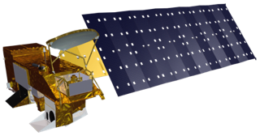




METHODOLOGY
Data Acquisition
Model Development
Real-time Model Output
In situ gauges
STREAM
Iterative Data Visualization
GOES-16 Earth Observations
Stage Height Prediction
OneRain
Portal Integration
NOAA Real-time and Modeled Weather Products
Sensitivity and Error Analysis
Source: DEVELOP Team, Behance
Notes:
(PLAY ANIMATIONS IN PRESENTATION VIEW TO SEE SLIDE ELEMENTS)
Our methodology has 3 primary stages: Data Acquisition, Model Development, and Real-time Model Output:
*CLICK*
We used a variety of both remotely sensed NASA and NOAA data as well as in situ gauge data to train and test our machine learning model. We also use real-time modeled weather products to allow our model to predict future out into the future.
*CLICK*
To develop the model, we used a deep-learning architecture called a Long Short-term Memory network. We will discuss the inner workings of the Long Short-term Memory network in the following slide. This type of model allowed us to create stage height predictions for up to 8 hours in advance of the current time point. We then conducted a sensitivity and error analysis to provide a measure of confidence for our stage height predictions
*CLICK*
Our final step was to integrate our model outputs in to an online platformed for our partners, called OneRain. We wrote scripts to iteratively run our model and output real-time stage height forecasts for the Hudson Branch in Ellicott City.

Slide 9


NASA Earth Observations
GOES - 16
Modeled Weather Products
STREAM
STREAM
Notes:
The NOAA Modeled Weather Products used in the model are built using GOES-16 Earth Observations data.

Slide 10
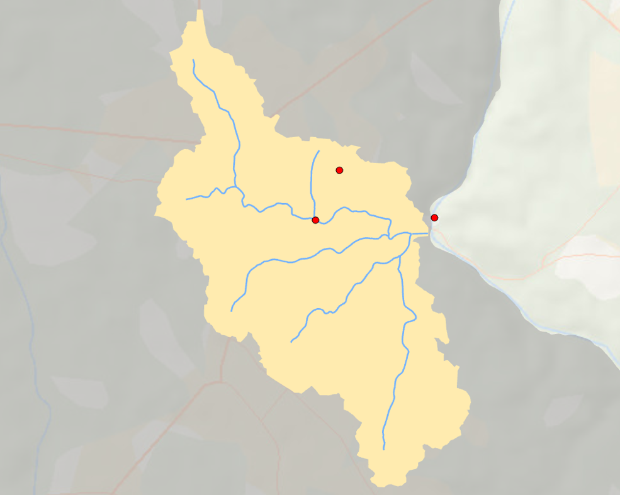
Gauge Data
Tiber-Hudson Watershed Gauges
Howard County Gauges:
  Rain Gauge
  Ellicott City Stage Gauge
  Hudson Branch Stage Gauge
    STREAM predicts stage height at this gauge
Rain Gauge
Ellicott City Stage Gauge
Hudson Branch Stage Gauge
Historic Downtown
Howard County, Maryland
N
Tiber Hudson Watershed,
Ellicott City
0
1
Miles
Notes:
To supplement the NASA and NOAA earth observations data, we also used in-situ gauge data from 3 gauges located in and around Ellicott City. We used a rain gauge to assess real-time precipitation as well as two stage height gauges maintained by Howard County. The Hudson Branch stage gauge, labeled in green on the map, is the gauge that our model STREAM has been designed to predict river height for.

Slide 11
MODEL INPUTS
Input Data
Total Hourly Precipitation
(OneRain, in)
Forecasted Precipitation
(HRRR, kg/m²)
Real-time Radar
(NEXRAD, in)
Ellicott City Stage Height
(OneRain, ft)
Hudson Branch Stage Height
(OneRain, ft)
Predicted Values
Notes:
Here, we provide more detailed description of our model inputs, which include hourly precipitation data from a rain gauge located just outside of Ellicott City, forecasted precipitation data from the HRRR model (produced by NOAA), forecasted precipitable water data from the HRRR model, real-time radar data from NEXRAD, and Stage Height measurements from the Hudson Branch sensor in Ellicott City.

Slide 12
MODEL DEVELOPMENT
Inputs
LSTM Approach
Forecasted Stage Height
T ₋₃
Ellicott City Stage Height
Precipitation
T ₋₂
Forecasted Precipitation
T ₋₁
Predicted Values
Real-time Stage Height
T ₀
= Time Series
T_{-n}
T₀
T_{n}
Notes:
The graphic shown here represents a simplified version of our neural network model. The model takes in a time series of current and forecasted input data described in the previous slide, and shown here by the colored tabs on the left…
*CLICK*
…runs it though our Long Short-term Memory architecture…
*CLICK*
…and outputs a time series of prediction values for stage height in Ellicott City. Our model follows an encoder-decoder approach wherein input data is joined by timestamp…
*CLICK*
…. denoted here by the T₀, T₋₁, T₋₂, and T₋₃ values….
*CLICK*
…and evaluates them to produce a layer of latent data…
*CLICK*
or hidden values, denoted by the blue circles…
*CLICK*
which, when combined with many observations, allows the model to learn and predict future timesteps.
*CLICK*
*CLICK*
The output of the model is a continuous series of predicted values which form the stage height forecast, shown in the sample graph.

Slide 13




MODEL PERFORMANCE
Predictions
Observed Data
Warning
Alarm
NSE = 0.82
Hudson Branch Stage Height (ft)
Notes:
In order to test our model, we chose to hindcast the 2018 flood event and treated the observed 2018 stage height as a validation dataset. In this hydrograph, you can see an example of our model prediction in blue and the actual observed stage height values for the 2018 flood event in black. As you can see, the model was able to accurately predict both the magnitude and the timeline of the flood event.
*CLICK*
You can also see the warning and alarm thresholds developed by the Office for Emergency Management. When the hydrograph values pass the thresholds, it signals that the warning and alarm systems should be initiated.
*CLICK*
Lastly, we used a Nash-Sutcliffe Efficiency metric (or NSE) to assess the accuracy of our model. The NSE score was 0.82, which suggests that our model has high predictive power.

Slide 14
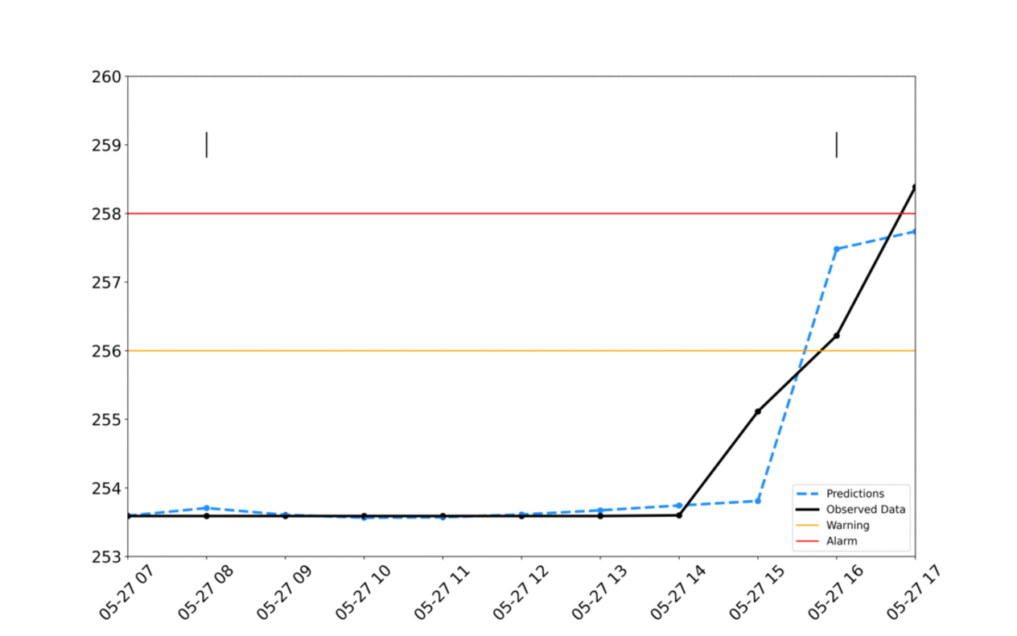
MODEL PERFORMANCE
Predictions
Observed Data
Warning
Alarm
Insert gif here
Hudson Branch Stage Height (ft)
Notes:
This animation illustrates what a sample model prediction for a flood event might look like in real time. Again, we are hindcasting a previous flood event, so we’ve also provided the observed data in black for comparison. While this animation only illustrates what 3 timesteps in the forecast would look like, our partners would have access to a regularly updating model output with a new 8-hour forecast every hour. To understand what we’re seeing, we’ll look at each time step individually in the next couple slides.

Slide 15
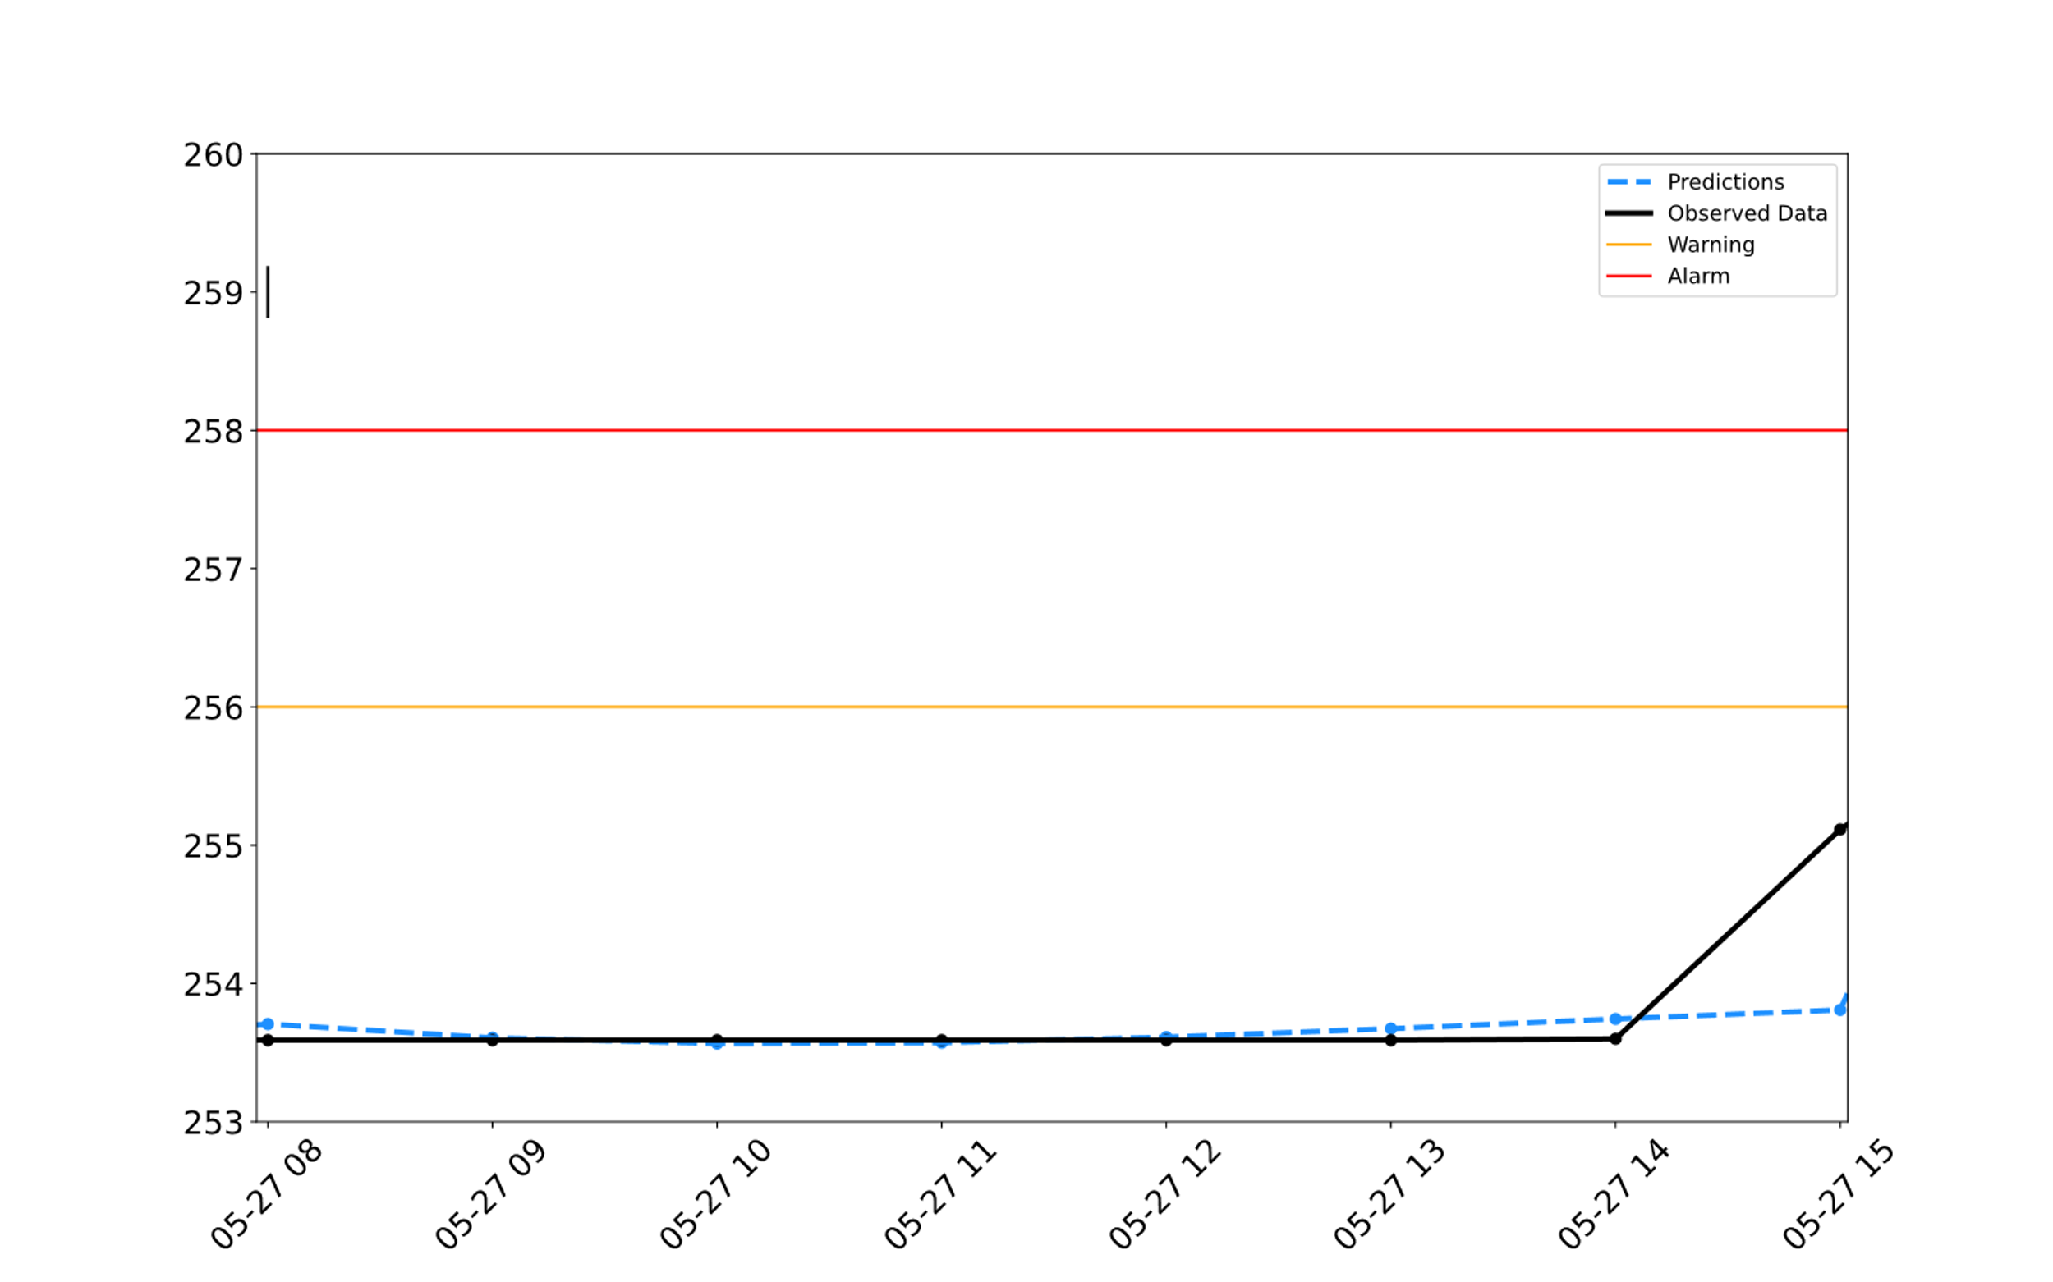
MODEL PERFORMANCE
Predictions
Observed Data
Warning
Alarm
Hudson Branch Stage Height (ft)
Notes:
As you can see in the first time step, which is 8-10 hours prior to a flood event, we begin to see the model anticipating an increase in stage height.

Slide 16
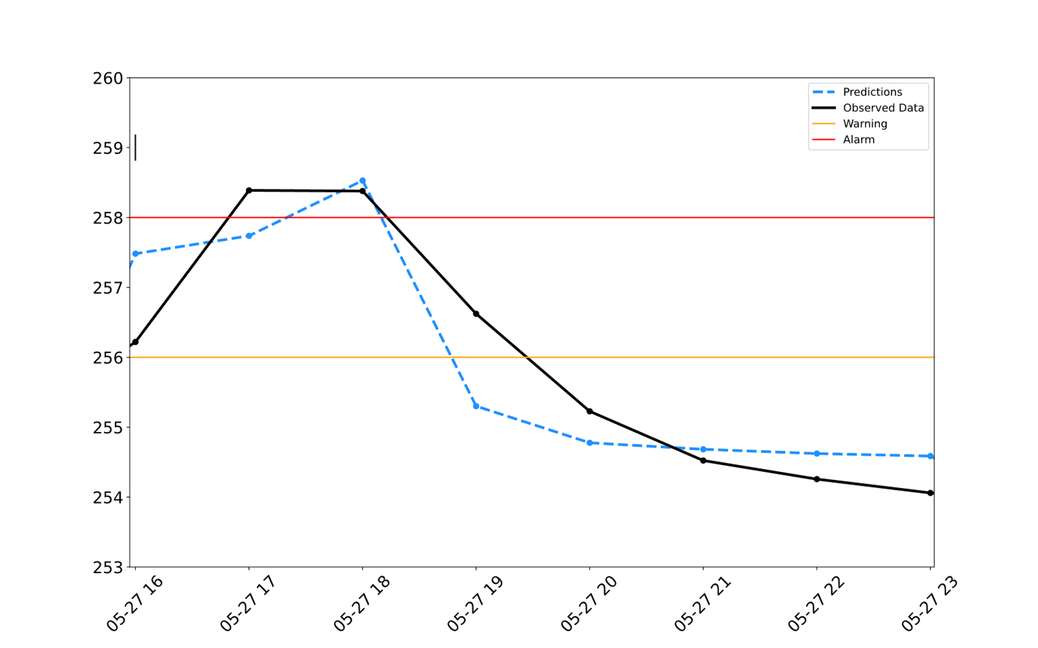
MODEL PERFORMANCE
Predictions
Observed Data
Warning
Alarm
Hudson Branch Stage Height (ft)
Notes:
As we get closer to the start of the flood event, however, we see an 8-hour prediction that captures the timing and magnitude of the event. This forecast, which is from an hour before the start of the flood event, illustrates how an alarm system can be triggered well before the flood event occurs. Although we’ve depicted 8-hour forecasts for ease of presentation, our model updates hourly, so if it has access to accurate forecasted weather products, the model has the capacity to alert relevant stakeholders several hours before the flood—not just an hour prior, like shown in this example.

Slide 17
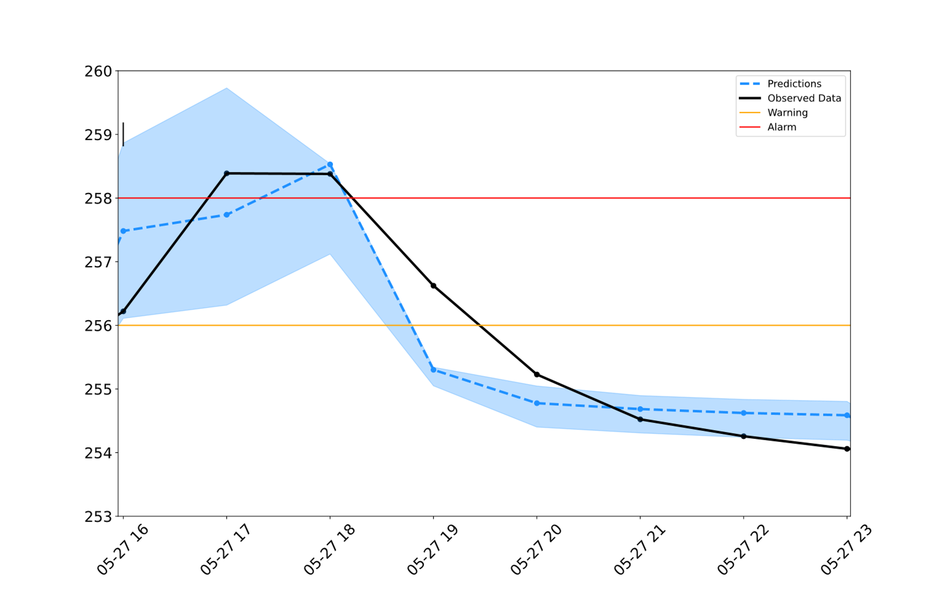
MODEL PERFORMANCE
Predictions
Observed Data
Warning
Alarm
Doubled Rainfall
Hudson Branch Stage Height (ft)
Halved Rainfall
Notes:
We recognize, however, that the forecasted weather products used in our model may not always be 100% accurate, so we’ve taken steps to make our model robust against these inaccuracies. In this example, we doubled the expected forecast for the main flood prediction interval to see how the model responded. This is represented by the upper outline of the shading. We did the same for a lower forecast estimate, which is the lower outline. Based on these upper and lower bounds, we can expect the majority of forecast errors to result in predictions somewhere between this range. As you can see, the timing and peak of the main flood event can differ based on the forecasted precipitation data inputted into the model. This illustrates the importance of having accurate modeled weather products in our model, which is both a strength and limitation of the tool.

Slide 18
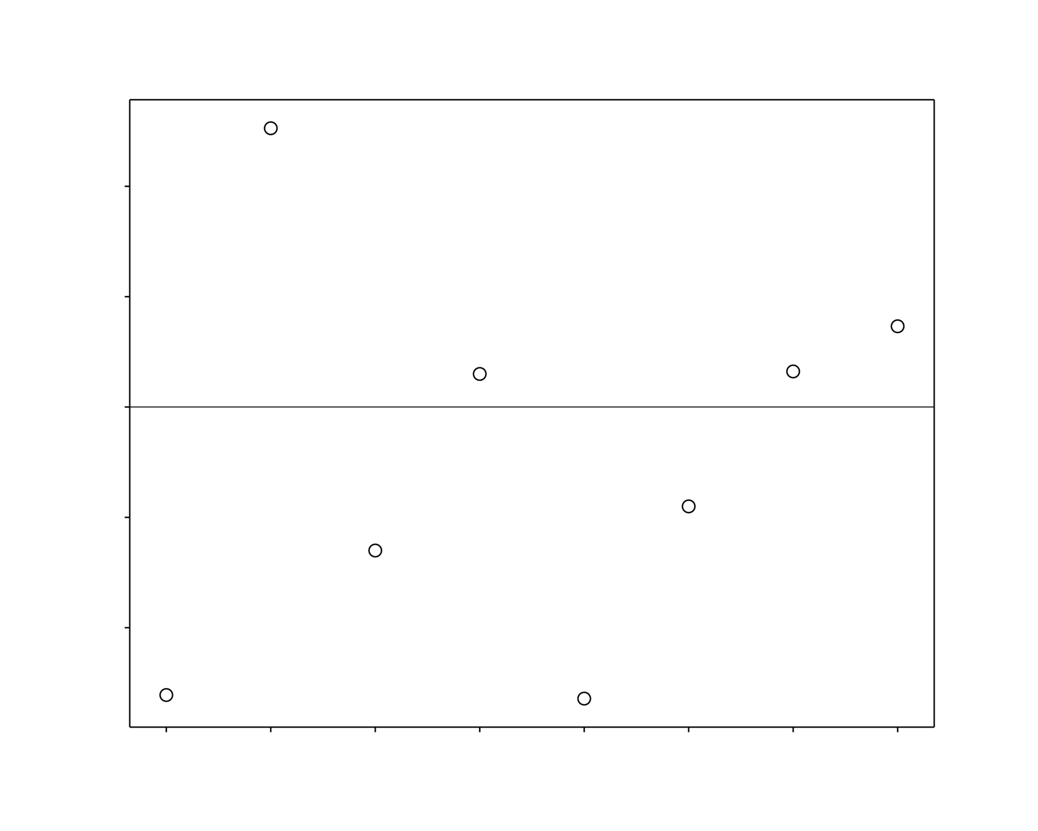
MODEL PERFORMANCE
Model Overpredictions
Prediction Error
Onset of Peak Magnitude
Model Underpredictions
Hours Relative to Peak Flood Magnitude
Notes:
It's also important to understand how the model focuses on showing the rising and falling limbs of our hydrograph. This figure shows how the model over- or underestimates the rising and falling limb values. Overall, this error is plus/minus one foot of the observed streamflow, in addition to very closely approximating the peak flood magnitude.

Slide 19
MODEL LIMITATIONS AND ASSUMPTIONS
Sequence-to-Sequence architecture used in the model assumes that the timesteps are equal and therefore, can only take data in at fixed intervals.
The model uses real-time data; therefore the accuracy of the model is limited by how accurate the real-time data is.
The model will need to be re-trained in the future.
STREAM
Notes:
Additional assumptions of the model are that:
The Sequence-to-Sequence architecture used in the model assumes that the timesteps are equal and therefore, can only take data in at fixed intervals. As a result, input data must be pre-processed to ensure that the time-steps associated with each observation meet the requirements for the model. Because the model pulls in real-time data, the accuracy of the model is limited by how accurate the real-time data is. For example, when training the model we simulated forecast data by using archived forecasts, which we were able to compare to observed data. Once implemented in real-time however, the model relies only on forecasts data (for which there cannot be observed data to match). To make the model more robust we introduced some noise to the training data to better simulate any differences that may be seen when the model is actively inputting real-time forecasts

Slide 20
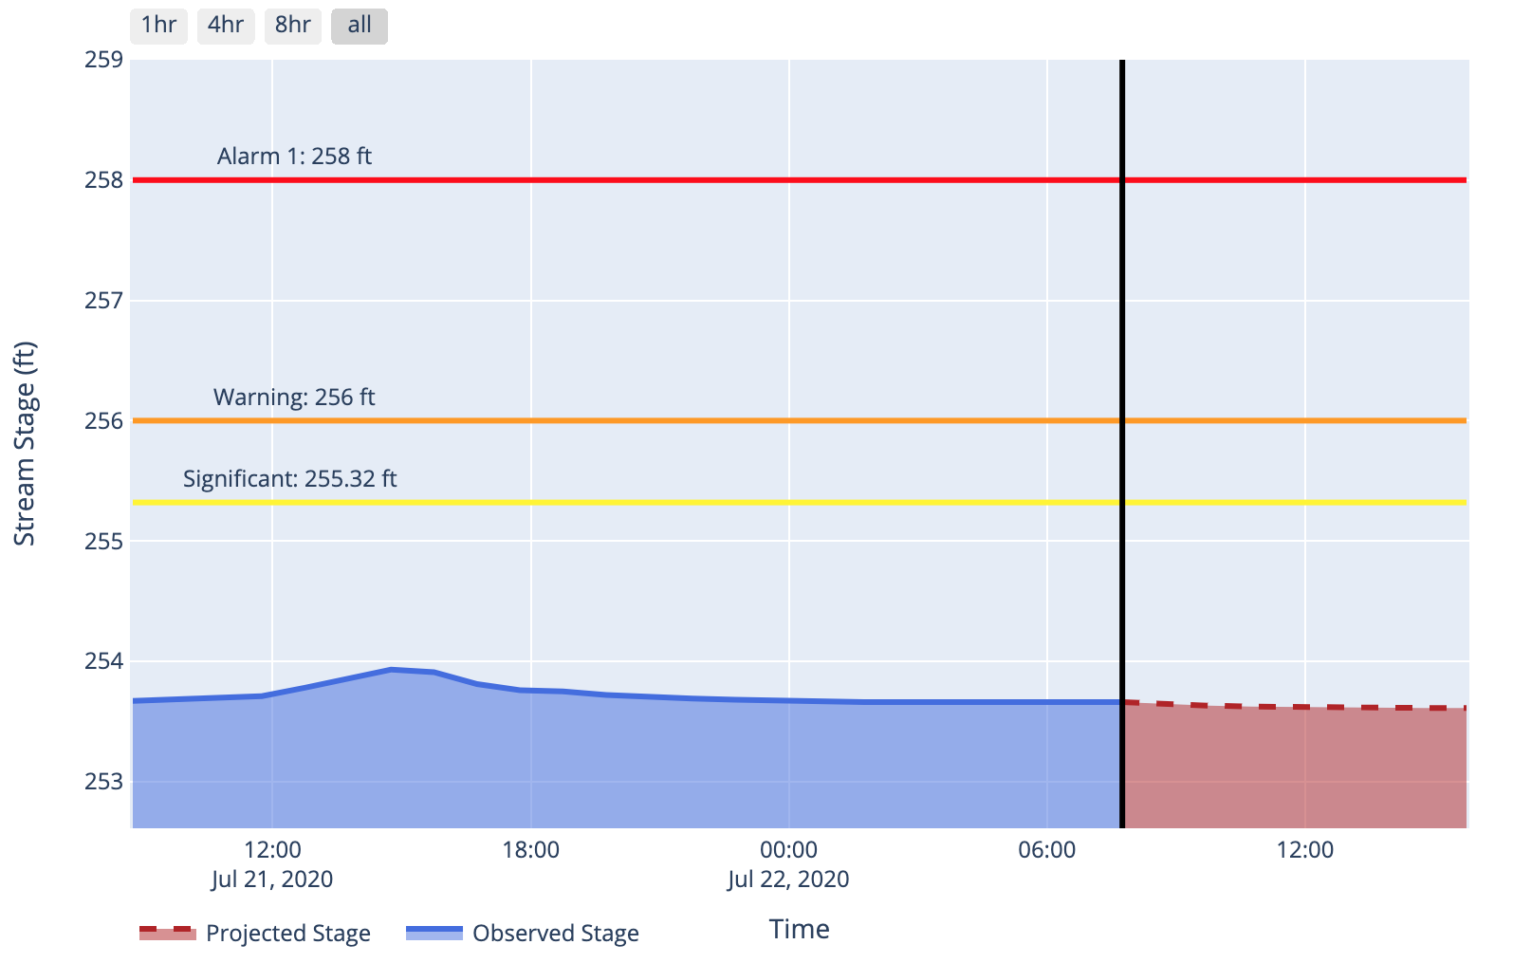


REAL-TIME IMPLEMENTATION
Sample model output for Stage Height as displayed on OneRain
STREAM
Notes:
One the output CSV is produced, the model is displayed on our online portal, OneRain. Here you see a sample display of what the output looks like on the portal. The early warning system thresholds are indicated by the…
*CLICK*
…red…
*CLICK*
…orange…
*CLICK*
… and yellow lines respectively.
This image is showing a snapshot of a real-time forecast from the morning of July 22nd. As you can see here, the model is able to iteratively show forecasts up to 8 hours in advance, displayed in a user-friendly and interactive format.

Slide 21
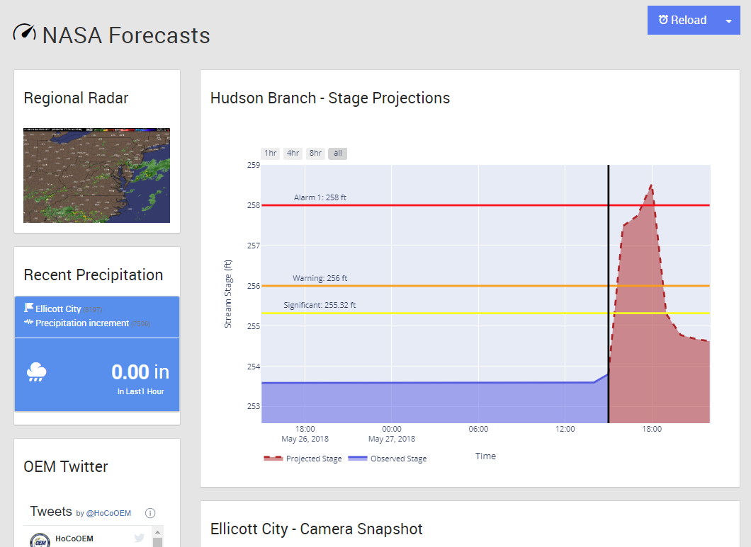
ONERAIN PORTAL
Notes:
This data will have real time applications for the partners. This screengrab shows the portal we've generated and what it would look like if you logged in before one of the flooding events in 2018. Here up top, you can see modelled gauge height for the next 8 hours. On the left the portal also shows you the regional radar, recent precip and the Howard County OEM 's twitter feed.

Slide 22
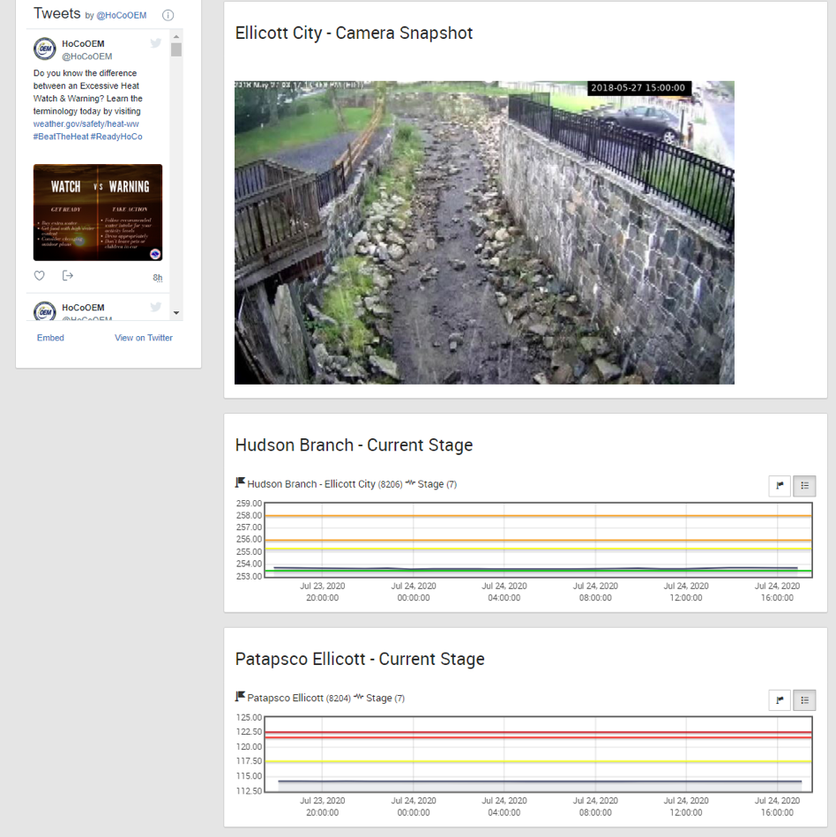
ONERAIN PORTAL
Notes:
If you scroll down, the one rain portal also shows you the most recent capture from the network of cameras and the current stage height at the Hudson Branch and the Patapsco Ellicott Stream Gauges.

Slide 23
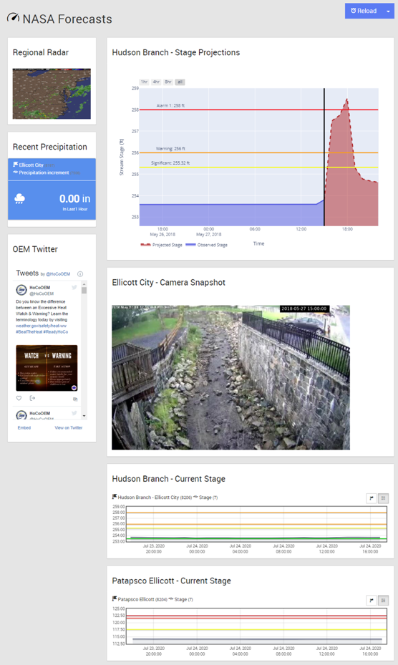
ONERAIN PORTAL
Notes:
So here's what the full portal looks like for the day of a storm.

Slide 24

PROJECT STORYMAP
Notes:
In addition to our real-time model updates fed through OneRain, the team created a storymap to communicate the history of flooding in Ellicott City and the workings of the STREAM model to the public. This storymap walks the public through the history of the 2016 and 2018 flood events in addition to how the team’s model is integrated for real-time use.
::AGOL Story map demo video::

Slide 25
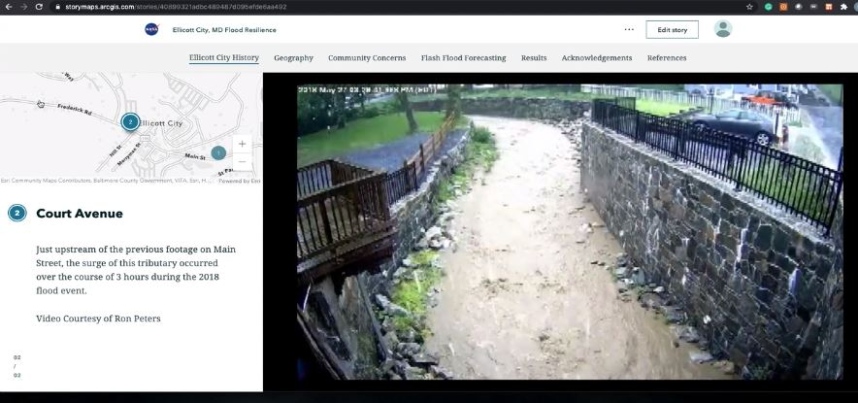
PROJECT STORYMAP
Notes:
::AGOL Story map demo::

Slide 26
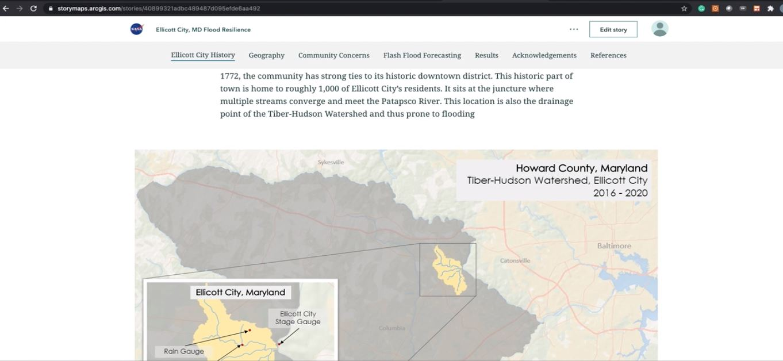
PROJECT STORYMAP
Notes:
::AGOL Story map demo::

Slide 27

CONCLUSIONS
To revisit our objectives:
Reconstructed model using Sequence-to-Sequence (multi-step) architecture
Utilized real-time and forecasted datasets to increase predictive capacity
Integrated model outputs into an online platform for partner use
Notes:
To revisit our objectives,
We managed to build a sequence-to-sequence model…
*CLICK*
…using real-time and forecasted data…
*CLICK*
…and successfully integrated our model outputs on to an online platform

Slide 28

NEXT STEPS
Sample model output for Stage Height as displayed on OneRain
STREAM will be maintained at Goddard Space Flight Center
Sequentially Trained Real-time EstimAted Model
STREAM
Notes:
STREAM will continue to operate beyond the scope of the term. It will be hosted and maintained by NASA Goddard Space Flight Center. The real-time model outputs will continue to appear on OneRain, where the Howard County Office of Emergency Management can continue to use it for their Early Warning System.

Slide 29
Advisors:
Dr. John Bolten, NASA GSFC Lead Science Advisor
  Dr. Sujay Kumar, NASA GSFC
  Perry Oddo, NASA GSFC
Darcy Gray, GSFC Lead/Fellow
Ellicott City Disasters I and II Team, NASA GSFC
  Terra Edenhart-Pepe, Julio Peredo, Caroline Resor, and Callum Wayman
  Alina Schulz, Scott Cunningham, Jonathan Donesky, Matthew Pruett
OneRain Support
  Mike Zucosky, OneRain
  Charles Yost, OneRain
Howard County Partners
  Brian Cleary, Mike Hinson, Shaina Hernandez
  Christopher Strong, Baltimore-Washington Weather Forecast Office of NOAA-NWS
  Ron Peters, Ellicott City resident, Media
  Pete Greer, Ellicott City resident, live video footage

