Slide 1
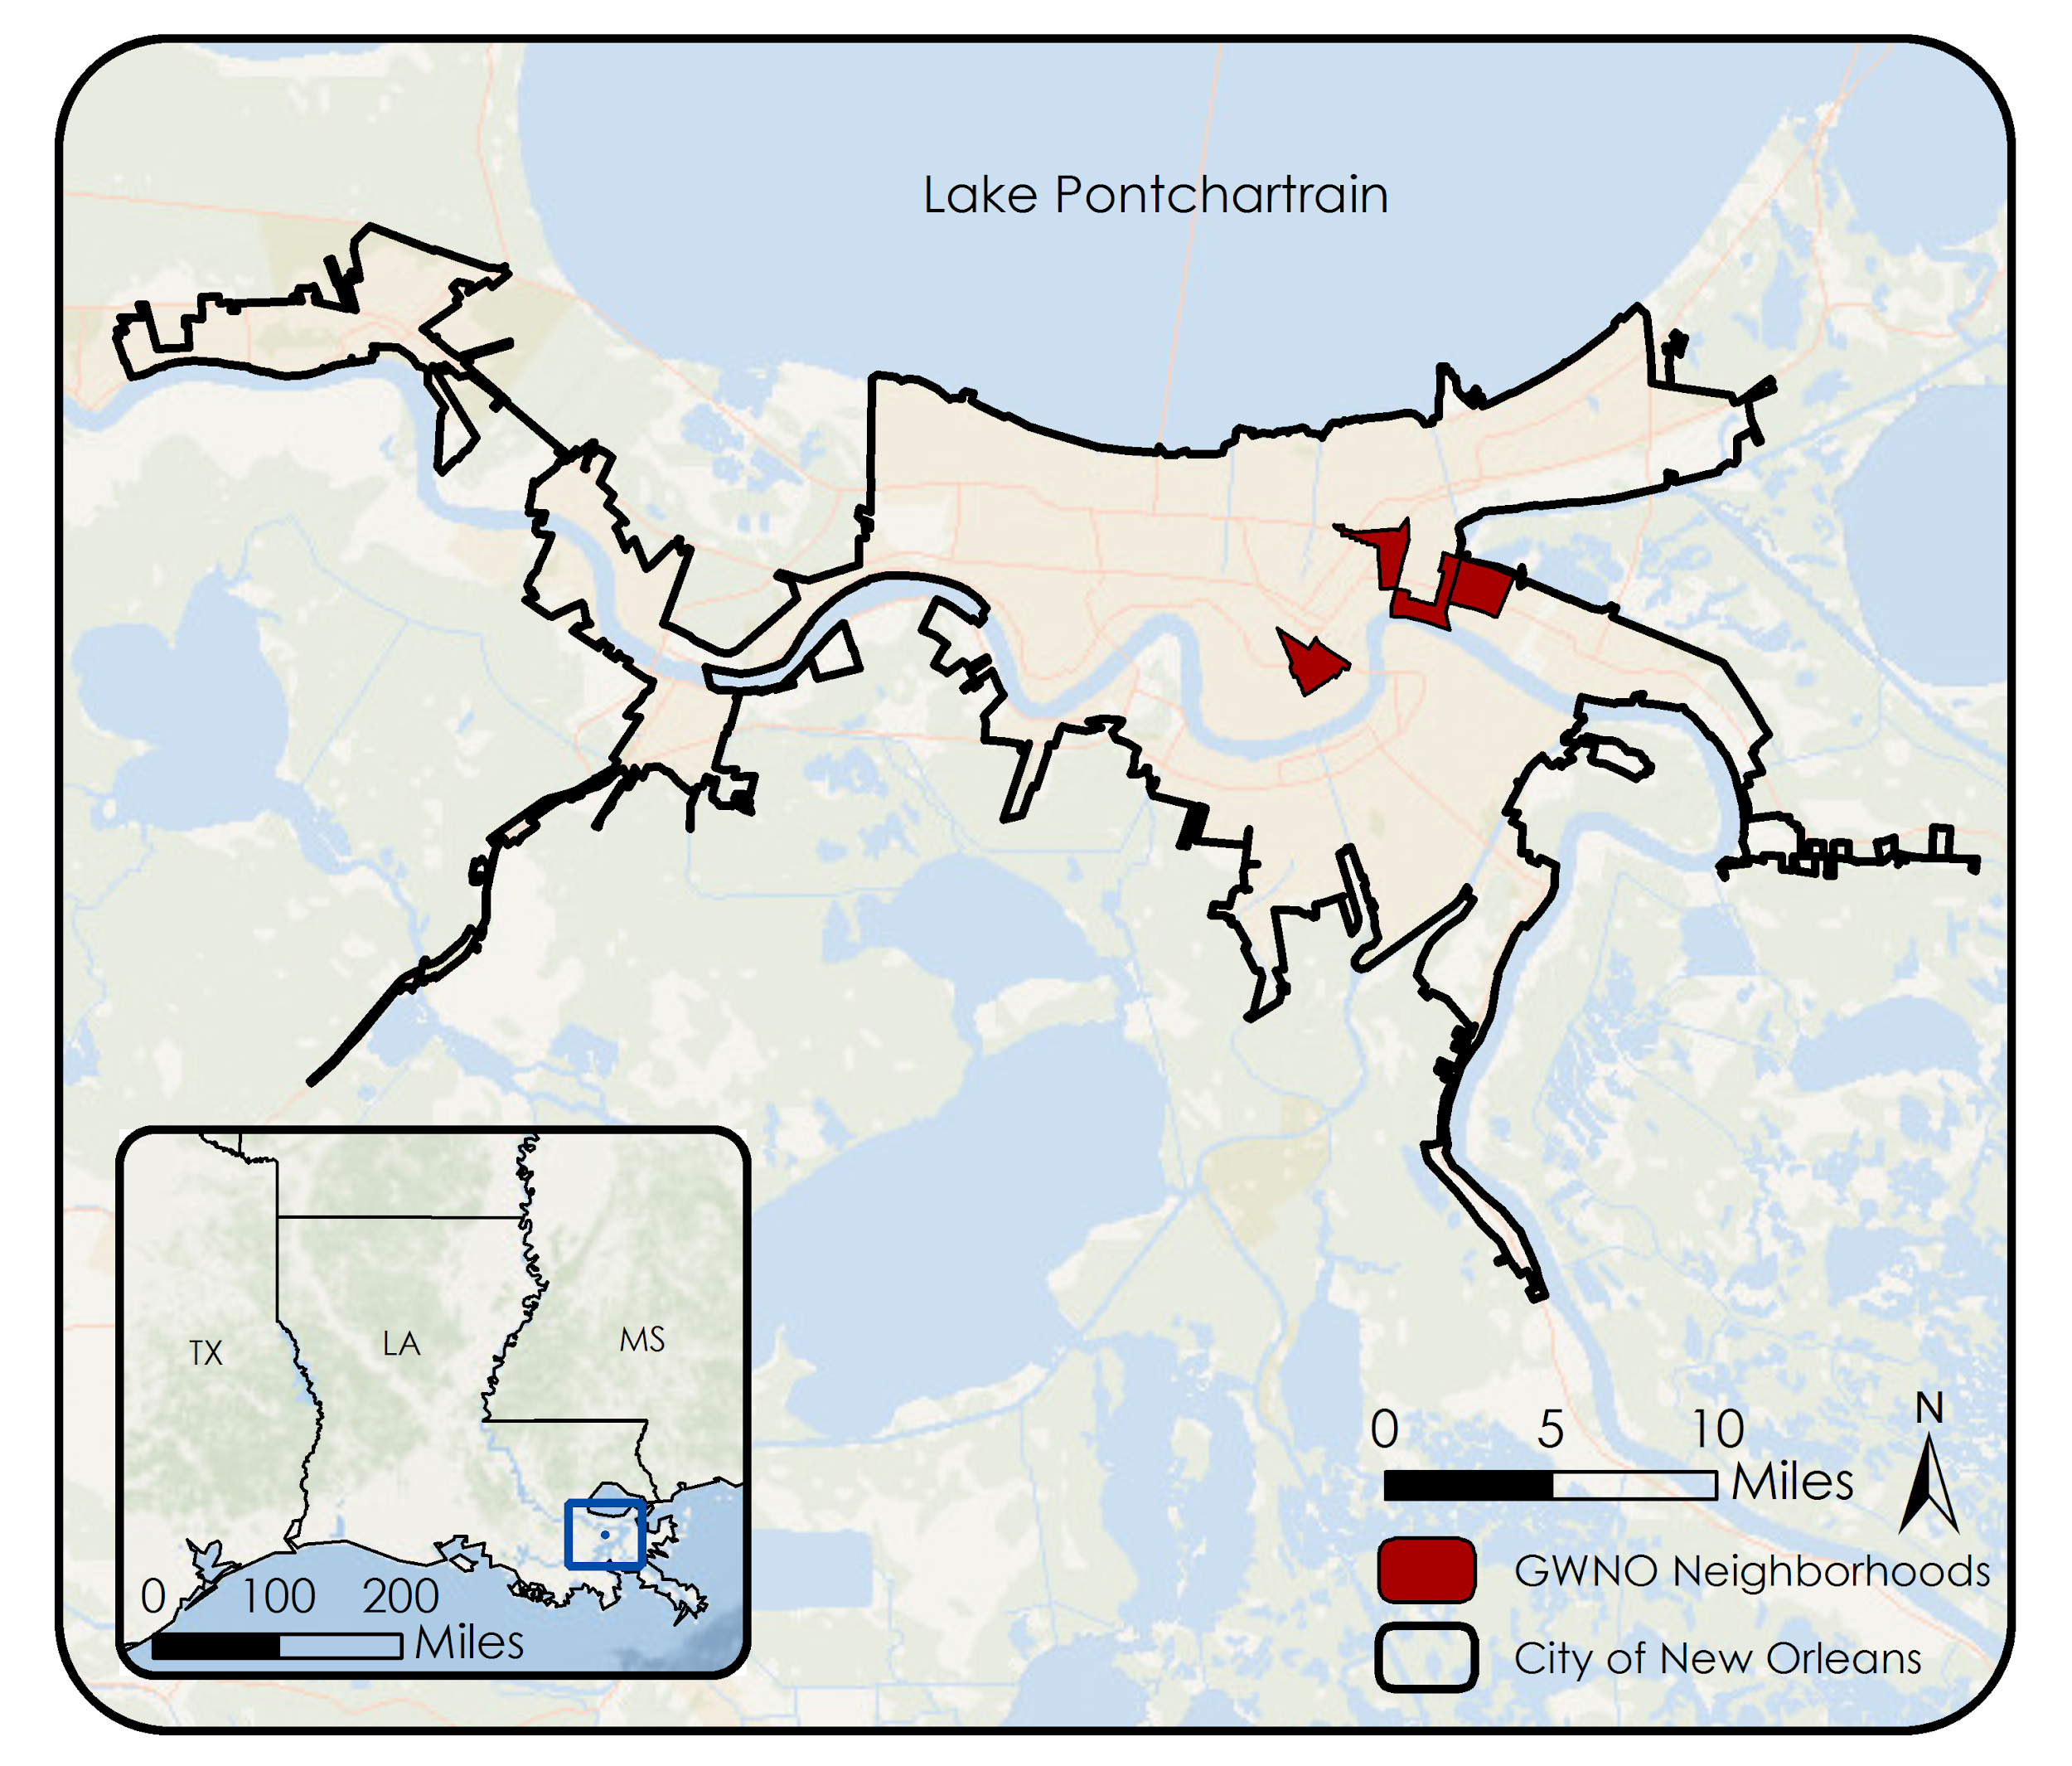
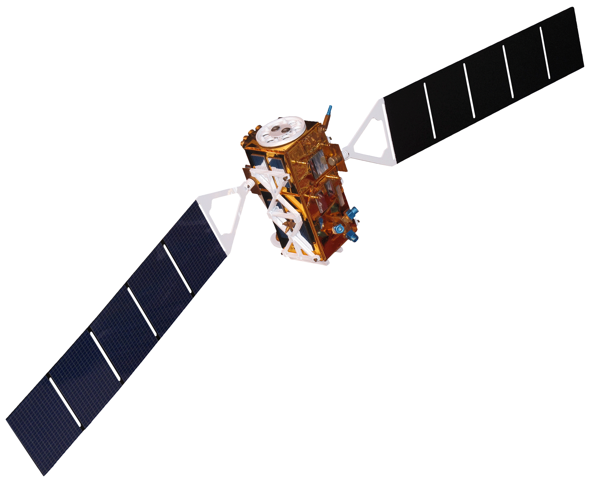
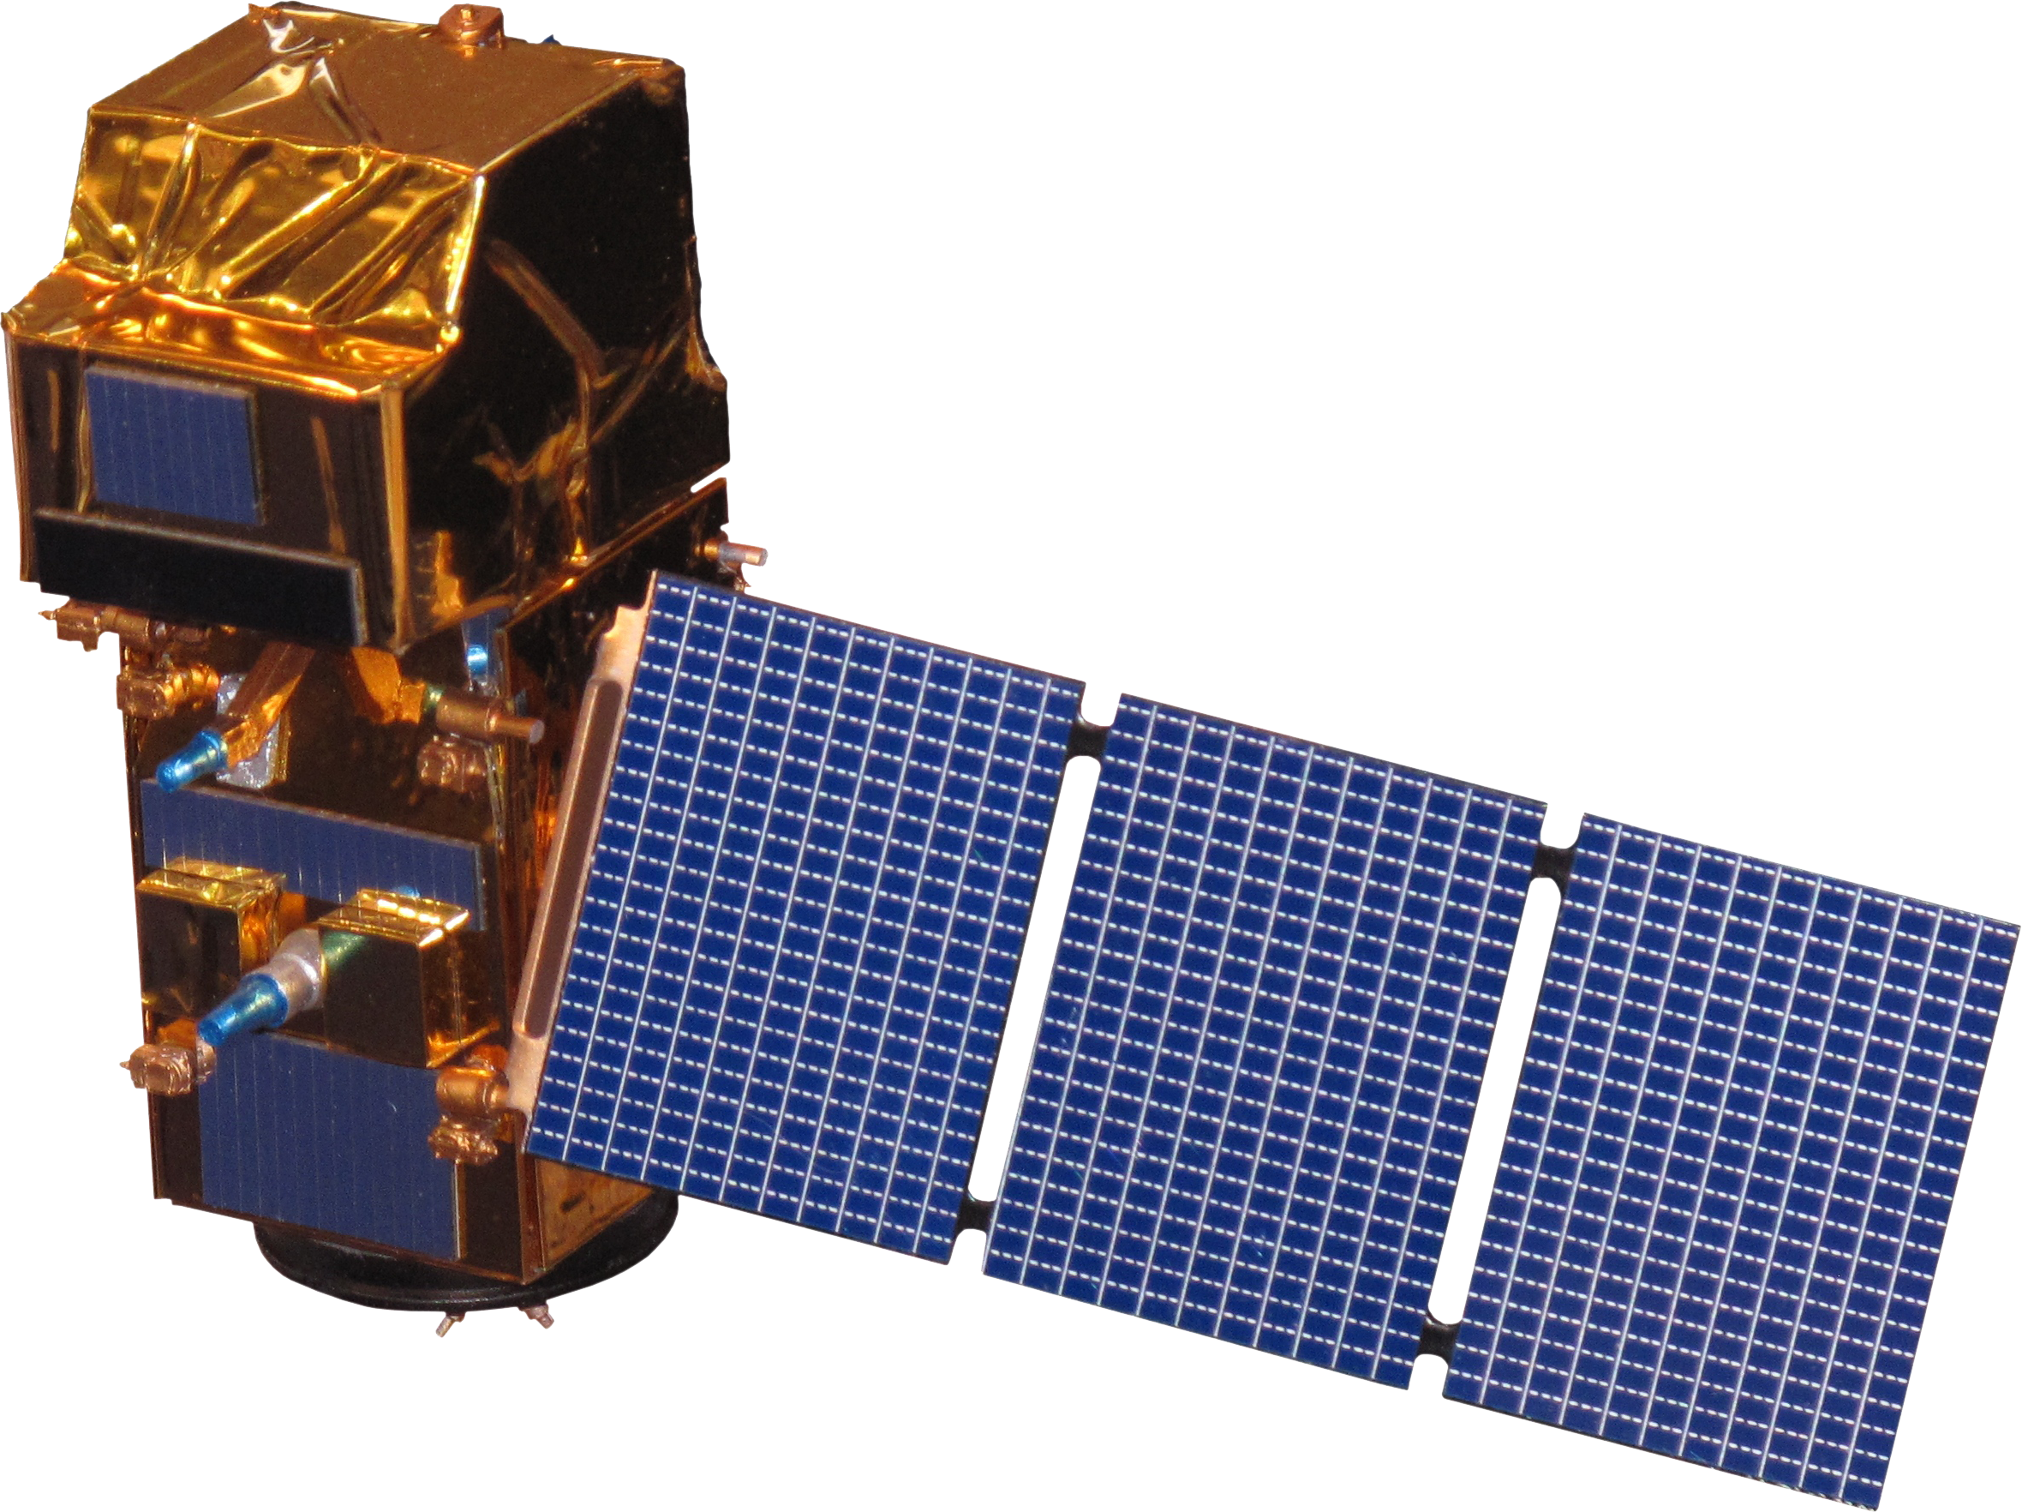
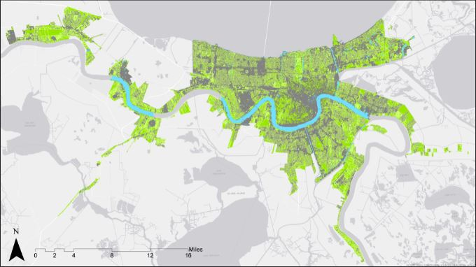
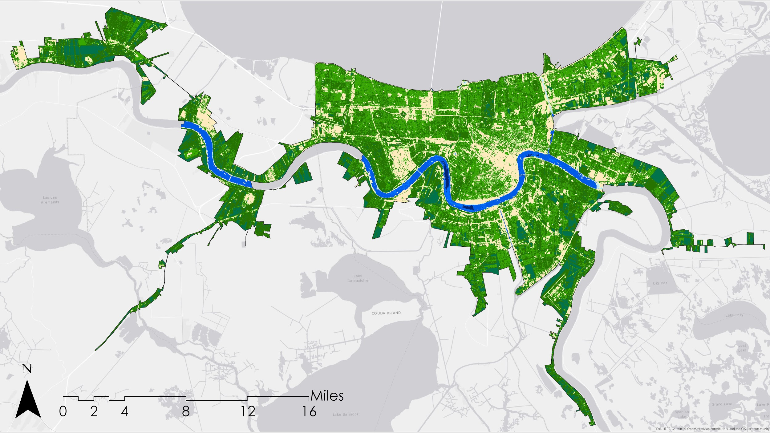
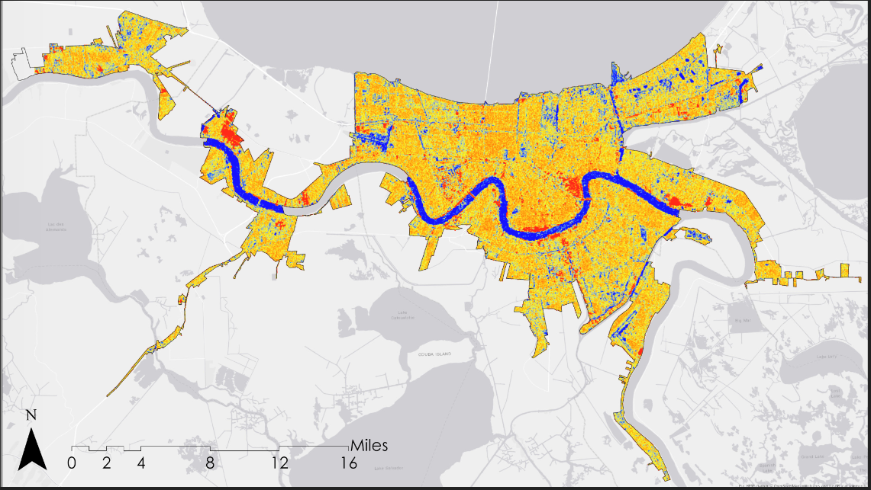
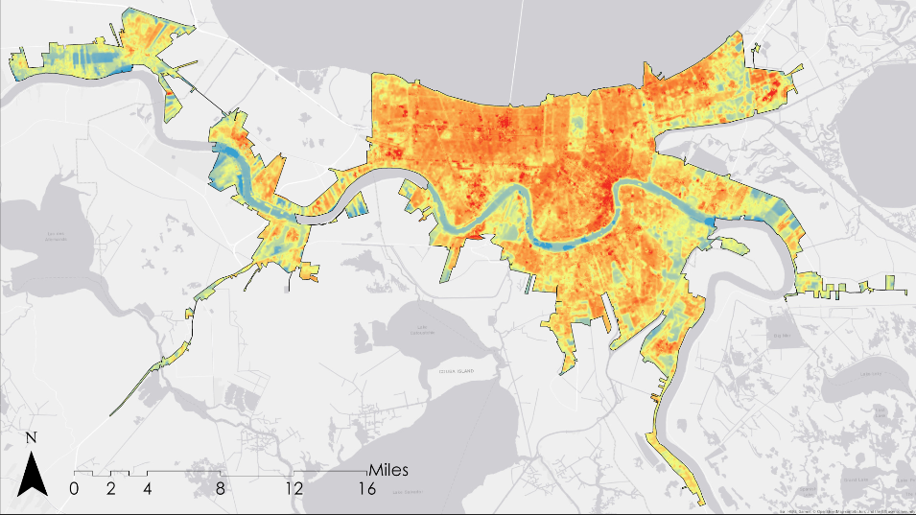
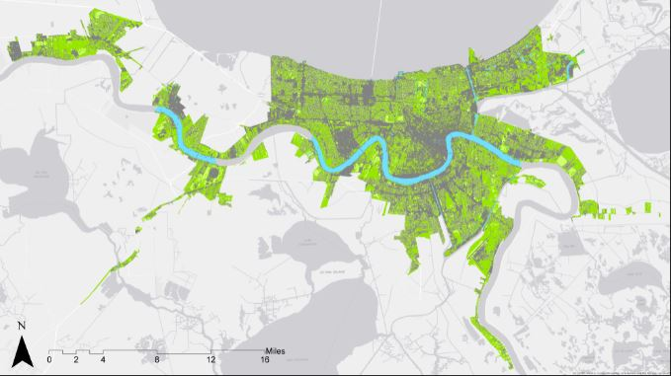
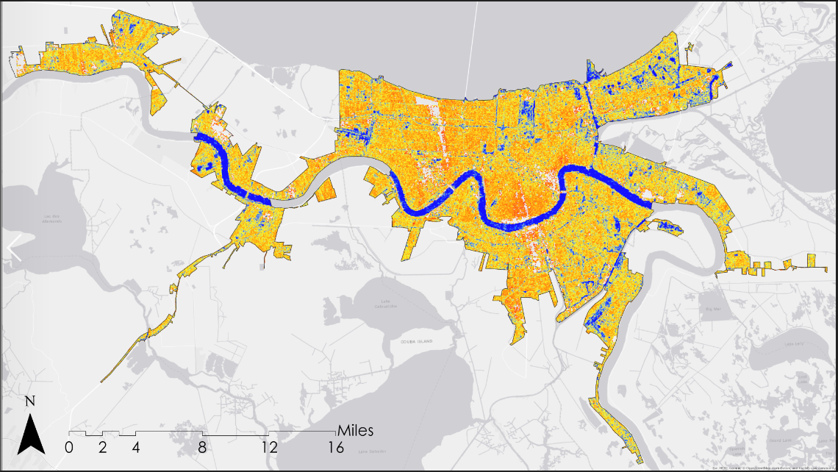
Utilizing Earth Observations to Assist Groundwork New Orleans to Reduce Flood Vulnerability in New Orleans, Louisiana Metropolitan Area
Abstract
Objectives
Flooding in New Orleans, Louisiana has increased in intensity and frequency due to sea level rise and land subsidence. Considered one of the rainiest cities in the country, New Orleans often experiences localized street flooding, causing damages to homes and businesses. Groundwork New Orleans (GWNO) is dedicated to increasing urban resilience to flooding by implementing green infrastructure. However, the current practices for site selection and assessment implemented by GWNO are costly and time consuming. NASA and ESA Earth observation data were acquired and used to create end products that can supplement GWNO’s current methods. The project utilized Landsat 8 Operational Land Imager (OLI) and Thermal Infrared Sensor (TIRS), Sentinel-2 Multispectral Instrument (MSI), Sentinel-1 C-Band Synthetic Aperture Radar (C-SAR), and Terra Moderate Resolution Imaging Spectroradiometer (MODIS) imagery from 2013 to 2018. Data were acquired for summer months with consideration to the Atlantic hurricane season to quantify the impact of GWNO’s tree planting campaigns and provide additional data to supplement GWNO’s current practices towards mitigating flood risk in the area. The team used remote sensing and geospatial analysis to map areas with high surface runoff and flood vulnerability. A land cover classification product and Normalized Difference Vegetation Index (NDVI) assessment were produced to monitor changes in urban tree canopy and impervious surface cover. The Normalized Difference Flood Index (NDFI) and Normalized Difference Flood Vegetation Index (NDFVI), along with land surface temperature data were computed to create a discrete-time series analysis of flood extent along with outlining shallow water in short vegetation and monitor the urban heat island effect in flood vulnerable communities. Project end products will provide GWNO with geospatial evidence of the effectiveness of their current tree-planting project for increasing the urban tree cover and improving community resilience to flooding over time.
Identify and monitor canopy cover and gray infrastructure changes to quantify the impacts of the green initiatives of Groundwork New Orleans (GWNO)
Produce discrete-time analysis of flood extent utilizing Normalized Difference Flood Index
Monitor land surface temperature to determine urban heat island effects on municipal zones with high exposure to surface runoff.
Study Area
New Orleans urban areas defined by United States Census Bureau 2010
Neighborhoods and areas where GWNO specifically operates include: Lower Ninth Ward Bywater St. Roch Central City Intersection of Claiborne Ave. and Saint Bernard Ave.
Data
Acquisition
Landsat 8 OLI
2013 to 2017
<10% cloud cover
Landsat 8 TIRS
2013 to 2015
Sentinel-1 C SAR
2016 to 2018
Earth Observations
Acquire Data
Data Processing
Classify land cover and
calculate NDVI for urban
canopy and impervious
surface
Calculation of land surface temperature
Calculation of NDFI and flood map creation
Data Analysis
Compare land classification and NDVI with land surface temperature results
Compare land cover classification, NDVI, and land surface temperature results with NDFI flood map
Project Partners
Landsat 8 OLI/TIRS
Sentinel-1 C-SAR
Sentinel-2 MSI
Terra MODIS
Our team partnered with Groundwork New Orleans, a local trust of Groundwork USA.
Results
Land Cover Classification
Normalized Difference Vegetation Index (NDVI)
Normalized Difference Flood Index (NDFI)
Land Surface Temperature (LST)
2013
2013
2016
2013
2013
2016
2013
-1.0
-.75
-.50
-.25
0
.25
.50
.75
1.0
Flood
Non flooded
High Temperature
315 K
Water
Highly urbanized
Urban
Tree
Non-tree Vegetation
2017
Low Temperature
270 K
2017
2017
2017
-1.0
-.75
-.50
-.25
0
.25
.50
.75
1.0
Flood
High Temperature
315 K
Water
Non flooded
Urban
Highly urbanized
Tree
Non-tree Vegetation
Low Temperature
270 K
Conclusions
Flood extent analysis shows an increasing trend in the spatial pattern of flooded areas from 2016 to 2017 in the eastern half of the city. The City Park region, the Seabrook region, and areas near the Lower Ninth Ward region are more vulnerable to frequent flood.
Land surface temperature shows a slight decreasing trend from 2013 to 2017. Within the urban areas, impervious space shows higher land surface temperature than areas with more green space. Downtown New Orleans is more vulnerable to the urban heat island effect.
Land cover classification demonstrated an increase in urban area in New Orleans from 2013 to 2017.
Acknowledgements
Team Members
Joe Spruce, Lead Science Advisor, Science Systems & Applications, Inc.
Dr. Kenton Ross, Science Advisor, NASA Langley Research Center
Bernard H. Eichold II, M.D., Dr. P.H., Mentor, Mobile County Health Department
Alicia Neal, Groundwork New Orleans
Farnaz Bayat, Center Lead, NASA DEVELOP AL-Mobile Node
Danielle Quick, Assistant Center Lead, Impact Analysis Fellow, NASA DEVELOP AL-Mobile Node
Rupsa Bhowmick
Project Lead
Lulin Zheng
Madison Murphy
Chelsea Randall
New Orleans Urban Development
Alabama - Mobile | Summer 2018

