Slide 1
CALIPSO Cross-Cutting
Enhancements to Visualization of CALIPSO (VOCAL) through Case Studies of Saharan Dust
Collin Pampalone (Project Lead)
William Turner
Ryan Avery
NASA Langley Research Center
2017 Summer
Notes:
C: Good morning all, my name is Collin Pampalone and I’m a rising senior at William and Mary studying physics
W: I’m William Turner i’m a freshman at Virginia Tech studying Cyber Security
R: And I’m Ryan Avery
C: Our project is CALIPSO Cross-Cutting, enhancements to Visualization of CALIPSO through case studies on Saharan dust

Slide 2
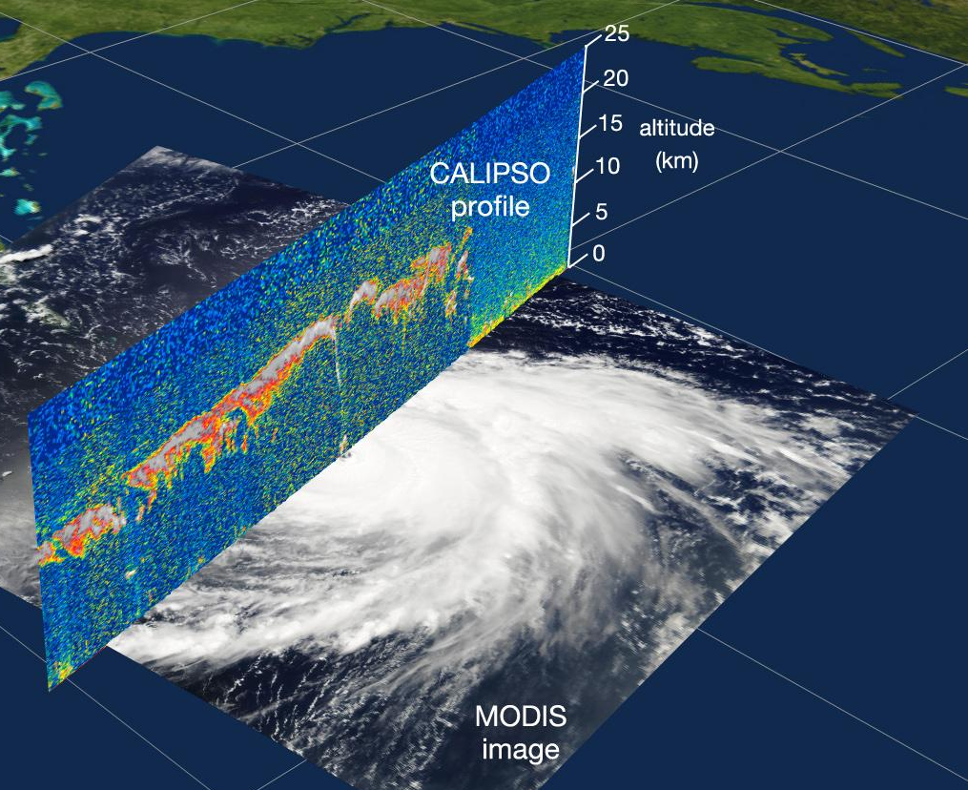
Background
Aerosols are small particles
CALIPSO uses Lidar to detect aerosols and clouds
Records vertical curtains
Allows researchers to view inside and underneath clouds
Credit: NASA
Notes:
C: Aerosols are small particles that play an important role in the Earth’s atmosphere, affecting everything from the radiation budget to cloud formation.
C: Launched over a decade ago, the CALIPSO satellite offers a unique way to view aerosols
C: Using Lidar, the satellite collects aerosol data as curtains, or vertical slices. This allows researchers to view aerosol properties and distribution in ways that were previously not available.
C: While a typical passive satellite instrument records only the mixed surface layers of aerosols, the Lidar aboard CALIPSO allows it to record data from inside and underneath clouds.
Image Source: https://www.nasa.gov/topics/earth/features/diabar.html

Slide 3
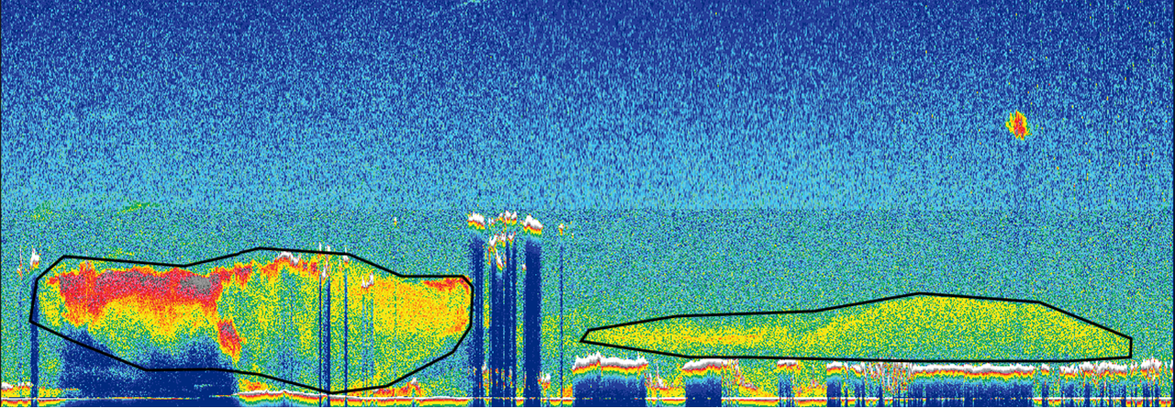
Background
Visualization of CALIPSO (VOCAL) offers a unique way to view and track aerosols and clouds |  | VOCAL enhances the capabilities of visualization scripts on the ASDC website
Dust
Smoke
Notes:
W: Over the past two years, several DEVELOP teams have built and expanded the Visualization of CALIPSO, or VOCAL tool.
W: This open source tool allows the user to visualize the vertical curtains of data from CALIPSO and select regions of data to export for study.
Image source: Self Made, VOCAL tool

Slide 4
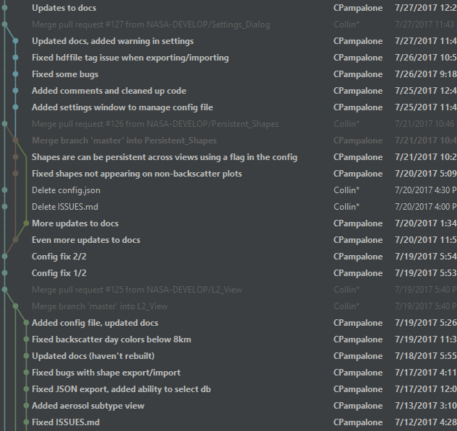
Objectives
Two main goals
Enhancements to VOCAL
Case Study of Saharan Dust
Notes:
R: Last Spring, NIFTS intern Britney Hopgood used VOCAL in a case study of cirrus clouds and noted areas of improvements for the interface and database backend that would make VOCAL more useful and accessible
R: With this feedback in mind, we created two main objectives for the term: developing enhancements software enhancements, and conducting a case study of long range Saharan dust transport using VOCAL. Our case study tests these enhancements and demonstrates VOCAL’s improved capability as a tool for aerosol identification.
Image Source: self made

Slide 5
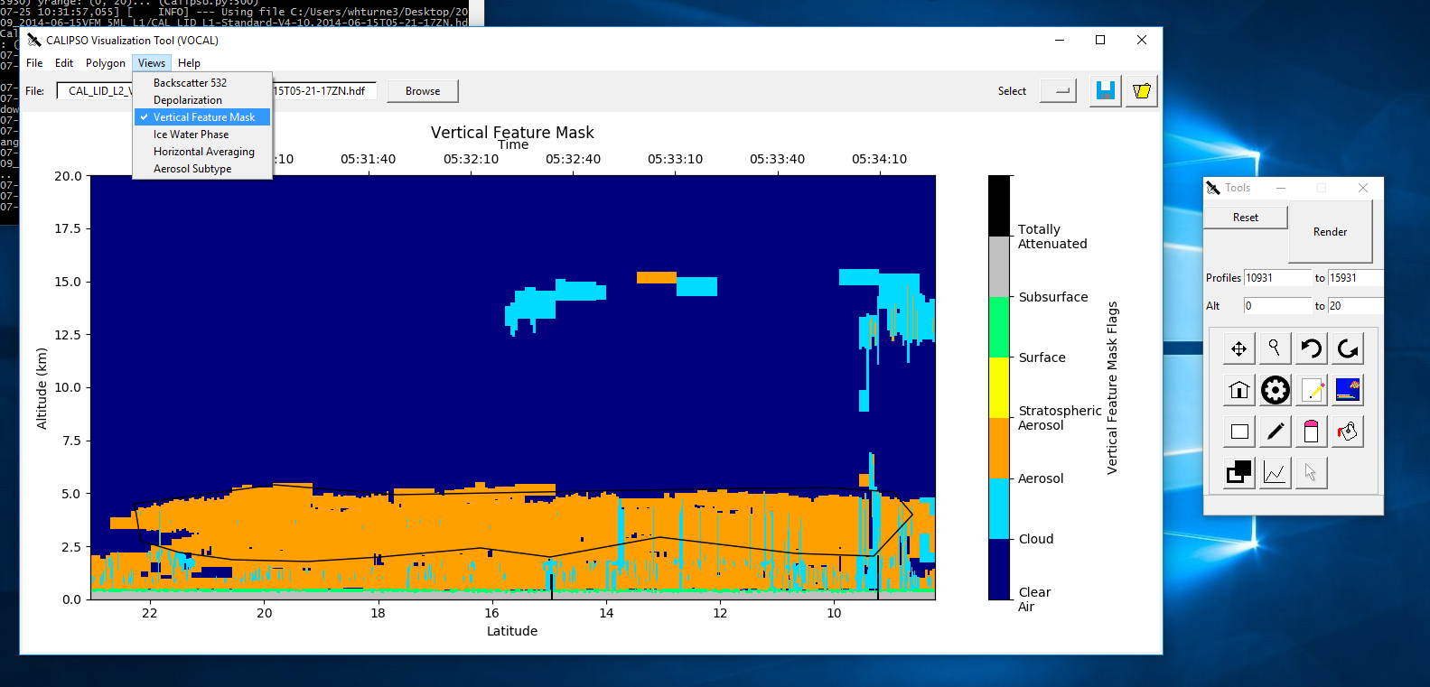
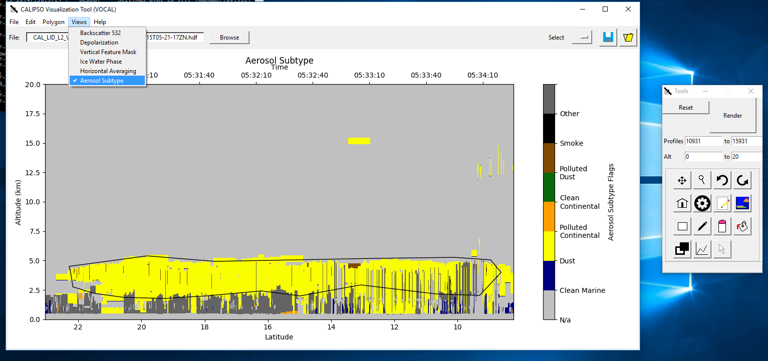
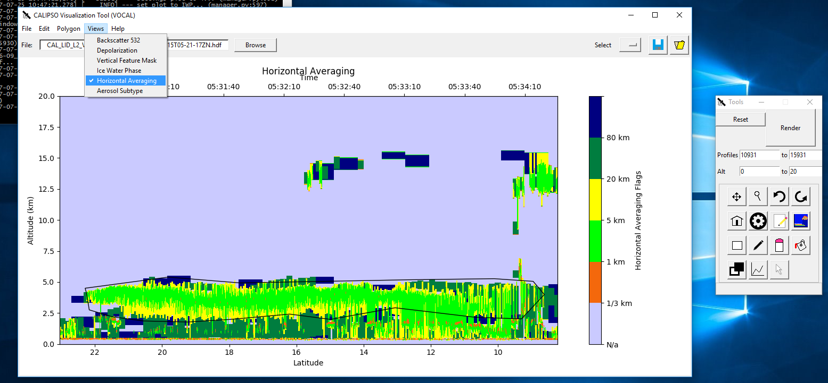
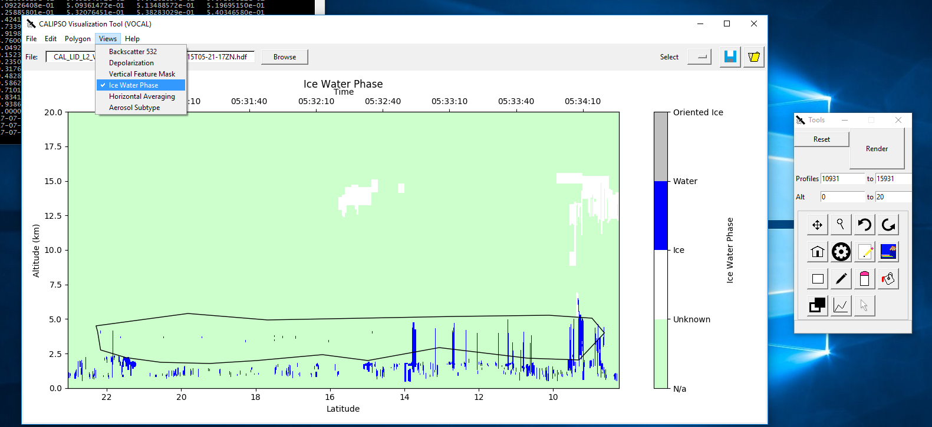
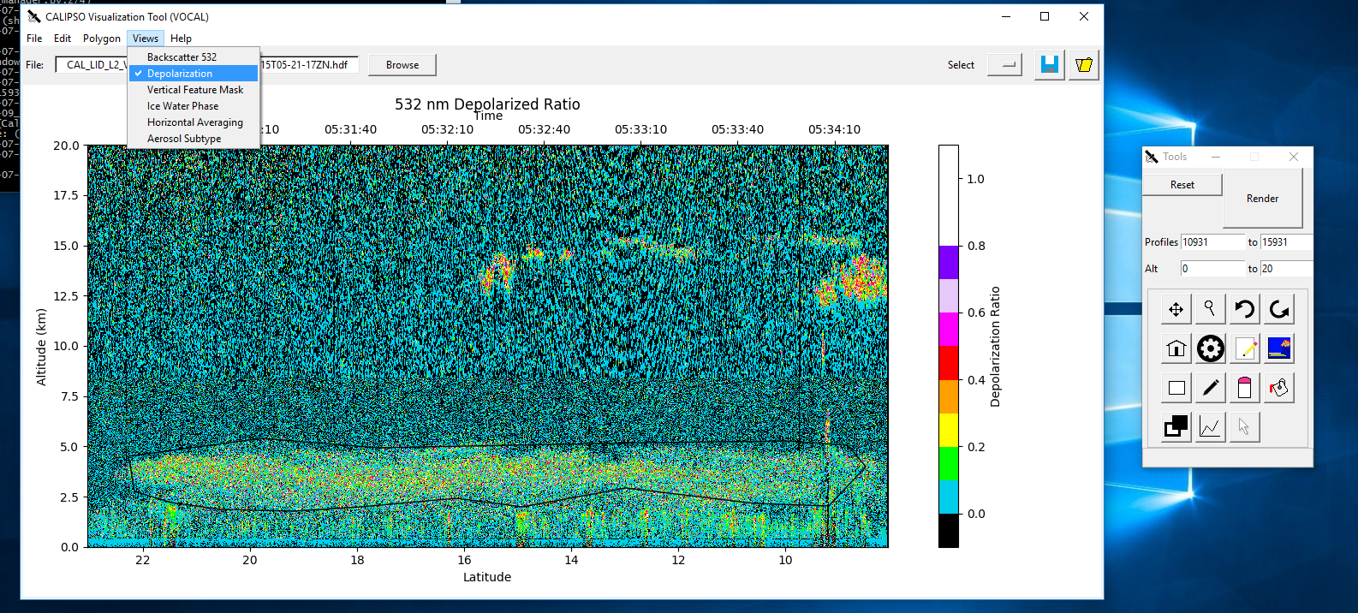
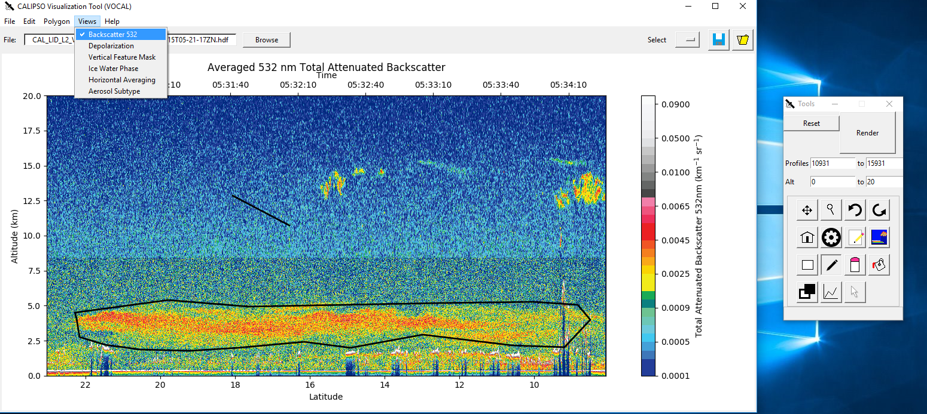
Enhancements to VOCAL
Notes:
C: Our primary enhancement was to add visualization capabilities for level two data, examples of which are shown here *point*.
Image source: self made in VOCAL

Slide 6
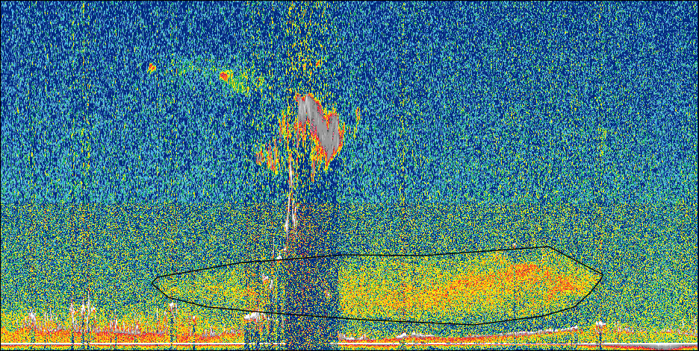
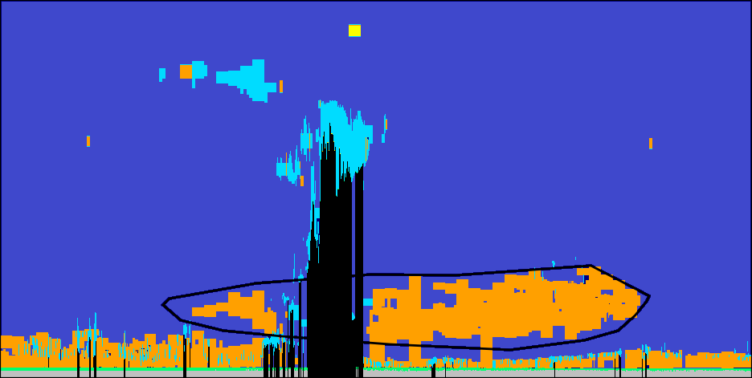
Integrating Features
Load and plot multiple levels of data
Tool interaction and persistent shapes
VFM
Backscatter
Implement features from previous term
Navigate views
Notes:
C: When we received the version of VOCAL from the previous term, many features were mostly complete, but needed to be finished, integrated into a single version, and debugged.
C: Building on their code, we implemented loading, plotting, and persistent shapes for all levels of data.
C: Now, if a user moves the plot or draws a shape in one view, the same area and shape will be displayed when the plot is changed.
Image Source: self made, VOCAL

Slide 7
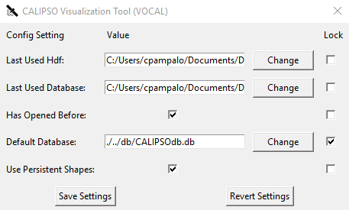
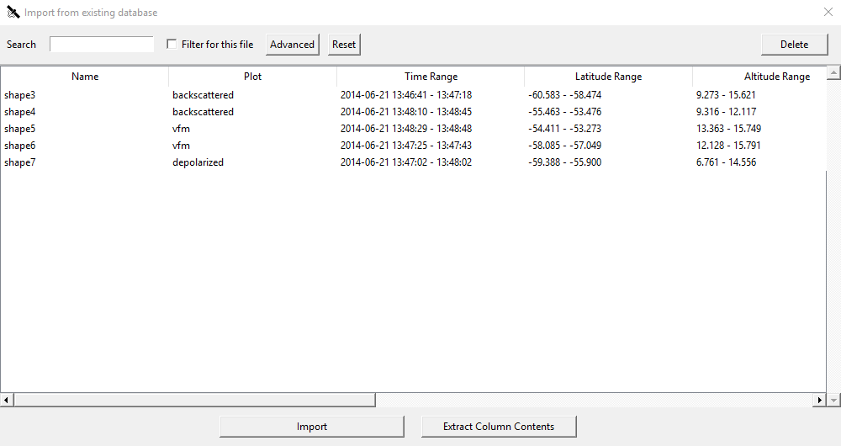
Dynamic Sharing Options
The location of the database can be changed so that it can be shared between multiple researchers
Settings allow users to toggle persistent shapes and choose a default database
Notes:
W: We also made exporting, importing and saving shapes more dynamic. Users now have the ability to select a directory where they may create a database to save drawn shapes. These saved shapes can be shared between several researchers.
W: Additionally, we added a settings menu so that users are able to configure VOCAL. For example, choosing which database to use by default and whether or not to allow persistent shapes.
Image Source: self made, VOCAL tool

Slide 8
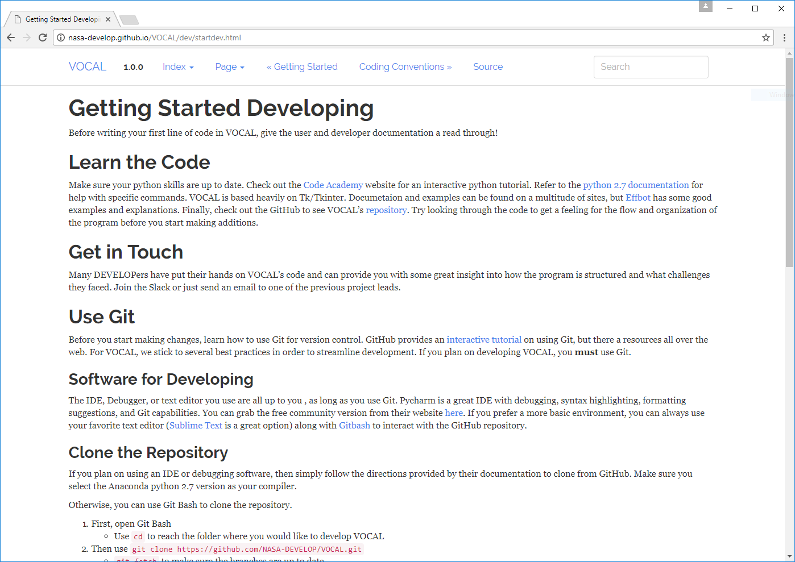
Updated Documentation
Documentation website was outdated
Renewed installation and tutorial, added developer procedures
Notes:
C: Finally, we updated the online documentation and added missing comments in the code. The documentation had not been since 2015, so this was a vital part of making VOCAL more accessible. A guide for developing VOCAL and procedures on handing it over to a new team are now available for future developers.
C: With the changes implemented, we released VOCAL 1.17.8 on GitHub, an open-source, public development platform. Any researcher in the world can access the VOCAL tool and source code.
Image Source: self made, VOCAL documentation website

Slide 9
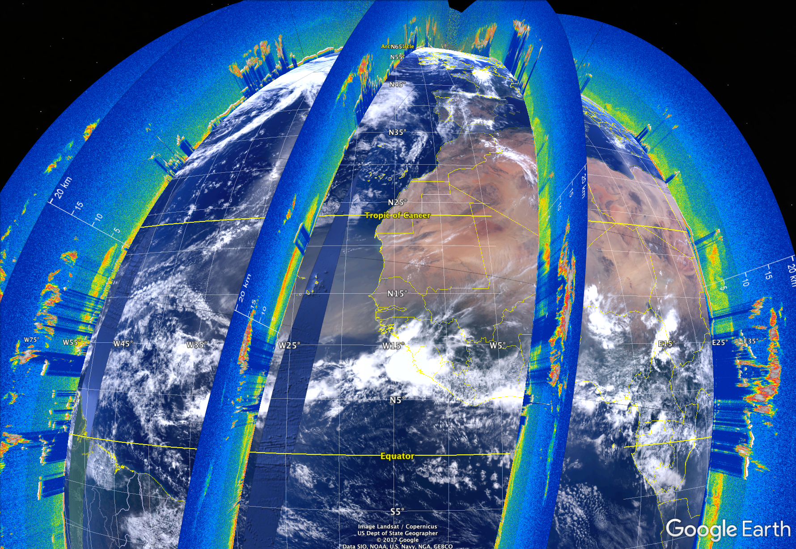
Case Study
Credit: Google Earth, Roman Kowch
Notes:
R: With these enhancements to VOCAL, we began working on our case study of Saharan dust transport. As we worked through the case study, we came across bugs and errors in the code, which gave us an opportunity to test and fix VOCAL on the go.
Image Source: Created in Google Earth using only NASA MODIS and CALIPSO imagery, produced by our partner Roman Kowch

Slide 10
Study Area
Summer months 2014-2016
West coast of Africa to Central and South America, over the Atlantic Ocean
Notes:
R: For this study we chose to focus on dust particles. One of the largest sources of this aerosol is the Saharan Desert, from which dust is transported over the Atlantic.
R: We began our case study by finding 10 multi-day dust events, occurring within the summer months between 2014-2016. The area enclosed by the blue line was our main area of focus.
Image Source: Self made, NASA Worldview

Slide 11
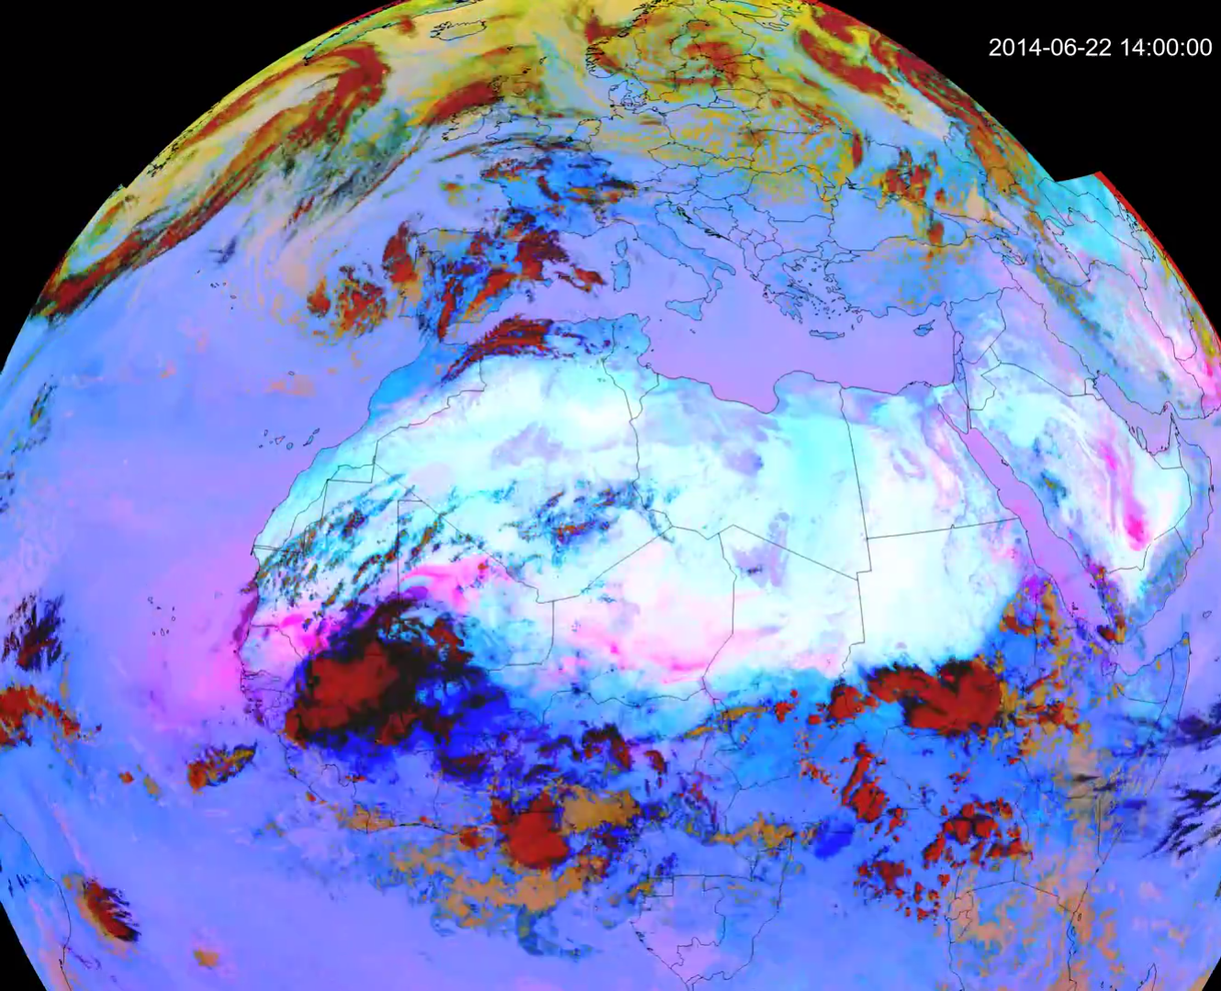
Identifying Features
NASA Worldview
MODIS data with CALIPSO track overlaid
Selected objects in VOCAL
Credit: Roman Kowch
Notes:
R: In order to find dates when dust was active, we used MODIS data on NASA Worldview. We searched for times, typically a week to ten days, where dust left the west coast of Africa and then collected curtain data between the West African coast and Central and South America. After finding ten such events from 2014 to 2016 and downloading the data, our analyst, Collin Pampalone, trained himself to identify dust features and then visually identify dust features using VOCAL with the polygon drawing tool.
Image Source: created by our partner Roman Kowch

Slide 12
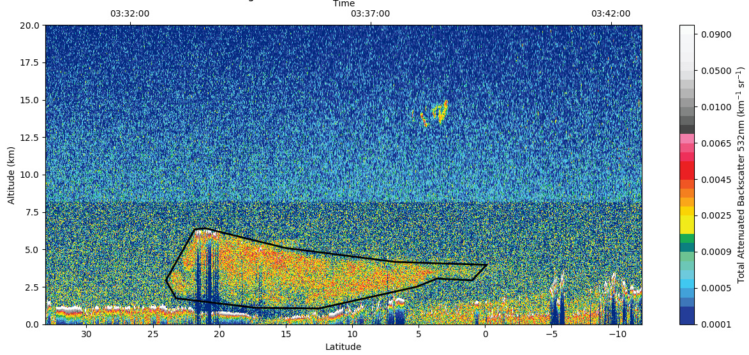
Identifying Features
Dust
Credit: NASA
Notes:
R: We looked for large features between 0 and thirty degrees latitude, and between zero to ten kilometers above sea level.
Image Source: Self made, NASA Worldview

Slide 13
Analyzing CALIPSO Data
CALSIPSO records backscatter attenuation and polarization
Shapes are drawn by researchers in Level One
Layers are produced by algorithms and shown in Level Two data
Level 1
Cumulous Clouds
Level 2
Notes:
C: CALIPSO records the backscatter attenuation and polarization of reflected Lidar beam at different altitudes. These variables are published as a Level One data product.
C: Further processing through algorithms written by the CALIPSO Science team allow objects to be identified and aerosols classified as layers. Layers are simply objects of averaged data that include the aerosol type, phase, and other higher level information. These object are organized into data curtains and releases as Level Two data products.

Slide 14
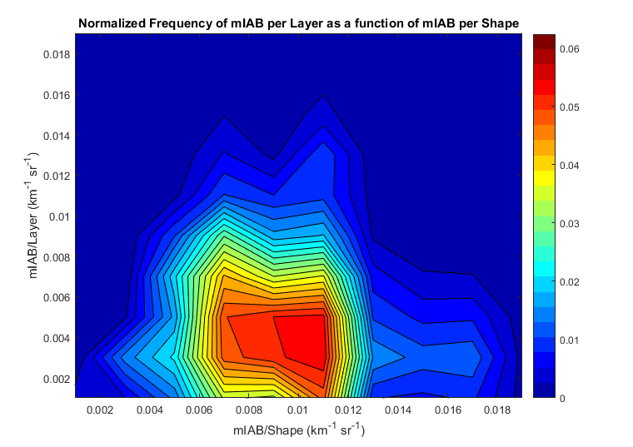
Comparing Data Products
Data analysis courtesy of Britney Hopgood
Shape backscatter on the x-axis, layer backscatter on the y-axis
Red color means more frequent
The backscatter for drawn shapes is higher than for algorithm identified layers
Notes:
C: Once we finished identifying dust shapes in the Level One data, we ran them through a data analysis script created by Britney Hopgood to produce a number of plots comparing level one and level two data.
C: One of the plots, shown here, compares shapes we drew on level one data and layers from level two data
C: This plot among others will be useful to the CALIPSO science team here at Langley as they continue to expand their understanding of CALIPSO data.

Slide 15
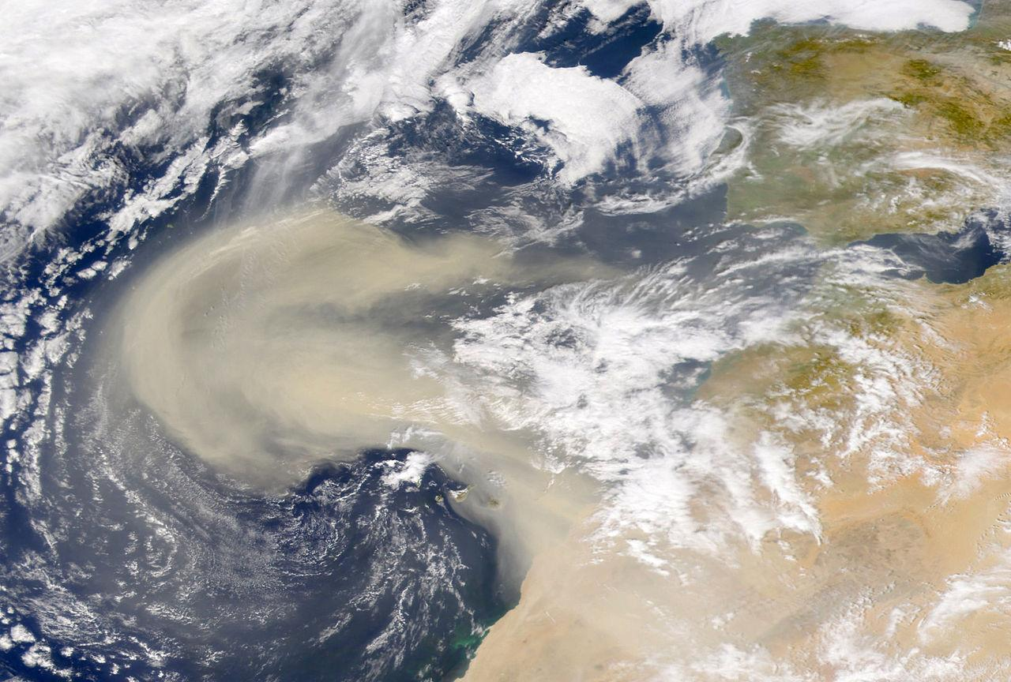
Conclusions
Added features to VOCAL
Updated documentation
Analyzed dust events in case study
Credit: Wikimedia Commons
Notes:
C: In conclusion, the added features make the tool more useful for viewing, tracking, and analyzing aerosols.
C: New documentation makes it easier for users to install and work with VOCAL, and easier for developers to continue to make changes to the software.
C: Finally, our case study has helped us improve the VOCAL tool, and serves as an example of how researchers can analyze CALIPSO data. Although CALIPSO has been orbiting Earth for over a decade, researchers are still publishing new papers about aerosols using CALIPSO data. We’ve only scratched the surface of what CALIPSO and aerosol research has to offer.
Image credit: https://commons.wikimedia.org/wiki/File:2000-Feb-26_NASA_SeaWiFS_African_Dust_Storm.jpg

Slide 16
Acknowledgements
Partners
Dr. Charles Trepte (CALIPSO Science Team)
Britney Hopgood (CALIPSO Science Team)
Roman Kowch (CALIPSO Science Team)
Advisors
Dr. Kathleen Moore (NASA LaRC)
Dr. Kenton Ross (NASA LaRC)
Grant Mercer (UNLV)
Credit: Wikimedia Commons
Notes:
W: and lastly we’d like to thank our partners and advisors for all of their continued support.
Image Source: https://commons.wikimedia.org/wiki/File:CALIPSO_-_Artist_Concept_2.jpg

Slide 17
Acknowledgements
Previous Contributors
Grant Mercer
Nathan Qian
Ashna Aggarwal
Jordan Vaa
Kathleen Moore
Ahmad Aburizaiza
Andrea Martinez
Adam Ba
Joseph Driscoll
Credit: Wikimedia Commons
Notes:
W: As well as all of the past contributors. and next to present we have the Chesepeake Bay Water Resources Team.
Image Source: https://commons.wikimedia.org/wiki/File:CALIPSO_-_Artist_Concept_2.jpg

