Slide 1
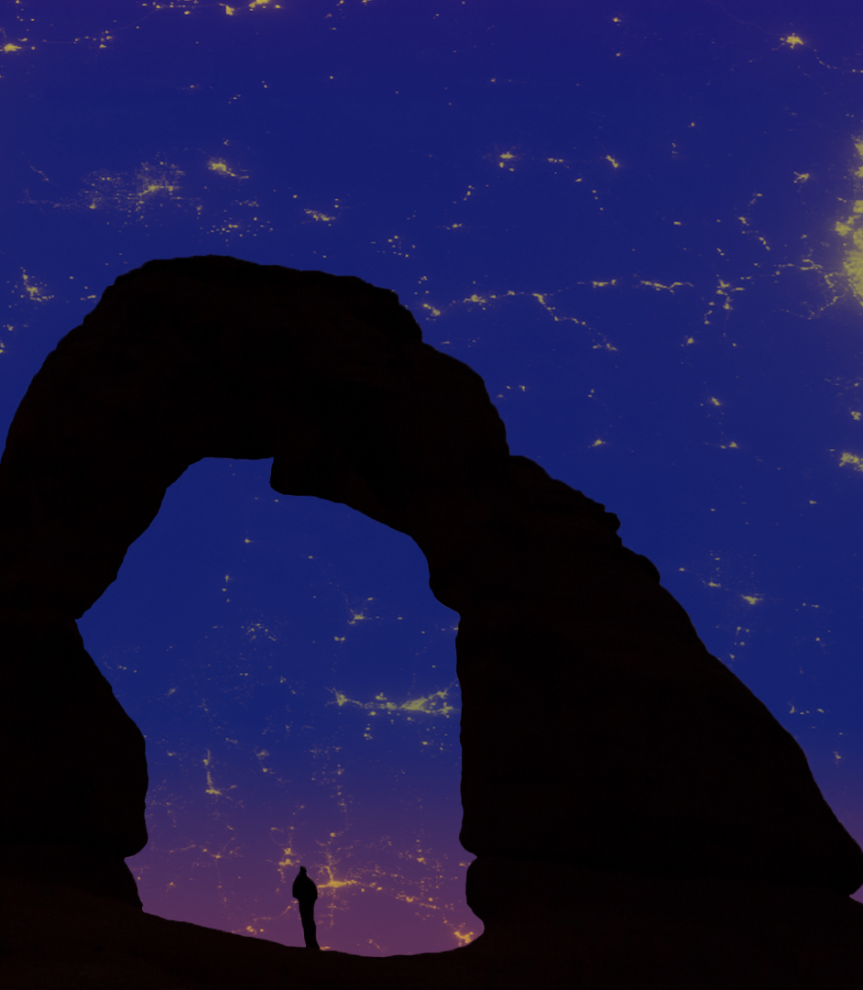


Colorado Plateau Urban Development
A Perspective on Nighttime Sky Glow Over the Colorado Plateau by Integrating the Suomi-NPP VIIRS Day Night Band Sensor with a Customized Geolocation Data Processing Program
Margaret Mulhern
Manda Au
Ian Brastow
Virginia – Wise
Fall 2017
Notes:
Hello, My name is Margaret Mulhern, and I am the project lead.
I am Manda Au
And I am Ian Brastow.
We are the Colorado Plateau Urban Development Team. This is the first term of this project, however, we are a continuation project of the Wyoming Cross Cutting I and II terms.
We looked at A Perspective on Nighttime Sky Glow over the Colorado Plateau by Integrating the Suomi-NPP VIIRS Day Night Band Sensor with a Customized Geolocation Data Processing Program.
Image Source: Colorado Plateau Urban Development Team

Slide 2
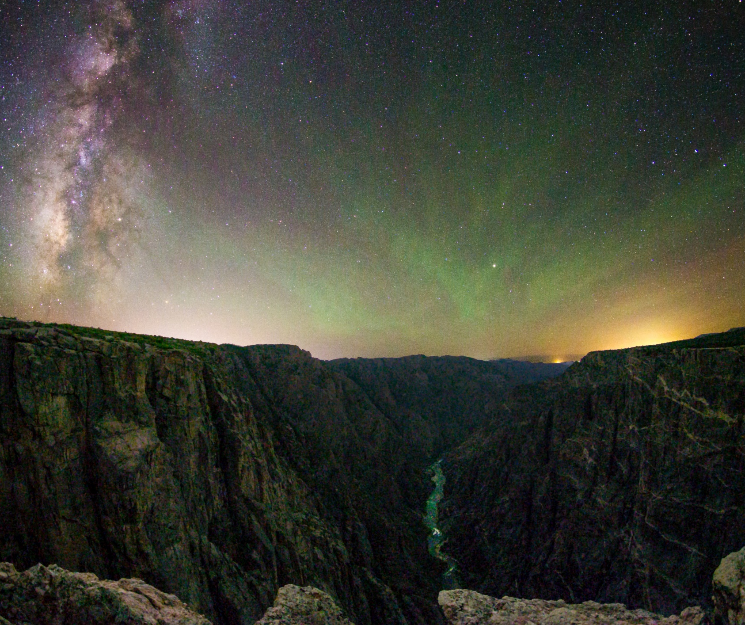
Light Pollution is…
2
...the inappropriate or excessive use of artificial light
Image Credit: Bettymaya Foott
Notes:
Short Script
When thinking about environmental pollution, light is not typically the first type of pollutant that comes to mind. Light pollution is defined as any inappropriate or excessive artificial light.
Long Script
When thinking about environmental pollution, light is not typically the first type of pollutant that comes to mind. Many people may have never given much thought to the constant brightness that surrounds us.
Light pollution is defined as any inappropriate or excessive artificial light. The primary causes are artificial lighting fixtures at night, such as building lights, street lights, car headlights, and billboards.
--advance slide--
Sources:
International Dark-Sky Association (n.d.) Light Pollution. Retrieved on October 30, 2017. Retrieved from http://www.darksky.org/light-pollution/
Cinzano, P., Falchi, F., Elvidge, C. D., & Baugh, K. E. (2000). The artificial night sky brightness mapped from DMSP satellite Operational Linescan System measurements. Monthly Notices of the Royal Astronomical Society, 318(3), 641; Falchi, F., Cinzano, P., Duriscoe, D., Kyba, C. C. M., Elvidge, C. D., Baugh, K., Furgoni, R. (2016). The new world atlas of artificial night sky brightness. Science Advances, 2(6), 19. doi:10.1126/sciadv.1600377
Image Source: Bettymaya Foott (project partner)

Slide 3
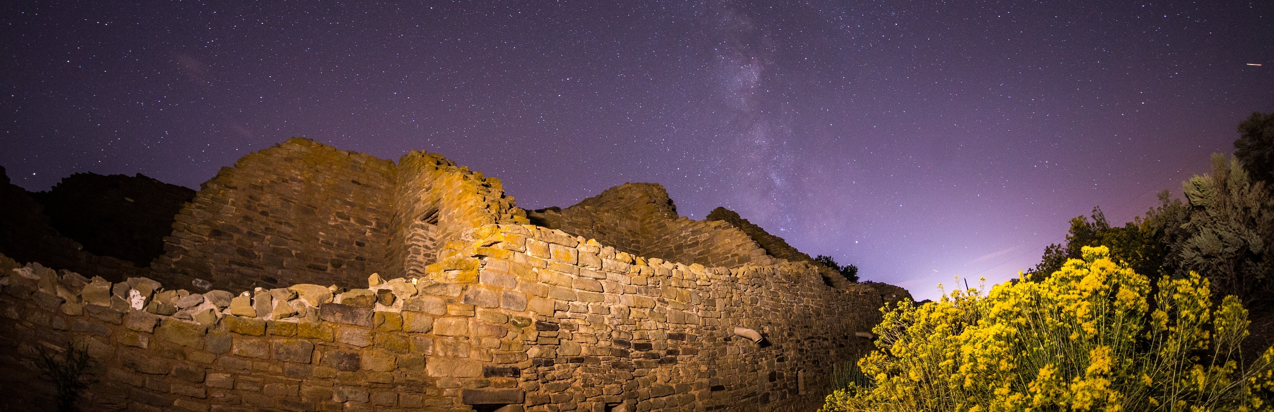
Community Concerns
3
“…as light pollution spreads, we are slowly losing one of the oldest and most universal links to all of human history.”
– Peter Lipscomb
Santa Fe Astronomer
Image Credit: Bettymaya Foott
Notes:
Script
The dark night sky is important because it is a universal link to our collective past. Today, artificial lighting threatens this history and can impact our quality of life as well as our surrounding environment in various ways.
--advance slide--
Quote Source: Santa Fe Conservation Trust. (2012). Bring Back the Stars! [Flyer]. Author. Retrieved June 29, 2017, from http://sfct.org/wp-content/uploads/2012/07/Bring-Back-the-Stars-6-steps1.pdf [emphasis added]
Image Source: Bettymaya Foott (project partner)

Slide 4
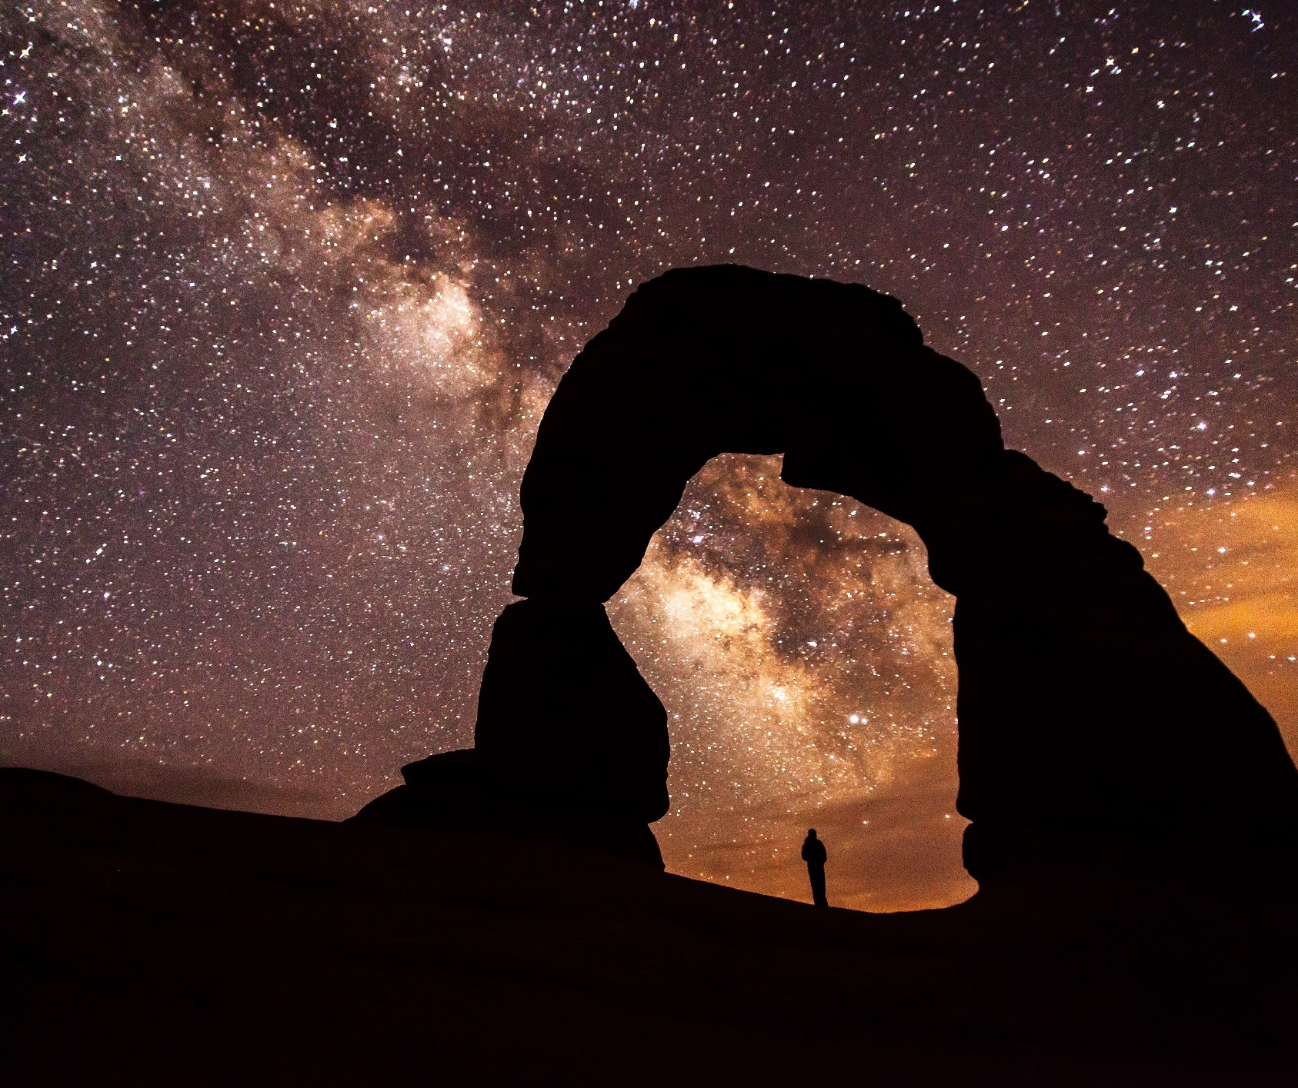
35,000 years
4
Community Concerns
For
the night skies have influenced cultures around the world
Source: Ruggles & Cotte (2010)
Image Credit: Jacob W. Frank, National Park Service
Notes:
Short Script
The earliest known documentation of stargazing was in Germany 35,000 years ago. Since then, the night sky has continued to influence cultures wherever humans have lived. But today, with light associated with economic development and safety, our connection to the stars is eroding.
Long Script
The earliest known documentation of stargazing was in Germany 35,000 years ago. Since then, the night sky has continued influence cultures wherever humans have lived. For instance, in North America, the Navajo nation painted stars on the ceilings of caves all across the southwest. The First Nations and other indigenous people relied on the stars for navigation. But today, with light associated with economic development and safety, our connection to the stars is eroding.
--advance slide--
Sources: B. VanGundy, personal communication, June 20, 2017;
Ruggles, C. L., & Cotte, M. (2010). Heritage Sites of Astronomy and Archaeoastronomy in the context of the UNESCO World Heritage Convention: A Thematic Study. Retrieved July 13, 2017, from http://www.astronomicalheritage.org/index.php?option=com_content&view=article&id=28&Itemid=33.
Image Source: Frank, J.W. (n.d.). Delicate Arch at Night [Photograph found in Arches National Park]. Retrieved October 17, 2017, from https://www.nps.gov/media/photo/gallery.htm?id=275B0E39-155D-451F-6752DA81D6E6018D

Slide 5
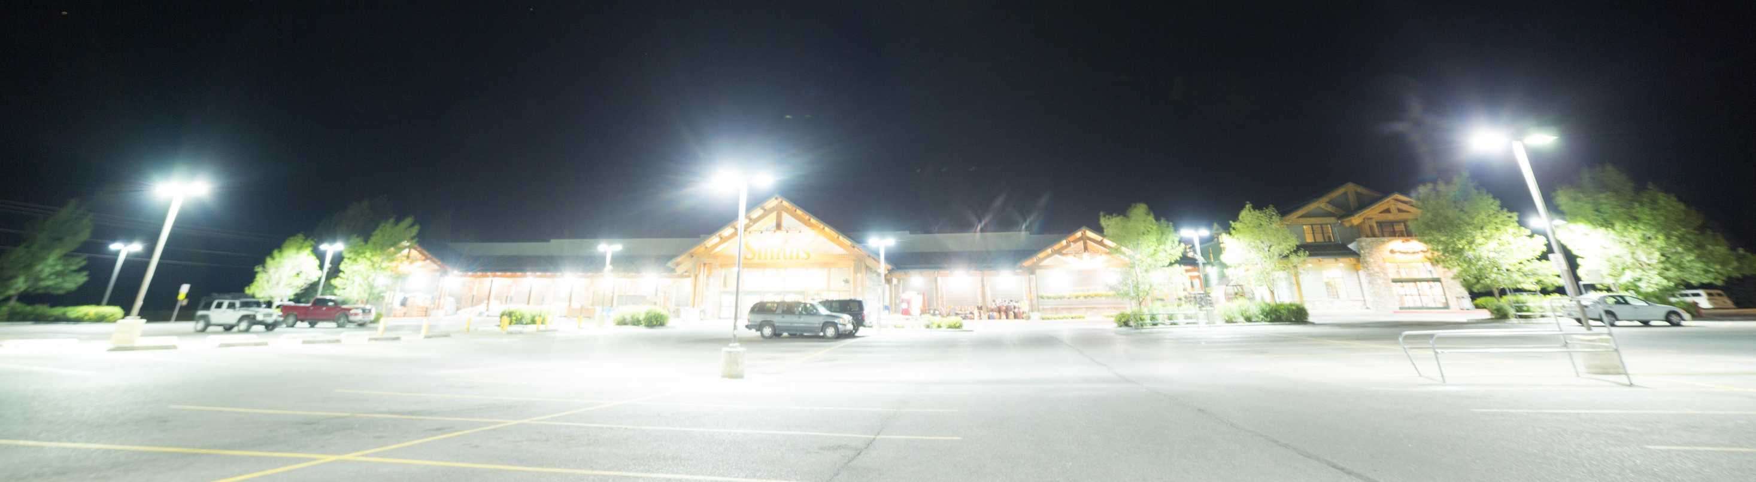
$7 billion
5
are wasted annually in unnecessary energy costs due to poorly-designed outdoor lighting in the United States
Source: Gallaway et al. (2010)
Image Credit: Wyoming Stargazing
Notes:
Short Script
With growing development, light pollution has become expensive. In a typical unshielded light fixture, 50% of light is wasted into the sky, costing the United States nearly $7 billion every year in energy costs.
Long Script
With growing development, light pollution has become expensive as many of our outdoor fixtures are poorly designed and shielded. In a typical unshielded light fixture, 50% of light is wasted into the sky, costing the United States nearly $7 billion every year in energy costs.
--advance slide--
Sources: S. Anderson, personal communication, October 26, 2017; Stone, T. (2017). Light Pollution: A Case Study in Framing an Environmental Problem. Retrieved October 30, 2017 from http://www.tandfonline.com/doi/full/10.1080/21550085.2017.1374010
Image Source: Samuel Singer, Wyoming Stargazing. (project partner)

Slide 6
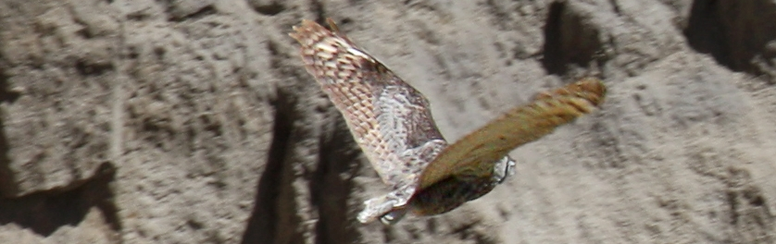
98 million+
6
bird deaths occur each year from collisions with buildings in North America
Source: Chepesiuk (2009)
Image Credit: National Park Service
Notes:
Script
Light at night disorients animals as well as alters wildlife behavior and migratory patterns. In fact, according to Liptak (2017), nearly 400 migrating birds collided with a single lit skyscraper in one night in Texas.
--advance slide--
Source: Chepesiuk, R. (2009). Missing the Dark: Health Effects of Light Pollution. Environmental Health Perspectives, 117(1), A24. doi:10.1289/ehp.117-a20; Liptak, A. (2017, May 13). After a massive bird strike last week, a Texas skyscraper will shut down its exterior lights. Retrieved July 12, 2017, from https://www.theverge.com/2017/5/13/15635240/texas-songbirds-skyscraper-save-migrating-birds-audubon-society
Image Source: National Park Service (n.d.). Owl [Photograph found in Dinosaur National Monument]. Retrieved October 17, 2017, from https://www.nps.gov/media/photo/view.htm?id=67DFE465-155D-451F-670C3CBCFCFB34AE

Slide 7
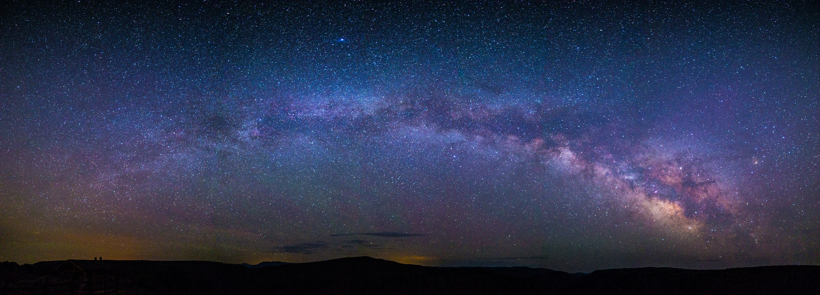
97%
7
of the U.S. population is unable to see the Milky Way at night
Source: Falchi et al. (2016)
Image Credit: Bettymaya Foott
Notes:
Short Script
There are impacts on humans as well. 97% of Americans are unable to see the Milky Way at night due to these light polluted skies. To put this into perspective, that means over 300 million Americans cannot see our galaxy in the night sky from their homes.
Long Script
There are impacts on humans as well. 97% of Americans are unable to see the Milky Way at night due these light polluted skies. To put this into perspective, of the 323 million people living in the US as of 2016, only 10 million people can see the Milky Way. That would be essentially the equivalent to only half the population of the New York City Urban Area being able to see the Milky Way.
--advance slide--
Source: Falchi, F., Cinzano, P., Duriscoe, D., Kyba, C. C. M., Elvidge, C. D., Baugh, K., Furgoni, R. (2016). The new world atlas of artificial night sky brightness. Science Advances, 2(6), 19. doi:10.1126/sciadv.1600377
U.S. Census Bureau (2010). 2010 Urban Area List All. https://www2.census.gov/geo/docs/reference/ua/ua_list_all.txt
Image Source: Bettymaya Foott (project partner)

Slide 8
Health Effects
8
Cancer
Increases risk of breast cancer by elevating estrogen levels
Depression
Affects serotonin conversion, which affects mood
Obesity
Harms metabolism due to melatonin suppression
Insomnia
Disrupts humans’ circadian rhythms
Source: Chepesiuk (2009); Dominoni et al.(2016); Fernandez et al.(2012); Haim et al. (2015); Korkmaz et al. (2009); Nature Bright (2015); Scaccia (2017)
Notes:
Short Script
There are also potential health effects. Artificial light has been linked to cancer, depression, obesity, and insomnia.
Long Script
There are also potential health effects. Artificial light suppresses melatonin production and alters circadian rhythms, resulting in increased risk of developing many health disorders, a few of which are listed here. The research connecting light pollution and human health is still in the early stages. Current research has revealed artificial light exposure at night can increase the risk of developing breast cancer by 30-50%.
--advance slide--
Sources: Chepesiuk, R. (2009). Missing the Dark: Health Effects of Light Pollution. Environmental Health Perspectives, 117(1), A24-A27. doi:10.1289/ehp.117-a20; Dominoni, D. M., Borniger, J. C., & Nelson, R. J. (2016). Light at night, clocks and health: from humans to wild organisms. Biology Letters, 12(2), 1-2. doi:10.1098/rsbl.2016.0015
Tumor Growth - Haim, A., & Zubidat, A. E. (2015). Artificial light at night: melatonin as a mediator between the environment and epigenome. Philosophical Transactions of the Royal Society B: Biological Sciences,370(1667), 1-7. doi:10.1098/rstb.2014.0121
Obesity - Korkmaz, A., Topal, T., Tan, D., & Reiter, R. J. (2009). Role of melatonin in metabolic regulation. Reviews in Endocrine and Metabolic Disorders, 10(4), 261-270. doi:10.1007/s11154-009-9117-5
Depression - Nature Bright. (2015, June 29). 5 Ways Light Pollution Affects Your Health. Retrieved July 05, 2017, from http://www.naturebright.com/research-news/5-ways-light-pollution-affects-your-health/; Scaccia, A. (2017, May 18). Serotonin: What You Need to Know. Retrieved July 05, 2017, from http://www.healthline.com/health/mental-health/serotonin
Insomnia - Fernandez, M., DG Health and Consumers of the European Commission, & EU SCENIHR. (2012). Health Effects of Artificial Light. Retrieved July 05, 2017, from http://ec.europa.eu/health/scientific_committees/opinions_layman/artificial-light/en/about-artificial-light.htm#7

Slide 9
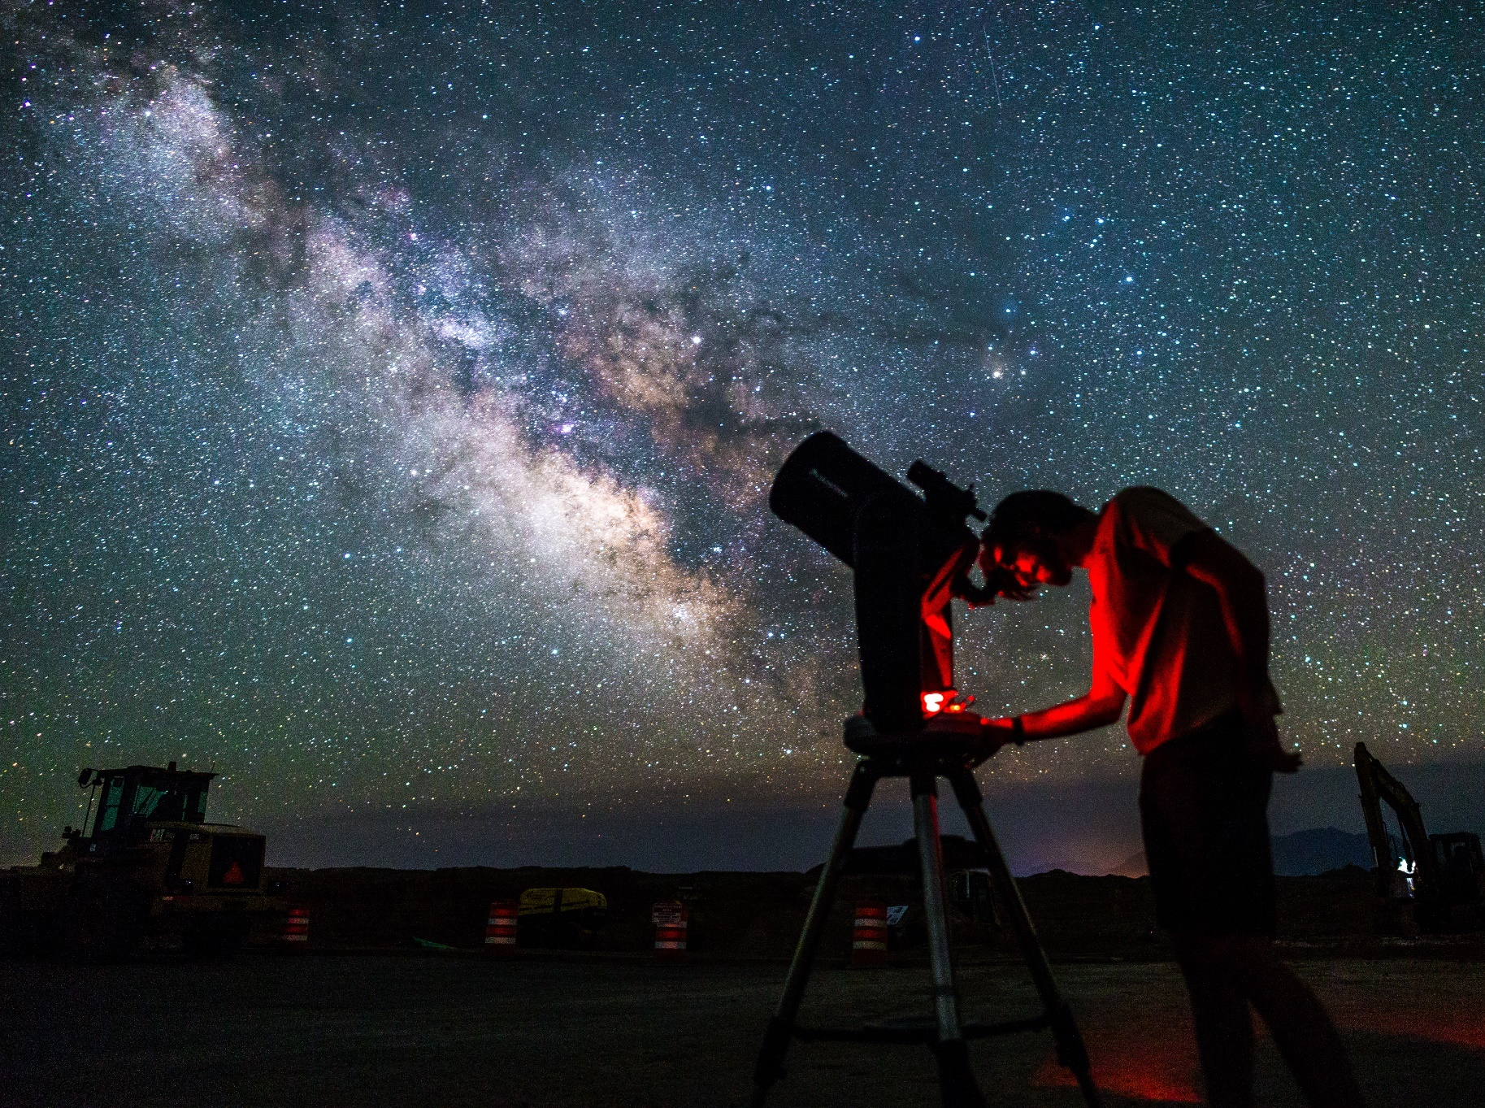
The Colorado Plateau
9
“For the vast majority of our U.S. citizens living in populated areas, the view of more delicate celestial objects like the Milky Way has been largely lost. The vast open areas of the Colorado Plateau provides a fantastic opportunity to regain our connection with the same night sky our ancestors viewed for millennia.”
Randy Stanley
Natural Sounds and Night Skies Coordinator, National Park Service, Intermountain Region
Image Credit: Bettymaya Foott
Notes:
Short Script
The Colorado Plateau has historically been an ideal area for stargazing due to its dark skies. In fact, (as of now) there are seventeen certified Dark Sky Places within the Colorado Plateau. However, light pollution from cities up to 200 kilometers away can impact the pristine night sky of this region.
Long Script
The Colorado Plateau has historically been an ideal area for stargazing due to its dark skies. In fact, (as of now) there are seventeen certified Dark Sky Places within the Colorado Plateau. Several National Parks host outreaching events, such as Star Parties. However, light pollution from cities up to 200 kilometers away can impact the pristine night sky of this region.
--advance slide--
Quote Source: Stanley, R. (2017, October 26). NASA DEVELOP National Program Virtual Poster Session Interview [Personal interview] [emphasis added]
Image Source: Bettymaya Foott (project partner)

Slide 10

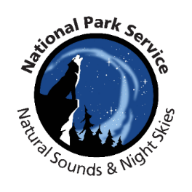
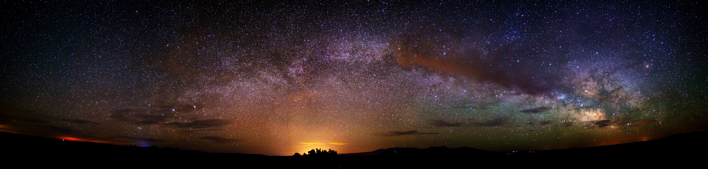
Partners
10
Colorado Plateau Dark Sky Cooperative
International Dark-Sky Cooperative
National Park Service, Intermountain Region
National Park Service, Natural Sounds and Night Skies Division
National Park Service, Grand Teton National Park,
Wyoming Stargazing
Image Credit: Bettymaya Foott
Notes:
Script
We partnered with the Colorado Plateau Dark Sky Cooperative, International Dark-Sky Cooperative, the Intermountain Region of the National Park Service, the Natural Sounds and Night Skies Division of the National Park Service, Grand Teton National Park, and Wyoming Stargazing.
--advance slide--
Image Source: Bettymaya Foott (project partner)

Slide 11
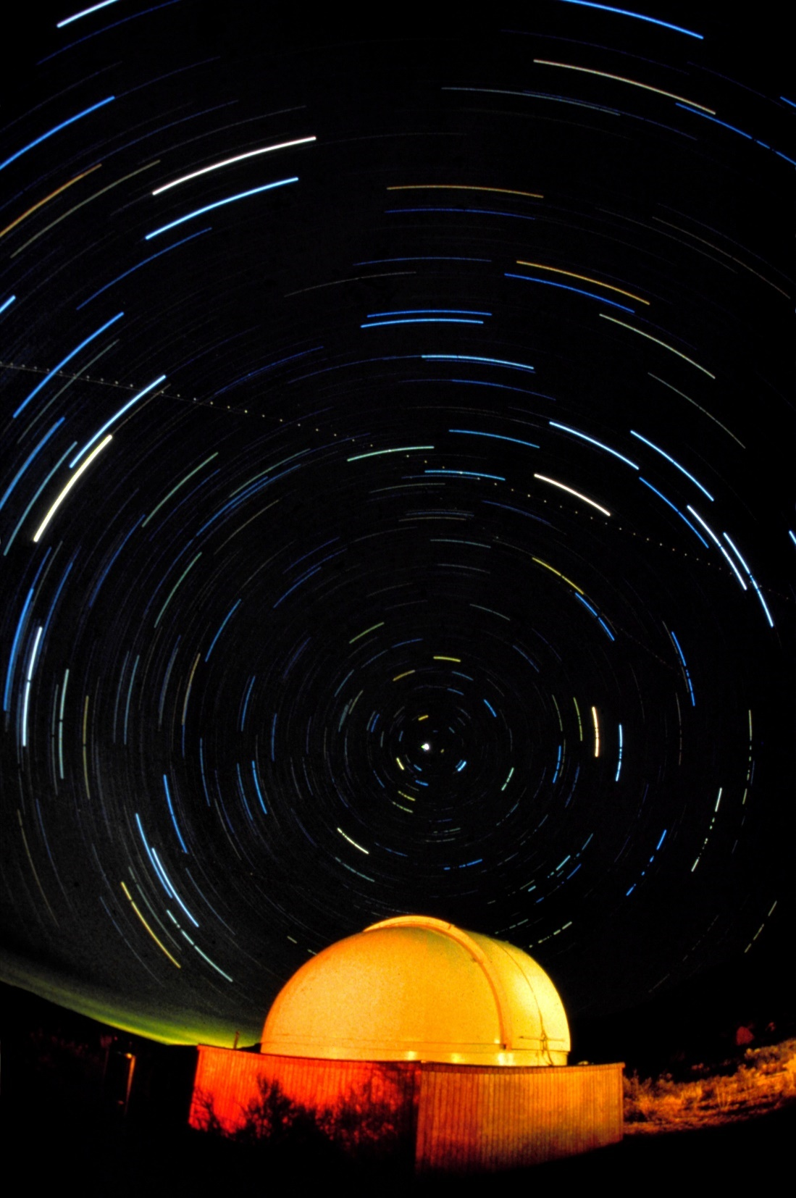
Objectives
  Analyze artificial light affecting the Colorado Plateau using the Skyglow Estimation Toolbox (SET)
  Determine zenith and azimuth angles with higher sky glow values
  Employ in situ data from the National Park to determine the statistical relevance of the values generated by SET
  Generate Artificial Skyglow Maps for the Colorado Plateau
Image Credit: National Park Service
Notes:
Script
Our objectives for our project were to:
Analyze artificial light affecting the Colorado Plateau using the Skyglow Estimation Toolbox (SET).
Determine zenith and azimuth angles with higher sky glow values.
Employ in situ data from the National Park to determine the statistical relevance of the values generated by SET.
Generate Artificial Skyglow Maps for the Colorado Plateau.
--advance slide--
Image Credit: National Park Service. (n.d.). [Photograph found in Chaco Culture National Historical Park]. Retrieved October 17, 2017, from https://www.nps.gov/media/photo/gallery.htm?id=9D6C7929-155D-451F-67A5660052FF8254

Slide 12
Study Area
12
ID
WY
SD
OR
Study Region
NE
Colorado Plateau Study Region
UT
NV
CO
200 km Accuracy Buffer
400 km Kernel Buffer
CA
AZ
NM
Mexico
TX
Notes:
Short Script
Our area of interest is the Colorado Plateau highlighted in orange on the map. We determined a 200 km Accuracy Buffer was necessary as light sources up to 200 km away can affect a region. An additional 200 km buffer is necessary for the kernel in the Skyglow Estimation Toolbox, which is depicted as the 400 km Kernel Buffer. The light found in the additional 200 km for the 400 km Kernel Buffer is being using within the calculations; however, the values given for this region are not accurate in the final image, and are therefore not shown in our final results. Only summer and fall months, with low snow cover, were used because of the brightening effect of snow. In addition, no Day/Night Imagery was available before 2014. As a result, our dataset utilized a multi-annual composite of a total of seventeen months from 2014 to 2016 for June, July, August, September, and October; as well as June and July in 2017.
Long Script
Our area of interest is the Colorado Plateau, which is highlighted in orange on the map. This area is the physiographical region for the Colorado Plateau, which lies over the four corners region in Utah, Colorado, Arizona, and New Mexico. We determined a 200 km Accuracy Buffer was necessary as light sources up to 200 km away can affect a region. We wanted to be sure we could accurately depict the sources of light affecting the Colorado Plateau in our final images. An additional 200 km buffer is necessary for the kernel in the Skyglow Estimation Toolbox, which is depicted as the 400 km Kernel Buffer. The light found in the additional 200 km for the 400 km Kernel Buffer is being using within the calculations, however, the values given for this region are not accurate in the final image, and are therefore not shown in our final results. Only summer and fall months, with low snow cover, were used because of the brightening effect of snow. Snow coverage increases sky brightness 1.3- to 2.6-fold when partially present on lit roads due to snow’s high reflectance. In addition, no Day/Night Imagery was available before 2014. As a result, our dataset utilized a multi-annual composite of a total of seventeen months from 2014 to 2016 for June, July, August, September, and October; as well as June and July in 2017.
--advance slide--
Map Credit: Colorado Plateau Urban Development
Map Sources: Fenneman, N.M. and Johnson, D.W. (1946). Physiographic divisions of the conterminous U. S. [shapefile]. Retrieved September 26, 2017, from https://water.usgs.gov/GIS/metadata/usgswrd/XML/physio.xml
University of California, Berkeley, and the International Rice Research Institute (2009). GADM Global Administrative Database [adm_1] Retrieved October 16, 2017, from http://gadm.org/

Slide 13
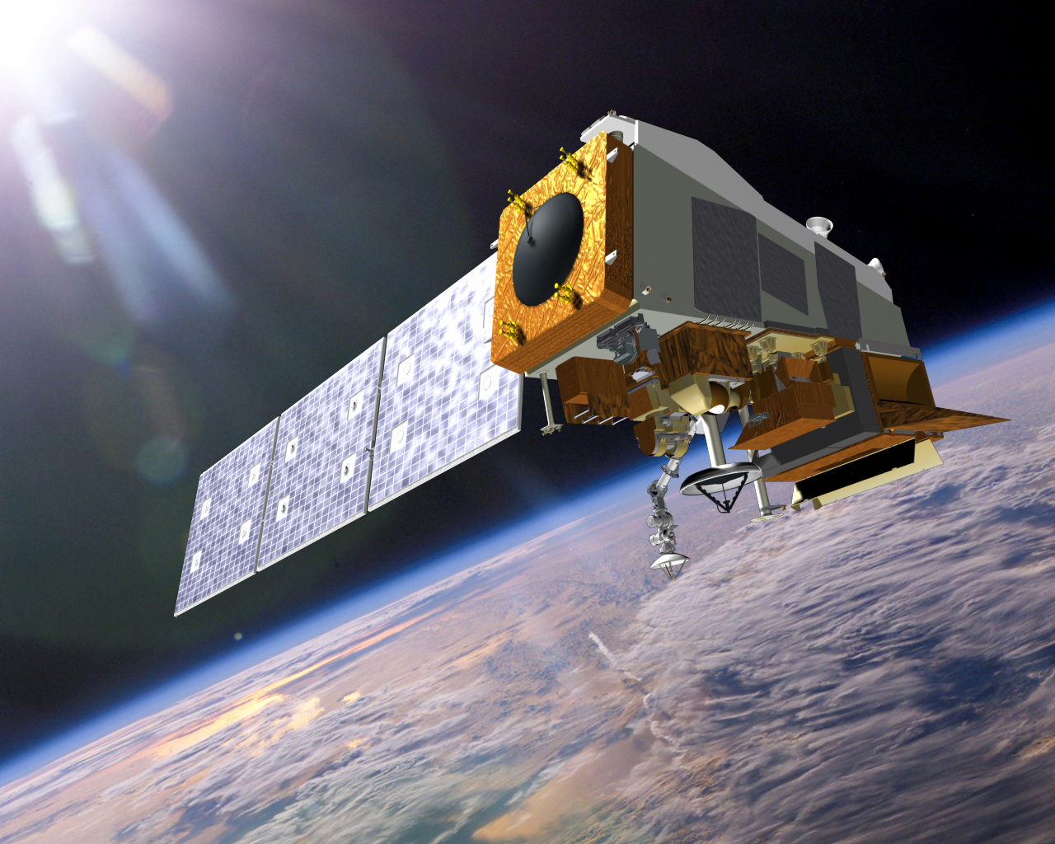
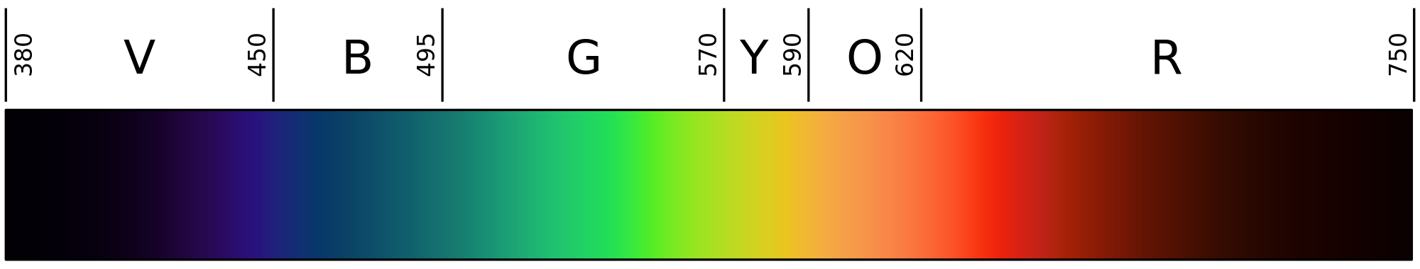
Suomi-NPP VIIRS DNB
13
NCEI Earth Observations Group
  Monthly composite images
  Stray light (striping) removed
  Moonlight removed
Sensitive to 500 nm - 900 nm wavelengths
Image Credit: 2008 Gringer/Wikimedia Commons Public Domain
Image Credit: NASA
Notes:
Short Script
We collected our project data from the Suomi NPP VIIRS Day/Night Band, which senses wavelengths from 500 nm to 900 nm. Looking at this image on the bottom, we see that this does not include light emitted from the blue end of the visible color spectrum. The NCEI Earth Observations Group in NOAA produces clean monthly composite images of VIIRS imagery.
Long Script
We collected our project data from the Day/Night Band, which is on the Visible Infrared Imaging Radiometer Suite Sensor housed on the Suomi National Polar-orbiting Partnership. The Day/Night Band senses wavelengths from 500 nm to 900 nm. Looking at this image on the bottom, we see that this does not include light emitted in the blue spectrum. This satellite is a joint project between NASA and NOAA that was launched in 2011 and started gathering data in 2012. The NCEI Earth Observations Group in NOAA produces monthly composite images of VIIRS DNB and removes cloud cover, stray light, and other temporary light sources. Furthermore, anytime the moon is above the horizon, the data is removed from the compilation.
--advance slide--
Source: Earth Observation Group. (2017). Version 1 Nighttime VIIRS Day/Night Band Monthly Composites. NOAA National Centers for Environmental Information. Retrieved September 2 -25, 2017, from https://www.ngdc.noaa.gov/eog/viirs/download_dnb_composites.html
Image Source: NASA. (n.d.). [Soumi NPP]. Retrieved June 29, 2017, from https://www.nasa.gov/sites/default/files/thumbnails/image/img_press_140106_suomi-npp.jpg; Gringer. (2008, August 27). Linear visible spectrum. Retrieved July 28, 2017, from https://commons.wikimedia.org/wiki/File:Linear_visible_spectrum.svg

Slide 14
Methods
14
VIIRS DNB Raster Data
Perform Noise Reduction
Sky Glow Map
Image Credit: Monet
Skyglow Estimation Toolbox
Determine Maximum Sky Brightness
Clip Data to Study Area
Notes:
Short Script
Once we downloaded the Suomi NPP VIIRS Day/Night Band Raster Data and clipped it to our study area, we performed noise reduction by creating a median. Through extra analysis, we were able to determine a median performed enough reduction to remove outliers, as we found evidence of wildfires through calculating percent differences for each individual month. The median file was convolved in the Skyglow Estimation Toolbox to create Artificial Skyglow Maps for a range of predetermined zenith and azimuth angles. We finally created Maximum Sky Brightness maps through further analysis of the convolved image files in ArcMap and compared them with in situ data.
Long Script
Once we downloaded the Suomi NPP VIIRS Day/Night Band Raster Data and clipped it to our study area, we performed noise reduction by creating a median. Through extra analysis, we were able to determine a median performed enough reduction to remove outliers as we found evidence of wildfires through calculating percent differences. For example, the South Bobcat Wildfire outside of Boise, ID was evident in the August 2015 raster file, but dropped in our median calculation. The median file was convolved in the Skyglow Estimation Toolbox to create Artificial Skyglow Maps for a range of predetermined zenith and azimuth angles. We finally created Maximum Sky Brightness maps through further analysis of the convolved image files in ArcMap and compared them with in situ data.
--advance slide--
Spruce, J. personal communication, November 8, 2017
Image Source: Colorado Plateau Urban Development Team

Slide 15
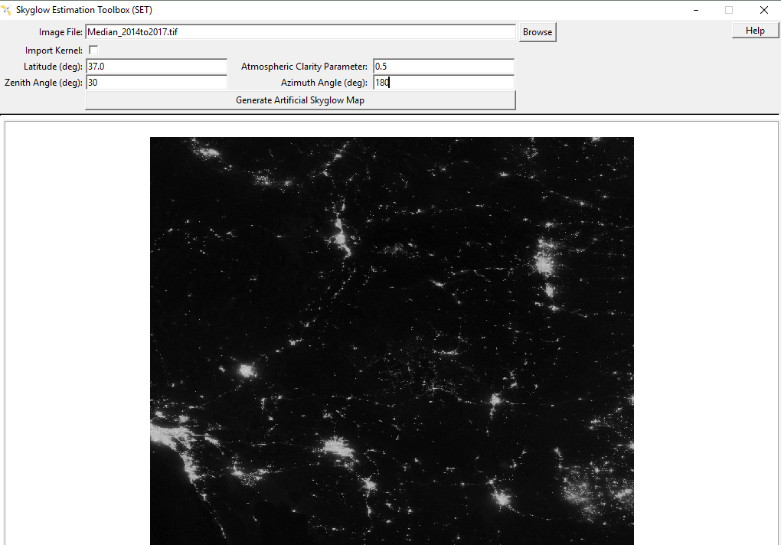
Skyglow Estimation Toolbox
15
User Interface
implementation of model with user-defined parameters
Image Credit: Colorado Plateau Urban Development Team
Notes:
Short Script
This image is a prototype of what the user interface will look like for our end-users. As you can see, there are various fields that allow you to change parameters, such as the zenith angle, and to import a VIIRS image of your area of interest.
Long Script
The Skyglow Estimation Toolbox is going through the NASA Software Release process and will be an open-source code on the NASA DEVELOP GitHub page once approved. This image is a prototype of what the user interface will look like. As you can see, there are various fields that allow you to change parameters, such as the zenith angle, and to import a VIIRS image of your area of interest. This GUI was originally developed by the Wyoming Cross-Cutting II Team.
--advance slide--
Image Source: Colorado Plateau Urban Development Team

Slide 16
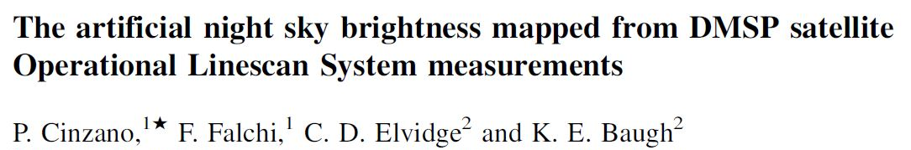
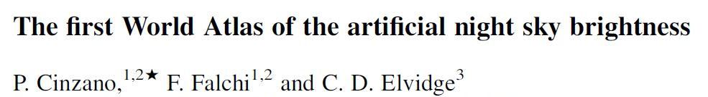
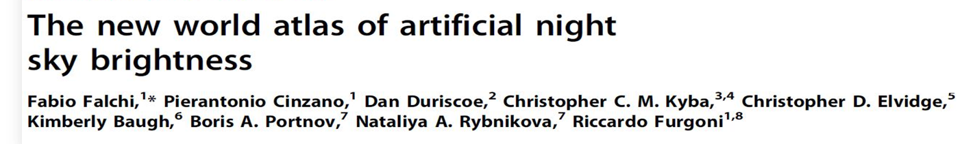
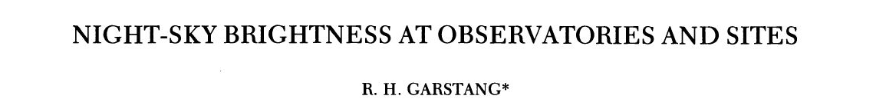
Building a Regional Model
Image Credit: Monet
Notes:
Script
The Skyglow Estimation Toolbox was created by the Wyoming Cross Cutting II Team during the Summer 2017 term based on the methods found in these paper. Our team used the same methods to expand SET to be able to calculate different angle combinations for zenith and azimuth, quickly and efficiently.
--advance slide--
Screenshot Sources: Cinzano, P., Falchi, F., Elvidge, C. D., & Baugh, K. E. (2000). The artificial night sky brightness mapped from DMSP satellite Operational Linescan System measurements. Monthly Notices of the Royal Astronomical Society,318(3), 641-657. doi:10.1046/j.1365-8711.2000.03562.x; Cinzano, P., Falchi, F., & Elvidge, C. D. (2001). The first World Atlas of the artificial night sky brightness. Monthly Notices of the Royal Astronomical Society, 328(3), 689-707. doi:10.1046/j.1365-8711.2001.04882.x; Falchi, F., Cinzano, P., Duriscoe, D., Kyba, C. C. M., Elvidge, C. D., Baugh, K., Furgoni, R. (2016). The new world atlas of artificial night sky brightness. Science Advances, 2(6), e1600377. doi:10.1126/sciadv.1600377; Garstang, R. H. (1989). Night-sky brightness at observatories and sites. Publications of the Astronomical Society of the Pacific, 101(637), 306-329. doi:10.1086/132436

Slide 17
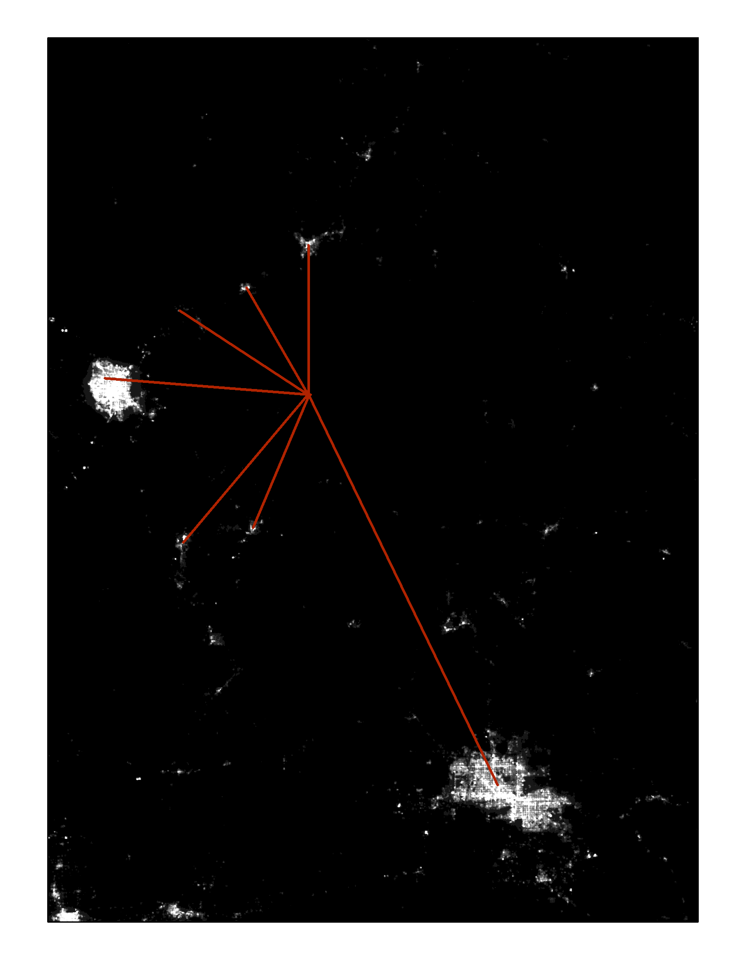

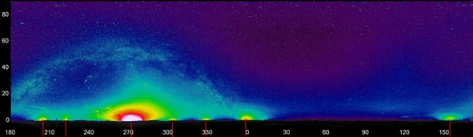

Building a Regional Model
17
VIIRS
Input: VIIRS image, viewing angle, latitude, atmospheric clarity parameter
Product: goal is to produce skyglow maps
N
Phoenix, AZ
St. George, UT
$$O$$
Kingman, AZ
Moapa, NV
Bullhead City, AZ
Las Vegas, NV
Map Credit: Wyoming Cross-Cutting I & II Teams
Image Credit: National Park Service
IN SITU
N
210
240
270
300
330
0
30
60
90
120
150
Kingman,
AZ
Bullhead
City, AZ
Las Vegas,
NV
Moapa,
NV
Mesquite,
NV
St. George, UT
Phoenix, AZ
Notes:
Short Script
It is difficult to create a model of a 3D object, the sky, with a 2D input, the VIIRS imagery. There are two differences between VIIRS’s measure of radiance, seen in the top image, and the in situ measure of sky-glow seen at the bottom. The difficulties lie in the physics of the atmosphere and the geometry of the Earth.
Long Script
It is difficult to create a model of a 3D object, the sky, with a 2D input, the VIIRS imagery. There are two differences between VIIRS’s measure of radiance, seen in the top image, and the in situ measure of sky-glow seen at the bottom. First, sky-glow spreads out over large areas while VIIRS shows points of light. The physics of the atmosphere mediate what each light source looks like from the ground at different places. The second difference is geometry: sky-glow appears in three-dimensions, and VIIRS can only measure two of those dimensions.
--advance slide--
Map Credit: Wyoming Cross-Cutting I & II Teams
Image Source: National Park Service

Slide 18
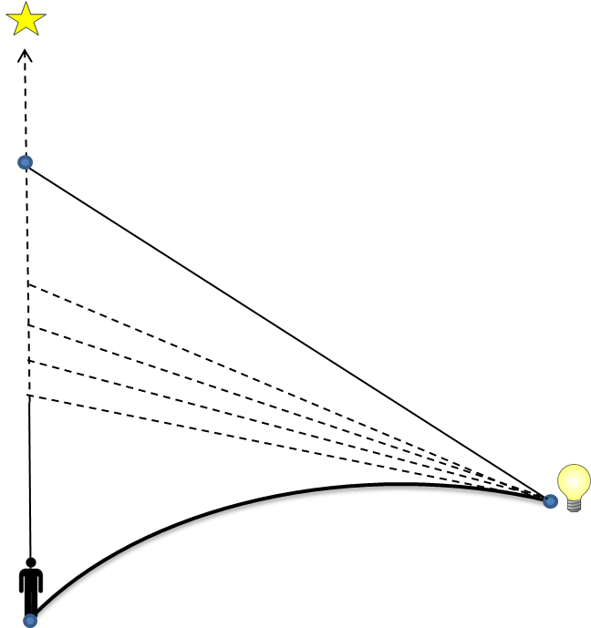
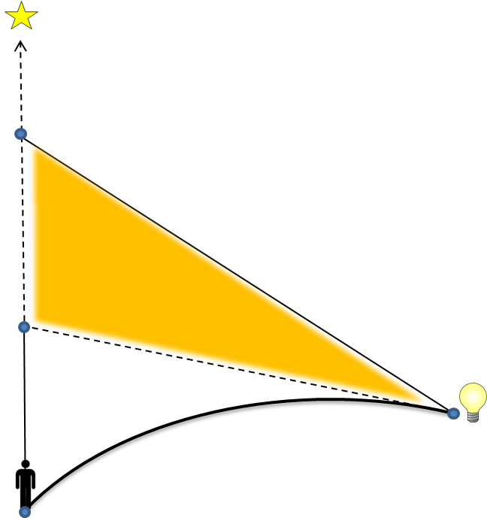
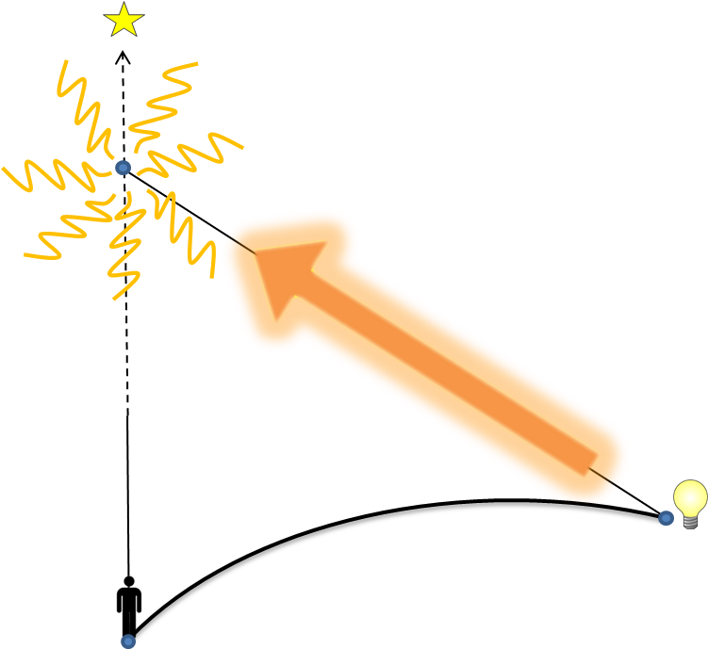
18
Building a Regional Model
Source
Source
Source
Target
Target
Target
VIIRS gives brightness at the source, source light scatters in all directions
The exact amount scattered by each path can be estimated
Adding up all values estimates the contribution of sky glow from a single point
Graphic Credit: Wyoming Cross-Cutting I & II Teams
Notes:
Script
In order to produce an Artificial Skyglow Map, we first calculated light scattering point-to-point. We consider a target being the area under one VIIRS pixel, and a nearby light source up to 200 kilometers away. We use quantities we can calculate, like distance, angle, and curvature of the Earth to imagine paths for a beam of light to go from the source to the target. There are different paths a beam of light can take to reach a target location. We add up all of these paths to see the effect a single light source has on sky brightness at an individual target location.
--advance slide--
Graphic Source: Wyoming Cross-Cutting I & II Teams

Slide 19
Results & Discussion
“These models will in the future allow us to monitor and look for changes to find out what is happening with light pollution.”
– Sharolyn Anderson, PhD
Research Scientist, National Park Service
Natural Sounds and Night Skies Division
Notes:
Furthermore, our results establish a baseline of sky brightness in the Colorado Plateau for future monitoring.
--advance slide--
Quote Source: Anderson, S. (2017, July 19). NASA DEVELOP National Program Virtual Poster Session Interview [Personal interview] [emphasis added].

Slide 20
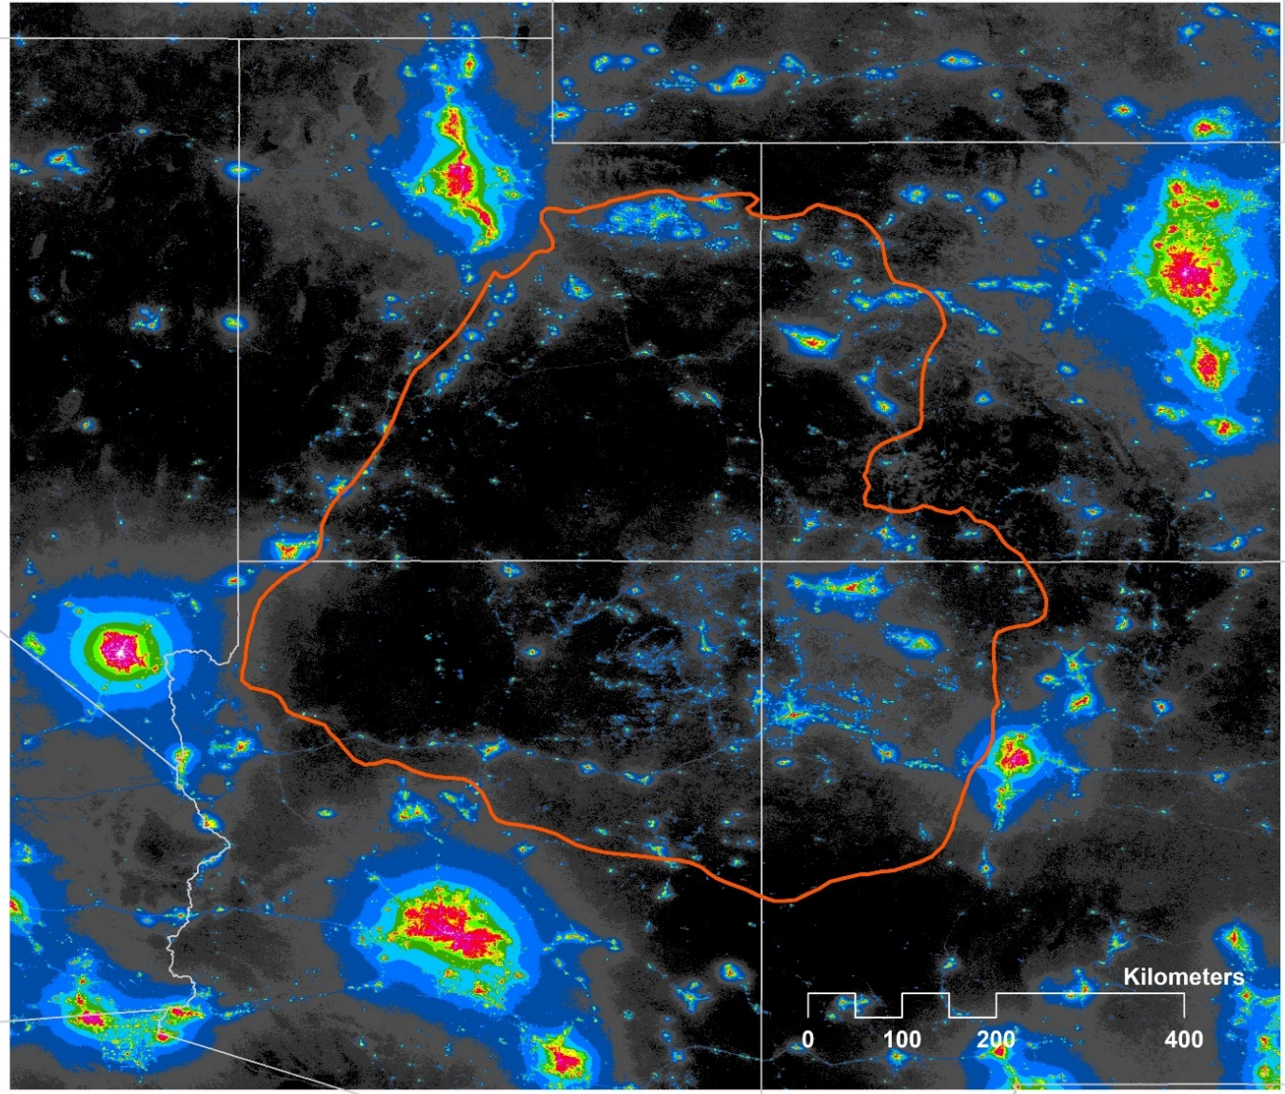
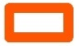

Results
20
Zenith Ratio to Natural Brightness
Colorado Plateau Study Region
< 0.01
0.01 – 0.02
0.02 – 0.04
0.04 – 0.08
0.08 – 0.16
0.16 – 0.32
0.32 – 0.64
0.64 – 1.28
1.28 – 2.56
2.56 – 5.12
5.12 – 10.2
10.2 – 20.5
20.5 - 41
> 41
Notes:
Script
The first result which we would like to present is the ratio of Artificial Light Pollution at Zenith to Natural Sky Brightness. To clarify, zenith describes looking straight up in the sky. We compared this image to The New World Atlas to determine the degree to which our models agree.
--advance slide--
Map Credit: Colorado Plateau Urban Development
Map Sources: Fenneman, N.M. and Johnson, D.W. (1946). Physiographic divisions of the conterminous U. S. [shapefile]. Retrieved September 26, 2017, from https://water.usgs.gov/GIS/metadata/usgswrd/XML/physio.xml
University of California, Berkeley, and the International Rice Research Institute (2009). GADM Global Administrative Database [adm_1] Retrieved October 16, 2017, from http://gadm.org/
Earth Observation Group. (2017). Version 1 Nighttime VIIRS Day/Night Band Monthly Composites. NOAA National Centers for Environmental Information. Retrieved September 21 & 25, 2017, from https://www.ngdc.noaa.gov/eog/viirs/download_dnb_composites.html;
Falchi, F. (2011). Campaign of sky brightness and extinction measurements using a portable CCD camera. Monthly Notices of the Royal Astronomical Society, 412(1), 33-48. doi:10.1111/j.1365-2966.2010.17845.x;
Falchi, F., Cinzano, P., Duriscoe, D., Kyba, C. C. M., Elvidge, C. D., Baugh, K., Furgoni, R. (2016). The new world atlas of artificial night sky brightness. Science Advances, 2(6), e1600377. doi:10.1126/sciadv.1600377

Slide 21
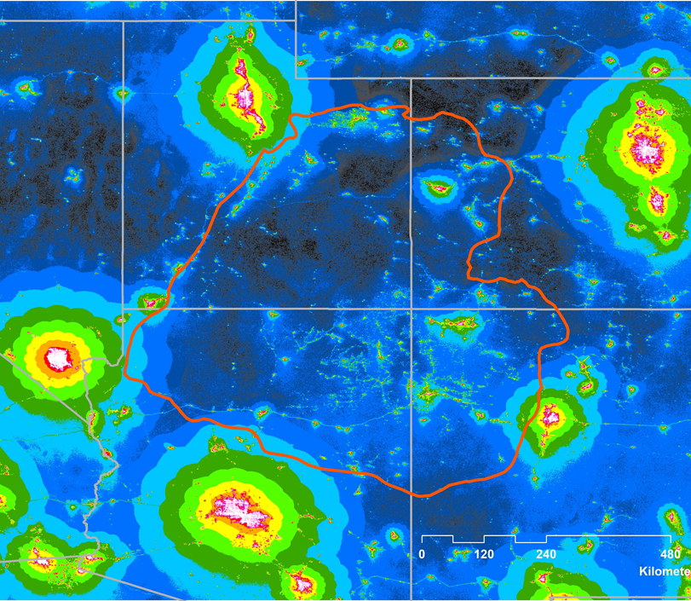
Results
21
Maximum Brightness Ratio
Colorado Plateau Study Region
< 0.01
0.01 – 0.02
0.02 – 0.04
0.04 – 0.08
0.08 – 0.16
0.16 – 0.32
0.32 – 0.64
0.64 – 1.28
1.28 – 2.56
2.56 – 5.12
5.12 – 10.2
10.2 – 20.5
20.5 - 41
> 41
Notes:
Script
We calculated the maximum brightness values from all the of convolved images across the different angles tested. We determined the maximum values were all generated at 67.5 degrees from zenith. The ratio displayed is the same ratio scale used in both the previous image at zenith and in the New World Atlas. We would like to take a moment and show the difference between the brightness values found at zenith versus the maximum brightness values.
--advance slide--
Map Credit: Colorado Plateau Urban Development
Map Sources: Fenneman, N.M. and Johnson, D.W. (1946). Physiographic divisions of the conterminous U. S. [shapefile]. Retrieved September 26, 2017, from https://water.usgs.gov/GIS/metadata/usgswrd/XML/physio.xml
University of California, Berkeley, and the International Rice Research Institute (2009). GADM Global Administrative Database [adm_1] Retrieved October 16, 2017, from http://gadm.org/
Earth Observation Group. (2017). Version 1 Nighttime VIIRS Day/Night Band Monthly Composites. NOAA National Centers for Environmental Information. Retrieved September 21 & 25, 2017, from https://www.ngdc.noaa.gov/eog/viirs/download_dnb_composites.html;
Falchi, F. (2011). Campaign of sky brightness and extinction measurements using a portable CCD camera. Monthly Notices of the Royal Astronomical Society, 412(1), 33-48. doi:10.1111/j.1365-2966.2010.17845.x;
Falchi, F., Cinzano, P., Duriscoe, D., Kyba, C. C. M., Elvidge, C. D., Baugh, K., Furgoni, R. (2016). The new world atlas of artificial night sky brightness. Science Advances, 2(6), e1600377. doi:10.1126/sciadv.1600377

Slide 22
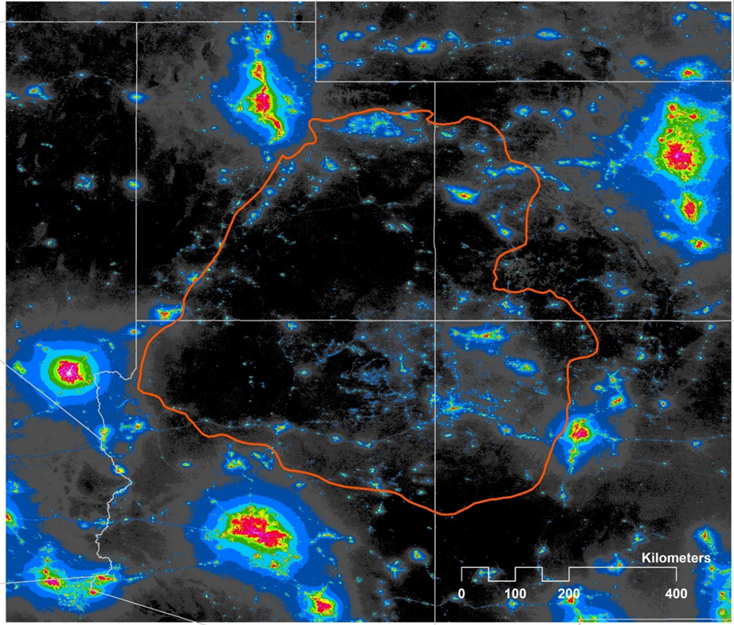
Results
22
Maximum Brightness Ratio
Colorado Plateau Study Region
< 0.01
0.01 – 0.02
0.02 – 0.04
0.04 – 0.08
0.08 – 0.16
0.16 – 0.32
0.32 – 0.64
0.64 – 1.28
1.28 – 2.56
2.56 – 5.12
5.12 – 10.2
10.2 – 20.5
20.5 - 41
> 41
Notes:
[click through animation]
Script
As you can see, there is a noticeable amount of light pollution that is not detectable at zenith.
--advance slide--
Map Credit: Colorado Plateau Urban Development
Map Sources: Fenneman, N.M. and Johnson, D.W. (1946). Physiographic divisions of the conterminous U. S. [shapefile]. Retrieved September 26, 2017, from https://water.usgs.gov/GIS/metadata/usgswrd/XML/physio.xml
University of California, Berkeley, and the International Rice Research Institute (2009). GADM Global Administrative Database [adm_1] Retrieved October 16, 2017, from http://gadm.org/
Earth Observation Group. (2017). Version 1 Nighttime VIIRS Day/Night Band Monthly Composites. NOAA National Centers for Environmental Information. Retrieved September 21 & 25, 2017, from https://www.ngdc.noaa.gov/eog/viirs/download_dnb_composites.html;
Falchi, F. (2011). Campaign of sky brightness and extinction measurements using a portable CCD camera. Monthly Notices of the Royal Astronomical Society, 412(1), 33-48. doi:10.1111/j.1365-2966.2010.17845.x;
Falchi, F., Cinzano, P., Duriscoe, D., Kyba, C. C. M., Elvidge, C. D., Baugh, K., Furgoni, R. (2016). The new world atlas of artificial night sky brightness. Science Advances, 2(6), e1600377. doi:10.1126/sciadv.1600377

Slide 23
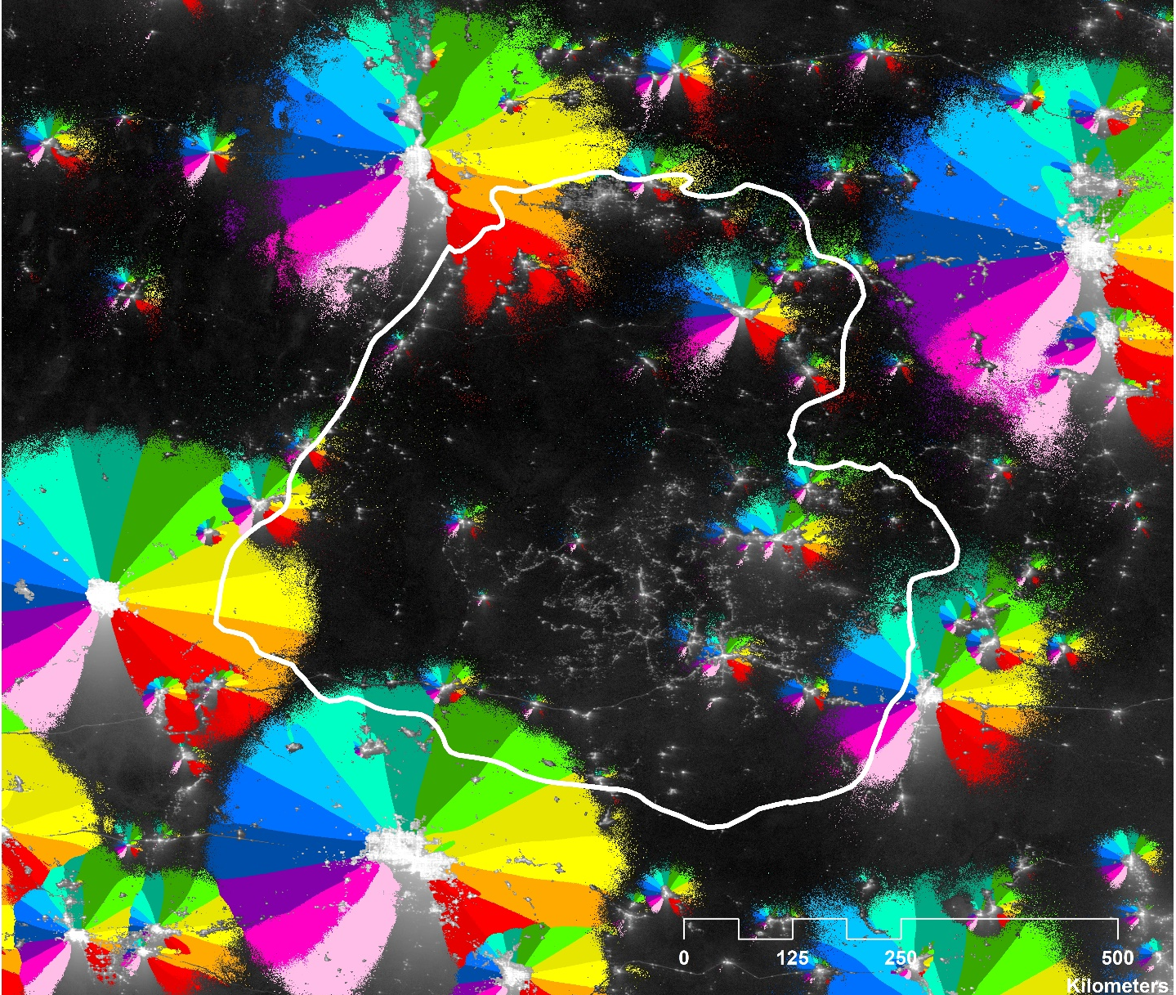
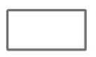

Results
23
Direction of Maximum Brightness
Colorado Plateau Study Region
Azimuth Angle (degrees)
360° | North
337.5°
315°
292.5°
270° | West
247.5°
225°
202.5°
180° | South
160.5°
135°
115.5°
90° | East
67.5°
45°
22.5°
Artificial Brightness (μcd/m²)
High: 7130
Low: 0
Notes:
Script
This image shows the azimuth, or compass, angle with the greatest contribution towards the total maximum light pollution. The angles themselves refer to the direction which an observer on the ground would be facing to experience the greatest sky brightness. Each angle depicted was generated at 67.5 degrees from zenith. It is important to note that we set the 360° angle to be transparent so that the glow itself is more visible.
[Start Animation]
For example, when an individual is looking west, they are looking towards 270 degrees. Or if they are looking north, they are looking towards 360 degrees.
--advance slide--
Map Credit: Colorado Plateau Urban Development
Map Sources: Fenneman, N.M. and Johnson, D.W. (1946). Physiographic divisions of the conterminous U. S. [shapefile]. Retrieved September 26, 2017, from https://water.usgs.gov/GIS/metadata/usgswrd/XML/physio.xml
University of California, Berkeley, and the International Rice Research Institute (2009). GADM Global Administrative Database [adm_1] Retrieved October 16, 2017, from http://gadm.org/
Earth Observation Group. (2017). Version 1 Nighttime VIIRS Day/Night Band Monthly Composites. NOAA National Centers for Environmental Information. Retrieved September 21 & 25, 2017, from https://www.ngdc.noaa.gov/eog/viirs/download_dnb_composites.html;
Falchi, F. (2011). Campaign of sky brightness and extinction measurements using a portable CCD camera. Monthly Notices of the Royal Astronomical Society, 412(1), 33-48. doi:10.1111/j.1365-2966.2010.17845.x;
Falchi, F., Cinzano, P., Duriscoe, D., Kyba, C. C. M., Elvidge, C. D., Baugh, K., Furgoni, R. (2016). The new world atlas of artificial night sky brightness. Science Advances, 2(6), e1600377. doi:10.1126/sciadv.1600377

Slide 24
Model Validation
24
Comparisons with ground-based measurements in the Colorado Plateau (August-October, 2016 and June-July, 2017)
-269
µcd/m²
Difference between SET Model (Median) & SQM data
2
µcd/m²
Difference in discrepancies
-271
µcd/m²
Difference between New World Atlas & SQM data
*Numbers rounded
Notes:
Short Script
To further validate our model, we compared the in situ data collected by our partners to our maps values. We found that our model tended to be 269 μcd/m² darker than the actual values and the New World Atlas was on average 271 μcd/m² darker than the in situ data.
Long Script
To further validate our model, we compared the in situ data collected by our partners to our maps values. We extracted the SQM values, originally in mag/arcsec², at each measurement location and converted them to μcd/m² values using the Unihedron Sky Quality Meter Conversion Tool. We compared these in situ values to the values predicted by the Artificial Skyglow Map by matching each in situ location to its corresponding location on the Artificial Skyglow Map and calculating the difference between the two values at that point. Next, we calculated the average discrepancy, the first time with all datasets and a second time with outliers removed. This process was repeated to calculate the average discrepancy between the in situ values and the New World Atlas. We found that our model tended to be 269 μcd/m² darker than the actual values and that the New World Atlas was on average 271 μcd/m² darker than the in situ data. In other words, it seems our model predicts values 2 μcd/m² brighter than what the New World Atlas predicts.
Note:
The standard deviation for (in situ – our model) was 172 μcd/m² and (in situ – The New World Atlas) was 177μcd/m²

Slide 25
Conclusions
“The project that the NASA DEVELOP team is developing for the Colorado Plateau Dark Sky Cooperative will be the best and most detailed map of light pollution of the Colorado Plateau that exists to date. That will really help us inform our decision making about where to direct our efforts for light pollution reduction.”
– Bettymaya Foott
Coordinator
Colorado Plateau Dark Sky Cooperative
Notes:
Script
The high quality Artificial Light Pollution imagery will help our partner’s direct their efforts for light pollution reduction.
--advance slide--
Quote Source: Foott, B. (2017, October 26). NASA DEVELOP National Program Virtual Poster Session Interview [Personal interview] [emphasis added]

Slide 26
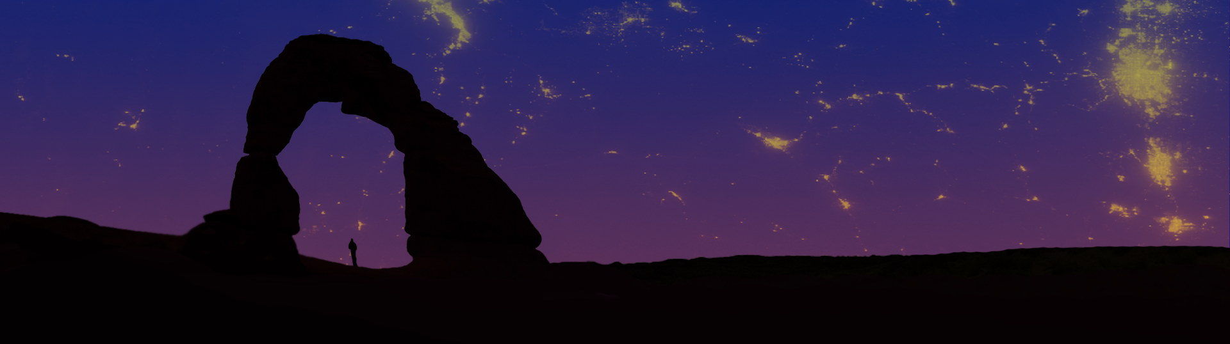
Conclusions
Image Credit: Colorado Plateau Urban Development Team
26
Combining SET and Suomi NPP VIIRS imagery will allow for the capability to model light pollution at predetermined zenith and azimuth angles.
SET offers broader, more dynamic capabilities and applications than handheld light meters, allowing local officials to expand the geographic scope of current light measurement practices.
Local officials and communities will have the capability to track changes in maximum brightness levels with SET.
Notes:
Script
During this term, our team reached the following conclusions:
Combining the Skyglow Estimation Toolbox and Suomi NPP VIIRS imagery will allow for the capability to model light pollution at predetermined zenith and azimuth angles.
SET offers broader, more dynamic capabilities and applications than handheld light meters, allowing local officials to expand the geographic scope of current light measurement practices.
Local officials and communities will have the capability to track changes in maximum brightness levels with the Skyglow Estimation Toolbox.
--advance slide--
Image Source: Colorado Plateau Urban Development Team

Slide 27
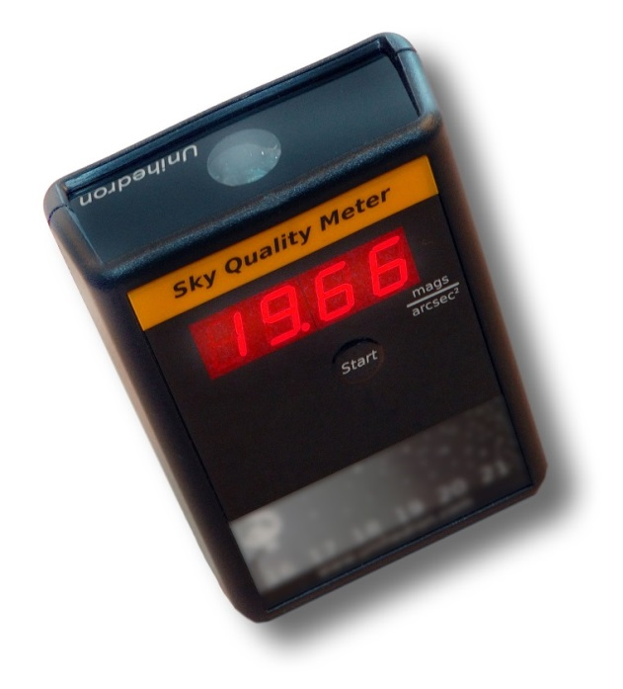
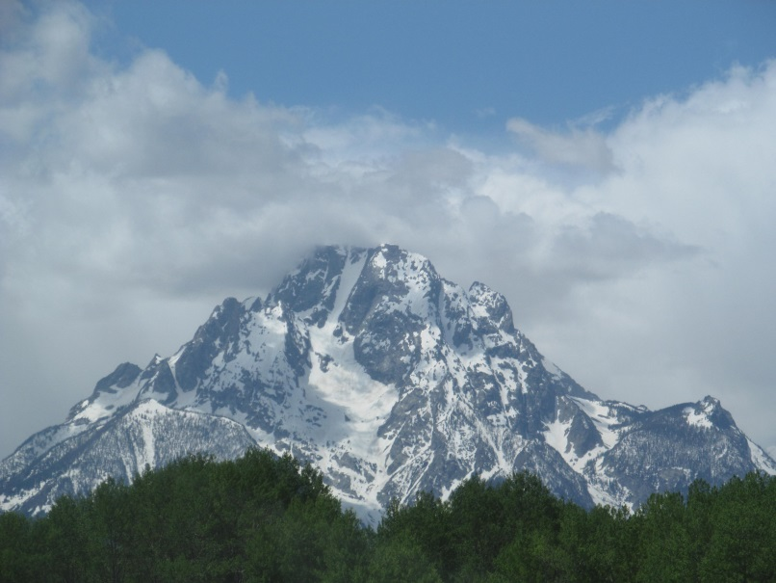
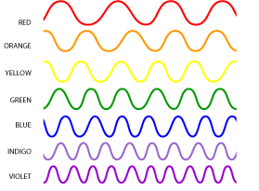
Uncertainties
27
Validation
Topographic shielding
Blue blindness
Needs further verification of model accuracy
Not accounted for in model
VIIRS DNB (500 nm - 900 nm) not sensitive to shorter wavelengths
Image Credit:
© 2010 Lamiot/Wikipedia cc by-sa 3.0
Image Credit:
© 2014 Doug Kerr/Flickr cc by-sa 2.0
Image Credit:
NASA
Notes:
Short Script
We would also like to discuss some sources of uncertainty in our model. While we have done some initial validation, the in situ measurements we used do not cover our entire study area. More in situ measurements throughout the Colorado Plateau would allow us to improve our toolbox’s accuracy. In addition, even though our study area contains a variety of terrain, we have not accounted for the effects of topographic shielding. Finally, as society transitions to LED lights, more emitted light comes from the blue end of the spectrum, which the VIIRS sensor is not sensitive to.
Long Script
We would also like to discuss some sources of uncertainty in our model. While we have done some initial validation, the in situ measurements we used do not cover our entire study area. More in situ measurements throughout the Colorado Plateau would allow us to improve our toolbox’s accuracy. In addition, even though our study area contains a variety of terrain, we have not accounted for the effects of topographic shielding, which could block light from surrounding areas. Finally, as society transitions to LED lights, more emitted light comes from the blue end of the spectrum, which the VIIRS sensor is not sensitive to. This could result in a perceived reduction in skyglow predicted by SET when in reality, the VIIRS sensor is not picking up the increased amount of blue light.
--advance slide--
Image Sources:
Kerr, D. (n.d.). Grand Teton National Park - Wyoming [Photograph found in Grand Teton National Park]. Retrieved June 29, 2017, from https://flic.kr/p/o79hvH (Originally photographed 2014, June 1); Lamiot. (2010, December 11). SkyQualityMeterQM-LFlou [Digital image]. Retrieved June 29, 2017, from https://zh.wikipedia.org/wiki/%E5%A4%9C%E7%A9%BA%E8%B4%A8%E9%87%8F%E4%BB%AA#/media/File:SkyQualityMeterQM-LFlou.jpg; NASA. (2011, February 25). [ROYGBIV Waves]. Retrieved June 29, 2017, from https://science.hq.nasa.gov/kids/imagers/ems/roygbiv_waves.gif

Slide 28
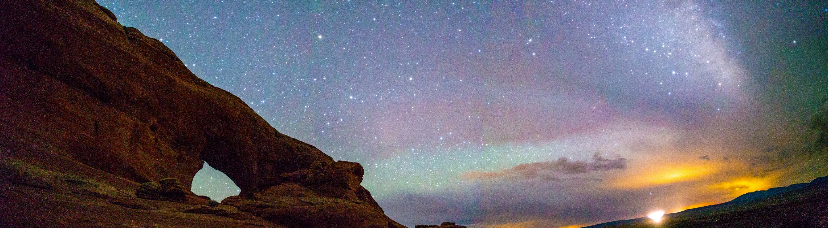
Future Work
28
Conduct more in situ measurements and validate model
Bring the user interface up to the same level of functionality as the command line code
Format to automatically update model with new images
Compile maps to analyze long-term lighting trends
Incorporate effects of topographic shielding
Image Credit: Bettymaya Foott
Notes:
Script
It is proposed for a new two term project to continue studying light pollution using the SET model starting in Spring 2018 at Langley. Future directions that team could take include further validation with SQM in situ measurements, bring the user interface up to the same level of functionality as the command line code, enhancing SET to update automatically to analyze long-term trends and eventually, incorporating the effects of topographic shielding.
In short, SET would give communities and parks around the world the power to determine the impact of outdoor artificial lighting on their night skies and to use this data to further enhance their decision making process in regards to lighting ordinances.
--advance slide--
Image Source: Bettymaya Foott (project partner)

Slide 29
Acknowledgements
29
Science Advisors
Joseph Spruce | Lead Science Advisor for NASA DEVELOP VA – Wise County, Research Consultant, Science Systems & Applications, Inc.
Dr. Kenton Ross | Lead Science Advisor for NASA DEVELOP National Program
Dr. L. DeWayne Cecil | Science Advisor, Chief Climatologist, NOAA National Centers for Environmental Information & Program Manager, Global Science and Technology, Inc.
Bob VanGundy | Science Advisor, Geology Instructor, The University of Virginia’s College at Wise
Notes:
Short Script
We are also grateful for the guidance and assistance received throughout the term from our science advisors.
Long Script
We are also grateful for the guidance and assistance received throughout the term from our science advisors: Joe Spruce, our Lead Science Advisor for NASA DEVELOP VA – Wise County and Research Consultant, Science Systems & Applications, Inc.; Dr. Kenton Ross, Lead Science Advisor for NASA DEVELOP National Program; Dr. L. DeWayne Cecil, Chief Climatologist at NOAA National Centers for Environmental Information and Program Manager of Global Science & Technology, Inc.; and Bob VanGundy, Geology Professor at The University of Virginia’s College at Wise.

Slide 30
Acknowledgements
30
Partners
Bettymaya Foott | Coordinator, Colorado Plateau Dark Sky Cooperative
Randy Stanley | Natural Sounds and Night Skies Coordinator, National Park Service, Intermountain Region
Sharolyn Anderson, PhD | Research Scientist, National Park Service, Natural Sounds and Night Skies Division
Li-Wei Hung, PhD | Research Scientist, National Park Service, Natural Sounds and Night Skies Division
John Barentine | Program Manager, International Dark-Sky Association
Dan Greenblatt | Colter Bay District Interpretive Ranger, Grand Teton National Park
Samuel Singer, PhD | Executive Director, Wyoming Stargazing
Notes:
Short Script
We would like to thank our partners for their cooperation, assistance, and enthusiasm.
Long Script
To conclude, we would like to thank our partners for their cooperation, assistance, and enthusiasm: Bettymaya Foot, Coordinator, Colorado Plateau Dark Sky Cooperative; Randy Stanley, Natural Sounds and Night Skies Coordinator of the National Park Service, Intermountain Region; Sharolyn Anderson, PhD, Research Scientist of the National Park Service, Natural Sounds and Night Skies Division; Li-Wei Hung, PhD, Research Scientist of the National Park Service Natural Sounds and Night Skies Division; John Barentine, Program Manager, International Dark-Sky Association; Dan Greenblatt, Colter Bay District Interpretive Ranger at Grand Teton National Park; and Samuel Singer, PhD, Executive Director of Wyoming Stargazing.
--advance slide--
We would like to thank you for listening to our presentation. We can now answer any questions you may have.
--end--
Image Source: Wyoming Cross-Cutting II Team

Slide 31
Acknowledgements
31
Wise County Clerk of Circuit Court’s Office
Veronica Warda | Project Lead, Wyoming Cross-Cutting I and II Teams, NASA DEVELOP National Program
Ryan Avery | Project Coordination/Geoinformatics Fellow, Wyoming Cross-Cutting II Team, NASA DEVELOP National Program
Steven Chao | Wyoming Cross-Cutting II Team, NASA DEVELOP National Program
Stanley Yu | Wyoming Cross-Cutting II Team, NASA DEVELOP National Program
Benjamin Marcovitz | Wyoming Cross-Cutting Team, NASA DEVELOP National Program
Aubrey Hilte | Wyoming Cross-Cutting Team, NASA DEVELOP National Program
Eric White | Center Lead, Wyoming Cross-Cutting Team, NASA DEVELOP National Program
Christine Stevens | Former Assistant Center Lead, Wyoming Cross-Cutting Team, NASA DEVELOP National Program
J. Michael Brooke | Former Center Lead, NASA DEVELOP National Program
Notes:
Short Script
Finally, we would like to acknowledge those at the Wise County node who have helped us make this project successful.
Long Script
Finally, we would like to acknowledge those at the Wise County node who have helped us make this project successful: Veronica Warda, former Project Lead; Ryan Avery, Steven Chao, Stanley Yu, Benjamin Marcovitz, and Aubrey Hilte, Wyoming Cross-Cutting Team I & II members at NASA DEVELOP Wise County Clerk of Circuit Court’s Office; Eric White, Center Lead and Wyoming Cross-Cutting Team member; Christine Stevens, Former Assistant Center Lead, and Wyoming Cross-Cutting Team member at NASA DEVELOP Wise County Clerk of Circuit Court’s Office; and Michael Brooke, Former Center Lead at NASA DEVELOP Wise County Clerk of Circuit Court’s Office.

Slide 32





Thank you!
Margaret Mulhern
Project Lead
Manda Au
Ian Brastow
Notes:
Script
We would like to thank you for listening to our presentation. We can now answer any questions you may have.
--end--
Image Source: Colorado Plateau Urban Development Team

Slide 33
Addenda
Notes:
**NOTE** The following are additional/backup slides that can be used as a reference to answer questions from the audience.

Slide 34
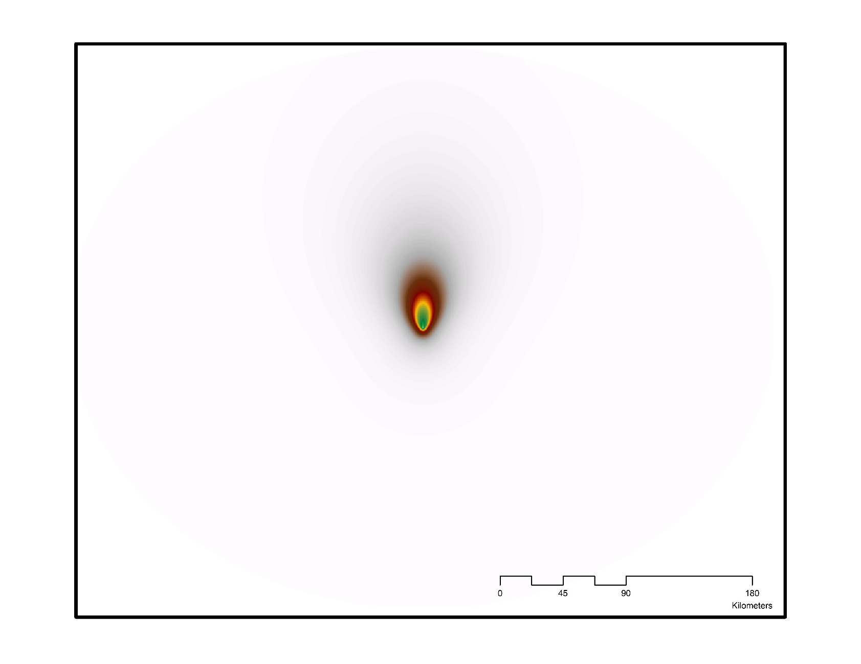
Light Propagation Kernel
Kernel to Calculate Scattered Light in the Direction of (67.5°, 180°)
Part of Skyglow Estimation Toolbox
Depends on parameters
Fast Fourier Transform
22 min – 2 hours to create
Image Credit: Colorado Plateau Urban Development Team
Notes:
The current project focused on calculating sky glow at predetermined zenith and azimuth angles on the Colorado Plateau. How it works is that a kernel is created to calculate the amount of scattered light affecting the line of sight at a location. Each pixel value in the kernel represents the relative weight of light propagation, a coefficient determining how much light from neighboring pixels contributes to the pixel of interest. In other words, the further the pixel is from the center, the dimmer the pixel is since there is less light from that pixel reaching the center. The kernel is not georeferenced to a specific position of the study area. However, the kernel does depend on other parameters input by the user when running the code, such as the zenith angle, beta angle, and central latitude of the region. Thus, changing the line of sight would necessitate producing a new kernel. This creation currently takes about 22 – 60 minutes to produce.
To improve the efficiency of the light propagation calculations, a mathematical shortcut known as the Fast Fourier Transform was used. This converts the input VIIRS DNB image and the kernel into frequency space. Because the inverse Fast Fourier Transform of the product of two transformed images is equal to the convolution of two images, using the Fast Fourier Transform to complete this calculation expedited the calculation of the final product.
----
Image Source: Colorado Plateau Urban Development Team

Slide 35
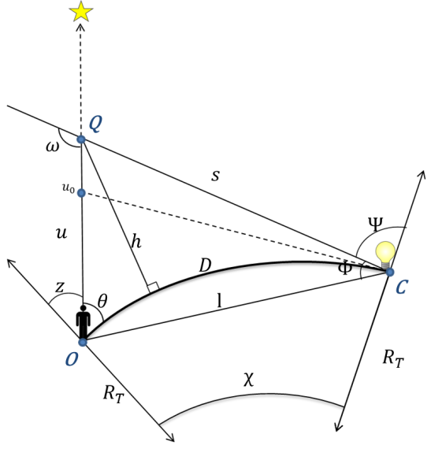
Geometric Relationships
Based on Cinzano et al. (2001) and Garstang (1989)
Graphic Credit: Wyoming Cross-Cutting I & II Teams
Notes:
This model is based on Garstang (1989) and Cinzano et al. (2001). It tells you how and how much light is scattered from that source (C) to the line of sight (u) from the observer (O). The math and physics regarding light propagation found in the code uses these geometrical relationships to construct a kernel.
----
Graphic Credit: Wyoming Cross-Cutting I & II Teams [Adapted from: Cinzano, P., Falchi, F., & Elvidge, C. D. (2001). The first World Atlas of the artificial night sky brightness. Monthly Notices of the Royal Astronomical Society, 328(3), 689-707. doi:10.1046/j.1365-8711.2001.04882.x; Garstang, R. H. (1989). Night-sky brightness at observatories and sites. Publications of the Astronomical Society of the Pacific, 101(637), 306. doi:10.1086/132436]

Slide 36
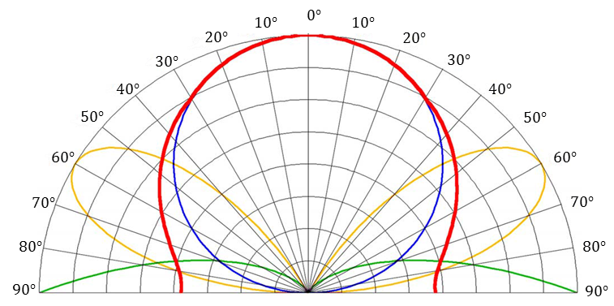
Skyglow Emissions Functions
Graphic Credit: Falchi et al. (2016)
Notes:
These equations describe how light travels through the atmosphere as sky-glow, but we have not yet described the emission of light at the source. Falchi et al. (2016) proposes three models of emission named $A$, $B$, and $C$.
Model A is the blue circle representing emissions due to Lambertian reflectance at the ground, directing the most energy toward the zenith above the light source. Model B, the green curves at the bottom of the figure, represent emissions due to specular reflectance at the ground. Model C, traced by the yellow curves, is a combination of models A and B. Note that with the view of the night sky angled in the above figure, the angle marked on the outside of the chart is $ψ$. The red line is the overall best fitting function.
----
Graphic Source: Falchi, F., Cinzano, P., Duriscoe, D., Kyba, C. C. M., Elvidge, C. D., Baugh, K., Furgoni, R. (2016). The new world atlas of artificial night sky brightness. Science Advances, 2(6), e1600377. doi:10.1126/sciadv.1600377

Slide 37
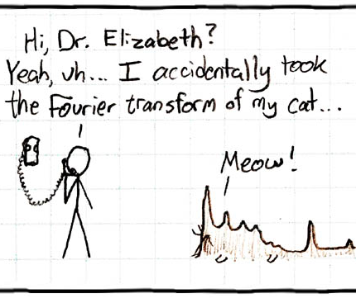
Building a Regional Model
37
Python function sums up sky brightness for each pixel using Fast Fourier Transform to estimate propagation behavior
Outputs Artificial Skyglow Map as TIFF image
Image Credit: © xkdc cc by-nc 2.5
Notes:
The impact from all sources of light that affect brightness must be added at an individual target location. A Fast Fourier Transform was used to help estimate light propagation behavior and speed up the process of calculating it. When all these sources nearby are added, we can look at the areas surrounding our pixel and get an idea of the overall quality of the night sky. We can also tell how much a particular light source is degrading the quality of the night sky.
--advance slide--
Image Source: Xkcd. Fourier. Retrieved July 26, 2017, from https://xkcd.com/26/

Slide 38
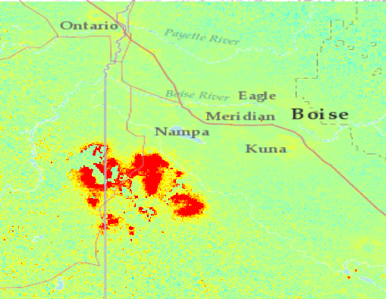


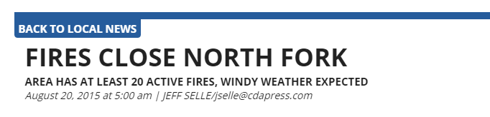
Artifacts Revealed in VIIRS Imagery
38
Wildfire in Idaho, August 2015
Percent Difference from Median
High: >5%
Low: <5%
Notes:
Script
The VIIRS image shows the South Bobcat wildfire which happened in Idaho during August 2015. This wildfire was revealed by looking at the percent median difference.
---advance slide---
Image source: Earth Observation Group. (2017). Version 1 Nighttime VIIRS Day/Night Band Monthly Composites. NOAA National Centers for Environmental Information. Retrieved September 21 & 25, 2017, from https://www.ngdc.noaa.gov/eog/viirs/download_dnb_composites.html; Selle, J. (2015, August 20). Fires close north fork, area has at least 20 active fires, windy weather expected. Coeur d’Alene/Post Falls Press. Retrieved from http://www.cdapress.com/archive/article-ac946017-d1bc-59e1-b8d0-9e0e5a88cfb0.html

Slide 39
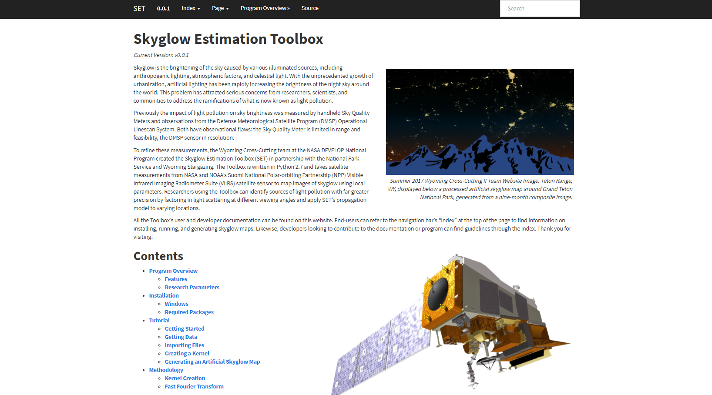
Documentation
39
Image Credit: Wyoming Cross-Cutting II Team
Notes:
Here is the documentation for SET. This support page will allow end-users and those interested in enhancing SET the information needed to be able to use and modify the code. Like the code, it will be available on the NASA GitHub page once approved.
----
Image Source: Wyoming Cross-Cutting II Team

Slide 40
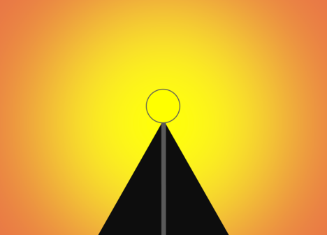
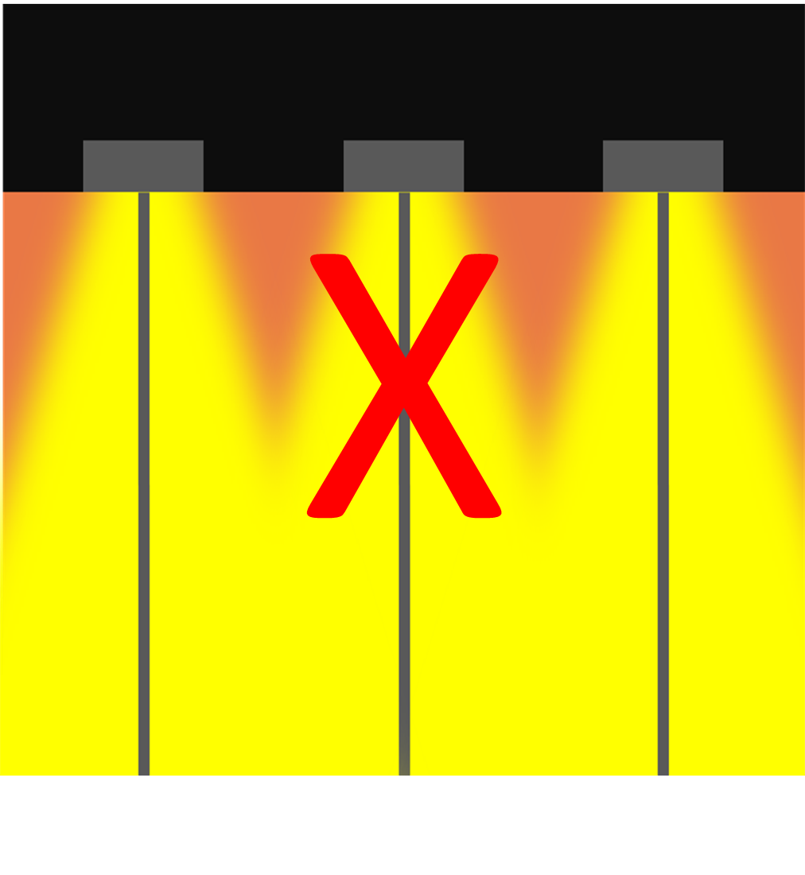
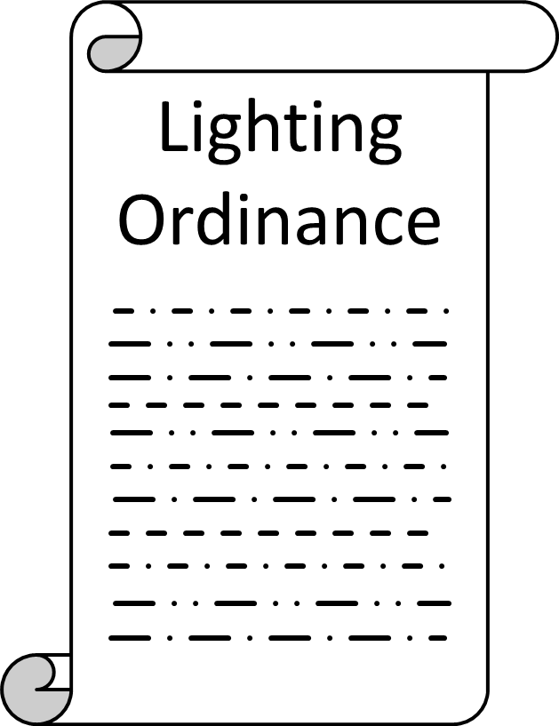
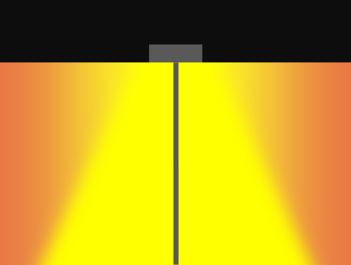
Reducing Light Pollution
40
Shield Light Fixtures
Light Only What Is Needed
Establish Lighting Ordinances
Graphics Credit: Wyoming Cross-Cutting II Team
Notes:
Although light pollution does have serious ramifications, it is a problem that can easily be reversed. You can easily make a measurable difference in your community by following these guidelines:
Shield light fixtures. In this graphic, the top image shows an unshielded light fixture, and the bottom shows a shielded one. As we mentioned during our presentation, half of the light in an unshielded light fixture is wasted. So by shielding your outdoor light fixtures, you not only save money in energy costs, but also protect the night skies. Light only
Light only what’s needed. Use the minimum amount of lightning needed to illuminate the target area, and turn on lights only for the time is needed. Here, the center fixture is not needed since the outer two fixtures already successfully illuminate the areas covered by the center one.
Finally, work with local governments to establish lighting ordinances that limit light pollution. Our project partner Wyoming Stargazing has been successful in this area, with Teton County and Jackson implementing lighting regulations in January 2017.
--advance slide--
Source: Clanton, N. (2014). Opinion: Light pollution … is it important? Lighting Research & Technology, 46(4), 4. doi:10.1177/1477153513519378
Graphics Source: Wyoming Cross-Cutting II Team

Slide 41
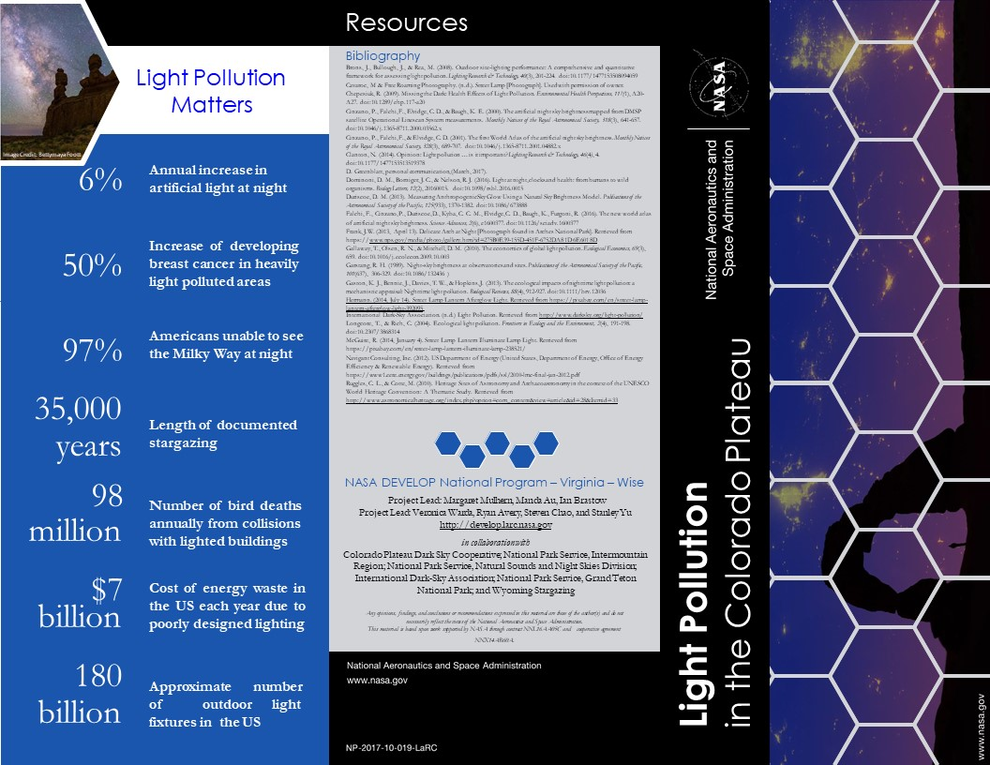
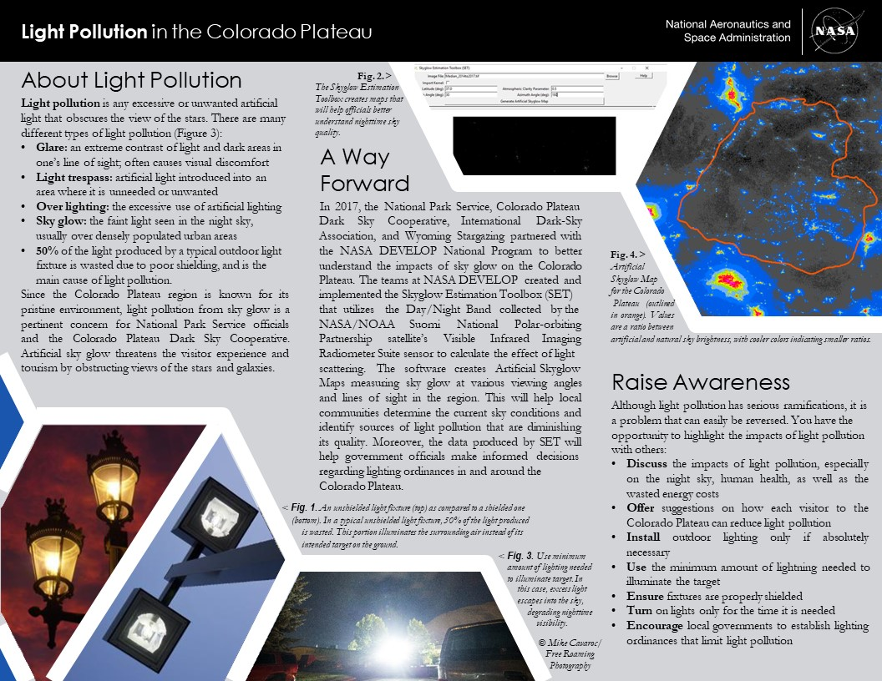
Brochure
41
Notes:
To bridge the gap between science and community, we designed and created a brochure, which has been approved for distribution by NASA. We have a statistics panel, a panel that discusses what light pollution is, a panel that highlights what we’re doing, and a panel on how we can reduce light pollution. This is intended for the public, including those attending the Colorado Plateau Dark Sky Cooperative Stakeholder’s Workshop, in order to better communicate the effects of light pollution.
----
Credit: Colorado Plateau Urban Development Team
Brochure Publication Number: NP-2017-10-019-LaRC

Slide 42
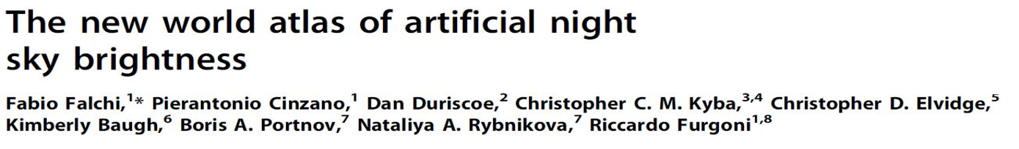
Additional Resources
42
Foundational Papers
Notes:
Here are the four papers that served as the basis for our project and our models. They should be accessible via most online subscription-based research databases.
----
**NOTE** We have this here so don’t have to go back into the presentation to find the articles we used.
Screenshot Sources: Cinzano, P., Falchi, F., Elvidge, C. D., & Baugh, K. E. (2000). The artificial night sky brightness mapped from DMSP satellite Operational Linescan System measurements. Monthly Notices of the Royal Astronomical Society,318(3), 641-657. doi:10.1046/j.1365-8711.2000.03562.x; Cinzano, P., Falchi, F., & Elvidge, C. D. (2001). The first World Atlas of the artificial night sky brightness. Monthly Notices of the Royal Astronomical Society, 328(3), 689-707. doi:10.1046/j.1365-8711.2001.04882.x; Falchi, F., Cinzano, P., Duriscoe, D., Kyba, C. C. M., Elvidge, C. D., Baugh, K., Furgoni, R. (2016). The new world atlas of artificial night sky brightness. Science Advances, 2(6), e1600377. doi:10.1126/sciadv.1600377; Garstang, R. H. (1989). Night-sky brightness at observatories and sites. Publications of the Astronomical Society of the Pacific, 101(637), 306-329. doi:10.1086/132436

Slide 43
Additional Resources
43
Human & Wildlife Impacts
Anderson (2017)
Blask et al. (2005)
Chepesiuk (2009)
Dauchy et al. (2014)
Dominoni (2016)
Evans Ogden (1996)
Gaston et al. (2013)
Hill (1992)
Hölker et al. (2010)
Kempenaers et al. (2010)
Kloog et al. (2008)
Kloog et al. (2010)
Kyba et al. (2012)
Lacoeuilhe et al. (2014)
Longcore & Rich (2004)
McFadden et al. (2014)
Moran & Salisbury (2006)
Ohta et al. (2006)
Rand et al. (1997)
Salmon et al. (1995)
Schernhammer et al. (2001)
Solano Lamphar & Kocifaj (2013)
Squires & Hanson (1918)
Vinogradova et al. (2009)
Notes:
There are many nuances regarding light pollution’s impacts on humans, plants, and animals. We’ve compiled some of our cited research on this slide, but their findings can be generally summarized into what we had in our presentation, which was: influences animal behavior and plant growth and correlated with various human health disorders.
----
Sources:
Anderson, S. (2017, July 19). NASA DEVELOP National Program Virtual Poster Session Interview [Personal interview].
Blask, D. E., Brainard, G. C., Dauchy, R. T., Hanifin, J. P., Davidson, L. K., Krause, J. A., … Zalatan, F. (2005). Melatonin-Depleted Blood from Premenopausal Women Exposed to Light at Night Stimulates Growth of Human Breast Cancer Xenografts in Nude Rats. Cancer Research, 65(23), 11174-11184. doi:10.1158/0008-5472.CAN-05-1945
Chepesiuk, R. (2009). Missing the Dark: Health Effects of Light Pollution. Environmental Health Perspectives, 117(1), A20-A27. doi:10.1289/ehp.117-a20
Dauchy, R. T., Xiang, S., Mao, L., Brimer, S., Wren, M. A., Yuan, L., … Hill, S. M. (2014). Circadian and Melatonin Disruption by Exposure to Light at Night Drives Intrinsic Resistance to Tamoxifen Therapy in Breast Cancer. Cancer Research, 74(15), 4099-4110. doi:10.1158/0008-5472.can-13-3156
Dominoni, D. M., Borniger, J. C., & Nelson, R. J. (2016). Light at night, clocks and health: from humans to wild organisms. Biology Letters, 12(2), 20160015. doi:10.1098/rsbl.2016.0015
Evans Ogden, L. J. (1996). Collision Course: The Hazards of Lighted Structures and Windows to Migrating Birds (pp. 1-46, Rep.). Fatal Light Awareness Program (FLAP). Retrieved August 8, 2017, from http://digitalcommons.unl.edu/cgi/viewcontent.cgi?article=1002&context=flap
Gaston, K. J., Bennie, J., Davies, T. W., & Hopkins, J. (2013). The ecological impacts of nighttime light pollution: a mechanistic appraisal: Nighttime light pollution. Biological Reviews, 88(4), 912-927. doi:10.1111/brv.12036
Hill, D. (1992). The Impact of Noise and Artificial Light on Waterfowl Behaviour: A Review and Synthesis of Available Literature. Retrieved August 8, 2017, from https://www.bto.org/file/335635/download?token=7TdSzNGG
Hölker, F., Wolter, C., Perkin, E. K., & Tockner, K. (2010). Light pollution as a biodiversity threat. Trends in Ecology & Evolution, 25(12), 681-682. doi:10.1016/j.tree.2010.09.007
Kempenaers, B., Borgström, P., Loës, P., Schlicht, E., & Valcu, M. (2010). Artificial Night Lighting Affects Dawn Song, Extra-Pair Siring Success, and Lay Date in Songbirds. Current Biology, 20(19), 1735-1739. doi:10.1016/j.cub.2010.08.028
Kloog, I., Haim, A., Stevens, R. G., Barchana, M., & Portnov, B. A. (2008). Light at Night Co‐distributes with Incident Breast but not Lung Cancer in the Female Population of Israel. Chronobiology International, 25(1), 65-81. doi:10.1080/07420520801921572
Kloog, I., Stevens, R. G., Haim, A., & Portnov, B. A. (2010). Nighttime light level co-distributes with breast cancer incidence worldwide. Cancer Causes & Control, 21(12), 2059-2068. doi:10.1007/s10552-010-9624-4
Kyba, C. C., Ruhtz, T., Fischer, J., & Hölker, F. (2012). Red is the new black: how the colour of urban skyglow varies with cloud cover. Monthly Notices of the Royal Astronomical Society, 425(1), 701-708. doi:10.1111/j.1365-2966.2012.21559.x
Lacoeuilhe, A., Machon, N., Julien, J., Bocq, A. L., & Kerbiriou, C. (2014). The Influence of Low Intensities of Light Pollution on Bat Communities in a Semi-Natural Context. PLoS ONE, 9(10), e103042. doi:10.1371/journal.pone.0103042
Longcore, T., & Rich, C. (2004). Ecological light pollution. Frontiers in Ecology and the Environment, 2(4), 191-198. doi:10.2307/3868314
McFadden, E., Jones, M. E., Schoemaker, M. J., Ashworth, A., & Swerdlow, A. J. (2014). The Relationship Between Obesity and Exposure to Light at Night: Cross-Sectional Analyses of Over 100,000 Women in the Breakthrough Generations Study. American Journal of Epidemiology, 180(3), 245-250. doi:10.1093/aje/kwu117
Moran, M., & Salisbury, D. F. (2006, August 21). Constant lighting may disrupt development of preemie’s biological clocks. Retrieved August 08, 2017, from https://news.vanderbilt.edu/2006/08/21/constant-lighting-may-disrupt-development-of-preemies-biological-clocks-58939/
Ohta, H., Mitchell, A. C., & McMahon, D. G. (2006). Constant Light Disrupts the Developing Mouse Biological Clock. Pediatric Research, 60(3), 304-308. doi:10.1203/01.pdr.0000233114.18403.66
Rand, A. S., Bridarolli, M. E., Dries, L., & Ryan, M. J. (1997). Light Levels Influence Female Choice in Túngara Frogs: Predation Risk Assessment? Copeia, 1997(2), 447-450. doi:10.2307/1447770
Salmon, M., Tolbert, M. G., Painter, D. P., Goff, M., & Reiners, R. (1995). Behavior of Loggerhead Sea Turtles on an Urban Beach. II. Hatchling Orientation. Journal of Herpetology, 29(4), 568-576. doi:10.2307/1564740
Schernhammer, E. S., Laden, F., Speizer, F. E., Willett, W. C., Hunter, D. J., Kawachi, I., & Colditz, G. A. (2001). Rotating night shifts and risk of colorectal cancer in women participating in the nurses health study. Journal of the National Cancer Institute, 93(20), 1563-1568. Retrieved from https://blog.lsgc.com/wp-content/uploads/2016/04/08.-Schernhammer-2001-Nurses-Health-Study.pdf
Solano Lamphar, H. A., & Kocifaj, M. (2013). Light Pollution in Ultraviolet and Visible Spectrum: Effect on Different Visual Perceptions. PLoS ONE, 8(2), e56563. doi:10.1371/journal.pone.0056563
Squires, W. A., & Hanson, H. E. (1918). The Destruction of Birds at the Lighthouses on the Coast of California. The Condor, 20(1), 6-10. doi:10.2307/1362354
Vinogradova, I. A., Anisimov, V. N., Bukalev, A. V., Semenchenko, A. V., & Zabezhinski, M. A. (2009). Circadian disruption induced by light-at-night accelerates aging and promotes tumorigenesis in rats. Aging, 1(10), 855-865. doi:10.18632/aging.100092

