Slide 1
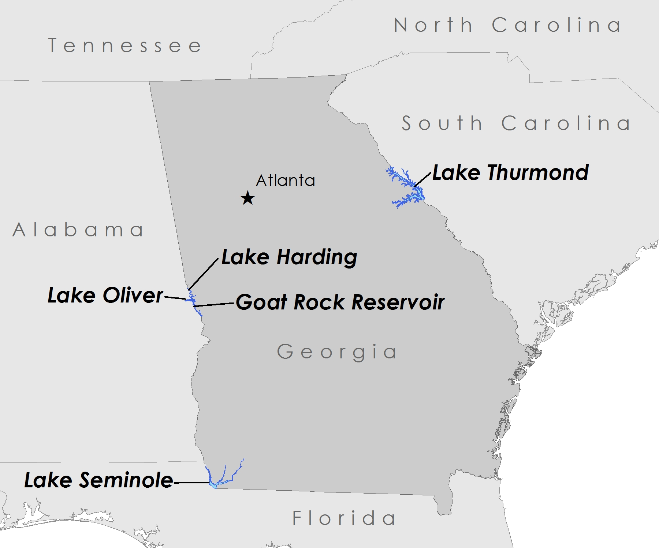
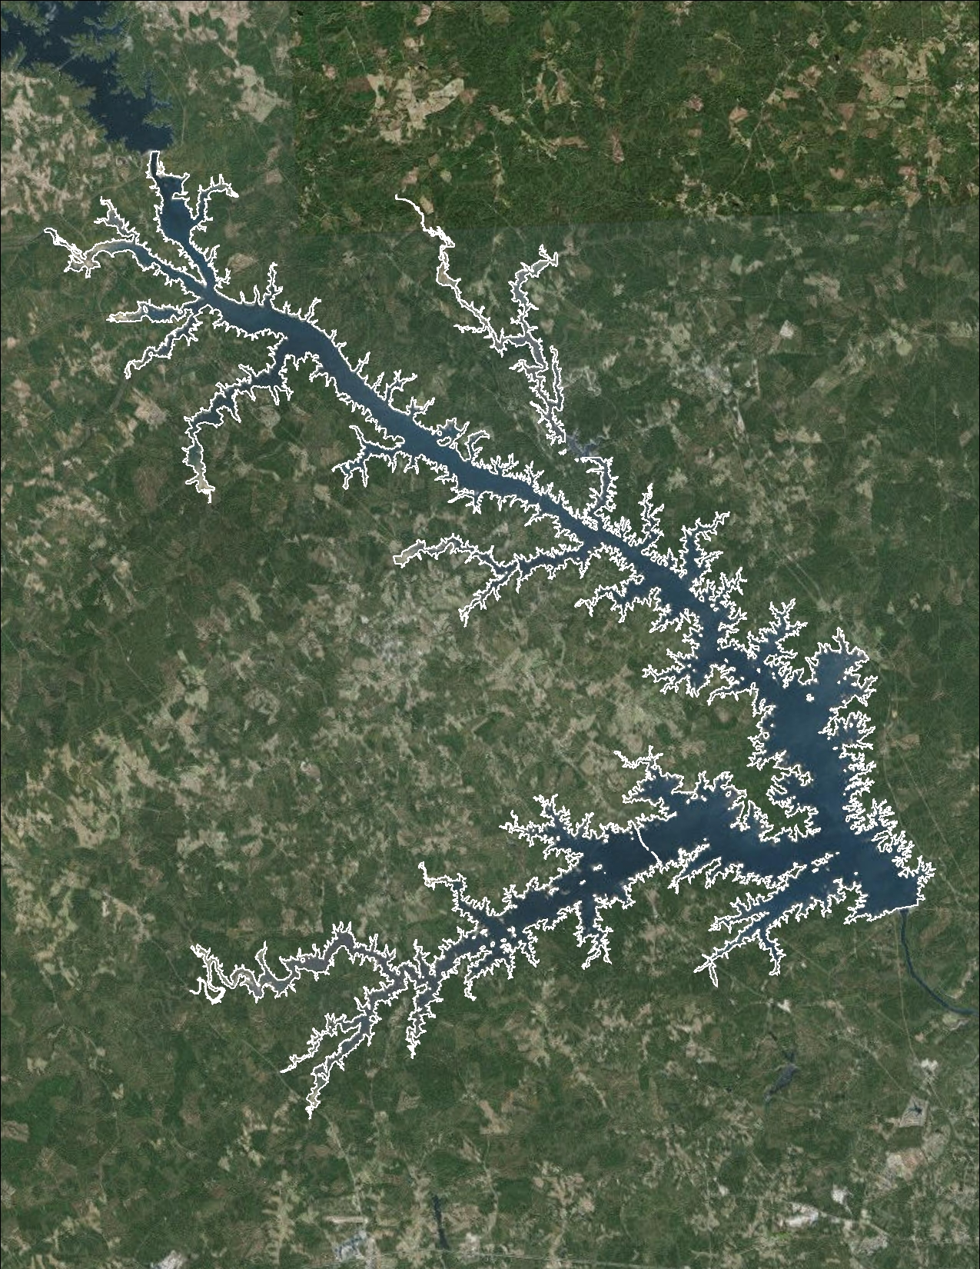
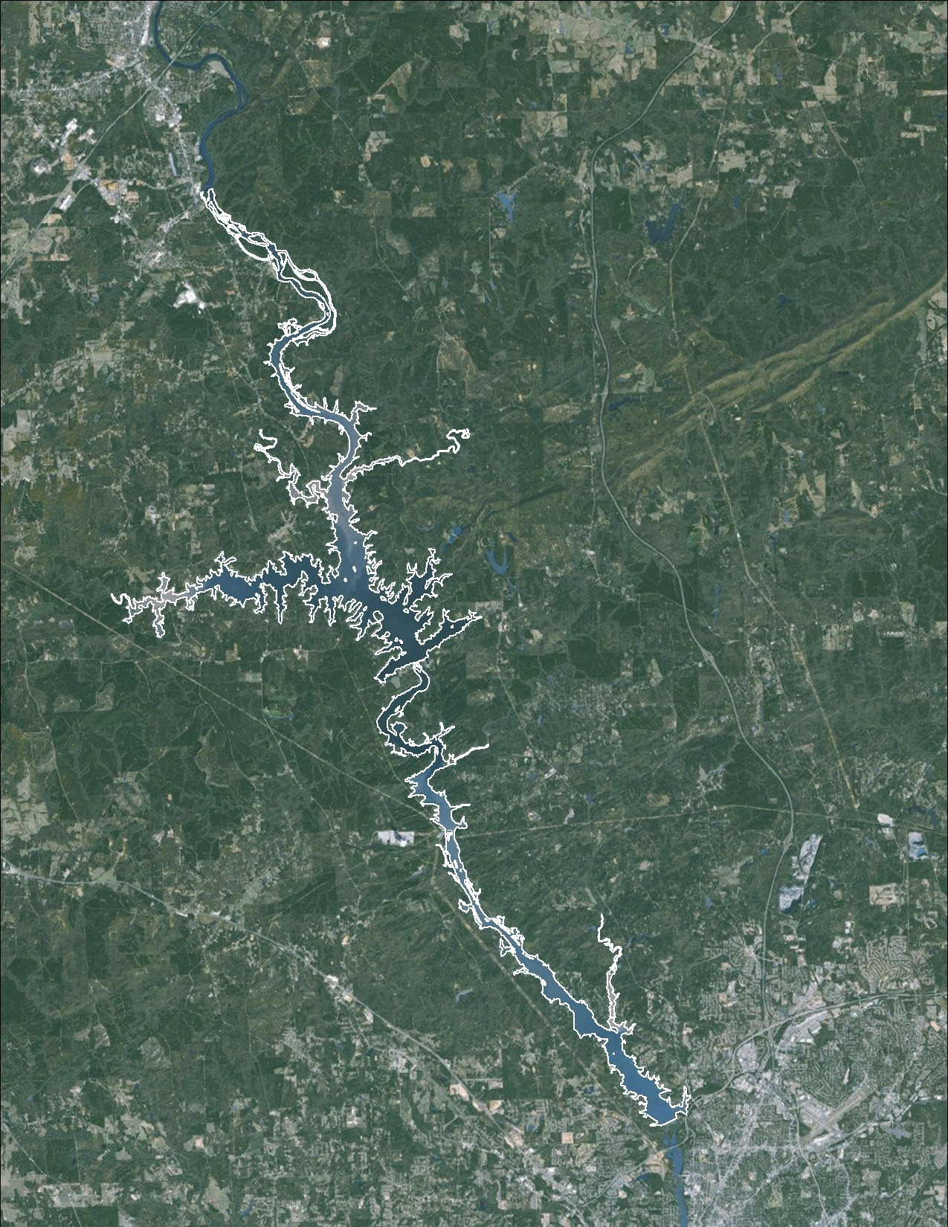
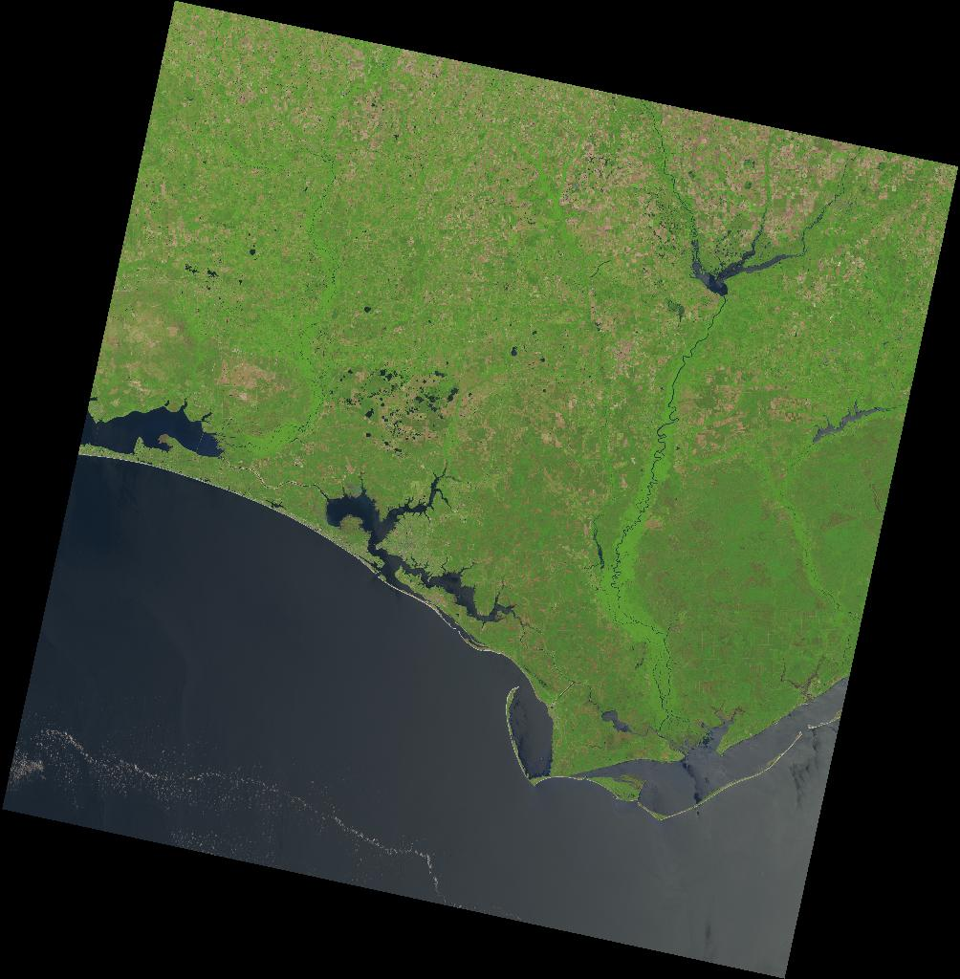
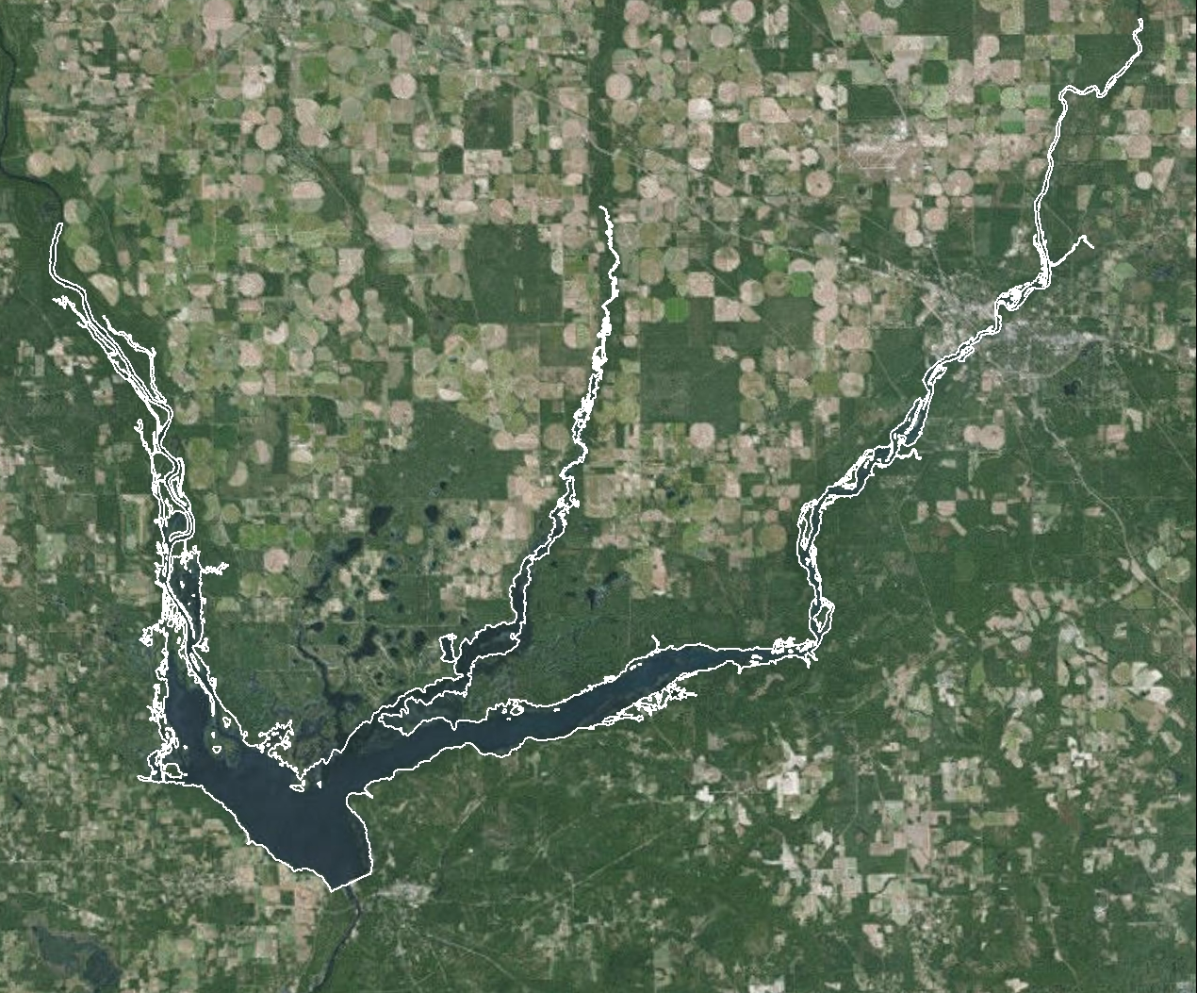
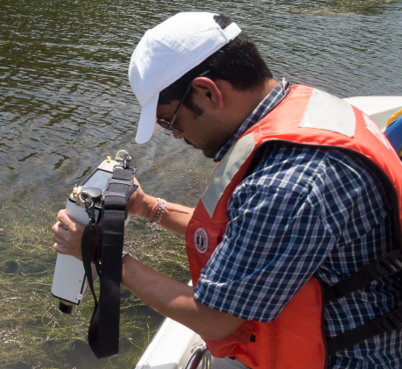
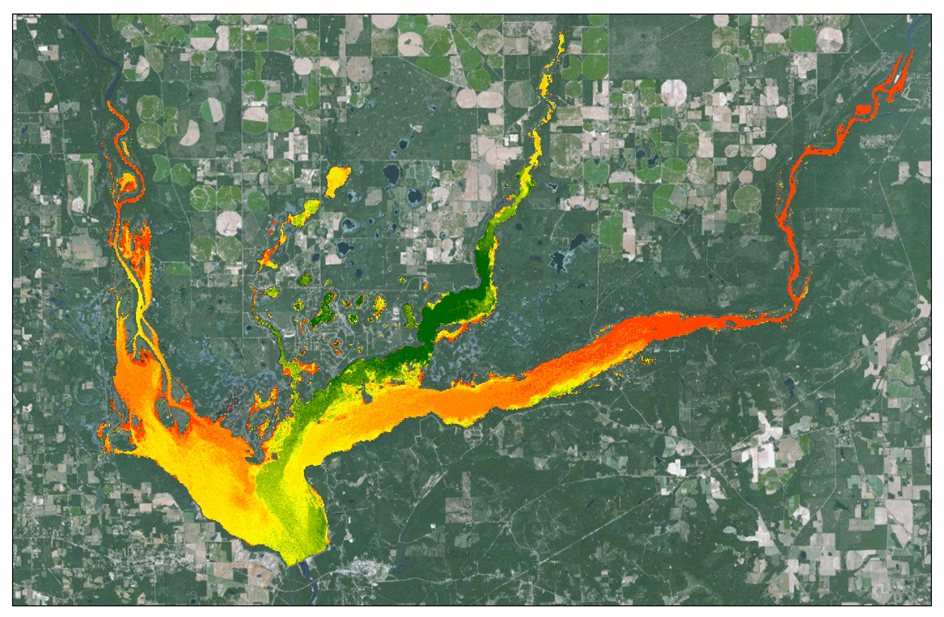

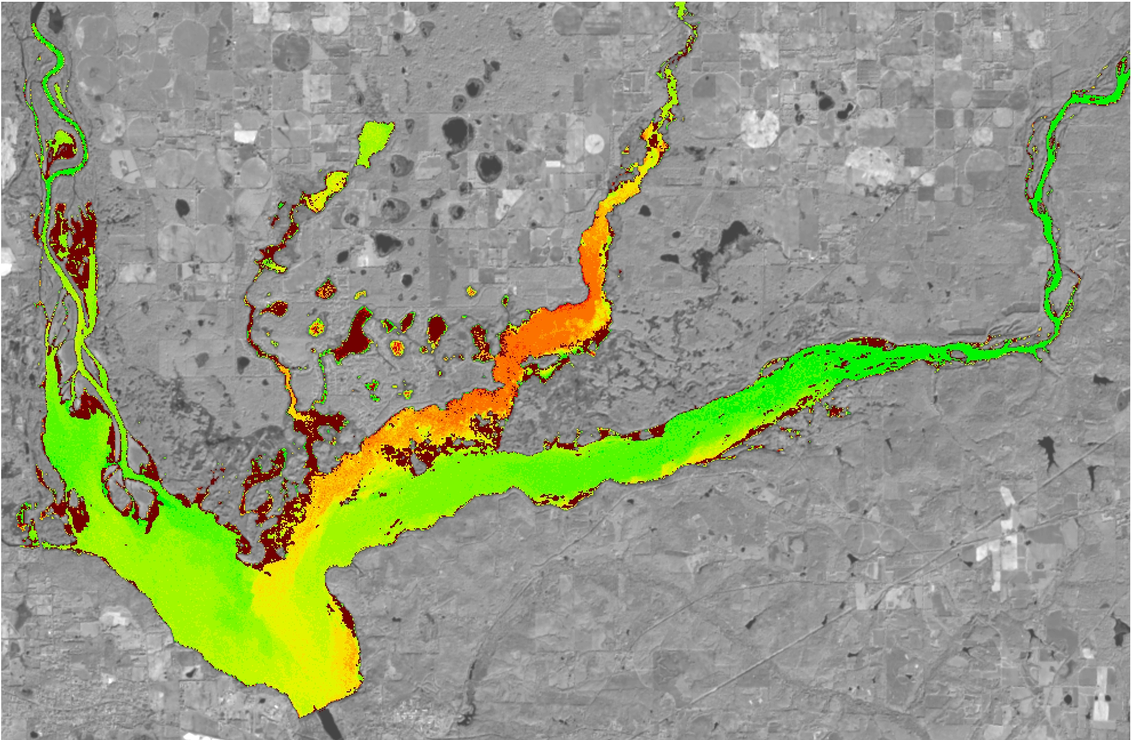
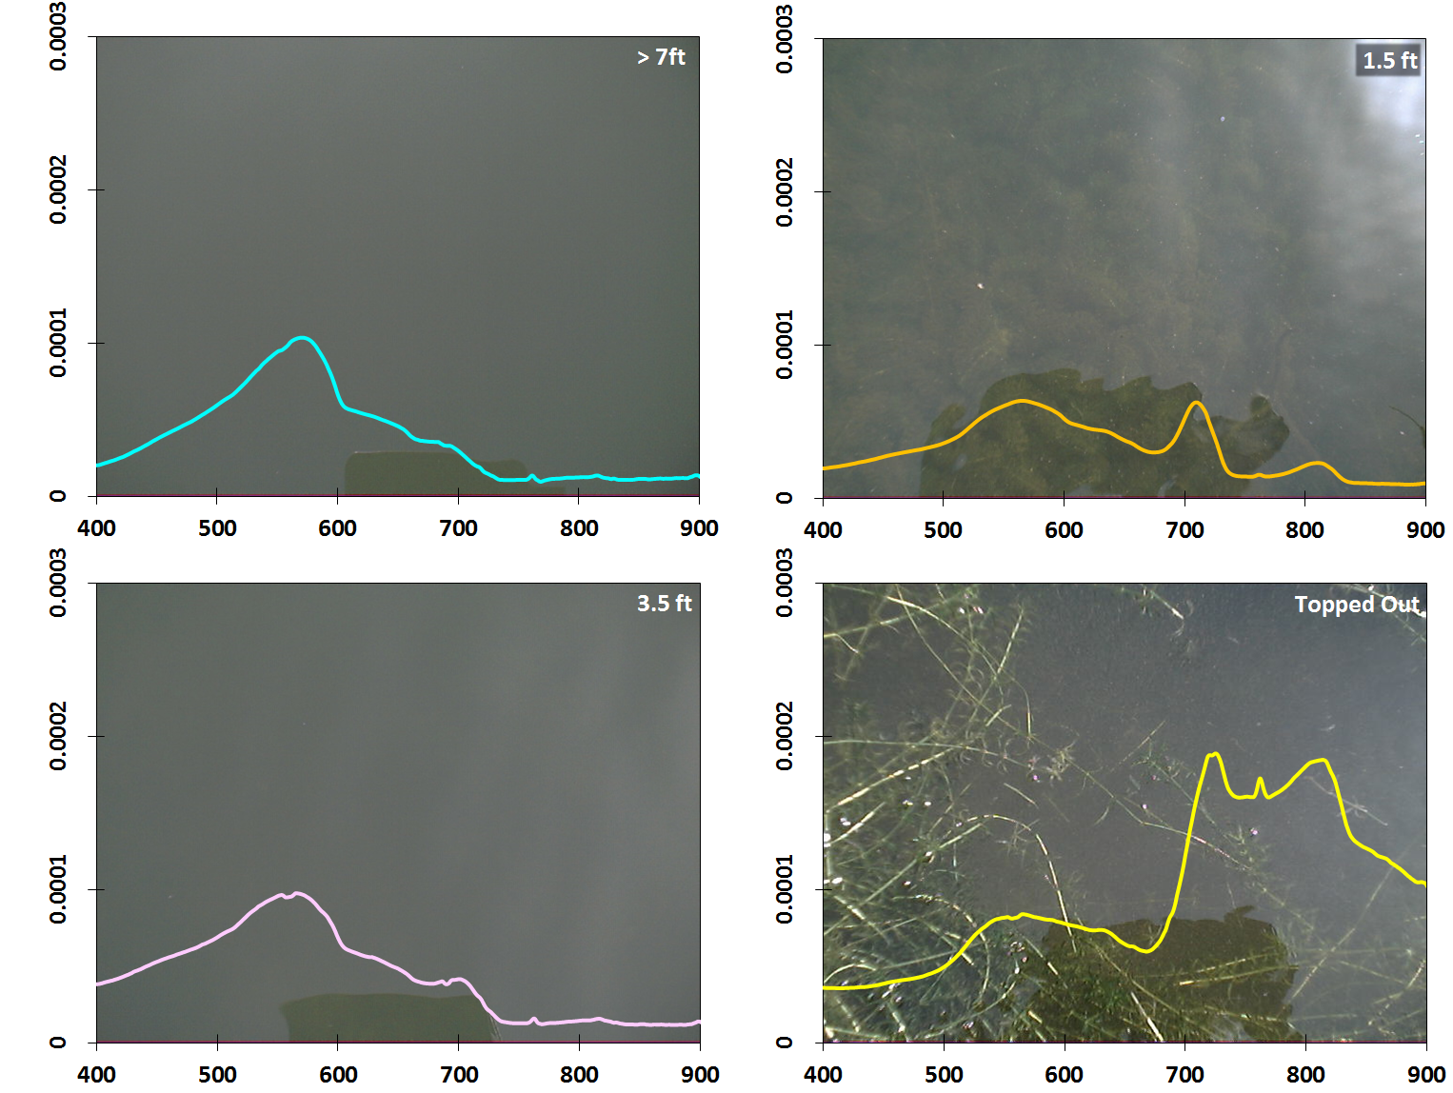
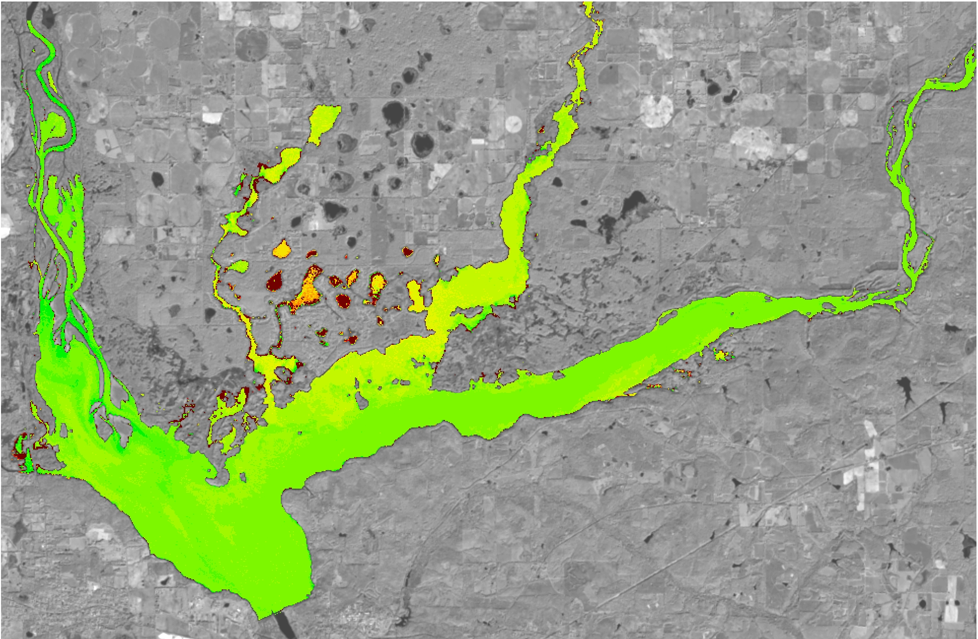
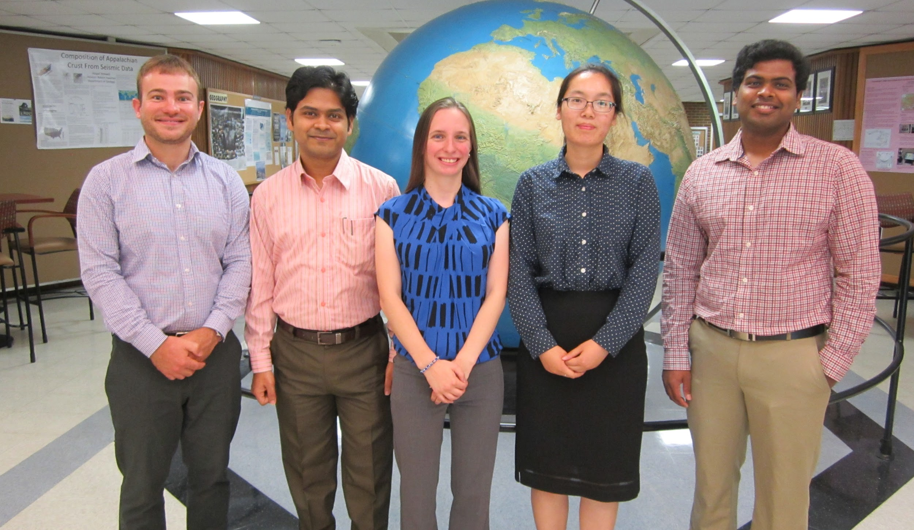
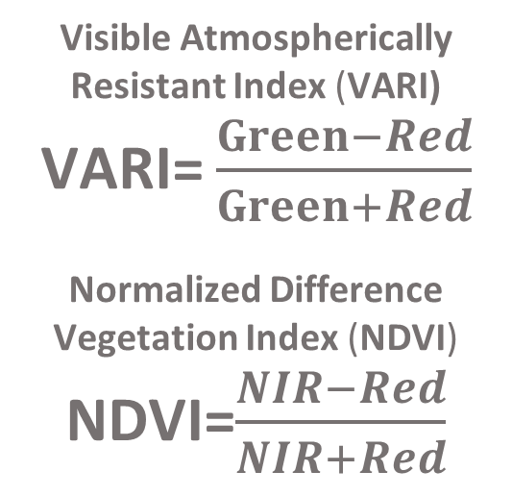
Southeast Ecological Forecasting
Utilizing NASA Earth observations and proximal remote sensing to map the spatio-temporal distribution of Hydrilla verticillata
Shuvankar Ghosh (Project Lead), Peter Hawman (Co-Project Lead), Wuyang Cai, Elizabeth Dyer, Pradeep Kumar Ragu Chanthar
NASA DEVELOP at University of Georgia
Abstract
Objectives
Hydrilla verticillata is an invasive aquatic plant that has become a serious problem in Southeastern United States, especially impacting vegetation and water quality. Traditionally, hydrilla infestation has been tackled using a combination of field-based physical, chemical and biological methods which are often costly. Rapid and accurate spatio-temporal estimates of hydrilla density and distribution are needed for better monitoring and management of this invasive plant. This project demonstrated an innovative approach using Landsat 8 OLI data to study the spread of this invasive aquatic plant in inland waters. NASA Landsat 8 Operational Land Imager (OLI) imagery in combination with in situ data was used to map hydrilla density and distribution in four lakes across Georgia and Florida. Performances of Visible Atmospherically Resistant Index (VARI) and Green Normalized Difference Vegetation Index (GNDVI) were analyzed for indications of hydrilla density and distribution, using a combination of statistical techniques, such as coefficient of determination (R2), percent normalized root mean square error (%RMSE), and residual trends. The resulting detection tool for monitoring hydrilla distribution was delivered to Georgia Power, the J. W. Jones Ecological Research Center, and the Henry County Water Authority for use in water quality restoration decision-making. This tool will be an efficient alternative to otherwise costly measures, and facilitate adaptive plant management.
Develop model based on Landsat 8 OLI and in situ field data that will enable partners to determine hydrilla density and distribution in the future
Create time series hydrilla distribution maps for the study region
Assess the seasonal spatio-temporal distribution of hydrilla
Study Area
Methodology
Lake Harding
Landsat 8 OLI
Vegetation Indices
Goat Rock
Lake Thurmond
Visible Atmospherically
Resistant Index (VARI)
VARI= $\frac{Green−Red}{Green+Red}$
Normalized Difference
Vegetation Index (NDVI)
NDVI=$\frac{NIR−Red}{NIR+Red}$
Model
Calibration
Lake Oliver
Lake Seminole
Maps
Field Data
Earth Observations
In situ measurements
Hyperspectral profiles
Hydrilla depth
Sonar depth
Biomass
Point location
Landsat 8 OLI
Results
Conclusions
1a
1c
Landsat 8 OLI has the potential to identify the presence of submerged aquatic vegetation allowing the team to map the spatial-temporal variation of hydrilla within the study lakes.
Additional in situ data collection is required for refinement and validation of the hydrilla density distribution models developed so far.
Mapping accuracy depends on the depth of the submerged vegetation.
This methodology can help the project partners to detect the presence of hydrilla using low cost methods that provide up to date hydrilla distribution maps.
Remote Sensing Reflectance (R_{rs})
2a
November 30, 2014
presence of submerged hydrilla
1b
1d
Figure 2a and 2b: Topped out and submerged vegetation maps prepared using Landsat 8 for November 30, 2014 and February 18, 2015. Submerged hydrilla presence is highlighted in the red box.
Wavelength (nm)
Figure 1a – d: Spectral signature of submerged Hydrilla across different water depths; reflectance at NIR becomes more prominent with decreasing depth
2b
February 18, 2015
Team Members
Acknowledgements
Project Partners
Dr. Stephen Golladay, J. W. Jones Ecological Research Centre
Mr. Anthony Dodd, Georgia Power
Mr. Ken Presley, Henry County Water Authority
Dr. Deepak Mishra, Department of Geography, University of Georgia
Dr. Susan Wilde, Warnell School of Forestry and Natural Resources, University of Georgia
Benjamin Page, Department of Geography, University of Georgia
Ike Sari Astuti, Department of Geography, University of Georgia
Joseph W. Jones Ecological Research Center
Georgia Power Company
Henry County Water Authority
Peter Hawman, Shuvankar Ghosh, Elizabeth Dyer, Wuyang Cai, Pradeep Kumar Ragu Chanthar
University of Georgia

