Slide 1
Pacific Water Resources
Using the NOAA PERSIANN CDR to Connect Phases of the El Niño Southern Oscillation (ENSO) with Precipitation Across Hawaii and the U.S. Affiliated Pacific Islands (USAPI)
Jessica Sutton (Project Lead)
Michael Kruk
Nicholas Luchetti
John Marra
Ethan Wright
Notes:
My name is Nick Luchetti and these are my teammates Ethan Wright and Jessica Sutton. We are the Pacific Water Resources team a part of the NASA Develop National Program. Our team collaborated with Michael Kruk, coastal climatologist with Earth Resources Technology, and Dr. John Marra, Regional Climate Services Director for the Pacific Region to provide a satellite-derived ENSO precipitation climatology for the USAPI. To do so, we utilized NOAA’s PERSIANN Climate Data Record (CDR). With the current ongoing El Nino event in place, the importance of our results cannot be undermined.

Slide 2
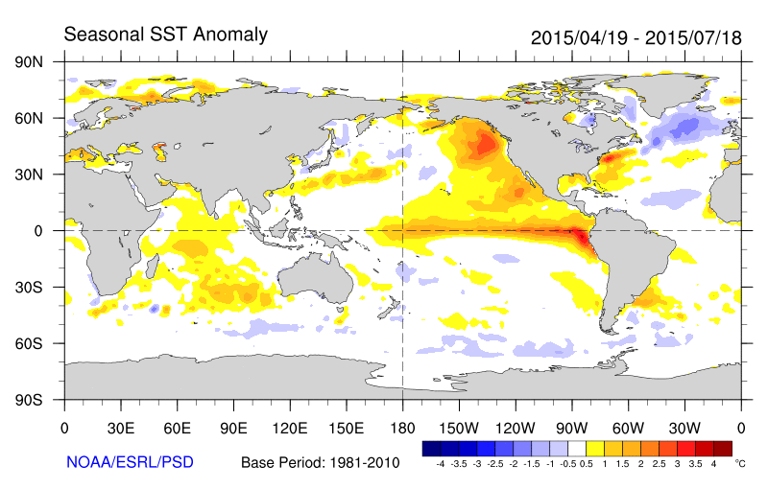
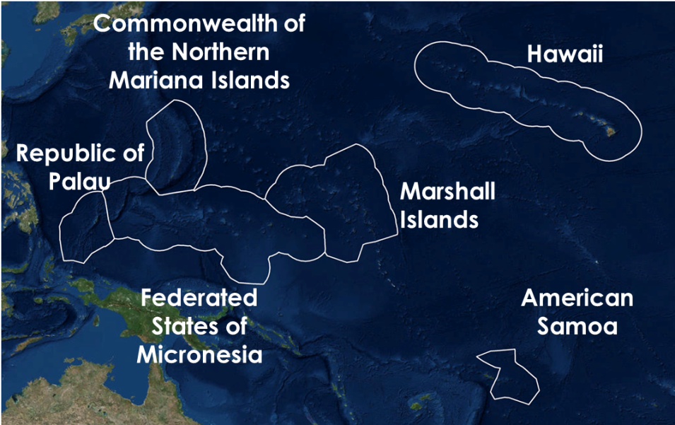
Motivation
Motivation El Niño La Niña Community Concerns Objectives Methods Results Future Work Conclusions
Exclusive Economic Zones (EEZ)
Credit: NOAA
El Niño Southern Oscillation (ENSO)
Influences precipitation distribution
Islands in the tropical Pacific are particularly vulnerable
Notes:
Image credit: http://www.esrl.noaa.gov/psd/map/images/sst/sst.anom.seasonal.gif
ENSO is a coupled oceanic-atmospheric circulation that develops off the west coast of South America. It influences climatological phenomena globally. As the following slides will display, islands in the tropical Pacific are particularly influenced by ENSO.

Slide 3
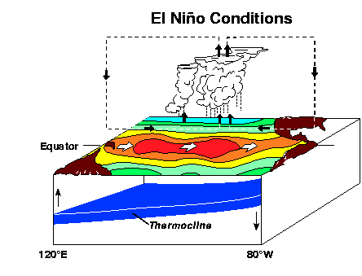
Motivation El Niño La Niña Community Concerns Objectives Methods Results Future Work Conclusions
El Niño
Warm SST anomalies in eastern Pacific
Cool SST anomalies in Western Pacific
Convection shifts eastward
Drier conditions in western Pacific
Credit:NOAA
Notes:
Image source: http://www.pmel.noaa.gov/tao/elnino/nino_normal.html
El Niño events are characterized by warm sea surface temperature anomalies in the eastern Pacific and cooler sea surface temperatures in the western Pacific. During these events, the trade winds slow down, allowing convection and thunderstorms to shift eastward. This creates generally drier conditions in the western Pacific.

Slide 4
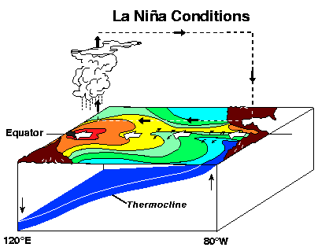
Motivation El Niño La Niña Community Concerns Objectives Methods Results Future Work Conclusions
La Niña
Cool SST anomalies in eastern Pacific
Warm SST anomalies in Western Pacific
Convection shifts westward
Wetter conditions in western Pacific
Credit: NOAA
Notes:
Image source: http://www.pmel.noaa.gov/tao/elnino/nino_normal.html
La Niña events are characterized by cool sea surface temperature anomalies in the eastern Pacific and warm sea surface temperatures in the western Pacific. During these events, the trade winds strengthen, shifting equatorial convection and thunderstorms westward towards Australia.

Slide 5
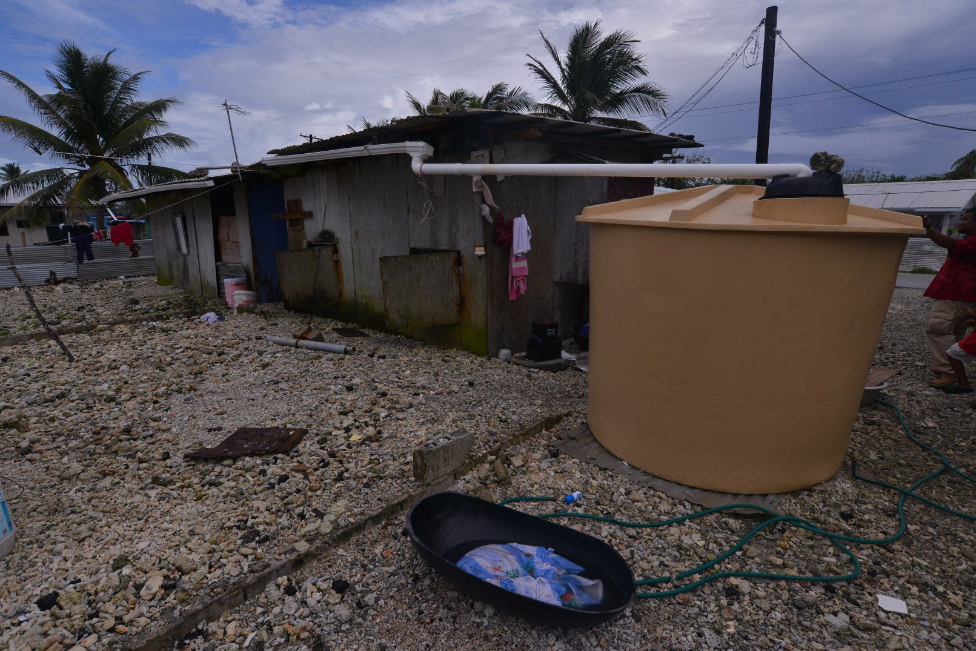
Motivation El Niño La Niña Community Concerns Objectives Methods Results Future Work Conclusions
Community Concerns
Commonwealth of the Northern Mariana Islands
Hawaii
Republic of Palau
Marshall Islands
Federated States of Micronesia
American Samoa
Credit: Dennis Huang (University of Hawaii)
Notes:
Most island communities in the Pacific have limited sources of freshwater, often times almost entirely dependent on the amount of precipitation. Many island homes supplement their freshwater supply by utilizing large tanks to capture rainfall. With these limited sources, an abundance of freshwater is not always available, and water supplies often need to be strictly conserved.
With this in mind, decision makers are increasingly concerned with how to, and where best to place their resources in order to mitigate negative impacts from drought during ENSO events. Due to dissemination time issues, decision makers must aim for at least 1-yr long lead-time forecasts. For example, in June 1997, forecasters predicted a considerable drought outlook for Micronesia for early 1998. Even with a 6-8 month lead-time, successful planning required a face to face sit down with leaders of Micronesia which did not happen until 2-4 months before the onset of the event.

Slide 6
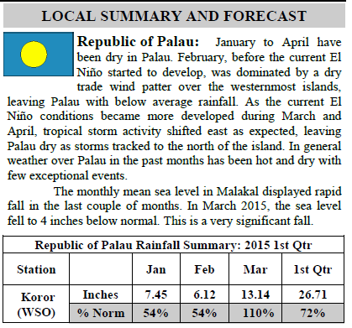
Motivation El Niño La Niña Community Concerns Objectives Methods Results Future Work Conclusions
Pacific ENSO Applications Center (PEAC)
“YAY!! Thank you so much Jessica! I have been waiting for something like this to come our way...”
– Maria Ngemaes, MIC in Palau
Hawaii
Republic of Palau
“This looks like terrific data.”
– Chip Guard, Warning Coordination Meteorologist at NWS Guam
Marshall Islands
Federated States of Micronesia
American Samoa
“This is great!! Keep up the good work.”
– Mark Lander, Professor of Water Resources Engineering, University of Guam
Credit: PEAC Quarterly Update Newsletter
Credit: Made in ArcGIS using basemap.
Notes:
NOTE: We have been given permission by our science advisor Dr. John Marra to use these quotes. He specifically asked for these quotes to be incorporated into our presentation in order to highlight the importance of our project.
Image link: http://www.weather.gov/media/peac/PEU/PEU_v21_n2.pdf
Established in 1994, the Pacific ENSO Applications Climate (PEAC) Center works to provide in-depth climatological forecasts as they relate to management of climate-sensitive sectors. Currently, PEAC collaborates with representatives from local Weather Service Offices (WSOs) to create precipitation forecasts and outlooks.
Forecasters currently rely on ENSO climatologies from sparse in situ station data to inform their precipitation outlooks. The current climatology uses data from 66 stations scattered throughout the USAPI from the years 1956-1998. Although still useful, decision makers in this region could benefit from an updated satellite-derived ENSO climatology to supplement their precipitation forecasts.
Initial emails were sent to the WSO meteorologists from each region to ask for input and we received some incredible feedback, highlighting the importance of our product. In the July PEAC precipitation outlook meeting, one of our final maps was HEAVILY used when making decisions about where drought would hit hardest in the next few months during this ongoing El Nino event.
Lead time is critical in the islands as many times dissemination of drought information takes time to resonate with island leaders. For example, in June 1997, forecasters predicted a considerable drought outlook for Micronesia for early 1998. Even with a 6-8 month lead-time, successful planning required a face to face sit down with leaders of Micronesia which did not happen until 2-4 months before the onset of the event.
Highlight: spatial need, updated climatology need, better lead time.

Slide 7
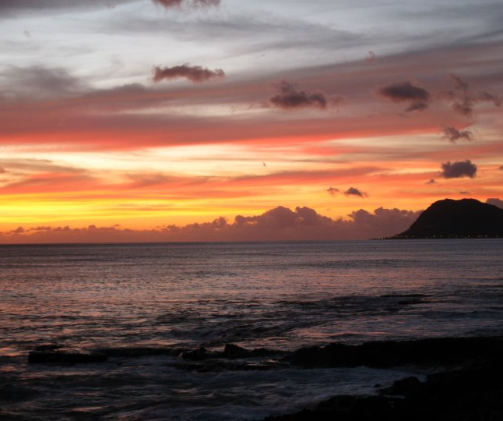
Motivation El Niño La Niña Community Concerns Objectives Methods Results Future Work Conclusions
Research Objectives
Provide an updated ENSO based climatology (1985-2014) using the NOAA PERSIANN Climate Data Record (CDR)
Conduct verification analyses with in situ precipitation data
Determine the relationship between PERSIANN CDR precipitation and 5 defined ENSO phases
Determine precipitation anomalies for each USAPI Exclusive Economic Zone (EEZ) during the five ENSO phases
Image Credit: Ethan Wright
Notes:
-Quick transition into the projects objectives.
-Briefly describe the project objectives as they are listed on the slide.

Slide 8
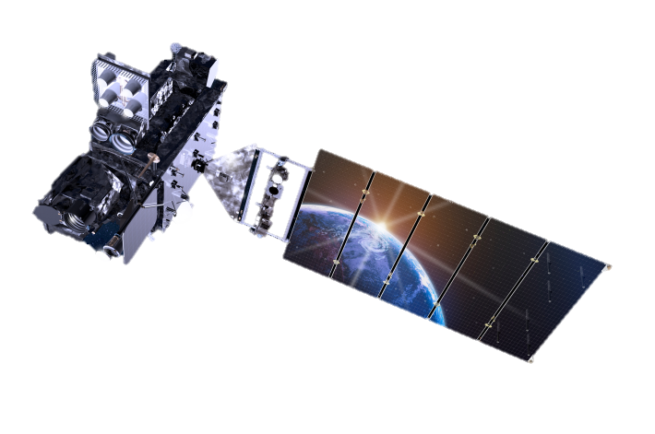
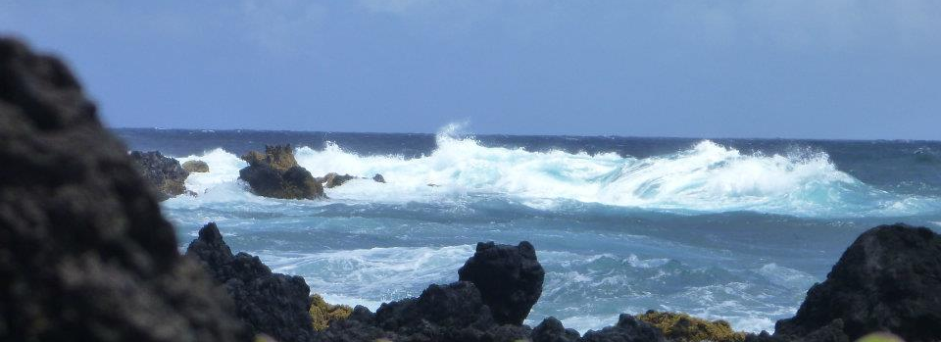
Motivation El Niño La Niña Community Concerns Objectives Methods Results Future Work Conclusions
PERSIANN Climate Data Record
Global precipitation data from 1983 to present.
Gridded 0.25° resolution
Daily Product
Satellite Image Credit: http://www.goes-r.gov/
Image Credit: Ethan Wright
Notes:
-Talk about how the PERSIANN-CDR was developed and the advantages of using satellite precipitation data vs. in-situ data for the precipitation climatology.
-Talk about the grid size in relation to small islands and the disadvantage thereof (Not able to pick up localized effects due to island topography).

Slide 9
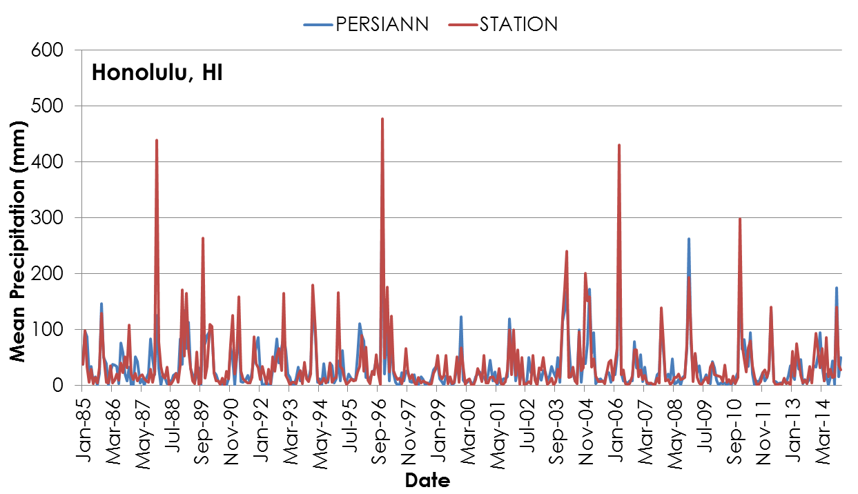
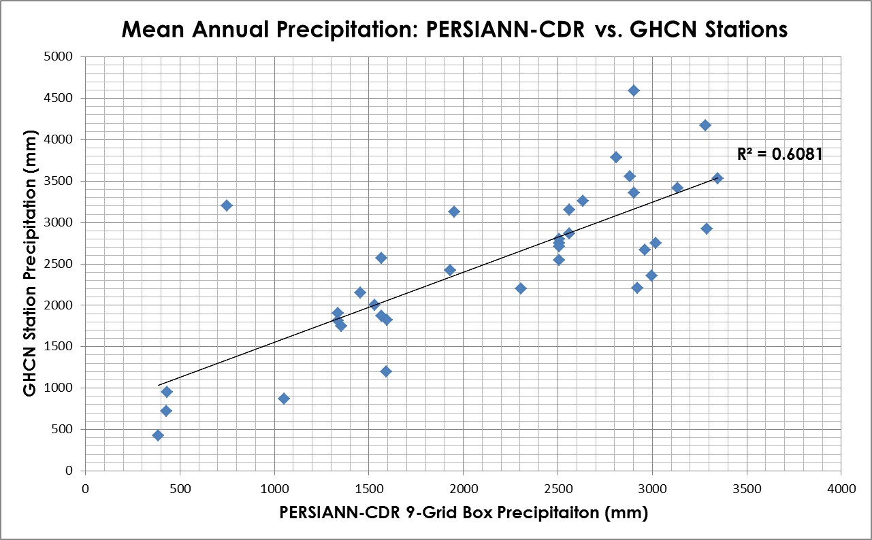
Motivation El Niño La Niña Community Concerns Objectives Methods Results Future Work Conclusions
METHODOLOGY: verification using
in situ station data
1. Extract in situ Global Historical Climatology Network (GHCN) precipitation data
2. Average by month, season, and year to compare to PERSIANN-CDR precipitation grid cells
GHCN STATION
LOCATIONS
Credit: Pacific Water Resources Team
Notes:
-Explain why the verification analysis was needed.
-Talk about the stations and the time period used for the analysis.
-Briefly discuss results while showing comparison chart of the GHCN stations vs. the PERSIANN-CDR (PERSIANN-CDR often underestimated station precipitation, especially on the eastern side of the islands in mountainous terrain).
-Conclude the slide by showing that even though the PERSIANN-CDR was often off by a large factor, it did pick up on precipitation trends very well. We therefore used the precipitation data for a trend analysis instead of directly estimating precipitation amounts.

Slide 10
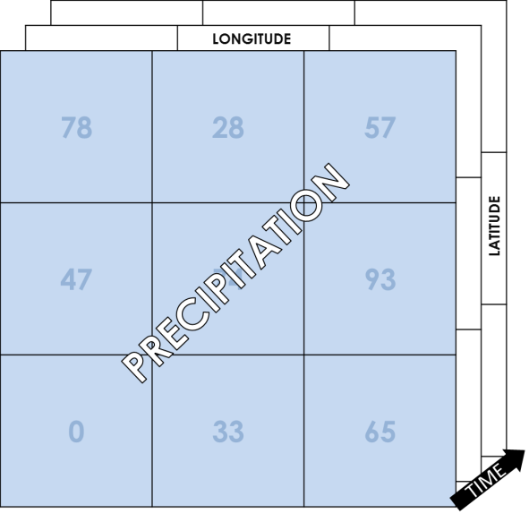
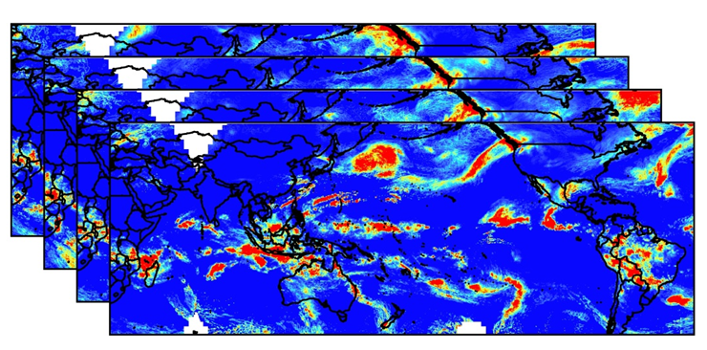
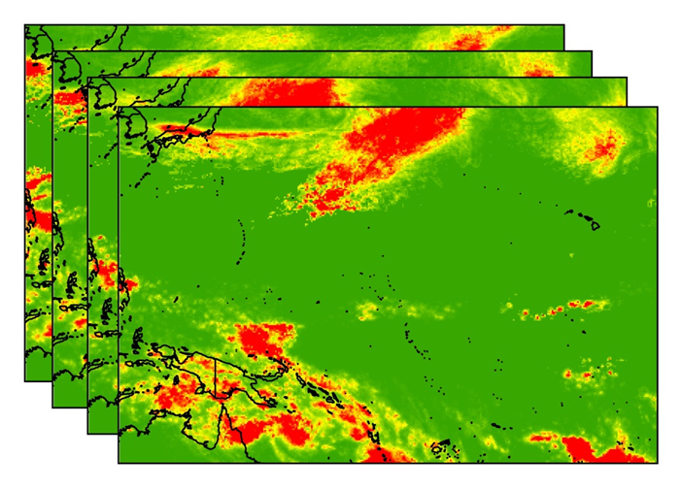
Motivation El Niño La Niña Community Concerns Objectives Methods Results Future Work Conclusions
METHODOLOGY: Data Preparation
NetCDF to Raster
Clip and sum
Download PERSIANN-CDR data via ftp
2. Convert NetCDF to raster using R
MONTHLY
SEASONAL
YEARLY
3. Clip rasters to study region and sum daily rasters to months, seasons, and years
Notes:
-Go through the slide by individual animation in the order that is listed. Highlight the software and programming languages used in the analysis.

Slide 11
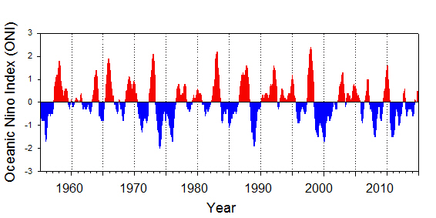
Motivation El Niño La Niña Community Concerns Objectives Methods Results Future Work Conclusions
METHODOLOGY: sub-setting by ONI
1. Use the ONI to divide by 5 phases
Neutral -0.5 < ONI < 0.5 | Mod-strong El Niño ONI ≥ 1.0 | Mod-strong La Niña ONI ≤ -1.0 | Weak El Niño 0.5 ≤ ONI <1.0 | Weak La Niña - 1.0 < ONI ≤-0.5
85/86 | 86/87 | 88/89 | 94/95 | 84/85
89/90 | 87/88 | 98/99 | 04/05 | 95/96
90/91 | 91/92 | 99/00 | 06/07 | 00/01
92/93 | 97/98 | 07/08 |  | 05/06
93/94 | 02/03 | 10/11 |  | 08/09
96/97 | 09/10 |  |  | 11/12
01/02
03/04
12/13
13/14
Oceanic Niño Index (ONI)
2. Average every 3 month season for each phase
3. Created precipitation climatology and anomaly maps
Notes:
-Talk about how we divided the different phases of the ONI in relation to PERSIANN-CDR precipitation.
-Explain the method of how we chose the years with each phase.
-Transition from the methods into the results by mentioning the precipitation climatology and anomaly maps.

Slide 12
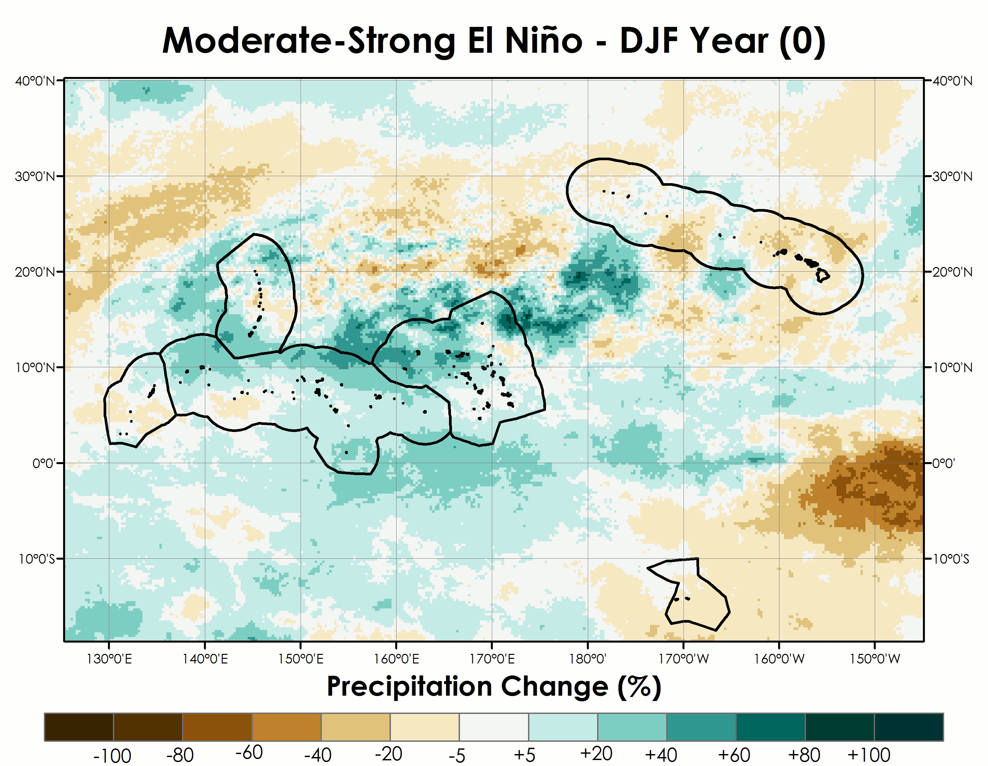
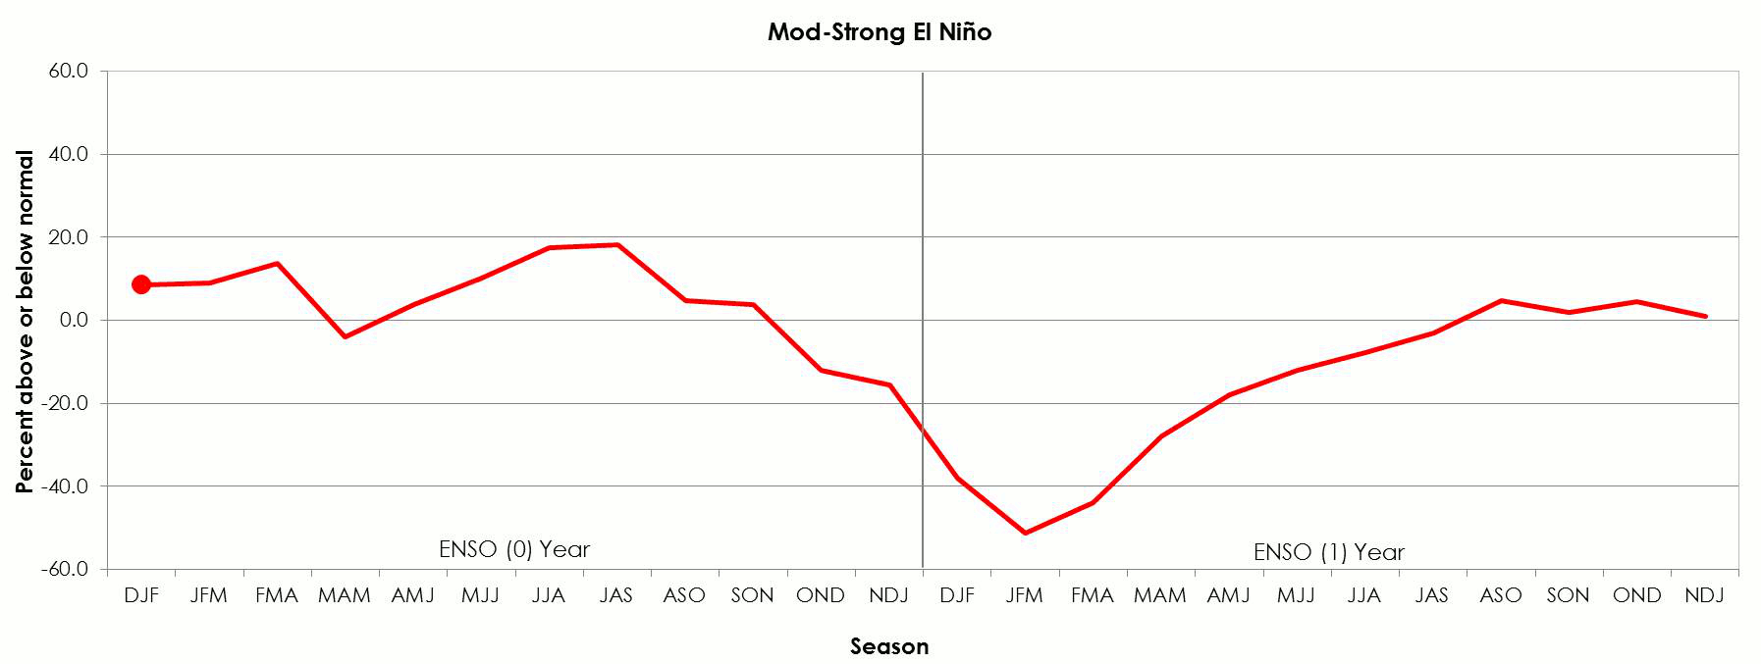
Motivation El Niño La Niña Community Concerns Objectives Methods Results Future Work Conclusions
Pre-ENSO vs.
Post- ENSO
Chuuk, FSM
Notes:
To see how precipitation change over space and time, we made maps and time series of the average 3 month seasons based on the 5 phases of the ONI. As you can see in the map and associated time series, precipitation in Chuuk decreases dramatically from October until February.

Slide 13
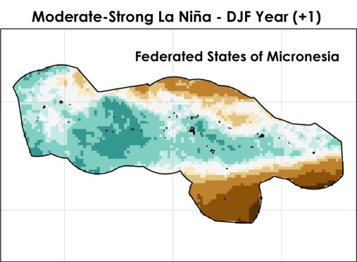
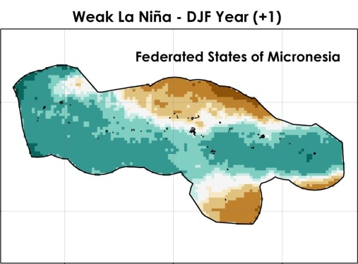
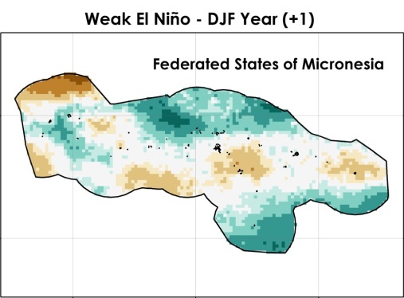
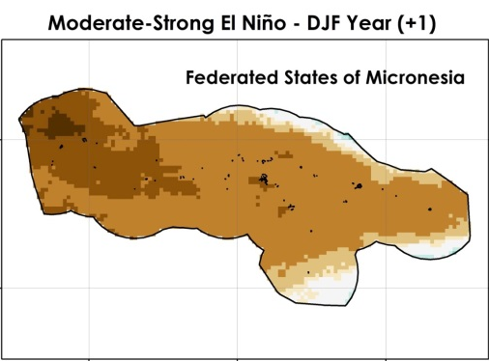
Motivation El Niño La Niña Community Concerns Objectives Methods Results Future Work Conclusions
Precipitation Changes in Micronesia

Slide 14
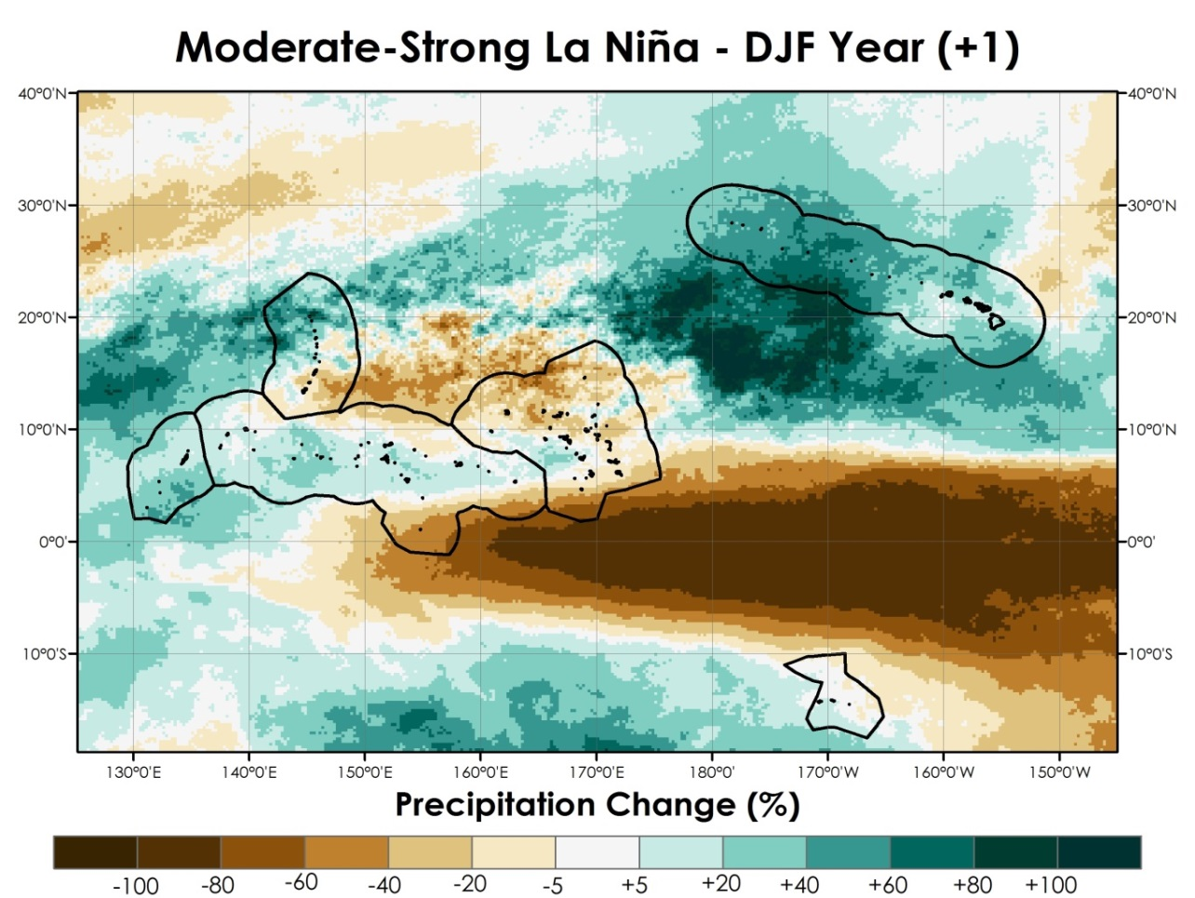
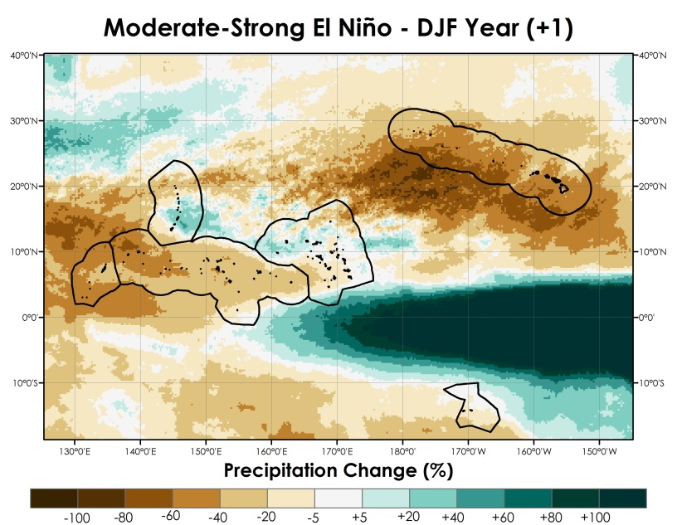
Motivation El Niño La Niña Community Concerns Objectives Methods Results Future Work Conclusions
Post-La Niña
Notes:
We also wanted to look across the region to see how the specific phases of ENSO influenced precipitation. As you can see in the map and associated graph, during moderate-strong La Nina years, there is more precipitation than normal except for 3 station locations which are Guam, Kwajalein, and Majuro.

Slide 15

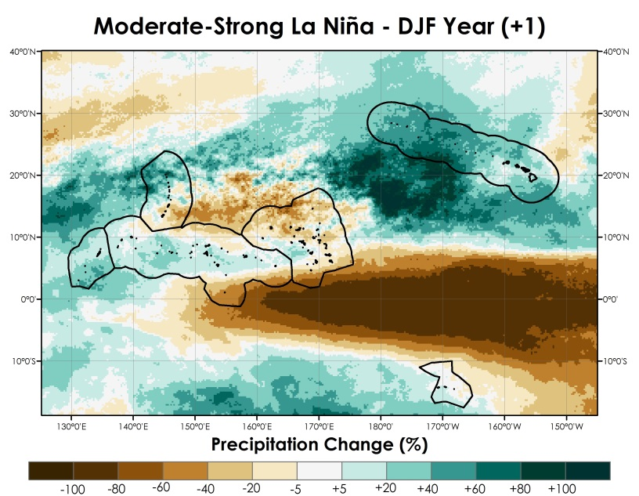
Motivation El Niño La Niña Community Concerns Objectives Methods Results Future Work Conclusions
Post-El Niño
Notes:
Comparing those results with the moderate-strong El Nino shows very different results. We can see in the map and associated figure that during a moderate-strong El Nino the precipitation across the region, with the exception of Kwajalein, is much lower than the normal.

Slide 16
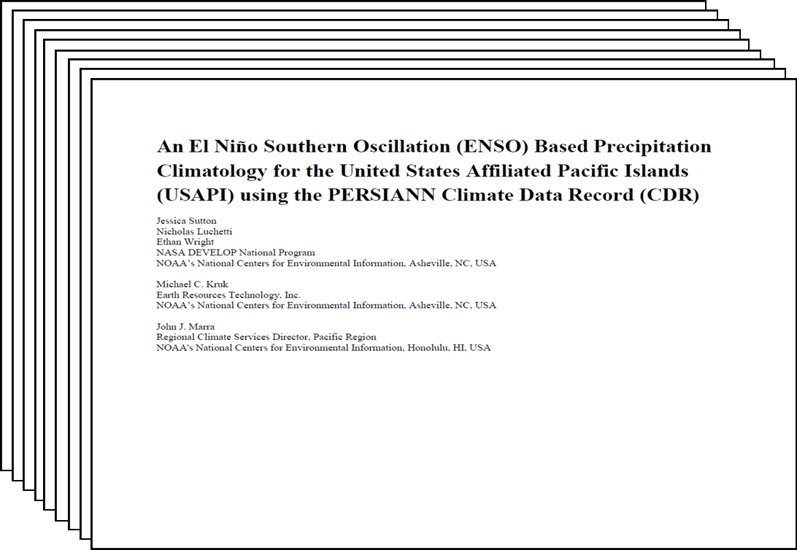
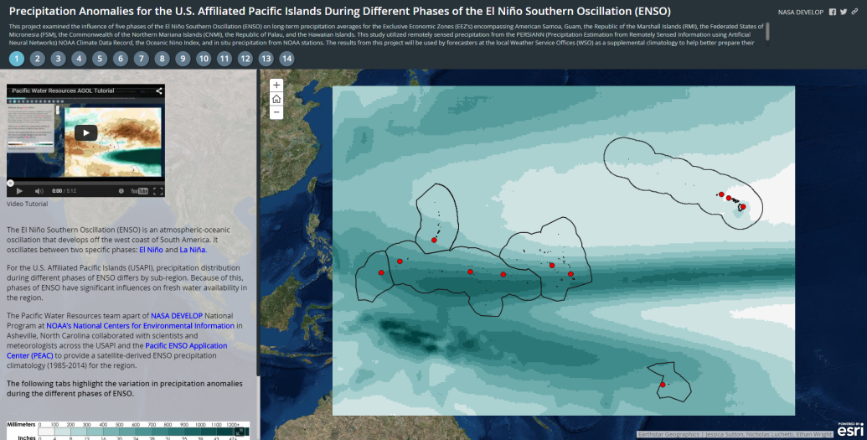
Motivation El Niño La Niña Community Concerns Objectives Methods Results Future Work Conclusions
Final Products
Final products were shared with our science advisors, end-users, and partners
Final Products included :
Maps, figures, and tables compiled into document for each WSO for their region
These included:
1. Maps - 30 year normal, clipped EEZ, and regional area
2. Time series and tables for each NOAA level one station
3. ArcGIS Online Mapping Application

Slide 17
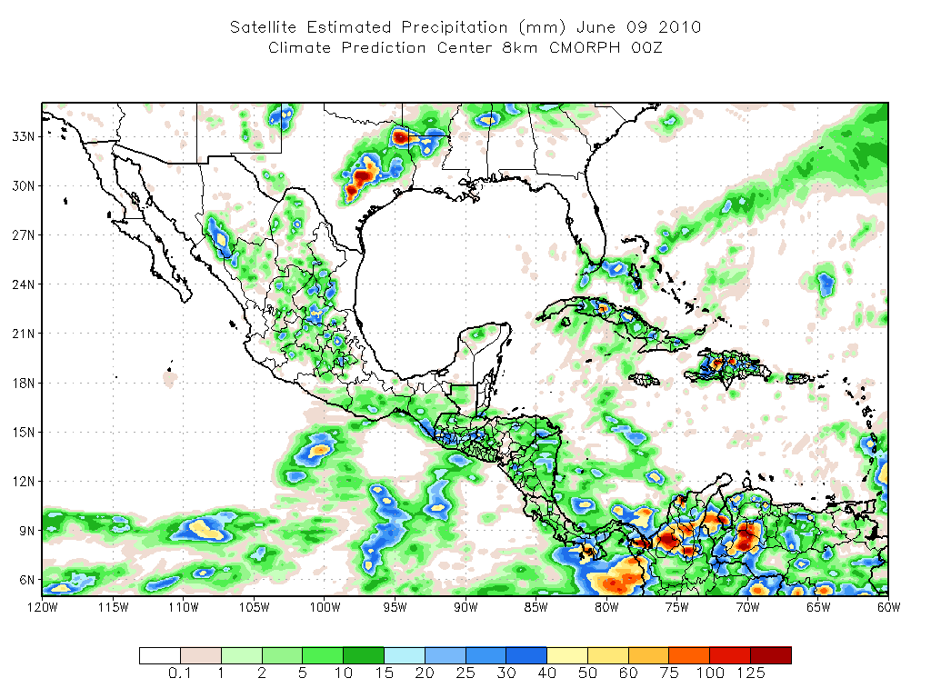
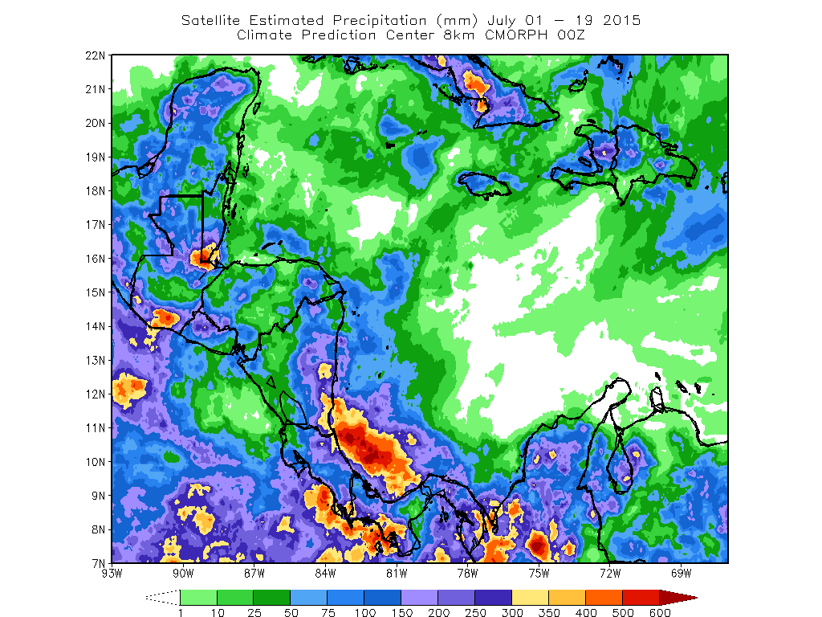
Motivation El Niño La Niña Community Concerns Objectives Methods Results Future Work Conclusions
Future Work
This work will be submitted for publication after the summer DEVELOP term
Future work will utilize other satellite products to provide higher resolution precipitation maps
This research will be presented at the 2015 AGU Fall Meeting and possibly at the 2016 AMS Annual Meeting
Image Credit: http://www.cpc.ncep.noaa.gov/products/fews/central_america/cmorph_rainfall.html
Notes:
After the completion of the term, we are going to work with our science advisors and partners to get the results into a publishable form. Additionally, we would like to continue with this type of research and add higher resolution precipitation from CMORPH to get a more accurate estimation of precipitation over the islands. We would also like to compare the precipitation from PERSIANN, CMORPH, and TRMM to better understand how the satellite products are performing across the board. Finally, Ethan will be presenting this research at the 2015 AGU Fall Meeting and Nick will hopefully be presenting it at the 2016 AMS Annual Meeting.

Slide 18
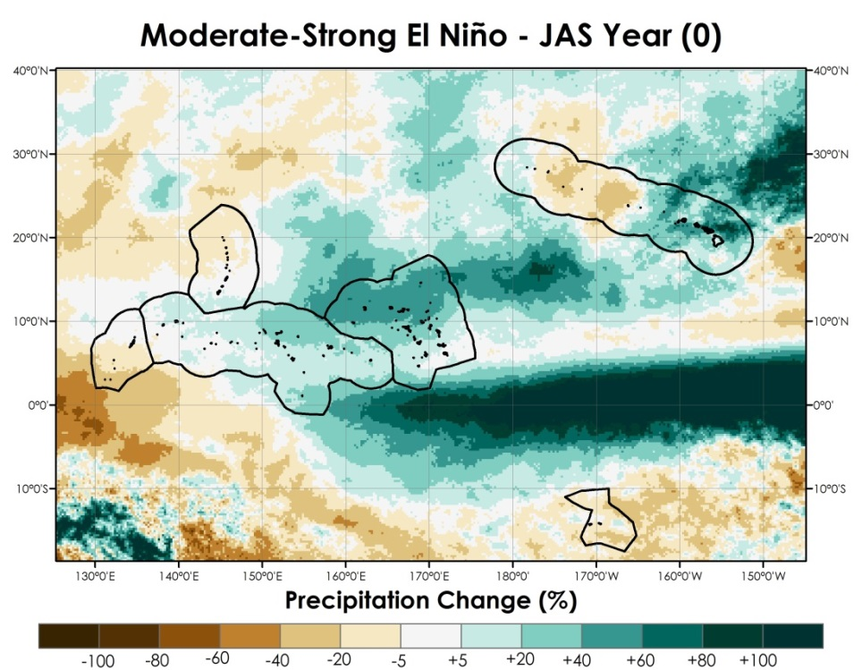
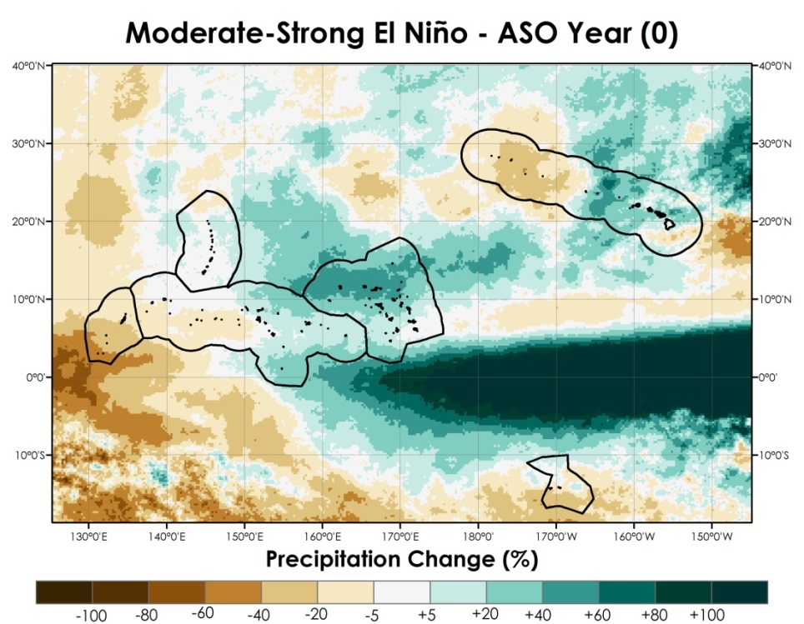
Motivation El Niño La Niña Community Concerns Objectives Methods Results Future Work Conclusions
Conclusions
PERSIANN-CDR precipitation was lower than in situ precipitation and varied with station
Distinct differences and spatial variation of precipitation during the five ENSO phases within each EEZ
Using the PERSIANN CDR climatology can help local communities better manage their fresh water resources
Notes:
The precipitation from the PERSIANN CDR was consistently lower than in situ precipitation and the verificaiton varied with station. There were distinct difference and spatial variation of precipitation during the 5 ENSO phases. Results were shared with local weather service offices for them better manage their fresh water resources by having a better idea of the possible precipitation patter before and after ENSO phases. The maps to the left of the screen show the expected precipitation change in the coming months over the U.S. Affiliated Pacific Islands.

Slide 19
Advisors
Michael Kruk, Earth Resources Technology
John Marra, NOAA Region Climate Services
Partners
Carl Noblitt, Pacific ENSO Applications Climate Center
Others
We would like to acknowledge Lance Watkins, Carl Schreck, Olivier Pratt, Mark Lander, Luke He, Kevin Kodama, Charles Guard, Thomas Schroeder, Maria Ngemaes, and the NASA DEVELOP National Program Office for their support, edits, and commentary that has strengthened this research.

