Slide 1
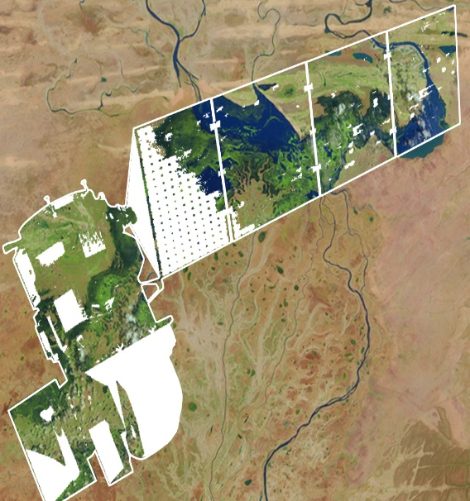

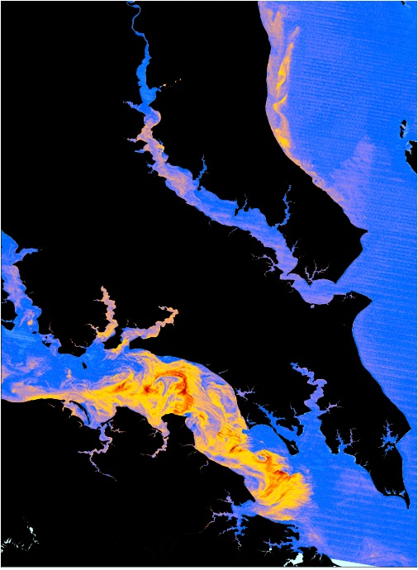
DEVELOP National Program
DEVELOP Projects & Partners:
Project Execution, Partner Engagement, Performance Metrics, Communicating results

Slide 2
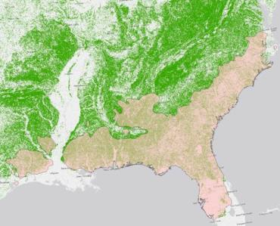
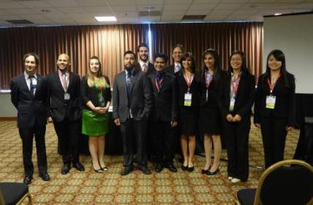
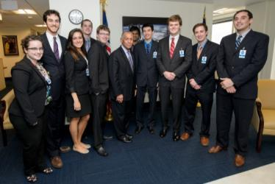
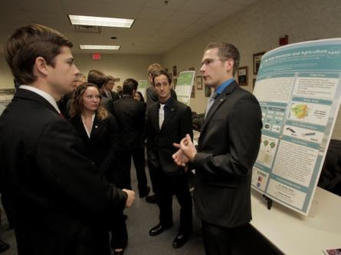
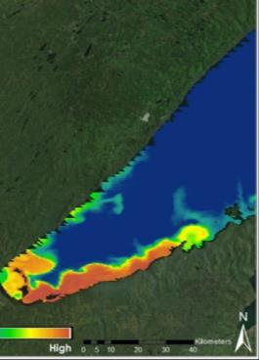
2015 Project Stats
Spring 2015
115 Participants working on
29 Projects with
64 Partners & End-Users
Summer 2015
175 Participants working on
38 Projects with
84 Partners & End-Users
Fall 2015
109 Participants working on
27 Projects with
63 Partners & End-Users

Slide 3
Project Lifecycle
Science
National Science Objectives
Program Managers
Science Advisors
Decadal Survey
Partners / End-Users
Community Demand
Local Policy Makers
State Governments
Federal Agencies
Applied Sciences Program
Project Execution
Partner with stakeholder
Support from science advisors
Data acquisition, processing, analysis
Creation of deliverables
Outreach
Present at Science & Policy conferences
Virtual Poster Session (VPS)
Recruiting events
Publications
Capacity Built:
Future Workforce
Capacity Built:
Partner Organizations
Capacity Built:
State/Local/Federal
Governments
Capacity Built:
General Public

Slide 4
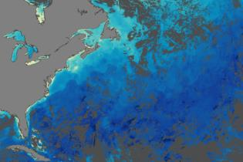

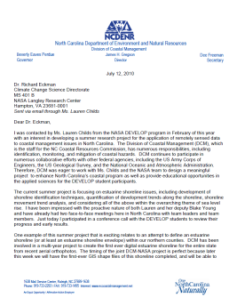
Project Characteristics
80+ projects take place each year - at their core they share these characteristics:
Highlight the applications and capabilities of NASA Earth observations
Address community concerns relating to decision-making for real-world environmental issues
Partner with organizations who can benefit from using NASA Earth observations to enhance decision making by providing decision support tools
Align with at least one of the nine NASA Applied Sciences Program’s National Application Areas
Research is conducted by teams with diverse backgrounds under the scientific guidance of Science Advisors and mentors from NASA and partner organizations

Slide 5









2016 Spring Portfolio
Puerto Rico Health AQ II (ARC)
Arizona Health AQ II (LaRC)
Coastal United States Health & AQ (NCEI)
Gulf of Mexico Health AQ (GSFC)
African Great Lakes Weather II (WC)
Great Lakes Eco Forecasting (GSFC)
Laramie Mountains Eco Forecasting (FC)
Southern Rockies Eco Forecasting II (LaRC)
Bolsa Chica Eco Forecasting (JPL)
Louisiana Eco Forecasting II (JPL)
El Salvador Eco Forecasting II (LaRC)
Mobile Bay Eco Forecasting (MCHD)
Alabama Eco Forecasting (MCHD)
CALIPSO Cross Cutting III (LaRC)
Gunnison Ag (FC)
Indonesia Ag (GSFC)
Uruguay Ag III (IRI)
Peru Climate II (UGA)
Wise County Disasters (WC)
Southeast Idaho Disasters II (ID)
Atlanta Water (UGA)
Texas Water II (LaRC)
Lake Victoria Water II (MSFC)
Cascade and Sierra Nevada Mountains Water (NCEI)
Caribbean Oceans (ARC)
Los Angeles Oceans II (JPL)

Slide 6
Project Team Responsibilities
Set goals and work towards them.
Complete all mandatory deliverables and weekly updates, as well as any optional deliverables the team decides.
Please respect the chain of command within the team - project team members report to Project Leads, who report to Center Leads, who report to NPO. However, don’t feel bogged down by the chain of command - DEVELOP fosters open communication between all levels!
Leave organized documentation of all research and contacts so the project and/or communication with end-users may be continued in following terms.
Cleanup team rooms and office space daily (common areas, etc.) – respect your office mates and stay orderly.
Look at what else needs to be done when you have completed the tasks your Project Lead(s) and Center Lead(s) have assigned. Take initiative!
Have an open mind & learn from each other!

Slide 7
Deliverable Descriptions and Uses
Project Summary
Digestible compilation of project information.
Use: reporting and outreach materials, project booklets, annual reports, close out presentations, quarterly program reviews, monthly status reports, the virtual poster session, and content for DEVELOPedia page.
Tech Paper
Provides a synopsis of the project with technical details for partners and future DEVELOP teams to replicate and understand. Methods should be the focus. It should be no longer than 12 pages and use the template unless permission is previously granted to use a different style. Any distribution or publications of this work must go through NASA Export Control.
Innovative Content - DEVELOP is exploring the establishment of a micro-journal focused on applications of Earth observations. This would be an opportunity to take tech papers from successful projects and publish them. The micro-journal format requires ‘innovative content’ to make the articles interactive for the reader. Options for types of IC can be found in the template.
Use: content for publications, provide to partners, improving technical writing skills for participants, etc.
Presentation
A visually appealing means of telling the “story” of the project and provide a flow of information that carries the viewer from abstract to conclusions. The page structure in the template is a guide, feel free to amend it to fit your project. It must include full speaker notes. Typical length is 6-20 slides, depending on the presentation venue.
Use: report to project partners, NASA HQ, conferences, improving communication of science and presentation skills of participants, etc.
VPS: Video & Transcript
The VPS deliverable consists of the video and full transcription of audio in the video. The transcript is mandatory, as the video must be compliant with Section 508 of the US Rehabilitation Act. Videos must not be longer than 4 minutes, include the mandatory DEVELOP beginning and ending clips, and provide a good overview of the project. Creativity is appreciated, however “goofy” is not. A good rule of thumb is to ask yourself if you would feel comfortable sending the video to your project partners. Keep in mind that you are representing NASA.
Use: Videos are the most visible outward-facing deliverable, provide potential partners, applicants, etc. the type of work DEVELOP does, can be used as innovative content for the micro-journal articles, highly praised by NASA HQ, improve video-making skills of participants, and can be referenced in future job interviews, etc.
Poster
Visual display of the project and its results in one overview. Content is often the same/similar to the presentation content. Posters are presented in a variety of venues. Creating a successful poster to demonstrate results is great skill and a standard practice in science.
Use: close-out events, conferences, meetings, improving science communication and presentation skills of participants, etc.

Slide 8
Deliverable Descriptions and Uses
New Mandatory Deliverables
Optional Deliverables
DEVELOPedia Page
Home page for your project with a description and all related materials for DEVELOPers to access for perpetuity.
Use: Future DEVELOP teams understanding your projects, gaining lessons learned, identifying methods used, etc.
Tutorial
Description of methodologies for data acquisition, processing and analysis; useful for hand-offs to partners/end-users and future DEVELOP teams. These are being collected for inclusion in DEVELOPedia and made available to future teams.
Software Release Forms
Projects that are creating specific types of decision support tools are required by NASA to submit the tools through NASA’s Software Release Authority process before they can be disseminated outside of NASA. These projects are identified through the proposal and project summary submissions. Talk to your CL and the Geoinformatics Team to discern whether this deliverable is required.
One Pager / Brochure
Useful for hand-offs and close out presentations. Similar content to the poster and project summary with imagery included.
AGOL Map
Useful for sharing w/partners/end-users, share maps with general public. Experience w/AGOL is a good resume builder.
Imagery Gallery
Used for brochures, close out print material, posters, presentations, social media, etc. Compiles all the beautiful images from your project in one place for later use. Highly appreciated by NPO but optional.

Slide 9
Deliverable Submission
1. Template
Make sure you are using the right template and the template font and formatting is intact (especially if your team used Google Docs to collaborate on the text)!
2. Nomenclature
YearTerm_Node_Team_Deliverable_Draft
Use this for EVERYTHING! (all deliverables and any separate attachments - images, etc.)
Examples: 2016Spring_LaRC_NorthCarolinaWater_Poster_FD
2016Spring_LaRC_NorthCarolinaWater_Imagery_legend.PDF
3. Center Lead & Science Advisor Review
Center Leads and Science Advisors should review and approve prior to submitting to NPO
Work in time for this! They are busy people!
4. Submit:
Submit through your project team’s DEVELOPedia page [there is a 60MB limit]
  There is a 60MB limit, so do not submit videos through DEVELOPedia – use NASA Large File Transfer System or Google to share those with the Project Coordination Team
If there are any issues or delays, email DEVELOP.ProjectCoordination@gmail.com
5. Archive: http://files.developexchange.com/
All teams should ensure there is a final set of deliverables on their DEVELOPedia page
Any files that are too large for DEVELOPedia or are file types not accepted by DEVELOPedia, must be archived in the team’s folder on the Exchange - http://files.developexchange.com/

Slide 10
Project Summary | Tech Paper | Poster | Presentation | Video & Transcript | Optional Deliverables
Week 1
Week 2
Week 3
Week 4
Week 5
Week 6
Week 7
Week 8
Week 9
Week 10
Rough Draft
Rough Draft
Rough Draft
Rough Draft
Final Draft
VPS Image
DEVELOPedia Page
Video & Transcript
Final Draft
Final Draft
Final Draft
Brochure, Imagery, AGOL Map, Tutorial

Slide 11
2016 Spring Deliverable Deadlines
January
Week 1 (1/29): Handbook Forms
February
Week 3 (2/11): Project Summary Rough Draft (& Software Release Forms, if applicable)
Week 4 (2/15): Offices Closed for President’s Day
Week 4 (2/18): Tech Paper Rough Draft
Week 5 (2/25): Poster Rough Draft
March
Week 6 (3/3): Presentation Rough Draft
Week 7 (3/10): Project Summary Final Draft (Includes VPS Image)
Week 9 (3/22): VPS (Video & Transcript)
Week 9 (3/24): DEVELOPedia Page
Week 10 (3/31): Technical Paper Final Draft, Final Poster & Final Presentation
April
Week 10 (4/1): Optional Deliverables
After Term
4/7: VPS Launch
4/22: Category Winners Announced
5/6: Announcement of Grand Prize Winner

Slide 12
Questions?
1. Check Out the Project Coordination Team DEVELOPedia Page
http://www.devpedia.developexchange.com/dv/index.php?title=Project_Coordination
This the hub of all things project-related. Guides, videos, templates, etc. Check it out!
2. Watch Deliverable How-To Videos
Each deliverable has a short narrated demonstration of how to successfully go about completing the deliverable. These are available on DEVELOPedia.
3. Join the Project Coordination Team Open Doors
Ahead of each deliverable deadline, the Project Coordination Team will host an “open door” session where anyone from any team can join and ask questions. The PCT will be in touch with exact day/times.
4. Email the Project Coordination Team
DEVELOP.ProjectCoordination@gmail.com
Don’t hesitate to email questions!
5. Call the Project Coordination Team
Fellows:
Vishal – 251.544.2123
Teresa – 757.864.4496
Emma – 828.251.4053
NPO:
Lauren – 757.864.4204
Jamie – 804.692.0136

Slide 13

Scientific Integrity
“The iconic success of NASA is planted firmly on three foundational elements: innovation, inspiration, and integrity. While innovation and inspiration are visible through our endeavors and successes, it is our integrity – how we work, and our commitment to excellence and openness – that earns us the trust of the public and ensures our continued ability to inspire and innovate. Integrity is woven throughout the fabric of NASA. It has always been there. And each and every day, we recommit ourselves to keeping it there.”
Dr. Waleed Abdalati
Former NASA
Chief Scientist
NASA SI Policy: http://www.nasa.gov/pdf/611201main_NASA_SI_Policy_12_15_11.pdf

Slide 14
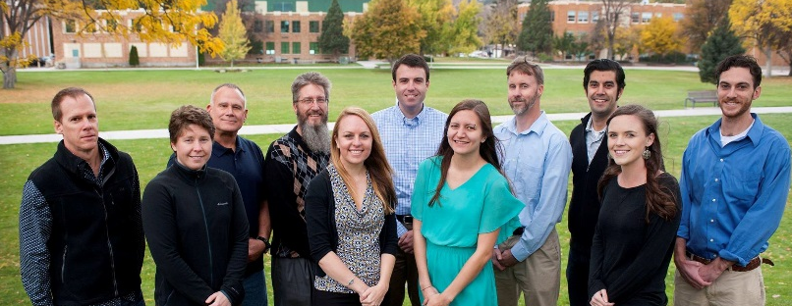
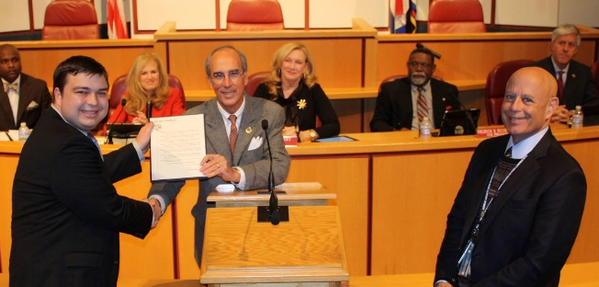
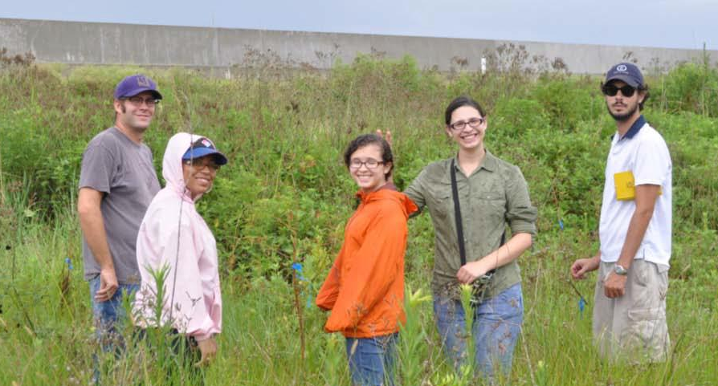
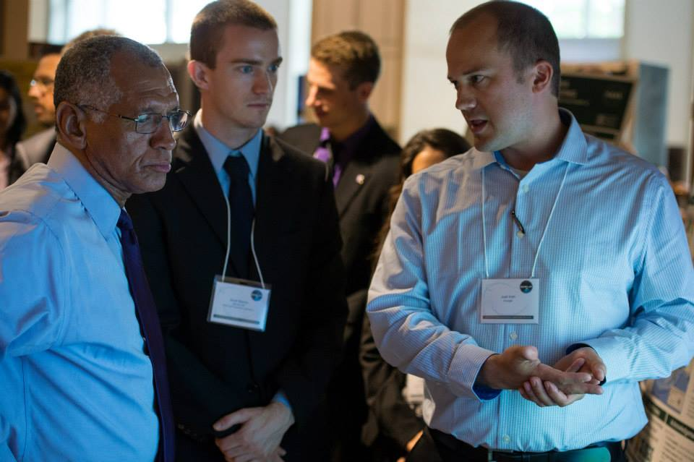
Partner Types: Definitions
Often, DEVELOP teams use the terms ‘partner’ and ‘end-user’ interchangeably. However, there are some distinct differences relating to these terms, and thus the standardized definitions of typical DEVELOP partners are provided.

Slide 15
Partner Types: Definitions
Partner: Umbrella term for any outside organization DEVELOP engages with through projects, nodes, or other activities
  Types of Partners
  End-User: Organization or individual that receives results and methodologies from DEVELOP (either directly from a DEVELOP project team or through a collaborator/boundary organization) and can use the project’s products or methodologies to make a decision or policy. They may also provide some kind of resources (advising, data, model, software, funding, etc.), but it is not required.
    Ex. The Texas Forest Service’s Predictive Services that can use the products/methodologies from the DEVELOP project in their risk mapping creation.
  Collaborator: Organization or individual that works directly with a DEVELOP project team and provides some kind of leveraged resource (advising, data, model, software, funding, etc.), but are not actually using the project’s products or methodologies to make a decision or policy.
    Ex. A researcher from a university who provides a team with an ancillary dataset to validate their results.
All partners are either end-users (using the results or products to make a decision) or collaborators (not using the results or products to make a decision).

Slide 16
Partner Types: Definitions
Partner: Umbrella term for any outside organization DEVELOP engages with through projects, nodes, or other activities
  Types of Partners
  Both end-users and collaborators can also be boundary organizations.
  Boundary Organization: Organization or individual that disseminates the project’s results to other end-users, decision-makers, policy-makers, etc. The Applied Sciences Program defines a boundary organization as “an organization outside of your own that broadens your reach across the boundary into the operational domain (i.e. policy-makers, decision-makers, and other key stakeholders).”
    Ex. The Smithsonian Conservation Biology Institute works with local groups in Myanmar and helped DEVELOP disseminate results from the Myanmar Ecological Forecasting project to those in-country groups.
All Partners
Collaborators
End-Users
Boundary Organizations

Slide 17
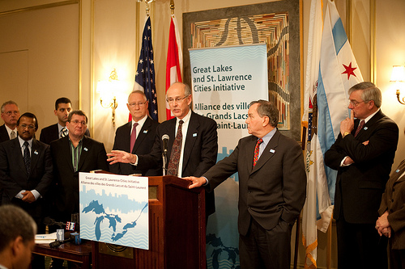
Partner Engagement & Communication
A cornerstone of DEVELOP projects is the engagement of management and policy makers who can benefit from the integration of NASA Earth observations in their decision making process. All DEVELOP projects strive to engage at least one decision-making organization to hand off project results and methodologies to.
The FY15 Project Coordination Fellows created a DEVELOP Partner Engagement Manual to further bolster this process.
Communication Strategies Commonly Employed:
Open communication lines with your partners, see what their needs and meeting abilities are, devise a plan, then be flexible!
Team-Partner greeting telecon during the first or second week
Weekly or bi-weekly telecons & emails with status updates
Hand-off event at the end of the term

Slide 18
Checklist: Working with Partners
Ensure professionalism in all interactions - you are representing yourself, your team, your advisors, your node, DEVELOP, Applied Sciences, and NASA!
Have a plan and schedule.
Be realistic in what you promise and the expectations of the partner, in fact don’t “promise” anything, but ensure the plan you are working to is clear and that there is a healthy understanding of challenges and potential obstacles/risks.
Keep in mind the limitations of resolution (spatial and temporal) of NASA data and work within them.
Understand the partner’s needs - what kind of data/tools are useful, what software do they have access to, what tutorials or products would be helpful?
Keep communication lines open and ensure the team follows through. Generally speaking, the Project Lead should be the POC for communicating with a partner unless it is specifically delegated to another team member.
All emails to partners should be approved by the Center Lead and you should cc the Center Lead always.
Include your project’s Science Advisor in partner communication as much as is possible per your advisor’s availability

Slide 19
Pre- and Post-Project Partner Forms
A Pre-Project Partner Form was sent out before the term to gather information about partner needs and expectations. A Post-Project Partner Form will follow the completion of the term to collect information regarding the perceptions of success of collaborating with DEVELOP.
  Were the project results and methodologies useful?
  Was the experience a good one?
  Is the partner using the results or methodologies in their decision-making process?
Timeline: Center Leads sent out the Pre-Project survey link a couple weeks before the beginning of the term. The Post-Project survey link will be sent to partners at the end of the term. In case of a project that has multiple terms, the survey goes out following the project’s final term.
Please communicate to your partners that DEVELOP will stay in touch and send a brief survey at the end of the project’s final term.

Slide 20
Understanding Partner Needs
Prepare for your first team communication with your partner by compiling questions relating to the following areas. Discuss this with CLs, look at responses to the pre-project form, and build off previous conversations with the partner. The following questions can guide you in understanding your partner’s needs:
Community Concern or Policy
Background, current policies, and upcoming/ongoing decisions relating to the issue at hand
Economic impact (ex. cost of fighting a wildfire or drought impacts to crops in a region)
Technology
Do they currently use GIS and/or remote sensing?
What data types are they familiar with?
Do they have access to Arc/ENVI/Matlab/etc. or whatever software you will use? If not, would they be able to purchase it? (this can guide the team’s use of open source software)
Partnership and Transition
Clarify expected level of involvement - how much can the partner interact with the team?
What organizations do they partner with?
What tutorials would be of use? What format should end-products be in to be useful?
What is the best transition approach? Email, telecon, videocon, in-person (consider distance for this one - if you’re 3000 miles apart choose a different option unless the partner can fund)

Slide 21
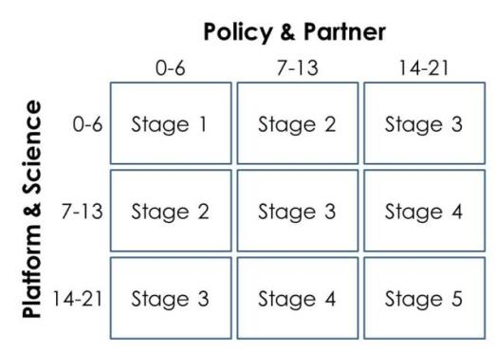
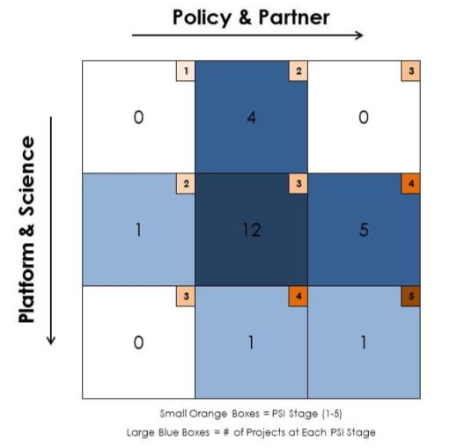
DEVELOP Project Strength Index (PSI)
DEVELOP projects have consistently improved and matured over the Program’s last 15+ years. A means of assessing project progression and comparing project success has, to date, been subjective. This project strength index provides DEVELOP a means of objectively evaluating projects and tracking progress.
A series of questions are answered earning a total of 21 points in two sections: 1. Policy & Partner and 2. Platform & Science. The score for each category is then placed on the index to receive the project’s current stage (1 to 5).
Stage 1: Basic Research
Stage 2: Application Concept Complete
Stage 3: Application Demonstration Successful
Stage 4: Application Verified / End-User Engaged
Stage 5: Transition to End-User / Decision Enhanced

Slide 22
Presenting & Publishing DEVELOP Work
For purposes of ensuring appropriate export control review, performance metric tracking, and reporting to NASA HQ, any and all presentations or publications related to DEVELOP (projects or the program in general) must be communicated to, and content shared with, the NPO before submission of the presentation or publication.
Submitting work for presentation or publication is encouraged; however, ALL research is the property of NASA and therefore, you must have permission prior to submitting your research anywhere. Also, to minimize duplication of effort, the NPO oversees all publications and presentations.
Coordinate with your Center Lead and if approved at your node, a simple email with your ideas before the presentation or publication to Karen.N.Allsbrook@nasa.gov and Lauren.M.Childs@nasa.gov with the following information will suffice:
Description of the activity - conference, presentation to a class, publication, etc.
Timeline for the activity - when the event is or deadline for publication, etc.
A copy of the material/content (because often presentations can be large, a PDF is good enough for a quick review)
Thank you for your consideration and help with this!

Slide 23
NASA’s Export Control
What is a Export Control?
The NASA Export Control Program is based on the philosophy: “We want to maximize the benefits of our international efforts while ensuring that we comply with U.S. export control laws and regulations”. This is the personal responsibility of each employee or contractor to pursue appropriate international activities involving transfers of technologies, software, and commodities. The Agency’s Export Control Program is the mechanism that provides checks and safeguards at key steps to help manage international activities and ensures that NASA works within Export Administration Regulations (Department of Commerce) and the International Traffic in Arms Regulations (Department of State), which could result in criminal, civil, or administrative enforcement actions against NASA, individual employees, and/or private contractors.
NASA Administrator’s Export Control Policy:
"As a U.S. Government Agency on the forefront of technological development and international cooperation in the fields of space, aeronautics, and science, the National Aeronautics and Space Administration will strive to fulfill its mission for cooperative international research and civil space development in harmony with the export control laws and regulations of the United States. Due to heightened proliferation challenges facing the United States and the world, including risks posed by the spread of missile technologies and weapons of mass destruction, and in view of the significant criminal, civil, and administrative penalties that may affect the Agency and its employees as a result of a failure to comply with U.S. export control laws and regulations, it is the responsibility of every NASA official and employee to ensure that the export control policies of the United States, including nonproliferation objectives, are fully observed in the pursuit of NASA's international mission."

Slide 24
Export Control & Designated Countries
What is a Designated Country?
This list of “Designated Countries” is a compilation of 41 countries with which the United States has no diplomatic relations, countries determined by Department of State to support terrorism, countries under Sanction or Embargo by the United States, and countries of Missile Technology Concern.
What does this mean to me?
It means that for any project deliverables, products, decision support tools, etc. to be transferred to any partner (domestic or international) a review must take place first. The NPO ensures that DEVELOP works within NASA Export Control guidelines. The NPO must be made aware of any presentations, publications, or information transfer that take place before they occur. A transfer can be an email, publication, presentation, telecon, webinar, etc. Communication with partners in designated countries has restrictions, so coordinate with NPO ahead of opening communication lines.
But my partner is domestic/not in a designated country?
While your project partner may be in the United States or not on the designated country list, the assumption is that anything that leaves the Agency/DEVELOP could be in turn transferred to any individual or organization anywhere and thus we must ensure that all material is appropriate for a global audience.
Questions? Contact Lauren.M.Childs@nasa.gov
NASA Export Control: http://oiir.hq.nasa.gov/nasaecp/index.html

Slide 25
NASA’s Software Release Authority
What is NASA’s Software Release Authority? NASA’s process for formally giving approval for software and tools to be released to the public for marketing, distribution, and use. All new “software” developed by NASA-funding must be made available through the Software Release Process, which coordinates export control review, intellectual property review, commercialization assessment, and software release actions and determines if it meets NASA policies and guidelines.
NEW - process involved:
  Identify which projects are creating the types of tools that must go through SRA by means of the proposal and project summary deliverables
To review the full process and steps involved - visit: www.devpedia.developexchange.com/dv/index.php?title=Open_Source_Software_Development_and_Release
Other considerations:
  All software released through NASA DEVELOP will be released open source.
  All software released through NASA DEVELOP will be distributed through the NASA DEVELOP GitHub account after Software Release Approval. Caution partners that this may not occur during the term.
  For questions about this form, refer to DEVELOPedia: Open Source Software Development and Release or contact Mike Bender at michael.r.bender@nasa.gov.
  You cannot include any lines of code in presentations unless it has been approved through the software release process
  You cannot handoff any coding tools/short scripts the team created to a partner until the software release process has been completed

Slide 26

Interacting w/ the Media
NPO and NASA Public Affairs must be involved with all media interaction from the beginning.
If you are interested in working with the media, contact NPO first.
If someone from the media reaches out to you, contact NPO about a response or connect them with NPO directly.
NPO POC – Lindsay Rogers Lindsay.M.Rogers@nasa.gov

Slide 27

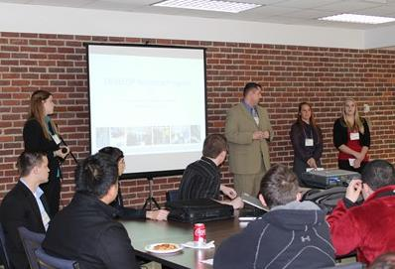
Hand-Offs
Hand-offs are an important step in transitioning results and methodologies to end-users, and working towards the goal of the end-user integrating NASA Earth observations in their decision making process.
Commonly Used Hand-off Styles
Email of deliverables (tech paper, tutorials, presentation, etc.)
Teleconference or videoconference presenting the results and methodologies
In-person presentation of results and methodologies
Get creative in how and what you hand-off. Interesting idea? Speak to your Center Lead about it!
Depending on what you are handing off, be cognizant that you must get them approved by NASA prior to handoff.

Slide 28
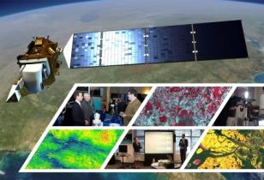
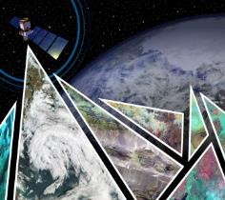

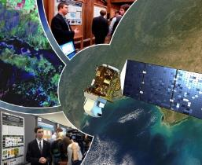
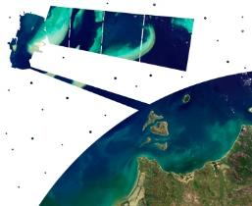
Virtual Poster Sessions
What is a Virtual Poster Session?
Since 2011, DEVELOP has regularly collaborated with IEEE’s Earthzine to showcase the work of participants through a series of ‘virtual poster sessions’ or VPS. Each VPS includes an impressive array of abstracts, videos, and other material on each DEVELOP project. A blogging period with question-and-answer discussion allows the teams to interact with the global community and share their work.
Thousands of people from around the world participate in the VPS – For example, the 2015 Spring VPS had visitors from 87 different counties with 3500 video views!
Key Dates:
VPS Video and Transcript – due March 22 (Week 9)
VPS Launch – April 7 (after the term)
Bonus: The winning team receives a prize package from VPS sponsors (geospatial software)
DEVELOP VPS Archive: www.earthzine.org/vps-archive/

Slide 29
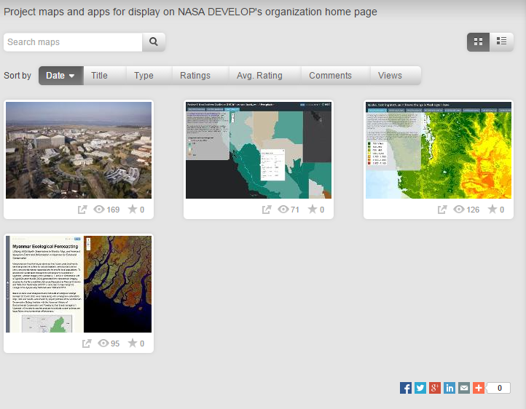
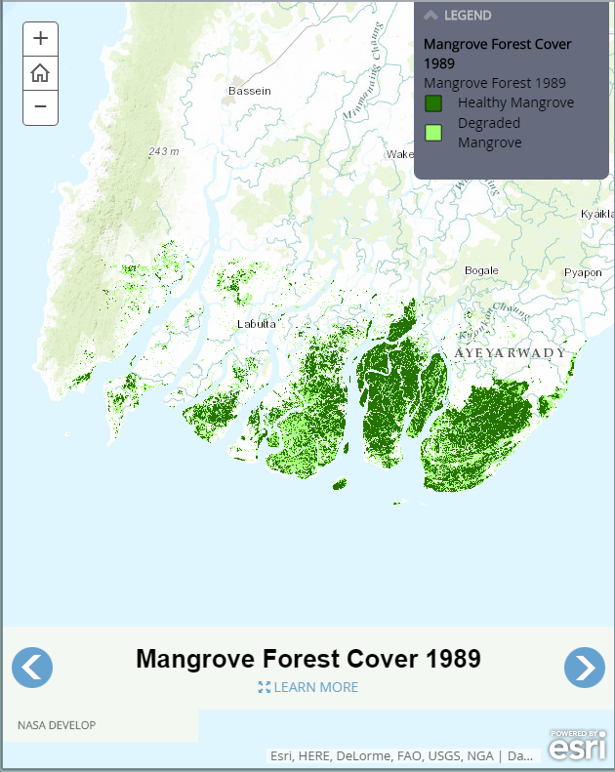
ArcGIS Online (AGOL)
Tell the story of your project with a publicly viewable app.
Easy to get started
Attend the interest meeting to learn more.
DEVELOP AGOL Project Gallery: http://goo.gl/gSH0TK

Slide 30
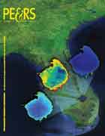
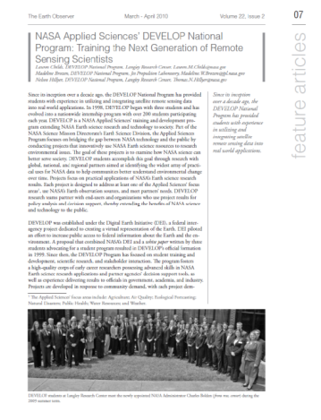
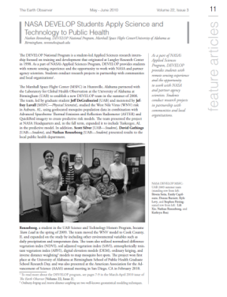
Publications
Publications are a huge avenue for getting the word out about the great research you are a part of with DEVELOP!
DEVELOP has a handful of peer-reviewed publications to date.
Currently, DEVELOP publishes frequently in Earthzine, Directions Magazine, and The Earth Observer
If you are interested in working your project toward a potential publication, contact your Center Lead and Tiffani Miller.
Reminder: All publications must be approved by NPO and NASA’s Export Control process before submission!

Slide 31
Publication Process
Coordinate with your Center Lead first
Contact Comm Team with initial interest
Select publication venue and draft article
  If this happens during the term, the article draft can replace the tech paper. Email the Project Coordination Team if you plan to do this.
Submit draft to NPO for review before submitting to the journal
Comm team and project team go back and forth with edits to create a final submission
NPO submits final version into export control
Once approved, the content can be submitted to publication venue
Keep Tiffani in the loop with any and all edits from venue
The final-final version must be resubmitted to NASA Export control
NASA Export Control takes about 2-3 weeks.

Slide 32
DEVELOPedia
DEVELOPedia is an internal wiki intended to serve three purposes:
  Enhance project workflow
  Capture lessons learned and make them available to future project teams
  Record data required for operational metrics
DEVELOPedia is a collaborative effort whose utility is directly related to the efforts of previous DEVELOP participants.
DEVELOPedia is a living document, constantly adapting to meet the needs of the NASA DEVELOP National Program and the people that make the program great. (That’s you!)
http://www.devpedia.developexchange.com

Slide 33
Resources
DEVELOP Handbook: Given to each participant at start of term, also on DEVELOPedia
DEVELOPedia: http://www.devpedia.developexchange.com/
You should have received information about your account just before the beginning of the term.
DEVELOP Exchange: http://developexchange.com/
Username: develop_user & Password: DEVELOPers2014!
Filezilla: Server file exchanging program to connect to the DEVELOP Exchange. Very easy to use, and free.
DEVELOP Website: http://develop.larc.nasa.gov/
DEVELOP’s Anonymous Dropbox: http://developexchange.com/dropbox.html
Need Help?
Geoinformatics Team: DEVELOP.Geoinformatics@gmail.com
Project Coordination Team: DEVELOP.ProjectCoordination@gmail.com
Communications Team: DEVELOP.Communications@gmail.com
NPO-level questions - refer to the questions page in the About DEVELOP section and email the appropriate contact, unsure who? Ask your Center Lead.

Slide 34
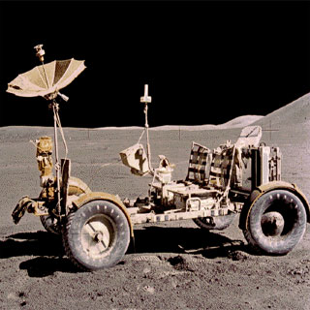
THANK YOU!
A lot goes into every DEVELOP project. What will your project’s legacy be?

