Slide 1
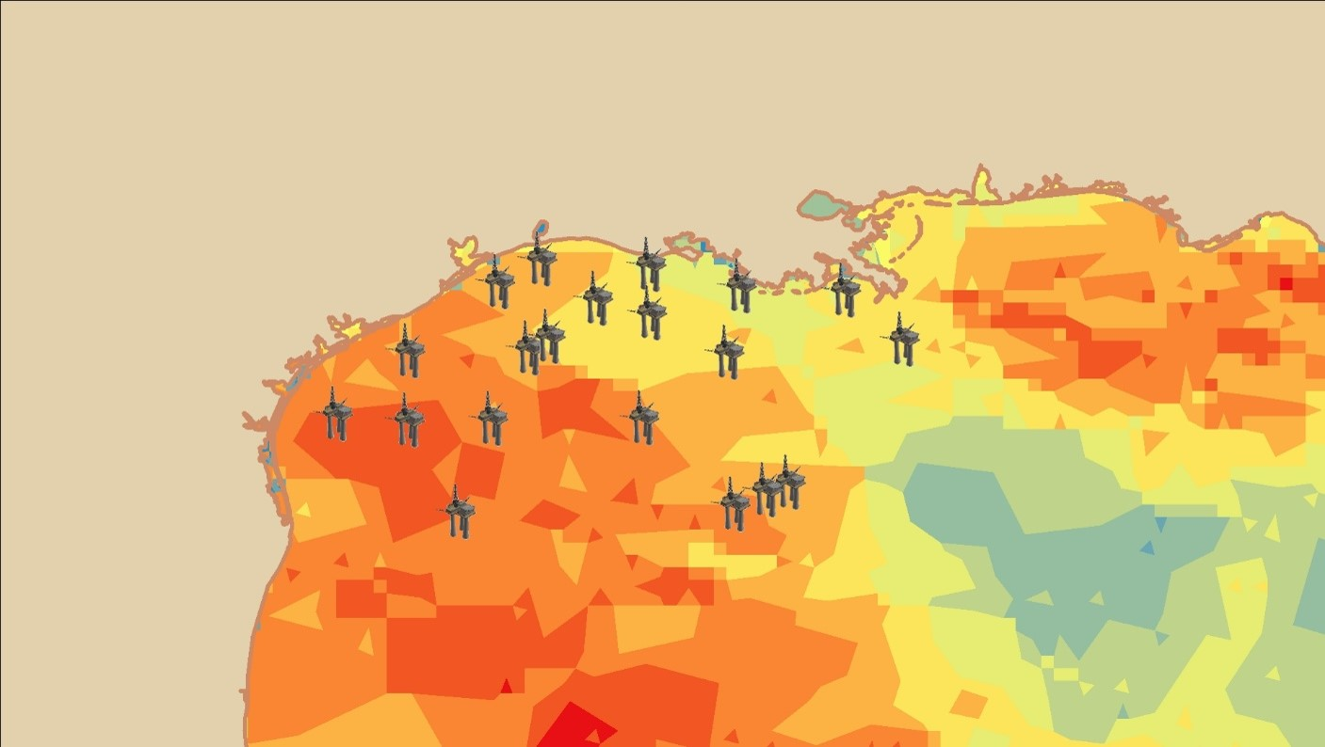


2018 Fall | Alabama – Marshall
GULF OF MÉXICO TRANSPORTATION & INFRASTRUCTURE
Evaluating the Potential of CYGNSS Wind Data to Assess Tropical Storm Impacts on Energy Infrastructure in the Gulf of México
Shelby Ingram
Jada Blankenship
Michelle De Luna
Essence Raphael
Notes:
We are the Gulf of Mexico Transportation and Infrastructure Team here at Marshall Space Flight Center. We will be evaluating the potential of CYGNSS wind data to assess tropical storm impacts on energy infrastructure in the Gulf of Mexico.
My name is Shelby Ingram and I am the team lead and this is my second term at DEVELOP.
My name is Jada Blankenship and this is my first term at DEVELOP.
My name is Michelle De Luna and this is my first term at DEVELOP.
My name is Essence Raphael and this is my second term at DEVELOP.
Image credit: (Michelle De Luna)

Slide 2
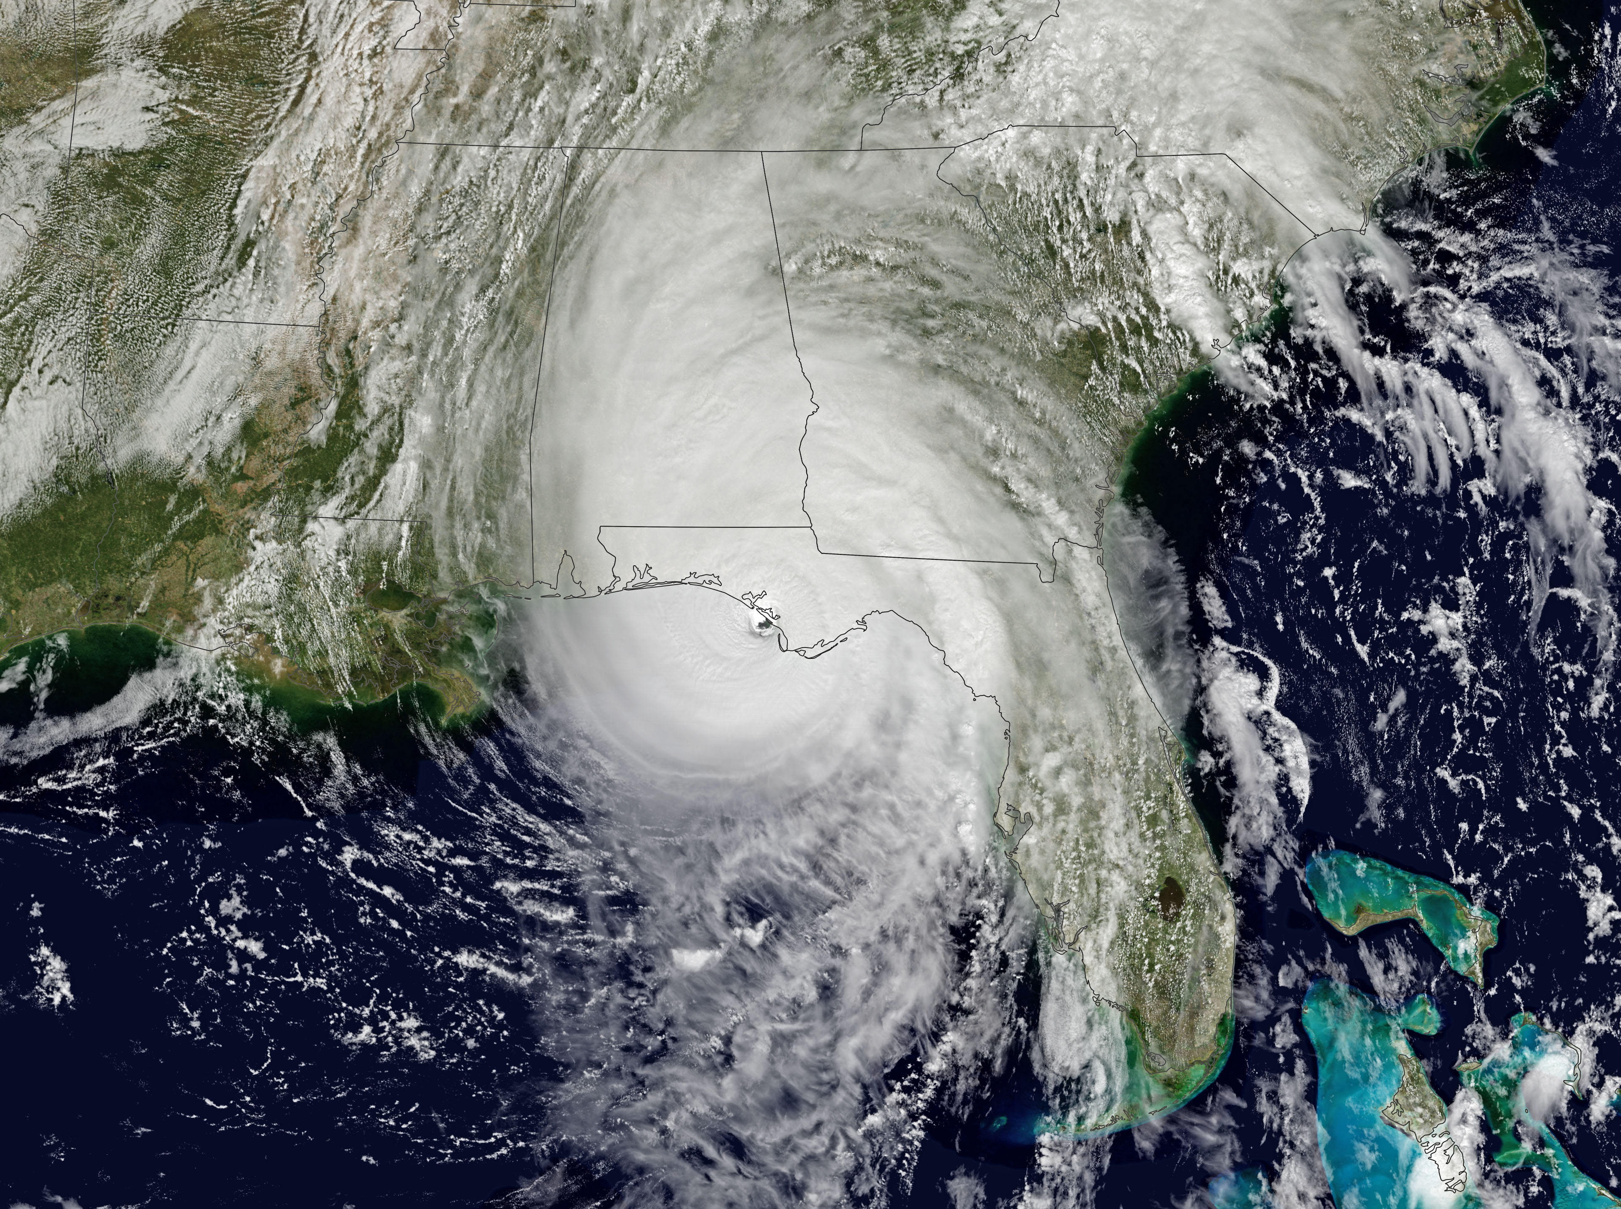
Overview
Hurricane Michael (2018)
Study Area
The Gulf of México (GoM) bordered by: AL, FL, LA, MS, & TX
Study Period
March 2018 – October 2018
Community Concerns
The GoM accounts for 17% of US offshore crude oil
Tropical storms disrupt the supply of oil and natural gas
Risk of oil leaks is increased
Image Credit: NASA
Image Credit: NASA Earth Observatory
Notes:
The Gulf of Mexico is a partially landlocked body of water bordered by the US and Mexico. Our project investigates wind speed and wave heights in the GoM during the 2018 hurricane season that ran from March 2018 – September 2018. The team focused on one random sample day from each month and the Tropical Storm Gordon Hurricane Michael as our case studies. The Gulf houses around 4,000 offshore oil drilling platforms, which are at risk due the hurricanes that regularly affect the area. The warm Loop Current runs through the GoM, strengthening tropical systems. Some of these storms result in the rigs being under stress, increasing the risk of oil leaks or spills into the ocean. Any damage may also lead to hazard released into the environment.
Image link: https://earthobservatory.nasa.gov/images/92868/florida-slammed-by-hurricane-Michael (public domain)

Slide 3

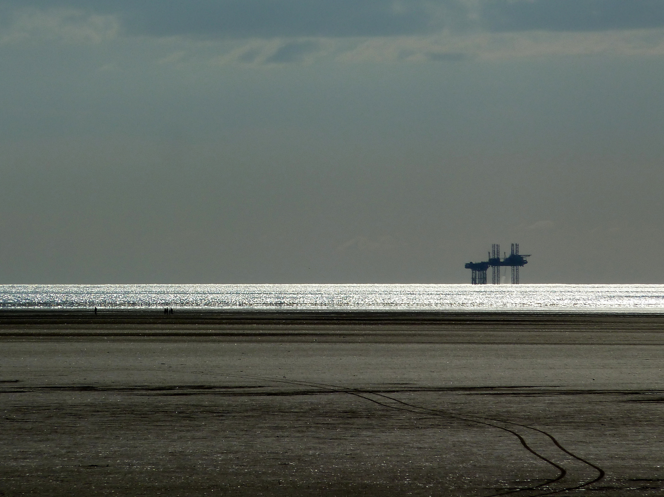
Partner
Bureau of Ocean Energy Management, Gulf of México Outer Continental Shelf Region, Office of Environment
Responsible for monitoring the environmental impacts of extraction procedures in Gulf
Image Credit: Fraser Mummery
Notes:
BOEM is a federal organization that monitors and assesses environmental impacts of mineral extraction in the Outer Continental Self of the U.S. The shelfs included under their view are Alaska, Pacific, Atlantic and Gulf of México. We are partnered with their office of environment sector in the Gulf of México which aims to maintain federal laws and regulations on leasing and extraction to ensure the most environmental and economically responsible plans are being processed for the region.
Image link : https://www.flickr.com/photos/73014677@N05/7850277748/in/photolist-cXGJ5m-8jVcsT-V7YMdM-cxgmEQ-MNWboQ-qXEMfa-TReuok-yvKn5-9YTtcu-yvKss-9A1izu-QQbgYz-6k5mMT-5HpnpX-TZ2xks-7mV2K5-bHqhM6-fZwERu-W9YPWa-V24Dbv-qjViRF-W6ycLG-qCPP5a-s8VGxo-5iVquW-ZPf4pF-suYLo3-yvKqD-tE7xFm-RZaVWF-du9nUH-98G8NB-74eSzs-6Pbf4z-Sz9STw-SfD3Qc-2BwAeD-J4rK2z-74aRG2-8gXXKS-WmWMxg-9VG3DQ-84FkB4-74dXBE-7JBmHH-iKL4X2-vQjyje-h3BHmy-YJyDz9-74eWMf (Attribution 2.0 Generic License)

Slide 4
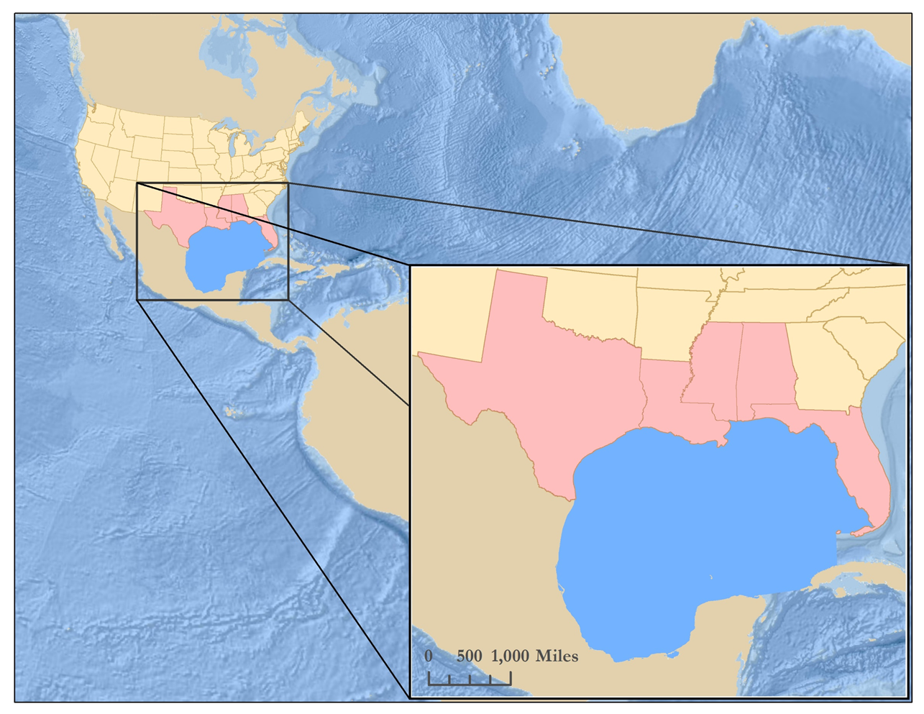
Objectives
Assess the wind and wave environment during tropical storms
Predict trends in wave height and wind speed
Calculate the correlation between wind speed and wave height
Compare the wind measurements from GYGNSS, MERRA-2, and NOAA buoy data
Assess the risk posed to energy infrastructure
TX
MS
AL
LA
FL
México
Gulf of México
United States
States of Interest
Gulf of México
Notes:
The purpose of this project was to assess the impact of tropical storms on energy infrastructure within the Gulf. The idea was to combine wind and wave data to identify areas more likely to suffer damage when tropical systems make their way through the area. A correlation between wind speed and wave height was tested. Rigs are typically damaged in category-3 and above hurricanes, so we focused on evaluating high wind speeds.
Map was created by team member Michelle De Luna

Slide 5
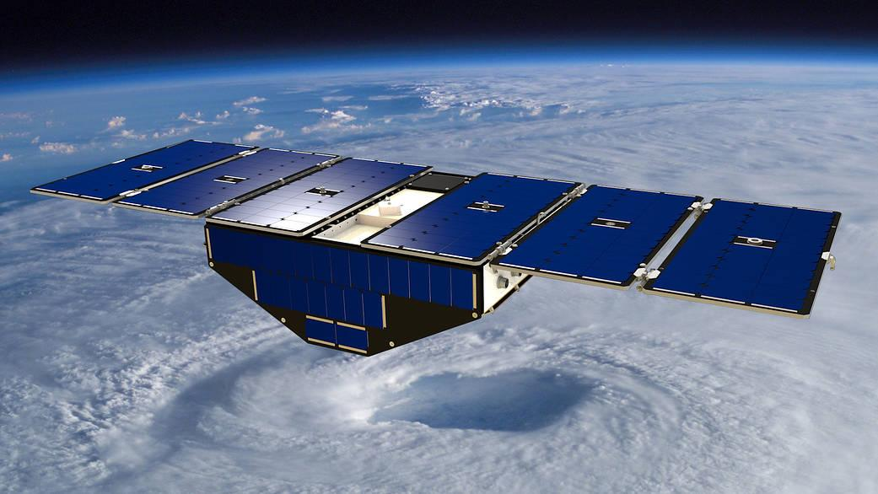
Earth Observation
Image Credit: NASA
CYGNSS – CYclone Global Navigation Satellite System
Launched in 2016
Spatial Resolution: 0.2° x 0.2°
Temporal Resolution: 3 to 7 hours
Notes:
We will be using CYGNSS which is a constellation that is a part of the Global Navigation Satellite System. For this project we are using CYGNSS because it has the ability to penetrate the eye wall of tropical systems and observe the surface below the storm. This satellite constellation is also very new so we would like to highlight the usefulness is this very recent NASA EO (March 2017). CYGNSS is very useful for our partner because it has a low return period of 2-7 hours, additionally it can reveal things about the ocean surface and conditions beneath storms that other satellites are not able to see.
Image Credit: https://www.nasa.gov/cygnss/cygnss-deployed-visualization (public domain)

Slide 6
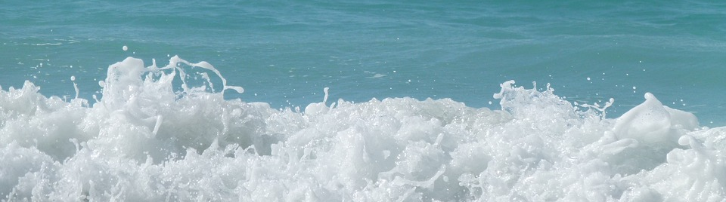
Model Data
NOAA WaveWatch III
NOAA WaveWatch III
Image Credit: U.S. Department of Energy
Image Credit: Max Pixel
Image Credit: Monet
National Oceanic and Atmospheric Administration (NOAA) WaveWatch III
Model Type: Multi-grid Hindcast
Spatial Resolution: 0.1666 x 0.1666
Temporal Resolution: 3 hours
Notes:
WaveWatch II is a product of the Marine Modeling and Analysis Branch of the NWS, Environmental Modeling Center . The team used this model because it is easily accessible via ftp and can also be downloaded and compiled to run on a personal computer, providing our partner the opportunity to use the data. Hindcast data is assembled using the model runs and the operational Global Forecast System analysis of winds at 10m height.
Image: https://www.maxpixel.net/Wave-Sea-Blue-Ocean-Ocean-Wave-Water-Ocean-Waves-2192754

Slide 7
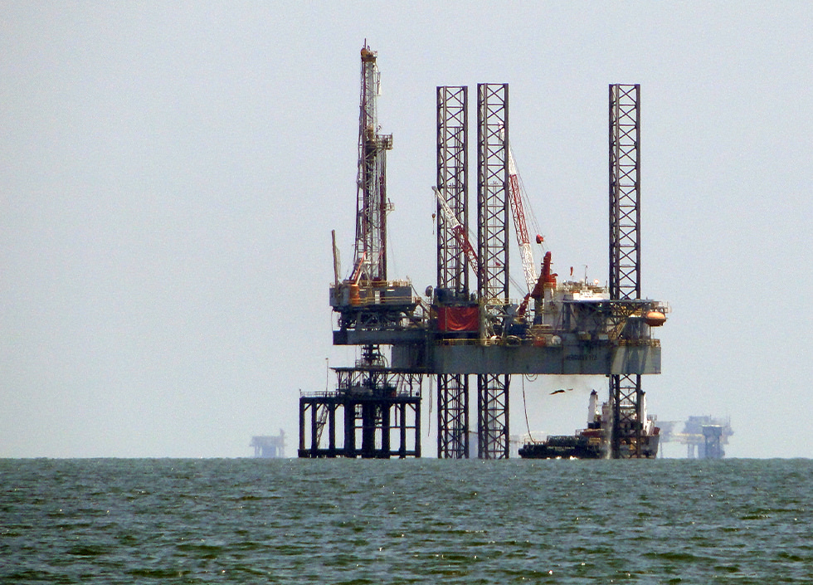
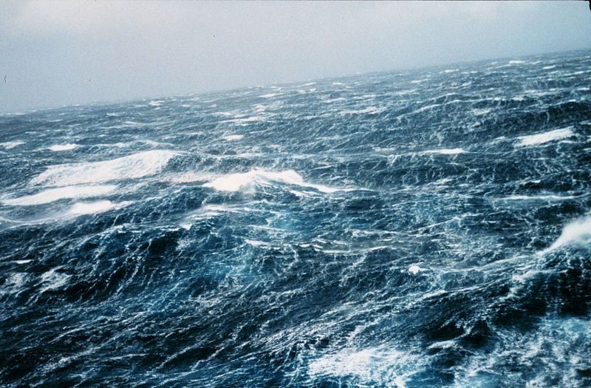
Ancillary Datasets
Offshore and Coastal Infrastructure
Wind Data and Observations
U.S. Energy Information Administration (EIA)
BOEM Geographic Mapping Data
NASA Modern-Era Retrospective Analysis for Research and Applications, Version 2 (MERRA-2) Atmospheric Reanalysis 2
NOAA National Data Buoy Center (NDBC)
Image Credit: NOAA
Image Credit: NOAA
Notes:
The team used EIA and BOEM Geographic Mapping Data to map the locations of infrastructure in the Gulf. MERRA-2 and NDBC provided wind data that the team used in combination with CYGNSS wind speeds. MERRA-2 is a reanalysis of Earth’s weather and climate using observational data with NASA’s GEOS-5 atmosphere model.
Image 1 link : https://www.flickr.com/photos/noaa_response_restoration/23923156722 (public domain)
Image 2 link : https://commons.wikimedia.org/wiki/File:Wea00816.jpg (public domain)

Slide 8
Methodology
NOAA Wave Watch
BOEM Infrastructure
NDBC Buoys
MERRA-2
CYGNSS
Wind Speed from UV Components
IDW Interpolation
Daily Average
Daily Average
Combine Wind Speed & Wave Height
Root Mean Square Error
Wind Speed Comparison
Storm Intensity Map
Infrastructure Overlay
Potential Infrastructure Map
Notes:
Data will be acquired from both NASA Earth Observatories and ancillary datasets. These include the Cyclone Global Navigation Satellite, MERRA-2, NDBC Buoy Data, and NOAA Wave Watch III. After validating altimeter (EO) data with in-situ ancillary data, rasters will be reclassified according to wind speed and wave height. Areas over the Gulf with higher raster calculator values will be deemed as being at higher risk of storm damage. The project’s end products will include 1) a storm intensity map, 2) a potential infrastructure impact analysis, and 3) a wind speed comparison.

Slide 9
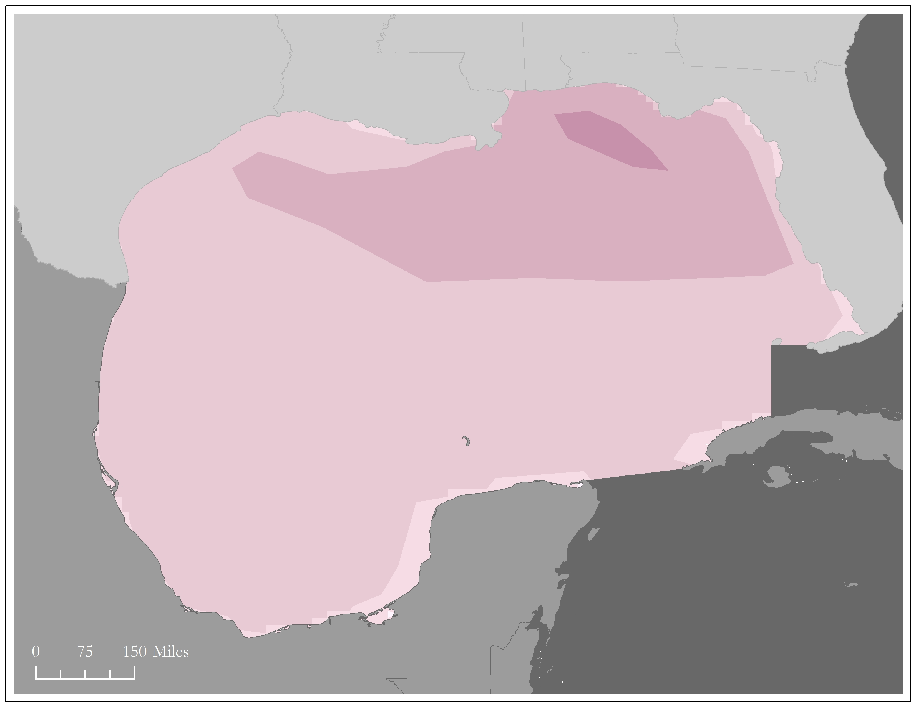
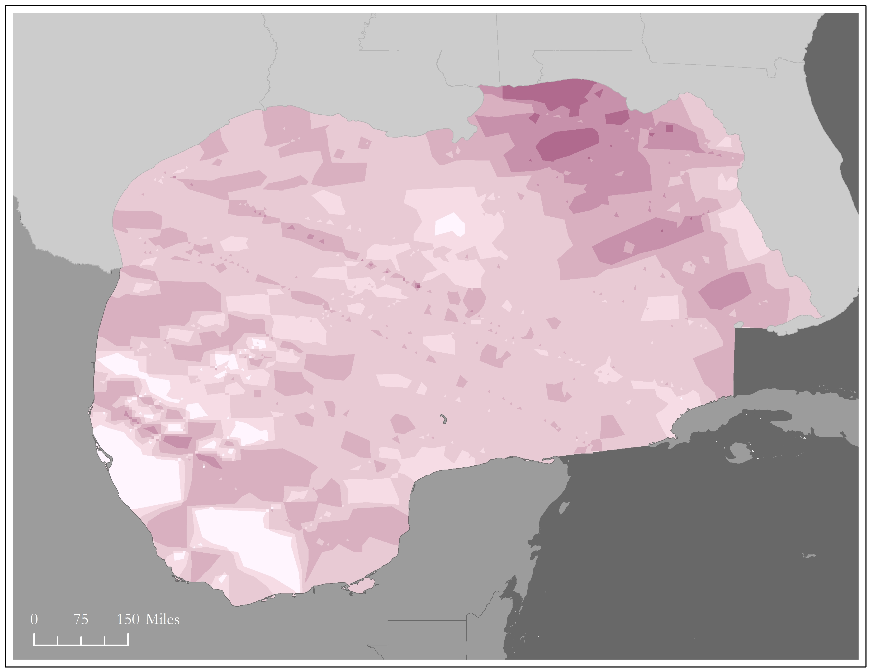
Methodology – Reclassification
Reclassified Wave Height
Douglas Sea Scale | Height (m) | Wind Speed (m/s) | Description
0 | No Waves | 0 – 0.77 | Calm (Glassy)
1 | 0 – 0.1 | 0.77 – 2.57 | Calm (Rippled)
2 | 0.1 – 0.5 | 2.57 – 4.37 | Smooth
3 | 0.5 – 1.25 | 4.37 – 6.95 | Slight
4 | 1.25 – 2.5 | 6.95 – 9.77 | Moderate
5 | 2.5 - 4 | 9.77 – 12.60 | Rough
6 | 4 - 6 | 12.60 – 19.29 | Very Rough
7 | 6 - 9 | 19.29 – 26.49 | High
8 | 9 - 14 | 26.49 – 30.61 | Very High
9 | 14+ | 30.61 – 32.92 | Phenomenal
Reclassified Wind Speed
Sea State Level
Sea State Level
1
2
3
4
5
6
Notes:
To reclassify our wind and wave data, the team used Douglas Sea Scale classifications for wave height and the typical associated wind speeds. This method was adopted from a paper that addressed passive sonar scenarios.

Slide 10
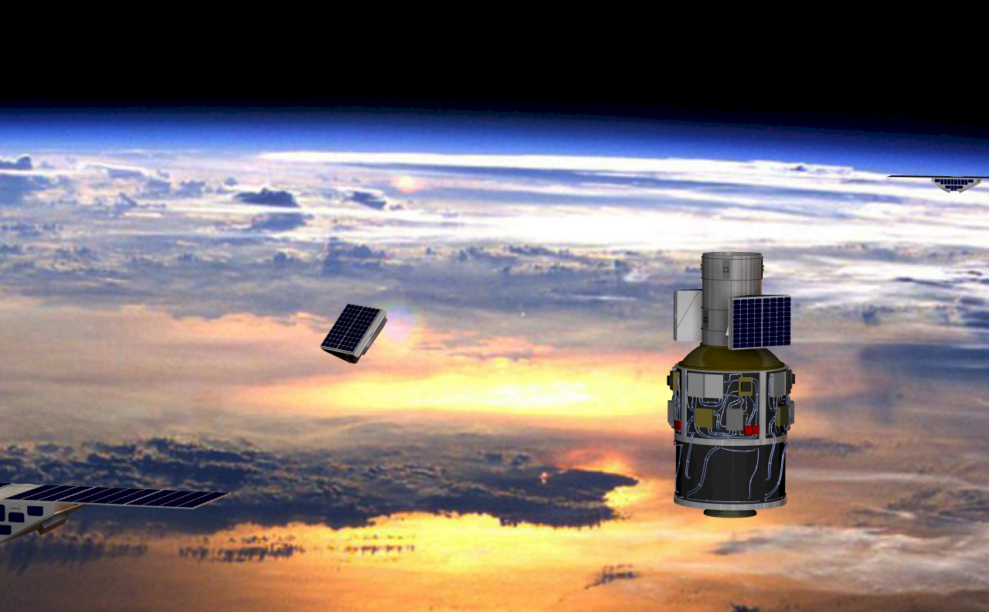
Limitations
Calibrating and validating CYGNSS is still underway
Limited number of case studies
One random sample day for each month
Wind direction and fetch
Daily averages
Image Credit: NASA
Notes:
Because of its novel status, CYGNSS is still undergoing calibration and validation. There are also multiple CYGNSS datasets in the form of Level-1, Level-2, and Level-3; choosing the right fit for particular projects is up to the team and its purpose. Also note that there was a limited number of available case-studies, i.e. tropical storms, for the 2018 hurricane season which made it necessary to study random days. Additionally, waves are not only driven by wind speed but the duration of wind and the wind direction, two factors not included in this study. Lastly, the team had to use daily averages in many of our analysis due to differences in time of observations.
Image link: https://www.nasa.gov/cygnss/the-science-of-cygnss (public domain)

Slide 11
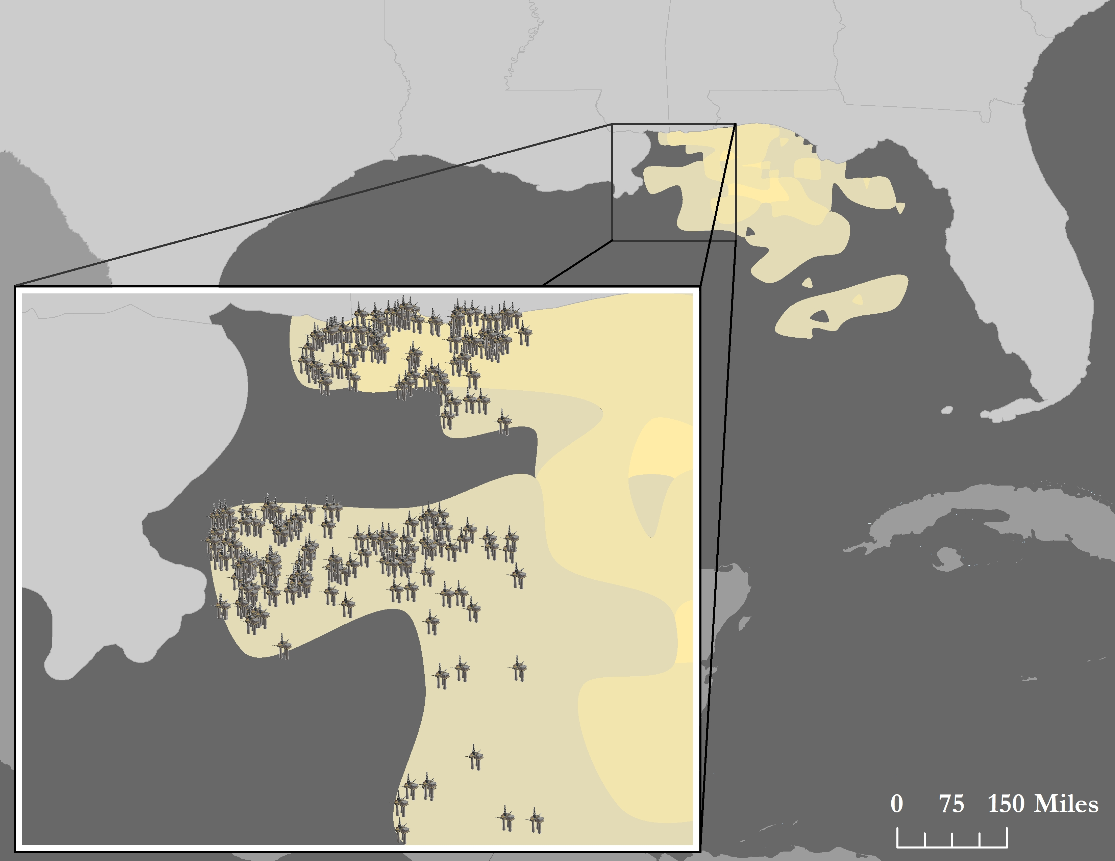
End Products
Infrastructure Risk Map (September 4, 2018)
Potential Storm Intensity Analysis
CYGNSS, MERRA-2, and buoy Wind Speed Comparison
Potential Infrastructure Risk Map
Platform
Notes:
From initial data like the one shown here for MERRA-2 wind speed on March 18th, the team produced a Potential Storm Intensity analysis, CYGNSS, MERRA-2, and buoy Wind Speed Comparison and Potential Infrastructure Risk Maps.
North arrow: http://clipart-library.com/clipart/ATbKzMqRc.htm
Image was created by team member Michelle De Luna

Slide 12
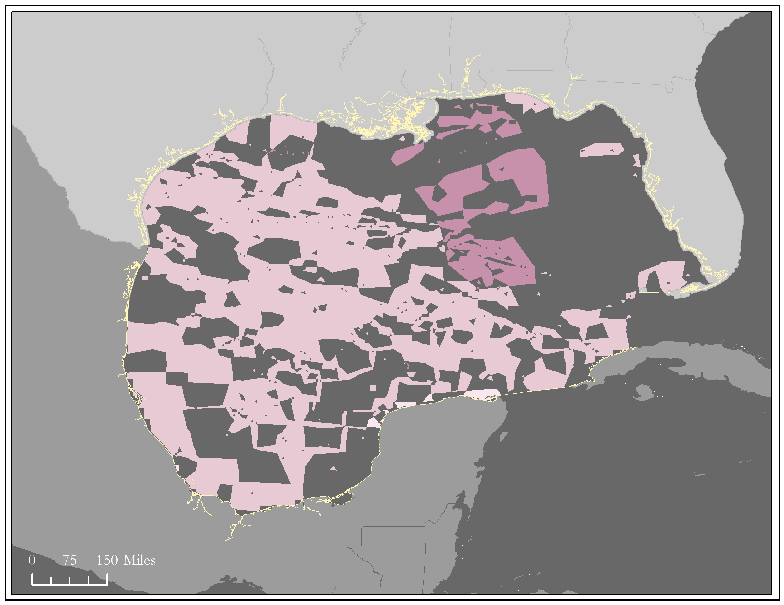
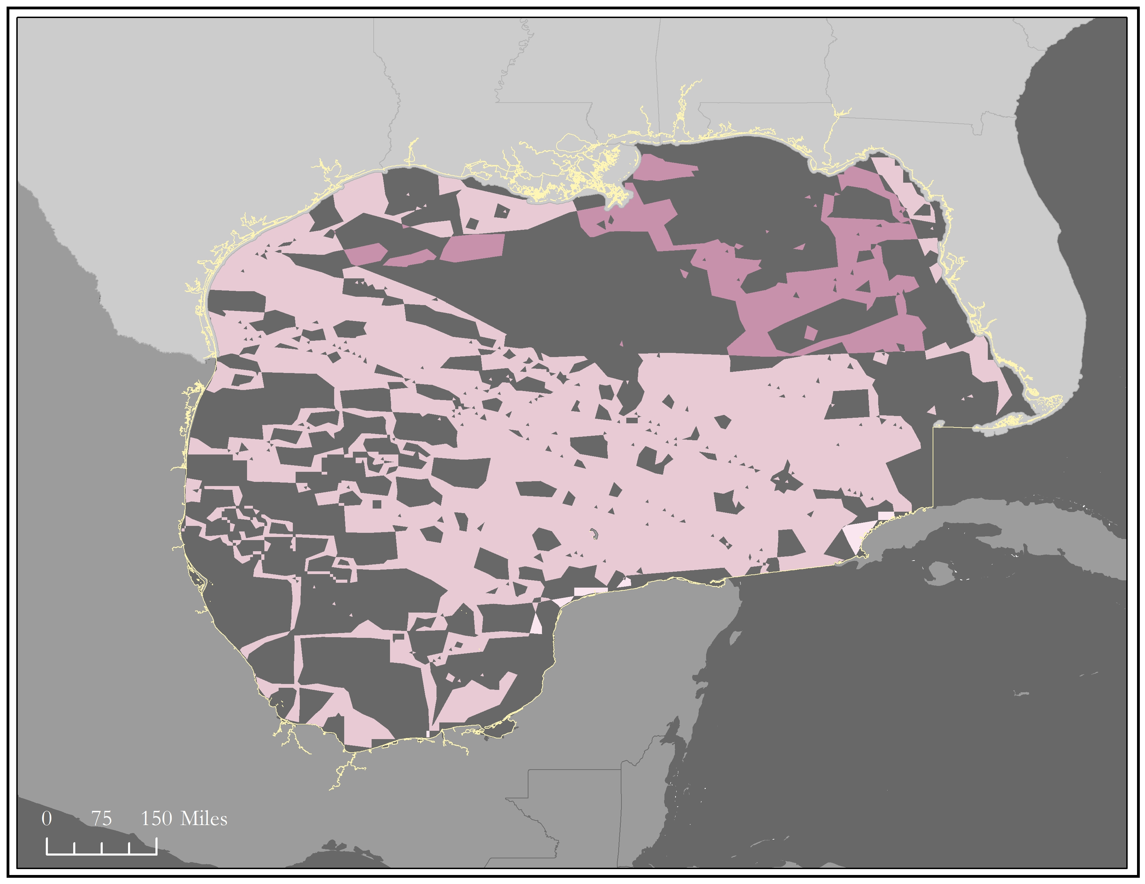
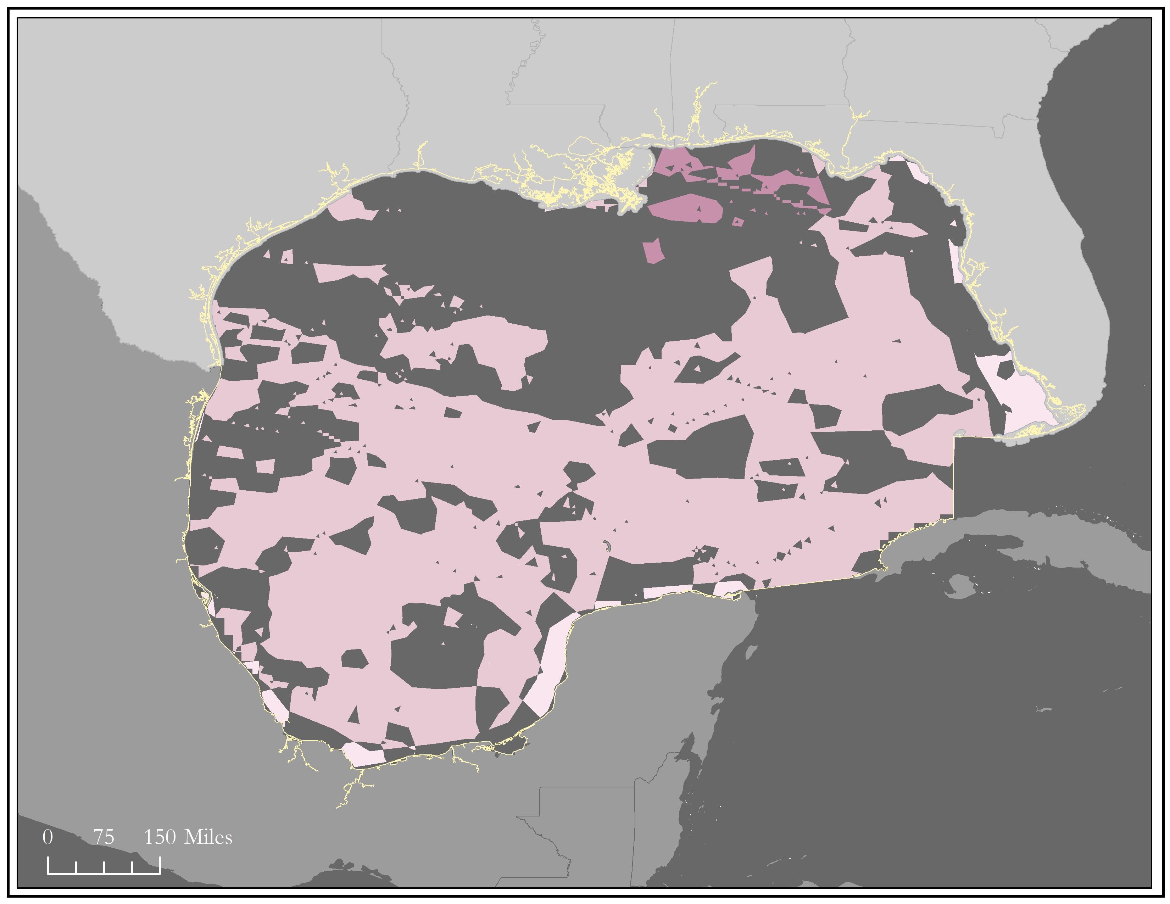
Results – Potential Storm Intensity
September 3rd
September 4th
September 5th
Sea State Level
1
2
3
4
Notes:
The images depict the overlay of our reclassified data for the most intense days of Tropical Storm Gordon. To create these maps the team matched Douglas Sea Scale level to level so we are seeing areas of 1 to 1, 2 to 2 and so on. This provides information on where the strongest winds and wave heights match, therefore areas of most intense sea state.

Slide 13
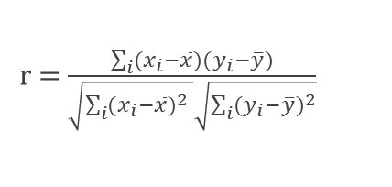
Results – Potential Storm Intensity
Date (2018) | Count of Wind measurements ≥ SSL 5* | r value (Pearson Correlation) | Maximum wave height (m)
September 2 | 135 | .372 | 1.17
September 3 | 133 | .253 | 1.48
September 4 | 245 | .731 | 3.66
September 5 | 53 | .441 | 4.96
r = $\frac{\sum_{i}{(x_{i}−\overline{x})(y_{i}−\overline{y})}}{\sqrt{\sum_{i}{{(x_{i}−\overline{x})}^{2} }}\sqrt{\sum_{i}{{(y_{i}−\overline{y})}^{2}}}}$
*SSL= Sea State Level
*SSL 5 = 9.77- 12.60 ms⁻¹
Notes:
If you would recall back to our reclassification scale that sea state level of 5 is correlated with winds of 9.77 m/s to 12.60 m/s. Our team focused on winds in this area and greater because the sea in this range is becoming rough and wave heights can have an impact on infrastructure. Approaching the 4th of September we see the maximum wave height increasing and the count of wind speeds remaining about constant. On the 4th, the day infrastructure is most impacted, CYGNSS recorded 245 wind measurements associated with SSL 5 and above. Additionally, the maximum wave height is now in the rough category. Moving into the 5th, wind measurements decrease but wave height maximum reaches very rough sea state. When Gordon is fully in the Gulf, the correlation is also the greatest.

Slide 14

Results – Comparison (RMSE)
Date (2018) | MERRA-2 RMSE* | CYGNSS RMSE*
March 18 | .47 | .96
April 26 | 1.35 | 1.90
May 28 | 2.50 | 2.36
June 19 | 2.22 | 3.60
July 24 | 1.74 | 2.70
August 11 | 1.26 | 2.43
RMSE = $\sqrt{\frac{\sum_{I=1}^{n}{{({predicted}_{i}−{actual}_{i})}^{2}}}{N}}$
*RMSE: Root Mean Square Error
Notes:
The root mean square error describes how concentrated the data is around a line of best fit. For these calculations, our “observed” values were our buoy wind speeds while our predicted values were either MERRA-2 or CYGNSS wind speed values. The RMSE values show that every month except March has values that lie far from the regression line. Desired RMSE lie between 0 and 1. This means that actual value observed from buoy’s does not predict the values from MERRA-2 and CYGNSS well. September buoy data had not become available by the time of this presentation so our random September day has been excluded.

Slide 15

Results – Validation (Percent Difference)
Date (2018) | MERRA-2 wind speed (m/s) | CYGNSS wind speed (m/s) | Average Percent Difference
March 18 | 3.96 | 4.62 | 15.23
April 26 | 3.24 | 4.55 | 33.42
May 28 | 4.96 | 6.52 | 27.3
June 19 | 5.33 | 7.14 | 28.92
July 24 | 4.32 | 5.23 | 18.99
August 11 | 4.62 | 5.76 | 22.01
September 25 | 3.95 | 5.85 | 38.71
Percent difference= $\frac{\left|actual−observed\right|}{\frac{actual+observed}{2}}$
Notes:
Using MERRA-2 and CYGNSS average wind speed for each randomized day the team calculated the percent difference in order to compare the two products. We do want to note that May 28th does actually overlap with Sub-tropical Storm Alberto. Percent difference here is the absolute value of the difference between the two values divided by the average of the values. Note that the results do reflect high values of difference and therefore, the wind values do not compare.

Slide 16
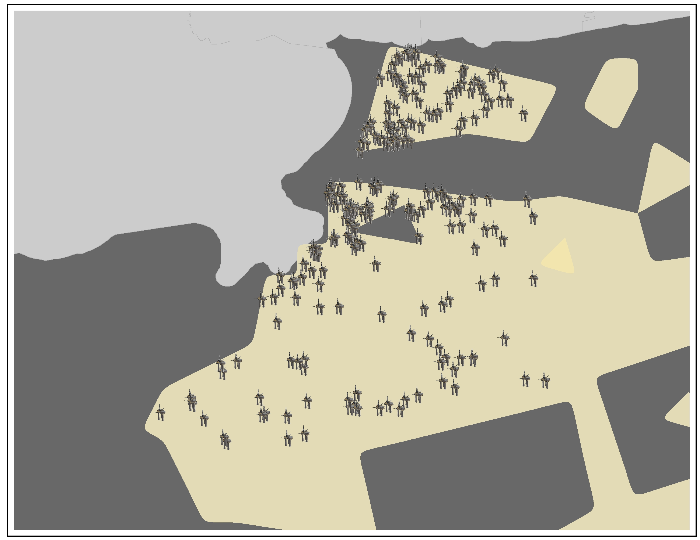
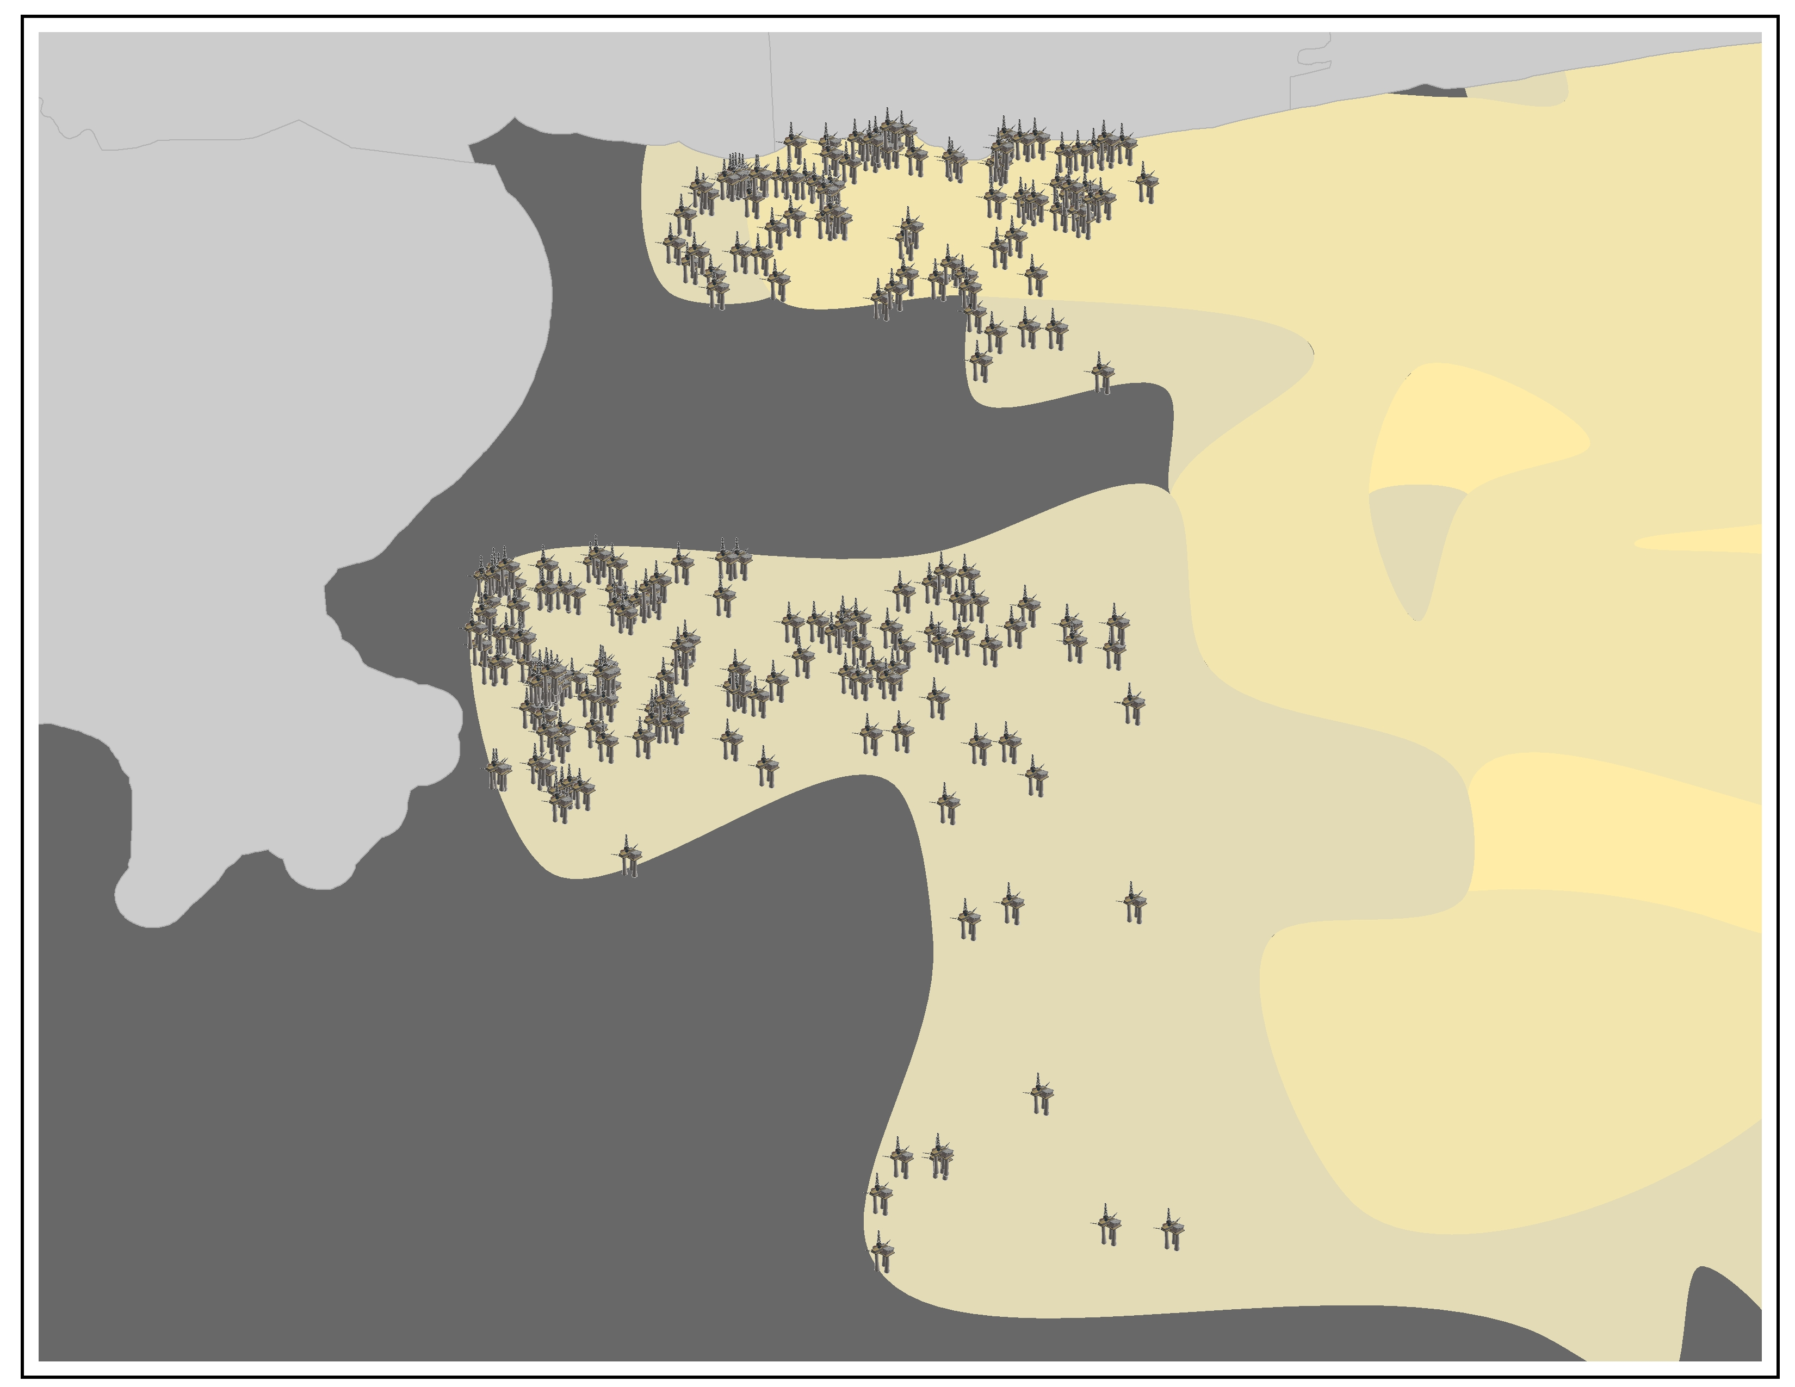
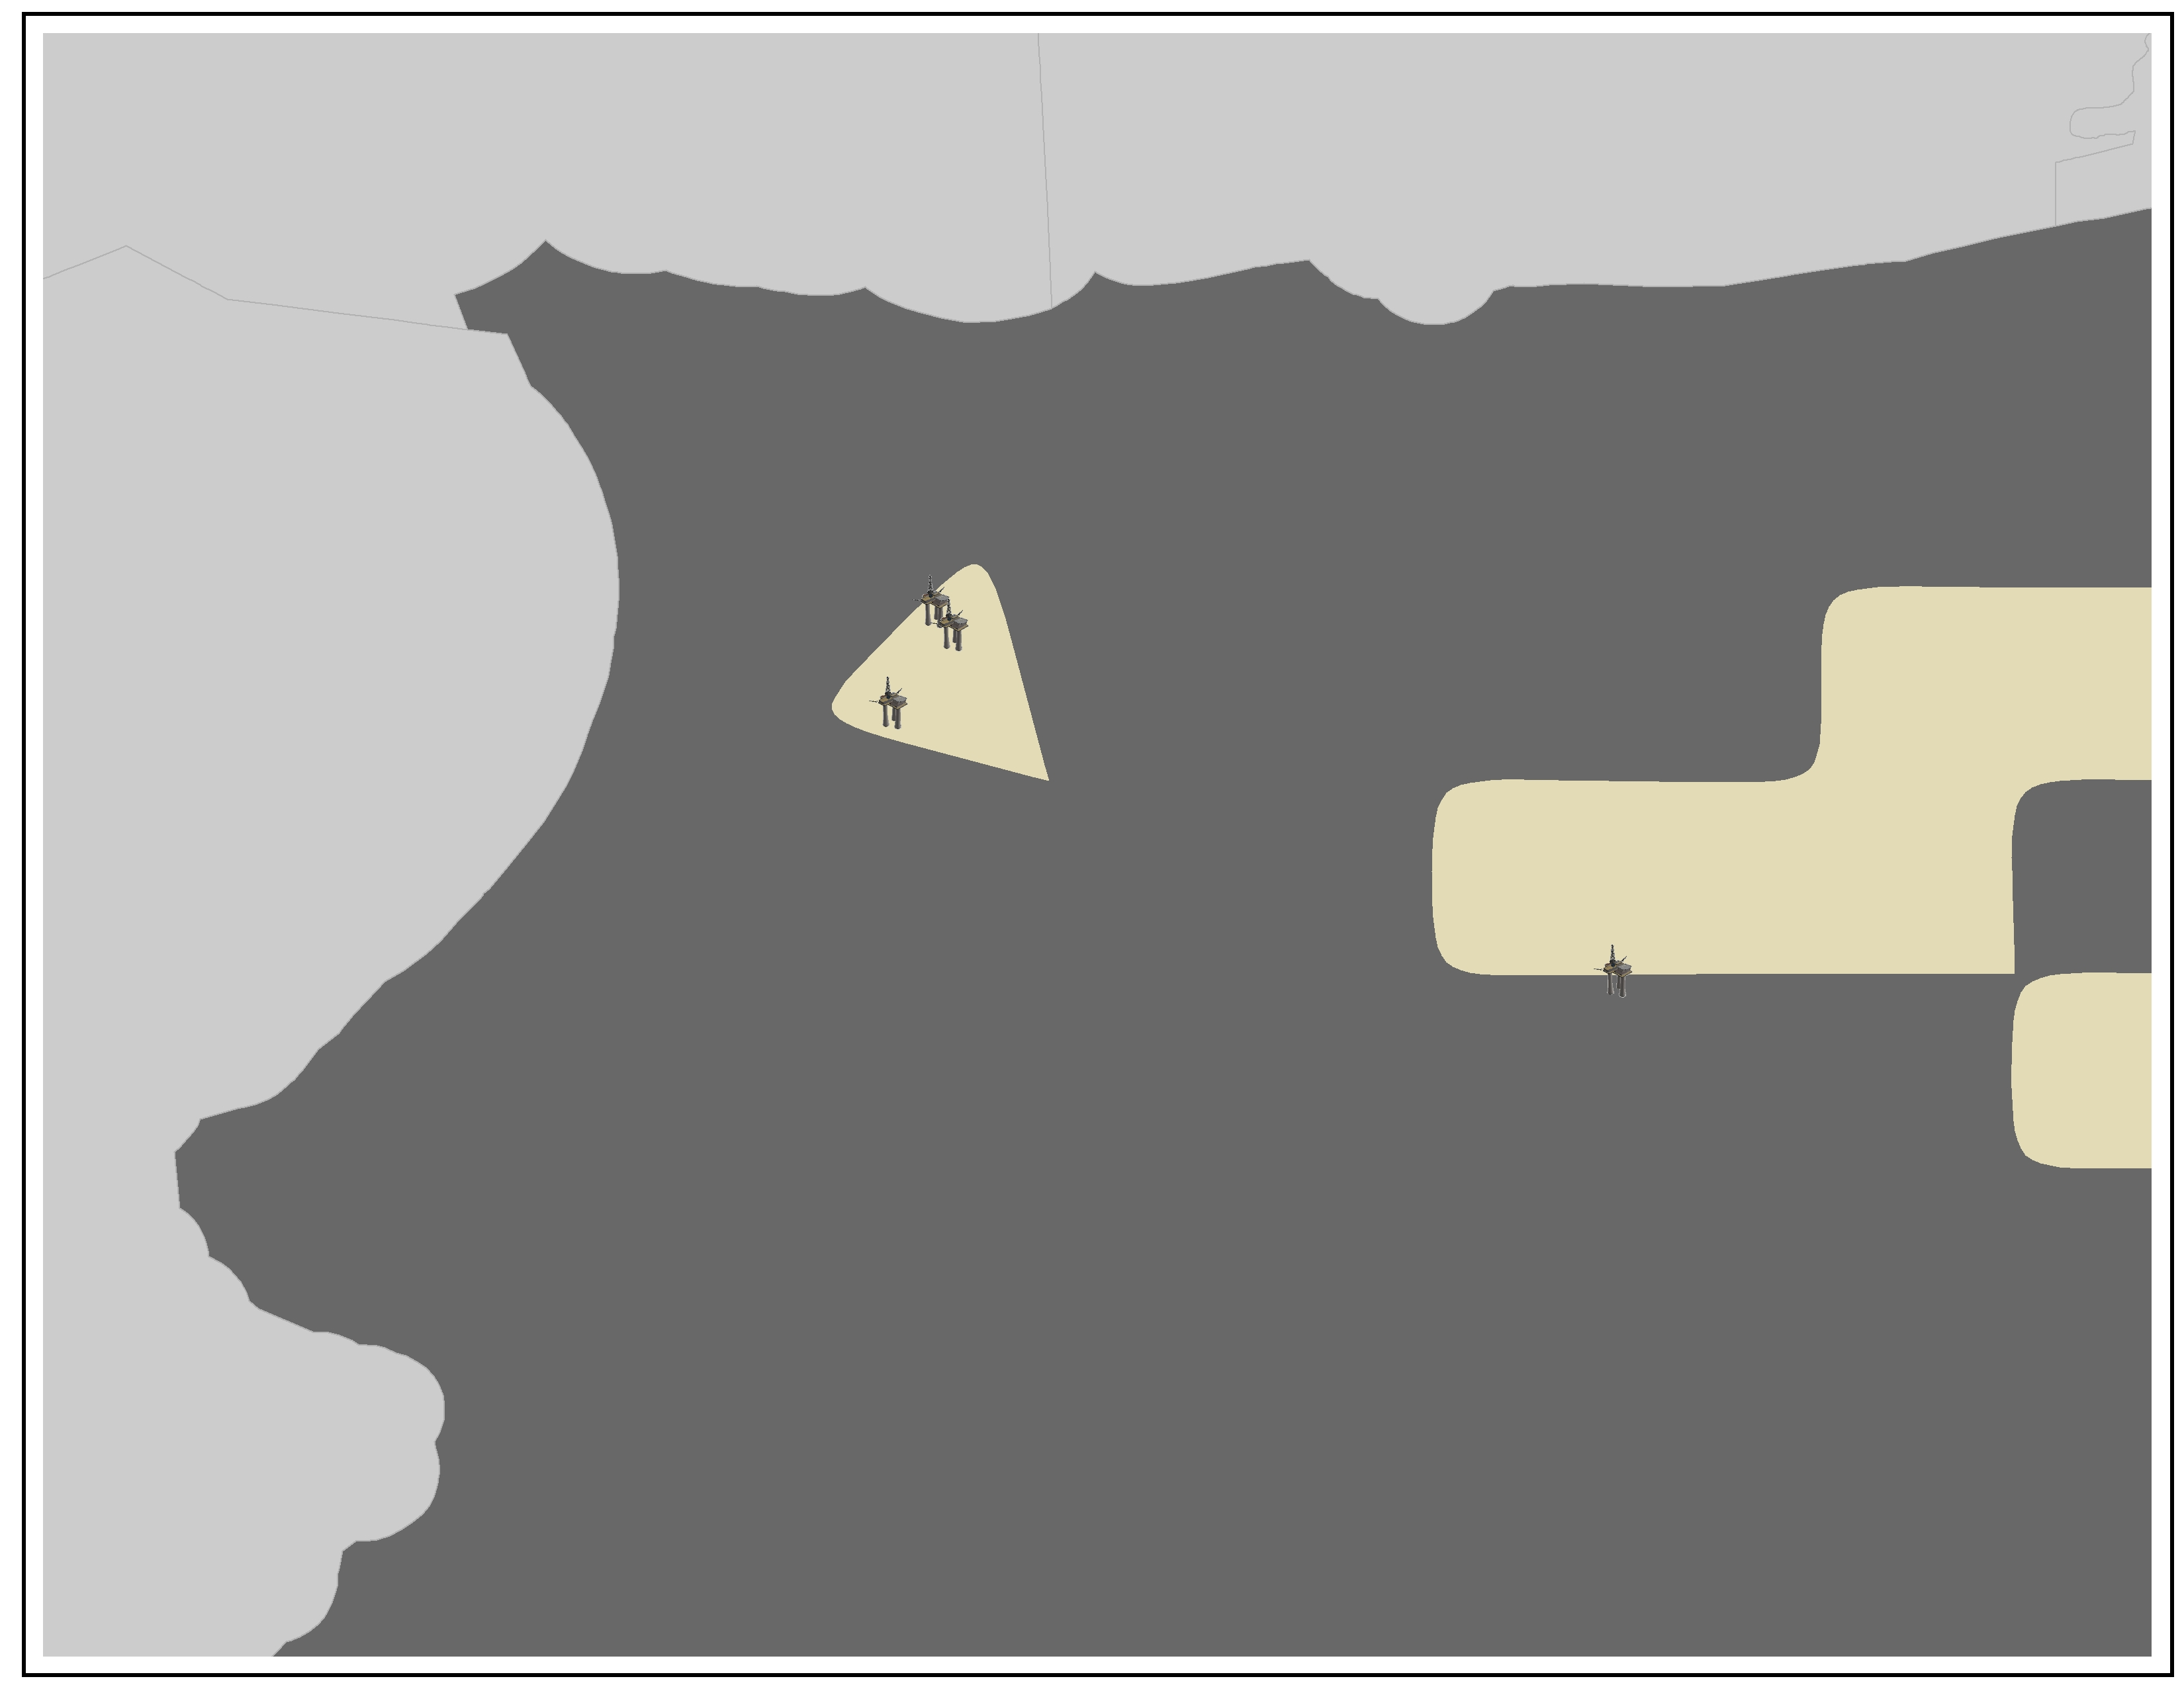
Results – Potential Infrastructure Risk
September 4th
September 3rd
September 5th
Strong
Strongest
Notes:
The images depict an addition of our raster value for Tropical Storm Gordon. Darker hues of yellow represent areas of strong over lap while lighter yellows show areas of the strongest over lap. The landfall of Gordon in the US can be clearly see in these maps with the third depicting increased susceptible area, the fourth the most area and the fifth little to no area. The addition of our sea state reclassification values are useful because we can still see the impact of winds and waves even when they are not in the same sea state classification.

Slide 17
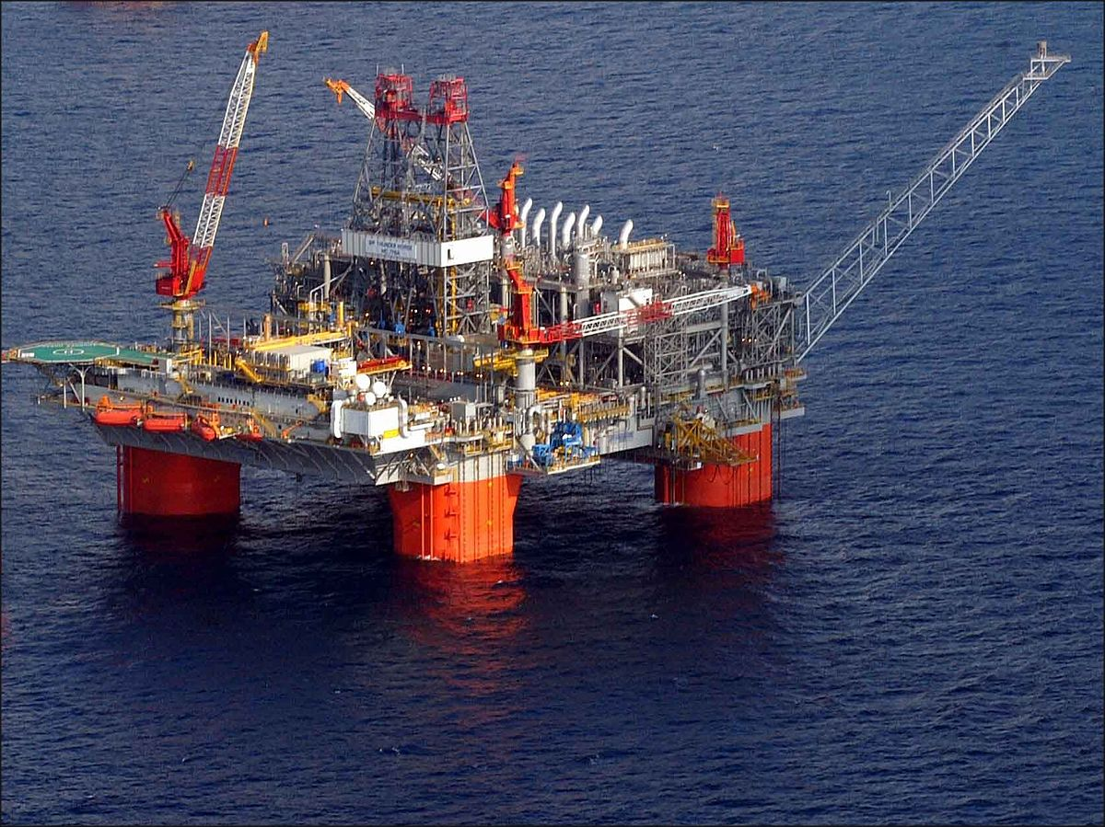
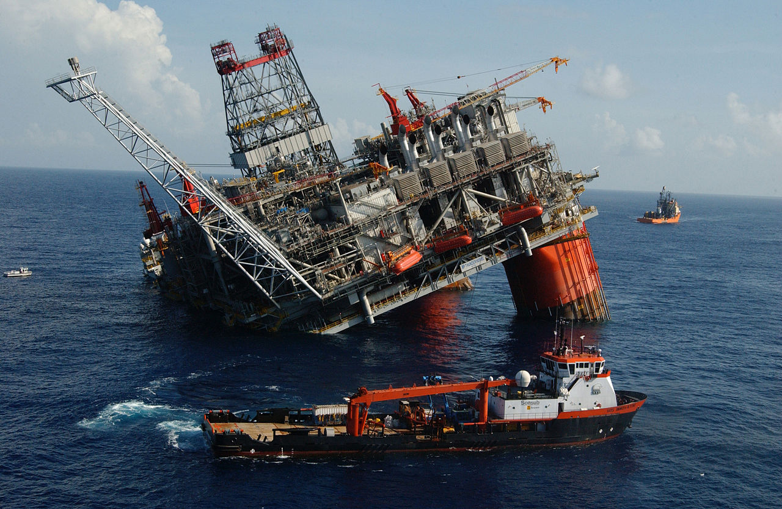
Conclusions
Products can be used to identify areas of risk; this can mitigate the economic and environmental impact of hurricanes in the Gulf.
CYGNSS wind speeds are faster than MERRA-2; our random study period showed a difference ranging from 15.23% to 38.71%.
CYGNSS wind speeds tend to increase in error during tropical storm events.
Areas of increased wind speed correlate with areas of increased wave height.
Image Credit: Andyminicooper
Image Credit: Robert M. Reed
Notes:
The maps provided in this study will identify areas of increased susceptibility to storm damage in the Gulf. They will provide BOEM with the necessary tools they may need to mitigate the economic and environmental impacts that hurricanes may have on the study area. This projects demonstrates the wide-ranging applications of NASA EOs like CYGNSS to address community concerns and encourages further research into the field of transportation and infrastructure.
Andyminicooper
https://commons.wikimedia.org/wiki/File:Thunder_Horse_Semisub.jpg (CC BY-SA 3.0)
Robert M. Reed
https://en.wikipedia.org/wiki/Thunder_Horse_PDQ#/media/File:HURRICANE_DENNIS_DVIDS1077691.jpg (public domain)

Slide 18
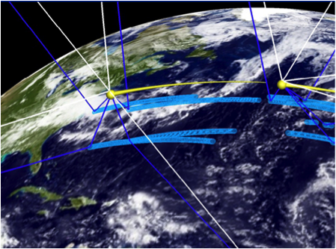
Future Work
Storm intensity forecasting using CYGNSS data
Improved validation of CYGNSS data in other tropical regions
Research on hurricane impacts to marine and coastal life
Image Credit: NASA
Notes:
As CYGNSS validation is still underway, replicating this project in other areas of the tropics would help to further validate CYGNSS. For example, other projects that could be conducted using similar parameters and methods as this project could be looking at the effects of hurricanes on marine and coastal life. Additionally, intensity forecasting of forming storms using CYGNSS wind speed data would aid in the accuracy of current models.
Image link: https://www.nasa.gov/larc/eight-little-satellites-to-take-a-new-look-into-hurricanes (public domain)

Slide 19
Acknowledgements
Dr. Jeffrey Luvall, NASA Marshall Space Flight Center
Dr. Robert Griffin, University of Alabama in Huntsville
Dr. John Mecikalski, University of Alabama in Huntsville
Dr. Xuanli Li, University of Alabama in Huntsville
Dr. Timothy Lang, NASA Marshall Space Flight Center
Dr. Brent Roberts, NASA Marshall Space Flight Center
Greg Kozlowski, BOEM Gulf of México OCS Region, Office of Environment
Helen Baldwin, NASA DEVELOP
Kathrene Garcia, NASA DEVELOP
Maggi Klug, University of Alabama in Huntsville
Leigh Sinclair, University of Alabama in Huntsville/Information Technology and Systems Center
Notes:
Special thanks to those who have contributed to the success of our project!

Slide 20
Extra Slides
Notes:
The team will upload an in-depth image of the statistical analysis mentioned in the previous slide.

Slide 21
Results
Actual vs. Predicted Wind Speed Values
(March 18, 2018)
BUOY (m/s) | MERRA-2 (m/s) | CYGNSS (m/s)
6.681 | 6.43249 | 6.570542
5.029 | 4.998 | 5.945792
4.265 | 3.84951 | 5.671929
3.0625 | 3.28667 | 4.184397
1.67 | 1.72726 | 0.896985
4.459 | 3.44036 | 3.679841
4.656 | 4.78833 | 5.156245
2.906 | 2.1571 | 2.491731
3.041 | 3.35675 | 4.090001
5.341 | 4.72545 | 5.645238
5.651 | 3.43811 | 3.802121
3.633 | 3.89341 | 6.082355
4.76 | 4.66312 | 5.045732
5.4875 | 4.73439 | 5.376431

