Slide 1
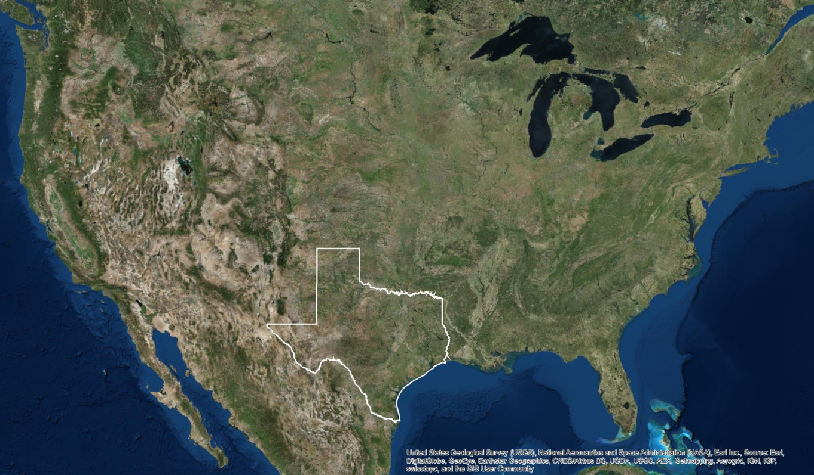
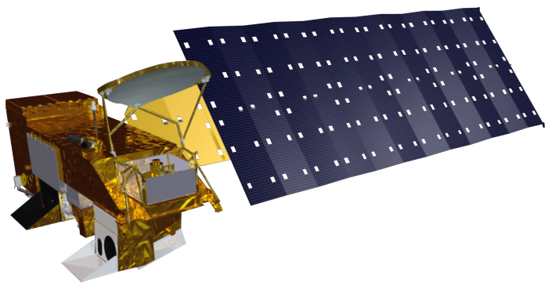
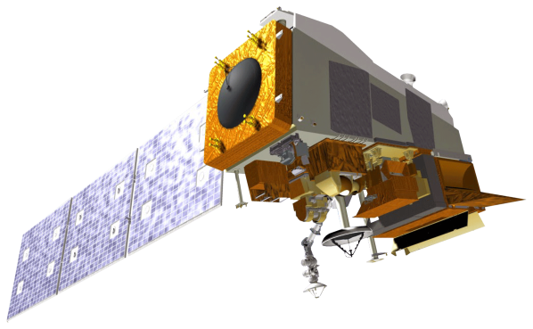
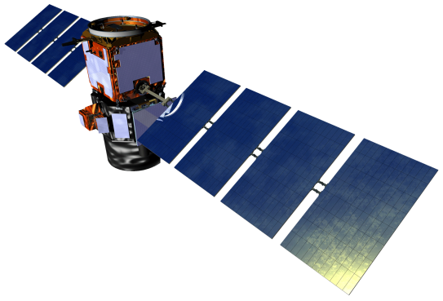
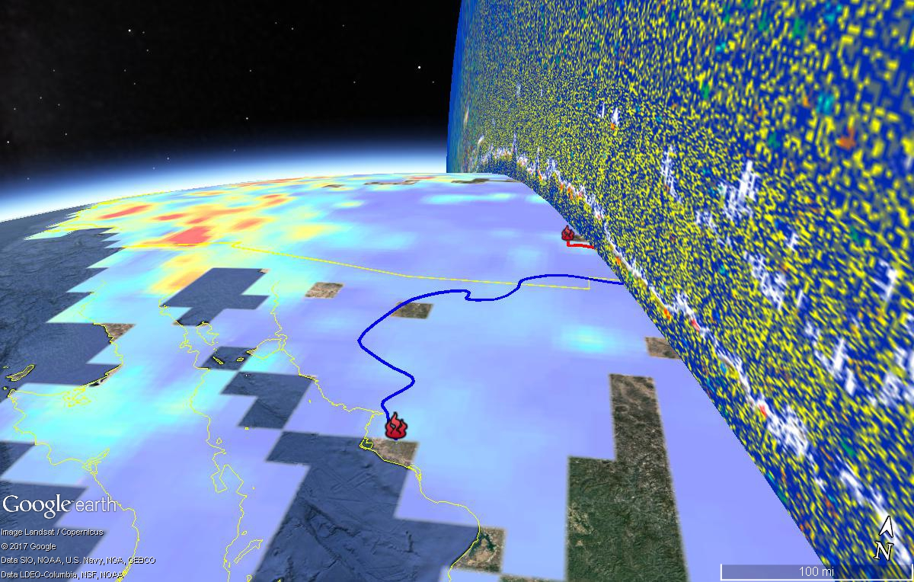
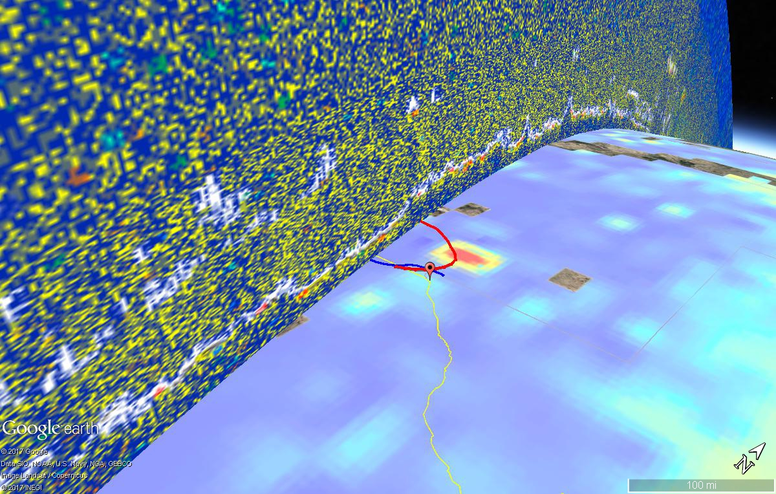

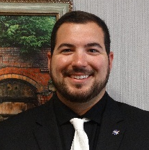

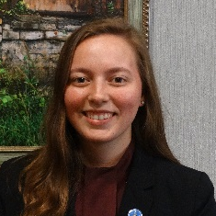

Monitoring Exceptional Air Pollution Events in Texas using NASA Earth Observations
Abstract
Objectives
Wildfires in the U.S. have the potential to impact not only the areas of origin, but also surrounding states. This is especially important for Texas, which is surrounded by wildfire-prone areas. Smoke plumes from wildfires travel across the state with trajectories that are greatly influenced by meteorological conditions. The plumes transport pollutants, which include those present in the ambient atmosphere, like volatile organic compounds and nitrous oxides, as well as those produced by wildfires, like aerosols. Aerosols have several negative effects on the environment and human health. Smoke plumes have the potential to negatively impact numerous lives when meteorological conditions allow them to reach highly populated metropolitan areas. For these reasons, the U.S. Environmental Protection Agency (EPA) has set standards to regulate the levels of these pollutants in the atmosphere. Observations from field monitors assist the Texas Commission on Environmental Quality (TCEQ) in ensuring that these standards are met. When these standards are exceeded, the TCEQ can claim an exceptional event, but it is often difficult to use in situ data alone to trace the origins of the pollutants that caused this. This project used data from Terra MODIS and CALIPSO CALIOP to observe the aerosol optical thickness and vertical composition of plumes, respectively, and to perform 3-D spatial temporal plume tracking. Thermal anomaly maps from Suomi NPP VIIRS were used for fire detection. The products of this project helped the TCEQ observe wildfire smoke plumes and monitor the origin, transport, and deposition of wildfire aerosols.
Use Terra MODIS, CALIPSO CALIOP, and Suomi NPP VIIRS to track aerosols from wildfire smoke plumes around dates specified by the TCEQ
Monitor aerosol concentration and distribution within the plumes as they move from source to destination
Provide a 3-D aerosol transport map to track aerosol deposition in Houston and El Paso, Texas
Assist the TCEQ in locating the origins of aerosols that cause air pollution events
Study Area
Methodology
El Paso
Observe vertical profile of smoke plume using CALIPSO CALIOP data
N
Houston
Track the aerosol movement across Texas using Terra MODIS data
Resample Level 3 data to finer spatial resolution using ArcMap
Earth Observations
3-D Aerosol Transport Map
Terra
Suomi NPP
CALIPSO
Locate fires using the I-band on Suomi NPP VIIRS
Compute forward and backward air parcel trajectories using HYSPLIT
Project Partner
Texas Commission on Environmental Quality (TCEQ), Air Quality Division
Texas Health & Air Quality
Results
Identify possible wildfire signatures using in situ data
CALIOP vertical profile
Conclusions
A combination of in situ ozone and PM 2.5 measurements, HYSPLIT backward and forward trajectories, and Suomi NPP VIIRS thermal anomalies facilitates identification of wildfires that cause air pollution events.
The School Fire and Black Range Complex Fires in New Mexico and agricultural biomass burning in Mexico are potential contributors to the air pollutant exceedance in El Paso, TX on July 16, 2016.
The 3-D aerosol transport map produced can be used by the TCEQ in exceptional event reporting for El Paso, TX on July 16, 2016.
Terra MODIS and CALIPSO CALIOP, while limited in their spatial and temporal resolution, provide a basis for creating 3-D maps to track aerosol transport from wildfires to cities.
The restricted spatial and temporal resolution of Terra MODIS and CALIPSO CALIOP data prevent definitive conclusion that these fires caused the exceedance. Additional in situ and meteorological datasets should be consulted for more certainty in exceptional event reporting.
wildfire
agricultural burning
HYSPLIT forward trajectory
MODIS AOD
HYSPLIT forward trajectory
El Paso, TX
Team Members
Acknowledgements
Dr. Kenton Ross, NASA Langley Research Center
Dr. DeWayne Cecil, NOAA National Center for Environmental Information, Global Science & Technology, Inc.
Bob VanGundy, The University of Virginia’s College at Wise
Dr. Travis Knepp, NASA Langley Research Center
Dave Westenbarger, Texas Commission on Environmental Quality
Eric White
Team Lead
Kannikha Kolandaivelu
Brooke Colley
Audrey Odwuor
Wise County Clerk of Circuit Court’s Office – Summer 2017

