Slide 1
DEVELOP National Program
[Project Title]
[Node]
sUMMER 2017
WEBSITE & CREATIVE Imagery

Slide 2
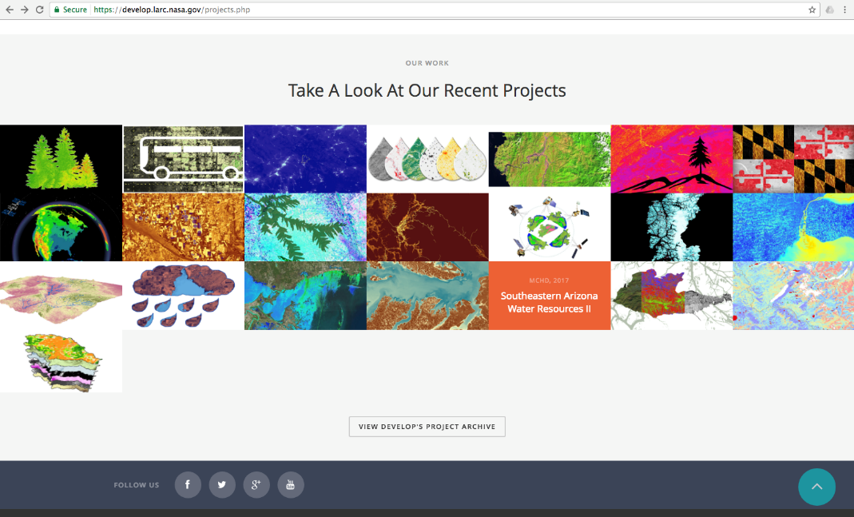
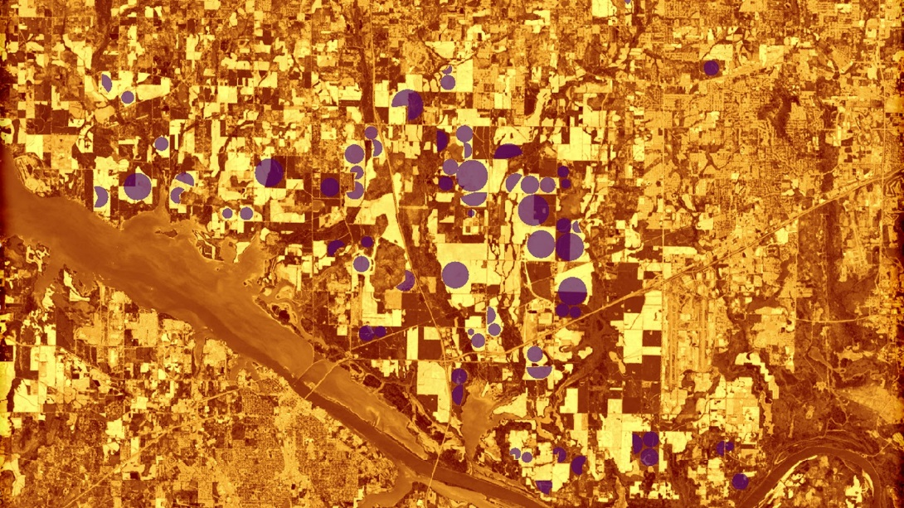
Purpose: What is a Website Image?
This image should be an attractive, processed image of your study area that will be used to represent the project. This image will be used as a cover image on the project page of the DEVELOP website, project image on NASA’s Applied Sciences eBooks website, Summer Booklet image, and as Earth imagery that can be used by DEVELOP’s graphic design team for future publications and promotional materials.
1920 px
1080 px
Delete this slide upon submission.

Slide 3
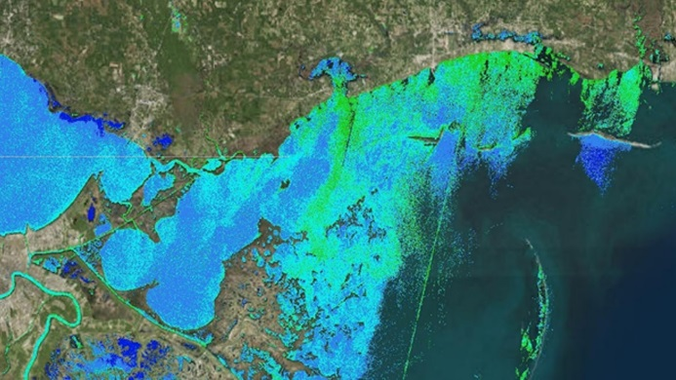
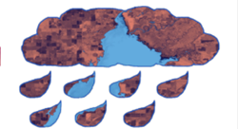
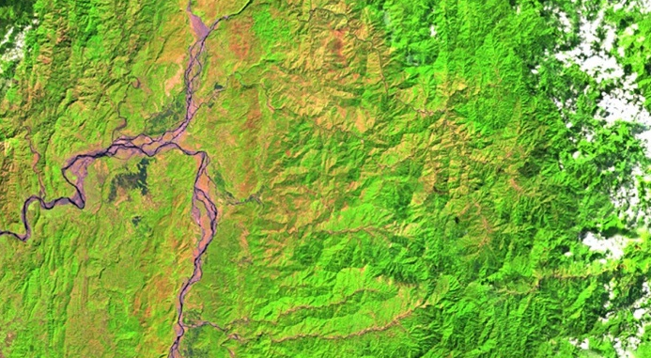
Website Image Checklist: Requirements
High-resolution, 1920 x 1080 (over 300 dpi) – landscape orientation
Entire frame is filled with imagery. No white space.
Saved as a JPEG or PNG
Text, legends, etc. must be separate items that are typed and created in PowerPoint. (No imported legends or text)
No images that are clipped to a shape (see center example)
Map resources available on DEVELOPedia
Image is derived from NASA sensor data
Not from an outside source
No a photographs
Exception: NCEI projects using CDRs
At least one image provided is derived from recent data (2016-2017)
Some kind of processing has taken place
Not just a raw satellite image or simple re-order of
spectral bands
The team actually created the image - NO outside
content included
For examples: https://develop.larc.nasa.gov/projects.php
Delete this slide upon submission.

Slide 4
Delete this box and place Website Image here.
Project Short Title Here
Caption: Image description. 25 word limit.
Metadata Tags: List any keywords, or project participant names that you would like included in the photo’s metadata.

Slide 5
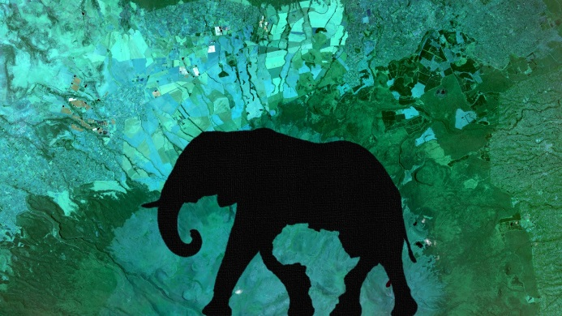
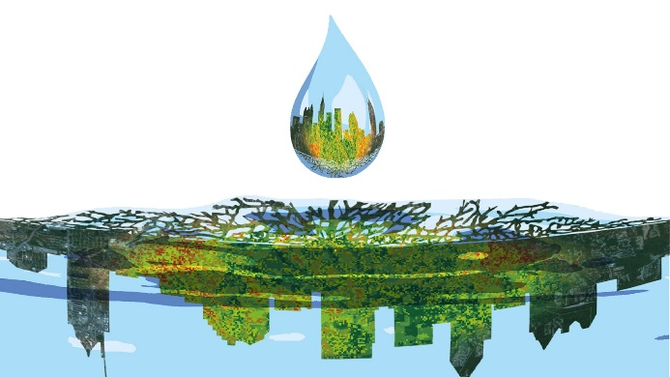
Creative Image Checklist: Optional
The Creative Image is an optional deliverable that teams can create and submit, in addition to the required Website Image. This is a great opportunity for teams to use their creativity to develop a visual representation of their project. This image follows many of the same requirements as the Website Image, with some minor, more flexible adjustments, listed below:
High-resolution 1920 x 1080 (over 300 dpi) – landscape orientation
White background
Saved as a JPEG or PNG
Image description in template description area
Image is derived from NASA sensor data
Not from an outside source
No photographs
Exception: NCEI projects using CDRs
At least one image provided is derived from recent data (2016-2017)
Some kind of processing has taken place
Not just a raw satellite image or simple re-order of spectral bands
Limited clipped shapes. Be mindful of shapes that could represent political, religious, or culturally offensive symbols.
Must be created by the team. NO outside content allowed.
Delete this slide upon submission.

Slide 6
Delete this box and place Creative Image here.
Project Short Title Here
Caption: Image description. 25 word limit.
Metadata Tags: List any keywords, or project participant names that you would like included in the photo’s metadata.

Slide 7
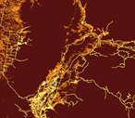
This image is cohesive and can be clipped into many shapes. The graphic design team often uses DEVELOP project imagery for brochures and flyers that need to fill creative spaces.
The image is already shaped and has white space. It cannot be easily clipped into other shapes.
Website & Creative Imagery
Further Usage Explanation
Website Images need to fill the entire space within the 1920 x 1080 frame. These examples illustrate two previous Website Images that have been submitted. Both images are attractive and useful to the program, but serve different purposes.
The fully-framed image can be placed into artistic shapes, but the clipped image cannot. The Graphic Design Team often uses Website Imagery this way, as displayed in slide two.

