Slide 1
Near Real-Time Southern Pine Beetle Susceptibility Model Guide
NASA DEVELOP National Program
Alabama Ecological Forecasting
Spring 2016
Ryan Schick, Kelsey Herndon, Maggi Klug, Leigh Sinclair

Slide 2
1. Move NRTSPBSM folder to desktop
In the flash drive given to you, move the ‘NRTSPBSM’ folder to your desktop by simply dragging it.

Slide 3
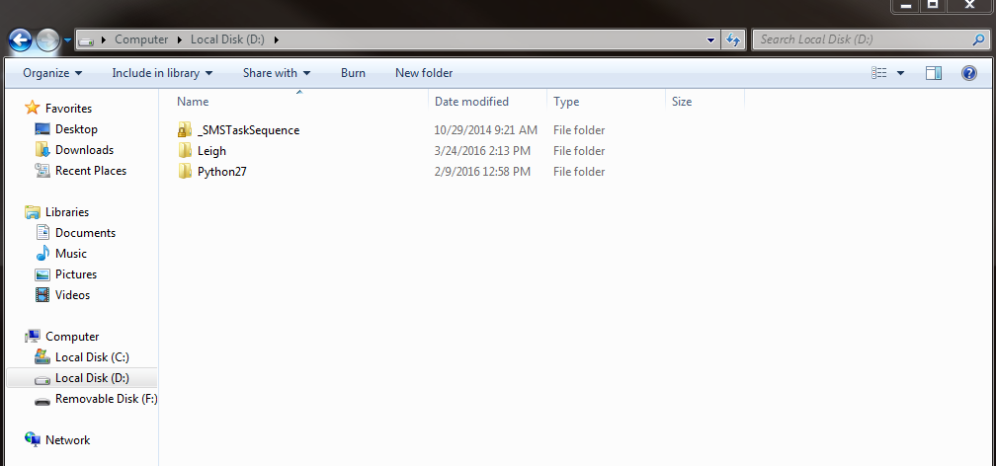
2. Delete python libraries
Click the ‘Start’ button at the bottom left corner of the desktop screen
Press ‘Computer’
Double-click on ‘Local Disk’
Double-click on ‘Python27’

Slide 4
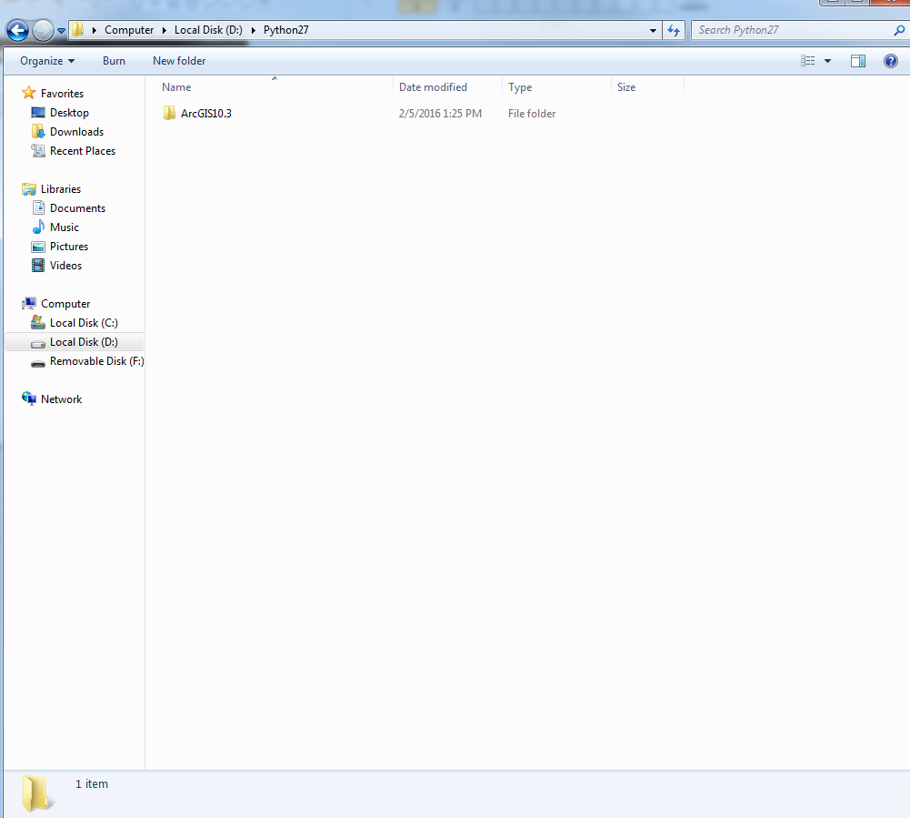
2. Delete python libraries – con’t
Double-click on the most up-to-date ArcGIS folder
For example, if you have an ‘ArcGIS10.2’ and ‘ArcGIS10.3’ delete ‘ArcGIS10.2’

Slide 5
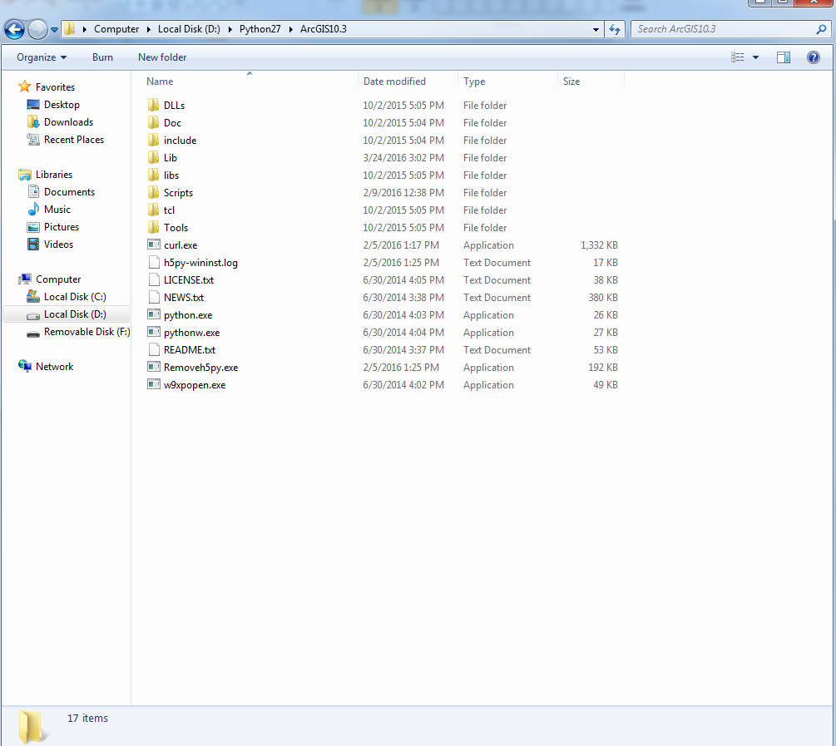
2. Delete python libraries – con’t
Double-click ‘Lib’ folder

Slide 6
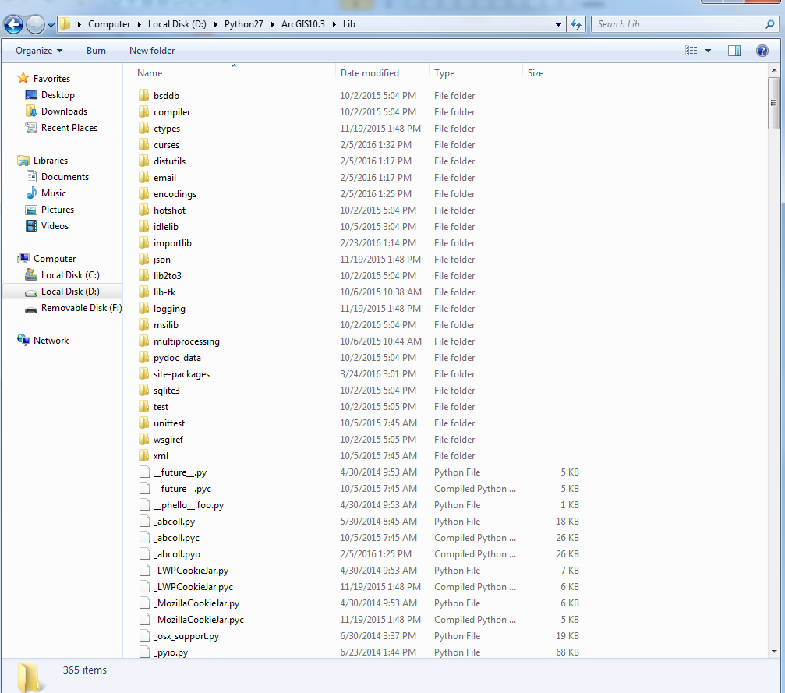
2. Delete python libraries – con’t
Double-click ‘site-packages’ folder

Slide 7
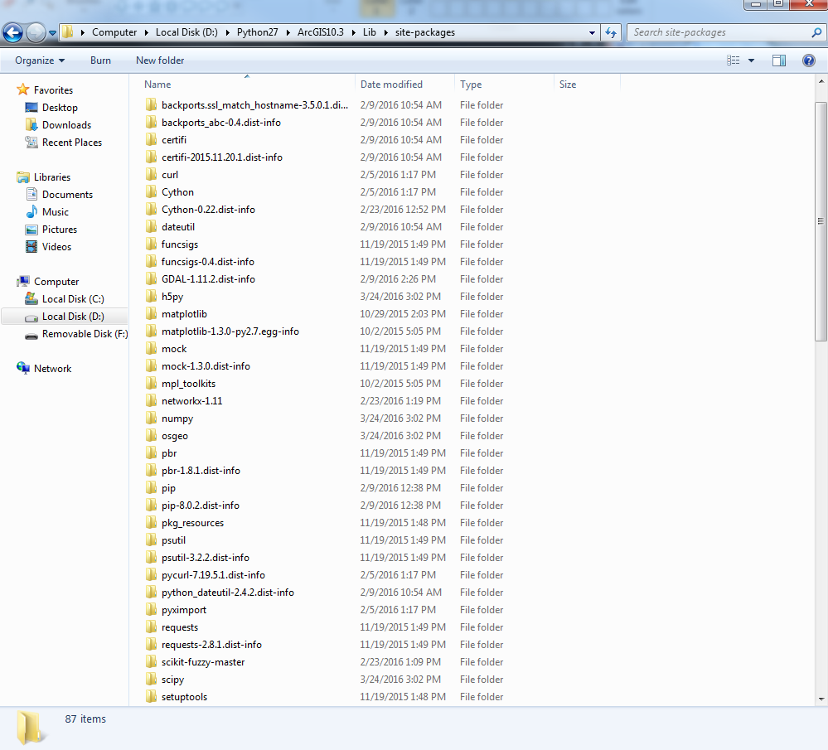
2. Delete python libraries – con’t
Delete the following folders:
‘h5py’
‘numpy’
‘osgeo’
‘scipy’
If you don’t have some of the folders above, then great! We didn’t want them anyways!
These folders have to be deleted because these folders and dnppy don’t get along well.

Slide 8
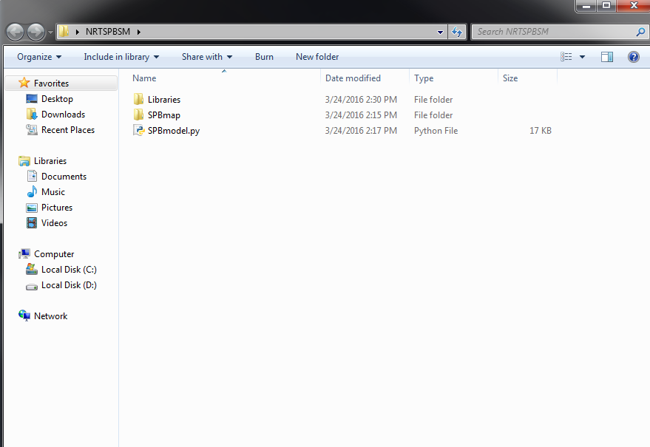
3. Install dnppy
Go to the ‘NRTSPBSM’ folder that was just copied over to your desktop
Double-click on ‘Libraries’

Slide 9
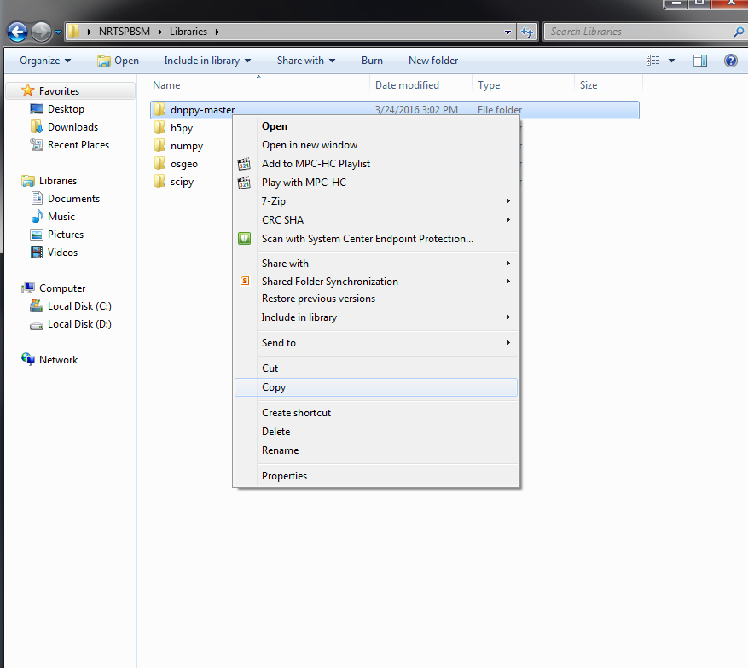
3. Install dnppy – con’t
Right click on the ‘dnppy-master’ folder and click ‘Copy’

Slide 10
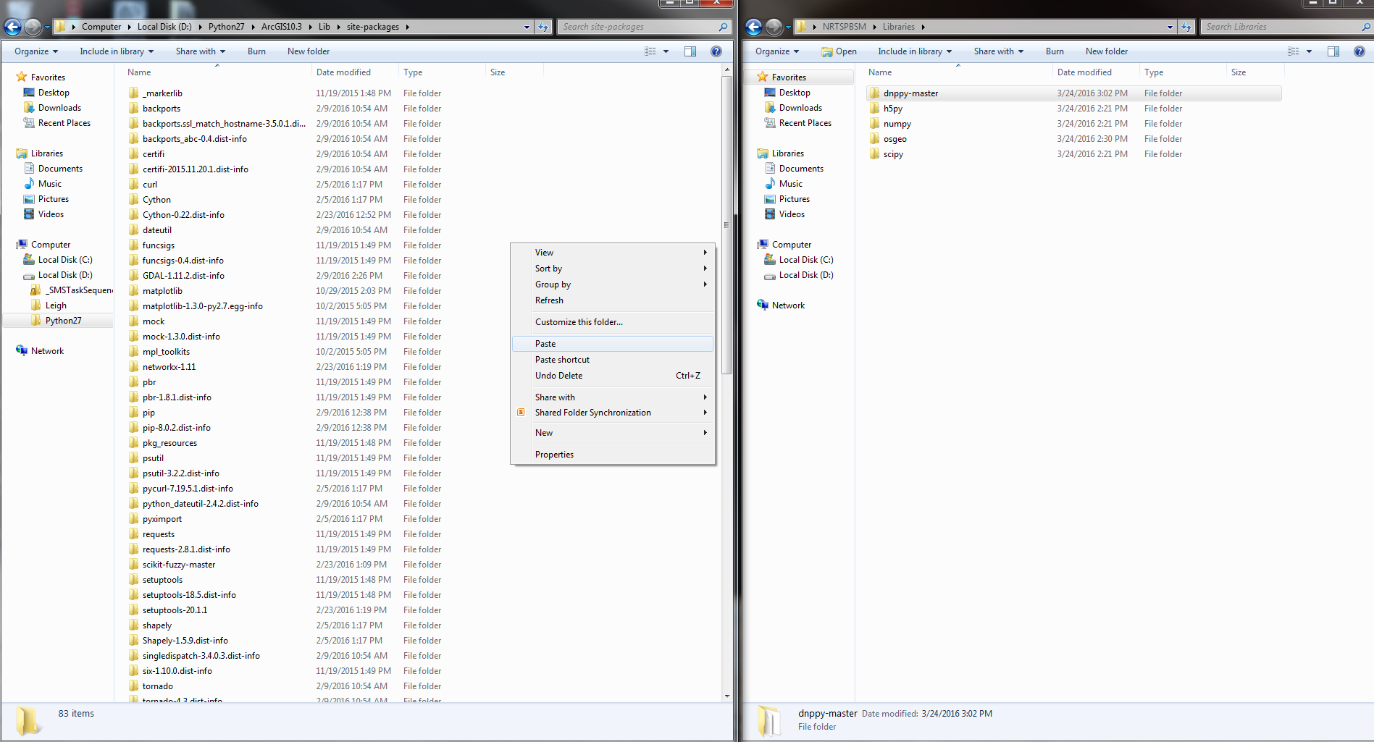
3. Install dnppy – con’t
Go back to the ‘site-packages’ folder where we just deleted stuff
Right click and hit ‘Paste’ in the ‘site-packages’ folder

Slide 11
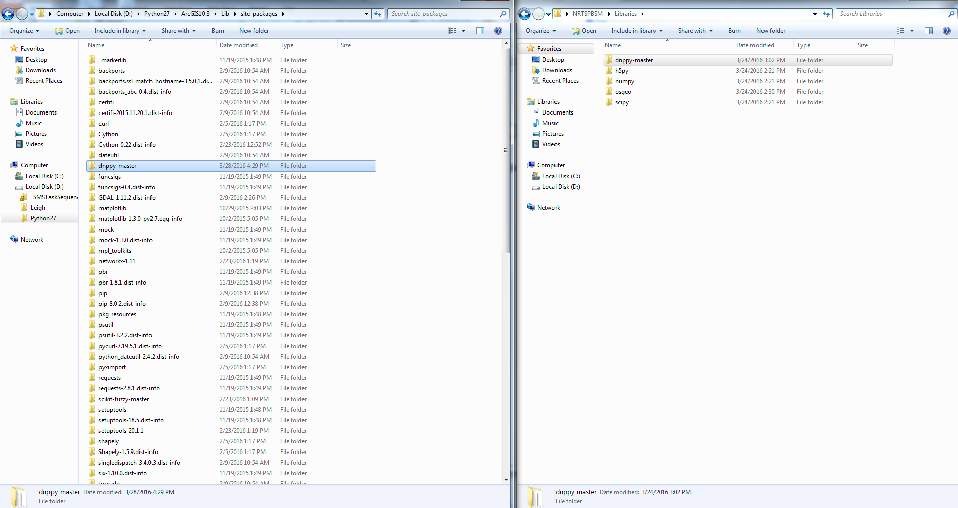
3. Install dnppy – con’t
Double-click ‘dnppy-master folder’

Slide 12
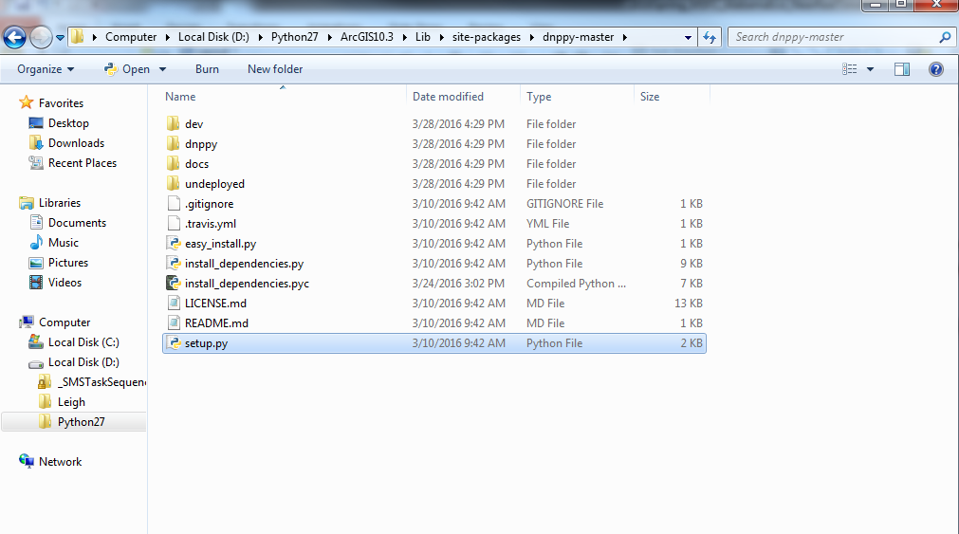
3. Install dnppy – con’t
Double-click ‘setup.py’ and follow the prompt

Slide 13
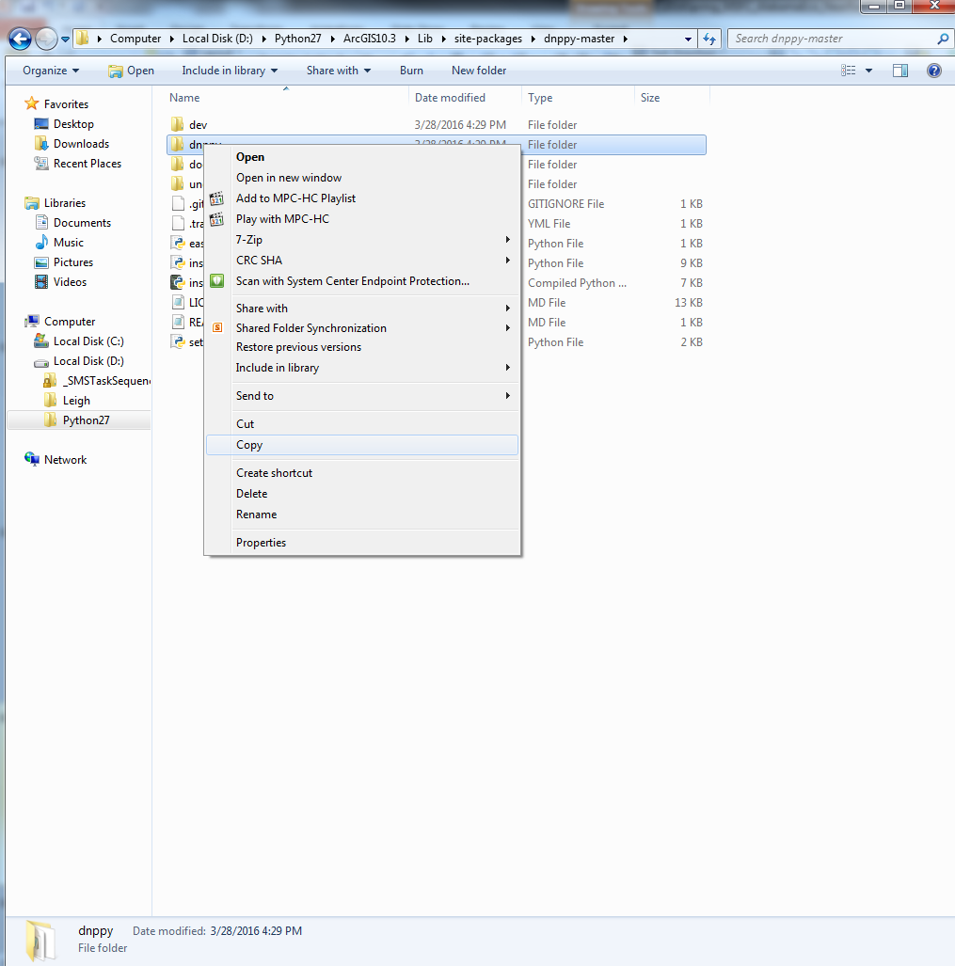
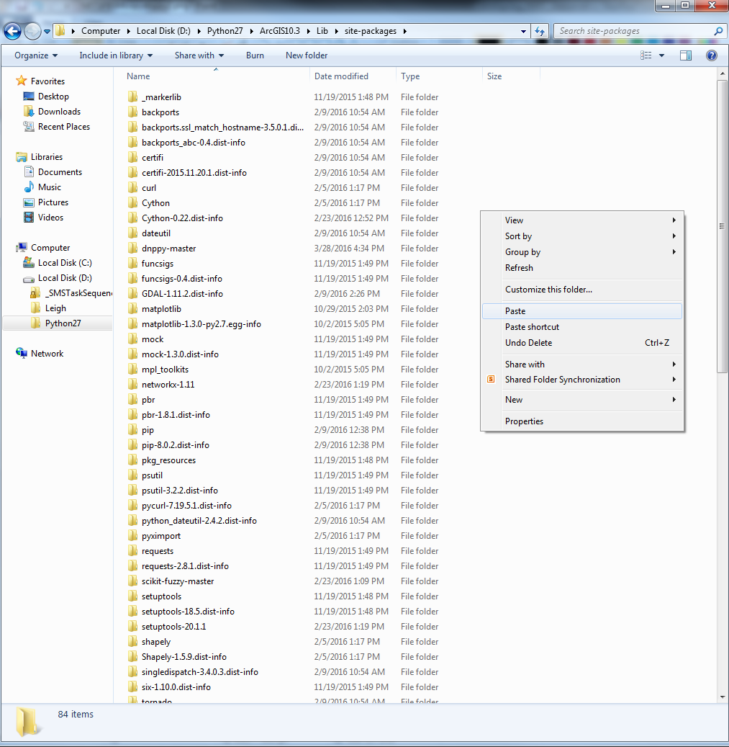
3. Install dnppy – con’t
Right click the ‘dnppy’ folder and click ‘Copy’
Go back to the ‘site-packages’ folder, right click, and hit ‘Paste’

Slide 14
4. Put in correct libraries
You will more than likely have to repeat step 2. These folders were deleted because dnppy reinstalls them. However, dnppy installs them incorrectly, so delete the folders again.
Go back to the handy ‘NRTSPBSM’ folder that was copies onto the Desktop
Double-click the ‘Libraries’ folder

Slide 15
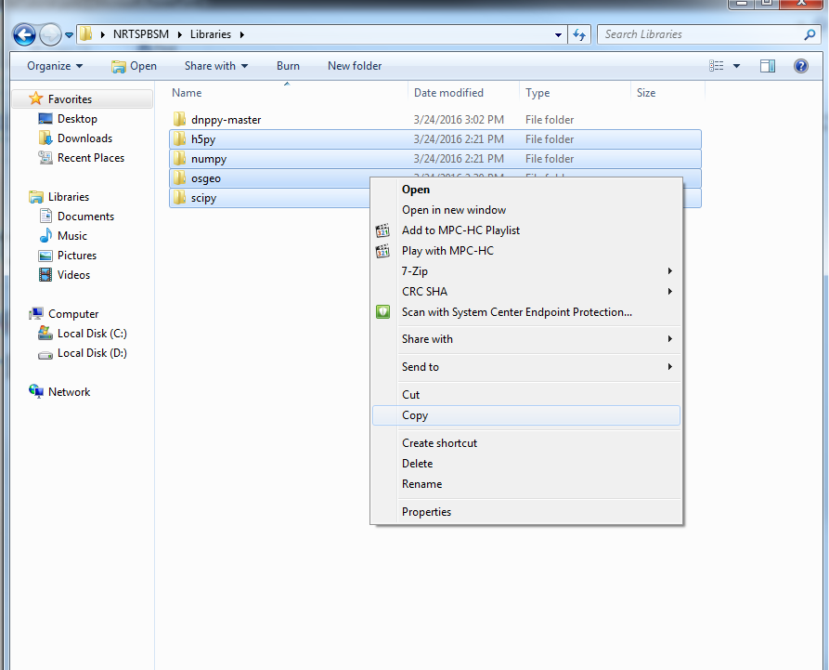
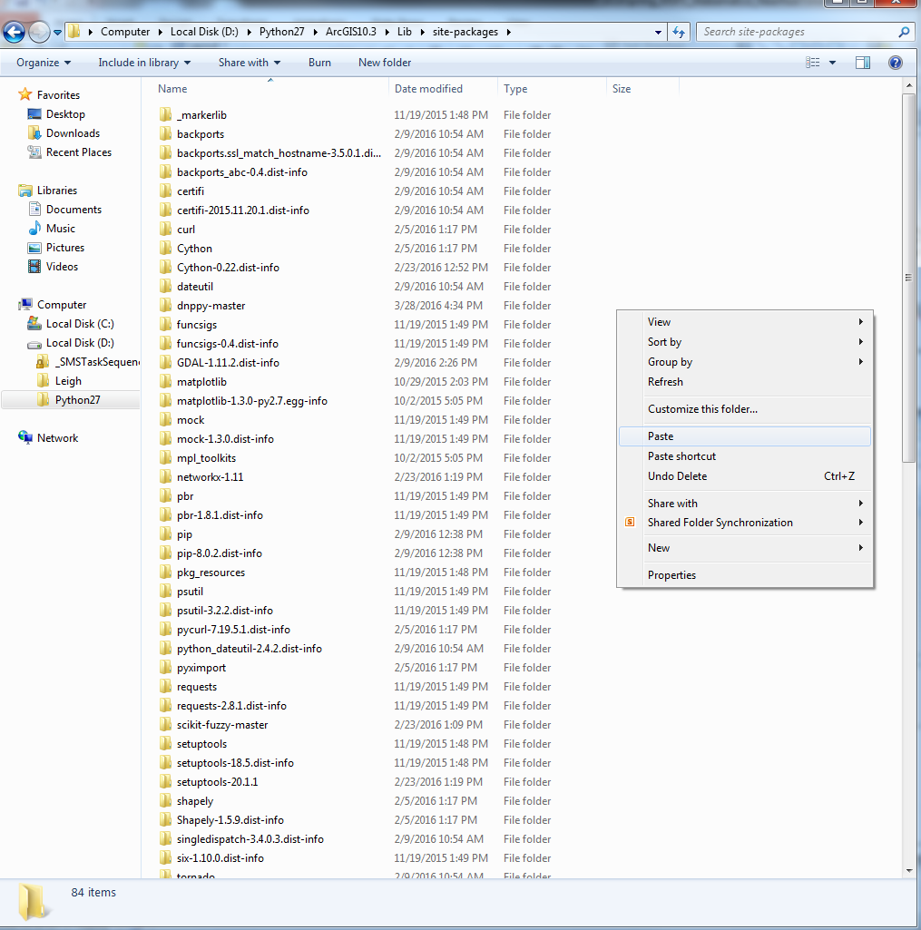
4. Put in correct libraries – con’t
Copy the ‘h5py’, ‘numpy’, ‘osgeo’, and ‘scipy’ folders and paste them to the ‘site-packages’ folder

Slide 16
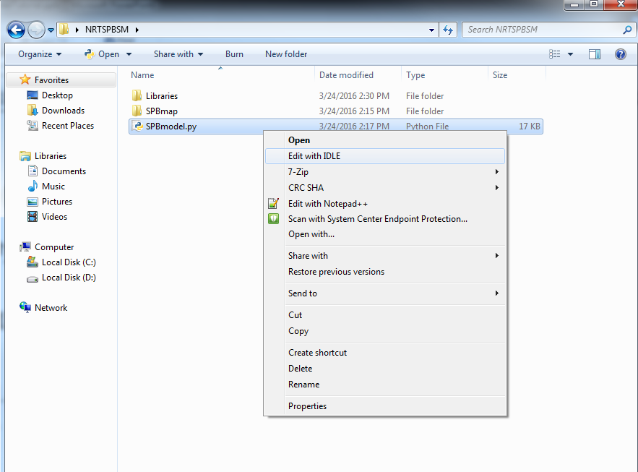
5. Change Workspace
Now that the hard party is out of the way, we can work on the easy step!
Go to the ‘NRTSPBSM’ folder that was copied on the Desktop
Right click ‘SPBmodel.py’
Click ‘Edit with IDLE’

Slide 17
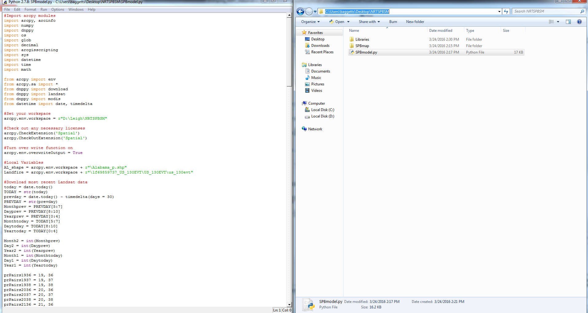
5. Change Workspace – con’t
In the line that says ‘arcpy.env.workspace = ‘, your own personal path needs to be put here. Go back to the ‘NRTSPBSM’ folder
Click on the path at the top of the window
Right click, click ‘Copy’

Slide 18
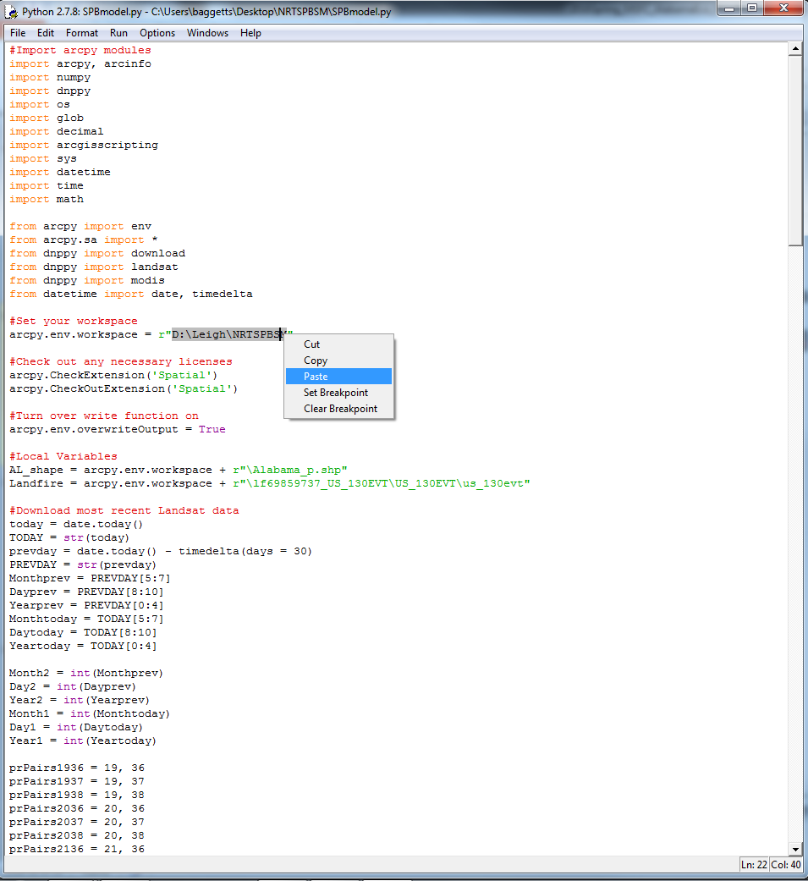
5. Change Workspace – con’t
Go back to ‘SPBmodel.py’ and paste the path beside the ‘arcpy.env.workspace’ line
Make sure to put the path between the r” and “

Slide 19
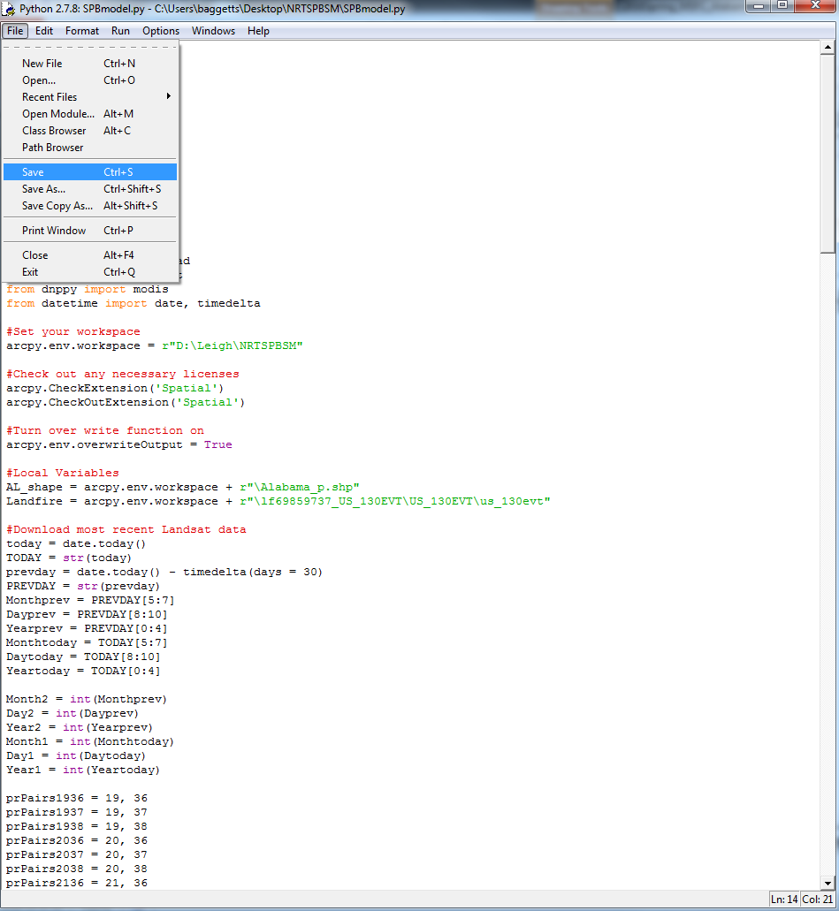
5. Change Workspace – con’t
Go to ‘File’ and click ‘Save’

Slide 20
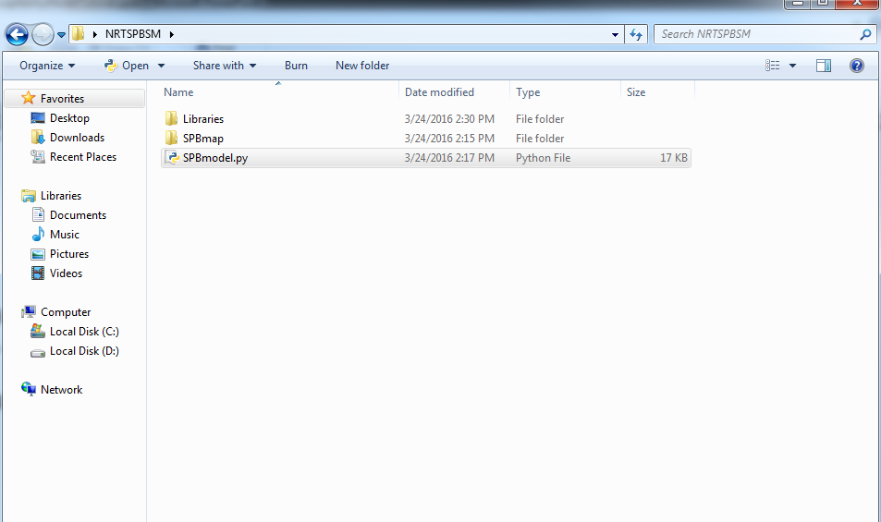
Done!
Now, to run the model whenever you want, all you have to do is to go to the ‘NRTSPBSM’ folder, double-click on ‘SPBmodel.py’, and let it do its thing!

Slide 21
Done!
The model will produce data in the ‘NRTSPBSM’ folder
The model will overwrite a majority of this stuff, so you don’t have to delete it
However, you do need to delete the Landsat imagery (usually the folders starts out as “LC80…”) before running the model
This is so the model won’t get the old Landsat imagery and new Landsat imagery confused

Slide 22
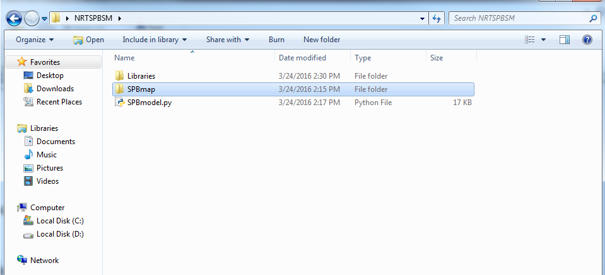
Done!
The final SPB Susceptibility Map will be under the ‘SPBmap’ folder
These maps with be named as ‘SPBmap_MMDDYYYY.tif’ with MM being the month, DD being the day, and YYYY being the year

