Slide 1
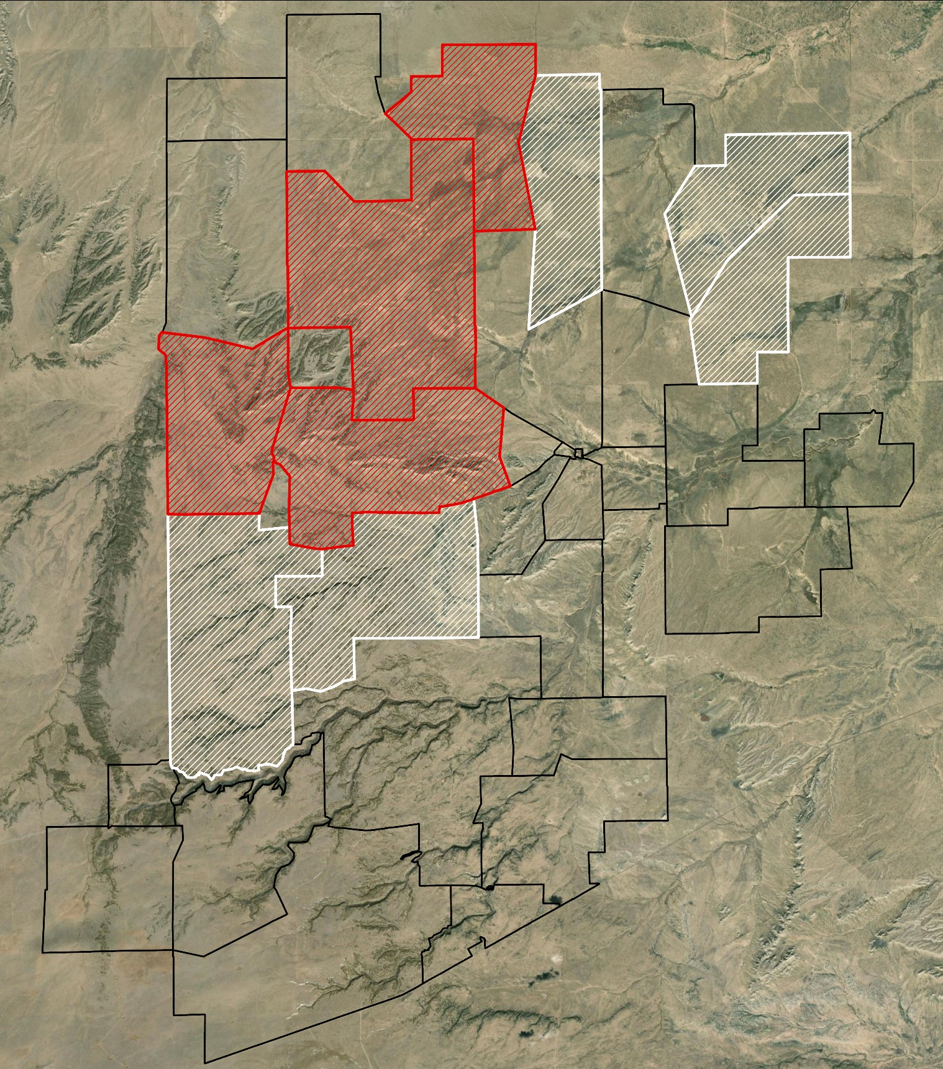
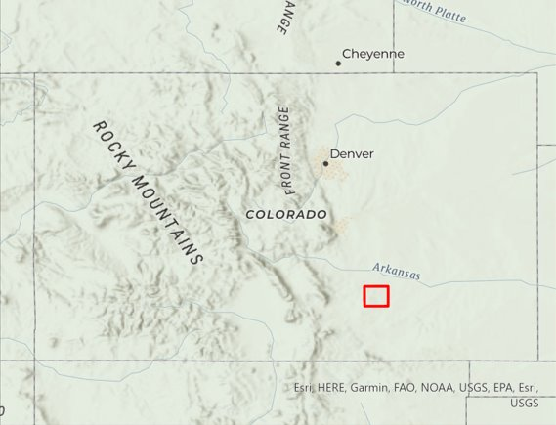
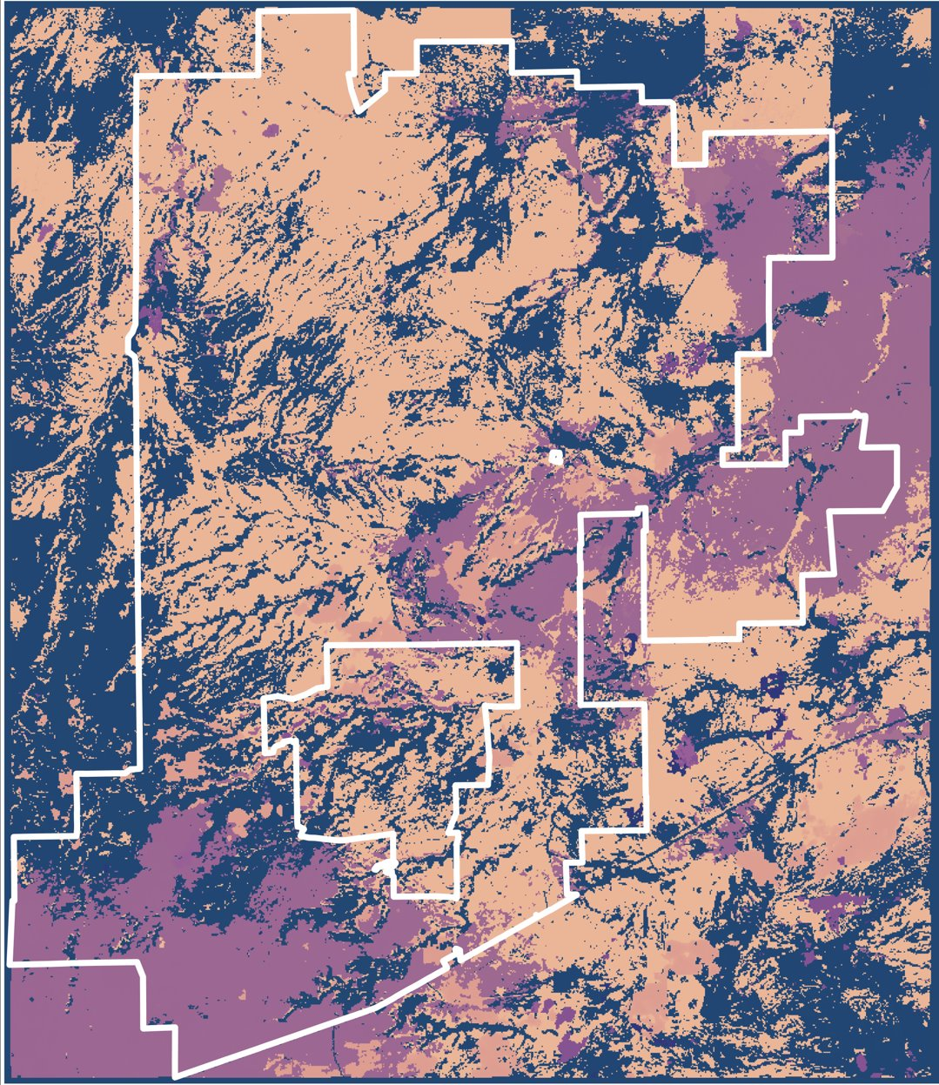
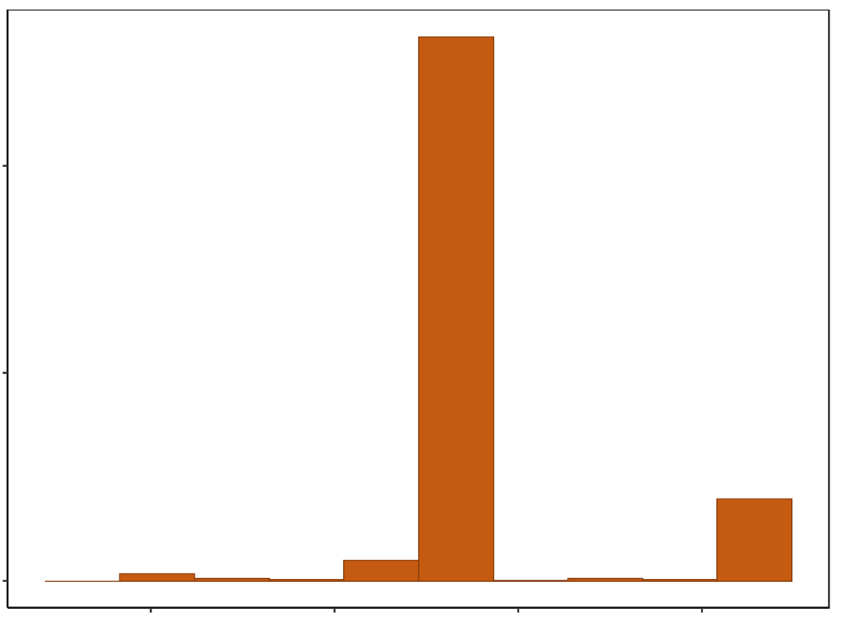
Rangeland Monitoring to Inform Grazing Management in Eastern Colorado​
COMMUNITY BACKGROUND
Red Top Ranch Agriculture
Virtual Fencing is being trialed at Red Top Ranch.
NASA DEVELOP is using satellite data to analyze biomass to support virtual fencing efforts for partners interested in grazing management and conservation.
2 spatial datasets were analyzed to quantify biomass within the study area.
- ARS Biomass Raster (Agricultural Research Service)
- LANDFIRE Existing Vegetation Layers
Colorado
Control Pastures
Experimental Pastures
Pasture Boundary
0 0.75 1.5 3 4.5 6
Miles
Figure 1. Study Area map showing Red Top Ranch and its pastures. Red polygons are experimental pastures where virtual fencing is being trialed. White polygons are the control pastures where normal management continues.
Monthly Biomass Maps (2022)
Day of Year Max (2022)
April
May
June
July
DOY
275
90
August
September
October
9000
kg/ha
Figure 3. Map of the day of year for the maximum biomass value per pixel. Light orange represents days later in the year and dark purple represent days closer to June (Day 90).
20
20
20000
Red Top Boundary
Count
10000
Figure 2. Monthly biomass maps using ARS 2022 data. The light green shows low biomass values and the dark green show high biomass values.
0
100
150
200
250
TAKEAWAYS
DOY of Max Biomass
Figure 4. Graph showing the count of biomass max occurrence per day of year.
1
ARS biomass dataset is a tool that can map the monthly biomass accumulation throughout the year and determine the maximum biomass values. This information can be given to ranch managers to inform their grazing rotation plans.
ACKNOWLEDGEMENTS
Partners:
Advisors:
Fellow:
Red Top Ranch
The Nature Conservancy
Christopher Choi (Colorado State University, NREL)
Dr. Paul Evangelista, (Colorado State University, NREL)
Dr. Catherine Jarnevich (USGS, Fort Collins Science Center)
Dr. Anthony Vorster (Colorado State University, NREL)
Nicholas Young (Colorado State University, NREL)
Sarah Hettema (NASA Colorado Node Fellow)
2
Pixels had highest values of max biomass in June through August in 2022, during the growing season. Second peak occurs in the middle of September due to regrowth of cool-season plants.
EXAMPL
Additional field validation should be used as the ARS biomass dataset was developed for a study area in Northern Colorado with different vegetation types. LANDFIRE proved useful for our study area to isolate specific vegetation cover types of interest.
3
Sarah Hettema
Fellow
Jillian Joubert
Deni Ranguelova
Fall 2022
Fort Collins, Colorado

