Slide 1
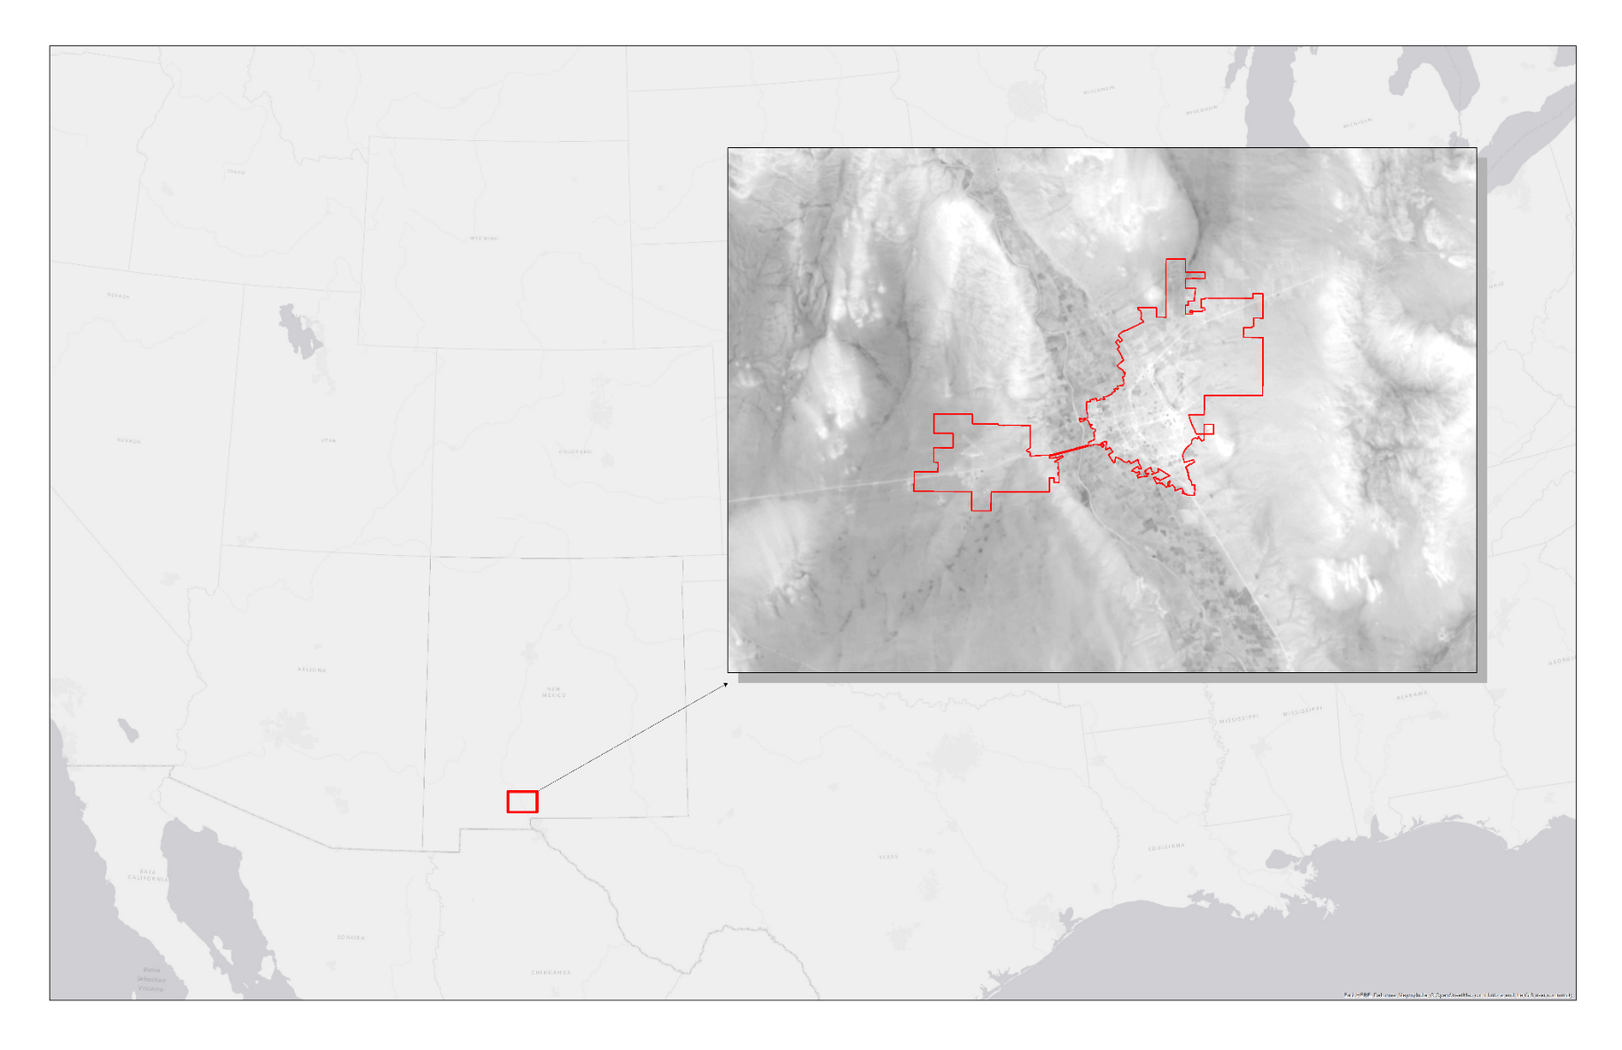
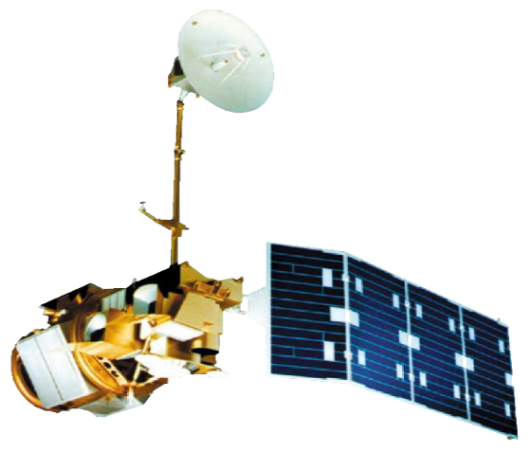
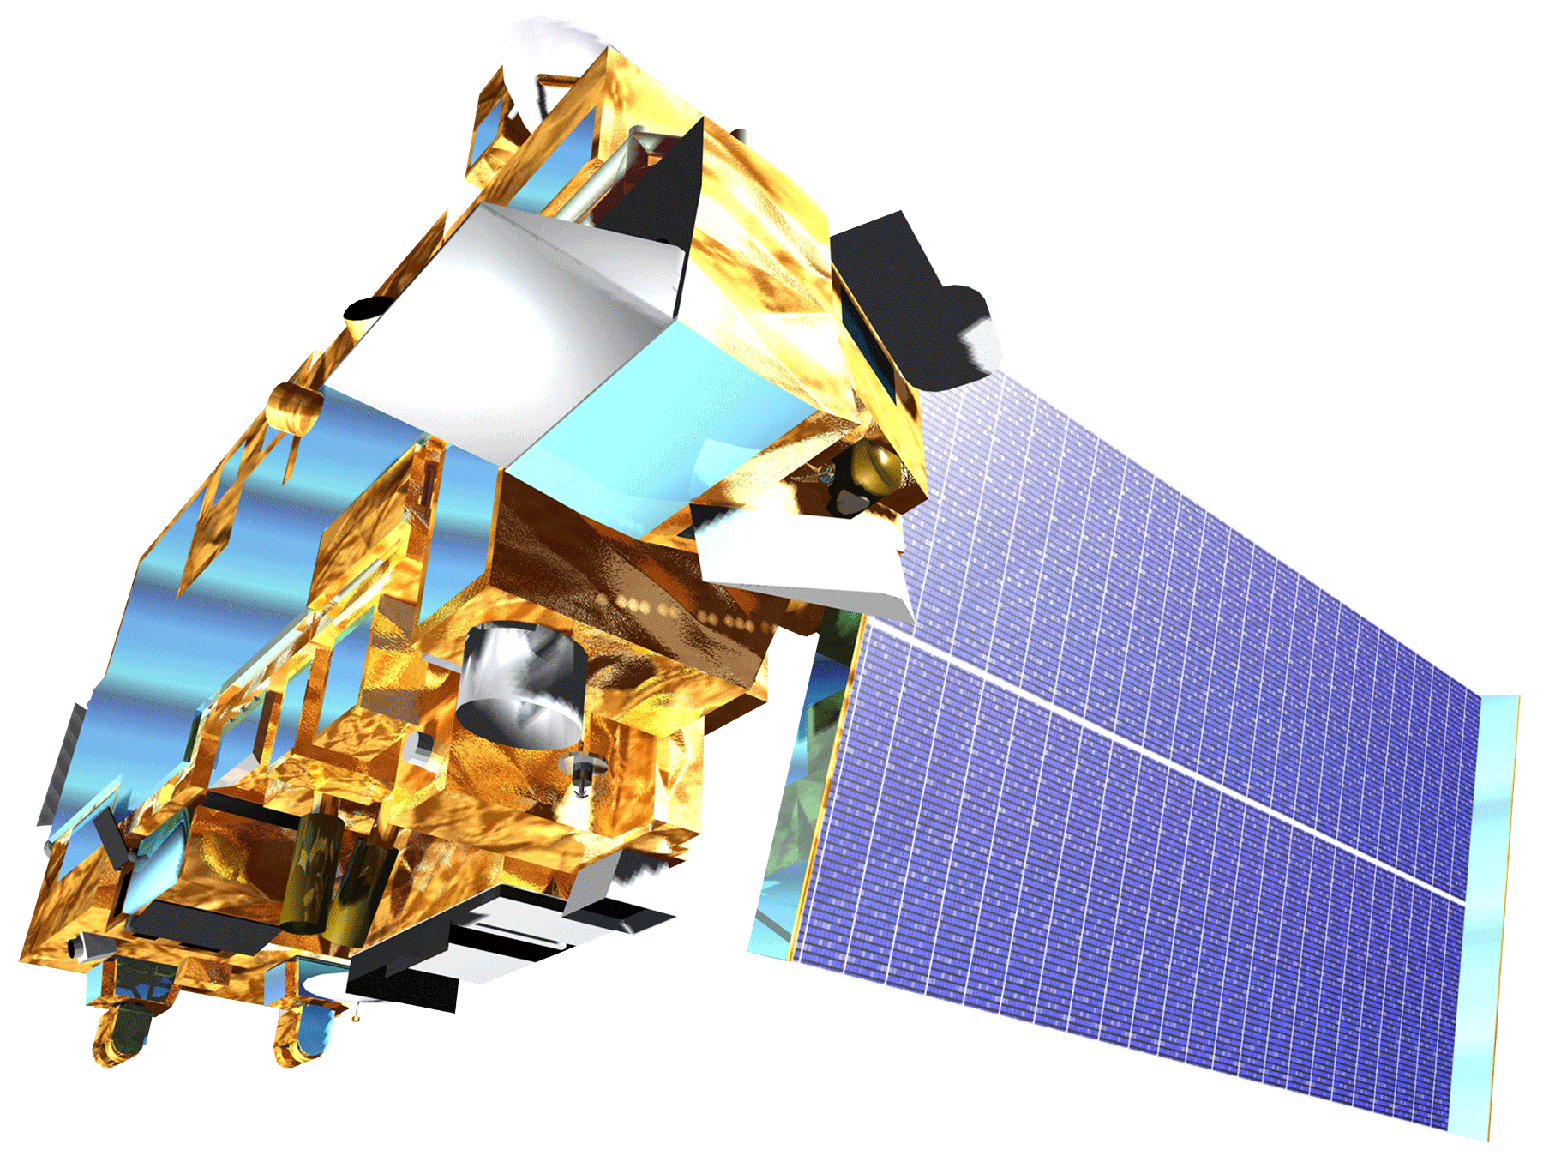
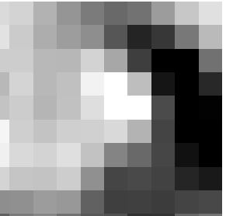
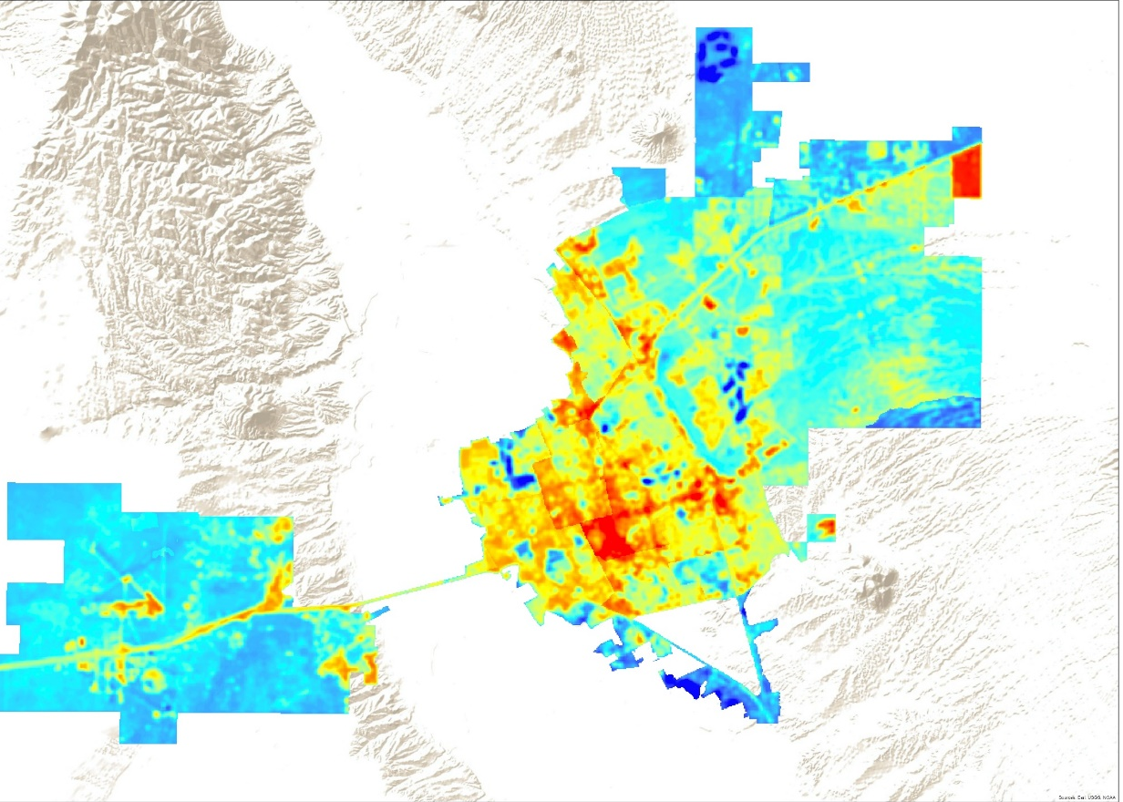
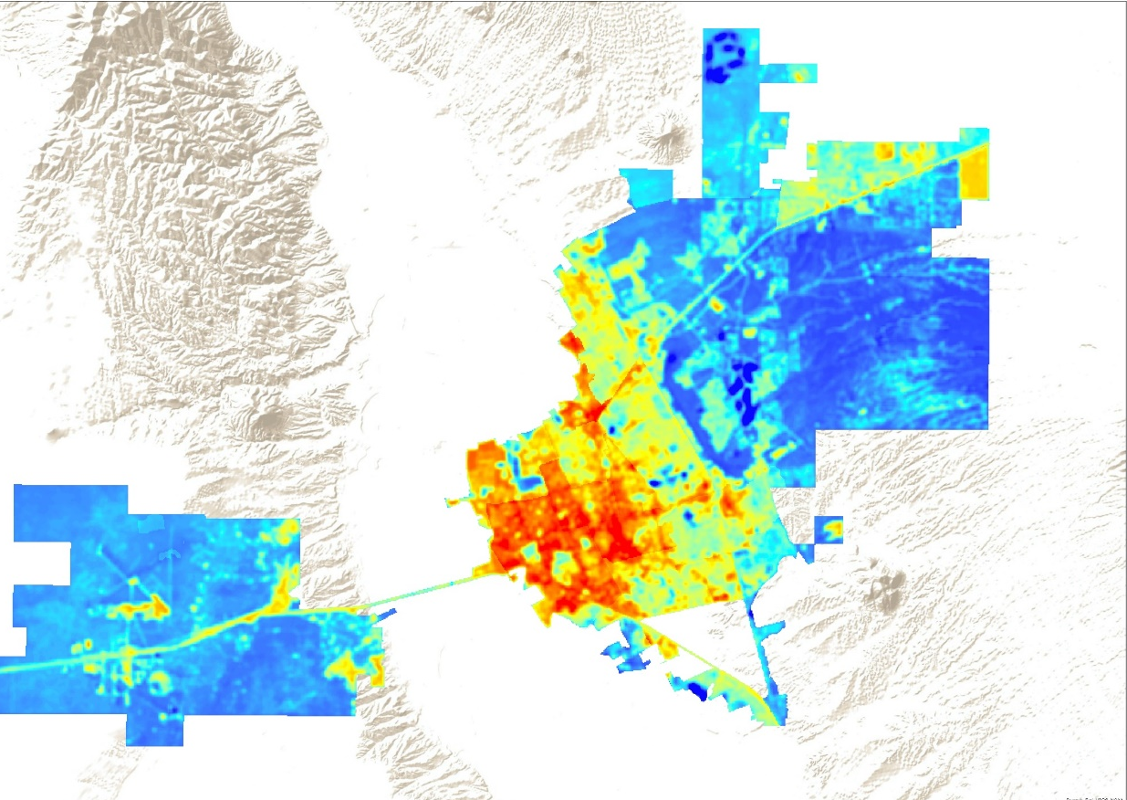
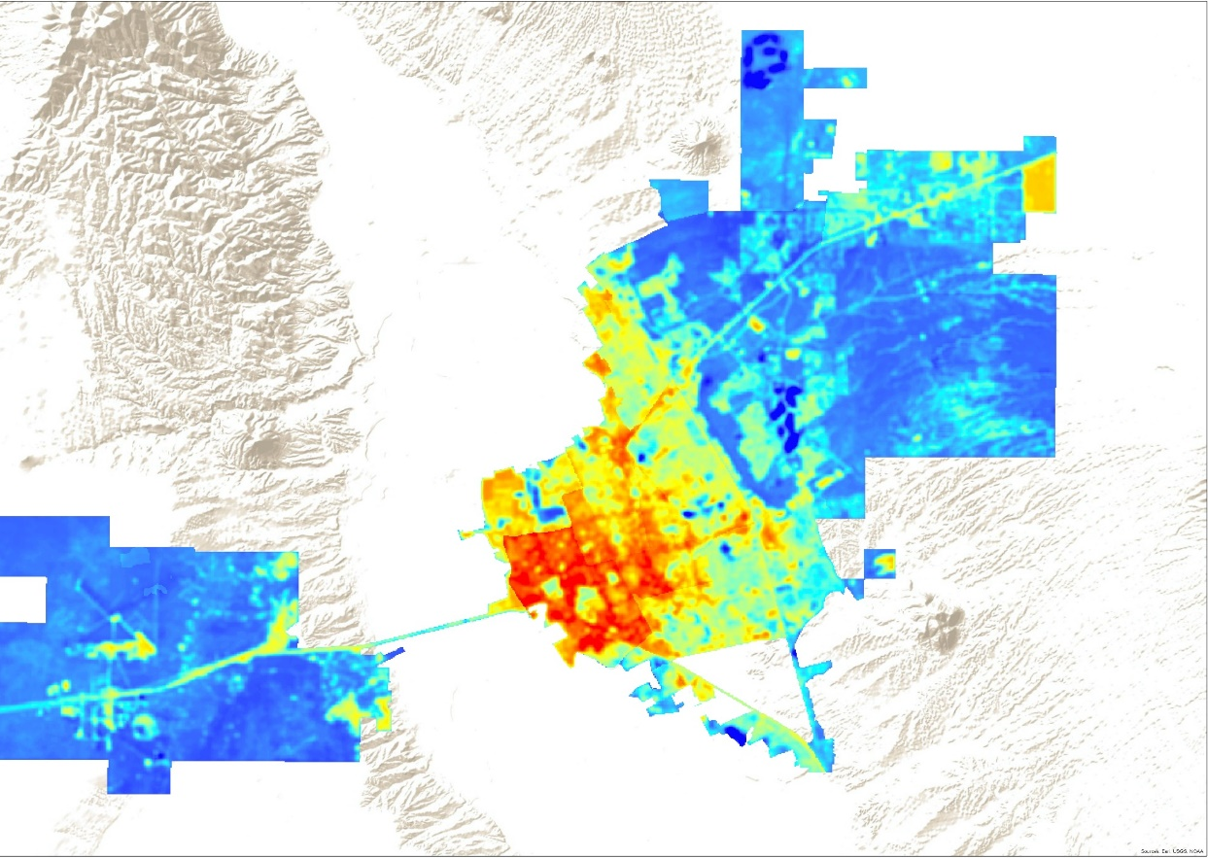
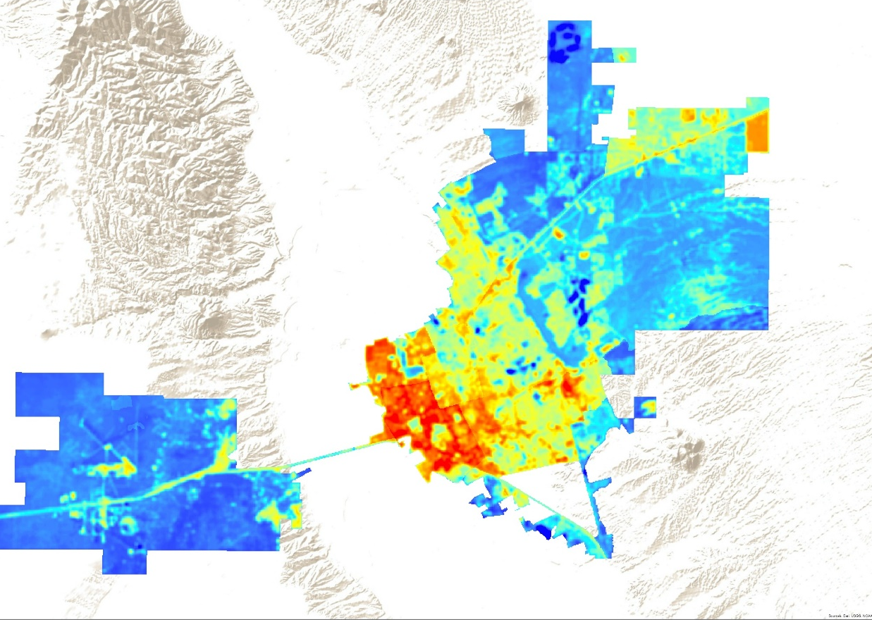
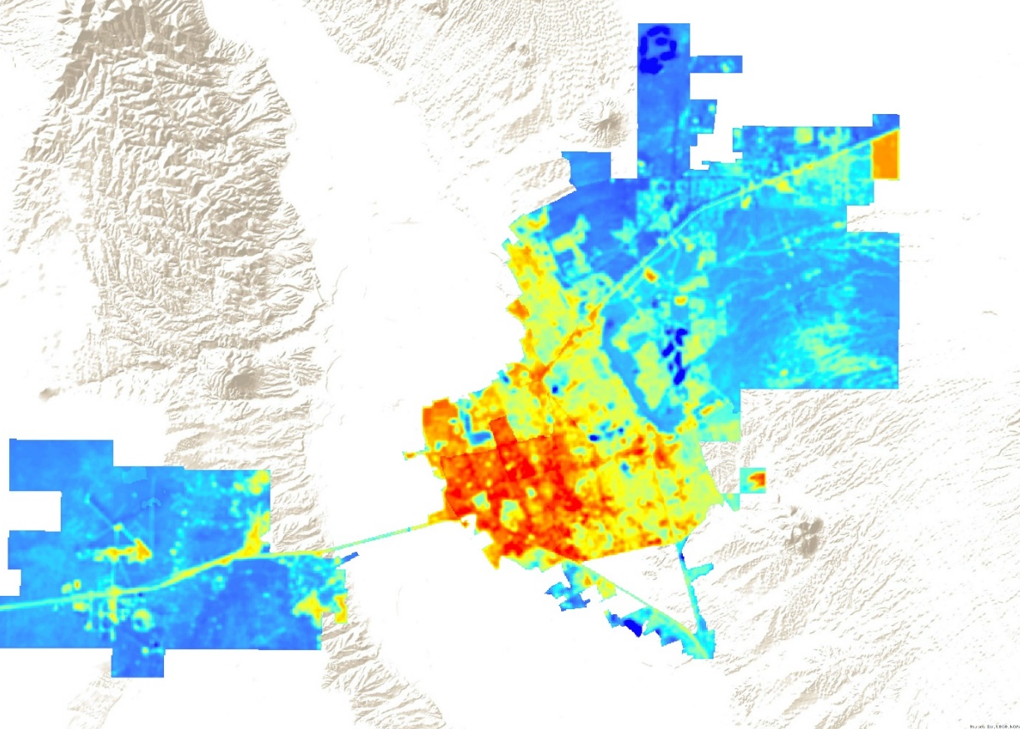
Assessing Urban Heat as it Relates to Social Vulnerability and Land Use Changes in Las Cruces, New Mexico
Abstract
Objectives
Study Area
Extreme heat during the summer months is a major public health issue in many cities worldwide. Local governments are increasing efforts to mitigate heat in cities through the implementation of infrastructure adaptations, including expansion of the urban tree canopy and white roofing, as well as revising design guidelines and principles for new construction. These strategies will be most beneficial for public health if they are deployed in places where risks of heat exposure are elevated as a result of higher temperatures and higher social vulnerability. Spatial variability in heat in the city arises because of the different ways in which the built environment impacts energy exchange between the surface and atmosphere. Social vulnerability is also unevenly distributed across urban areas and previous research demonstrates that socially disadvantaged populations often live in the hottest parts of the city. In this project, we used Landsat and Advanced Space-borne Thermal Emission and Reflection Radiometer (ASTER) data to construct a time series of Las Cruces’ urban heat patterns and assess the influence that urban morphology has on those patterns. Extreme heat vulnerability indicators were developed utilizing census and health records and aerial imagery from the National Agriculture Imagery Program (NAIP). These heat vulnerability indicators describe the sensitivity of the population to extreme heat and identify where vulnerable populations reside. The Las Cruces Sustainability Office will use the heat vulnerability indicators, urban heat island assessment, and urban heat island morphology comparison to improve the city’s resilience and mitigation efforts.
Delineate the urban heat island in Las Cruces
Assess patterns of social vulnerability and land cover
Compare land cover, social vulnerability, and land surface temperature
Locate areas of concern
Inform heat mitigation strategies
City of Las Cruces
New Mexico
Earth Observations
LST
Use Landsat data to calculate yearly and monthly land surface temperature averages
Tree Canopy
Use NAIP imagery and object-based classification to calculate percentage of tree canopy cover
Impervious Surfaces
Use NAIP imagery and object-based classification to calculate impervious surfaces
Social Factors
Use census data and principal component analysis to create social vulnerability layers and convert to raster format
Landsat 5 (1984)
Landsat 8 (2013)
Terra (1999)
Methodology
LST
Use Landsat data to calculate average land surface temperature
NDVI
Use Landsat data to calculate vegetation health and distribution
Impervious Surfaces
Use NAIP imagery and object-based classification to calculate impervious surfaces
Tree Canopy
Use NAIP imagery and object-based classification to calculate percentage of tree canopy cover
Rasterized Result Layers
GWR
Social factors were grouped into 5 categories, Household Composition, Economic Stability, Minority Status, Housing & Transportation, and Health. Each vulnerability category was combined with LST, NDVI, and Impervious Surface to produce a heat vulnerability layers.
Geographically weighted regression was used to relate NDVI, density of impervious surfaces, and density of residential and commercial space to LST for the year of 2016.
Las Cruces Health & Air Quality
Heat Vulnerability Layer
Geographically Weighted Regression
Results
Heat Exposure & Minority Status
Heat Exposure & Transportation/ Housing
Heat Exposure & Household Composition
Heat Exposure & Economic Stability
Heat Exposure & Health Status
Conclusions
Acknowledgements
Areas with more impervious surfaces, fewer trees, and less vegetation experienced higher land surface temperature.
Vulnerability analysis revealed that the central and southwest regions of the historical “Infill District” as have the highest levels of social vulnerability.
The Las Cruces Health & Air Quality team would like to thank:
Lance Watkins, NASA DEVELOP Center Lead, Maricopa County Department of Public Health & Arizona State University
Dr. David Hondula, NASA DEVELOP Science Advisor, Arizona State University
Lisa LaRocque, Las Cruces Sustainability Officer, City of Las Cruces
Dr. Gregg Garfin, Climate Assessment for the Southwest, University of Arizona
Sarah Leroy, Climate Assessment for the Southwest, University of Arizona
Team Members
Project Partners
Lisa LaRocque, Sustainability Officer, City of Las Cruces Sustainability Office
Sarah Leroy, Climate Assessment for the Southwest (CLIMAS)
Dr. Gregg Garfin, Climate Assessment for the Southwest (CLIMAS)
Jonathan O’Brien
(Project Lead)
Fanqi Jia
Rebia Khan
Christopher Wilson
Maricopa County Department of Public Health & Arizona State University – Summer 2017

