Slide 1
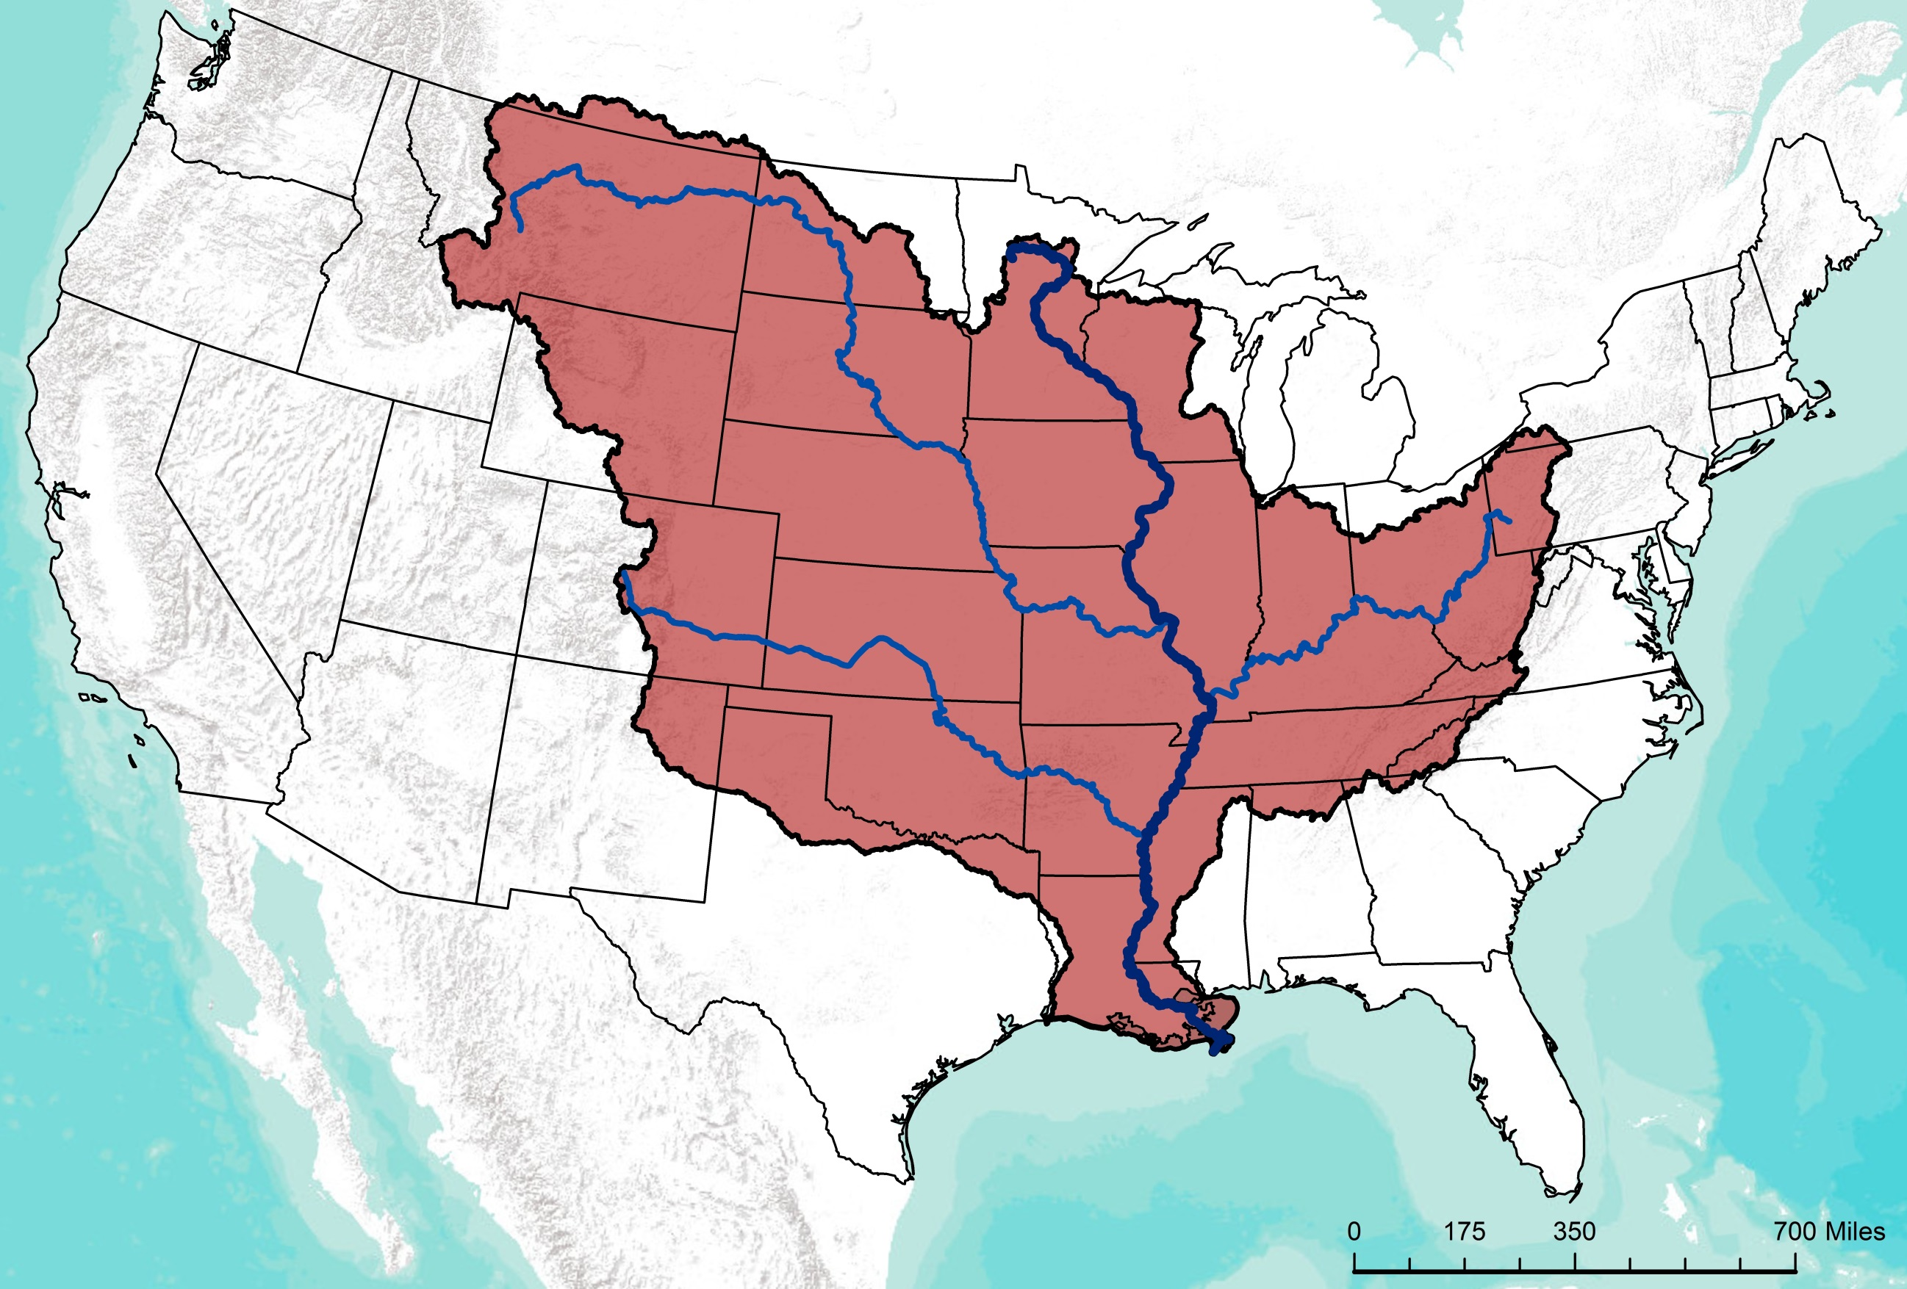


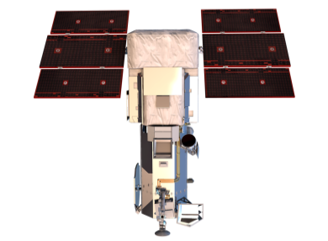
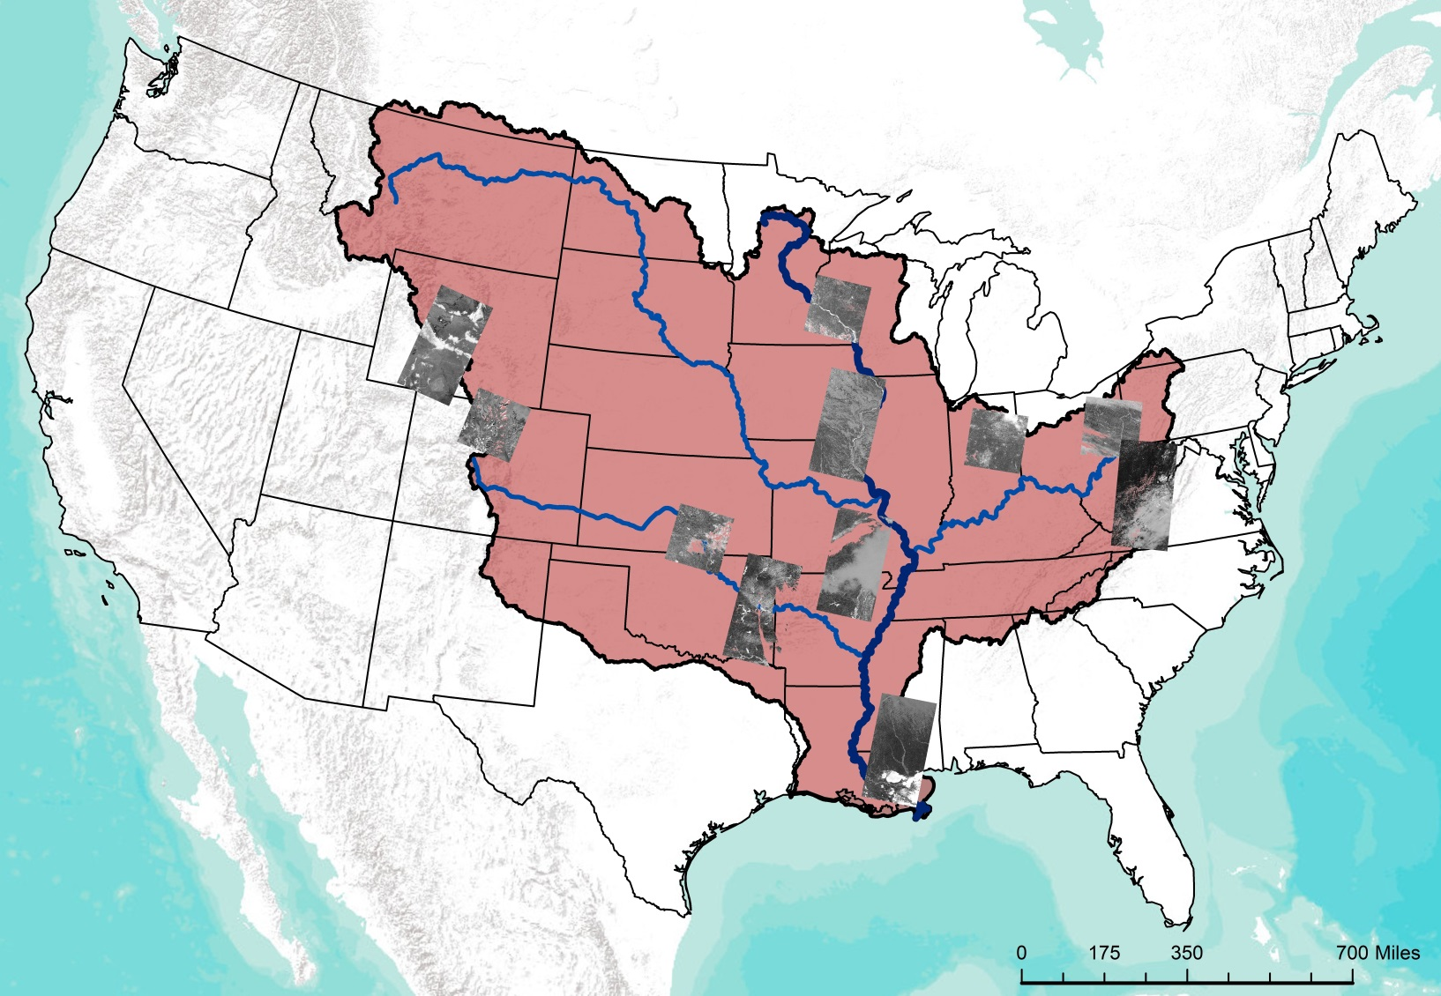
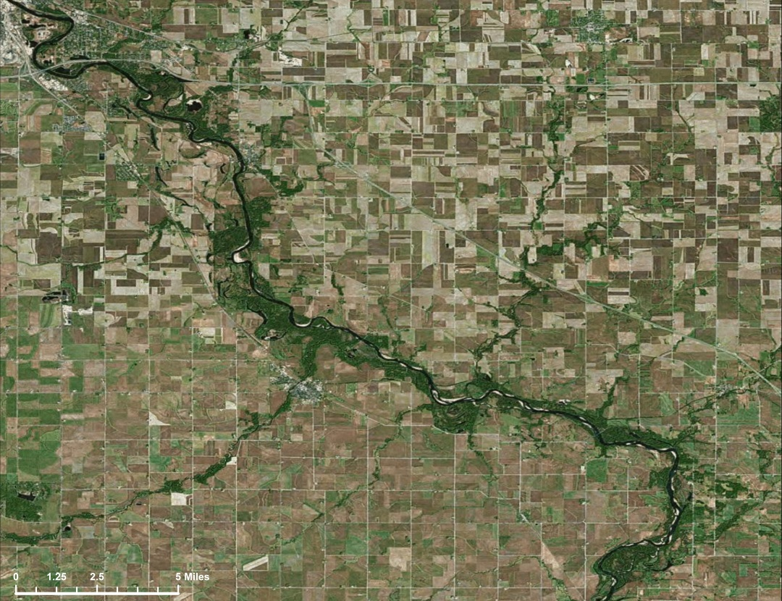
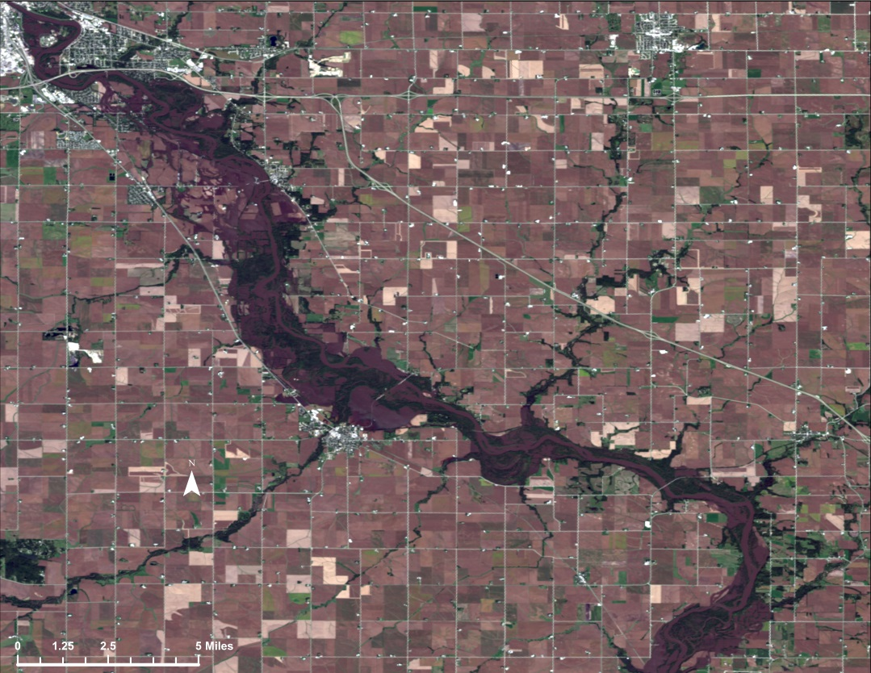
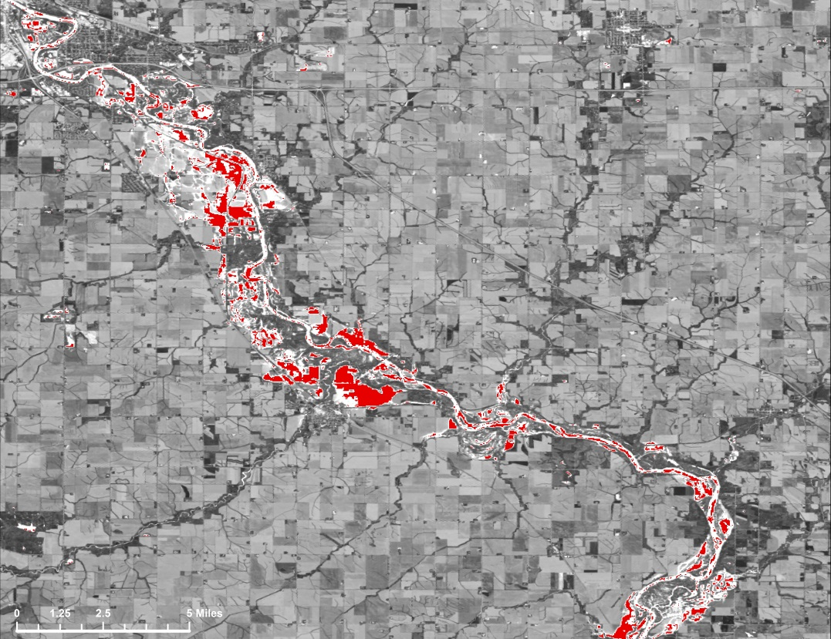
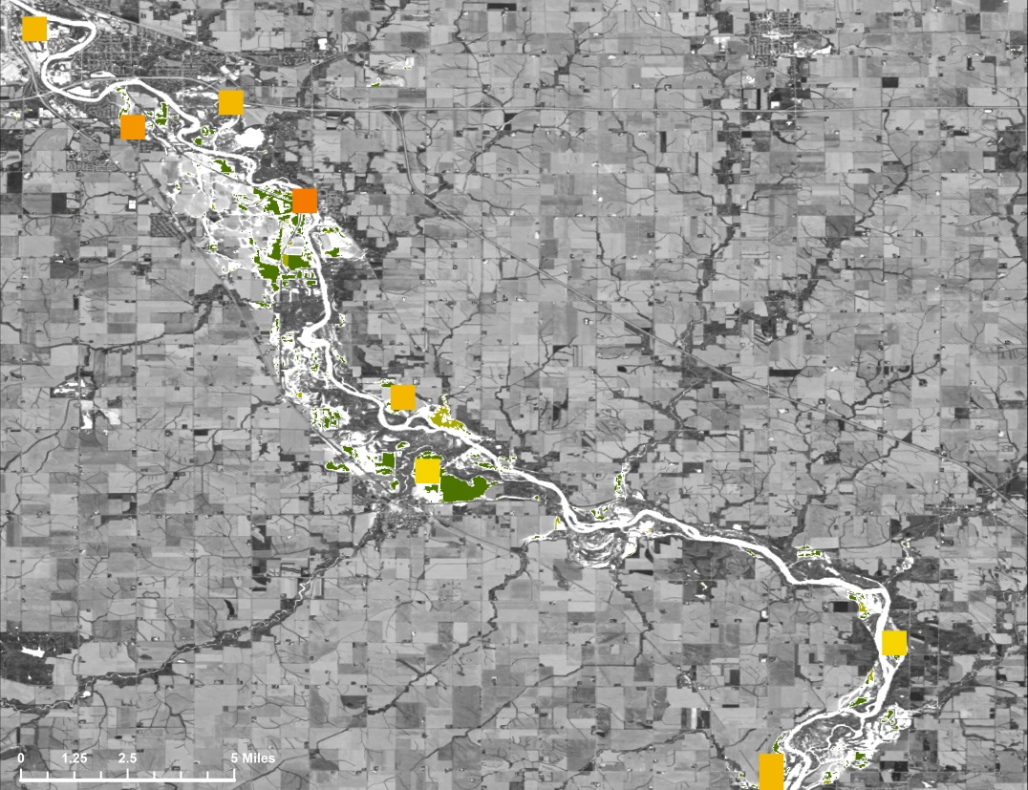




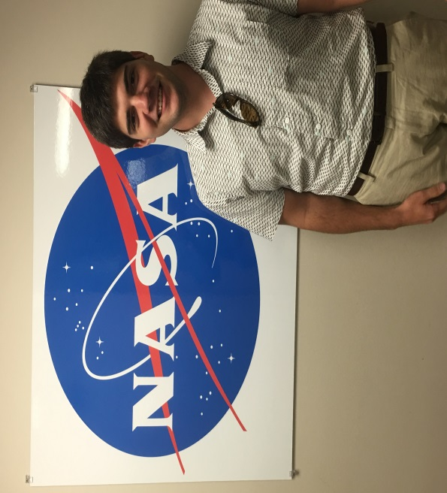
Utilizing NASA Earth Observations to Create an Automated Flood Probability Map in the Mississippi River Basin
Abstract
Objectives
The Mississippi River Basin is the fourth largest drainage basin in the world, and is susceptible to multi-level flood events caused by heavy precipitation, snow melt, and changes in water table levels. Conducting flood analysis during periods of disaster is a challenging endeavor for NASA’s Short-term Prediction Research and Transition Center (SPoRT), Federal Emergency Management Agency (FEMA), and the US Geological Survey’s Hazards Data Distribution Center (USGS HDDS), due to heavily-involved research and lack of manpower. During this project, an automated script was generated that performs high-level flood analysis to relieve work load for end-users. The script incorporated Landsat 8 Operational Land Imager (OLI) tiles and utilized computer-learning techniques to generate accurate water extent maps. The script referenced the Moderate Resolution Imaging Spectroradiometer (MODIS) land-water mask, to isolate areas of flood induced waters. These areas were overlaid onto the National Land Cover Database’s (NLCD) land cover data, the Oak Ridge National Laboratory’s LandScan data, and Homeland Infrastructure Foundation-Level Data (HIFLD) to determine the classification of areas impacted and the population density affected by flooding. The automated algorithm was tested on multiple flood events within the Mississippi River Basin, and focused on the September 2016 flood event that occurred in Upper Mississippi River Basin. This script allows end-users to create their own flood probability and impact maps for disaster mitigation and recovery efforts.
Improve the accuracy and feasibility of mapping floods within the Mississippi River Basin
Automate flood mapping by creating a python script to allow the end-user to produce a user-specific flood analysis of the given area
Create Flood Exposure and Flood Impact maps, using the automated script, to aid in project partner’s decision making process
Map a list of flood events given by FEMA using the python script to collect post-flood data
Study Area
Methodology
Manual Data Acquisition:
Set Workspace
Download Landsat 8 OLI Imagery
Automated Analysis within Python script:
Extract clouds, convert to TOA, and perform NDWI
Run Maximum Likelihood Classification and apply water mask
Clip impact variables to study area
FLOOD IMPACT MAP
FLOOD EXTENT MAP
Extract impact variables that fall within flooded cell
Data Processing
Data Analysis
End-Products
Study Area
Mississippi River
Mississippi River Major Drainages
Mississippi River Basin
Earth Observations
Mississippi River Basin Disasters II
WorldView - 3
Landsat 8 OLI
Terra MODIS
Results
Conclusions
Pre-Flood Imagery
Post-Flood Imagery
Automated algorithm from previous term
Analyzed flood events from multiple physiographic regions
  Distinguished flood induced water
  Intersected LandScan, HIFLD, and Land Cover datasets
Quantified impact from flood events
Key Features
Mississippi River
Mississippi River Major Drainages
Mississippi River Basin
Flood Extent Map
Flood Impact Map
NDWI of Areas Analyzed
Team Members
Landscan Population
0
0 - 5
5 – 25
25 – 50
50 – 100
100 – 500
500 – 2,500
2,500 – 5,000
5,000 – 180,000
Water Classification
Flood Water
NLCD Agriculture
Pasture/Hay
Cultivated Crops
Mercedes Bartkovich
Team Lead
Dashiell Cruz
Project Partners
Acknowledgements
NASA Short-term Prediction Research and Transition Center (SPoRT)
Dr. Andrew Molthan
USGS Hazards Data Distribution System
Brenda Jones
Federal Emergency Management Agency (FEMA)
Glen Russell
Dr. Jeffrey Luvall
NASA at National Space Science and Technology
Center
Dr. Robert Griffin
University of Alabama in Huntsville
Dr. Andrew Molthan
NASA SPoRT
Leigh Sinclair
University of Alabama in Huntsville/Information Technology and Systems Center
Maggi Klug
NASA DEVELOP MSFC Center Lead
Helen Baldwin-Zook
Nicholas McVey
NASA Marshall Space Flight Center – 2017 Spring

