Slide 1
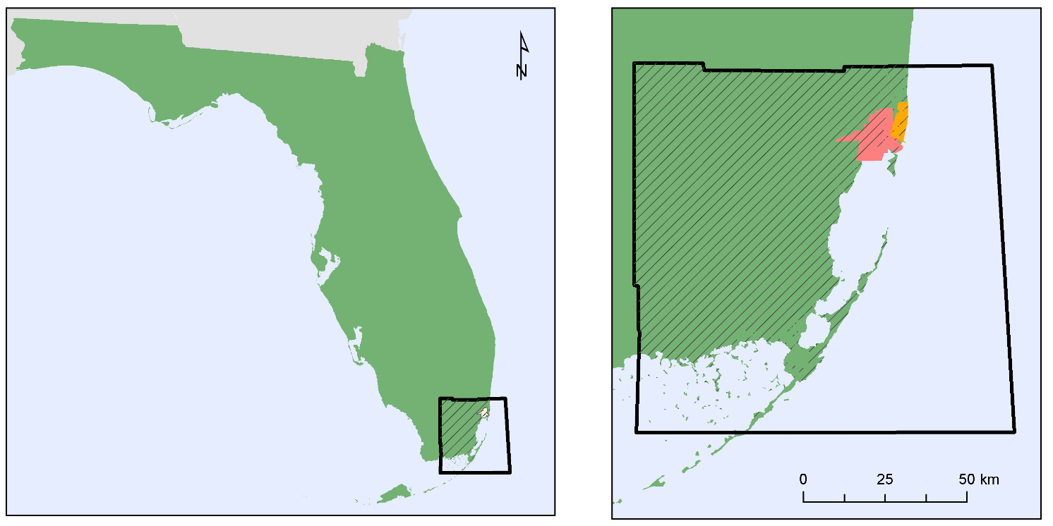
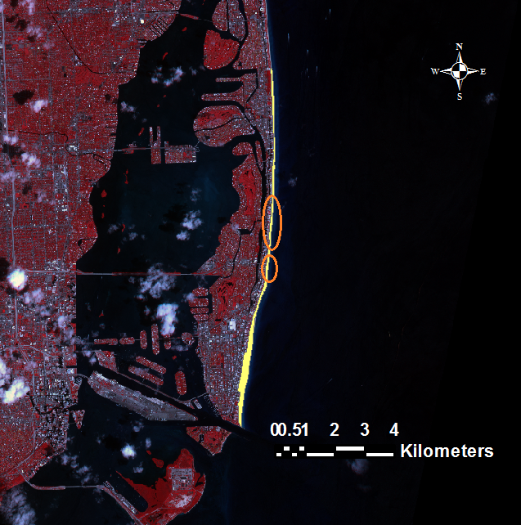
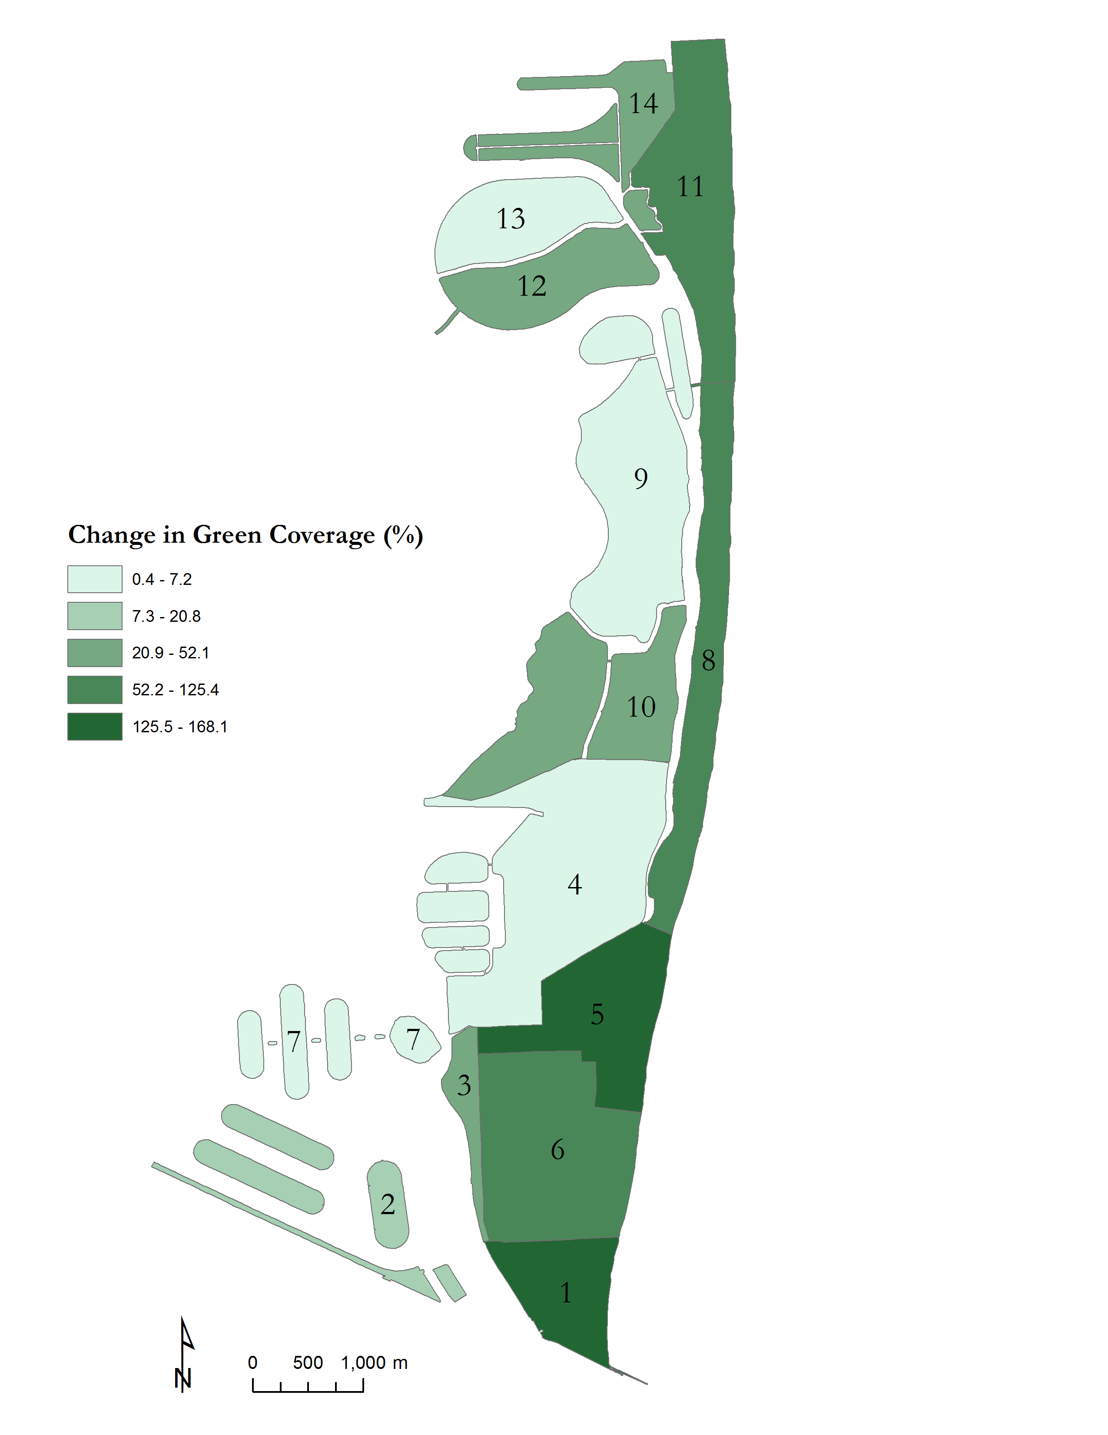
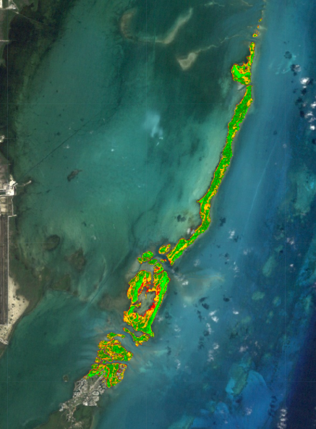
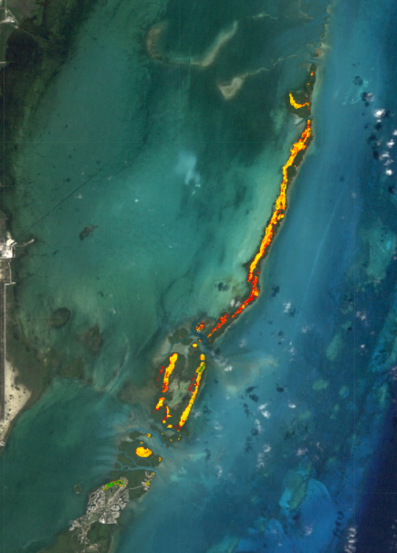
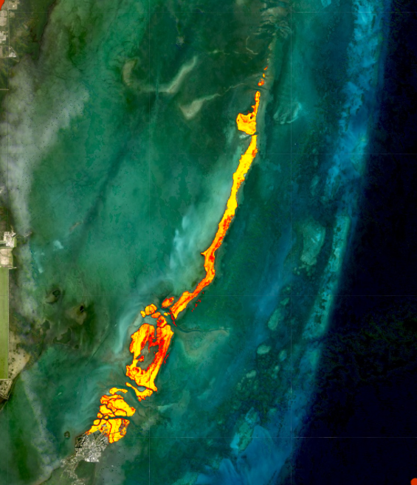
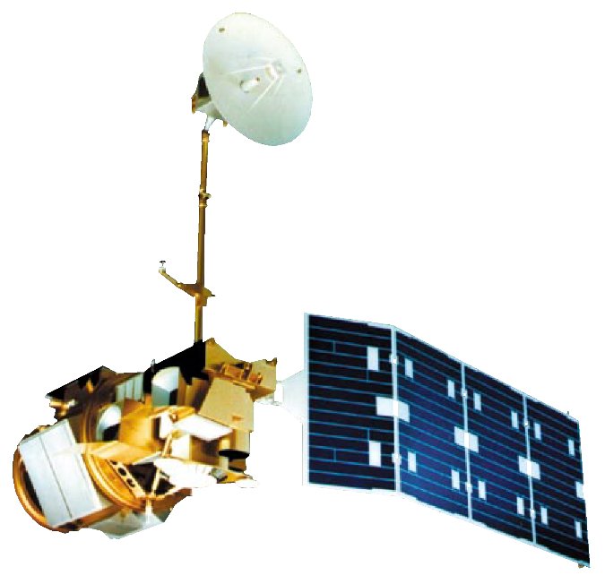
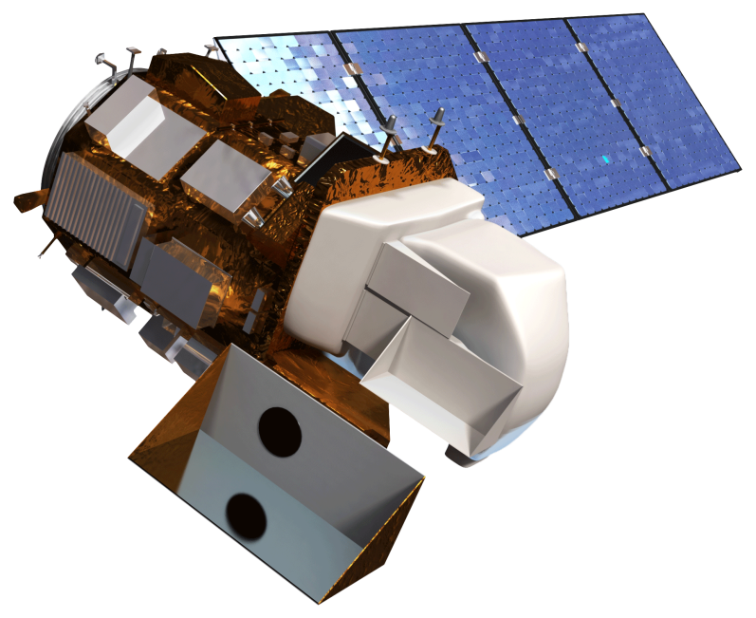
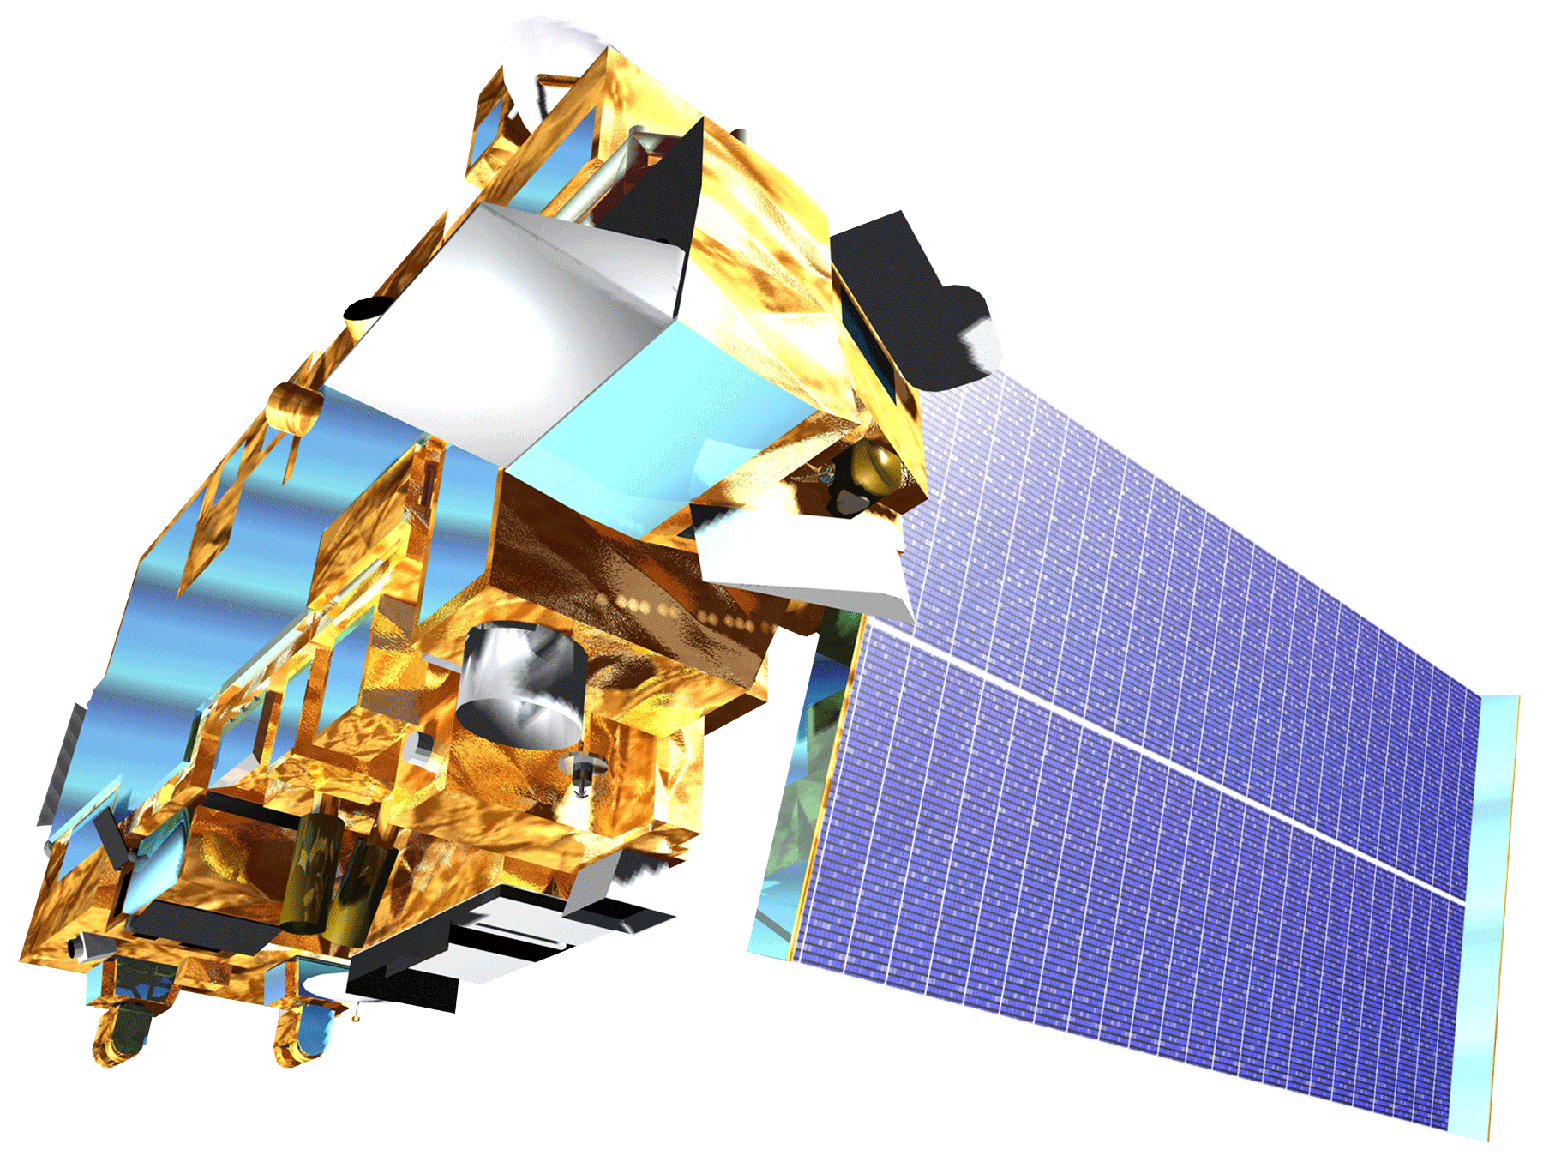
Utilizing NASA Earth Observations to Assess Sea Level Rise and Develop Optimal Green Infrastructure Plans to Restore Mangrove Habitat and Enhance Coastal Resiliency
Abstract
Study Area
In response to projected sea level rise and extreme weather events, Miami Beach and other urban areas surrounding Biscayne Bay are developing adaptive strategies to mitigate the effects of changing environmental conditions. Because the local economy, especially the tourism industry, is intricately tied to coastal resources, city officials are involved with on-going efforts to reduce storm damage and monitor shoreline conditions. Some important considerations for these adaptive strategies include water drainage capacity, green infrastructure, and maintenance of natural wetland ecosystems, particularly mangrove forests. This NASA DEVELOP project employed Earth observations to assess historical trends in urban vegetation density, post Hurricane Irma coastal damage, and the current extent and health of mangrove ecosystems in protected areas. The goal of this project was to enhance the wetland monitoring and shoreline management programs led by local organizations, such as the City of Miami Beach Public Works Department. The results of this project will be incorporated into a mangrove habitat suitability analysis that will aid the ecological management and land use planning efforts led by the City of Miami Beach Public Works Department to improve coastal resiliency.
Florida
Gulf of Mexico
Biscayne Bay
Miami-Dade County
Miami Beach
Miami
Methodology
Results
Coastal
Damage
PlanetScope
4-band
Maximum Likelihood Classification
Land Use-Land Cover Change
Coastal Damage & Recovery Assessment
Coastal Damage
Urban Vegetation
Training Sites
% Vegetation
Cover Change
(1994-2015)
Urban Vegetation
Digital Orthophoto Quadrangles
Normalized Difference Vegetation Index
Zonal Statistics
Historic Green Space Distribution Assessment
% Vegetation Cover Change
(1994-2015)
National Agriculture Imagery Program
0.4 – 7.2
7.3 – 20.8
20.9 – 52.1
52.2 – 125.5
125.5 – 168.1
Mangrove
Health
Landsat 5 TM
Enhanced Vegetation Index
Gross Primary Productivity
Historic Mangrove Health Assessment
Classification
Landsat 8 OLI
Gross Primary Productivity
3km
Terra MODIS
Sand
Vegetation
Water
Project Partner
Miami Beach Urban Development
City of Miami Beach, Public Works Department
Objectives
Mangrove Health
Examine coastal damage in Miami Beach following Hurricane Irma
Map the distribution of historic urban vegetation in Miami Beach
Assess the range and health of coastal wetlands in southeast Florida using Landsat 5 TM, Landsat 8 OLI, and Terra MODIS data products
Gross Primary Productivity
(KgC/m² )
0 – 0.035 0.035 – 0.045
0.045 – 0.055
0.055 – 0.065
0.065
Earth Observations
12/18/1990
12/07/1992
03/15/2017
Conclusions
2 km
Landsat 5 TM
Landsat 8 OLI
Terra MODIS
As a result of Hurricane Irma, approximately 45% of coastal vegetation along Miami Beach was lost or damaged. An estimated 26% of this vegetation recovered within 40 days of the storm’s passing.
The city of Miami Beach saw a 24% increase in vegetation cover between 1994 and 2015.
Mangrove forests in Biscayne National Park represent effective, self-sustaining green infrastructure options because of their resiliency in both hurricane and non-hurricane years.
These results demonstrate the importance of existing resiliency strategies in geographically vulnerable areas like Miami Beach.
Team Members
Maria Luisa Escobar Pardo
Project Lead
Christopher Cameron
Abhishek Kumar
Sonia Linton
Acknowledgements
We would like to thank our science advisors, Dr. Rosanna Rivero and Dr. Marguerite Madden, for their guidance on this project.
We would also like to thank our project partner at the City of Miami Beach Public Works Department, Francisco D’Elia, as well as Bruce Mowry for their support and involvement throughout this project.
David Rickless
Navid Hashemi Tonekaboni
Sam Weber
Georgia – Athens
Fall 2017

