Slide 1
Alabama Ecological Forecasting
Assessing Southern Pine Beetle Epidemics in the Bankhead National Forest Using NASA Earth Observations
Ryan Schick (Project Lead)
Leigh Sinclair
Kelsey Herndon
Maggi Klug

Slide 2
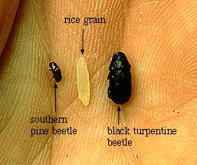
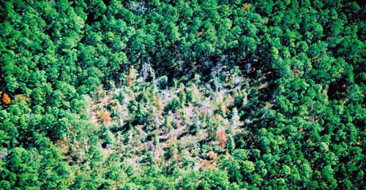
Background
Southern Pine Beetles (SPB), or Dendroctonus frontalis, is an opportunistic species that attacks stressed trees
Stress can be caused by drought, fire, or damage from storms or machinery
Most active during warm, summer months
2-4 mm in length
Image Credit: USDA Forest Service
Image Credit: USDA Forest Service
Notes:
The Southern Pine Beetle (SPB), or Dendroctonus frontalis, is an opportunistic species that attacks stressed trees weakened by drought, fire, or storm damage
They cause the most damage in the summer months where they are most active. They typically go dormant during the cold, winter months.
The beetle is only 2-4mm in length and is considered one of the most destructive pests in the southern United States.
Image Source: http://blogs.usda.gov/2011/11/15/southern-pine-beetle-one-million-acres-protected-one-acre-at-a-time/
Image Source: http://www.srs.fs.usda.gov/compass/2014/01/09/guidelines-for-regenerating-southern-pine-beetle-spots-2/

Slide 3
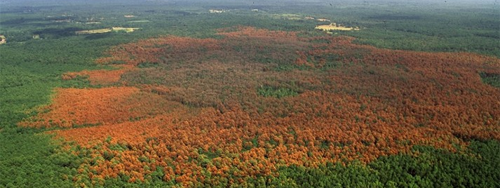
Community Concerns
SPB causes hundreds of thousands of dollars in damage to pines trees annually
Trees killed by SPB can increase severity of forest fires
Damages caused by SPB may result in limited diversity
Image Credit: Texas Forest Service
Notes:
SPB causes hundreds of thousands of dollars in damage to pine trees each year.
Trees killed by SPB can increase the risk or severity of forest fires by increasing the fuel load available to burn.
Damages caused by the SPB may result in limited diversity in surrounding plants and harm other animals’ habitats, such as the near-threatened Red-cockaded Woodpecker.
Image Source: Ronald F. Billings, Texas Forest Service, forestryimages.org Damage to a forest from the Southern pine beetle

Slide 4
Project Partners
USDA Forest Service
Notes:
This project partnered with the United States Forest Service. The forest service currently uses expensive manned aerial surveys, MODIS ForWarn, and Forest Disturbance Monitor data in addition to ground surveys to monitor Southern Pine Beetle infestations.

Slide 5
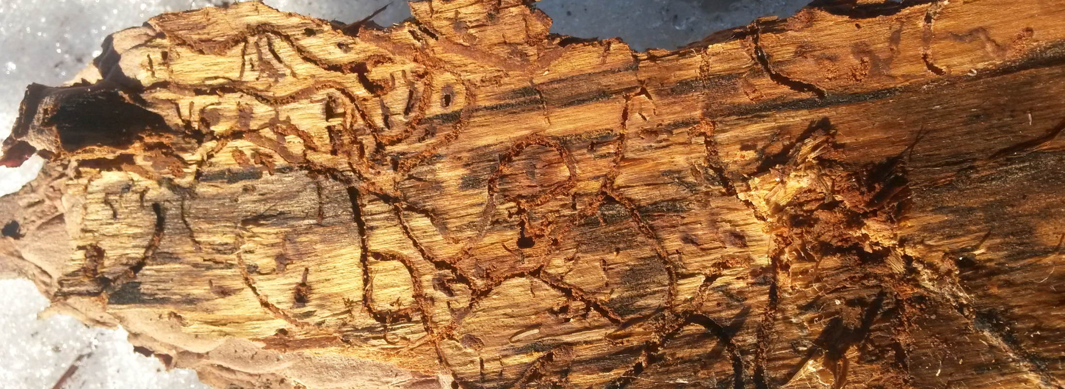
Image Credit: State of Connecticut
Objectives
Map previous SPB infestations to determine areas affected by the SPB
Assess current and future susceptibility of SPB outbreaks to help determine where suppression efforts should be focused
Create a near real-time susceptibility model to continually assess the ongoing risk of SPB outbreaks
Notes:
There were 3 objectives to this project. One, to determine the locations of previous pine beetle infestations to determine what environmental thresholds it prefers. Two, assess the current and future risks of outbreaks to aid in suppression efforts. Finally three, generate a Near Real-Time Susceptibility Model for project partners to assess the continuous risk of Southern Pine Beetle infestations on a weekly basis.
Image Source: http://www.ct.gov/deep/cwp/view.asp?a=2697&q=563452

Slide 6
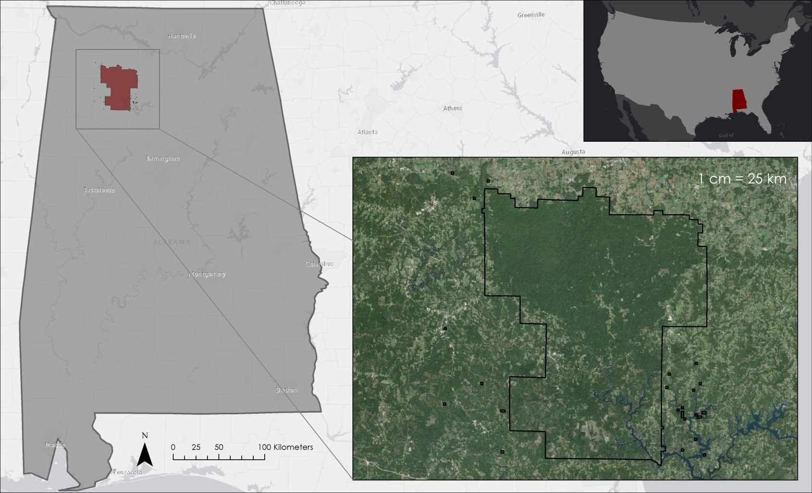
Study Area
Alabama, with a focus on Bankhead National Forest
Notes:
The study area is the state of Alabama with a particular focus on Bankhead National Forest. An estimated 69% of Alabama is forested, which consists mainly of hardwoods and pine trees, specifically loblolly and longleaf pines which the Southern Pine Beetle Prefers.

Slide 7
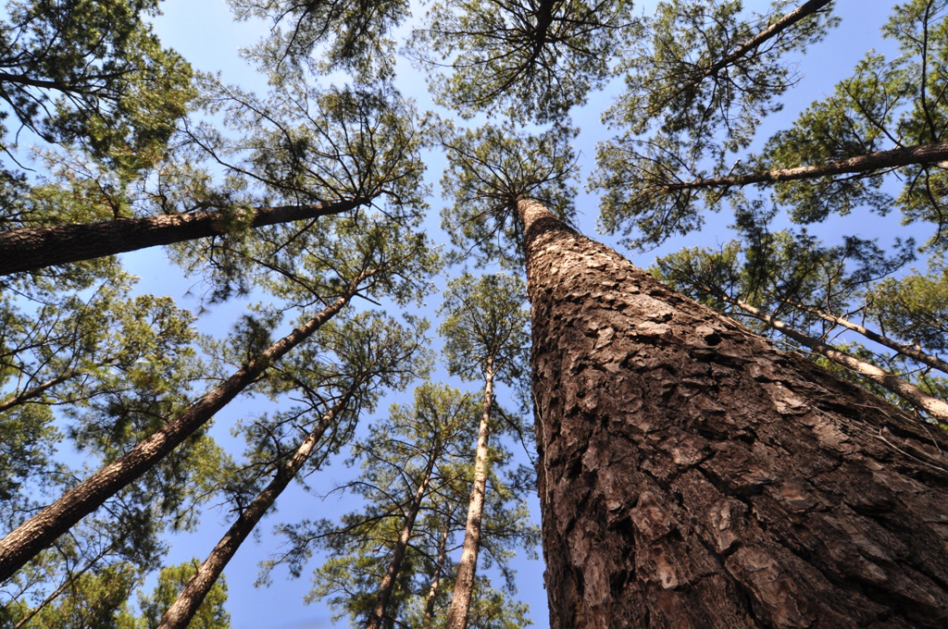
Study Period
Image Credit: Texas A&M Forest Service
Past
Future
January 2010
December
2015
2050
Notes:
The study period was from Januray 2010 to December 2015 while forecasting outbreaks to 2050.
Image Source: Ron Billings/Texas A and M Forest Service

Slide 8
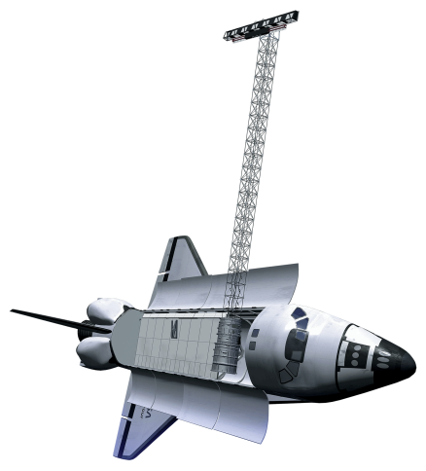
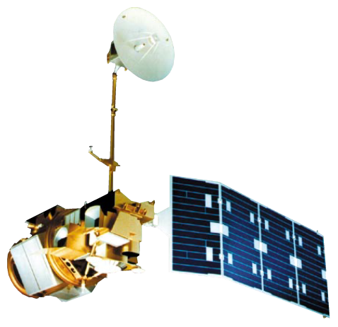
NASA Satellites/Sensors
SRTM-v2 C-band
Landsat 5 TM
Landsat 8 OLI
Notes:
The NASA Satellites and Sensors used for this project were Landsat 5 Thematic Mapper, Landsat 8 Operational Land Imager, and Shuttle Radar Topographic Mission version 2 C band.

Slide 9
Methodology
Historical Pine Beetle Susceptibility Map (TBD)

Slide 10
Methodology
Southern Pine Beetle Prediction Map
Calculate:
NDVI
GRVI
Tree Species
Variables
Elevation
Slope
Aspect
Climate Data
Landsat 8
Pine Beetle Prediction Map
Princeton Maximum Entropy Model
Notes:
Landsat data were downloaded and used to calculate NDVI, GRVI, and tree species. This data combined with elevation, slope, aspect, and climate data variables were added to the Princeton Maximum Entropy Model to create a pine beetle prediction map that forecasts pine beetle outbreaks to December of 2050.

Slide 11
Methodology
Near- Real Time Southern Pine Beetle Susceptibility Map
Calculate:
Surface Temperature
Minimum Temperature
Maximum Temperature
Mean Temperature
NDVI
GRVI
Tree Species
Fuzzy Memberships
Landsat 8
Variables
Elevation
Slope
Aspect
Fuzzy Logic Near Real-Time Map
Notes:
The Near-Real Time Pine Beetle Susceptibility Map was created by a python code where the most recent Landsat 8 tiles were downloaded and used to calculate surface temperature, minimum temperature, maximum temperature, mean temperature, NDVI, GRVI, and tree species. The python code concluded with creating Fuzzy memberships to be used in the Fuzzy Logic Model. Also contributing to the model were the variables of elevation, slope, and aspect. This created a product that assesses the susceptibility of pine beetle outbreaks in the study area based on the most recent data from Landsat.

Slide 12
Results
TBD

Slide 13
Image Credit: USDA Forest Service
Conclusions
TBD
Notes:
Image Source: http://www.srs.fs.usda.gov/compass/2015/07/21/thinning-and-burning-the-best-defense-against-southern-pine-beetle/

Slide 14
Errors and Uncertainties
Cloud cover
Erroneous dashes (Landsat 5)
In situ data – Engraver beetle
Image Credit: Leigh Sinclair

Slide 15
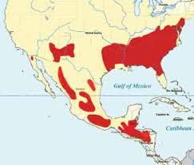
Future Work
TBD
SPB distribution:
Image Credit: USDA Forest Service
Notes:
Image from USFS: http://www.fs.usda.gov/Internet/FSE_DOCUMENTS/fsbdev2_042840.pdf

Slide 16
Advisors:
Dr. Jeffrey Luvall, NASA at NSSTC
Dr. Robert Griffin, University of Alabama in Huntsville
Partners:
Dave Casey, USDA Forest Service
Dr. John Nowak, USDA Forest Service
Dr. Chris Asaro, USDA Forest Service
Other:
Daryl Ann Winstead, NASA DEVELOP
Tim Klug, University of Alabama in Huntsville Graduate Research Assistant
Alabama Forestry Commission

