Slide 1
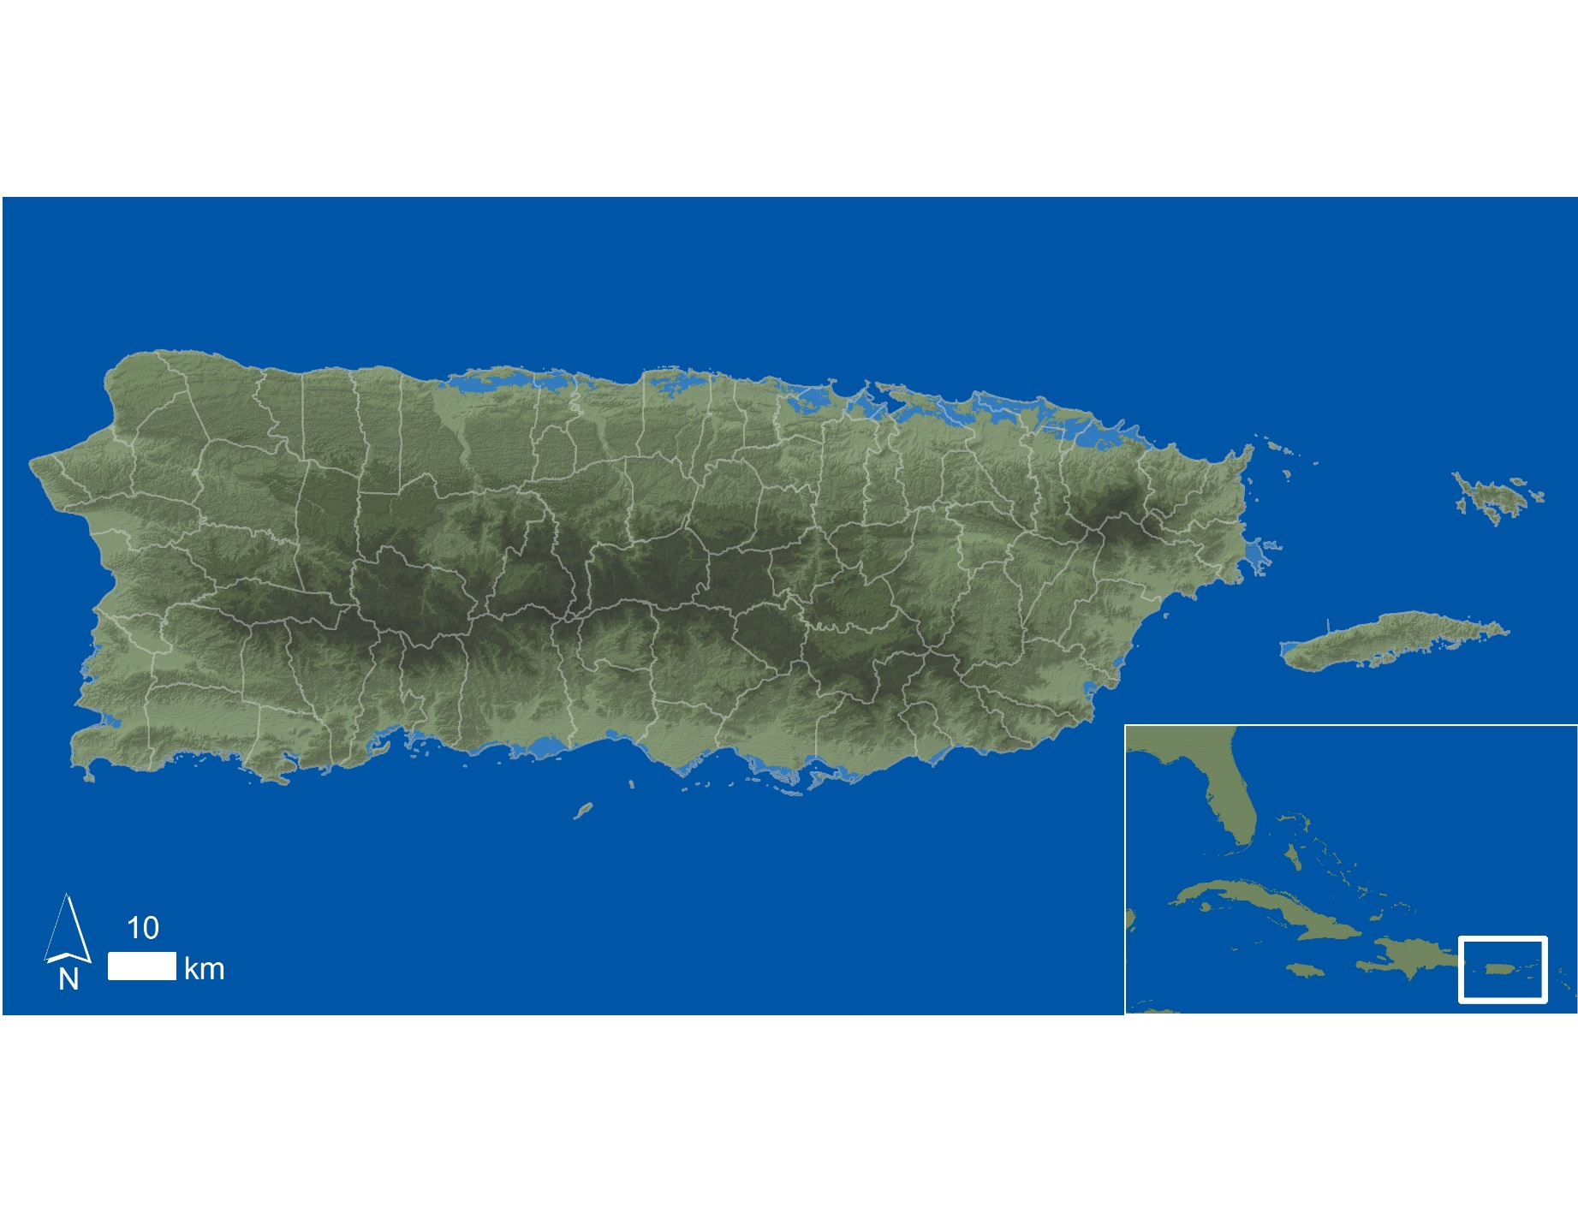
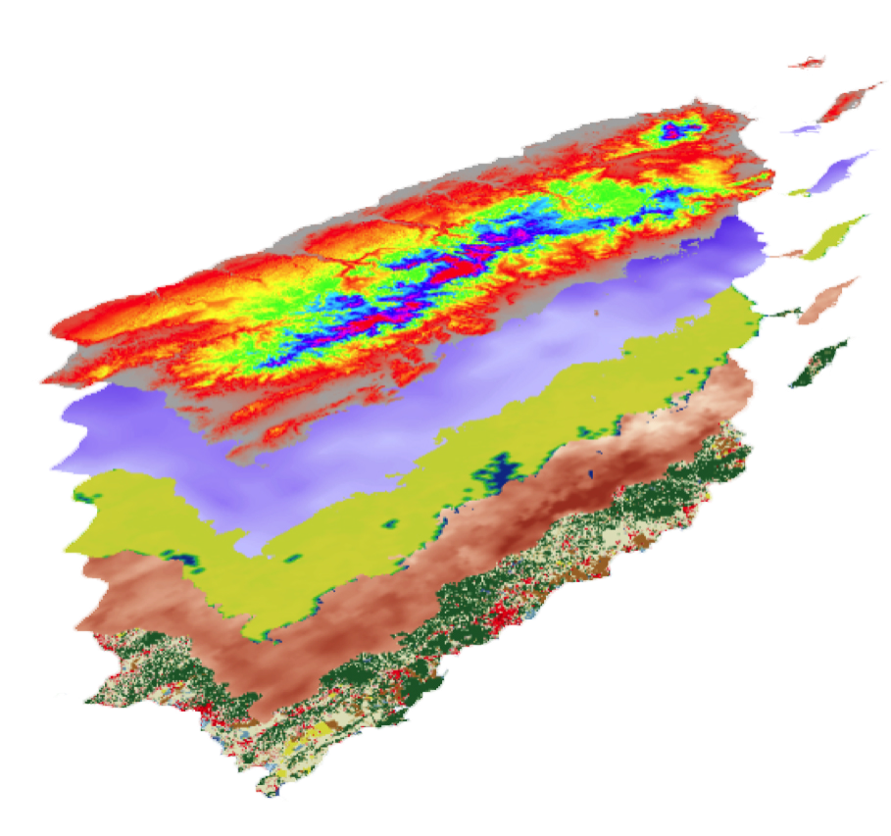
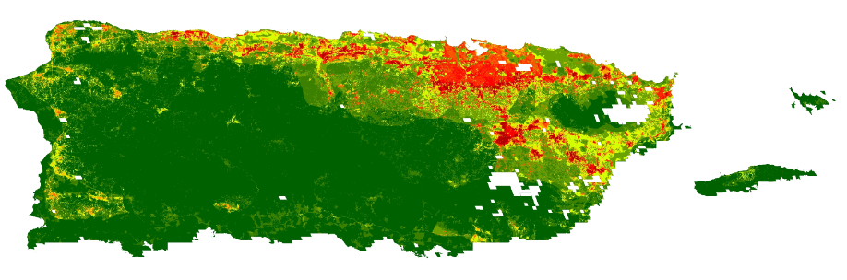
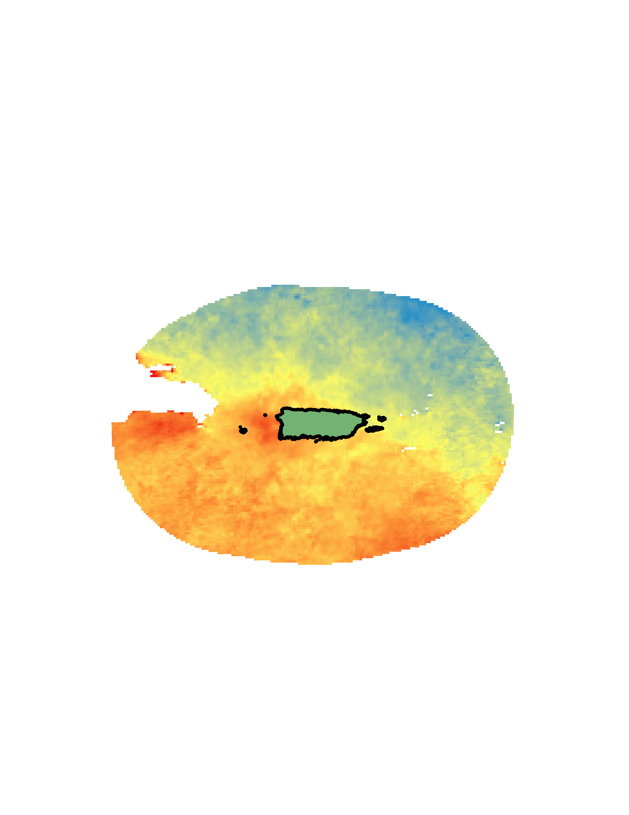


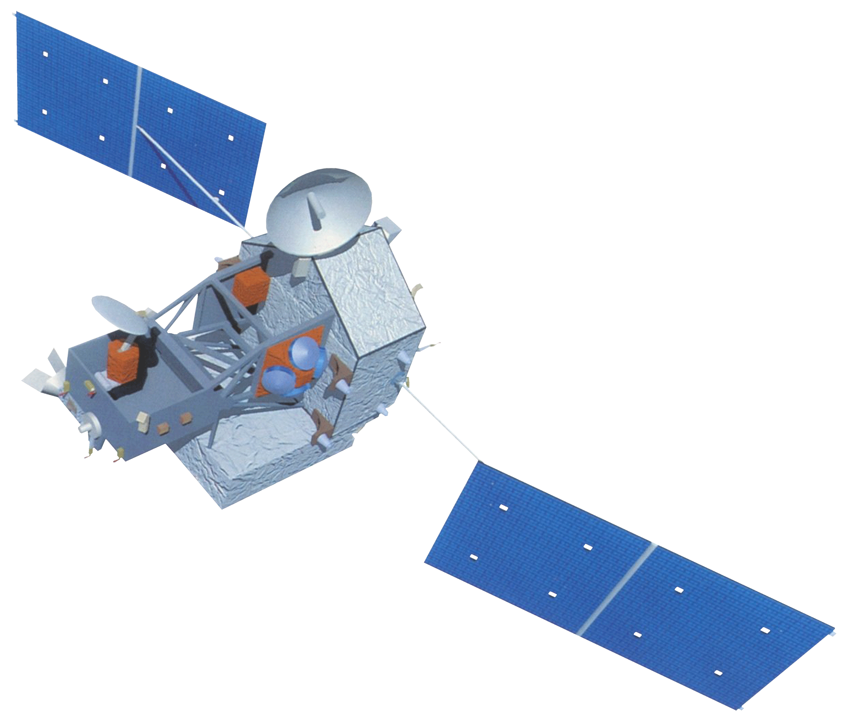

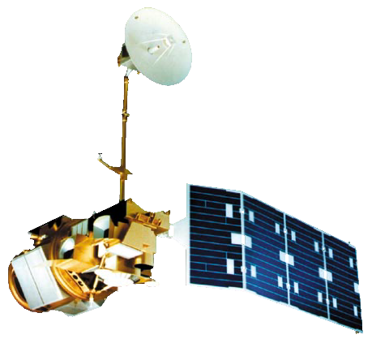
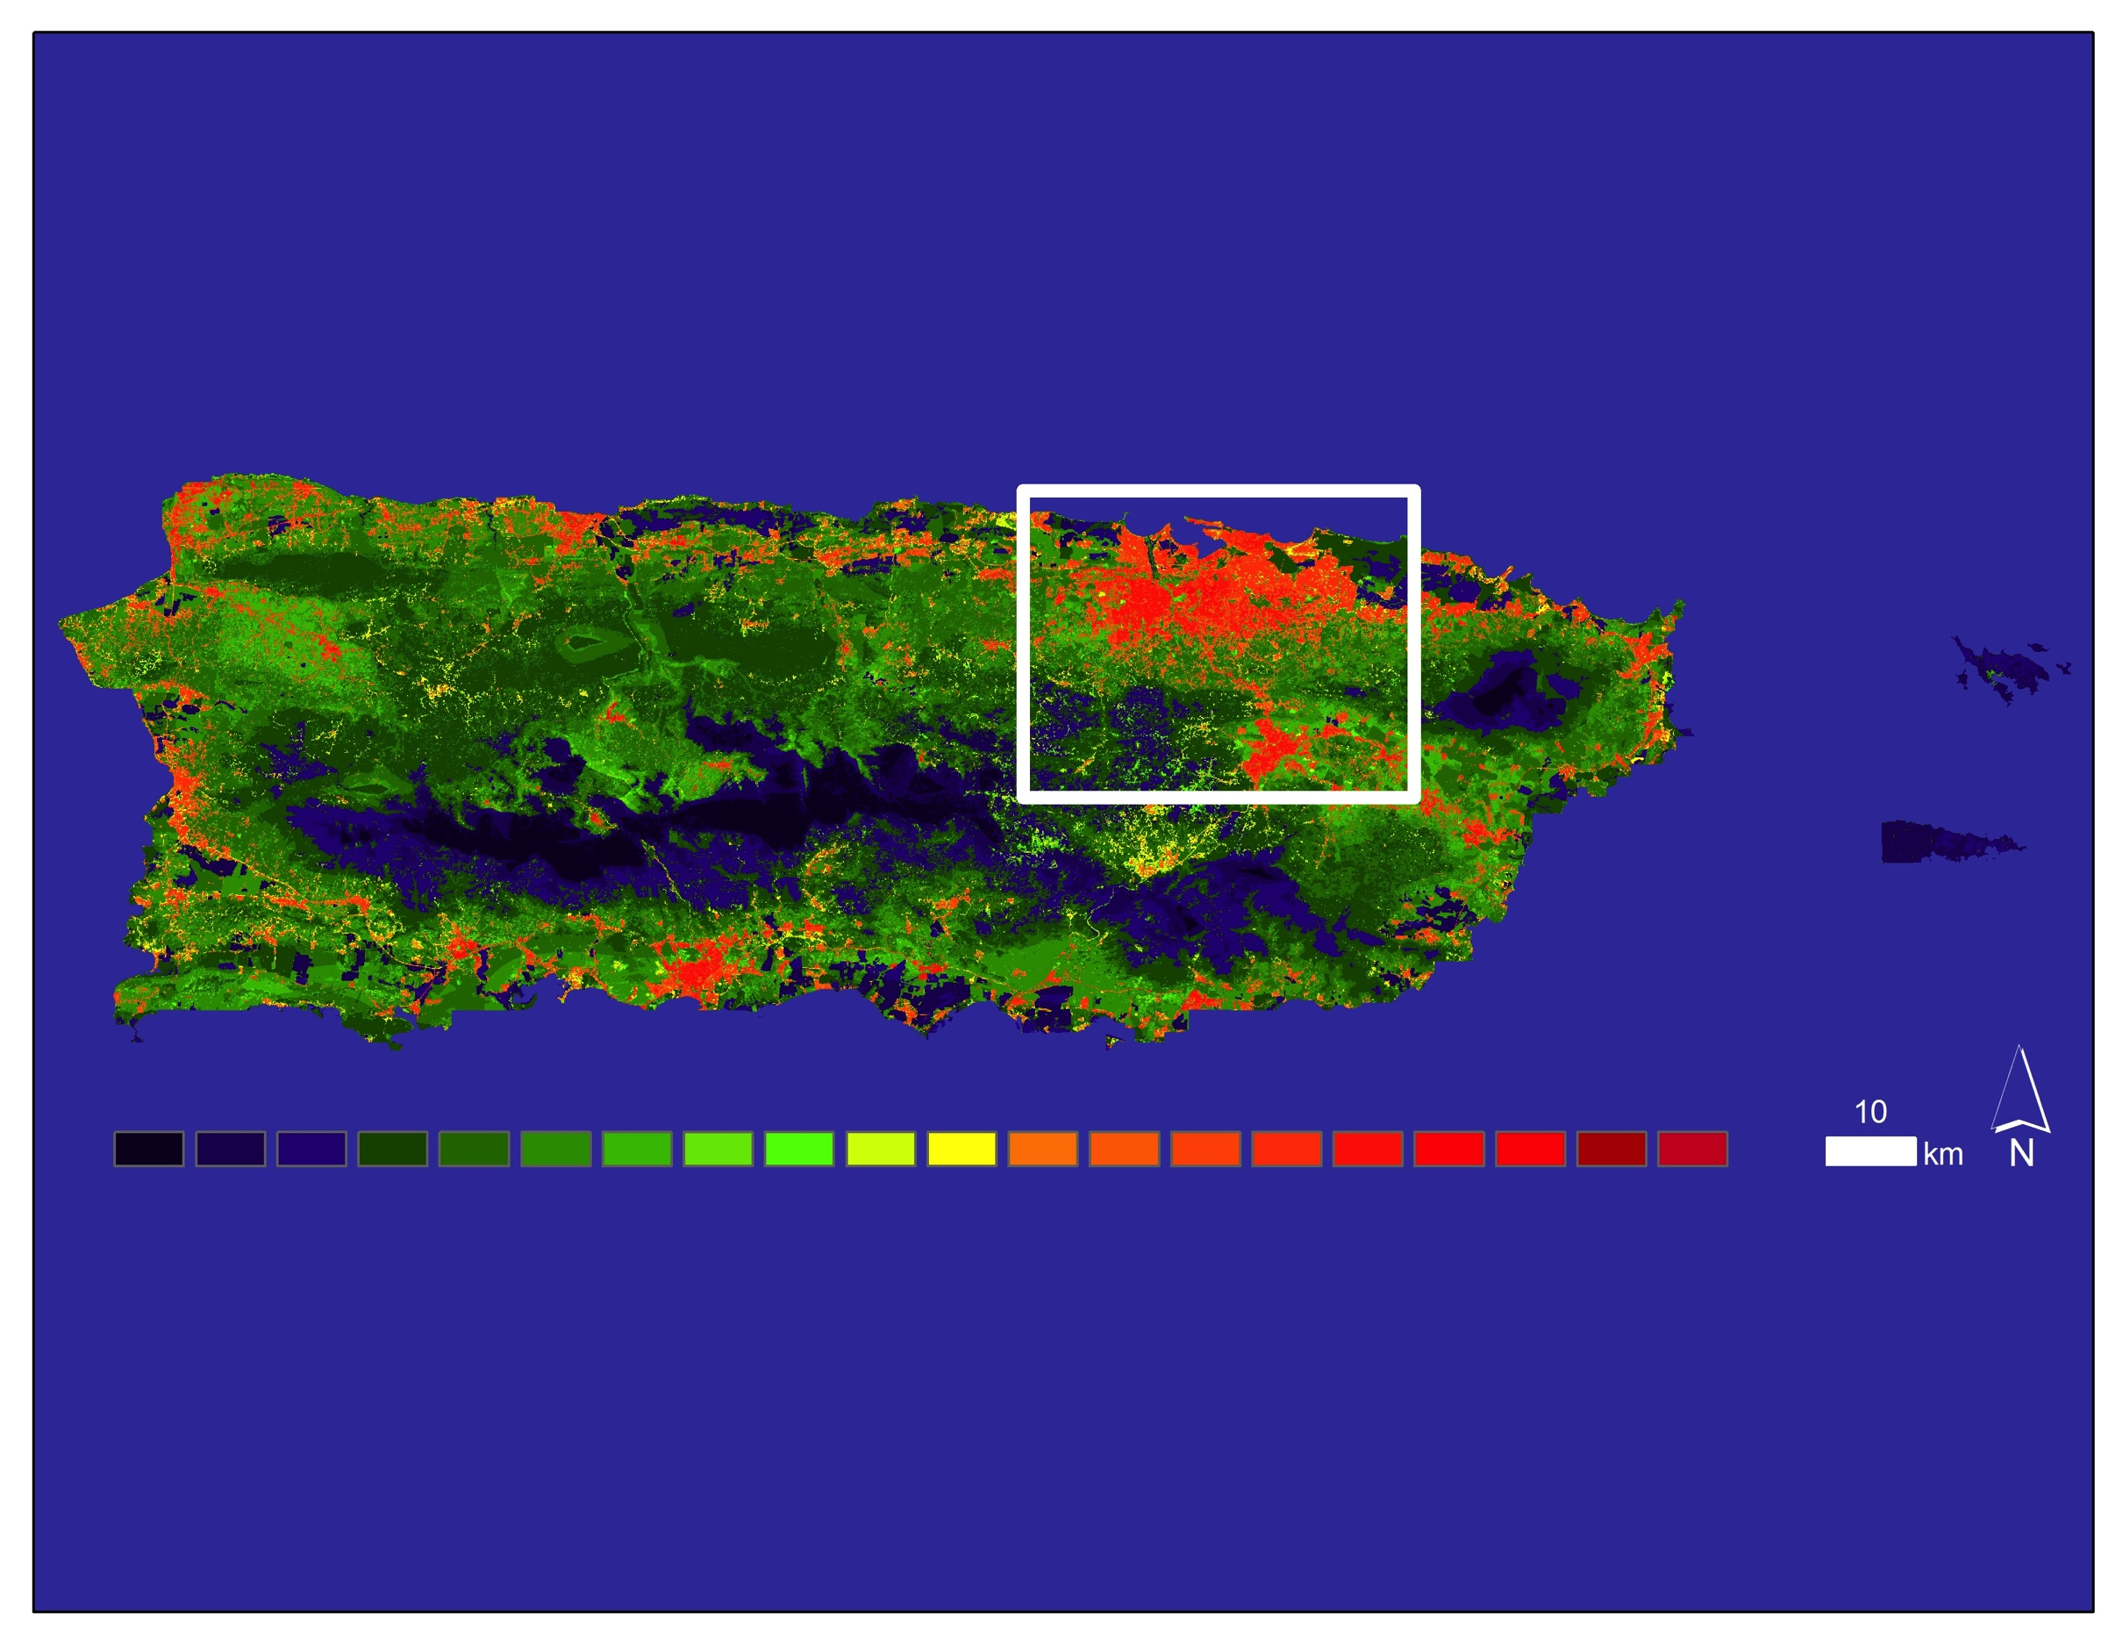
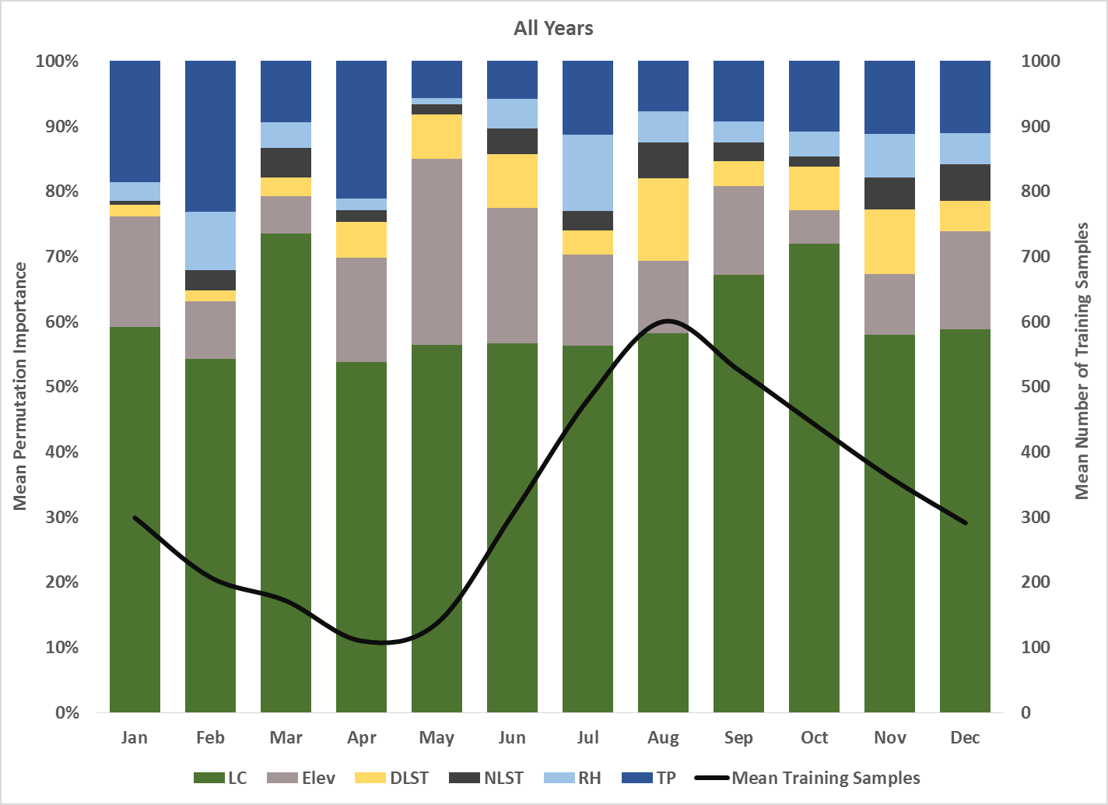
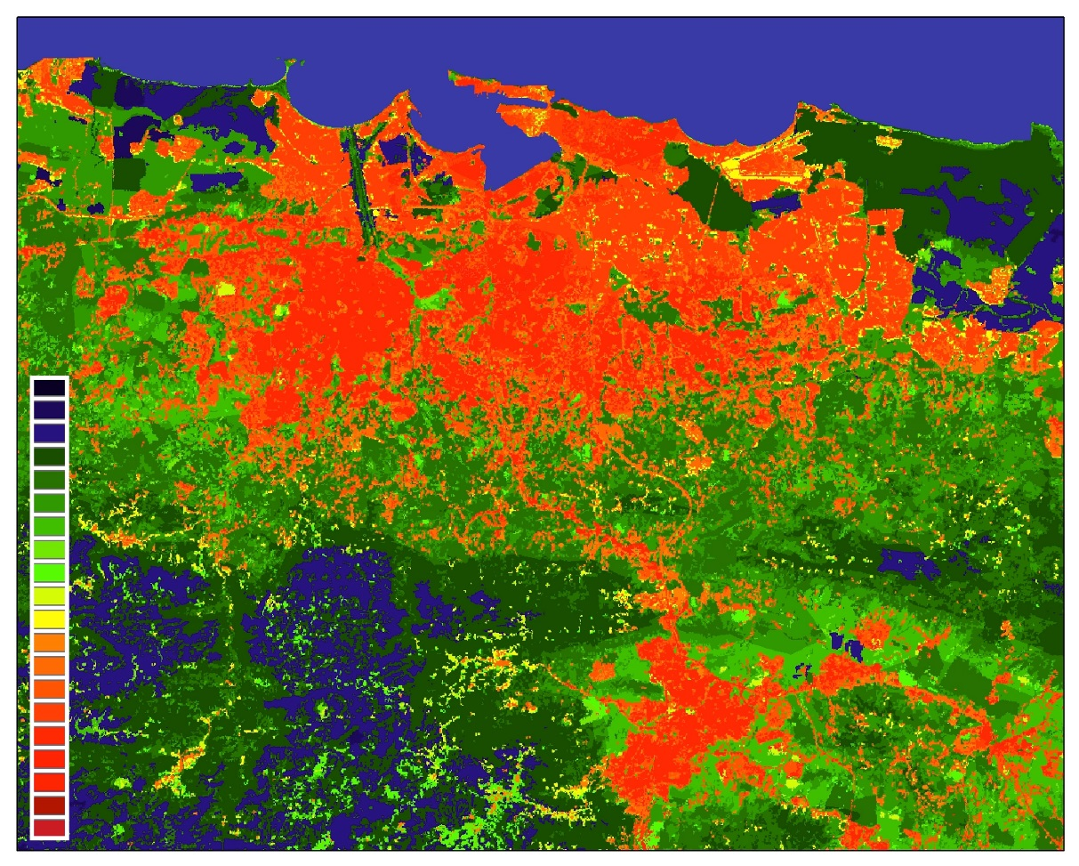
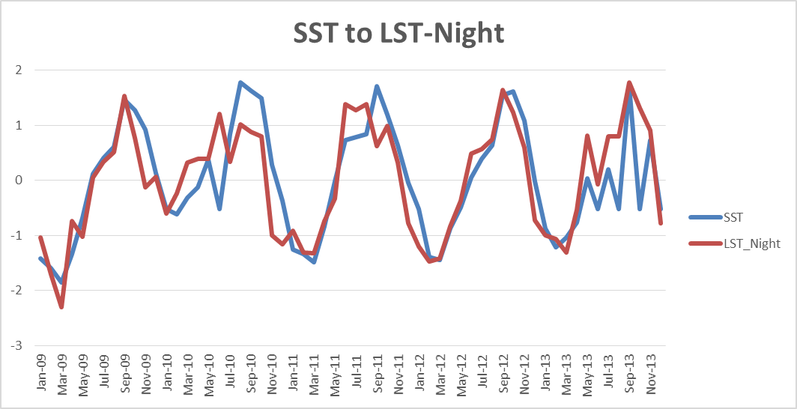
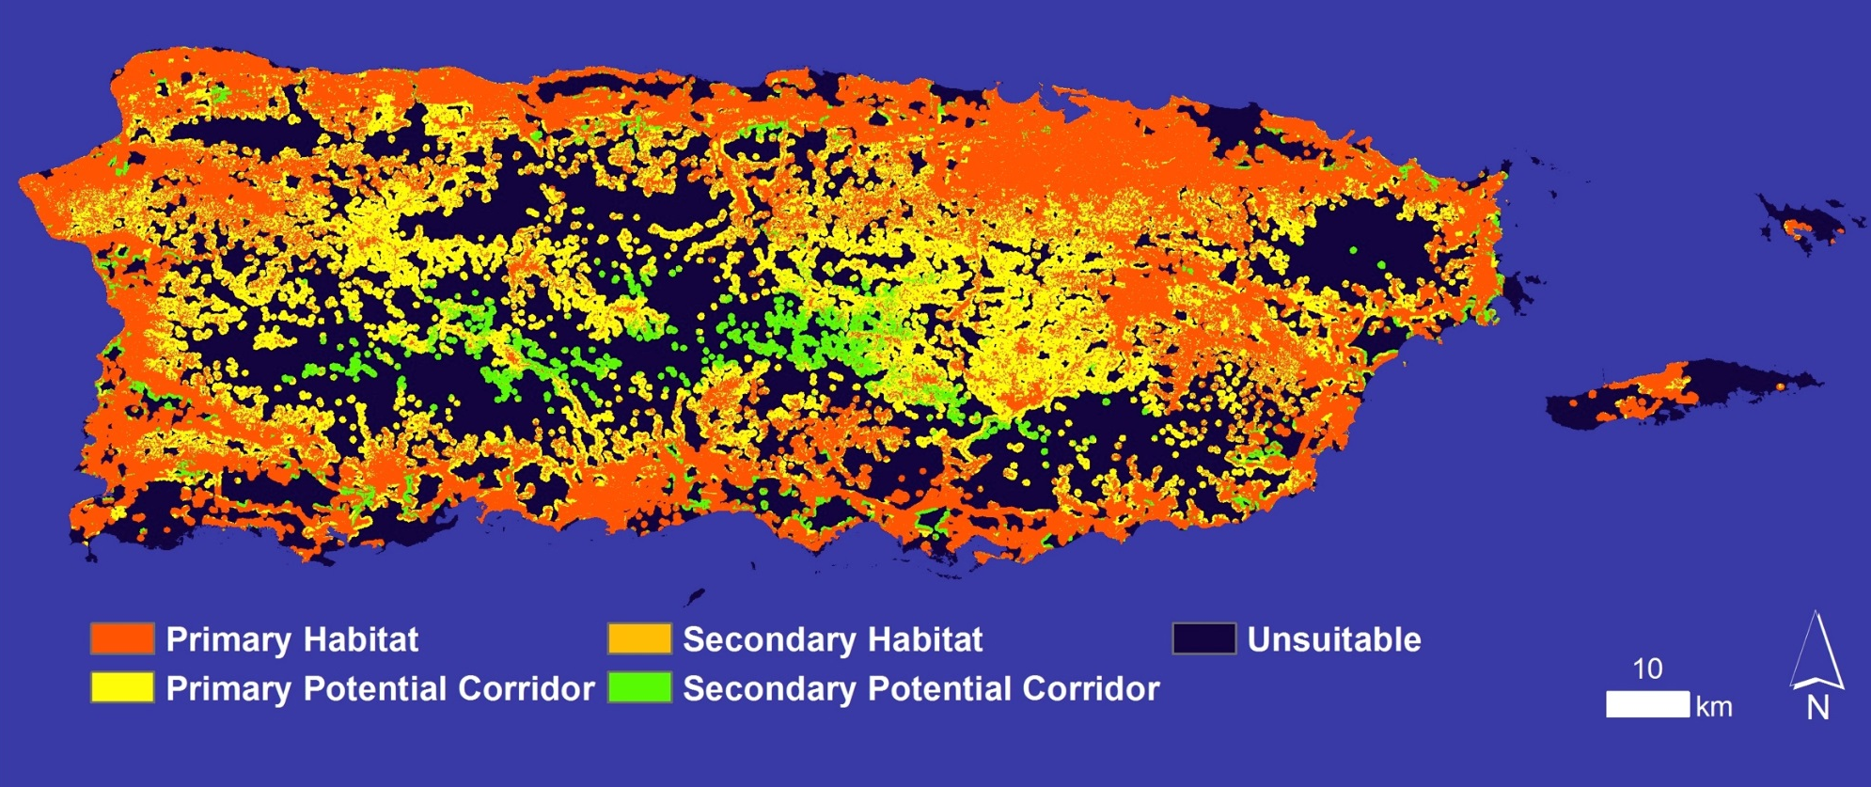

Puerto Rico Health
A Geospatial Assessment of Environmental Variability in Puerto Rico and its Relation to Confirmed Dengue Cases
Andrew Nguyen (Project Lead^{)1,} Alannah Johansen¹, Martha Sayre¹, Dr. Pablo Mendez- Lazaro², Dr. Roberto Barrera³, Dr. Juan Torres-Perez^{1, 4}
¹NASA DEVELOP National Program, ²Medical Sciences Campus of the University of Puerto Rico, ³U.S. Centers for Disease Control and Prevention Dengue Branch, ⁴Bay Area Environmental Research Institute
Abstract
Objectives
Dengue fever (DF) is the fastest-growing vector-borne disease in the world. This deleterious illness is endemic in the Caribbean and can lead to hemorrhagic fever, shock, and death in severe cases, posing a major threat to the health of Caribbean communities. A high occurrence of the primary vector of the dengue virus (Aedes aegypti) has been detected in populated areas within Puerto Rico, contributing to several dengue outbreaks, including instances in 2010, 2012, and 2013. This study examined environmental conditions contributing to Confirmed Dengue Fever Cases (CDFC) for the island of Puerto Rico from January 2009 - December 2013 using monthly NASA Terra/ Aqua Moderate Resolution Imaging Spectroradiometer (MODIS) 0.05° day land surface temperature (DLST) and night land surface temperature (NLST) products, 1 km Geostationary Operational Environmental Satellite system Puerto Rico Water Energy Balance (GOES-PRWEB) humidity products, and 0.05° Climate Hazards Group InfraRed Precipitation and Satellite (CHIRPS) total precipitation (TP) modeled data, elevation, and land cover (LC). These data were incorporated into a Maximum Entropy Species Distribution Model to spatially delineate monthly potential dengue risk and to determine the permutation importance of variables based on CDFC. Land cover, elevation, and TP had the highest mean relative importance of environmental variables indicating that the disease spreads easily through low-elevation urban areas following periods of increased rainfall. Lastly, using Time Series Frequency Analysis, the correlation between MODIS 4km sea surface temperature (SST) products and CDFC were separately tested against environmental conditions to better understand the relationship between oceanic and land conditions contributing to dengue. SST and environmental conditions correlation coefficients indicate moderate to strong relationships.
Use the Maximum Entropy Species Distribution Model to determine the contribution of environmental factors to DF epidemics and produce DF risk assessment maps.
Better understand the relationship among Sea Surface Temperature (SST), CDFC, and contributing environmental variables using Time Series Frequency Analysis.
Study Area
Methodology
Maximum Entropy Habitat Suitability Model
Relative Importance of variables
to CDFC
Figure 1. The Commonwealth of Puerto Rico has an area of appx. 9,104 km². It is divided into 78 municipalities. The climate is tropical with annual average temperatures between 21°C and 27°C, and a rainy season from April to November. Climate varies along the length of the island, with the drier regions occurring in the south.
Project Partners
University of Puerto Rico, Medical Sciences Department
Center for Disease Control (CDC) – Dengue Branch
Puerto Rico Department of Health
Geospatial Assessment of Dengue Fever Risk
Monthly Jan 2009- Dec 2013
Earth Observations
1) LST- Day (MODIS)
2) LST- Night (MODIS)
3) RH (GOES-PRWEB)
4) TP (CHIRPS)
5) Land Cover (NLCD)
6) Elevation (USGS)
7) CDFC (CDC, In-Situ)
r value Correlation Coefficients of SST to:
Figure 2. Diagram outlining the data project workflow. Two approaches were taken (upper and lower sections). The upper section outlines the Maximum Entropy model environmental contributor inputs and potential model results. The lower section outlines the use of Time Series Frequency Analysis to separately correlate SST to environmental contributors and potential correlation coefficient values.
Time Series Frequency Analysis
1) LST- Day
2) LST- Night
3) RH
4) TP
7) CDFC
Aqua-MODIS
TRMM-PR
Jan 2009- Dec 2013
Monthly SST
Results
Terra-MODIS
Landsat 5-TM
Time Series Frequency Analysis (TSFA) for SST and CDFC
 | Variable | r - value | Lag Time (MO)
To SST | NLST | 0.82 | n/a
 | DLST | 0.40 | n/a
 | RH | 0.45 | n/a
 | TP | 0.60 | 5
 | CDFC | 0.41 | n/a
To CDFC | NLST | 0.37 | 3
 | DLST | 0.41 | 3
 | RH | -0.13 | 2
 | TP | 0.38 | 5
 | TP | -0.36 | 2
Table 1. TSFA correlation coefficient values for SST and CDFC to contribution environmental conditions. CDFC to TP were applied with 5 and 2 month lag times to account for lag times based on literature review and assessments based on actual data values.
Figure 3 (top left) & 4 (left). Dengue risk for August 2010 according to Maximum Entropy outputs. Darker red shades show areas of high risk, while darker green shades delineate areas of low risk. Red dots indicate CDFC locations. Fig. 4 magnifies urban environments for San Juan (upper extent) and Caguas (lower left extent).
Figure 5 (top right). Timeline of MaxEnt output of mean monthly permutation importance values for all environmental variables in Puerto Rico from January 2009 – December 2013. Mean permutation importance for the variables are as follows: LC = 60% ; Elevation = 14%, TP = 12%, DLST = 6%, NLST = 3% , RH = 5%.
Figure 7. TSFA of SST to NLST correlation resulted in an r value of 0.82.
Figure 6 (bottom right). Habitat assessment map for dengue virus infected A. aegypti produced by TerrSet’s Habitat Suitability Module using map inputs of LC and elevation.
Team Members
Conclusions
Acknowledgements
According to model results, top contributing conditions to CDFC include:
(1) Urban areas, (2) Elevation and (3) Precipitation
There is a moderate to strong relationship between SST and CDFC contributing environmental conditions.
Maximum Entropy is a viable option for dengue fever risk assessment.
We would like to thank Emily “Chippie” Kislik and Victoria Ly from Ames DEVELOP for their input and guidance throughout this project.
We would like to acknowledge Dr. Pablo Méndez-Lázaro from Medical Sciences Campus of the University of Puerto Rico, and Dr. Roberto Barrera from the U.S. Centers for Disease Control and Prevention (CDC) Dengue Branch for project advisement and data sources. We would also like to thank Jessica Cabrera from the Puerto Rico Department of Health for her overall support of the project.
Figure 6. Left to right: Martha Sayre, Alannah Johansen, and Andrew Nguyen.
NASA Ames Research Center

