Slide 1
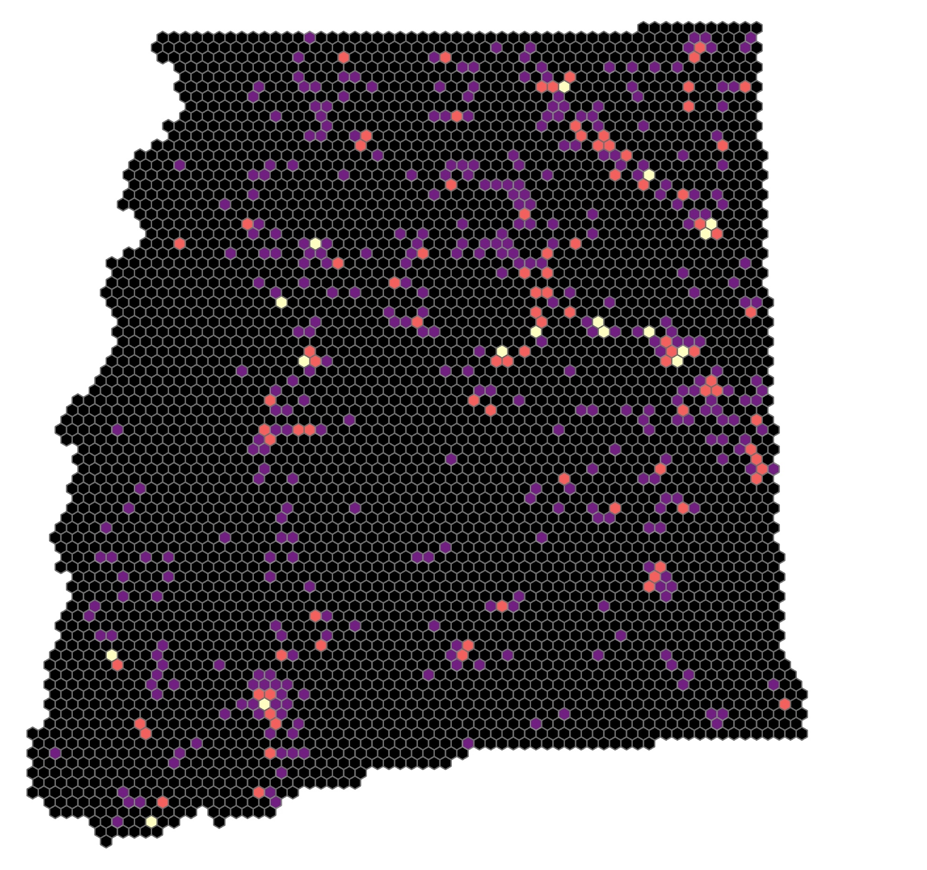
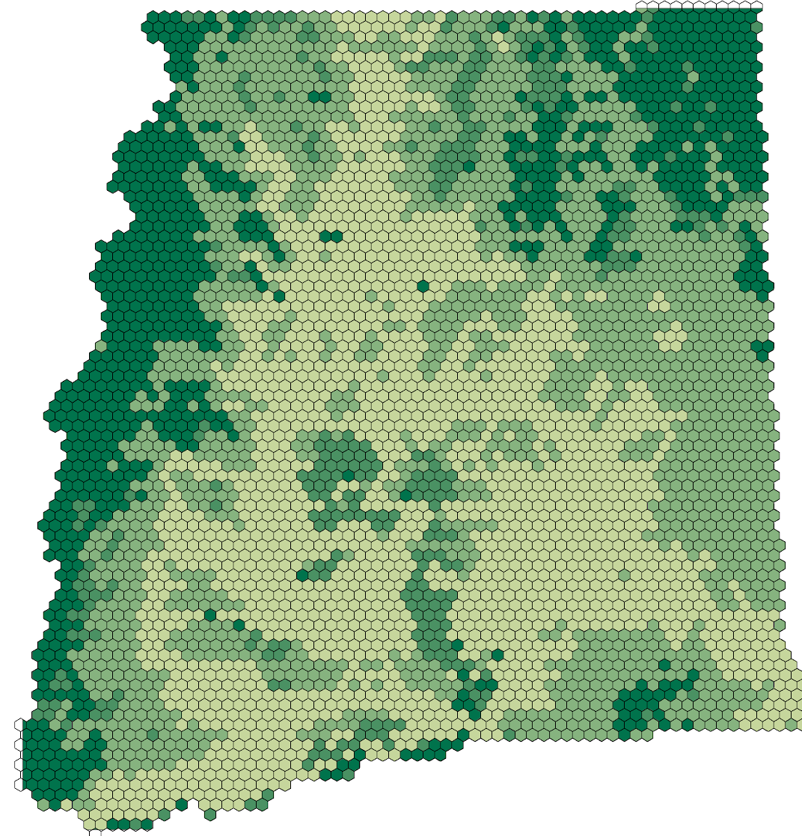
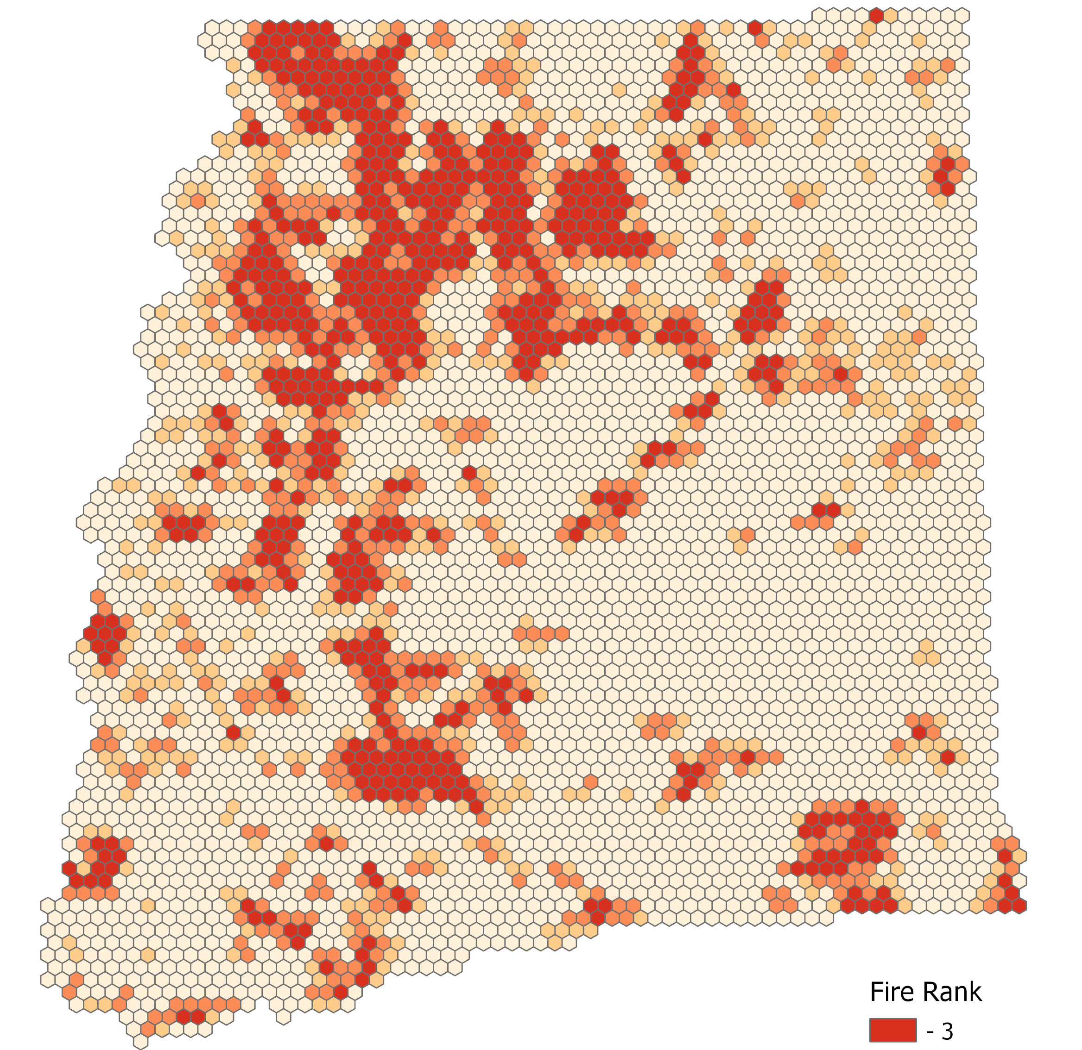
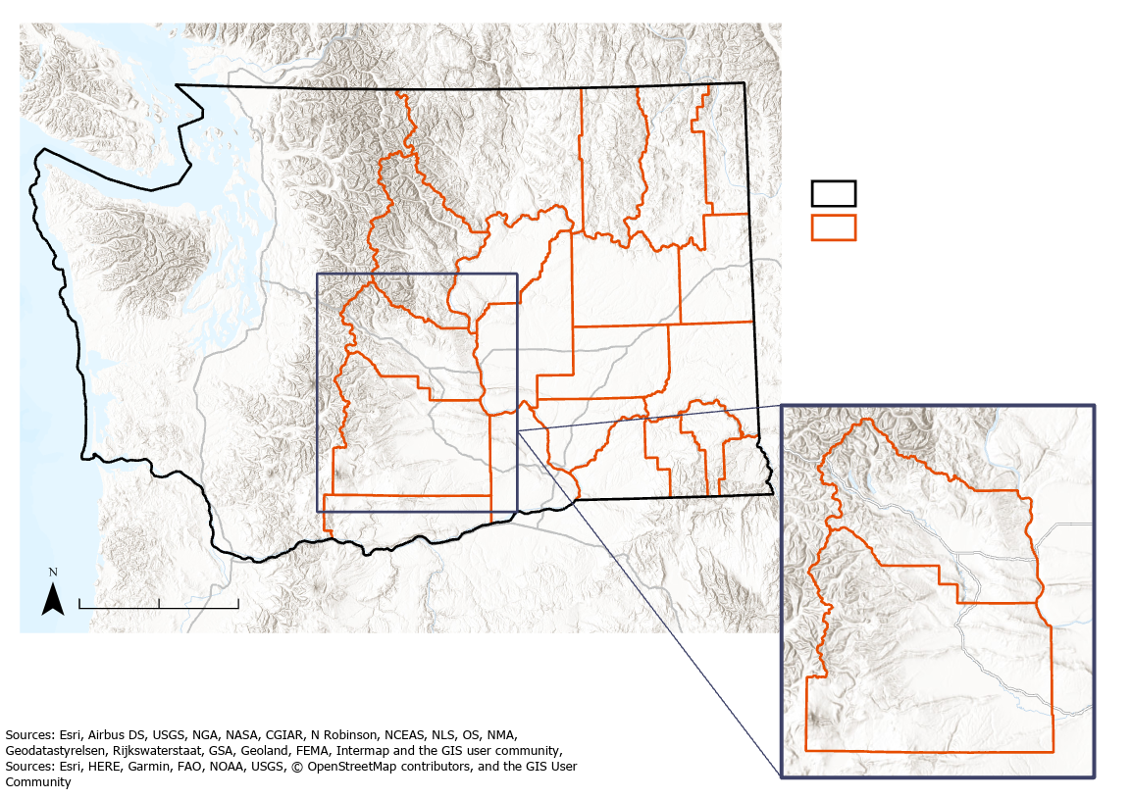
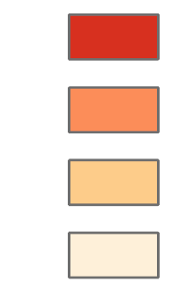
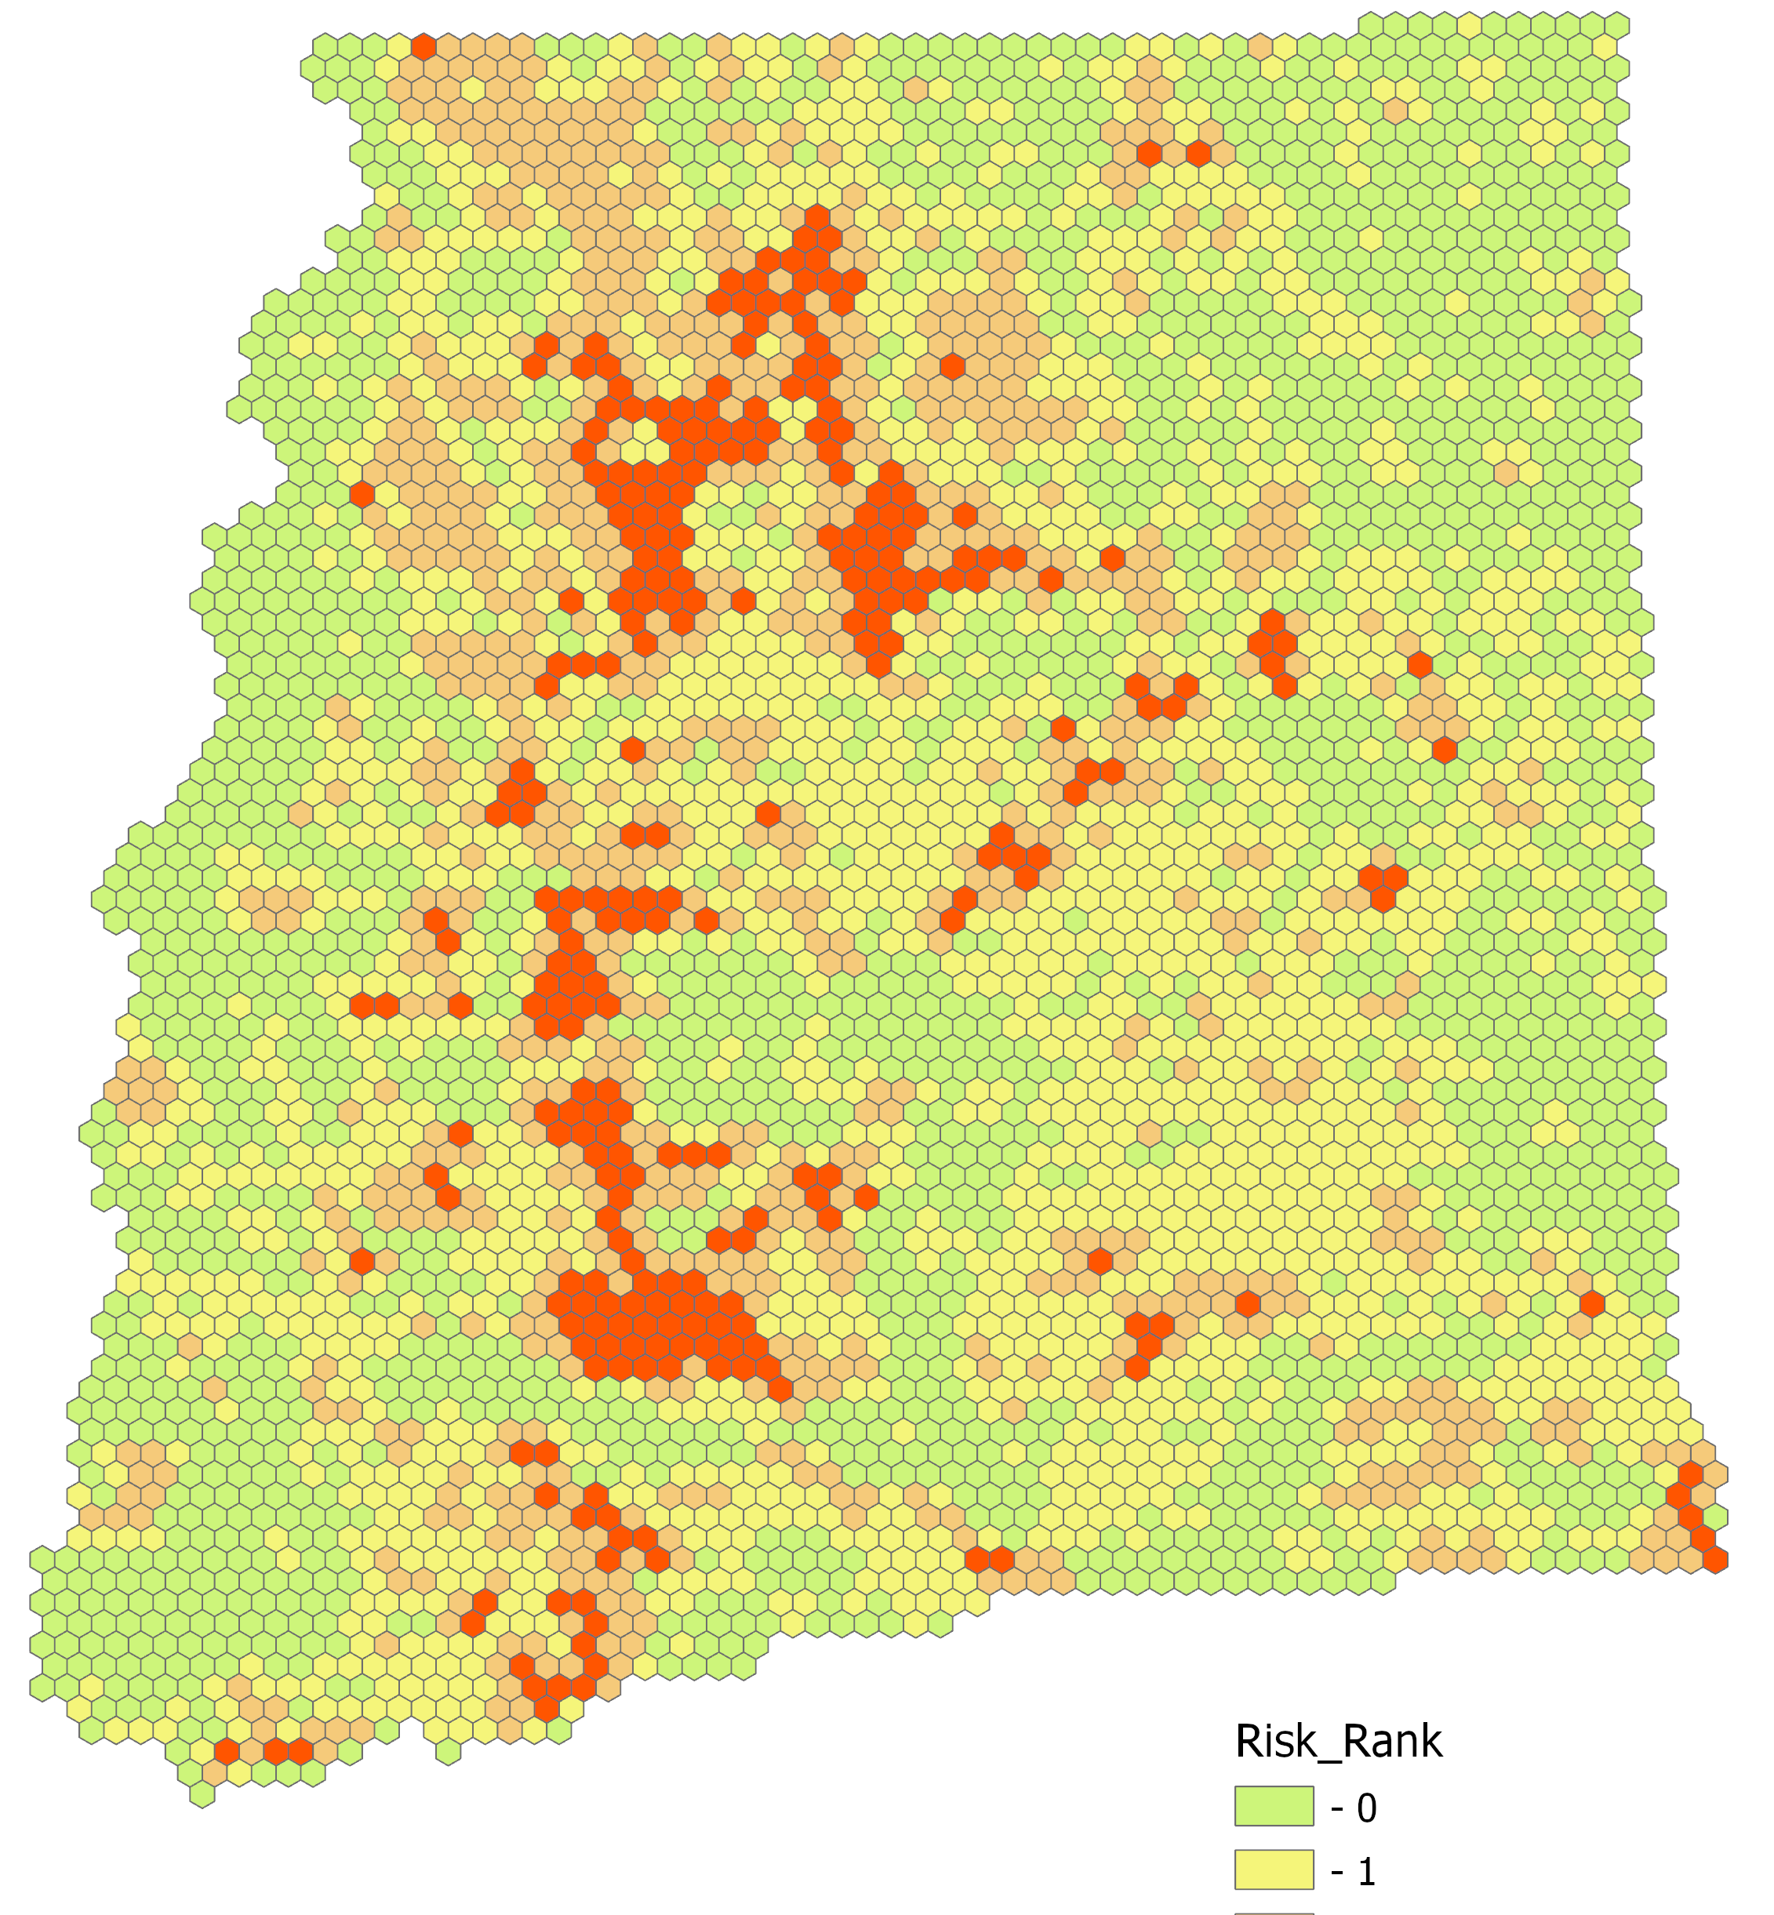
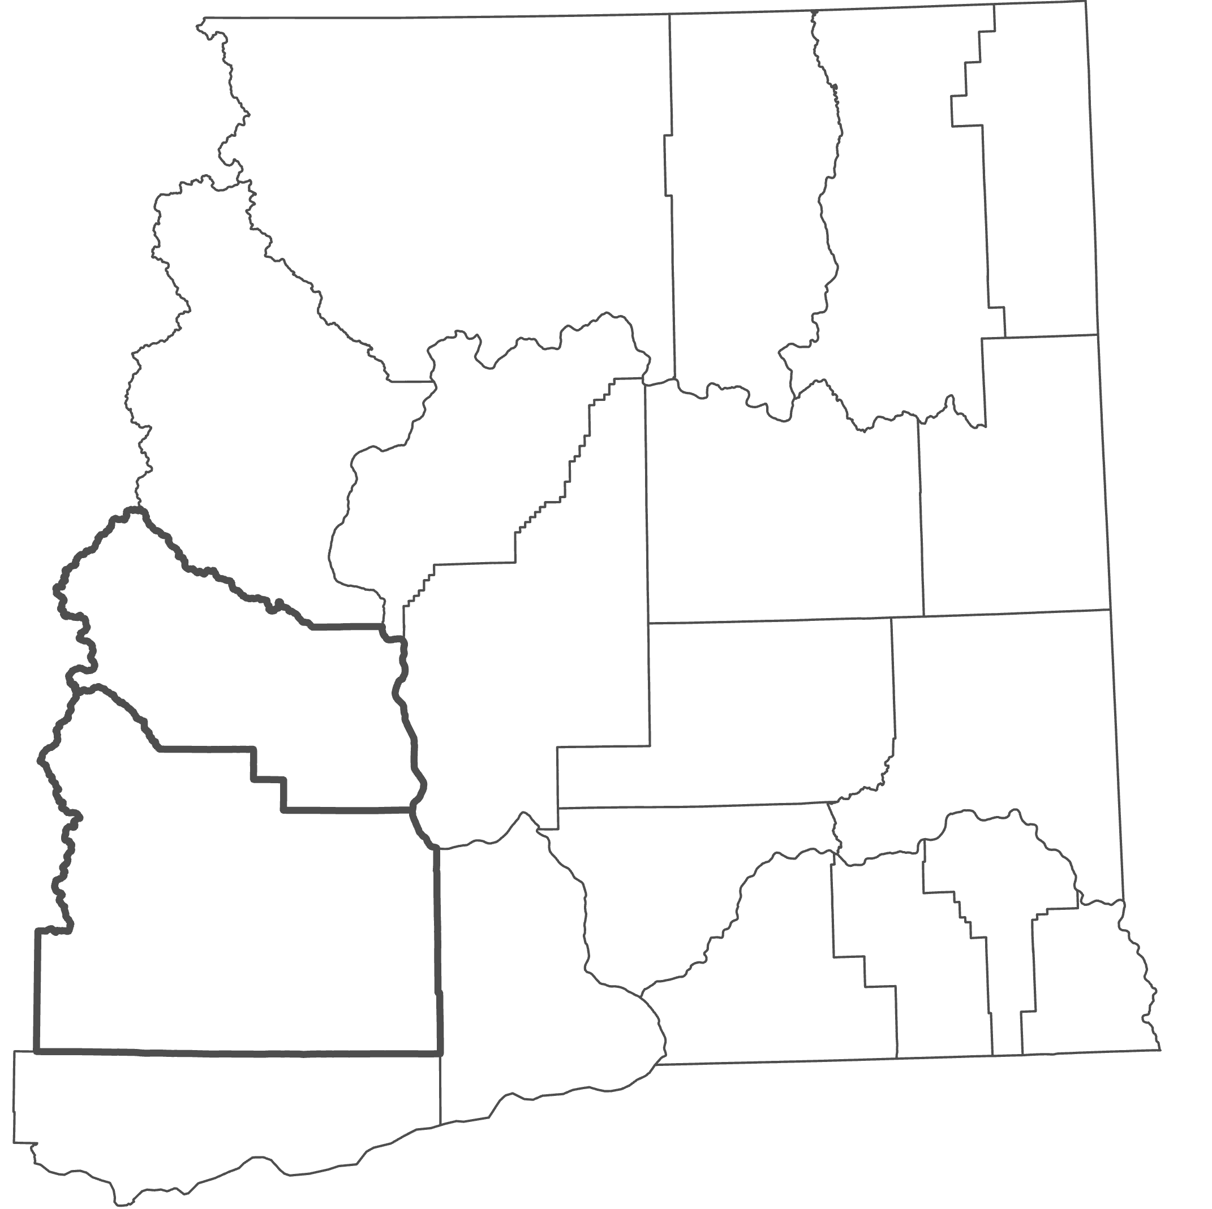
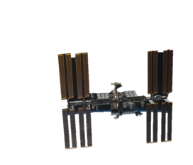
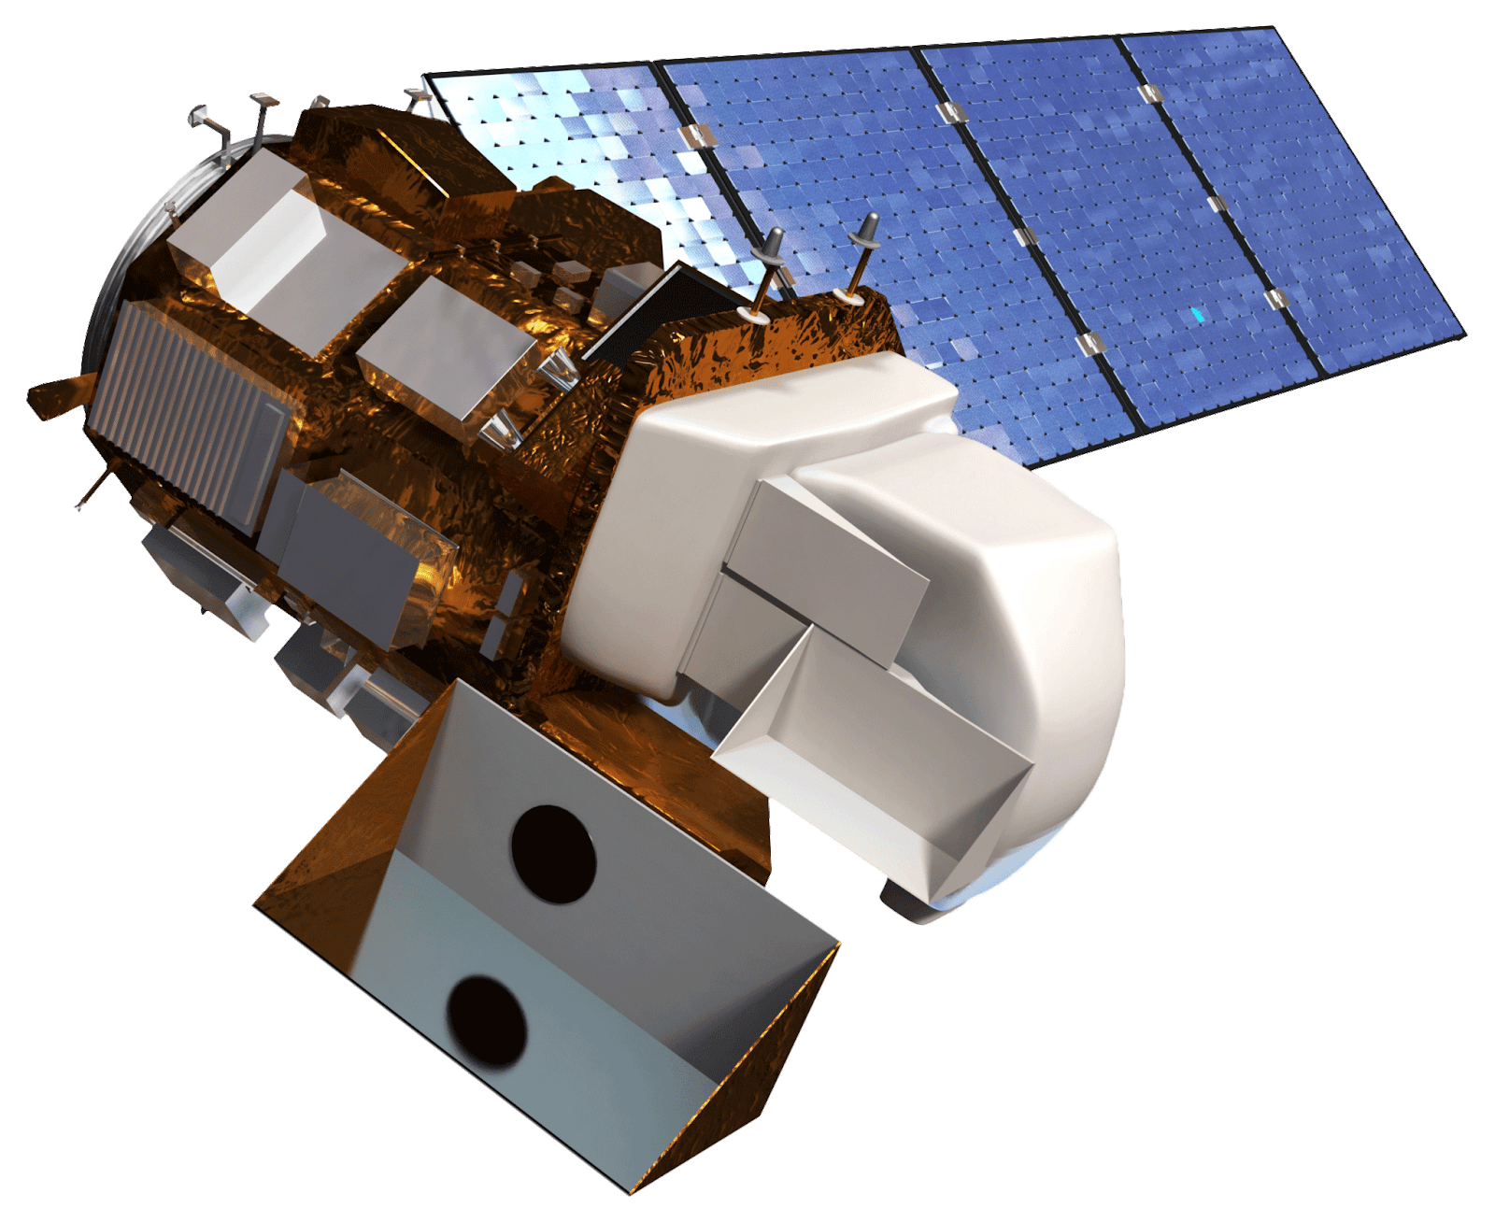
Integrating NASA Earth Observations to Analyze Spatiotemporal Distributions of Lightning-Caused Wildfires in Eastern Washington
Abstract
Objectives
Eastern Washington Disasters
According to the Washington Department of Natural Resources, roughly 36% of large fires in the state since 2010 were caused by lightning. General trends also show a greater increase in the number of lightning-ignited fires over the last three decades. The NASA DEVELOP Eastern Washington Disasters team partnered with The Nature Conservancy’s Washington Chapter to analyze the relationship between lightning strikes and wildfire events in Eastern Washington, with an emphasis on Kittitas and Yakima Counties. Using the International Space Station Lightning Imaging Sensor, the Landsat 5 Thematic Mapper and Landsat 8 Operational Land Imager vegetation moisture index, and Washington Department of Natural Resources historical fire data, the team generated a lightning-caused fire vulnerability index for 2001-2019. Climatology maps of lightning, wildfire, and vegetation moisture of the study area, along with an Esri ArcGIS StoryMap, further communicated project findings. Results demonstrated spatiotemporal patterns of lightning-ignited wildfires in Eastern Washington to inform land management practices and better predict areas that may be more vulnerable to these events.
Identify spatiotemporal patterns of lightning-ignited wildfires
Analyze the frequency and severity of lightning-ignited wildfires
Assess the risk of wildfire ignition in Kittitas and Yakima Counties of Washington and the surrounding region
Provide our partner with resources to visualize, interpret, and share data on Eastern Washington’s fire regime
Results
Lightning Exposure
(2017-2019)
Vegetation Moisture
(2017-2019)
Percent Burn Area
(2001-2019)
Study Area
Eastern Washington
0
100 km
Fire Vulnerability Rank
Lightning Vulnerability Rank
Moisture Vulnerability Rank
50
3
3
3
Washington State
2
2
2
1
1
1
Seattle
Spokane
Eastern Washington
0
0
0
Composite Vulnerability Index
Okanogan
The Composite Vulnerability Index Climatology combines the three factors - percent area burned, lightning exposure, and vegetation moisture - to show areas with low to high vulnerability; these are ranked from 0-3 where an index of 0 is low vulnerability and 3 is high.
Kittitas County
Cle Elum
Vulnerability Rank
0 80
3
Distance (miles)
Yakima
County
Kittitas
2
1
Earth Observations
Yakima
0
0
100 km
Sum of Fire, Lightning, and Vegetation Moisture Ranks by County
International Space Station Lightning Imaging Sensor
Aqua MODIS
Terra MODIS
Landsat 5 TM
Landsat 8 OLI
1500
Fire Rank
Sum of Ranks
1000
Lightning Rank
Methodology
500
Moisture Rank
Data Acquisition
Data Processing
0
Asotin
Franklin
Benton
Garfield
Adams
Chelan
Ferry
Kittitas
Lincoln
Yakima
Douglas
Klickitat
Columbia
Stevens
Whitman
Spokane
Grant
Pend Oreille
Data Analysis
End Products
Okanogan
Walla Walla
Inputs
Fire Burn Record
ISS LIS Lightning Flash Locations
Landsat Vegetation Moisture
Calculate
Percent Burn Area, Lightning Counts, Moisture Level from Landsat NDMI
Fishnet Methodology
Divide data by natural breaks into 4 classes, ranked as 0-3
Climatology for 2001 to 2019
ArcGIS Online StoryMap
Conclusions
County
The highest index cells, or the most vulnerable, were concentrated in the northwest region of the study area, specifically in Okanogan County.
Within Kittitas and Yakima Counties, there were 1,750 total square kilometers classified as having the highest vulnerability (index of 3).
Vector fishnet layers derived from Earth observation data can be an effective, flexible way of conducting vulnerability assessment.
Project Partners
Acknowledgements
The Nature Conservancy, Washington Chapter
Brian Straniti, The Nature Conservancy Washington Chapter
Dr. Juan Torres-Pérez, Bay Area Environmental Research Institute, NASA Ames Research Center
Dr. Kenton Ross, NASA Langley Research Center
Dr. Christopher Schultz and Dr. Chris Hain, Short-term Prediction Research and Transition Center (SPoRT), NASA Marshall Space Flight Center
Dr. Vincent Ambrosia, NASA Ames Research Center
Gina Cova, DEVELOP Fellow – NASA Ames Research Center
Zachary Bengtsson, DEVELOP Fellow – NASA Ames Research Center
John Dilger, Spatial Informatics Group
Christine Evans and Essence Raphael, University of Alabama, Huntsville
Team Members
Ani Matevosian
Project Lead
Ani Matevosian
Project Lead
Amelia Zaino
Amelia Zaino
Amy Kennedy
Amy Kennedy
Evan Bradish
Evan Bradish
California - Ames

