Slide 1
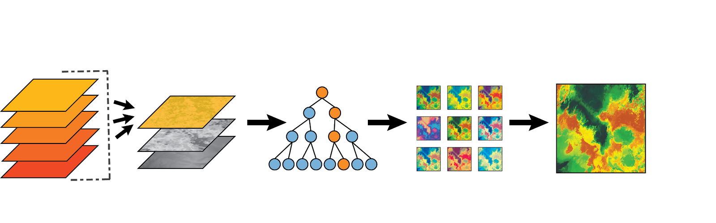
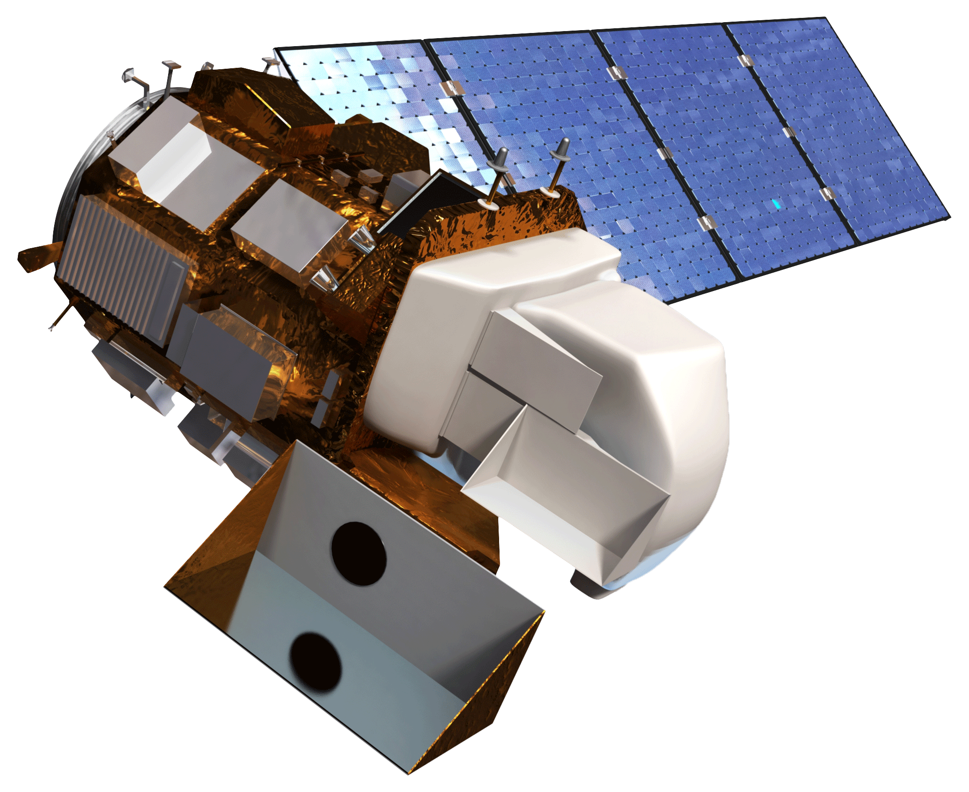
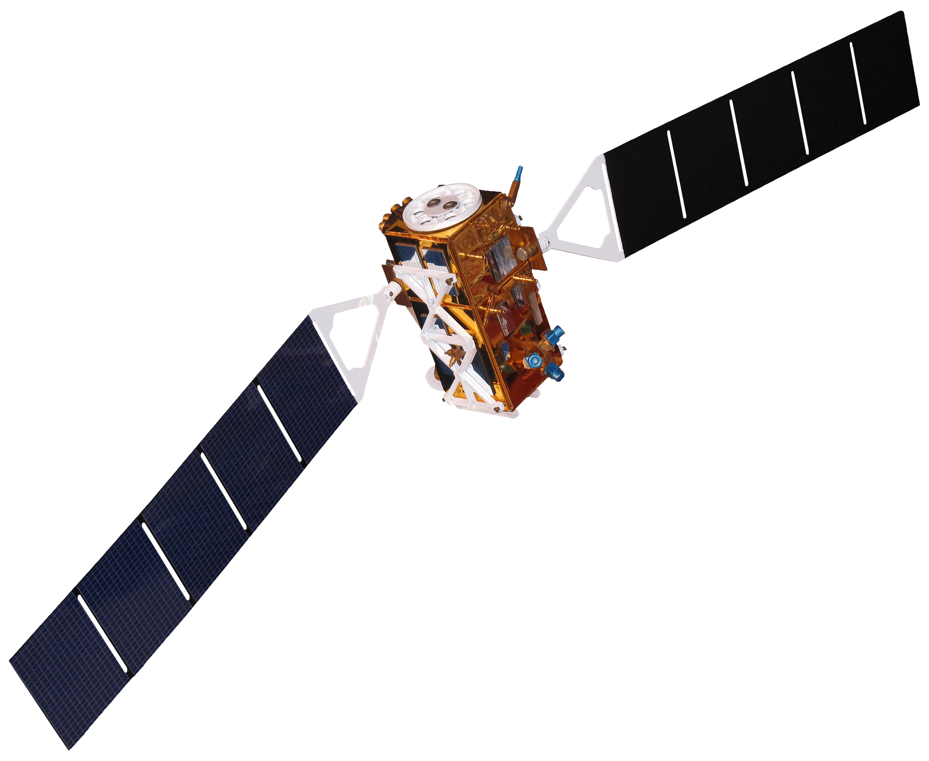

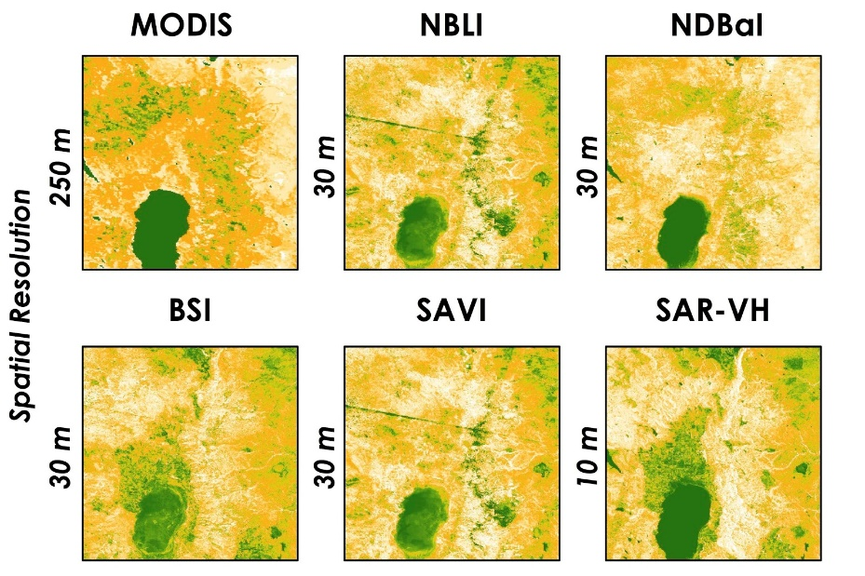
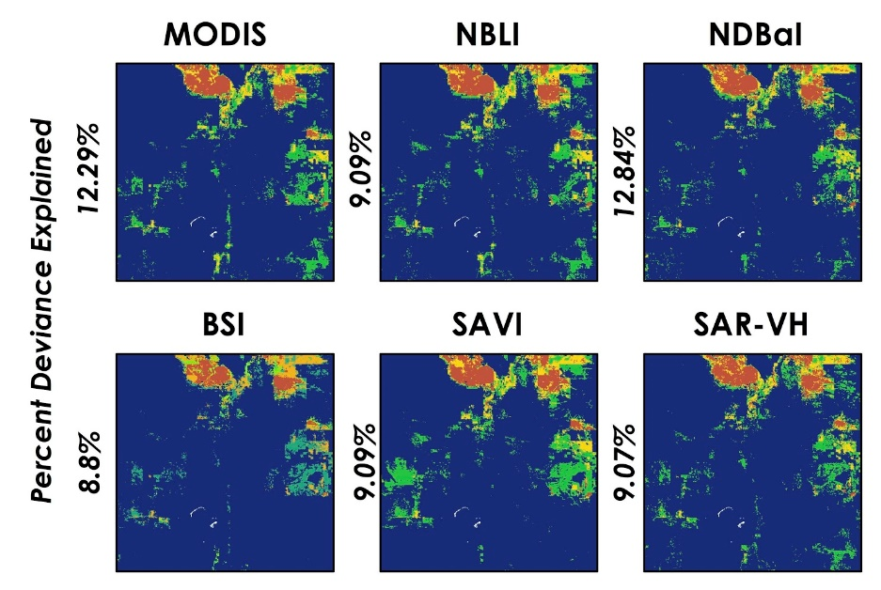
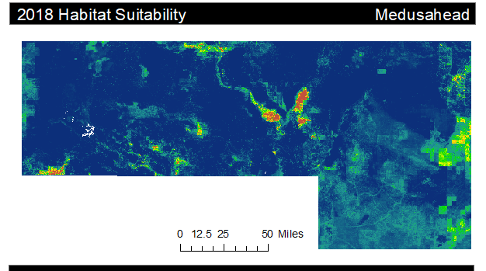
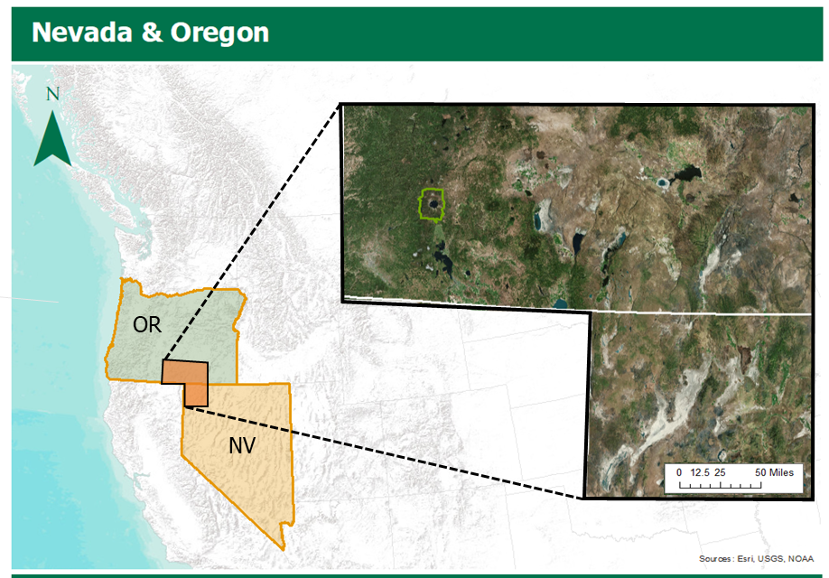
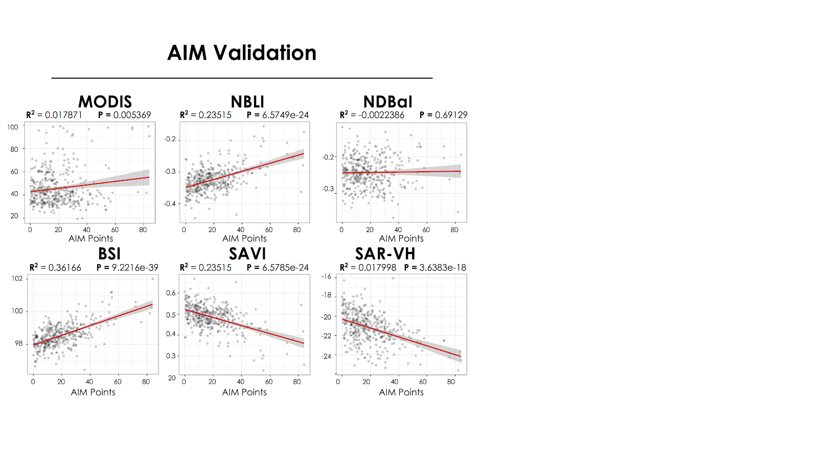
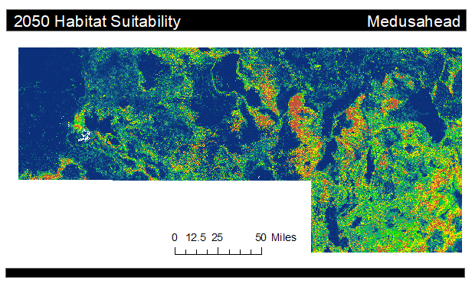







Employing NASA Earth Observations to Create Enhanced Bare Ground Layers for Invasive Species Habitat Suitability Modeling
Abstract
Nevada & Oregon Ecological Forecasting
Invasive species threaten the ecological integrity of a region. Such threats have further implications that can affect regional economies and, in some cases, human health. Organizations including the National Parks Service (NPS) and the United States Geological Survey (USGS) are dedicated to the early detection of and rapid response to invasive species of high concern, like medusahead (Taeniatherum caput-medusae). To improve these efforts, our team partnered with researchers from the NPS Exotic Plant Management Team and the USGS Fort Collins Science Center. Our partners currently rely on habitat suitability models to discern the geographic range of invasive species. They identified regions with low vegetation and exposed bare ground to be at higher risk of invasion. However the USGS and NPS are not using the most detailed resolution available for this bare ground variable. Research shows that the incorporation of high-resolution spectral information can improve the precision of habitat suitability models. To test this, our team focused on enhancing our partner’s bare ground layer (250-meter resolution) by utilizing Earth observations from NASA’s Landsat 8 Operational Land Imager (30-meter resolution) and the European Space Agency’s Sentinel-1 C-Band Synthetic Aperture Radar (10-meter resolution). We found that overall model performance was not significantly altered by the incorporation of higher resolution soil variables, however these soil layers did allow for higher resolution spatial outputs. With more precise habitat suitability models, our partners’ management practices can be more time efficient and cost effective, thus allowing them to scale up the methodology geographically and expand it to other invasive species.
Objectives
Methodology
Derive & Compile a collection of high resolution bare ground layers from NASA and European Space Agency Earth observations
Model habitat suitability by integrating various bare ground layers and evaluate model performance in the Software for Assisted Habitat Modeling (SAHM)
Create a habitat suitability map for medusahead based on updated bare ground data
Forecast the habitat suitability of medusahead for the year 2050 by incorporating NASA climate predictions
Model Using Classification Trees
Bare Ground
Layers
Environmental
Layers
Compare
Model Outputs
Final Habitat Suitability Model
NDBaI
Bare Ground
NDBI
SAR
Enviro.
NLDC
Anthro.
MODIS
Google Earth Engine
Software for Assisted Habitat Modeling
Earth Observations
Results
Bare Ground Comparison
Random Forest Model Statistics
250 m
MODIS
30 m
NBLI
30 m
NDBaI
High
Index | Area Under Curve | Correctly Classified
MODIS | 0.984 | 96.25 %
NBLI | 0.985 | 96.25 %
NDBaI | 0.985 | 96.25 %
BSI | 0.984 | 96.20 %
SAVI | 0.984 | 96.24 %
SAR-VH | 0.985 | 96.31 %
Spatial Resolution
30 m
BSI
30 m
SAVI
10 m
SAR-VH
Landsat 8 OLI
Sentinel-1 C-SAR
Aqua MODIS
Low
2018 Habitat Suitability
Medusahead
Study Area
Ensemble Model Agreement
Nevada & Oregon
12.29 %
MODIS
9.09 %
NBLI
12.84 %
NDBaI
0
Deviance Explained
1
Study Area
BSI
SAVI
SAR-VH
2
Crater Lake NP
Low
High
Nevada
8.8 %
9.09 %
9.07 %
3
Probability
Oregon
AIM Validation
0 50 miles
MODIS
NBLI
NDBaI
2050 Habitat Suitability
Medusahead
100
R²=0.018 P=0.0054
R²=0.235 P=6.57e⁻²⁴
R²=-0.002 P=0.691
-0.2
-0.2
20
AIM Points
-0.4
AIM Points
-0.3
AIM Points
0
BSI
80
0
SAVI
80
0
80
R²=0.362 P=9.22e⁻³⁹
SAR-VH
102
R²=0.235 P=6.58e⁻²⁴
R²=0.018 P=3.64e⁻¹⁸
0.6
-16
Low
Probability
High
0 50 miles
96
AIM Points
0.3
AIM Points
80
-24
0 50 miles
0
80
0
0
AIM Points
80
Conclusions
Figure 1. A map of our study area encompassing Southeast Oregon and Northwest Nevada, a region characterized by arid to semi-arid climate conditions.
This project succeeded in providing the USGS with a portfolio of higher resolution bare ground layers in order to refine their habitat suitability models. Each layer detected bare ground differently but improved the spatial resolution of model outputs when compared to current USGS practices.
We found that exchanging our partner’s bare ground variable with higher resolution layers didn’t result in a significant change in model outputs statistics. This trend could be attributed to the low importance of bare ground in their habitat suitability models.
Our team produced current and future habitat suitability maps for medusahead over the study area. Our forecast map shows that the geographic habitat distribution for medusahead is expected to increase by the year 2050. Incorporating higher resolution layers into habitat suitability models can facilitate more targeted and cost effective management strategies for land managers. These strategies can help mitigate the impacts of medusahead and prevent future impacts to high risk areas.
Project Partners
United States Geological Survey,
Fort Collins Science Center
National Park Service, Biological Resource Division, Landscape Restoration and Adaptive Branch, North Rocky Mountain Exotic Plant Management Team
Team Members
Acknowledgements
The Nevada & Oregon Ecological Forecasting Team would like to thank the USGS
and NPS for partnering with NASA DEVELOP to make this research possible.
A special thanks to Dr. Paul Evangelista, Dr. Catherine Jarnevich, Terri Hogan, Tony Vorster, Nicholas Young, and Kristen Dennis for their support throughout this research project.
This material contains modified Copernicus Sentinel data (2016-2018), processed by ESA.
Nicole Pepper
Project Lead
Anastasia Kunz
Sophia Leiker
Rebecca Girma
Colorado – Fort Collins | Spring 2019

