Slide 1
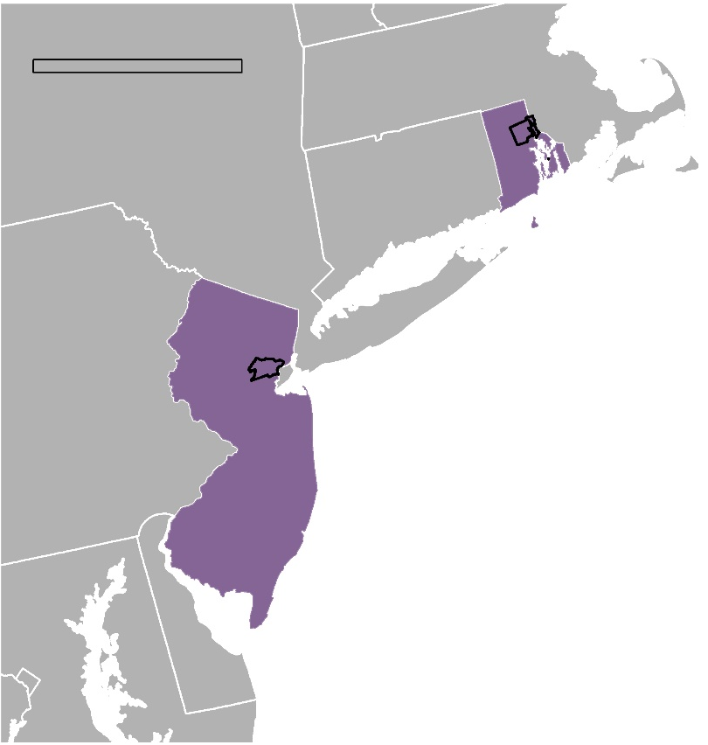
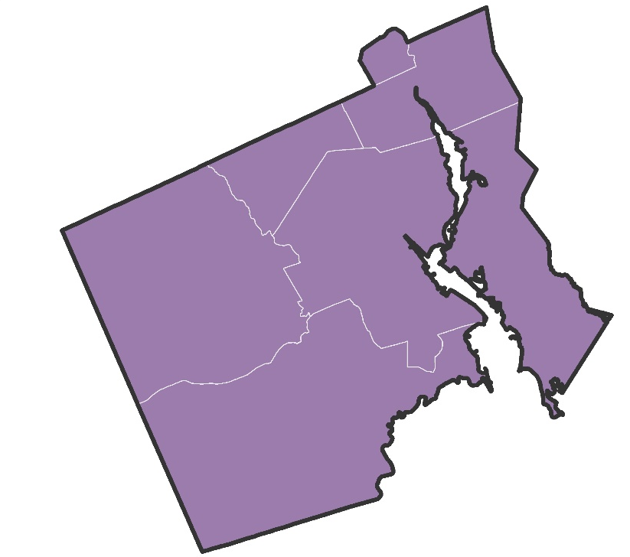
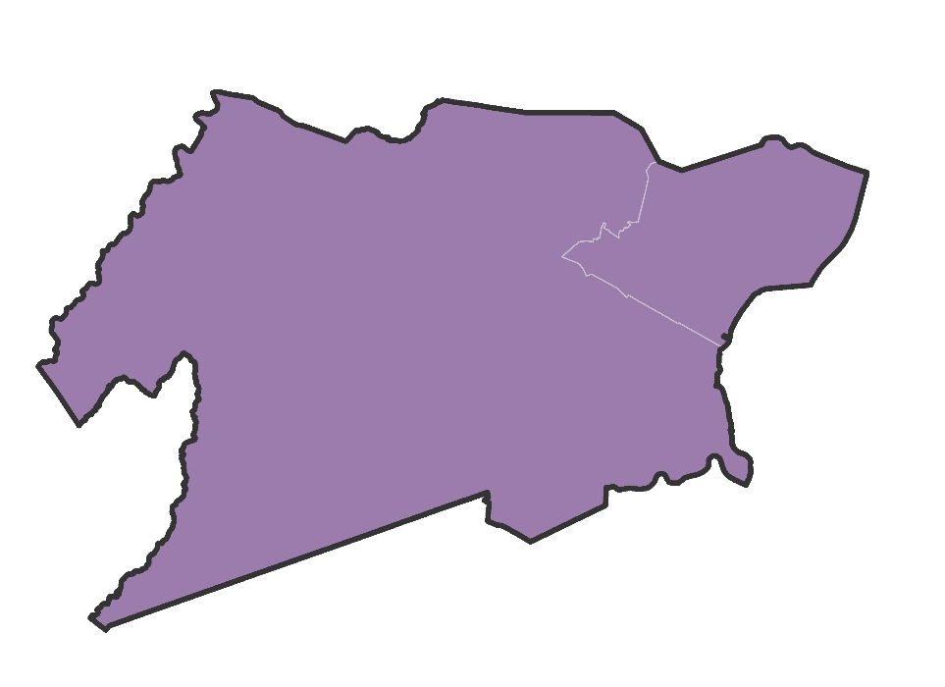
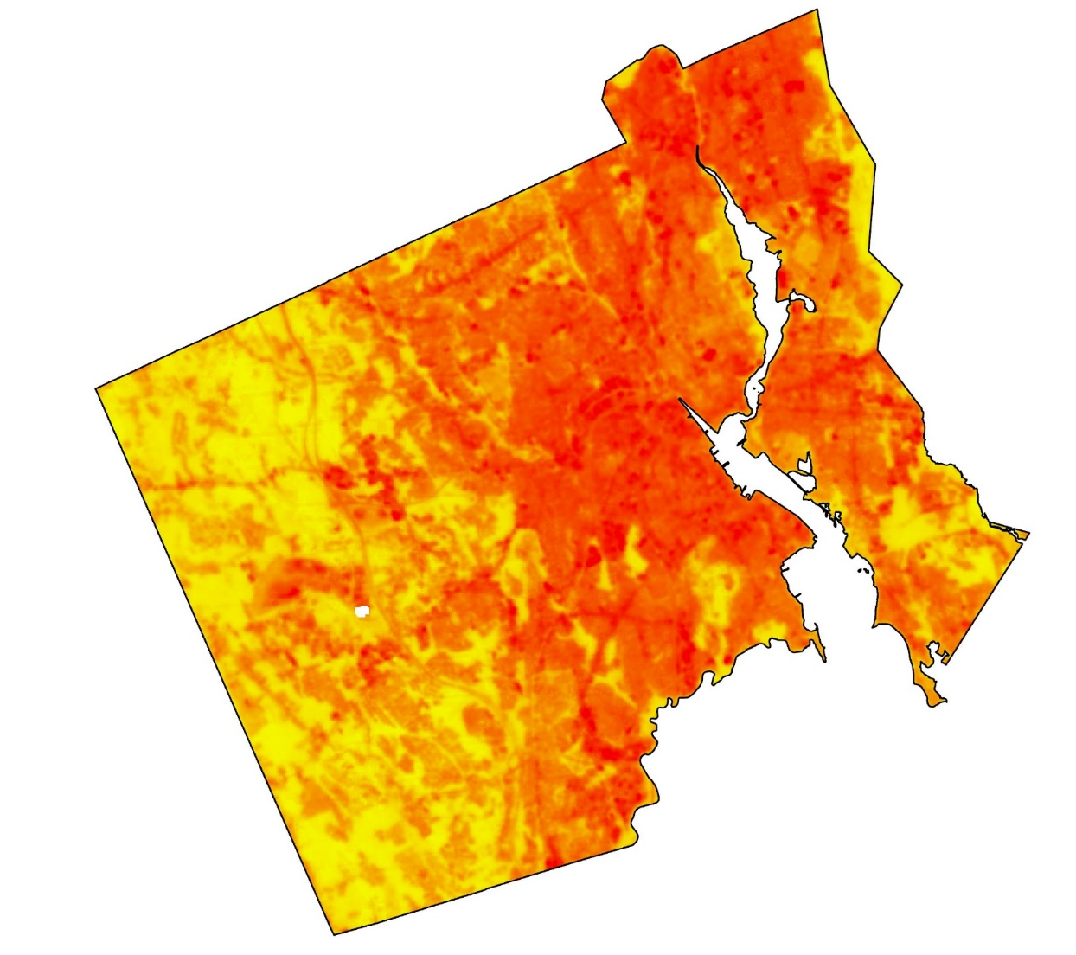
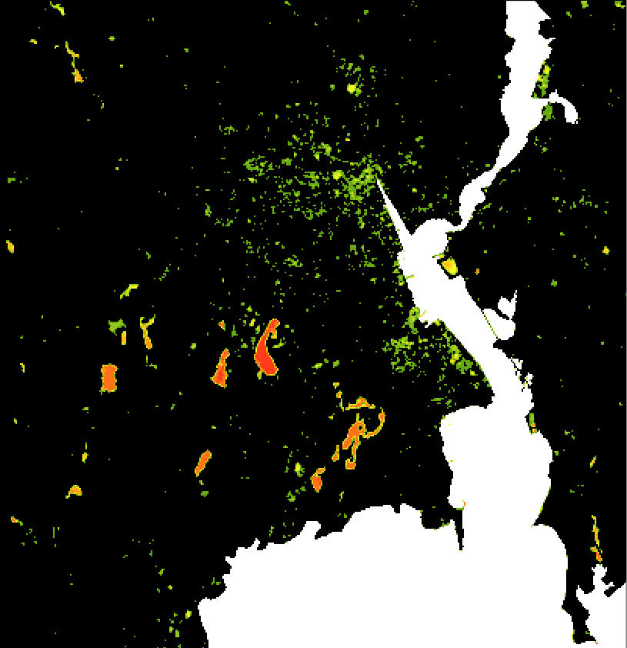
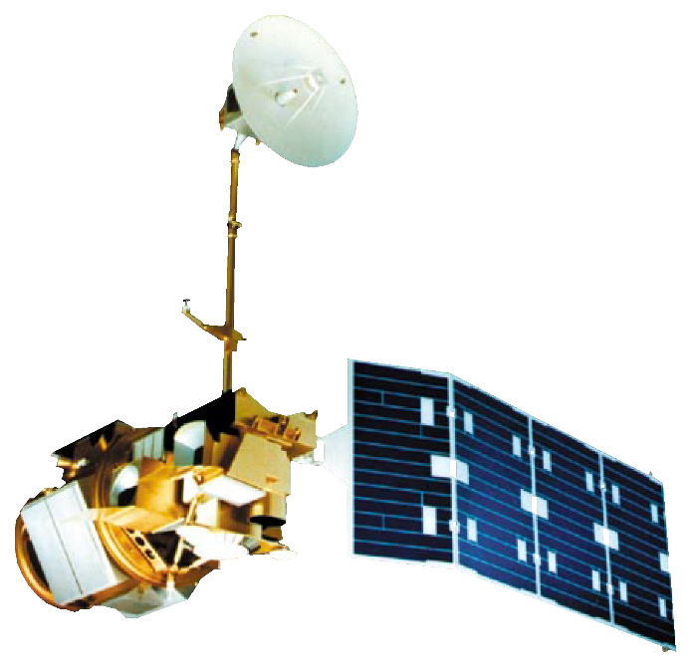
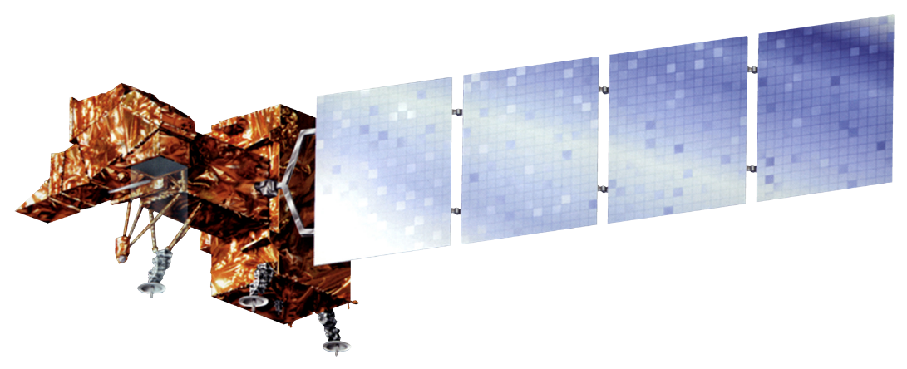
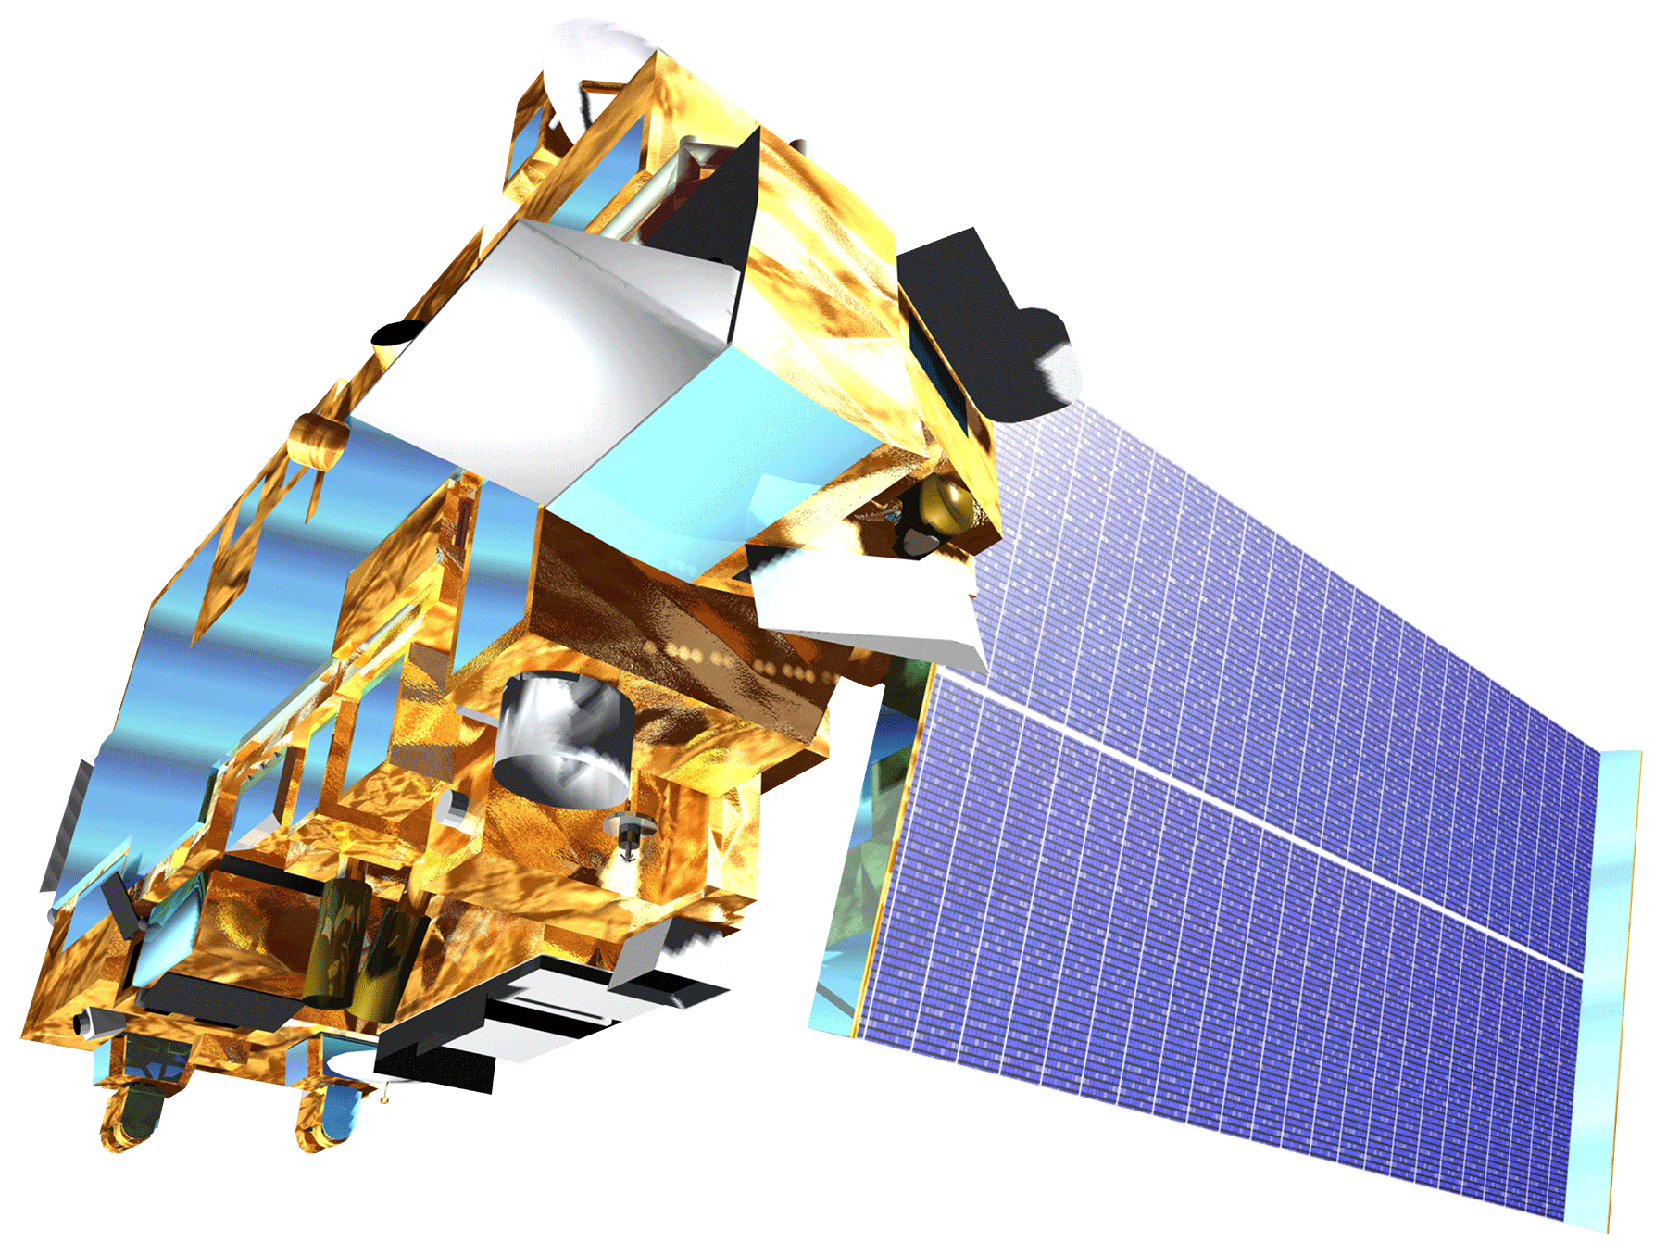
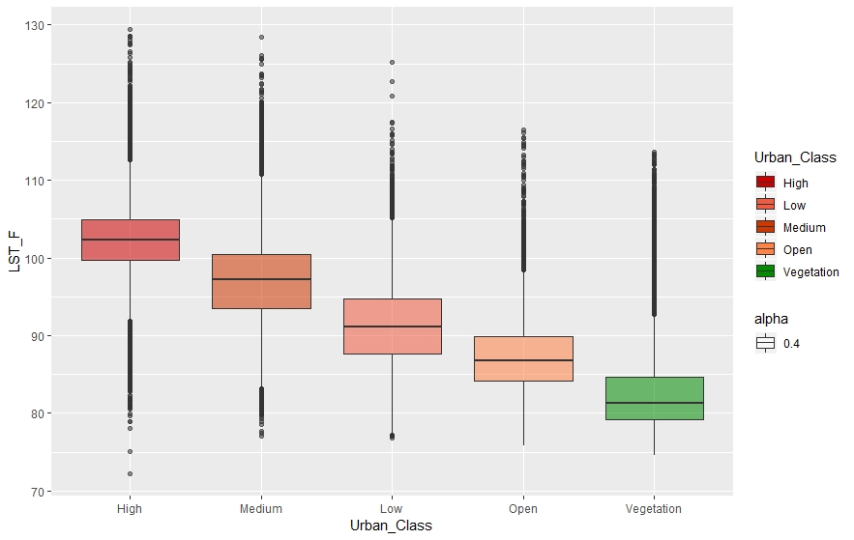
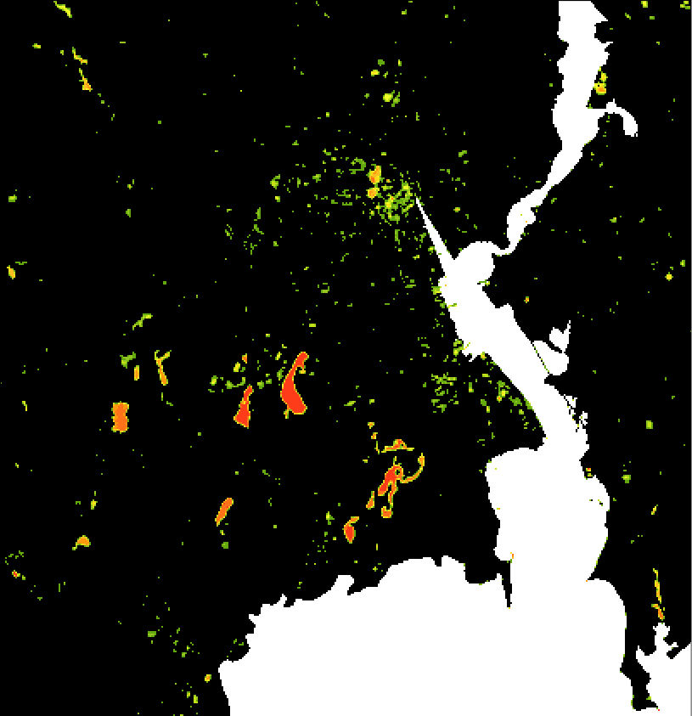
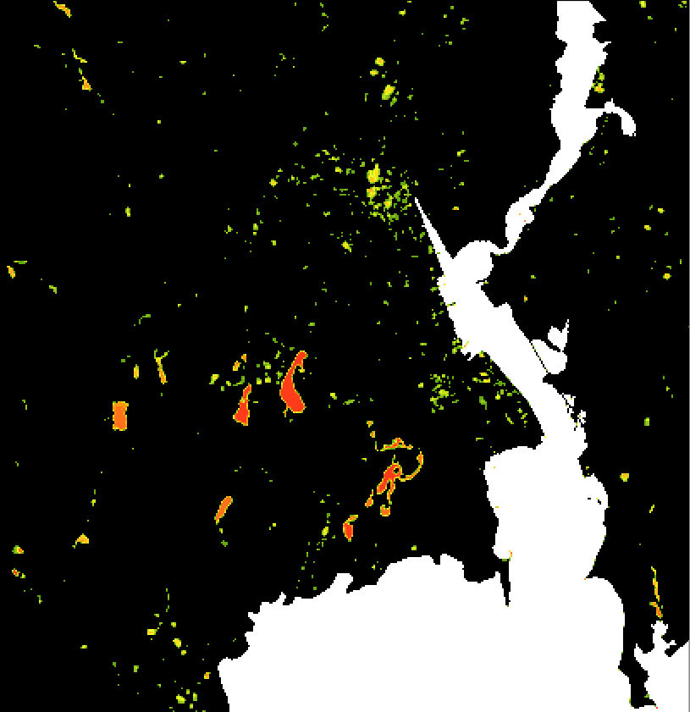
Utilizing NASA Earth Observations to Explore Heat and Flood-Related Vulnerability in Urban Settings
Abstract
Study Area
Providence & Elizabeth Urban Development
Coastal cities like Providence, RI, and Elizabeth, NJ, are directly affected by extreme heat and flooding events, which impacts the lives of community members. Groundwork USA is a community-based non-profit organization dedicated to increasing environmental resilience in urban communities. One of its initiatives, the Climate Safe Neighborhoods project, is aimed at assessing climate resiliency through the implementation of urban heat and flood mapping methodologies. This project used the Landsat Level-2 Provisional Surface Temperature product (STP), provided by the United States Geological Survey (USGS), to analyze land surface temperatures. The team cross-referenced the STP with both Terra Moderate Resolution Imaging Spectroradiometer (MODIS) and Advanced Spaceborne Thermal Emission and Reflection (ASTER) land surface temperature data for validation purposes. Similarities in the land surface temperature values from the three products proved that STP is a viable alternative to other previously established heat methodologies. The results of this analysis showed significantly higher temperatures in the highest urbanized areas. The flood distribution map analysis utilized surface reflectance data from Landsat 5, Landsat 7, and Landsat 8 over a 30-year time series. Normalized Difference Water Index (NDWI) and Modified Normalized Difference Water Index (MNDWI) were applied to the Landsat images to calculate and visualize annual and decadal flood frequency. This allowed for a robust methodology to analyze flood frequency over a 30-year time period and the analysis showed areas within both cities that had higher flooding frequency rates. The heat and flood assessment maps generated from this project will aid Groundwork USA in its resilience planning efforts and urban planning advocacy.
100 mi
Providence & Surrounding Cities, RI
Elizabeth & Union County, NJ
NJ
RI
Atlantic Ocean
Methodology
5 miles
Landsat 5 ETM
Landsat 7 ETM+
Landsat 8 OLI/TIRS
PROCESS
Data Processing in Python Script & ArcGIS Pro
Land Surface Temperature (LST) data processing in Python Script & ArcMap
Objectives
Compute NDWI & MNDWI
Set water threshold equal to zero
Calculate inundation frequency for pixels
Calculate Mean LST
2014-2018
Acquire NLCD land cover data (2011)
Categorize urbanized land cover
Identify areas of Providence, RI, and Elizabeth, NJ, that are vulnerable to urban heat and flooding events
Produce data and maps to allow Groundwork USA to inform the public and make data driven decisions for their communities
Develop an efficient methodology for assessing urban heat and flood in various locations
ANALYSIS
Calculate frequency of inundated pixels
Overlay Mean LST with urbanized areas and calculate spatial statistics
Heat Results
Flood Results
Annual Flood Distribution
Decadal Flood Distribution
5-Year Flood Distribution
5-Year Mean LST
LST & land cover map
Cross-reference with Terra MODIS & ASTER
Providence, RI
Providence, RI
PRODUCTS
2014-2018 Heat Distribution
1988-1997 Flooding Frequency (%)
0
2
Earth Observations
Landsat 5
TM
Landsat 7
ETM+
Landsat 8
OLI/TIRS
Terra
MODIS & ASTER
Land Surface
Temperature (°F)
Conclusions
0
5 mi
129
72
0-10
41-50
91-100
Higher land surface temperatures were concentrated in areas with higher impervious surface cover such as asphalt, concrete, and large buildings.
The Provisional Level-2 Landsat Surface Temperature Science Product proved a viable and accurate option for heat distribution mapping in urban landscapes.
Terra MODIS surface temperature values did not correlate with Landsat and ASTER measurements over areas of high urban development.
Higher flood frequencies are found in urban and suburban areas
Scale of flood frequency analysis influences interpretation of local and regional trends.
Overlay Analysis: Land Surface Temperature
Distribution by Land Cover Type
1998-2007 Flooding Frequency (%)
130
120
110
Project Partners
Land Surface Temperature (°F)
100
Groundwork USA
90
Team Members
80
70
High
Medium
Low
Open
Vegetation
Land Cover Type (by NLCD 2011 Class)
2008-2018 Flooding Frequency (%)
Holly Gould
Project Lead
Sarah Aldama
Colton Avila
Heather Dulaney
Acknowledgements
Lawrence Hoffman | GIS Program Manager, Groundwork USA
Cate Mingoya | Director of Capacity Building, Groundwork USA
Steve Burrington | Executive Director, Groundwork USA
Amelia Rose | Executive Director, Groundwork Rhode Island
Jonathan Phillips | Executive Director, Groundwork Elizabeth
Dr. Kenton Ross | Lead Science Advisor, NASA DEVELOP National Program
Lance Watkins | P.H.D Candidate, Arizona State University
Patrick Frier | Center Lead, NASA DEVELOP Langley
Virginia – Langley | Spring 2019

