Slide 1
NASA DEVELOP National Program
DEVELOP Opportunities:
Publications, Conferences, and Long-Term Opportunities

Slide 2
Travel
Any travel funded by the DEVELOP Program will be coordinated and originate through the DEVELOP NPO.
Travel is a privilege and the program does it’s best to provide opportunities to present DEVELOP work and engage with partners when appropriate and resources and timing allow.
Travel Process:
  DEVELEOPer identifies a conference or meeting they are interested in attending
  Talk to the Center Lead about the opportunity, if they approve of the opportunity then they will work with you to submit a request to NPO (includes description, attendee info, justification for travel, and cost estimate)
  NPO will assess merit of the event and funds available
  If NPO approves the travel, NPO will input the traveler and event into the NASA Conference Tracking System to gain agency approval
  Once agency approvals are received, travel requests must be submitted for the travel to be approved by the funding contract
  Once funding organizations approve, travel arrangements (if needed) will be made by NPO and reimbursements will be processed upon the travelers’ return

Slide 3
Presenting and Publishing DEVELOP Work
For purposes of ensuring appropriate export control review, performance metric tracking, and reporting to NASA HQ, any and all presentations or publications related to DEVELOP (projects or the program in general) must be communicated to, and content shared with, the NPO before submission of the presentation or publication.
Submitting work for presentation or publication is encouraged; however, ALL research is the property of NASA and therefore, you must have permission prior to submitting your research anywhere. Also, to minimize duplication of effort, the NPO oversees all publications and presentations.
Coordinate with your Center Lead and, if approved at your node, send a simple email with your ideas before the presentation or publication to Lauren.M.Childs@nasa.gov and Karen.N.Allsbrook@nasa.gov with the following information:
Description of the activity - conference, presentation to a class, publication, etc.
Timeline for the activity - when the event is or deadline for publication, etc.
A copy of the material/content (because often presentations can be large, a PDF is good enough for a quick review)
Cost estimate (if applicable)
Thank you for your consideration and help with this!

Slide 4
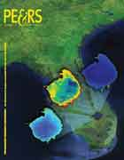
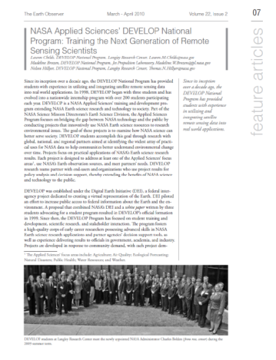
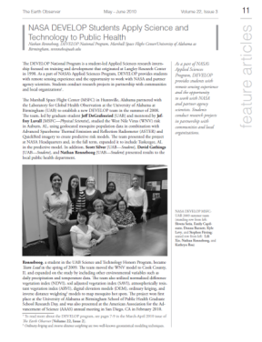
Publications
Publications are a huge avenue for getting the word out about the great research you are a part of with DEVELOP!
DEVELOP is working on increasing the number of its peer-reviewed publications.
Currently, DEVELOP publishes often in “gray literature” like Earthzine, Directions Magazine, and The Earth Observer
If you are interested in working your project toward a potential publication, contact your Center Lead, Lauren & Tiffani.
Note: If your team wants to pursue publication, you can talk to the PC Team about writing your technical paper using the style guide specific to the publication venue.
Reminder: All publications must be approved by NPO and NASA’s Export Control process before submission!

Slide 5
Publication Process
Discuss with your Center Lead and Science Advisor
Contact Lauren & Tiffani with initial interest
Select publication venue and draft the manuscript
  If this happens during the term, the article draft can replace the tech paper. Email the Project Coordination Team if you are interested in pursuing this.
Submit draft to NPO for review before submitting to the journal
Comm team and project team go back and forth with edits to create a final submission
NPO submits final version into export control - NASA Export Control takes about 2-3 weeks.
Once approved, the content can be submitted to publication venue
Keep Lauren in the loop with any and all edits from venue
The final-final version must be resubmitted to NASA Export control
Submitting work for presentation or publication is encouraged; however, ALL research is the property of NASA and therefore, you must have permission prior to submitting your research anywhere. Also, to minimize duplication of effort, the NPO oversees all publications and presentations.
Step by Step Publishing Process
Initiate Communication w/NPO
Send Manuscript to NPO for Review Feedback & Edits
Write Manuscript & Review at Node (Includes Advisor)
Node Creates Final Version, Returns to NPO
NPO Submits to Export Control & Gains Approval
Node Submits to Publisher
Back & Forth Edits w/Publisher
Publisher Approves & Article Published
Following NPO Approval, Pursue Communication w/Publisher

Slide 6
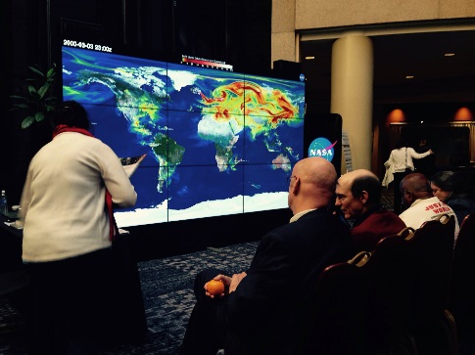
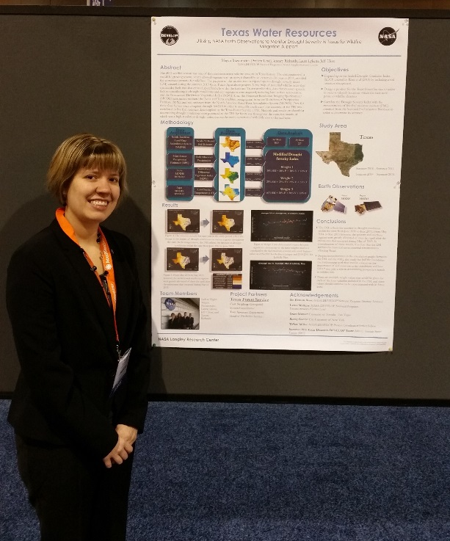
Conferences
DEVELOP presents projects at over 50 conferences each year
If you have an idea for a conference you’d like to attend, discuss with your Center Lead and then reach out to NPO
There is a meager travel pot provided to each node to support some travel, this may already be accounted for
Ways to attend cost-effectively:
  Choose a conference that is local
  Present DEVELOP work at a conference you already are planning to attend either for school or personally
  Pursue school-funding opportunities
  Apply for travel grants offered by professional societies

Slide 7
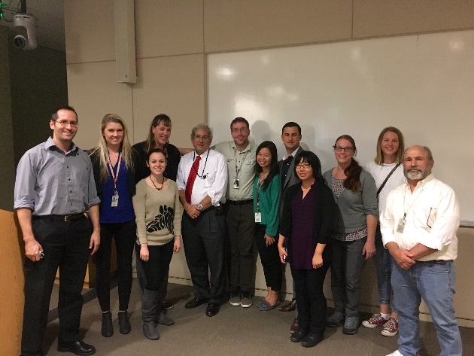
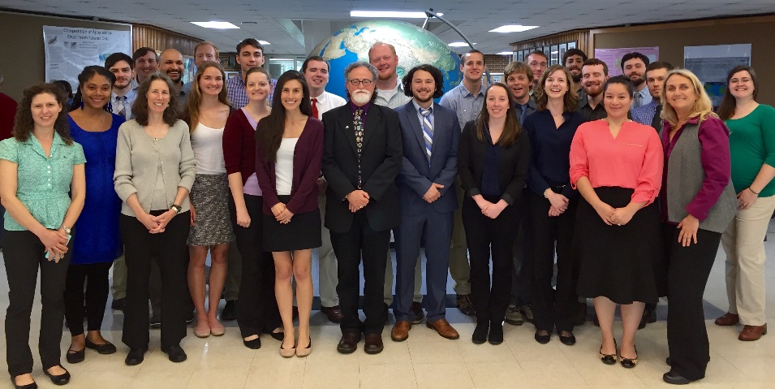
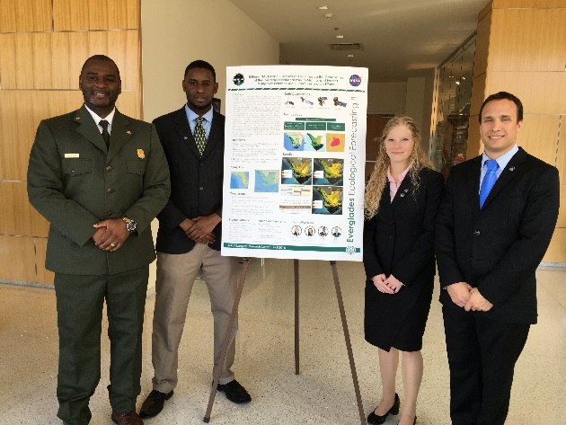
Node Closeouts
At the end of each term each node hosts a closeout event where teams present their work
Typically partners, friends, and family are invited
Talk to your Center Lead about the specifics for your node
Great networking opportunity
Exciting wrap up of the term!

Slide 8
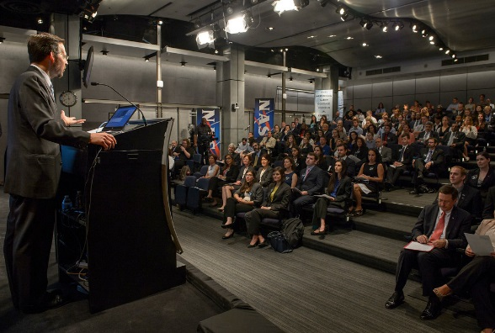
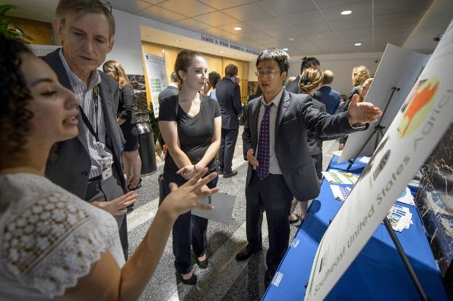
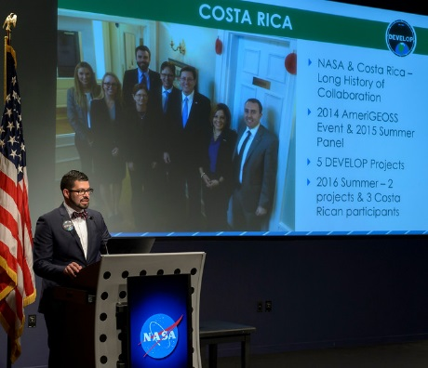

AESAS
What: Annual Earth Science Applications Showcase
Why: To highlight the work being done by DEVELOP and the Applied Sciences, network with NASA HQ officials and partner organizations
Where: NASA Headquarters in Washington DC
Who: Typically a competitively selected representative from each project, however depending on the structure of the event details will be communicated closer to the event.
When: Tentatively schedule for August 4th

Slide 9

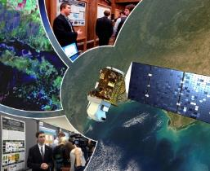
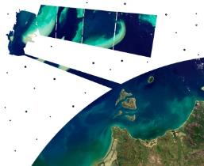
Virtual Poster Session
What is the VPS?
Since 2011, DEVELOP has regularly showcased the work of participants through a series of short, informative videos. These videos are the most publically viewed deliverable and display the impressive work conducted by each team through the use of a digital medium. This deliverable is hosted on our YouTube channel and allows the teams to interact with the global community and share their work. The VPS is one of the most unique ways in which teams communicate earth science to the public! There is a light-hearted internal competition for the best video and judges range from DEVELOP alumni to science advisors.
Thousands of people from around the world view these project videos – For example, the 2017 Spring VPS had visitors from 85 different counties with over 4,000 video views!
Key Dates:
Video Outline – due Week 5
Comm Team Check-In – Week 6
VPS Video & Transcript – due Week 8
VPS Launch – Week 10
2011-2016, the VPS was hosted by Earthzine, in the past few terms it was hosted on the DEVELOP website. This summer DEVELOP and Earthzine will team up and co-host. More will be shared as details are finalized!
Bonus: Teams have the chance to win superlatives and various prizes and certificates!
Questions?
Contact the Communications Team for any questions regarding the video deliverable
DEVELOP VPS Archive: www.youtube.com/nasadevelop

Slide 10
Enhanced Capacity Building Opportunities
Center Leads & Fellow Position Competition

Slide 11
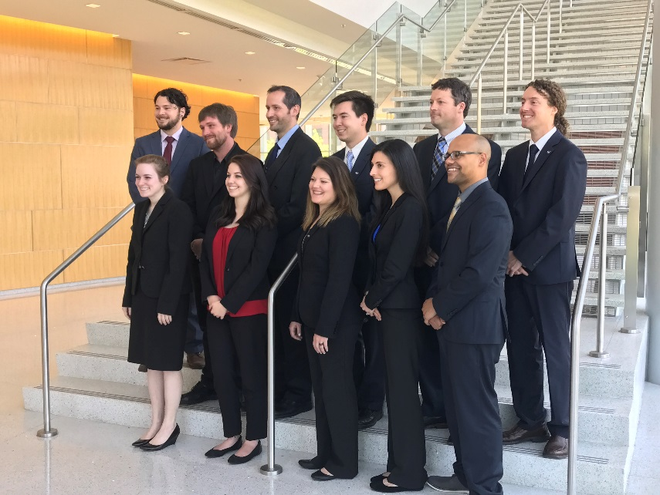
Center Lead Positions
What is a DEVELOP Center Lead?
The Center Lead (CL) is an integral piece of the leadership team in the DEVELOP model. The people who assume this role are responsible for managing the majority of the day-to-day operations at their individual nodes, providing guidance and direction to their teams, and supporting strategic planning for their node and the program as a whole.
Center Lead Term: One year (recompeted annually, 2 term limit)
Eligibility Requirements:
  At least one term with DEVELOP, multiple are preferred
  Strong leadership and communication skills
  Proficient knowledge and understanding of DEVELOP
  Demonstrated ability to generate project ideas and start/maintain partnerships
  Ability to spend 20-40 hours/week in the position
  Minimum 3.0 GPA (at current or at most recent academic institution)
  U.S. Citizenship
http://www.devpedia.developexchange.com/dp/index.php?title=Center_Lead_Selections

Slide 12
Center Lead Positions
Skills Gained & Opportunities:
Project Management: Project idea generation, proposal writing, technical editing, deliverable creation and review, dissemination of results.
Leadership: Opportunities for early career leadership, working with diverse teams.
Communication: Writing skills, presentations, telecon communication, meeting organization, working with diverse groups.
Increased Personal & Professional Awareness: Personality tests & assessments, and critical feedback and skill strengthening.
Shaping the Future of DEVELOP: Participation in leadership and strategic planning retreats, leading innovative projects and activities, and strategic planning.
Networking Opportunities: Meet & Greets with NASA and partner organizations leadership, representing DEVELOP at meetings, and workshops and conferences (as funds and opportunities arise).
Nodes Accepting Applications:
ARC: Ames Research Center - Moffett Field, CA
AZ: MCDPH at Arizona State University - Tempe, AZ
FC: USGS at Colorado State University - Fort Collins, CO
GSFC: Goddard Space Flight Center - Greenbelt, MD
ID: BLM at Idaho State University GISTReC - Pocatello, ID
JPL: Jet Propulsion Laboratory - Pasadena, CA
LaRC: Langley Research Center - Hampton, VA
MCHD: Mobile County Health Dept - Mobile, AL
MSFC: Marshall Space Flight Center - Huntsville, AL
WC: Wise County - Wise, VA
http://www.devpedia.developexchange.com/dp/index.php?title=Center_Lead_Selections

Slide 13
Fellows
What is a DEVELOP Fellow?
A Fellow is a recent college graduate who spends one year with DEVELOP growing personally and professionally while contributing to the program as a whole and their node. The position serves in a dual-role by splitting their time between their node and NPO-related tasks.
Fellow Term: One year
Eligibility Requirements:
  Minimum 3.0 GPA, cumulative or most recent semester
  Participation in at least one term with DEVELOP (two or more terms preferable)
  40 hours per week
  U.S. Citizenship
  Limited to one term
http://www.devpedia.developexchange.com/dp/index.php?title=Fellows_Class_Selections

Slide 14
Fellows
FY18 Elements
Development Opportunities:
Increase personal & professional awareness: Personality tests & assessments; Critical feedback and skill strengthening
Opportunity to play a key role in the future of DEVELOP: Participation in leadership and strategic planning retreats; Participating and leading key activities and program initiatives
Networking opportunities: Meet & Greets with NASA and partner organizations leadership; Representing DEVELOP at meetings, workshops and conferences (as funds and opportunities arise)
Intellectual Challenges: Participation in the DEVELOP Junto series - 30 minute presentations on personal area of interest for the purpose of sharing a spirit of inquiry and a desire to improve ourselves, our community, and to help others, through discussion and debate of questions in science, politics, philosophy, business and leadership; Flash talk & incubator talk presentations; Leading innovative activities and working with a diverse group of participants each term
Communications
Geoinformatics
Impact Analysis
Information Technology
Project Coordination
All Nodes Accept Applications: competition is fierce!
http://www.devpedia.developexchange.com/dp/index.php?title=Fellows_Class_Selections

Slide 15









Social Media
Promotional Videos
Create and post campaigns and programmatic news on DEVELOP’s social media accounts
Create new and engaging videos to showcase participants, partners, and the program, overall
Project Videos
Newsletter
Coordinate and promote team project videos, as well as facilitate the Virtual Poster Session competition each term
Design and distribute the DEVELOPer Newsletter each term to report program success and highlight important people and events
Recruitment
Alumni Engagement
Expand DEVELOP’s applicant pool and reach a wider audience; Assist Center Leads with tracking & efforts
Collaborate with Impact Analysis to incorporate alumni into current DEVELOP activities through interactive events and activities
Ambassador Corps
Graphic Design
Utilize talent and enthusiasm of Campus and Alumni Ambassadors who recruit at their respective locations
Design attractive and informational flyers, templates, reports, and other programmatic collateral for the National Program Office

Slide 16



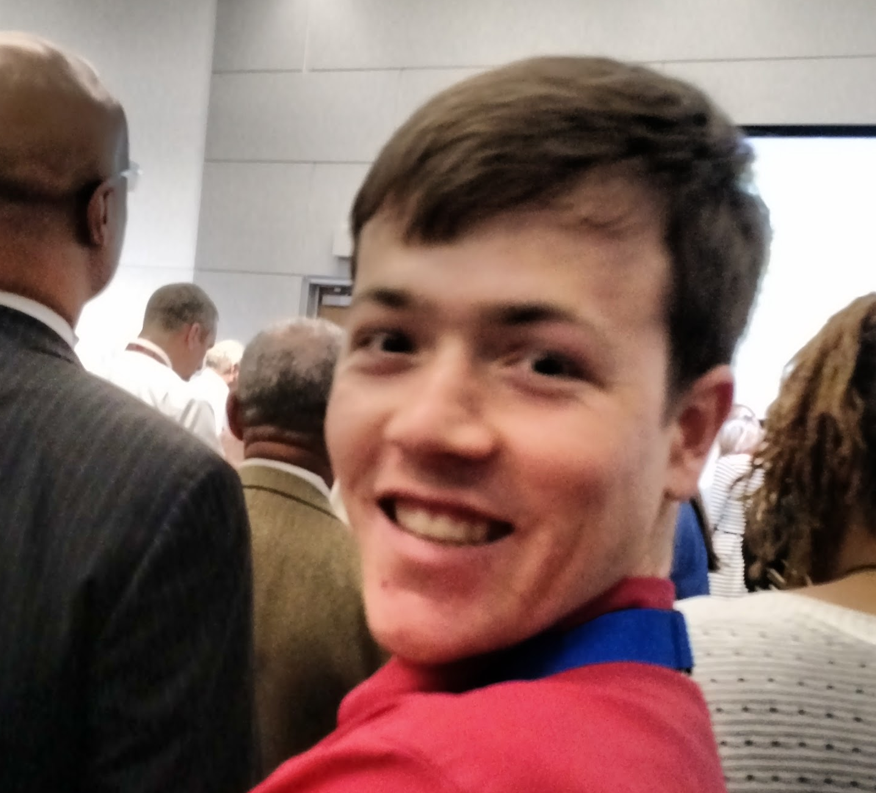
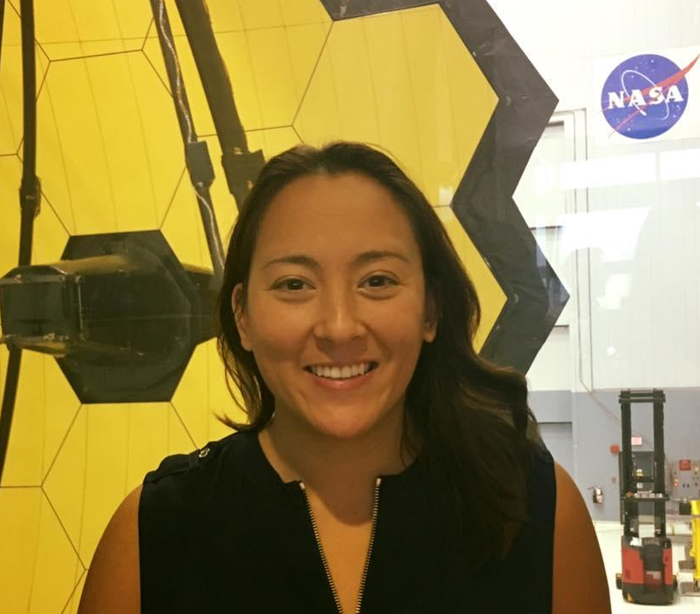





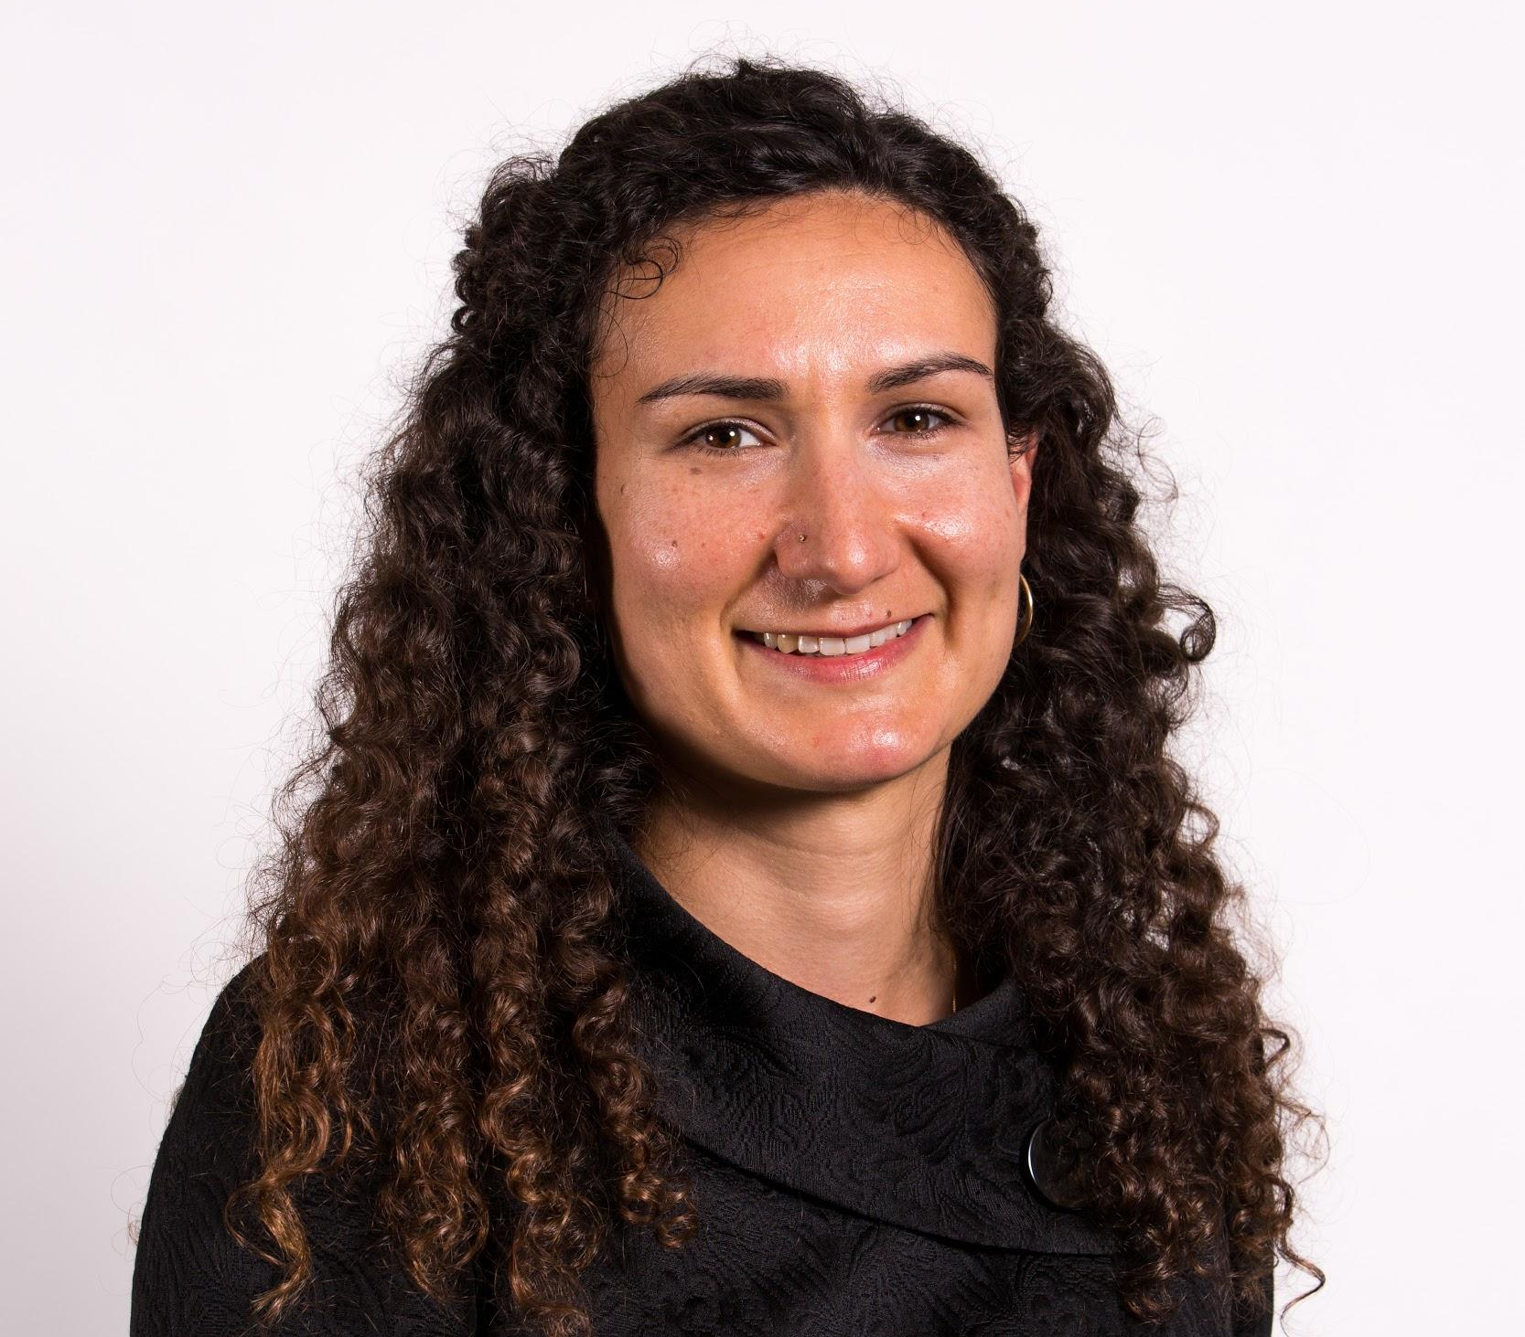
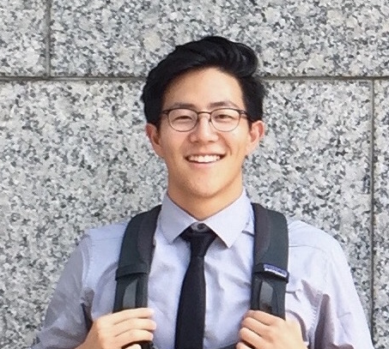
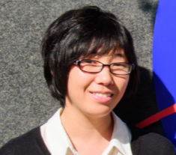
Geoinformatics Team
Common Goals:
Point of contact for GIS and remote sensing needs
Provide programming support and trainings
Support software release and collect internal code
Answer questions during Open Doors
Ryan Avery (LaRC)
Alison Thieme (GSFC)
Kelly Meehan (NCEI)
Sol Kim (JPL)
Erika Higa (JPL)

Slide 17
Benefits and Achievements as a Geoinformatics Fellow:
Enhance current programming skillsets and learn new ones
Opportunity to attend and present at conferences, including:
  Esri FedGIS, US-IALE, Esri Developer Summit, FedGeoDay, Google Earth Engine Summit, AGU, The George Wright Society
Gain familiarity with NASA Earth Observations—new and underutilized sensors
Opportunity to learn new software (i.e. ArcGIS Pro)
Develop your ability to teach and self-learn
Individual Achievements (fun facts):
3 Fellows got into a PhD program
2 Fellows working towards publication

Slide 18
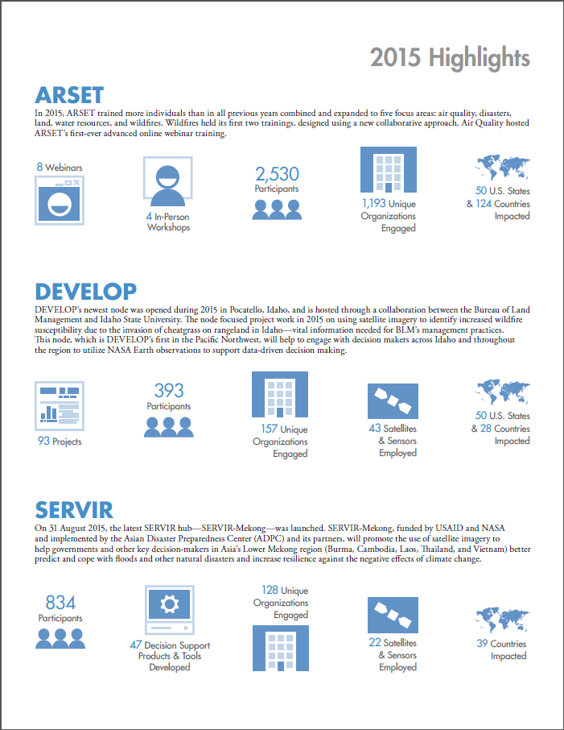

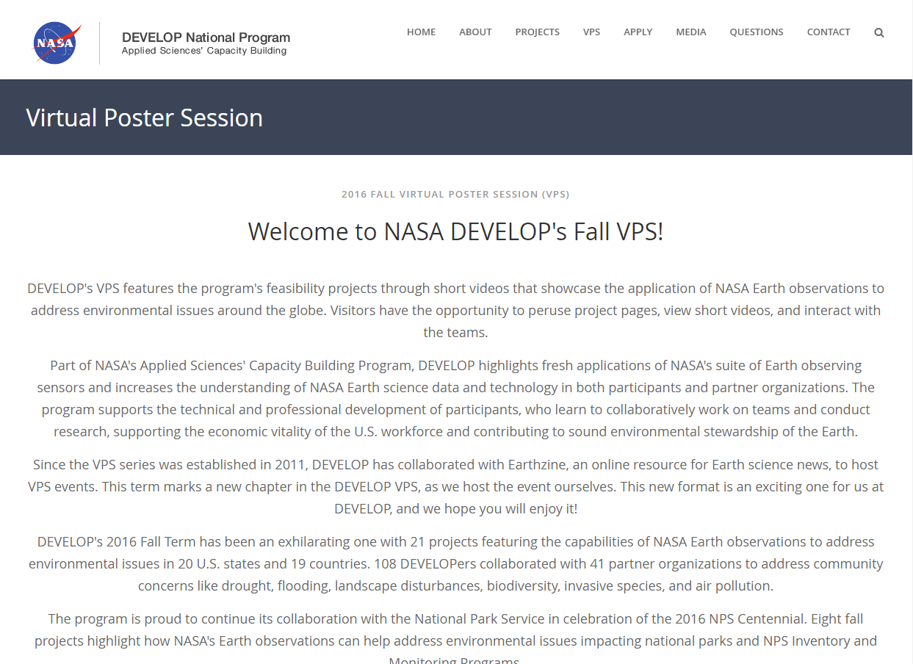

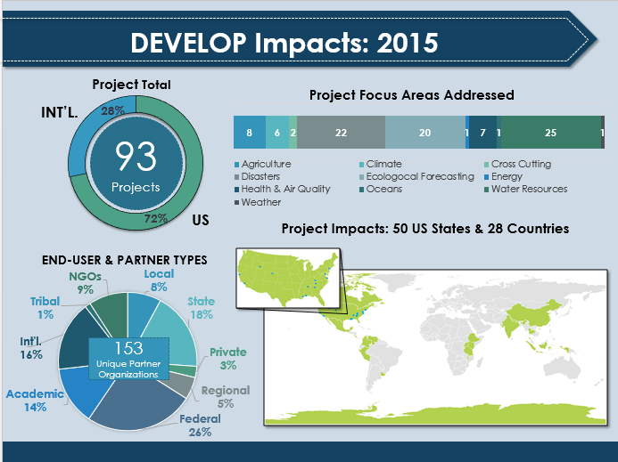
Impact Analysis
Our Data is Everywhere!
Partners
Participants
Projects
Capacity Building Program Indicators (CBPI)
DEVELOP Results Framework (DRF)
Impact Analysis Reports
Partner Tracking & Forms
Original Exit Survey
Alumni Highlight Stories
Alumni Survey
CBPI
Center Lead Exit Survey/ PGA
DRF
Equal Futures Report
Exit Survey (including fellows)
Fellow Tracking
Indicator Tracking
Participant Info Sheet
Capacity Building Program Indicators
DEVELOP Results Framework
eBooks
Impact Analysis Reports
Indicator Tracking
Project Strength Index (I&II)
Project Tracking Sheet
Notes:
On the left, you see a chart highlighting the groups in which each datum aims to track. On the right, you see graphics of mediums in which are data is presented. These data are distributed amongst the fellows and completed at various times throughout the year. Please review your “How to Guide” for assistance on where to locate and assess this information.
Also – Inside in the Impact Analysis google drive, there is a Data Inventory document that provides a more detailed breakdown of these data. (Ie. Implementation dates, collection timelines, collection method/formatting, content, distribution protocol, etc….)

Slide 19
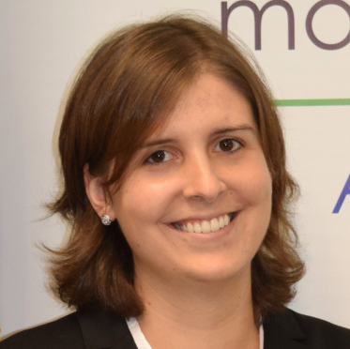
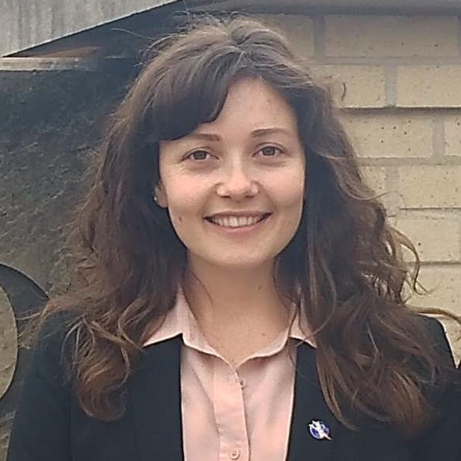
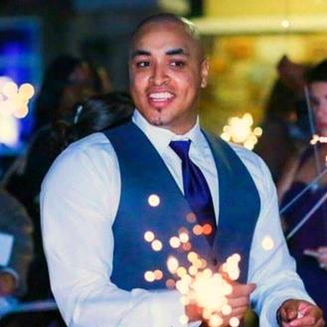
Insight from IA Fellows
"Being an IA fellow has helped develop my skills in many areas including creating metrics, evaluating data, and conducting interviews. Most importantly, I have learned to use data to tell the story of DEVELOP projects and their impacts on participants and partners. Knowing how to really use data is powerful and has been a valuable lesson from my fellow year as I move forward in my career.“
- Elaina Gonsoroski
“My experience as an Impact Analysis fellow was a tremendous opportunity for personal and professional growth. I gained insight into what it takes to successfully implement a large, collaborative program like DEVELOP while exploring and building diverse and interdisciplinary skillsets. Ultimately I was able to use those skillsets to contribute to the mission of DEVELOP, and I know all I have learned will support me in my future professional endeavors.”
- Sarah Carroll
“The privilege of serving as an Impact Analysis fellow has been rewarding this past year! Our Senior fellow provided an atmosphere that encouraged innovative thinking and stimulated collaboration with other elements. This was particularly helpful to me; providing an outlet for the unlimited ideas floating in my head. As an IA fellow I was able to enhance my project management skills, improve my ability to communicate concepts, and build a network of professionals that I will always call friends!”
- Dash Cruz
Tips from an IA Fellow:
If you are interested in learning more about NASA’s Capacity Building program, and you like working with data then Impact Analysis may be for you!
The DEVELOP fellow position is what you make of it! You get out what you put in.
If you are interested in something, speak-up, get involved, and pursue it.
-Sarah Carroll
Notes:
The fellows from CY17 have given some feedback, tips and tricks on how to survive your time as an Impact Analysis fellow. This team aimed to provide words of encouragement, assurance, and confidence to the next class of fellows to grace DEVELOP.
[Pictured from Top to Bottom: Elaina Gonsoroski, Sarah Carroll, Dashiell Cruz]

Slide 20

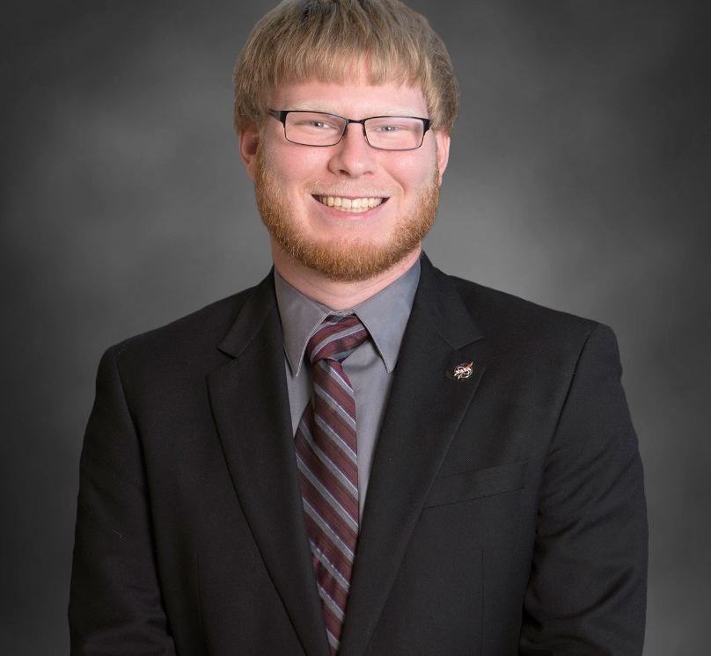
Information Technology Team
Software Release
Guide Team through the entire Release Process
DEVELOPedia
Knowledge Repository for DEVELOP
Every Participant has an Account
DEVELOP Website
Public Face of DEVELOP
Provide Information about what DEVELOPers are doing
Retain Access after leaving the program
Create and Release Open-Source Software
Meet with Teams and Explain Release Process
Present Projects and Media Appearances
IT Senior Fellow:
Jordan Vaa

Slide 21
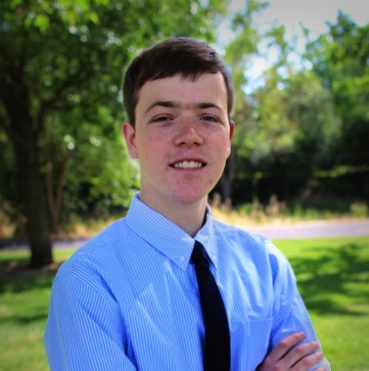
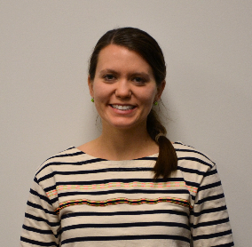
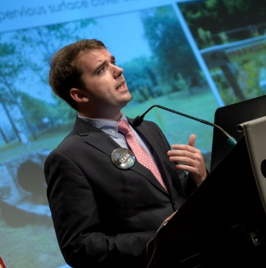
Project Coordination
Responsibilities:
Proposal review & development
Oversee publication efforts
Coordinate project deliverables
Maintain DEVELOPedia resources
Update orientation & handbook
Enhance deliverable templates
Track project information
Amanda Clayton
Sean Cameron
Ryan Avery
Benefits:
Gain experience managing the project portfolio
Increase knowledge of project backgrounds & methodologies
Help participants develop strong writing and communication skills
Provide feedback to CLs & participants (deliverables, end-products, etc.)
Work with other Fellow elements to support projects
Enhance understanding of the program at a national scale

Slide 22
Center Lead & Fellow Application Timeline & Process
Process:
Review full eligibility requirements and position logistics on the website
Interested candidates should feel free to talk to Center Leads, Fellows, and NPO
Fellow Candidates: Identify the elements and node(s) you are interested in
CL Candidates: Identify the node(s) you are interested in
Complete the application and submit by email to Lauren & Karen
Important Things to Note:
Candidates interested in both opportunities can apply using the same application
Flexibility in location increases your competitiveness
There is only one Center Lead position being competed at each node
Typically only one Fellow position is offered for each node
Timeline:
June 28th: Submit application
June 29th – July 21st: Application Review & Interviews
July 26th: Final Notifications by Email
Aug 1st: Position Acceptance Deadline
Aug 4th: Public Announcement at NASA HQ Showcase
Questions?
Email Lauren Lauren.M.Childs@nasa.gov

Slide 23
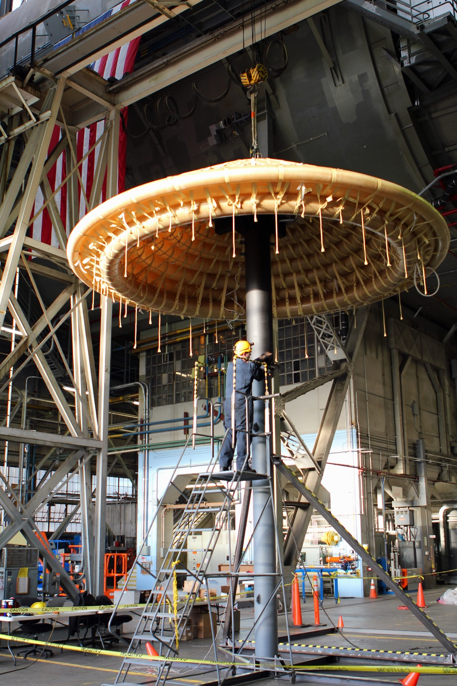
Thank You!
Your DEVELOP experience is what you make it.
What opportunities are right for you?

