Slide 1
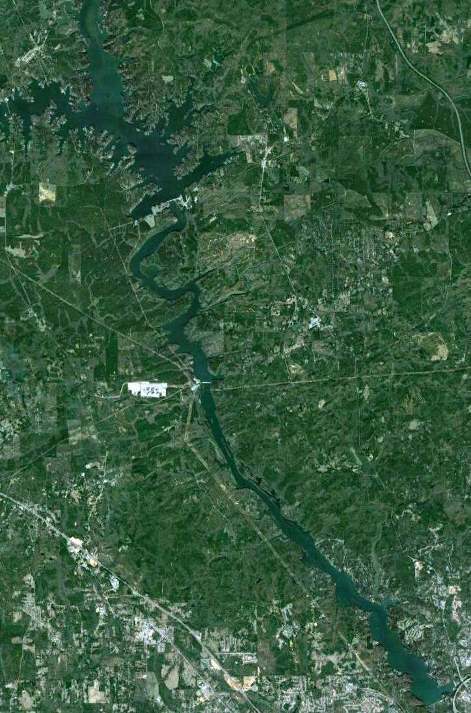
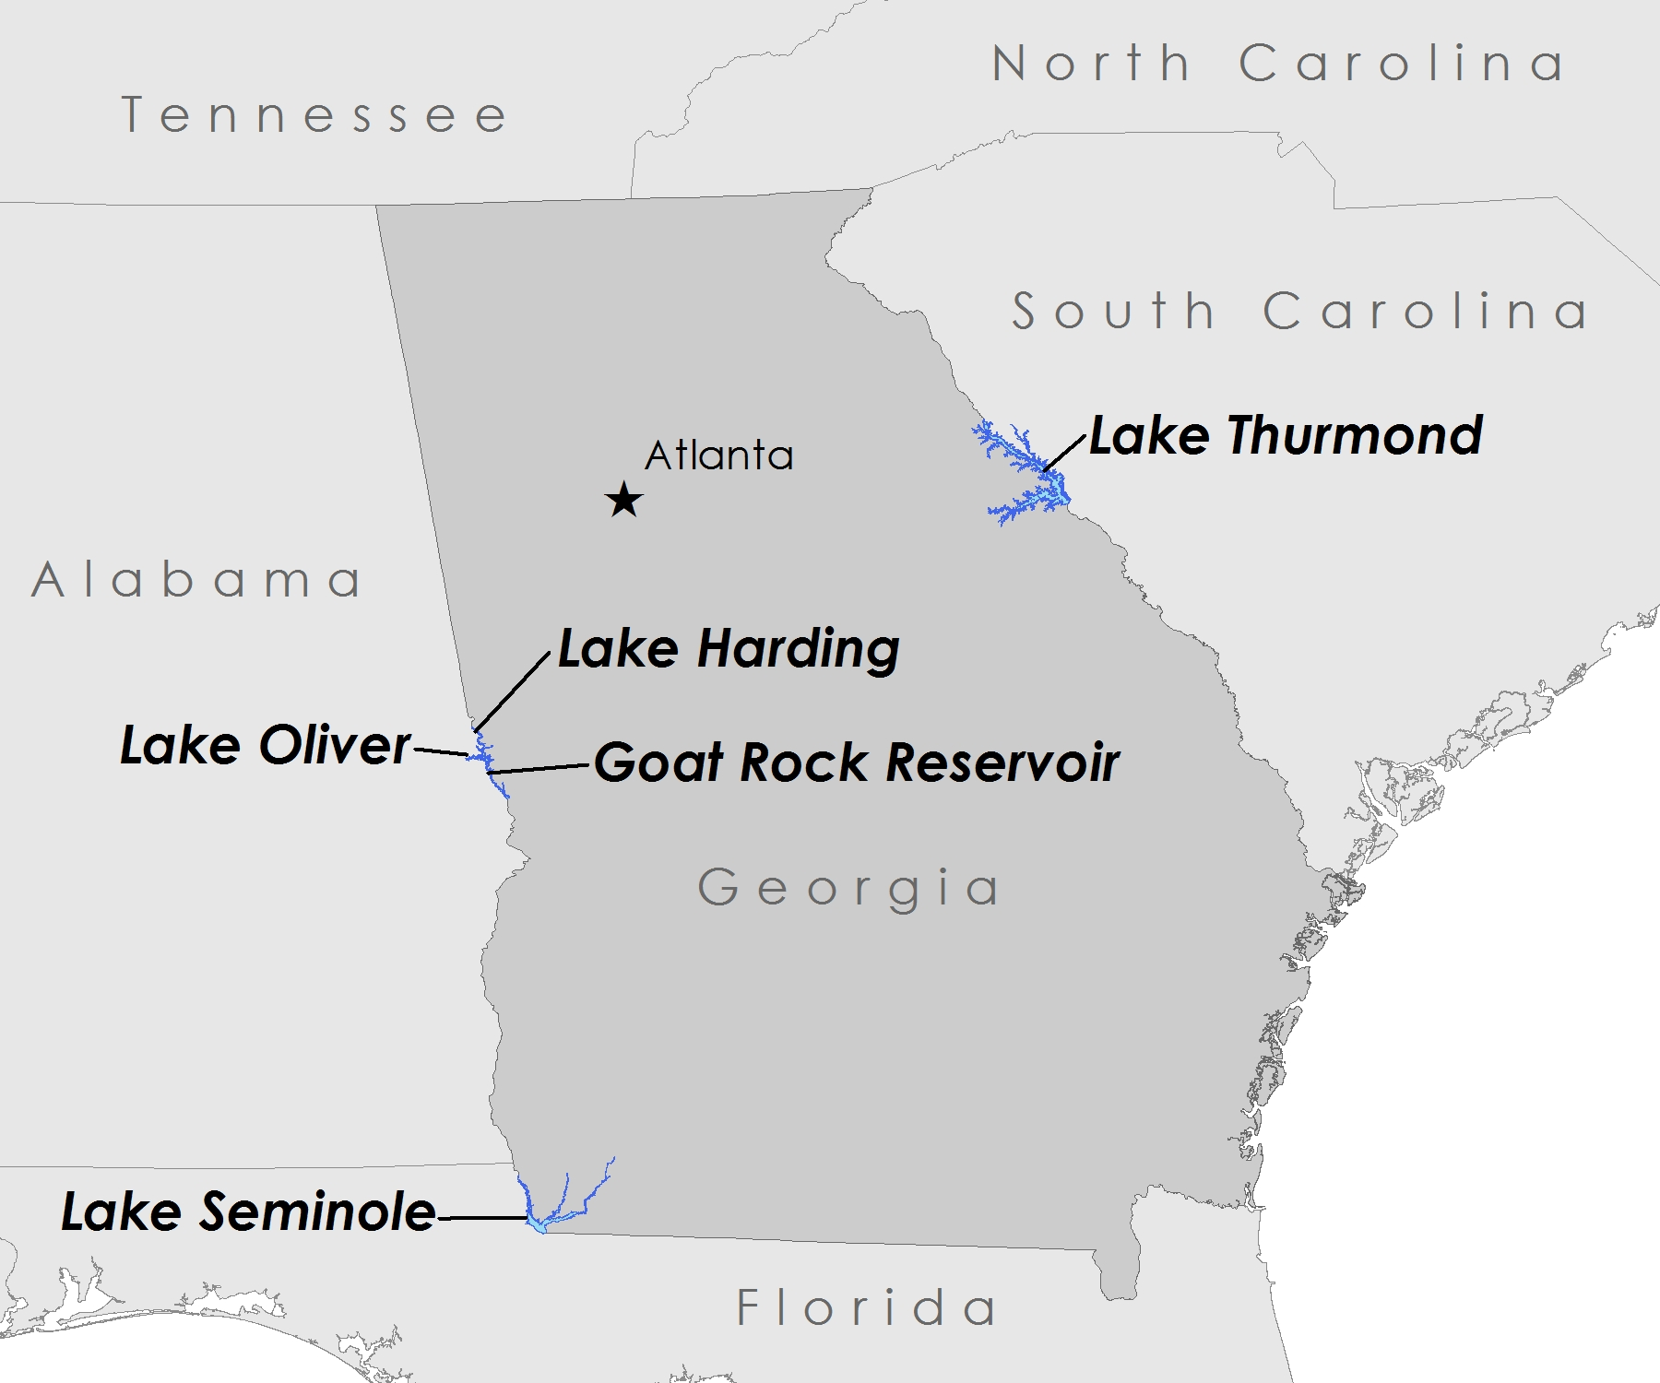
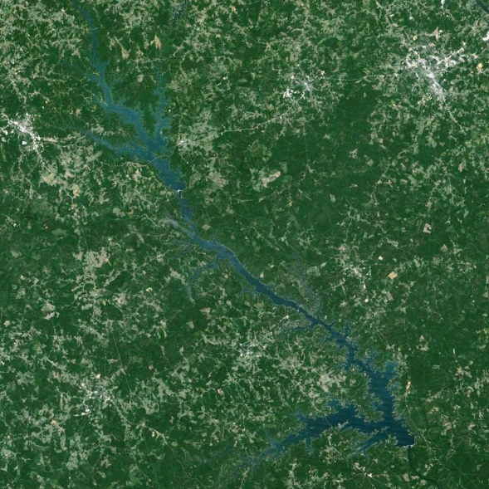
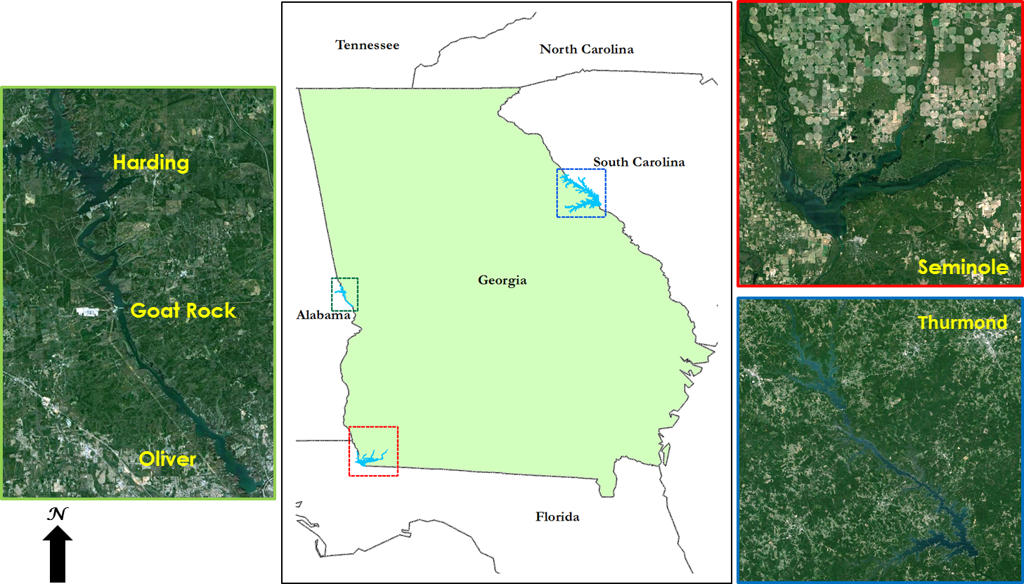
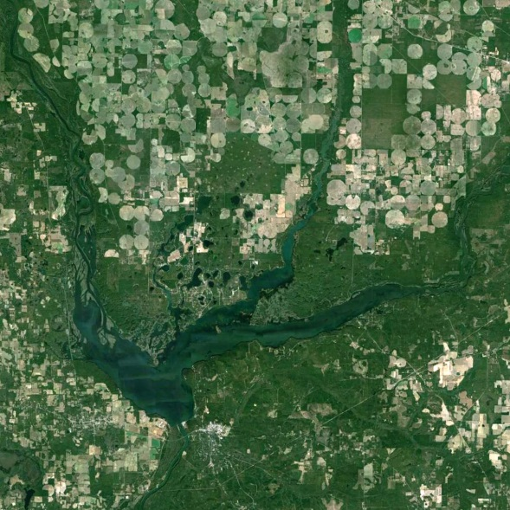
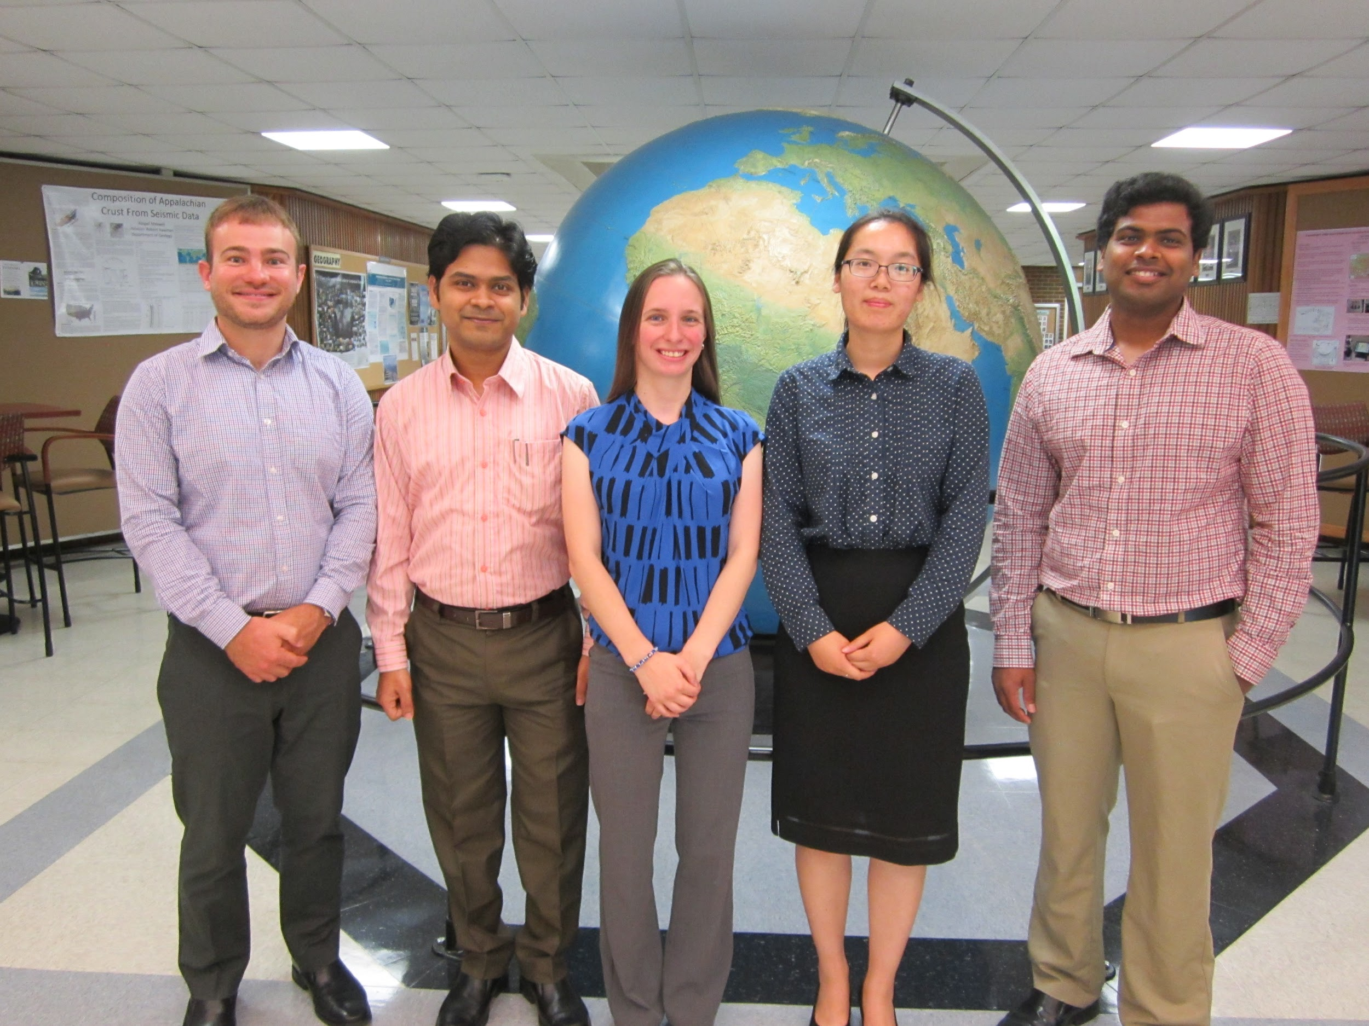
Southeast Ecological Forecasting
Utilizing NASA Earth Observations and Proximal Remote Sensing To Map the Spatio-temporal Distribution of Hydrilla verticillata
Shuvankar Ghosh (Project Lead), Peter Hawman (Co-Project Lead), Wuyang Cai, Elizabeth Dyer, Pradeep Kumar Ragu Chanthar
NASA DEVELOP University of Georgia
Abstract
Objectives
Keep this blank for now.
Body text point size should be at least 24.
Caption text point size should be at least 16.
Feel free to rename, move, and resize sections as needed.
Develop hydrilla density and distribution models based on Landsat 8 OLI and in situ field data that will enable partners to determine hydrilla density and distribution in the future.
Create time series hydrilla distribution maps for the study region and assess seasonal spatio-temporal distribution of hydrilla.
Study Area
Methodology
Lake Harding
Landsat 8 OLI
VARI
Goat Rock
Lake Thurmond
OceanOptics JAZ
Green NDVI
Lake Oliver
Model Calibration
Hydrilla Density and Distribution Maps
Lake Seminole
Basler acA1300
Vegetation Fraction
Best Fit Model Selection
Earth Observations
Model Validation
Landsat 8 OLI
Biomass
DJI Phantom 2 Vision+
Results
Conclusions
Use images.
Make sure that it has some sort of flow, that it makes sense. Show your results in a logical order.
No bullets.
Use bullets.
Use complete sentences with periods.
Team Members
Project Partners
Acknowledgements
Joseph W. Jones Ecological Research Center
Georgia Power Company
Henry County Water Authority
Dr. Stephen Golladay, J. W. Jones Ecological Research Centre
Mr. Anthony Dodd, Georgia Power
Mr. Ken Presley, Henry County Water Authority
Dr. Deepak Mishra, Department of Geography, University of Georgia
Dr. Susan Wilde, Warnell School of Forestry and Natural Resources, University of Georgia
Benjamin Page, Department of Geography, University of Georgia
Ike Sari Astuti, Department of Geography, University of Georgia
Partner Picture coming soon!
Peter Hawman, Shuvankar Ghosh, Elizabeth Dyer, Wuyang Cai, Pradeep Kumar Ragu Chanthar
University of Georgia

