Slide 1
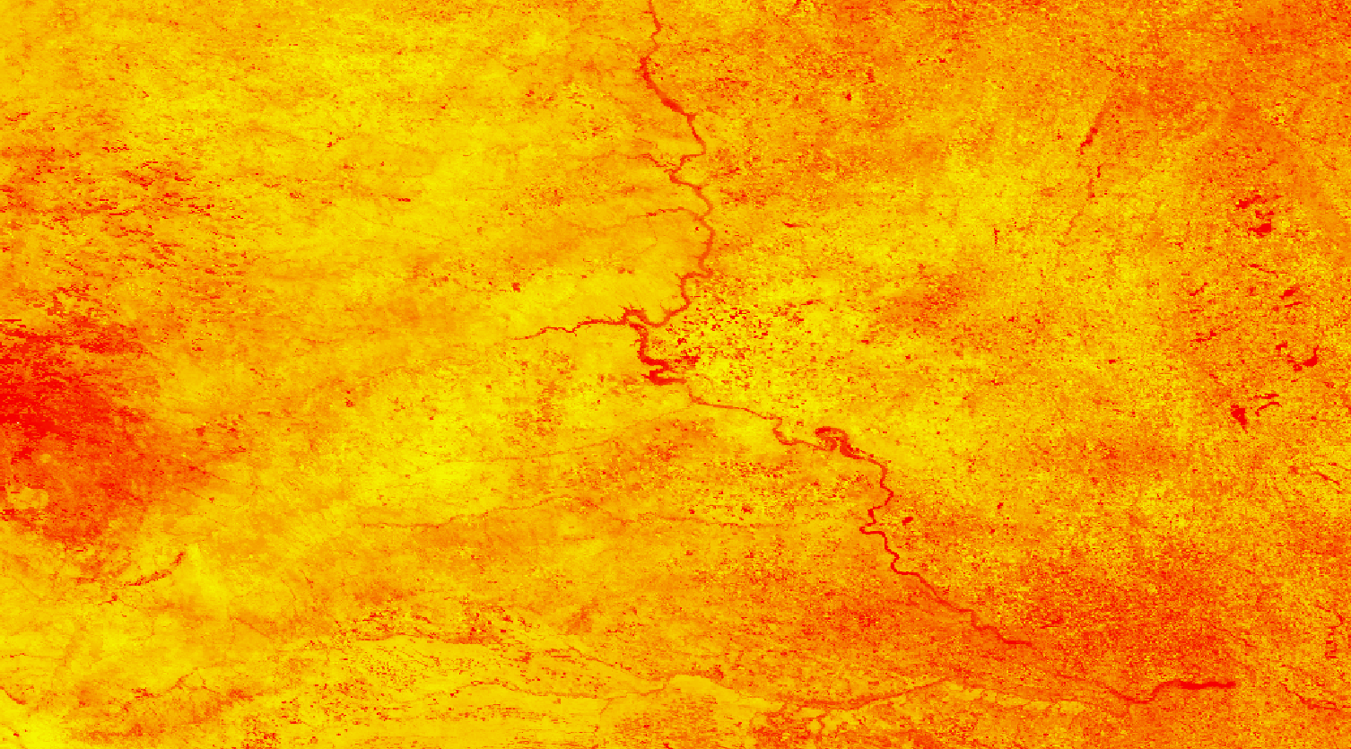
2018 Fall | North Carolina – NCEI
MISSOURI RIVER BASIN DISASTERS
Utilizing NASA Earth Observations and NOAA Climate Data Records to Produce Climate Indicators of Rangeland Health and Wildfire Risk
Natalie Belew
Tyler Hennessee
Nick Roberts
Notes:
NB: Hello, everyone! Thank you all for joining us today. I’m Natalie Belew. I’m Tyler Hennessee. I’m Nick Roberts. And we’re the Missouri River Basin Disasters team. We’ve spent the last nine weeks here at NCEI modifying and updating a wildfire risk map for the Great Plains.

Slide 2
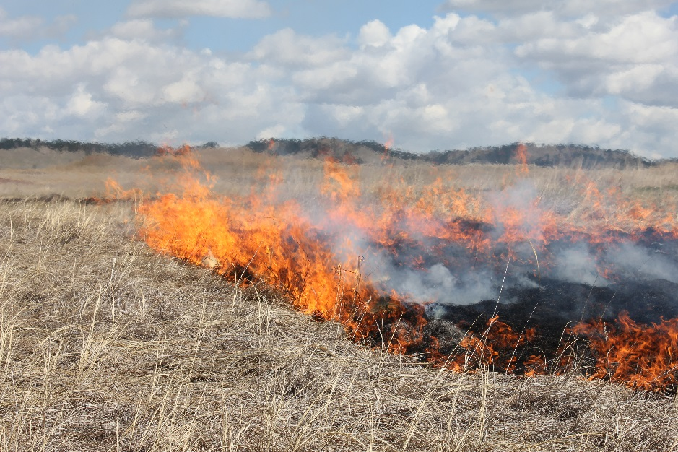
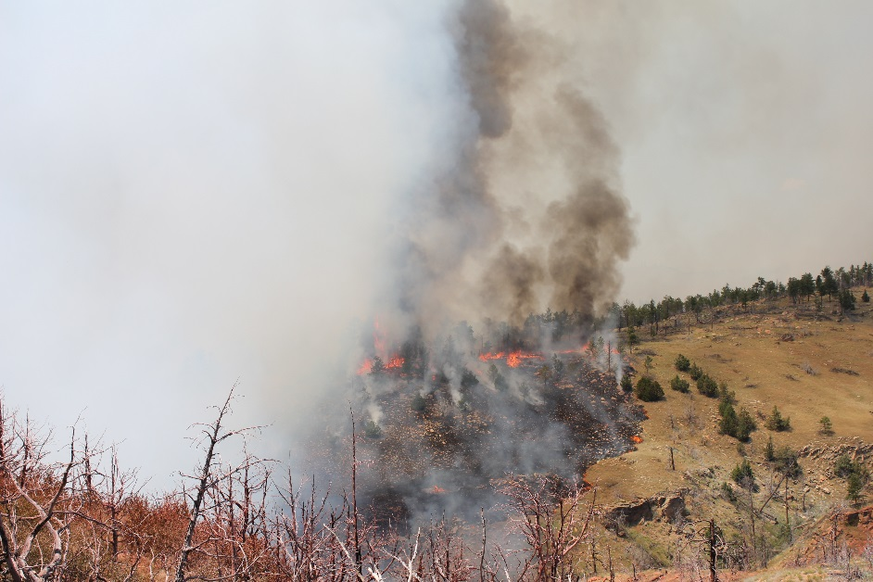
Background
Regional fire management requires monitoring of ecosystem vulnerabilities
Creation of the Fire Risk Estimation (FIRE) Tool in Spring 2017
Images Source: Darren Clabo
Notes:
NB: For a bit of a background information, I’m sure most of us are familiar with the devastating wildfires that have been occurring recently across the western half of the US and even across the world. Although wildfires are essential to maintaining a place’s ecological integrity, in recent years larger and more frequent fires have threatened and destroyed communities and ecosystem. So, the Great Plains are no exception with scores of large fires in recent years. Regional fire managers have observed many weather and fuel parameters that when combined, can lead to the onset of a large, fast-moving wildfire. And many of these parameters are inter-related. For instance, a prolonged drought can lead to poor vegetative health and lower fuel and soil moisture. As a result (click), regional wildfire management requires in-depth monitoring of ecosystem vulnerabilities. And from there, (click) the first FIRE Tool was created.
Images Source:
Darren Clabo, partner

Slide 3
Original Fire Risk Estimation (FIRE) Tool
Missouri River Climate II (Spring 2017)
Daily Fire Risk Map: March 13, 2017
Fire Potential
Low
High
Source: Missouri River Climate II Team
Notes:
In Spring 2017, the Missouri River Climate II team, involving Alec Courtright, was the first to create a daily wildfire risk map that used NASA Earth Observations and NOAA climate data records to create a high-resolution map to demonstrate fire potential across the Missouri River Basin. This wildfire risk assessment tool operated at a near-real-time capacity that instructed on-ground fire management teams when and where to observe potential fires. (pause) And their partners loved the tool! So much so that after using it for a fire season, they came back to NASA DEVELOP asking to work together to make improvements on it. And from there, our project came along.

Slide 4
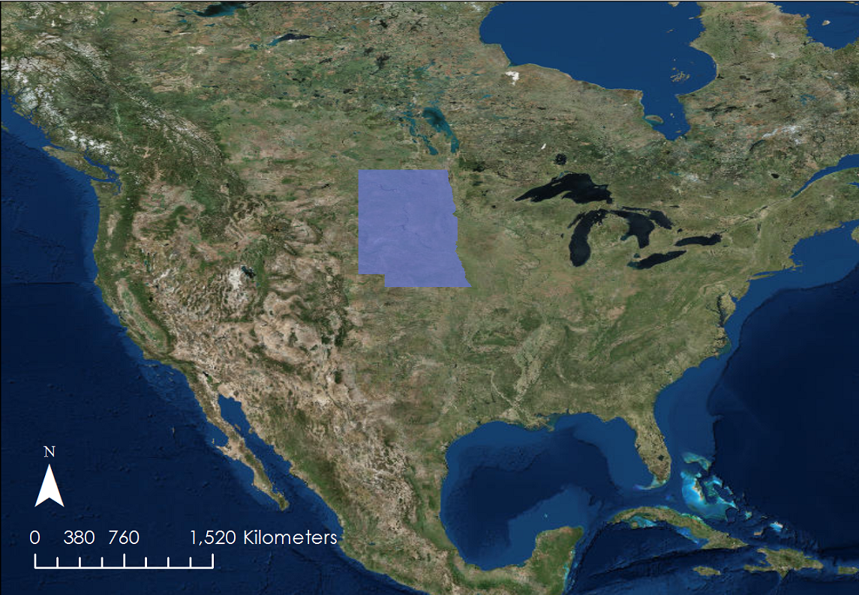
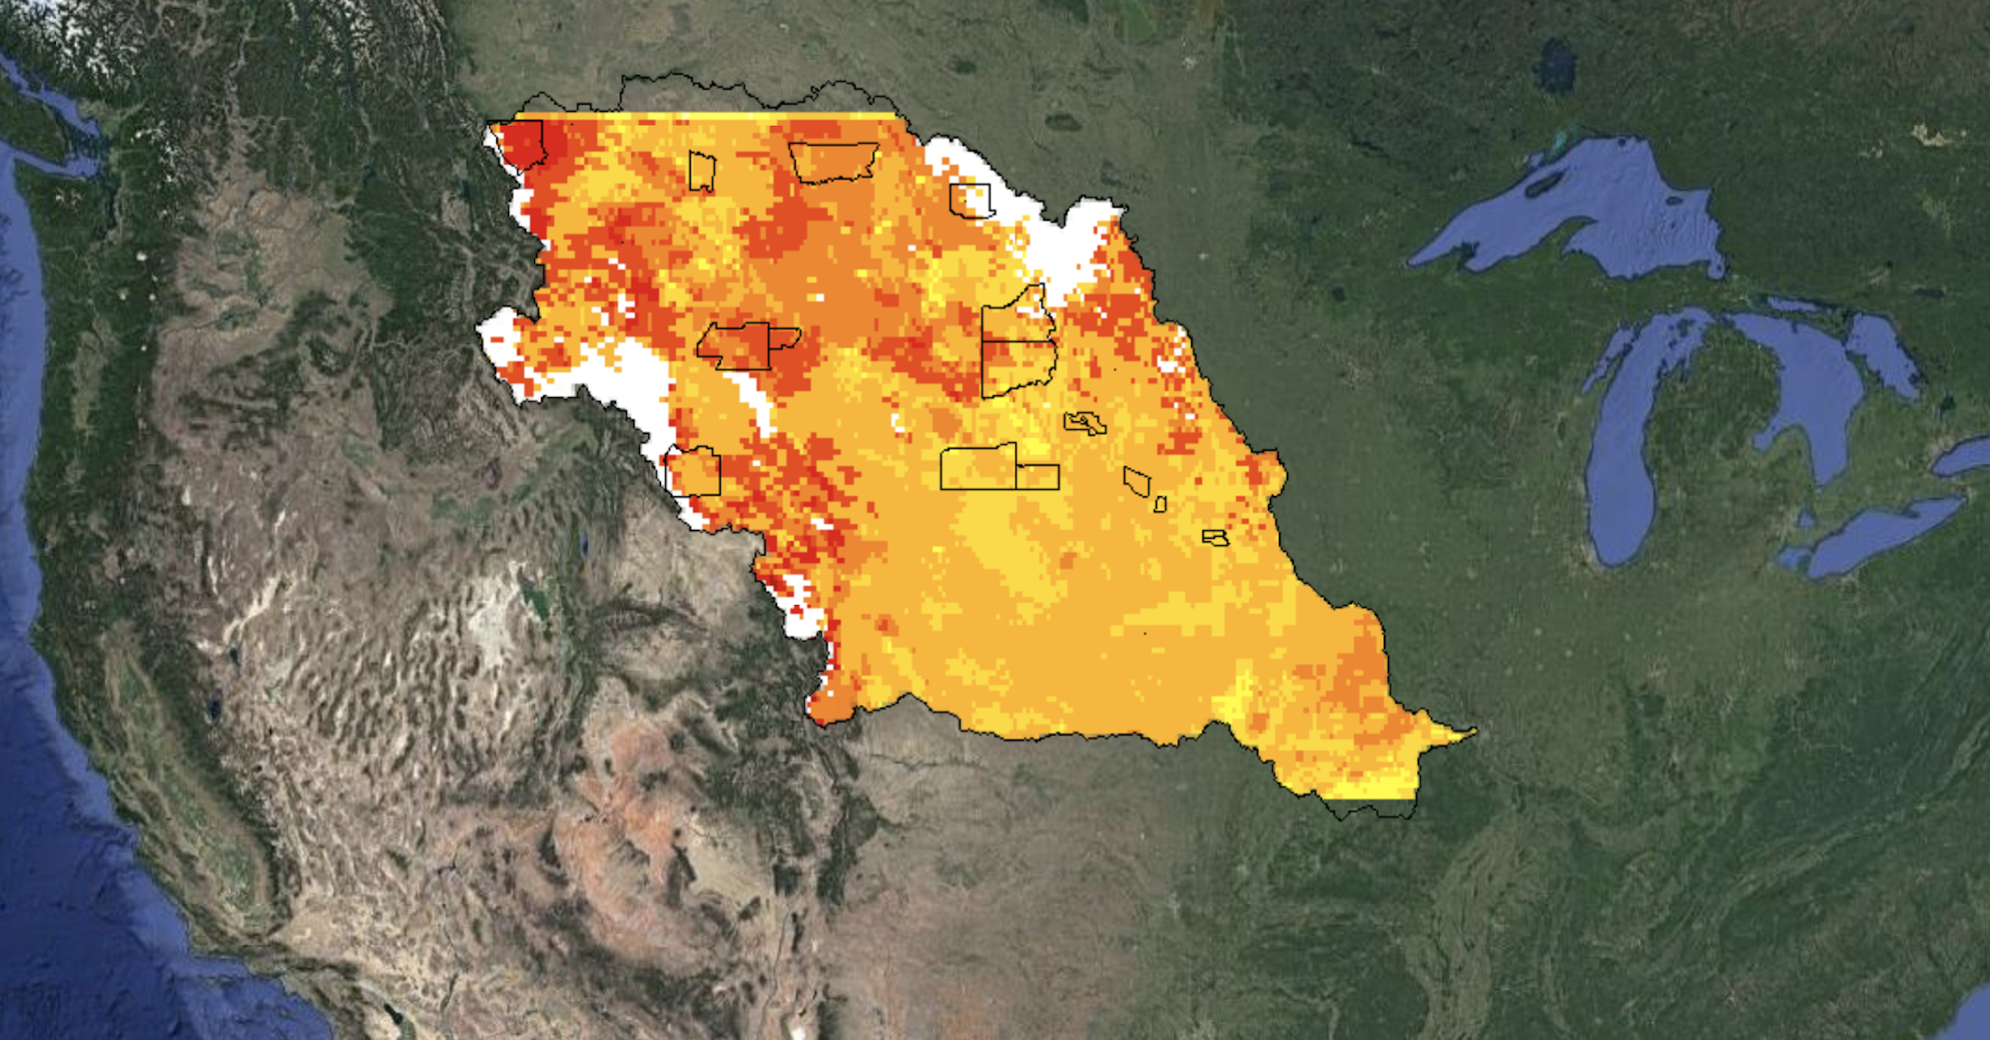
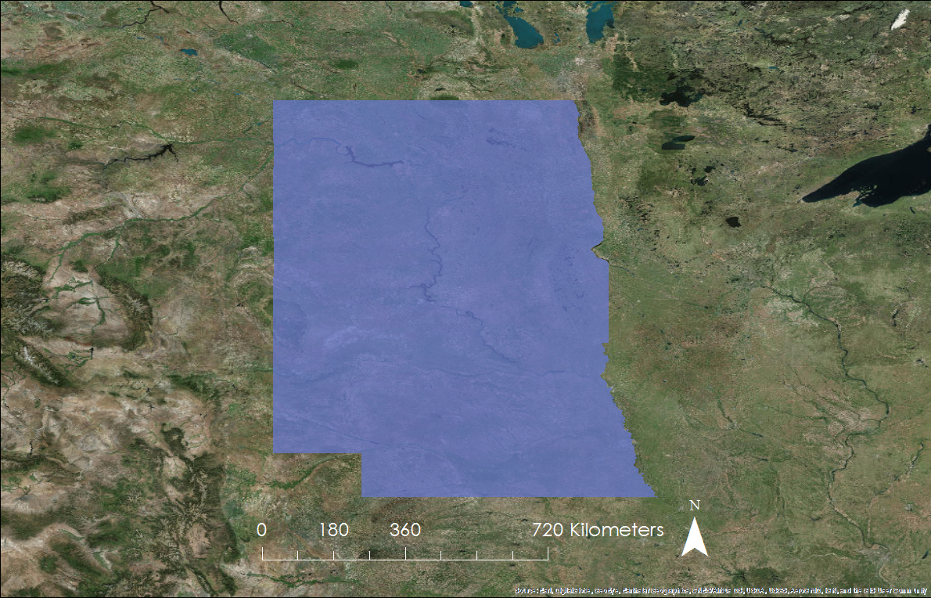
Study Area
North Dakota
South Dakota
Nebraska
Missouri River Basin
Source: Missouri River Climate II Team
Notes:
NB: Now as you can see, the original FIRE tool spanned the entirety of the Missouri River Basin. But based on partner requests, we shifted away from the Missouri River Basin as a whole and (click) instead narrowed to specifically the states of Nebraska, North Dakota, and South Dakota.
Images Source: Missouri River Basin Disasters Team

Slide 5
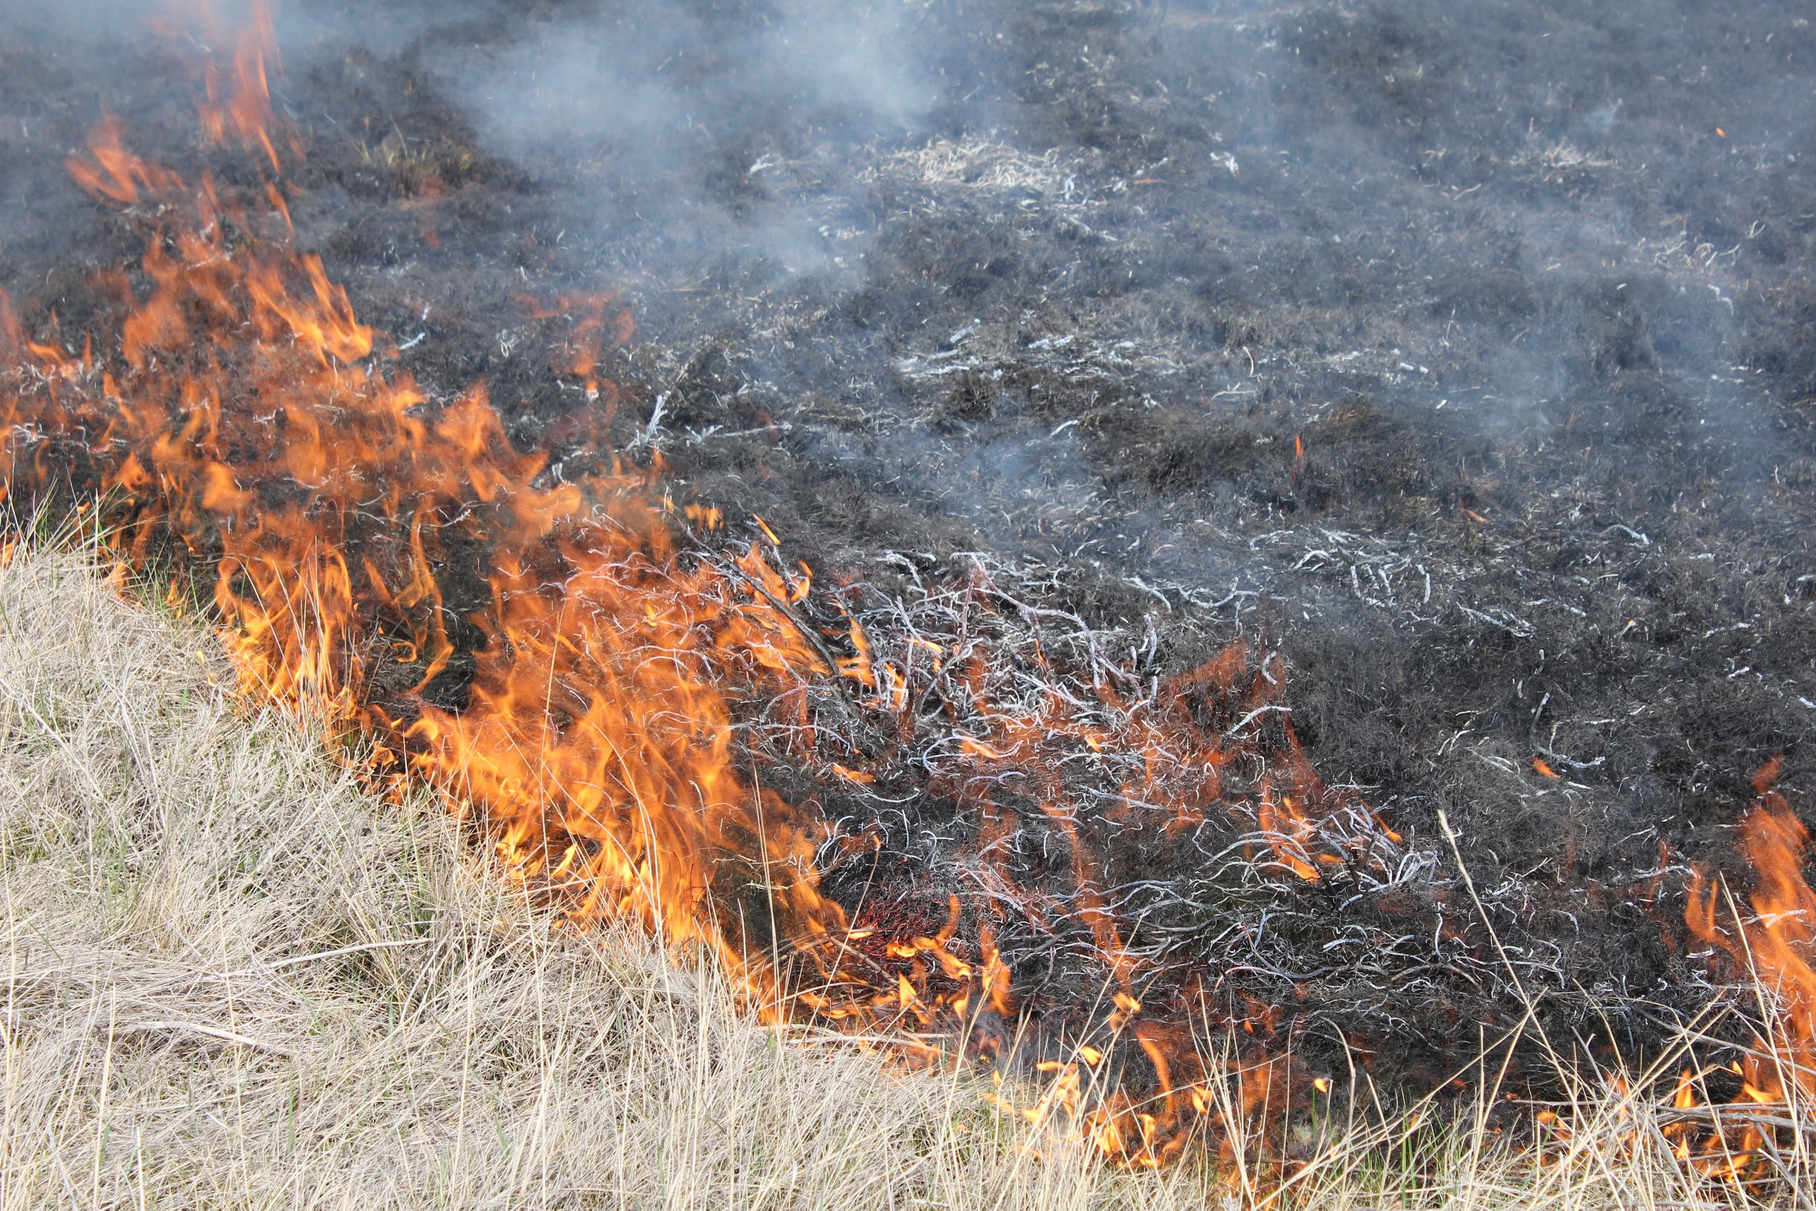
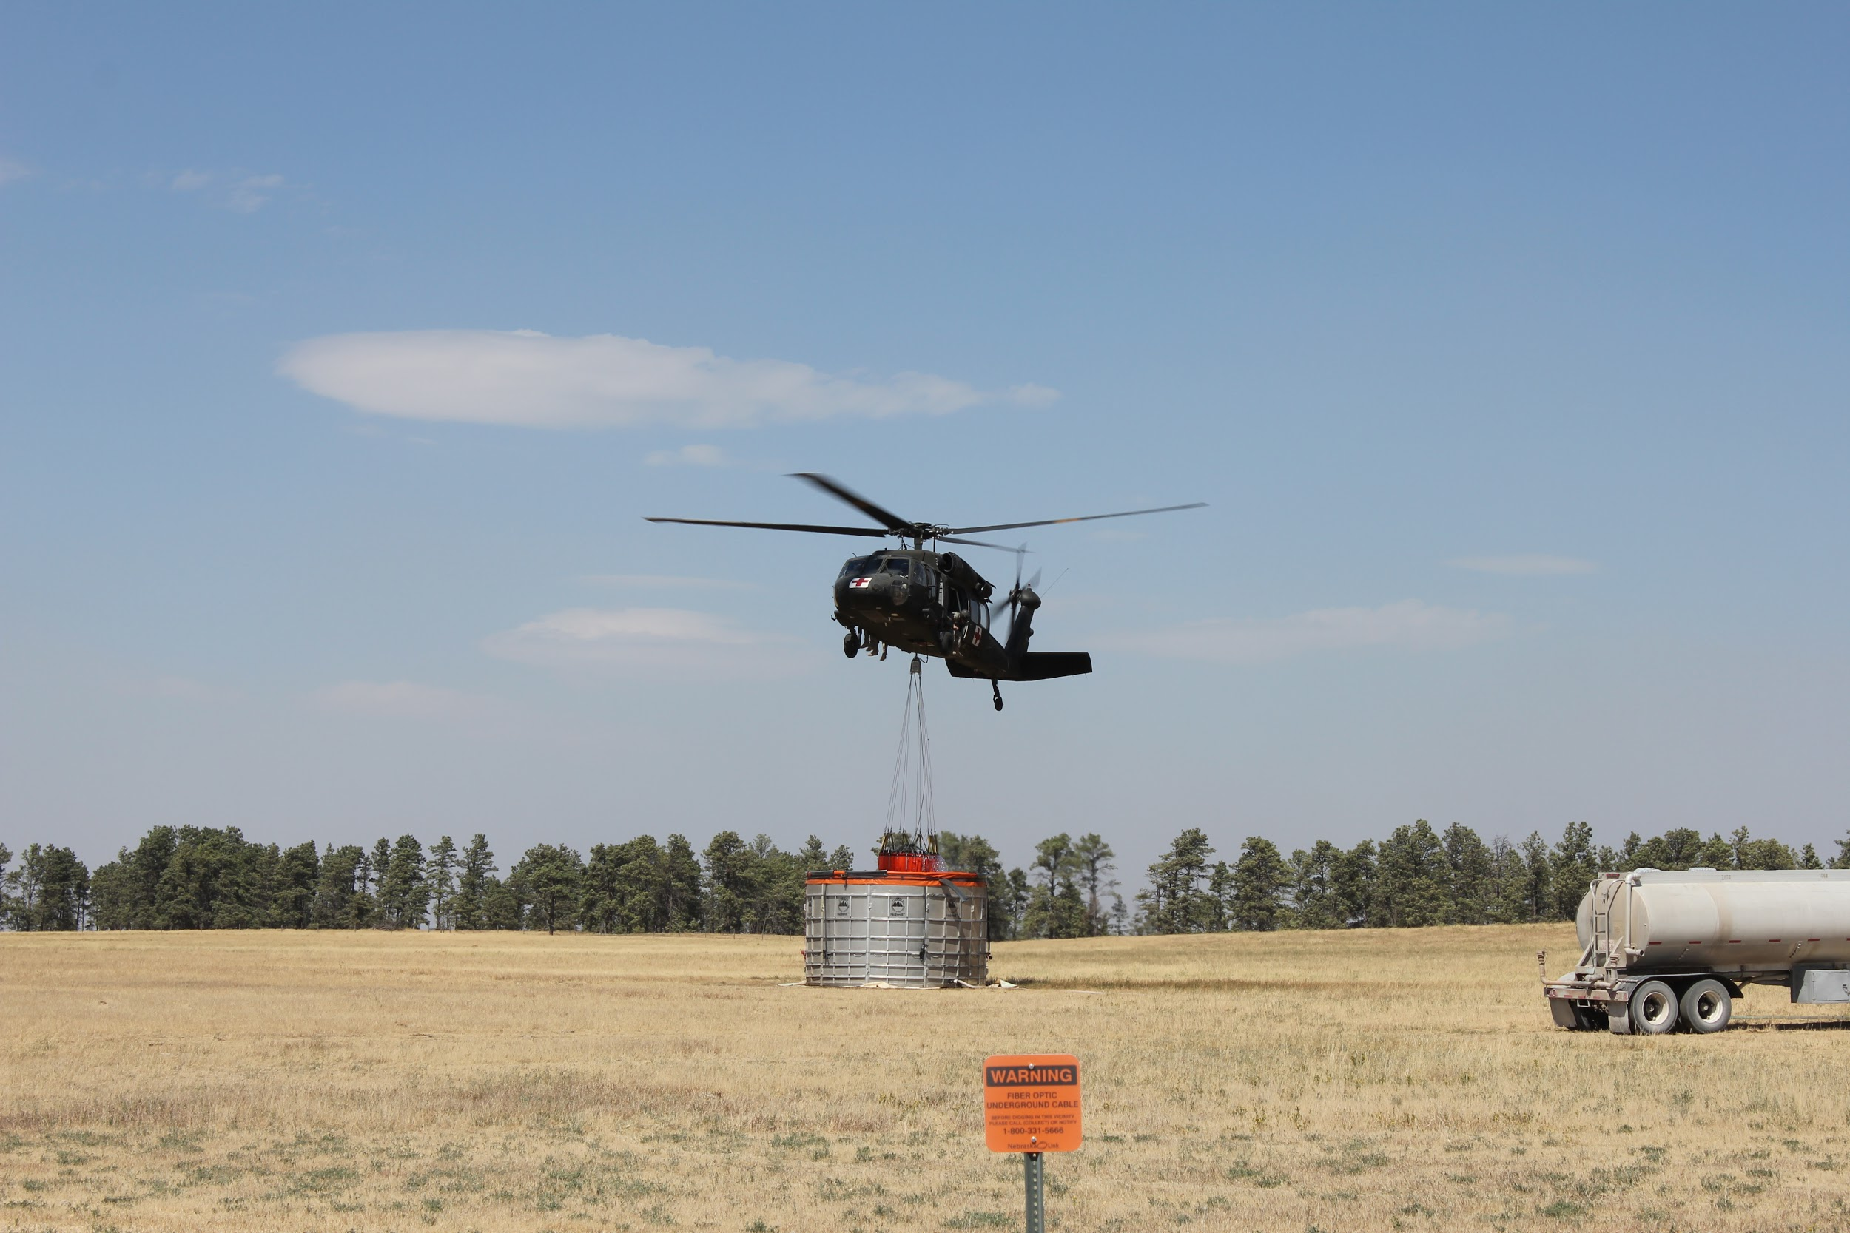
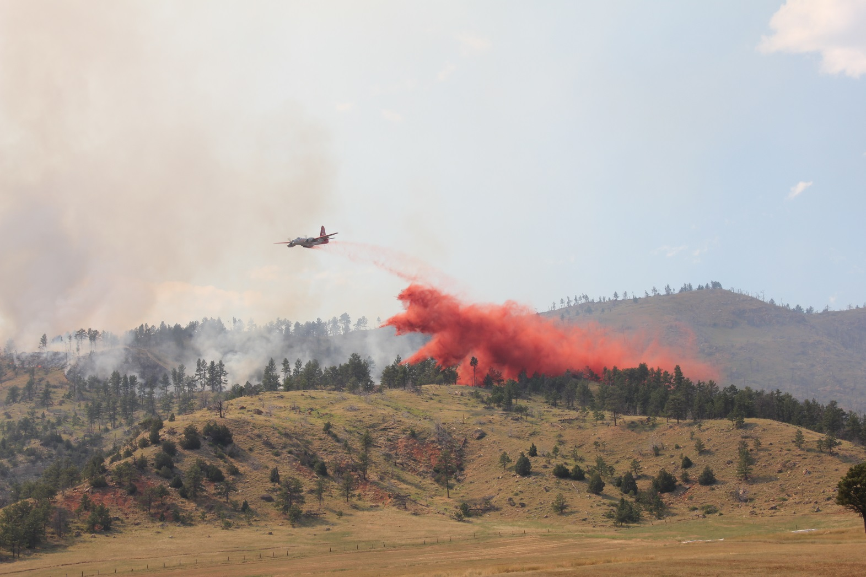
Partners
Image Source: Darren Clabo
Bureau of Indian Affairs, Wildland Fire Management, Great Plains Region
David Martin: Regional Assistant Fire Management Officer
South Dakota School of Mines and Technology
Darren Clabo: South Dakota State Fire Meteorologist
NOAA NCEI Regional Climate Services, Central Region
Doug Kluck: Central Region Director
NOAA National Integrated Drought and Information System (NIDIS)
Britt Parker: Regional Drought Information Coordinator
Notes:
NB: So throughout our process of modifying and improving the FIRE tool, we collaborated with the BIA, the State Fire Meteorologist of South Dakota, NOAA’s Central Region Climate Services Director, and NIDIS to determine what improvements they wanted to see made in our ten-week timeframe.
Image Source: Darren Clabo

Slide 6
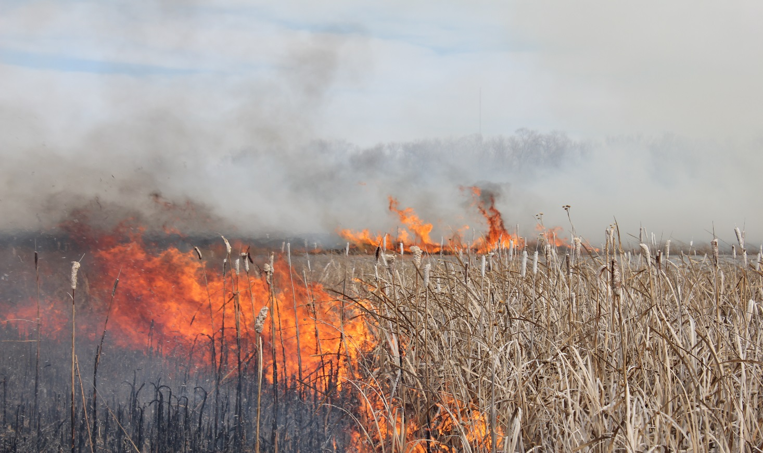
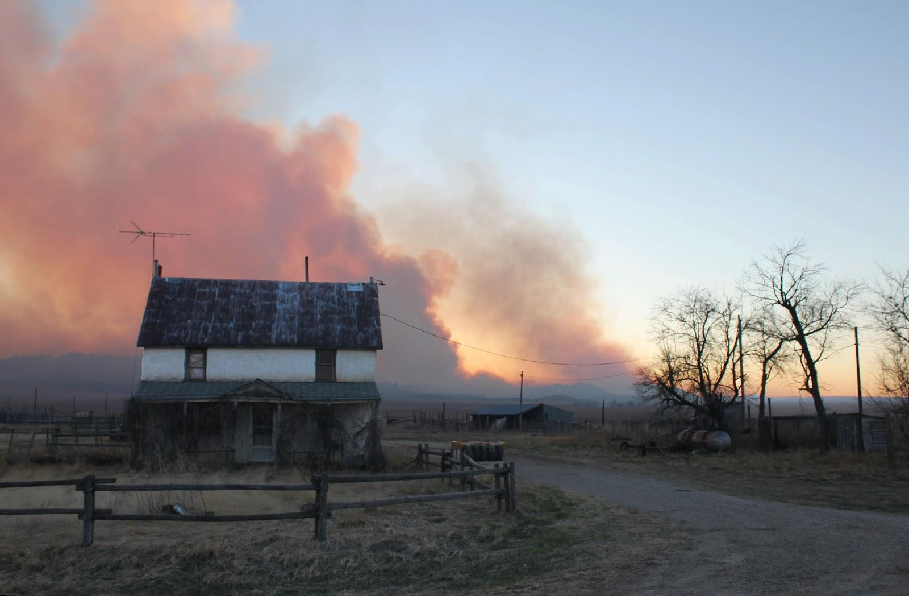
Community Concerns
Need for monitoring wildfire indicators in near-real-time
Current fire maps mostly rely on sparse in situ data
Grassland fires can be difficult to quickly contain and costly to monitor ground conditions
Images Source: Darren Clabo
Notes:
NB: As I stated before, monitoring the potential for wildfires is a major concern for regional fire managers. Now other fire maps are out there, but many of them rely on spare in situ data and only function on a multi-county scale. Plus it’s very difficult and expensive to monitor conditions such as changing fuel and soil moisture and other ground conditions. So, the use of high-resolution satellite data and climate data records is an appealing avenue for monitoring the various factors that can contribute to wildfire potential in the Great Plains.
Image Source: Darren Clabo

Slide 7
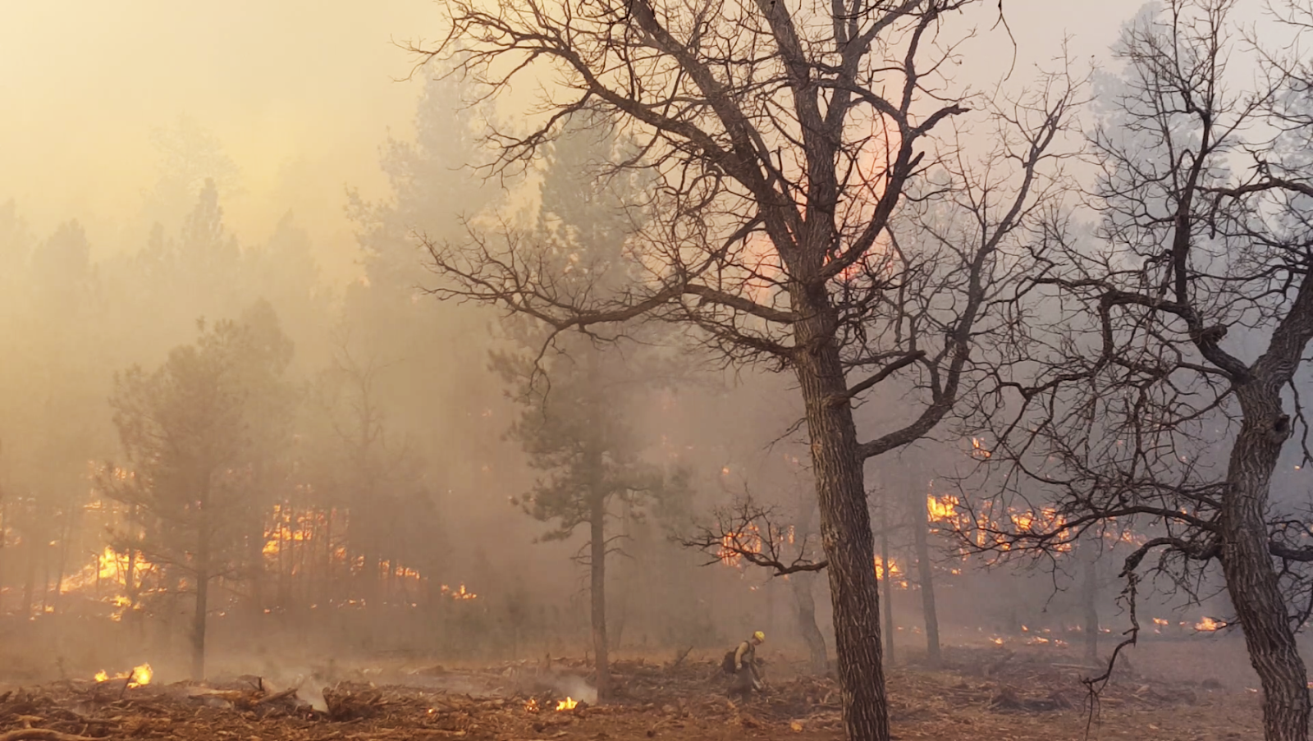
Objectives
Transition from Google Earth Engine to Esri ArcGIS
Modify to North Dakota, South Dakota, & Nebraska
Update data layers, thresholds, and weight matrix
Produce automated daily fire risk maps
Image Source: Darren Clabo
Notes:
NR: Our objectives were to take an existing FIRE tool produced by the Missouri River Basin Climate II project and to make it functional again. The tool was housed in Google Earth Engine (GEE), and some of the datasets that the tool utilized had stopped updating completely, or were updating at slower than desired intervals. Additionally, the tool had to be manually run by someone at NECI, which meant that the data from this tool was only available to partners on the weekdays.
Our project worked to remove the existing tool from GEE and translate it into Python in order to ingest data directly from their sources. Using ESRI also gives our group (or others, if we do not have enough time to get it set up) the ability to host the tool online so the FIRE risk product can be visible to our partners and others.
As was previously discussed, we also refocused to the tool on North Dakota, South Dakota, and Nebraska based on partner interest.
Additionally, changes were made to the data layers including a reconfiguring of precipitation data to meet partner needs, changing from MODIS to VIIRS for fuel moisture, and applying additional overlays to display counties and reservations, as well as soil moisture. Changes were also made to thresholds and weights based on partner input.
Currently, this tool reliably produces an automated daily fire risk map. Additional goals for this project (currently in progress) are to automate the code so it will run and distribute products to partners at a fixed time of day, whether that be in a viewable web map or through automated email distribution of map packages.
Image Source:
https://pixabay.com/en/helicopter-dropping-water-forest-fire-595422/

Slide 8
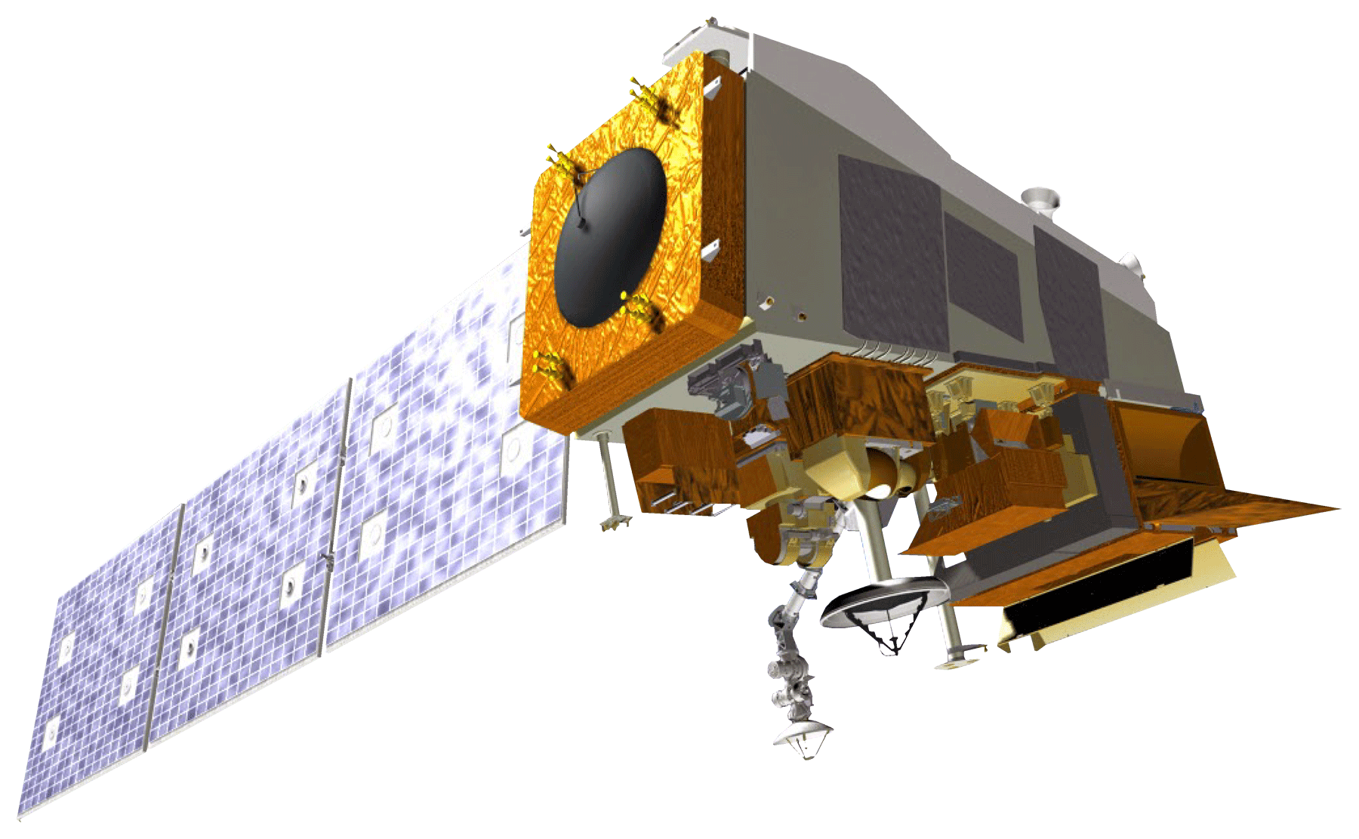
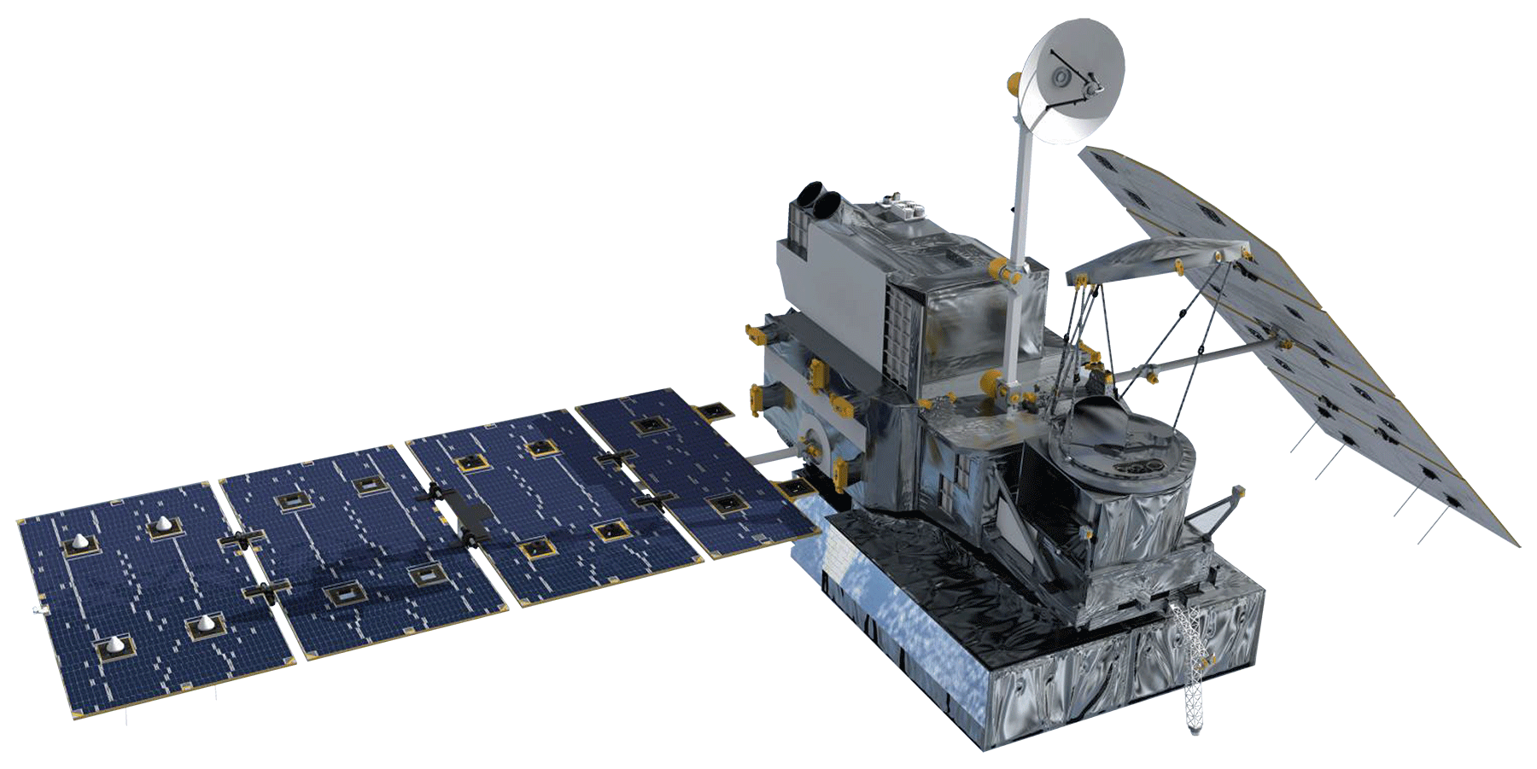
Methodology: Data Acquisition
Suomi National Polar-orbiting Partnership (NPP) Visible Infrared Imaging Radiometer Suite (VIIRS)
Terra Moderate Resolution Imaging Spectrometer (MODIS)
Global Precipitation Measurement (GPM) Integrated Multi-satellite Retrievals for GPM (IMERG)
NASA Satellites/Sensors Used
Notes:
There are 3 satellites used in this project. The first is GPM IMERG, used to retrieve 15 daily precipitation datasets used to create our soaking and wetting precipitation layers.
The second is Suomi NPP VIIRS, used to retrieve 8 day composites of high resolution imagery and create Normalized Difference Infrared Indices (NDII) which approximate the change in fuel moisture.
The third is Terra MODIS, used both to retrieve a daily snow cover product and to create climatology normals for NDIIs, which current NDIIs from VIIRS can reference in order to approximate fuel moisture anomalies.
Satellite Images Sources:
http://www.devpedia.developexchange.com/dp/index.php?title=List_of_Satellite_Pictures

Slide 9
Methodology: Data Acquisition
Real Time Mesoscale Analysis (RTMA)
Parameter- elevation Regression on Independent Slopes Model (PRISM)
U.S. Drought Monitor (USDM)
North American Land Data Assimilation System (NLDAS)
GPM (Precipitation)
NOAA & Other Climate Data
Notes:
TH:
In addition to using satellite data, we also used NOAA and modeled data for our project.
For RTMA, we downloaded twenty four hourly raster datasets that we then combined to get the average temperature, the average dewpoint, and the maximum windspeed. It was very helpful having three datasets contained in one source! Using RTMA, we were able to calculate percent relative humidity using the average temperature and average dewpoint.
Drought data was acquired from USDM each week.
PRISM data was brought in to look at the 30 year climatic normals from the period of 1981 to 2010. This data provided us with an average temperature normals to compare to the current average temperature in order to get temperature abnormalities.
Finally, our partners wanted to be able to view data related to soil moisture, so we downloaded soil moisture from NLDAS.

Slide 10
Methodology: Data Processing
Applying Seasonal Threshold Criteria for Large Fire Potential
 |  | Partner-Provided Thresholds
 |  | Spring | Summer | Fall | Winter
VARIABLES | Drought (USDM) | D1 | D1 | D1 | D1
 | Wind Speed (m/s) | 8.94 | 8.94 | 8.94 | 8.94
 | Rain – Soaking (mm) | 12.7 | 12.7 | 12.7 | 12.7
 | Rain – Wetting (mm) | 2.54 | 2.54 | 2.54 | 2.54
 | Relative Humidity (%) | 30 | 20 | 30 | 40
 | Temperature Anomaly (ºC) | 10 | 8 | 10 | 15
Notes:
TH:
After bringing the data into the tool and clipping it to the study area, we applied partner defined thresholds to the data.
If there were drought conditions of D1 or higher (D2, D3, D4), then these contributed to the fire risk.
Sustained windspeeds of 11 m/s contribute to fire risk, while windspeeds below 11 m/s do not.
If there is less than the threshold values for soaking and wetting rain, then these variables contribute to fire risk.
If the average relative humidity is below these seasonal percentages, then the percent relative humidity would contribute to fire risk.
If the temperature anomaly is greater than these temperatures, then this contributes to fire risk.

Slide 11
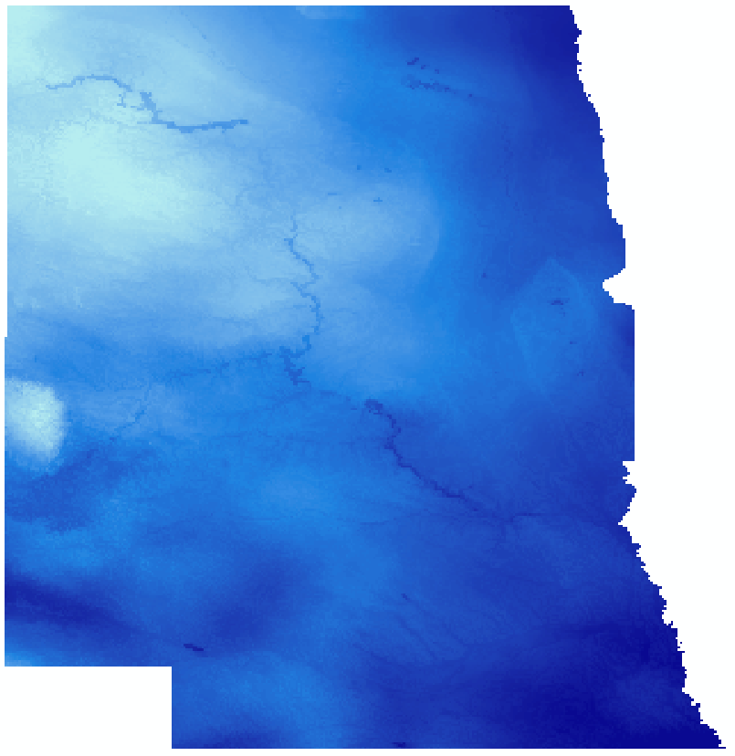
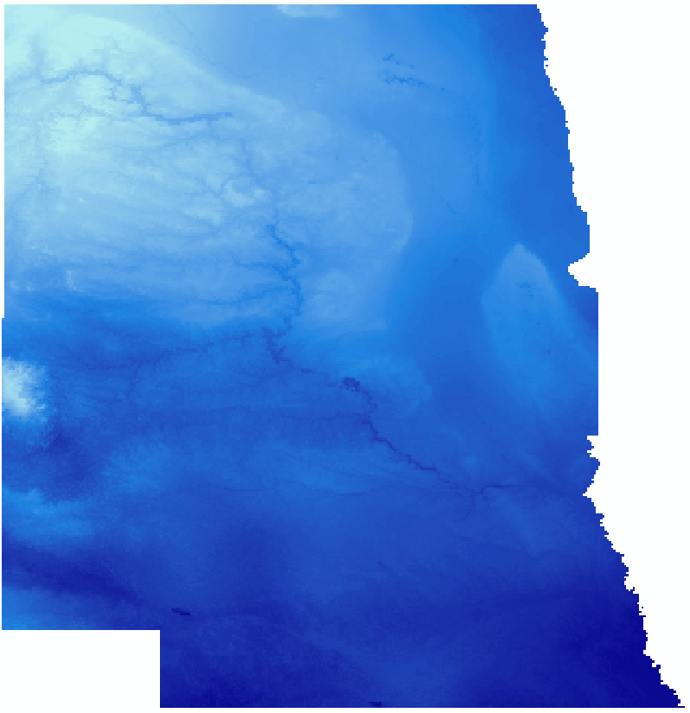
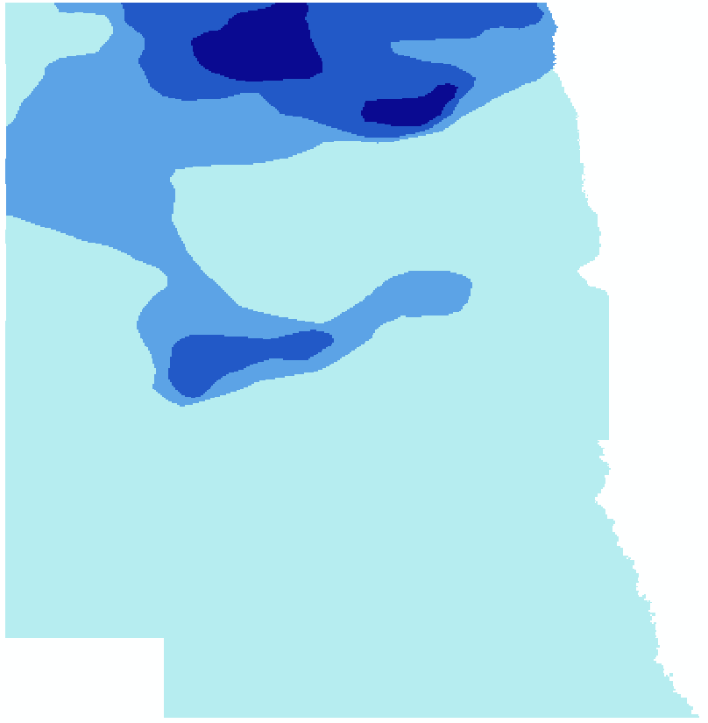
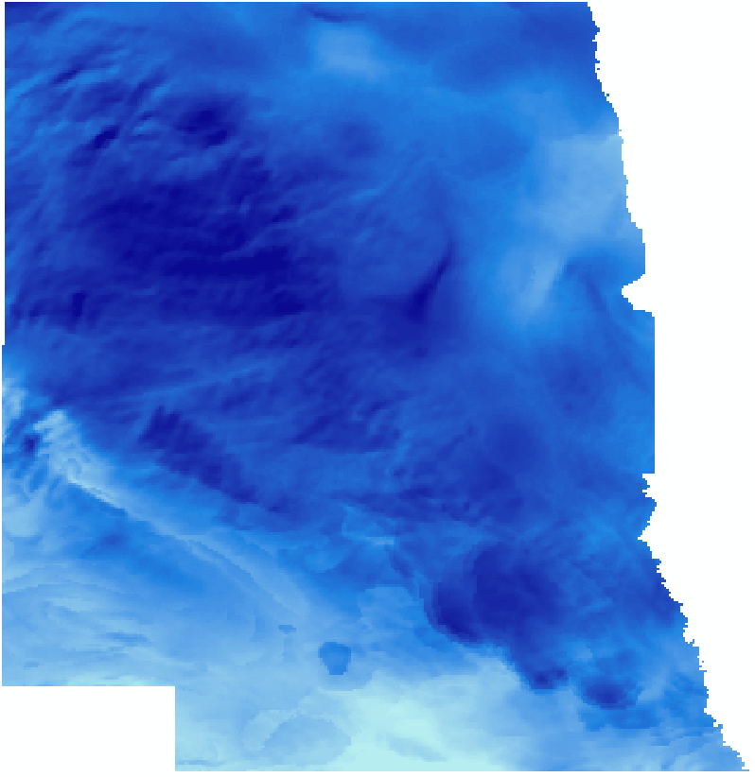
Methodology: Data Processing
Semi-Processed Data for November 6, 2018
Value
High
Average Daily Dew Point
Average Daily Temperature
Low
0
180
360
720
Kilometers
USDM Drought
Daily Maximum Wind Speed
Notes:
Here are some examples of what some of our data look like after they’ve been processed, but not yet reclassified using a partner defined threshold.
For a bit more context, the wind, dewpoint, and temperature data are extracted from the 24 most recent RTMA hourly datasets and processed to display average daily dewpoint, average daily temperature, and daily maximum wind speed. The most current USDM drought is also automatically ingested and clipped to the relevant study area.
These data are either then reclassified, or further processed in order to yield relevant data such as relative humidity or temperature anomalies.
Images Source: Missouri River Basin Disasters Team

Slide 12
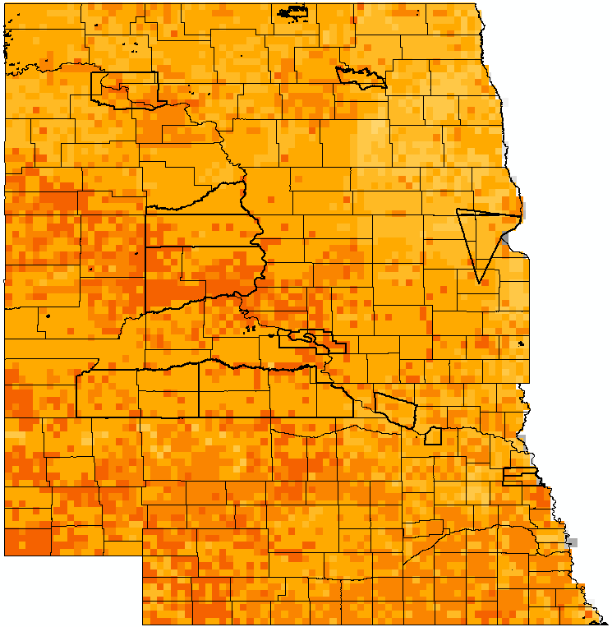
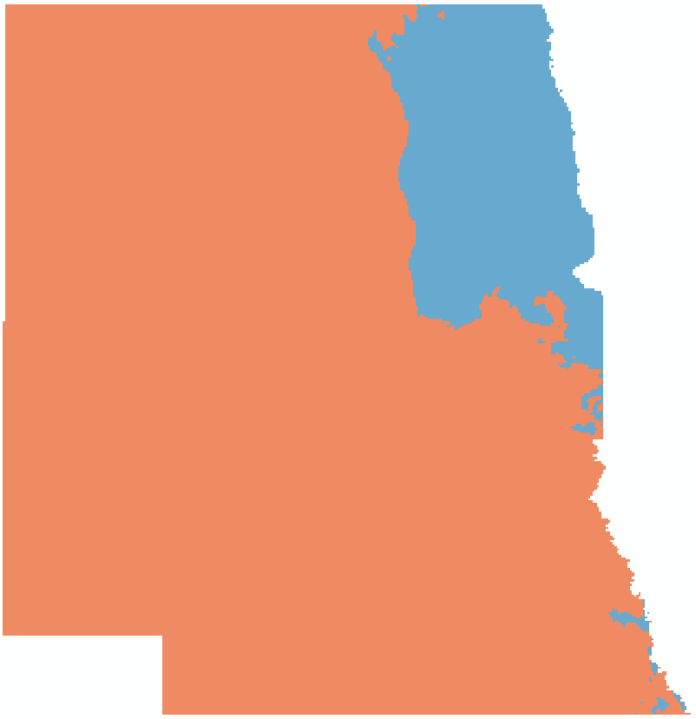
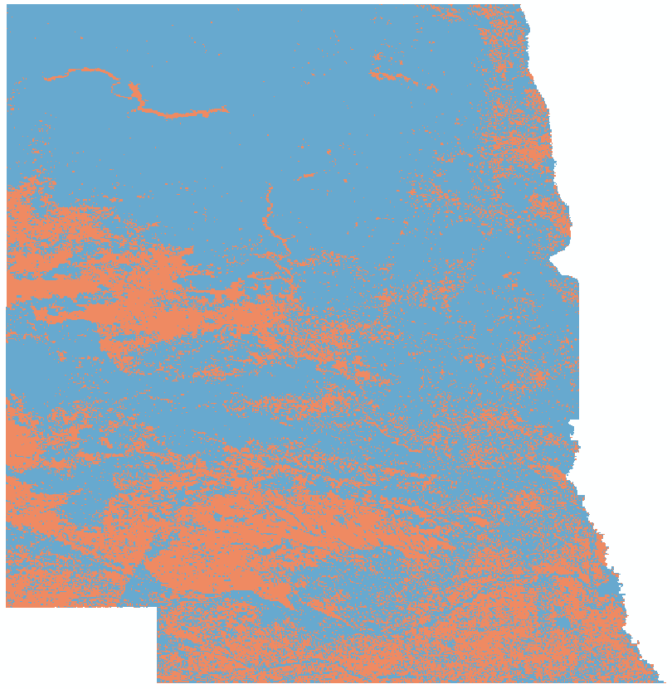
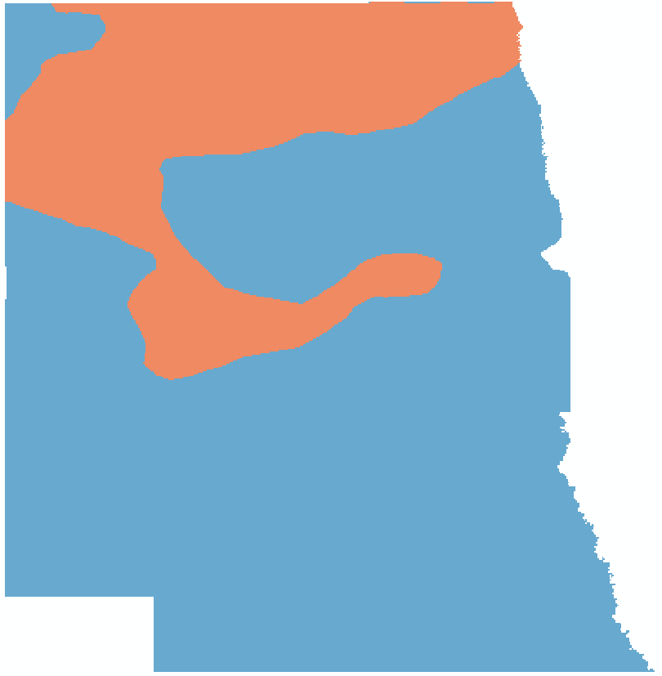
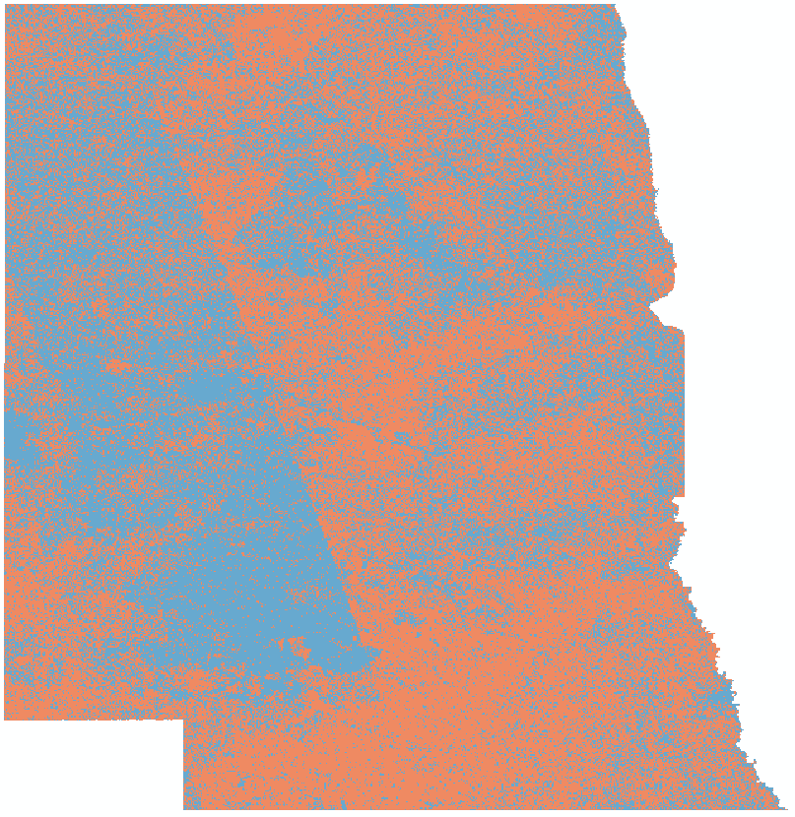
Results
Contribution to Fire Risk
Does Not Contribute
Does Contribute
0
180
360
720
Kilometers
Counties
Reservations
Snow Cover
Fire Risk Potential
0
0.5 – 0.6
0 – 0.1
0.6 – 0.7
0.1 – 0.2
0.7 – 0.8
0.2 – 0.3
0.8 – 0.9
0.3 – 0.4
0.9 – 1
0.4 – 0.5
0
180
360
720
Kilometers
Temperature Anomalies
NDII Change
Wind Speed
Relative Humidity
NDII Anomalies
Wetting Precipitation
Drought
Soaking Precipitation
Daily Fire Risk Map: November 6, 2018
Notes:
These ingested processed and reclassified data are then combined to create our “Daily Fire Risk Map”. Each of the 8 variables we use to calculate fire risk is shown on the left here. The Fire Risk map displays fire risk on a scale from 0 to 1, with 0 being the absolute minimum fire risk possible with every layer not contributing to fire risk and 1 being the absolute maximum with every variable fully contributing to fire risk.
Additionally, there are several overlays, one of which shows individual counties and reservations within the study area in order to be better utilized on a county and reservation level. There is also a snow cover overlay which shows areas of snow cover in which fire risk is irrelevant. Because this map example was produced on a day when the snow cover was not present in the study area, this overlay is not visible, but it would be on top of the fire risk map. Finally, there is a soil moisture overlay which displays the most current soil moisture data obtained from NLDAS.
Images Source: Missouri River Basin Disasters Team

Slide 13
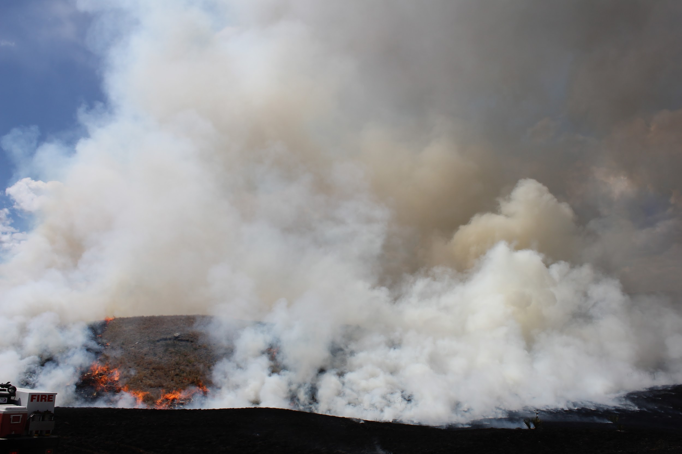
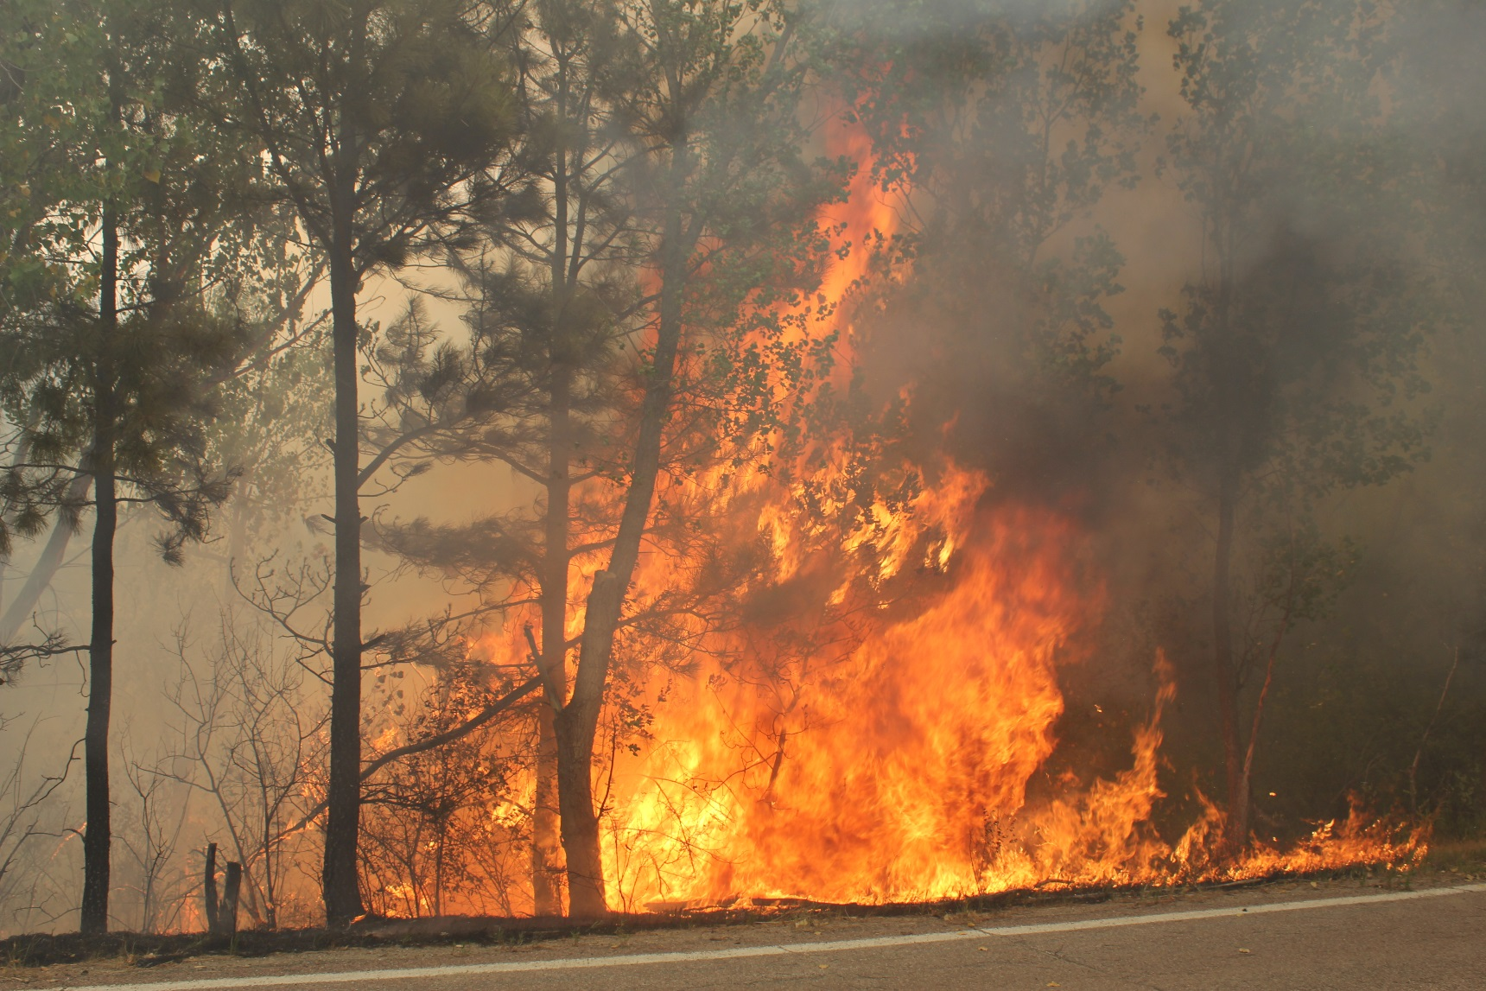
Errors & Uncertainties
The FIRE 2.0 tool is not a predictive tool
Changes to weights and thresholds are not possible until code release
If data sources change, the code will not retrieve most recent data
Images Source: Darren Clabo
Notes:
The FIRE 2.0 tool does not guarantee that fires will occur in a given location. The tool takes data from various inputs that the partners have identified as contributing to wildfire risk, and using partner-defined thresholds, it generates a map that shows the areas that wildfires are more likely to occur in.
Our partners did a great job of using their expertise from years in the field observing and combating wildfires to define thresholds for the variables that affect fire risk. However, as more information becomes available and as our partners utilize this tool, they may find changes in the weights and thresholds that they wish to make. Unfortunately, until the code goes through the code release process, they will not be able to enact those changes.
As websites are updated, the URLs and the file naming scheme may change. The code knows how to go to a specific URL and find the data needed by following an established pattern. Additionally, it’s possible that a data source will stop updating completely. If this occurs, the code should not break; however, the data that was downloaded most recently will be used, introducing uncertainty.
Image Source:
Darren Clabo, partner.

Slide 14
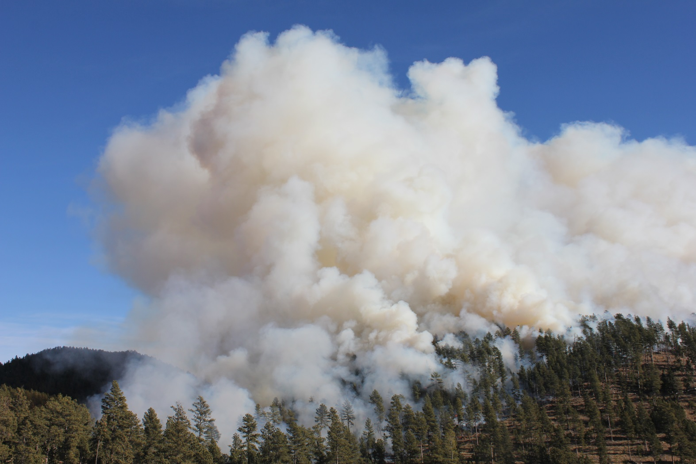
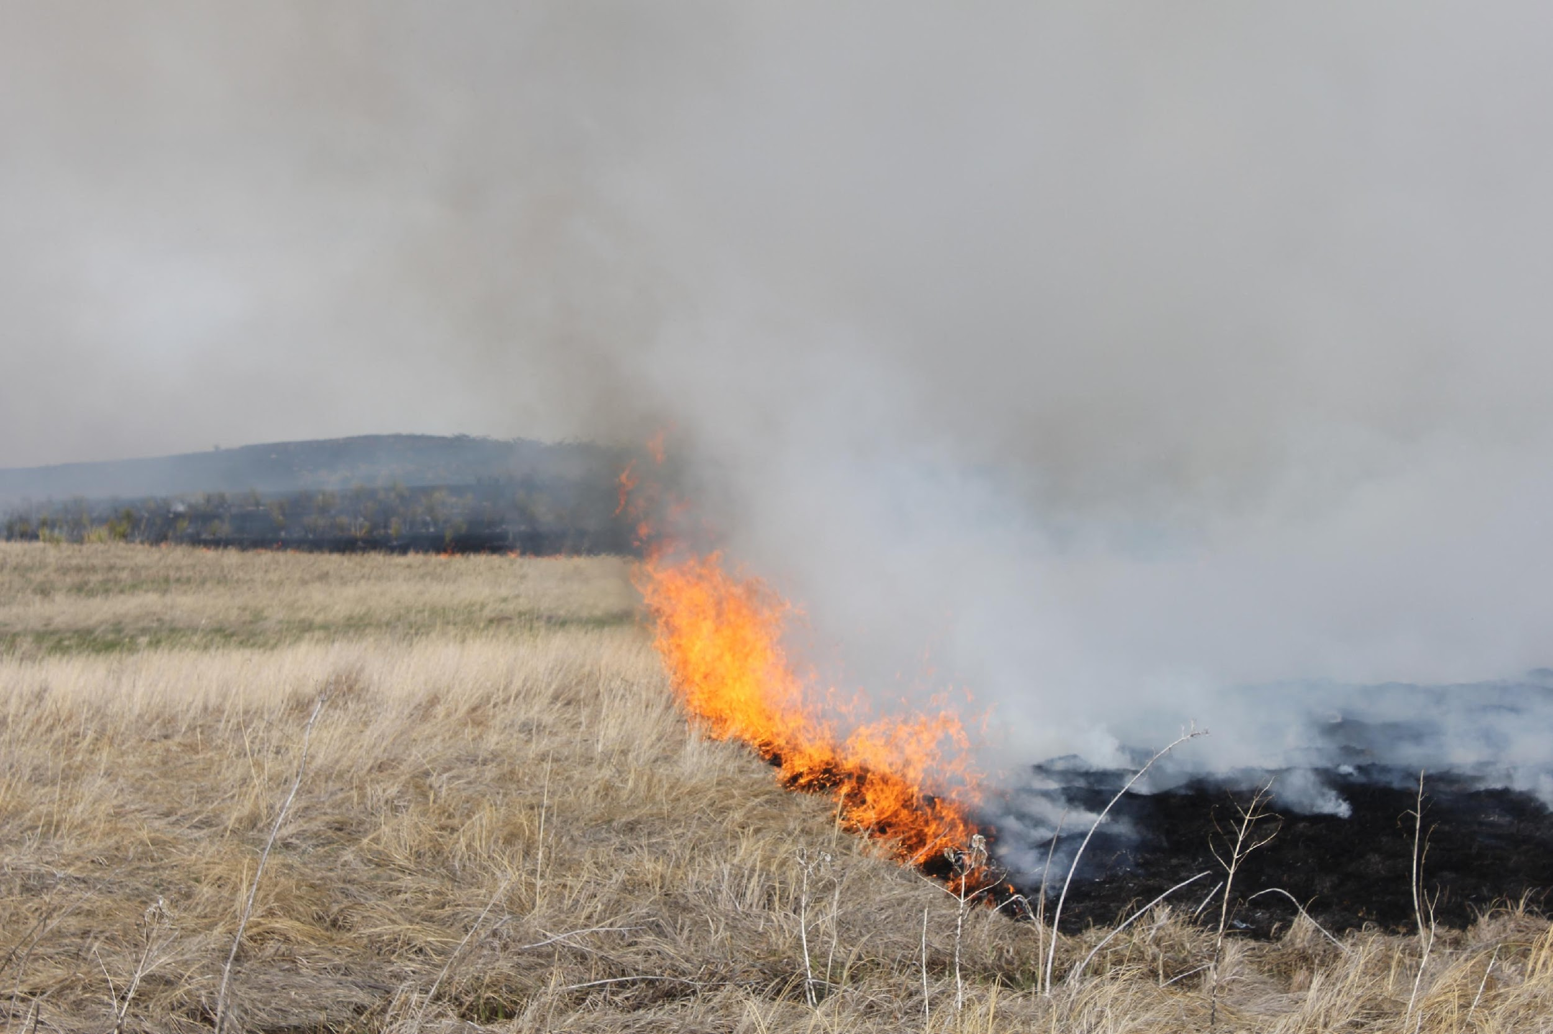
Future Work
Images Source: Darren Clabo
Additional functionality with a user interface
Soil moisture layer could be expanded
Statistical verification against previous fires
Possible to configure tool to a different area of interest
Notes:
TH:
The FIRE 2.0 tool could be put on an online platform with a user interface to allow viewers to modify the thresholds or how they are weighted to make an interactive tool that can encompass new knowledge about the thresholds and their impacts on fire risk.
Partners requested a layer showing soil moisture to be included to reference with the output of the FIRE 2.0 tool, however, it was not included in the weighting and analysis of the data. In future work, this layer and soil moisture abnormalities could be added to the analysis of the current fire risk.
As this was a ten-week project, we did not have as much time as we would have liked to perform statistical validation of our tool using previous fires. Additional validation could help refine our model and make it more representative of the fires that are experienced in this region.
While our partners requested a specific focus on the states of Nebraska, North Dakota, and South Dakota, it is possible to recode the tool in order to focus on another region or areas of interest.
Additionally, as wildfires continue to be studied, new information or a more accurate method of predicting where wildfires will occur could be devised. Working this method of analysis into the code could help improve its’ functionality and accuracy.
Image Source:
Darren Clabo, partner.

Slide 15
FIRE 2.0 Tool
Counties
“This tool can really give our first responders an edge on the initial attack of suppressing those wildfires. If they know the status of the fuels and the other models aren’t showing that like ours could, that would definitely give us a leg up on suppressing that fire as quickly as possible.”
– Darren Clabo, State Fire Meteorologist of South Dakota
Reservations
Snow Cover
Fire Risk Potential
0
0.5 – 0.6
0 – 0.1
0.6 – 0.7
0.1 – 0.2
0.7 – 0.8
0.2 – 0.3
0.8 – 0.9
0.3 – 0.4
0.9 – 1
0.4 – 0.5
Daily Fire Risk Map: November 6, 2018
Image Source: Missouri River Basin Disasters Team
Notes:
As Nick and Tyler discussed, our updated FIRE 2.0 Tool aims to automatically ingest the most recent climate information from NOAA and NASA satellites to produce a daily fire risk map for the northern Great Plains. We believe this map can be a helpful product for our partners to monitor climate indicators across the three states and maybe beyond! I cannot end today’s presentation better than with a quote from one of our partners, Darren Clabo, the State Fire Meteorologist of South Dakota: “This tool can really give our first responders an edge on the initial attack of suppressing those wildfires. If [our product] knows the status of the fuels and the other models aren’t showing that like ours could, that would definitely give us a leg up on suppressing that fire as quickly as possible.” That’s our hope for this product.
Maps created by the Missouri River Basin Disasters team

Slide 16
Acknowledgments
We would like to thank our science advisor Michael Kruk, center lead Aaron Mackey, as well as our partners Darren Clabo, David Martin, Doug Kluck, and Britt Parker for their expertise and guidance throughout this project.
Additionally, we would like to acknowledge people within NOAA NCEI:
Rocky Bilotta, Alec Courtright, Karin Gleason, Jared Rennie, Kate Johnson, and Jonathan Brannock
And everyone else at NCEI who helped us along the way
Notes:
First off, we three are unbelievably grateful to NCEI for their continued support of the NOAA NASA node. We would not have been able to do this work without the guidance of so many phenomenal individuals in this building. From our science advisor Michael Kruk to our center lead Aaron Mackey to Alec Courtright, Rocky Bilotta, Karin Gleason, Jared Rennie, Kate Johnson, Jonathon Brannock, the list goes on and on, and we can’t thank each and everyone of y’all enough for sharing your time and expertise with us during these ten weeks. Thank you for joining us here today.

