Slide 1

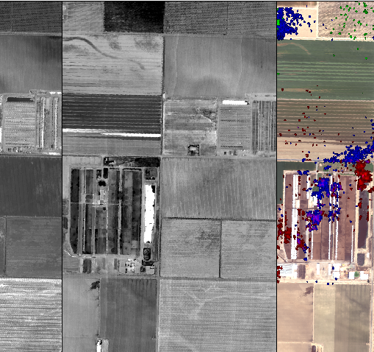

CALIFORNIA HEALTH AND AIR QUALITY
Identifying Methane Emissions Patterns from Dairy Farms Using Aircraft Remote Sensing Observations and Image Classification
Jacob Arndt
Kelsey Foster
Erika Higa
NASA Jet Propulsion Laboratory
2017 Summer
Notes:
Erika

Slide 2
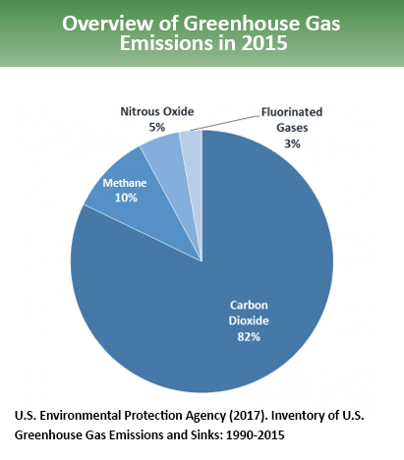
Greenhouse Gases
Carbon Dioxide, Methane, Nitrous Oxide, CFCs, Water Vapor
Methane
25 times more effective than CO2 at trapping heat in the atmosphere
Agriculture
Dairies
Enteric fermentation
Manure management
Discrepancy between bottom-up and top-down emission estimates
Notes:
Erika
10% of all greenhouse gas emissions from human activities is methane.
Methane is a potent greenhouse gas with an atmospheric lifetime of approximately 10 years and global warming potential of 25 (methane is 25 times more effective than C02 at trapping heat in the atmosphere).
Between the Energy, Waste, Industrial Processes and product use, and Agriculture sectors, the agriculture sector accounts for the largest proportion of methane emissions.
Within the agriculture sector, enteric fermentation by domestic livestock and manure management account for nearly 35% of total methane emissions.
Enteric Fermentation is a digestive process that occurs in cows by which methane is produced
Recent studies show that there are large discrepencies between bottom-up and top-down emissions estimates
Top-down – directly measured, etc.
Bottom-up – uses emissions factors, activities, ground based, etc.

Slide 3
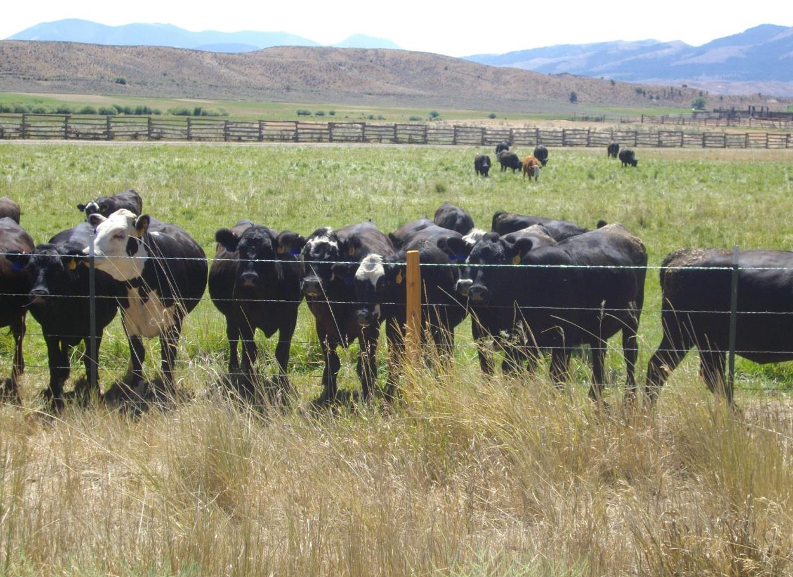
Partner: California Environmental Protection Agency, Air Resources Board
Legislation
AB 1803
AB 32
AB 1496
SB 1383
Current Methods
Reported facility information
Bottom-up emission estimates
IPCC guidelines
Research Interest
Understanding dairy farm emission sources
Image source: NASA DEVELOP flickr Amberle Keith
Notes:
Erika
California Air Resources Board is part of the California Environmental Protection Agency, an organization which reports directly to the Governor's Office
Understanding ghg emissions in California (methane, dairies are important)
ARB’s goals include:
Provide Safe, Clean Air to All Californians
Reduce California's Emission of Greenhouse Gases
Provide Leadership in Implementing and Enforcing Air Pollution Control Rules and Regulations
Provide Innovative Approaches for Complying with Air Pollution Rules and Regulations
Notes about important legislation:
AB No. 1803 – requires ARB to develop and maintain a greenhouse gas emissions inventory for the state
AB No. 32 – requires that the state reduce its greenhouse gas emissions to 1990 levels by 2020
AB No. 1496 – This bill would require the state board to take specified actions and conduct specified analyses with respect to methane emissions.
SB No. 1383 - This bill would require the state board, no later than January 1, 2018, to approve and begin implementing that comprehensive strategy to reduce emissions of short-lived climate pollutants to achieve a reduction in methane by 40%, hydrofluorocarbon gases by 40%, and anthropogenic black carbon by 50% below 2013 levels by 2030, as specified
Current practices/methods:
ARB statewide emission estimates rely on regional, state, and national data
Facilities throughout the state are required to report all greenhouse gas emissions following the established requirements
Follow the guidelines established in the 2006 Intergovernmental Panel on Climate Change (IPCC) Guidelines for National Greenhouse Gas (GHG) Inventories report to estimate emissions
Research interest:
Dairy features change frequently and physical changes to dairy features over time may correlate with changes in emission rates
Want to better understand dairy emission sources and improve the inventory in the future
identify dairy features (lagoons, settling ponds, silage piles, compost, etc.)
map the size and shape of each feature
track how the number and size of these features change over time
see if there are any diurnal or seasonal patterns and any general trends in changes in dairy features across the years.
Image source: https://www.flickr.com/photos/nasa_develop/16386716038/in/album-72157648318032603/

Slide 4
Community Concerns
Methane is a potent greenhouse gas
The life cycle of methane and the processes that produce methane are not fully documented or understood
Accurately estimating emissions and understanding their sources will help inform policy
Image source: NASA/Goddard Space Flight Center Conceptual Image Lab
Notes:
Erika
Methane is a potent greenhouse gas with a lifetime of 12 years and a global warming potential that is approximately 25 times greater than carbon dioxide over a 100 year time period.
Methane emission estimates derived from bottom-up and top-down approaches are consistently at odds with each other, suggesting that the life cycle of methane and the processes that produce methane are not fully documented or understood.
The life cycle of methane and processes that produce methane need to be better understood to more accurately estimate and reduce emissions, and ultimately mitigate the adverse effects of a changing climate.
Image source: https://svs.gsfc.nasa.gov/20114

Slide 5
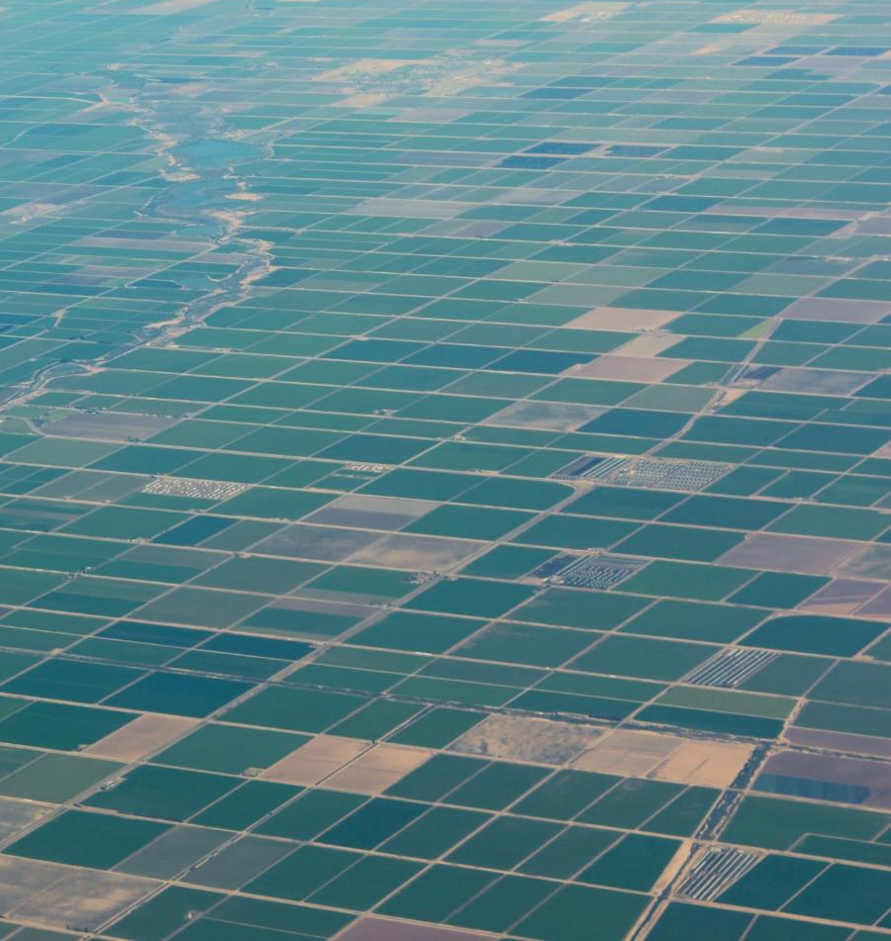
Objectives
Identify best satellite observations and data products to study dairy farms
Develop a methodology for classifying dairy farms
Classify imagery to identify locations, sizes, and management practices of dairy farms
Create a GIS dataset of dairy farms
Assist our project partner in improving their dairy farm inventory and understanding of emissions
Image source: NASA DEVELOP flickr Merna Saad
Notes:
Erika
Identify which satellite observations or data products work best to classify and study dairy farms
Develop a methodology for classifying dairy farms
Classify imagery to identify the locations, sizes, and management practices of dairy farms in the Tulare and Turlock regions
Create a GIS dataset of dairy farms to better understand facility-level activities that lead to methane emissions
Assist the California Environmental Protection Agency, Air Resources Board in improving their inventory of dairy farms and understanding their emissions
Image Source: https://www.flickr.com/photos/nasa_develop/16669396208/in/album-72157648318032603/

Slide 6
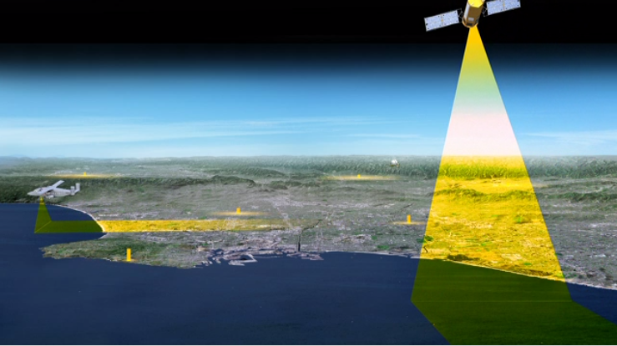
Tiered Observation Strategy
1. Satellite-based remote sensing
2. Aircraft-based remote sensing
3. Ground verification
4. Regional Inventory Analysis
Image source: NASA's Goddard Space Flight Center Conceptual Image Lab
Notes:
Jake
How we will study dairy emissions in the context of a tiered observation strategy.
EXAMPLES of parts of the tiered observations.
From ARB website (https://www.arb.ca.gov/research/methane/ab1496_research.htm)
Begin walking down the tiered observation explaining the methane anomaly over the central valley and each smaller scale/higher resolution step.
Our project falls in number 4. Regional Inventory Analysis, using satellite data to build ground data that can be incorporated into inventory analysis.
Satellite-based remote sensing
Broad, coarse identification of high-methane regions
Augmented by facility locations, emission inventory, Statewide GHG Monitoring Network, and modeling
Aircraft-based remote sensing
Total methane flux by source region with tracers for limited source type identification
Identification of individual methane plumes
Ground verification
Mobile methane monitors and infrared cameras
Flux measurements
Regional Inventory Analysis
ARB Statewide GHG Monitoring Network
Air Quality Modeling
Image source: https://svs.gsfc.nasa.gov/20197

Slide 7
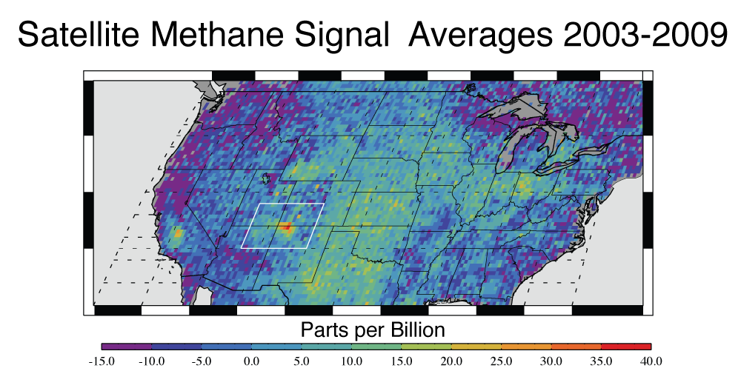
Tiered Observation Strategy
1. Satellite-based remote sensing
Image source: NASA/JPL-Caltech/University of Michigan
Kort et al. (2014)
Notes:
Jake
From Kort et al.
Column methane anomalies and emissions over the conterminous U.S. (a) Average SCIAMACHY anomaly from 2003 to 2009 gridded at 1/3° resolution.
Reasons for choosing our study area:
Methane anomalies detected by satellites – regional hotspots that we need to explore with finer resolution data from airborne sensors or ground based measurements
Dairy farms and their large contribution to methane emissions
Image source: https://news.agu.org/press-release/satellite-data-shows-u-s-methane-hot-spot-bigger-than-expected/

Slide 8
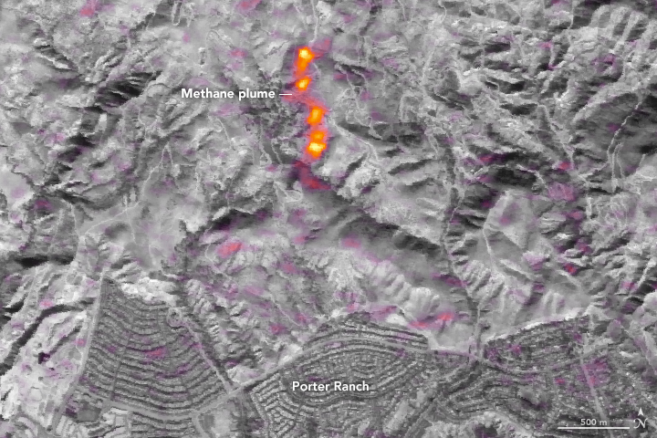
Tiered Observation Strategy
1. Satellite-based remote sensing
Image source: NASA Earth Observatory; images by Joshua Stevens, using data from the EO-1 Hyperion courtesy of David Thompson, NASA/JPL and the NASA EO-1 team.
Thompson et al. (2016)
Notes:
Jake
EO-1’s Hyperion instrument.
Image source: https://earthobservatory.nasa.gov/IOTD/view.php?id=88245

Slide 9
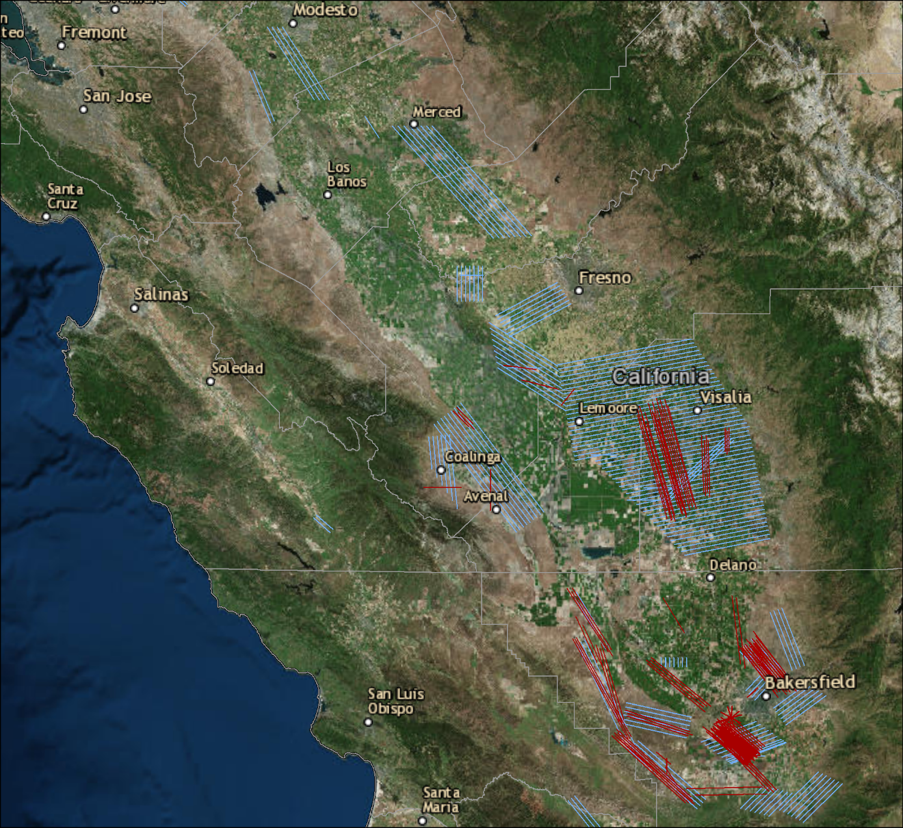
Tiered Observation Strategy
2. Aircraft-based remote sensing
Notes:
Jake
Statewide methane emissions campaign 2016 AVIRIS-NG (supported by ARB)
For point source identification, satellites can’t get this level of detail yet.

Slide 10
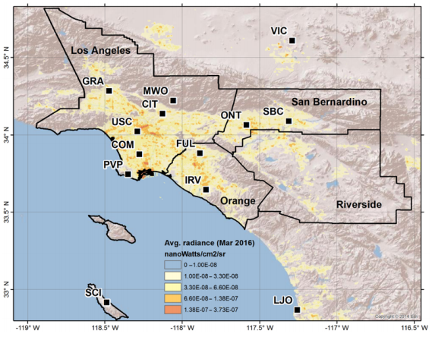
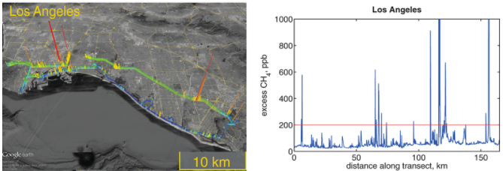
Tiered Observation Strategy
3. Ground verification
Megacities in situ network
Mobile measurements
Verhulst et al. (2017)
Hopkins et al. (2016)
Notes:
Jake
Megacities in situ network. Provides spatial temporal perspective of ghg Carbon and methane emissions derived from surface networks
Provides context for satellite and aircraft data.
Background is nightlights (pop density) the map shows locations of the surface stations
driving network Hopkins
Spatial analysis, visualization of data
Note that the in situ tower network and mobile measurements are “surface observations,” meaning they are only sensitive to the top ~10 m (mobile) and ~30-100 m (tower) of the planetary boundary layer. Deriving fluxes from the tower network also requires an inverse model (such as a Lagrangian Particle Dispersion Model or LPDM). It is more difficult to derive a flux from mobile measurements, but those observations are useful for hotspot detection or ground validation of aircraft data.

Slide 11
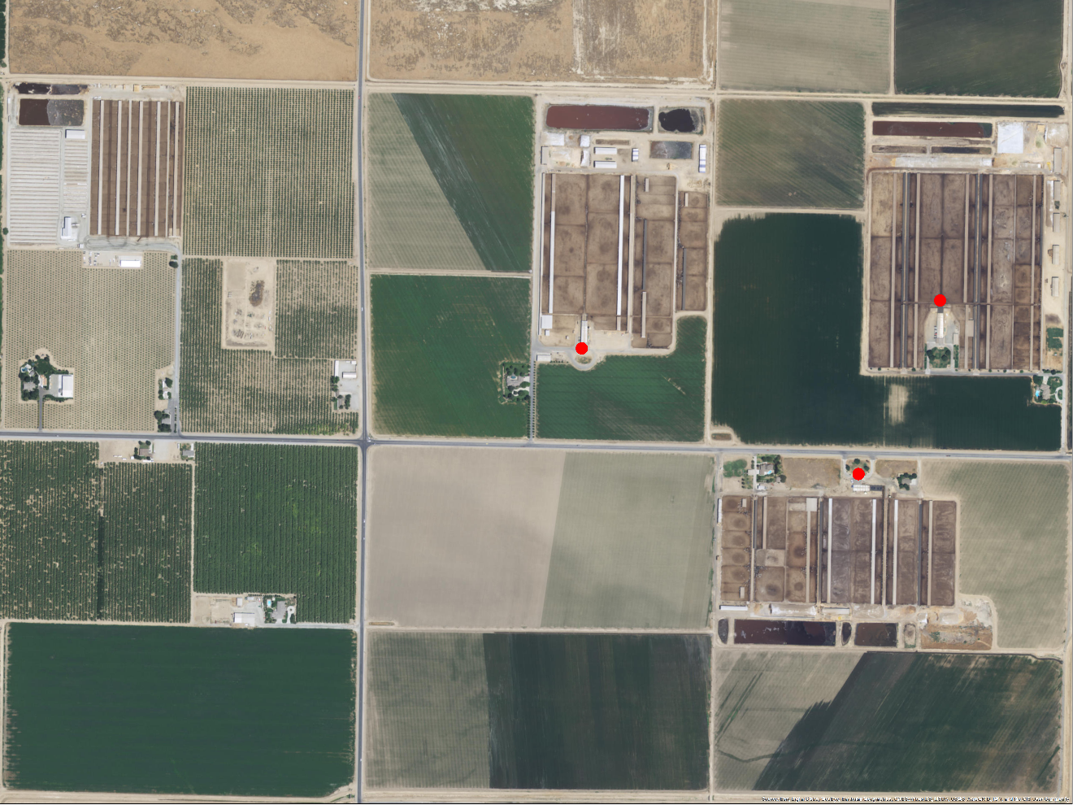
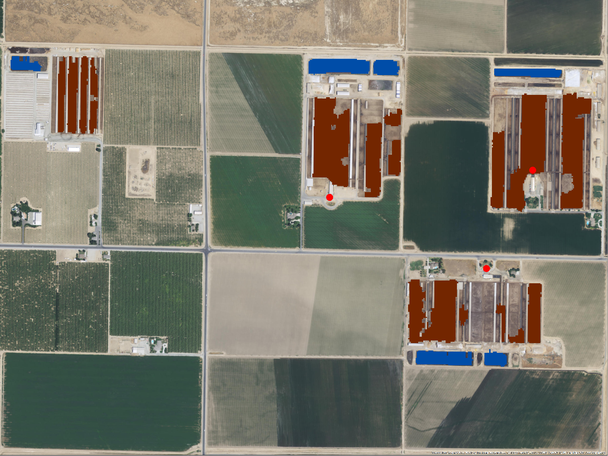
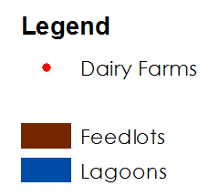

Tiered Observation Strategy
4. Regional Inventory Analysis
Notes:
Jake
He mentioned the EPA inventory is really coarse as it involved gathering the number of cows at the county level and dividing it up between the number of farms in each county. For manure lagoons they also apply some temperature scaling similar to IPCC. In general, he thought much could be done to improve emissions estimates for this sector across the U.S. with your approach.
Dairies are the least understood.
VISTA-LA
Trying to enhance spatial datasets,
Permit data alone cannot help us fully understand emissions from dairies. We need a combined approach – (aircraft, permit, spatial data derived from satellites)
Need finer scale data, and locations of facilities.
What are important features of dairies?
Discrepencies in the locations of dairies,

Slide 12
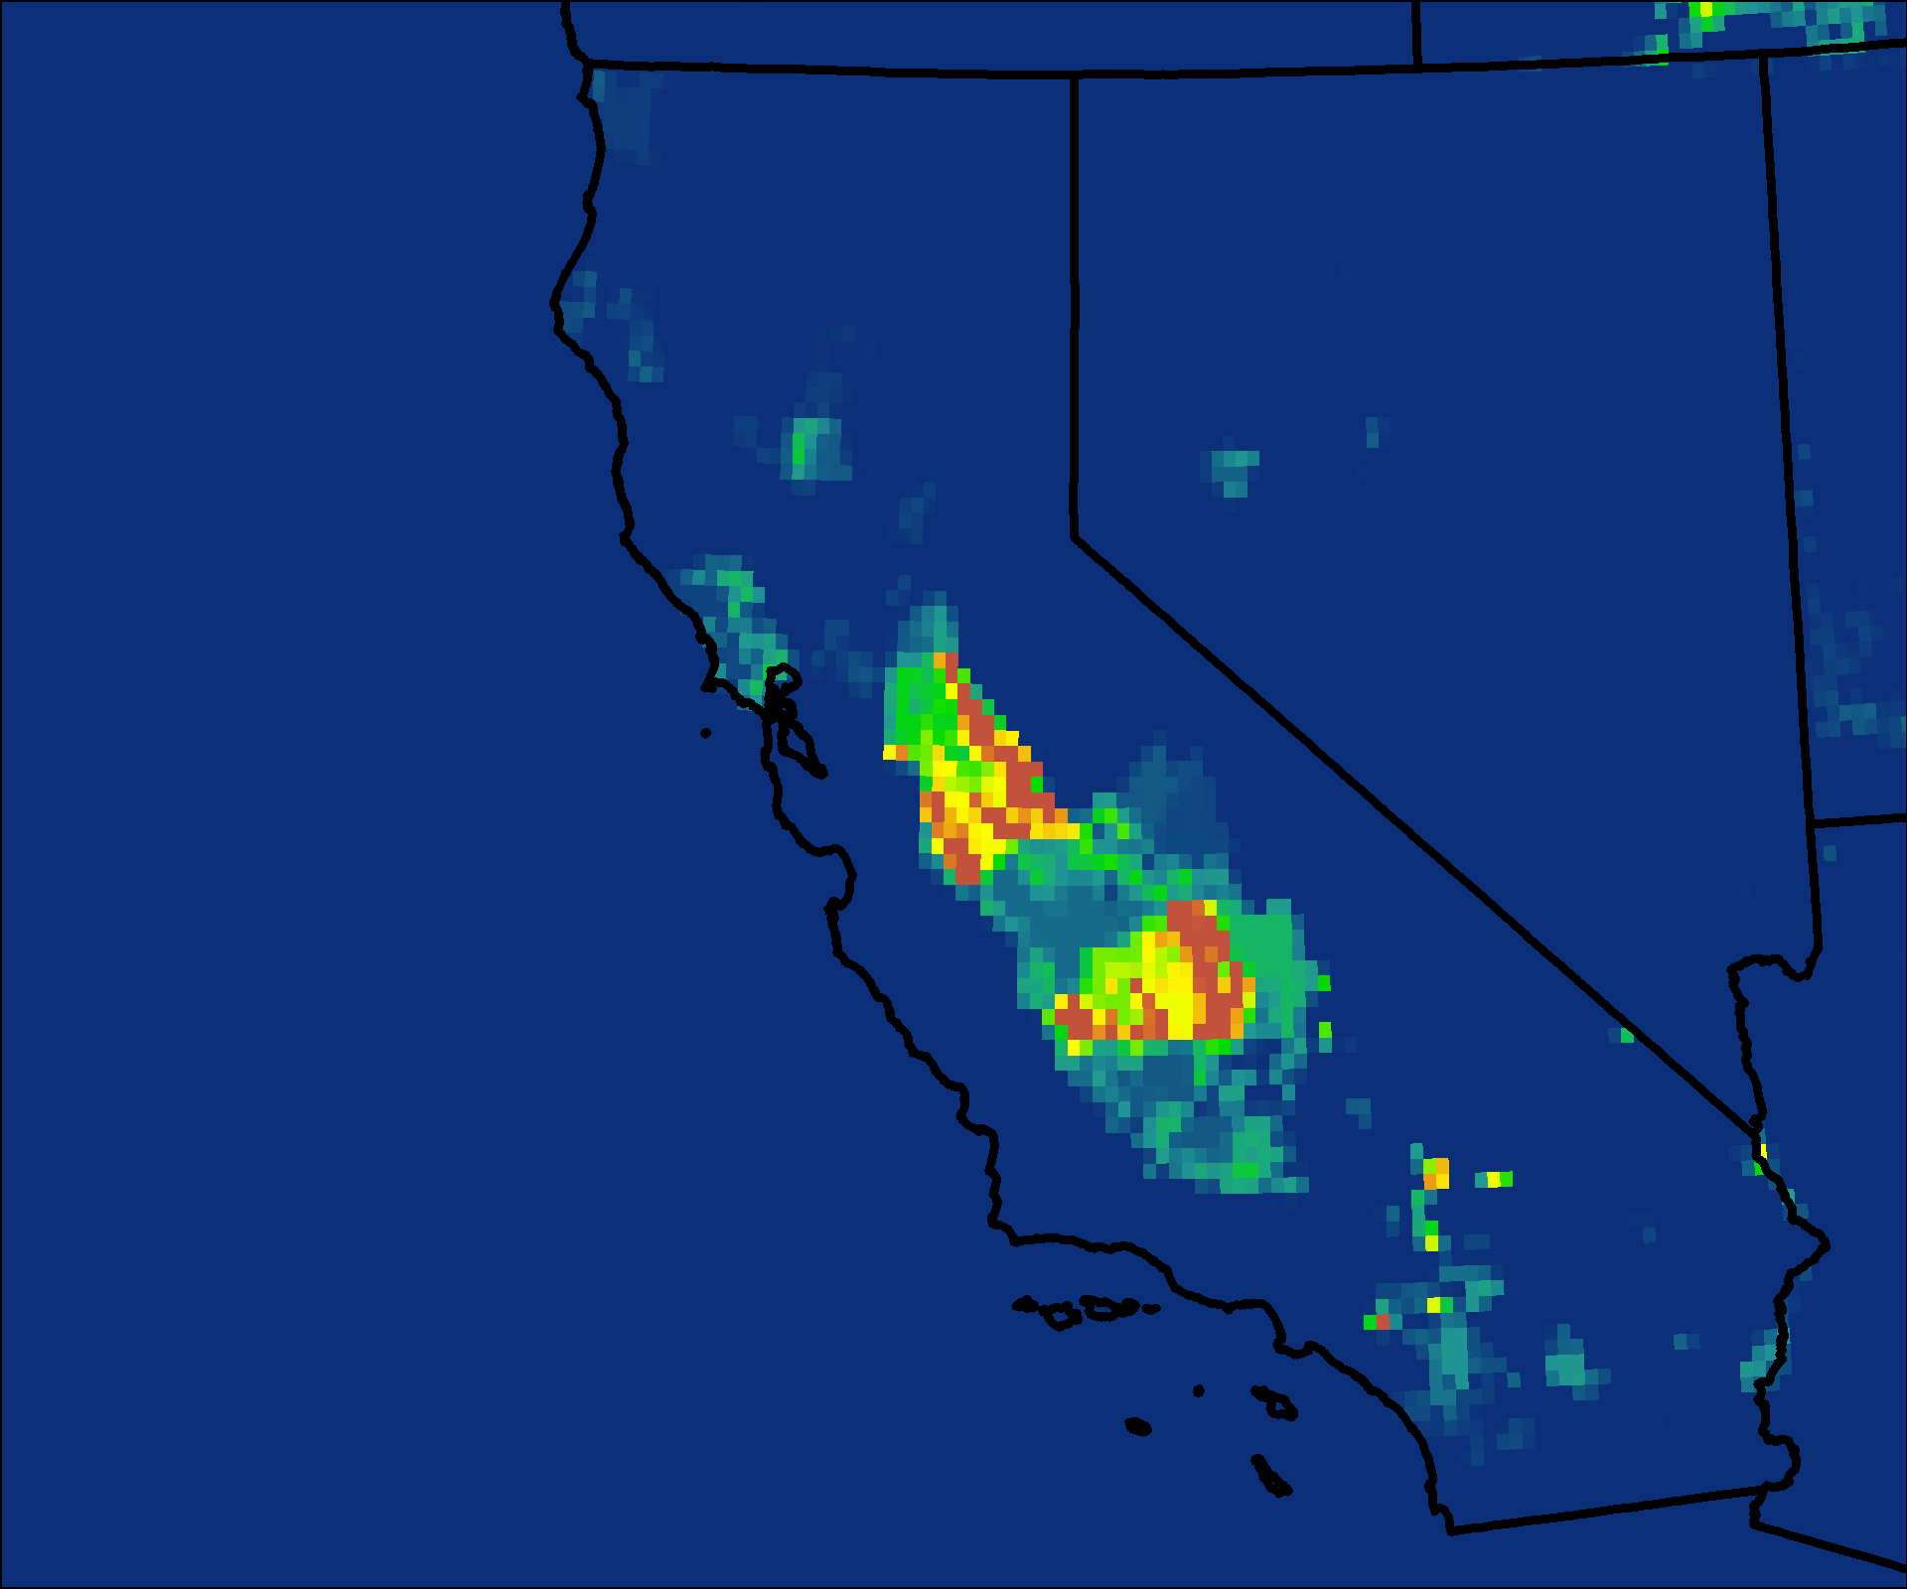
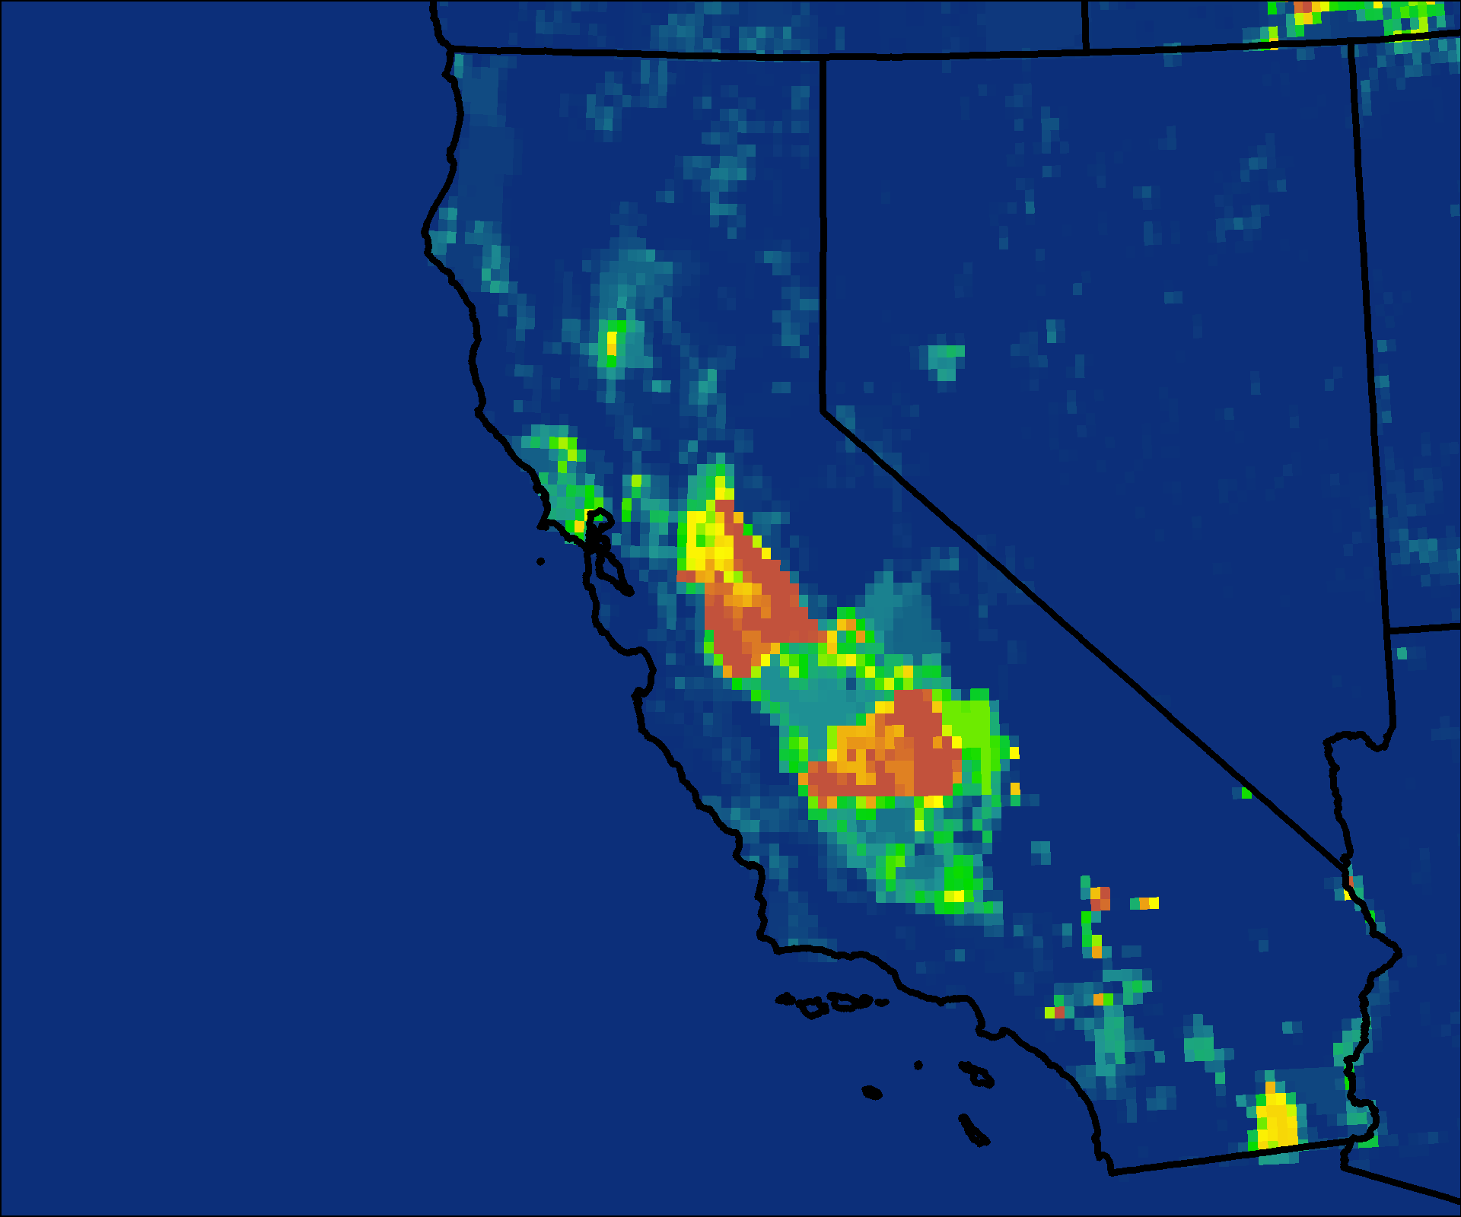
Gridded National Inventory of Methane Emissions
2012 Annual Gridded Methane Emissions
molec cm-2s-1
molec cm-2s-1
4.6428e+12
4.54479e+12
0
0
Manure Management
Enteric Fermentation
Maasakkers et al. (2016)
Notes:
Kelsey
2012 annual EPA gridded methane emissions.
Methane importance
Hot spots from epa, arb
How we decided our study area…

Slide 13
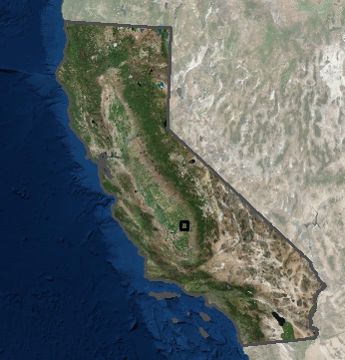
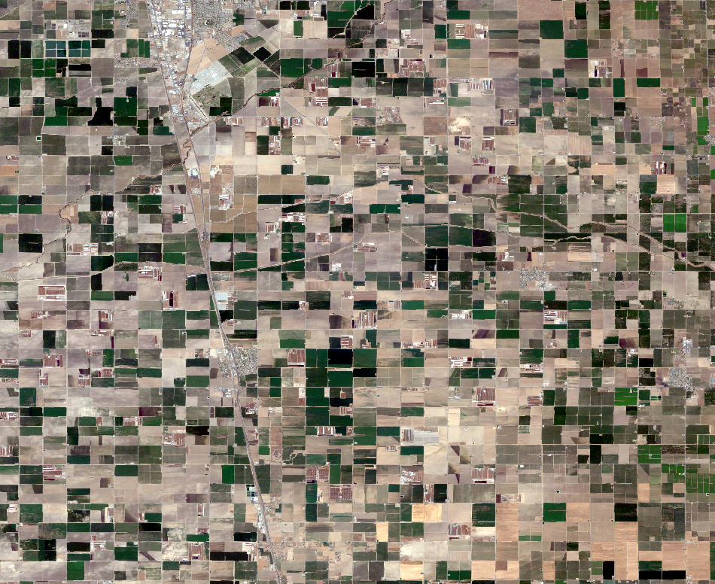
Study Area
Tulare
Imagery © 2017 Planet Labs Inc.
Notes:
Kelsey
Study Area is California
Include dairy data
The Central Valley of California is where most agriculture occurs within the state
Tulare and Turlock regions have high concentrations of dairy farms and are where we focused our land classification of dairies and their infrastructure

Slide 14
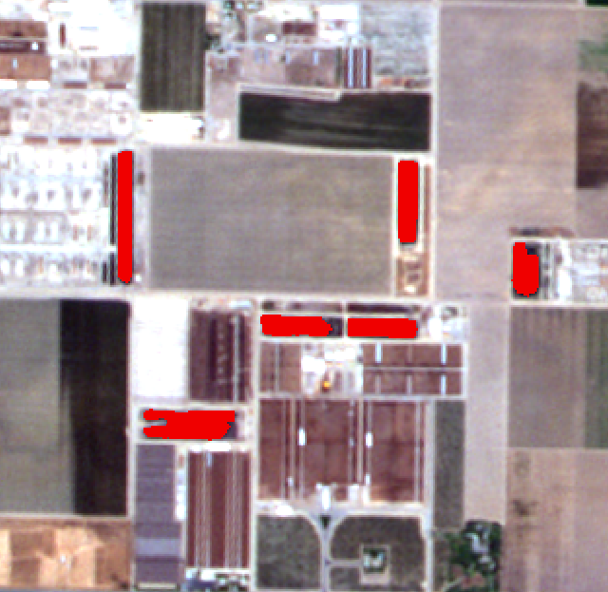
Methodology
Satellite – land classification
Dairy farm features dataset
Choose satellite data for image classification
feedlots
Rule based feature extraction
lagoons
Aircraft – methane data
Extract plumes and overlay onto classified image
Analyze methane plumes over dairy farms
Find GHG plumes in study region
Build flight line footprint
Notes:
Kelsey

Slide 15
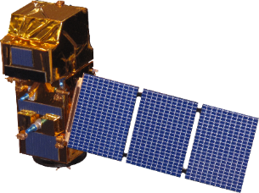

Satellite Sensors – Land Classification
Satellite | Sensor | Spatial Resolution (m) | Revisit Time (days) | Time Span | Bands
RapidEye | constellation | 5 | 5 | 2009 - present | 5
PlanetScope | constellation | 3 | 1 | 2015 - present | 4
Sentinel-2 | MSI | 20 | 16 | 2015 - present | 13
Landsat 8 | OLI | 30 | 16 | 2013 - present | 9
Sentinel-2
Landsat 8
Notes:
Kelsey

Slide 16
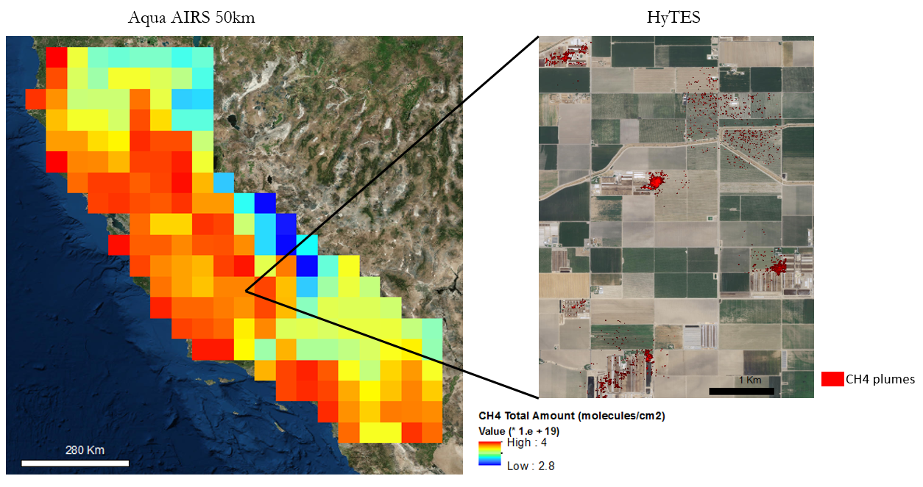
AIRS Methane Data
Notes:
Erika
AIRS (left) and HyTES data (right) collected on May 1, 2015.
Discuss AIRS spatial resolution and lack of sensitivity to the surface. Compare and contrast with the HyTES data and how it’s higher resolution allows us to identify point sources.

Slide 17
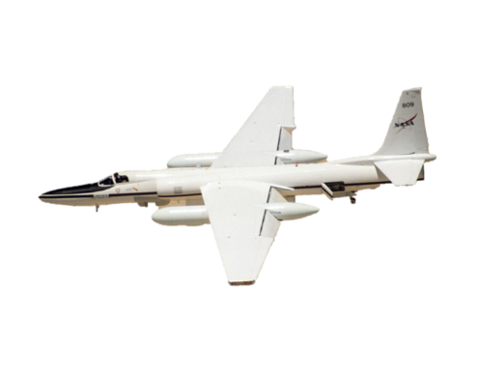
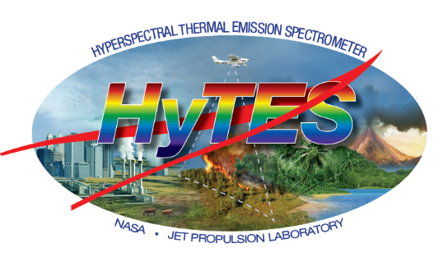

Aircraft Sensors – Methane Data
Sensor | Spatial Resolution (m) | Time Span* | Spectral Range | Bands | Band Width | Level 3 products
AVIRIS-NG | 4 - 8 | 2014 - present | 0.380 - 2.510 μm | 430 | 5nm ± 0.5 nm | CH4
HyTES | 3 - 6 | 2013 - present | 7.5 - 12 μm | 256 | 17nm | CH4, NH3
Image source: HyTES Team
Image source: AVIRIS-NG Team
Notes:
Erika
These are hyperspectral sensors that have level 3 methane products.
These products have high spatial resolution and allow us to identify methane emission point sources
There were several campaigns where each sensor was flown intermittently over the interval listed in time span
Image Sources: https://hytes.jpl.nasa.gov/
https://aviris-ng.jpl.nasa.gov/

Slide 18
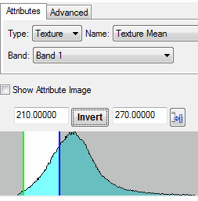
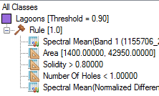
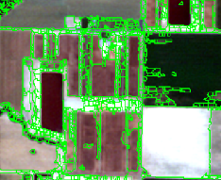
ENVI Rule Based Feature Extraction
Rule Based Feature Extraction
Choose Input File
Select Attribute Values
Build Rule Sets
210 < texture mean < 270
Segment & Merge
Preview Results
Select Attributes
Refine Attribute Values
Spatial
Ex: area
Spectral
Ex: max
Texture
Ex: mean
Export Classification Results
Notes:
Jake

Slide 19
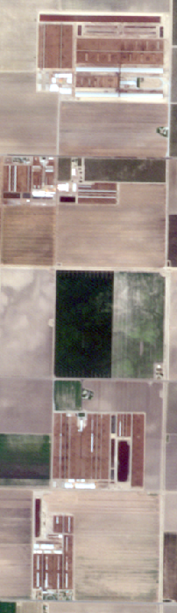
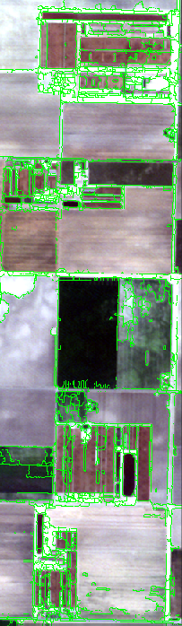



Dairy Classification: Feedlots
Imagery © 2017 Planet Labs Inc.
Notes:
Jake

Slide 20
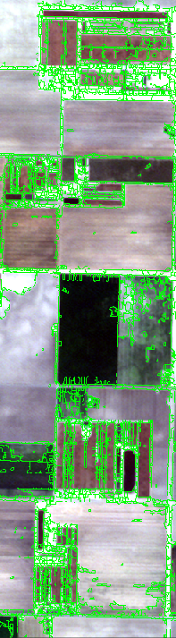



Dairy Classification: Lagoons
Imagery © 2017 Planet Labs Inc.
Notes:
Jake

Slide 21
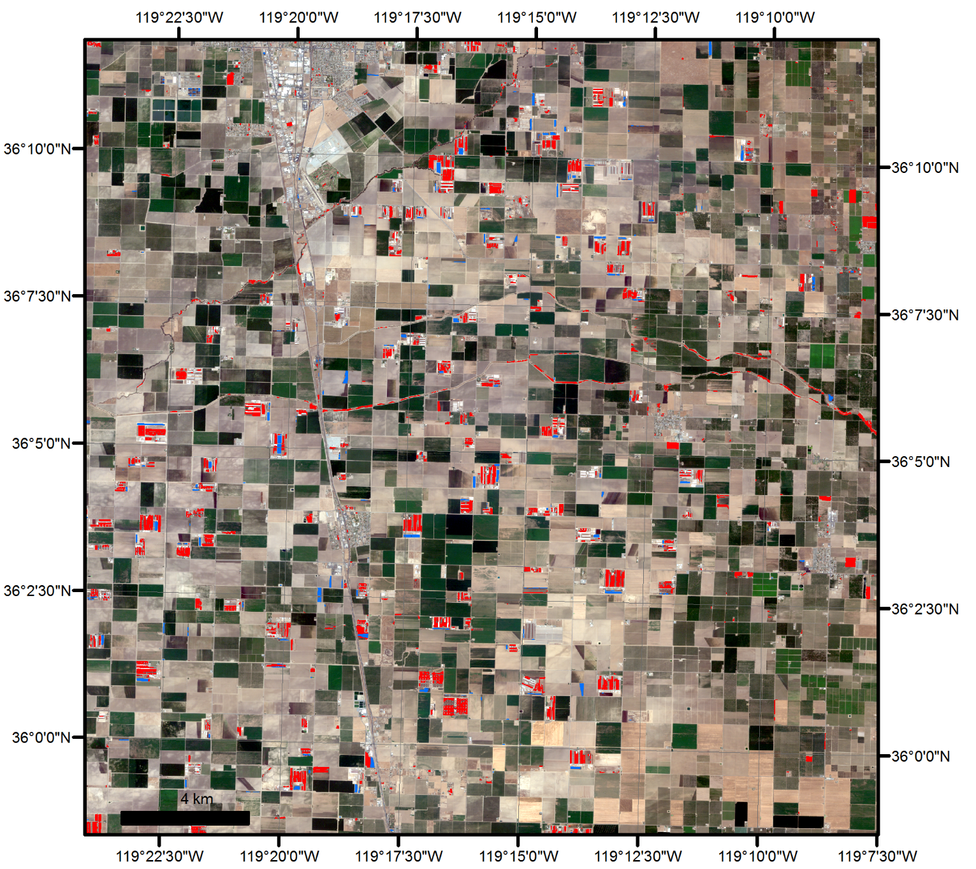
Dairy Classification: Tulare
Imagery © 2017 Planet Labs Inc.
Notes:
Jake

Slide 22
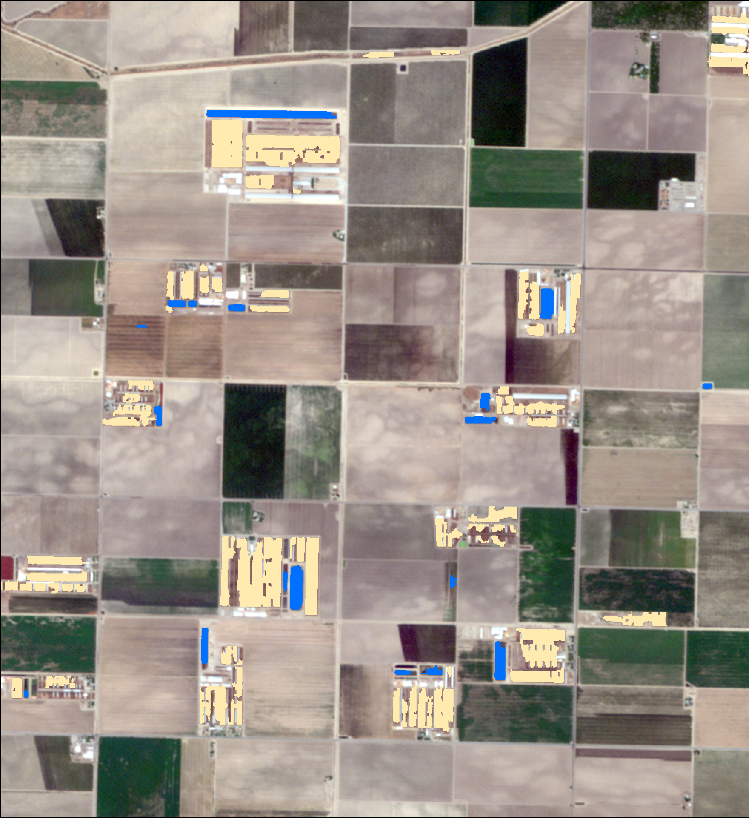
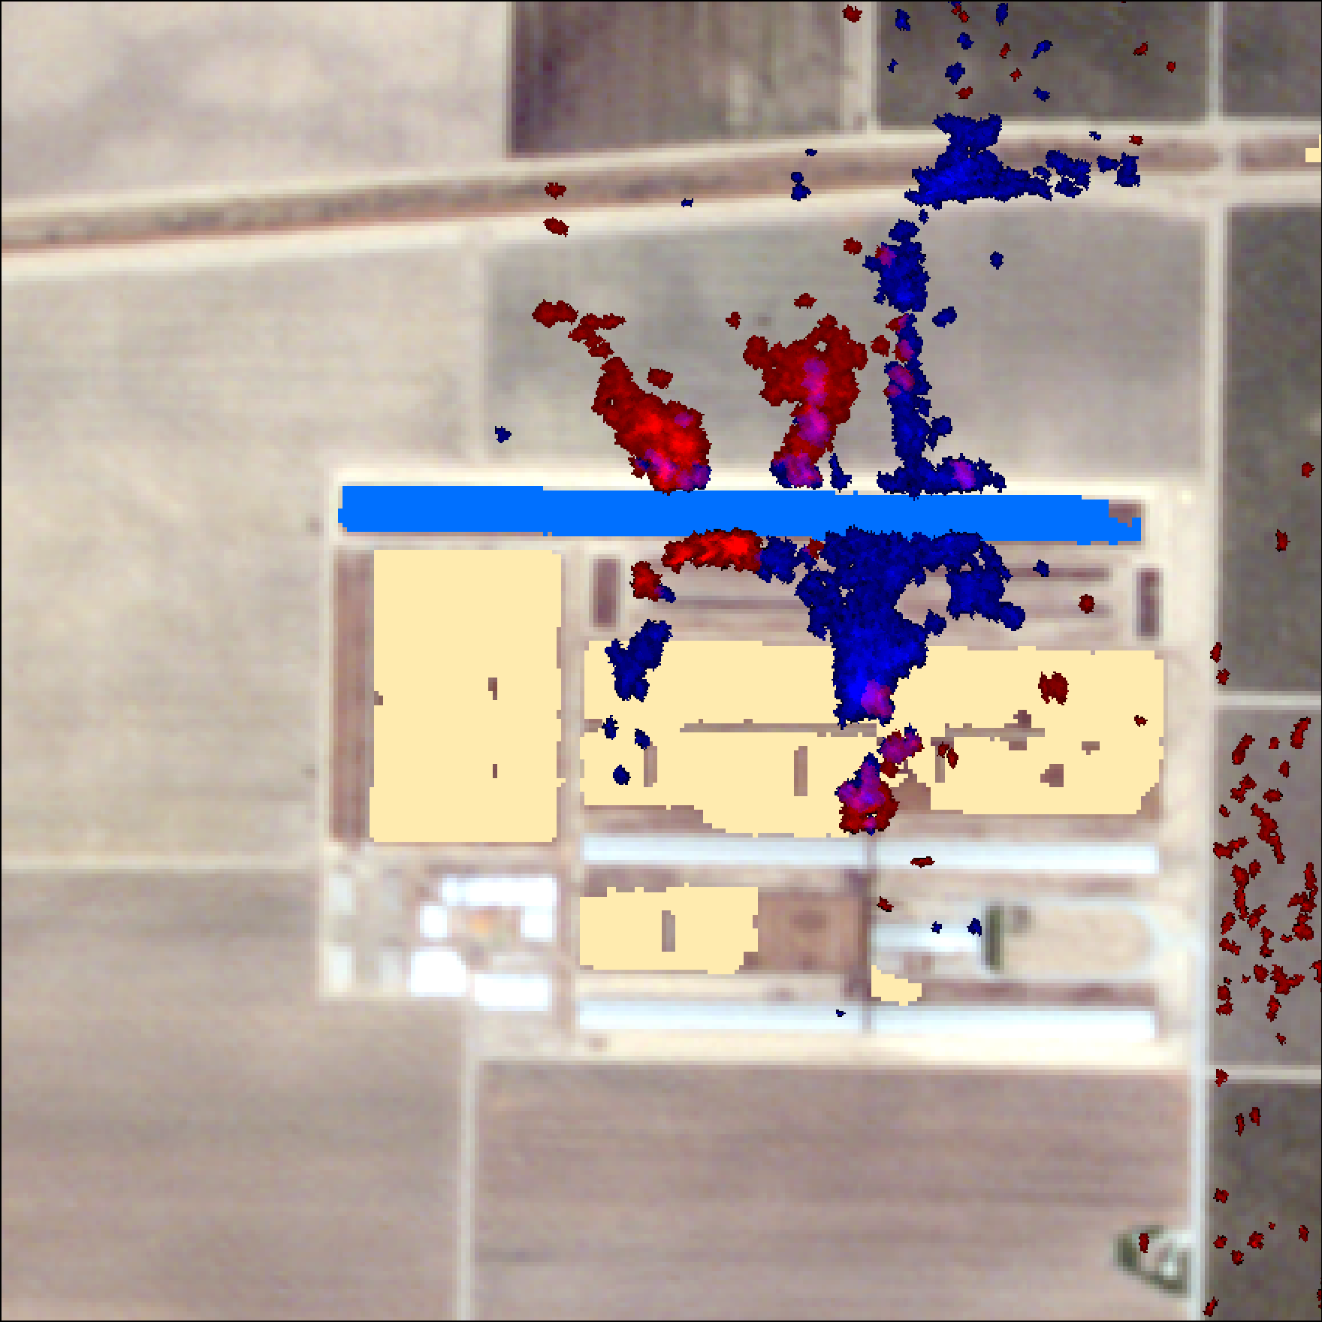
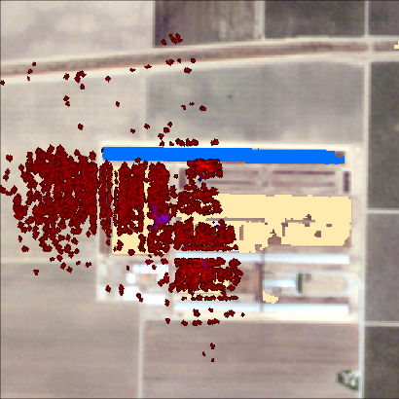
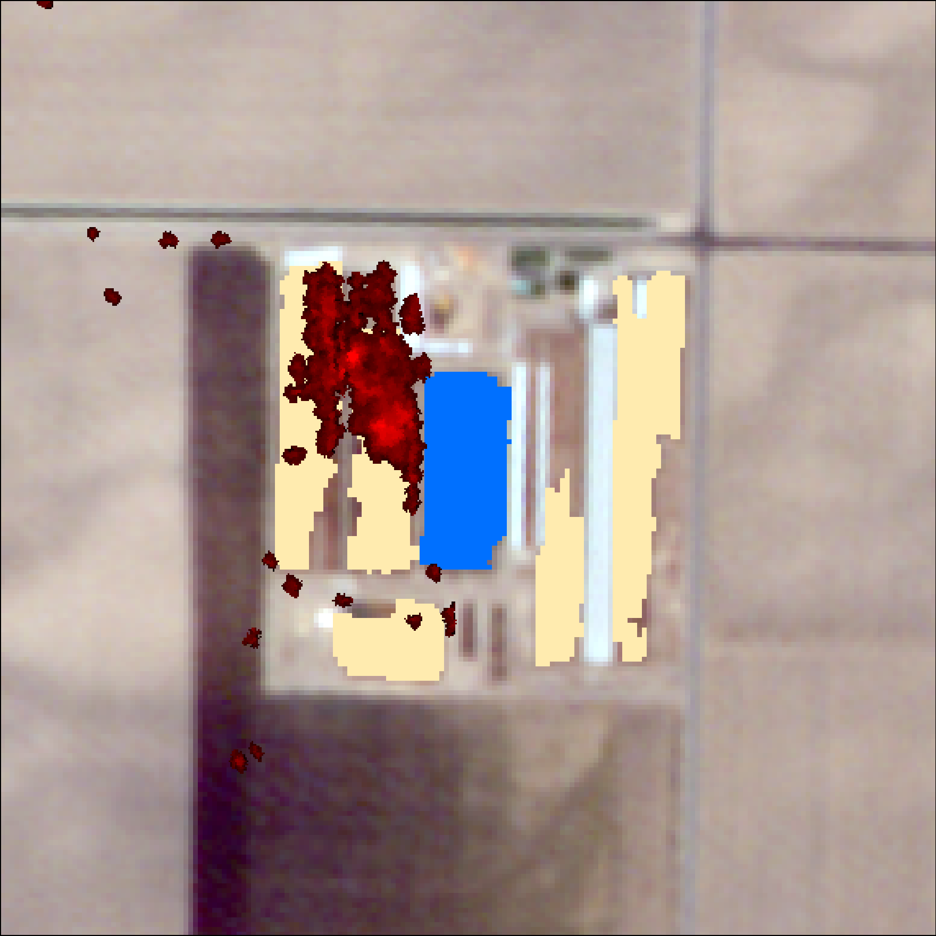
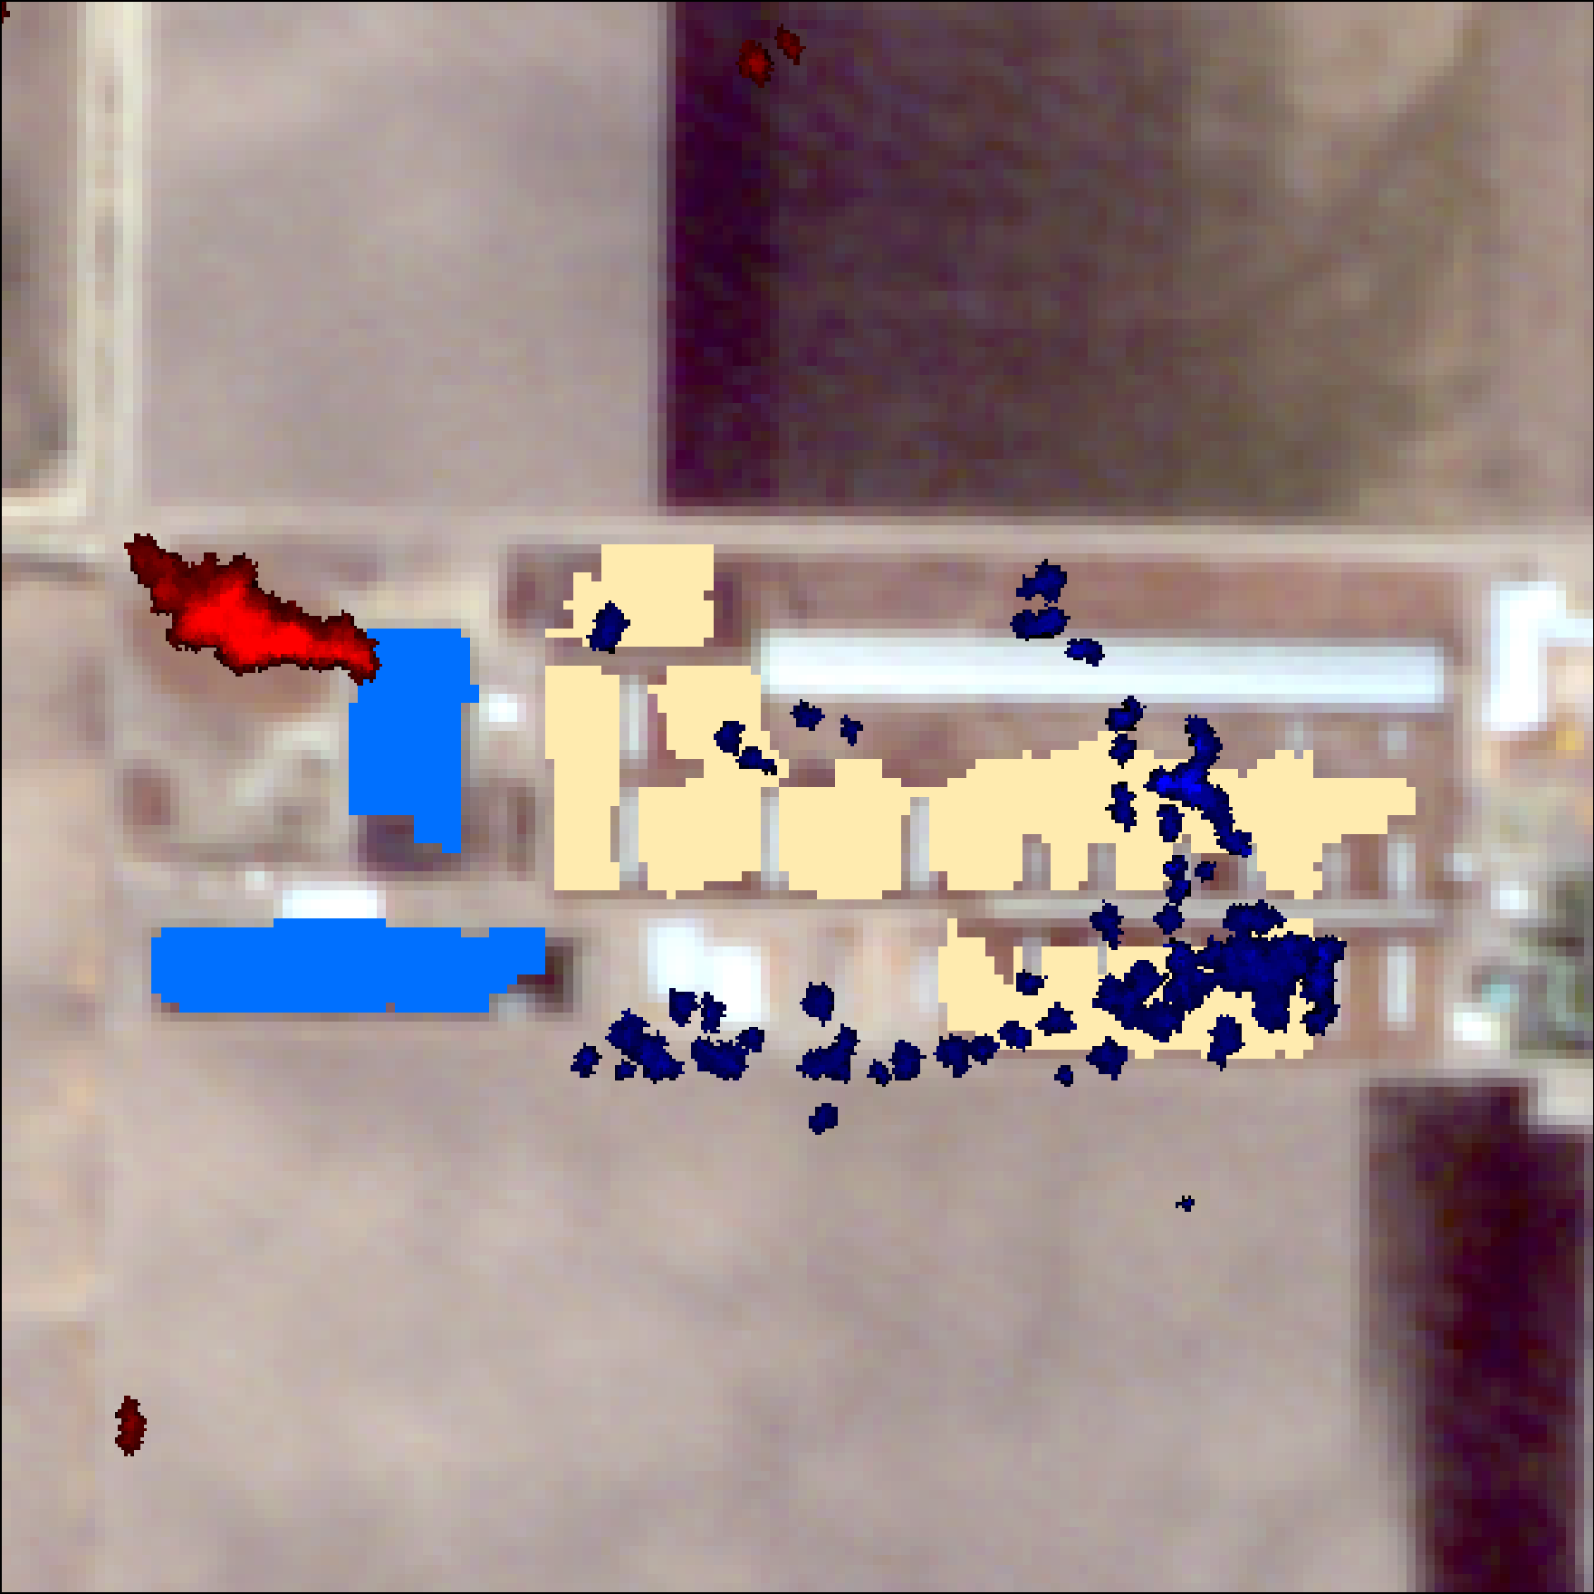
Aircraft Data - HyTES
May 1, 2015
May 2, 2015
May 1, 2015
May 1, 2015
Notes:
Jake

Slide 23
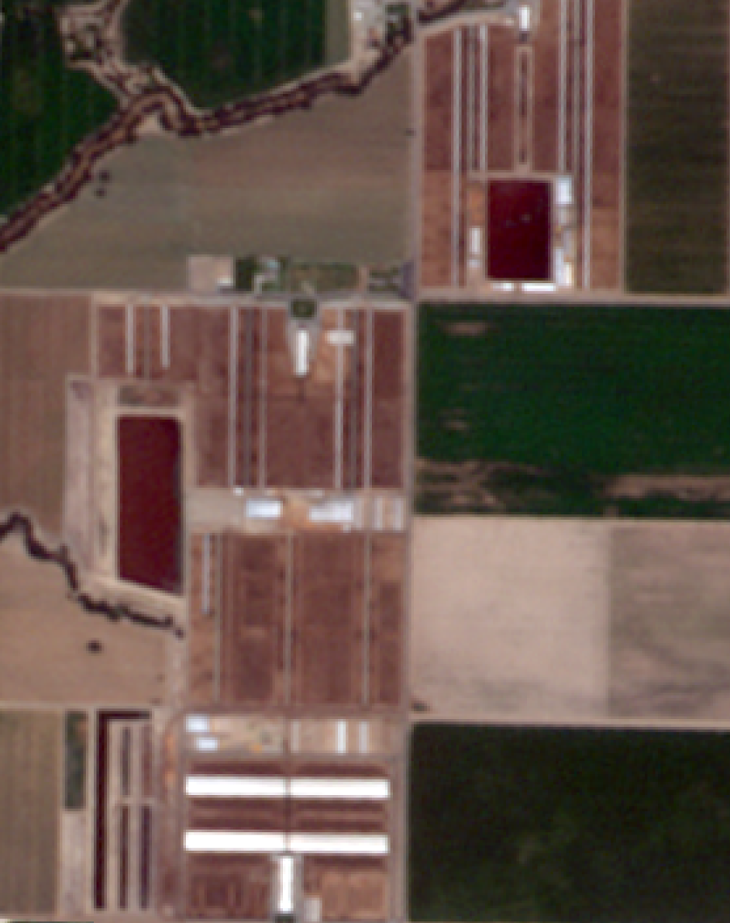
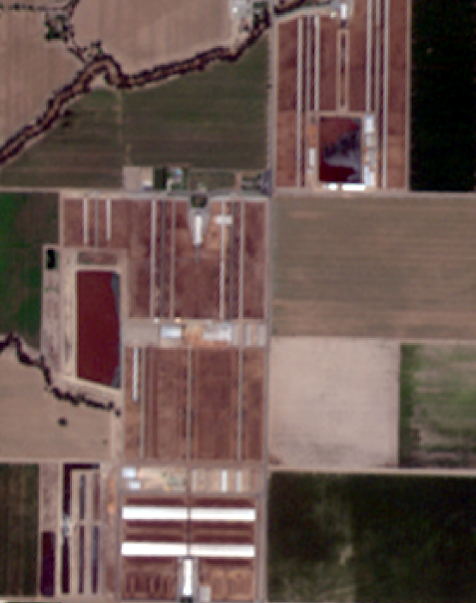
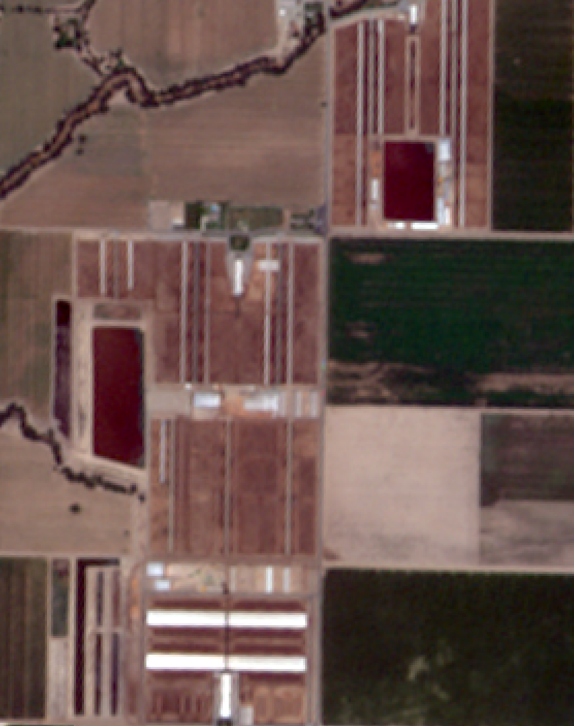
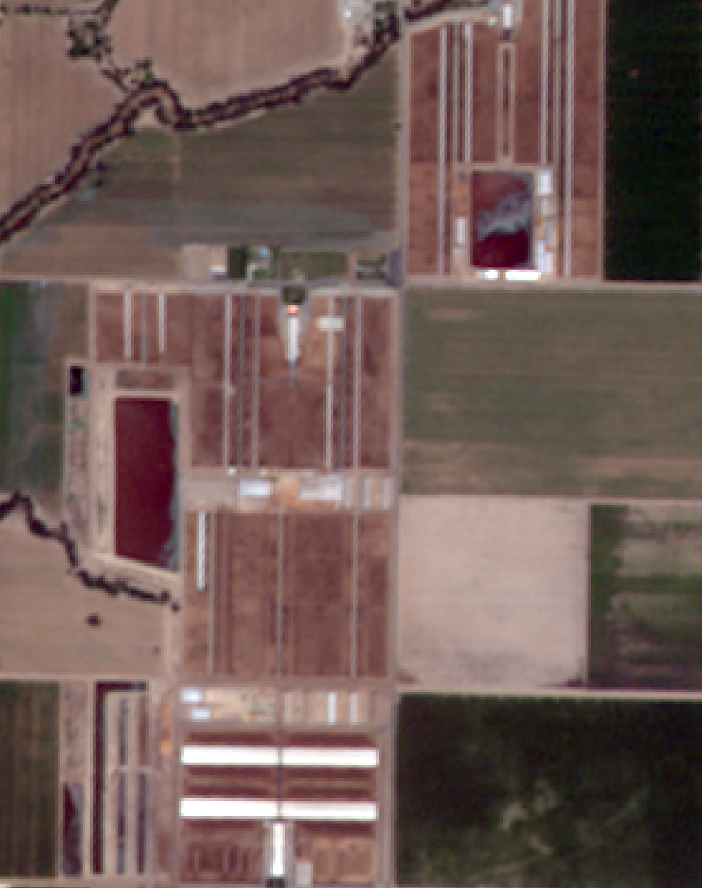
Variation in Lagoons
06/13/2015
06/17/2015
06/20/2015
06/22/2015
Imagery © 2017 Planet Labs Inc.
Notes:
Kelsey
RapidEye September 2016 – AVIRIS-NG data
Image showing how quickly different manure management practices change on a dairy farm:
Top oval – example of anaerobic lagoon changing
Lagoons hold liquid manure and are not stirred
Middle oval – example of settling basin/pond changing
Unseparated manure that is separated
Bottom oval – example of settling basin/pond changing

Slide 24
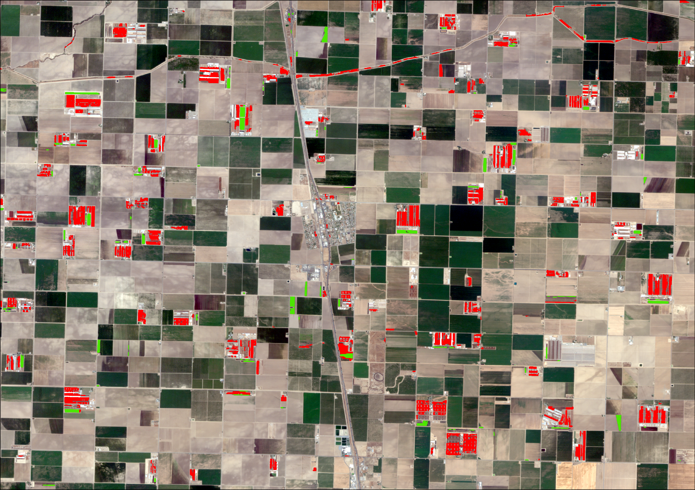
Errors and Uncertainties
Classified Data | Feedlot | Lagoon | Other | column total | User’s Accuracy
Feedlot | 49 | 0 | 32 | 49/81 | 60%
Lagoon | 6 | 57 | 21 | 57/84 | 68%
Other | 2 | 1 | 82 | 82/85 | 96%
row total | 49/57 | 57/58 | 82/135 | 188/250
Producer’s Accuracy | 86% | 98% | 61%
Overall Accuracy: 75% Kappa: 0.63
Lagoon
Reference Data
Feedlot
Imagery © 2017 Planet Labs Inc.
Notes:
Kelsey
Overall accuracy good, but not at accepted accuracy level (~85%, ideally higher)
Reason accuracy not as high is because of user’s accuracy/error of commission
Producer’s accuracy: Errors of omission occur when a feature is left out of the category being evaluated
Example of lagoon being left out
User’s accuracy: Errors of commission occur when a feature is incorrectly included in the category being evaluated
Example of crop being classified as a lagoon
Example of dried river being classified as a feedlot

Slide 25
Future Work
Research into best methods for image classification of dairies and infrastructure at dairies
Machine Learning – Convolutional Neural Networks
Measure Accuracy with precision and recall
Refine
pre-trained classifier using training images
Collect training samples
Split images into training and test sets
Apply classifier to test images
Notes:
Jake

Slide 26
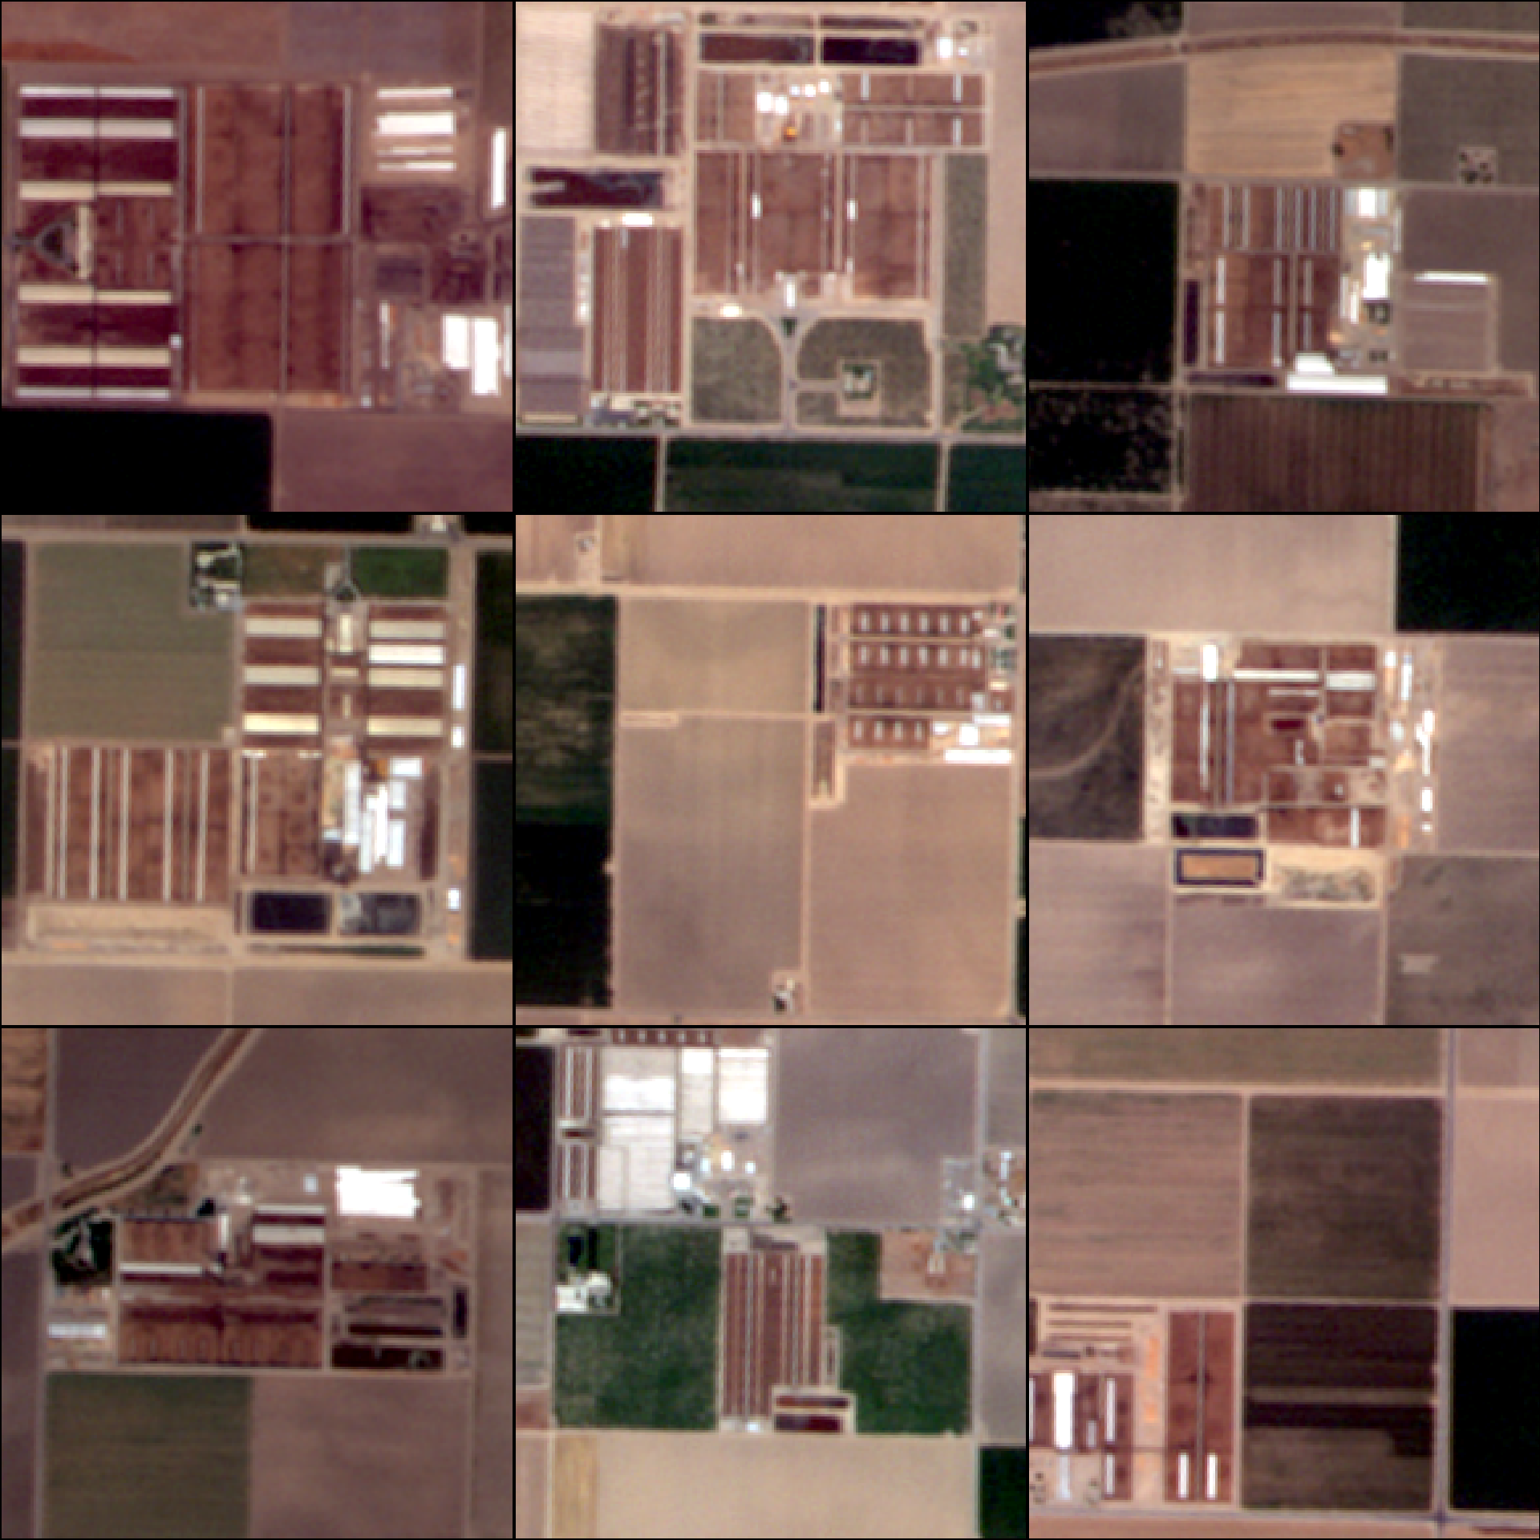
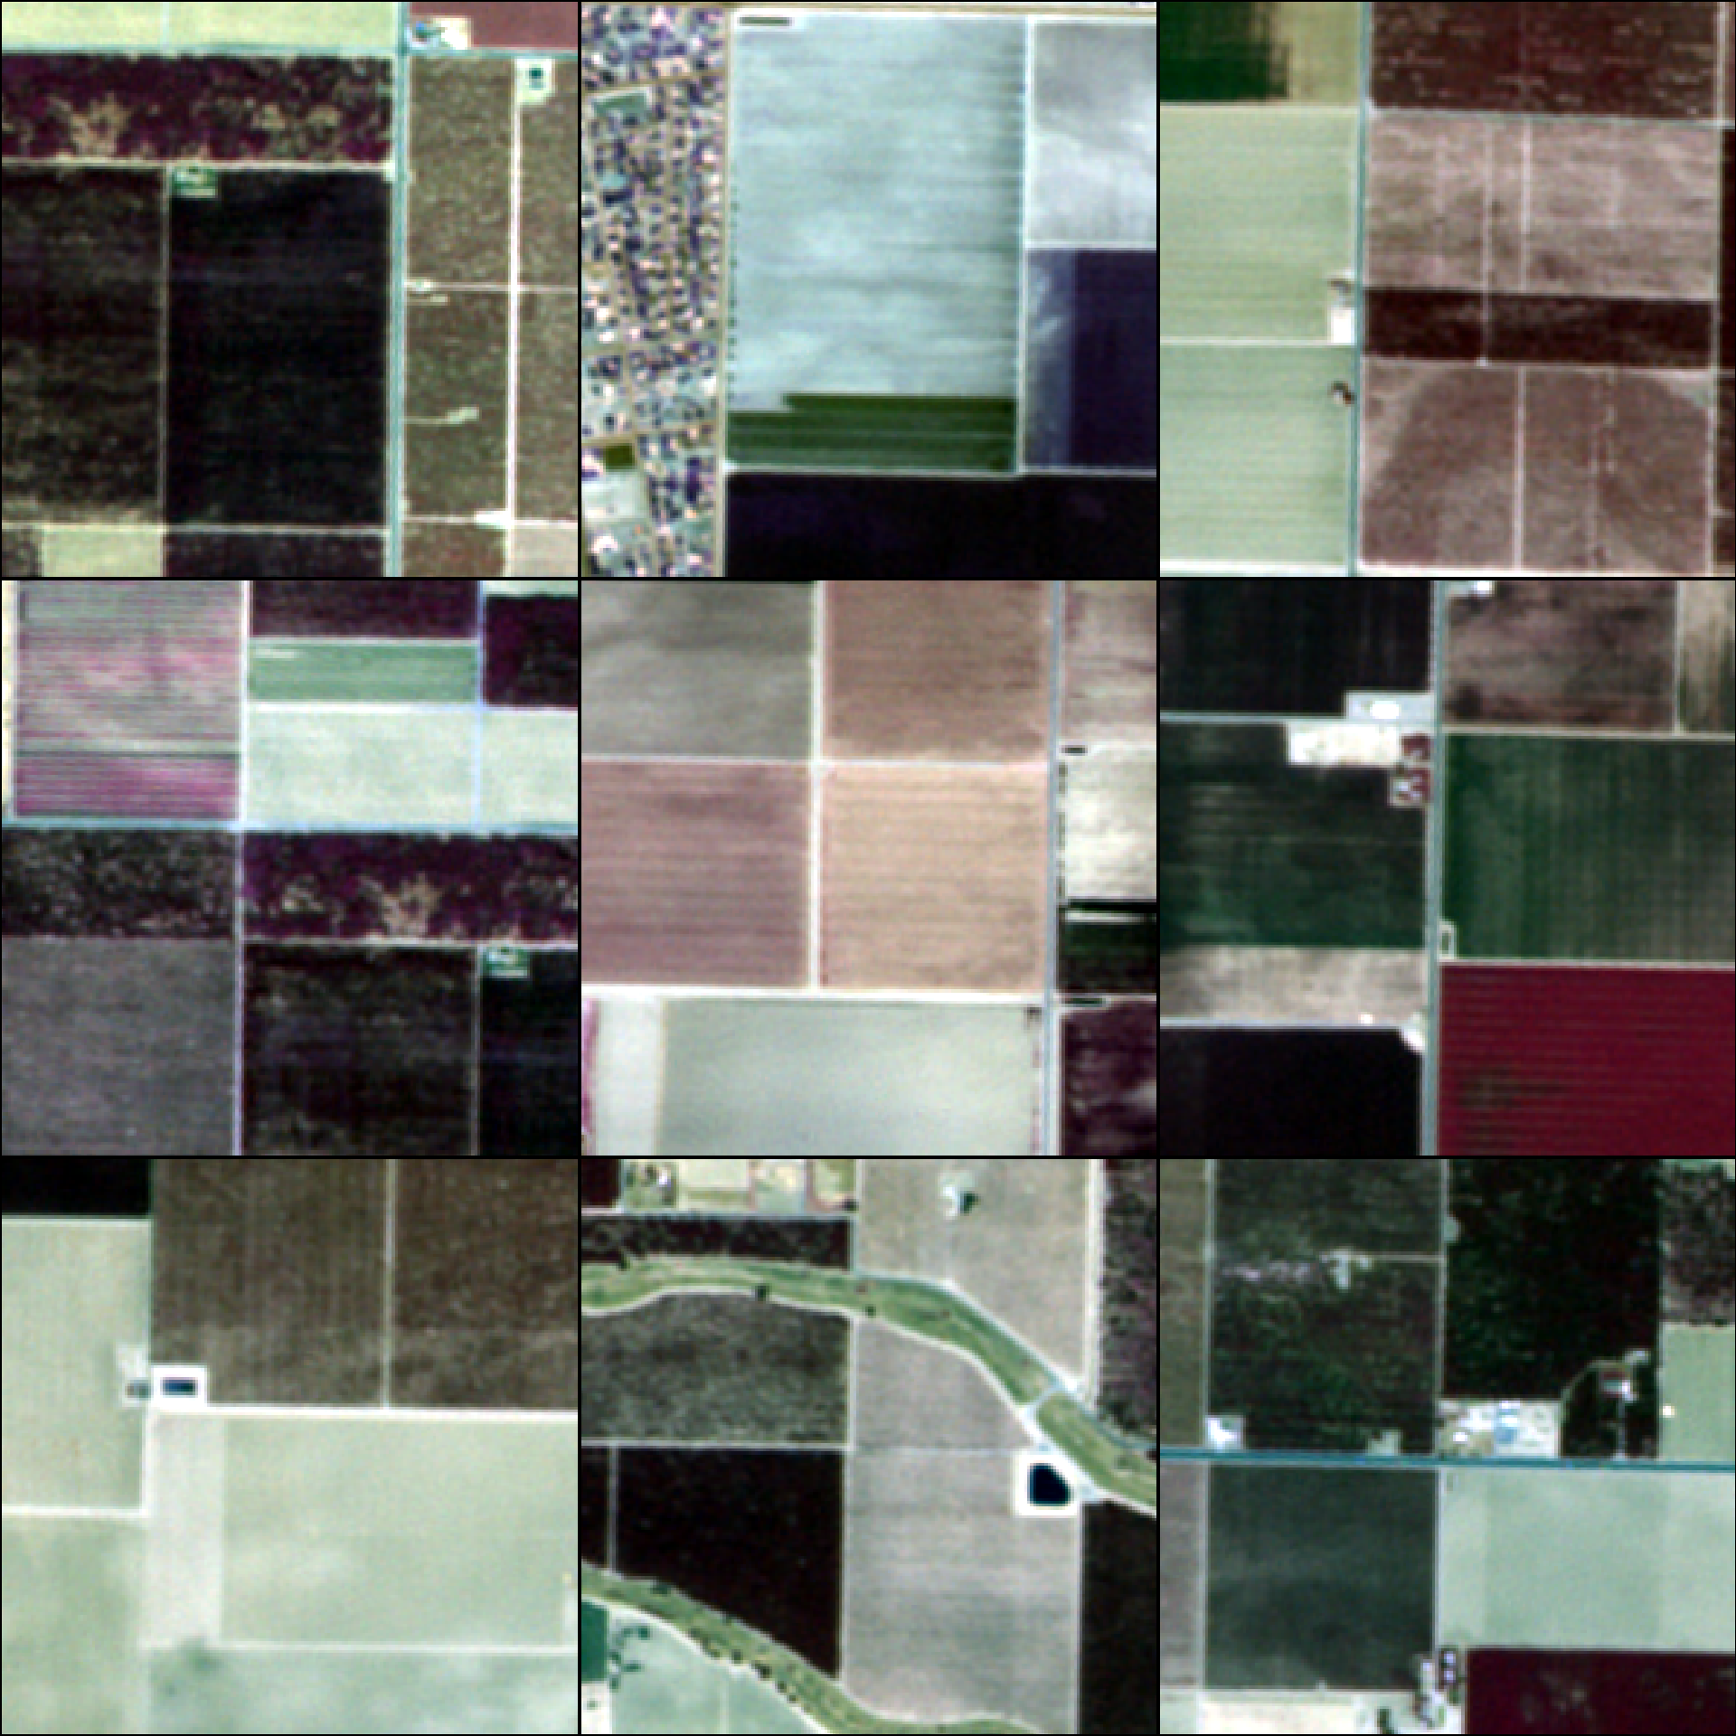
Convolutional Neural Network
1. Collect training samples

Slide 27
Convolutional Neural Network
2. Refine a pre-trained convolutional neural network
Load the pre-trained network with its predefined weights
Split data into training and testing examples
Train the model
Remove the top layer of the network
Compile the new model
Apply the model to the test set
Create and add a fully connected layer on top of the model
Measure accuracy with precision and recall
Freeze the base model layers

Slide 28
Future work
Future satellites for studying GHGs
Country and Organization | Sensor | Spatial Resolution (m) | Revisit Time (days) | Number of Bands | Progress
USA JPL,NASA | HyspIRI | 60 | 5 - 19 | > 200 | Currently at study stage
Germany GFZ/DLR | EnMAP | 30 | 27 | 218 | Currently at development and production phase
Notes:
Erika
HyspIRI:
Information from: https://hyspiri.jpl.nasa.gov/
study the world’s ecosystems
identify the type of vegetation and whether the vegetation is healthy
assess the pre-eruptive behavior of volcanoes and the likelihood of future eruptions
assess carbon and other gases released from wildfires
About mission:
2 instruments on satellite in Low Earth Orbit:
Imaging spectrometer measuring from visible to short wave IR (VSWIR: 380 nm – 2500 nm)
Multispectral imager measuring from 3 – 12 um and thermal infrared (TIR)
VSWIR 19 day revisit
TIR 5 day revisit
EnMAP:
Information from: http://www.enmap.org/?q=mission
measure and model key dynamic processes of the Earth’s ecosystems by extracting geochemical, biochemical and biophysical parameters
main objective: to study and decipher coupled environmental processes and to assist and promote the sustainable management of the Earth’s resources
About mission:
Pushbroom hyperspectral sensor
VNIR: 420 nm – 1000 nm
SWIR: 900 nm – 2450 nm

Slide 29
Conclusions
Aircraft sensors are currently best for identifying CH4 emission point sources
Image classification + plume data → insight into emission sources/management practices
Rule based feature extraction is not ideal for in depth analysis
Bigger Picture: Hyperspectral data vs PlanetScope data
Notes:
Kelsey
Current satellite products do not have the spatial resolution and sensitivity for identifying methane emissions from point sources, but aircraft data allows us to identify point sources at higher resolution
Satellite data and image classification products when combined with plume data offers insight into dairies, their management, and emissions.
Rule based classification in ENVI for one image tile gives an accuracy of 75%, but when applying the same ruleset to other areas, accuracy is much lower
More work needs to be done to refine the ruleset for it to be applied to other areas in the Central Valley
Timely imagery is important for classification of dairy farms because features, such as lagoons, change so frequently
Need new approach for better classification results → machine learning
An accurate dairy dataset derived from image classification techniques may help in future flight planning.
Increased spatial and temporal (seasonal, diurnal) coverage of aircraft data would help in quantifying emissions, their sources, and how they vary, especially when combined with high resolution imagery

Slide 30
Acknowledgements
Dr. Kristal Verhulst, NASA JPL/UCLA Joint Institute for Regional Earth System Science and Engineering
Dr. Charles Miller, NASA JPL
Talha Rafiq, NASA JPL/UCLA Joint Institute for Regional Earth System Science and Engineering
Dr. Brian Bue, NASA JPL
Dr. Francesca Hopkins, University of California Riverside
Riley Duren, NASA JPL
Nick Rousseau, NASA JPL, DEVELOP Center Lead
Ben Holt, NASA JPL, DEVELOP mentor

Slide 31
References
Hopkins, F. M., Ehleringer, J. R., Bush, S. E., Duren, R. M., Miller, C. E., Lai, C.-T., Hsu, Y.-K., Carranza, V. and Randerson, J. T. (2016), Mitigation of methane emissions in cities: How new measurements and partnerships can contribute to emissions reduction strategies. Earth's Future, 4: 408–425. doi:10.1002/2016EF000381
Kort, E. A., C. Frankenberg, K. R. Costigan, R. Lindenmaier, M. K. Dubey, and D. Wunch (2014), Four corners: The largest US methane anomaly viewed from space, Geophys. Res. Lett., 41, 6898–6903, doi:10.1002/2014GL061503.
Maasakkers, J. D., et al (2016), Gridded National Inventory of U.S. Methane Emissions, Environ. Sci. Technol., 50, 13123–13133, doi:10.1021/acs.est.6b02878.
Thompson, D. R., A. K. Thorpe, C. Frankenberg, R. O. Green, R. Duren, L. Guanter, A. Hollstein, E. Middleton, L. Ong, and S. Ungar (2016), Space-based remote imaging spectroscopy of the Aliso Canyon CH4 superemitter, Geo-phys. Res. Lett., 43, 6571–6578, doi:10.1002/2016GL069079.
U.S. Environmental Protection Agency (2017), Inventory of U.S. Greenhouse Gas Emissions and Sinks: 1990 – 2015.
Verhulst, K. R., Karion, A., Kim, J., Salameh, P. K., Keeling, R. F., Newman, S., Miller, J., Sloop, C., Pongetti, T., Rao, P., Wong, C., Hopkins, F. M., Yadav, V., Weiss, R. F., Duren, R. M., and Miller, C. E.: Carbon dioxide and methane measurements from the Los Angeles Megacity Carbon Project – Part 1: calibration, urban enhancements, and uncertainty estimates, Atmos. Chem. Phys., 17, 8313-8341, https://doi.org/10.5194/acp-17-8313-2017, 2017.

