Slide 1
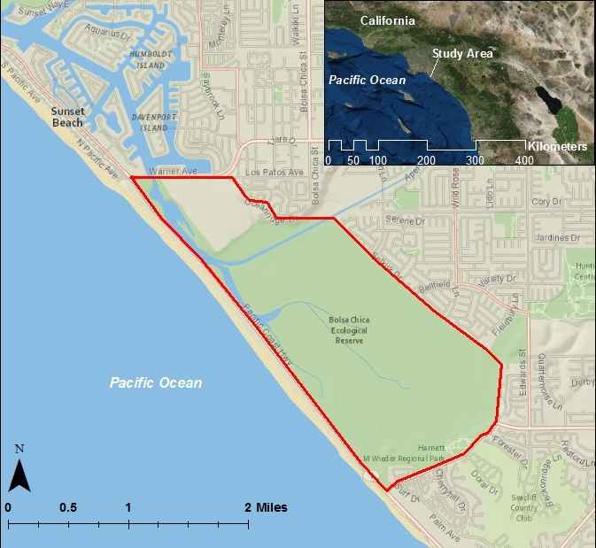
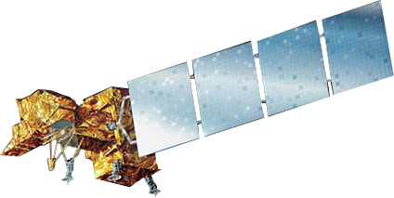
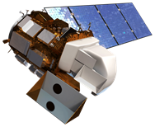
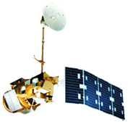
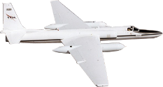
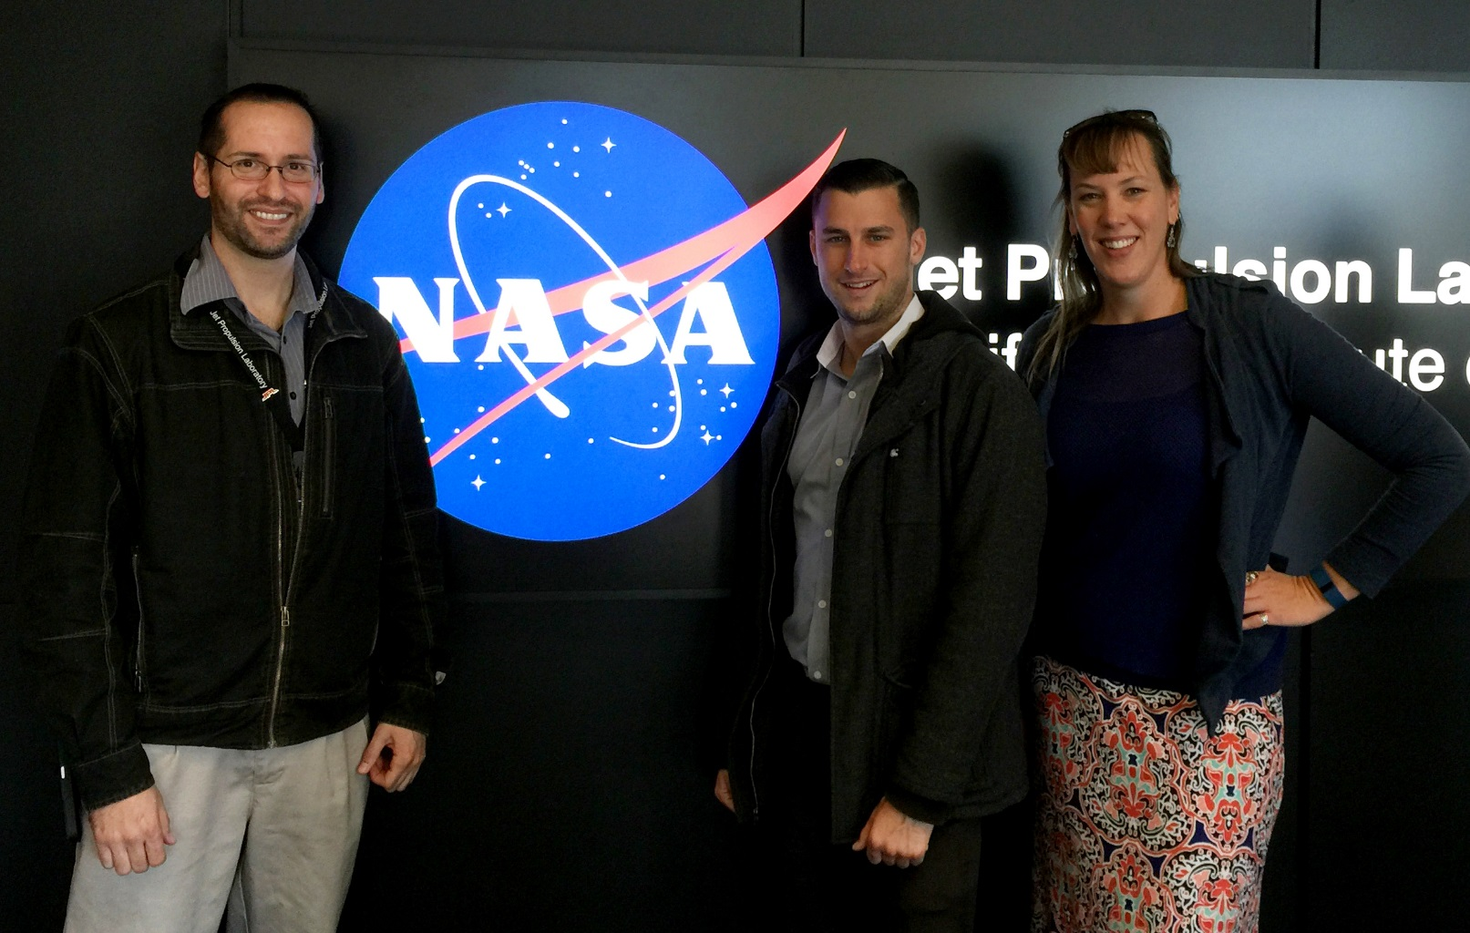
Bolsa Chica Ecological Forecasting
Analyzing the success of the Bolsa Chica Wetland Restoration Using Multi-Spectral NASA Earth Observations
Christine Elowitt (Project Lead), Steven Kerns, Nick Rousseau
NASA Jet Propulsion Laboratory
Abstract
Objectives
Keep this blank for now.
Body text point size should be at least 24.
Caption text point size should be at least 16.
Feel free to rename, move, and resize sections as needed.
Expand the Amigos de Bolsa Chica’s education and outreach program by creating an interactive online map resource for public use.
Create a time-series analysis to demonstrate Bolsa Chica wetland restoration success from 1984-2015.
Determine the location of specific plant species in inaccessible regions using NASA remote sensing technologies.
Synthesize existing biological data, project results, and satellite images in order to provide a new framework in which to view wetlands success.
Methodology
Study Area
Acquire
Analyze
Produce
AVIRIS Imagery (2014 and 2015)
Classify land cover types (ENVI)
Detailed Current Land Cover Map
Landsat Imagery (1984, 2002, and 2015)
Calculate NDVI and WRI indices (ArcGIS)
Time Series Maps (changes in water extent and vegetation)
NAIP Imagery (2005 and 2014)
Pan-sharpen (ArcGIS)
NOAA Coastal Change Analysis (1996 to 2010)
Create vegetation and water extent vector layers (ArcGIS)
Interactive Web Map
Study Period: 1984 - 2015
Results
Earth Observations
Use images.
Make sure that it has some sort of flow, that it makes sense. Show your results in a logical order.
No bullets.
Landsat 7 ETM+
Landsat 8 OLI
Landsat 5 TM
ER-2 AVIRIS
Conclusions
Project Partners
TBD
The Amigos de Bolsa Chica
Team Members
Acknowledgements
We would like to thank Ben Holt (NASA JPL) for his leadership and insight into remote sensing technologies.
We would like to thank our project advisor Cedric Fichot (NASA JPL) for his support and technical expertise.
We would like to thank our partners Joana Taveras-Reager, Vic Leipzig and Jerry Donohue of the Amigos de Bolsa Chica advocacy group.
We would also like to thank Bruce Chapman (NASA JPL) for his advice on radar systems.
From left to right: Nick Rousseau, Steven Kerns, and Christine Elowitt
NASA Jet Propulsion Laboratory

