Slide 1
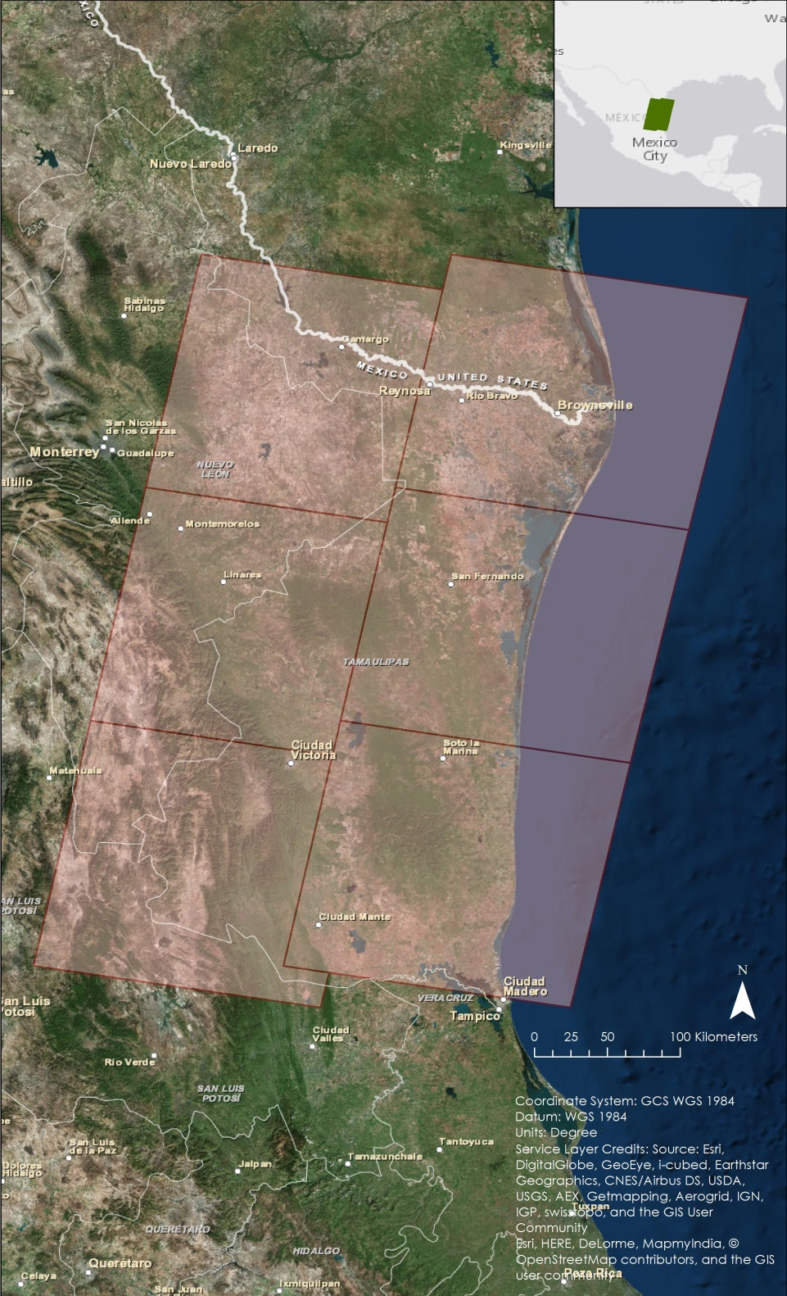
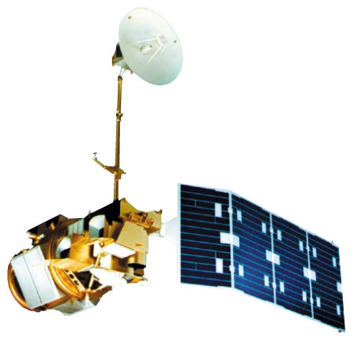
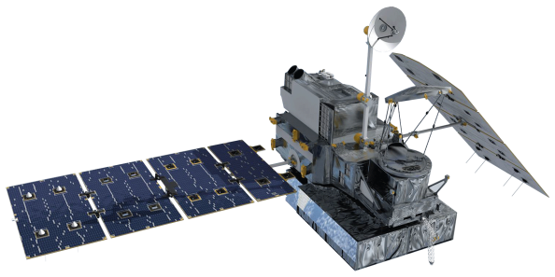
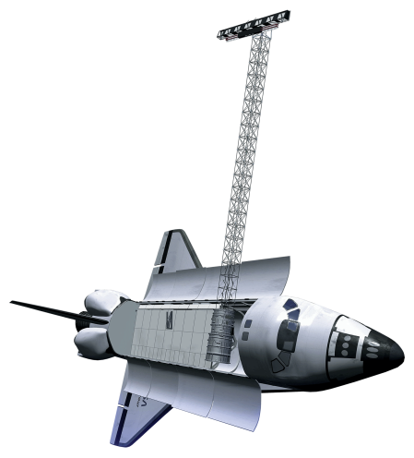
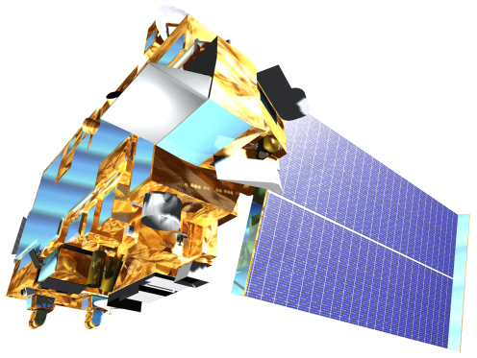
North Mexico Ecological Forecasting
Using NASA Earth observations to monitor and manage ocelot habitat loss in north Mexico
Ryan Schick (Project Lead), Padraic Conner, Maggi Klug, Leigh Sinclair
NASA DEVELOP National Program at Marshall Space Flight Center
Abstract
Objectives
Create a Habitat Percent Cover Map to assess the current extent of the ocelot habitat in Northeastern Mexico
Create a Habitat Probability Map to show areas most likely to be inhabited by breeding populations
Use the SLEUTH model to project future ocelot habitat
Study Area
Methodology
Variables
Distance to Roads
Distance to Streams
Areas of Forest and Scrub Brush
Protected Areas
Distance to Gap
Distance to Urban Areas
Fuzzy Memberships
TBD
Fuzzy Overlay
Northeast Mexico
Maximum Entropy Model
Habitat Percent Cover Map
Road Networks
Habitat Probability Map
Variables
Slope
Land Cover Classifications
Protected Areas
Urban Areas
Road Networks
Hillshade
Earth Observations
SLEUTH
Model
Future Habitat Probability Map
Landsat 5
Results
Suomi NPP
TBD
Landsat 8
SRTM-V2
Terra
Conclusions
TBD
Team Members
Project Partners
Acknowledgements
Need to take new picture!
Ken Kaemmerer, Pittsburg Zoo & PPG Aquarium
Dr. Josh Gaspard, Pittsburg Zoo & PPG Aquarium
Michael Tewes, Caesar Kleberg Wildlife Research Institute at Texas A&M University-Kingsville
Nanette Bragin, The Denver Zoo
Mitch Sternberg, South Texas Refuge Complex
Dr. John Young Jr, Texas Department of Transportation
Dr. Arturo Caso, SEMARNAT
Dr. Arturo Flores-Martinez, SEMARNAT
Dr. Tyler Campbell, East Wildlife Foundation
Dr. Jeffrey Luvall, NASA at NSSTC
Dr. Robert Griffin, University of Alabama in Huntsville
Daryl Ann Winstead, NASA DEVELOP
Christina Fischer, NASA DEVELOP
Amberle Keith, NASA DEVELOP Alumni
Timothy Klug, NASA DEVELOP Alumni
Kaushik Narasimhan, NASA DEVELOP Alumni
NASA Marshall Space Flight Center

