Slide 1
Richmond Disasters
Tracking and Assessing Stormwater Flooding in Richmond, Virginia to Improve Water Quality Monitoring and Resources Management
Kaylee Tanner • Trinity Johnson • Maggie Lincoln • Brodie Thiele
Virginia – Langley | Summer 2023
Notes:
Kaylee
Our project focused on stormwater flooding in the RVA area
Everyone introduce themselves

Slide 2
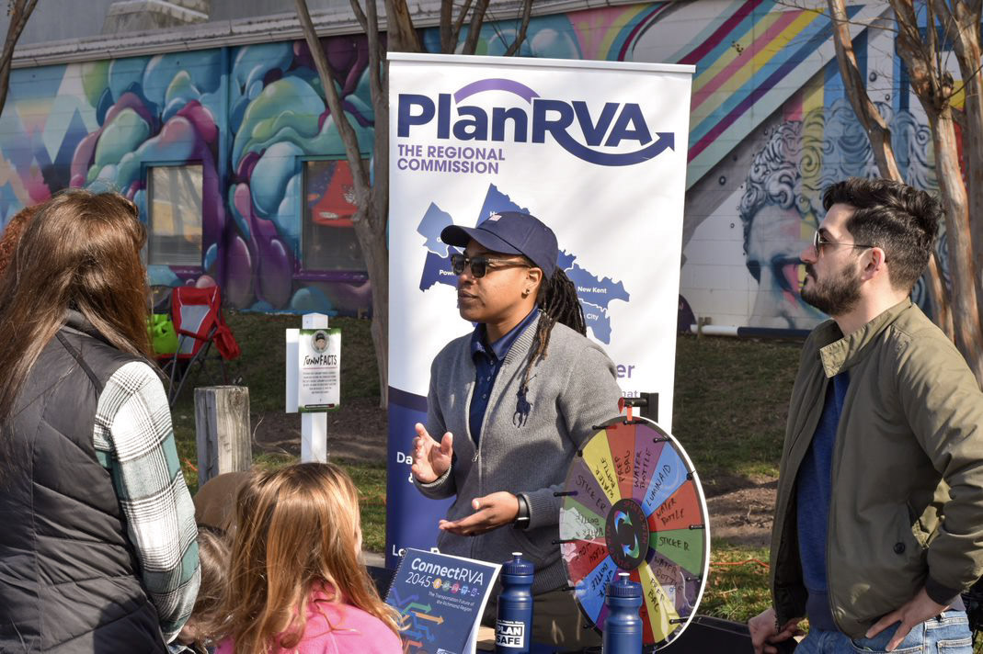
Partners
PlanRVA
Groundwork RVA
“Where the region comes together to look ahead”
“To cultivate the next generation of urban conservationists”
*Insert partner image*
Image Credit: PlanRVA
Image Credit: Groundwork RVA
Image Credit: Bernardo62
Notes:
Brodie
PlanRVA was formed in 1969 as a coalition of local governments in central Virginia. PlanRVA is governed by a 33-member Board of Commissioners consisting of officials elected by the nine member governments, Ashland, Charles City, Chesterfield, Goochland, Hanover, Henrico, New Kent, Powhatan, and Richmond, as well as local planning commissioners and citizen representatives.
PlanRVA’s mission is to promote regional cooperation and collaboration to address challenges and sustain the region’s growth. The main areas of PlanRVA’s work are community development, emergency management, the environment, and transportation.
Nicole Keller, who joined PlanRVA in 2022 as a Resilience Planner and is a DEVELOP alumna, instigated this project as a way to enhance PlanRVA’s work with the use of EOs.
Groundwork RVA is a nonprofit that works with youth to enhance green spaces in Richmond communities
They have initiatives both for highschoolers and recent graduates to learn about landscape architecture and design and implement it in their communities
Links to Partners Websites
https://planrva.org/home/about-the-commission/#:~:text=What%20We%20Do,citizens%20in%20the%20planning%20district.
https://www.groundworkrva.org/mission
------------------------------Image Information Below ------------------------------
Image 1 Credit: Nicole Keller, PlanRVA
Image 1 Source: Provided by DEVELOP partner
Image 2 Credit: Rosa Roncales, Groundwork RVA
Image 2 Source: Provided by DEVELOP partner

Slide 3
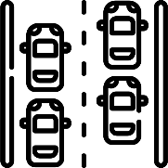
COMMUNITY CONCERNS
Water Quality – Overwhelmed sewer systems discharge sewage into waterways
Traffic – Road closures increase commute times and leave people stranded
Property Damage – Water damage affects the structure and contents of buildings
Notes:
Trinity
Our partners listed these as the primary community concerns
Parts of the study area have a combined sewer overflow system
water that is pooling on the streets is potentially contaminated
Intersections in underserved residential areas frequently flood and close roads
Many of these communities are underinvested in, and therefore, have no curbs or water drainage system, allowing water to pool in resident’s yards
This can damage resident’s homes
Icon Attribution Citations
From Flat Icon [Water Quality Icon], by Iconjam, Smart City Pack, 2022. https://www.flaticon.com/free-icon/water-quality_8382788
From Flat Icon [Automobile Traffic Icon], by Freepik, City Life Pack, 2021.https://www.flaticon.com/free-icon/automobile_1786885
From Flat Icon [Flooded House Icon], by Konkapp, Natural Disaster Pack, 2021. https://www.flaticon.com/free-icon/flooded-house_3242581

Slide 4
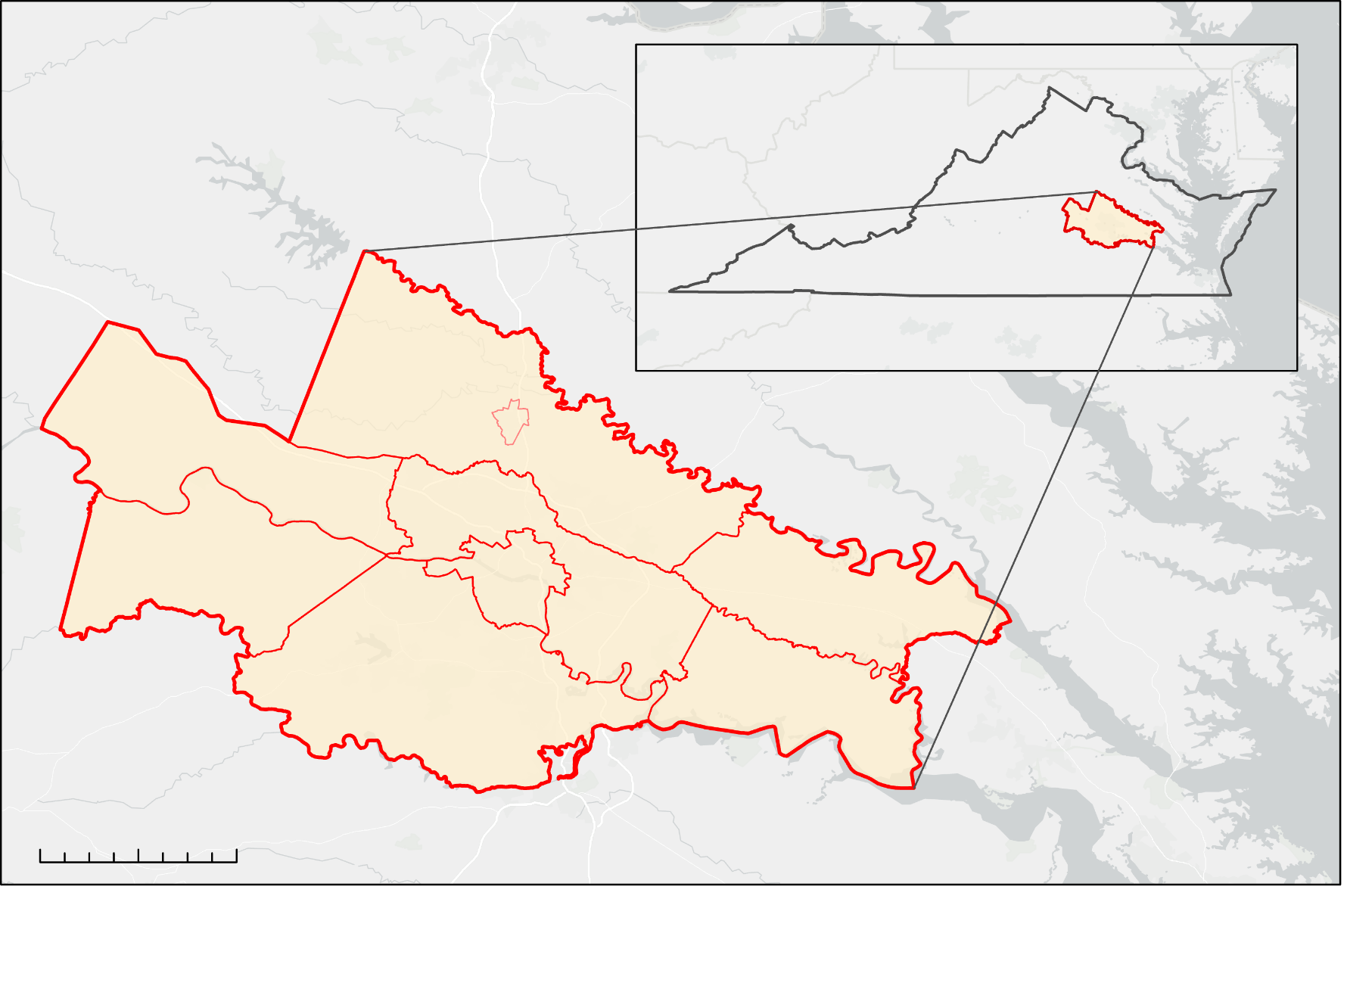
Study Area & Period
N
Greater Richmond Region
VIRGINIA
HANOVER
June 2010 - June 2023
GOOCHLAND
ASHLAND
POWHATAN
RICHMOND
NEW KENT
HENRICO
CHESTERFIELD
CHARLES CITY
0
8
16
32
Km
Notes:
Trinity
The study area for this work was the Greater Richmond Region, which encompasses the City of Richmond along with 7 neighboring counties: Charles City, Chesterfield, Goochland, Hanover, Henrico, New Kent, and Powhatan (as well as the locality of the Town of Ashland, located within Hanover County)
This project focused on flood events occurring between June 2010 and June 2023. 6 specific case study events were utilized. These occurred on August 27th, 2011, September 4th 2011, May 18th and 19th 2018, June 2nd and 3rd 2018, June 7th 2019, and August 15th, 2020
------------------------------Image Information Below ------------------------------
Image Credit: Maggie Lincoln
Image Source: Provided by a DEVELOPer

Slide 5
Objectives
Map areas at risk of pluvial flooding
Identify flood-prone areas that intersect
disadvantaged communities
Inform allocation of resources for
disaster management and mitigation efforts
Notes:
Maggie
Use InVEST and Arc Malstrom to model pluvial flooding
Created a Flood vulnerability index based on the outcome of both models
Used Census data and Social Vulnerability index data to identify disadvantaged communities
Created bivariate maps to see how flood vulnerability correlated with social vulnerability variables
Provided results to partners and allowed them to take action

Slide 6
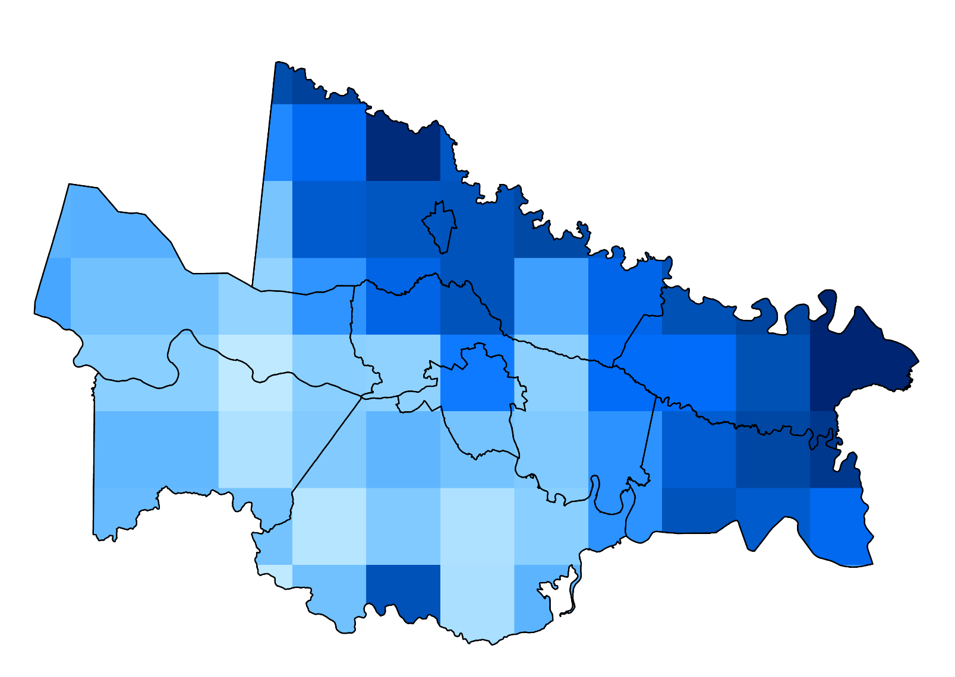
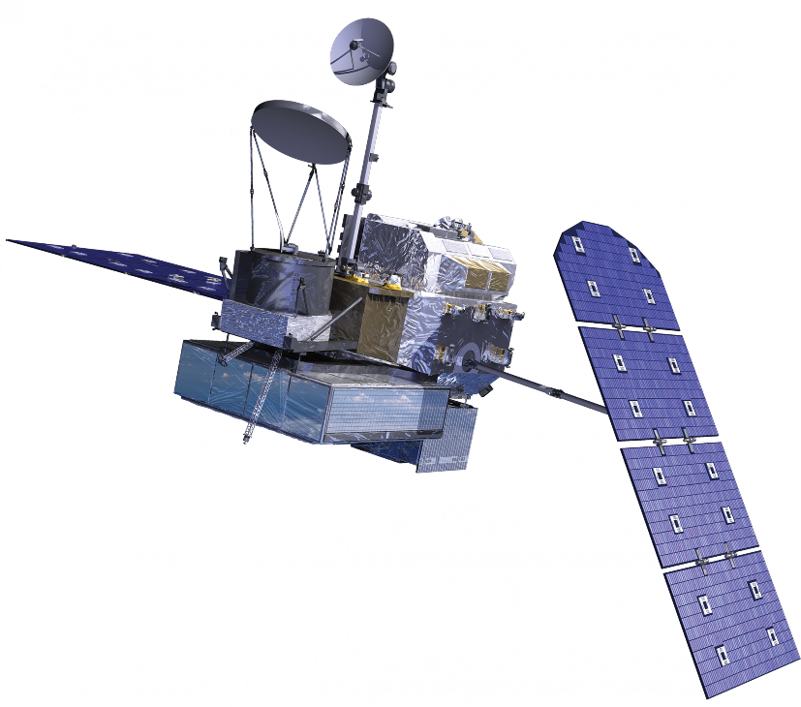
Earth Observations
N
103.91
27.16
Global Precipitation Measurement
Integrated Multi-satellitE Retrievals
0
20 km
Precipitation Depth (mm) 5/18/18
Notes:
Kaylee
Used GPM IMERG from NASA to run the InVEST model, captured by NASA
Image is from a date of significant flooding in Richmond
Varied precipitation across the study area will provide a more realistic outcome in the model opposed to a flat number of precipitation
------------------------------Image Information Below ------------------------------
Image Source: https://science.nasa.gov/get-involved/toolkits/spacecraft-icons (CC BY-SA 2.0 FR)

Slide 7
Methodology: Arc-Malstrøm Bluespots
Streams
Flowlines
Burn Flowlines onto DTM
Pour Points
Identify
Bluespot
Features
DEM
Input DTM
Watersheds
Building Footprints
Add Buildings to DTM
Minimum Depth
(5 cm)
Minimum Volume
(1 m²)
Bluespots
Notes:
Brodie
Buildings added to DEM to account for building elevation
Flowlines used to account for routing in the model, as InVEST accounted for retention but not routing
Minimum depth and volume allowed us to weed out bluespots that were not of moderate concern
The bluespot model generated streams, pour points, watersheds, and bluespots.
In our application, only the bluespots and watersheds were used for further analysis of the study area

Slide 8
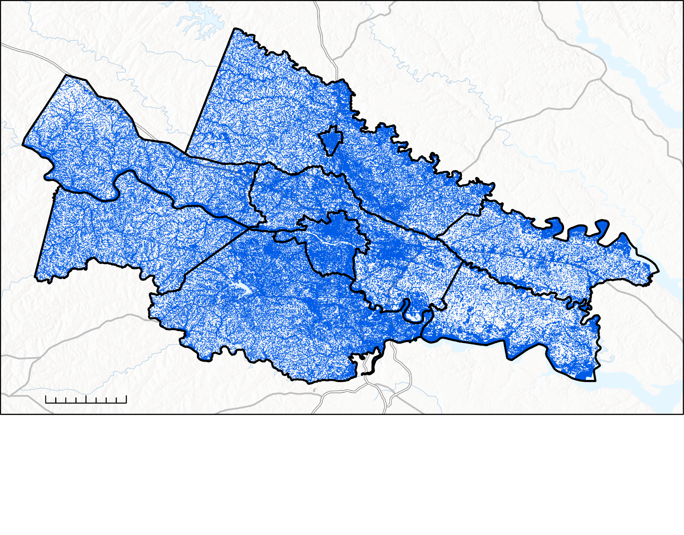
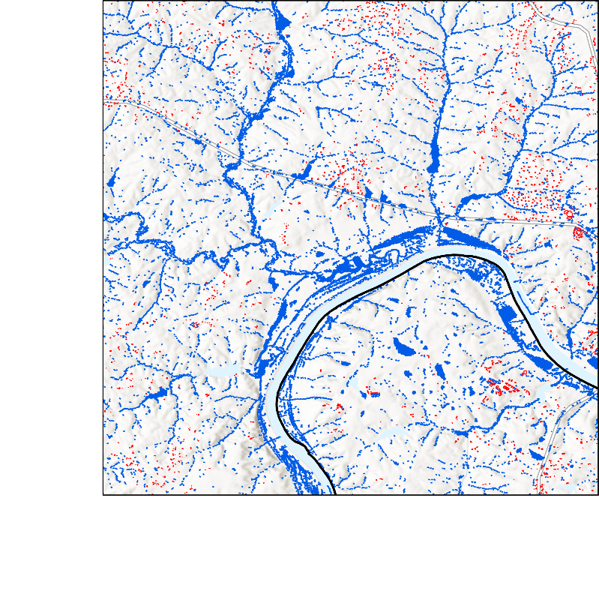
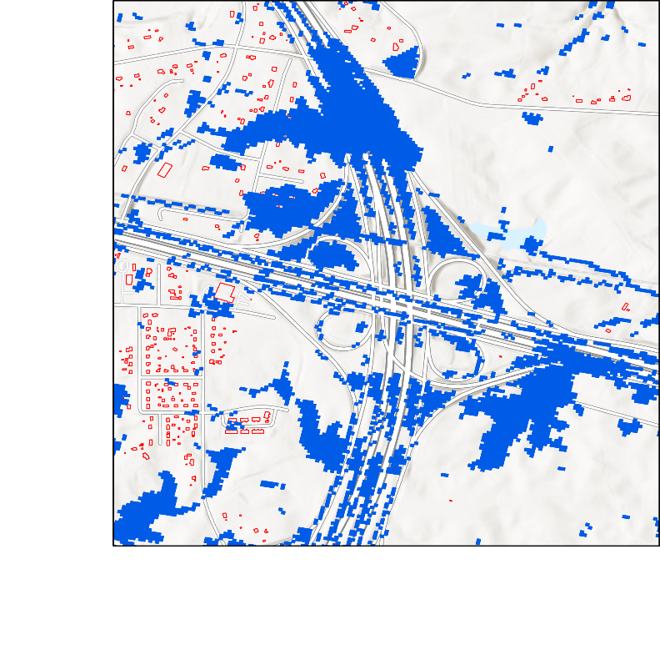
10-Meter Resolution Bluespots
N
0
20 km
Locality Boundary
Building Footprints
Bluespots
Notes:
Brodie
10m DEM yields bluespots across the entire study area
They are specific to the street level, which is helpful for predicting possible road closures
Let partners know where green infrastructure projects need to be focused

Slide 9
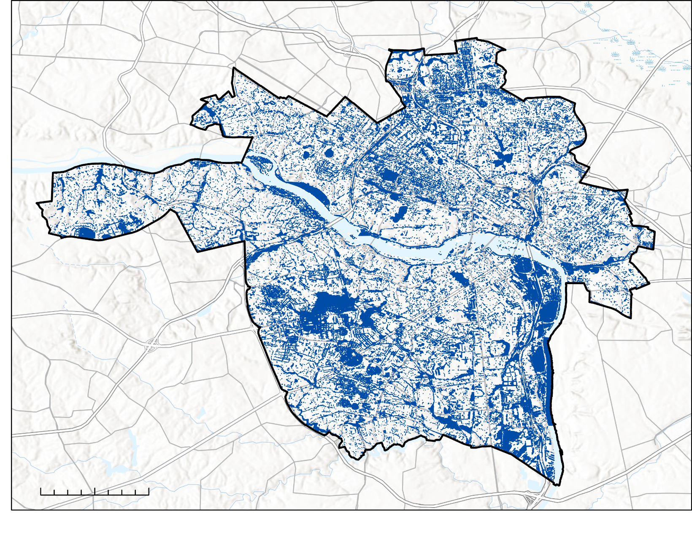
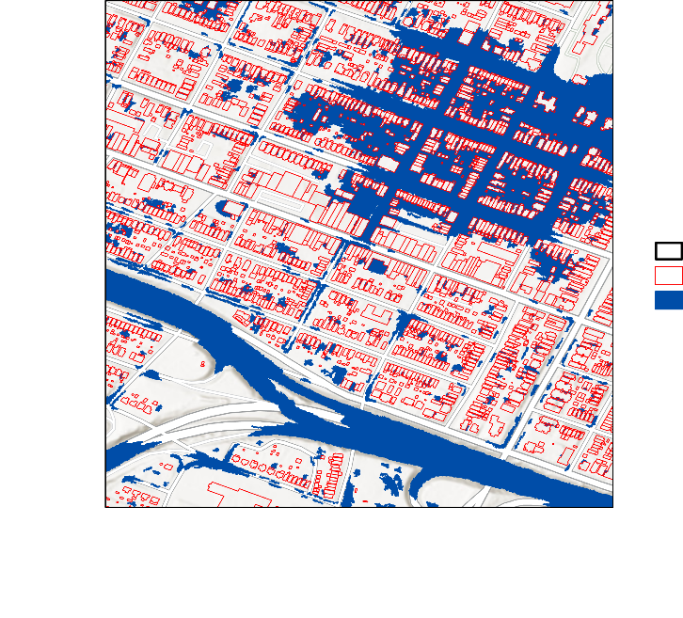
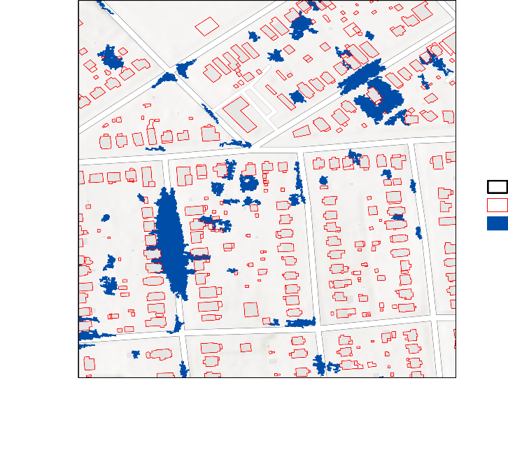
1-Meter Resolution Bluespots: Richmond
N
Richmond
Building Footprints
Bluespots
0
1
2
4 km
Notes:
Brodie
1m DEM yields even more specific results
Highlights very specific streets susceptible to flooding, and even specific buildings
Could only do this at a very small scale because getting 1m DEM data for the entire region took up space and model runs would have taken significantly longer

Slide 10
Methodology: InVEST Urban Flood Risk Mitigation
Watersheds
(Delineated or Bluespot)
Flood Volume by Watershed
Rainfall Depth
(Design storm or IMERG)
Urban Flood Risk Mitigation Model
Land Cover / Land Use
Runoff Retention Per Pixel
Soil Hydrologic Group
Runoff Depth per Pixel
Curve Number Values
Notes:
Trinity
The InVEST Urban Flood Risk Mitigation Model is a simple hydrologic model that uses soil type and landcover data to predict retention of stormwater. Areas with impervious land cover, like concrete and soils that do not conduct water well will produce more runoff during a storm than areas with highly pervious land cover (like turfgrass) and high conductivity soils.
We used both the original InVEST model that takes a “design storm” for the precipitation input—a single rainfall depth that is applied across the entire study area, and a modified version of InVEST created by a past DEVELOP term that allowed us to use a raster of spatially varying rainfall depths as the precipitation input, rather than a single number. This improved the accuracy when analyzing past storms.
The model takes into account the type of soil and type of land cover and refers to a biophysical table of curve numbers, which identify the runoff retention capacity of each type of land cover and soil type, in order to calculate retention per pixel. It then subtracts runoff retention from the total storm depth at that pixel to get the runoff volume per pixel
The model produces 3 outputs:
1. a shapefile of the input watersheds, with an estimated flood volume for each watershed.
2. a raster showing runoff retention per pixel, both as a percentage of the storm depth and as a volume
3. a raster showing runoff depth per pixel—basically an estimate of how deep water will be on the surface at that point (this assumes no movement of the water so it is very inaccurate).
We ran the InVEST model with a variety of rainfall inputs, including multiple storms measured by IMERG and design storms of various depths in order to provide more in-depth information about how food risk varies with different size storms. The next three slides show the outputs of InVEST for the 100-year storm, which is 213mm in 24 hours.

Slide 11
Runoff Retention, 100-Year Storm (213 mm)
N
Retention Proportion
0.9
0
0
20 km
Notes:
Trinity
- The runoff retention map shows what proportion of a storm the soil in that area will absorb. High retention is good, because that means that the water will infiltrate into the ground instead of staying on the surface, and low retention is bad, because that means the water will stay on the surface and either cause flooding in that spot or flow to another location where it may cause flooding.
-The stark changes at the county boundaries are due to differences in soil hydrologic group classifications, so comparing runoff retention across county boundaries is not very accurate.
- The low runoff retention values in Richmond are due to the large amounts of impervious surfaces in the urban area.

Slide 12
Runoff Retention, 100-Year Storm (213 mm)
N
Runoff Depth (mm)
213
24
0
20 km
Notes:
Trinity
The runoff depth output shows the amount of excess precipitation that is not absorbed by the soil for the modeled storm. In this case, the storm was 213mm, the 100-year storm, and you can see the only areas with the value of 213 are the rivers, which don’t absorb any rainfall. Because this is such an intense storm, there were no areas that were able to absorb 100% of the rainfall.
Although this gives a depth value for every pixel, in reality the water would not remain where it fell, so you would not observe any of these depths during an actual storm, but they are useful for understanding how much runoff is generated by different areas during storms of different sizes.

Slide 13
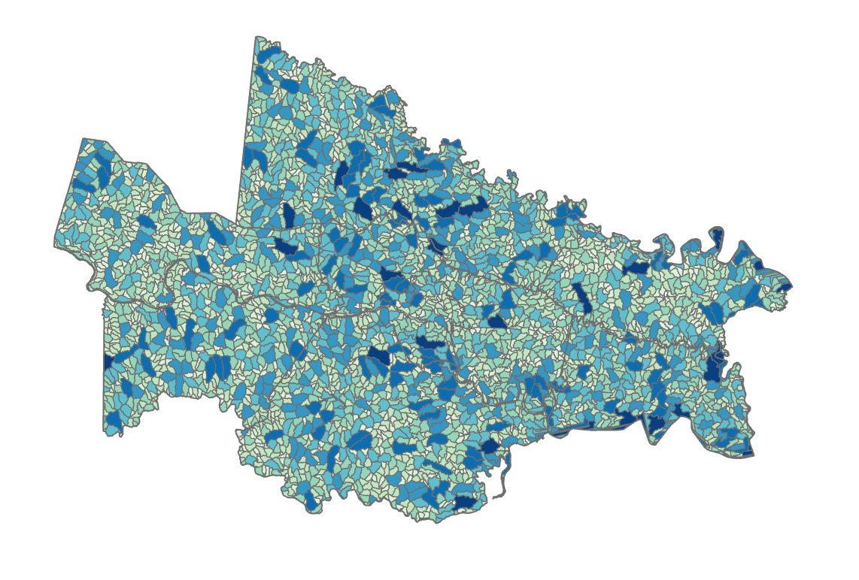
Flood Volume, 100-Year Storm (213 mm)
N
Predicted flood volume (m³)
24 - 51,184
51,185 – 129,219
129,220 – 204,197
204,189 – 299,172
299,173 – 421,882
421,883 – 590,773
590,774 – 866,031
866,032 – 1,744,022
0
20 km
Notes:
Trinity
- The flood volume output sums the predicted runoff depths for each watershed to give an overall flood volume per watershed. Again, this is a catastrophic storm and the model assumes no drainage or routing, so the numbers look inaccurate, but this output is useful for identifying which areas are most likely to be at risk of flooding based on the overall capacity for runoff retention in their watershed.

Slide 14
Methodology: Bluespot Depth Analysis
Flood Volume
÷
Bluespot Area
Bluespots
Estimated pooling depth
InVEST Flood Volume for Bluespot Watersheds
Notes:
Kaylee
The InVEST model only predicts runoff retention with no routing of the water from areas of high elevation to low, and the Malstrom model only predicts pooling of water based on elevation, without taking into account how the water might infiltrate. We can combine them to get a more accurate picture of flooding.
To do this, we ran the InVEST model using the “bluespot watersheds”, which are the areas of land that drain into a bluespot, as the input, instead of the watersheds delineated from HUC-12. This gave us a predicted flood volume for each bluespot watershed, based on the runoff retention capacity of the land inside that watershed. We then divided the predicted food volume for each watershed by the area of the associated bluespot. This produced an estimated depth of pooling for each bluespot.
This allowed us to see which bluespots are likely to actually flood during a storm—a bluespot who’s entire watershed is just turfgrass probably isn’t going to flood that much, because the water will infiltrate before it can run off into the bluespot. But a bluespot surrounded by a bunch of concrete is going to fill up quickly as none of the rain that falls in its watershed will be absorbed by the ground.
Significant limitations: does not account for any type of drainage infrastructure; there is also large error caused by the building heights

Slide 15
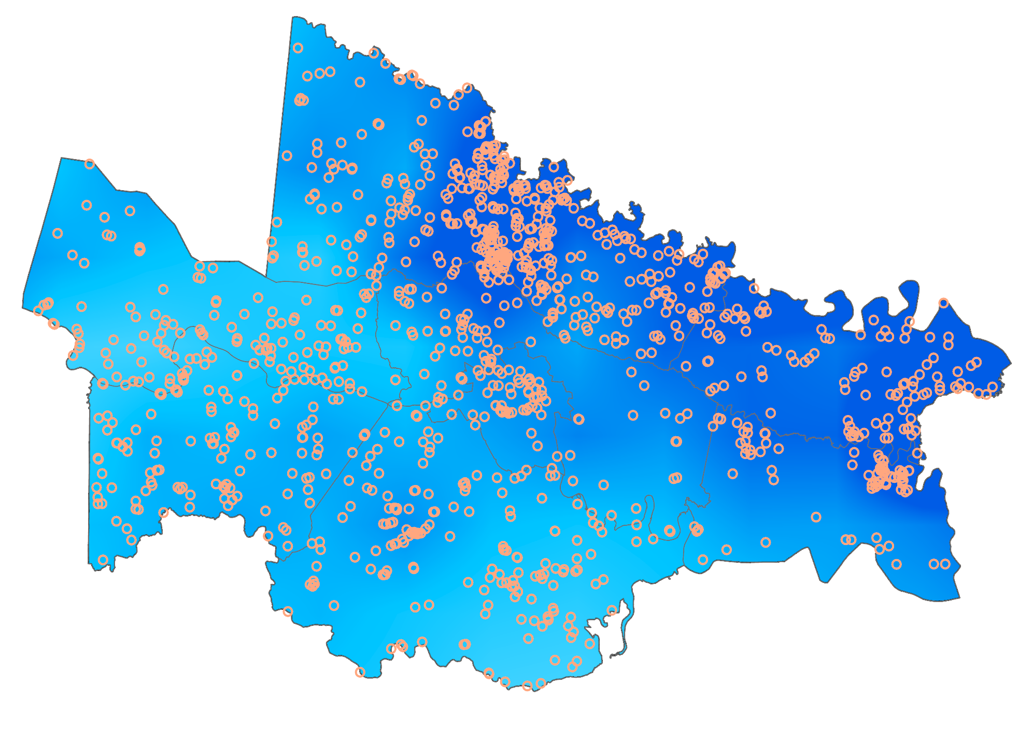
Predicted Flood Locations (Observed Storm)
May 18th -19th, 2018
N
Predicted bluespot depth greater than 20mm
103
Precipitation depth (mm)
27
0
20 km
N
Rainfall Depth and Predicted Flood Locations
May 18th-19th, 2018
Predicted bluespot depth greater than 20mm
103
Precipitation depth (mm)
27
0
20 km
Notes:
Kaylee
To create this map, we ran the InVEST model using the bluespot watersheds and a gridded rainfall raster compiled from IMERG data from May 18th-19th, 2018—one of the storms recommended by our partners. This gave us an estimated flood volume for each bluespot watershed. We divided that volume by the area of the associated blue spot to get the depth in each bluespot (assuming all the water in its watershed that did not infiltrate runs into the bluespot and there is no drain inside the bluespot).
The orange dots show the locations of bluespots predicted to have a depth greater than 20mm (about 6 inches) as a result of this storm. This is probably not what was observed, because most of these bluespots have drainage systems.
The background is the estimated rainfall depth from IMERG, interpolated from a 1000km resolution to 30m
This map shows how flooding was worst in the areas with the highest precipitation (top and far right); however, it’s also important to note areas where precipitation was high but there was less flooding (center right), and areas where precipitation was low but there were still many predicted floods (left side of image). Those are the areas that may need infrastructure improvements.

Slide 16
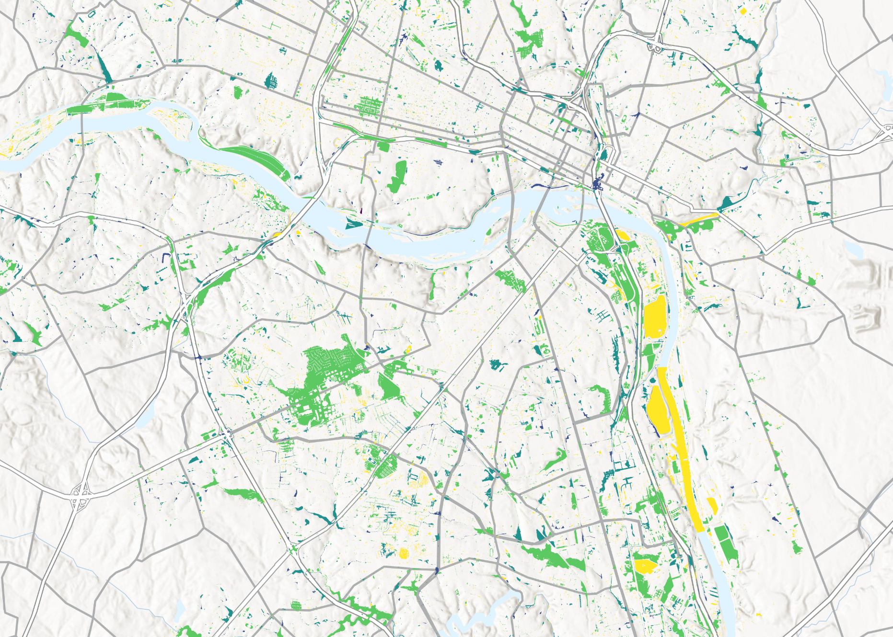
Predicted Flood Locations (213 mm Storm)
N
Depth (m)
0 - 0.2
0.3 - 0.5
0
2 km
0.6 – 1.1
1.2 – 3.1
3.2 – 10.0
Notes:
Kaylee
The IMERG data helped us see what happened in the past, but to analyze relative risk between different areas we use a single rainfall depth input to the model—this lets us see how different areas will respond to the same level of rainfall. For better visualization of this result, we zoomed in on a smaller area of Richmond.
This map was generated using the same process as the previous one, except the rainfall input was a single number—213mm—rather than a spatially varied raster from IMERG data. Instead of selecting a specific depth threshold, we colored each bluespot by the predicted depth.
These numbers look pretty catastrophic and unrealistic, but keep in mind that this assumes no drainage systems and 213mm is the 100-year-storm, so this is not a normal rainfall event. We produced this map for several smaller storms with shorter return periods, like 1 year or 5 years, so that our partners could see the relative impact of various storms on different areas.
This map shows, at the city block level, where floods are most likely and a worst-case estimate of how deep they could be.

Slide 17
Methodology: Flood Risk
Bluespots
Bluespot
Coverage
Normalized
Bluespot
Coverage
Summarize
Within
Raster
Calculator
(x-min)/(max-min)
BS + (1-Ret)
2
Census
Tracts
Flood Risk Index
Normalized
Average Retention
Average Retention
Retention
Notes:
Maggie
Used retention output from InVEST model
Found average retention in each bluespot watershed
Retention is more important in the area surrounding the bluespot than the bluespot itself, because that is the water flowing into the bluespot
Created flood index by adding bluespot coverage and average retention to weigh them evenly
Created a bivariate map to show the areas that are both most at risk for flooding and also at risk socially

Slide 18
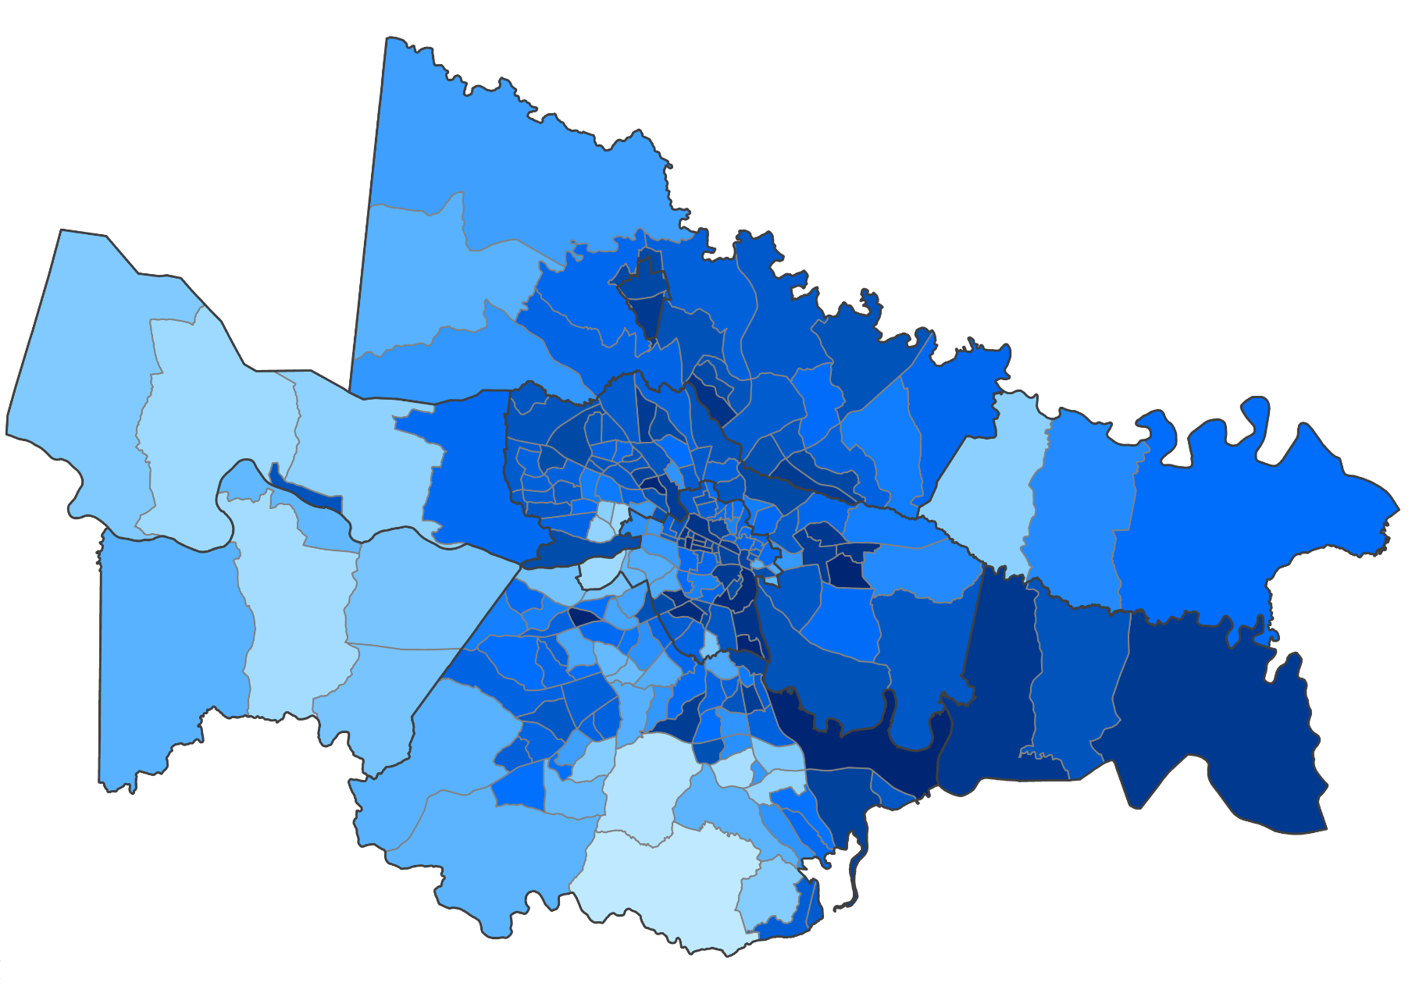
Flood Risk Index Map
N
Flood Risk Index Value
0.95
0.094
0
20 km
Notes:
Maggie
Output of Flood Risk Methodology
Each census tract has an assigned flood risk index value
We will use these values for comparison with CDC Social Vulnerability values
Can see that Richmond, Charles City County, and Town of Ashland have some of the worst values
Charles City likely due to soil classification issues
Richmond and Ashland because they’re more urban, have lots of impermeable paved surfaces

Slide 19
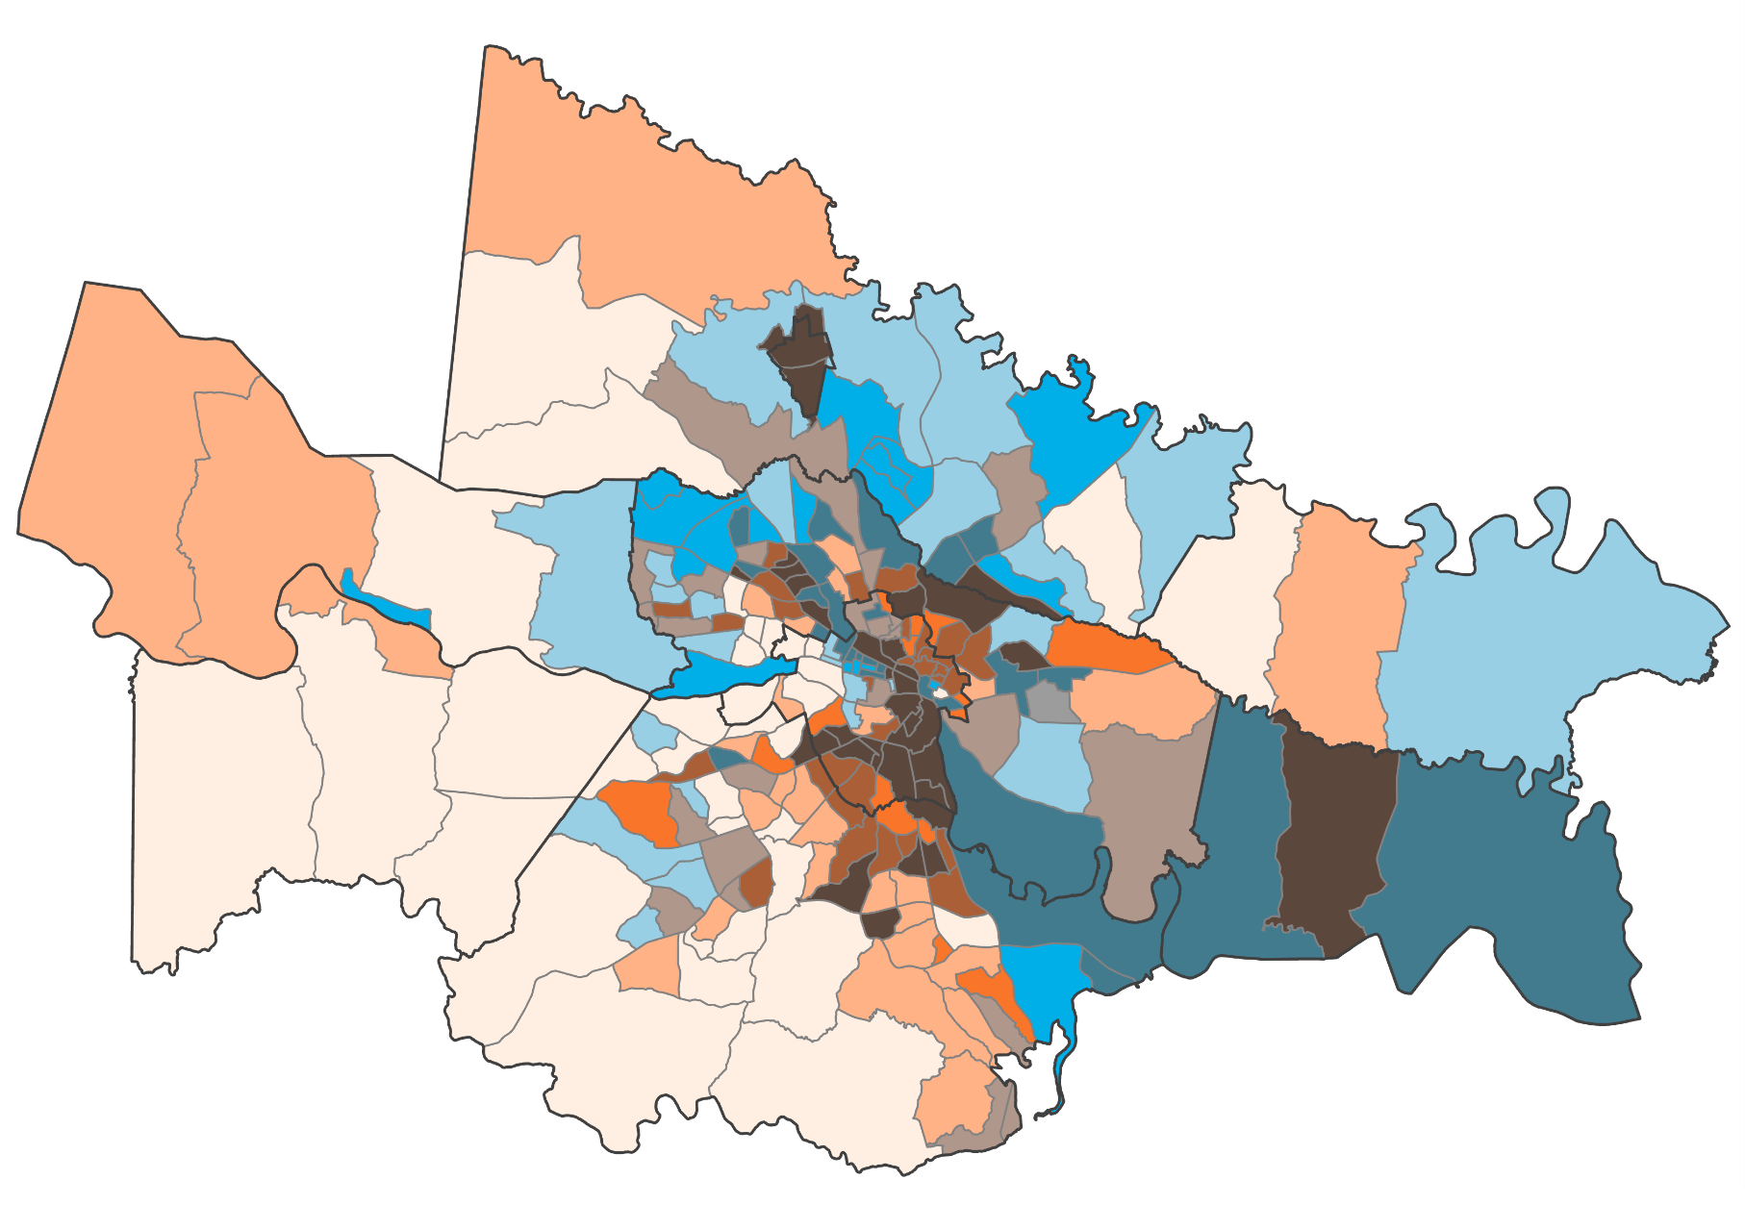
Flood Risk and Social Vulnerability Index Bivariate Map
N
Flood Risk
Social Vulnerability
High
Low
Low
High
0
20 km
Notes:
Trinity:
The SVI score is broken into four themes: 1. Racial and Ethnic Minority Status 2. Socioeconomic Status 3. Household Characteristics and 4. Housing and Transportation Type.
The degree to which a community exhibits certain social and financial conditions, may affect that community’s ability to prevent suffering and financial loss in the event of disaster.
The SVI score allows us to assess community need during emergency preparedness planning.
Communities with a high SVI and high flood risk are less likely to quickly recover from a disaster or hazard.
Some standout areas, Ashland, Charles City, Richmond (Clopton, East Highland Park)

Slide 20
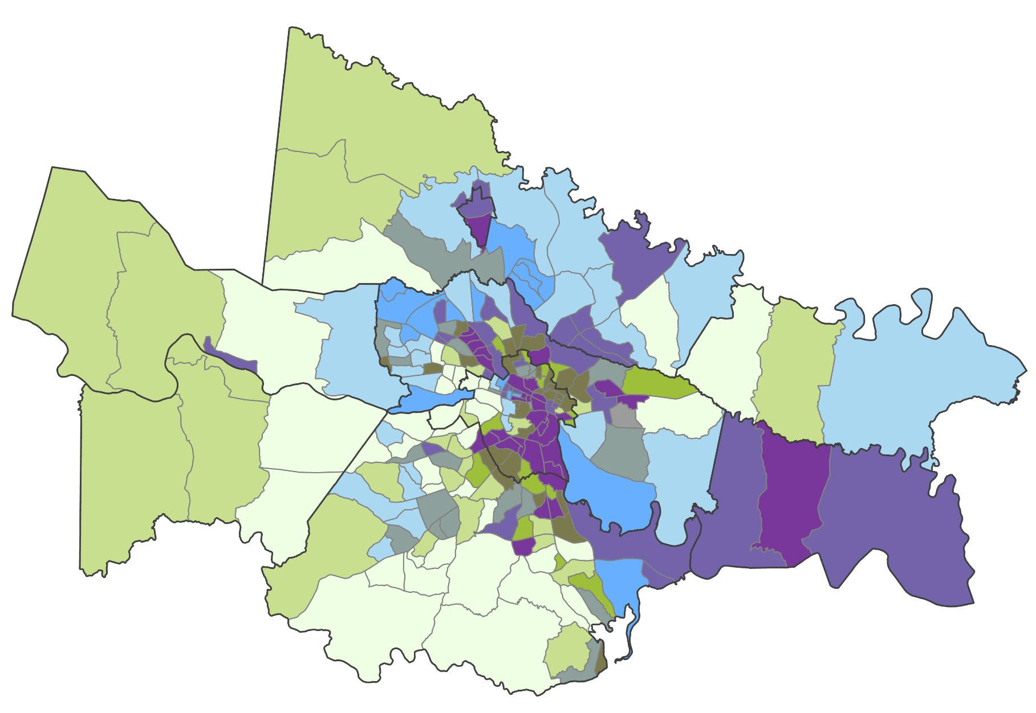
Flood Risk and Socioeconomic Status Bivariate Map
N
Flood Risk
SES Vulnerability
High
Low
Low
High
0
20 km
Notes:
Trinity
SES: The darker the color the higher the vulnerability and the lower the income. There is a correlation between flood risk and socioeconomic status.
This theme highlights the following fields:
Below 150% Poverty
Unemployed
Housing Cost Burden
No High School Diploma
No Health Insurance
Much of Richmond proper is high flood risk and high amount of disadvantaged socioeconomic status
Charles City County is also disproportionately affected in terms of flood risk and socioeconomic status
Some standout areas include Ashland, Richmond (and metro Richmond proper, Charles City County)
Data gathered from SVI dataset

Slide 21
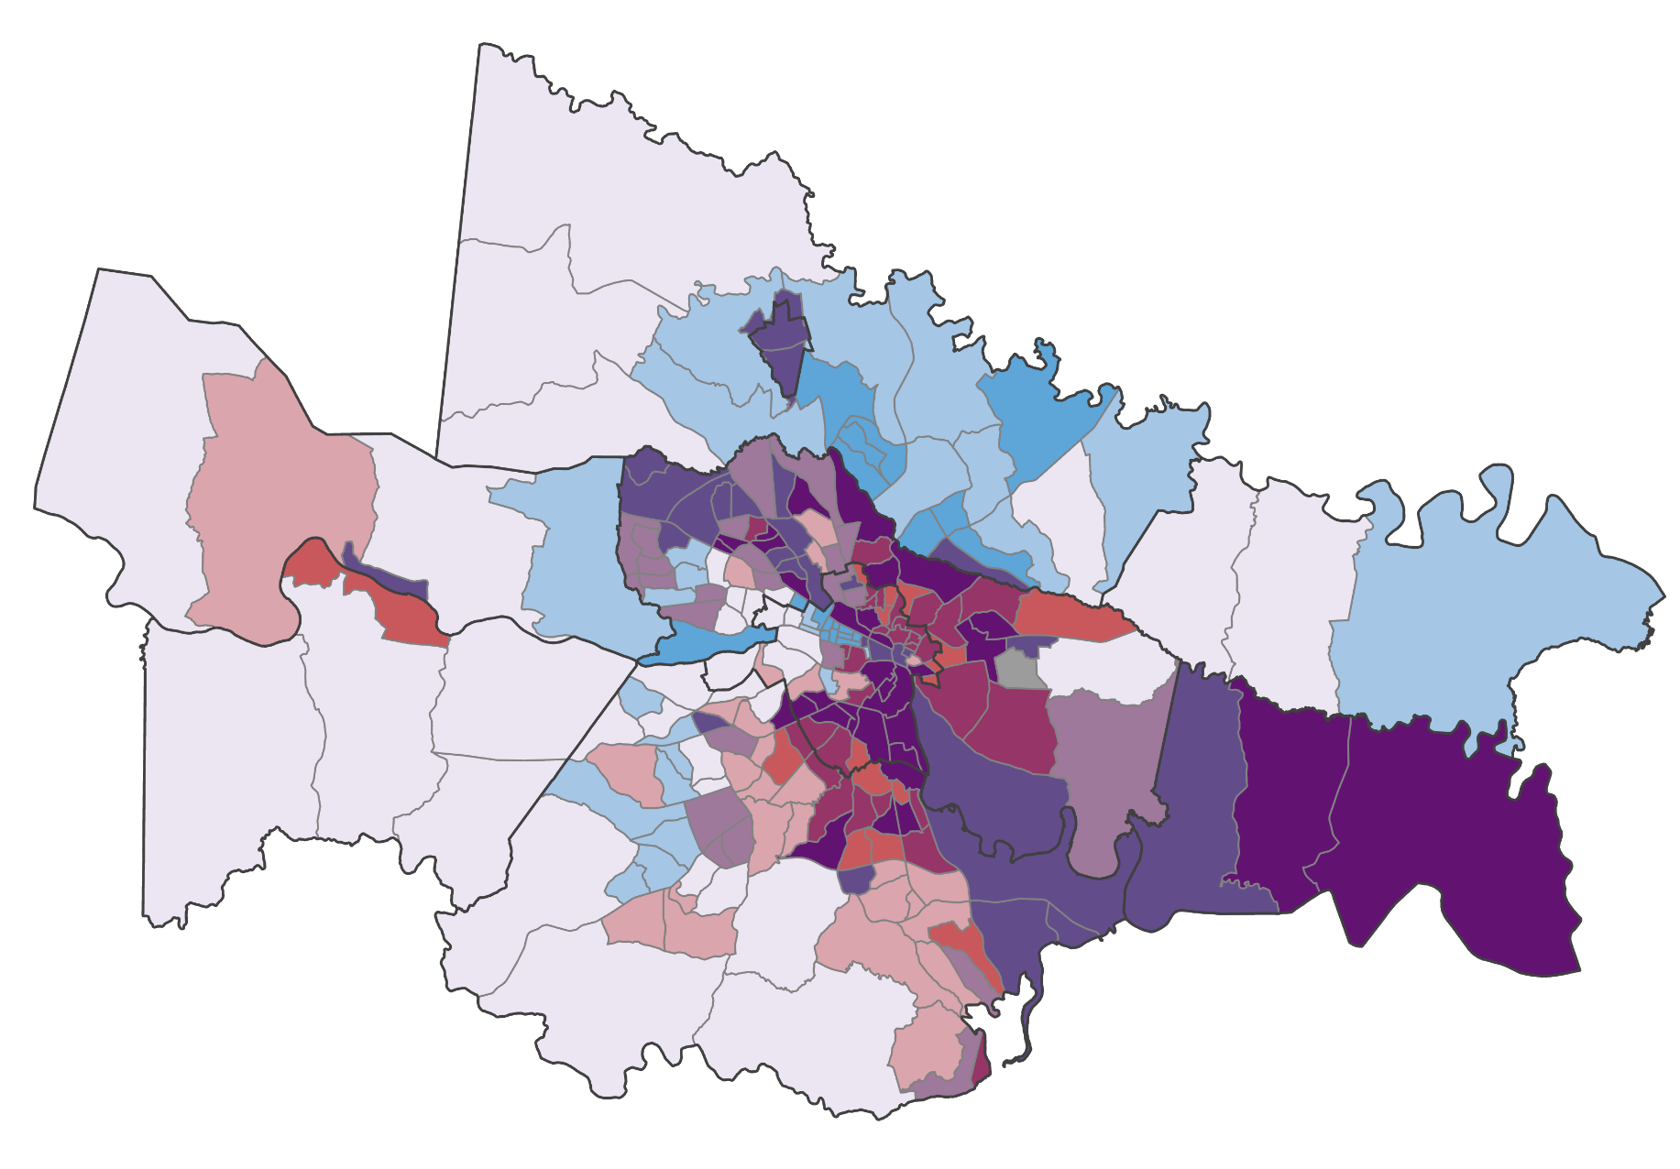
Flood Risk and Racial and Ethnic Minority Status Bivariate Map
N
Flood Risk
RacEth Vulnerability
High
Low
Low
High
0
20 km
Notes:
Trinity
Racial and Ethnic minority status: The darker the color on the map, the higher the population and percentage of racial and ethnic minorities or people of color.
There is a strong correlation between census tracts that have a large population of minority communities and tracts that are at high flood risk
Ashland, Richmond and metro region, Charles City County is also a notably disadvantaged region
Data gathered from SVI dataset

Slide 22
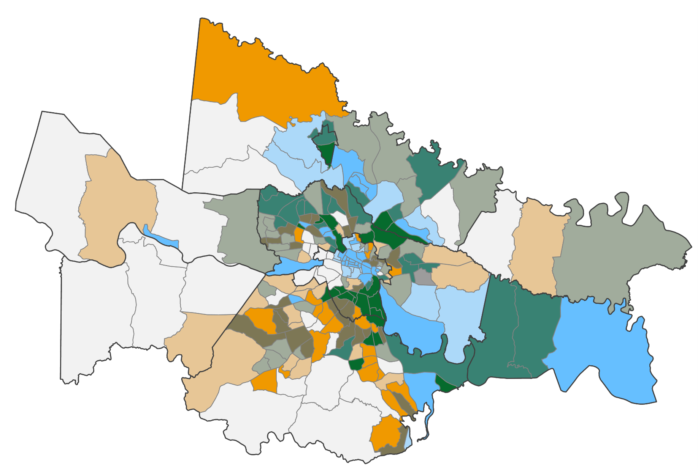
Flood Risk and Household Characteristics Bivariate Map
N
Flood Risk
HC Vulnerability
High
Low
Low
High
0
20 km
Notes:
Trinity
This theme highlights the following variables:
Individuals ages 65 & Older
Individuals ages 17 & Younger
Individuals with a Disability
Single-Parent Households
English Language Proficiency
Some standout areas with combined high flood risk and housing characteristics vulnerability include, Richmond and the metro area, Hanovertown, East Highland Park, Ashland and Charles City County

Slide 23
Conclusions
Several census tracts with a high flood risk index also ranked high in the social vulnerability index.
Census tracts in urban areas tended to have both higher flood risk and higher social vulnerability.
GPM IMERG data can be used to examine the impact of previous storms and validate pluvial flood models.
Notes:
Brodie
Using the bivariate map, we identified the most vulnerable census tracts
Majority of census tracts that are high SVI and high FRI are located in Richmond Proper, and specifically Southside Richmond.
We found that although GPM IMERG data is not best for predicting future storms or worst case scenarios, it is good for examining the impact of previous storms

Slide 24
Errors and Uncertainties
Models are very simplistic and do not account for runoff processes or antecedent moisture conditions.
Models do not account for existing drainage infrastructure.
Soil classification is not standardized across counties.
IMERG data consistently underestimates rainfall depths based on comparisons with rain gauge data.
Census-tract level results have multiple layers of aggregation and summary.
Analysis of 1m bluespots was limited to Richmond proper because of data storage constraints.
Notes:
Kaylee
Most of the error and uncertainty in this work comes from the InVEST and Arc-Malstrom models, both of which are very simple. Which is good for a short project but means they are not very accurate. Neither model incorporates any kind of runoff processes, which significantly impacts flood depth. We created a rough approximation of runoff by combining the models in the bluespot depth analysis; however, this still does not account for existing drainage infrastructure. So our model might see a parking lot that’s 6 feet below the surrounding area, which is all impervious surface that doesn’t absorb any precipitation, and it predicts a massive flood, but in reality there’s a drain in the middle that moves water very effectively so there’s never actually flooding there.
In addition, although InVEST estimates runoff retention, the actual retention capacity of a given area depends significantly on the antecedent moisture condition—or how much water was in the soil before it started raining—and InVEST does not have any way to account for this. We used values that tried to hit a middle ground, but this means that the model sometimes underestimated and sometimes overestimated actual runoff.
Another major problem with the InVEST model specifically is that it relies on soil hydrologic group data to help predict runoff retention capacity, and soil hydrologic group data is not standardized between counties. This is very obvious when looking at Charles City County specifically on our maps—it’s always highlighted as having high flood risk—but this is mainly because soils in Charles City county are more likely to be classified as soils with poor infiltration capacity, when those same soils would be classified as having better infiltration capacity in a different county. So comparisons of relative flood risk between counties are likely not accurate. Comparing areas within a single county is better.
While IMERG is great for analyzing past storm events, we noticed that it severely underestimates rainfall depths when compared with data from rain gauges on the ground. This may be due to how the data is collected (a measurement of intensity every half hour, which may miss short peak events), but this may result in predicting smaller flood volumes than would actually be the case.
Producing estimates of flood risk at the census-tract level required several steps of aggregating and summarizing the results, each of which lowers the precision of the estimate and increases error. They are still useful for comparison, but it’s important to also look at the higher-resolution results with less processing.
Finally, while an analysis of bluespots at the 1-meter resolution for the entire study area would be helpful, 1-meter DEMs are massive files and require a lot of storage space and processing time, so we were limited to a smaller area.

Slide 25
Future Work
Incorporate standardized soil hydrologic group data from PlanRVA.
Ground truth- observe actual flood depths to assess the accuracy of the models.
Analyze other areas outside of Richmond at the 1-meter level.
Partners
Visit high-risk bluespots to determine whether adequate drainage is in place.
Assist with ground truthing.
Share flood risk information from model results.
Promote green infrastructure work in identified areas of need.
Notes:
Maggie
-Fixing errors and uncertainties
-Ground truthing our models to check them for accuracy
-Potentially incorporate some field data (from ground truthing), flood reports to improve models
-Impact of work:
-Push for green infrastructure, other methods of drainage, in identified high-risk BS areas
-Addition of pluvial flooding to risk maps (important data for decision makers, homeowners, businesses, etc)

Slide 26
Partners:
NASA DEVELOP:
PlanRVA
Nicole Keller, Resilience Planner
Sarah Stewart, Planning Manager
Groundwork RVA
Rosa Roncales, Youth Program Manager
Olivia Landry, Fellow
Cecil Byles, Project Coordination Senior Fellow
Dr. Kenton Ross, Science Advisor
Lauren Childs-Gleason, Science Advisor
Notes:
Trinity
We’d like to thank everyone that provided us resources and feedback on our project, as well as the communities of PlanRVA and Groundwork RVA welcoming us on our trip to Richmond and showing us all the work they have done in their communities.
Thank you to everyone who helped to contribute to this project, we truly appreciate your time, resources, effort, and commitment.

