Slide 1
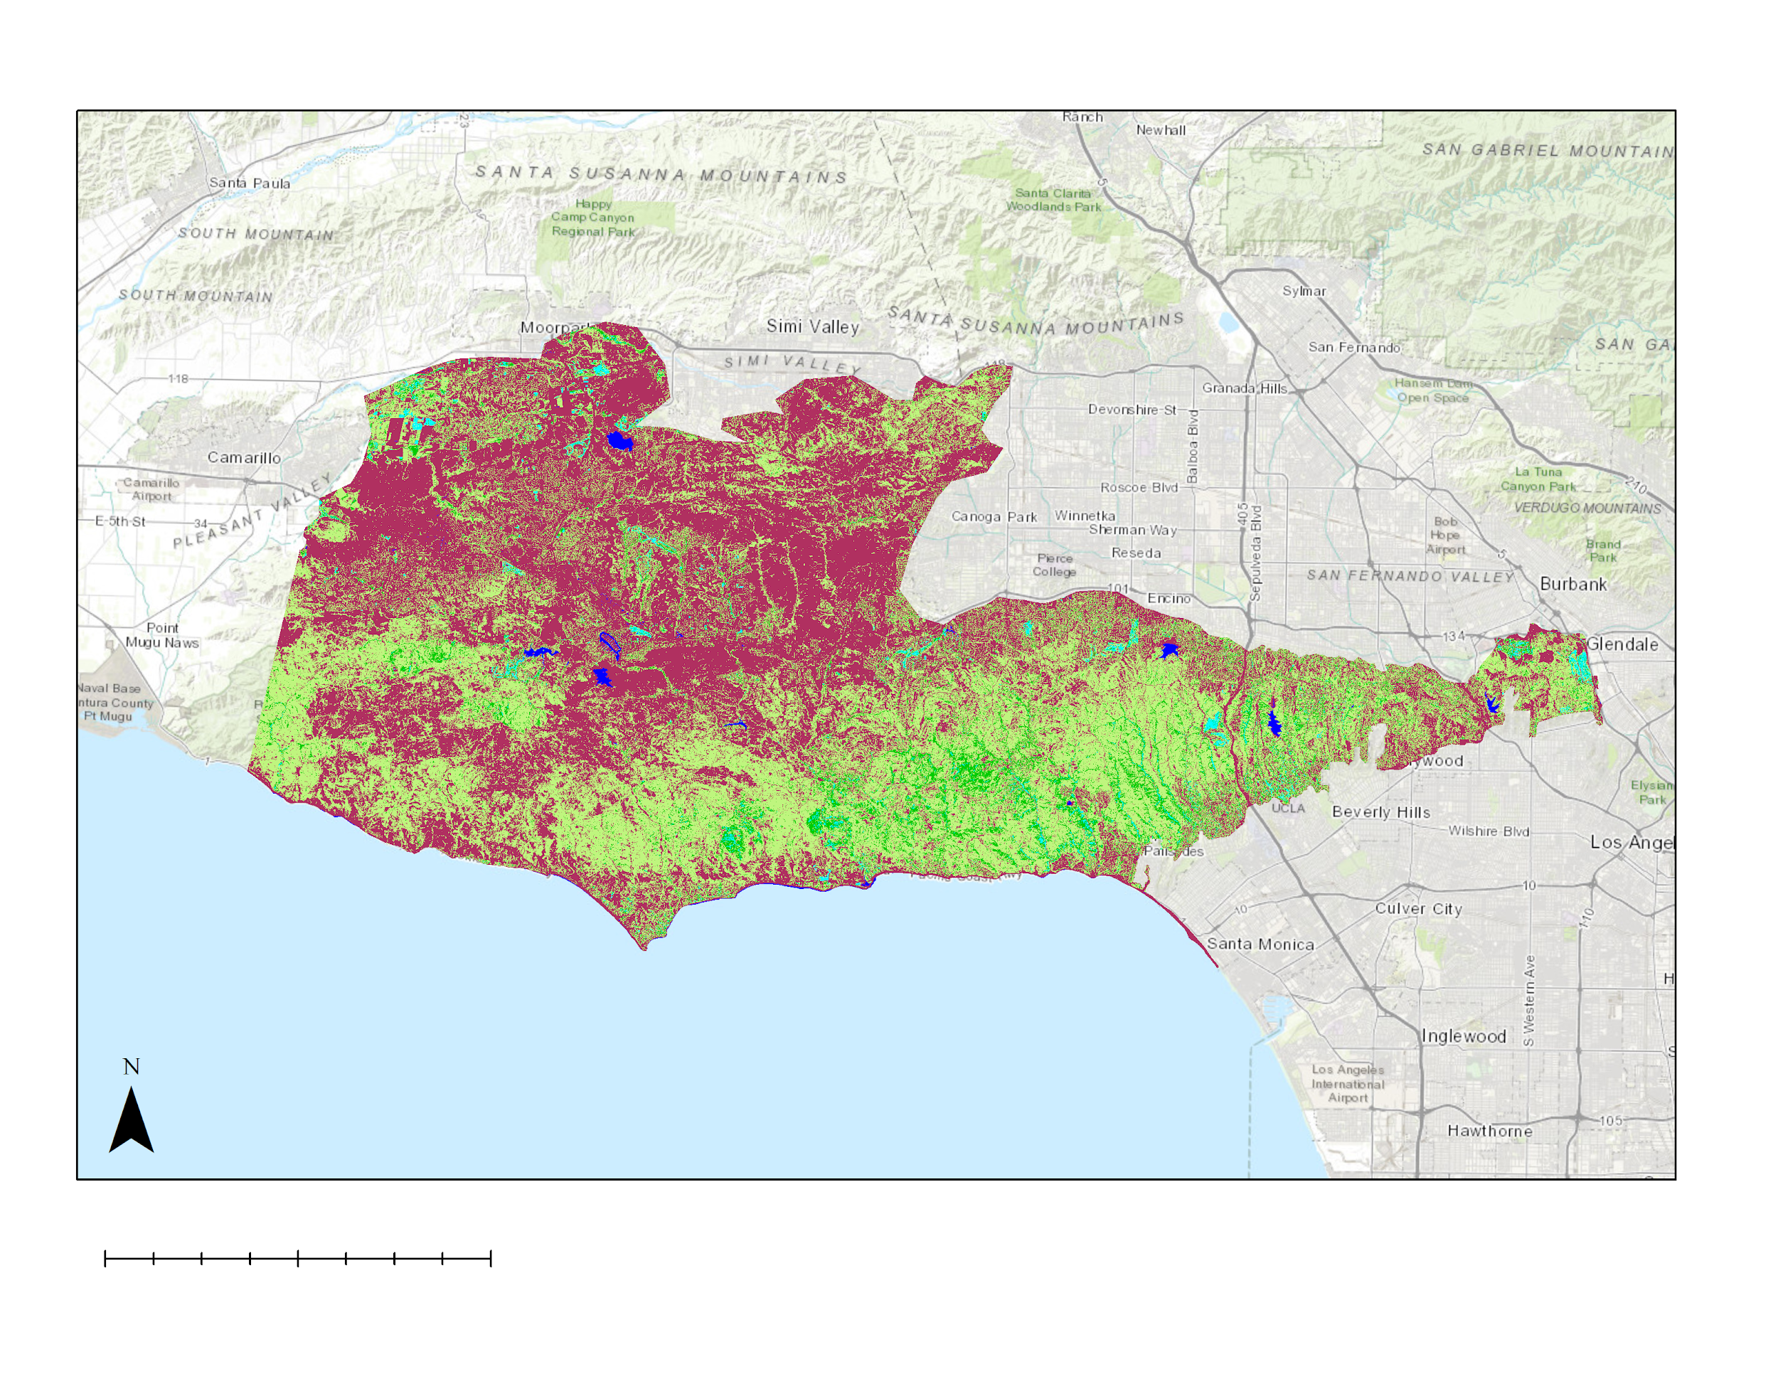
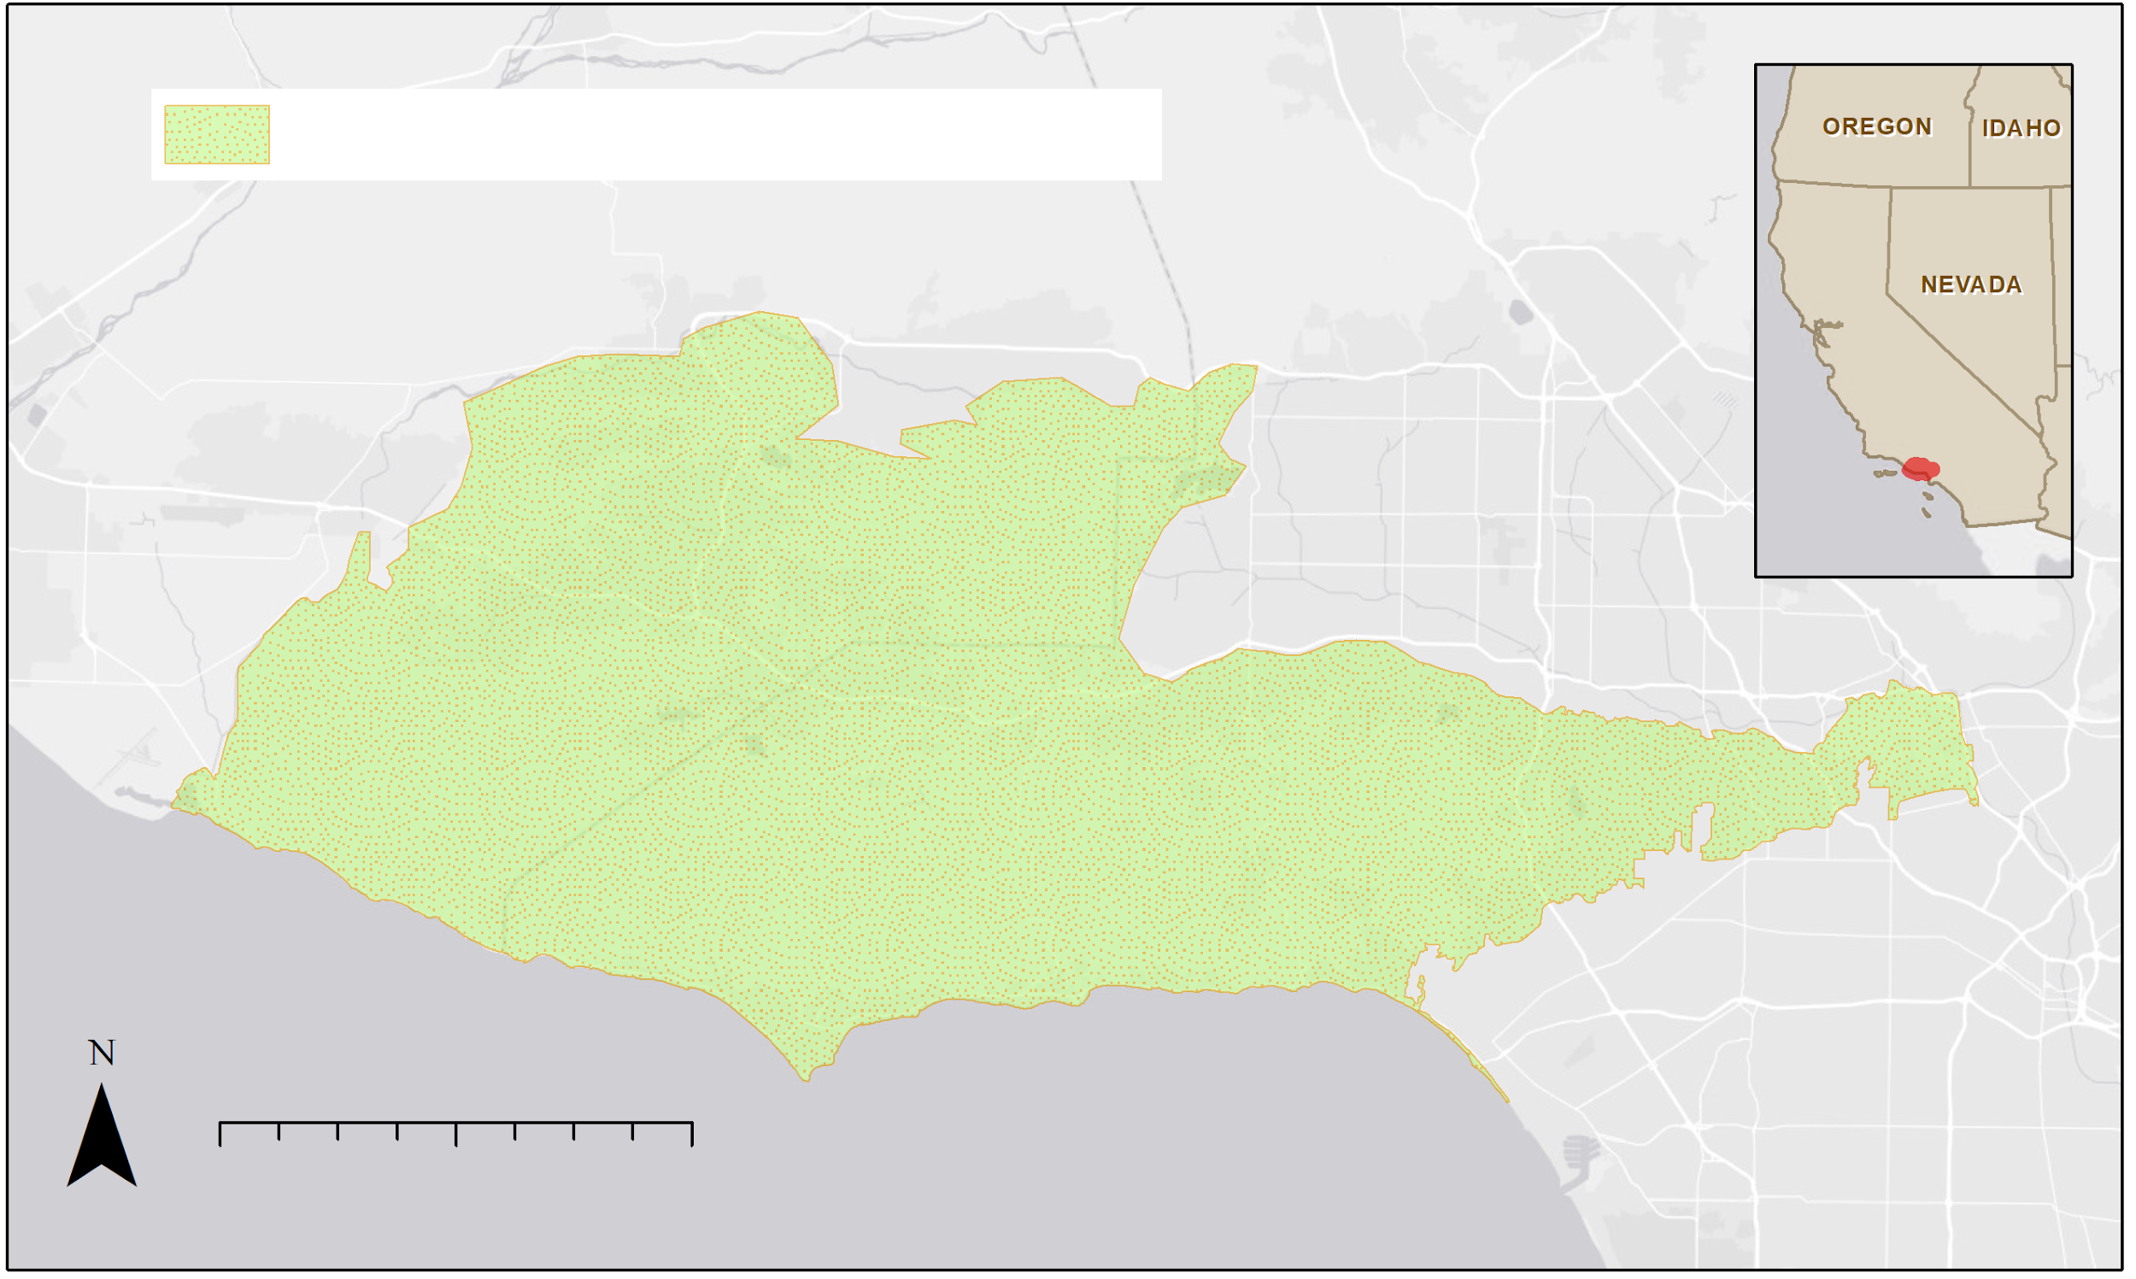
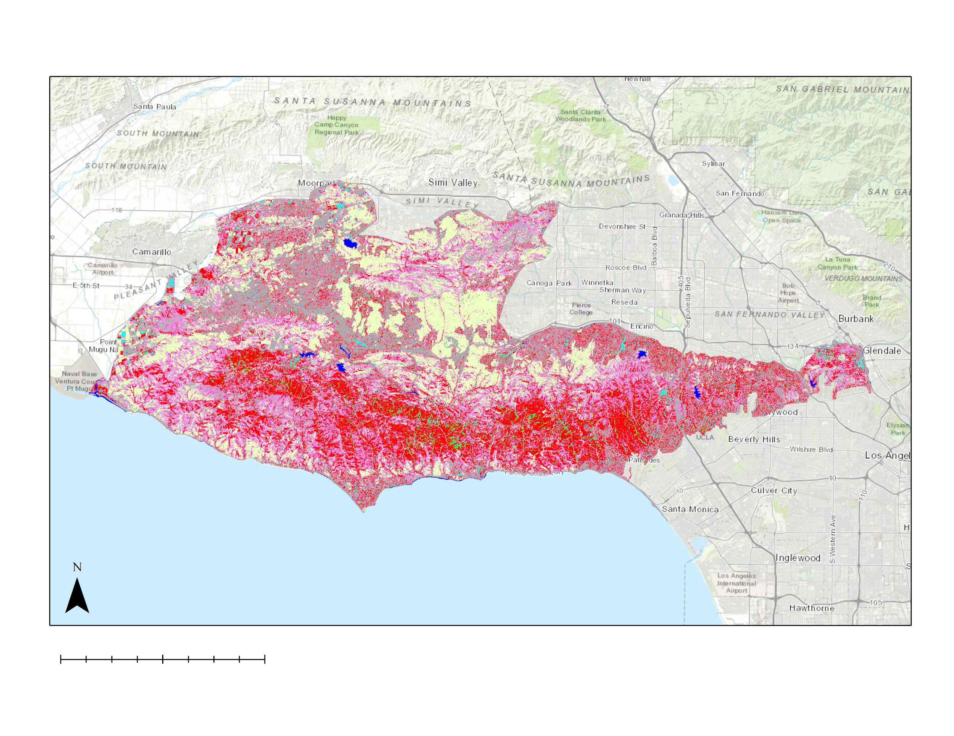
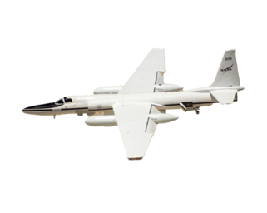
Analyzing Recent Wildfire Impacts to Assist the Resource Conservation District of the Santa Monica Mountains in Identifying Tree Species to Replant
Abstract
Objectives
The Woolsey Fire began on November 8, 2018, and lasted for almost two weeks, during which it burned almost 100,000 acres of valuable landscape and habitat, including a vast area of woodland. The persistence of key woodland species provides aesthetic, monetary, and ecological value to the landscape through carbon sequestration, air temperature moderation, and erosion mitigation, among other ecosystem services. This study investigated the impact of the Woolsey Fire on native woodland species distributions and identified areas suitable for restoration within the Santa Monica Mountains National Recreation Area. The team partnered with the Resource Conservation District of the Santa Monica Mountains; National Park Service, Santa Monica Mountains National Recreation Area; California Department of Parks and Recreation, Los Angeles County Division; County of Los Angeles Fire Department, Prevention Services Bureau, Forestry Division; County of Los Angeles Department of Regional Planning; and the University of Montana. The Earth observations used include data from Landsat 8 Operational Land Imager, NASA ER-2 Jet Airborne Visible InfraRed Imaging Spectrometer, Shuttle Radar Topography Mission, and RapidEye. The team produced maps of burn severity from the Woolsey Fire, its impact on plant species distributions, and habitat suitability projections for 2050 and 2099 to assist partners in prioritizing areas for restoration. A plant community classification was successfully created using Multiple Endmember Spectral Mixture Analysis (MESMA). Overall accuracy was assessed at 90.54% by comparing the classification to validation pixels derived from ground truth information provided by our partners.
Determine where and what species were still alive following the recent fires and drought
Map topographical and environmental conditions such as surface temperature and precipitation in 2050 and 2099
Identify sites with suitable conditions to support native woodlands in the next 50 to 100 years using MaxEnt
Results
Vegetation Health of Santa Monica Mountains Recreation Area 06/30/2019
Study Area
Santa Monica Mountains National Recreation Area
Oregon
Idaho
Thriving Vegetation
Substrate
Water
Nevada
0
10
20 km
Healthy Vegetation
Vegetation Presence
Vegetation Community Map of Santa Monica Mountains Recreation Area 06/25/2018
0 5 10 20 km
Santa Monica Mountains Ecological Forecasting III
Methodology
Pre-Processing
Species Mapping
Habitat Suitability
End Products
AVIRIS
MESMA
Tree Species and Burn Severity Maps
Shade Normalization
Accuracy Assessment
Coast Live Oak
Annual Grass
RapidEye
Identify Living Vegetation
Existing vegetation map
Species Occurrence Data
Existing Conditions Map
0
10
20 km
Riparian
Chaparral
Predicted Suitable Woodlands Planting Sites Map
Substrate/Urban
Coastal Sage Scrub
Landsat 8 OLI
Historic Climate Data
Maxent
Conclusions
Water
Projected Climate Data
Species Distribution Map
Map of Annual Climate Variables
Riparian areas have significantly decreased after prolonged drought.
Annual grass and chaparral experienced an increase in land cover post drought.
Oak woodlands and riparian areas were heavily damaged from the Woolsey Fire.
NASA NEX DCP30
Project Partners
Earth Observations
Resource Conservation District of the Santa Monica Mountains
National Park Service, Santa Monica Mountains National Recreation Area
California Department of Parks and Recreation, Los Angeles Division
County of Los Angeles Fire Department, Prevention Services Bureau, Forestry Division
County of Los Angeles Department of Regional Planning
University of Montana, Department of Geography
Landsat 8 OLI
ER-2 Jet AVIRIS
SRTM
Acknowledgements
Team Members
Dr. Natasha Stavros (NASA Jet Propulsion Laboratory, California Institute of Technology)
Dr. Latha Baskaran (NASA Jet Propulsion Laboratory, California Institute of Technology)
Erika Higa (NASA DEVELOP, NASA Jet Propulsion Laboratory)
Rosi Dagit (Resource Conservation District of the Santa Monica Mountains)
Natalie Queally (NASA DEVELOP, NASA Jet Propulsion Laboratory)
Kelsey Foster (NASA DEVELOP, NASA Jet Propulsion Laboratory)
Emil Chang (NASA DEVELOP, NASA Jet Propulsion Laboratory)
Ariana Nickmeyer (NASA DEVELOP, NASA Jet Propulsion Laboratory)
Nick Rousseau (NASA DEVELOP, NASA Jet Propulsion Laboratory)
Melissa Ferriter
Project Lead
Laura Jessup
Roger Ly
Joshua Spector
California – JPL|Summer 2019

