Slide 1
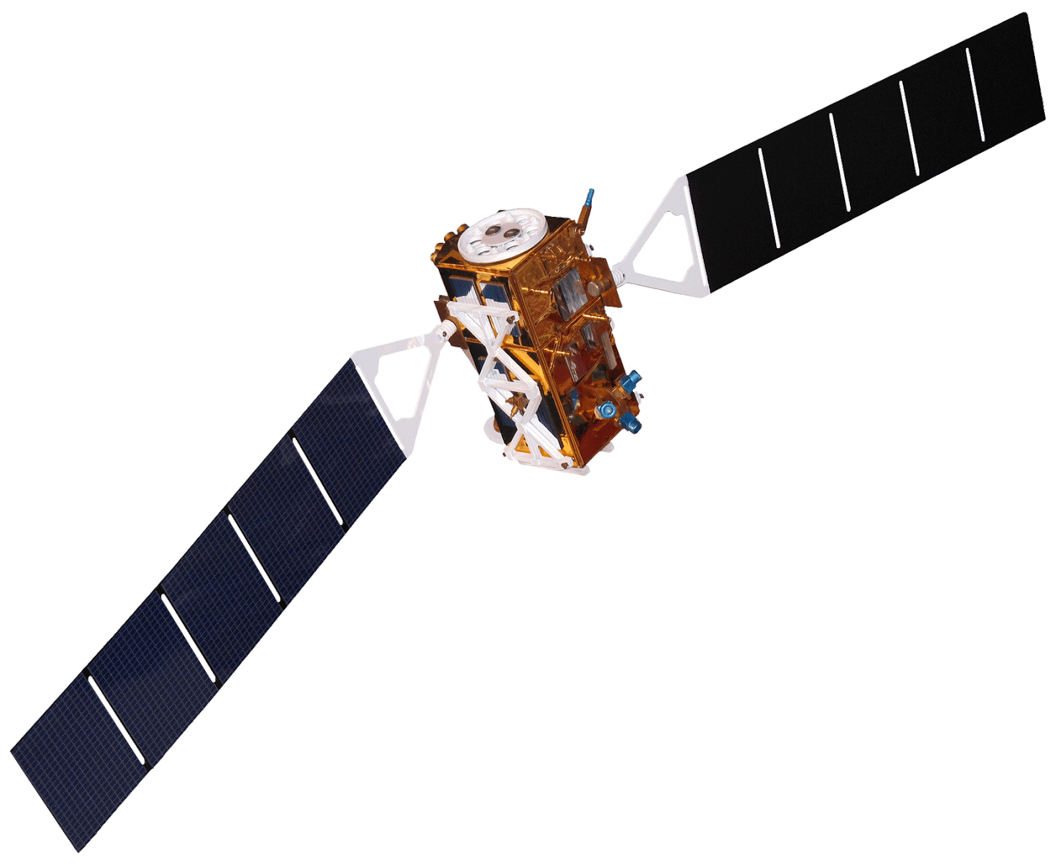
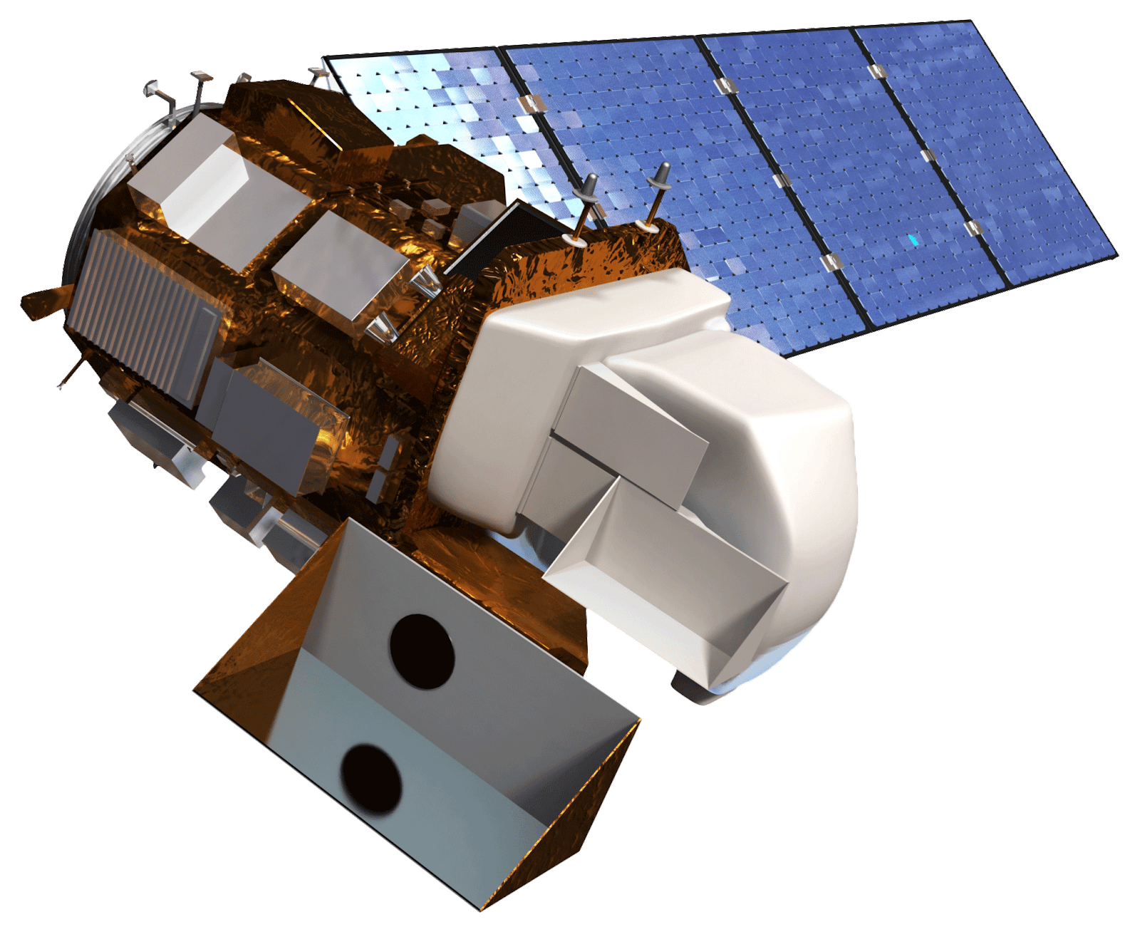
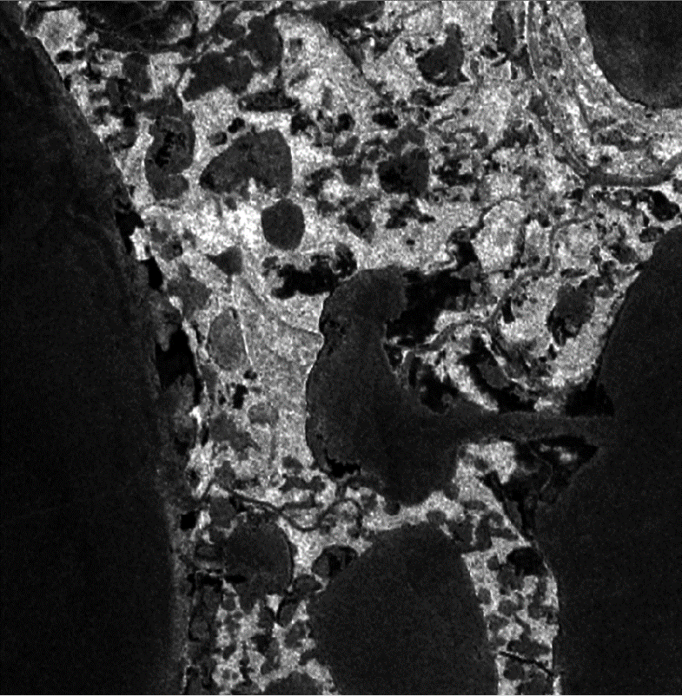
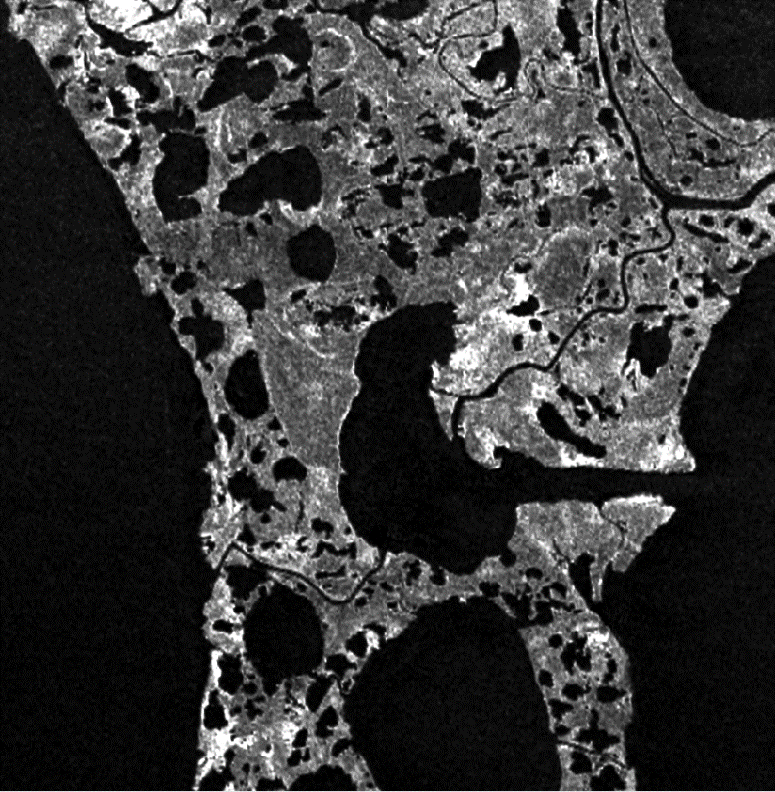
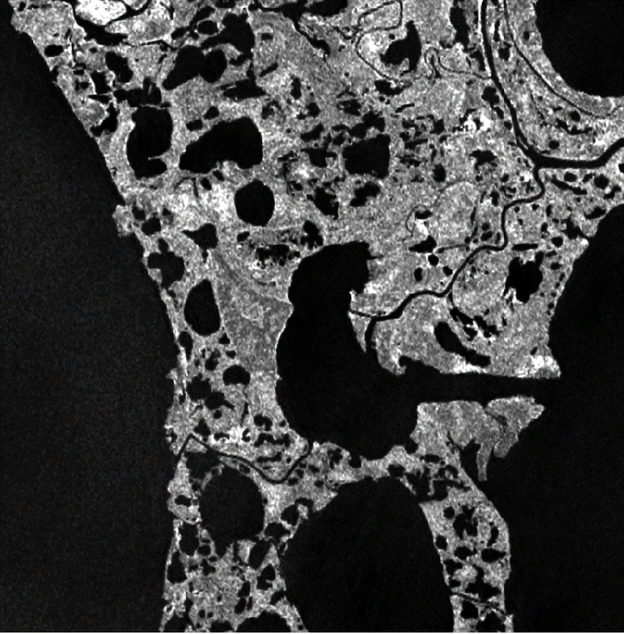
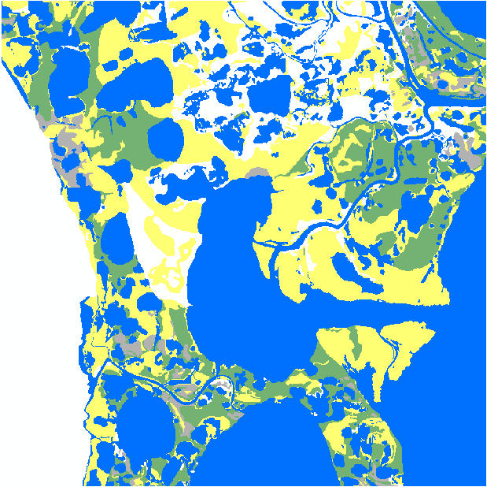
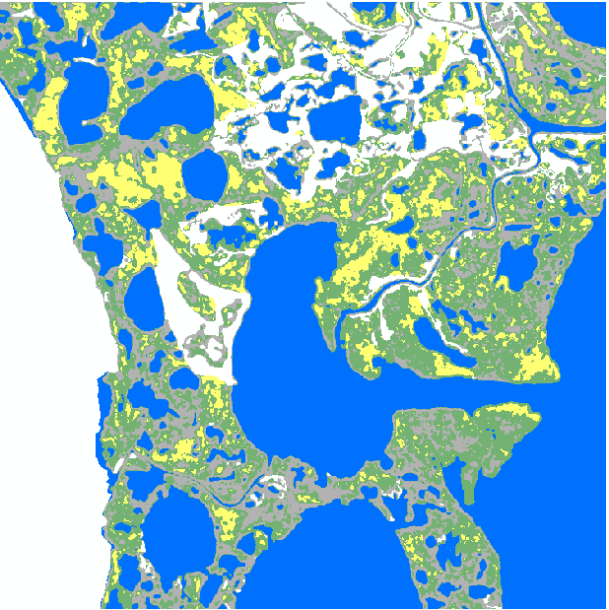
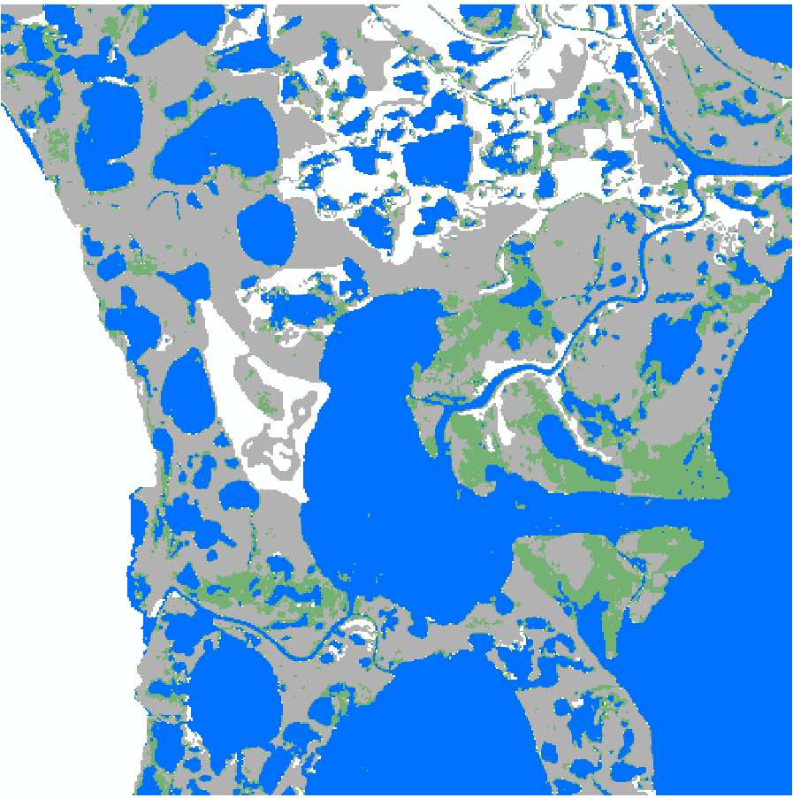
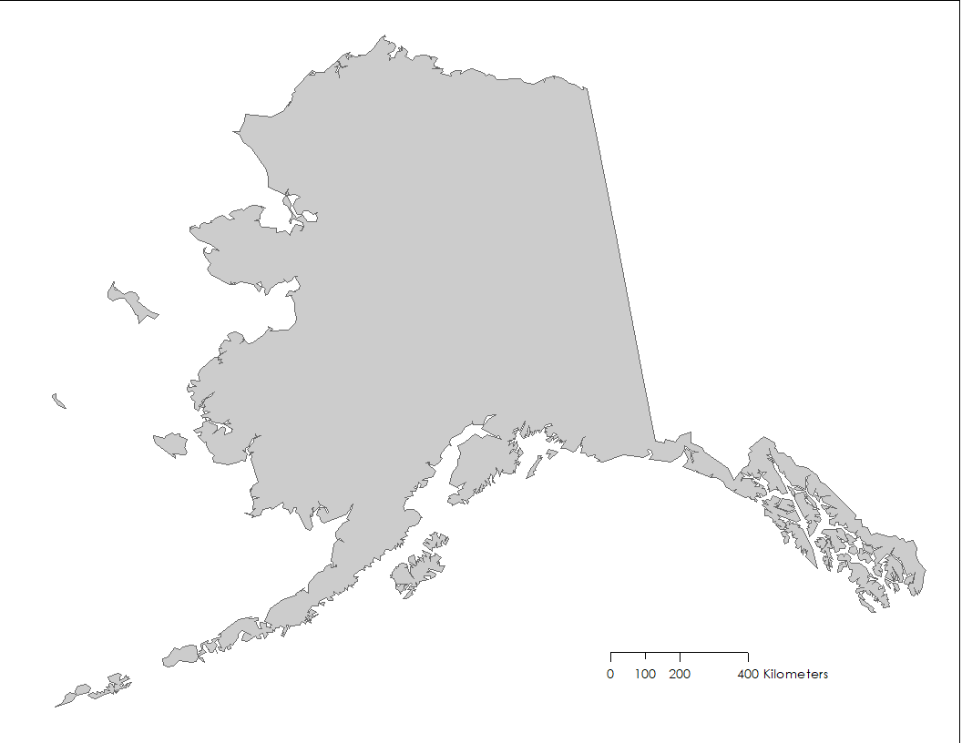
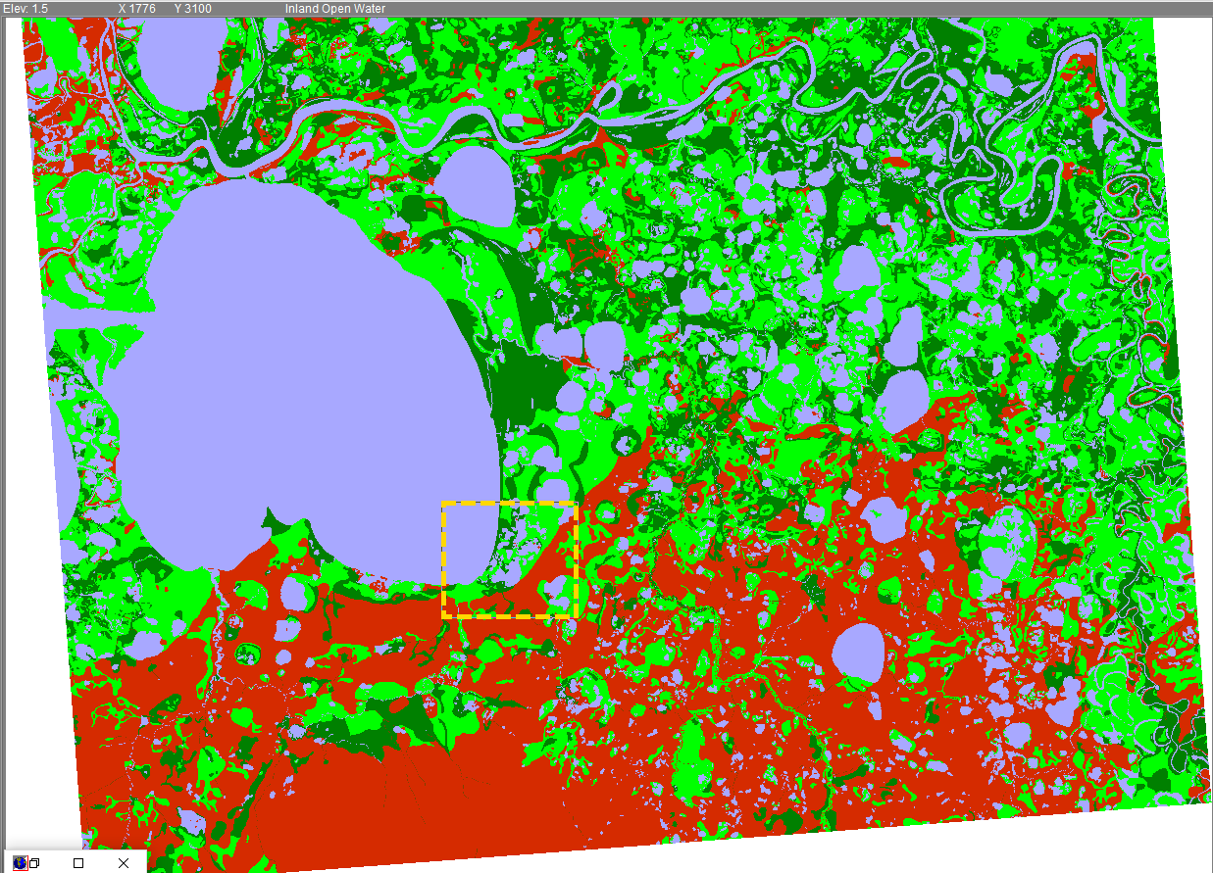
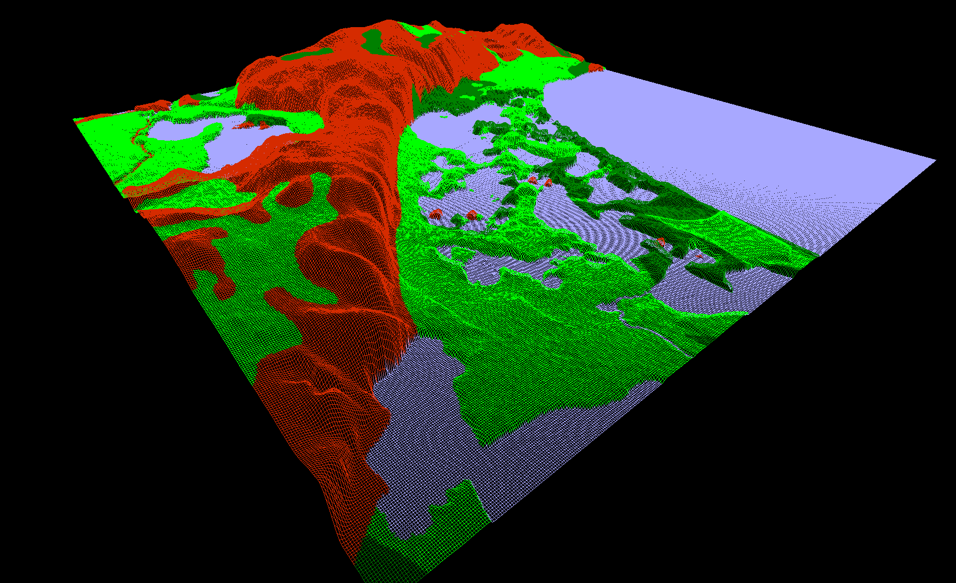
Semi-Automated Mapping of Alaskan Wetland Inundation by Integrating Synthetic Aperture Radar and Optical Satellite Imagery
Abstract
Objectives
Alaska’s wetlands make up over a third of the state’s land cover and provide numerous ecosystem services, such as water filtration and storage, nutrient retention, and habitat to a diverse range of plant and animal species. Temporal variations in wetland inundation impact these ecosystem services, thus monitoring patterns and change is crucial for proper wetland management and future sustainability. The spring 2019 NASA DEVELOP Alaska Ecological Forecasting II team, in partnership with the Alaska Satellite Facility (ASF) and US Fish and Wildlife National Wetlands Inventory (USFWS NWI), built on the existing SAR Wetland Extent Exploration Tool (SWEET) created by the previous Alaska Ecological Forecasting team. The original features of SWEET included the creation of a land cover classification map showing wetland inundation using C-Band Synthetic Aperture Radar (C-SAR). This term, the tool additionally classified water regime based on inundation detected from a collection of multi-temporal C-SAR data. This new feature allowed for the analysis of inundation frequency, an attribute that gave important information on the behavior of wetlands throughout the year. The inundation tool was edited in a Jupyter Notebook and used radar data from Sentinel-1 C-SAR to create its inundation extent products. A new validation method that incorporated polygon data from the NWI was used to assess the accuracy of the inundation products created by the tool, in addition to validation using Landsat 8 Operational Land Imager imagery. With the addition of wetland frequency used in the assessment of SWEET products, end users were better equipped to analyze wetland extent by incorporating Alaska’s highly seasonal climate.
Build on the wetland inundation tool (SWEET) created in the project’s previous term to incorporate a more automated approach to wetland mapping using C-SAR data
Incorporate an NWI water regime classification feature into SWEET
Create inundation extent products as a resource for the NWI wetland map production of Alaska
Validate the accuracy of inundation extent products using published NWI data and Landsat 8 imagery
Integrate SWEET with the ASF’s Hybrid Pluggable Processing Pipeline (HyP3)
Earth Observations
Sentinel-1 C-SAR
Landsat 8 OLI
Results
Sentinel-1 C-SAR Imagery (VV Polarization) for Selawik Summer 2017
Methodology
May 17, 2017
July 16, 2017
September 14, 2017
Classification
Classification
Output
Processing
Output
Processing
Calibration
Calibration
Validation
Sentinel-1 C-SAR VV, VH
Validation
Sentinel-1 C-SAR VV, VH
VV / VH Ratio
Verify Image
Co-registration
VV / VH Ratio
Verify Image
Co-registration
VV, VH, VV/VH Thresholds
Avg. Region Brightness
VV, VH, VV/VH Thresholds
Inundated Vegetation
Subset
Avg. Region Brightness
Open
Water
Subset
Classification Per Date
0 2.5 5 km
Calibrate
Classification Per Date
Inundation Classifications Selawik Summer 2017
Calibrate
Wetland Inundation Map
Multi-Temp Classification
Wetland Inundation Map
Reclassified NWI
Sentinel-1 C-SAR
Landsat DSWE
Multi-Temp Classification
Confusion Matrix
Temporal & Spatial Avg.
Confusion Matrix
Temporal & Spatial Avg.
Refined Classification
Refined Classification
Alaska Ecological Forecasting II
Study Area
Area 1002
NWI Active Mapping Site
Permanent Open Water
Seasonal Inundation
0 1.25 2.5 5 km
Not Inundated
No Data
Selawik
NWI Active Mapping Site
Bear Lake
Algorithm Testing Site
Permanent Inundation
Sea Level Affecting Marshes Model (SLAMM) 2020 Forecast of Selawik
Not Inundated
Open Water
Inundated Vegetation
0 100 200 400 km
0 2.5 5 10 km
Inundated
Vegetation (Marsh)
Conclusions
The C-SAR threshold process effectively detected inundation, and VV, VH, and VV/VH ratio thresholds varied between sites.
Comparing a season's worth of SAR data from 2017, maximum inundation extent was found to be less than NWI estimates of wetland extent from the 1970s and 80s and more sensitive to inundation than Landsat DSWE.
Sentinel-1 C-SAR data are most accurate in delineating inundation in open water areas and in herbaceous and shrub-filled wetlands.
Project Partners
US Fish and Wildlife Service, National Wetlands Inventory
Alaska Satellite Facility
Team Members
Acknowledgements
Alice Lin | Fall 2018 DEVELOP Alaska Eco I Team Member
Briant Fabela | Fall 2018 DEVELOP Alaska Eco I Team Member
Erika Higa | Center Lead at the DEVELOP California – JPL Node
Bruce Chapman | Science Advisor at the DEVELOP California – JPL Node
Megan Lang | Chief Scientist at the US Fish and Wildlife Service
Jeremy Nicoll | Deputy Director at the Alaska Satellite Facility
Franz Meyer | Chief Scientist at the Alaska Satellite Facility
This material contains modified Copernicus Sentinel data (2017), processed by ESA.
Alana Higgins
Project Lead
Roger Ly
Annemarie Peacock
Adam Vaccaro
California – JPL | Spring 2019

