Slide 1
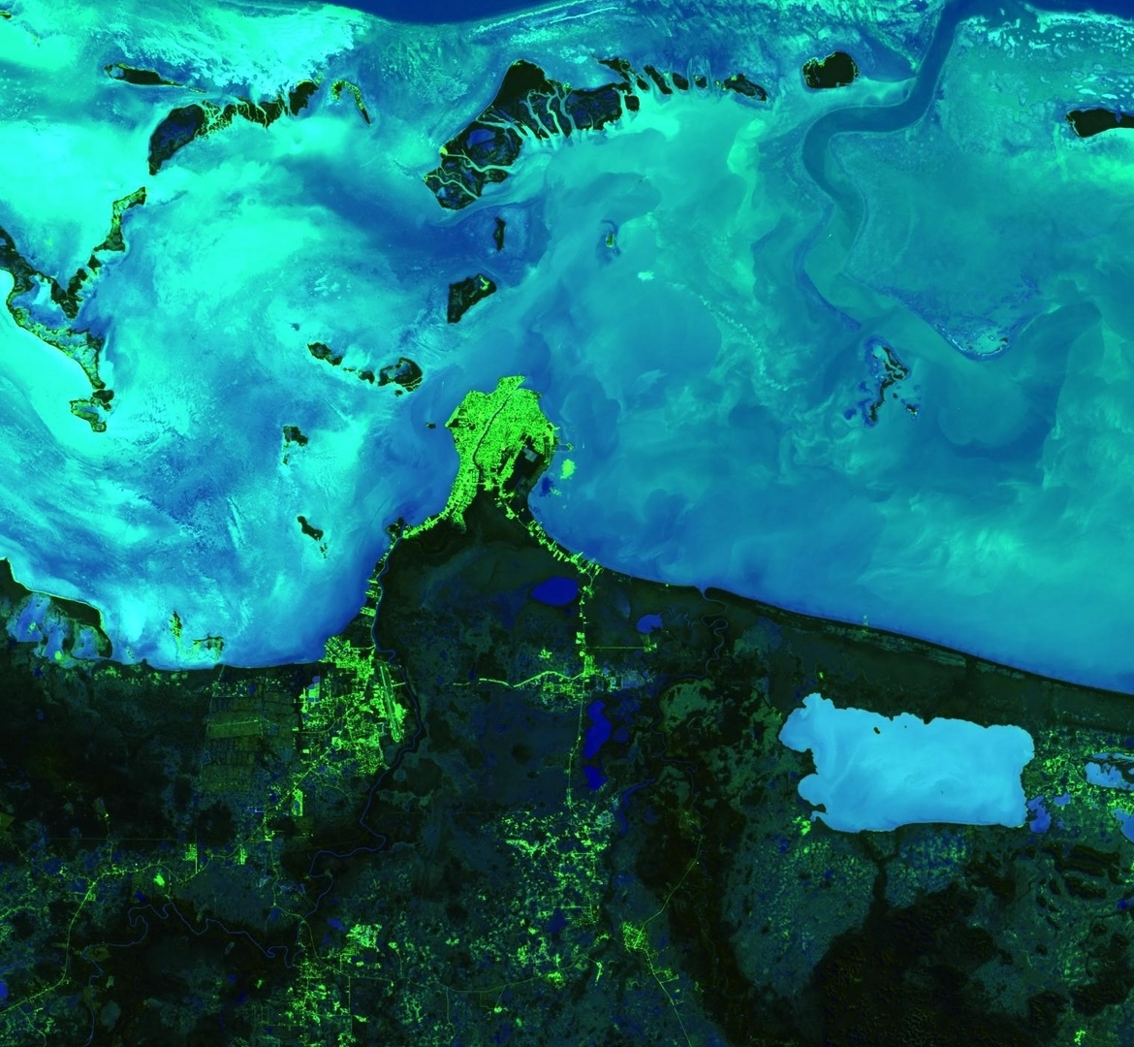
BELIZE & HONDURAS WATER RESOURCES II
Developing a Google Earth Engine Dashboard for Assessing Coastal Water Quality in the Belize and Honduras Barrier Reefs to Identify Adequate Waste Control and Inform Coastal Resource Monitoring and Management
Hayley Pippin
Arbyn Olarte
Roxana Pilot
Vanessa Valenti
California – JPL | Fall 2019
Notes:
We are the Belize & Honduras Water Resources II Team, and we, in conjunction with a previous term, developed a tool to monitor water quality along the coastal reef systems of Belize and Honduras.
Image Caption: Colored Dissolved Organic Matter (CDOM) derived using Landsat 8 OLI data on January 28th, 2019 off the coast of Belize City. Darker shades of blue indicate higher levels of CDOM, while lighter blue shades show lower levels of CDOM in the coastal and inland waters. Very high levels of CDOM can inhibit photosynthesis; thus, the visualization of CDOM allows coastal management to identify regions where reef health and water quality are at risk.
Map Source: NASA DEVELOP JPL Belize & Honduras Water Resources II Team
Base Layer Source: Google Earth Engine

Slide 2
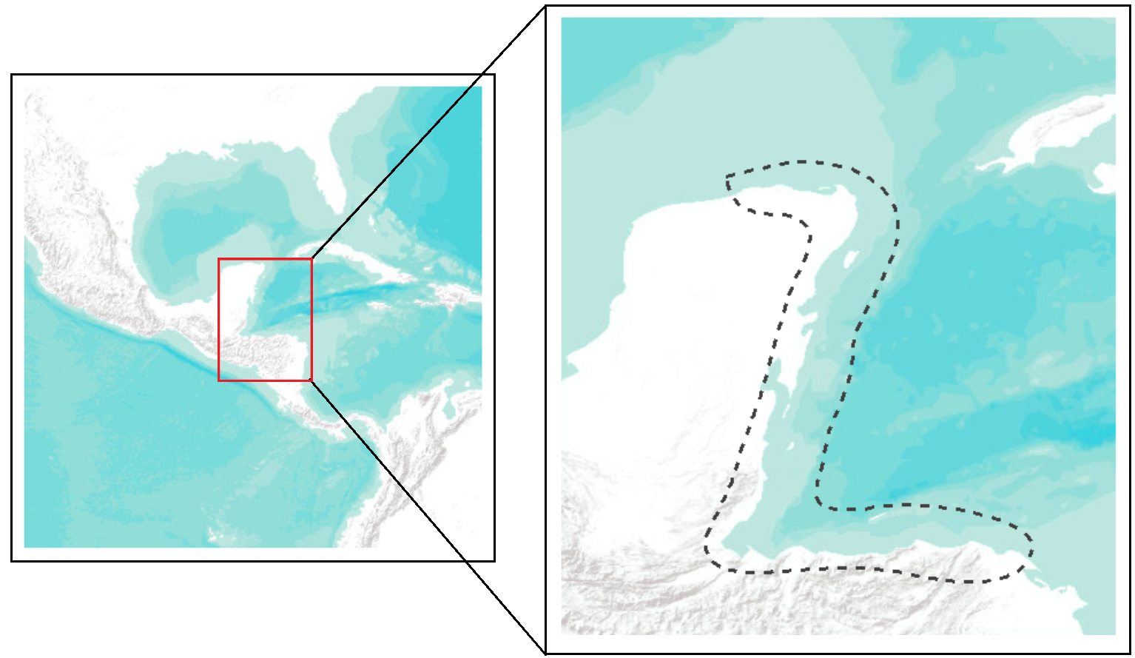
Mesoamerican Barrier Reef System
Belize and Honduras Barrier Reefs
Central America
Belize
0 410 820 1,230 1,640 mi
Honduras
0 35 70 140 210 280 mi
Notes:
The Mesoamerican Barrier Reef is the second largest reef system in the world, housed along the Caribbean coasts of four countries: Mexico, Guatemala, Belize, and Honduras. Parts of this biodiverse reef are designated as UNESCO World Heritage Sites, protecting at least six endangered and five critically endangered coral species. The reef provides support to coastal communities through its economic value. Thousands of tourists visit the Belize and Honduras Barrier Reef Systems each year, spending an average of $999 per individual each visit. The revenue stream accounts for more than 25% of both the Belizean and Honduran economies and must be preserved to sustain both countries’ economic stability by maintaining and improving the health of this reef system.
Map Source: NASA DEVELOP JPL Belize & Honduras Water Resources II Team
Base Layer Source: ESRI “Terrain” Layer Package, ArcMap

Slide 3
Reef Health
“Some measure of reef-building coral abundance.”
Smith, et. al. (2016)
Percent coral coverage
Colony number
Size-frequency distribution
Relative abundance
Species diversity
Coral mortality
Disease
Bleaching
Percent macroalgae
Notes:
What exactly is reef health? One of the problems with protecting coral reefs across the globe is that there is no universal definition for “reef health.” Smith, et. al., defines reef health as “some measure of reef-building coral abundance,” which generally means that sites with greater coral cover are ‘healthier.’ There are, however, other markers that scientists use to measure the health of a reef. Increase species diversity and relative species abundance are thought to denote a healthy reef. Unhealthy reefs, on the other hand, are marked by a decline in coral cover and an increase in coral mortality, disease, and bleaching, which occurs when coral polyps expel the algae that lives inside their tissues. Macroalgae populations also mark unhealthy reefs, as those organisms are thought to proliferate where corals have degraded.
Article source: Smith, J.E., Brainard, R., Carter, A., Grillo, S., Edwards, C., Harris, J., … Sandin, S. (2016). Re-evaluating the health of coral reef communities: baselines and evidence for human impacts across the central Pacific. Proceedings of the Royal Society B [Biological Sciences]. 283:20151985. doi:10.1098/rspb.2015.1985

Slide 4
Reef Health Index
Honduras
Belize
Critical
Poor
Fair
Good
5.0
6%
12%
20%
20%
1.0
28%
Reef Health
29%
Parameters
46%
39%
Coral coverage
Fleshy macroalgae coverage
Herbivorous and commercial fish biomass
81 sites
Reef score: 3.0
94 sites
Reef score: 2.8
Notes:
In 2018, the Healthy Reefs for Healthy People Initiative released a 10-year report evaluating the health of the Mesoamerican Barrier Reef (MAR). It looked at the coral and fleshy macroalgae coverage percentages, as well as the biomass of commercial and herbivorous fish at 319 sites along the MAR System to determine a reef health score between 1 and 5. The good news is that over the past 10 years, the health of the Mesoamerican reef has improved from a “poor” value of 2.3 to a “fair” value of 2.8. Honduras and Belize have the highest and second-highest reef scores, respectively, of the four countries that make up the MAR System. Both of these values, however, still only fall within the “fair” category. Over one-third of Honduras’s reefs and over one-half of Belize’s reefs are in critical or poor condition, and none of the regions in either country can be classified as being in “very good” health.
Data source: Healthy Reefs for Healthy People Initiative, “2018 Mesoamerican Barrier Reef Report Card”

Slide 5
Water Quality and Reef Health
Turbidity: The quality of being cloudy, opaque, or thick with suspended matter
Chlorophyll-a: A chemical used in oxygenic photosynthesis, it contributes heavily to the green color observed in plants
Colored dissolved organic matter: The optically measured component of dissolved organic matter in water
Notes:
Another theory scientists have is that you can evaluate reef health with water quality metrics. Land-based pollution leads to a deposit of excess nutrients into bodies of water, which can result in eutrophication, or the over-enrichment of a body of water with minerals and nutrients, and decreased levels of oxygen. This depletion in water quality can lead to enhanced algal growth on reefs which crowd out corals and harm the ecosystem. You can gauge water quality with turbidity, chlorophyll-a, and colored dissolved organic matter, which are all metrics that can be derived from remote sensing data. The higher the levels of these three measures, the worse the water quality is thought to be. By studying these parameters, we can get an idea of the status of the health of the reefs in Belize and Honduras.

Slide 6
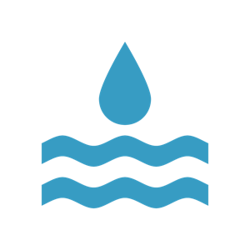
Community Concerns
Support for coastal economies and food production for local and regional communities
Human and natural disturbances endanger marine ecosystems and coastal populations
Lack of government oversight and reef protection due to difficulty in broadscale monitoring
Notes:
As we stated earlier, the preservation of the Mesoamerican Barrier Reef is immensely important for national and local communities alike. Without it, the both Belize and Honduras could risk economic collapse.
Both countries have experienced an uptick in economic development that puts their coastal environments at risk. Nutrient enrichment, excess sedimentation, and increased levels of toxins from land sewage runoffs associated with agriculture and population growth prevent coral growth and increase fish and other marine species mortality.
Unfortunately, there are too few government regulations enforced that protect the reef system. Only 5.6% of the Belize and Honduras Barrier Reefs combined are guarded by replenishment zones. Coupled with the difficulty of in situ monitoring of the entire reef system and unsustainable economic development, this lack of oversight will lead to a rapid and irreparable deterioration of the MAR system. A comprehensive spatial and temporal monitoring system is necessary to defend stakeholder interests and pass policies to control waste and resource managements.

Slide 7
Objectives
ORCAA
Monitoring
Processing
Incorporate a new water quality parameter into the tool
Provide Optical Reef and Coastal Area Assessment (ORCAA) tool to our partners
Facilitate coastal water quality monitoring
Visualize changes in coastal water quality
Improve quality of data used in analysis
Produce output charts and images
Notes:
In order to prevent this decline, we are building upon the work begun at JPL & Ames Research Center by a previous DEVELOP team to create a water quality monitoring tool in Google Earth Engine called ORCAA: the Optical Reef and Coastal Area Assessment tool. This term, we aim to improve and complete ORCAA by applying cloud-masking and atmospheric correction algorithms to improve the quality of data that ORCAA uses to generate outputs, and hopefully obtain more accurate results by doing so. We also incorporated a new parameter into the tool, colored dissolved organic matter (CDOM), which our partners expressed desire for.
We aimed to facilitate water quality monitoring in Belize and Honduras by providing our partners with the ORCAA tool as a web-based app (pending the software release process). We improved the graphical user interface of the tool so that they may evaluate past, present, and future reef health.
Finally, we produced daily time-series charts and composite imagery using the improved data to visualize changes in coastal water quality.

Slide 8
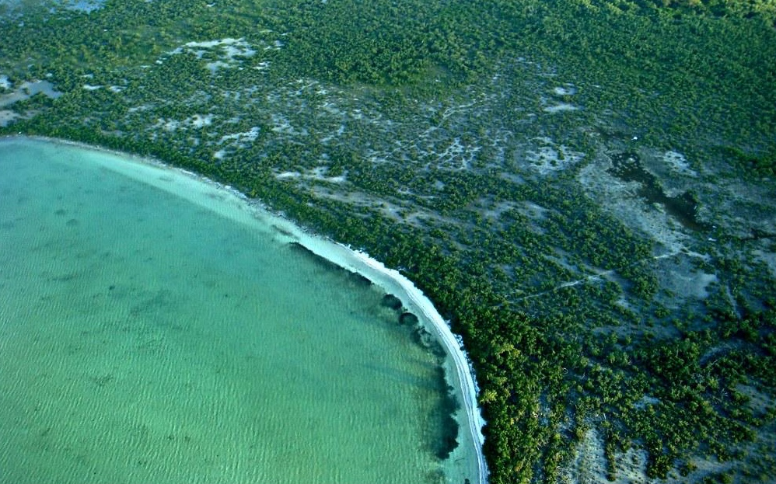
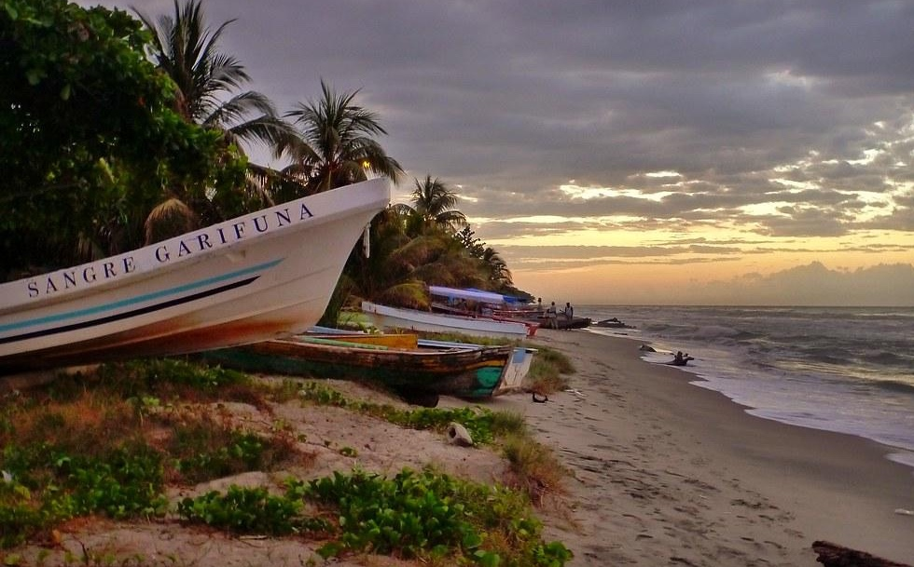
Project Partners
Coastal Zone Management Authority and Institute
Secretaría de Recursos Naturales y Ambiente, Honduras
Comisión Centroamericana de Ambiente y Desarrollo
Wildlife Conservation Society
Image Credits: CameliaTWU; Recovering Vagabond
Notes:
To help achieve these objectives, we partnered with CZMAI, a quasi-governmental agency in Belize that focuses on ecologically-sustainable development through collaborative management practices in the region. Their main focus is to effectively deal with environmental concerns that result from population growth and rapid economic development along the coast.
We also partnered with The Secretaría de Recursos Naturales y Ambiente, Honduras, also known as MiAmbiente Honduras, a government institution responsible for formulating policy and legislation in a manner that promotes regional cooperation. MiAmbiente Honduras has allied with the Comisíon Centroamericana de Ambiente y Desarrollo (CCAD) to promote regional cooperation from government, NGO’s, private sector industries, and the community to ensure conservation, restoration, and ecological management of natural resources.
Finally, we collaborated with the Wildlife Conservation Society to support Belize in their efforts to address water quality and coastal degradation using geospatial data.
Image Credits (from top to bottom): “Belize mangroves” by CameliaTWU. Licensed under CC BY-NC-ND 2.0. https://ccsearch.creativecommons.org/photos/7f052432-4d54-4e05-ab6e-662985d10e92; “Sangre Garifuna” by Recovering Vagabond. Licensed under CC-BY-NC-SA 2.0. https://ccsearch.creativecommons.org/photos/7bc0a959-9452-47b5-81e8-87b3497fabf0

Slide 9
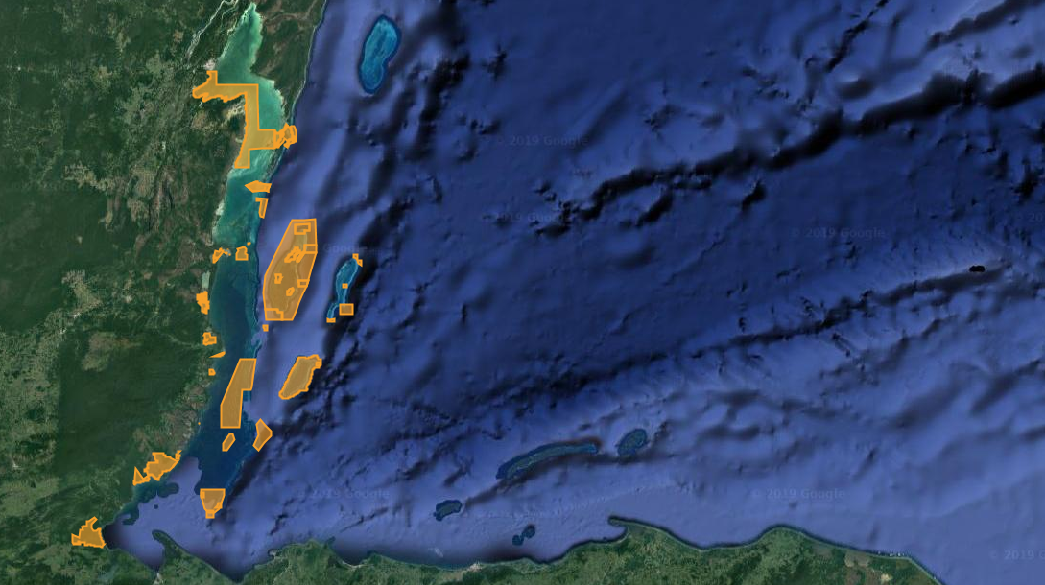
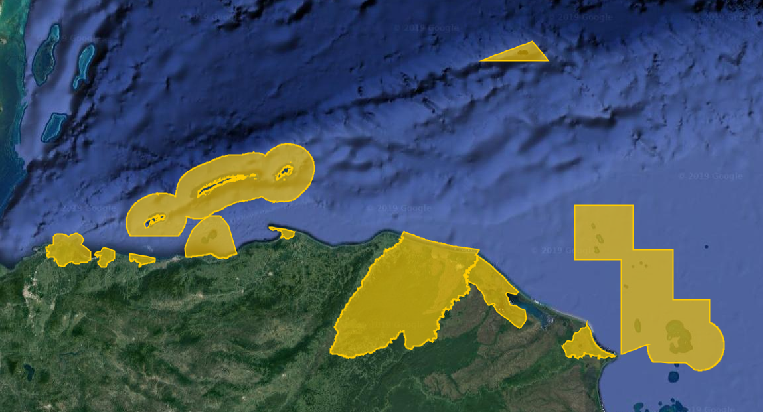
Study Design
30 mi
30 mi
Belize Marine Protected Areas
Belize Marine Protected Areas
Honduras Marine Protected Areas
Study Location
Coastal Belize and the Belize Barrier Reef
Coastal Honduras and the Honduras Barrier Reef
Study Period
January 2013 – November 2019
Will incorporate future dates with more observations
Notes:
The previous DEVELOP team built ORCAA to study changing water quality in the coastal Belize region and the Belize Barrier Reef between January 2013 and July 2019. We expanded the study area to include coastal Honduras and the Honduras Barrier Reef. Furthermore, we expanded the study period to include the most recent NASA Earth observations that are available in Google Earth Engine. ORCAA will continue to include the most recent observations from each of the sensors as they become available in the platform. Per the request of our partners, we focused our analysis on the Marine Protected Areas for each country, but the tool conducts analysis across the entire Belize and Honduras region.
Map Source: NASA DEVELOP JPL Belize & Honduras Water Resources II Team
Base Layer Source: Google Earth Engine
Marine Protected Areas Boundary Source: United Nations Environment World Conservation Monitoring Centre

Slide 10
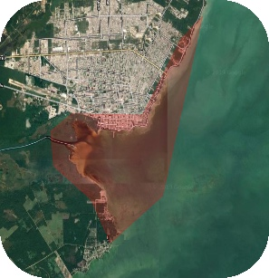
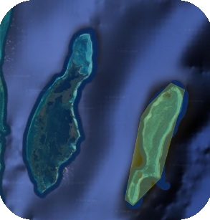
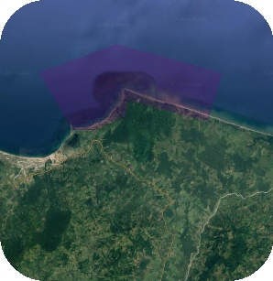
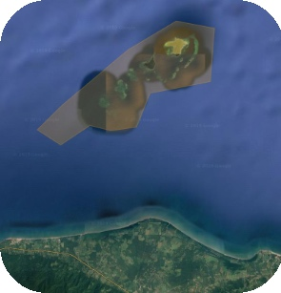
Case Study Areas
2 km
10 km
5 km
2 km
Chetumal Bay
Belize
River mouth
Lighthouse Reef
Belize
Island
Punta Izopo
Honduras
River mouth
Cayos Cochinos
Honduras
Island
Notes:
Since Belize and Honduras house over 75 marine protected areas, we chose to conduct our analysis on four case study sites. We selected two distinct types of areas: an urban river mouth and an isolated island. Further, we selected one of each of these types in both countries so that we could compare the differences between Belize and Honduras. In Belize, we selected the mouth of a river in Chetumal Bay near Chetumal, a city in northern Belize. For the island, we chose Lighthouse Reef, one of the healthiest and well-preserved reefs systems in the Belize Barrier Reef. In Honduras, we selected Punta Izopo as our urban river mouth, an area that has faced rapid agricultural expansion in the last ten years. Finally, for our Honduran island we selected Cayos Cochinos, a UNESCO World Heritage Site off the central coast of Honduras.
Map Source: NASA DEVELOP JPL Belize & Honduras Water Resources II Team
Base Layer Source: Google Earth Engine
Boundary Source: United Nations Environment World Conservation Monitoring Centre

Slide 11
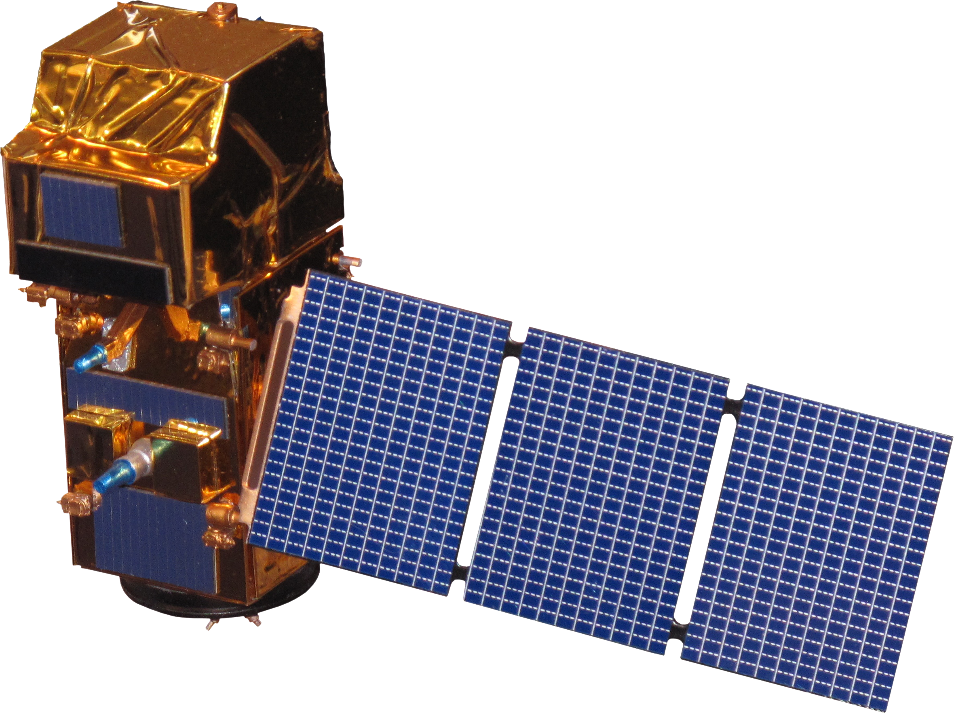
Satellites and Sensors
Landsat 8 Operational Land Imager
Level 2 Surface Reflectance Tier 1
Aqua Moderate Resolution Imaging Spectroradiometer (MODIS)
Level 3 Standard Mapped Image (SMI)
Google
Earth Engine
Sentinel-2 Multispectral Instrument
Level 1C Top Of Atmosphere
Terra MODIS
Level 3 SMI
Image Credit: NASA
Notes:
The team used Level 2 Surface Reflectance Tier 1 data from the Landsat 8 Operational Land Imager, Level 1C Top of Atmosphere imagery, rather than pre-processed Level 2A Surface Reflectance data as the previous team did, from the Sentinel-2 Multispectral Instrument, and Level 3 Standard Mapped Image products from Aqua and Terra Moderate Resolution Imaging Spectroradiometer. The data from these satellites and sensors were obtained and processed in the cloud-computing platform Google Earth Engine.
Image Credit: NASA

Slide 12
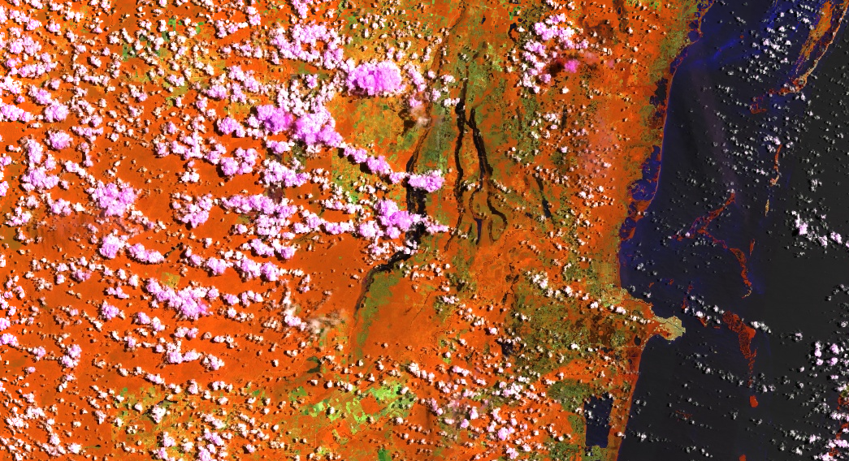
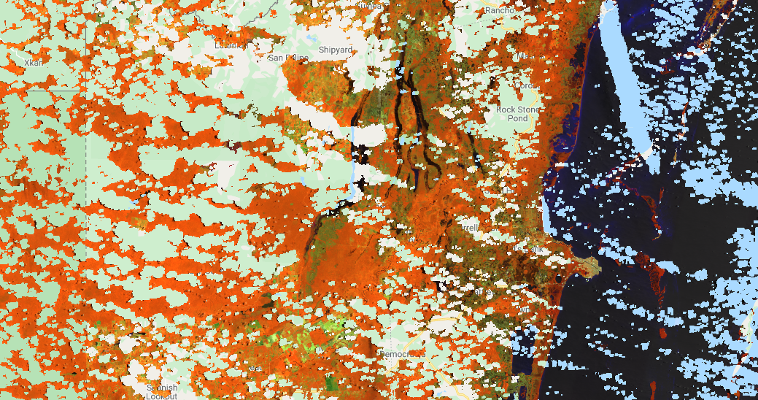
Methodology
Cloud Masking
Sensor
Algorithm
Landsat 8 OLI
Identify image pixel relative cloudiness
Temporally composite images with maximum value function
⇒
⇒
Image Credit: NASA
Notes:
To process this data, we first had to mask the images for clouds and their shadows. We utilized a variation of a Simple Cloud Score algorithm that is built into Google Earth Engine used to remove both cloud cover and shadows from Landsat 8 imagery. The code was developed by Rodrigo E. Principe, and creates cloud-free composites by identify image pixels by relative cloudiness, and then temporally composting the image with a maximum value function and filtering with the “pixel_qa” band. QA information enhances the quality of images by indicating which pixels might be subject to cloud contamination. This code only works for Landsat 8 Tier 1 SR images.
Image Credits (top to bottom): NASA; NASA DEVELOP JPL Belize & Honduras Water Resources II Team, Basemap Google Earth Engine

Slide 13
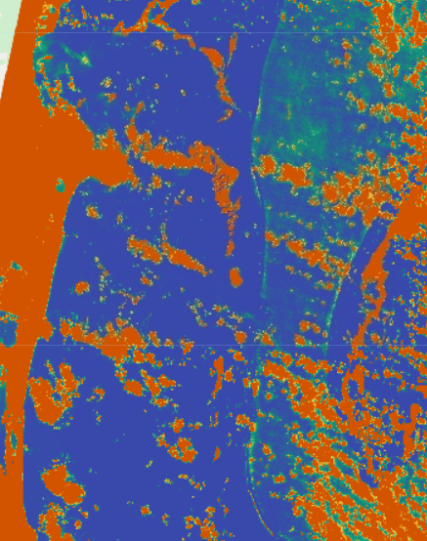
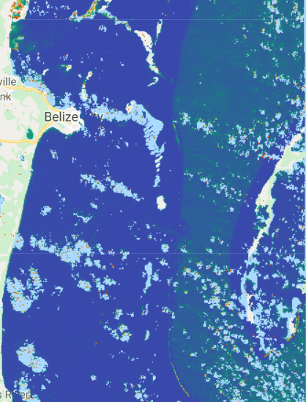
Methodology
Cloud Masking & Atmospheric Correction
Sensor
Sentinel 2 MSI
Level 1C Products
⇒
MAIN Algorithm
Modified Atmospheric Correction for Inland Waters
Google Earth Engine algorithm for atmospheric correction
Calculates Normalized Difference Water Index for cloud masking
Page, et. al.
Notes:
For our Sentinel-2 data, we ran the imagery through the MAIN atmospheric correction algorithm in GEE developed by Ben Page at the University of Minnesota. This algorithm also incorporates an NDWI threshold to mask for clouds, since there are not effective cloud masking algorithms available in GEE for Sentinel-2 data at present. The team last term found that Sentinel-2 Level 1C data corrected with this algorithm derived water quality parameters that more closely matched the ones derived by the well-tested atmospheric correction processor ACOLITE than the values derived from Sentinel-2 Level 2A products. Page helped us incorporate the algorithm into the ORCAA tool.
Image Credits (top to bottom): NASA; NASA DEVELOP Belize & Honduras Water Resources II Team, Basemap Google Earth Engine

Slide 14
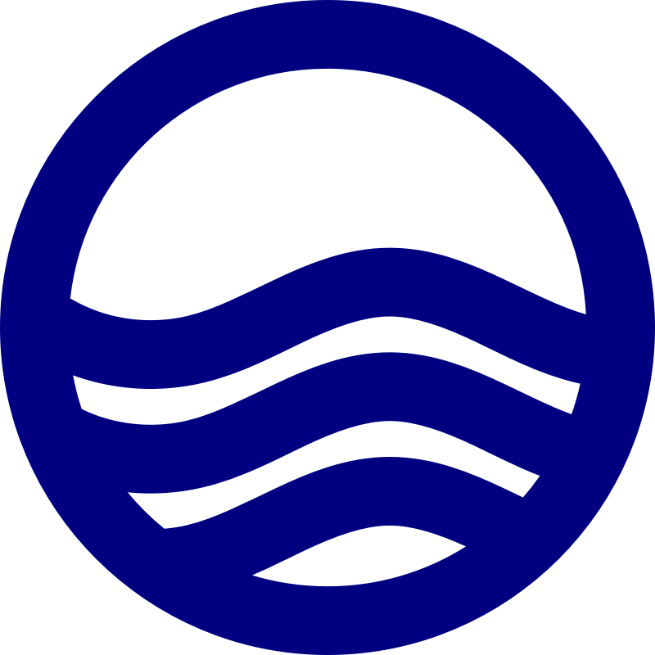
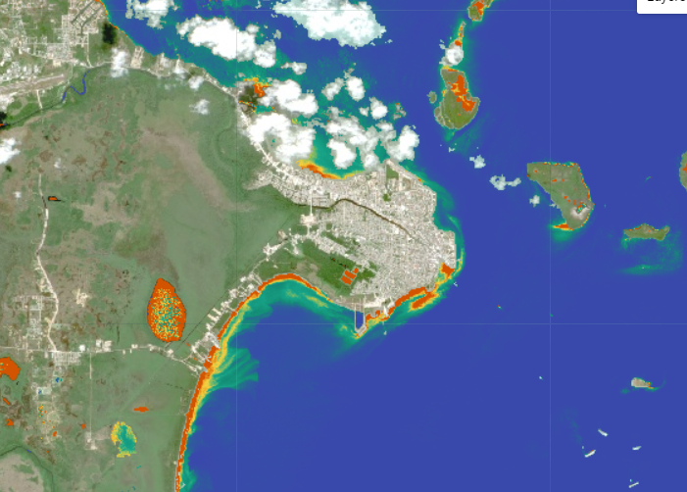
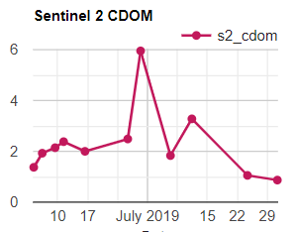
Methodology
Colored Dissolved Organic Matter (CDOM)
Sensor
Sentinel-2 MSI
Algorithm
Incorporate into ORCAA
⇒
CDOM = 22.283e⁻ ^{1.74X}
⇒
Chen et al., 2017
Analysis
Spatial
Temporal
Image Credit: NASA
Notes:
We added colored dissolved organic matter as a monitoring metric to the ORCAA tool. To measure CDOM, we utilized Sentinel-2 Level 1C observations that were atmospherically corrected by Ben Page’s MAIN algorithm. The equation to obtain CDOM, developed by Chen et al., 2017, uses the near infrared (NIR) red-edge band and green band to calculate CDOM and is calibrated for coastal regions with complex waters. We wrote the algorithm into GEE script and incorporated it into ORCAA. The tool outputs a composite spatial visualization of CDOM in the ocean regions, as well as a time series chart showing metrics of CDOM over the study period, allowing our partners to conduct spatial and temporal analyses of CDOM values across the study area.
Image Credit:
Gear icon: http://www.myiconfinder.com/icon/config-configuration-gear-gears-setting-machine-options-preferences-black-solid-three-3gear/3797
Ocean icon: https://www.kissclipart.com/wave-icon-clipart-computer-icons-wave-clip-art-53vv4h/
Computer analysis: https://www.kissclipart.com/icon-clipart-computer-icons-market-research-8u9ax4/
Satellite: NASA
Map: NASA DEVELOP Belize & Honduras Water Resources II Team, Basemap Google Earth Engine

Slide 15
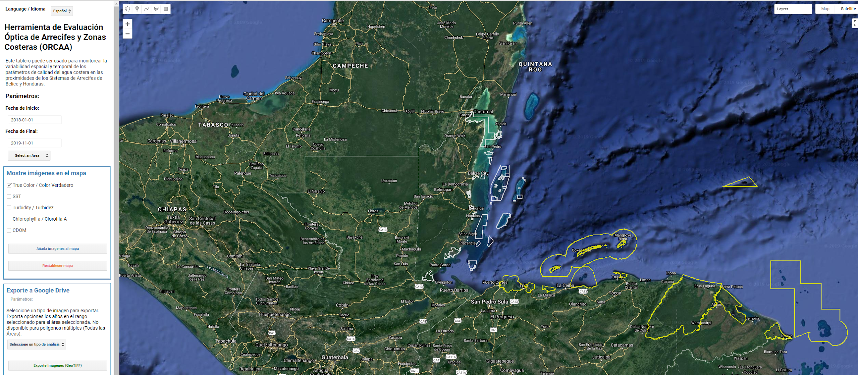
Optical Reef and Coastal Area Assessment (ORCAA) Tool
Notes:
All of these processes take place in the Optical Reef and Coastal Area Assessment tool, or ORCAA. ORCAA is hosted in a Google Earth Engine app that the partners can access from the web, so they do not need a Google Earth Engine account to use it. It has a graphical user interface for the partners to easily generate and export imagery and time-series charts of turbidity levels, chlorophyll-a concentrations, colored dissolved organic matter concentrations, and sea surface temperatures. Our tool allows the users to select an area of interest from a drop-down menu and conduct analysis within a specified date range that may extend to the day of the most recently available satellite observation. The charts can display daily or monthly averages. Additionally, partners can upload their own in situ data to compare with the values derived from ORCAA. The user may click on the points to view the in situ data values for that area.
Image credit: NASA DEVELOP Belize & Honduras Water Resources II Team
Base Map: Google Earth Engine

Slide 16
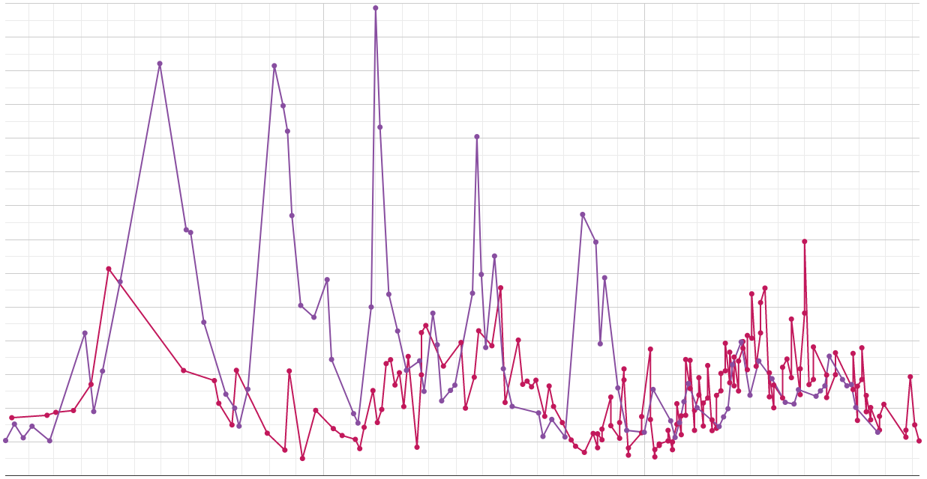
Results
CDOM: Belize
CDOM Around Belize Coastal Reef Regions (January 2017 – November 2019)
2.8
2.6
2017
Feb
Mar
Apr
May
June
July
Aug
Sept
Oct
Nov
Dec
2018
Feb
Mar
Apr
May
June
July
Aug
Sept
Oct
Nov
Dec
2019
Feb
Mar
Apr
May
June
July
Aug
Sept
Oct
Nov
Lighthouse Reef
2.4
2.2
Chetumal Bay
2.0
1.8
1.6
1.4
CDOM (m⁻ ¹)
1.2
1.0
0.8
0.6
0.4
0.2
0.0
Notes:
This first chart shows the CDOM levels in the two Belize AOIs from January 2017 through November 2019. It is important to note that there is much less data available in the years 2017 and 2018, which is why the trend over time looks much sharper. We cannot detect a significant difference in CDOM levels between the two regions, but the tool does pick up very clearly on the seasonal variation in CDOM levels. The blue region signifies the rainy season in Belize and Honduras. It looks as though the CDOM levels rise during the rainy season, and slowly fall as the season comes to a close.
Chart Source: NASA DEVELOP JPL Belize & Honduras Water Resources II Team

Slide 17
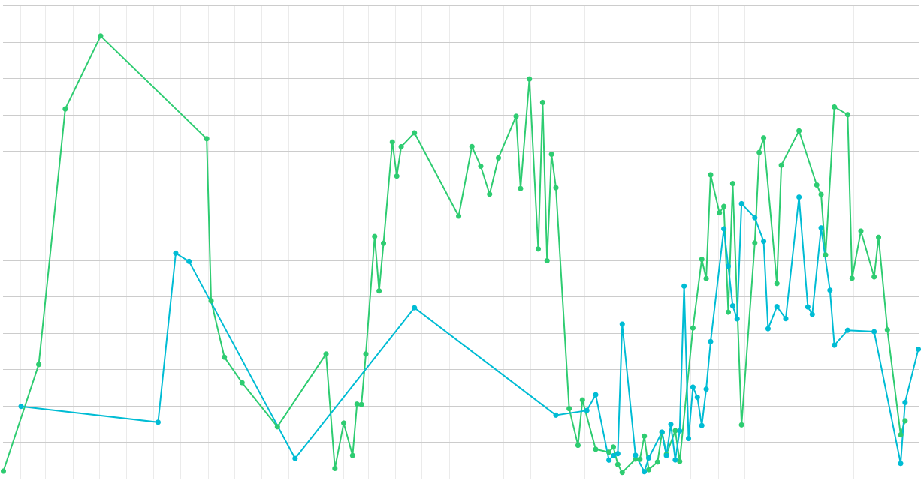
Results
CDOM: Honduras
CDOM Around Honduras Coastal Reef Regions (January 2017 – November 2019)
3.25
3.00
2017
Feb
Mar
Apr
May
June
July
Aug
Sept
Oct
Nov
Dec
2018
Feb
Mar
Apr
May
June
July
Aug
Sept
Oct
Nov
Dec
2019
Feb
Mar
Apr
May
June
July
Aug
Sept
Oct
Nov
Cayos Cochinos
2.75
2.50
Punta Izopo
2.25
2.00
CDOM (m⁻ ¹)
1.75
1.50
1.25
1.00
0.75
0.50
0.25
0.00
Notes:
We can observe this trend in Honduras for CDOM levels as well. As you can see, there are sharp increases in the levels of CDOM around both the river mouth and the protected island area during the rainy season. This seasonal variation can be observed since 2017, even with limited data availability for those years.
Chart Source: NASA DEVELOP JPL Belize & Honduras Water Resources II Team

Slide 18
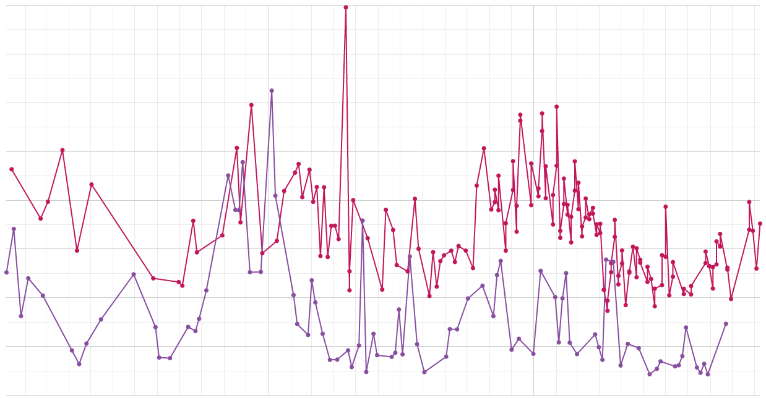
Results
Chlorophyll-a: Belize
Chlorophyll-a Around Belize Coastal Reef Regions (January 2017 – November 2019)
8.5
8.0
Lighthouse Reef
2017
Feb
Mar
Apr
May
June
July
Aug
Sept
Oct
Nov
Dec
2018
Feb
Mar
Apr
May
June
July
Aug
Sept
Oct
Nov
Dec
2019
Feb
Mar
Apr
May
June
July
Aug
Sept
Oct
Nov
Chetumal Bay
7.5
7.0
Chlorophyll-a (mg/m³)
6.5
6.0
5.5
5.0
4.5
Notes:
We see this trend less with chlorophyll-a, but we can still see distinct seasonal variations throughout the years. Interestingly, Lighthouse Reef maintains higher chlorophyll-a values than Chetumal Bay. We should mention that the data we have for chlorophyll-a, unfortunately, is not of the same quality as the other parameters. We found exorbitantly high values of chlorophyll-a in some regions that we had to filter out, and it is possible that the sensor could be picking up on seagrass rather than the pigment.
Chart Source: NASA DEVELOP JPL Belize & Honduras Water Resources II Team

Slide 19
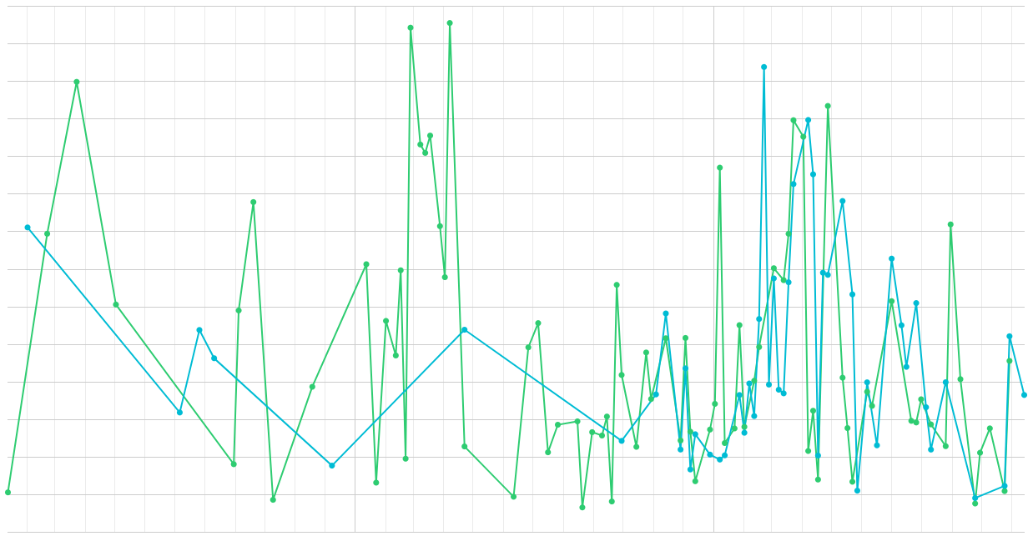
Results
Chlorophyll-a: Honduras
Chlorophyll-a Around Honduras Coastal Reef Regions (January 2017 – November 2019)
8.0
7.5
Cayos Cochinos
2017
Feb
Mar
Apr
May
June
July
Aug
Sept
Oct
Nov
Dec
2018
Feb
Mar
Apr
May
June
July
Aug
Sept
Oct
Nov
Dec
2019
Feb
Mar
Apr
May
June
July
Aug
Sept
Oct
Nov
Punta Izopo
7.0
6.5
Chlorophyll-a (mg/m³)
6.0
5.5
5.0
4.5
Notes:
Here, the lack of data in 2017 and 2018 is quite evident in the sharp peaks and valleys that occur over time. Even so, we can still detect some level of seasonal variation, and not a lot of difference between the island and the river mouth.
Chart Source: NASA DEVELOP JPL Belize & Honduras Water Resources II Team

Slide 20
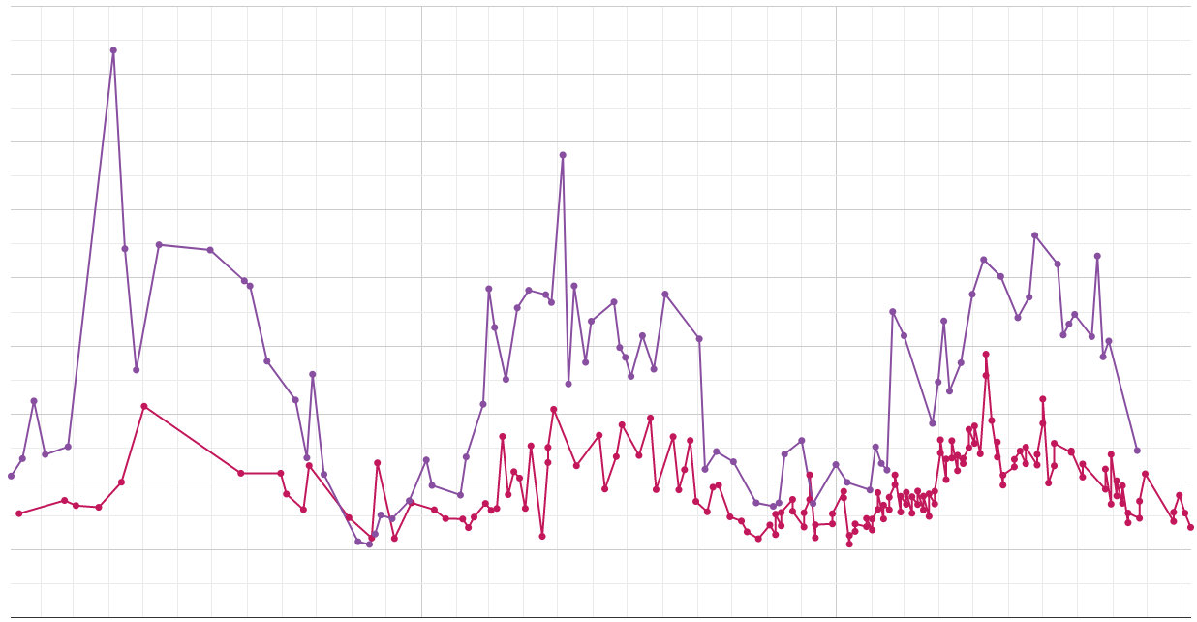
Results
Turbidity: Belize
Turbidity Around Belize Coastal Reef Regions (January 2017 – November 2019)
18
16
2017
Feb
Mar
Apr
May
June
July
Aug
Sept
Oct
Nov
Dec
2018
Feb
Mar
Apr
May
June
July
Aug
Sept
Oct
Nov
Dec
2019
Feb
Mar
Apr
May
June
July
Aug
Sept
Oct
Nov
Lighthouse Reef
Chetumal Bay
14
12
10
8
Turbidity (FNU)
6
4
2
0
Notes:
We can very clearly see the seasonal variation in turbidity levels for the two AOIs in Belize. The river mouth appears to maintain consistently higher values than the island, with these levels peaking at the start of the rainy season and falling until the season comes to a close. The turbidity values for the two areas are relatively similar during the dry seasons.
Chart Source: NASA DEVELOP JPL Belize & Honduras Water Resources II Team

Slide 21
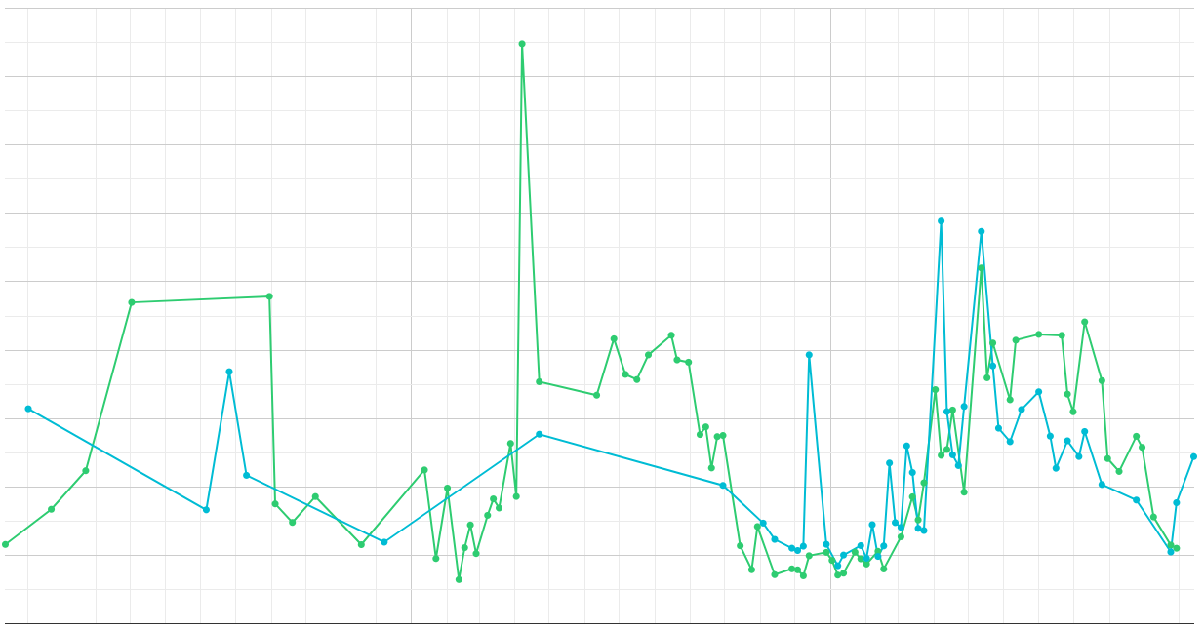
Results
Turbidity: Honduras
Turbidity Around Belize Coastal Reef Regions (January 2017 – November 2019)
9
8
2017
Feb
Mar
Apr
May
June
July
Aug
Sept
Oct
Nov
Dec
2018
Feb
Mar
Apr
May
June
July
Aug
Sept
Oct
Nov
Dec
2019
Feb
Mar
Apr
May
June
July
Aug
Sept
Oct
Nov
Cayos Cochinos
Punta Izopo
7
6
5
4
Turbidity (FNU)
3
2
1
0
Notes:
In Honduras, there is not that much of a distinction between the levels surrounding the river mouth and the island. Like in Belize, both levels peak at the start of the rainy season and fall to a minimum at the start of the dry season, reflecting the seasonal effect on turbidity levels.
Chart Source: NASA DEVELOP JPL Belize & Honduras Water Resources II Team

Slide 22
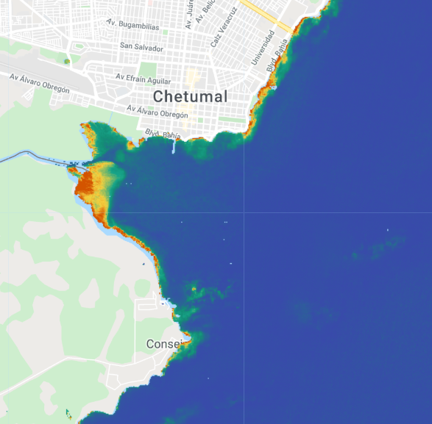
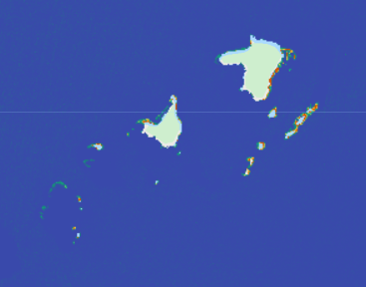
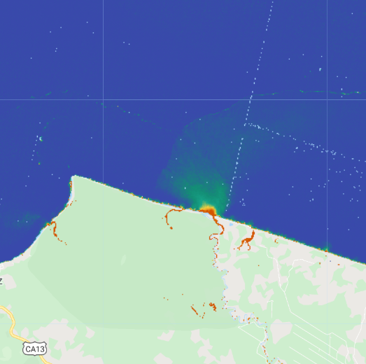
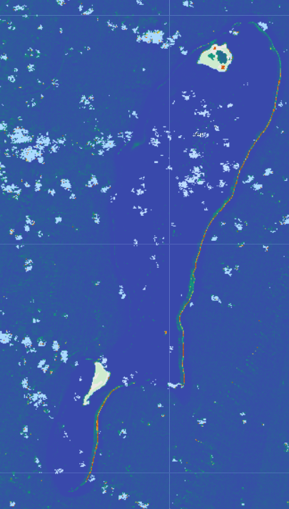
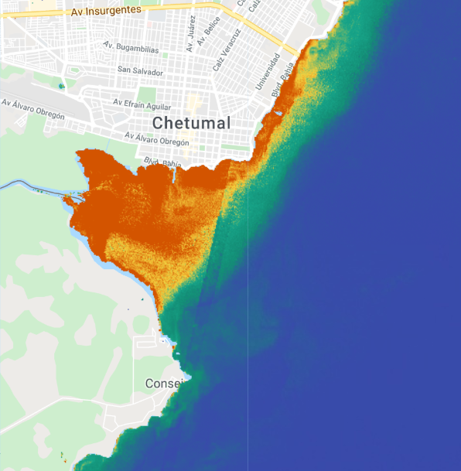
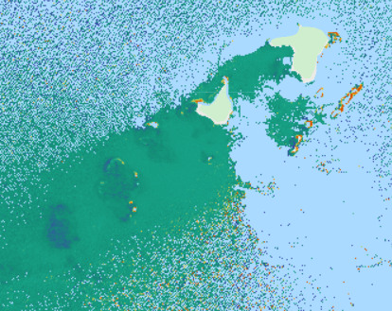
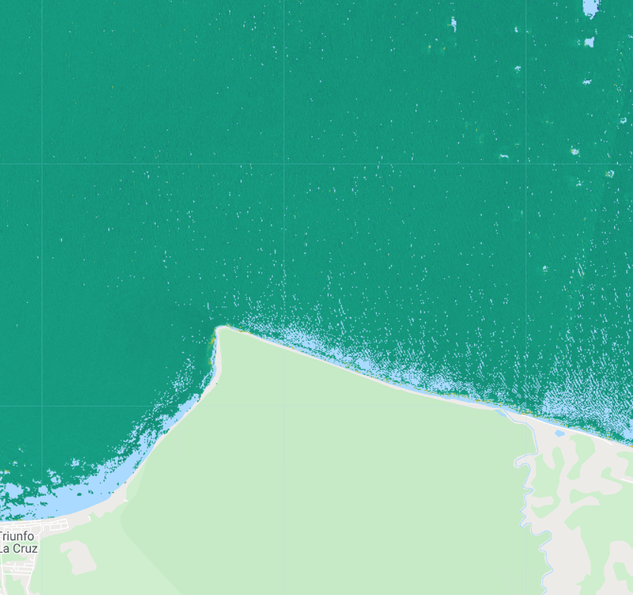
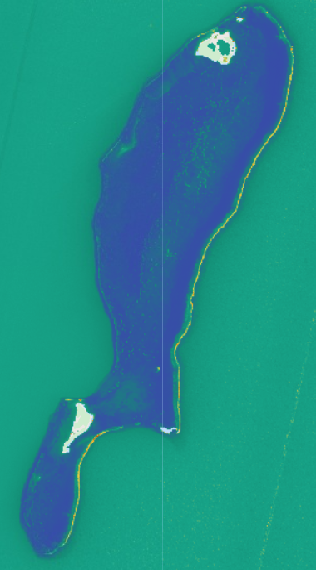
Results
Cayos Cochinos
N
0 15 30 km
0 5 m⁻ ¹
CDOM Images
Jan 12
2019
Jan 10
2018
Jan 12
2019
Jan 12
2019
Chetumal Bay
Cayos Cochinos
Punta Izopo
Lighthouse Reef
Mar 1
2018
May 12
2019
May 12
2019
May 12
2019
Cayos Cochinos
Chetumal Bay
Notes:
We wanted to visualize this trend, so the next slides will showcase images of the two regions during both the during dry seasons in the top images and wet season in the bottom. We selected dates that reflected the minimum value during the dry season and the maximum value during the wet season to visually inspect the difference.
In each of these images, there is a distinct increase in CDOM between the dry and wet season images. We can observe a large red plume emanating from the river mouth in Chetumal Bay, and in the other three images, the water goes from blue, indicating very low CDOM values, to green, which signifies moderate CDOM values.
Map Source: NASA DEVELOP JPL Belize & Honduras Water Resources II Team
Base Layer Source: Google Earth Engine

Slide 23
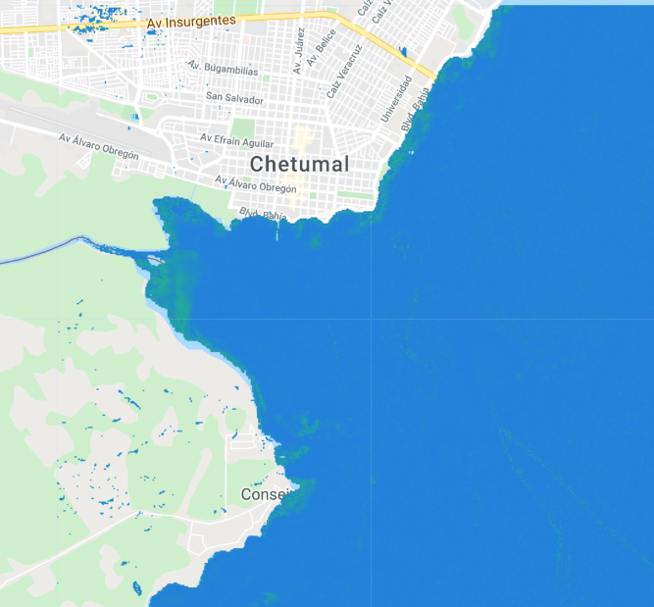
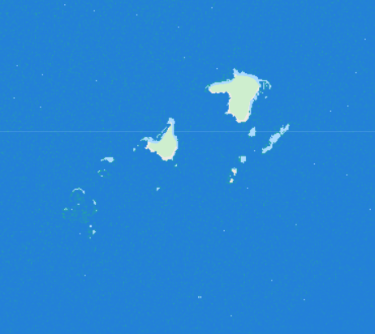
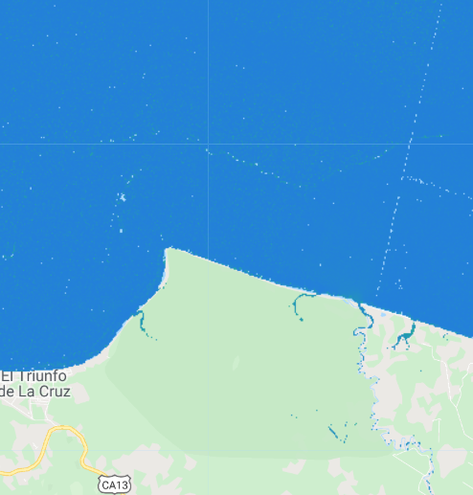
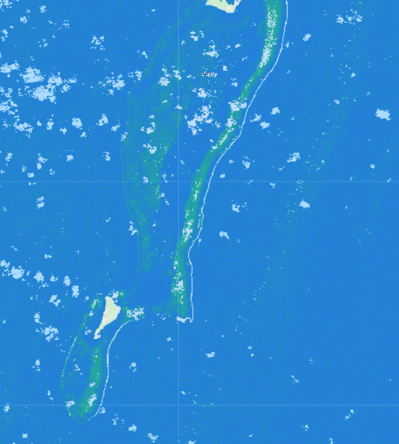
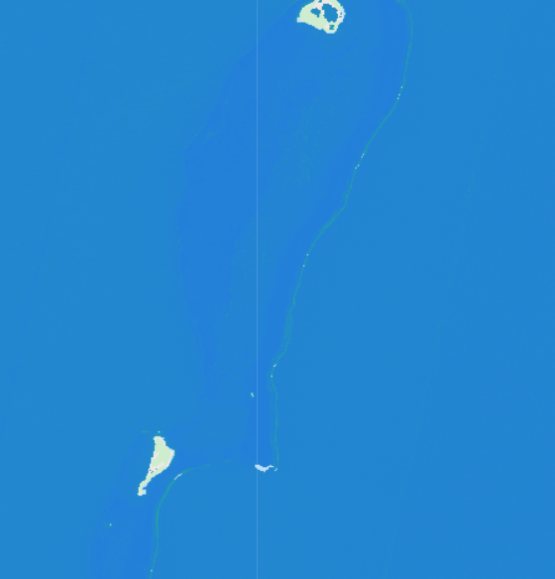
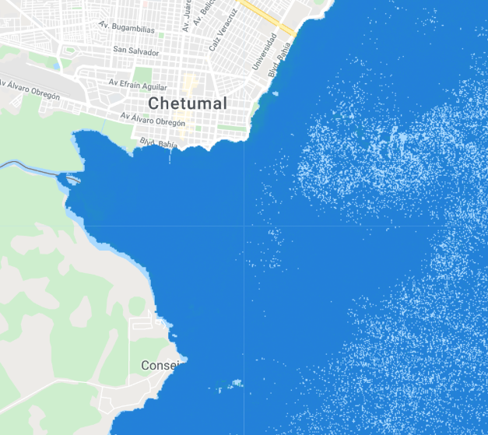
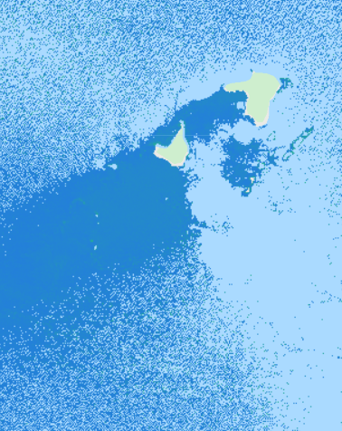
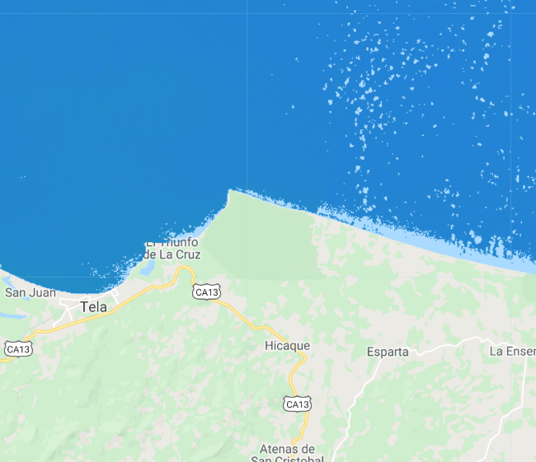
Results
Cayos Cochinos
N
0 15 30 km
0 50 mg/m³
Chlorophyll-a Images
Jan 10
2019
Jan 12
2019
Jan 12
2019
Jan 12
2019
Chetumal Bay
Cayos Cochinos
Punta Izopo
Lighthouse Reef
Cayos Cochinos
May 12
2019
May 10
2019
May 12
2019
May 12
2019
Chetumal Bay
Notes:
We do not observe a very strong difference between the dry and wet seasons for chlorophyll-a imagery. As we stated earlier, we experienced some difficulty in producing reasonable data for the chlorophyll-a parameter. The small variations in chlorophyll-a could also be skewed by cloud-masking, observable in the May 12 Cayos Cochinos image.
Map Source: NASA DEVELOP JPL Belize & Honduras Water Resources II Team
Base Layer Source: Google Earth Engine

Slide 24
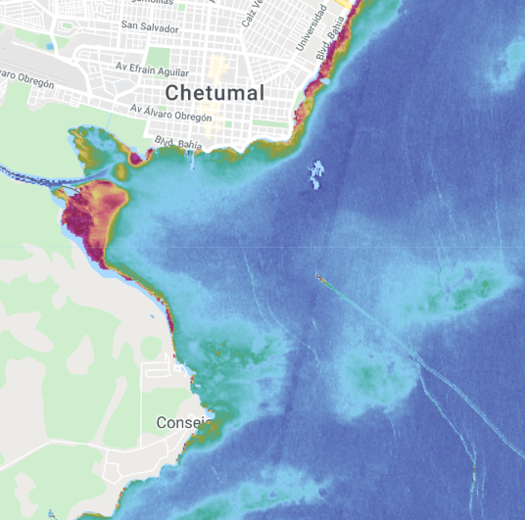
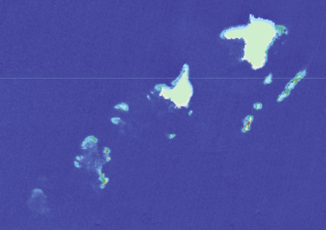
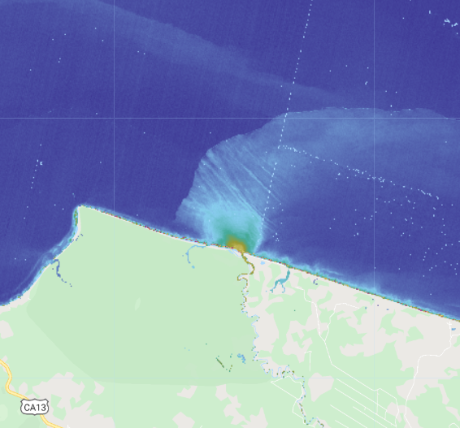
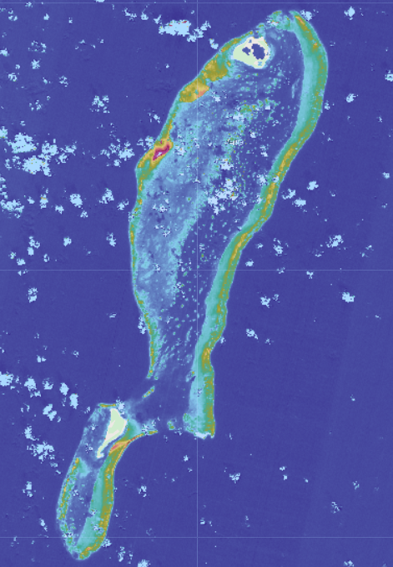
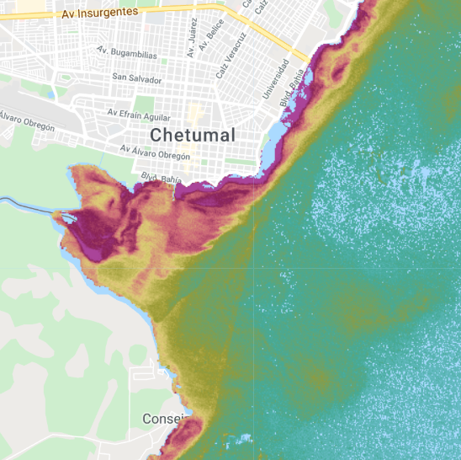
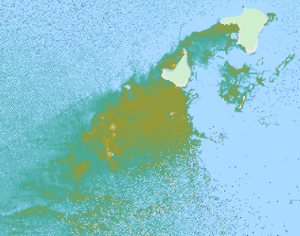
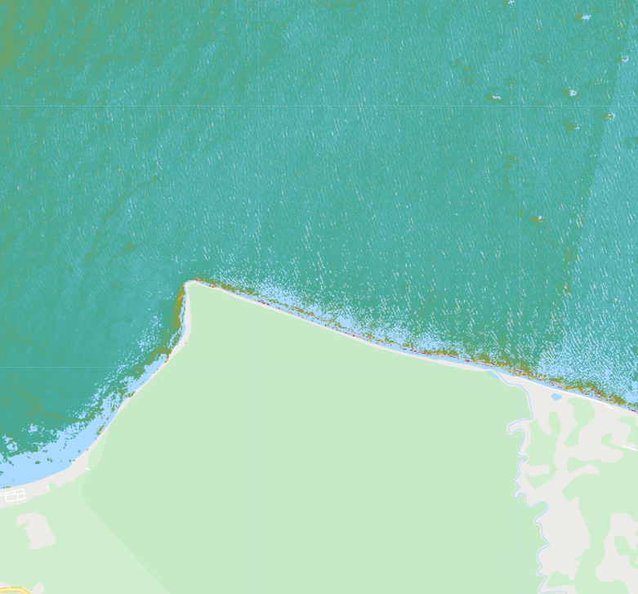
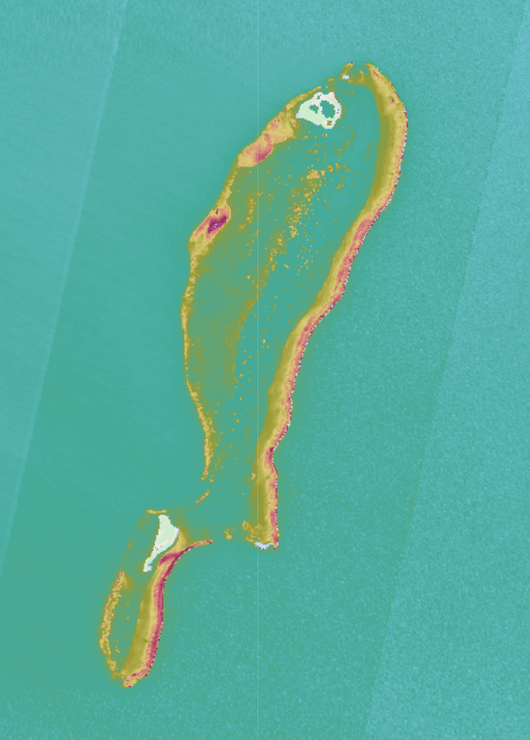
Results
Cayos Cochinos
N
0 15 30 km
0 100 FNU
Turbidity Images
Jan 12
2019
Jan 10
2019
Jan 12
2019
Jan 12
2019
Chetumal Bay
Cayos Cochinos
Punta Izopo
Lighthouse Reef
May 12
2019
May 12
2019
May 12
2019
May 10
2019
Notes:
Similar to CDOM we see greater turbidity during the wet season primarily because the runoff yield increases substantially. We notice this pattern more starkly in mainly urbanized areas such Chetumal Bay, but we can observe a change in the color of the water (from blue to green) in the other images as well.
Map Source: NASA DEVELOP JPL Belize & Honduras Water Resources II Team
Base Layer Source: Google Earth Engine

Slide 25
Results
CDOM Box Plots
CDOM in Belize and Honduras in the Dry and Wet Season
8
6
4
2
0
CDOM (m⁻ ¹)
1/01/18
3/01/18
1/12/19
5/12/19
1/12/19
5/12/19
1/12/19
5/12/19
Chetumal Bay
Belize
Lighthouse Reef
Belize
Punta Izopo
Honduras
Cayos Cochinos
Honduras
Notes:
Here we show the distribution of CDOM values in different areas of Belize and Honduras. The areas highlighted in green are the islands. On the left, we show the box plot for the dry season, and on the right, the box plot for the wet season. Our area with the lowest overall CDOM values is the Lighthouse Reef, while Chetumal Bay in Belize and Cayos Cochinos in Honduras show high values.
Lighthouse reef is known to be one of the healthiest and most thriving reefs in the Mesoamerican Barrier Reef, so our results confirm that the Lighthouse Reef sees significantly lower values of CDOM than all other areas.
In each case except for Punta Izopo, we see a marked increase in CDOM levels during the wet season.
Plot Source: NASA DEVELOP JPL Belize & Honduras Water Resources II Team

Slide 26
Results
Chlorophyll-a Box Plots
Chlorophyll-a in Belize and Honduras in the Dry and Wet Season
20
15
10
5
Chlorophyll-a (mg/m³)
1/1/18
3/1/18
1/12/19
5/12/19
1/12/19
5/12/19
1/12/19
5/12/19
Chetumal Bay
Belize
Lighthouse Reef
Belize
Punta Izopo
Honduras
Cayos Cochinos
Honduras
Notes:
Here we show the distribution of Chlorophyll-a values across the four AOIs in the two countries. As we saw in the imagery, there is no real difference between the wet and dry seasons, and not much variation between the river mouths or the islands. Lighthouse Reef exhibits unusually high chlorophyll-a levels during the dry season. Again, our imagery could be picking up on sea grass, or it could be a fault in the data, since is thought to be the cleanest area. Also, it is important to note that the chlorophyll-a values that we are getting are much higher than one would usually find in a reef (range is 5-20, normal would be 0-5), further illustrating the fault in the data.
Plot Source: NASA DEVELOP JPL Belize & Honduras Water Resources II Team

Slide 27
Results
Turbidity Box Plots
Turbidity in Belize and Honduras in the Dry and Wet Season
Turbidity (FNU)
1/1/18
3/1/18
1/12/19
5/12/19
1/12/19
5/12/19
1/12/19
5/12/19
Chetumal Bay
Belize
Lighthouse Reef
Belize
Punta Izopo
Honduras
Cayos Cochinos
Honduras
Notes:
Lastly, we are comparing the distribution of turbidity values between the wet and dry seasons in each area of interest. As with CDOM, there is an uptick in the turbidity levels during the wet season.
One thing we noticed in looking at this data is that the rate at which the turbidity and CDOM levels increased in Honduras was faster than the rate of increase in Belize (i.e., the time-series charts looked sharper because the Honduras AOIs reached their maximum value more rapidly). We wanted to find a possible reason to explain this difference.
Plot Source: NASA DEVELOP JPL Belize & Honduras Water Resources II Team

Slide 28
Honduras Palm Oil Production
Palm Oil Production in Honduras
800
600
Palm oil production has doubled in the last ten years
Three protected forests undergone illegal deforestation
Runoff and waste drains into the rivers
Production (1000 MT)
400
200
0
1974
1979
1984
1989
1994
1999
2004
2009
2014
2019
Year
Notes:
As it turns out, there has been a steep increase in palm oil production in Honduras; total production levels have doubled in just the last ten years. This uptick can be attributed to the legal and illegal deforestation that has occurred to clear space for palm oil plantations in three of Honduras’ National Parks: Jeanette Kawas National Park, Punta Izopo National Park, and Cuero y Salado National Park. This agricultural shift gives way to runoff and waste that drain into the rivers and along the coast.
Chart source: Google Sheets, NASA DEVELOP JPL Belize & Honduras Water Resources II Team
Data Source: USDA, https://www.indexmundi.com/agriculture/?country=hn&commodity=palm-oil&graph=production

Slide 29
Palm Oil: Honduras Coastline
Kawas Park
Punta Izopo Park
Cuero y Salado Park
N
0 15 30 km
0 5 m⁻ ¹
Kawas Park
Punta Izopo Park
Cuero y Salado Park
Notes:
Our tool is able to pick up on the massive plumes along the Honduras coastline. These plumes can only be seen near palm oil plantations in national forests, and not on the rest of the coast, indicating that palm oil and deforestation may be causing an increases in the levels and plumes of CDOM in coastal waters.
The next three slides look more closely at each of the national parks’ plantations and plumes.
Map Sources (top and bottom): NASA DEVELOP JPL Belize & Honduras Water Resources II Team
Base Layer Sources (top to bottom): Esri “Terrain” Layer Package, ArcMap; Google Earth Engine

Slide 30
Palm Oil: Jeanette Kawas National Park
🠜
N
0 5 km
0 5 m⁻ ¹
Notes:
The center image displays CDOM in Jeanette Kawas National Park on the northern coast of Honduras. These forest have experienced a massive increase in deforestation for palm oil plantations. You can observe the red color of the river, likely due to agricultural runoffs, next to the plantations flowing into the sea.
Map Source: NASA DEVELOP JPL Belize & Honduras Water Resources II Team
Base Layer Source: Google Earth Engine

Slide 31
Palm Oil: Punta Izopo National Park
N
0 5 km
0 5 m⁻ ¹
Notes:
This image gives a closer look at Punta Izopo National Park, the river mouth area of interest for Honduras that we displayed in earlier slides. You can see the massive plume exiting the river that is surrounded by palm oil plantations.
Map Source: NASA DEVELOP JPL Belize & Honduras Water Resources II Team
Base Layer Source: Google Earth Engine

Slide 32
Palm Oil: Cuero y Salado National Park
N
0 5 km
0 5 m⁻ ¹
Rio Cuero
Notes:
Finally, here is Cuero y Salado National Park. Similarly to the previous two locations, the river is almost entirely red, leading to a massive red CDOM plume off the coast. Palm oil plantations near the coast increase the presence of matter in these coastal waters.
The spread of palm oil plantations and the presence of these plumes in Honduras and not Belize illustrate the looser coastal and environmental regulations that exist in Honduras. To further test the differences in the water quality of Belize and Honduras resulting from these regulatory differences, we quantified the levels of CDOM, chlorophyll-a, and turbidity in each of the areas of interest and compared them against each other.
Map Source: NASA DEVELOP JPL Belize & Honduras Water Resources II Team
Base Layer Source: Google Earth Engine

Slide 33
Conclusions
The wet seasons in Belize and Honduras generally exhibit higher levels of turbidity and CDOM than the drier seasons.
Atmospherically corrected Sentinel-2 Level 1C products provide more robust datasets that derive water quality parameter measurements more effectively than Sentinel-2 Level 2A products.
ORCAA assists coastal land-use managers in regulating marine protected areas by providing maps and time-series graphs of changing water quality conditions across a six-year time period.
Notes:
From these results we can conclude three major findings:
First, as we can see from the line graphs, areas in Belize have much lower levels of chlorophyll-a and CDOM surrounding their reefs than the Honduran regions of interest. While all of these regions are marine protected areas, the river mouths in Honduras pass through active urban and agricultural areas that do not face the same legal limitations as those areas in Belize. Thus, the rivers carry contaminants that degrade the water quality and heighten these metrics in the surrounding area. This trend illustrates the need for legal protections to prevent a decline in reef health.
Second, we implemented an atmospheric correction algorithm that allowed us to gather Sentinel-2 data starting in 2016 through current day. As the previous team found, these corrected data sets derive values that match more closely to values derived by the ACOLITE atmospheric correction processor. The larger amount of data coupled with external correction allowed us to better evaluate the health of the Belize and Honduras Barrier Reefs.
Lastly, we created a tool with a user-friendly graphical interface that allows coastal managers with a ranging spectrum of experience in remote sensing to produce maps and time-series charts that aid them in coastal land-use decision making. By quickly being able to generate imagery and evaluate water quality parameter trends, they can identify areas that need greater protection and which laws are effective in both maintaining and improving the health of the reefs.

Slide 34
Errors and Uncertainties
Lack of in situ data for validation
Calibration of CDOM and chlorophyll-a algorithms for shallow, coastal areas
Medium-low spatial resolution of satellites skews values
Image credit:
Dr. Juan Torres-Perez
Notes:
The biggest uncertainty in our study is the lack of in situ data to validate the results that we derived from satellite imagery. This prevents us from calibrating the coefficients algorithms specifically to our study area. Furthermore, the CDOM algorithm we used was designed for northern coastal lakeshore waters, rather than the shallow tropical coasts of Belize and Honduras. If we had in situ data, we could calibrate the CDOM algorithm to our study area as well. Currently, the true viability of this algorithm in tropical coastal waters is unknown. Additionally, Landsat 8 and MODIS have a spatial resolution of 30 m and 1 km, respectively. Especially in reefs near more remote islands, these medium and low spatial resolutions cannot capture the variation present in smaller areas.
Image Credit: Shared with us by Dr. Juan Torres-Perez, taken while collecting in situ data.

Slide 35
Future Work
Validation of satellite derived water metrics with in situ data
Develop a Sargassum parameter to monitor macroalgae blooms
Incorporate benthic reflectance algorithm for shallow coastal waters
Image credit:(Top) rjsinenomine; (Bottom) Dr. Juan Torres-Perez
Notes:
Our GEE tool requires validation of satellite derived water quality metrics with in situ field measurements. Limited in situ data gathering and processing occurs in the Mesoamerican reef region. None of the data was available during the DEVELOP term. We are aware that data is currently being collected and processed, so future projects should use these field datasets to calibrate model coefficients suitable for the region and validate the results of the tool.
Although our team was unable to incorporate a Sargassum metric because of time constraints, a parameter to monitor harmful macroalgae blooms near the reefs would be useful.
Reflectance from the bottom of the sea floor, benthic reflectance, can distort satellite derived water quality parameters. Active research is being conducted to correct for sea floor reflectance and improve the accuracy of satellite data and metrics. Including an algorithm that corrects this reflectance would improve the ORCAA outputs.
Image Credits (from top to bottom): "CLbKHaDVAAAJOse” by rjsinenomine. Licensed under CC BY 2.0. https://www.flickr.com/photos/101077452@N05/20785104922/; Shared with us by Dr. Juan Toores-Perez, taken while collecting in situ data

Slide 36
Partners
Rosabel Martinez Arriaga and Fausto Diaz (MiAmbiente Honduras)
Chantalle Clark-Samuels, Arlene Young, Andria Rosado, and Samir Rosado (CZMAI)
Luis Castellanos (CCAD)
Alexander Tewfik and Myles Phillips (WCS)
Science Advisors
Dr. Christine Lee (NASA Jet Propulsion Laboratory, California Institute of Technology)
Dr. Juan Torres-Perez (Bay Area Environmental Research Institute, NASA Ames Research Center)
Dr. Emil Cherrington (University of Alabama in Huntsville, NASA SERVIR)
Dr. Deepak Mishra (University of Georgia)
Benjamin Page (University of Minnesota, Water Resources Center)
Past Contributors
Charlie Devine (NASA DEVELOP, NASA Ames Research Center)
Alana Higgins (NASA DEVELOP, NASA Jet Propulsion Laboratory)
Alice Lin (NASA DEVELOP, NASA Jet Propulsion Laboratory)
Sophia Skoglund (NASA DEVELOP, NASA Ames Research Center)
Additional thanks to Sean McCartney (NASA Goddard Space Flight Center), Cecil Byles (NASA DEVELOP Fellow), and Benjamin Holt (NASA Jet Propulsion Laboratory)
This material contains modified Copernicus Sentinel data (2016-2019), processed by ESA.
Notes:
We’d like to extend an enormous thanks to all of our partners, science advisers, past contributors, our Fellow Cecil Byles, Sean McCartney, and DEVELOP adviser Ben Holt. We so appreciate all the support and guidance that you all offered to us throughout the term.

