Slide 1
2018 Fall | Idaho – Pocatello
IDAHO WATER RESOURCES II
Evaluating Evapotranspiration and Water Budget Components in Semi-Arid Sagebrush Steppe
Ian Lauer
Carl Jurkowski
Carolyn Macek
Frank Zurek
Notes:
Good afternoon and thank you for coming. Our team is really pleased to have the opportunity to share our research evaluating evapotranspiration and water budget components in the semi-arid sagebrush steppe.
--------------Image Credits Below --------------
Image produced by Idaho Water Resources Team

Slide 2
Background
Image Credit: Ian Lauer
60% of Idaho is publicly managed land
Notes:
Over 60% of Idaho is managed by state or federal institutions. These diverse areas have complex management objectives and are oftentimes in remote, difficult to access locations.
Image Source: Ian Lauer

Slide 3
Background
Image Credit: Ian Lauer
60% of Idaho is publicly managed land
Receives an average of 12 inches of precipitation per year
Notes:
This area is considered semi-arid with an average of 12 inches of precipitation per year; a third of the national average
Image Source: Ian Lauer

Slide 4
Background
Image Credit: Ian Lauer
60% of Idaho is publicly managed land
Receives an average of 12 inches of precipitation per year
Landcover ranges from semi-arid sagebrush Steppe at low elevations transitions to mixed forest at higher elevations
Notes:
Adapted to this low and seasonal precipitation, much of southern Idaho is sagebrush steppe at lower elevations and mixed forest at higher elevations.
Image Source: Ian Lauer

Slide 5
Community Concerns
The water balance is critical to managing semi-arid environments:
fire susceptibility
native plant management
wildlife range management
grazing allotments
Image Credit: Leah Kucera
Notes:
We’re partnered with a number of agencies that manage Idaho’s public and private lands; understanding the water balance in a water-limited system is crucial to these managers. Understanding the different components of the water balance can inform fire susceptibility, native plant management practices, wildlife range management, and grazing rotations.
Image Source: Leah Kucera

Slide 6
Community Concerns
The water balance is critical to managing semi-arid environments:
fire susceptibility
native plant management
wildlife range management
grazing allotments
Our partners currently use field-based methods to collect ET data.
costly and time intensive
limited distribution for regional scales
Image Credit: Leah Kucera
Notes:
Currently, our managers use field-based measurements to estimate evapotranspiration. ET is currently measured using data from Eddy Covariance Flux towers, which are relatively expensive and so are limited in distribution. These towers measure variables that are put into a mathematical model for ET. However, because ET is spatially variable and can differ with changes in elevation, vegetation, and topography, calculations made at one tower might not apply across the landscape. In order to fill in these gaps, many ET models using remotely sensed data have been developed.
Image Source: Leah Kucera

Slide 7
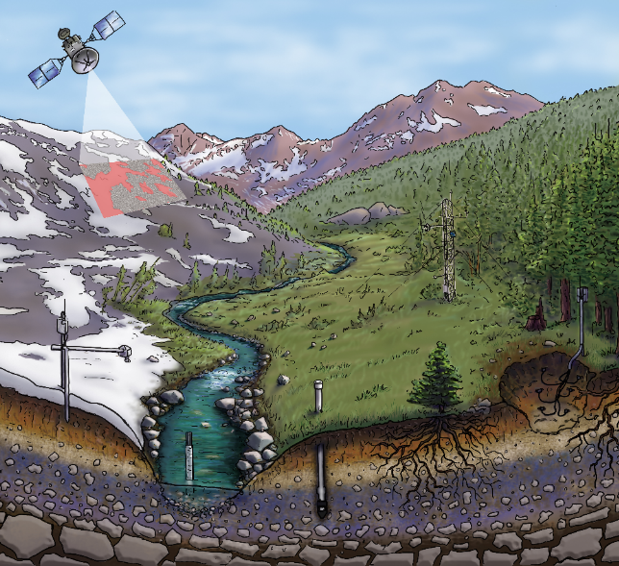
The Water Cycle
There are various inputs to the water cycle such as precipitation.
Image Credit: Jenny Parks Illustration/SSCZO
Notes:
Lets take a closer look at the water cycle and what it might tell us in a semiarid system. Inputs to the system, such as precipitation, can be relatively easy to measure but can be highly spatially variable. It’s important to be able to quantify these inputs to understand how much water a system starts with and where that water goes.
Image Source: http://criticalzone.org/national/research/annual-findings-1national/
Provided by project partner

Slide 8
The Water Cycle
There are various inputs to the water cycle such as precipitation.
The previous term focused on water storage as soil moisture.
Image Credit: Jenny Parks Illustration/SSCZO
Notes:
The storage component is an important part of understanding where water ends up, and how long it is available for plants and animals to use. In the summer of 2018, Idaho’s DEVELOP team focused on a storage component of the hydrologic cycle– surface soil moisture. Because soil moisture is so spatially variable, being able to utilize remotely sensed data for making improved moisture estimates is crucial to land managers.
Image Source: http://criticalzone.org/national/research/annual-findings-1national/
Provided by project partner

Slide 9
The Water Cycle
There are various inputs to the water cycle such as precipitation.
The previous term focused on water storage as soil moisture.
This term focused on evapotranspiration (ET).
Transfer of water vapor from surfaces to the atmosphere
Evaporation + Transpiration
Image Credit: Jenny Parks Illustration/SSCZO
Notes:
Finally, the export components of a water budget tell us how much water is leaving a system. This fall, our team aimed to look into the export component of evapotranspiration. Evapotranspiration quantifies the movement of water from the surface to the atmosphere through evaporation and transpiration.
Image Source: http://criticalzone.org/national/research/annual-findings-1national/
Provided by project partner

Slide 10
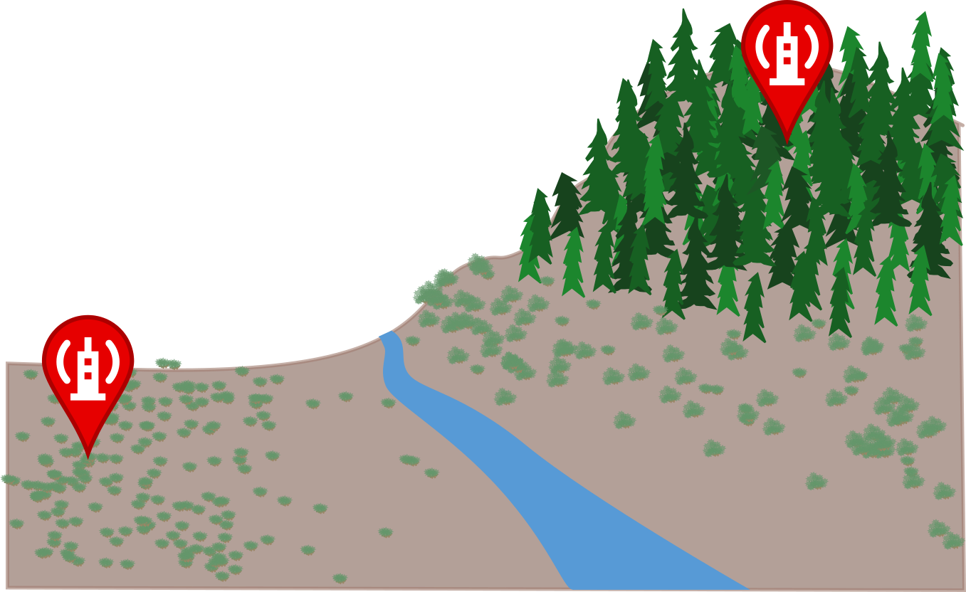
Objectives
ASSESS
the potential of multiple models to map ET across semi-arid environments
Notes:
In order to help our partners more easily and accurately estimate ET, our team had 4 major objectives: the first and most important objective was to assess the potential of currently available ET models to map ET in a semi-arid environment.
To reiterate the importance of using satellite-based ET measures, we’ll look at our theoretical watershed on the right. We currently know the ET values at our eddy flux covariance tower sites, marked with the red pins.
Image produced by Idaho Water Resources II Team

Slide 11
Objectives
ASSESS
the potential of multiple models to map ET across semi-arid environments
Notes:
We can extrapolate from that data to estimate what’s occurring within the red area, but these estimates may not be accurate if there are changes in vegetation and topography that alter ET.
Image produced by Idaho Water Resources II Team

Slide 12
Objectives
ASSESS
the potential of multiple models to map ET across semi-arid environments
ET Model
Notes:
Satellites can gather information from these areas between in situ measures, input them into ET models…
Image produced by Idaho Water Resources II Team

Slide 13
Objectives
ASSESS
the potential of multiple models to map ET across semi-arid environments
ET Model
?
Notes:
… and fill in those gaps. But how accurate are those satellite based measurements in a semi-arid steppe?
Image produced by Idaho Water Resources II Team

Slide 14
Objectives
ASSESS
the potential of multiple models to map ET across semi-arid environments
VALIDATE
models by comparing them to Eddy Covariance Flux Tower Measurements
ET Model
Notes:
To assess this accuracy, we validated the satellite-modeled ET with eddy flux covariance tower ET data.
Image produced by Idaho Water Resources II Team

Slide 15
Objectives
ASSESS
the potential of multiple models to map ET across semi-arid environments
VALIDATE
models by comparing them to Eddy Covariance Flux Tower Measurements
COMPARE
ET data to soil moisture, vegetation health, & precipitation to produce a holistic view of water availability
Notes:
Next we compared ET data to a number of environmental variables to produce a more holistic view of water availability in our study area.
Image produced by Idaho Water Resources II Team

Slide 16
Objectives
ASSESS
the potential of multiple models to map ET across semi-arid environments
VALIDATE
models by comparing them to Eddy Covariance Flux Tower Measurements
COMPARE
ET data to soil moisture, vegetation health, & precipitation to produce a holistic view of water availability
SHARE
A model or methodology that can
be used by project partners in
their respective disciplines
ET Model
Notes:
And, finally, we aimed to create an easily reproducible methodology for estimating ET that would be useful to our project partners.
Image produced by Idaho Water Resources II Team

Slide 17
Methodology
DATA INPUTS
ANALYZE
COMPARE
OUTPUT
GEE ET Models: EEFlux
MOD16
SSEBop
Google Earth Engine:
Combine GEE and in situ data; extract values at RCEW sites
RCEW ET & soil moisture, MSAVI2
Compare ET maps to elevation, soil moisture, etc.
ET Maps & Correlation
Plots
ArcGIS Pro:
Clip to study area; extract values at RCEW Points
Other Models:
NLDAS-2-Noah
Notes:
In order to meet our objectives, we had a relatively simple workflow. We collected data from four ET models: EEFlux, MOD16, SSEBop, and NLDAS-2-Noah as well as eddy covariance flux tower data from RCEW.
We then used either GEE or ArcPro to clip the modeled ET to the RCEW boundary and extracted values at RCEW flux tower sites for available dates that overlap with RCEW flux data.
The clipped maps were then compared to NDVI, soil moisture, and other environmental variables to determine if there were correlations between these variables and modeled ET.
The final output from the project include the clipped ET maps for the different models, as well as correlations between modeled ET and RCEW eddy covariance flux tower data.
Image produced by Idaho Water Resources II Team

Slide 18
NASA Satellites Used
Terra
MODIS & ASTER
Aqua MODIS
Landsat 7
ETM+
Landsat 8
OLI & TIRS
Notes:
Satellite imagery from NASA’s Terra Moderate-resolution Imaging Spectroradiometer (MODIS), Terra Advanced Spacebourne Thermal Emission and Reflection Radiometer (ASTER), Aqua MODIS, Landsat 7 Enhanced Thematic Mapper Plus (ETM+), Landsat 8 Operational Land Imager (OLI), and Landsat 8 Thermal Infrared Sensor (TIRS) were used to inform the four ET models we examined– SSEBop, MOD16, EEFlux (METRIC), and NLDAS-2-Noah.
Image Source: NASA

Slide 19
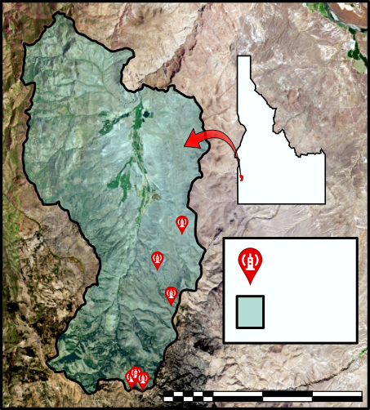
Study Area
Validation Sites: RCEW
Reynolds Creek Experimental Watershed
founded in 1959 as an outdoor laboratory for study of critical zone processes
IDAHO
E.C. Flux
Towers
Study Area Outline
0 5 10 20 km
Notes:
Our study area is the Reynolds Creek Experimental Watershed, which is located in southwest Idaho. Reynolds Creek was founded by an act of congress in 1959 and has been designated as a “Critical Zone Observatory”, where soil, water and organic systems have been studied over time. As a result, this area has long-term datasets that are spatially extensive and include data for diverse vegetation and elevation gradients. This gave us a valuable opportunity for checking the accuracy of satellite-based ET measurements across variable environmental conditions.
Image produced by Idaho Water Resources II Team

Slide 20
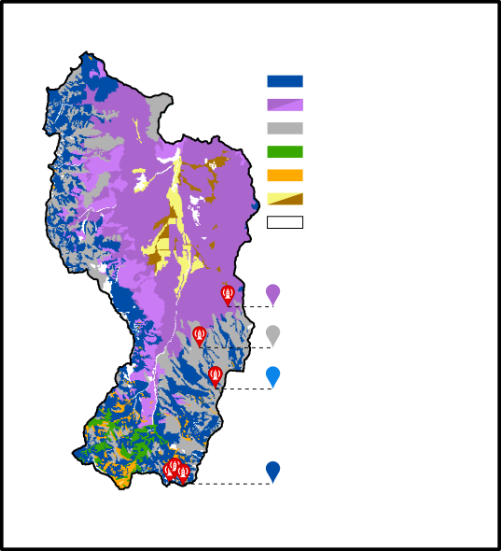
RCEW Sites & Vegetation
Mtn Sage
Mtn Sage/ btrbr
Low Sage
Conifer
Quaking Aspen
Cult. / greasewood
Other veg.
Representative sagebrush steppe, high desert
4 Eddy Covariance Flux Towers
3 vegetation types
Elevation gradient
WY Sage → Mtn. Sage 2
WY Sagebrush
Low Sagebrush
Mtn Sagebrush 1
Mtn Sagebrush 2
Notes:
RCEW is representative of a sagebrush steppe, high desert environment. At lower elevations vegetation is mainlu

Slide 21
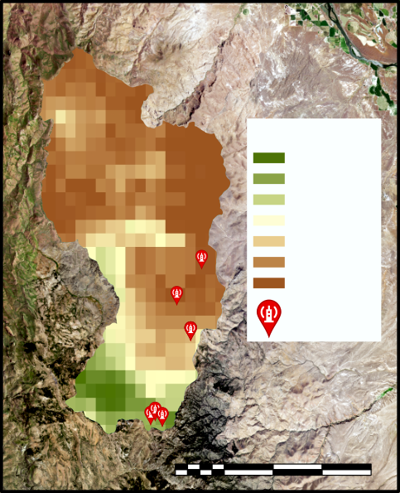
Results: SSEBop
E.C. Flux Towers
SSEBop
Low Sage
Mtn. Sage 1
Mtn. Sage 2
WY Sage
Evapotranspiration
110
ET (mm/month)
(mm/
month)
0
E.C. Flux Towers
0 5 10 20 km
Notes:
The SSEBop model is based on earlier models that use a surface energy balance to model ET. On the top we have a time series showing monthly cumulative ET at RCEW, with months on the x axis and ET in mm/month on the y for 2016. On the bottom, we have a time series for SSEBop modeled ET data for 2016, again with time in months on the x axis and ET on the y in mm/month. Our different colored lines represent the different eddy covariance tower sites at Reynolds that are located within different vegetation communities and at diverse elevations, as discussed on the previous slide. On the top, we can see ET peaks at different times depending on the vegetation community– low and Wyoming sagebrush peak in May while our high and low elevation mountain sagebrush peak in June.
The map on the right is from June of 2016. It shows the spatial variation in ET across the watershed. The colors here indicate ET values, with low values of in brown and high ET values in green. The ET distribution appears to follow the vegetation and elevation gradient, with higher ET values in higher elevation mixed forest areas. SSEBop spatial resolution is 1 km.
Images produced by Idaho Water Resources II Team

Slide 22
Results: SSEBop
E.C. Flux Towers
Low Sage
Mtn. Sage 1
Mtn. Sage 2
WY Sage
ET (mm/month)
Notes:
These are our same time series for RCEW and SSEBop on the left, and a correlation plot on the right. We can see that while SSEBop fits to the patterns in RCEW data well for our lower elevation mountain sagebrush (in dark blue) and moderately well for low sage (grey), SSEBop ET did not closely replicate Reynolds Creek ET for our higher elevation mountain sagebrush (light blue) or the Wyoming sage (purple).
Images produced by Idaho Water Resources II Team

Slide 23
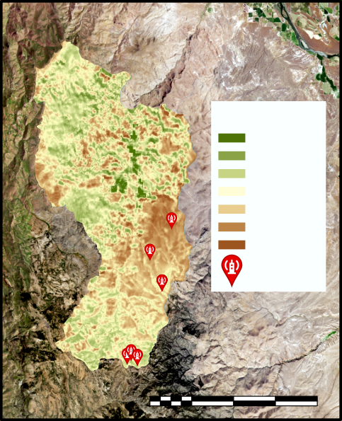
Results: EEFlux
E.C. Flux Towers
EEFlux
Low Sage
Mtn. Sage 1
Mtn. Sage 2
WY Sage
Evapotranspiration
ET (mm/month)
15
(mm/
8 days)
0
E.C. Flux Towers
0 5 10 20 km
Notes:
The EEFlux model is a Google Earth Engine toolset based on the METRIC ET model. On the bottom we have the time series for EEFlux modeled ET data for 2016, with time on the x axis and ET on the y in mm/month. Again, the different lines represent the different eddy covariance tower sites at RCEW. Looking quickly at the comparison to Reynolds’ ET, EEFlux overestimates some ET values, such as the peak ET at the higher elevation mountain sage site, and underestimates others such as the July values for low and Wyoming sage.
The map on the right is again from June of 2016. It shows the spatial variation in ET across the watershed. Again, green represents highest ET values and at the higher 30 m spatial resolution, the EEFlux model picks up on irrigated agricultural fields, shown in dark green.
Images produced by Idaho Water Resources Team

Slide 24
Results: EEFlux
E.C. Flux Towers
Low Sage
Mtn. Sage 1
Mtn. Sage 2
WY Sage
ET (mm/month)
Notes:
Looking at the time series against the correlation plot for 2016, EEFlux most closely approximated RCEW ET values for the high elevation mountain sage (yellow) and was moderately close for low sage (orange) and low elevation mountain sagebrush (green). Patterns in EEFlux ET did not closely match RCEW ET for the Wyoming sage (blue).
Images produced by Idaho Water Resources II Team

Slide 25
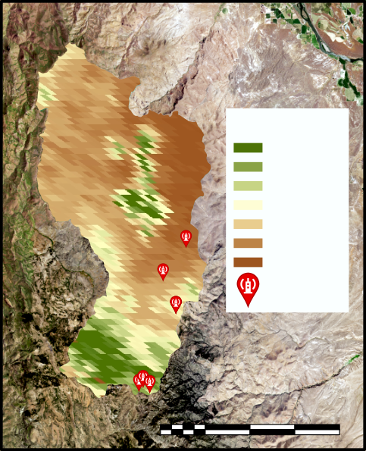
Results: MOD16
E.C. Flux Towers
MOD16
Low Sage
Mtn. Sage 1
Mtn. Sage 2
WY Sage
Evapotranspiration
ET (mm/month)
45
(mm/
8 days)
0
E.C. Flux Towers
0 5 10 20 km
Notes:
MOD16 is a Penmen-Monteith-based global ET model that utilizes MODIS data as well as meteorological data. On the left we have our 2016 time series again. It is important to note that the y-axis scale for MOD16 here is 3 times that of the RCEW data. This is because MOD16 severely overestimated ET values at our sampled sites. For example, while our highest monthly cumulative ET value for Reynolds was around 115 mm/month, the highest value for MOD16 was close to 475.
The map on the right shows an intermediate spatial scale, falling between EEFlux and SSEBop. The map indicates that our highest ET values in the watershed occurred in the agricultural lands in the northeast part of the watershed and the higher elevation mixed forested areas in the southernmost portion.
Images produced by Idaho Water Resources II Team

Slide 26
Results: MOD16
MOD16 vs. RCEW, 2016
E.C. Flux Towers
Low Sage
Mtn. Sage 1
Mtn. Sage 2
WY Sage
ET (mm/month)
Notes:
Looking at the correlations we see that MOD16 was highly successful at replicating ET patterns found in the higher elevation mountain sage (yellow) and the low sage (orange). However patterns for the Wyoming and lower elevation mountain sage did not fit well to our RCEW ET series.
Images produced by Idaho Water Resources II Team

Slide 27
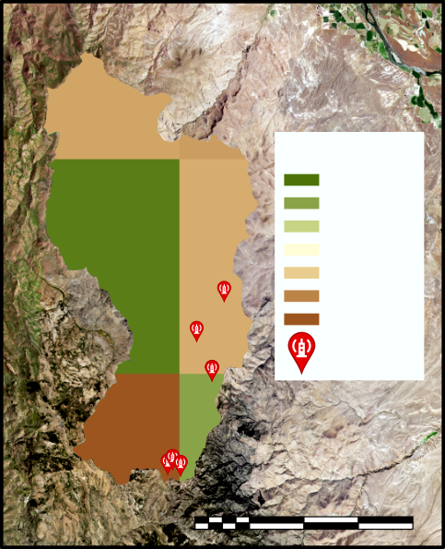
Results: NLDAS-2-Noah
E.C. Flux Towers
NLDAS-2-Noah
Low Sage
Mtn. Sage 1
Mtn. Sage 2
WY Sage
Evapotranspiration
ET (mm/month)
60
(mm/
month)
0
E.C. Flux Towers
0 5 10 20 km
Notes:
NLDAS-2-Noah is an ET model that supplements satellite data with a lot of meteorological datasets. NLDAS generally tends to underestimate cumulative monthly ET values. You’ll also notice that NLDAS plot looks as though there are only two lines plotted. If you look at the map on the right, we can see why. NLDAS has a relatively poor spatial resolution with ~12 km² pixels. This means that a total of 6 pixels make up our entire watershed, and that our measured sites fall within 2 pixels.
Images produced by Idaho Water Resources II Team

Slide 28
Results: NLDAS-2-Noah
NLDAS-2-Noah vs. RCEW, 2016
E.C. Flux Towers
Low Sage
Mtn. Sage 1
Mtn. Sage 2
WY Sage
ET (mm/month)
Notes:
Despite low spatial resolution, NLDAS was well-correlated to ET patterns in Reynolds ET data for our mountain and low sage. Even Wyoming sage, which had a relatively poor correlation to RCEW ET in all other models, had a moderately strong correlation.
Images produced by Idaho Water Resources II Team

Slide 29
Results: Model Comparison
MODEL | PROS | CONS
SSEBop | Easy to access/download data | Underestimates ET Highly variable correlations depending on vegetation/elevation
EEFlux (METRIC)
MOD16
NLDAS
Notes:
In addition to the information on correlations, this process allowed us to work with multiple ET datasets and assess applicability to our partners’ needs. Each dataset had strengths and limitations. SSEBop was easy to access and download through the ClimateEngine App, both in a time series and map image format. However, SSEBop consistently underestimates ET and our correlation strength was highly variable depending on vegetation type and elevation.

Slide 30
Results: Model Comparison
MODEL | PROS | CONS
SSEBop | Easy to access/download data | Underestimates ET Highly variable correlations depending on vegetation/elevation
EEFlux (METRIC) | High spatial resolution | Difficult to access & download data Cloud cover limits usability Landsat 7 images may be unusable
MOD16
NLDAS
Notes:
The EEFlux dataset has a high spatial resolution, at 30 m. On the negative side, it is difficult to access and downlo

Slide 31
Results: Model Comparison
MODEL | PROS | CONS
SSEBop | Easy to access/download data | Underestimates ET Highly variable correlations depending on vegetation/elevation
EEFlux (METRIC) | High spatial resolution | Difficult to access & download data Cloud cover limits usability Landsat 7 images may be unusable
MOD16 | Fairly high spatial resolution | Overestimates ET across the board
NLDAS
Notes:
In addition to the information on correlations, this process allowed us to work with multiple ET datasets and assess applicability to our partners’ needs. Each dataset had benefits and limitations. SSEBop was easy to access and download through the ClimateEngine App, both in a time series and map image format.

Slide 32
Results: Model Comparison
MODEL | PROS | CONS
SSEBop | Easy to access/download data | Underestimates ET Highly variable correlations depending on vegetation/elevation
EEFlux (METRIC) | High spatial resolution | Difficult to access & download data Cloud cover limits usability Landsat 7 images may be unusable
MOD16 | Fairly high spatial resolution | Overestimates ET across the board
NLDAS | Best correlations High temporal resolution | Low spatial resolution Correlation may depend on availability of meteorological data
Notes:
In addition to the information on correlations, this process allowed us to work with multiple ET datasets and assess applicability to our partners’ needs. Each dataset had benefits and limitations. SSEBop was easy to access and download through the ClimateEngine App, both in a time series and map image format.

Slide 33
Results: Elevation
EEFlux (METRIC)
EEFlux generally increases linearly with elevation from 1200-2000m
Low and high elevations show models sensitivity to plant type
Spatial resolution (30m) leads to greater sensitivity in elevation bins
SSEBop
Linear increase in ET with elevation
Low sensitivity to different vegetation types at extremes of elevation, possibly due to spatial resolution (1000m)
NLDAS-2 Noah
Not shown, spatial resolution is ~12km, containing a large range of elevations per pixel, too coarse for analysis
Mean ET (mm/day)
Notes:
In order to meet our third objective, we assessed how ET was influenced by environmental variables. Because the ET values were so severely overestimated for MOD16, we did not assess MOD16’s correlations with any of the environmental variables. NLDAS-2 Noah was excluded from analysis that required high spatial resolution datasets, because its coarse resolution was insensitive to variation within its pixels.
The first environmental variable we examined at was elevation. We found strong correlation that ET estimates increase linearly with elevation in both EEFlux and SSEBop models. This relationship is nearly identical to the same relationship derived from in situ measures at the validation sites. This suggests that both models accurately assess ET across elevation without bias and that elevation may be valuable as one proxy variable in estimating ET. Note, the linearly relationship fails in extreme elevations in the EEFlux model. Because of EEFlux’s high spatial resolution, it picks up variability in ET in small vegetation communities, such as thin riparian zones along streams at lower elevations. Additionally, it was able to accurately assess decreasing ET along high elevations. These high elevations are sampled along ridgelines, which are likely controlled by limited soil thickness, sparse vegetaion, and limited water, all which factor in to reduce ET in these areas.

Slide 34
Results: Vegetation Type
Distribution of ET
Sagebrush types account for 94% of vegetation
Conifer and Aspen account for <4%
ET by Vegetation Type
EEFlux, SSEBop, and MOD16 all showed similar trends in ET by vegetation type
Notes:
Next, we assessed the influence of vegetation type on ET estimates across the watershed. Again MOD16 and NLDAS are excluded for aforementioned reason. The distribution of vegetation types in the watershed is dominated by several types of sagebrush which contribute to 94% of all landcover. Conifers, aspens, riparian, and other vegetation contribute the remaining 6%. The bar plots represent the minimum, maximum, and the standard deviation around the mean. These plots show that differing models produced little to no detectable bias for vegetation type across the available landcover.

Slide 35
Results: Vegetation Health
Mtn Sage 1
Mtn Sage 2
Low Sage
WY Sage
ET vs Vegetation Health
ET increased linearly with vegetation health in all 4 models and in situ data
Relationship is similar across sites, which vary in vegetation type, but are all dominated by varying species of sagebrush
Notes:
Finally, we assessed the influence of vegetation health on ET estimates from three of our models. MSAVI-2, the Modified Soil-Adjusted Vegetation Index, has been shown to be the best indicator of vegetation health in environments with significant bare-soil and limited vegetation such as the sagebrush steppe. ET estimates were found to have a positive, linear correlation to MSAVI-2 index, although the strength of this relationship varied by validation site. However, the strength of these relationships is currently based on a relatively limited sample, all corresponding Landsat 8 scenes and ET measures, and may change with additional sampling.

Slide 36
Conclusions
Image Credit: Ian Lauer
NLDAS-2 Noah was the best estimator of in situ ET measurements and had the best temporal resolution at 1 hr, but had the lowest spatial resolution.
Choose ET model based on the question you want to answer– Different spatial and temporal scales mean they would apply to different problems.
Sharpening high temporal resolution (NLDAS) data with high spatial resolution models (SSEBop, MOD16, or EEFlux) has the potential to be an ideal model.
Notes:
NLDAS-2 Noah was the best estimator of in situ ET measurements and had the best temporal resolution at 1 hr, but had the worst spatial resolution at 13km. The coarse resolution severely inhibits NLDAS-2 Noah from being used in watershed or smaller scale studies, which are the focus of most of our partners.
Sharpening high temporal resolution (NLDAS) data with high spatial resolution models (SSEBop, MOD16, or EEFlux) has the potential to be an ideal model for our partner’s applications. However, additional resources will need to be invested by partners or otherwise to make this a reality.
Image Source: Ian Lauer

Slide 37
Future Work
Image Credit: Reynolds Creek Experimental Watershed
Compare this term’s ET model results to the Patagonia steppe in Argentina and apply a new model developed there to Idaho
Evaluate the ability of Ecosystem Spaceborne Thermal Radiometer Experiment on Space Station (ECOSTRESS) to measure ET in the semiarid sagebrush steppe
Notes:
The Spring 2018 project will be a spiritual successor to the Idaho Water Resources Projects, applying their methodologies to partner research areas in Patagonian steppe of Argentina. That project will apply similar methodology in validating a new ET model from our partner in the Reynolds Creek Experimental Watershed. This project will improve the skill base of researchers working on ET models, as well as provided needed expansion of test sites to a similar ecoregion.
In addition, future work will likely focus on producing hybrid ET models, potentially combing a NLDAS-2 Noah’s high temporal resolution and high precision ET estimates with a high spatial resolution dataset, such as SSEBop using Landsat 8 inputs at 30m resolution. The Ecosystem Spaceborne Thermal Radiometer Experiment on Space Station (ECOSTRESS), currently being tested on the International Space Station, represents the newest sensor with ET capabilities, and could hold future potential in these applications.
Image Source: Provided by partners at RCEW
Image Link: https://criticalzone.org/reynolds/infrastructure/field-area/johnston-draw/

Slide 38
Acknowledgements
Node Science Advisor:
Keith Weber, GIS Director at Idaho State University GIS TReC
U.S. Fish and Wildlife Service:
Evan Ohr, Biologist
Lisa Dlugolecki, Biologist
Matt Bringhurst, Soil Conservation Tech
USDA Natural Resources Conservation Service:
Nate Matlack, Soil Conservationist
Trudy Pink, Resource Soil Scientist
Idaho Department of Fish and Game:
Scott Bergen, Sr. Wildlife Research Biologist
USDA Agricultural Research Service:
Patrick E. Clark, Range Scientist
Mark Seyfried, Soil Scientist
Idaho National Laboratory:
Tammie Borders, Research Scientist
Trent Armstrong, Research Scientist
Former ID – Pocatello Center Lead:
Brandon Crawford, Research Scientist
Notes:
see above
--------------Image Credits Below --------------
N/A

Slide 39
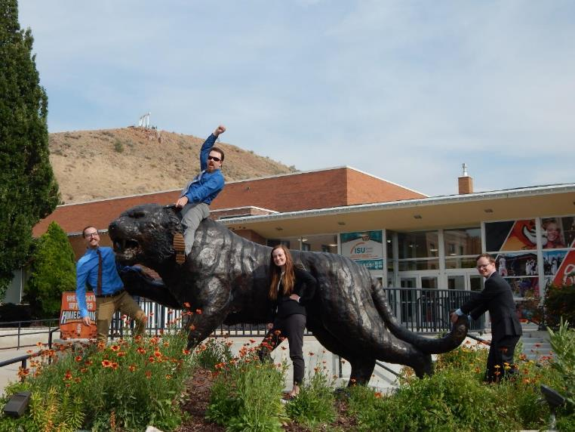
Questions?
Notes:
Thank you for listening to our presentation. Any questions?
--------------Image Credits Below --------------
Image produced by Idaho Water Resources Team

