Slide 1
Assessing Landscape Vulnerability to Drought and Climate Change in National Parks of the Western United States
Western US Water Resources
Kelly Meehan (Project Lead)
Teresa Fenn
Kaylie Taliaferro
Molly Spater
Thomas Smith
Grant Jaccoud
Image Credit: NPS
Notes:
Hi I’m Kelly Meehan, I graduated from Duke University with a master’s in Environmental Management. Hi I’m Teresa Fenn, I have a bachelor’s degree in Environmental Science from the University of Mary Washington. Hi I’m Molly Spater, I graduated from UCLA with a bachelor’s in Geography. I’m Kaylie Taliaferro, I am currently studying mathematics at Biola University. Hi I’m Tom Smith, I am currently studying geography at Clark University. Along with our Air Force volunteer, Grant Jaccoud, we are the Western US Water Resources Team at LaRC.
URL: https://www.nps.gov/media/photo/gallery.htm?id=68A74017-155D-451F-671F241DA6E2A925

Slide 2
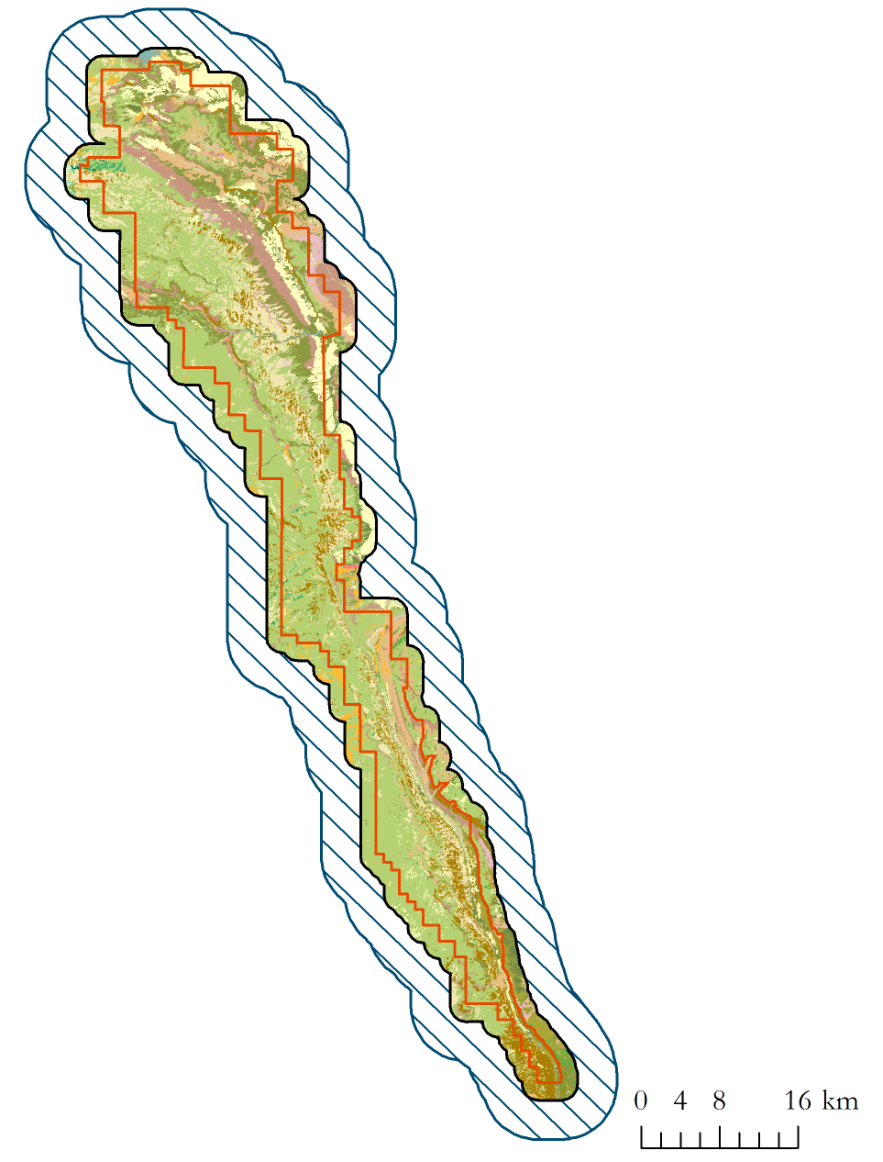
Study Area and Period
Capitol Reef National Park, Utah
2000
2014
Notes:
The study area for our project was Capitol Reef National Park in south-central Utah. The study period ranged from 2000- 2014, corresponding to the availability of MODIS data.
TOM

Slide 3
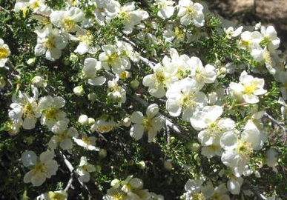
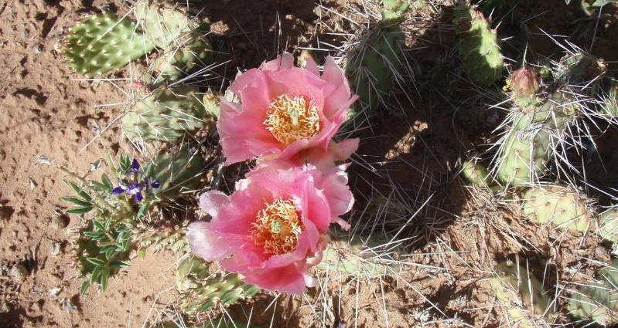
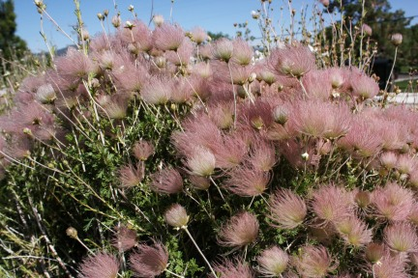
Community Concerns
The West has been experiencing drought for over a decade
Much of the vegetation in the American West is water limited
Vegetation shifts are the early warning signs of: Environmental thresholds
Image Credit: BiodiversityWarriors
Image credit: NPS
Image Credit: Garden of Edith
Notes:
Much of the American West has experienced drought in 11 of the past 14 years. Combined with rising temperatures, water availability is of increasing concern to land managers.
Prolonged disturbances, such as drought, could push an ecosystem past a threshold which signifies an irreversible change from one type of ecosystem to another.
TOM
Left Image Credit: http://images.fineartamerica.com/images-medium-large-5/cliff-rose-charles-robinson.jpg
Center Image Credit: https://www.nps.gov/common/uploads/photogallery/imr/park/care/68CA8441-155D-451F-67E9CF2651D2E1AB/68CA8441-155D-451F-67E9CF2651D2E1AB-large.jpg
Right Image Credit: Image Credit: http://www.garden-of-edith.com/wp-content/uploads/2015/05/IMG_5065ApachePlumeCloseUpAfterBloom.jpg

Slide 4
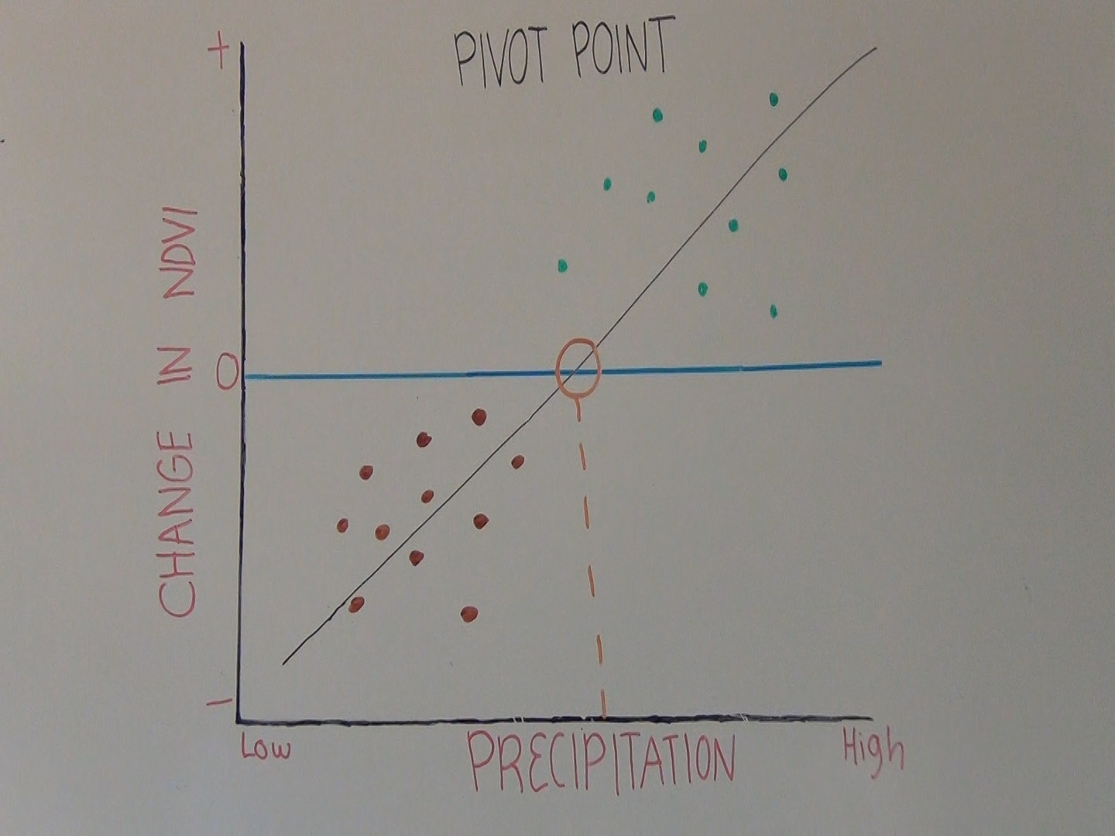
Objectives
Determine climate pivot points
Evapotranspiration
Precipitation
Temperature
Identify Best Vegetation Index
Formulate a methodology to determine vegetation response
Account for Time Lag
Example of Pivot Point Extraction
Image Credit: Virgin Town, Utah
Notes:
Climate pivot points are early warning signs of such an approaching irreversible threshold; they are indicators of when vegetation productivity may either begin to increase or decrease.
The primary objective of this study was to determine climate pivot points for different environmental factors – including evapotranspiration, precipitation, and temperature for varying vegetation types. These environmental factors were related to water availability, which is critical in this arid region. Our methodology will be offered to land managers at the National Park Service in the western United States to better understand the response of vegetation to a changing climate.
TOM
Image Credit: http://www.virginutah.org/files/PHOTOS/PHOTOGALLERY/MESA_VIEW1.jpg

Slide 5
Methodology
Data acquisition and
pre-processing
Multiple Linear Regression Model
Pivot Point Extraction
Data Analysis
Image Credit: Travel Around USA
Notes:
Our analysis consisted of four main parts: data acquisition and pre-processing, data analysis, creating a multiple linear regression, and extracting pivot point values.
Kaylie
http://www.travelaroundusa.com/capitol-reef-national-park-ut.html

Slide 6
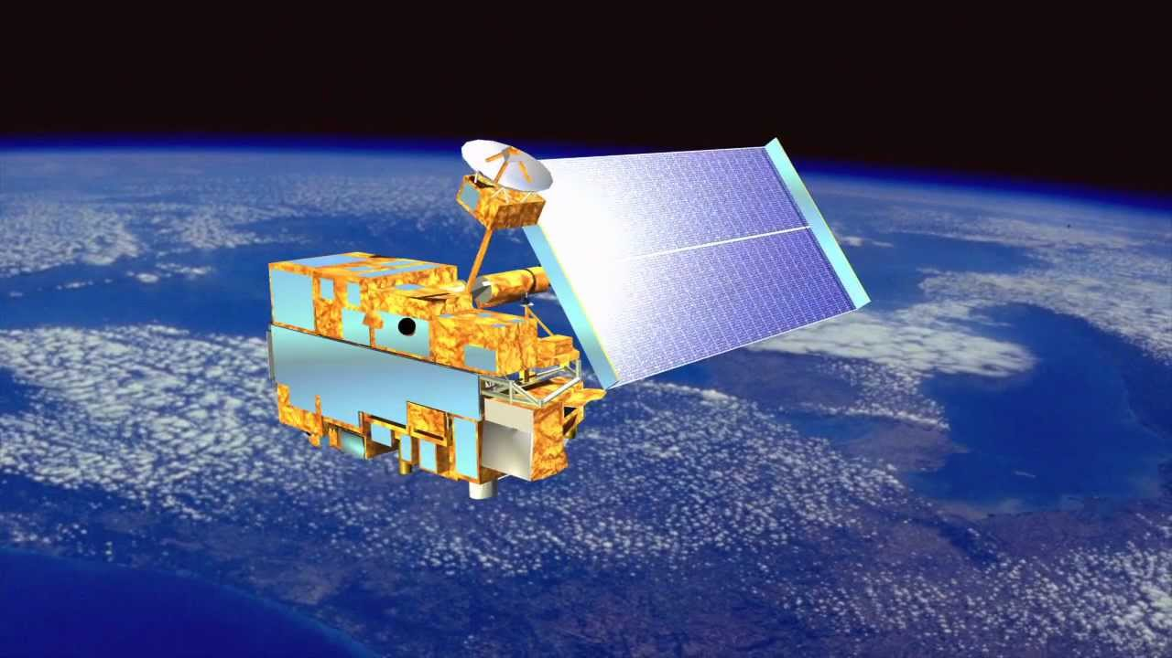
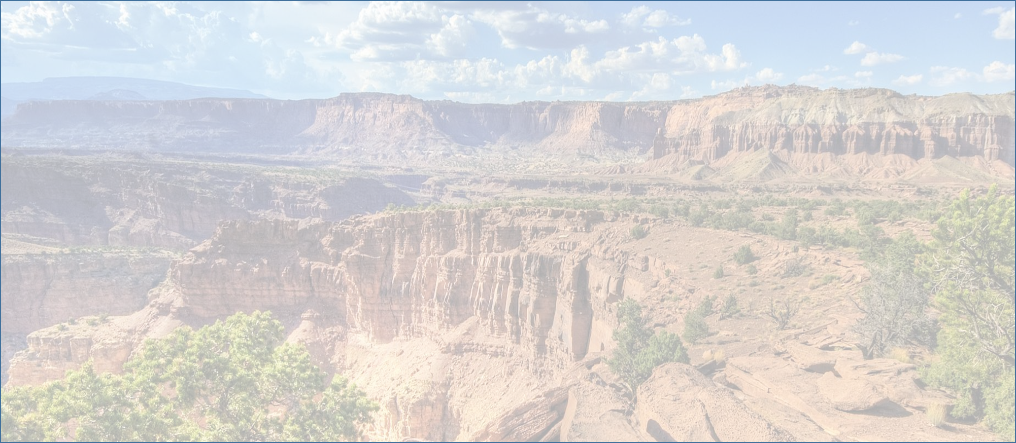
MAX NDVI and Evapotranspiration
Moderate
Resolution
Imaging
Spectroradiometer
Image Credit: retostockli’s channel
Notes:
For our dependent variable, we utilized the US Forest Service’s ForWarn vegetation change recognition and tracking system data, which is derived from the MODIS sensor onboard TERRA. ForWarn datasets are processed to correct for errors caused by cloud cover. We used ForWarn’s NDVI product as a proxy for vegetation productivity.
For one of our independent variables, predicted actual evapotranspiration, we used MOD16 data, derived from MODIS by the University of Montana.
Kaylie
Image Credit: https://www.youtube.com/watch?v=_t6elBIN-Wc

Slide 7
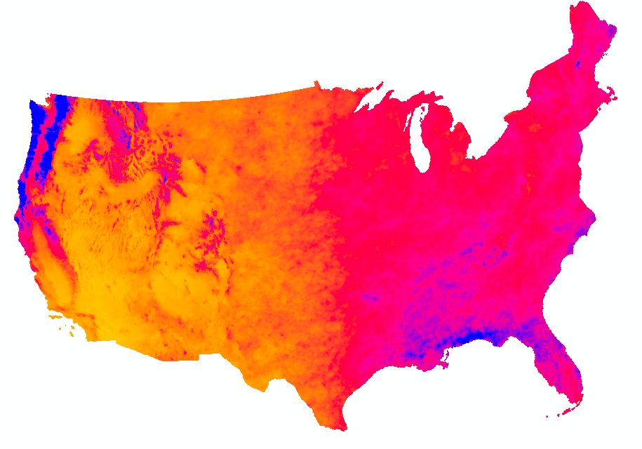
PRISM Climate Group
January
December
December
November
November
October
October
September
September
August
August
September
Notes:
Mean Temperature and Precipitation data were downloaded from the PRISM Climate Group.
To account for the time necessary for vegetation to respond to precipitation events, we tested lag times ranging from 0 to 6 months against delta NDVI, identifying the one with the strongest correlation.
For each year of the study period, we calculated the average temperature of the growing season because our analysis showed that it was most closely correlated with maximum NDVI values.
Kaylie

Slide 8
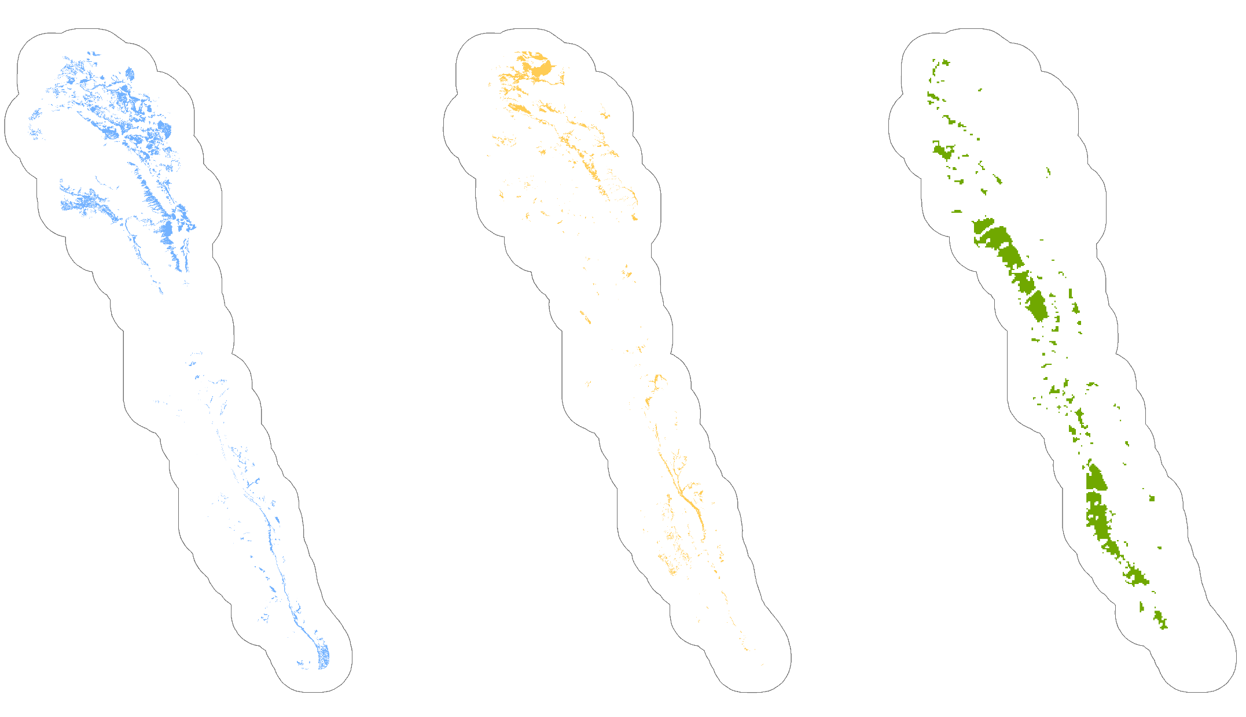
National Park Service Inventory & Monitoring Program
Capitol Reef
Vegetation Classes
Sagebrush
Shrubland
Semi-Desert
Grassland
Pinyon- Juniper
Woodland
Notes:
In order to investigate each vegetation type individually, we utilized a vegetation classification dataset provided by the National Park Service’s Inventory and Monitoring Program. In this project we looked at three classes of vegetation: Colorado Plateau Sagebrush Shrubland, Inter-Mountain Basins Semi-Desert Grassland, and Colorado Plateau Pinyon-Juniper Woodland.
Molly

Slide 9
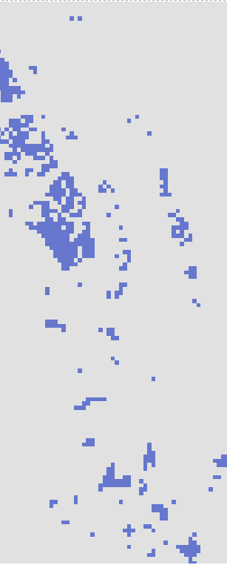
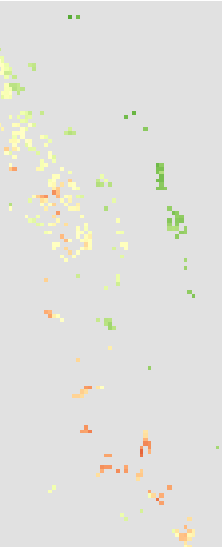
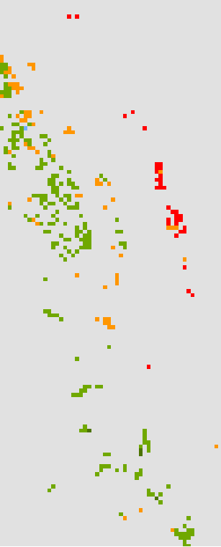
Methodology
Part 2: Data Analysis
Observed
Theoretical
Delta NDVI
Image Credit: Travel
Around USA
Notes:
In order to select pixels to represent each of the three vegetation types, we removed pixels that potentially contained vegetation outside the class of interest.
Calculating slope from a USGS digital elevation model, we also eliminated pixels within high slope areas which may have possible errors in the imagery.
Second, we calculated delta NDVI for each year by taking the observed value for that year and subtracting from it the theoretical NDVI value. The theoretical NDVI value was calculated as the average NDVI value for that vegetation group over the course of the study period.
Molly

Slide 10
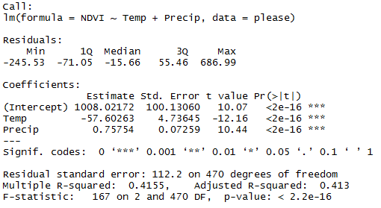
Methodology
Part 3: Multiple Linear Regression
Image Credit: Travel Around USA
Notes:
For each vegetation type, we ran a stepwise backward elimination multiple linear regression with delta NDVI as our dependent variable, and with our climate factors as our independent variables.
Molly

Slide 11
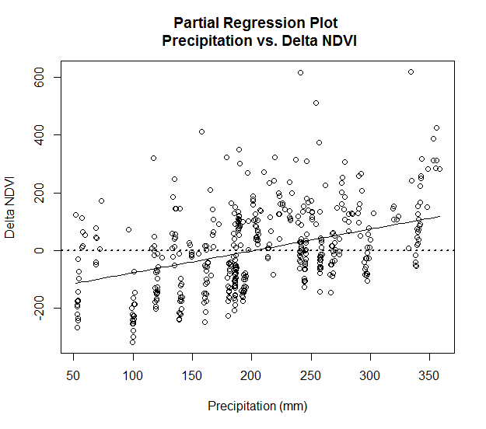
Methodology
Part 4: Pivot Points
Image Credit: Travel Around USA
 | Adjusted R-squared | Equation
Sagebrush Shrubland | 0.413 | y = 0.75754(P) - 57.60263(T) +1008.02172
Semi-Desert Grassland | 0.3882 | y = 2.246(P) +113.8(T) + .03747(E) - 3217
Pinyon-Juniper Woodland | 0.1924 | y =- 1.10513(P) -232.50463(T) + 0.35845(E) + 3979.4436
Notes:
*Graph of pivot point extraction.
*Equations here
The equation from this model can be used to predict delta NDVI values, as well as to extract pivot point values.
We extracted pivot point values for one variable at a time. We solved for each variable by setting delta NDVI to 0 and all other variables to their mean value over the study period.
Teresa

Slide 12
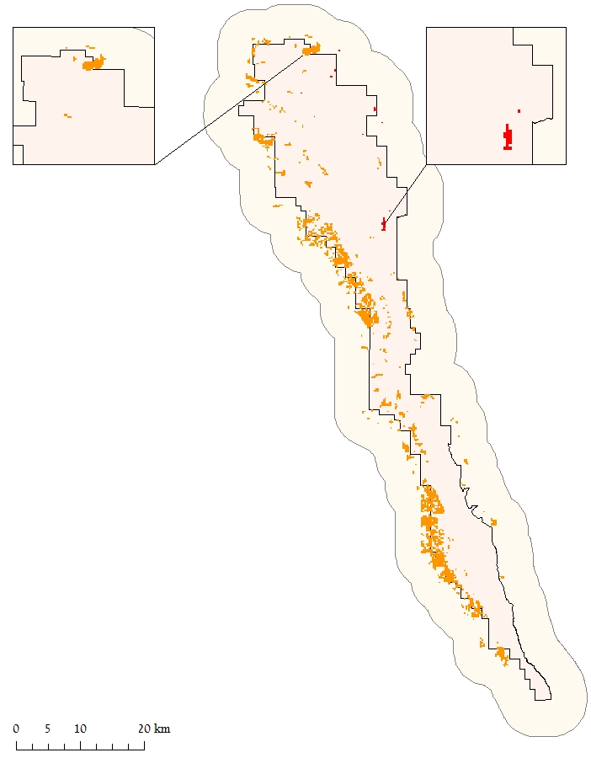
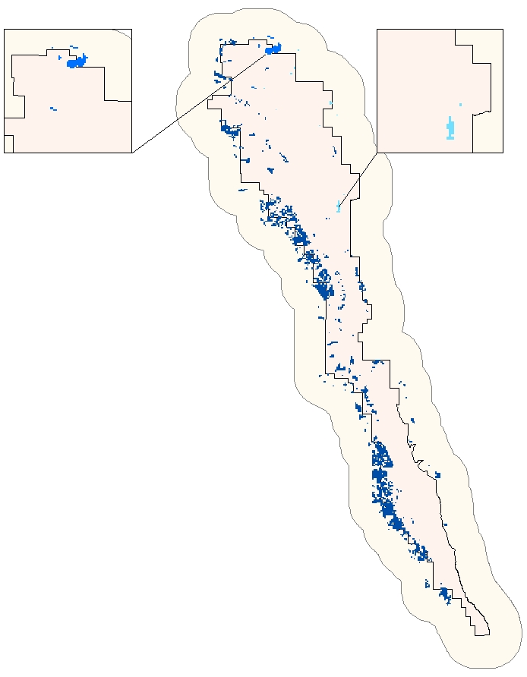
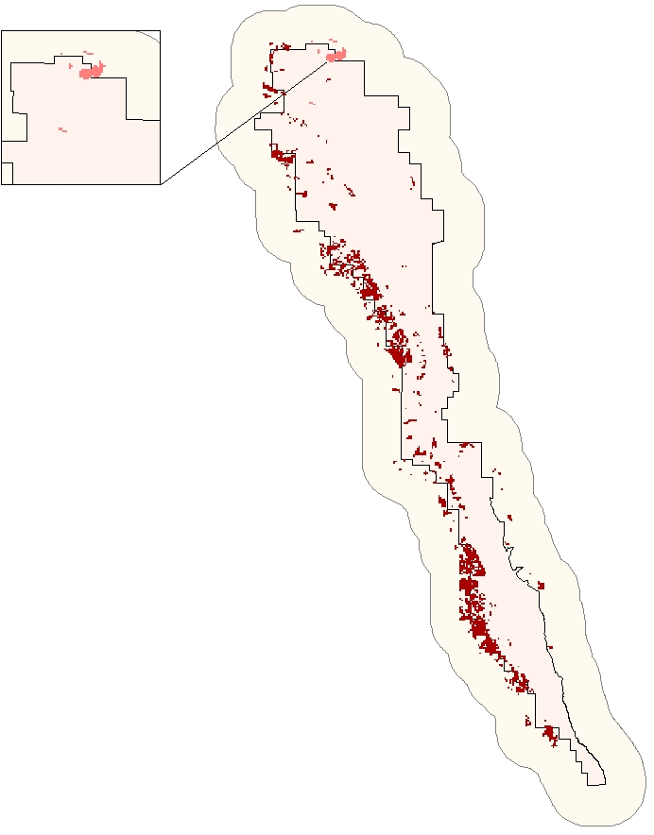
Results
Temperature (°C)
Precipitation (mm)
Evapotranspiration (.1mm/yr)
Grassland: 18.08
Sagebrush: 202.59
Grassland: 1783.19
Sagebrush: 18.64
Grassland: 216.48
Pinyon-Juniper: 1798.78
Pinyon- Juniper: 20.18
Pinyon-Juniper: 230.64
4km Buffer
Park Boundary
Notes:
We interpreted vegetation types with lower precipitation pivot point values, or higher temperature and evapotranspiration values as being more resistant to drought.
Based on our results, we anticipate Shrublands to be more resistant to higher temperatures and lower precipitation. Woodlands and grasslands seem to be similar in terms of resistance to temperature. However, in terms of precipitation, Woodlands are more vulnerable to lower precipitation rates.
Teresa

Slide 13
Limitations
Possible vegetation shifts
Resampling
Adjusted r-squared value for Pinyon Juniper Woodland
Image Credit: NPS
Notes:
Possible limitations of this project were that the vegetation shifts could have occurred over the course of our study period.
Additionally, all of our independent variables were resampled to the finer resolution of our NDVI data.
Lastly, some vegetation regions had low adjusted r-squared values, indicating that this type of analysis might be more complicated for certain vegetation types.
Kelly
Image Source: https://www.nps.gov/colm/learn/nature/images/Utah-Juniper.JPG

Slide 14
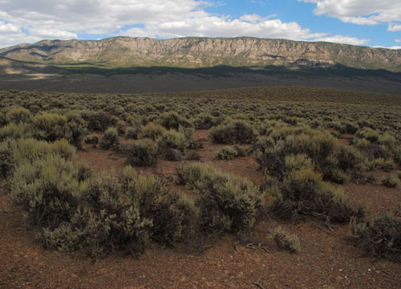
Conclusions
Precipitation and temperature significantly correlated with Delta NDVI
Sagebrush Shrublands more resilient to higher temperatures and lower precipitation
Image Source: BLM
Notes:
*Explanation of what makes vulnerable or resilient.
In all cases precipitation and temperature were significantly correlated with delta NDVI, whereas evapotranspiration was only significant in the Semi-desert Grassland and Pinyon- Juniper Woodland areas. The results indicated that Sagebrush Shrublands will be more resilient to higher temperatures and lower precipitation rates compared to the other two vegetation types.
Kelly
Image Source:http://www.blm.gov/style/medialib/blm/ut/natural_resources/Colorado_Plateau/landCoverGallery.Par.56058.Image.500.360.jpg

Slide 15
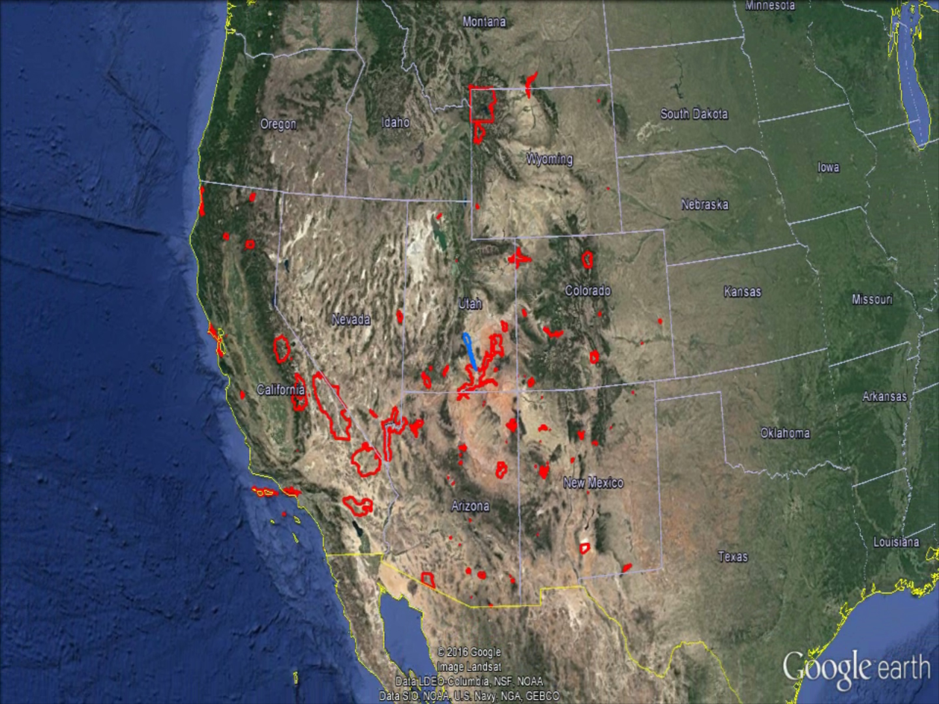
Future Work
Alternative vegetation index
Additional parks
Additional climate variables
Different calculations of delta NDVI
Creating our own vegetation classifications using remote sensing
Exploring the use of higher resolution imagery
Removing disturbed areas using the Normalized Burn Ratio
Notes:
Future work might explore alternative vegetation indices, classifying vegetation types via remote sensing, and using higher resolution imagery amongst other things.
Kelly

Slide 16
Dr. Seth Munson, United States Geological Survey Southwest Biological Science Center Plant Ecologist
Dr. David Thoma, National Park Service Inventory and Monitoring Program Ecologist
Dr. Kenton Ross, NASA National DEVELOP Program Lead Science Advisor
Emily Gotschalk and Tyler Rhodes, Center Leads NASA Langley Research Center
Notes:
We would like to thank our partners,
Kelly

