Slide 1
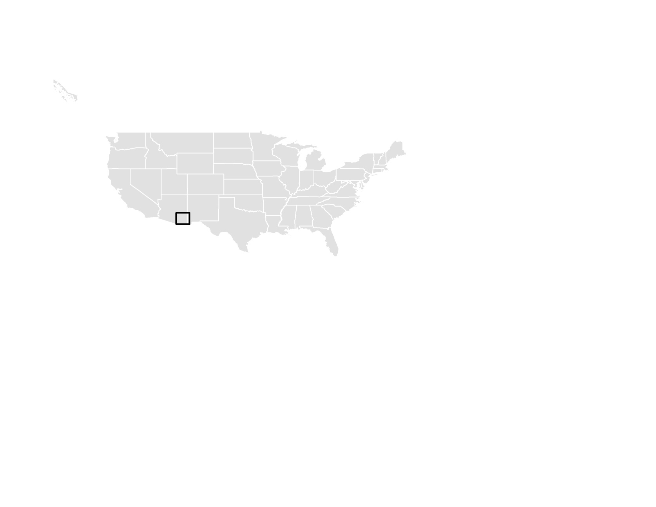
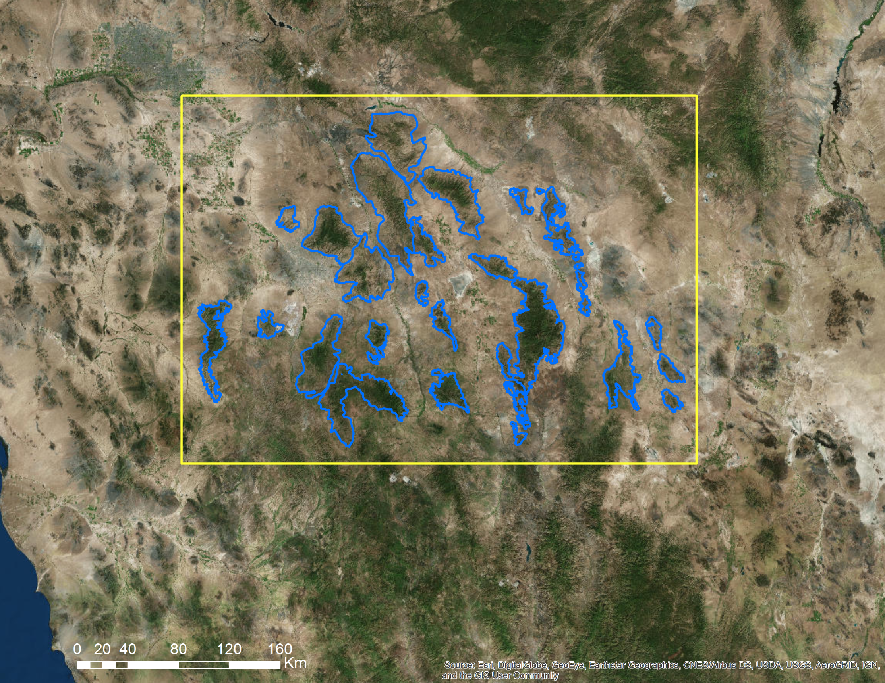





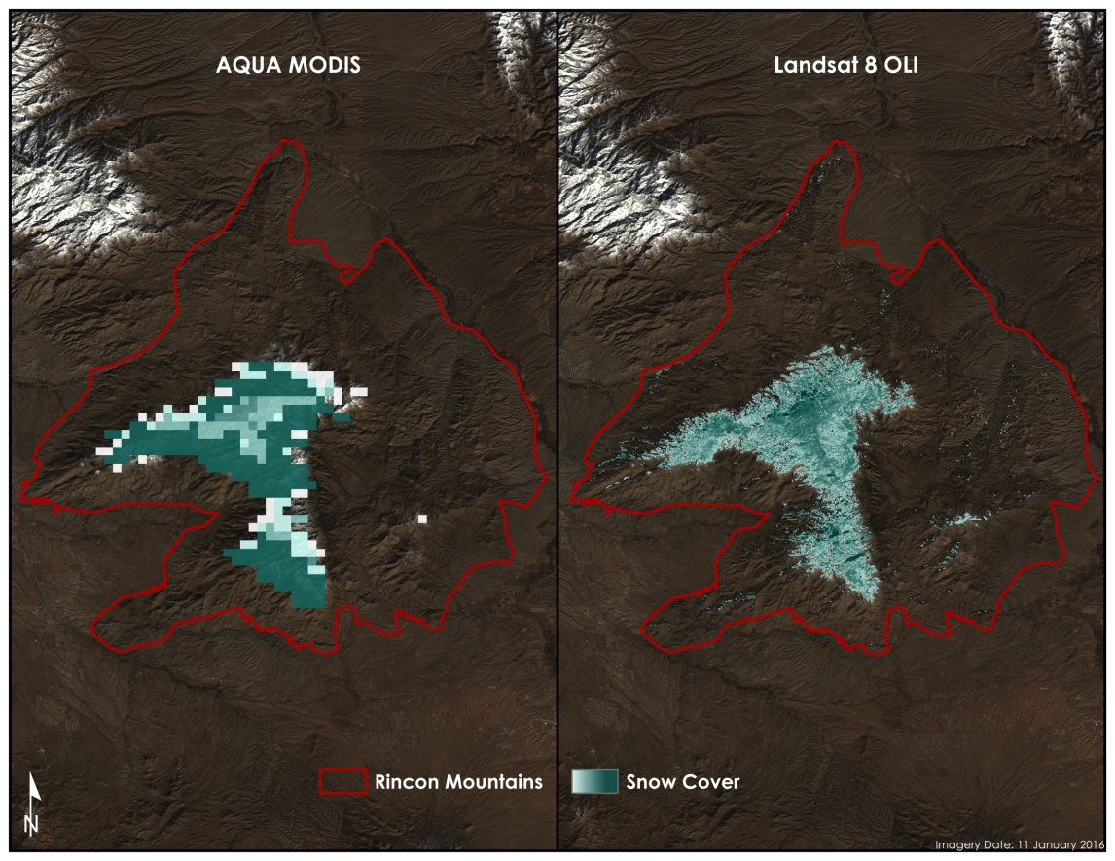
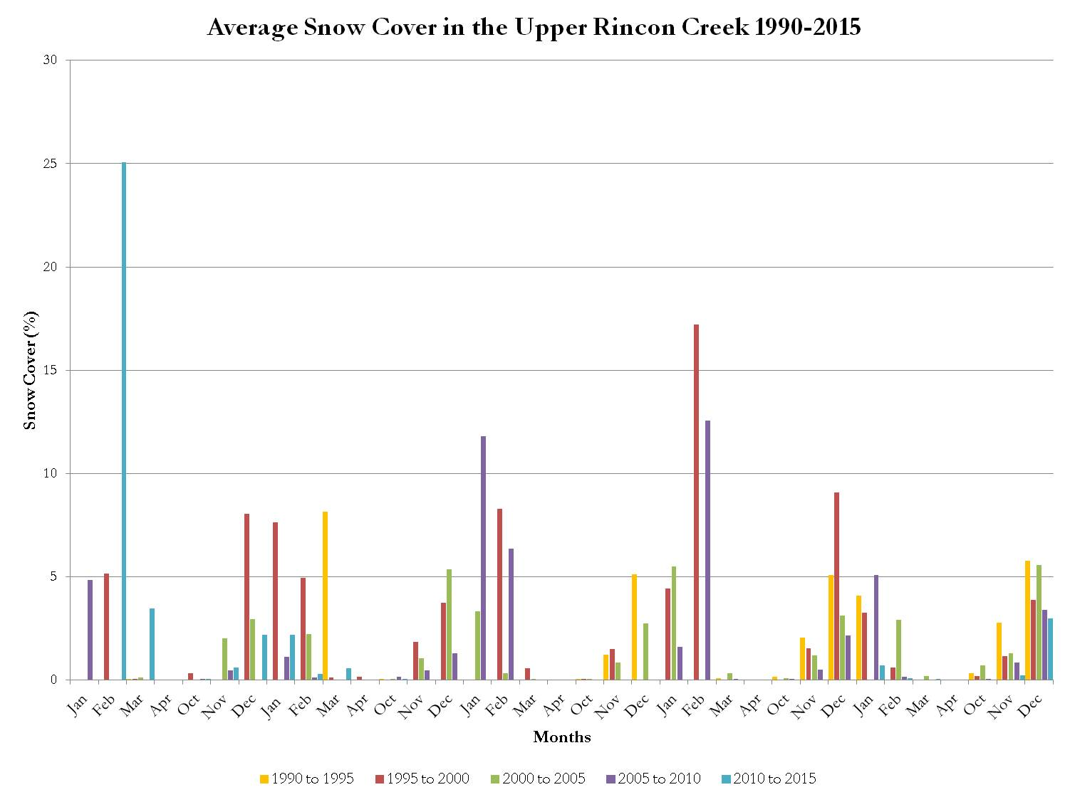
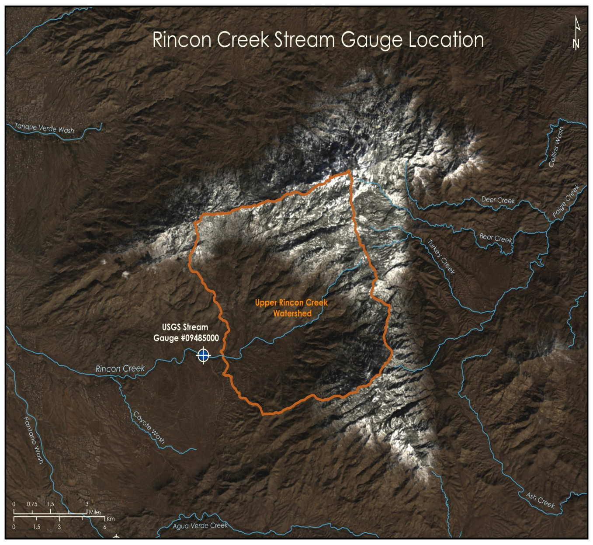
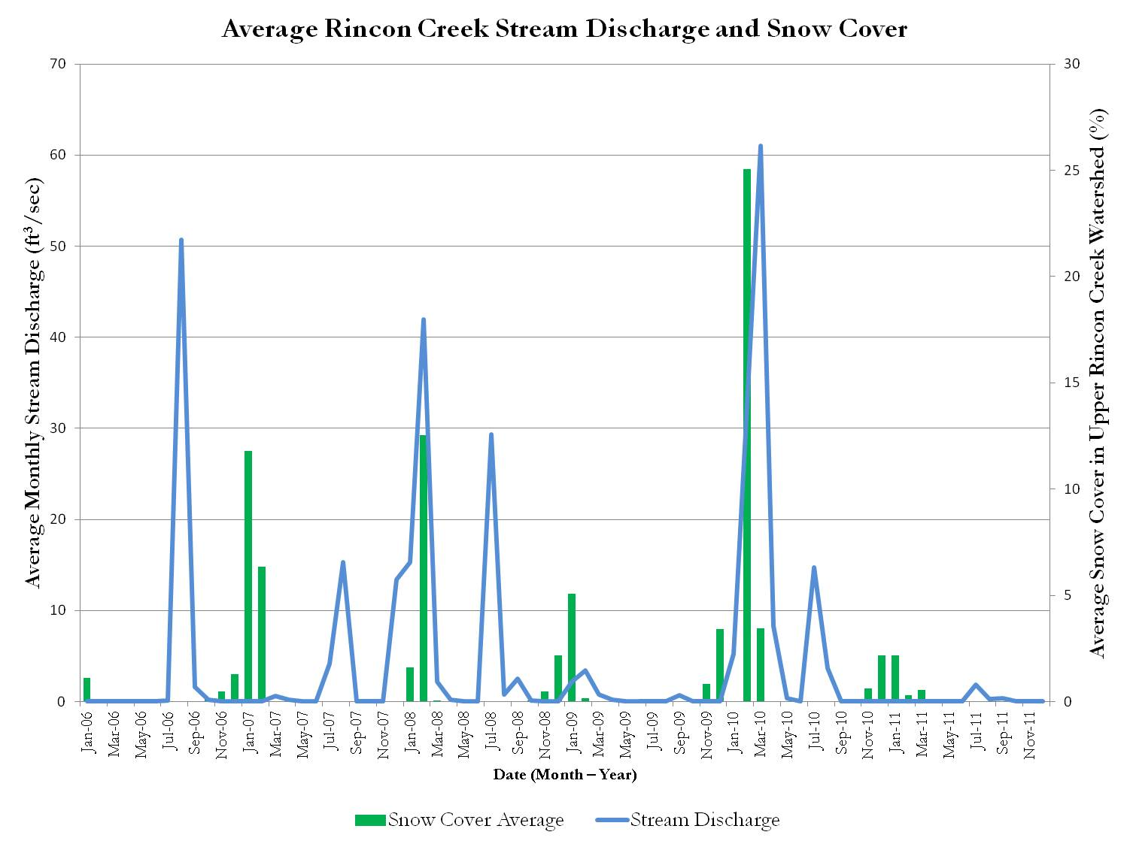







Using NASA Earth Observations to Assist the National Park Service in Assessing Snow Cover Distribution and Persistence Changes in the Sky Islands
Abstract
Study Area
Saguaro National Park in southeastern Arizona occupies one of several unique mountain ranges known collectively as the Sky Islands or the Madrean Archipelago. The Sky Islands are Biodiversity Hotspots and host different ecosystems, ranging from arid deserts to temperate forests. Snowmelt provides a source of water during the dry season for the various flora and fauna that inhabit the Sky Islands. However, climate change and its effect on snow cover is of growing concern. Currently, the National Park Service (NPS) monitors water presence, but a synoptic record of snow presence does not exist due to the remote and rugged topography of the region. As a result, it is difficult to study how climate change has affected water resources in the Sky Islands and what effect this has on wildlife and vegetation. This project used NASA Earth observations to aid the NPS in understanding the role of snow cover in the Sky Islands. Historical snow cover maps were created to address the current gap in information regarding snow presence. With a more complete understanding of the impact of snow cover, the NPS will be able to analyze past snow cover changes to improve future land management decisions.
Objectives
Earth Observations & Study Period
  Assess historic snow cover distribution and persistence in the sky islands region.
  Analyze water availability in Saguaro National Park watersheds during dry seasons.
Landsat 5 TM (1985-2011)
Landsat 7 ETM+ (2011-2013)
Landsat 8 OLI (2013-2016)
1985
Aqua/Terra MODIS (2000-2016)
2016
Methodology and Results
Data
Acquisition
Data
Processing
Data
Analysis
Landsat 4/5 TM
Landsat 7 ETM +
Landsat 8 OLI
Top of Atmospheric Correction
NDSI Calculation
Snow cover distribution for the focus area
Southeastern Arizona Water Resources
TERRA/MODIS
AQUA/MODIS
Extract Sub dataset
Cloud Mask
Snow cover distribution for the focus area
USGS Stream Gauge Data
Historical and current stream discharge, and stream flow
Conclusions
Figure 1: Side by side view of Aqua MODIS NDSI data and Landsat 8 OLI NDSI data overlaid on a Landsat true color image.
Figure 2: Graphical depiction of the average snow cover of the Upper Rincon Creek Watershed as a percent of the total area of the watershed from 1990 to 2015. The graph only shows months when the possibility of snow cover was more likely (October – April).
Snow cover area analyses were compared with stream discharge data in order to assess the effect of snow on water resources within the Rincon Mountain watersheds.
Initial results indicate Landsat and MODIS snow maps provide useful information on snowpack phenology; however, some issues with satellite data (e.g., clouds and shadow) were encountered.
Work on long term trend analysis was begun and will be addressed in more depth during the second term.
Project Partners
National Park Service (NPS), Intermountain Region and Saguaro National Park
Figure 3: Landsat true color image of the Rincon Creek watershed and the location of the USGS stream gauge.
Figure 4: Graphical depiction of the daily discharge measured at the Rincon Creek stream gauge and the area of snow cover calculated with NDSI data from Landsat for the years 1990 to 1999.
This material is based upon work supported by NASA through contract NNL11AA00B and cooperative agreement NNX14AB60A. Any mention of a commercial product, service, or activity in this material does not constitute NASA endorsement. Any opinions, findings, and conclusions or recommendations expressed in this material are those of the author(s) and do not necessarily reflect the views of the National Aeronautics and Space Administration and partner organizations.
Team Members
Acknowledgements
Bernard Eichold, M.D., Dr. PH (Mobile County Health Department)
Joseph Spruce (NASA Langley Research Center)
Kenton Ross, PhD (NASA Langley Research Center)
Colleen Filippone (NPS)
Don Swann (NPS)
.
Saranee Dutta
Team Lead
Farnaz Bayat
Elaina Gonsoroski
Katie Harville
Tyler Lynn
Mobile County Health Department – Fall 2016

