Slide 1
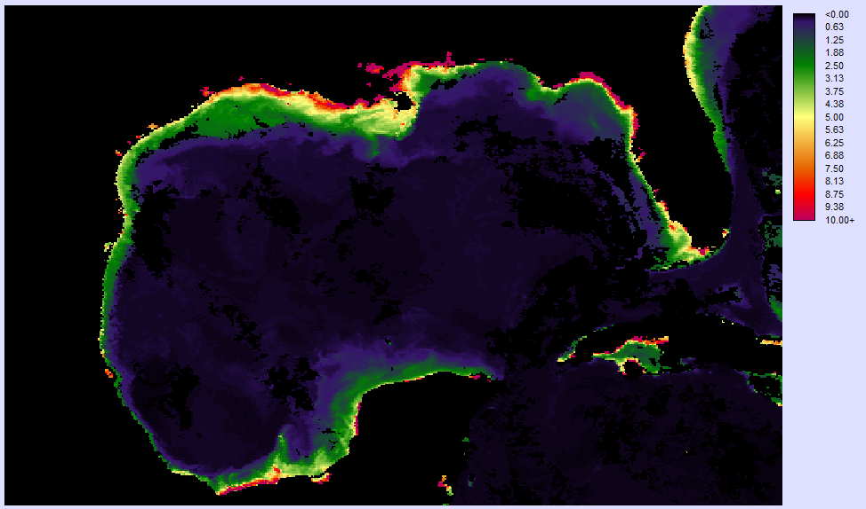
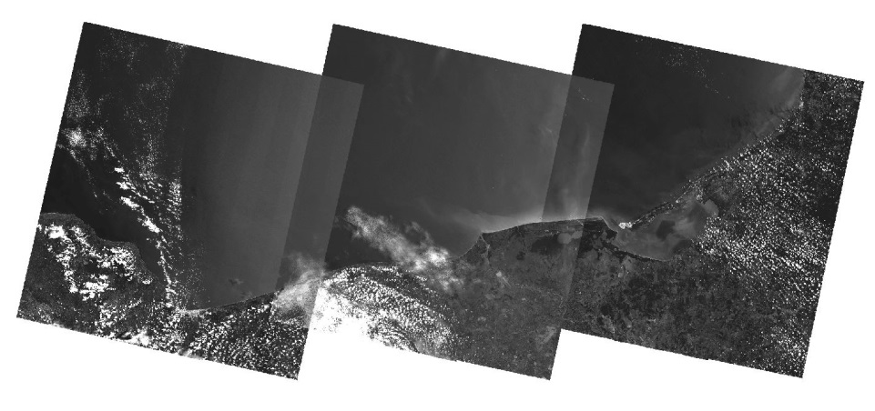
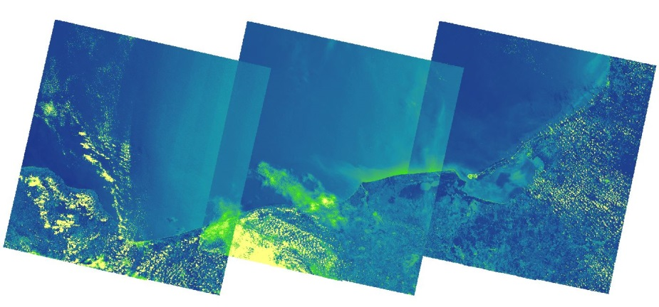
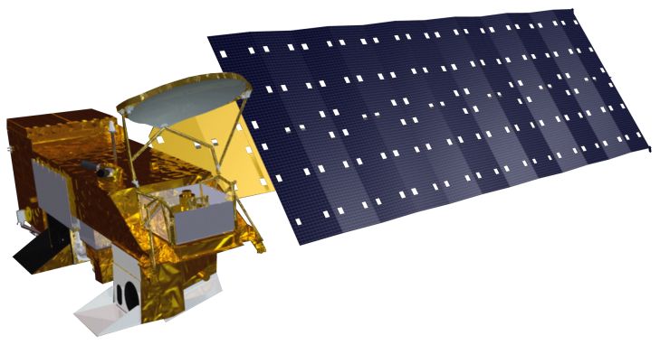
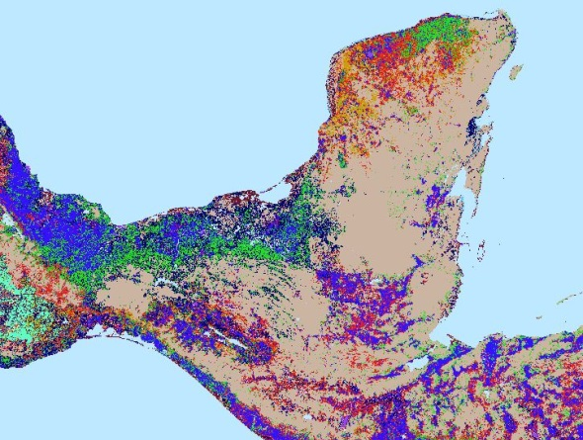
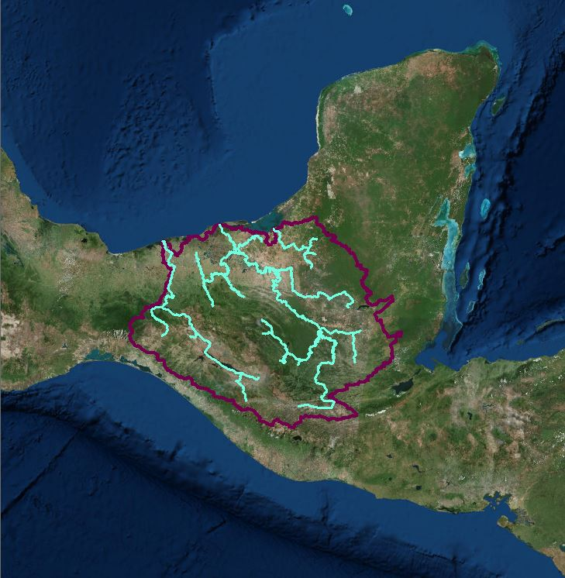
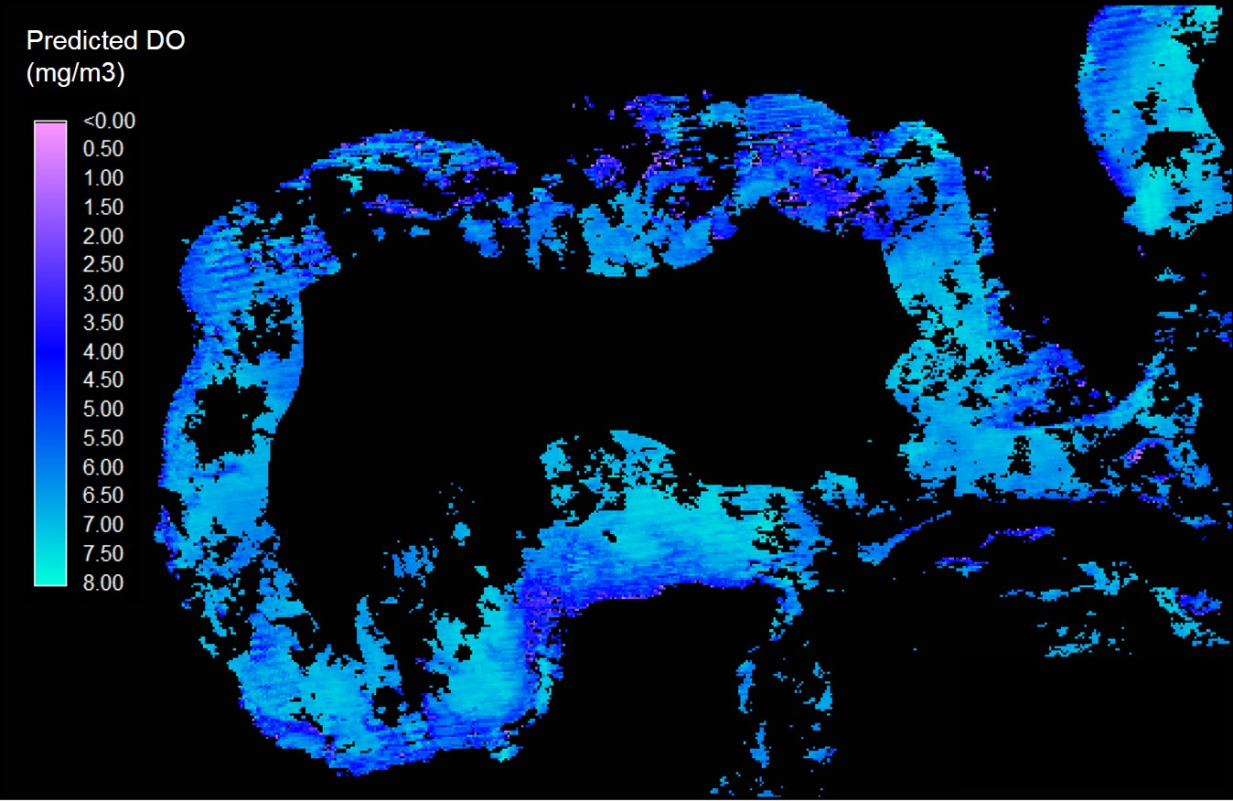
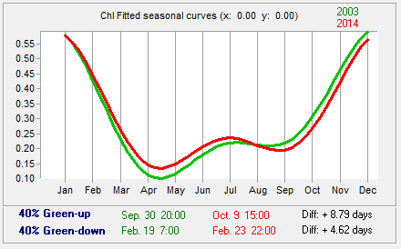
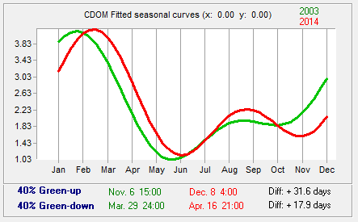
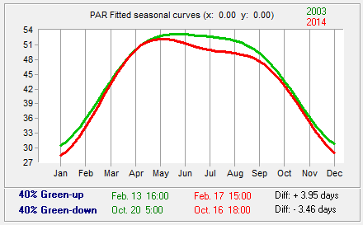
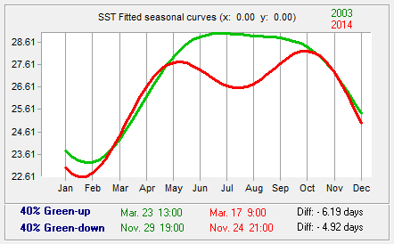
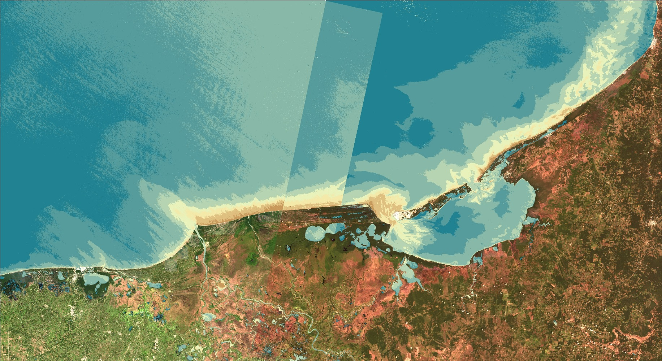
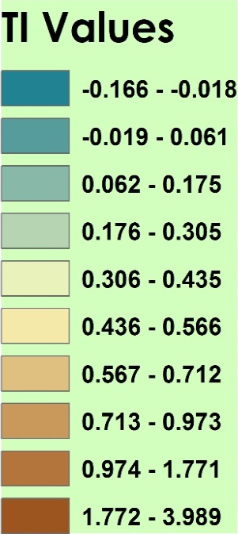
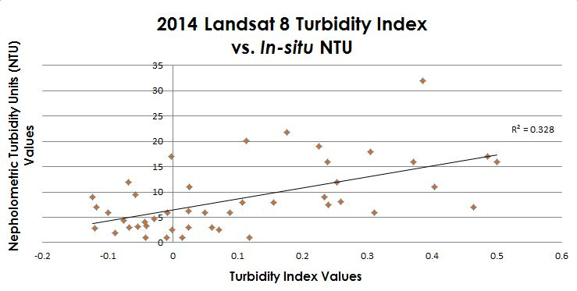
Gulf of Mexico Water Resources
Utilizing NASA Earth Observations to Detect Factors Contributing to Hypoxic Events in the Southern Gulf of Mexico
Rebecca Chapman(Project Lead)¹, Irma Caraballo Álvarez¹, Alannah Johansen¹, Åse Mitchell¹, Bridget Smith¹, Mackenzie Taggart¹
¹ NASA Ames DEVELOP Program
Abstract
Study Areas
Monitoring and analyzing harmful algal blooms (HABs) and hypoxic events in the southern coastal areas of the Gulf of Mexico (GoM) is important for watershed management and mitigation of environmental degradation. This study uncovered trends and dynamic characteristics of chlorophyll a (Chl) concentration, sea surface temperature (SST), colored dissolved organic matter index (CDOM), and photosynthetically available radiation (PAR); as evident in 8-day standard mapped image (SMI) products from the MODIS instrument on the Aqua platform from 2002-2015 using Clark Labs TerrSet Earth Trends Modeler (ETM). Additionally, sediment and nutrient loading values of the Grijalva-Usumacinta watershed were modeled using the ArcGIS Soil and Water Assessment Tool (SWAT). A Turbidity Index was generated using Landsat 8 Operational Land Imager (OLI) scenes for 2014-2015. Results will assist local environmental and health authorities in revising water quality standards and mitigating the impacts of future HABs and hypoxic events in the region.
Methodology
Objectives
Earth
Observations
Run TerrSet
ETM
Chl, SST,
CDOM & PAR Anomalies
Analyze Trends
Run MLP
Predict DO
Utilize NASA Earth observations to identify indicators of hypoxic events and HABs in the southern Gulf of Mexico.
Conduct time series analysis on MODIS Level III 8-day SMI products of Chl, SST, CDOM, and PAR.
Apply the Turbidity Index to Landsat 8 OLI data.
Run the Soil Water Assessment Tool (SWAT) to model nutrient and sediment loading for the entire Grijalava-Usumacinta river basin.
Landsat 8 OLI
Aqua MODIS
1) Download Aqua Modis Data: 2002 - 2015
Apply
Turbidity Index
Measure Plumes
2) Download Landsat 8 OLI Data: 2013 - 2014
Project Partners
Inputs: DEM, Soil, Weather & Land Use data
Outputs: Nutrient &
Sediment loading
Instruction Manual
Consorcio de Instituciones de Investigación Marina del Golfo de México y del Caribe (CiiMar-GoMC)
Centro del Cambio Global y la Sustentabilidad en el Sureste (CCGSS)
Comisión Nacional para el Conocimiento y Uso de la Biodiversidad (CONABIO)
The Federal Ministry of Health
Centro Nacional de Datos Oceanográficos (CENDO)
Universidad Autónoma de Baja California (UABC)
Universidad Juárez Autónoma De Tabasco (UJAT)
Secretaría de Marina (SEMAR)
Run SWAT
3) Acquire SWAT input data
Results
Conclusions
The results from this project will assist our partners in future assessments of algal blooms and hypoxic events in the southern Gulf of Mexico.
The analyses of Chl, CDOM, PAR, and SST could potentially be used to forecast the timing of hypoxic events and HABs.
The turbidity index could be continually performed as a method of remote water quality monitoring.
Once in-situ data becomes available, the SWAT model can be used to revise regulatory water quality standards.
Supplementing environmental monitoring efforts with analyses of Earth observations is especially important in regions where little to no in-situ data exists.
Figure 1: Map of predicted dissolved oxygen values for June 10 – 17, 2014 in the GoM generated from TerrSet’s Multi-Layer Perceptron (MLP) Classifier. DO was estimated using Chl, CDOM, SST, PAR, and bathymetry, and trained using in-situ dissolved oxygen from buoy stations in the northern GoM.
Figures 2-5: Fitted seasonal curves of Chl, CDOM, PAR, and SST for the Bay of Campeche, generated from TerrSet’s ETM Seasonal Trend Analysis (STA).
Green curves represent the first 6 years and red curves represent the last 6 years of each time series. For each parameter, green-up and green-down refer to the dates corresponding to the maximum rates of increase and decrease, respectively.
Team Members
Table 1: SWAT model outputs giving average annual values for influx of sediment, organic nitrogen, and organic phosphorous from the Grijalva-Usumacinta River Basin into the Bay of Campeche from 2000-2014.
Watershed Area (km2) | 153516.7
Number of Sub-basins | 45
Total Sediment Loading (T/Ha) | 88.9
Organic N (kg/Ha) | 13.7
Organic P (kg/Ha) | 2.1
Left to Right: Mackenzie Taggart Irma Caraballo Álvarez Bridget Smith Alannah Johansen Rebecca Chapman Åse Mitchell
Acknowledgements
Figure 6: Turbidity index generated from Landsat 8 OLI scenes in the Bay of Campeche.
Figure 7: Linear regression showing the correlation between in-situ nepholometric turbidity unit values and Landsat OLI derived turbidity index values for the northern Gulf of Mexico in 2014 (R² = 0.328).
Special thanks to our science advisors Dr. Juan L. Torres-Pérez, Dr. Sherry L. Palacios, and Chase Mueller from the Bay Area Environmental Research Institute. The authors also wish to thank the NASA Ames DEVELOP management team for their overall support and help with this project.
NASA Ames Research Center

