Slide 1
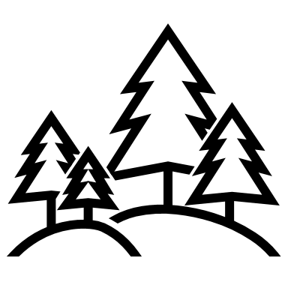
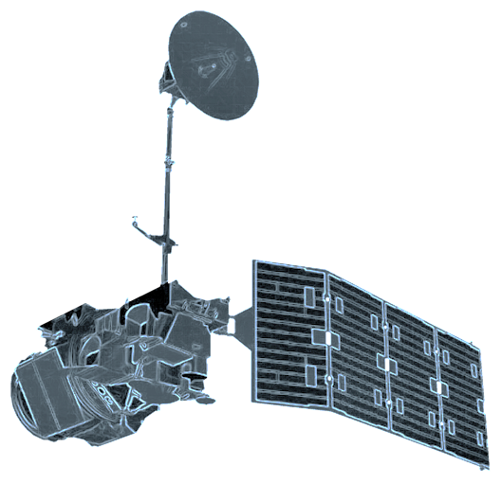
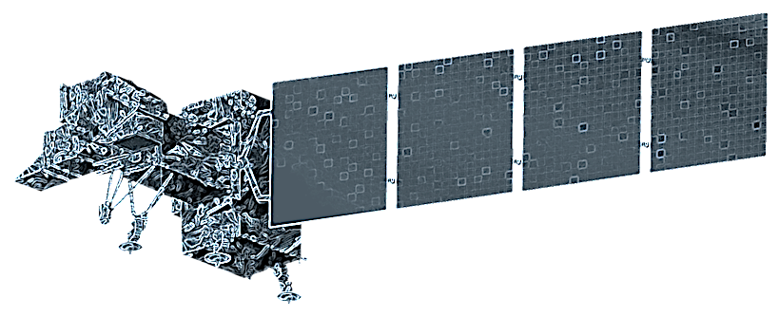
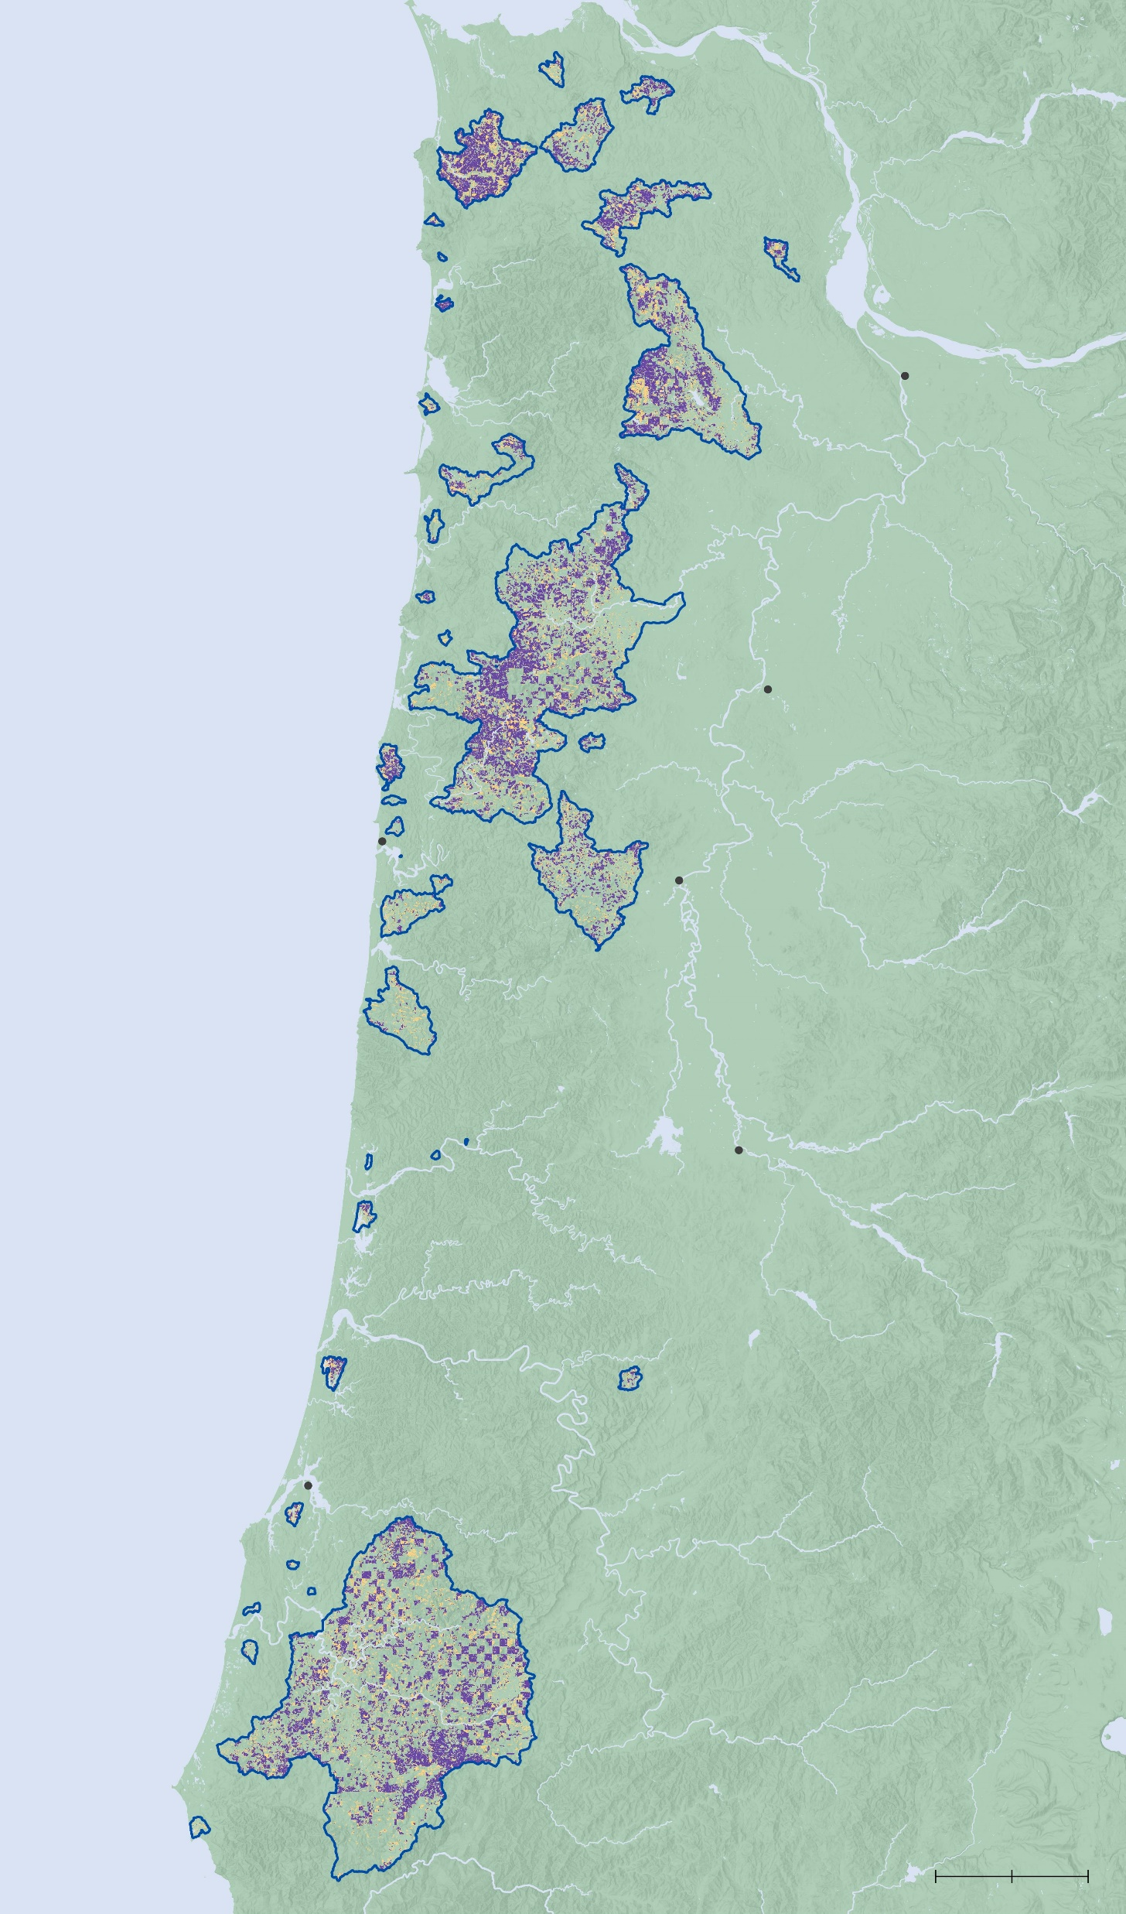
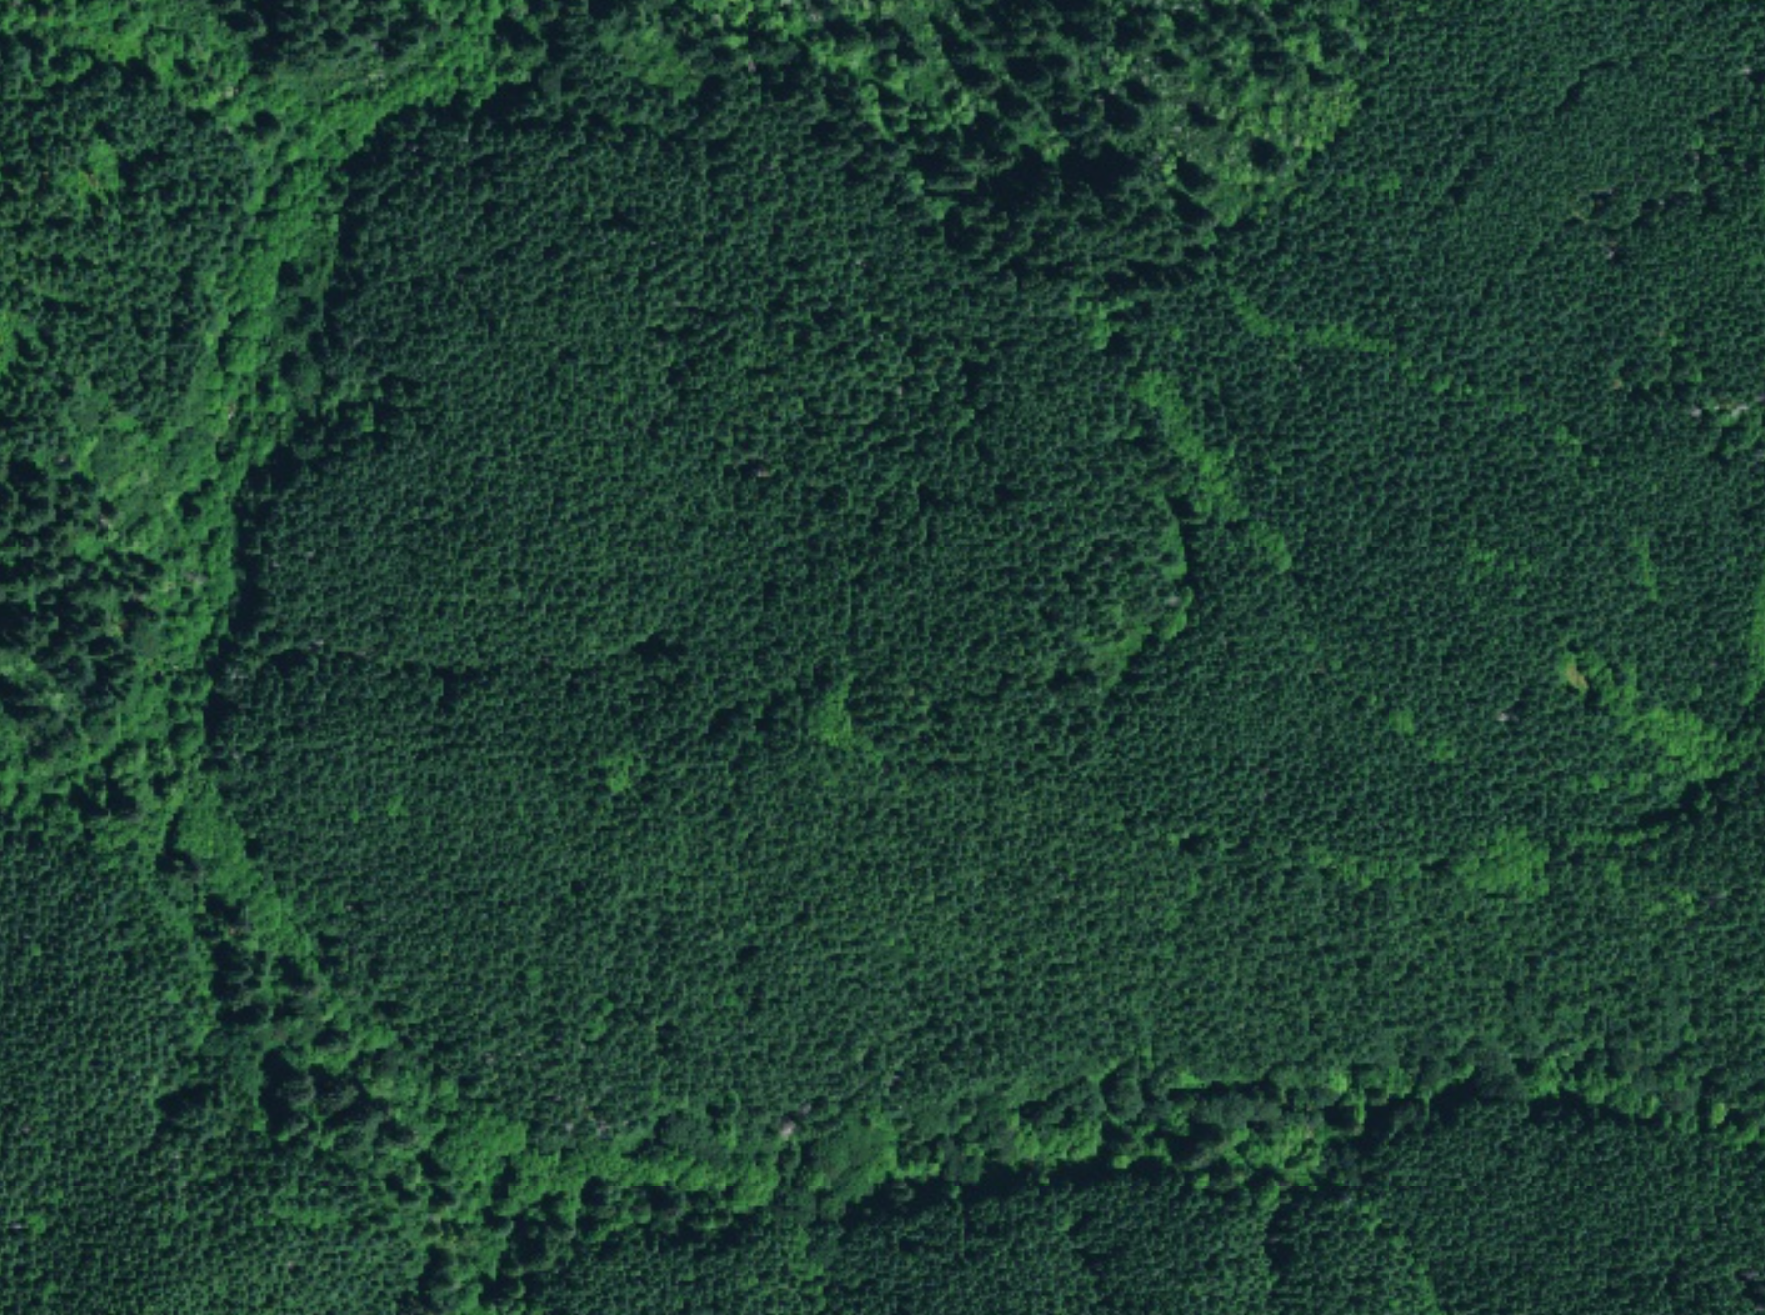
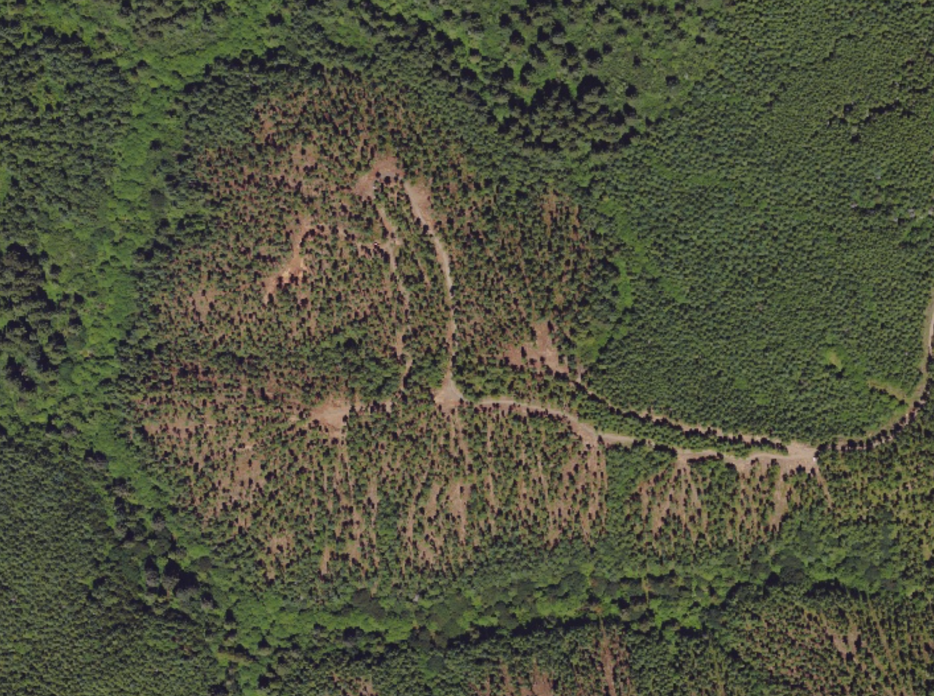
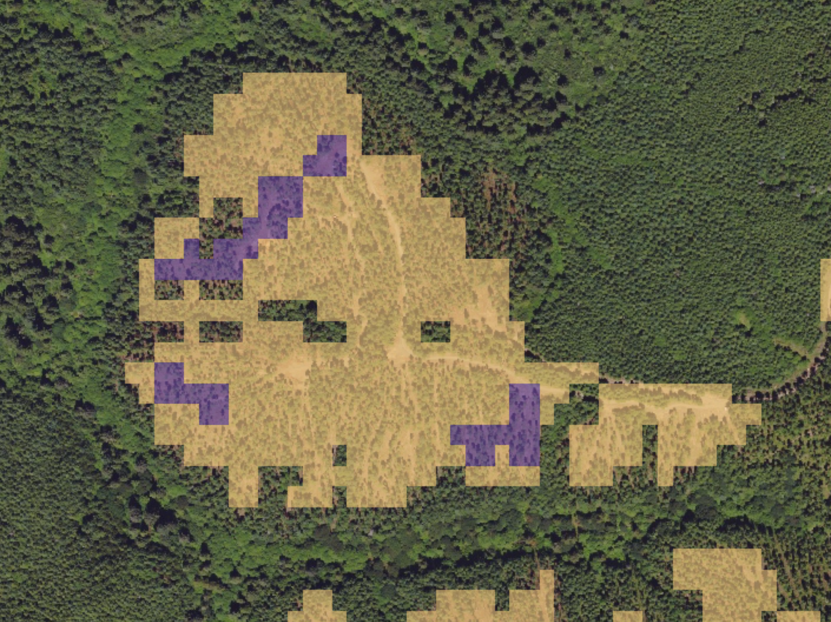
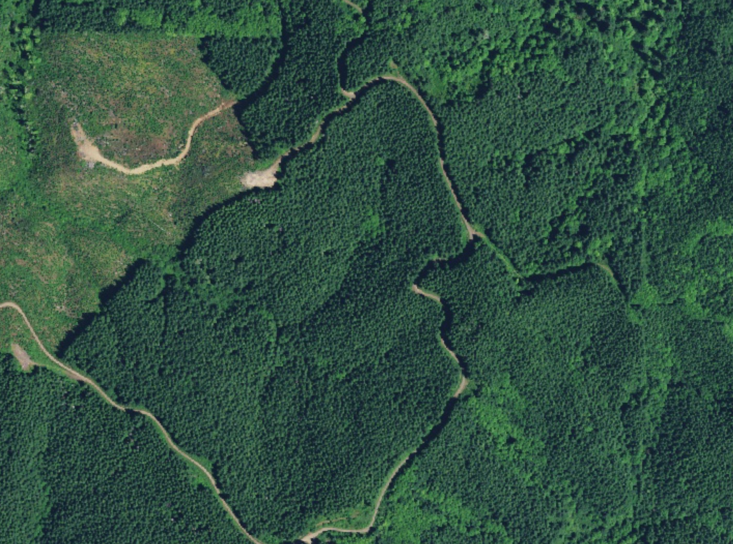
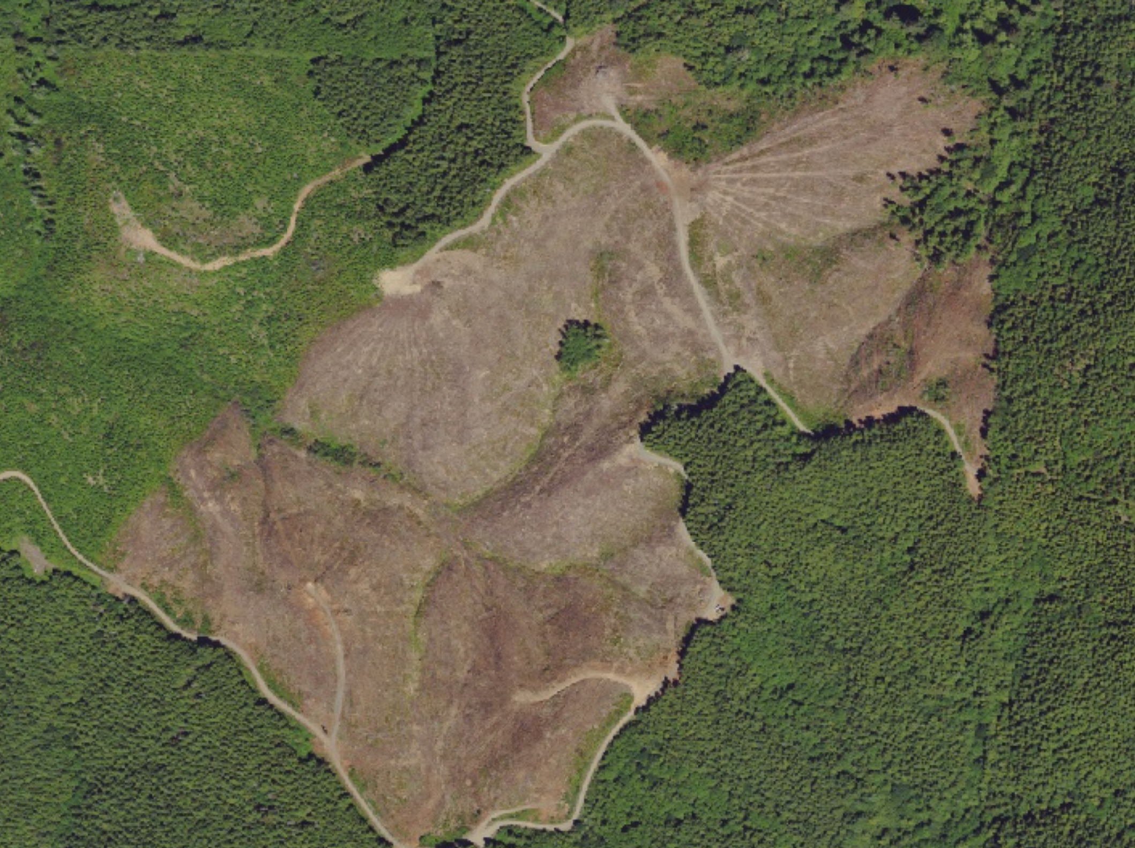
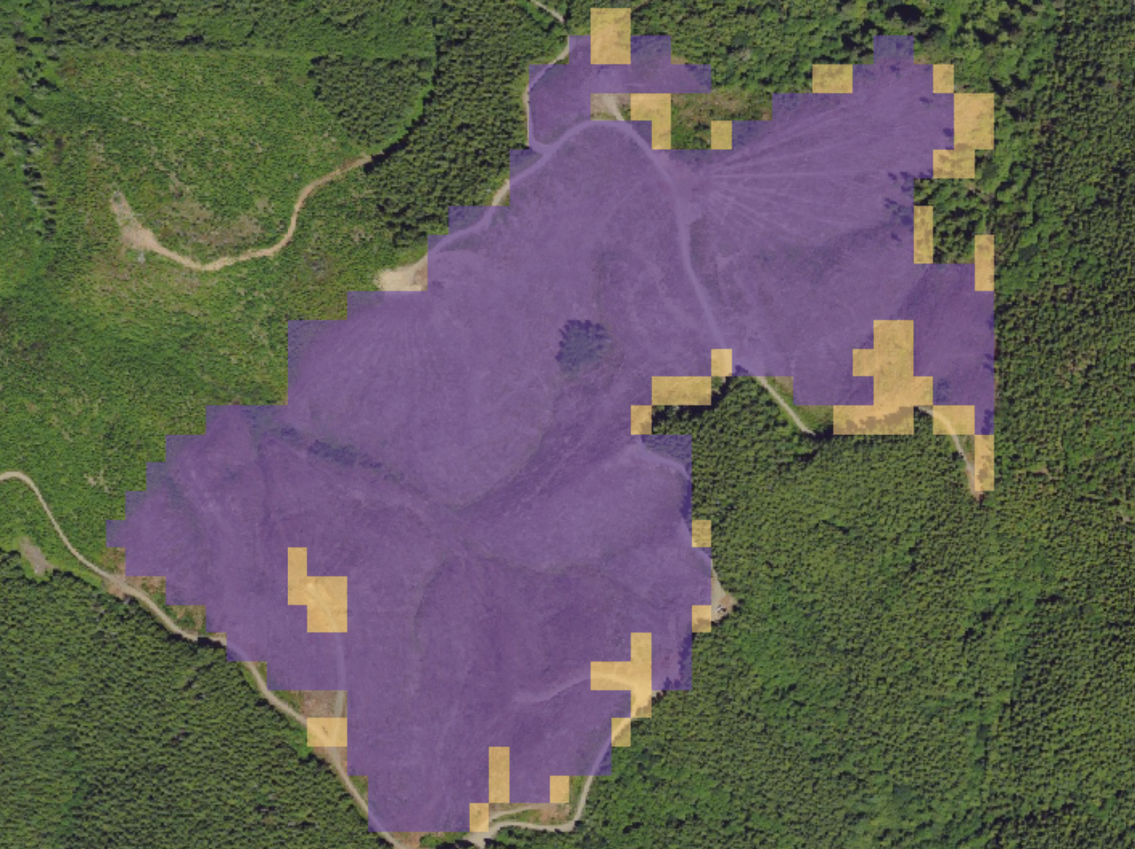
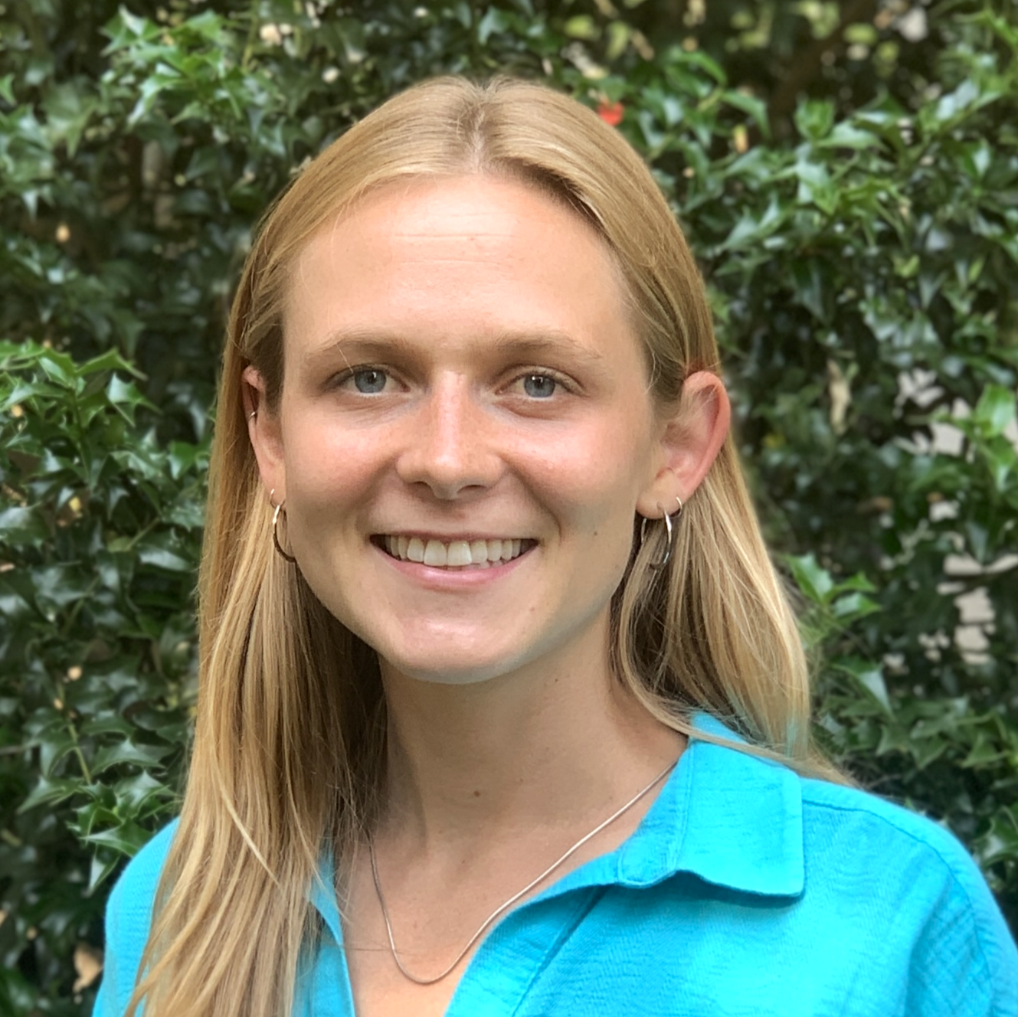
Oregon Coast Range Ecological Conservation
Mapping Recent Logging within Drinking Watersheds of Oregon’s Coastal Range to Support Future Resource Management Policies
42% of forested area in drinking watersheds on the Oregon Coast Range have been impacted by logging from 2000 to 2022.
Approximately 26% of this total can be attributed to clear cutting which happens primarily on private industrial lands.
Another 16% of forest area has been disturbed. One of the primary disturbances is commercial thinning which happens mainly on federal and state land.
Conventional logging practices pose a significant threat to drinking water quality on the Coast Range.
Forests protect drinking water sources from contamination by preventing erosion and filtering precipitation before delivering it to streams.
DEVELOP project partner, Oregon Wild, is a vocal advocate for sustainable forest management practices and public education to protect public drinking water sources.
Objectives
Earth Observations
Quantify the extent of clear cutting
Landsat 5 TM
Landsat 7 ETM+
Landsat 8 OLI
Landsat 9 OLI-2
Quantify the extent of commercial thinning
Create maps for public education
Town of Seaside Drinking Watershed
WA
Portland
Salem
Thinning
24% of watershed forest thinned
Newport
Corvalis
Clear Cut Year
56% of watershed forest clear cut
2000
2022
OR
2020
2022
2022
Eugene
North Bend
0
20 mi
Team
Members
Acknowledgements
Tyler Pantle – MA Fellow, NASA DEVELOP
Dr. Cédric Fichot – Science Advisor, Boston University
Joseph Spruce – Science Advisor, Science Systems & Applications, Inc.
Dr. Paulo Arévalo – Research Scientist, Boston University
Erik Fernandez – Project Partner, Oregon Wild
Emily French
(Project Lead)
Uma Edulbehram
Madison Arndt
Sarah Hughes
Massachusetts – Boston

