Slide 1
Lake Anna Water Resources
Using NASA Earth Observations to Identify Algal Event Risk Factors in Lake Anna and Help Inform Future Management Practices
Olivia Etherton • Caroline Bahun • Alexander Krest • Justin Wilder
Virginia – Langley | Summer 2023

Slide 2
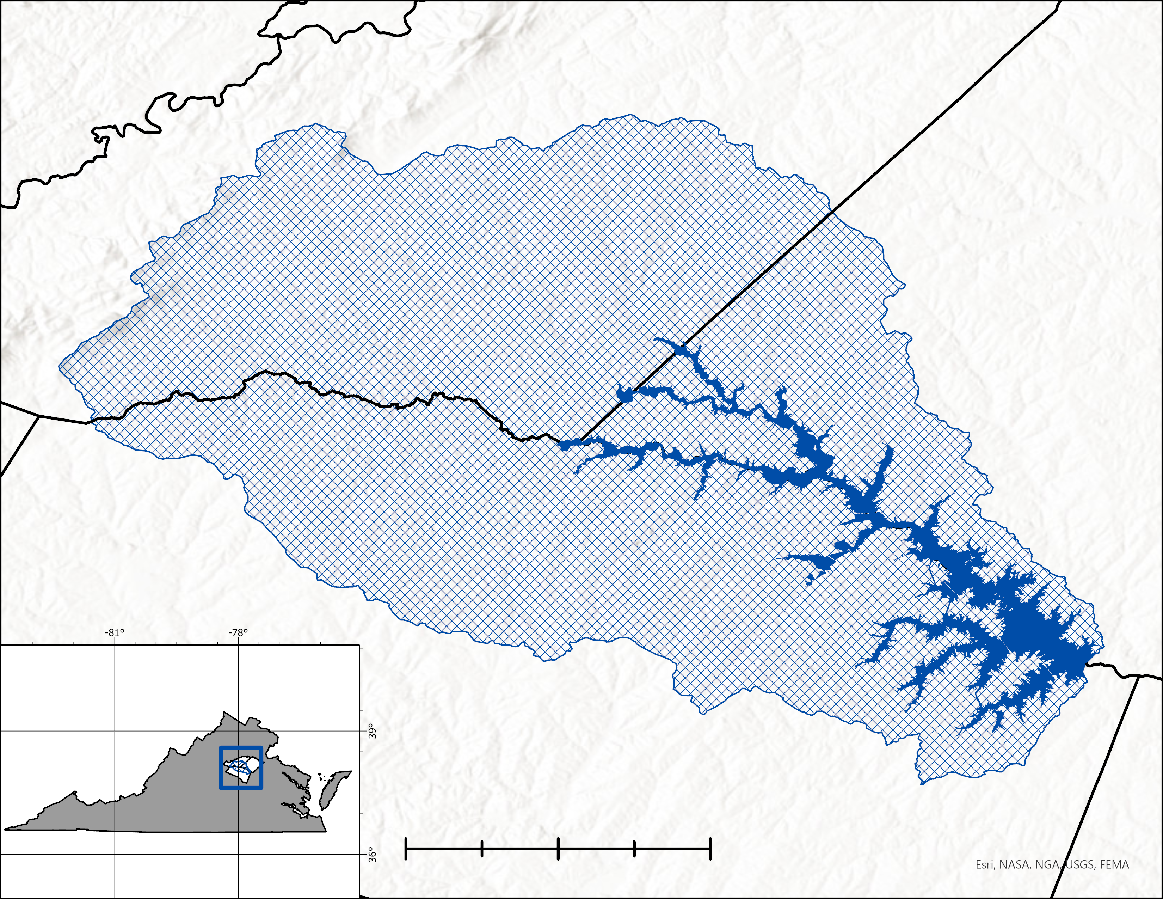
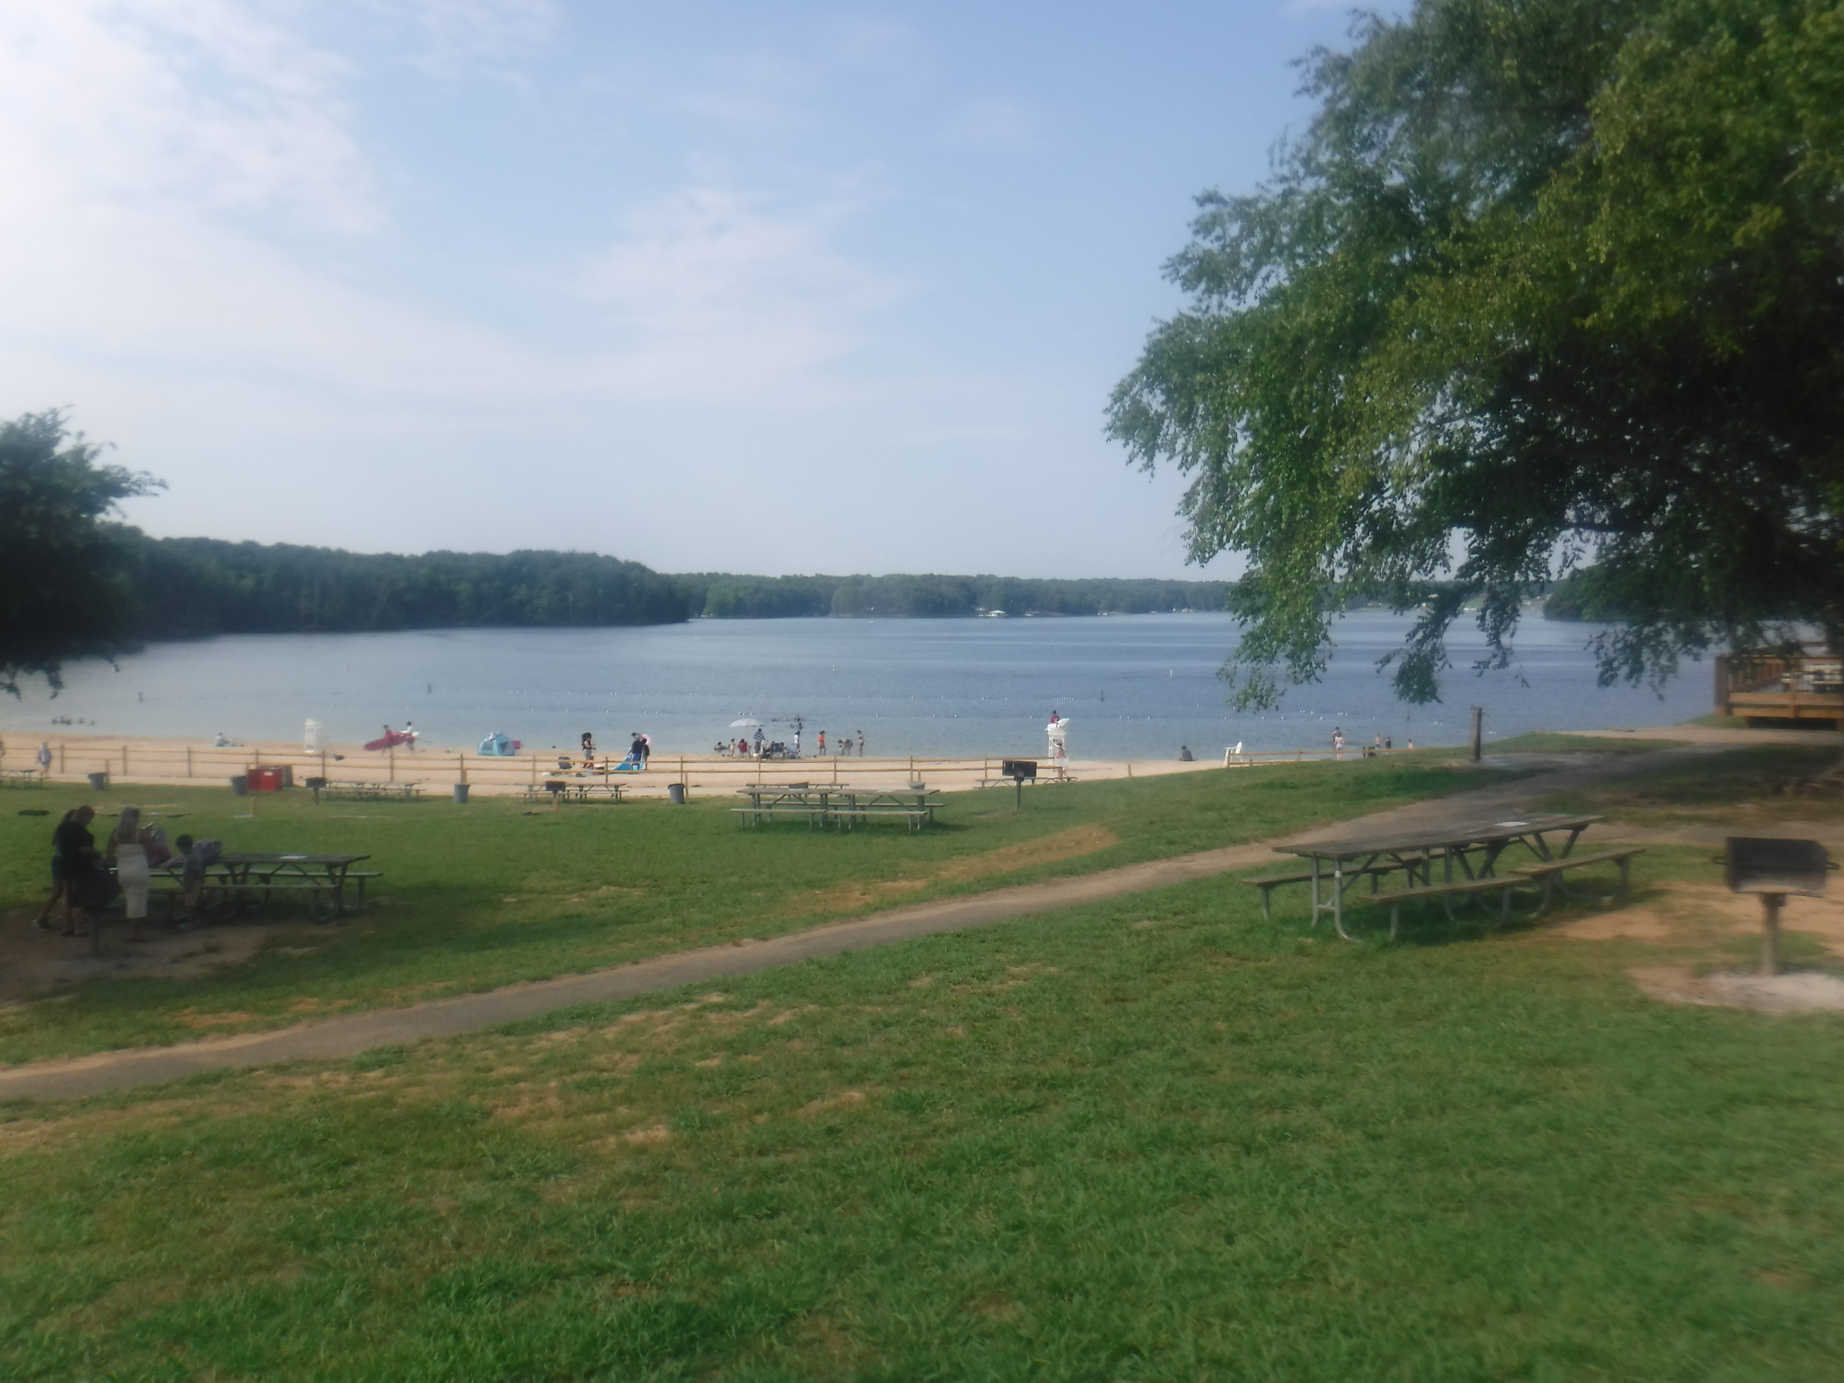
Study Area
Orange County
Lake Anna,
Virginia
Est. 1972
13,000 acres
Spotsylvania County
Lake Anna
L. Anna Watershed
County Boundary
N
Louisa County
0 2.5 5 10
Miles
Image courtesy of Alexander Krest
Notes:
Speaker notes: Alex
Study Area: Lake Anna, VA
*North Anna River was dammed to supply a reliable cooling source for the North Anna Power Station. (Nuclear)
*Lake Anna was filled ahead of schedule in 1972, following the impacts of a tropical system that dumped massive amounts of rainfall across the region.
*Spanning roughly 13,000 acres, of which approximately 3,400 acres are considered part of the Waste Heat Treatment Facility, operated by Dominion Energy. This portion includes the 3 –4 large fingers jutting out from the southwest corner of the Lake.
*Distinct Sections, upper and lower Lake Anna, split by New Bridge (Rt. 208). Anecdotally north of New Bridge is considered more riverine while south is considered more Lacustrine.
*A rural but popular recreation destination, Lake Anna State Park attracts over $10 million annually in visitor spending.
------------------------------------------------------------------------------------------------------------------------------------------------------------------------------
Image credit: Alex Krest
Image source: taken by team

Slide 3
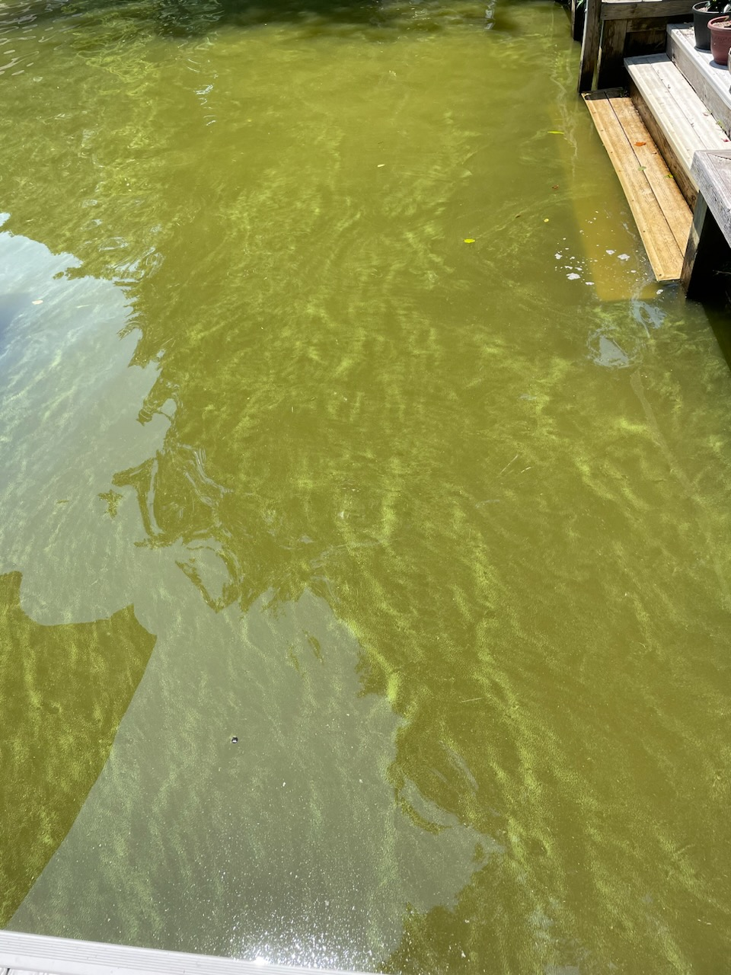
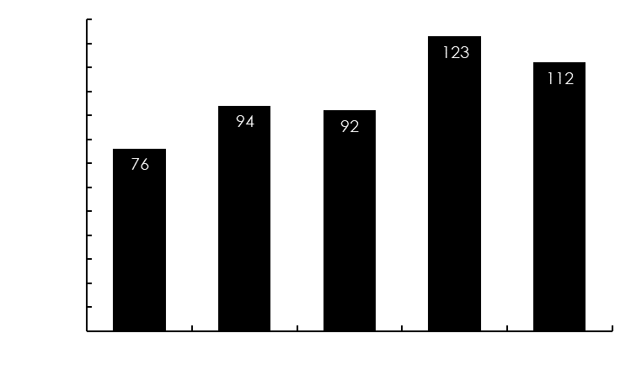
Harmful Algal Blooms
An event in which toxigenic algal/cyanobacterial populations achieve a sufficiently high density, as to where the well-being of the natural environment and human health are negatively impacted.
130
120
110
Length of Swimming Season
100
90
80
70
Days Under Advisory
60
50
40
30
20
10
0
2018
2019
2020
2021
2022
HAB at Lake Anna
Pamunkey Creek, June 10, 2023
Years
Image courtesy of Lake Anna Civic Association
Notes:
Speaker notes: Alex
*A natural phenomenon that may be exacerbated by anthropogenic and or climatological impacts (i.e. land-use, hydrologic alteration, etc.).
*Lake Anna swimming season (as compared to state recreation season). Lake Anna swim season = Memorial Day to Labor Day // DEQ Recreation season from May – October
*Chart is not representative of advisories occurring during the swimming season as DEQ generally monitors from late June / early July to October
*May pose a variety of risks to public health including but not limited to the contraction of gastrointestinal, respiratory, and neurological illness.
*Depending upon the species, risk may be encountered during recreation or subsistence activities.
Image provided with permission from Lake Anna Civic Association

Slide 4
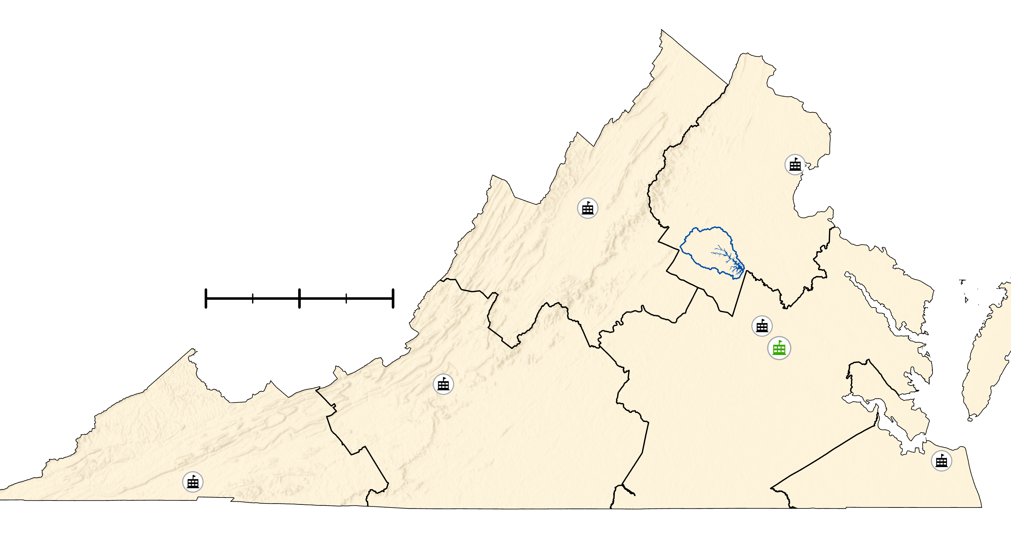
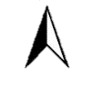
PARTNERS
Virginia Department of Environmental Quality (DEQ)
Dr. Tish Robertson
Monitoring & Assessment Scientist
Amanda Shaver
Water Quality Assessment Team Lead
Bryant Thomas
Office of Ecology Manager
Virginia DEQ Locations
N
0
25
50
100
Miles
Basemap: Esri, NASA, NGA, USGS, FEMA
Notes:
Speaker notes: Olivia
This project was conducted in partnership with the Virginia Department of Environmental Quality (DEQ), more specifically with Dr. Tish Robertson, Amanda Shaver, & Bryant Thomas.
The DEQ is responsible for establishing water quality standards and facilitating HAB monitoring statewide. They regularly work in conjunction with the Virginia Department of Health (VDH), which issues HAB advisories, as well as local citizen groups like the Lake Anna Civic Association (LACA), which engage in their own algae monitoring and mitigation efforts.
HABs have become a priority for the DEQ in recent years as public engagement with the issue has gained momentum and it has become clear that a strong need exists for improved watershed monitoring and management.
As a part of an effort accelerate work on HABs in Virginia's freshwaters, the DEQ has begun Phase 1 of a two-phase project, the outcome of which will be a comprehensive report detailing the drivers of Virginia's freshwater HABs and best watershed management practices.
Our DEVELOP team's work nests into Phase 1 of the DEQ's plan. Prior to this project the DEQ has not used NASA EO due to a lack of expertise and capacity. Our goal has been to assess the utility of Earth Observing data to enhance the DEQ's ability to address HABs by mobilizing monitoring resources and informing decision-making for at-risk watersheds.
Basemap: Esri, NASA, NGA, USGS, FEMA

Slide 5
COMMUNITY CONCERNS
Impacts of Harmful Algal Blooms
Public Health​​
Ecological​​
Economic​
Recreation​
Aesthetics
Notes:
Speaker notes: Olivia
The increasing frequency and duration of HAB events in Lake Anna has put it on Virginia’s impaired waters list, a classification which indicates it to be unsuitable for recreational use. Lake Anna has had no-swim advisories issued every year for the last 5 years.
One of the most urgent consequences of HABs is its impact on public health. During a bloom, certain cyanobacteria species will produce neurotoxins and hepatotoxins which can cause a variety of health complications, including gastrointestinal, respiratory, and neurological illness.
HABs also pose risk to ecological systems. The same cyanobacteria toxins which harm humans are also toxic to aquatic life. Additionally, the die-off that occurs after excessive algal proliferation depletes the oxygen necessary to sustain aquatic life.
Higher incidence of HABs also raises economic concerns around the impact reduced recreation and impaired aesthetics have on local business and real estate value.

Slide 6
OBJECTIVES
Analyze trends in cyanobacteria concentrations:
Chlorophyll-a, phycocyanin, & turbidity
Analyze risk factor trends:
Nutrient runoff potential, water surface temperature
Generate a timeseries of historic nuisance & harmful algal bloom events
Icon credit: Humam
Notes:
Speaker notes: Caroline
Overarching objective is to use NASA EO to provide the Virginia DEQ with tools to better monitor cyanobacteria & HAB risk factors to empower and enhance their decision-making capabilities. Our team's goal was to explore where HABs are likely to occur throughout Lake Anna, what the potential contributing factors are to algal blooms, and how can we enhance HAB monitoring capabilities through various indices and analyses. We then used these outcomes to generate timeseries of historic algal blooms and historic nuisance events. We strived to have reproducible methodologies in order to contribute to sustainable water resource management strategies for Lake Anna (reword).
-----
'cyanobacteria' icon: pearls by Humam from Noun Project (CCBY3.0): https://thenounproject.com/icon/pearls-5523010/

Slide 7
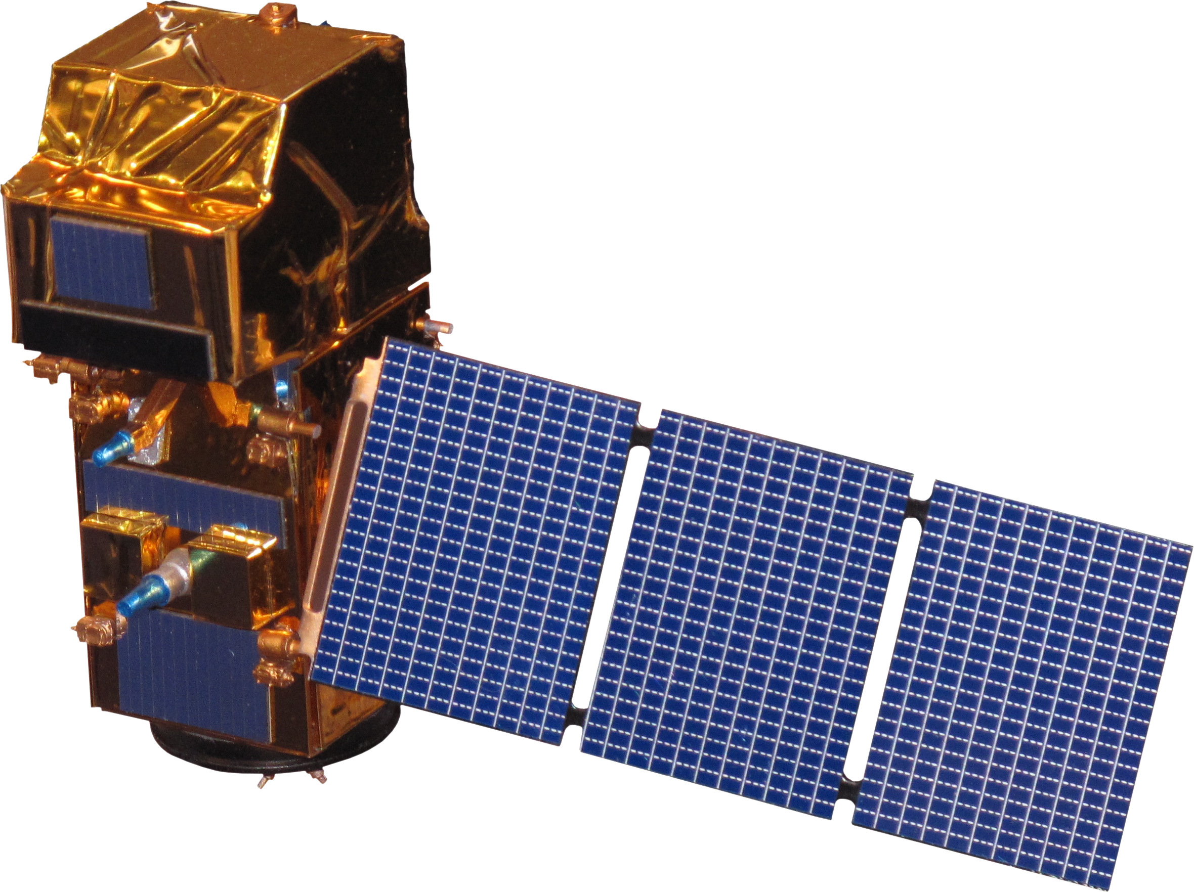
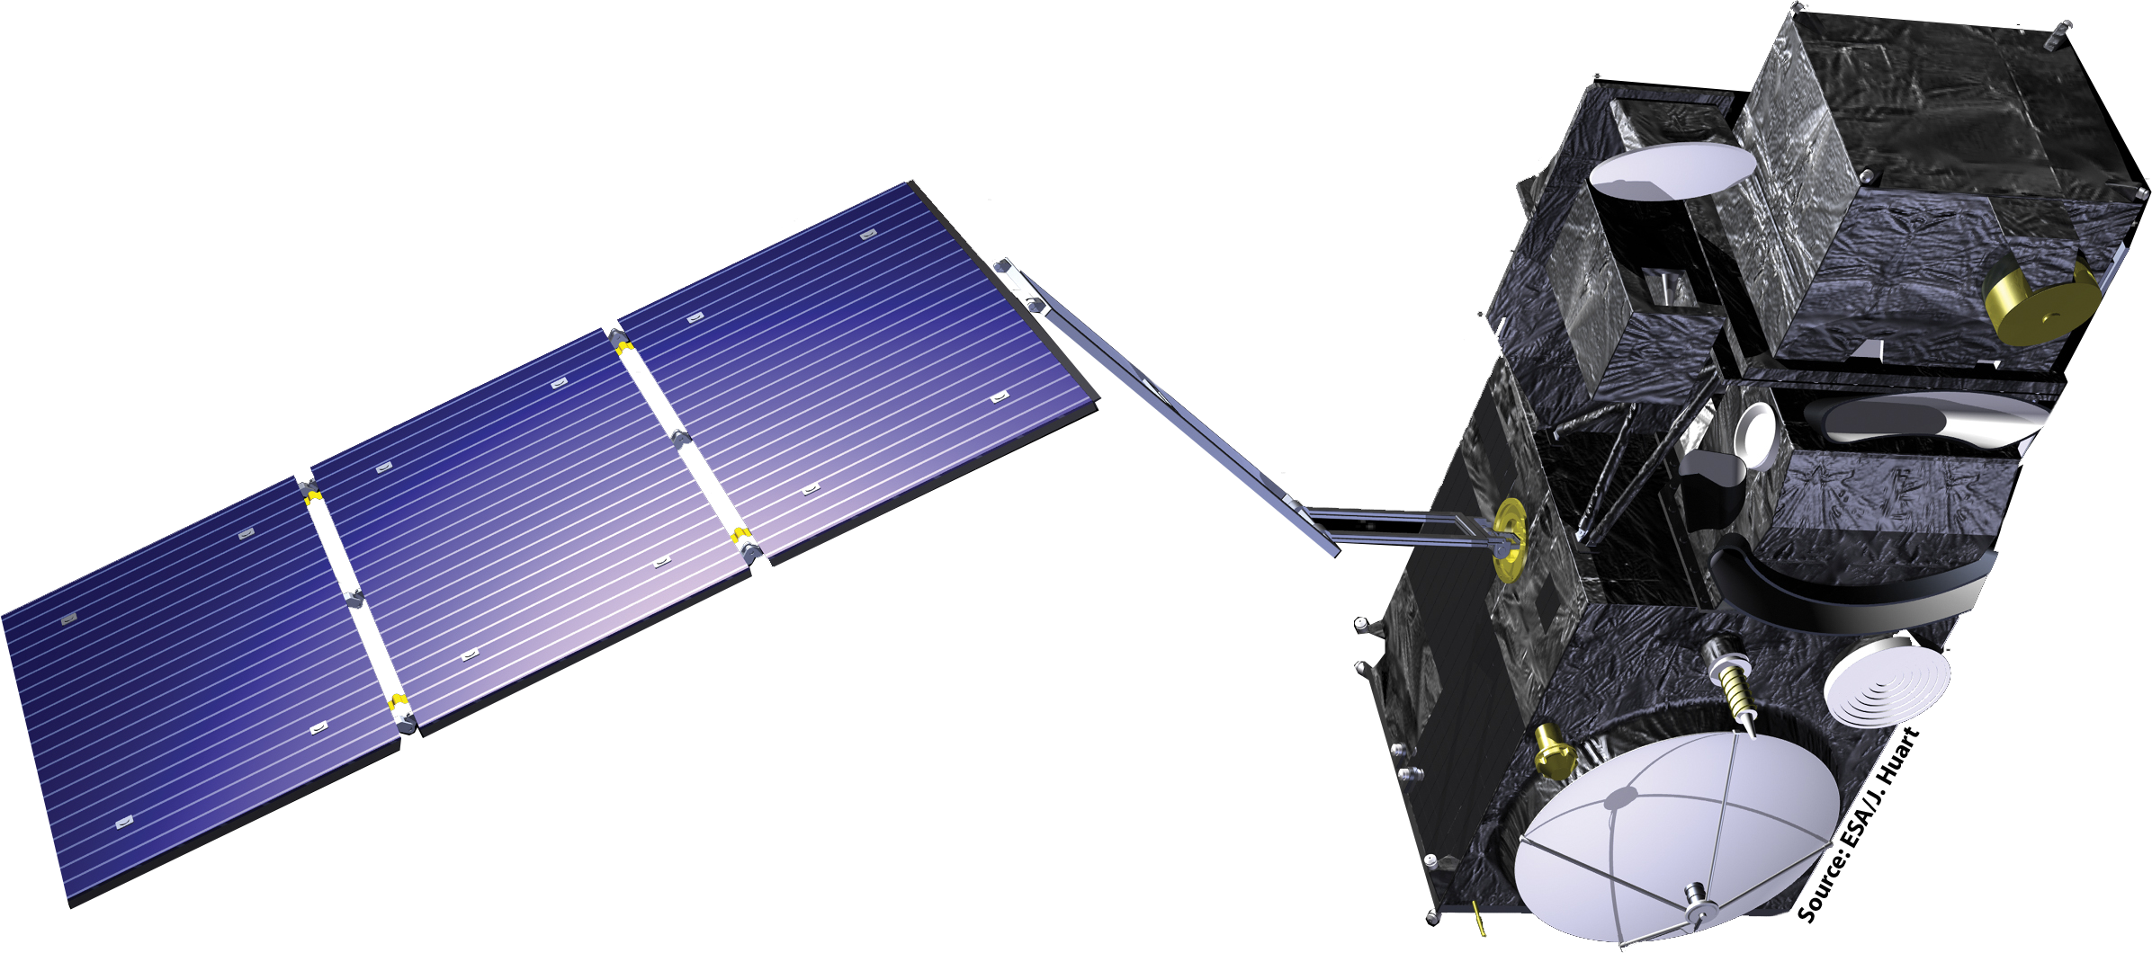
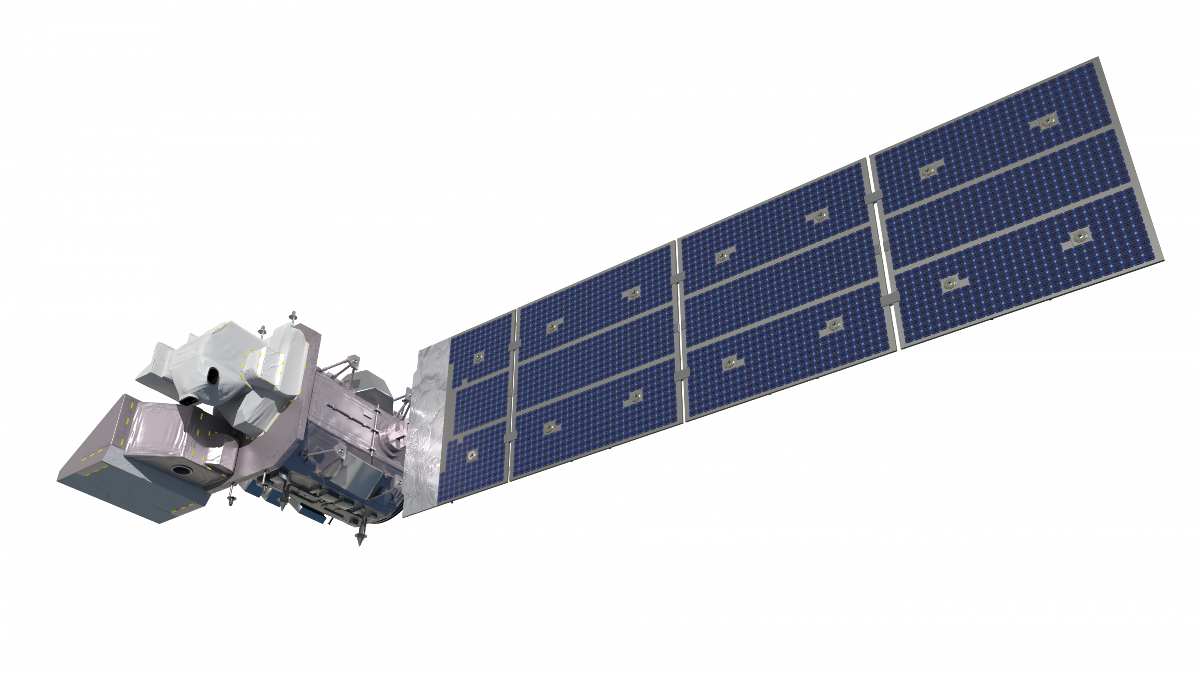
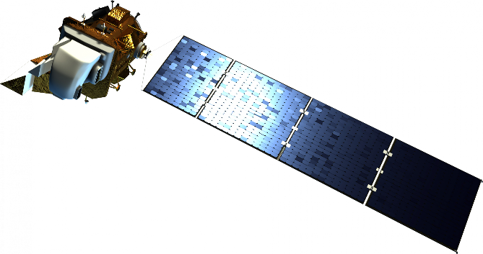
EARTH OBSERVATIONS
Sentinel-3 OLCI WFR
2016
Sentinel- 2 MSI 2015
Landsat 9 OLI-2/TIRS-2
2021
Landsat 8 OLI/TIRS
2013
Images credit to NASA, ESA, Rama
Notes:
Speaker notes: Caroline
As mentioned in the previous slide, the overall goal of this project is to use satellite images to provide the Virginia DEQ with tools to better monitor cyanobacteria & HAB risk factors to empower and enhance their decision-making capabilities. The main satellites used for our analyses included NASA's Landsat 8 OLI/TIRS and Landsat 9 OLI-2/TIRS-2 and ESA's Sentinel 2 MSI and Sentinel 3 OLCI WFR. The timeline above shows when data from each satellite became available (may need to reword). Sentinel-2 is comprised of 13 spectral bands, which helped our team to identify chlorophyll concentration and turbidity using various spectral band combinations. The two Landsat satellites were used to detect surface temperature, and Sentinel-3 was used to detect cyanobacteria in Lake Anna. Sentinel- 3 OLCI WFR contains a higher spectral, temporal, and spatial resolution of 300m that allows the satellite to detect cyanobacteria in water.
-----
Photo credit to NASA
https://spaceplace.nasa.gov/gallery-earth/en/ (Public Domain)
Images credited to
https://science.nasa.gov/get-involved/toolkits/spacecraft-icons (CC BY-SA 2.0 FR)
https://en.wikipedia.org/wiki/Sentinel-2#/media/File:Sentinel_2-IMG_5873-white_(crop).jpg (CC BY-SA 2.0 FR)
https://www.esa.int/ESA_Multimedia/Images/2012/02/Sentinel-32 (CC BY-SA 2.0 FR)

Slide 8
METHODOLOGY:
Data Acquisition:
Data Processing:
Data Analysis:
End Products:
Google Earth Engine
Landsat 8 OLI/TIRS​
Landsat 9 OLI-2/TIRS-2
Google Earth Engine
Surface Temperature
NDCI
NDTI
Standard Deviation
Sentinel-2 MSI
Google Earth Engine
ArcGIS Pro -
Map products
Excel -
Datasets
R-Studio
Algal bloom trend maps
Risk factor trend maps
PCA visualization
EUMETSAT
Sentinel-3 OLCI WFR
SNAP to
Google Earth Engine
CIcyano
Area Time-Series
DEQ In-Situ
Excel​
ArcGIS Pro​
Model Builder
Ancillary Datasets​
Kriging
PCA
Notes:
Speaker notes: Justin
Data Acquistion:
-Used GEE to pull Landsat 8 and 9, as well as Sentinel-2 images
-EUMETSAT was used to pull Sentinel-3 images
-DEQ In-Situ data: includes water variables and conditions and Ancillary Datasets for crop land data
Data Processing: GEE, Excel, ArcGIS Pro, SNAP, and Model Builder were all used to run various filters and conversion in order for our analyses to be more readable. We used cloud masks, water masks, unit conversions- ex. Kelvin to Celsius, seasonal and date filtering reprojection, subset, and vis. Inspection.
Data Analysis: We ran analyses on the median values of our image collections, as well as the maximum values of our data collections. The Kriging focused on nutrient detection such as phosphorus and nitrogen, chlorophyll, total suspended solids, and dissolved oxygen. A Principal Component Analysis was conducted on portions of the North Anna and Pamunkey branches of Lake Anna. Hot spot analysis of HAB occurrence.
The analyses that we ran were exported to ArcGIS Pro, Excel data sets, and R-Studio in order to create maps and tables to pass off to our partners.
End Products: The maps and tables created are used to identify algal bloom trends and risk factor trend maps.

Slide 9
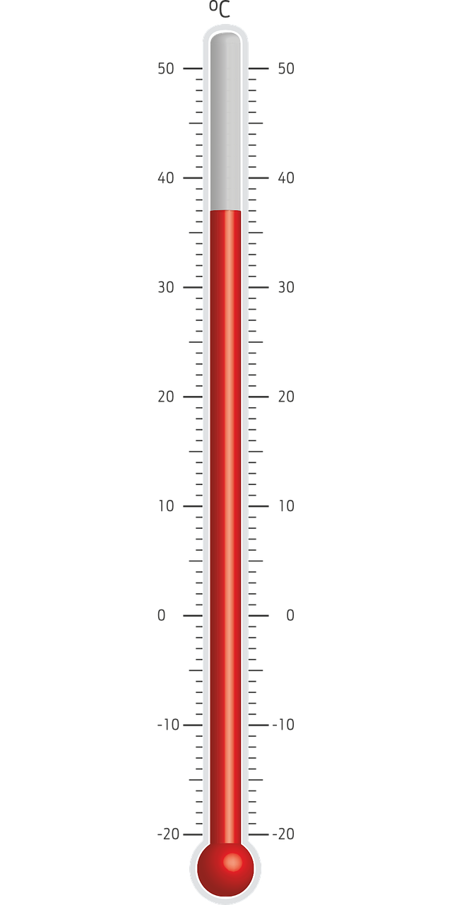
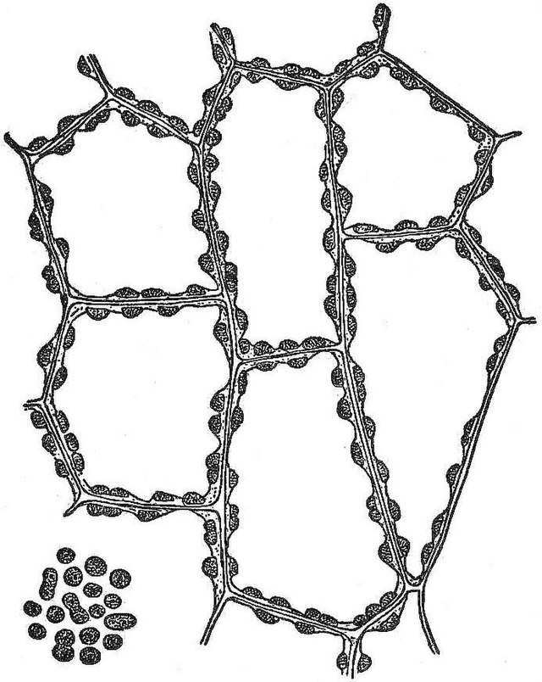
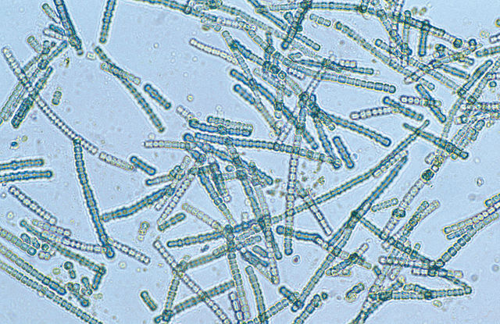
METHODOLOGY:
Water Quality Variables
Chlorophyll/Algae | Cyanobacteria | Nutrients | Surface Temperature | Turbidity
NDCI = (RE1 – R)/(RE1 + R) Floating Algal Index | CIcyano Cyanobacteria Index N / P / Temp °C / pH | Kriging: Phosphorus Nitrogen Dissolved Oxygen Total Suspended Solids | Lake surface temperature in (°C) | NDTI = (R – G)/(R + G)
15
P
Phosphorus
30.97
7
N
Nitrogen
14.007
Image credits: Chandler B. Beach and Frank Morton McMurry, Willem van Aken (CSIRO), Pixaline, Mysid
Notes:
Speaker notes: Justin
The team investigated the relationship and interactions between several water quality parameters such as chlorophyll, cyanobacteria, nutrients in the water, surface temperature and turbidity.
The Virginia DEQ provided NASA DEVELOP with In-situ data to process, which included variables such as nitrogen, chlorophyll, phosphorus, dissolved oxygen and total suspended solids.
Using Sentinel-3 OLCI, the team was able to identify cyanobacteria in the lower portion of the lake. Surface temperature was taken using Landsat-9, and turbidity was taken using Sentinel-2.
Nitrogen and Phosphorus created in power point by Justin
Chlorophyll, cyanobacteria, and Secchi disk are from wikimedia commons
Secchi Disk: https://commons.wikimedia.org/wiki/File:Secchi_disk_pattern.svg (public domain)
Chlorophyll: https://commons.wikimedia.org/wiki/File:NSRW_Chlorophyll_-_Chloroplasts_(2).jpg (public domain)
Cyanobacteria: https://commons.wikimedia.org/wiki/File:CSIRO_ScienceImage_4203_A_bluegreen_algae_species_Cylindrospermum_sp_under_magnification.jpg (public domain)
Thermometer is from Pixabay
https://pixabay.com/vectors/thermometer-temperature-1134182/ (pixabay license)

Slide 10
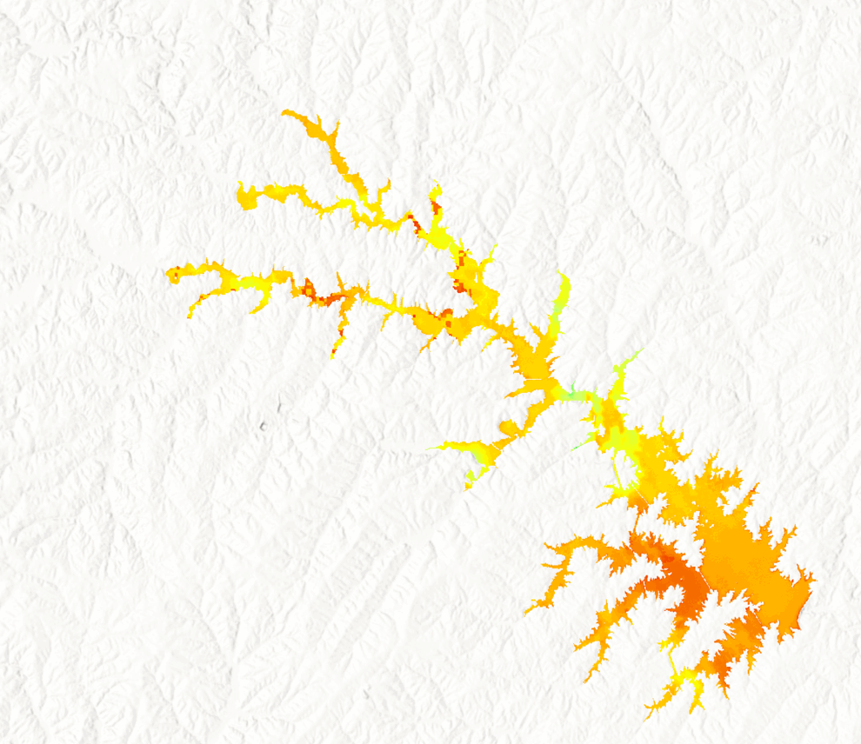
RESULTS
Surface Temperature
Median Surface Temperature (°C) Jun-Sept, 2016 - 2022
N
35 °C
0 °C
0
1
2
4
Miles
ESRI, NASA, NGA, USGS, FEMA
Notes:
Speaker notes: Olivia
Our team examined Landsat 8 & 9-derived surface temperature across sub-annual periods of our study. We looked at each year's 'recreation' and 'swimming' seasons as defined by the DEQ & VDH, however, we focused on the summer months because the lack of cool weather outliers skewing data most useful for teasing out trends and the period during which temperature is most likely playing its most substantial role and algae proliferation is typically highest.
This map shows the lake surface median temperature in Celsius for 2016 through 2022. Orange gradient indicates a temperature around 25C and above. Temperatures of 25 C (77 F) have been shown to be the lower threshold promoting algae proliferation. According to these observations, Lake Anna's summer water temperatures are frequently in the mid-20s and higher.
Year to year, Lake Anna's waters show higher temperatures consistently in two places: in the upper "Splits" (Northern branches) of the lake and what is called the "hot side" of the lake. Higher temperatures in the Splits correspond to areas of the lake susceptible to HABs. It is interesting to note that this region of Lake Anna is generally shallower and easily warmed by insolation; it is also a region where our study saw high indications of other HABs risk factors. The "hot side" of the lake, as it is called, functions as cooling lagoon for the North Anna Nuclear Power Station, the temperatures there can reach into the upper 30s and 40s Celsius (above 100F), but upon discharge into the lake is typically around 15 degrees above the intake temperature.
These surface temperature observations are consistent with in-situ temperature data from the DEQ and appear to correspond to areas of the lake susceptible to HABs.

Slide 11
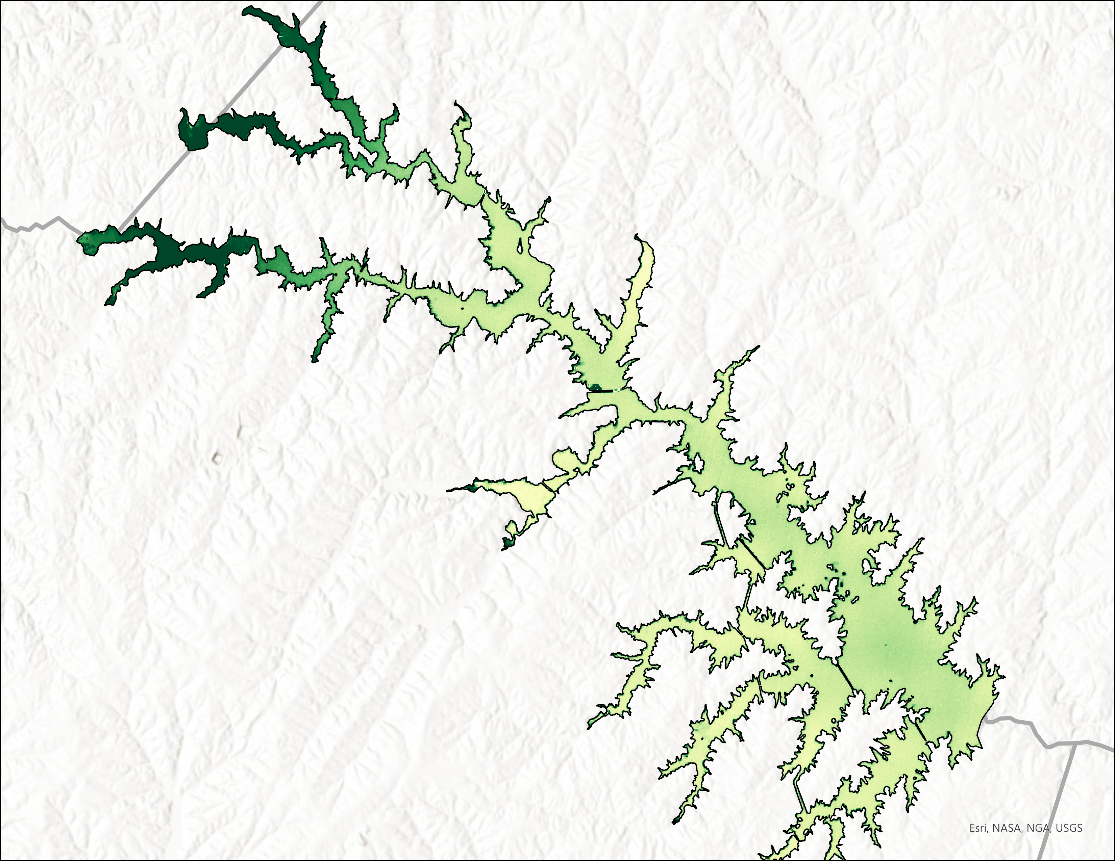
RESULTS
Normalized Difference Chlorophyll Index
NDCI
Orange County
1
NDCI Percentiles (2016 to 2022)
Spotsylvania County
0.5
0.4
0.3
-1
0.2
0.1
0
Louisa County
25
50
75
90
100
0
1.25
2.5
5
Notes:
Speaker notes: Caroline
The map above represents the mean NDCI off all the swim seasons from 2016 to 2022. To calculate the NDCI the ratio of the Red-Edge 1 and Red Bands were used to identify chlorophyll concentrations. The red-edge band is sensitive to medium to high chlorophyll levels. Because the NDCI is a ratio, the values calculated are unitless. Chlorophyll concentrations are represented by a green gradient where the darker green is higher concentrations and lower concentrations are lighter green. The results show that the higher chlorophyll concentrations can be seen in the upper three branches of Lake Anna, as well as along the edges of the entire water body. The figure on the left represents the concentration of chlorophyll broken down into percentiles. As you can see, the 100th percentile appears to be significantly larger than the other four percentiles included in this histogram. I will go over in more detail of contributing factors to why there is a large difference between the 90th and 100th percentile in the errors section (needs rewording). After conducting the NDCI on all the swim seasons between 2016 and 2022, 2021 had the higher overall chlorophyll concentration average.

Slide 12
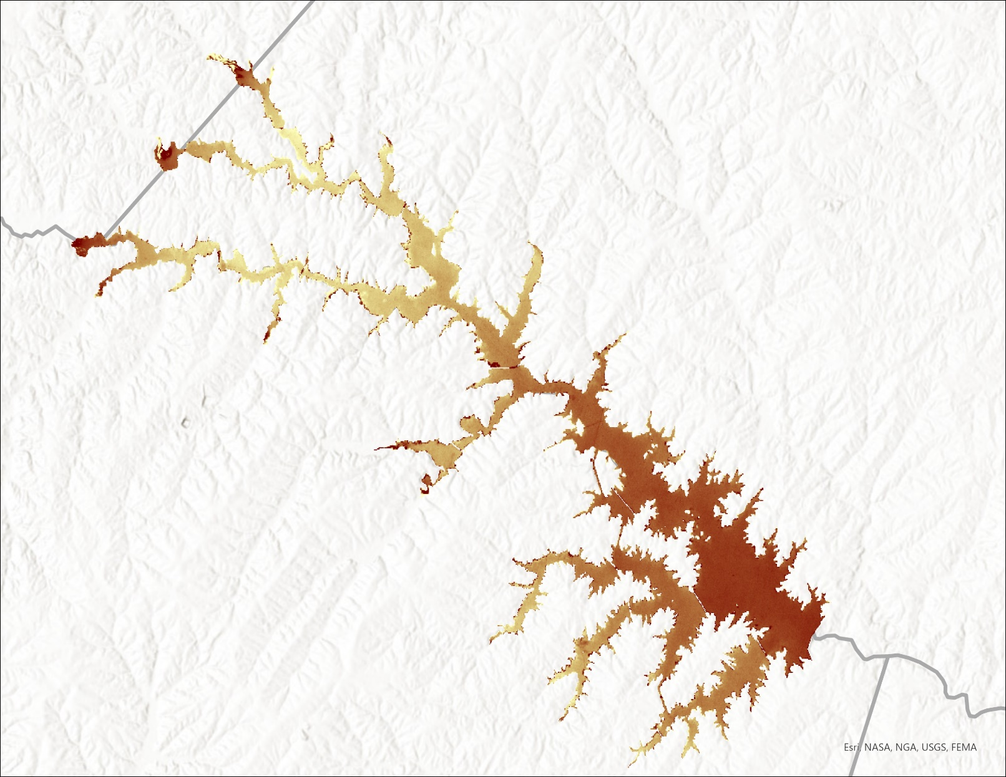
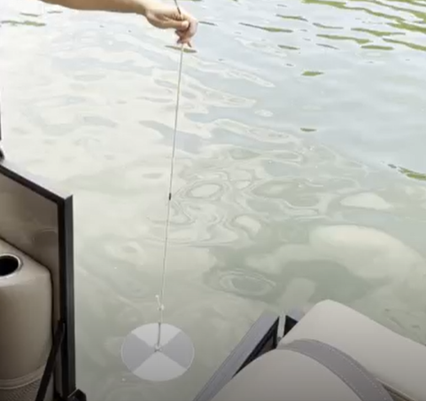
RESULTS
Normalized Difference Turbidity Index 2016-2022
Orange County
NDTI
1
Spotsylvania County
-1
Louisa County
Photo by: DEVELOP Team Member
0
1.5
3
6
Secchi disk measuring the turbidity in Lake Anna
Notes:
Speaker notes: Caroline
Similar to the NDCI, the data used for the NDTI are the mean values off all the swim seasons from 2016 to 2022. The turbidity is calculated by taking the ratio of the red and green spectral bands from the Sentinel 2 MSI. These bands are used because of their electromagnetic reflectance. There is a higher green than red spectrum for clear water, meaning that as the turbidity increases the red reflectance also increases. However, I altered the color gradient in ArcGIS Pro. The more turbid waters are represented by a darker brown, while clearer waters are shown in a lighter yellow color. The more turbid waters are seen at the very tips of the northern branches of Lake Anna. There is also some turbidity seen in the southern half of the lake. Again, like the NDCI the calculated values are unitless. The upper tributaries are clearer which is both expected and unexpected. Algae needs sunlight to grow, and if the water has less sediment or other particles blocking the algae is able to bloom. However, if there are active blooms occurring in the water, we would expect to see more turbid waters due to the bloom blocking the sunlight from penetrating through the water.
The photo on the right was taken from our field trip to Lake Anna and we were given the opportunity to use the Secchi Disk to measure turbidity levels of Lake Anna. I wanted to include this photo to give a good representation of Lake Anna’s water clarity
------------------------------------------------------------------------------------------------------------------------------------------------------------------------------
Image credit: NASA DEVELOP, Lake Anna Water Resources team
Image source:

Slide 13
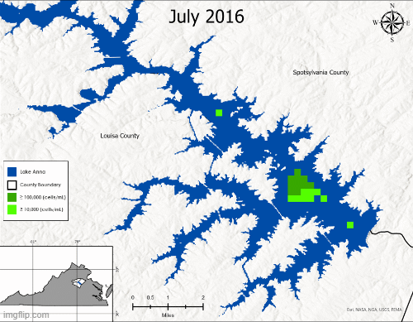
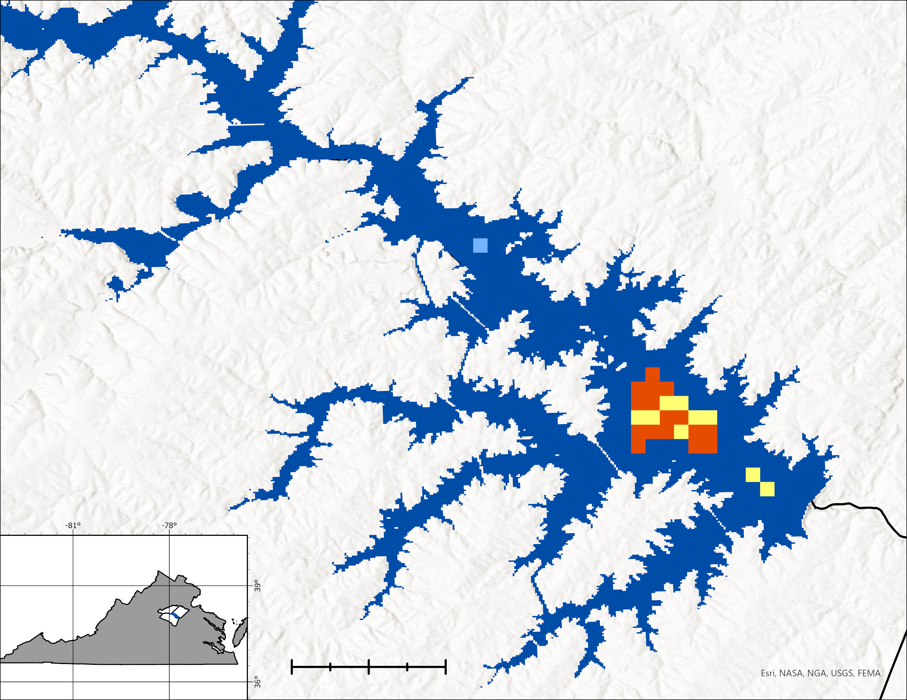
RESULTS
Cyanobacteria
Monthly Composites
Hot Spot Analysis
N
Spotsylvania County
Louisa County
Lake Anna
County Boundary
Low Occurrence
Medium Occurrence
High Occurrence
0
0.5
1
2
Notes:
Speaker notes: Alex
August 2018 experienced the biggest HAB event in this lower portion of the Lake, covering all square 1.95km being studied. Of this, ( ≈ 1.27 sq km) were at or above Advisory level and ( ≈ .68 sq km) were at or above the detection threshold
** Hot Spot Analysis is Advisory Level Data only** ( greater than or equal to 100,000 cells / mL)
Low Occurrence: 4 Months ( ≈ 0.08 sq km)
Medium Occurrence: 5-7 Months ( ≈ 0.68 sq km)
High Occurrence: 8-12 Months ( ≈ 1.2 sq km)
Study Period of 28 months total
Discuss lack of perceived mixing, relatively small size of the Lake compared to Lake Erie, stratification, spillway dam, past events in region, etc.
2018: Only available year for citizen reported blooms – 20 citizen reported HABs in lower half of the Lake, 3 confirmed by DEQ, with Fisherman's Cove exhibiting highest recorded concentration at 10,800,000 cells/mL.
Coincided with highest number of pixels recorded during October (during study period) … same time as Fisherman's Cove citizen report.
2018 data available from link below (only year with records retained including citizen reports)
https://www.google.com/maps/d/viewer?mid=1TDt_yKTG3QyYbtZN3nYnLCB904dddOe-&ll=38.039792558878965%2C-77.77694667933915&z=13

Slide 14
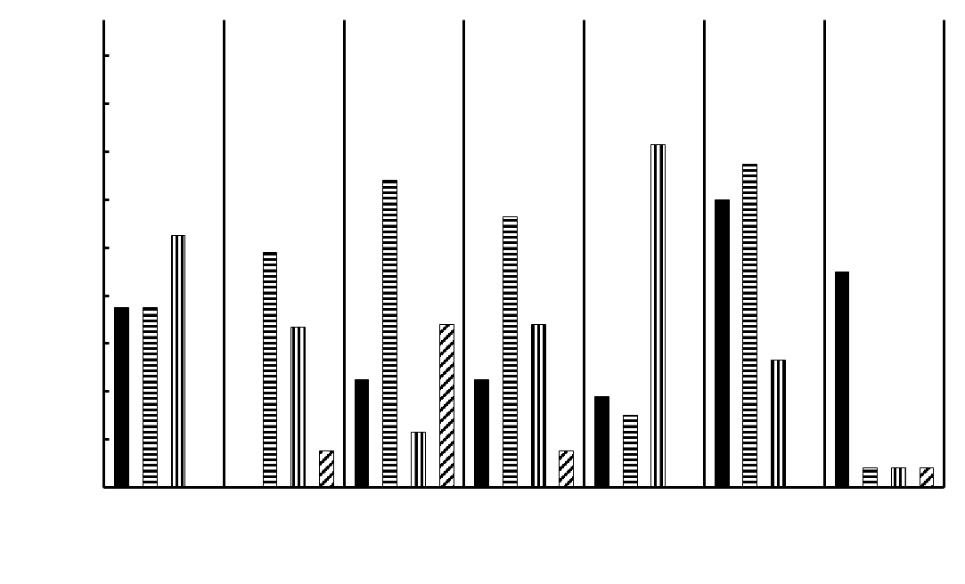
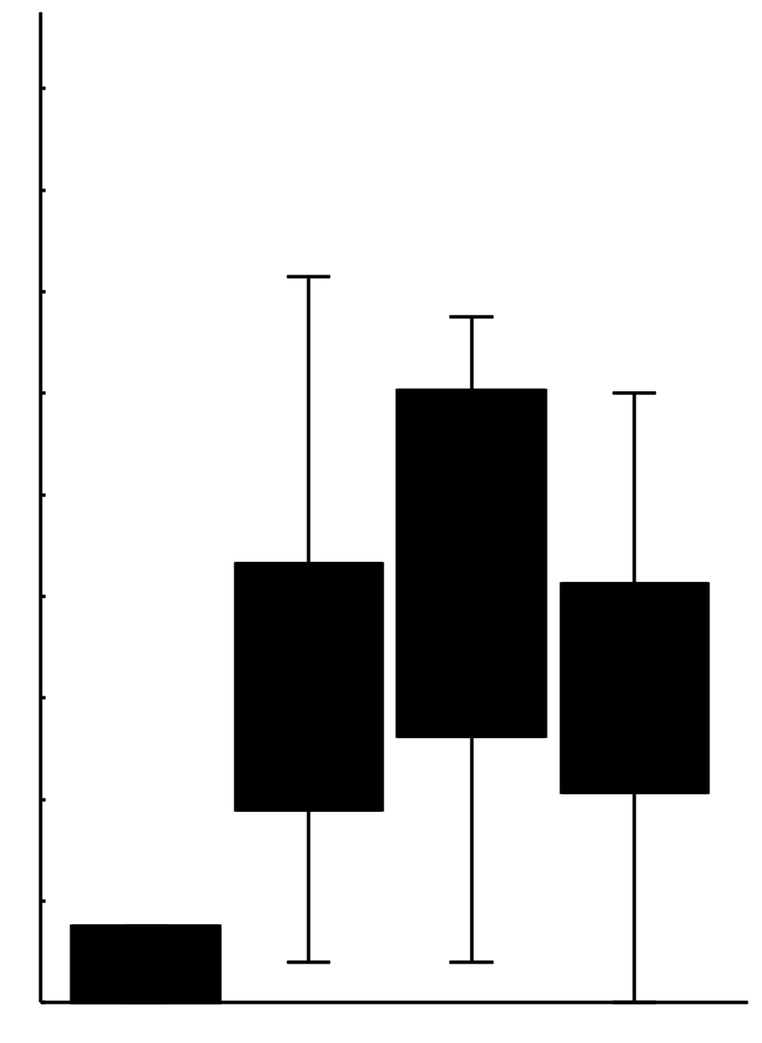
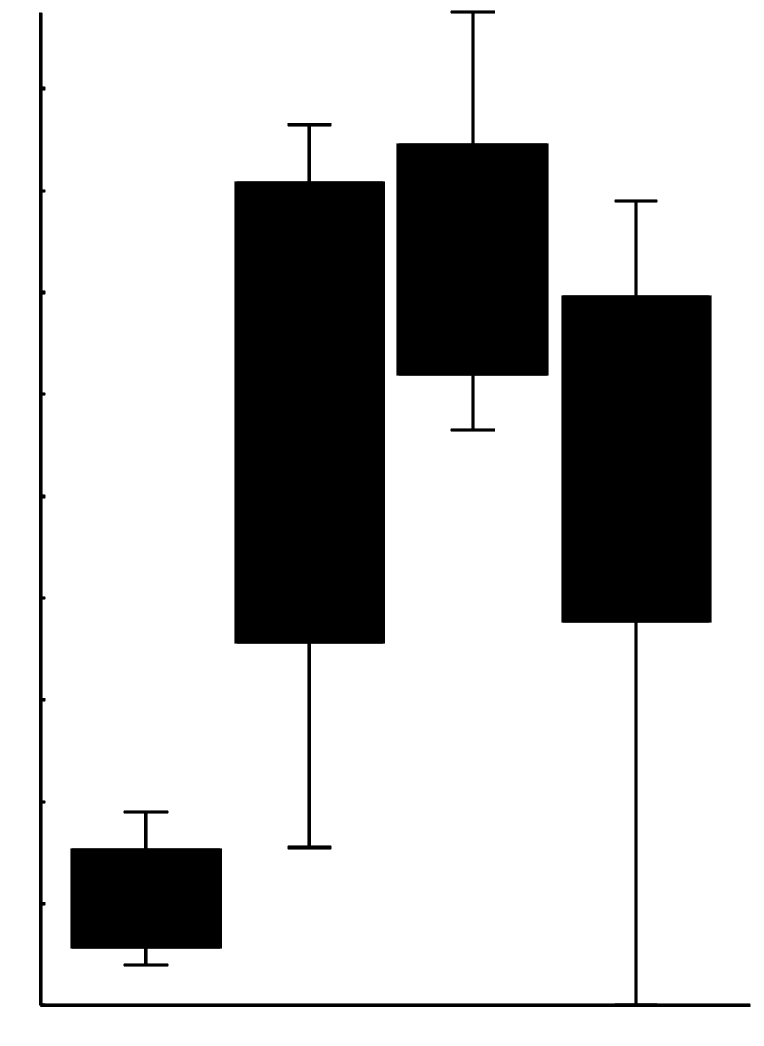
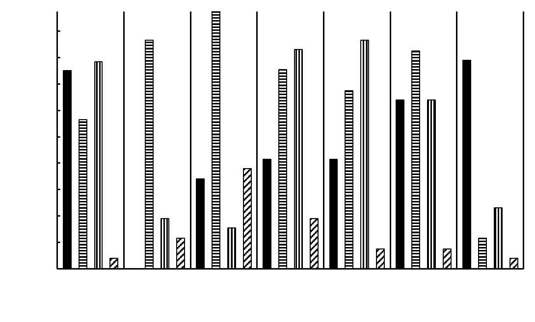
July
August
September
October
RESULTS
1.8
Cyanobacteria
HABs have been a persistent issue over the study period.
Lower portion of the Lake is not immune to HABs.
Similar phenology to locations across the eastern US.
1.6
1.4
1.2
Area (km²)
1
0.8
0.6
0.4
0.2
0
2016
2017
2018
2019
2020
2021
2022
Years
^ ≥ 100,000 (cells/mL) Area Yearly Comparison ^
≥ 100,000 (cells/mL) Area Monthly Comparison
Total Area Monthly Comparison
July
August
September
October
1.8
Jul
Jul
1.6
1.4
Aug
Aug
1.2
1
Month
Month
Area (km²)
0.8
Sep
Sep
0.6
0.4
Oct
Oct
0.2
0
0
0.2
0.4
0.6
0.8
1
1.2
1.4
1.6
1.8
0
0.2
0.4
0.6
0.8
1
1.2
1.4
1.6
1.8
2016
2017
2018
2019
2020
2021
2022
Area (km²)
Area (km²)
Years
^ Total Area Yearly Comparison ^
Notes:
Speaker notes: Alex
Advisory Level for these purposes is ≥ 100,000 (total cells/mL) of total potentially toxigenic (PTOX) cyanobacteria taxa.
Detection Level for these purposes ≥ 10,000 (total cells/mL) of total potentially toxigenic (PTOX) cyanobacteria taxa. (Based on Sentinel-3 spectral capability / (Lunetta et al. 2015) + (Schaeffer et al. 2023)
Top Right = Advisory Level (≥ 100,000 (total cells/mL)) year comparison
Bottom Right = Total Area Yearly Comparison
Middle Right = Total Area Yearly Comparison
Middle Left = Advisory Level (≥ 100,000 (total cells/mL)) year comparison
Offer examples of Lake Erie and Lake Okeechobee // Phenological Implications?
Kruskal-Wallis (Yearly)
- No significant difference for total detected area or advisory area (p: 0.87)
Kruskal-Wallis (Monthly) // Dunn's Post-Hoc Comparison
Significant Difference (advisory area): (p: 0.007)
October is significantly different from September & August. (p: 0.007 & p: 0.001) respectively … (0.06 for July)
----------------------------------------------------------------------------------------------------------------------------------
Significant Difference (total detected area): (p: 0.03)
October is significantly different from September & August. (p: 0.03 & p: 0.004) respectively … (0.06 for July)

Slide 15
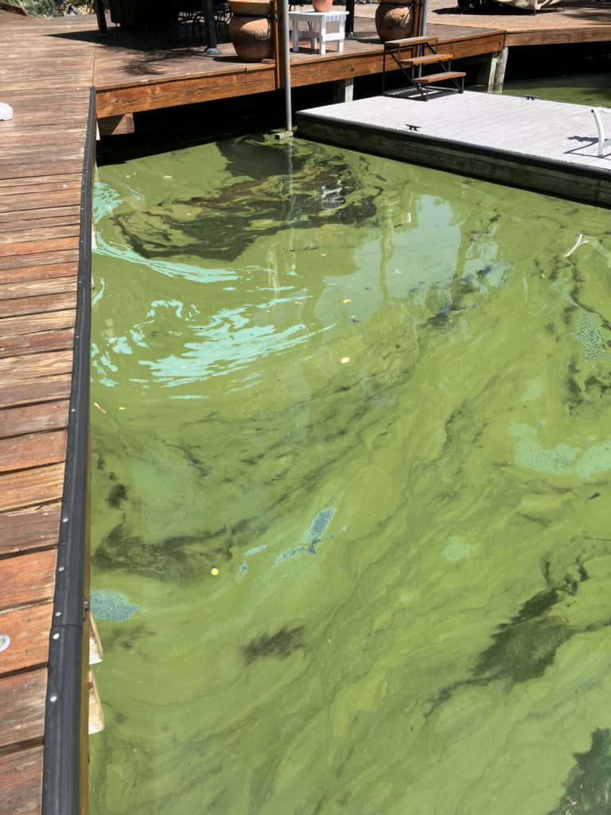
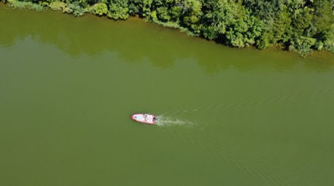
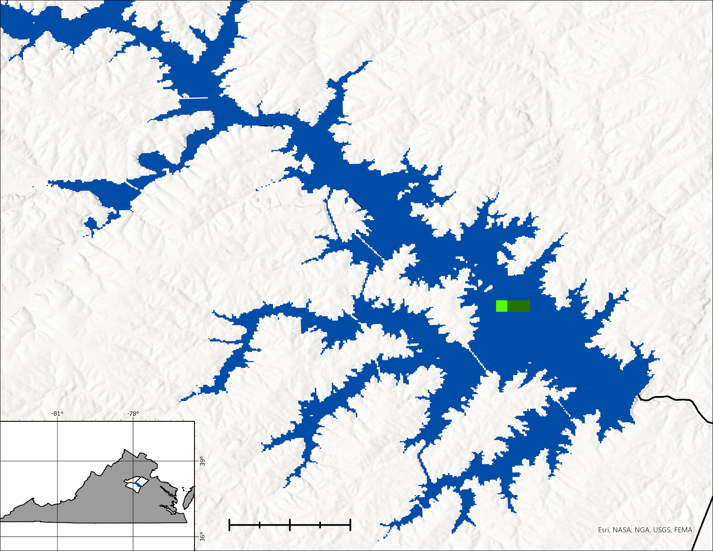
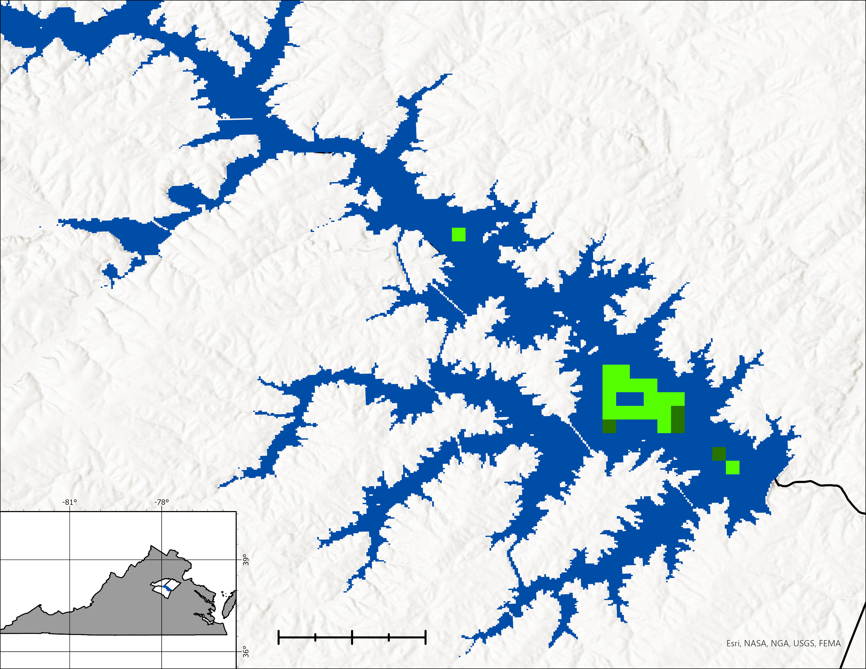
RESULTS
Cyanobacteria: Index Comparison
(665 – 620)
(681 – 665)
R(665) – R(620) + [R(681) – R(620)] *
– [R(681) – R(665) + [R(709) – R(665)] *
(681 – 620)
(709 – 665)
N
N
Spotsylvania County
Spotsylvania County
Louisa County
Louisa County
Lake Anna
Lake Anna
County Boundary
County Boundary
≥ 100,000 (cells/mL)
≥ 100,000 (cells/mL)
≥ 10,000 (cells/mL)
≥ 10,000 (cells/mL)
0
0.5
1
2
0
0.5
1
2
CIcyano
Cyanobacteria Index
Image courtesy of Anthony Ford
Image courtesy of Kenny Fletcher
Notes:
Speaker notes: Alex
Images from October 2017, (picked for low occurrence in original formula). The Cyanbacteria Index by Wynne et al., is known for producing false positives and detecting blooms that are not necessarily representative of phycocyanin absorption (which is of primary interest to this study) (Timothy et al. 2020). CIcyano was developed for the Chesapeake Bay, and has been shown to be more attune to detecting solely phycocyanin producing blooms. Indices were tested / validated on reported HAB occurrences in Lake Erie (2 NOAA reported events).
Top left image blue-green example from nearby Smith-Mountain Lake.
Top right image from Lake Anna, showing heavily greened water.

Slide 16
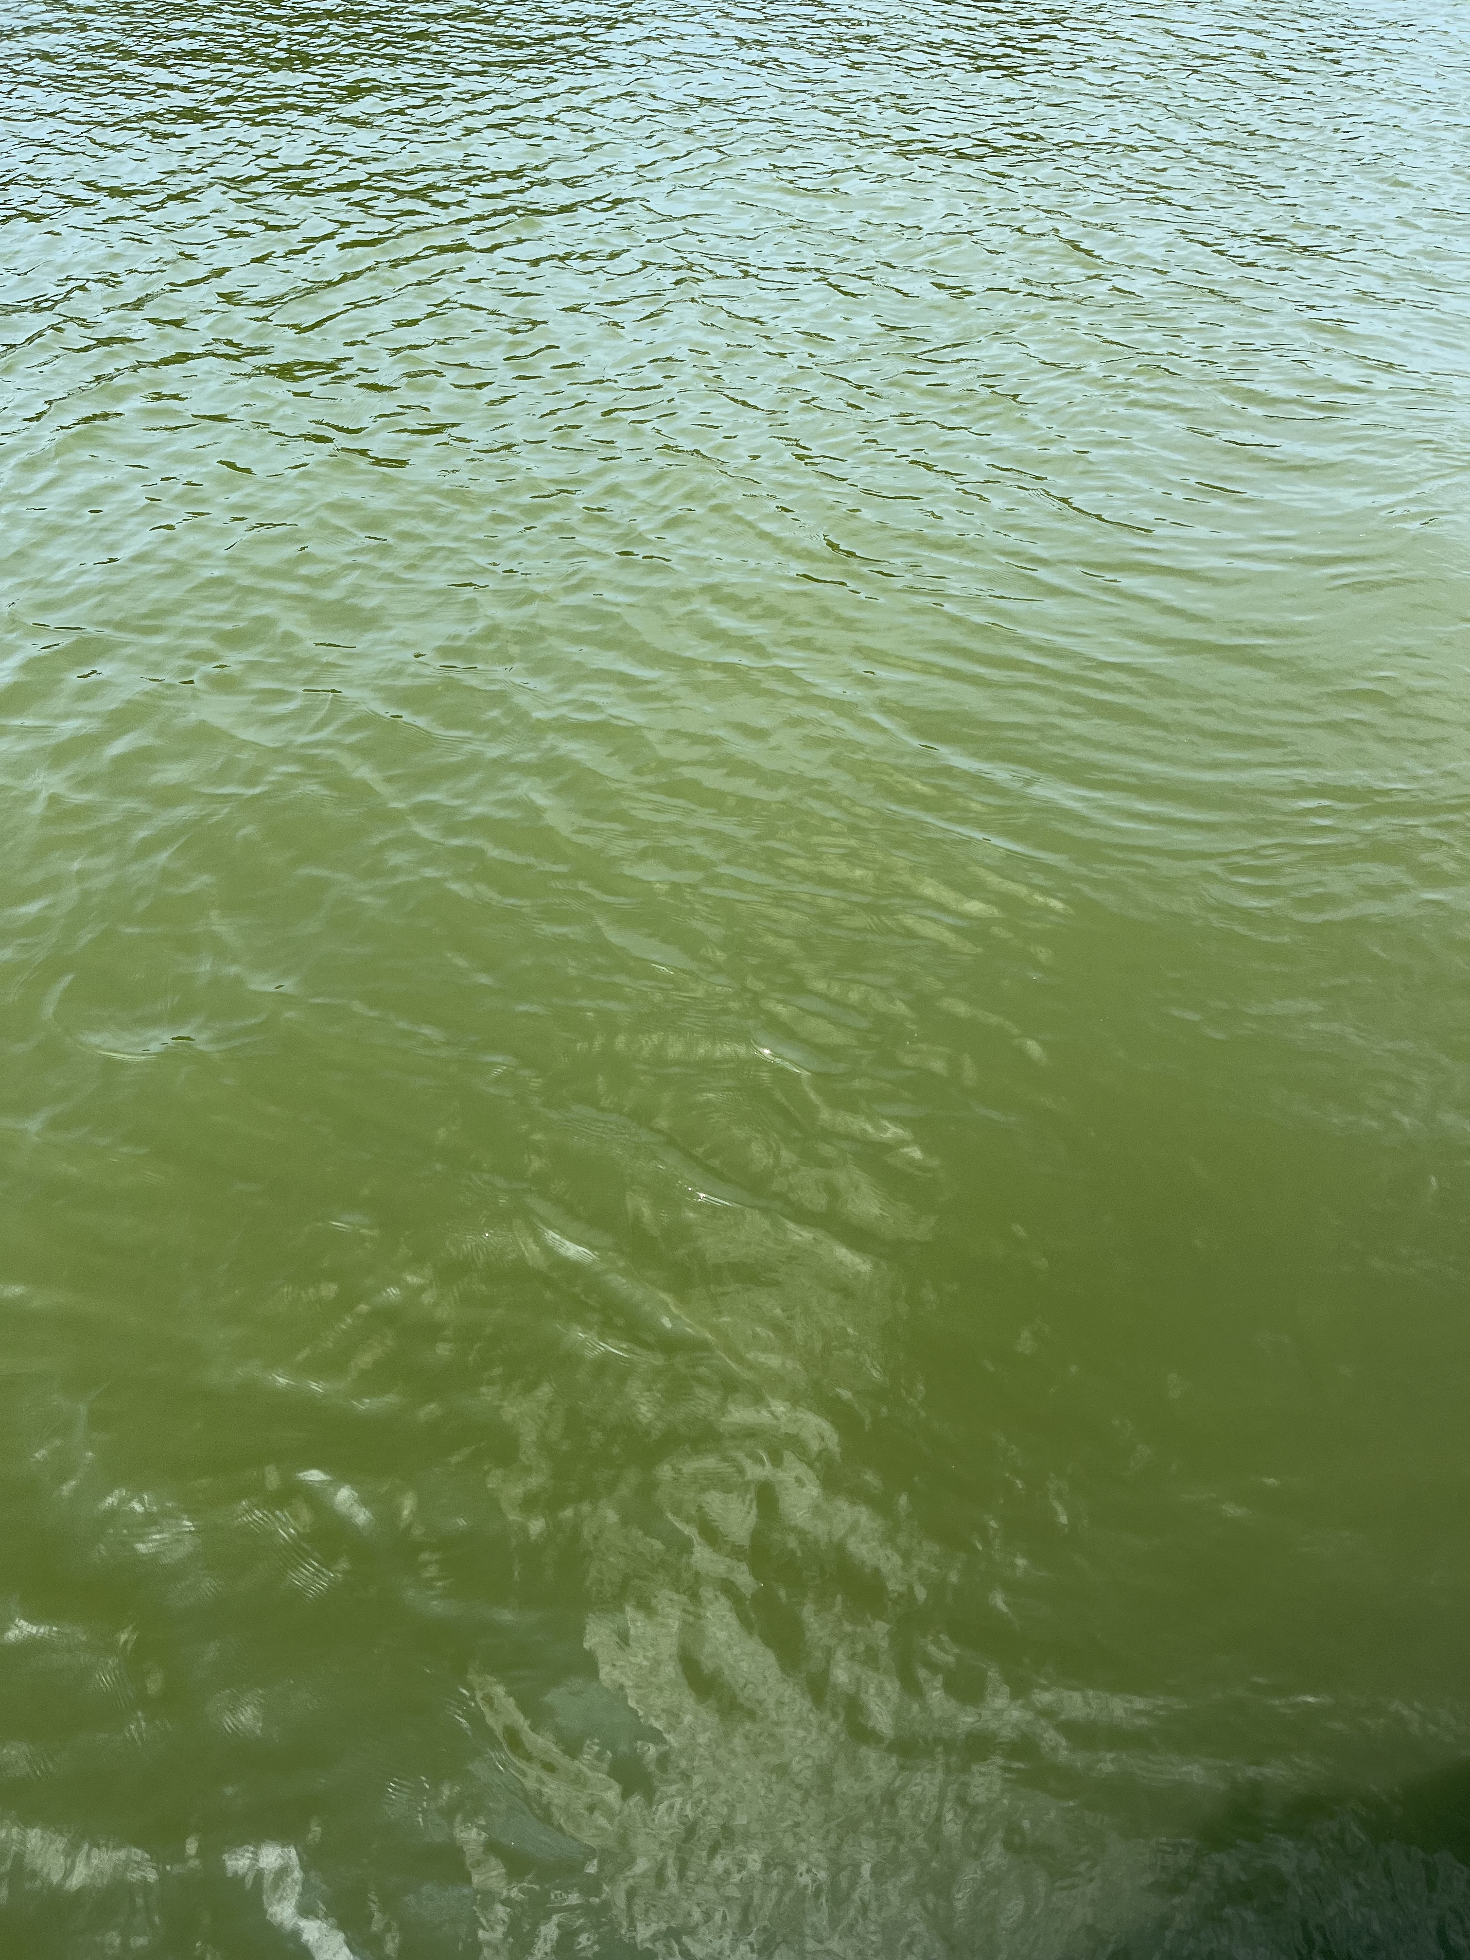
RESULTS
Floating Algal Bloom in Turbid Waters Index
S2A/MSI 2018-10-18 15:57:51 FAIT (Dogliotti et al. 2018) [-]
N
1.0
0.8
0.6
0.4
0.2
0.0
Photo by: Caroline Bahun
Harmful algal bloom in Lake Anna
Notes:
Speaker notes:
Using a program called Acolite, the team performed an analysis on floating algal blooms on Lake Anna.
Floating Algal Bloom in Turbid Waters (FAIT) Index by Dogliotti uses the surface reflectance rather than Rayleigh corrected reflectance (Rrc).
The floating algal index makes use of the strong signal in the Near-infrared part of the spectrum along with conditions on the red band to avoid misclassification of pixels to confirm the green pixels as floating vegetation.
In general, positive values of FAI indicate floating algae.
---------------------------------------------------------
Image credit: Caroline Bahun

Slide 17
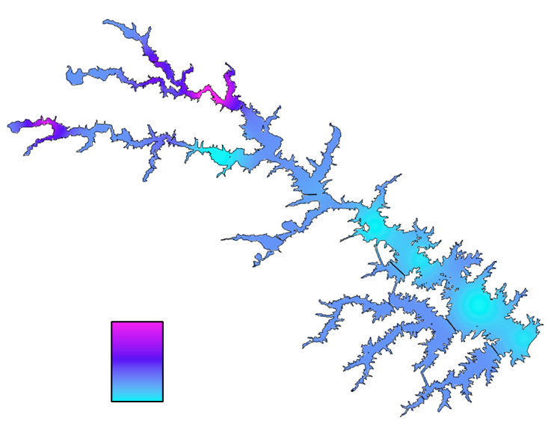
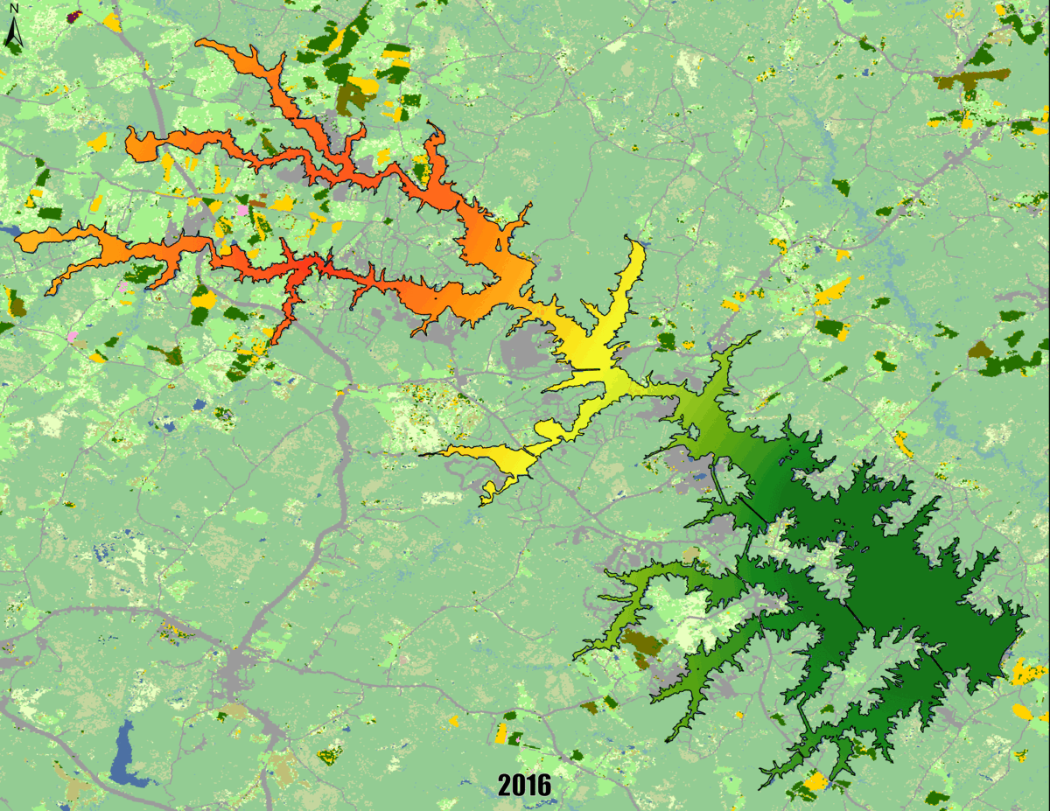
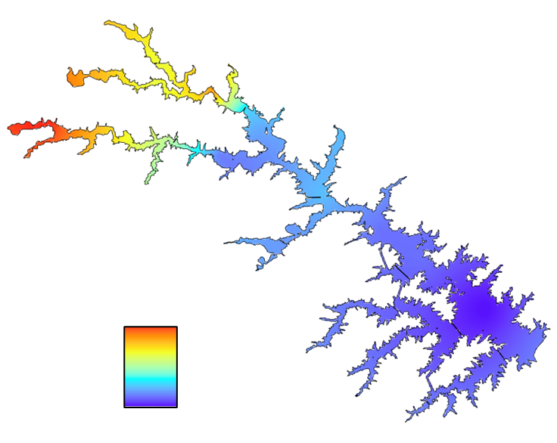
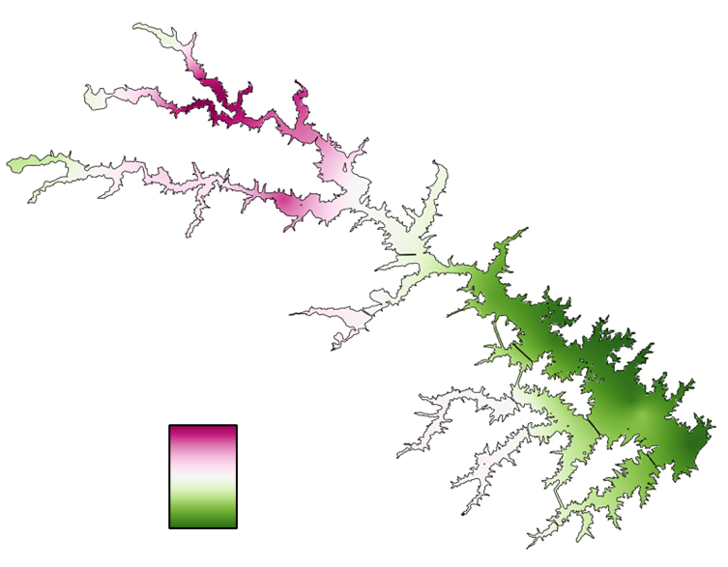
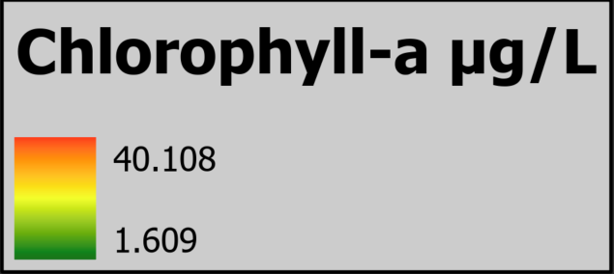
RESULTS
1.69
0.1
Nitrogen Mg/L
0.25
0.01
0
3
6 Miles
Phosphorous Mg/L
8.9
6.4
pH
The team performed a Kriging analysis to interpolate the concentration spread of chlorophyll-a throughout Lake Anna for the 2016-2022 time period.
Notes:
Speaker notes:
A gif was created of a Kriging analysis performed using the DEQ's In-situ data on Lake Anna. The gif displays the spread of concentration of chlorophyll-a throughout the lake and is overlayed on top of the USDA's Crop Land Data Layer for each respective year showing the correlation between most crops and the amount of nutrients.

Slide 18
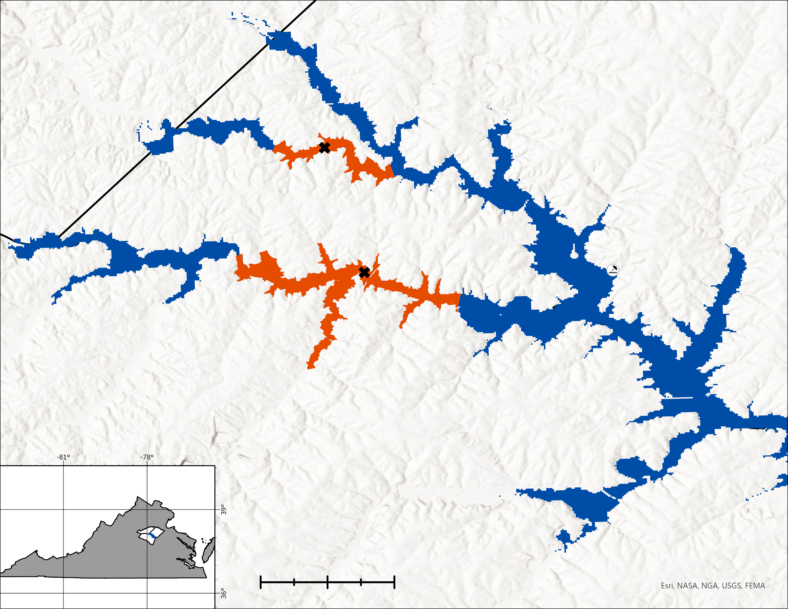
RESULTS
Localized Principal Component Analysis
N
Orange County
Spotsylvania County
Lake Anna
Study Area
County Boundary
Sampling Location
Louisa County
Lake Anna Beach
0
0.5
1
2
Miles
Notes:
Speaker notes: Alex
PCAs were performed in the (Middle) Lake Anna branch and (Upper) Pamunkey branch as classified by the VDH. These sites were chosen based on data availability and all data utilized, were recorded at a depth of 0.3 m.
Data was gathered from June to November when possible, all but two months only received a single data point.
Discuss the possibility of different ecological functioning in the separate branches.
Basemap: Esri, NASA, USGS, FEMA

Slide 19
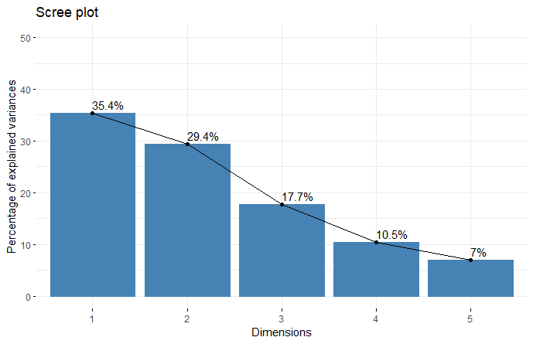
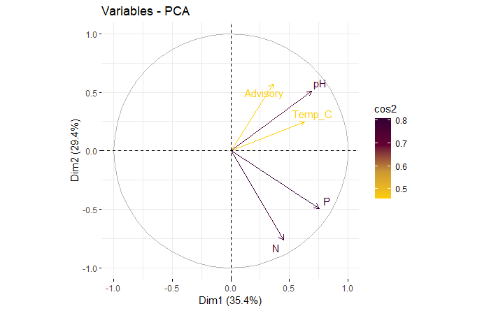
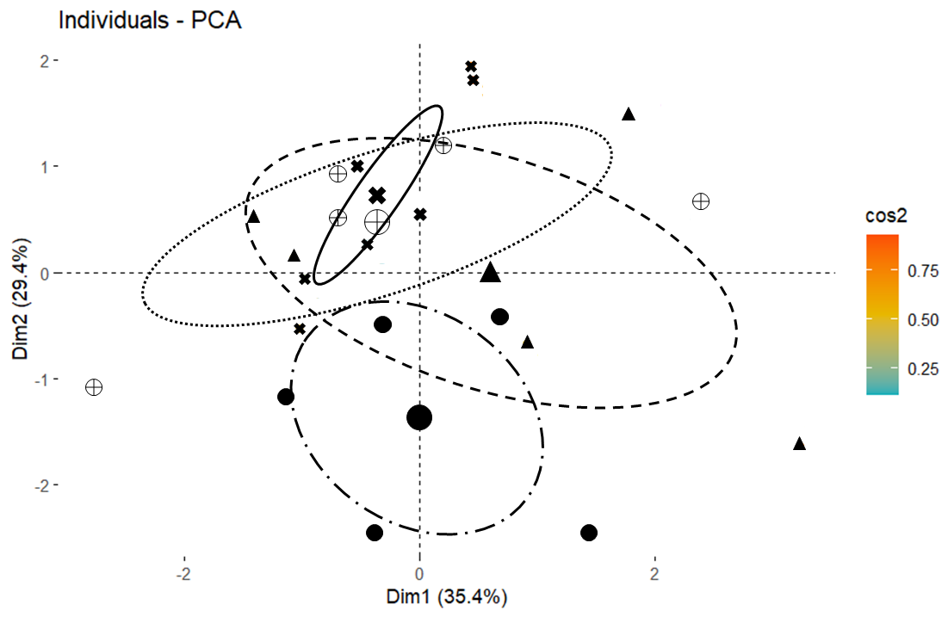
RESULTS
Localized Principal Component Analysis
North Anna (Middle)
50
40
30
% of Explained Variance
20
10
0
4
5
1
2
3
Dimensions
1.0
2
0.5
1
0
2019
0.0
Dim2 (29.4%)
Dim2 (29.4%)
2020
-1
2021
-0.5
2022
-2
-1.0
-1.0
-0.5
0.0
0.5
1.0
2
-1.0
-0.5
0.0
0.5
1.0
-2
0
Dim1 (35.4%)
Dim1 (35.4%)
Notes:
Speaker notes: Alex
First 2 Principal Components in North Anna explain: 64.8% of the variance in the data. First PC is likely pH.
North Anna visual correlation with pH / Temp_C / Advisory … numerical correlation highest between pH / Advisory (.37) … low for other variables and even slightly negative for N
pH was the notable correlating factor with advisories in this branch, interesting because the recorded pHs here hovered between 7-7.5 … slightly below those levels favored by HABs (8-9.5)

Slide 20
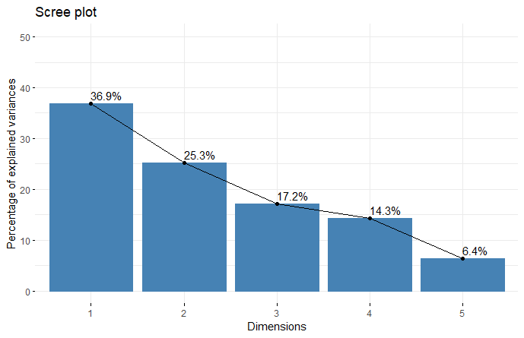
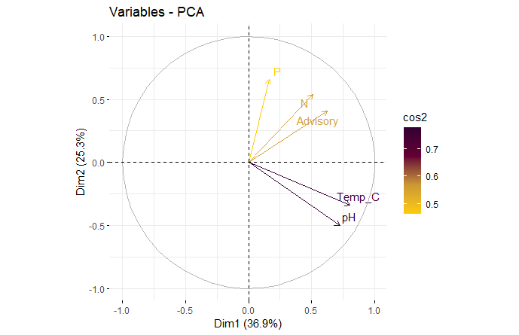
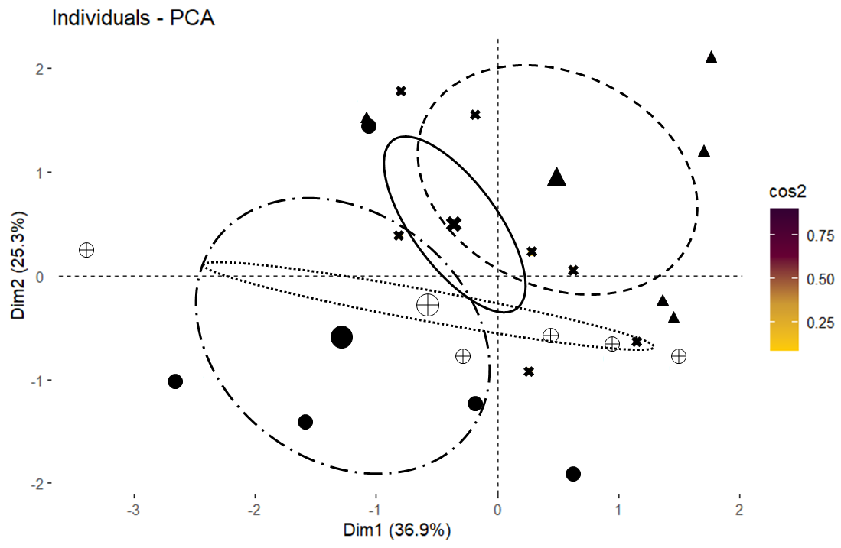
RESULTS
Localized Principal Component Analysis
Pamunkey (Upper)
50
40
30
% of Explained Variance
20
10
0
1
2
3
4
5
1.0
Dimensions
2
0.5
1
2019
0.0
Dim2 (25.3%)
2020
0
Dim2 (25.3%)
2021
-0.5
2022
-1
-1.0
-2
-1.0
-0.5
0.0
0.5
1.0
-3
-2
-1
0
1
2
Dim1 (36.9%)
Dim1 (36.9%)
Notes:
Speaker notes: Alex
First 2 Principal Components in Pamunkey explain: 62.2% of the variance in the data.
Pamunkey visual correlation with N / P / Advisory … numerical correlation highest between N / Advisory (.34) & Temp_C / Advisory (.32) … P correlation (.12) & pH correlation (.11)
Discuss the possibility of different ecological functioning in the separate branches. While relatively small in size, the various branches in Lake Anna may harbor conditions that favor (or not) algal blooms.
The relationship shown here is what ne may consider the traditional correlation where N and P concentrations are closely associated with the number of HABs.

Slide 21
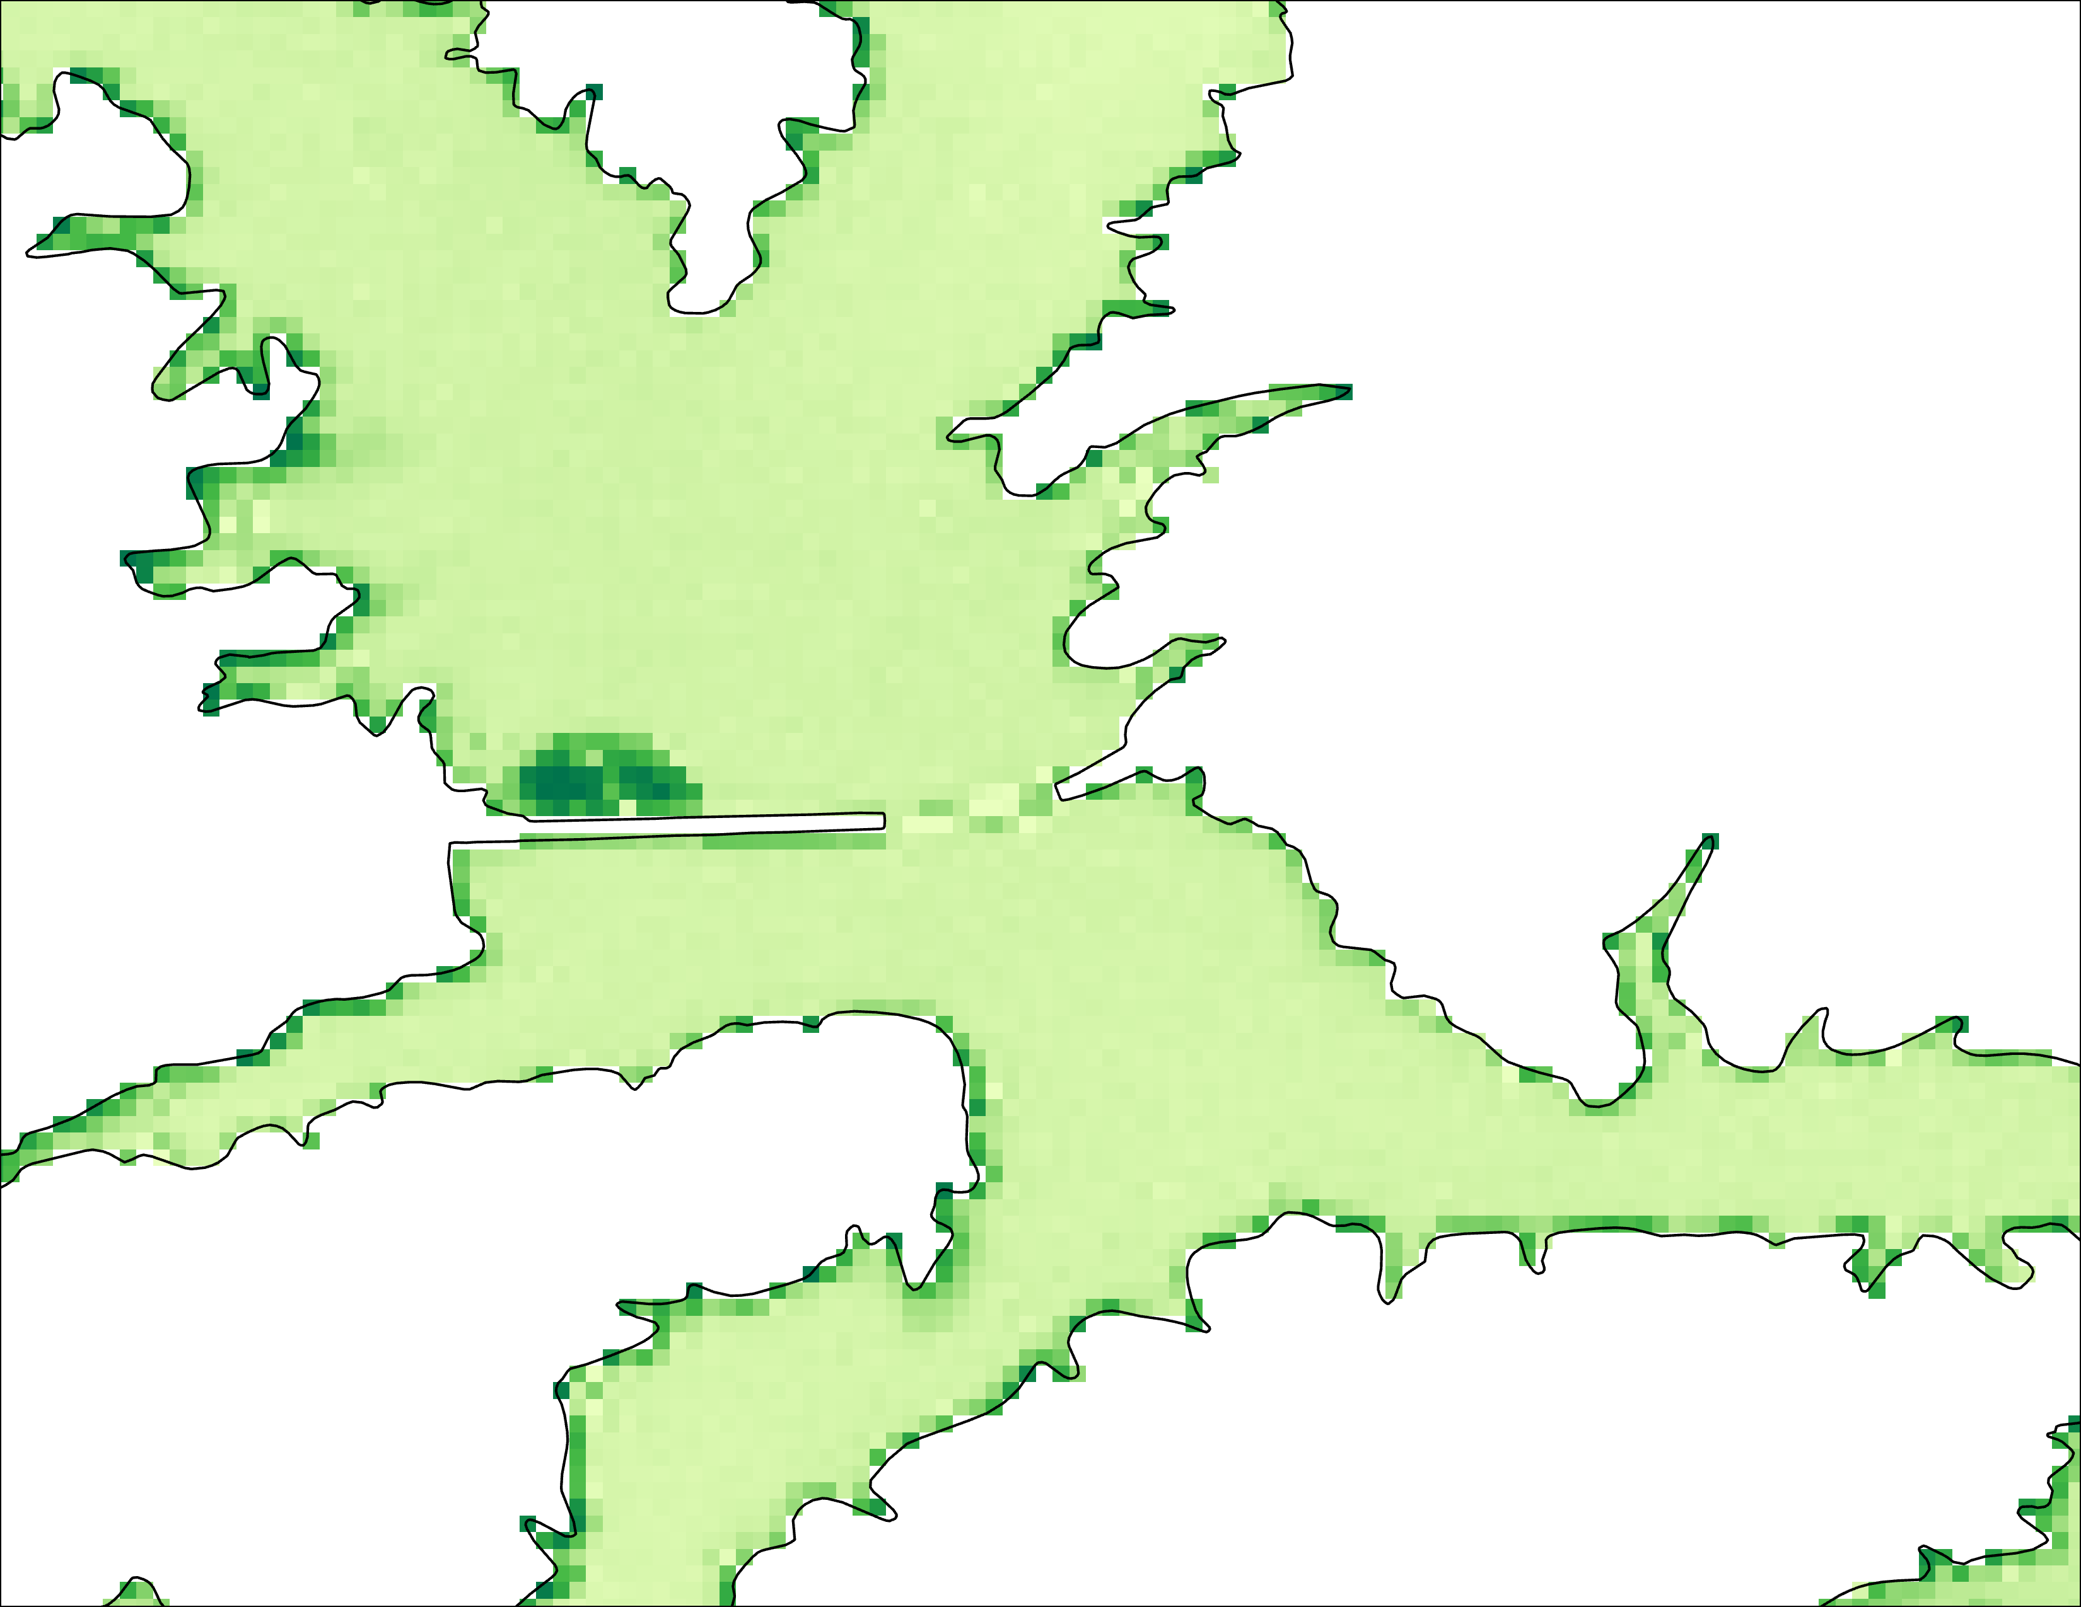
ERRORS & UNCERTAINTIES
Lack of verifiable HAB events within buffered study area
Patchy temporal coverage regarding Sentinel-3 monthly composites
Limited field data provided for a sparce PCA.
Outside variables such as docks, boats, wake, and bridges skewed the indices
Shallow, clear waters are more subjected to bottom reflectance
Notes:
Speaker notes:
NDCI/ NDTI:
-Cloud Mask did not remove all the clouds from the sentinel collection: certain cloud masks would filter through the data and run with no errors, but there was no image produced.
-there were docks or panels that were on the edge of the lake that were being picked up as chlorophyll and turbidity
-areas where the water is shallow and contains sediment swirls in the “true color” image were detected as chlorophyll
-areas of shallow waters and are clear (not turbid) are more subjected to bottom reflectance
General:
Variable pre-processing efforts and water mask coverages which may have altered symbology.
Cyanobacteria:
300 meter buffer made it difficult to compare the data to existing HAB reports, especially since the VDH only monitors the top half of Lake Anna.
Possible issues for PCA with limited field and advisory data.
Sentinel-3 monthly composites were composed of 4-5 images, including a greater number of images for analysis would be beneficial.

Slide 22
CONCLUSIONS
Remote sensing is not 100% accurate but can help identify trends & allow managers to target "problematic” areas
Sentinel-2: Generalized algal growth trends
Sentinel-3: Enables selective retrievals of cyanobacteria, but coarse spatial resolution limits practicality for monitoring more problematic areas
Parameters derived from Landsat & ancillary datasets can help DEQ assess HABs risk factors
Results suggest that the expansion of regular HAB monitoring efforts across Lake Anna may be beneficial to fully understanding this phenomenon.
Spatially dependent limiting factors may influence the development of HABs across Lake Anna.
Notes:
Speaker notes:
*From our findings, we believe NASA & ESA Earth Observations can enhance the DEQ's future monitoring efforts in Lake Anna. Using Sentinel-2, we were able to identify higher chlorophyll concentrations, turbidity, and XX in the upper Splits of the lake, which corresponds to the higher incidence of blooms and HABs in this region. While Sentinel-3 data enabled us to selectively retrieve data on cyanobacteria, its coarse spatial resolution makes it impractical for DEQ use throughout the lake, and especially in the areas currently of most concern for HABs. Parameters derived from Landsat & ancillary datasets can help the DEQ assess risk factors contributing to HABs.
*Need for HAB monitoring to occur in the southern half of Lake Anna, a region which is currently not vetted by the VDH. Besides investigating some citizen reported blooms. (By that point its already too late)
*Although the Lake is relatively small, the region's topography along with a variety of choke points may serve to isolate certain conditions that may be favorable (or not so) to the formation and persistence of HABs.

Slide 23
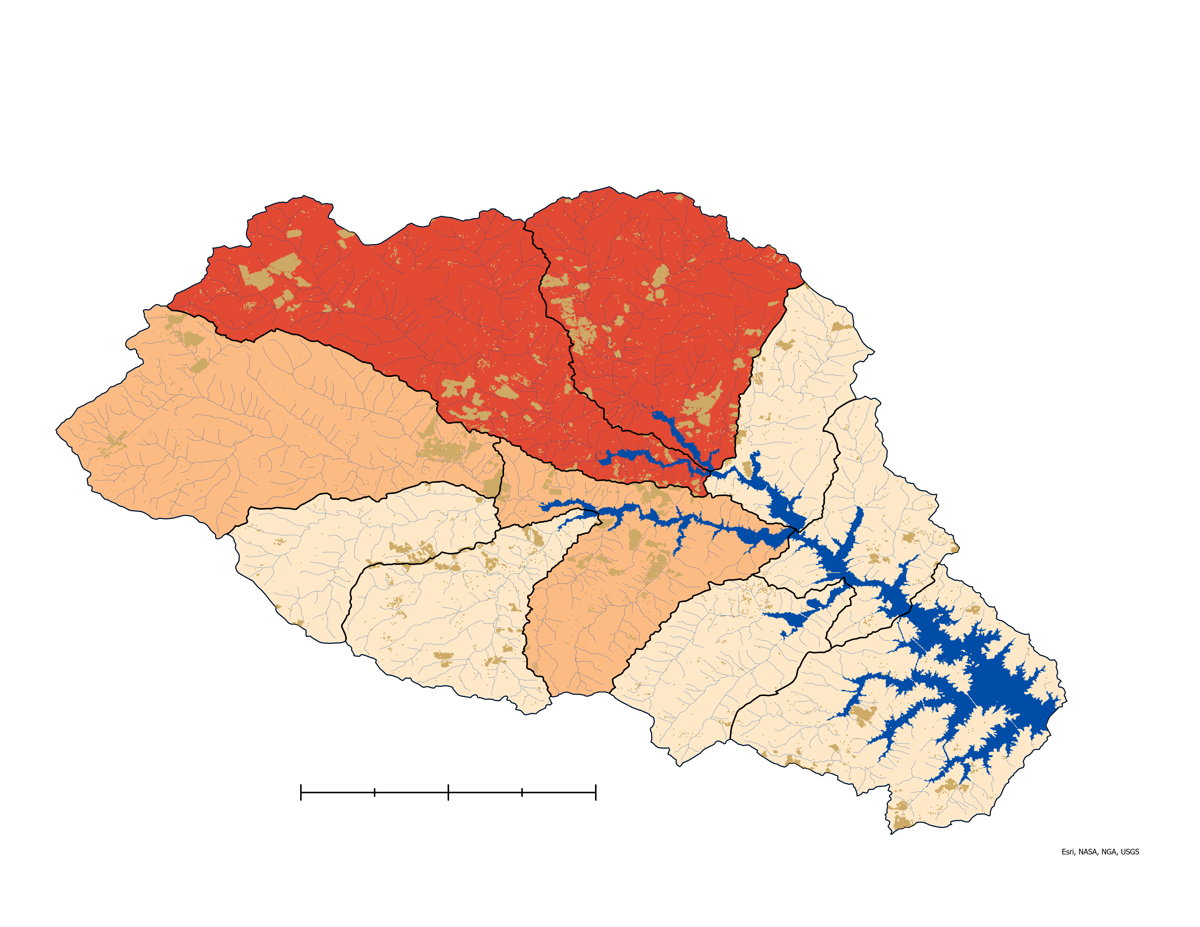
FUTURE WORK
Resolution Develop a cyanobacteria detection workflow that affords greater spatial resolution.
N
Modeling Incorporate watershed model-building in order to identify nutrient loading and possible sources of contamination.​
Validation Perform a more robust validation of satellite observations with in-situ data.​
(ex: data collected at USGS continuous monitoring sites, newly installed May of 2023)​
Lake Anna
Row Crops
High P Loading
Mod P Loading
Low P Loading
Streams
0
2.5
5
10
HUC 12 Watersheds
Earth Observing Data Use NASA’s Plankton, Aerosol, Cloud, ocean Ecosystem (PACE) imaging to detect HABs.
Notes:
Speaker notes:
Row Crop / Phosphorous Export Coefficient Map:
Overall crop area highest in watersheds feeding Pamunkey Creek and Terry's Run (15.3 sq km of crop land) … also areas that often experience greatest number of HAB advisories. Total area of those two watersheds roughly 250 sq km. Row crops selected = corn, soybean, cotton, tobacco (as listed by VA DWR Gap Analysis [Land Cover Code / Description]).
**based on export coefficient**
High P = 2400-3600 kg/yr
Mod P = 1300-2300 kg/yr
Low P= 210-1200 kg/yr
Cyanobacteria:
Sentinel-3 300x300m resolution is likely too coarse to be of sufficient use for many inland lakes.
Validation:
Perform a more robust validation of satellite observations with more spatially and temporally continuous in-situ data, where possible. This should be feasible in the near term because, early this summer, the USGS began installing continuous monitoring stations at 4 different sites at the lake. A wide range of water quality parameters (fluorescence, conductivity, pH, nitrate, etc.) are collected at regular () min intervals,
Modeling:
Relate to row crop map and possibility of expanded analysis.

Slide 24
Virginia DEQ:
Tish Robertson, Amanda Shaver, Bryant Thomas
Photo by: DEVELOP Team Member
LaRC Science Advisors: ​
Dr. Kenton Ross, Lauren Childs-Gleason
Special thanks to Harry Looney (LACA Co-Chair), Olivia Landry (DEVELOP Fellow), Robert Cecil Byles (DEVELOP Senior Fellow)​
This material contains modified Copernicus Sentinel data (2016-2023), processed by ESA.

