Slide 1
2021 Spring
NATIONAL
ORIENTATION
MODULE 7. Opportunities

Slide 2
Note: NASA SMD travel has been suspended since March 2020 due to COVID-19 but this information is good to know for the future!
Travel
Any travel funded by the DEVELOP Program will be coordinated and originated through the DEVELOP NPO.
Travel is a privilege. The program does its best to provide opportunities to present DEVELOP work and engage with partners when appropriate – and resources and timing allow.
Travel Process:
DEVELOPer identifies a conference or meeting they are interested in attending.
Talk to the Fellow about the opportunity; if they approve of the opportunity, then they will work with you to submit a request to NPO (includes description, attendee info, justification for travel, and cost estimate).
NPO will assess merit of the event and funds available.
If NPO approves the travel, NPO will input the traveler and event into the NASA Conference Tracking System to gain agency approval.
Once agency approvals are received, travel requests must be submitted for the travel to be approved by the funding contract.
Once funding organizations approve, travel arrangements (if needed) will be made by NPO and reimbursements will be processed upon the travelers’ return.
By The Way
Certain large conferences (AGU Fall Meeting, AAG Annual Meeting, ASPRS Annual Conference, etc.) are planned 6+ months ahead and opportunities to attend are competed across the program. Talk to your Fellow. There may be opportunities for virtual conference participation!
Notes:
*Note that NASA and SSAI are not currently approving travel

Slide 3
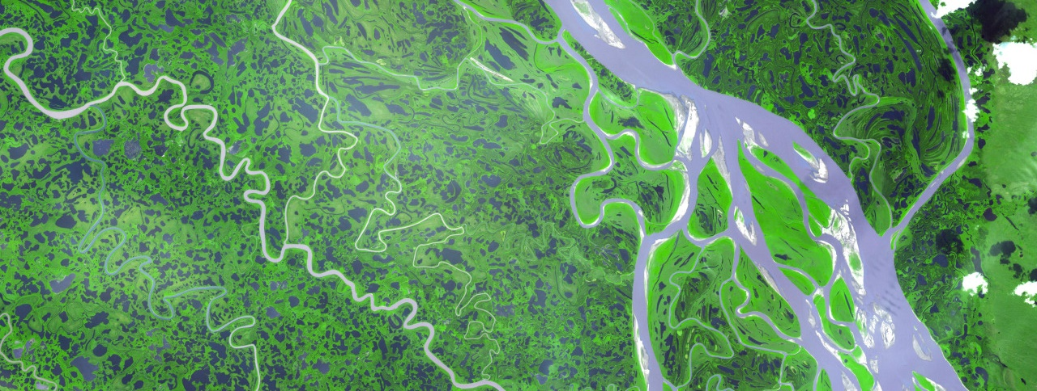
Presenting & Publishing Your Work
For the purposes of ensuring appropriate export control review, performance metric tracking, and reporting to NASA HQ, any and all presentations or publications related to DEVELOP (projects or the program in general) must be communicated to, and content shared with, NPO before submission of the presentation or publication.
Submitting work for presentation or publication is encouraged; however, ALL research is shared property of NASA; therefore, you must have permission prior to submitting your research anywhere. Also, to minimize duplication of effort, the NPO oversees all publications and presentations.
Coordinate with your Fellow, and, if approved at your node, send a simple email with your ideas before the presentation or publication to Amanda.L.Clayton@nasa.gov and Karen.N.Allsbrook@nasa.gov with the following information:
Description of the activity – conference, presentation to a class, publication, etc.
Timeline for the activity – when the event is or deadline for publication, etc.
A copy of the material (because often presentations can be large, a PDF is good enough for a quick review)
Cost estimate (if applicable)
Thank you for your help with this!

Slide 4
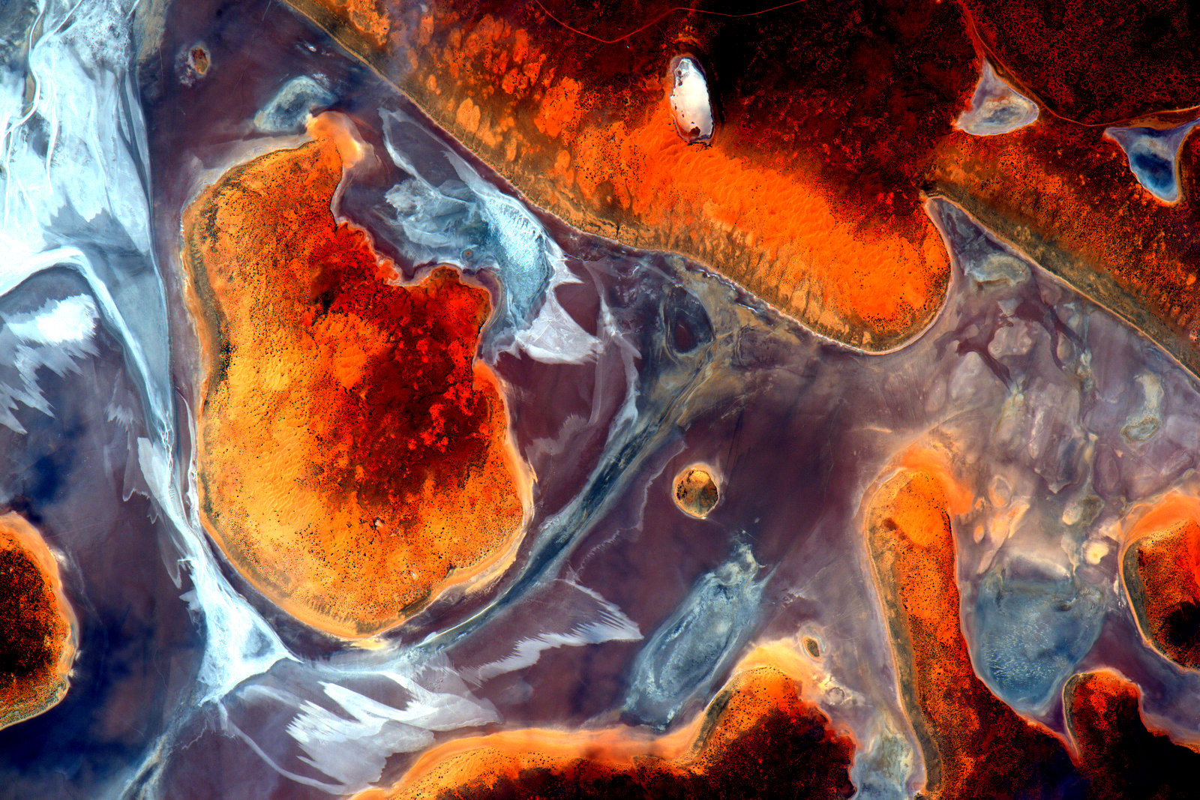
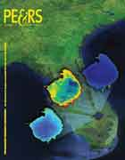
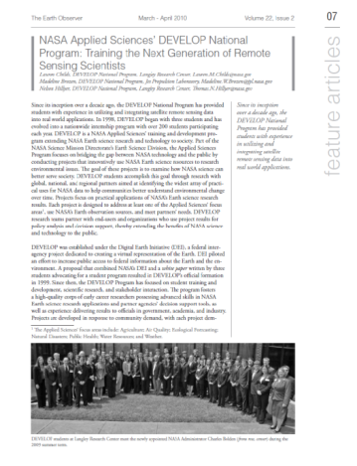
Publications
Publications are a great avenue for getting the word out about the great research you are a part of with DEVELOP!
DEVELOP is working on increasing the number of its peer-reviewed publications and has seen 3-5 each per year the past couple years.
Publications can be pursued by motivated DEVELOPers, however, the are not a metric of project success!
If you are interested in working your project toward a potential publication, contact your Lead and Amanda.
Reminder: All publications must be approved by NPO and NASA’s Export Control process before submission! This means before you ever send a draft to the publisher!
By The Way
DEVELOP publishes in both peer-reviewed venues and in “gray literature” venues! You can see all of the publications on the DEVELOP website’s Media Page.

Slide 5
Publication Process
Discuss with your Fellow and Science Advisor
Select publication venue
Contact Amanda
Draft the manuscript. Note that this will look different from a DEVELOP tech paper.
Submit draft to NPO for review
NPO and project team go back-and-forth with edits to create a final version
NPO submits this pre-print version into export control – NASA Export Control takes about 1-3 weeks
Once approved, the content can be submitted to publication venue
Keep Amanda in the loop with any and all edits from the publisher
The final-final version must be resubmitted to NASA Export control
By The Way
If the decision to publish occurs before the technical paper FD is submitted, you can ask the PC Team about using the journal’s style for your tech paper.
If the decision to publish occurs after the term, the person leading the effort must ensure that all team members are aware, involved to the extent they want to be, and listed as co-authors.

Slide 6
Conferences
DEVELOP presents projects at over 30 conferences each year.
If you have an idea for a conference you’d like to attend, discuss with your Fellow and together reach out to NPO. For virtual conferences you should follow the same steps.
There is a small travel pot provided to each node to support some travel, however those funds may already be accounted for at any specific time.
Ways to attend cost-effectively:
Choose a conference that is local.
Present DEVELOP work at a conference you already are planning to attend either for school or personally.
Pursue school-funding opportunities.
Apply for travel grants offered by professional societies.
Look for opportunities to volunteer in exchange for registration or travel costs.
Look for competitions like the AGU Data Visualization & Storytelling Contest.

Slide 7
Enhanced Capacity Building
Opportunities
Lead/Fellow Competition
Within the organizational structure of DEVELOP fellows are elevated positions that support the program as a whole.
These positions are full-time supporting both nodes and the national program.
No Fellow positions will be competed in this spring, but the the following nodes will compete in the summer for a fall 2020 start: Arizona – Tempe, Idaho – Pocatello, California – Ames, California – JPL, Virginia - Langley
More information is available on DEVELOPedia:
Fellows: http://www.devpedia.developexchange.com/dp/index.php?title=Fellow_Positions
By The Way
DEVELOPers in these positions will be supporting both a node and national tasks. Still have questions? Reach out to any Lead/Fellow or Amanda!

Slide 8
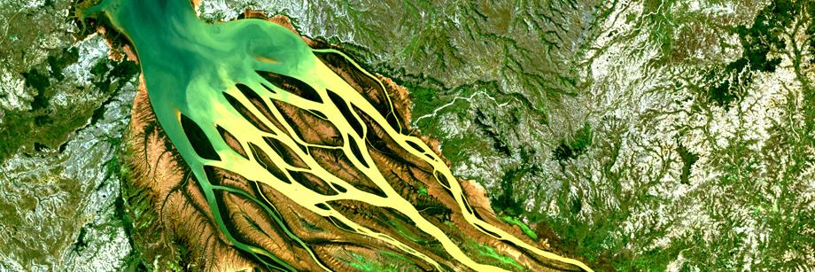
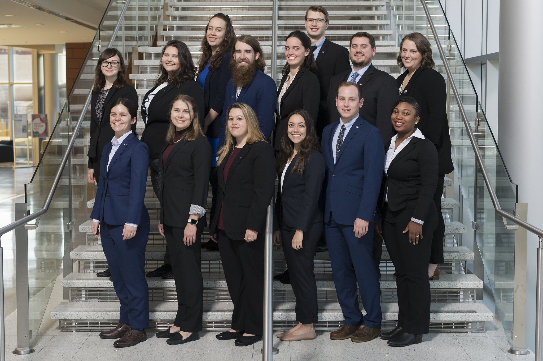
DEVELOP Leads/Fellows
What is a DEVELOP Lead/Fellow? The DEVELOP Lead/Fellow is an integral piece of the leadership team in the DEVELOP model. The people who assume this role are responsible for managing the majority of the day-to-day operations at their individual nodes, providing guidance and direction to their teams, supporting strategic planning for their node, and providing program-level NPO support.
Eligibility Requirements:
US Citizenship is required for all Fellow positions
College degree with minimum 3.0 GPA
One or more terms with DEVELOP
Open to Recent Graduate and Early/Transitioning Career Professional applicants
Ability to begin the position in early September
Ability to work 40 hours/week during typical business hours
Proficient knowledge and understanding of DEVELOP
Strong leadership and communication skills
Demonstrated ability to generate project ideas and start/maintain partnerships

Slide 9
Program Support
Communications
Geoinformatics
Impact Analysis
Project Coordination
Skills Gained & Opportunities:
Project Management: Project idea generation, proposal writing, technical editing, deliverable creation and review, dissemination of results.
Leadership: Opportunities for early career leadership, working with diverse teams.
Communication: Writing skills, presentations, telecon communication, meeting organization, working with diverse groups.
Increased Personal & Professional Awareness: Personality tests & assessments, and critical feedback and skill strengthening.
Shaping the Future of DEVELOP: Participation in leadership and strategic planning retreats, leading innovative projects and activities, participating in Fellow element teams, and strategic planning.
Networking Opportunities: Meet & Greets with NASA and partner organizations leadership, representing DEVELOP at meetings, and workshops and conferences (as funds and opportunities arise).

Slide 10
Program Support
Communications
Geoinformatics
Impact Analysis
Project Coordination
Social Media
Project & Promotional Videos
Recruitment
Ambassador corps
Newsletter
Alumni Engagement
Graphic Design
GIS & Remote Sensing
Programming & Coding
Software Release
Collection and Management of Internal Code
Maintenance of the DESC
Project, Partner, & Participant Tracking
Project Strength Index
Partner Reports & Highlights
Personal Growth Assessments & Exit Survey
Indicator Tracking
Deliverable Coordination & Review
Proposal Review
DEVELOPedia Maintenance
Project Tracking
Deliverable Templates
Publications

Slide 11
Quiz Time!
What’s the first step if you want to publish?
Can I travel on behalf of DEVELOP this spring?
Does any content that would be published or presented need to gain export control approval prior to submission/presentation?
Are Lead/Fellow positions full-time employees working 40 hrs/wk?
Where can you find more information about which nodes are accepting Lead/Fellow applicants for any given term?

Slide 12
THANK YOU!
Your DEVELOP experience is what you make it.
What opportunities are right for you?

