Slide 1
OHIO RIVER BASIN
Water Resources
Monitoring Flash Drought Potential and Quantifying the Hydrologic Impacts in the Ohio River Basin Utilizing NASA Earth Observations
Adelaide Schmidt, Isabelle Runde, Jessica Ganim, & Kayleigh DeBruyne
North Carolina – NCEI

Slide 2
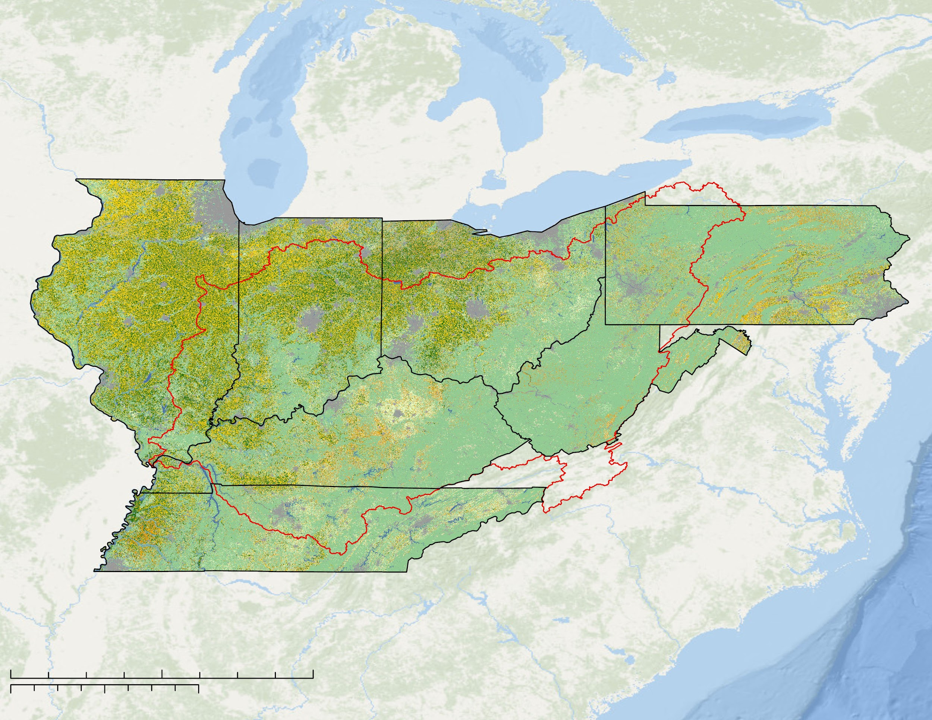
Study Area
OHIO RIVER BASIN
LAND COVER
Ohio River Basin
Provides freshwater resources
Major agricultural producer
Main crops
Moisture rich environment
Manufacturing
Energy
Recreation
Agricultural industries
OH, KY, IL, TN rank in the top 10 states by number of farms
Corn
Wetlands
Grain Crops
Developed
Soybeans
Barren
Soybeans, corn, small grains
Other Crops
Forest
0
100
200
400
Fallow/Idle Cropland
Grassland/
Pasture
Kilometers
Miles
0
100
200
400
Ohio River Basin
State Boundary
SOURCE: National Cropland Dataset 2019
Notes:
Our study area is the Ohio River Basin, a watershed in the Midwest/southeast that intersects 11 states. Our focus was on the 7 states that comprise the majority of the ORB – IL, IN, OH, PA, WV, KY, TN.
The basin provides freshwater resources for a variety of sectors including manufacturing, energy, recreation and agricultural.
The watershed is a major agriculture producer with almost 50 million acres in farms (48,240,073) and includes 4 of the top ten states in the US of farms per state, with IL and IN in the top 10 agriculture producing states grossing over $10 billion each. According to 2017 Census of Agriculture, the annual market value of agricultural products in KY alone is over $5 billion.
The major crops are soybeans, corn and small grains (wheat, barley, oats, rye).
Source: USDA 2017 Census of Agriculture
The Ohio River basin includes the climate transition zone between the humid continental and humid subtropical zones. This creates a moisture rich environment that is important to consider when talking about drought. The ORB has also seen general trends in increasing temperature and increasing annual precipitation.
Source: OHIO RIVER BASIN – Formulating Climate Change Mitigation/Adaptation Strategies through Regional Collaboration with the ORB Alliance
SOURCE National Cropland Dataset 2019

Slide 3
Flash Drought
Flash Drought Evolution
PERSISTENT
ATMOSPHERIC
ANOMALIES
Higher temperatures
More sunny days
Stronger winds
Larger vapor pressure deficits
Develops rapidly in a few weeks
Driven by precipitation deficits combined with extreme weather anomalies
Leads to decreased soil moisture and vegetation stress
INCREASED EVAPORATIVE DEMAND
ET increases
(meet atmospheric demand)
ET anomaly transitions from positive to negative
TIME
Surficial evaporation increases
Increased temperature anomalies
ET decreases
(vegetation decreases water usage)
Reduced evaporative cooling
Vegetation appearance changes once rootzone soil moisture falls below threshold
Drier topsoil
DECREASED SOIL MOISTURE & AGRICULTURAL DROUGHT
Moisture depletion at depth
Notes:
A term that started to show up around the 2000s and became popularized surrounding drought events in 2011-12, flash drought is a drought that develops very rapidly over the course of a few weeks. While low precipitation is a factor, as with all droughts, the key to flash drought is that these average to below average precipitation levels are coupled with persistent atmospheric anomalies such as higher temperatures, stronger winds, or more sun.
These drivers lead to increased evaporative demand, which can be described as the thirst of the atmosphere. This has multiple effects:
- Surficial evaporation increases leading to drier topsoil
- to meet this demand, ET also increases thus depleting soil moisture at lower depths
- As the moisture in the environment decreases there is a shift to a water-limited system which causes ET to decrease and vegetation stress increases
Flowchart generated by DEVELOP team.

Slide 4
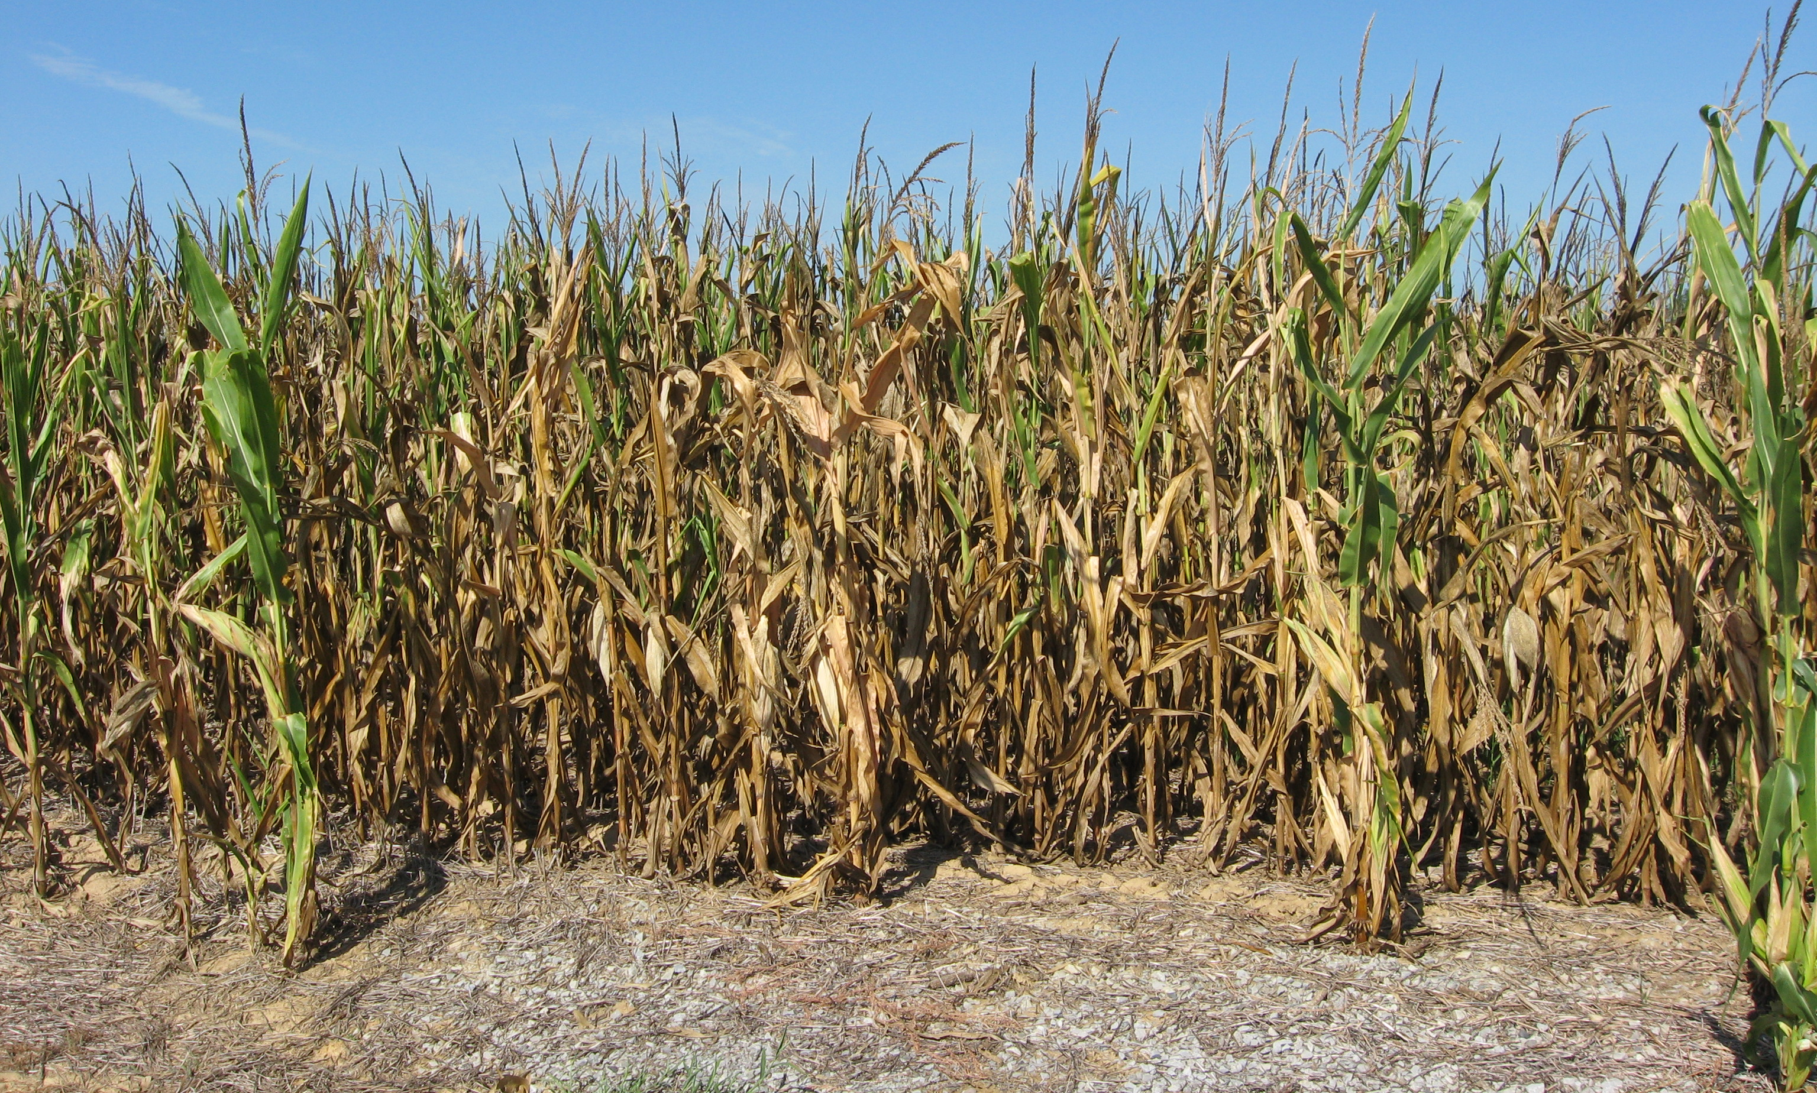
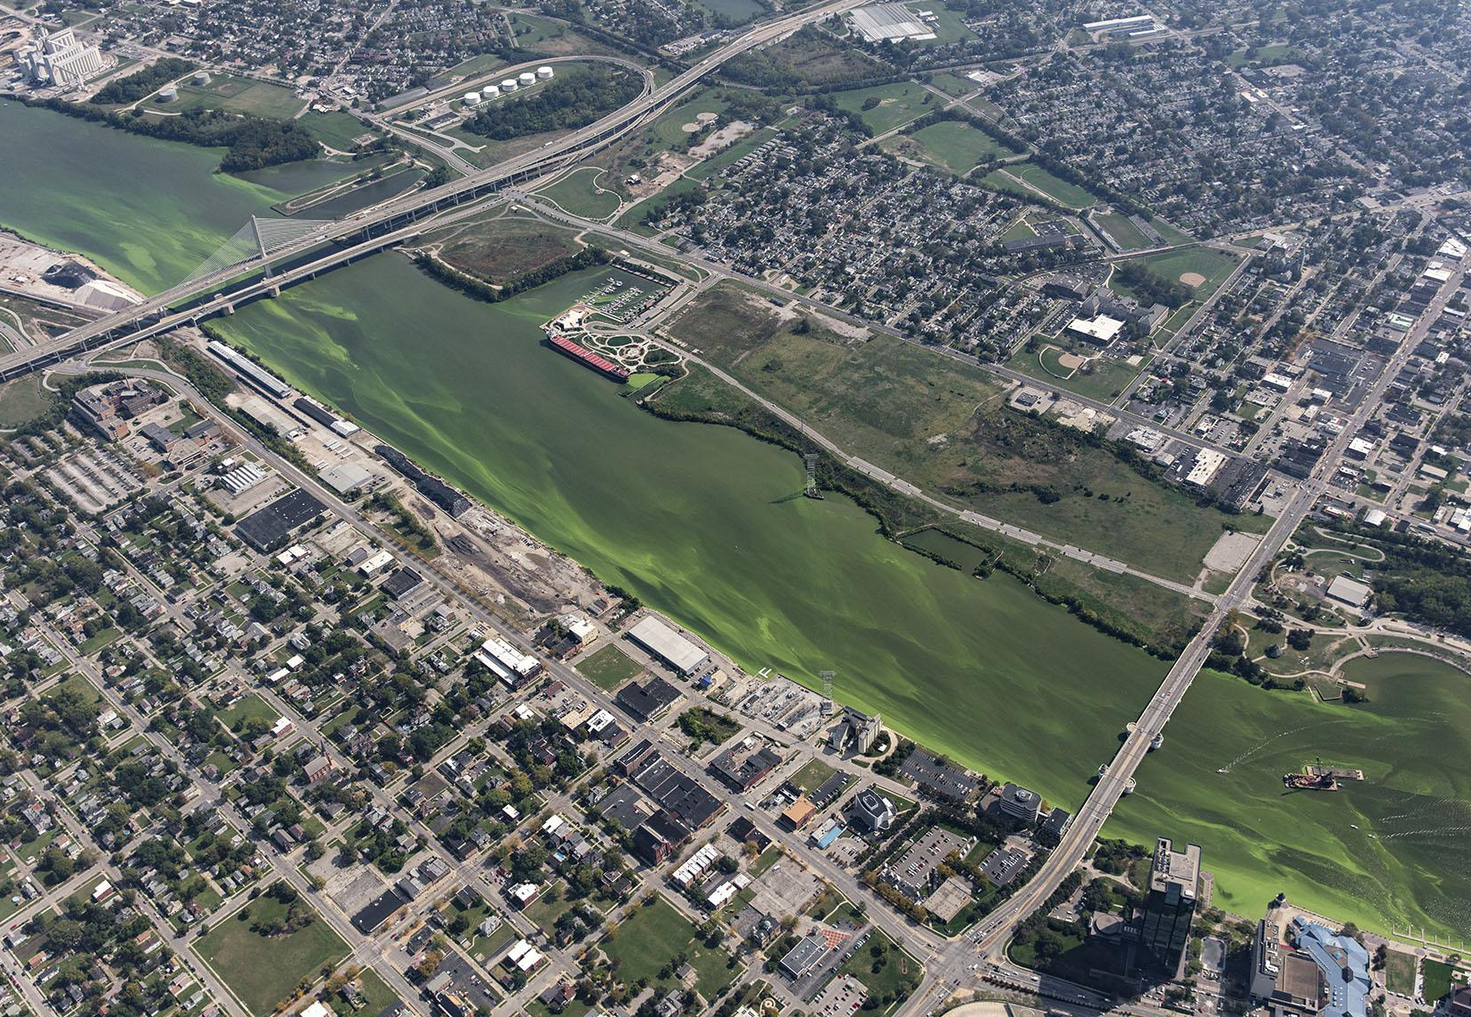
Community Concerns
Intensifying cycles of excess moisture followed by drought in the region
Growing interest to apply newly developed flash drought indicators to water resource monitoring
Image: Kentucky Climate Center
Flash Drought Impacts:
Agricultural losses
Increased wildfire risk
Increase in harmful algal blooms (HAB)
2012 flash drought cost over $30 billion
HAB in Maumee River, OH
Image: Aerial Associates Photography, Inc. by Zachary Haslick
Notes:
Flash droughts are a growing concern in the ORB community. The patterns of excess moisture followed by drought the area has seen recently are expected to continue and intensify. This concerns forecasters, as flash drought is an understudied phenomenon and they want more tools to predict the onset of flash drought
Flash drought can have serious impacts on communities and its nature of agricultural drought has particularly harmful effects on the agricultural community. Knowing how prominent agriculture is in the ORB this is a strong concern.
In 2012, there was a large flash drought across much of the US. It developed over just two months during the growing season and resulted in over $30 billion losses in the agricultural sector (Otkin et al., 2018; National Centers for Environmental Information, 2017).
Other associated impacts flash drought can have include an increased risk for wildfires and increases in HABs.
Image (left): Courtesy of Kentucky Climate Center
Image (right): Flickr. Aerial Associates Photography, Inc. by Zachary Haslick. Maumee River HABs Sept 22 2017 2298. Public Domain Mark 1.0. https://www.flickr.com/photos/noaa_glerl/36621364324/in/photolist-YNDdSS-XRCQoR-XRCPEX-XRCMTk-XN74GL-XRCQrM-BLLUVf-BLLUz5-BLLW85-BLLWaE-BLLUqC-XRCQAp-BLLWdL-BLLTTL-YNDeg7-XRCMQ4-YNDdtL-YNDe2j-XN74Kb-YNDdwb-XRCQEH-XRCQya-YNDdZq-XN73cw-XRCMVz-9UhCu2-ejuTXG-ejuU91-ejpb8M-ejpbok-RXniWs-7dbEmf-RXn3Hb-Sx9QgH-RXmGQq-SikAZm-SxaFni-Ri7kxz-SxaFFz-Ri7EAe-SikBos-Ri7jQH-Ri7Ej2-SikfQy-Sike8L-RXnpsC-SikiZj-SikiBA-RXmZDA-SikAgY/

Slide 5
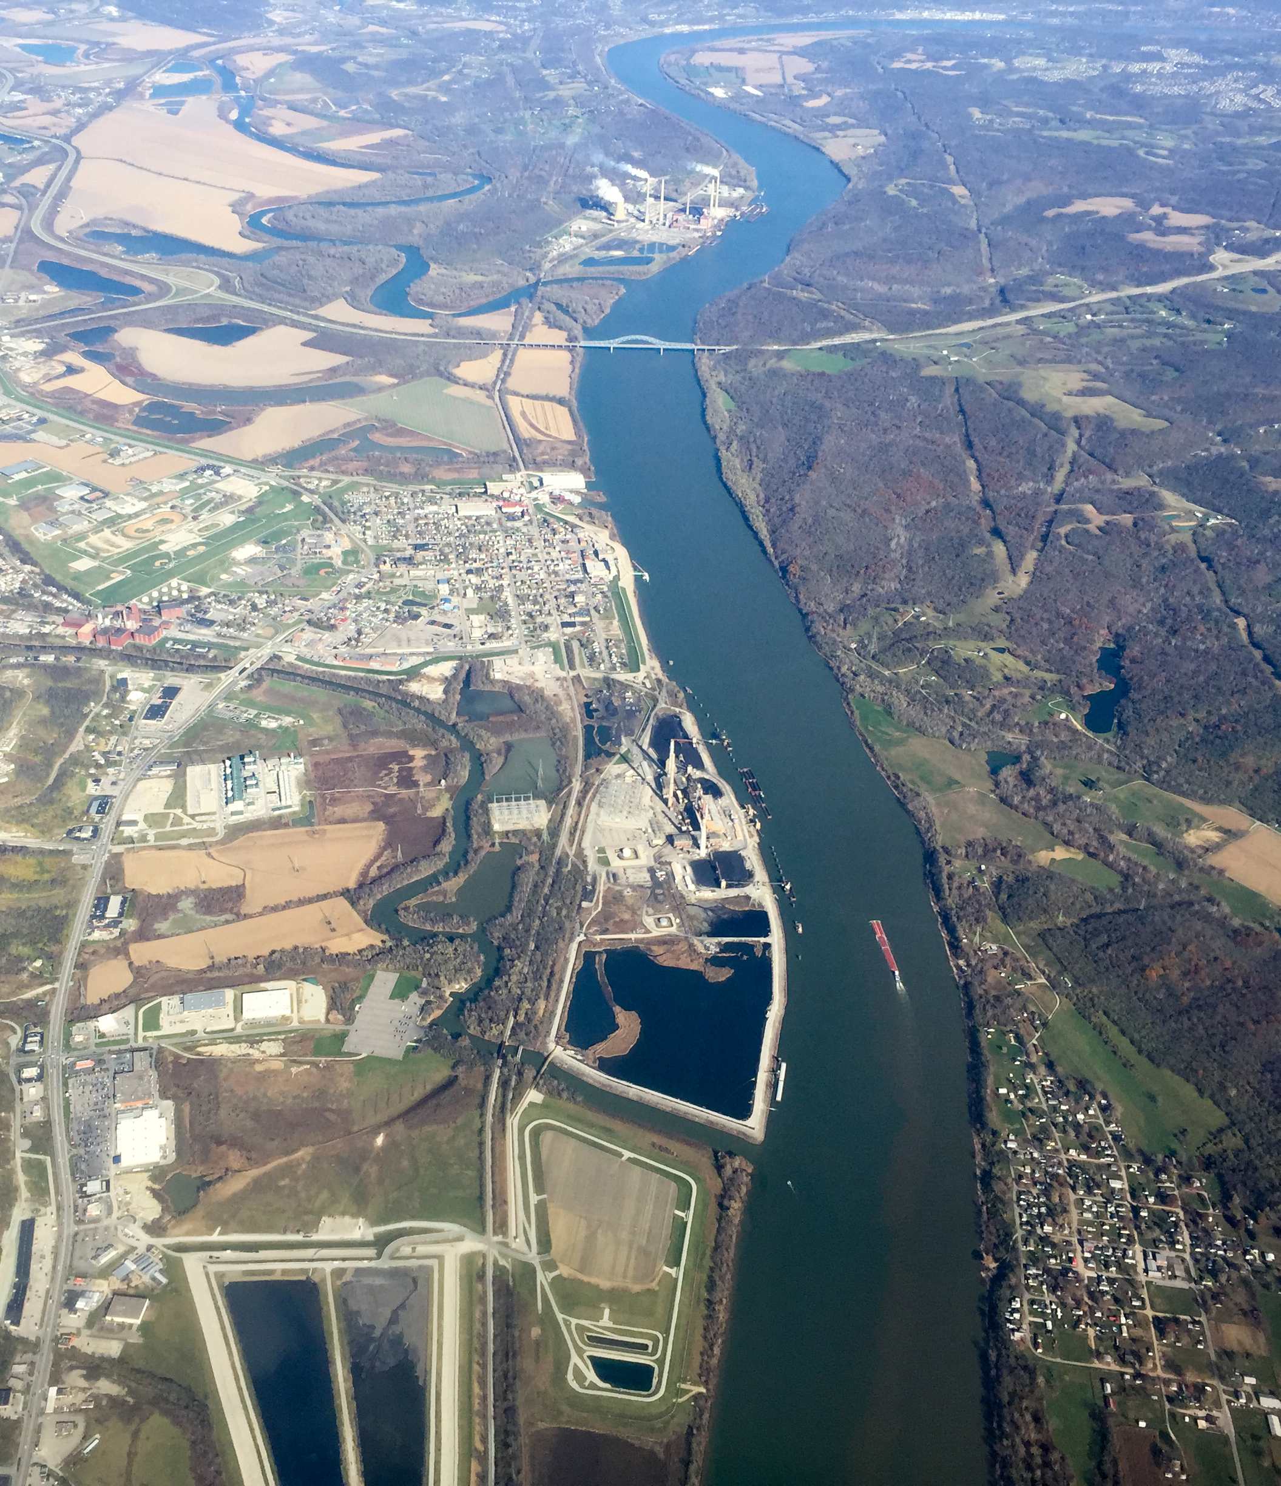
Project Partners
Kentucky Climate Center
Provides forecasting and early drought warning
Houses the KY Mesonet
Distributes data and data-derived products to stakeholders
NOAA National Weather Service, Ohio River Forecast Center
Produces meteorological and hydrological products
Provides impact-based decision support
Water resource outlooks
Drought briefings
Image: Eden, Janine, and Jim
Image: Ken Lund
Image: Scott Beale / Laughing Squid
Ohio River
Notes:
To address some of the community concerns around flash drought in the ORB we are partnering with two organizations that work on weather forecasting and provide climate information to the public and stakeholders.
We are working with the state climatologist at the Kentucky Climate Center. The KY Climate Center, at Western Kentucky University, houses the Kentucky Mesonet, a weather and climate data network of 74 stations across the state. They work in areas of water management, drought early warning, and forecasting. They distribute data and data-derived products on their website and also through a mobile app. These outlets allow for the distribution of information to various stakeholders and decision-
makers across the state, including those in government, water management, and farming communities.
(Mahmood, Schargorodski, Foster, & Quilligan, 2019).
We also partnered with a hydrologist at NOAA National Weather Service, Ohio Forecast Center (ORFC).They produce a variety of weather and hydrological information products
involving precipitation and water resources outlooks. These include streamflow forecasts and drought briefings. They disseminate climate and forecasting information to provide impact-based decision support to the public.
Both organizations were interested in developing a product that utilizes various drought indices to build confidence in their ability to accurately inform stakeholders of drought risk. They currently rely heavily on the Standardized Precipitation Index (SPI), an entirely precipitation-based drought index, to identify drought and to develop the appropriate warnings. SPI, however, does not incorporate evapotranspiration, which, as we just learned, is a key process associated with flash drought onset and evolution.
Image: Flickr. Scott Beale / Laughing Squid. The Ohio River. CC BY-NC-ND 2.0 https://www.flickr.com/photos/laughingsquid/15574742699/in/faves-187233743@N05/

Slide 6
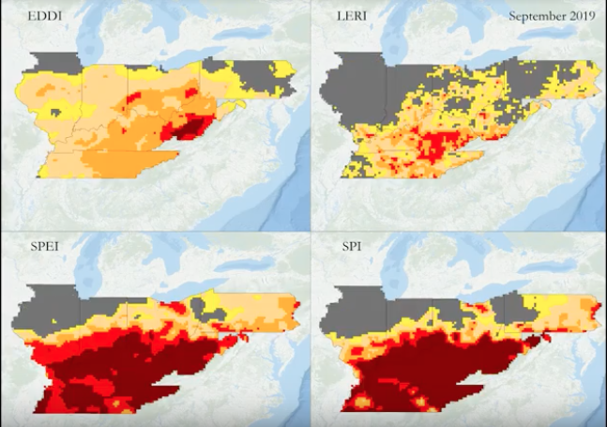
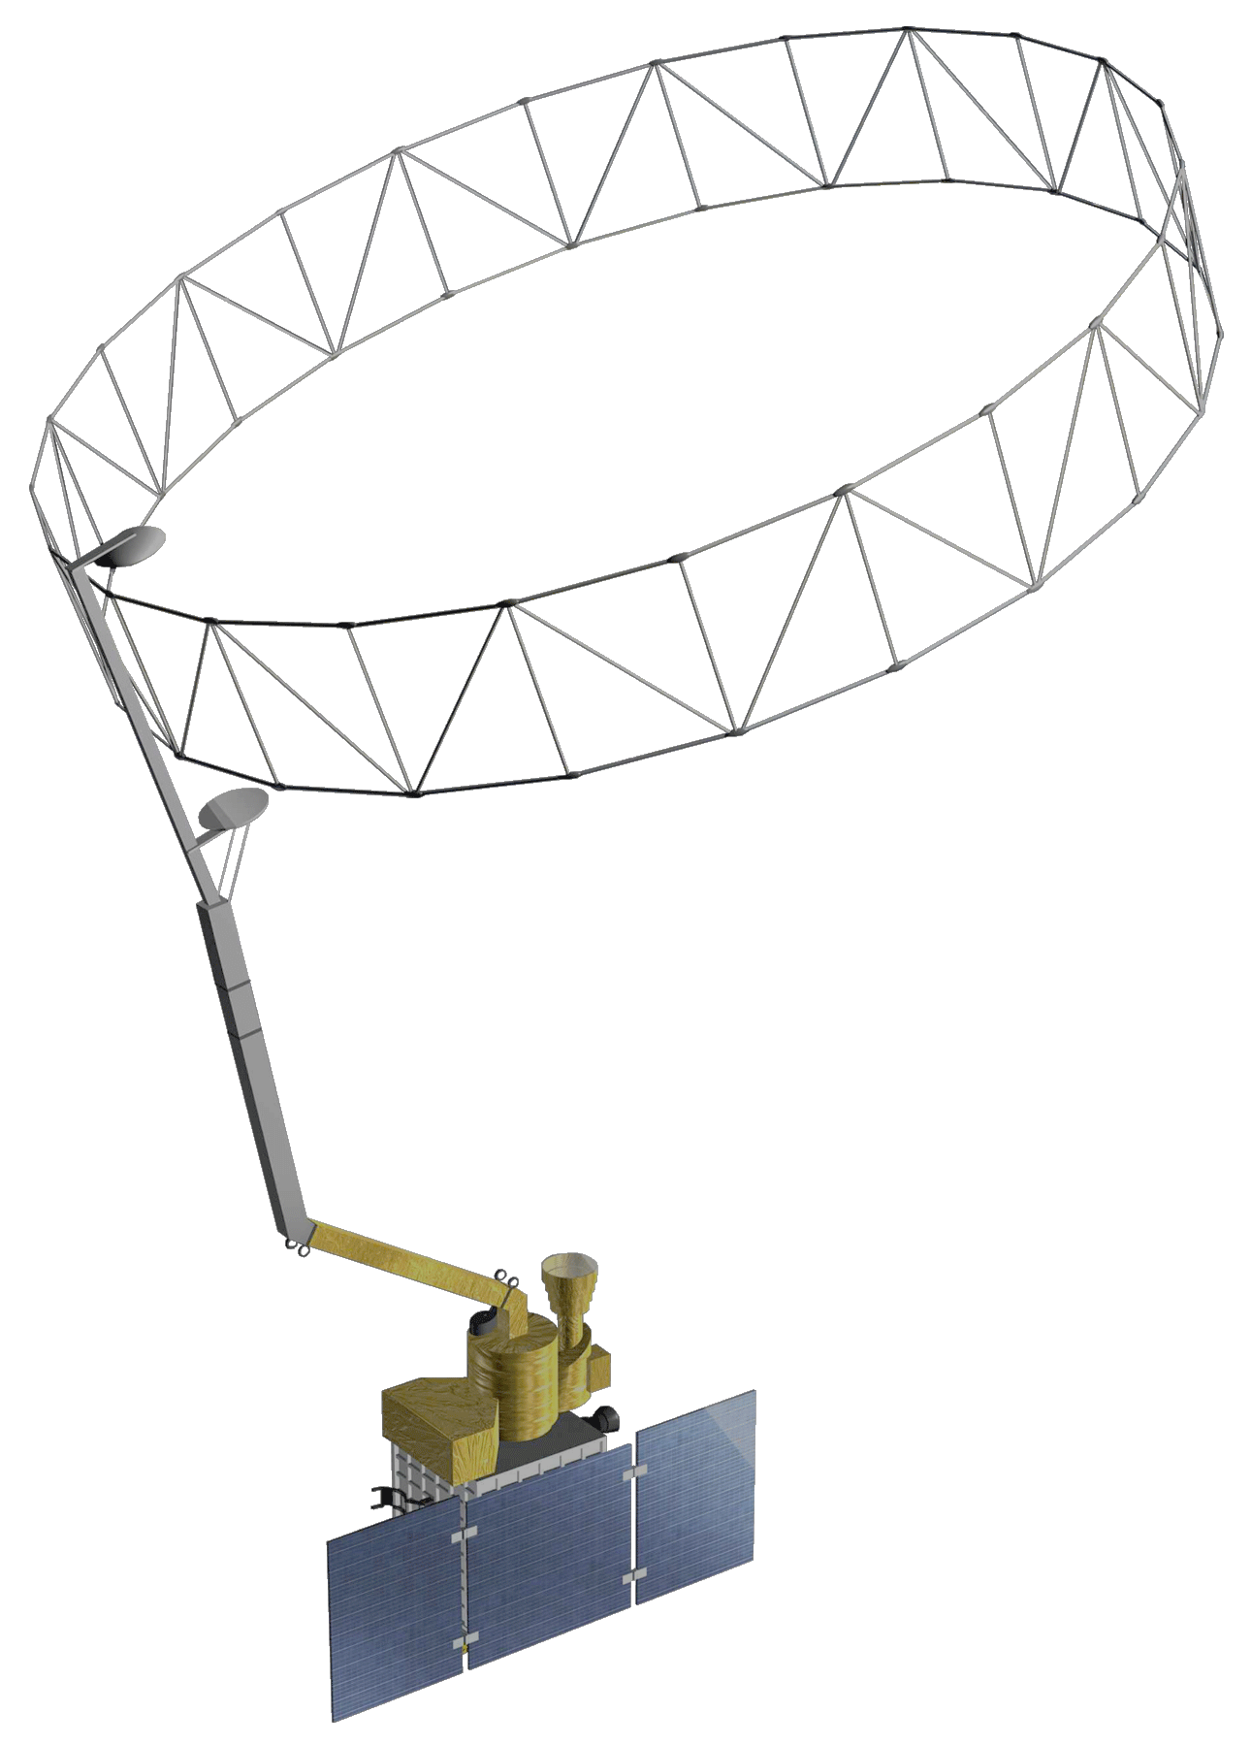
Objectives
Compare drought index products to identify potential leading and reacting flash drought indicators
Investigate environmental hydrologic response through soil moisture observations to better understand nature of flash drought in ORB
Demonstrate the use of SMAP-derived soil moisture to enhance in situ data observations in Kentucky
Image: Kentucky Climate Center
Notes:
Based on the needs of our project partners and the DEVELOP program, we outlined 3 main objectives for the project.
Image (top): Produced by NASA DEVELOP
Image (middle): Courtesy of Kentucky Climate Center
Image (bottom): NASA

Slide 7
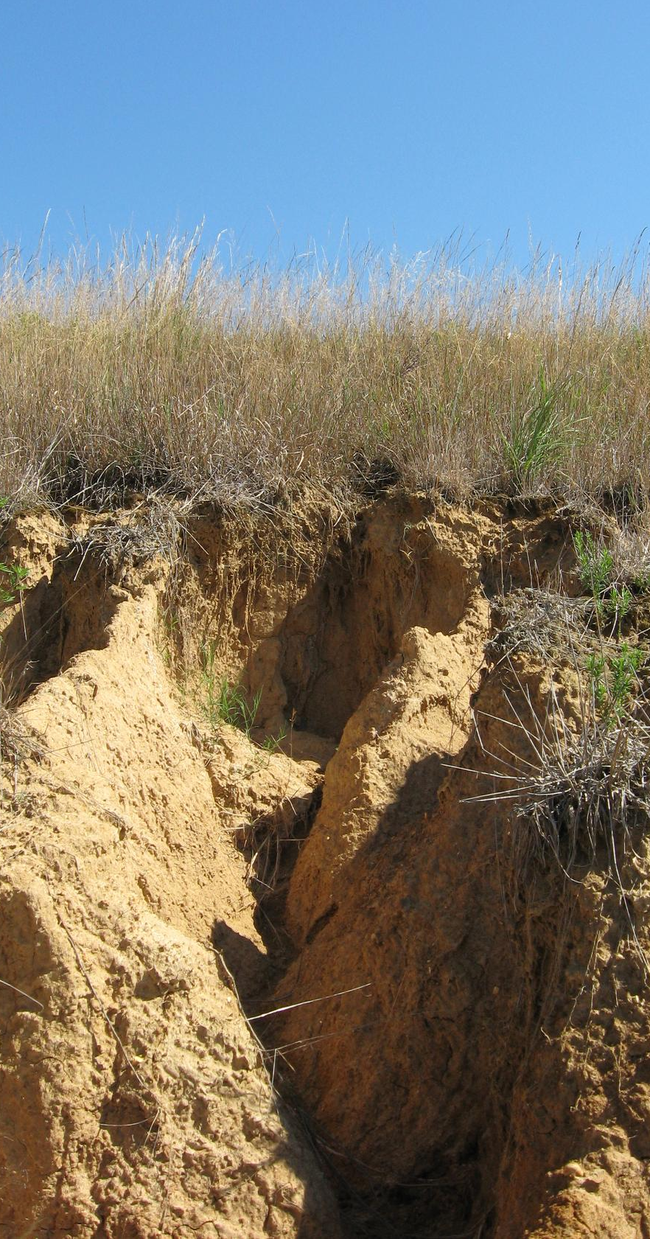
Analysis Components
1. Drought Indicator Analysis
A. 2019 September Flash Drought Case Study
June 01 – October 31 2019
B. Decadal Time Series (TS)
January 01 2010 – December 31 2019
2. Soil Moisture Analysis
A. Kentucky Mesonet and SMAP soil moisture
July 01 – October 31 2019
Image: Kentucky Climate Center
Notes:
Our analysis was broken up into two different components.
Image: Courtesy of Kentucky Climate Center

Slide 8
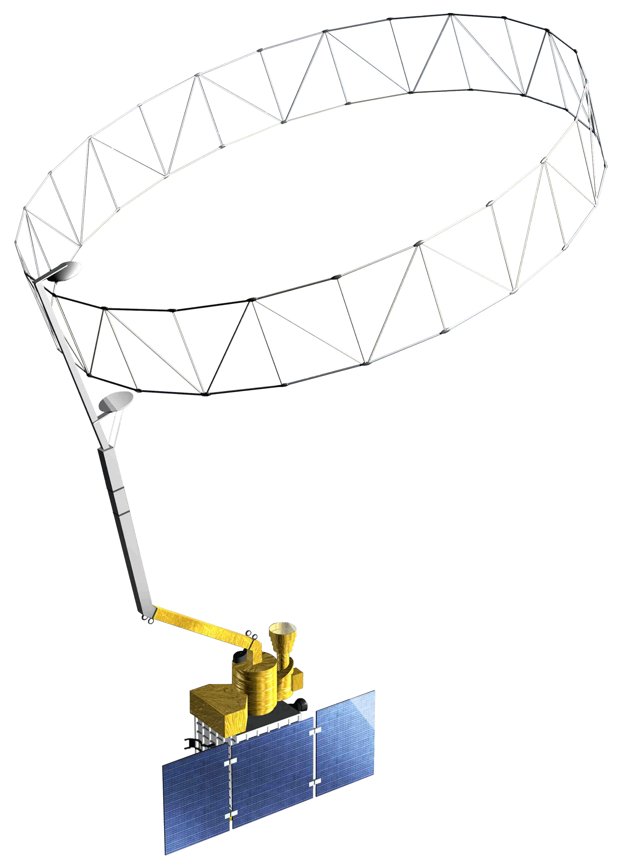
NASA Earth Observations
Soil Moisture Active Passive
(SMAP)
Terra MODerate Resolution Imaging Spectroradiometer (Terra MODIS)
Level 4 gridded surface (5 cm) soil moisture
Thermal imagery used to compute evapotranspiration fraction for LERI
Notes:
In this study we used two different NASA satellites and sensors.
SMAP was used to collect remotely sensed soil moisture and MODIS provided land surface temperature that was used as an input for the LERI drought index.
Image (left, right): NASA

Slide 9
1. DROUGHT INDICATOR ANALYSIS

Slide 10
Drought Indicators
Index | Physical Measurement | Output | Grid
Landscape Evaporative Response Index | Terra MODIS land surface temperature | actual evapotranspiration (ET_{a}) anomaly 2000 – 2019 | 1 km
Evaporative Demand Drought Index | NASA National Land Data Assimilation Systems (NLDAS-2) temperature, humidity, wind speed, & solar radiation | evaporative demand (E₀) anomaly 1980 – 2019 | 12 km
Standardized Precipitation-Evapotranspiration Index | NOAA NCEI nClimGrid precipitation and temperature | water balance standardized 1895 – 2019 | 5 km
Standardized Precipitation Index | NOAA NCEI nClimGrid precipitation | precipitation standardized 1895 – 2019 | 5 km
LERI
EDDI
SPEI
SPI
Notes:
Drought indices are used by forecasters to detect and predict droughts. Indices quantitatively categorize drought by combining data from one or more indicators, such as precipitation or evapotranspiration to look for signals of drought (Zargar, Sadiq, Naser, &amp; Khan, 2011).
For our study we focused on 4 indices, including industry standards like SPI as well as newer indices such as LERI and EDDI.
Our partners traditionally use SPI, however it solely considers precipitation and is only available in 1-month or longer products, which in the moisture rich environment of the ORB and considering the rapid onset of flash drought may not be the most useful.
Therefore, our project partners were particularly interested in looking into EDDI and LERI due to them being more recent and their potential for flash drought detection. These indices use input parameters such as temperature, evapotranspiration and wind speed which are some of those persistent weather anomalies we highlighted earlier that can lead to flash drought. They are also available on a shorter time scale.

Slide 11
Methods
1. DROUGHT INDICATOR ANALYSIS
Acquisition
Processing
1. Resample to 12 km grid
MONTHLY PRODUCTS
LERI 1 - MO
SPI 1 - MO
EDDI 1 - MO
SPI 3 - MO
SPEI 1 - MO
SPEI 3 - MO
WEEKLY PRODUCTS
EDDI 1 - WK
EDDI 2 - WK
LERI 8 - DAY AC
LERI 8 - DAY NAC
Notes:
To analyze how different indicators performed throughout the 2019 flash drought, we downloaded the data for different indices and their various products. First, we resampled to the 12 km grid – EDDI has the coarsest resolution

Slide 12
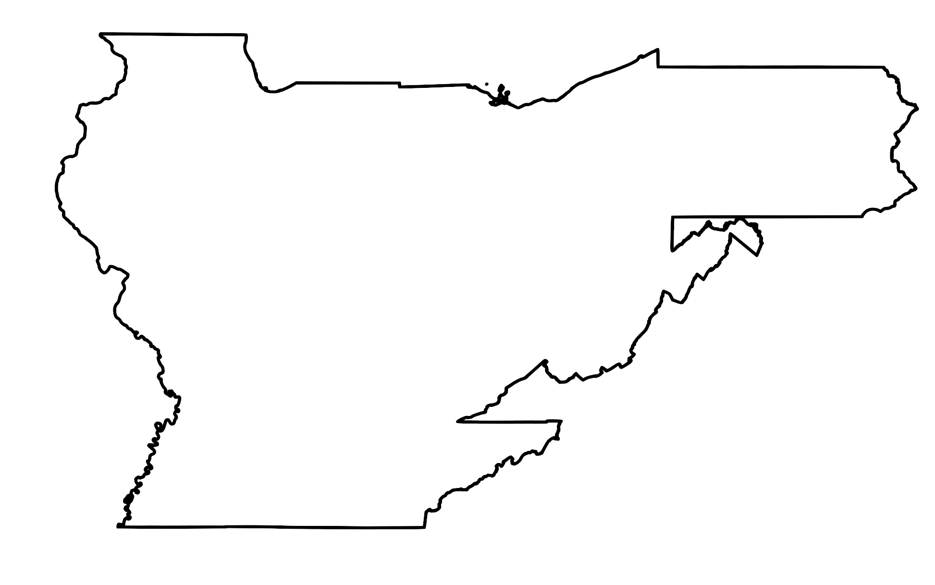
Methods
1. DROUGHT INDICATOR ANALYSIS
Acquisition
Processing
1. Resample to 12 km grid
MONTHLY PRODUCTS
LERI 1 - MO
SPI 1 - MO
2. Crop to region of interest
EDDI 1 - MO
SPI 3 - MO
SPEI 1 - MO
SPEI 3 - MO
WEEKLY PRODUCTS
EDDI 1 - WK
EDDI 2 - WK
LERI 8 - DAY AC
LERI 8 - DAY NAC

Slide 13
Methods
1. DROUGHT INDICATOR ANALYSIS
Acquisition
Processing
1. Resample to 12 km grid
MONTHLY PRODUCTS
LERI 1 - MO
SPI 1 - MO
2. Crop to region of interest
EDDI 1 - MO
SPI 3 - MO
SPEI 1 - MO
SPEI 3 - MO
3. Reclassify to USDM categories:
USDM | Z-SCORE | PERCENTILE
ND | -0.4 or greater | 31 to 100
D0 | - 0.5 to -0.7 | 21 to 30
D1 | - 0.8 to -1.2 | 11 to 20
D2 | -1.3 to -1.5 | 6 to 10
D3 | -1.6 to -1.9 | 3 to 5
D4 | -2.0 or less | 0 to 2
WEEKLY PRODUCTS
EDDI 1 - WK
EDDI 2 - WK
LERI 8 - DAY AC
LERI 8 - DAY NAC
Notes:
Cite to USDM The U.S. Drought Monitor (USDM) categorizes drought into 6 groups that correspond to an index’s z-score or percentile value. The drought categories are:
ND – No Drought
D0 – Abnormally Dry
D1 – Moderate Drought
D2 – Severe Drought
D3 – Extreme Drought
D4 – Exceptional Drought

Slide 14
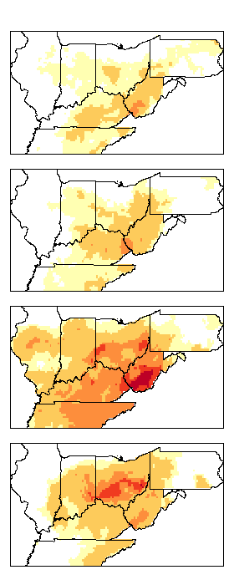
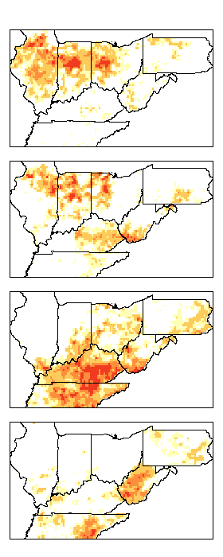
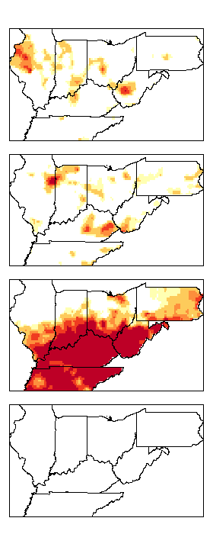
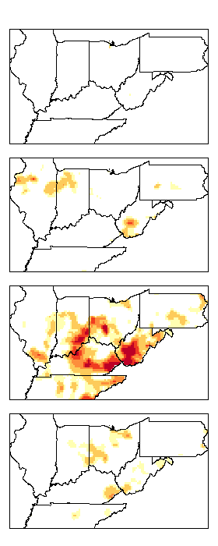
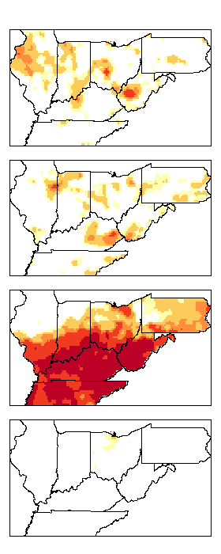
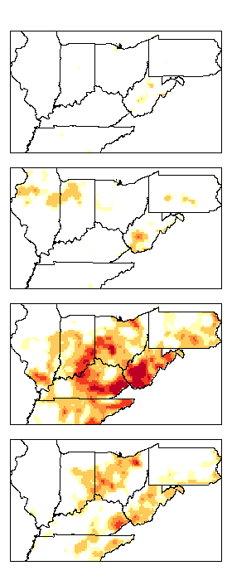
2019 Results
EDDI 1 MO LERI 1 MO SPI 1 MO SPI 3 MO SPEI 1 MO SPEI 3 MO
JUL
AUG
D0
D1
D2
D3
D4
ND
SEP
OCT

Slide 15
2019 Results
2019 Regional drought classification by month
Jul
Aug
Sep
Oct
100
90
80
70
60
D0
D1
Percent area (%)
D2
50
D3
40
D4
30
ND
20
10
0
SPI 3MO
SPI 1MO
SPI 3MO
SPI 1MO
SPI 3MO
SPI 1MO
LERI 1MO
SPI 1MO
LERI 1MO
LERI 1MO
LERI 1MO
SPI 3MO
SPEI 1MO
SPEI 3MO
SPEI 3MO
SPEI 1MO
SPEI 1MO
SPEI 3MO
EDDI 1MO
SPEI 3MO
EDDI 1MO
EDDI 1MO
SPEI 1MO
EDDI 1MO

Slide 16
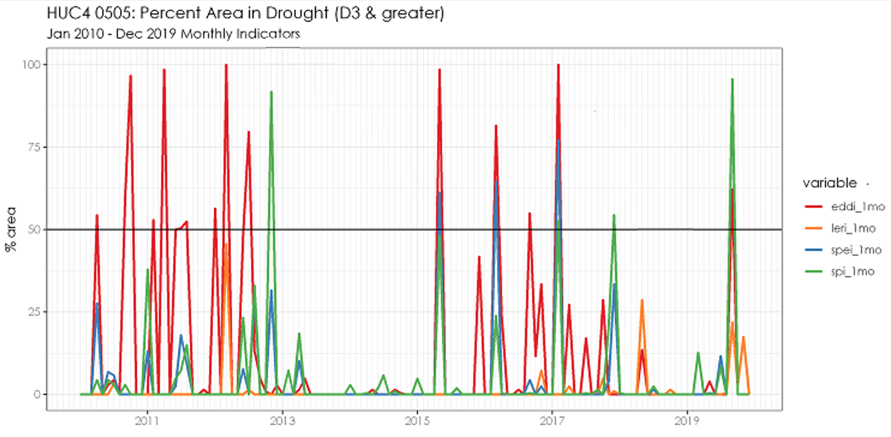
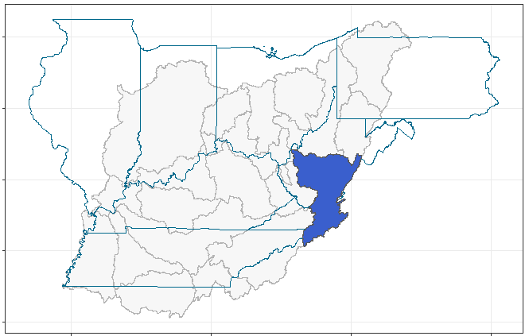
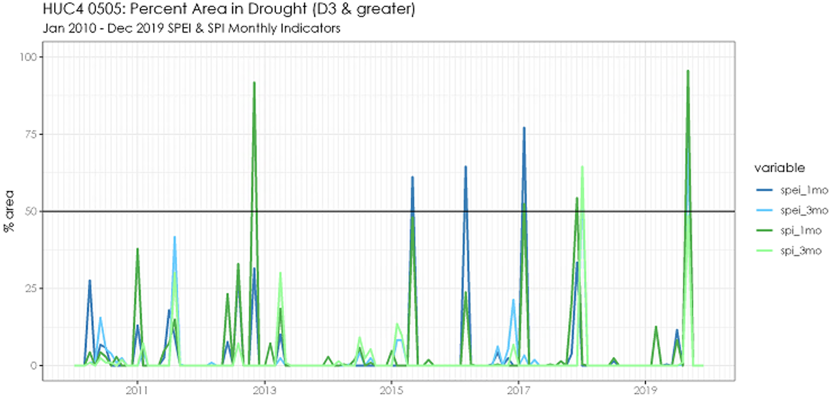
TS Results
100
75
EDDI 1 MO
LERI 1 MO
HUC4 0505
Kanawha
% area >= D3
50
SPEI 1 MO
SPI 1 MO
25
0
2011
2013
2015
2017
2019
100
75
SPEI 1 MO
SPEI 3 MO
% area >= D3
SPI 1 MO
50
SPI 3 MO
25
0
2011
2013
2015
2017
2019

Slide 17
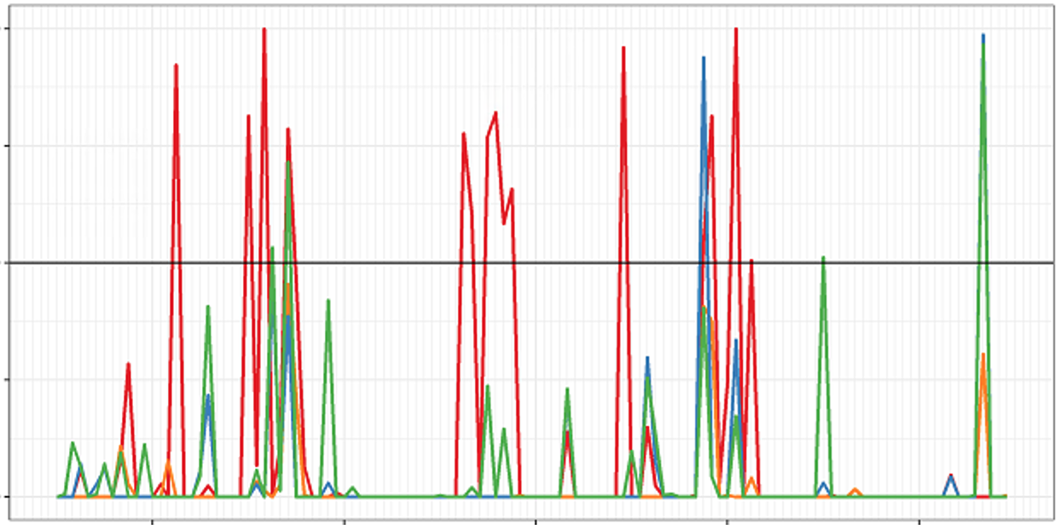
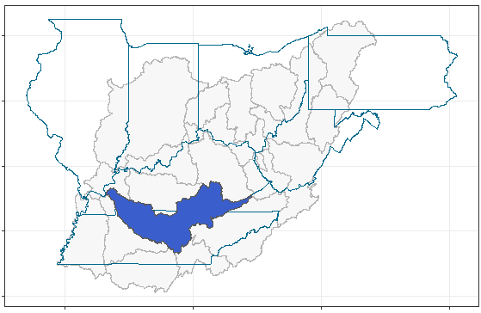
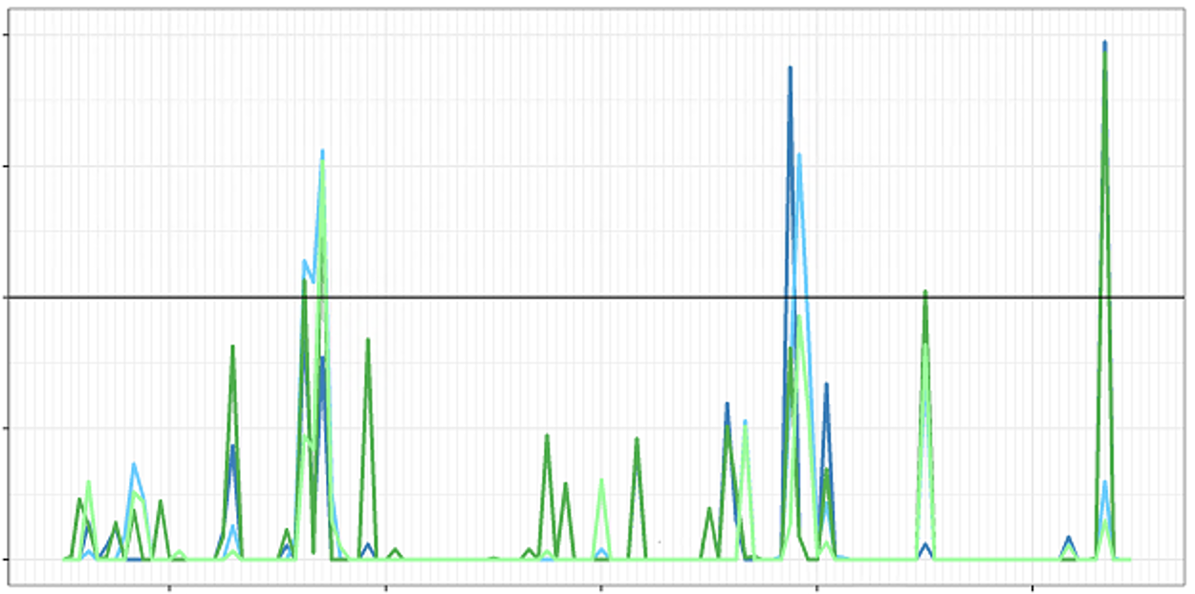
TS Results
100
75
EDDI 1 MO
LERI 1 MO
HUC4 0513
Cumberland
% area >= D3
50
SPEI 1 MO
SPI 1 MO
25
0
2011
2013
2015
2017
2019
100
75
SPEI 1 MO
SPEI 3 MO
% area >= D3
SPI 1 MO
50
SPI 3 MO
25
0
2011
2013
2015
2017
2019

Slide 18
Discussion & Conclusions
EDDI displays sensitivity – represents potential evapotranspiration, which frequently changes according to meteorological variations
LERI has a shorter reference period and does not have a D4 equivalent
SPI and SPEI 1-month products capture the observed severity of the 2019 flash drought
September 2019 SPI and SPEI 3-month products reflect local knowledge of the spatial distribution of initial drying

Slide 19
2. SOIL MOISTURE ANALYSIS

Slide 20
Kentucky Mesonet
Kentucky Climate Center Soil Moisture Monitoring Stations:
Measures surface soil moisture (2, 4, & 8 inches)
30-minute intervals at 42 stations
Stevens Digital Hydraprobe-II sensors
Notes:
This current map will be changed to be editable – generated by DEVELOP team.

Slide 21
Methods
2. SOIL MOISTURE ANALYSIS
1) Mesonet dataset converted to spatial data frame
2) Values extracted from SMAP raster layer
3) Medians computed for 5-cm SMAP and 2-, 4-, & 8-inch Mesonet
5) RMSE computed for daily time scale
6) 3-day & 7-day rolling means
4) Time series plots & soil descriptions data table
7) Soil texture comparison to RMSE
DATA ACQUISITION
DATA VISUALIZATION
DATA ANALYSIS
Study Period:
July-October 2019
Time Scale:
Weekly,
Biweekly,
Monthly

Slide 22
Surface Soil Moisture Comparisons
SMAP vs. Mesonet Daily Surface Soil Moisture
SMAP vs. Mesonet Daily Surface Soil Moisture
PVRT
0.5
FCHV
0.4
0.4
Data Product
2-inch Mesonet
2-inch Mesonet
Surface Soil Moisture
Surface Soil Moisture
4-inch Mesonet
0.3
4-inch Mesonet
0.3
8-inch Mesonet
8-inch Mesonet
5-cm SMAP
5-cm SMAP
0.2
0.2
Data Product
Jul
Aug
Sep
Oct
Nov
Jul
Aug
Sep
Oct
Nov
2-inch Mesonet
Time
Time
4-inch Mesonet
SMAP vs. Mesonet Daily Surface Soil Moisture
SMAP vs. Mesonet Daily Surface Soil Moisture
8-inch Mesonet
HARD
LXGN
5-cm SMAP
0.4
0.4
Data Product
Data Product
0.3
0.3
Surface Soil Moisture
2-inch Mesonet
2-inch Mesonet
Surface Soil Moisture
4-inch Mesonet
4-inch Mesonet
0.2
8-inch Mesonet
8-inch Mesonet
5-cm SMAP
0.2
5-cm SMAP
0.1
0.1
Jul
Aug
Sep
Oct
Nov
Jul
Aug
Sep
Oct
Nov
Time
Time
Daily time series of 5-cm SMAP, 2-inch Mesonet, 4-inch Mesonet, and 8-inch Mesonet from July 1-October 31, 2019 at four sample Mesonet stations (PVRT, FCHV, HARD, and LXGN)
Notes:
-These selected sites show similar values of surface soil moisture up to 8 inches
-Each site shows similar trends of wetness and dryness between 5-cm SMAP, 2-inch Mesonet, 4-inch Mesonet, & 8-inch Mesonet

Slide 23
SMAP vs. Mesonet 3-Day Rolling Means
SMAP vs. Mesonet 3-Day Rolling Means
PVRT
FCHV
0.40
0.4
0.35
0.30
Surface Soil Moisture
Surface Soil Moisture
0.3
0.25
0.2
0.20
Data Product
SMAP vs. Mesonet 3-Day Rolling Means
SMAP vs. Mesonet 3-Day Rolling Means
Jul
Aug
Sep
Oct
Nov
Jul
Aug
Sep
Oct
Nov
HARD
Time
LXGN
Time
2-inch Mesonet
0.4
5-cm SMAP
0.3
0.3
Surface Soil Moisture
Surface Soil Moisture
0.2
0.2
0.1
0.1
Jul
Aug
Sep
Oct
Nov
Jul
Aug
Sep
Oct
Nov
Time
Time
Time series of 5-cm SMAP and 2-inch Mesonet 3-day rolling means from July 1-October 31, 2019 at four sample Mesonet stations (PVRT, FCHV, HARD, and LXGN)

Slide 24
SMAP vs. Mesonet Daily Surface Soil Moisture
FARM
0.4
0.3
Data Product
2-inch Mesonet
Surface Soil Moisture
4-inch Mesonet
0.2
8-inch Mesonet
SMAP vs. Mesonet Daily Surface Soil Moisture
GAMA
5-cm SMAP
0.1
0.0
Data Product
0.3
Data Product
Jul
Aug
Sep
Oct
Nov
Time
2-inch Mesonet
2-inch Mesonet
SMAP vs. Mesonet Daily Surface Soil Moisture
Surface Soil Moisture
4-inch Mesonet
4-inch Mesonet
0.2
WNCH
8-inch Mesonet
8-inch Mesonet
5-cm SMAP
0.1
0.4
5-cm SMAP
Data Product
Jul
Aug
Sep
Oct
Nov
0.3
2-inch Mesonet
Time
Surface Soil Moisture
4-inch Mesonet
0.2
8-inch Mesonet
5-cm SMAP
0.1
Jul
Aug
Sep
Oct
Nov
Time
Daily time series of 5-cm SMAP, 2-inch Mesonet, 4-inch Mesonet, and 8-inch Mesonet from July 1-October 31, 2019 at three sample Mesonet stations (FARM, GAMA, and WNCH)
Notes:
-These sites show similar trends of wetness and dryness between SMAP and each Mesonet soil depth
-We can observe that values at different depths are different, but we do similar patterns of wetness and dryness

Slide 25
SMAP vs. Mesonet 3-Day Rolling Means
FARM
0.4
0.3
Data Product
Surface Soil Moisture
SMAP vs. Mesonet 3-Day Rolling Means
0.2
2-inch Mesonet
GAMA
5-cm SMAP
0.1
0.3
0.0
Jul
Aug
Sep
Oct
Nov
Data Product
Data Product
Time
Surface Soil Moisture
2-inch Mesonet
SMAP vs. Mesonet 3-Day Rolling Means
2-inch Mesonet
0.2
5-cm SMAP
WNCH
5-cm SMAP
0.1
0.3
Jul
Aug
Sep
Oct
Nov
Surface Soil Moisture
Time
0.2
0.1
Jul
Aug
Sep
Oct
Nov
Time
Time series of 5-cm SMAP and 2-inch Mesonet 3-day rolling means from July 1-October 31, 2019 at three sample Mesonet stations (FARM, GAMA, and WNCH)

Slide 26
Soil Texture Comparisons
Soil Texture Analysis
Soil Texture Analysis
Soil Texture Analysis
Clay
Silt
Sand
0.06
0.06
0.06
0.05
Blue Grass Region
0.05
0.05
Mississippi Embayment
RMSE
0.04
RMSE
0.04
RMSE
0.04
Mississippian Plateaus
0.03
0.03
0.03
Western KY Coal Field
0.02
0.02
0.02
0
20
40
60
80
0
20
40
60
80
0
20
40
60
80
Soil Texture (%)
Soil Texture (%)
Soil Texture (%)
Figures 15-17. Percent silt, sand, & clay vs. RMSE derived from pedon descriptions and regression model of 2-inch Mesonet (x value) and 5-cm SMAP (y value) across 22 Mesonet stations from July 1 through October 31, 2019
Notes:
-representation of sites per Physiographic region of Kentucky is disproportionate
-While it is evident that each station is majority silt, there is no observed relationship between RMSE and soil texture→therefore,
No observed relationship between SMAP and Mesonet comparisons when analyzed with soil texture/don’t see one classification showing stronger matching than the other

Slide 27
Discussion & Conclusions
SMAP varies in representation of actual soil moisture across 35 sites
SMAP and Mesonet measurements exhibit similar patterns of wetting & drying
Wetting and drying patterns reflect patterns of categorical drought changes
Soil textural class has no observable relationship with SMAP and Mesonet comparison
Notes:
SMAP and Mesonet measurements exhibit similar patterns of wetness & dryness regardless of quantitative variations

Slide 28
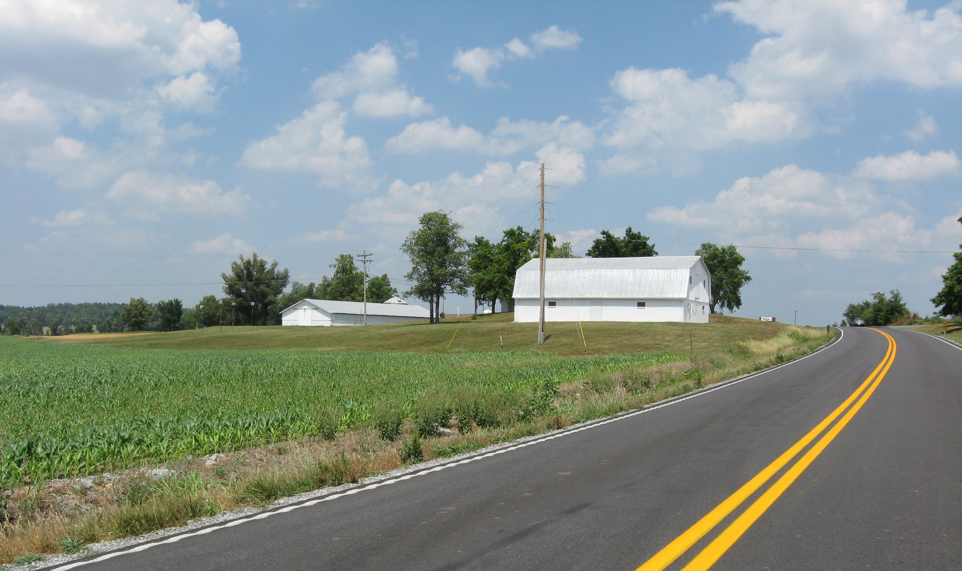
Future Work
Create composite drought indicator that balances the strengths of each index
Analyze 2012 and 2016 drought events to detect spatial distribution of drought evolution
Image: Kentucky Climate Center
Examine time series of sub-monthly SPI
Extend gridded SMAP and other gridded soil moisture products analysis to 2012 and 2016 events
Notes:
Image: Courtesy of Kentucky Climate Center

Slide 29
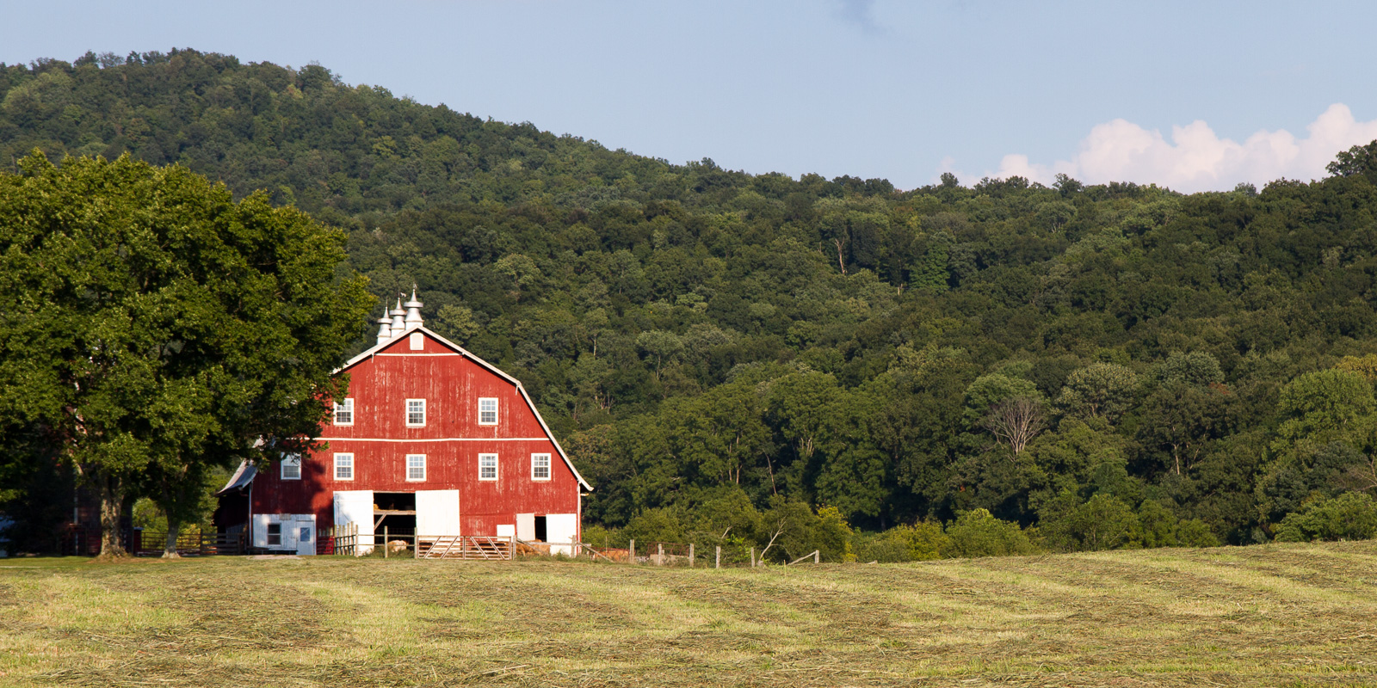
Stuart Foster
Kentucky Climate Network
James Noel
NOAA NWS Ohio River Forecasting Center
Ronald Leeper
Science Advisor, NOAA NCEI, North Carolina Institute for Climate Studies
Rocky Bilotta
NOAA NCEI, Center for Weather and Climate
Andrew Shannon
NASA DEVELOP NC – NCEI Fellow
Jordan Basham
Western Kentucky University PBS
Image: Arthur LaBar
Notes:
We would like to acknowledge a few people in particular who contributed their knowledge, time, insights, and support to make this project possible. Thank you.
Image: Flickr. Arthur T. LaBar. Barn, Albany, Kentucky. CC BY NC 2.0. https://www.flickr.com/photos/arthurtlabar/40239915444/in/faves-187233743@N05/

