Slide 1
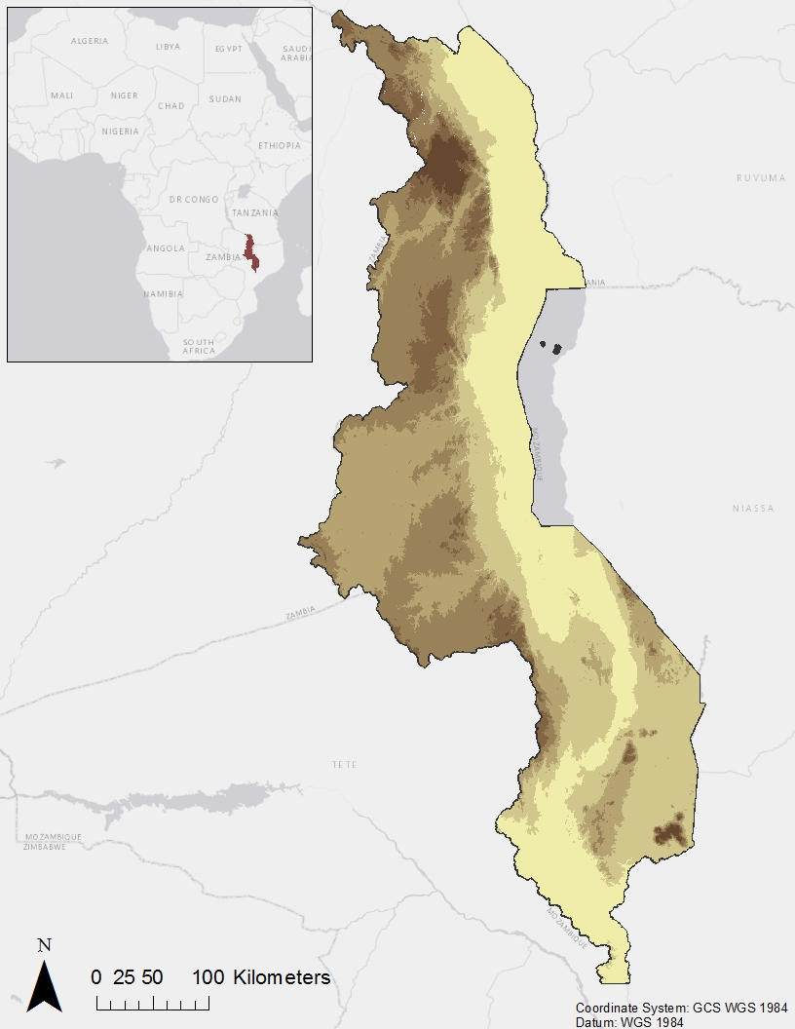






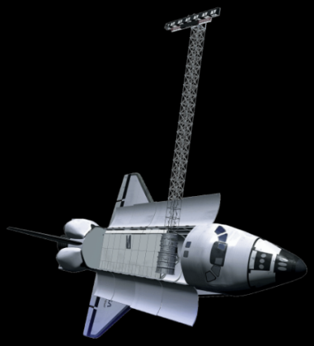

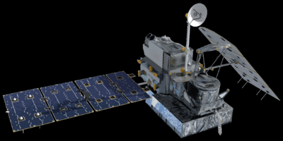
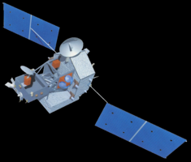
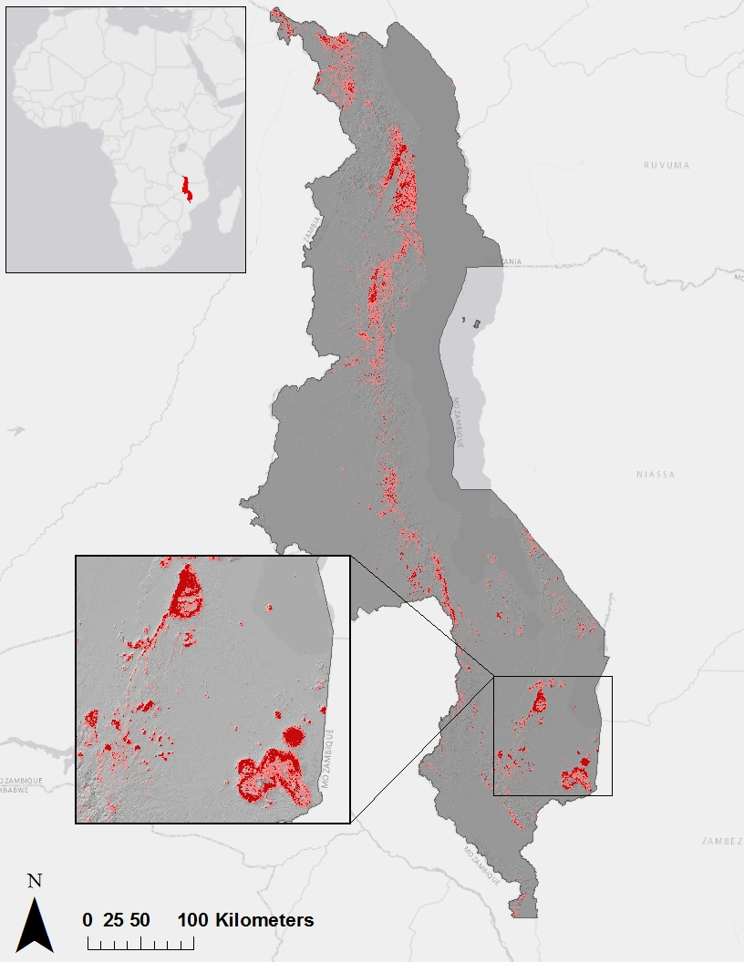
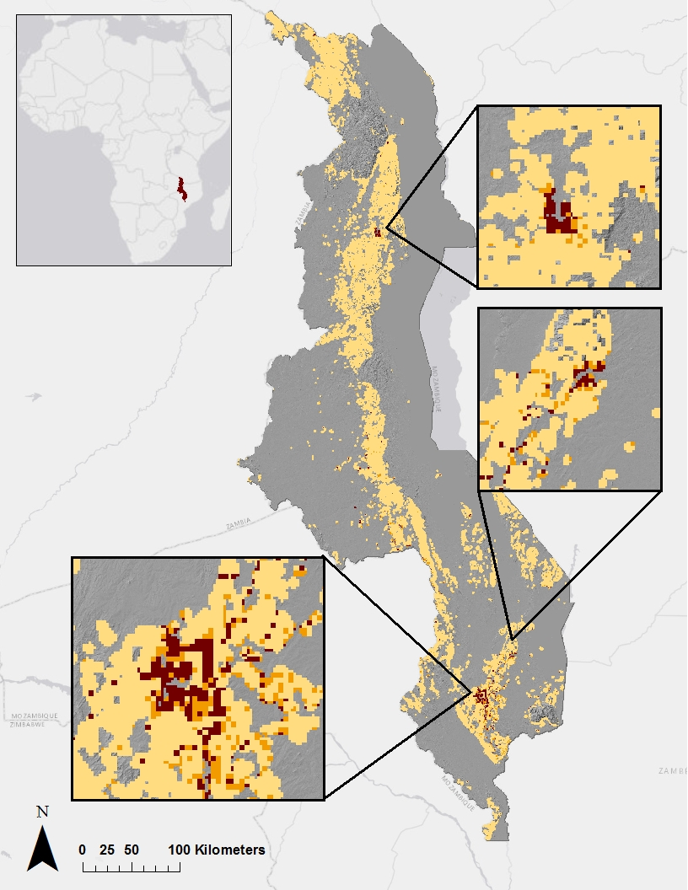




Assessing Landslide Characteristics and Developing Susceptibility and Exposure Maps in Malawi
Abstract
Objectives
Malawi has become increasingly prone to landslides in the past few decades. This can be attributed to the terrain, types of soil and vegetation, increased human interference, and heavy flooding after long periods of drought. In addition to the floods and droughts, landslides cause extra stress to farmlands, thus exacerbating the current food security crisis in the country. It can be difficult to pinpoint just how many people are affected by landslides in Malawi because landslides often occur in rural areas or are grouped with other disasters, such as floods or earthquakes. This project created a Landslide Susceptibility Map to assess landslide-prone areas in Malawi using variables such as slope, distance to roads, distance to streams, soil type, land cover type, and precipitation. These variables were derived using imagery from Landsat 8 Operational Land Imager (OLI), Shuttle Radar Topography Mission Version 3 (SRTM-v3), Global Precipitation Measurement (GPM), and Tropical Rainfall Measuring Mission (TRMM) satellites. Furthermore, this project created a Landslide Exposure Map to estimate how much of the local population lives in susceptible areas by intersecting population data with the Landslide Susceptibility Map. Additionally, an assessment of GPM and TRMM precipitation measurements was generated to better understand the reliability of both measurements for landslide monitoring. Finally, this project updated NASA SERVIR’s Global Landslide Catalog (GLC) for Malawi by using WorldView data from Google Earth and Landsat 8 OLI. These end products were used by NASA SERVIR and the Regional Centre for Mapping of Resources for Development (RCMRD) for aiding in disaster management throughout Malawi.
Update SERVIR’s Global Landslide Catalog (GLC) with new landslide points for Malawi using Google Earth Imagery
Create susceptibility and exposure maps for the study period using variables that contribute to landslides and the aforementioned landslide points in the MaxEnt and Fuzzy Logic models
Assess the accuracy of GPM and TRMM measurements in comparisons to CHIRPS 1.9 for total and extreme monthly rainfalls
Study Area
Malawi
Methodology
Update Global Landslide Catalog
Data Acquisition
Data Processing
Data Analysis
Locate landslide points in Google Earth.
Verify landslide points and dates with news reports and journal articles.
Publish confirmed points to Global Landslide Catalog.
2) Create Susceptibility and Exposure Maps
Data Acquisition
Data Processing
Data Analysis
Create topography, land cover, soil type, and other landslide related datasets from NASA Earth observations.
Extract dataset values at landslide points for fuzzy membership layers and use in fuzzy logic model. Test MaxEnt with points & datasets.
Generate Landslide Susceptibility Map from model outputs. Intersect map with population to create Landslide Exposure Map.
3) Assess GPM and TRMM Measurements
East Africa Disasters II
Data Acquisition
Data Processing
Data Analysis
Earth Observations
Download TRMM, GPM, and CHIRPS 1.9 data during TRMM and GPM overlap months.
Produce datasets for entire sample, lower quartiles, and upper quartiles.
Calculate and report correlation coefficient for GPM & CHIRPS 1.9 and TRMM & CHIRPS 1.9.
Results
Landsat 5-TM
Landsat 8-OLI
SRTM - V3 C - Band
Landslide Susceptibility
in Malawi
Exposure Map
of Malawi
GPM IMERG
TRMM - PR
Conclusions
The updated Global Landslide Catalog enhanced the thoroughness of the documentation available for landslide events that occurred in Malawi between January of 2000 and April of 2016.
Rugged areas in Northern, Central, and Southeastern Malawi are susceptible to landslide events.
More than 13 million Malawians live in or within 1-kilometer of susceptible areas, making them exposed to potential landslide events.
Evaluating the correlation of GPM IMERG and TRMM – PR measurements with CHIRPS data assessed the appropriateness of applying these remotely sensed precipitation data products to landslide modeling in Malawi.
Team Members
Project Partners
Acknowledgements
Regional Centre for Mapping of Resources for Development (RCMRD)
NASA SERVIR Coordination office at NASA MSFC
NASA SERVIR Applied Sciences Team at NASA GSFC
The East Africa Disasters II team would like to acknowledge Dr. Jeffrey Luvall, Dr. Robert Griffin, and Eric Anderson for providing guidance and support throughout this project.
Additionally, the team thanks Leigh Sinclair, Daryl Ann Winstead, Padraic Connor, Tyler Finley, and Jeanné le Roux for their guidance and previous contributions to the project.
Any opinions, findings, and conclusions or recommendations expressed in this material are those of the author(s) and do not necessarily reflect the views of the National Aeronautics and Space Administration. This material is based upon work supported by NASA through contract NNL11AA00B and cooperative agreement NNX14AB60A.
Maggi Klug
Project Lead
Max
Grossman
Jordan
Cissell
NASA Marshall Space Flight Center – Summer 2016

