Slide 1
Mississippi Ecological Forecasting
Utilizing NASA Earth Observations to Locate Potential Habitat for the Dusky Gopher Frog
Ross Reahard (Project Lead)
James Brooke
Rudy Bartels
Meredith Williams
Notes:
Introduction: The Mississippi Ecological Forecasting team at John C. Stennis Space Center utilized NASA Earth observations to locate potential habitat for the dusky gopher frog.

Slide 2
Study Area
Hancock County
Harrison County
Jackson County
St. Tammany Parish
Study Period
January 2005-Present
Notes:
The focus for our project consists of the following three Mississippi counties and one Louisiana Parish: Hancock county (533 sq mi), Harrison county (976 sq mi), Jackson county (1,043 sq mi), and St. Tammany Parish (854 sq mi).
These three counties are located south of Hattiesburg, Mississippi and all border the Gulf of Mexico.
St. Tammany Parish is located north of New Orleans, is west/borders Hancock county, Mississippi.
The total combined areas of the three counties and parish is approximately 3,406 square miles, with a total population of about 613,000 according to the 2013 census. St. Tammany has a population of approximately 242,000, Hancock 44,000, Harrison 188,000 and Jackson 140,000.

Slide 3
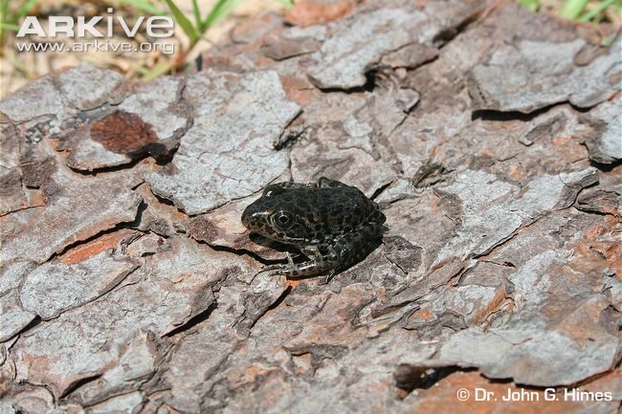
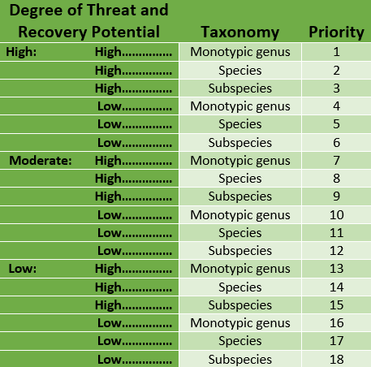
Background
The most endangered species of frog in North America and top 100 in the world.
U.S. Fish and Wildlife Service listed Mississippi Gopher Frog under the Endangered Species Act on December 4, 2001.
DGF received a recovery priority number of 6, with low potential recovery and classified as a subspecies.
Taxonomic status was changed to “species” and changed the name to the dusky gopher frog in 2012.
Credit: Dr. John G. Himes
Notes:
http://www.arkive.org/dusky-gopher-frog/lithobates-sevosus/
https://www.fws.gov/endangered/esa-library/pdf/1983_LPN_Policy_FR_pub.pdf
The DGF is in the top 100 most endangered species in the world and the most endangered species of frog in North America. The U.S. Fish and Wildlife Service listed the Mississippi Gopher Frog under the Endangered Species Act on December 4, 2001 and listed the frog with a recovery priority number of 6, indicating a high degree of threat, low potential recovery and classification of subspecies. On June 12, 2012, the taxonomic status was changed to “species” and changed the name to the dusky gopher frog instead of the subspecies Mississippi Gopher Frog. The recovery priority number was changed to 5 reflecting this taxonomic change.

Slide 4
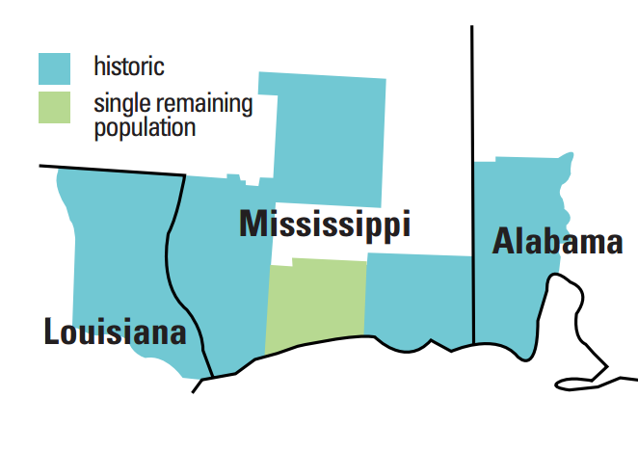
Background
Historic records indicate that the Dusky Gopher Frog existed from East of the Mississippi River to the West of Mobile Bay.
Credit: USFWS
Notes:
Historically, the DGF inhabited the Gulf Coastal Plain in Southwest Alabama, Southern Mississippi, and Southeast Louisiana from east of the Mississippi River Delta to Mobile Bay.
http://www.fws.gov/southeast/publications/gopher.pdf

Slide 5
Background
Known Dusky Gopher Frog breeding ponds
Glen’s Pond
Pony Ranch
Mike’s Pond
McCoy’s Pond
Notes:
Glen’s Pond was originally the only known pond to inhabit the DGF but currently Glen’s Pond, two naturally-occurring populations and a fourth pond which was established as a recovery plan using translocation experiments are the only known ponds. The four ponds are located in Southern Mississippi.
U.S. Fish and Wildlife Service. 2014. Technical/Agency Draft Recovery Plan for the Dusky Gopher Frog (Rana sevosa). Atlanta, Georgia. 90 pp.

Slide 6
Partners
Focus on conservation of the Dusky Gopher Frog
End-Users/Partners/Boundary Organizations
End-Users
Partners
Boundary Organizations
The Nature Conservancy
The Nature Conservancy
USDA Forest Service: DeSoto Ranger District
US Fish and Wildlife Service
US Fish and Wildlife Service
US Army Corp of Engineers
Notes:
Our End-Users and Partners for our project are the Nature Conservancy and the U.S Fish and Wildlife Service. Our boundary organizations consisted of the US Army Corps of Engineers and the USDA Forest Service.

Slide 7
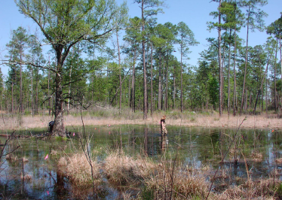
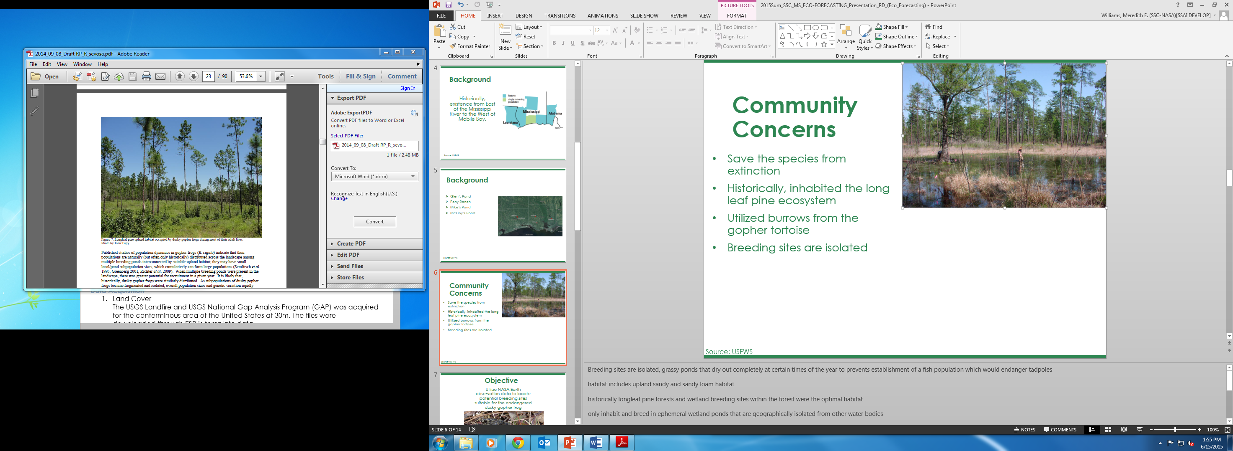
Community Concerns
Save the species from extinction
Historically, inhabited the long leaf pine ecosystem
Utilized burrows from the gopher tortoise
Breeding sites are isolated
Credit: USFWS
Credit: USFWS
Notes:
Breeding sites are isolated, grassy ponds that dry out completely at certain times of the year to prevents establishment of a fish population which would endanger tadpoles
habitat includes upland sandy and sandy loam habitat
historically longleaf pine forests and wetland breeding sites within the forest were the optimal habitat
only inhabit and breed in ephemeral wetland ponds that are geographically isolated from other water bodies
making rainfall the only source of water for these ponds.
Ponds must also be hard bottomed, drain almost completely during the non-breeding season, have emergent and submergent vegetation present for egg attachment,
open canopy cover which is essential for tadpole development.
abandoned gopher tortoise burrows however a decline in gopher tortoises has resulted in the DGF living in stump holes or small mammal burrows
U.S. Fish and Wildlife Service. 2014. Technical/Agency Draft Recovery Plan for the Dusky Gopher Frog (Rana sevosa). Atlanta, Georgia. 90 pp.

Slide 8
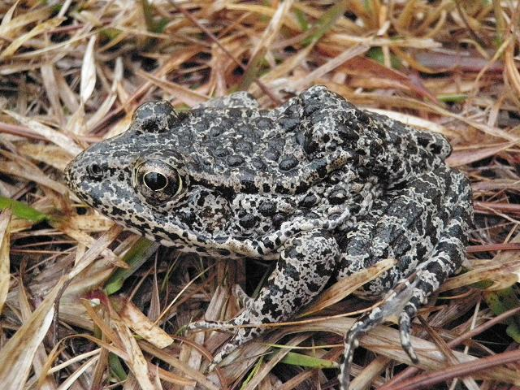
Objective
Utilize NASA Earth observation data to locate potential breeding sites suitable for the endangered dusky gopher frog
Credit: U.S. Fish & Wildlife Service
Notes:
The objective was to Utilize NASA Earth observation data to locate potential breeding sites suitable for the endangered dusky gopher frog.
http://www.nature.org/ourinitiatives/regions/northamerica/unitedstates/mississippi/explore/dusky-gopher-frog-profile.xml
Written permission to image

Slide 9
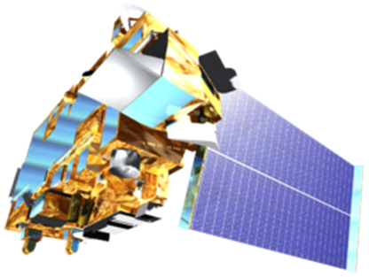
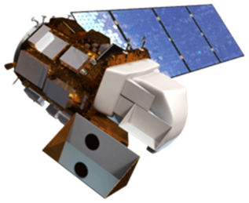
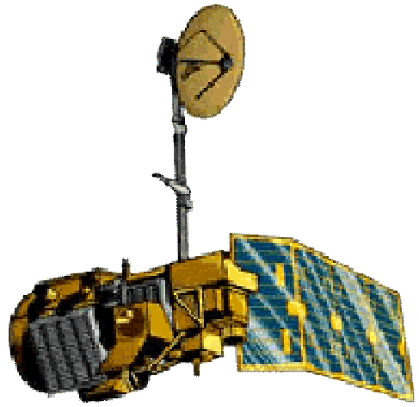
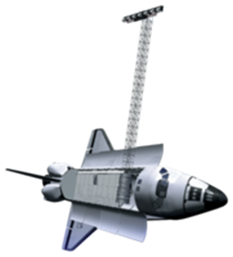
NASA Earth Observations
Terra
Landsat 8
Landsat 5
Space Shuttle
Notes:
DEVELOPEDIA image sources
Landsat 8 OLI was used for vegetation NDVI Normalized Difference Vegetation Index and NDMI and Land Use Land Cover Data
Landsat 5 TM was used for historical imagery, vegetation indices
Terra, ASTER, was used for NDVI, water quality indices
Space Shuttle, SRTM, was used for elevation data and DEMs

Slide 10
Methodology
Elevation
Soil Type
Final Habitat Prediction
Precipitation
Landcover
Imagery
Notes:
Landcover, soil type, elevation, precipitation and multi spectral imagery were the five methodologies used in project. These layers were overlaid to create a habitat suitability map.

Slide 11



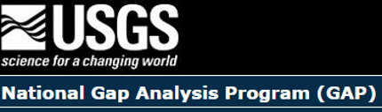

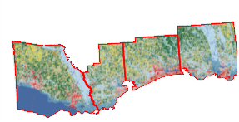
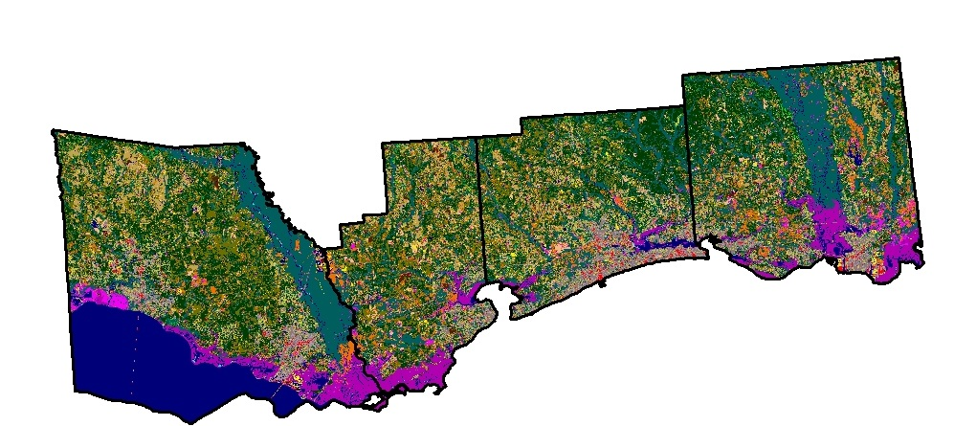
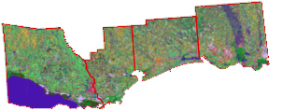
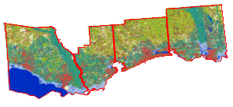
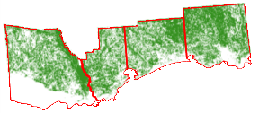
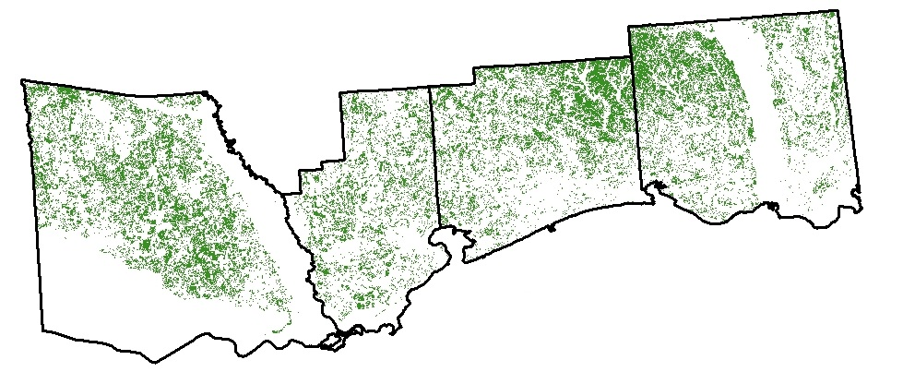
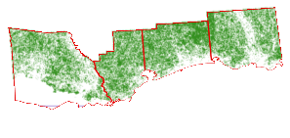
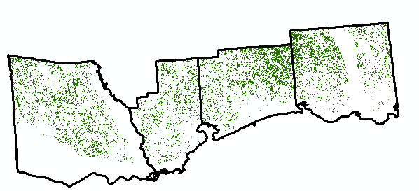
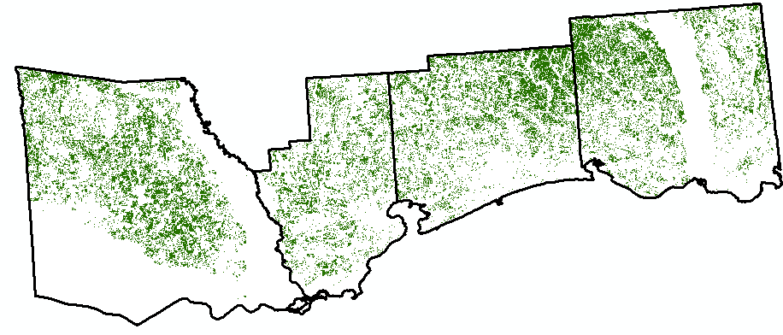
Methodology- Landcover
Source
Clipped
Weighted by habitat preference
NLCD & NOAA
Final Landcover Image
Notes:
The landcover data was acquired from 4 different datasets. The USGS NLCD, National Landcover dataset, NOAA, CCAP, USGS Landfire and USGS GAP.
All the data was clipped to the study area.
Next, the NLCD AND NOAA CCAP data was weighted separately to determine developed areas vs forests and then overlaid together.
The USGS GAP data was used to select longleaf pine forests which is the DGF preference but due to a decline in longleaf forests, loblolly and longleaf pines were used.
Lastly, the land fire data was used to select the shrub cover, canopy cover and herbaceous cover preferred by the dusky gopher frog. The DGF optimal pond habitat would consist of a maximum of 10-30% tree cover, 10% scrub cover and 90% herb cover.
Lastly the NLCD, CCAP, LANDFIRE and GAP was overlaid based on the preferences and a final image was produced.

Slide 12
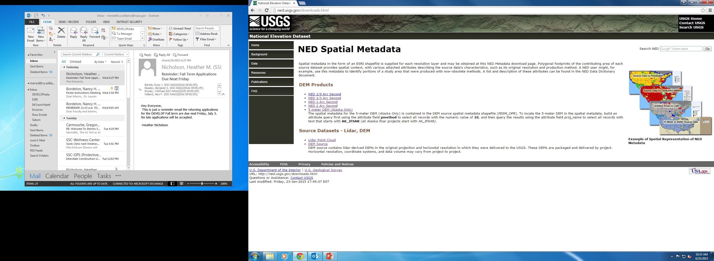
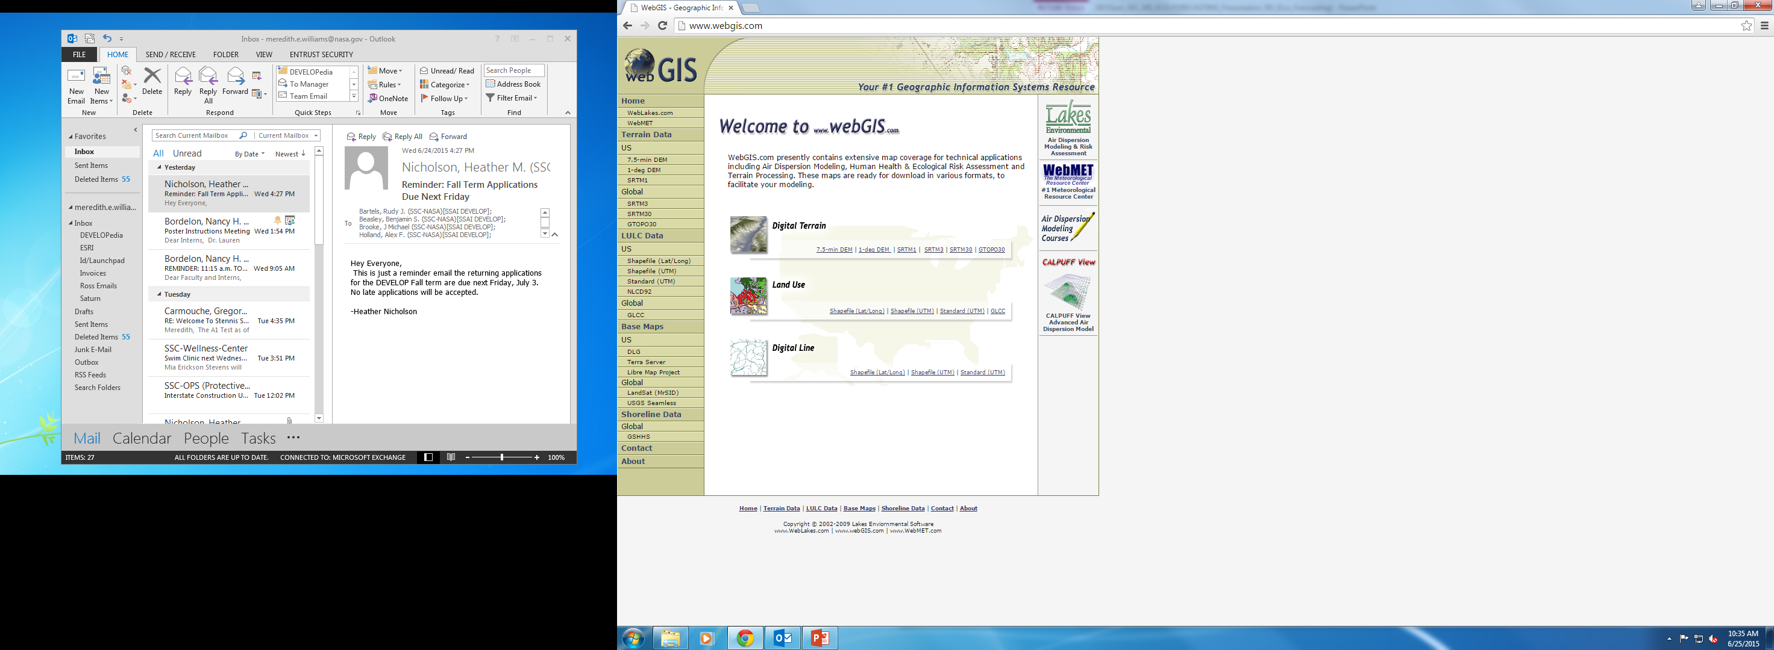
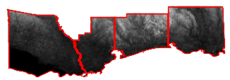
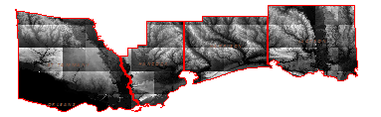
Methodology- Elevation
Clipped to Study Area
Clipped to Study Area
Notes:
Elevation data was acquired from USGS NED, National Elevation Dataset and WebGIS, then the data was clipped to the study area and used as a reference to locate ponds.

Slide 13
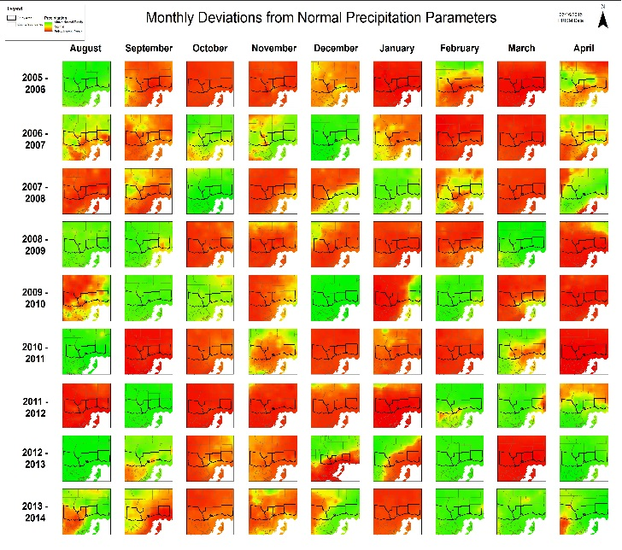

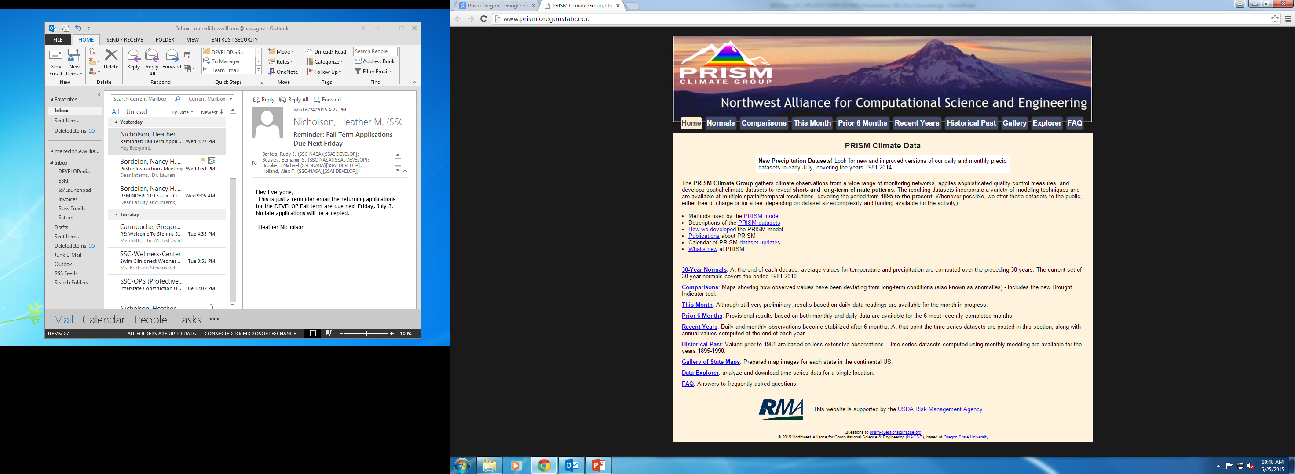
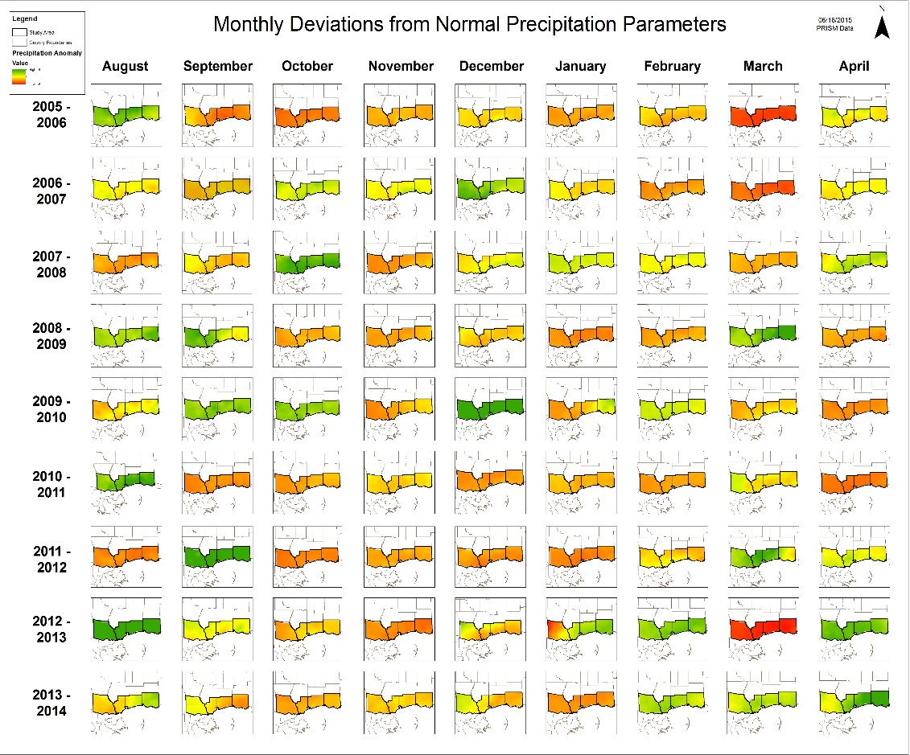
Methodology- Precipitation
Normalization and Anomalies
Clipped to Study Area and Normalized to scale
Notes:
The precipitation was gathered from PRISM Climate Group and NOAA. The data was in raster form, using GIS the data was normalized on a 0 mean and 1 standard deviation scale. Next the data was subtracted by the monthly means from 1980-2010 to calculate the anomalies. Once the anomalies were calculated, the data was clipped into the study area parameters. Lastly the scale was normalized to range from a -6 to 6 inch range to determine extreme wet and dry months.

Slide 14
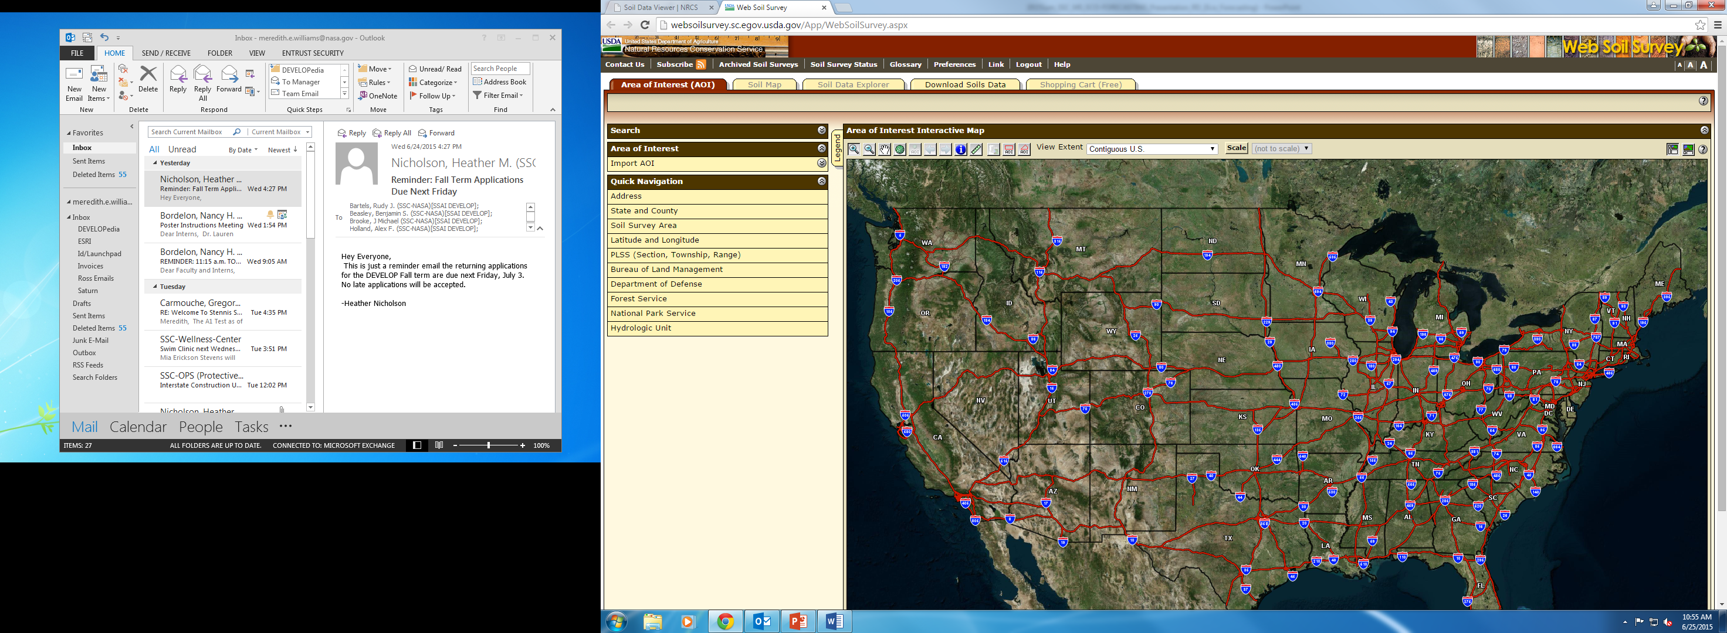
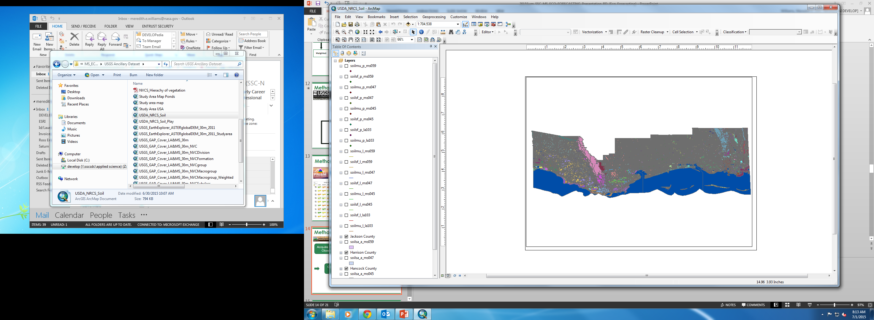
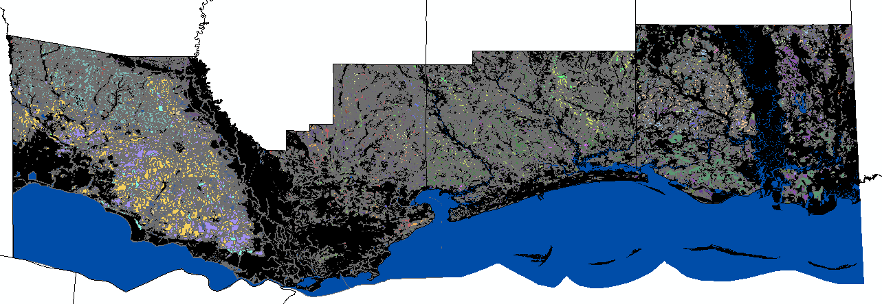
Methodology- Soils
Soil Information for Environmental Modeling and Ecosystem Management
Weighted
Weighted
Notes:
Soil data was acquired from USDA NRCS, Natural Resource Conservation Service and from Soil Information and Environmental modeling and ecosystem management. The data was clipped to the study area and then weighted based on the preferences of the DGF. The DGF prefers to have sandy loam or upland sandy soil.

Slide 15
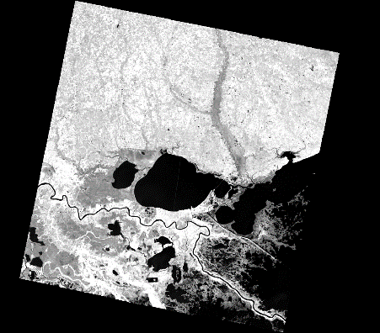

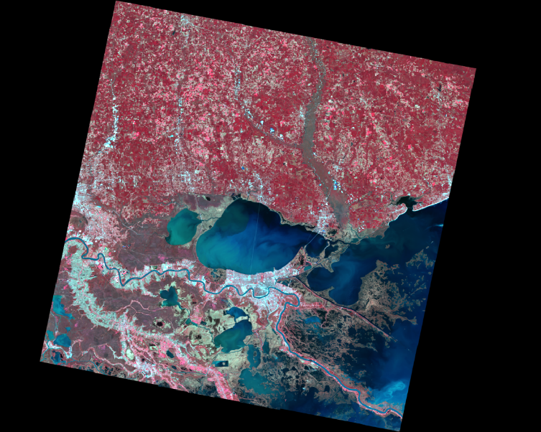
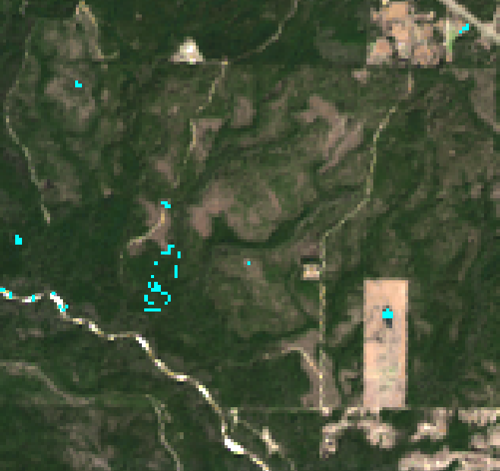
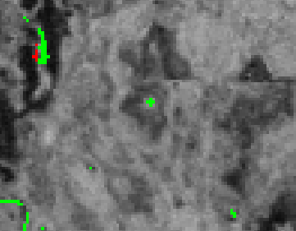
Methodology-Imagery
Atmospherically corrected, Level 1 GeoTiff images
Performed change detection on infrared bands
Images pre-processed using ERDAS IMAGINE
Images reclassified into seasonal water and non-water areas, results mosaicked using ERDAS IMAGINE Mosaic Pro
Notes:
Atmospherically corrected Landsat 5 images were obtained from the USGS via Earthexplorer. In order to assess ephemeral ponds, very wet winter conditions were compared to very dry summer conditions. Images from February were used for the wet images and images from August were used for the dry images.
Infrared bands (4, 5, 6) from each season were processed using ERDAS IMAGINE’s change detection function. The results of the change detection were stacked into a single image and classified into seasonal water and non-water classes. Images of the results of the change detection were mosaicked using ERDAS IMAGINE Mosaic Pro.

Slide 16
Pond Analysis (PA)
200 | 0 | 200
200 | 200 | 0
0 | 200 | 200
Methodology-Weight
Total (T)
290 | 95 | 195
230 | 320 | 120
65 | 220 | 290
Land Cover (LC)
75 | 75 | 0
0 | 75 | 75
75 | 0 | 75
Canopy Cover (CC)
10 | 0 | 0
0 | 10 | 10
0 | 0 | 10
Precipitation (P)
0 | 20 | -10
30 | 30 | 30
-10 | 20 | 0
Layer | Weight
Ponds | 200
Forests | 75
Canopy Cover | 10
Precipitation | (-10 to 30)
Soils | 05
Soil (S)
5 | 0 | 5
0 | 5 | 5
0 | 0 | 5
Notes:
The weighted layers were assigned a value depending on the impact the layer had on the habitat. The layers weights were Pond Analysis (PA): 200, Land Cover (LC): 75, Canopy Cover (CC): 10, Precipitation (P): 10, and Soils (S): 5. The precipitation layer can have different values other than just the zero or weighted value due to varying precipitation values. The weighted layer values for each pixel were then overlaid using an additive sum method, which adds each single layer pixel value together into one overall total. The total (T) matrix shows the output from the additive sum method. The color scheme shown is green being lower suitable values, yellow being moderate suitable values, and red being high probable values.

Slide 17
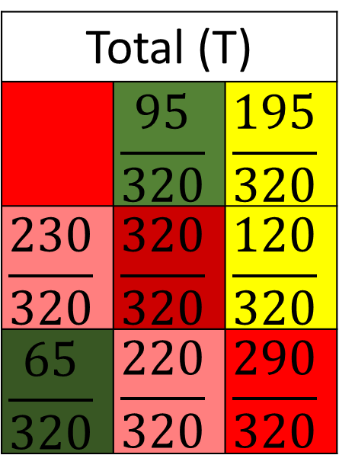

Methodology-Suitability
Total (T)
290 | 95 | 195
230 | 320 | 120
65 | 220 | 290
Total (T)
 | $$\frac{95}{320}$$ | $$\frac{195}{320}$$
$$\frac{230}{320}$$ | $$\frac{320}{320}$$ | $$\frac{120}{320}$$
$$\frac{65}{320}$$ | $$\frac{220}{320}$$ | $$\frac{290}{320}$$
Divide by maximum possible number
Example Max = 320
$$\frac{290}{320}$$
Suitability (P)
91% | 30% | 61%
72% | 100% | 38%
20% | 69% | 91%
Multiplied by 100
Notes:
Once the total (T) matrix was completed for each pixel in the study area, it was inputted into a probability model. The probability model used a ratio technique which determined the level of potential dusky gopher frog habitat. The total (T) values were all divided by the total possible sum for the study area (In this example the total possible sum was 320). Once the values were divided by the total maximum sum they were multiplied by 100 to create a percentage probability (P) for the dusky gopher frog for each pixel in the study area.

Slide 18
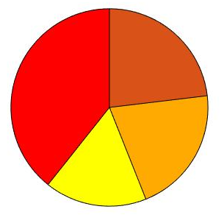

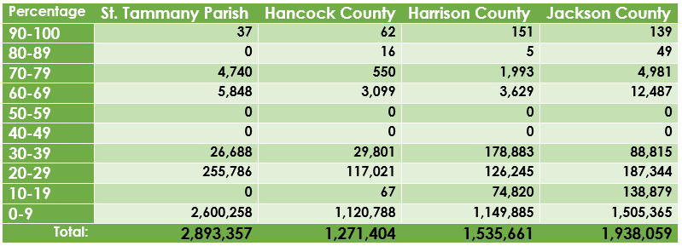
Methodology
Total Pixels in each County
St. Tammany Parish
39%
Jackson County
23%
17%
21%
Source: NASA
Hancock County
Harrison County
Notes:
The pixels from each county were summed and graphed as shown in the pie chart. The table shows the individual pixel count for each county and probability value.

Slide 19
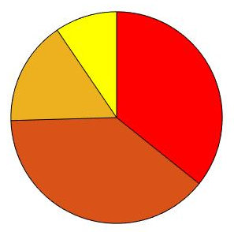


Methodology
90% Suitability
Jackson County
Hancock County
36%
16%
80% Suitability
9%
Hancock County
Jackson County
39%
13%
Harrison County
St. Tammany Parish
41%
46%
70% Suitability
Harrison County
St. Tammany Parish
Harrison County
39%
St. Tammany Parish – 0%
16%
41%
4%
Jackson County
Hancock County
Notes:
The 70, 80, and 90 percent probabilities were graphed in order to see the distributions per county. Harrison county has the greatest amount of pixels for 80 and 90 percent probability and Jackson has the greatest amount of pixels for the 70% probability.

Slide 20
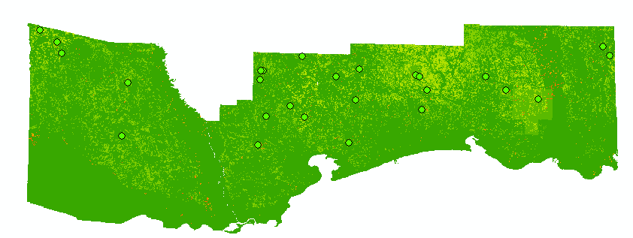
Results
County/Parish | Potential Habitats Discovered
St. Tammany | 5
Hancock | 8
Harrison | 10
Jackson | 5
Notes:
St. Tammany Parish had 5 potential habitats, Jackson has 5, Hancock had 8 and Harrison County had 10 as shown below in the image

Slide 21
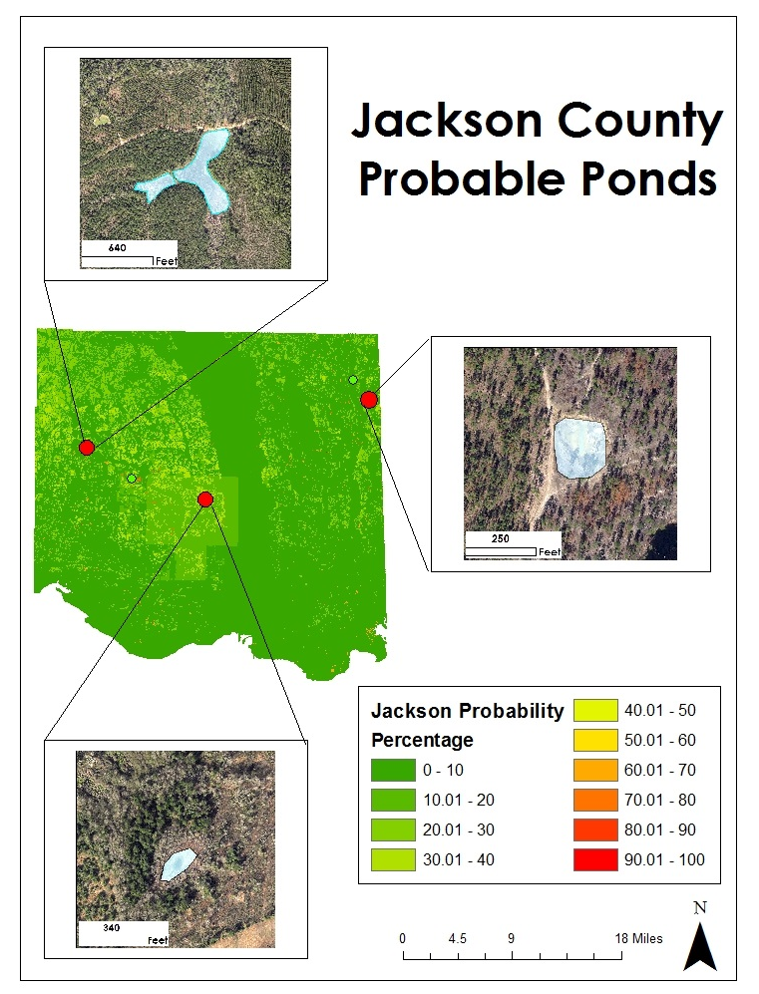
Results
Notes:
Jackson County had 4 probable habitats which three are displayed here.

Slide 22
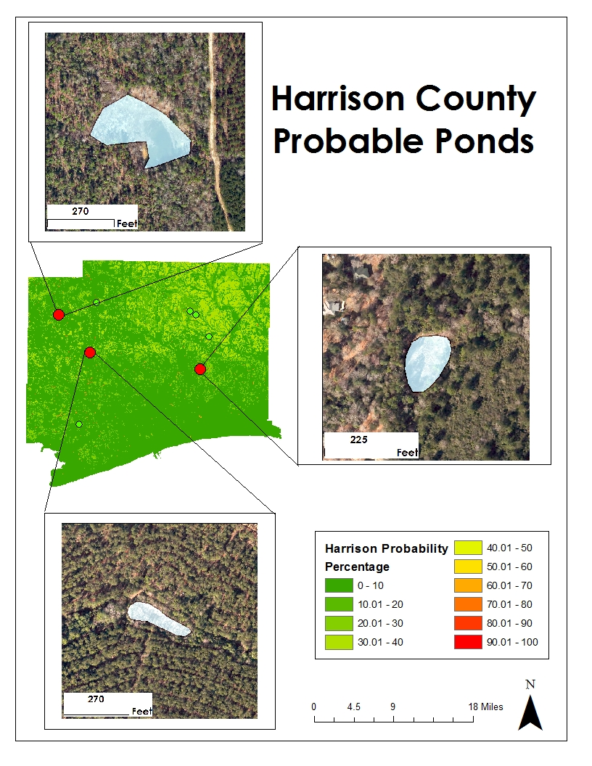
Results
Notes:
Harrison County had 10 potential habitats with three being displayed here.

Slide 23
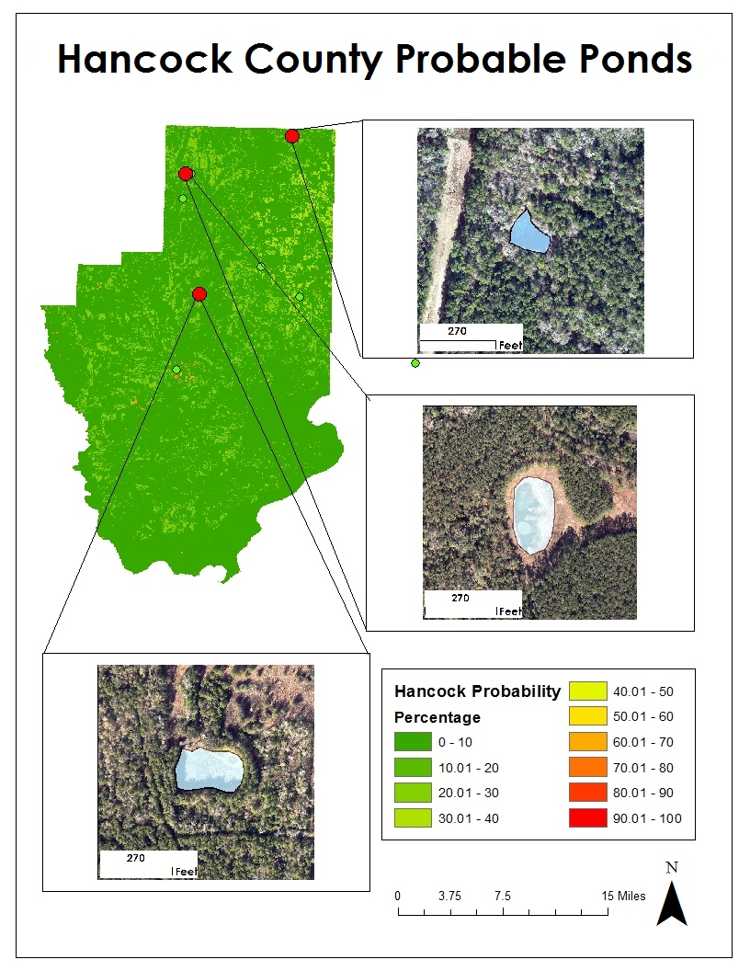
Results
Notes:
Hancock had 8 potential new habitats with three displayed here.

Slide 24
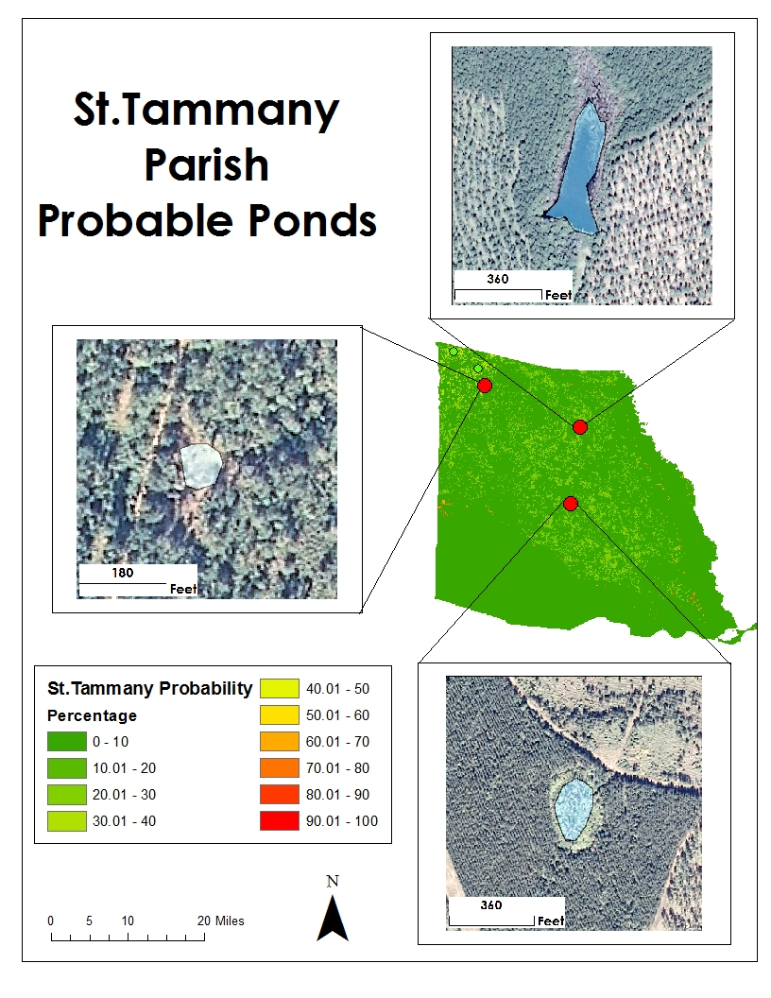
Results
Notes:
St. Tammany had 5 potential habitats with three displayed here.

Slide 25
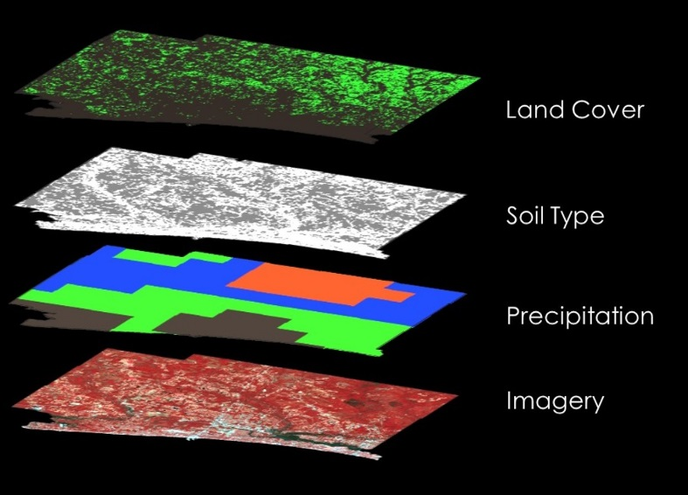
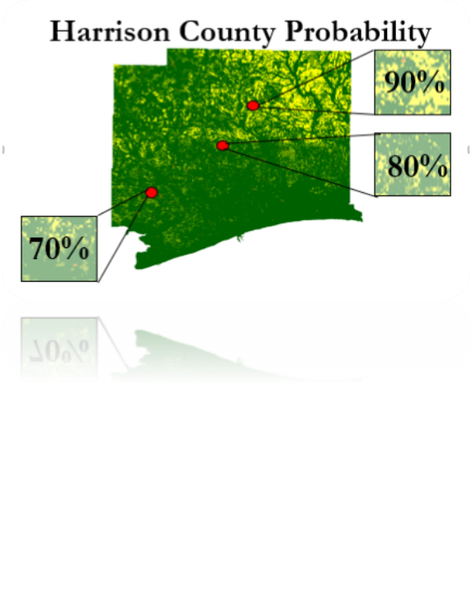
Conclusions
Discovered areas with 70% and above potential habitat in each county.
Harrison had the greatest potential habitat.
St. Tammany had the least likely potential habitat.
The model proved to be 75% accurate after quality check using NAIP aerial imagery.
Harrison County Suitability
Notes:
The probability model proved to find areas that have the potential habitat parameters for the dusky gopher frog. Probability values of 70 percent and above were found in the study area.
The greatest amount of probability values between 80 and 100 percent were located in the Northeastern part of Harrison County Mississippi.

Slide 26
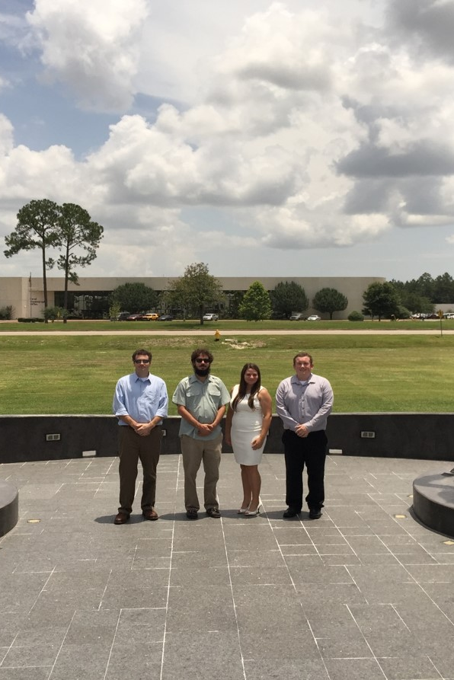
Limitations and Future Work
Limitations
Data Resolution
  Lack of High Resolution data
Scarce Point Data
  Lack of Accurate Point Data
Future Work
Expand the Study Area
Create multiple Habitat Models
Source: Amber Todoroff – DEVELOPer SSC
Notes:
The Data Resolution available for some of the layers was low and at times difficult to interpret. Higher Resolution Imagery and Precipitation would be helpful for future work. Also, point data was difficult to gather as many places in the study area are recovering from hurricanes or other issues.
For future work the team suggests to expand the study area to counties around the original study area for this project. Expanding the study area may find more suitable places for the Dusky Gopher Frog to live. Different types of models should be created using different layers and data sources. A different combination and figuring out more about the suitable habitat for the Dusky Gopher Frog may be beneficial for its future.

Slide 27
Advisors
Joseph Spruce, NASA Stennis Space Center
James “Doc” Smoot, NASA Stennis Space Center
Dr. Kenton Ross, NASA Langley Research Center
Partners
Jim Lee, The Nature Conservancy
Linda LaClaire, US Fish and Wildlife Service
Others
Julie Moore, US Fish and Wildlife Service
Ed Moody, USDA Forest Service
Danny Hartley, US Army Corps of Engineers
Notes:
Read from slide mostly.

Slide 28
References
U.S. Fish and Wildlife Service. 2014. Technical/Agency Draft Recovery Plan for the Dusky Gopher Frog (Rana sevosa). Atlanta, Georgia. 90 pp. Available online at http://www.fws.gov/endangered/species/recovery-plans.html
National Gap Analysis Program Land Cover Data. US Geological Survey. U.S General Land Cover Map. Available online at http://gapanalysis.usgs.gov/gaplandcover/viewer/.
National Land Cover Database. US Geological Survey. Conterminous United States Land Cover. Available online at http://www.mrlc.gov/nlcd2011.php.
LANDFIRE. US Geological Survey. Conterminous United States Land Cover. Available online at http://www.landfire.gov/
The National Elevation Dataset, US Geological Survey. U.S General Elevation Map. Available online at http://ned.usgs.gov/.
WebGIS. Geographic Information Systems Resource. Elevation Map Available online at http://www.webgis.com/.
Soil Survey Staff, Natural Resources Conservation Service, United States Department of Agriculture. U.S. General Soil Map (STATSGO2). Available online at http://sdmdataaccess.nrcs.usda.gov/.
Soil Information for Environmental Modeling and Ecosystem Management. US Conterminous Soil Map. Available online at http://www.soilinfo.psu.edu/index.cgi?soil_data&conus&data_cov&texture
Coastal Change Analysis Program Regional Land Cover and Change. NOAA Digital Coast Office for Coastal Management. Available at
http://coast.noaa.gov/dataregistry/search/collection/info/ccapregional
PRISM Climate Group, Oregon State University. US Conterminous Precipitation Data. Available online at http://www.prism.oregonstate.edu/

Slide 29

Questions?

